Slide 1
Neutron Interferometry 童欣 Xin (Tony) Tong

Slide 2
Laser Interferometer Gravitational-Wave Observatory

Slide 3
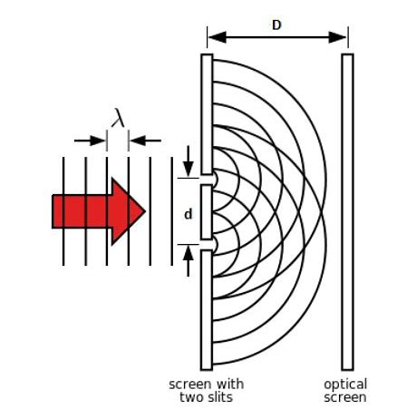
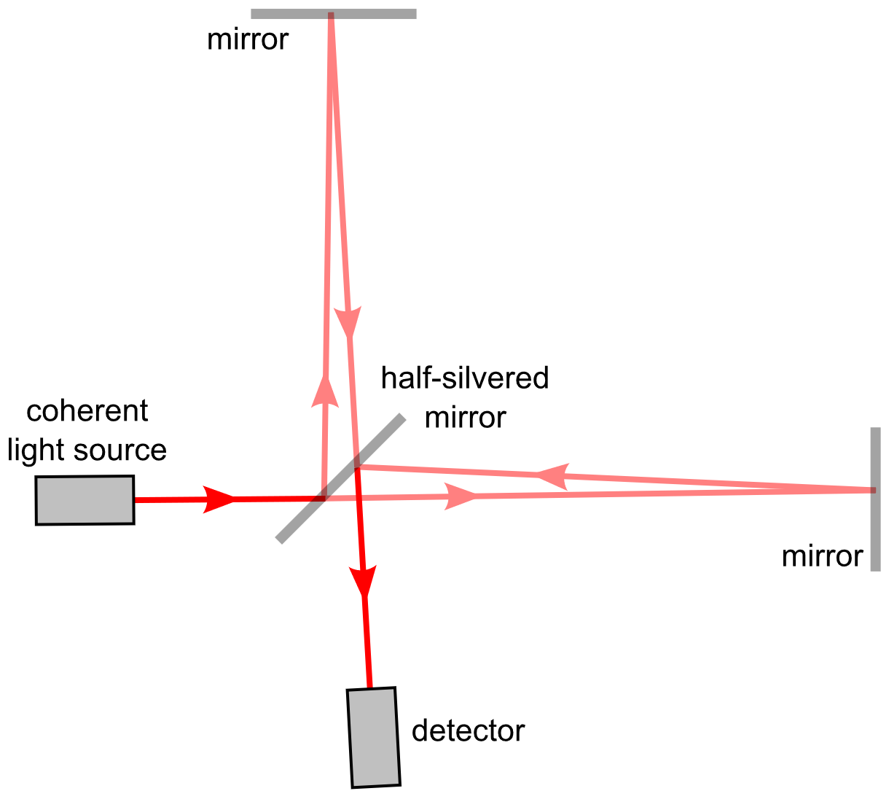
Light interferometry
Young's interference experiment
Michelson–Morley experiment (1887)
Interferometry can be carried out with any wave phenomenon

Slide 4
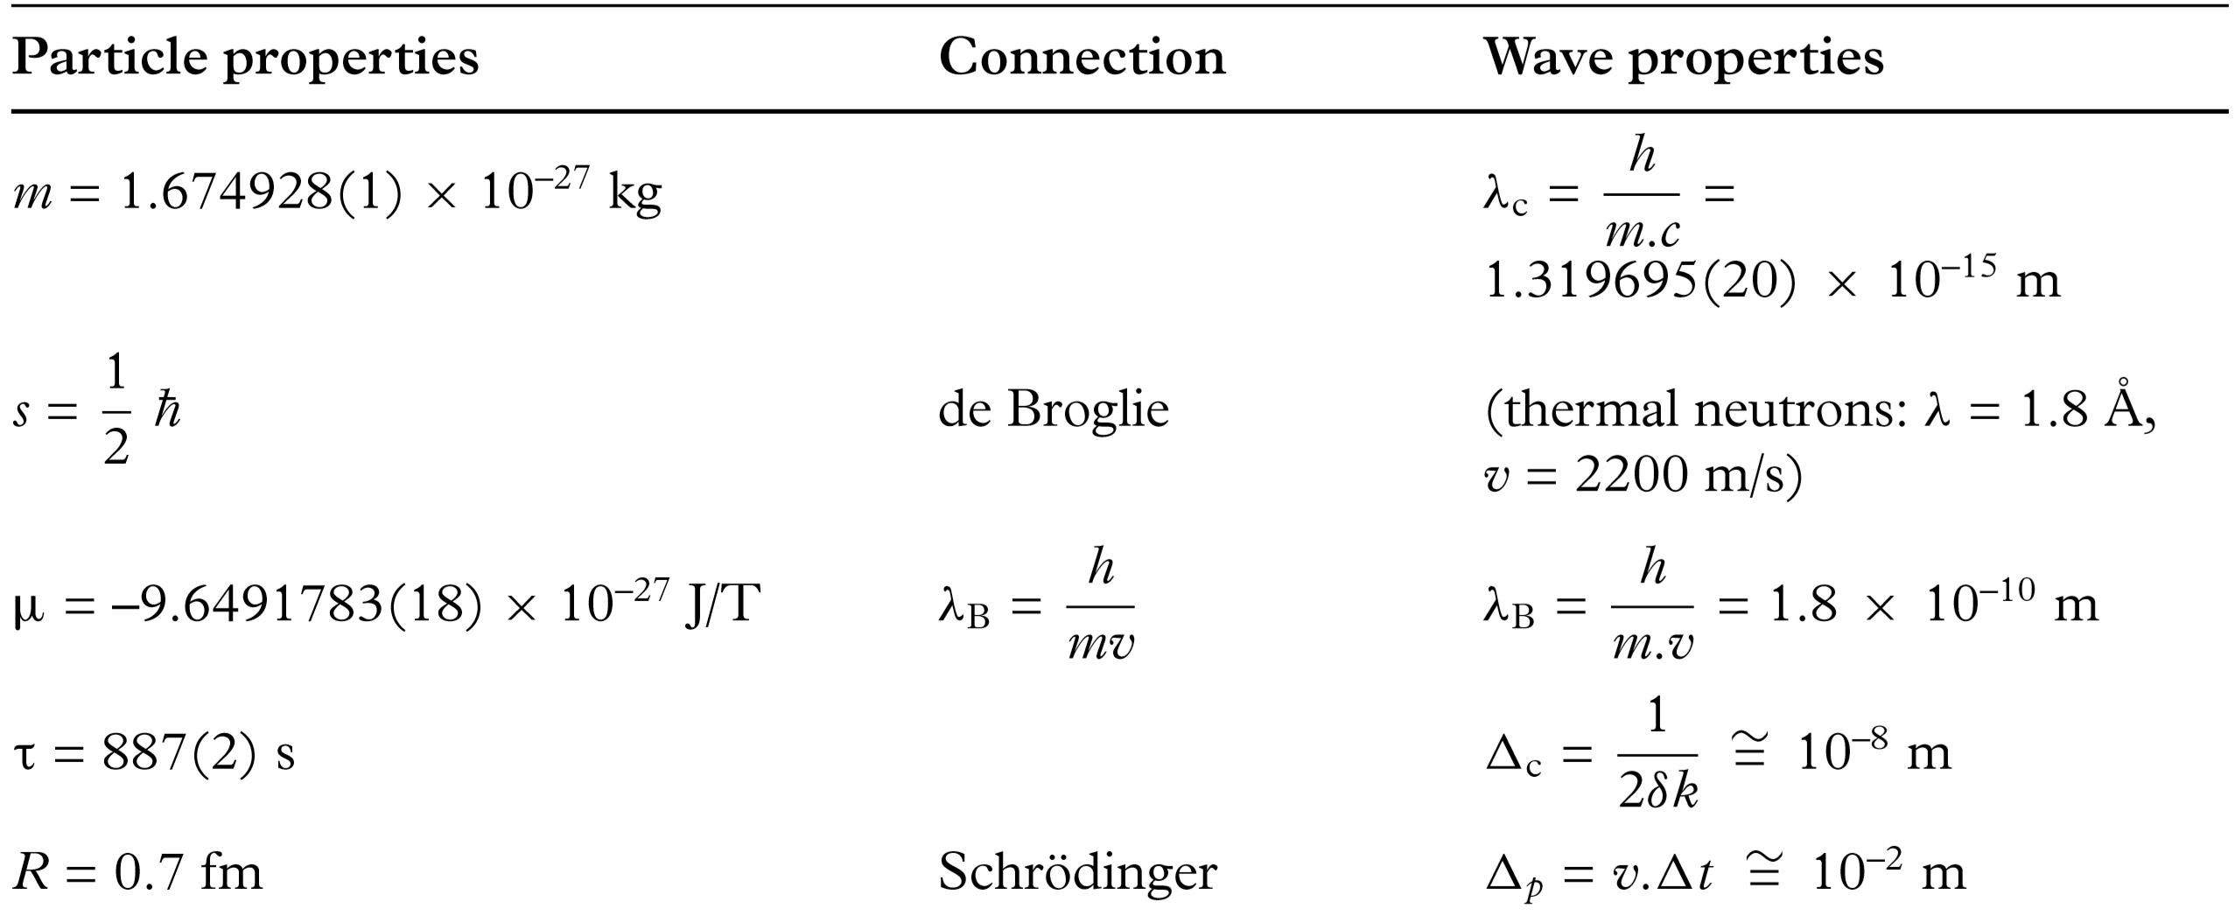
Neutron particle/wave duality
Neutrons: Massive and composite

Slide 5
Neutrons interact with all four forces
1
10⁻⁷
10⁻²
10⁻³⁹

Slide 6
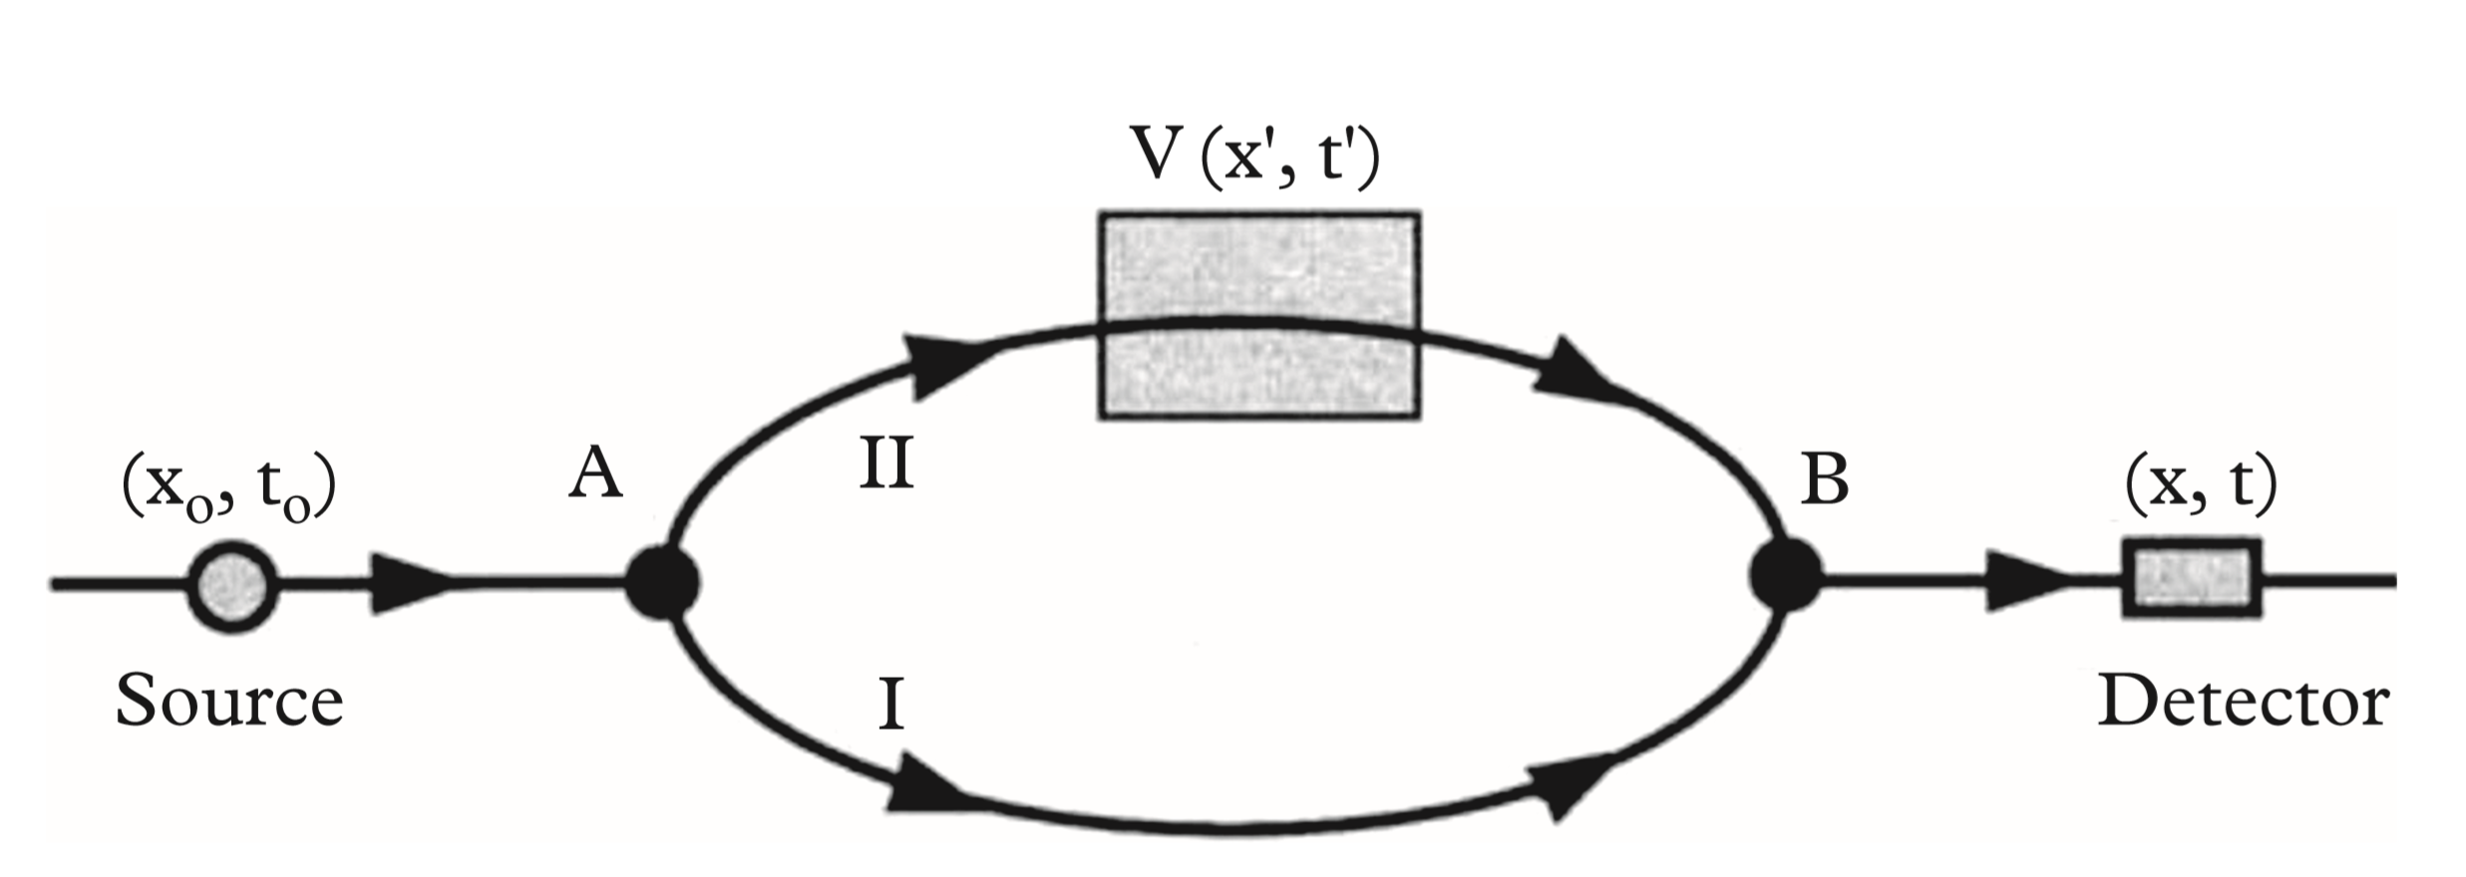
General scheme of a neutron interferometry

Slide 7
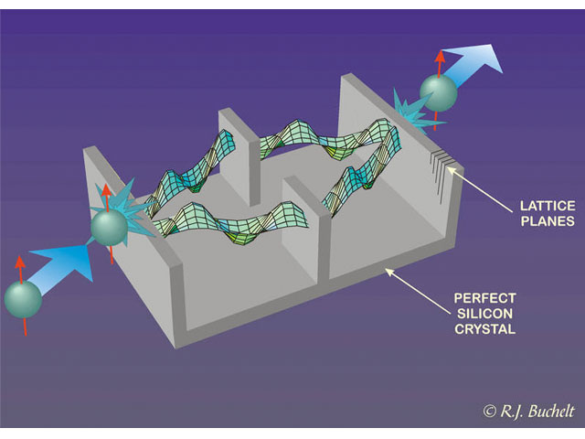
The birth of neutron interferometry
Rauch, Treimer, and Bonse, 1974
Beam split by Bragg diffraction in vertical crystal planes
Whole interferometer carved from a perfect crystal of silicon:
Separation between elements exact multiple of inter-atomic spacing.
Only ~ a dozen successfully made in 30 years!
One neutron at a time (in phase space)

Slide 8
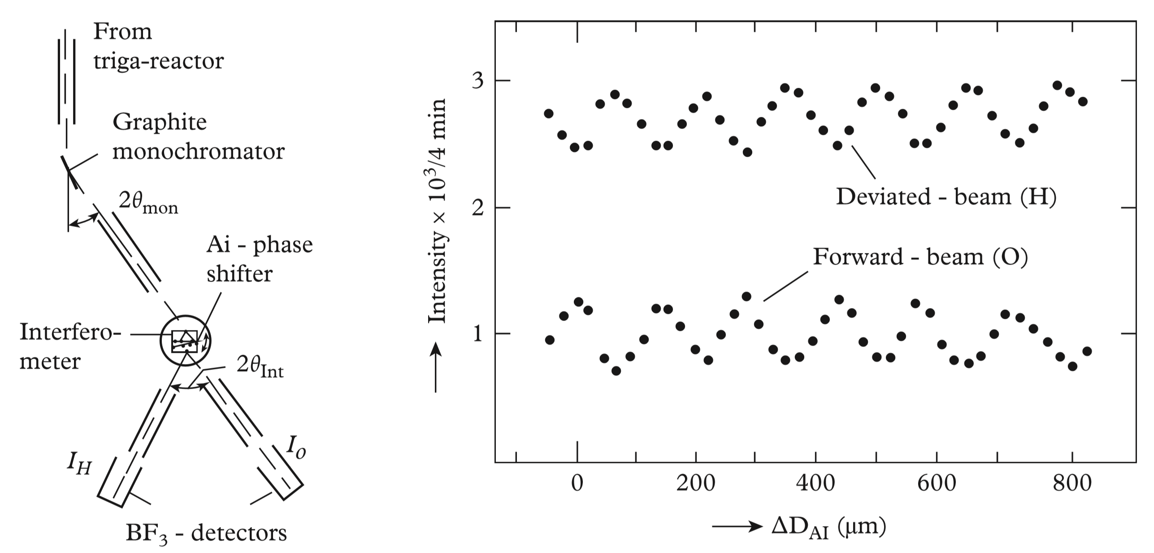
The birth of neutron interferometry
Rauch, Treimer, and Bonse, 1974

Slide 9
About quantum mechanics
Will you understand what I'm going to tell you? … No, you're not going to be able to understand it. … That is because I don't understand it. Nobody does.
Accept Nature as She is — absurd.

Slide 10
Benchmark experiments

Slide 11
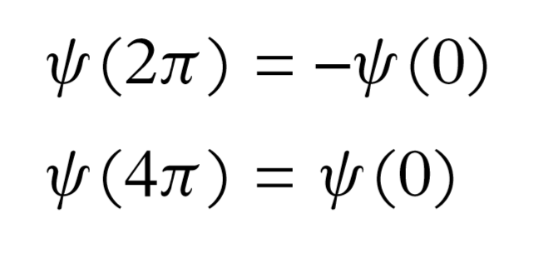
Strange properties of Spinor formalism
Dirac 1930
The magnetic field induced Hamiltonian
Wavefunction propogation

Slide 12
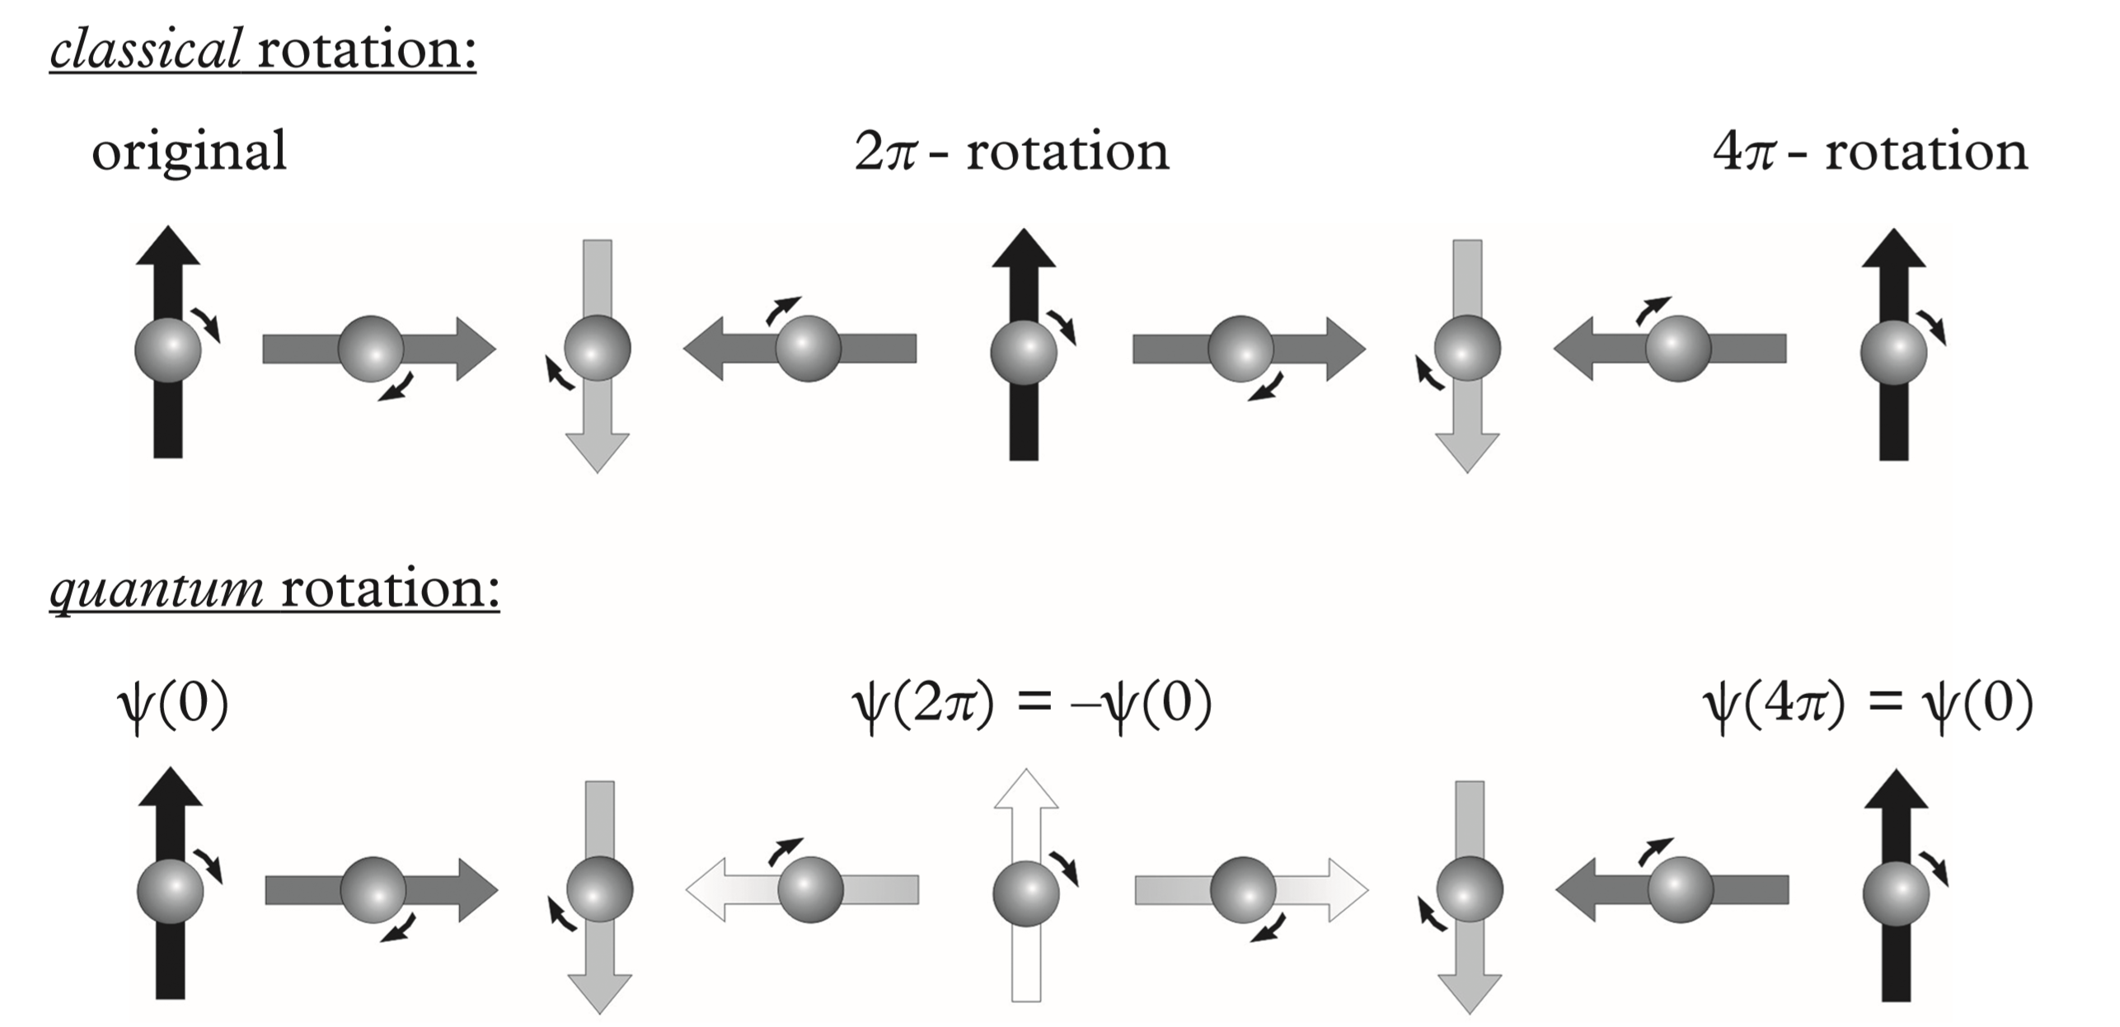
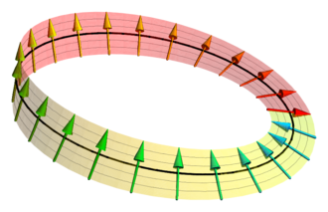
non-observable property of spinor quantum mechanics

Slide 13
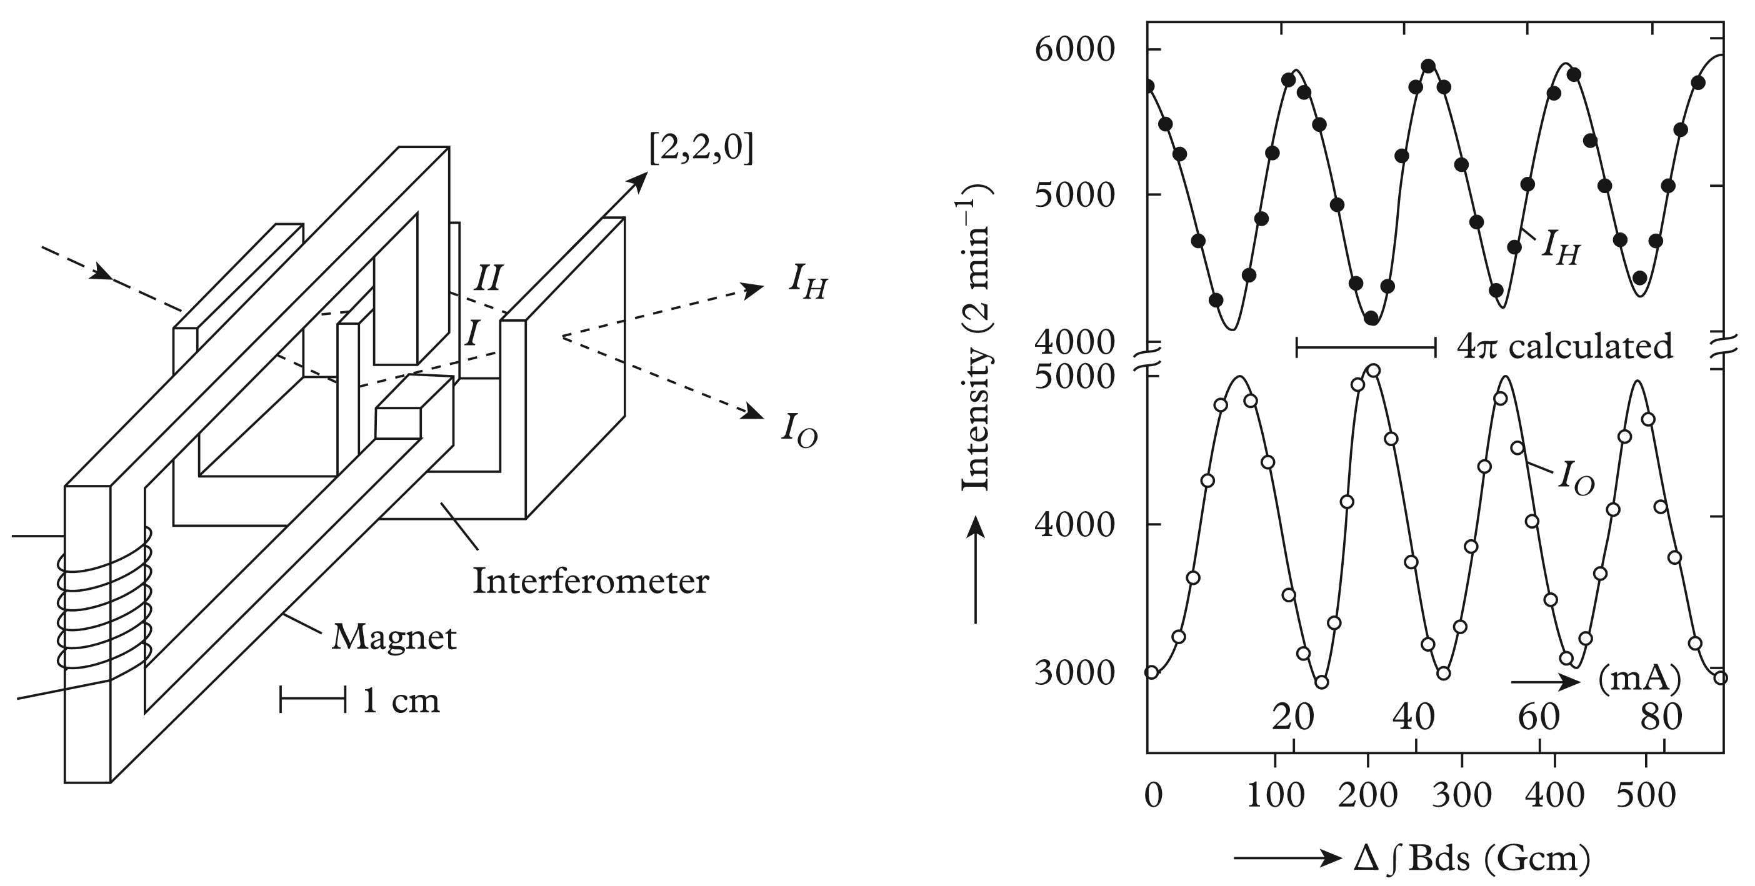
Spinor 4pi-symmetry
Measured quantity:
Rauch et al. 1975, Werner et al. 1975, Klein and Opat 1976

Slide 14
Gravitation induced phase shift
Different from classical theory, m matters

Slide 15
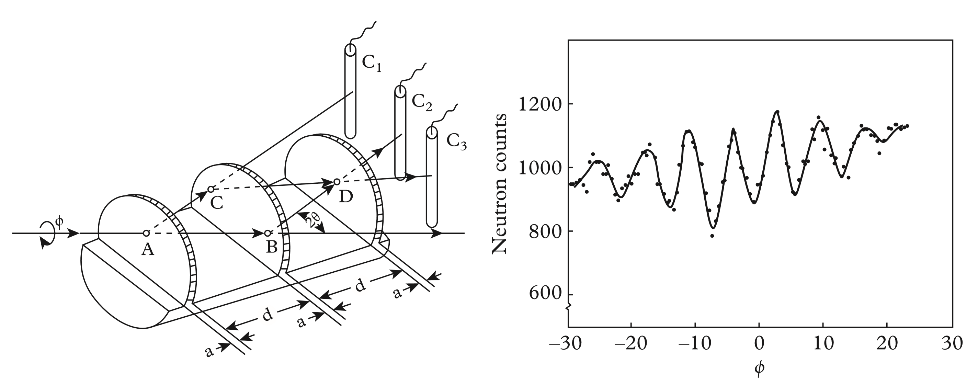
Gravitation induced phase shift
Colella et al. 1975, Staudenmann et al. 1980, Werner et al. 1988
Disclaim: not yet agreed with atomic interferometry

Slide 16
Spin Coherent Superposition
Formation of a new state

Slide 17
Spin Superposition
Summhammer et al. 1982, 1983

Slide 18
Phases measured by neutron interferometry

Slide 19
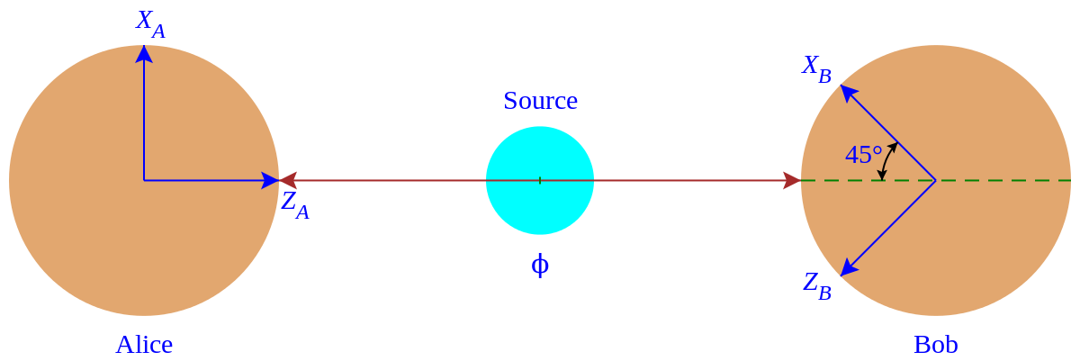
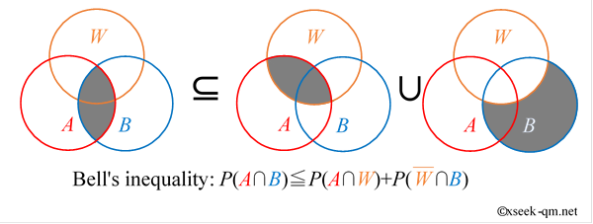
EPR Paradox and Bell's inequalities
Violation of a Bell's inequality proves the presence of entanglement

Slide 20
Maths for Bell's inequality in neutron interferometry

Slide 21
violation of Bell's inequalities
Hasegawa et al. 2006

Slide 22
violation of Bell's inequalities, better instrumentation

Slide 23
violation of Bell's inequalities, better equipment
violation of 28 standard diviations

Slide 24
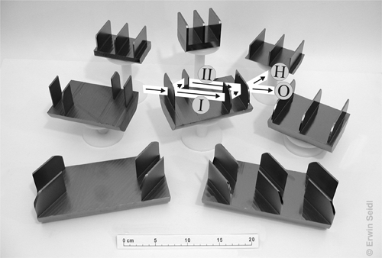
Different types of perfect Si interferometer
Photograph of an assembly of several perfect crystal interferometers at the Atominstitut, TU-Vienna. Courtesy E. Seidl

Slide 25
An actual neutron interferometer instrument

Slide 26
Polarized neutron (neutron spin) interferometry
neutron spin echo spectroscopy
tilted fields for spatial separation

Slide 27
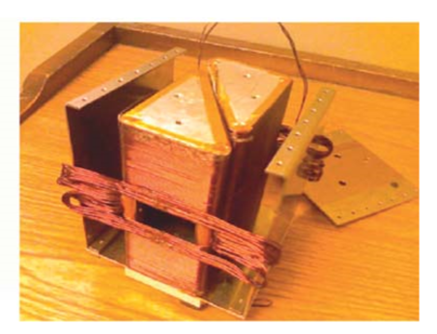
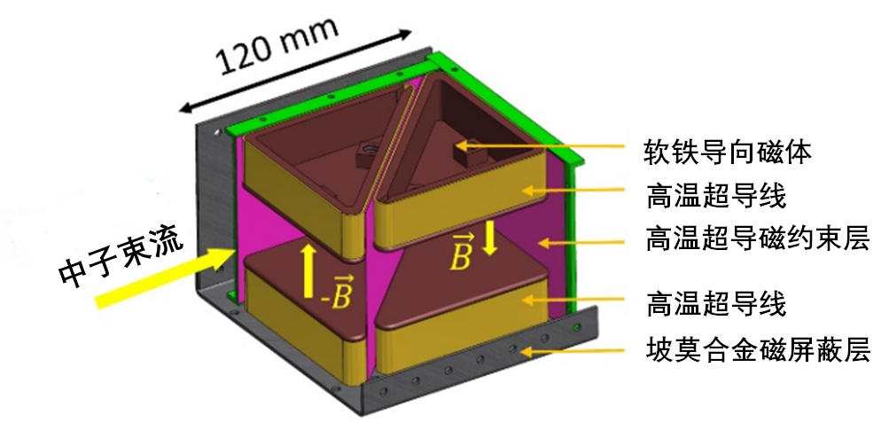
Superconducting wollaston prisms
利用超导体的零电阻与完全抗磁性突破中子棱镜的技术瓶颈
常温棱镜磁场强度：50 G 常温棱镜极化输运率：91%
超导棱镜磁场强度：up to 200 G 超导棱镜极化输运率：99%
常温导线表面磁场分布
超导体表面磁场分布

Slide 28
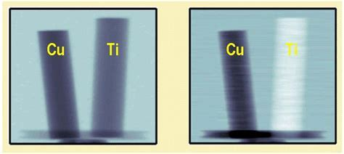
Neutron interferometry for material sciences
Allman and Nugent 2006

Slide 29
Summary for neutron interferometry
Massive, compositite particle interferometry
Self interference
Higher interference order possible
Extremely sensitive to decoherencing and dephasing
Energy sensitivity up to 10⁻¹⁹ev
Different degrees of freedom, spin/path/energy
Good for material sciences
Great for quantum measurement

