Slide 1
Feasibility of next generation mu-e conversion at CiADS
Chen Liangwen
IMPCAS

Slide 2
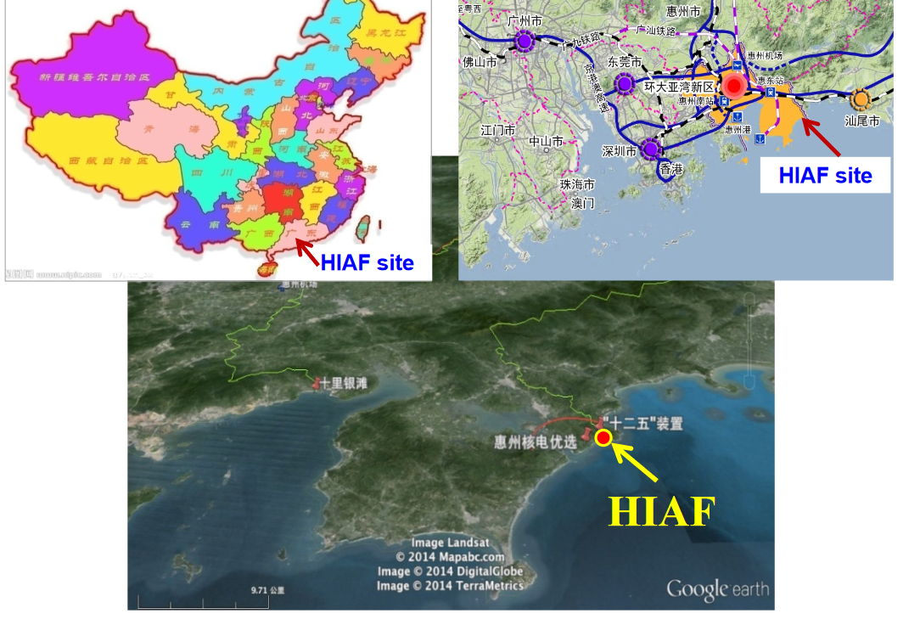
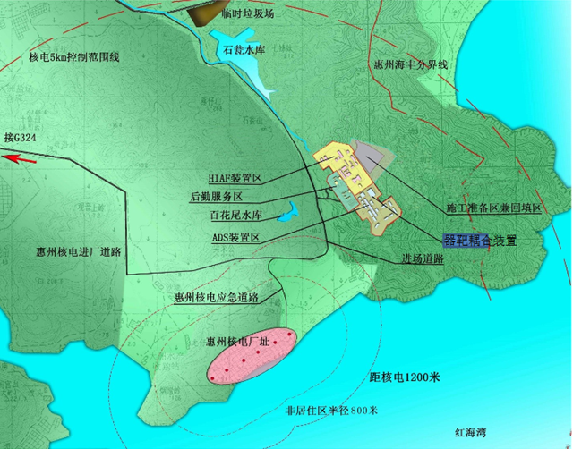
Location of HIAF and CiADS

Slide 3
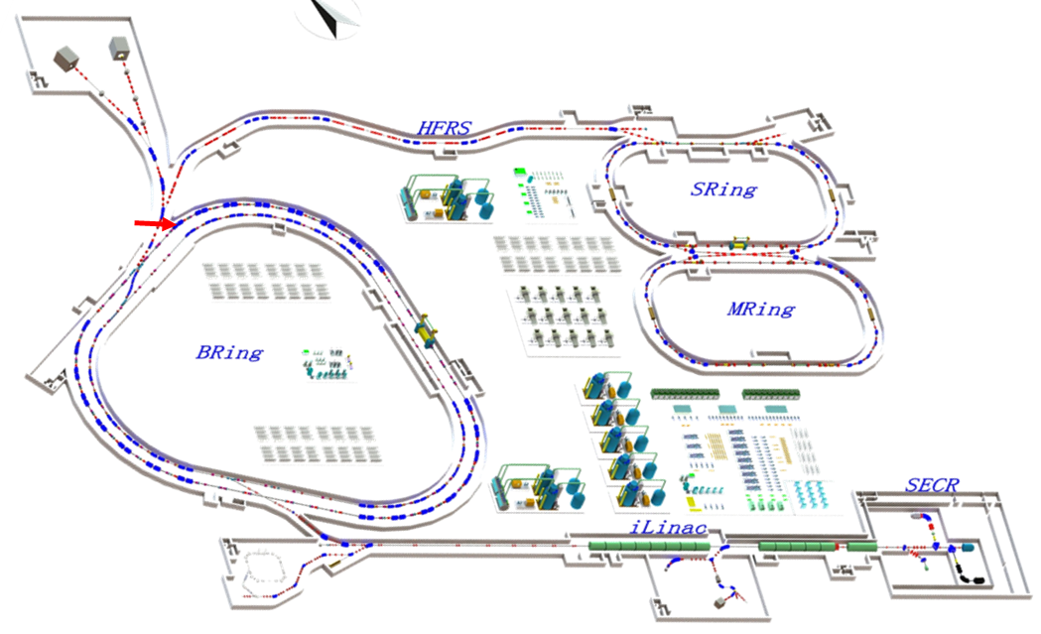
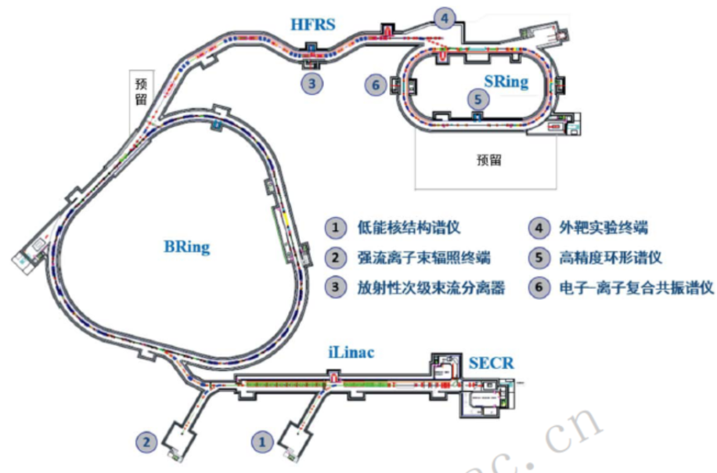
HIAF装置
HIAF 2018-2024
Budget: 1.5+1.2 B CNY, approved
HIAF Upgrade
常温磁铁
全超导
磁刚度
34Tm => 86Tm
E_{B1}:
0.8 AGeV, 3×10¹⁰ppp ²³⁸U³⁵⁺
1.75AGeV, 7.5×10¹⁰ppp ⁷⁸Kr¹⁹⁺
2.6AGeV, 1.0×10¹¹ppp ¹⁶O⁶⁺
E_{B2}:
>9AGeV, 1×10¹²ppp U⁹²⁺
~10GeV, >1×10¹³ppp Xe⁵⁴⁺
~12AGeV, >5×10¹³ppp He²⁺
~24.8GeV, >1×10¹⁴ ppp H

Slide 4
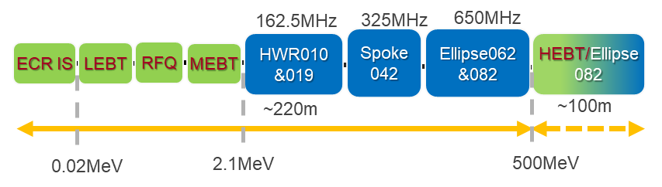
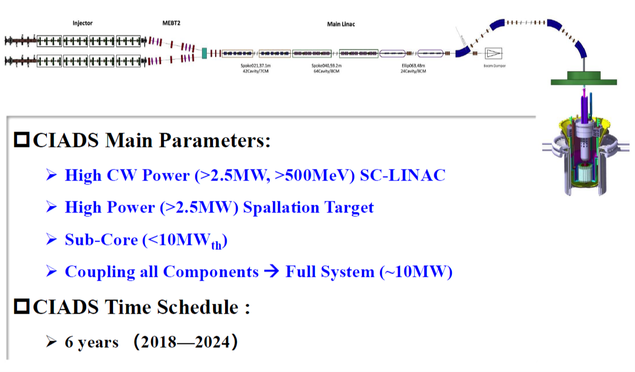
CiADS
Cavity name | βopt | Freq. (MHz) | Cavity type | Energy gain at βopt per cavity(MeV) | Energy range (MeV)
HWR010 | 0.10 | 162.5 | Half wave resonator | 0.84 | 2.1-6.8
HWR015 | 0.19 | 162.5 | Half wave resonator | 2.32 | 6.8-44.7
Spoke42 | 0.42 | 325 | Spoke 3-cell resonator | 4.30 | 44.7-171.2
Ellip062 | 0.62 | 650 | Elliptic 6-cell cavity | 8.54 | 171.2-346
Ellip0825 | 0.82 | 650 | Elliptic 5-cell cavity | 12.36 | 346-540

Slide 5
Outline
CiADS and Mu-e Conversion
g-2@HIAF-U
Neutrino production@HIAF-U
The Granular Waterfall Flow Target

Slide 6
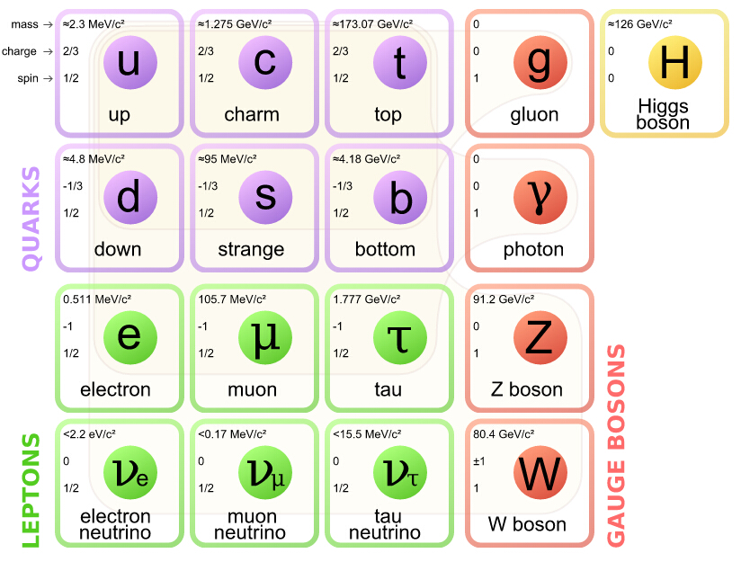
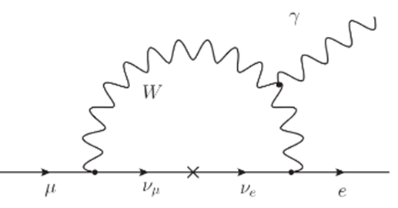
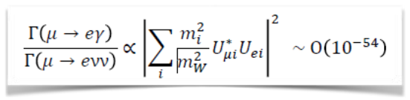
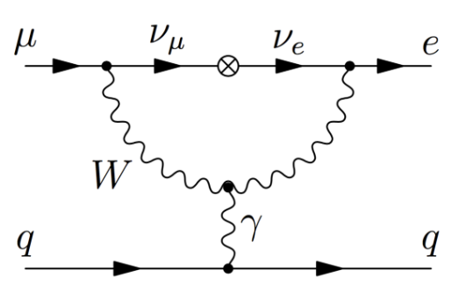
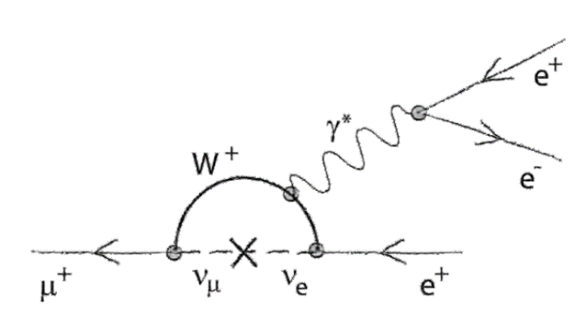
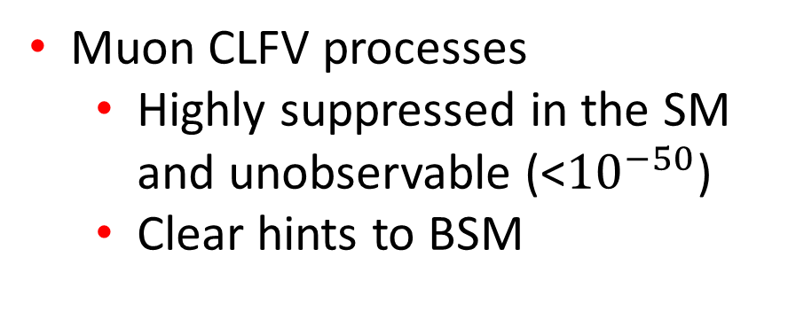
Charged Lepton Flavor Violation
Flavor violation in the SM
  quark sector
  neutrino oscillation
  charged lepton?
Muon CLFV processes
  Highly suppressed in the SM and unobservable (<${10}^{−50}$)
  Clear hints to BSM
?
?

Slide 7
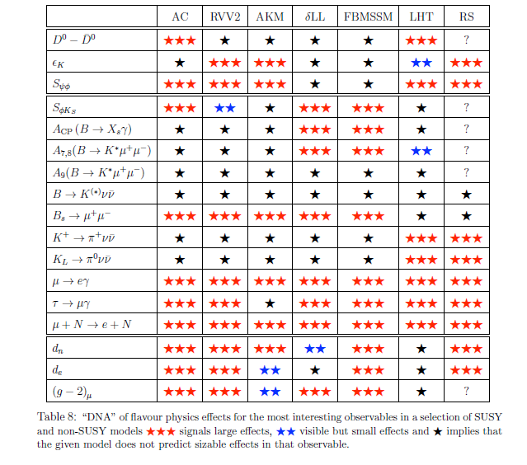
Muon electron conversion: golden channel for BSM
0909.1333
Excellent sensitivity to most physics models at or beyond direct reach by the LHC

Slide 8
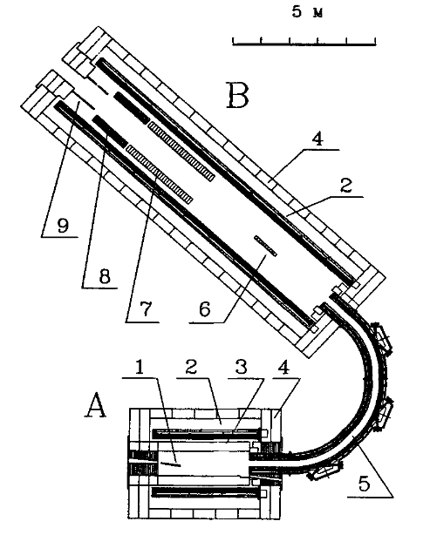

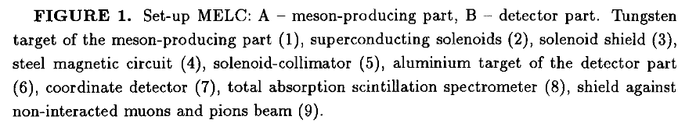
Search for Muon electron conversion
The MELC and then the MECO
Pulsed proton beam
Pion capture with high solenoid field
Muon transport with curved solenoid
Current Search for muon electron conversion based on MELC and MECO configuration
proton

Slide 9
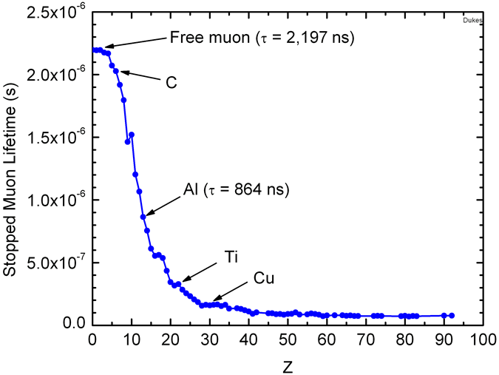
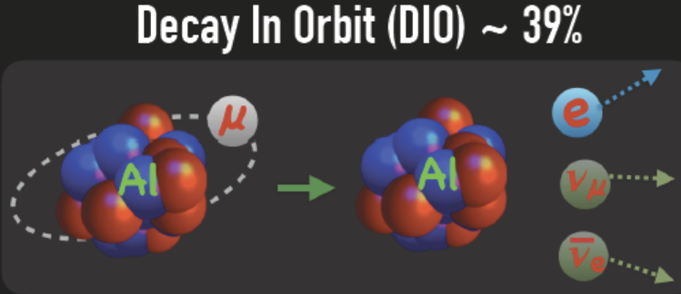
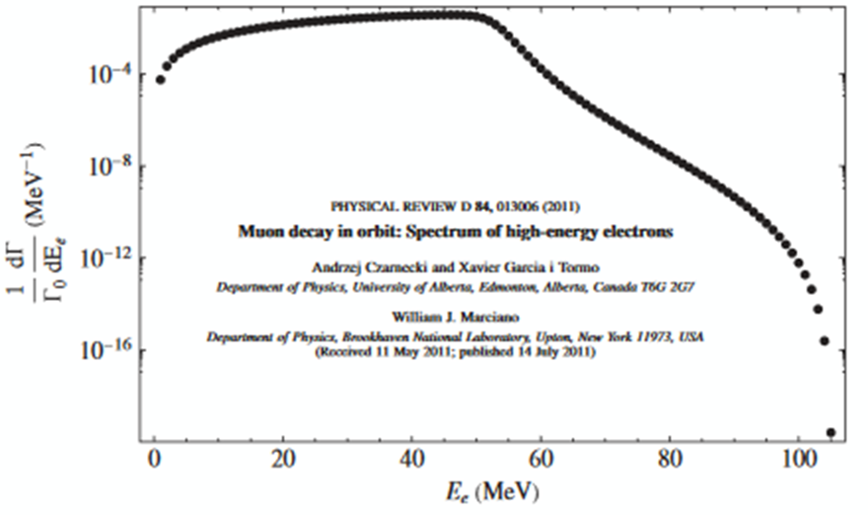
Search for Muon electron conversion
Low energy muon captured by atom
Muons cascade to 1s state emitting x-ray
Muon dissapearance
  Decay in orbit

Slide 10
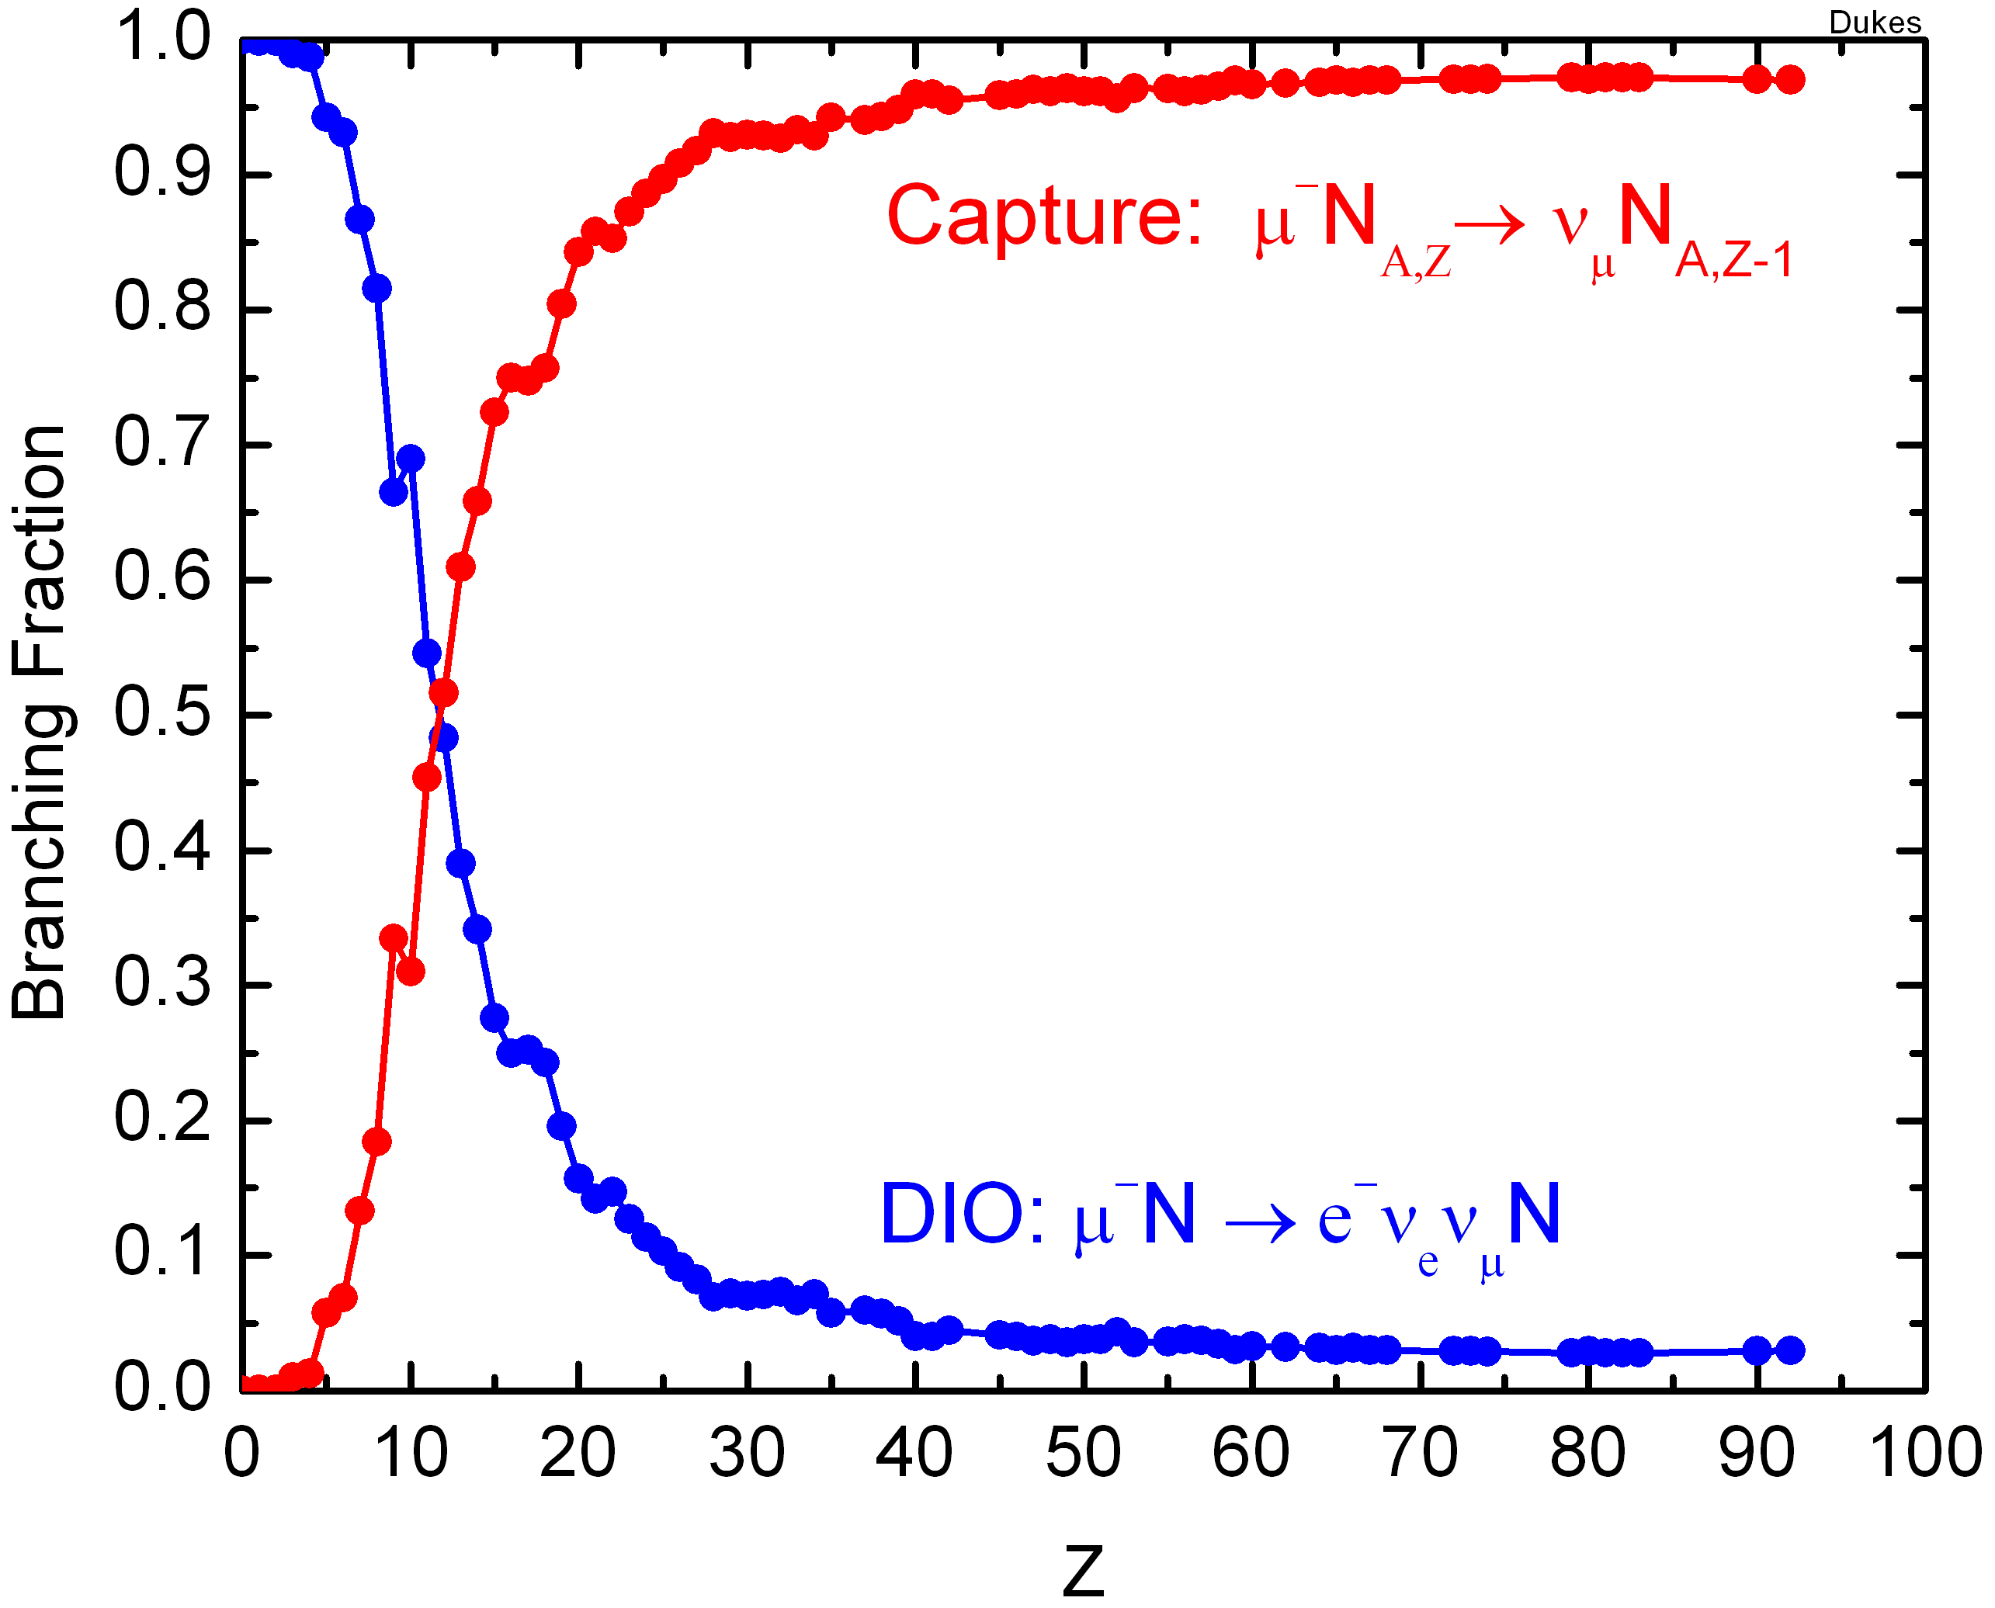
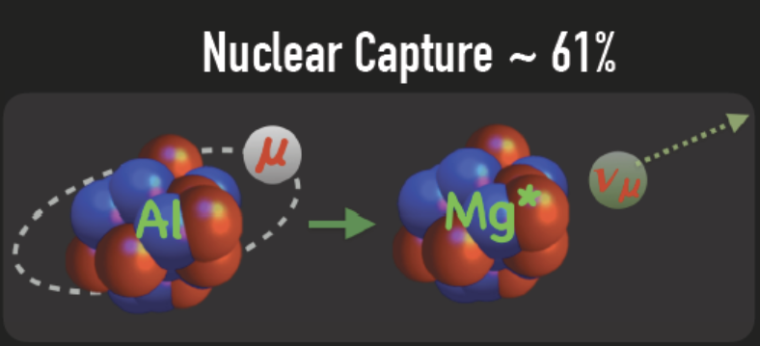
Search for Muon electron conversion
Low energy muon captured by atom
Muons cascade to 1s state emitting x-ray
Muon dissapearance
  Decay in orbit
  Captured by nucleus

Slide 11
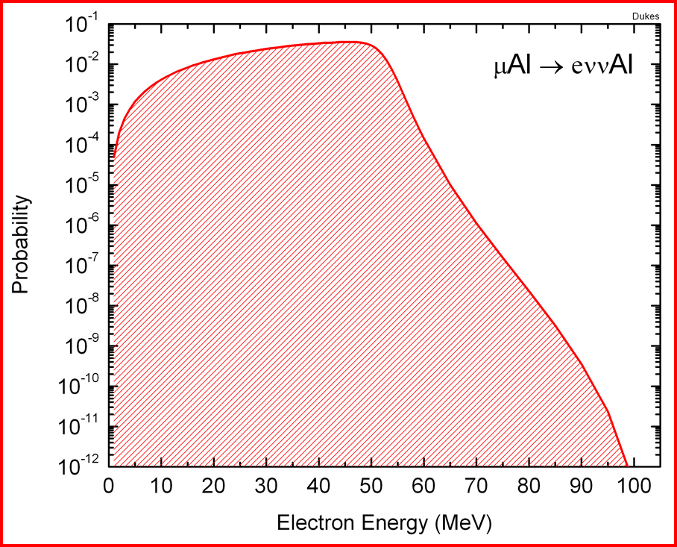
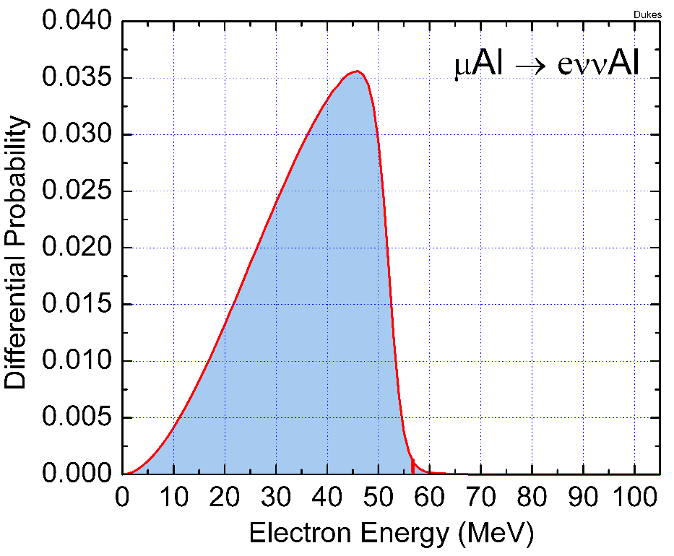
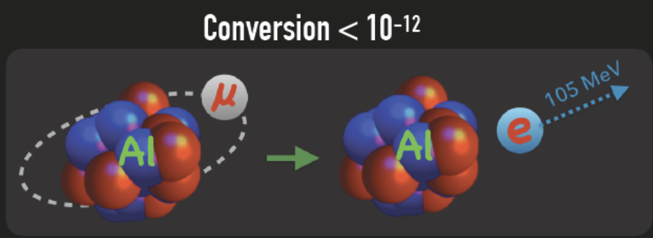
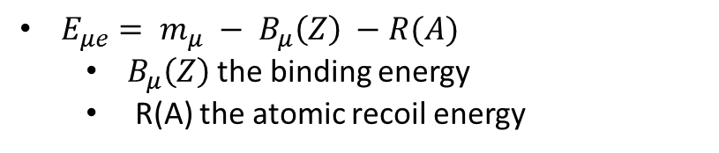
Search for Muon electron conversion
Low energy muon captured by atom
Muons cascade to 1s state emitting x-ray
Muon dissapearance
  Decay in orbit
  Captured by nucleus
  Coherent Muon electron conversion
Mu2e signature:
A single mono-energetic electron
$E_{μe}= m_{μ} − B_{μ}\left(Z\right) −R(A)$
  $B_{μ}\left(Z\right)$the binding energy
  R(A) the atomic recoil energy
signature
Electron from Decay in orbit

Slide 12
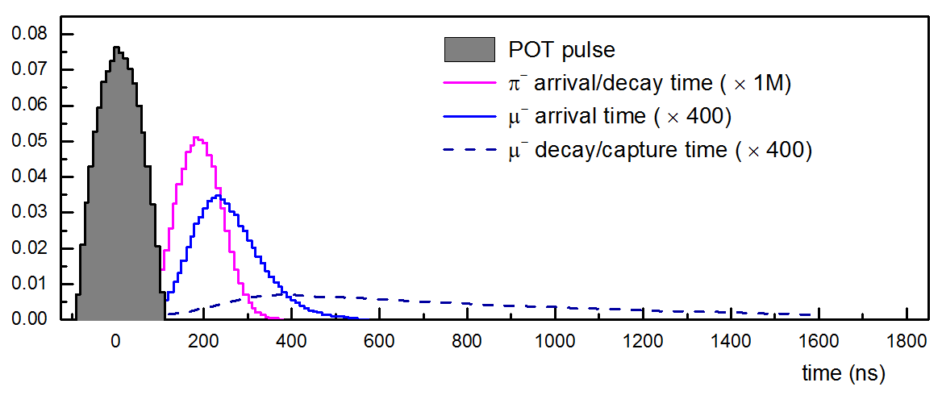
Search for Muon electron conversion

Slide 13
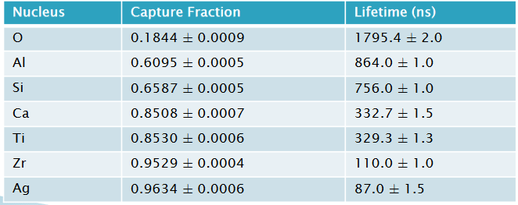
Search for Muon electron conversion

Slide 14
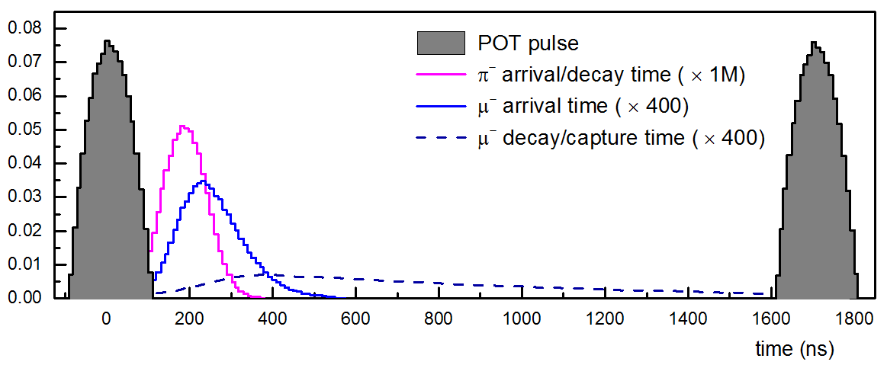
Search for Muon electron conversion

Slide 15

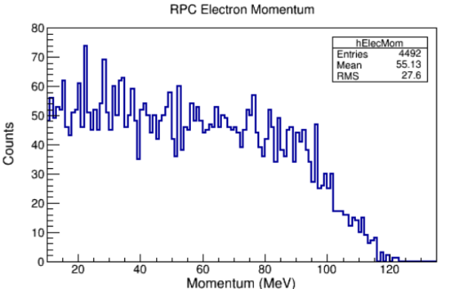
Search for Muon electron conversion
Radiative pion capture (RPC)
R. Torres, 2015
signature

Slide 16
Search for Muon electron conversion
Radiative pion capture (RPC)
R. Torres, 2015
signature
Delayed signal window
Eliminated this kind of prompt background by
delayed signal time window

Slide 17
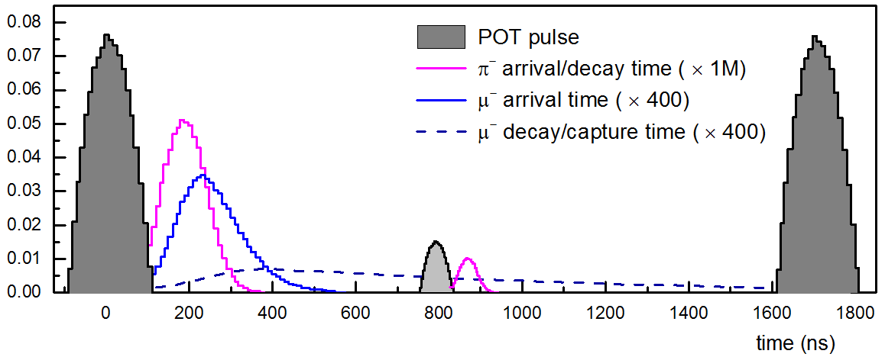
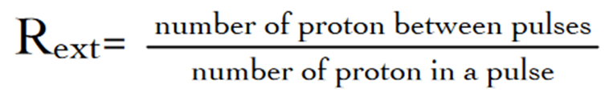
Search for Muon electron conversion
Radiative pion capture (RPC)
R. Torres, 2015
signature
Leaked proton
Delayed signal window
Eliminated this kind of prompt background by
delayed signal time window
good extinction

Slide 18
Search for Muon electron conversion
Radiative pion capture (RPC)
R. Torres, 2015
signature
Leaked proton
Delayed signal window
Eliminated this kind of prompt background by
delayed signal time window
good extinction
long muon beamline ?
shorter pulse duration ： the arrival time distribution of pion will be more sharper

Slide 19
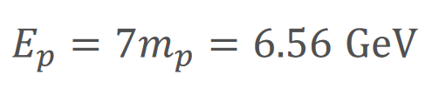
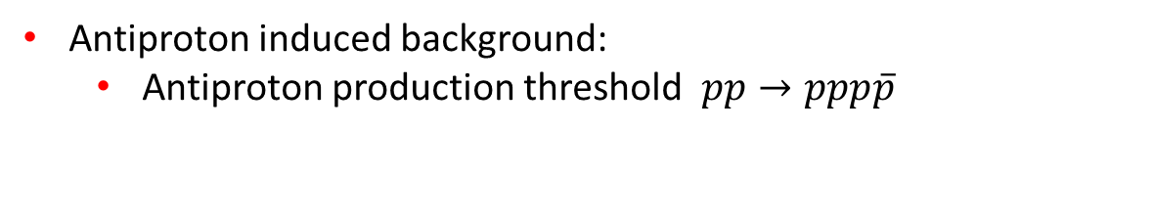
Search for Muon electron conversion
Antiproton induced background:
  Antiproton production threshold $pp→ppp\overline{p}$
  Low energy antiproton pass through the beam line and annihilate on materials in the detector region, leading directly or indirectly to 100MeV/c electrons
Delayed signal window

Slide 20
Search for Muon electron conversion
Antiproton induced background:
  Antiproton production threshold $pp→ppp\overline{p}$
  Low energy antiproton pass through the beam line and annihilate on materials in the detector region, leading directly or indirectly to 100MeV/c electrons
  Very low kinetic energy antiprotons, cannot be suppressed by the delayed window
Delayed signal window

Slide 21
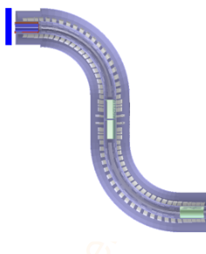
Search for Muon electron conversion
Antiproton induced background:
  Antiproton production threshold $pp→ppp\overline{p}$
  Low energy antiproton pass through the beam line and annihilate on materials in the detector region, leading directly or indirectly to 100MeV/c electrons
  Very low kinetic energy antiprotons, cannot be suppressed by the delayed window
Delayed signal window
Eliminated antiproton background by
Decreasing the proton beam energy
Adding a thin absorber material in the muon beam line (also muon will be absorbed )

Slide 22

Search for Muon electron conversion
Muon decay in orbit (DIO)
  Intrinsic background
signature
Delayed signal window

Slide 23
Search for Muon electron conversion
Muon decay in orbit (DIO)
  Intrinsic background
signature
Delayed signal window
Eliminated this kind of prompt background by
delayed signal time window
minimizing the momentum resolution of the detector

Slide 24
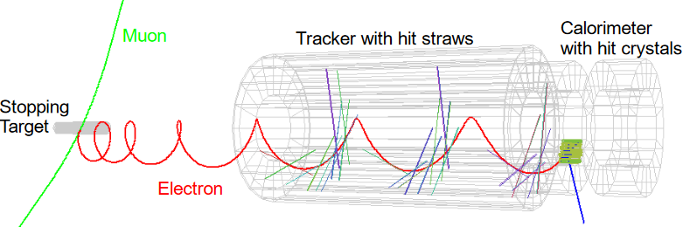
Search for Muon electron conversion
Cosmic Ray induced backgrounds
  Cosmic-ray muons interact
  Within the detector region
  and produce background
  electrons
Delayed signal window
From R. Bonventre, nufact 2019

Slide 25
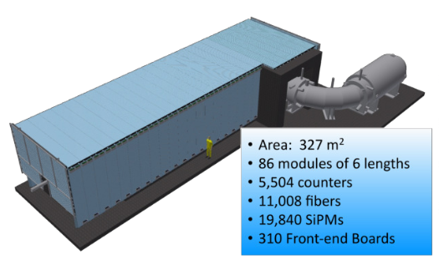
Search for Muon electron conversion
Cosmic Ray induced backgrounds
  Cosmic-ray muons interact
  Within the detector region
  and produce background
  electrons
Delayed signal window
From R. Bonventre, nufact 2019
Cosmic-ray veto system

Slide 26
Search for Muon electron conversion
Delayed signal window

Slide 27
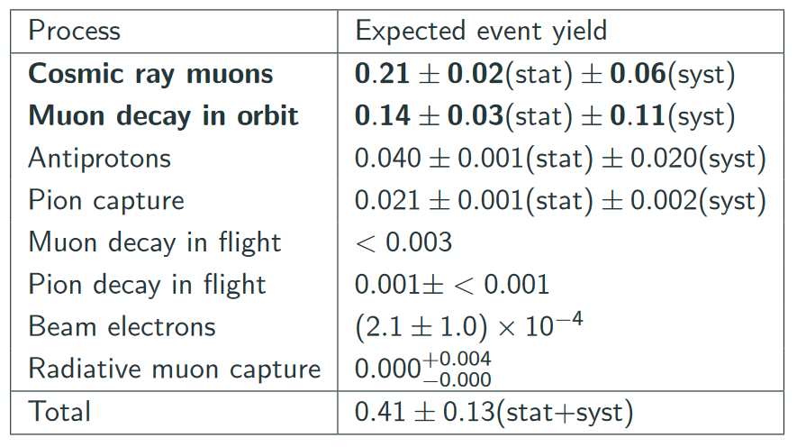
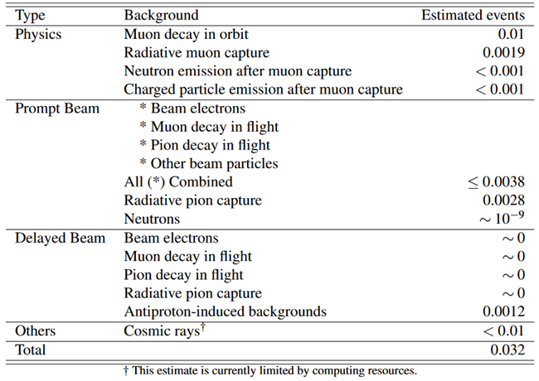

Search for muon electron conversion
Mu2e with $3.6×{10}^{20}$ POT
COMET phase I with $3.2×{10}^{19}$ POT
From R. Bonventre, nufact 2019
From 1812.09018

Slide 28
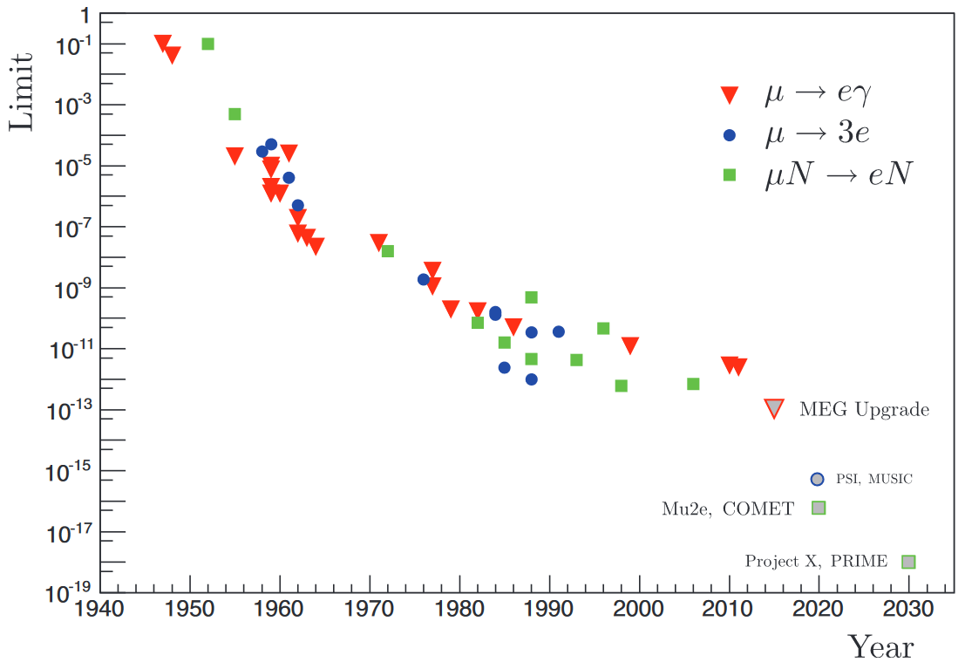
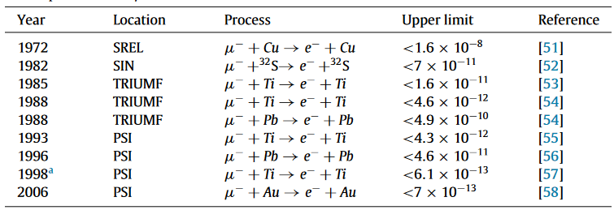

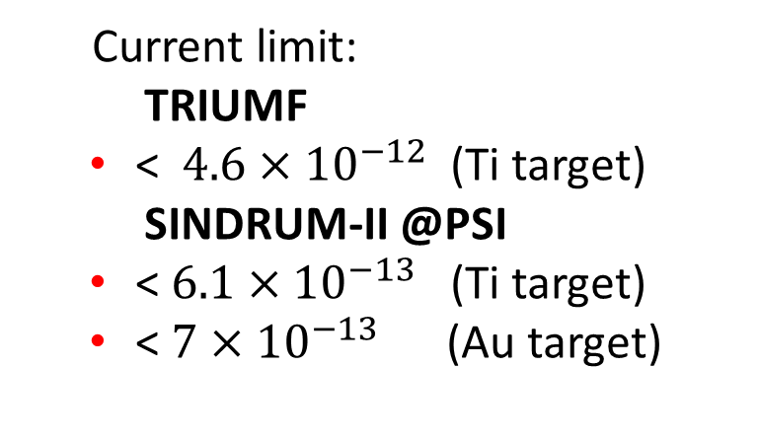
Search for Muon electron conversion
Current limit:
  TRIUMF
  < $4.6×{10}^{−12}$ (Ti target)
  SINDRUM-II @PSI
  < $6.1×{10}^{−13}$ (Ti target)
  < $7×{10}^{−13}$ (Au target)

Slide 29


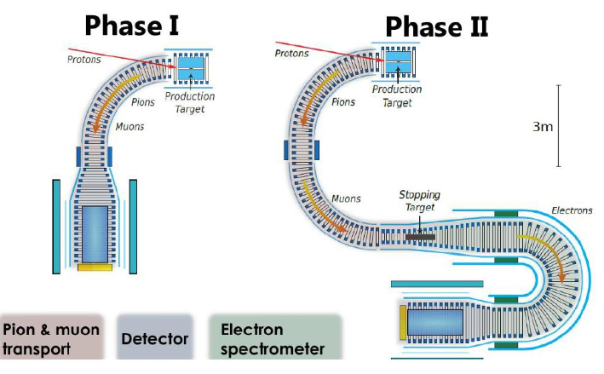

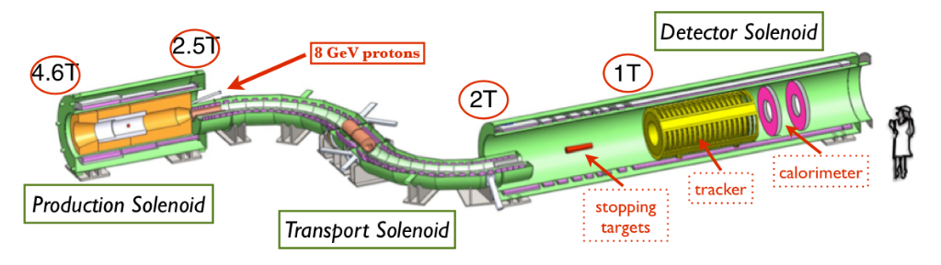
Next search for muon electron conversion at ${10}^{−17}$

Slide 30
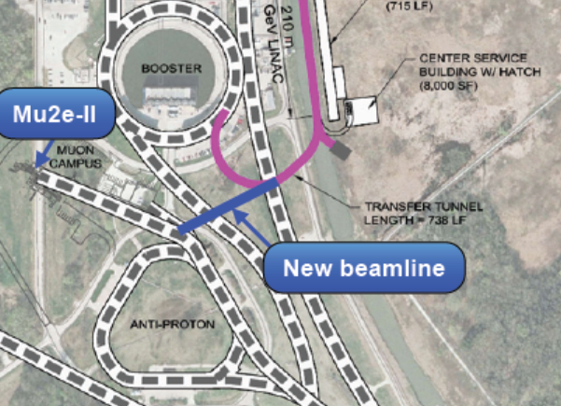
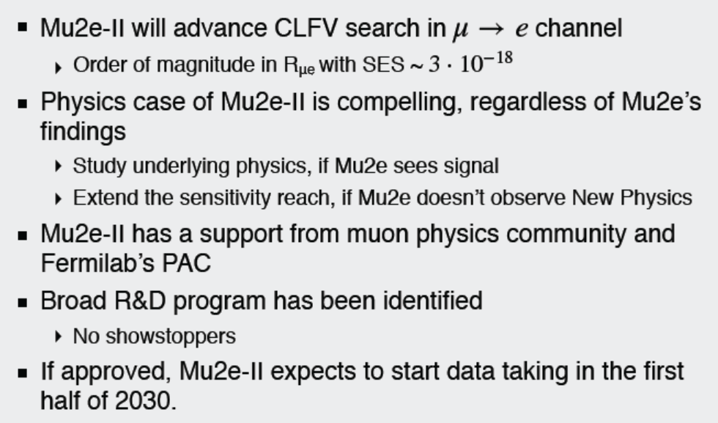

Next generation mu2e at ${10}^{−19}$?
Mu2e II
  Update to Mu2e
next generation mu2e <= ${10}^{−18}$
From Yuri Oksuzian, NuFact 2019

Slide 31
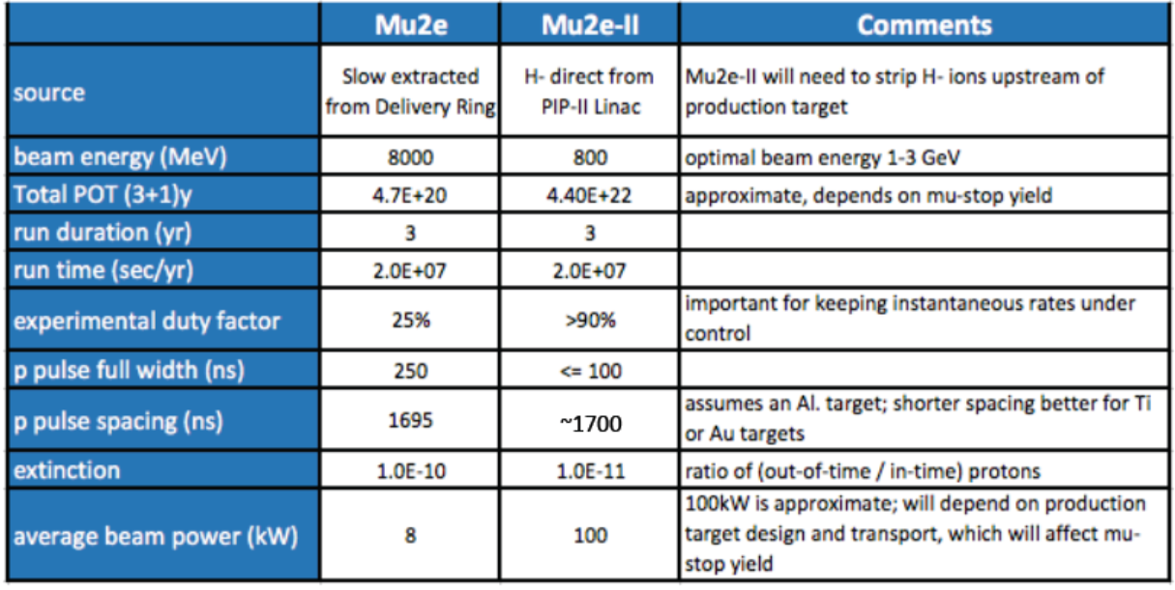
Next generation mu2e at PIP-II
From D. Glenzinski, 2018

Slide 32
Next generation mu2e at PIP-II
From D. Glenzinski, 2018

Slide 33
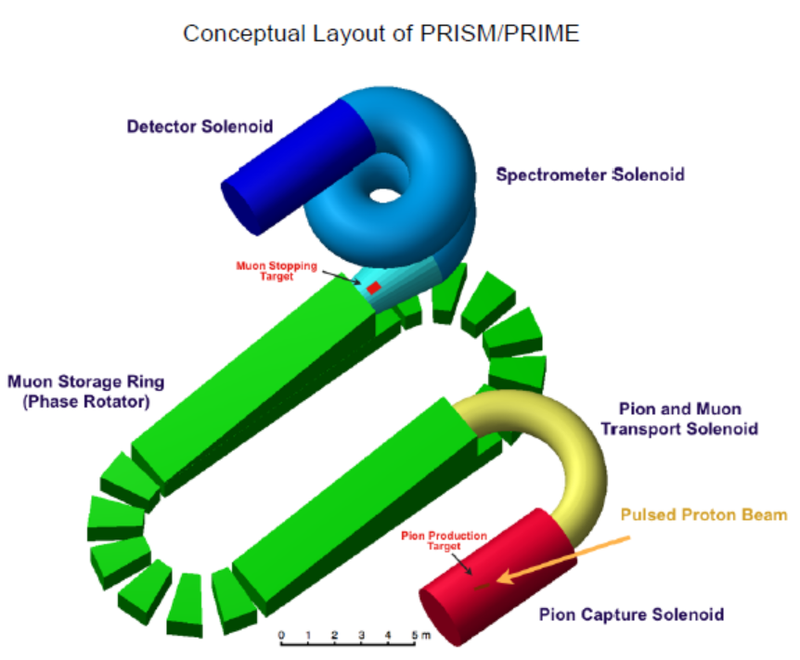
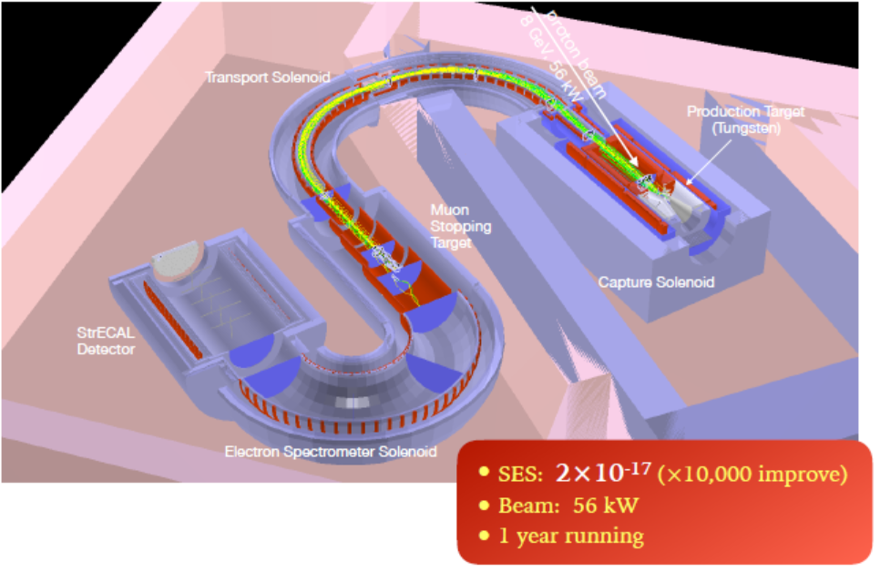
Next generation mu2e at J-PARC
COMET II
PRISM

Slide 34
Next generation mu2e at CiADS ?

Slide 35
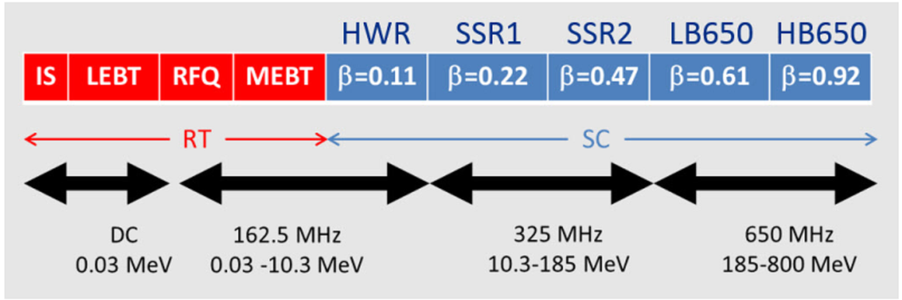
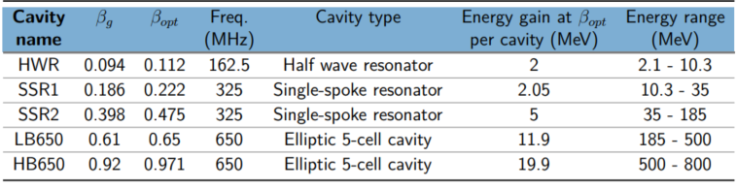
CiADS and PIP-II
PIP-II
800MeV, 1.6MW
By Chen W. L

Slide 36
CiADS and PIP-II
PIP-II
800MeV, 1.6MW
By Chen W. L

Slide 37
CiADS and PIP-II
PIP-II
CiADS
800MeV, 1.6MW
500MeV, 2.5MW
Cavity name | βopt | Freq. (MHz) | Cavity type | Energy gain at βopt per cavity(MeV) | Energy range (MeV)
HWR010 | 0.10 | 162.5 | Half wave resonator | 0.84 | 2.1-6.8
HWR015 | 0.19 | 162.5 | Half wave resonator | 2.32 | 6.8-44.7
Spoke42 | 0.42 | 325 | Spoke 3-cell resonator | 4.30 | 44.7-171.2
Ellip062 | 0.62 | 650 | Elliptic 6-cell cavity | 8.54 | 171.2-346
Ellip0825 | 0.82 | 650 | Elliptic 5-cell cavity | 12.36 | 346-540
By Chen W. L

Slide 38
CiADS and PIP-II
PIP-II
CiADS
800MeV, 1.6MW
500MeV, 2.5MW
Cavity name | βopt | Freq. (MHz) | Cavity type | Energy gain at βopt per cavity(MeV) | Energy range (MeV)
HWR010 | 0.10 | 162.5 | Half wave resonator | 0.84 | 2.1-6.8
HWR015 | 0.19 | 162.5 | Half wave resonator | 2.32 | 6.8-44.7
Spoke42 | 0.42 | 325 | Spoke 3-cell resonator | 4.30 | 44.7-171.2
Ellip062 | 0.62 | 650 | Elliptic 6-cell cavity | 8.54 | 171.2-346
Ellip0825 | 0.82 | 650 | Elliptic 5-cell cavity | 12.36 | 346-540
By Chen W. L

Slide 39
CiADS and PIP-II
PIP-II
CiADS
800MeV, 1.6MW
500MeV, 2.5MW
Cavity name | βopt | Freq. (MHz) | Cavity type | Energy gain at βopt per cavity(MeV) | Energy range (MeV)
HWR010 | 0.10 | 162.5 | Half wave resonator | 0.84 | 2.1-6.8
HWR015 | 0.19 | 162.5 | Half wave resonator | 2.32 | 6.8-44.7
Spoke42 | 0.42 | 325 | Spoke 3-cell resonator | 4.30 | 44.7-171.2
Ellip062 | 0.62 | 650 | Elliptic 6-cell cavity | 8.54 | 171.2-346
Ellip0825 | 0.82 | 650 | Elliptic 5-cell cavity | 12.36 | 346-540
By Chen W. L

Slide 40
CiADS and PIP-II
PIP-II
CiADS
800MeV, 1.6MW
500MeV, 2.5MW
1GeV proton
Cavity name | βopt | Freq. (MHz) | Cavity type | Energy gain at βopt per cavity(MeV) | Energy range (MeV)
HWR010 | 0.10 | 162.5 | Half wave resonator | 0.84 | 2.1-6.8
HWR015 | 0.19 | 162.5 | Half wave resonator | 2.32 | 6.8-44.7
Spoke42 | 0.42 | 325 | Spoke 3-cell resonator | 4.30 | 44.7-171.2
Ellip062 | 0.62 | 650 | Elliptic 6-cell cavity | 8.54 | 171.2-346
Ellip0825 | 0.82 | 650 | Elliptic 5-cell cavity | 12.36 | 346-540
By Chen W. L

Slide 41
CiADS and PIP-II
PIP-II
CiADS
800MeV, 1.6MW
500MeV, 2.5MW
1GeV proton
Cavity name | βopt | Freq. (MHz) | Cavity type | Energy gain at βopt per cavity(MeV) | Energy range (MeV)
HWR010 | 0.10 | 162.5 | Half wave resonator | 0.84 | 2.1-6.8
HWR015 | 0.19 | 162.5 | Half wave resonator | 2.32 | 6.8-44.7
Spoke42 | 0.42 | 325 | Spoke 3-cell resonator | 4.30 | 44.7-171.2
Ellip062 | 0.62 | 650 | Elliptic 6-cell cavity | 8.54 | 171.2-346
Ellip0825 | 0.82 | 650 | Elliptic 5-cell cavity | 12.36 | 346-540
CiADS-I 500MeV, 2.5MW
CiADS-II 1GeV, 10MW
By Chen W. L

Slide 42
Mu2e@CiADS
Delayed signal window
The time structure of the beam can be realized in CiADS
advantage
1、 pulse width shorter ~100ns
2、 no antiproton background
disadvantage
1、 lower energy and lower muon yield efficiency

Slide 43
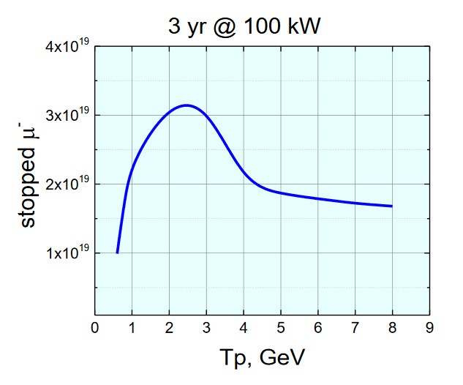

Mu2e with different proton energy
Stopped muon rates estimation:
assume 90% duty factor
1695ns pulse space
pulse width < 200ns
Production target can stands the power
Al stopping target
  Same geometry as Mu2e
The same detector system as Mu2e
3 years running time (6e7 s)
Data taken from papers of D. Glenzinski, et al. 1612.08931,1307.1168

Slide 44
Outline
g-2@HIAF-U

Slide 45





缪子g-2/EDM
π注入
μ注入

Slide 46





缪子g-2/EDM
$$a_{μ}=\frac{ω_{a}}{\tilde{ω_{p}}}\frac{m_{μ}}{m_{e}}\frac{μ_{p}}{μ_{e}}\frac{g_{e}}{2}$$
E821@BNL vs E989@Fermilab
E821@
E821@
E989@Fermilab

Slide 47




缪子g-2/EDM@HIAF-U可行性
Parameter | ¹³⁶Xe
Nucleon on target(POT) / pulse | 136*2*10¹²
Pulse width (ns) | 120
Number of pulses | 5
Cycle length (s) | 4
Beam momentum (AGeV/C) | 10.23
Selection momentum (GeV/c) | ~3.1
>30 times of μ+ （3.1 GeV/c）can be provided

Slide 48










缪子g-2/EDM@HIAF-U可行性
$$a_{μ}=\frac{ω_{a}}{\tilde{ω_{p}}}\frac{m_{μ}}{m_{e}}\frac{μ_{p}}{μ_{e}}\frac{g_{e}}{2}$$
$$δ\left(\frac{g_{e}}{2}\right)\sim 0.3ppt$$
$$δ\left(\frac{μ_{p}}{μ_{e}}\right)\sim 0.008ppm$$
$$δ\left(\frac{m_{μ}}{m_{e}}\right)\sim 0.025ppm$$
g-2@HIAF
E989@Fermilab vs g-2@HIAF-U
$δ_{stat}\sim 0.1 ppm$ 0.018 ppm
$δ_{ω_{a}} \sim 0.07ppm$ 0.02ppm
${ δ}_{ω_{p}} \sim 0.07ppm$ 0.02ppm
E821@BNL
?
E989@Fermilab
be compatible with $δ_{stat}$
?
 | BNL | Fermilab | HIAF
$$δ{(a}_{μ})\sim 0.03ppm$$
E989@Fermilab的$\frac{1}{4}$
单位: $e∙cm$

Slide 49
Outline
Neutrino@HIAF-U

Slide 50

Energy similar with BNB neutrino source
HIAF Upgrade
BNB@Fermilab
全超导
E_{B1}:
0.8 AGeV, 3×10¹⁰ppp ²³⁸U³⁵⁺
1.75AGeV, 7.5×10¹⁰ppp ⁷⁸Kr¹⁹⁺
2.6AGeV, 1.0×10¹¹ppp ¹⁶O⁶⁺
E_{B2}:
>9AGeV, 1×10¹²ppp U⁹²⁺
~10GeV, >1×10¹³ppp Xe⁵⁴⁺
~12AGeV, >5×10¹³ppp He²⁺
~24.8GeV, >1×10¹⁴ ppp H
磁刚度
34Tm => 86Tm

Slide 51


重离子产生π介子
相同能量的重离子能产生更多低能端π介子
π+能量 (GeV)
π+能量 (GeV)

Slide 52

Horn based beam
NuMI beam line@Fermilab

Slide 53



HIAF-U中微子源
Ar 18/40, 9AGeV, Be target , 10x100cm, horn#1 in NoVA
0.0A 1e6POT
0.02MA 1e6POT
0.2MA 1e5POT

Slide 54

collection scheme

Slide 55

collection scheme

Slide 56


中微子散射截面研究?
2014年

Slide 57
Outline
The Granular Waterfall Flow Target solution

Slide 58





  密集颗粒流靶：极高的热移除能力
束流轰击
“全新的概念，融合固态靶和液态靶的优势，极具潜力……”---G. Munzenberg
颗粒流散裂靶
重力驱动密集颗粒流
中子出射
电子束耦合原理试验

Slide 59





高亮度次级粒子源高功率靶的技术挑战
束流功率高，有效靶体积小——热移除、辐照损伤问题
单脉冲束流粒子数高——热冲击硬化、脆化等
次级粒子收集、输运通道对靶结构设计的限制——工作形态、稳定性问题
束流功率升高到100kW，靶的温度将达到3150以上。
Tests of a prototype tungsten
production target at RAL
  High melting temp, radiative cooling (~1600ºC), with 8kW beam (700w in target)
一种瀑布型颗粒流靶概念设计

Slide 60


MOMENT颗粒流靶概念设计（IMP&IHEP）
Solenoid
一种顺束流径迹的曲型设计
Solenoid

Slide 61


Slide 62
Conclusion
the accelerator structure of CiADS is similar with PIP-II
CiADS-I and CiADS-II could be feasible platform for next generation mu e conversion experiments
  No antiproton background
  Shorter pulse width
  Relatively low muon yields
g-2@HIAF-U feasible? Systematic uncertainty need improved
neutrino@HIAF-U
  Neutrino cross section experiment?

Slide 63
Thanks for
your attention！

Slide 64
backups

Slide 65





Kick and pick
MEBT layout
K
P
K
+500V
0V
kick beam dynamic envelop
-500V
Beam stop and power distrbution
0
6
12
18
Time (ns)
Ideal Voltage between the electrode
( K: kicked P: picked)
Pick beam dynamic envelop

Slide 66

PIP-II
From D. Glenzinski, 2018

Slide 67

不同停止靶

Slide 68


From 1612.08931

Slide 70


Slide 71
Stopped muon yields at CiADS
Stopped muon rates estimation:
assume 90% duty factor
1695ns pulse space
pulse width < 200ns
Al stopping target
3 years running time (6e7 s)
 | 0.5GeV | 1GeV
Stops/POT |  | 1.4e-4
Stops/kW ? | 5.8e18 | 2.2e19
100 kW sensitivity
Data taken from papers of D. Glenzinski, et al. 1612.08931,1307.1168

Slide 72

Sensitivity estimation
The single event sensitivity
The number of stopped muon per POT for a given stopping target with proton kin energy E(p)
The muon capture fraction for a given stopping target : 0.6 for Al target
The fraction of muon captures that occur in the signal time window for a given stopping target : 0.489 for Mu2e stopping target
The total reconstruction and selection efficiency for electrons from conversion: 0.173 for Mu2e
from papers of D. Glenzinski, et al. 1612.08931,1307.1168

