Slide 1
Mu-Mu conversion for cLFV at CSNS
Yu Bao
IHEP,CSNS
@ CSNS
2019.12.8

Slide 2
Outlines
Muonium and MuMuBar search
Muon beam design based on CSNS
From muon to muonium
MuMuBar @ CSNS
Summary

Slide 3


Muonium and anti-muonium
Muonium ($Mu$)
Anti-muonium ($\overline{Mu}$)
e⁻
e⁺
μ⁺
μ⁻
Different way searching for cLFV, other than Mu2e/COMET, MEG, mu3e…
  Mu2e/COMET
  MEG
  Mu3e

Slide 4
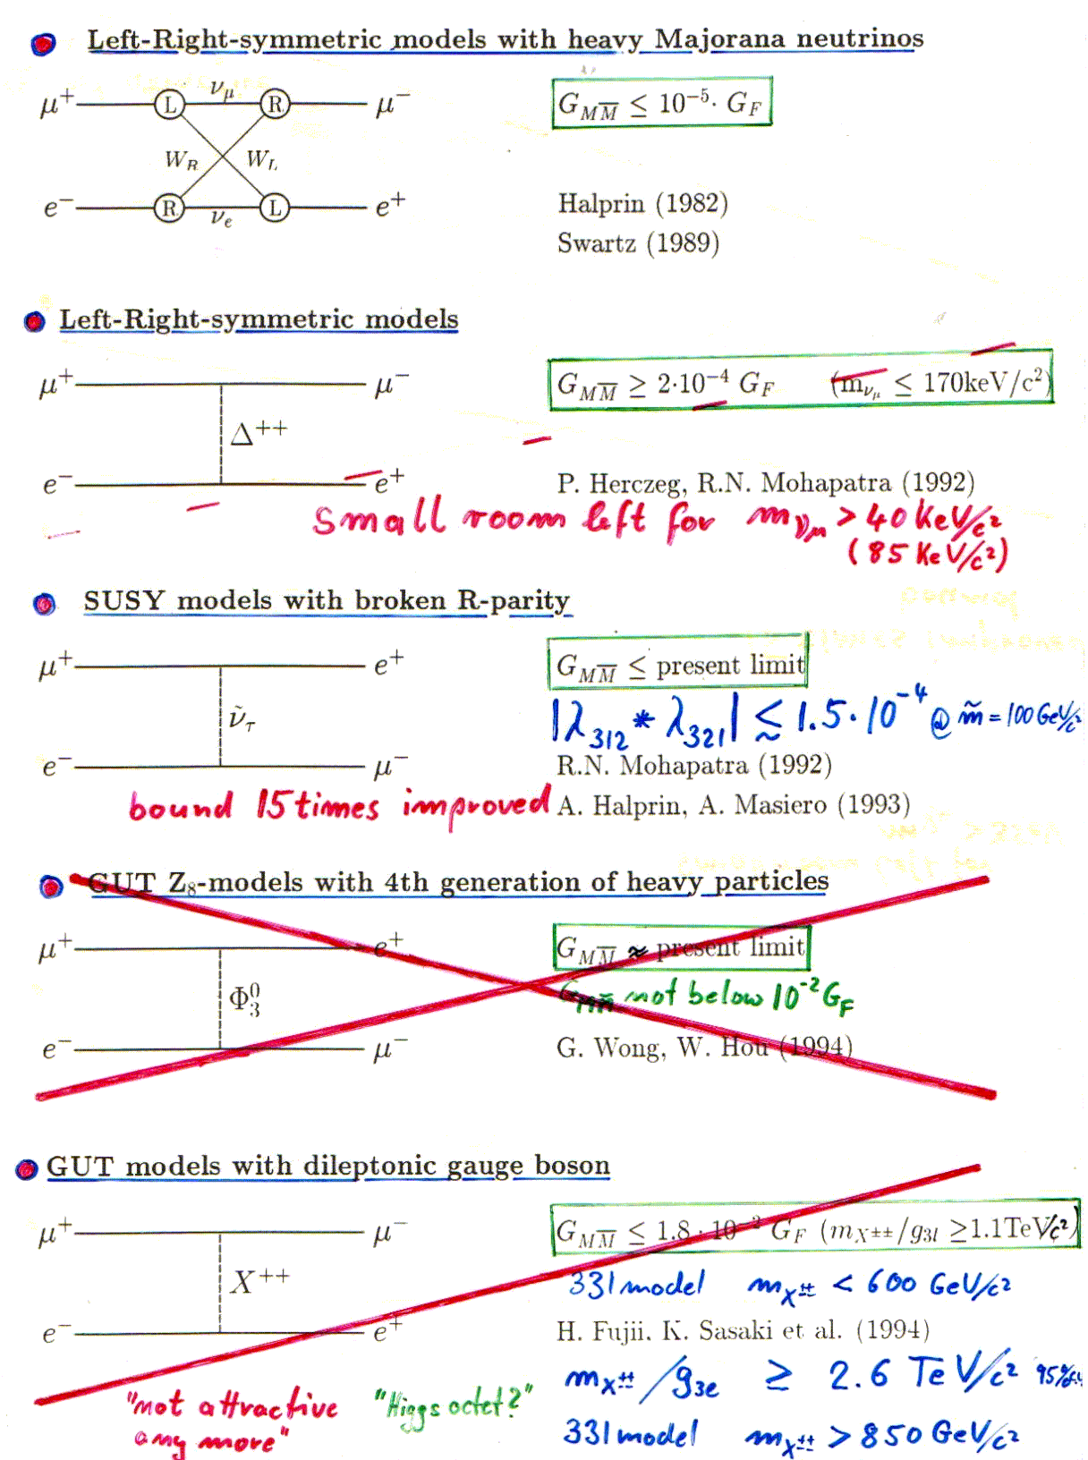
Mu-Mu conversion
Strongly suppressed in SM
Theory is proposing lots of models
  e.g.
  Clark, Love “Muonium-Antimuonium Oscillations and Massive Majorana Neutrinos”,
  hep-ph/0307264 (2003)
  Gusso, Pires, Pires, Rodrigues da Silva “Minimal 3-3-1 Model, lepton Mixing and
  Muonium- Antimuonium Conversion”, hep-ph/0208062 (2002)
  Cvetic,Dib, Kim, Kim, “Muonium-Antimuonium Conversion in models with heavy neutrinos”,
  hep-ph/0504126 (2005)
  Applequist, Christensen, Piai, Schrock “ Flavour-Changing Processes in Extended Technicolor”,
  Phys. Rev.D70, 093919 (2004)
  ….

Slide 5
MuMuBar history
PSI,1999
CSNS,2029
Last search was at PSI, 20 years ago.
We propose a new MuMuBar experiment based on CSNS proton driver, and expect to increase the sensitivity by 2 orders of magnitude.
No on-going experiment currently in the world.
Notes:
历史上已经开展了多次对这一过程的探索，尤其是在上世纪的八九十年代。而最近一次探索是在1999年瑞士PSI完成的，二十年来的科技进步将使我们有机会从多个技术手段改进该实验，将其精度提高两个数量级。而目前国际上没有正在进行的相关实验，这是我国在带电轻子味道数破坏领域实现0到1的突破的重大机遇。

Slide 6
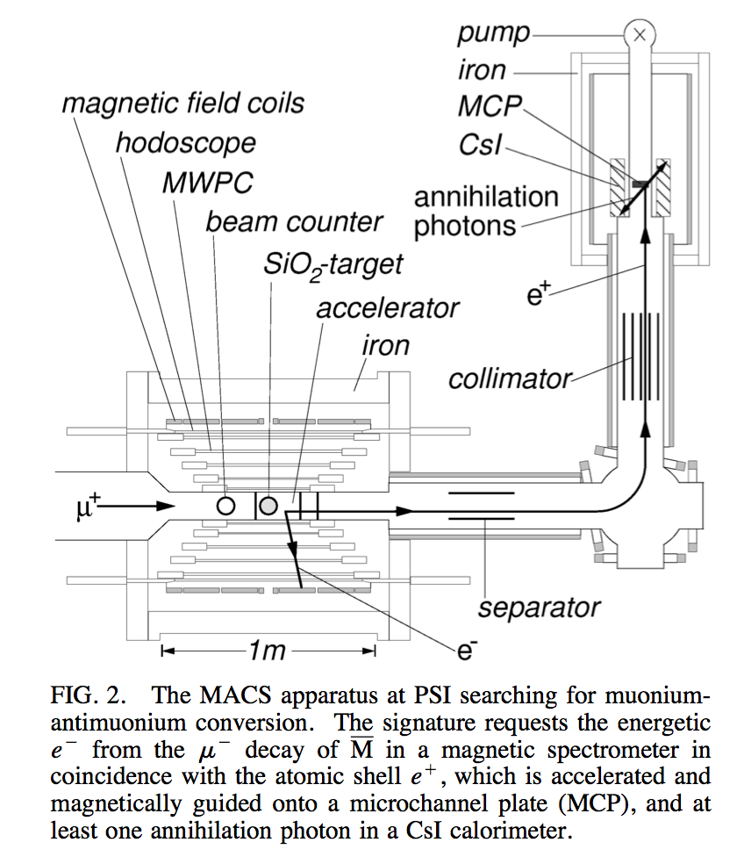
PSI experiment 1998
Double coincidence：
Signal1：HE electron from mu- decay
Signal2：thermal positron released
Muon rate: 8*10^6 mu+/s
Muonium efficiency: 1.8%
Detected muonium: 5*10^-3 /mu+
Total accumulation:
  5*10^10 Mu atoms
Our Improvement:
Muon rate
Muonium efficiency
Background

Slide 7
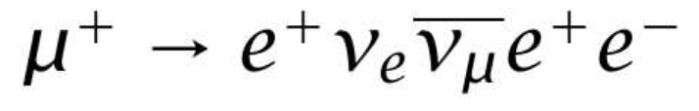
Background
Accidental coincidences of energetic e- produced by Bhabha scattering of e+ from Mu decays and scattered e+
Allowed decay：
  Branch ratio = 3.4*10⁻⁵

Slide 8
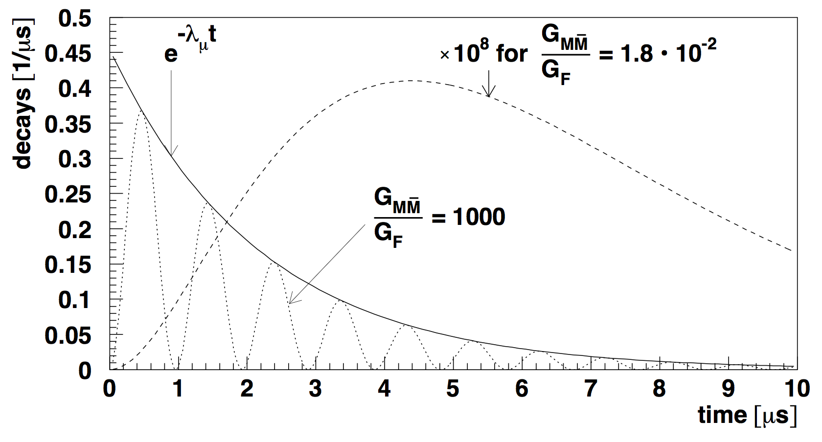
Background of continuous/pulsed beam
P(Mu) ∝ sin² [const * (G_{MM}/G_{F})*t]*exp[-λ_{μ}*t]
Background ∝ exp(- n λ_{μ}*t) ; n-fold coincidence detection
For G_{MM} << G_{F} M gains over Background
P(Mu) / Background ∝ t² * exp[+(n-1)* λ_{μ}*t]
⇒ Pulsed ACCELERATOR
By Jungman,2016

Slide 9
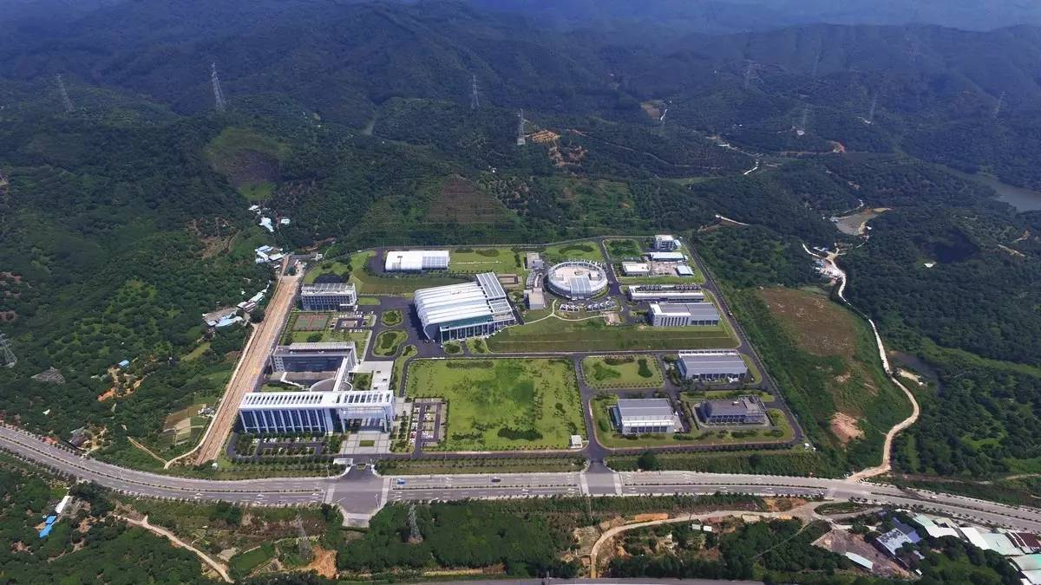
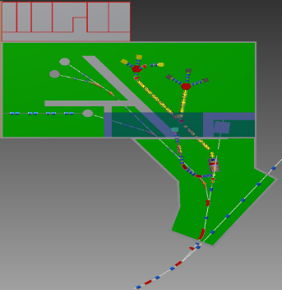
Muon source @ CSNS
MuMuBar
Decay muon
Proton: 1.6GeV，25Hz，100kW~500kW
Conceptual design has been completed for the muSR applications.
MuMuBar needs a dedicated beam line for 1 – 2 years for data taking.
Muon source project has been planed in the CSNS phase II upgrade.
Surface muon
We are designing a MuMuBar beamline to reach an intensity of 10⁸ mu+/s, which is more than 10 times higher than 1999 PSI experiment.

Slide 10
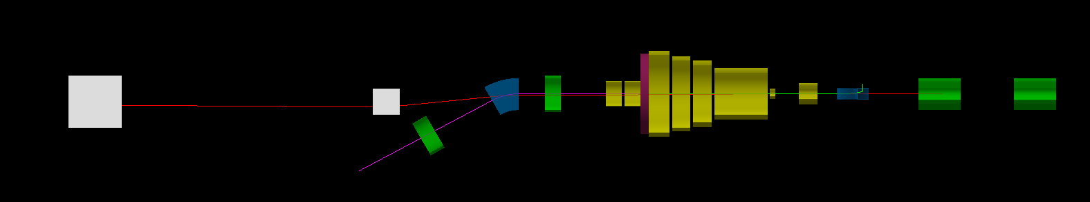
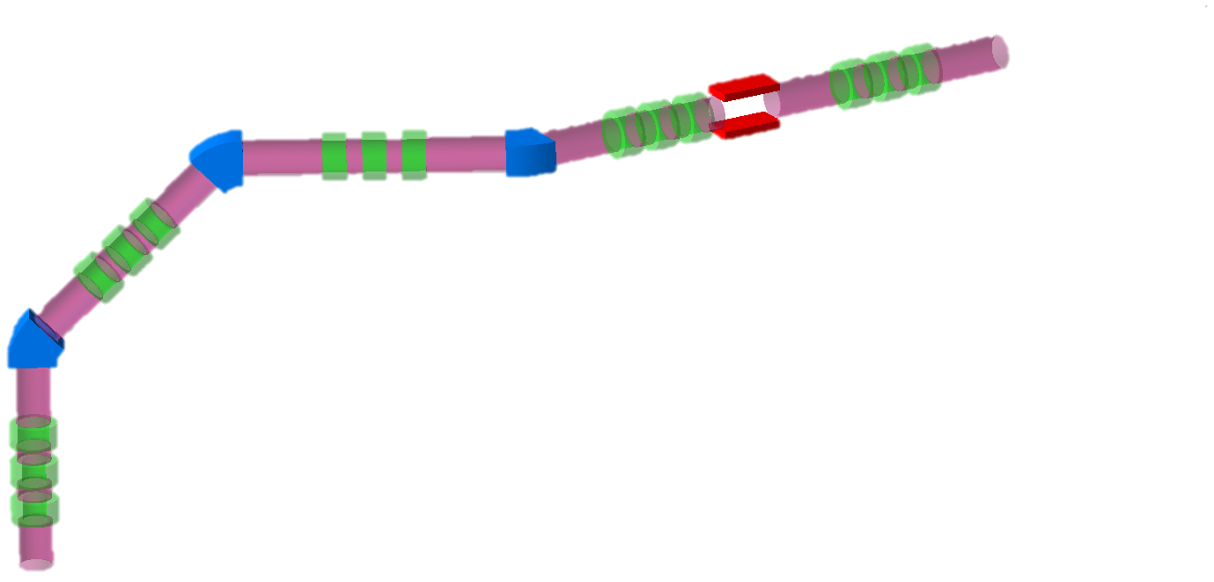
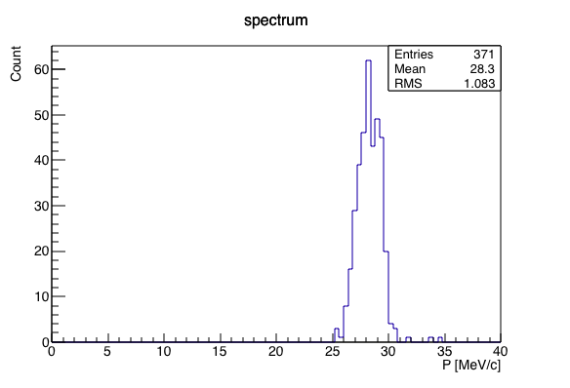
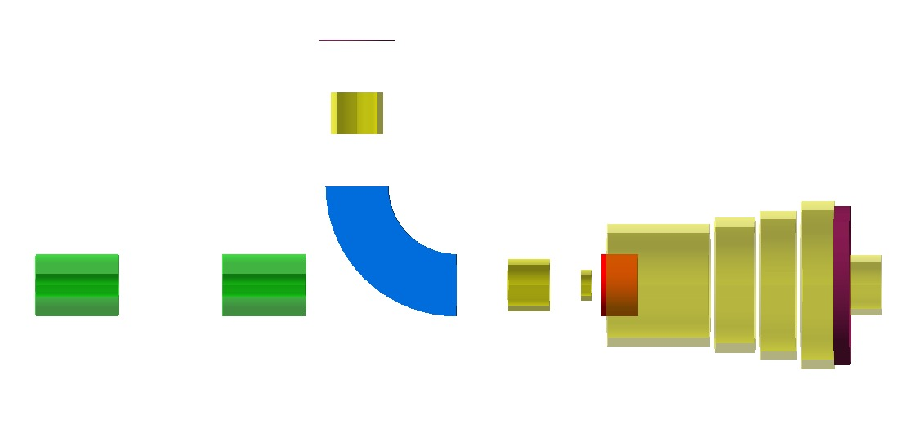
Alternative design – collect muons backward
Proton
MuMuBar
muSR
First design and simulation shows 2*10⁸ mu+/s can be reached at proton power of 25 kW.
Beam spot 24*50mm
Energy spread ~3.5%@28MeV/c (rms)
mu+
Proton
EMuS

Slide 11
MuMuBar @ CSNS
10⁸/s
Notes:
在具体实验方案方面，我们创新提出了将缪子素先降能压缩，再用独特的缪子素产生靶产生大量缪子素，然后使用高分辨率的探测器系统压低实验本底。

Slide 12
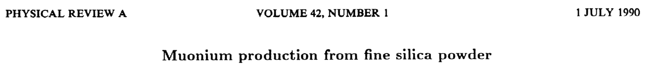
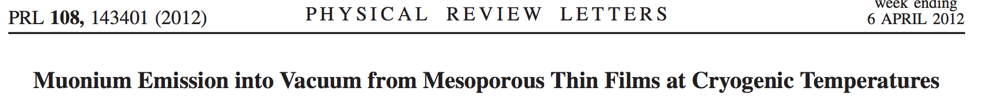
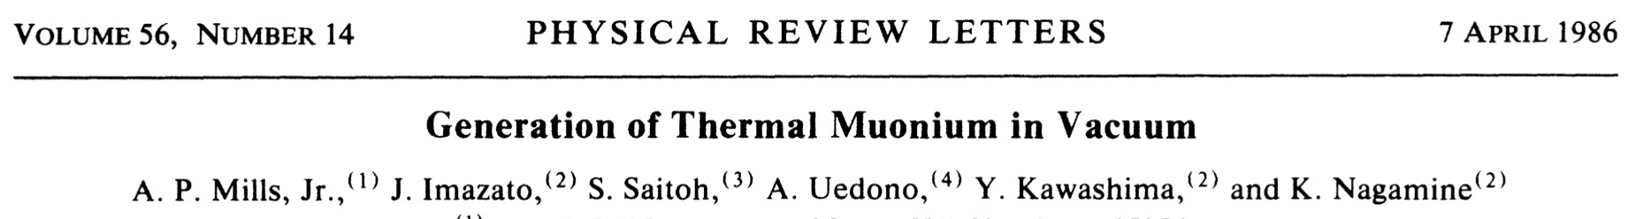
How to produce Mu
Known:
SiO2 powder：efficiency1%~2% from 4MeV mu+
SiO2 film(cold)： efficiency 40% from 5keV mu+
Hot tungsten： efficiency 4% from 4MeV mu+
More methods:
1. Aerogel： PSI, JPARC, TRIUMF, CSNS
2. Superfluid helium： PSI
3. Low-energy muon：PSI, CSNS

Slide 13
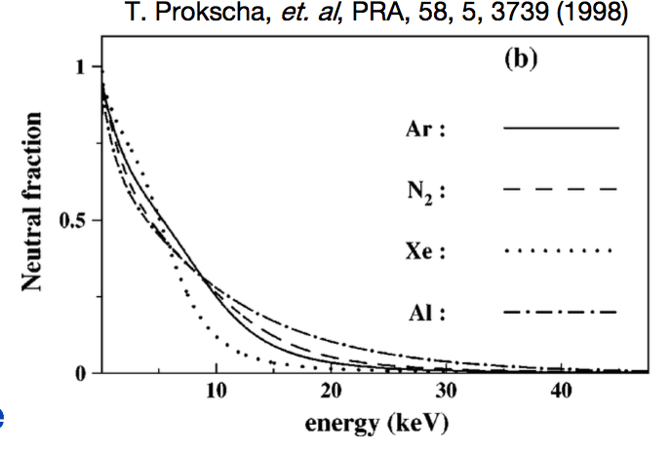
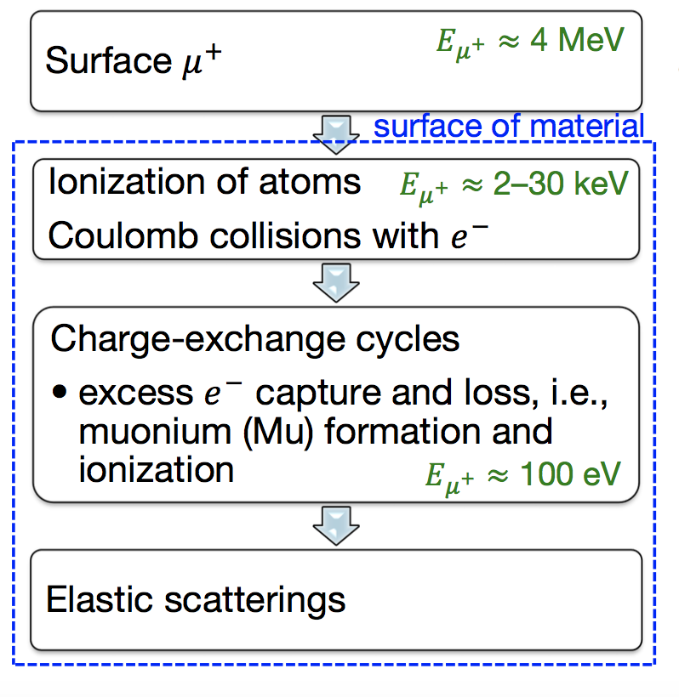
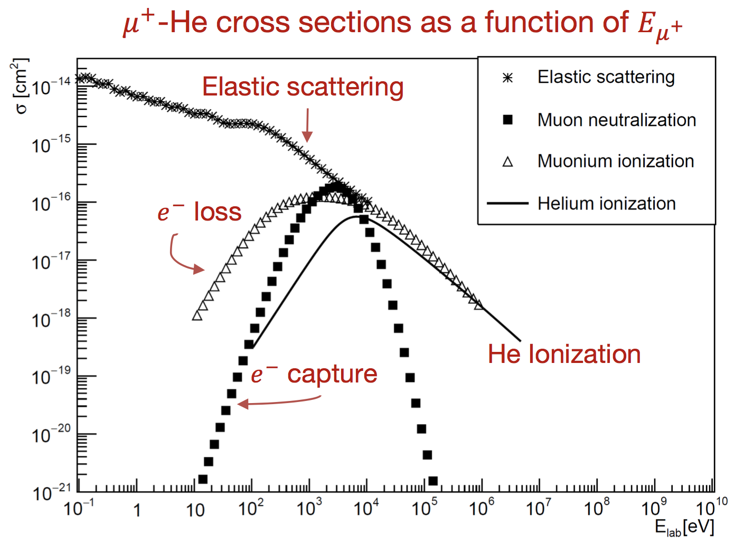
Slowing down processes

Slide 14
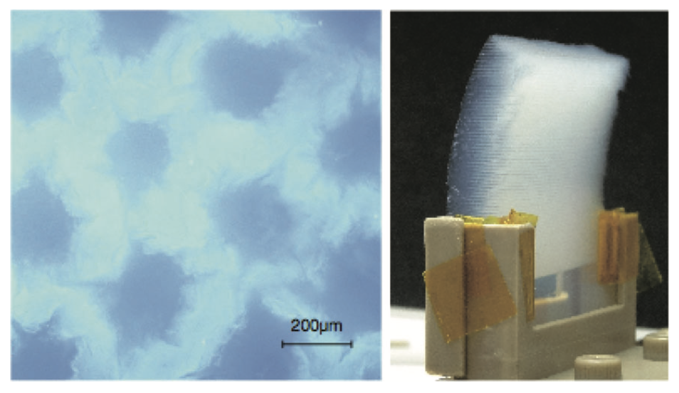
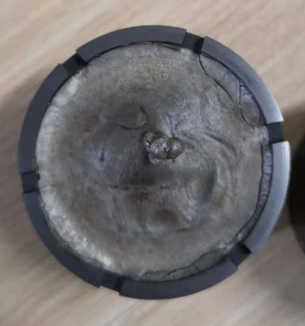
Aerogel
Sample provided by Zhejiang University
Silica aerogel: density ~ 20mg/cm3, laser ablated, efficiency ~ 3%
  - G.A. Beer, Prog. Theor. Exp. Phys. 2014
Graphene Aerogel:
Density: 0.2-20mg/cm3
on going…

Slide 15
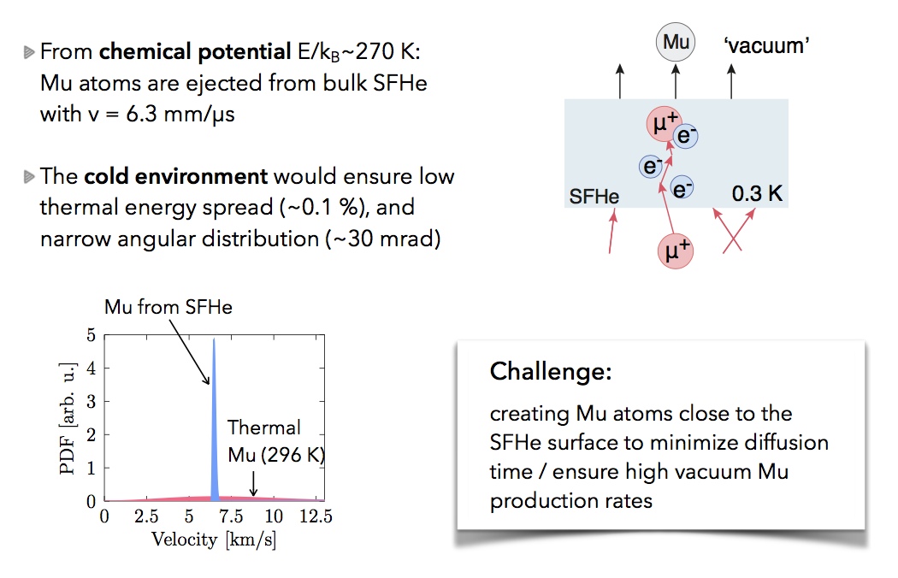
Superfluid helium (courtesy of A. Soter)

Slide 16
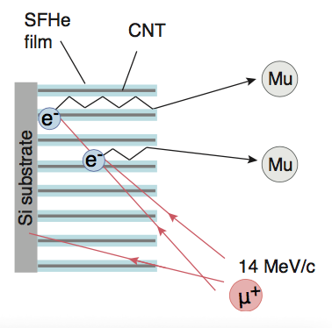
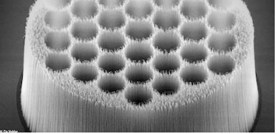
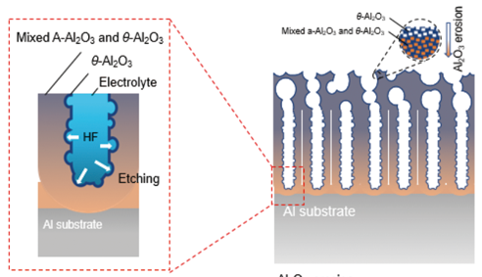
Superfluid helium + CNT/eroded Al₂O₃
Carbon nano tubes to host SF helium
Porus structure
Large surface area
collaborating with RIKEN and PSI…
Eroded Al₂O₃ by Peking University

Slide 17
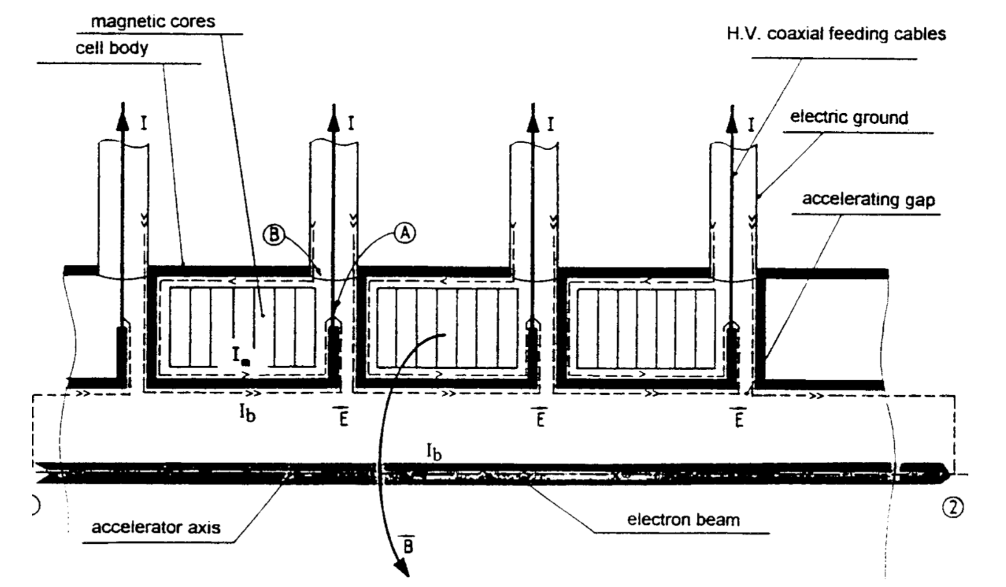
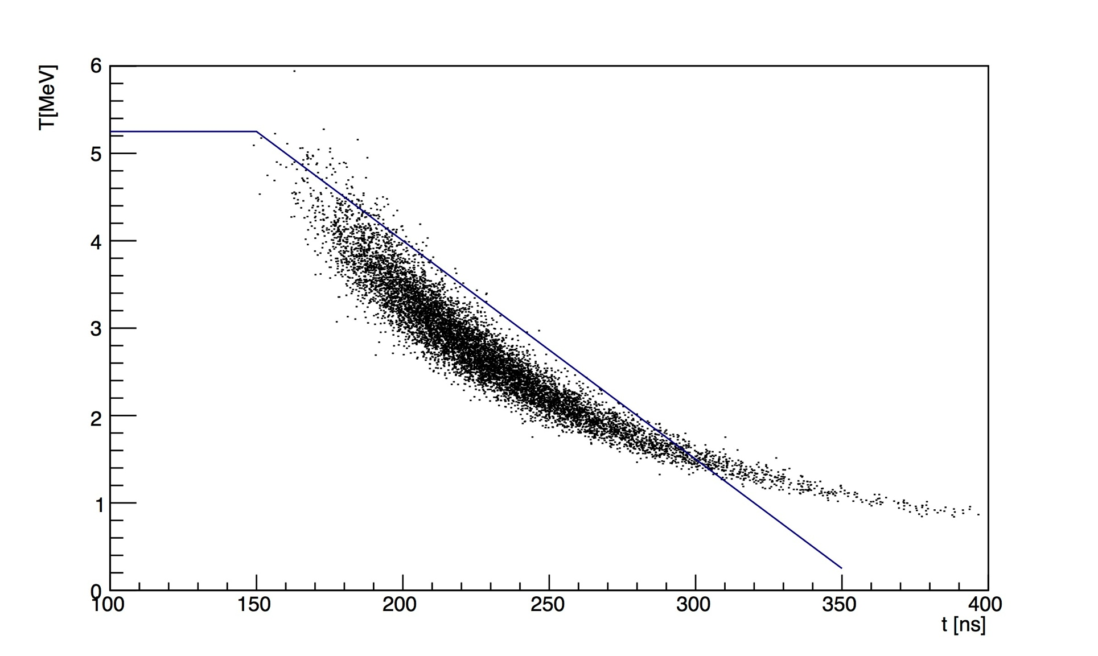
Phase rotation by induction LINAC/ RFQ
Reduce the energy of surface muon from 4MeV to low energy.
Using the time-energy correlation to do the phase rotation by an induction linac or RFQ.
Need to measure the real correlation.
Even with NO correlation at all, deceleration itself will increase the slow muon production greatly.
After Linac
Surface muon
After a foil

Slide 18
MuMuBar Detector System
Solenoid ~ 0.1 T
Scintillator
Positron detector
TPC
e⁻
10keV e⁺
Mu
e⁺
Vacuum tube
Reflector
10kV E-Field cage
10kV

Slide 19
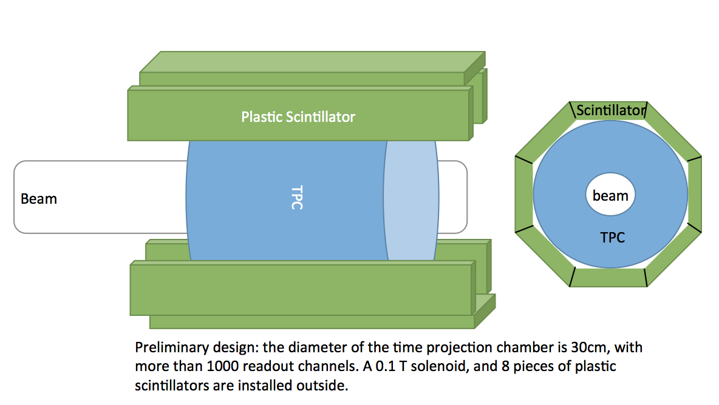
Electron Detector

Slide 20
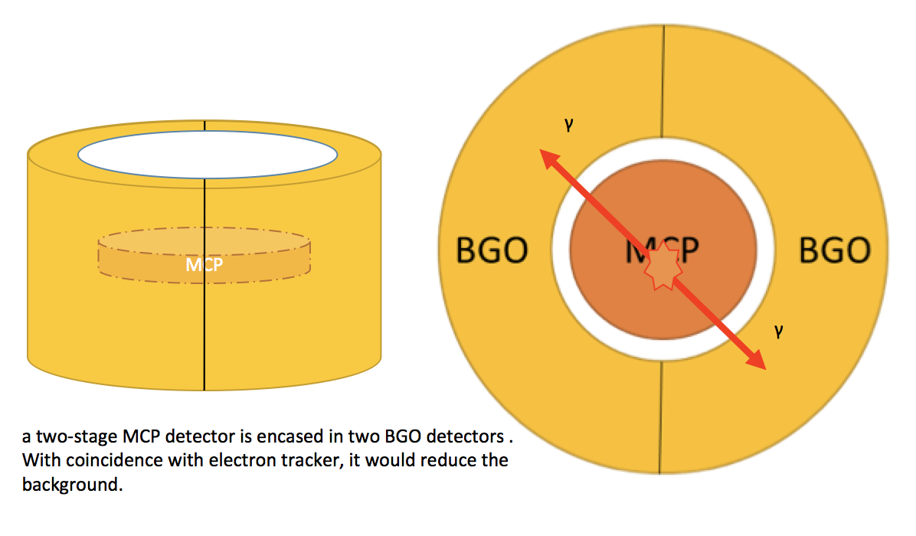
Positron Detector

Slide 21
Roadmap and milestones
CDR
TDR
Data taking
We have got a start up funding to do the CDR!
Notes:
我们初步列出了MuMuBar实验的重要时间节点，我们将在2025年给出实验的概念设计报告，2027年完成技术设计报告并开始实验建设，在2030年完成实验建设并开始取数，计划1年的取数时间给出实验结果。

Slide 22
Summary
MuMuBar is an unique way searching for cLFV.
We propose a MuMuBar experiment based on CSNS high power proton driver.
We expect to increase the sensitivity by a factor of 100 through improvement on several technologies.
  20* in μ⁺ beam intensity
  5* in muonium production efficiency by
    Reducing μ⁺ energy.
    Improving the production target.

Slide 23
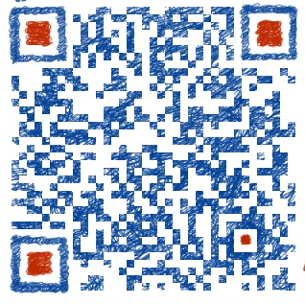
We are hiring
My WeChat for details
To work on:
Design and simulation of the experiment
R&D of the muon beam line
Muonium production
Benefits:
350k – 400k RMB/year base salary
500k – 1 M RMB compensation (from local government)
Possibility for permanent position (more benefits, pls ask me if you are interested)
            Dr. Yu Bao, yubao@ihep.ac.cn

Slide 24
What we can do with Muonium and slow muon?
Muonium physics:
  Muonium to anti-Muonium conversion
  Hyperfine structure of Mu
  1s-2s interval
  Antimatter gravity
Slow muon physics：
  g-2
Need complex laser system!!!

Slide 25
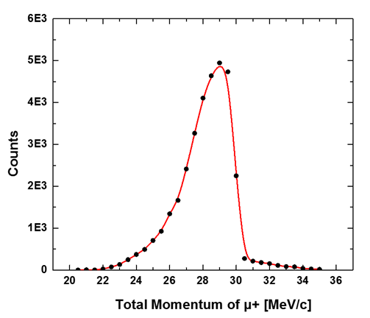
Beam parameters (preliminary)
 | PSI1998 | EMuS for MuMuBar
Intensity(1E6/s) | 8 | ~200 (25kW)
Momentum（MeV/c） | 26 | 28
δp/p(FWHM) | 5% | 15%
Pulse length(ns) | continuous | <200
Repetition Rate(Hz) | continuous | 2.5
Magnetic field (T) | 0.1 | <0.001

Slide 26
Preliminary simulation (beamline on-going)
Polarization
Phase space
Intensity ~ 5*10⁸ mu+/s
Polarization up to 90%, can be used for other experiments requiring polarization, and can be transferred to muSR study after MuMuBar

