Slide 1
Charged Lepton Flavor Violation search on Mu2e at Fermilab
在费米实验室Mu2e实验上寻找带电轻子味破坏
Ying Wang (王莹)， Zhengyun You（尤郑昀）
Sun Yat-Sen University（中山大学）
Workshop on Intensity Frontier of Particle Physics
7/12/2019, China Spallation Neutron Source, CSNS, Dongguan
Notes:
I will introduce the CLFV search experiment at Fermilab Mu2e

Slide 2
Overview
Motivation of Mu2e：
Physical: Charged Lepton Flavor Violation (CLFV)
Experimental: mu2e channel
The experimental apparatus :
Signal and Backgrounds
Current status: Platform and simulation
Next plan – Mu2eII
Notes:
The outline of this introduction,
1> will introduce the motivation, physical side why people interested in searching this signal, experimentally why mu2e experiment came up
2> will introduce the design and the setups, and the current status, then will give mu2e 2nd phase

Slide 3
Physical Motivation

Slide 4
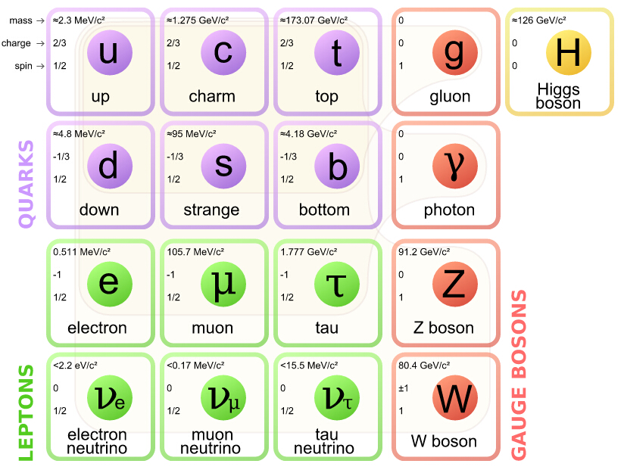
Lepton Flavor Violation
Standard Model of Elementary Particles
Quark Mixing (CKM)
Charged Lepton Flavor Violation？
Neutrino Oscillation
?
?
Notes:
Here is the figure including almost all the LFV channels. The neutral channel from neutrino oscillation. For the charged LFV have not been seen. The world searching are through these channels, mu2e and comet are one of those searching experiments.

Slide 5
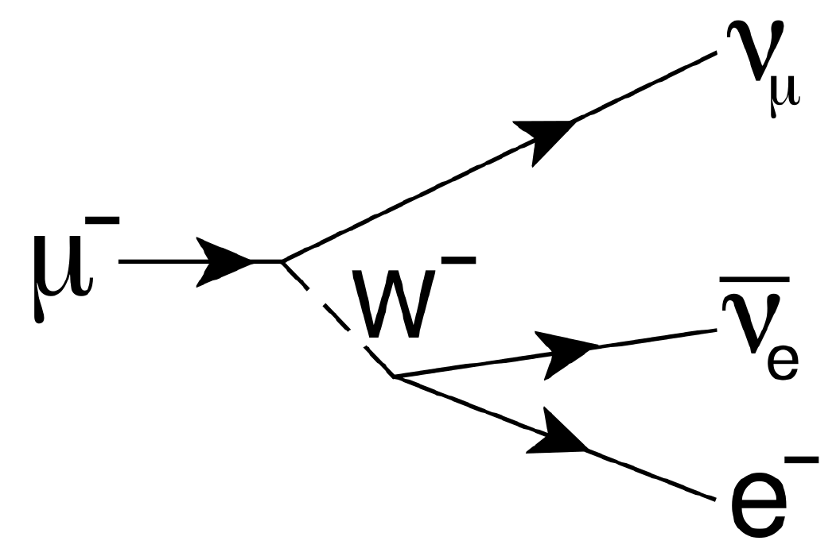
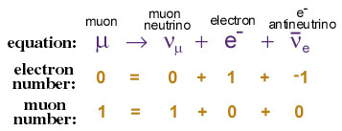
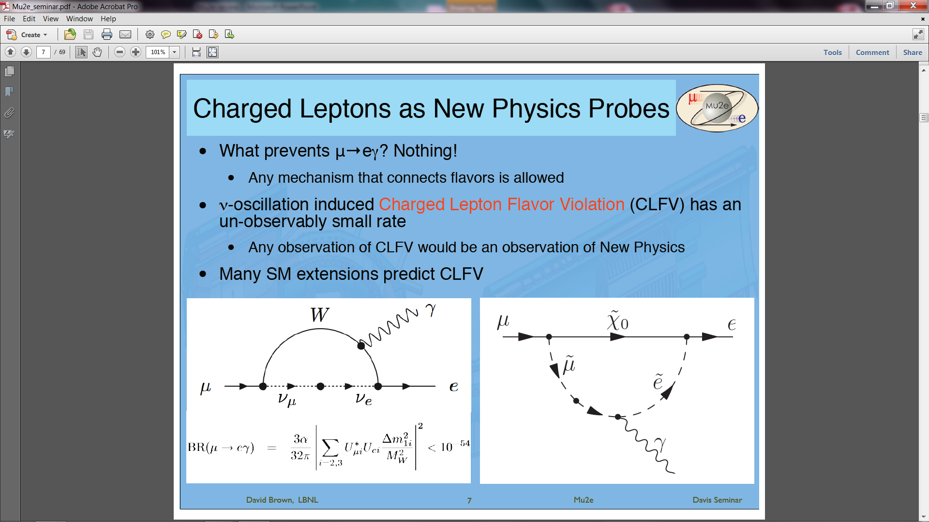
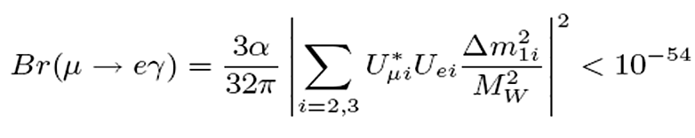
CLFV and BSM
Ordinary muon decay Lepton Flavor Conservation
CLFV could exist but is too tiny to be measurable
Any CLFV observation implies New Physics Beyond the Standard Model (BSM)
μ → eγ
B
PMNS unitary, Σ U_{μi}* U_{ei} = 0
Notes:
Also as theorists are expecting this phenomena, they invented many possible models to predict the signal, or they invented the models for other physics questions, and also predict this signal. One of them is that the CLFV from 2 parts, one is from this contact feynman diagam the other part is the higher order penguin diagram. Which particles are involved will decide the signal rates, the experiment will tell us and rule out some of them guessing.
Typical model of SUSY after symmetry breaking predicts ~ 10^-15, about 40 events for Mu2e/COMET

Slide 6
Experimental Motivation
Notes:
As this subject is so important, the searching has been going very long. What is the reason to come up with Mu2e/comet ?
The design of mu2e and comet was proposed by 2 russian scietists, the

Slide 7
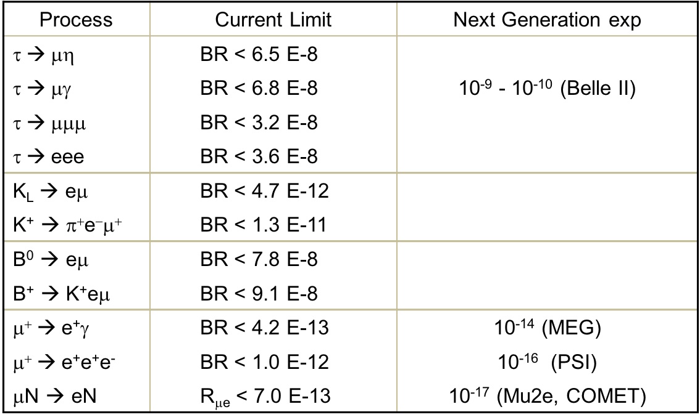
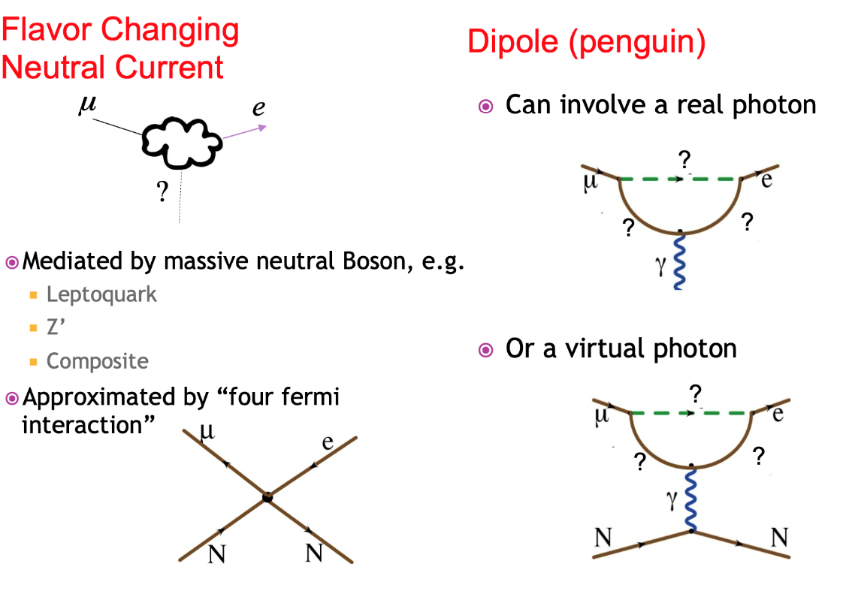
CLFV searches
μ channels
One of the most effective channels
Or other virtual particle
Notes:
This table lists the current world CLFV channels and the current limitations. We can see clearly the muon channels speciallized experiments can achieve higher accurate results, than from the collider experiments. If there is a signal, it will be seen by one of these experiments first.

Slide 8
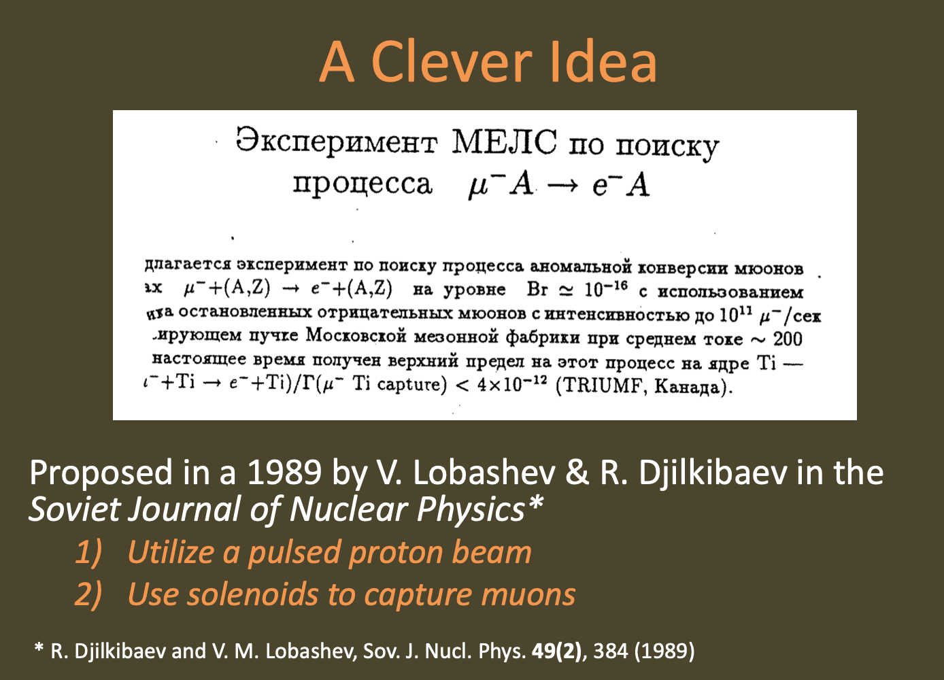
Current Best Limit in μN → eN
Adapted from talk By D. Glenzinski
Notes:
The initial design of mu2e idea was from 2 russian scientists. They came up with the pulsed proton beam and a solenoid to collect muons

Slide 9
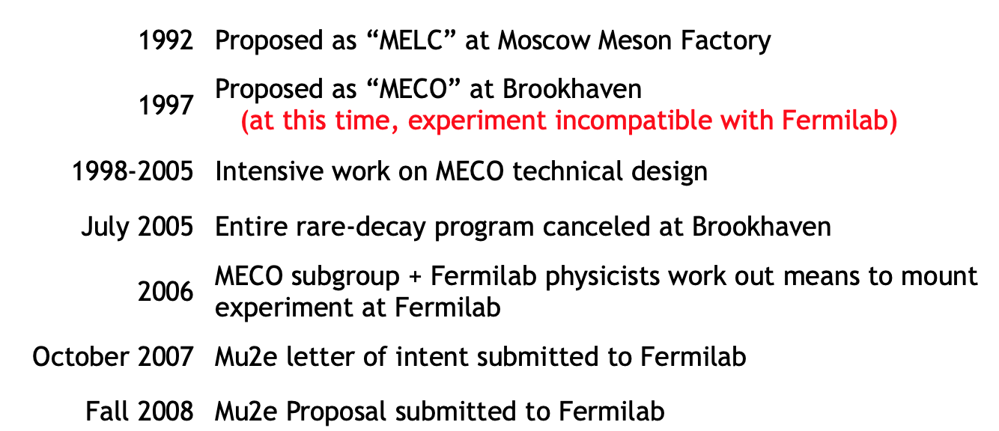
Current Best Limit in μN → eN
Notes:
The initial design of mu2e idea was from 2 russian scientists. They came up with the pulsed proton beam and a solenoid to collect muons

Slide 10
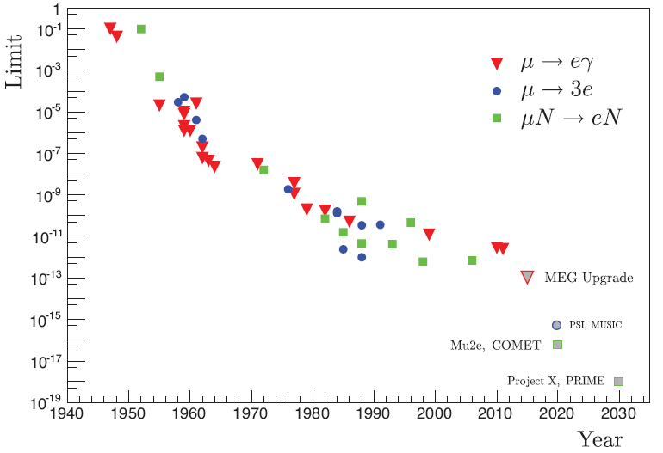
Muon CLFV search history
CLFV Searches History
Current best limit
MEG <4.2x10⁻¹³ (90%C.L.)
Next goal <6x10⁻¹⁷ (90%C.L.)
Next generation experiments …
90% C.L.
x10,000
R. H. Bernstein & P. S. Cooper, Phys. Rept. 532 (2013) 27
Mu3e @PSI
MEG Upgrade @PSI
Mu2e @FNAL
COMET @KEK
Notes:
Here is the world CLFV experiment history. During about half century the limitation has been pushed 10 to 10 magnetude. The designed results from mu2e/comet will be 4 magnetude more than current limitation.

Slide 11
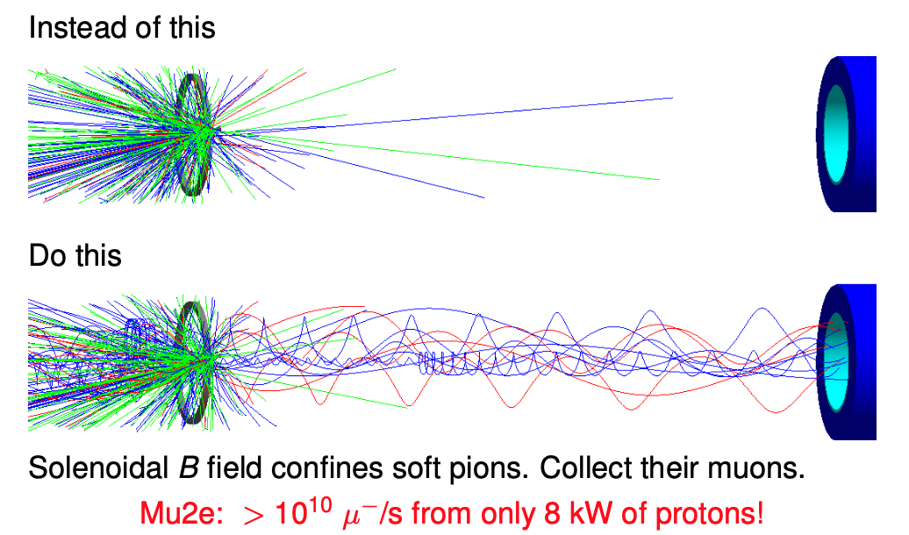
Current Best Limit in μN → eN
W. Bertl et al, Eur. Phys. J. C 47, 337-346 (2006)
Adapted from talk by Andrei Gaponenko
Current best limit
  by SINDRUM II at PSI
  R_{μe} (Au) < 7 x 10⁻¹³ (90%C.L.)
Mu2e, stop muon will
Be 10000 larger
Notes:
SINDRUM II use

Slide 12
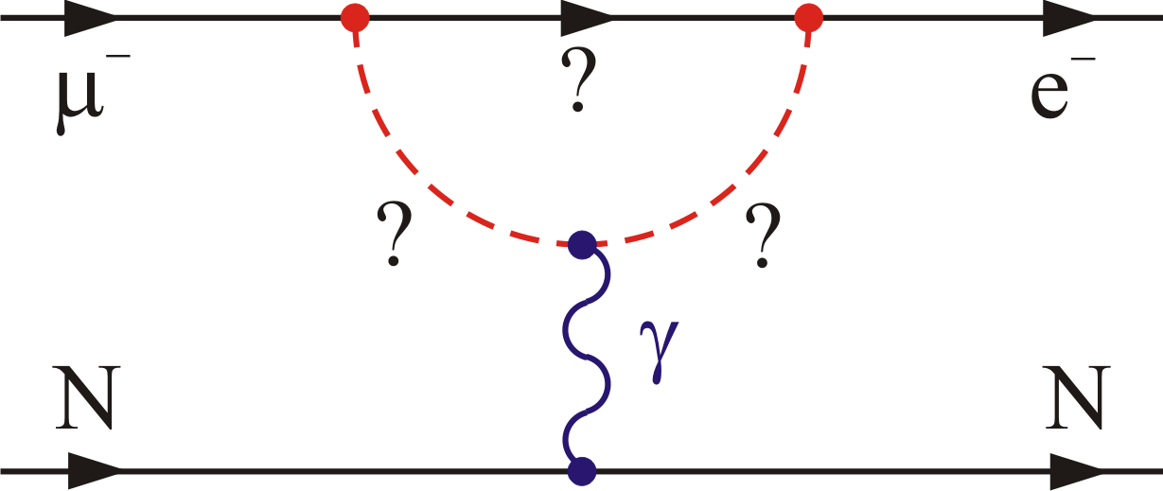
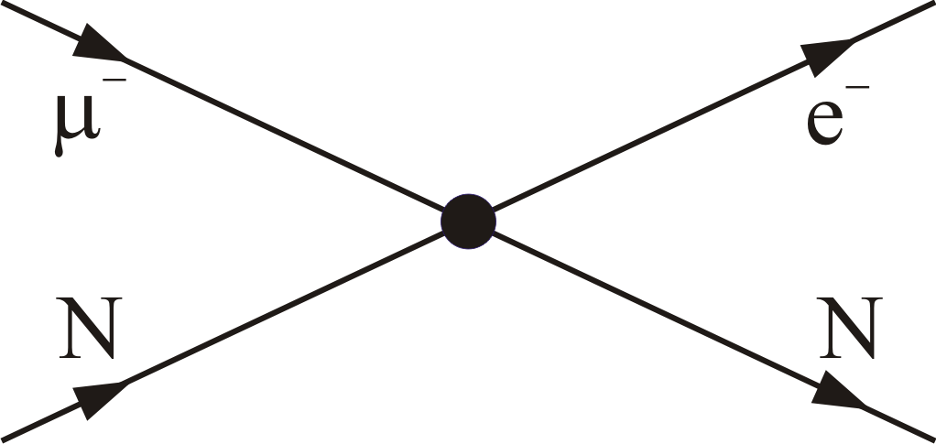
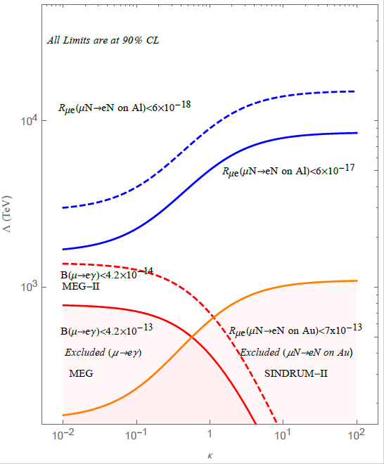
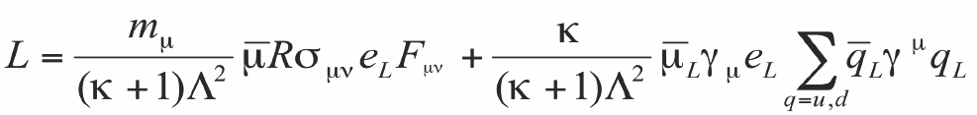


Probing New Physics with CLFV
Loops
Contact terms
Effective CLFV Lagrangian
Relative strength κ, mass scale Λ
‘Loops’, electromagnetic operator, κ<<1, can be probed by μ→eγ and μN→eN
‘Contact terms’, direct coupling between quarks and leptons, κ>>1, accessible by μN→eN
Mu2e will probe mass scale Λ 2,000 ~10,000 TeV Beyond the reach of accelerators
A. de Gouvêa, R. Bernstein, et al
Mu2e-Ⅱ
Mu2e
$$Λ (TeV)$$
MEG
$$κ$$
Notes:
MEG more sensitive in Loops (Dipole dominant), 1:1/390:1/170 = 4e-14:1e-16:2e-16 (see Mori’s MEG talk)

Slide 13
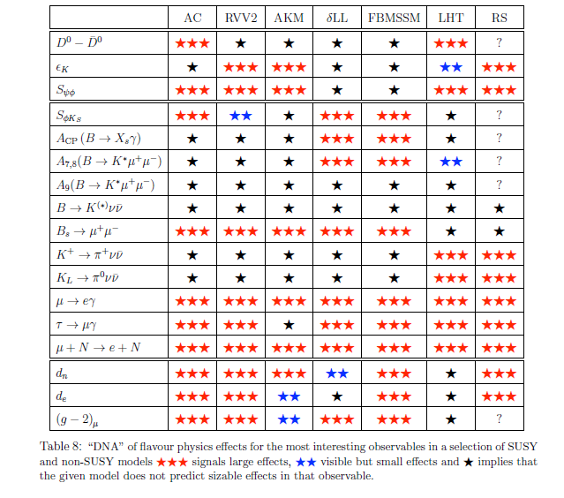
CLFV and Theoretic Models
μ → e + γ
μ⁻ + N → e⁻ + N
Two most effective channels
Large effects
Visible, but small
No sizable effect
W. Altmannshofer , A.J.Buras, S.Gori, P.Paradisi, D.M.Straub, NPB 830, 17 (2010)
Notes:
The table shows these 2 channels are sensitive to all the models

Slide 14
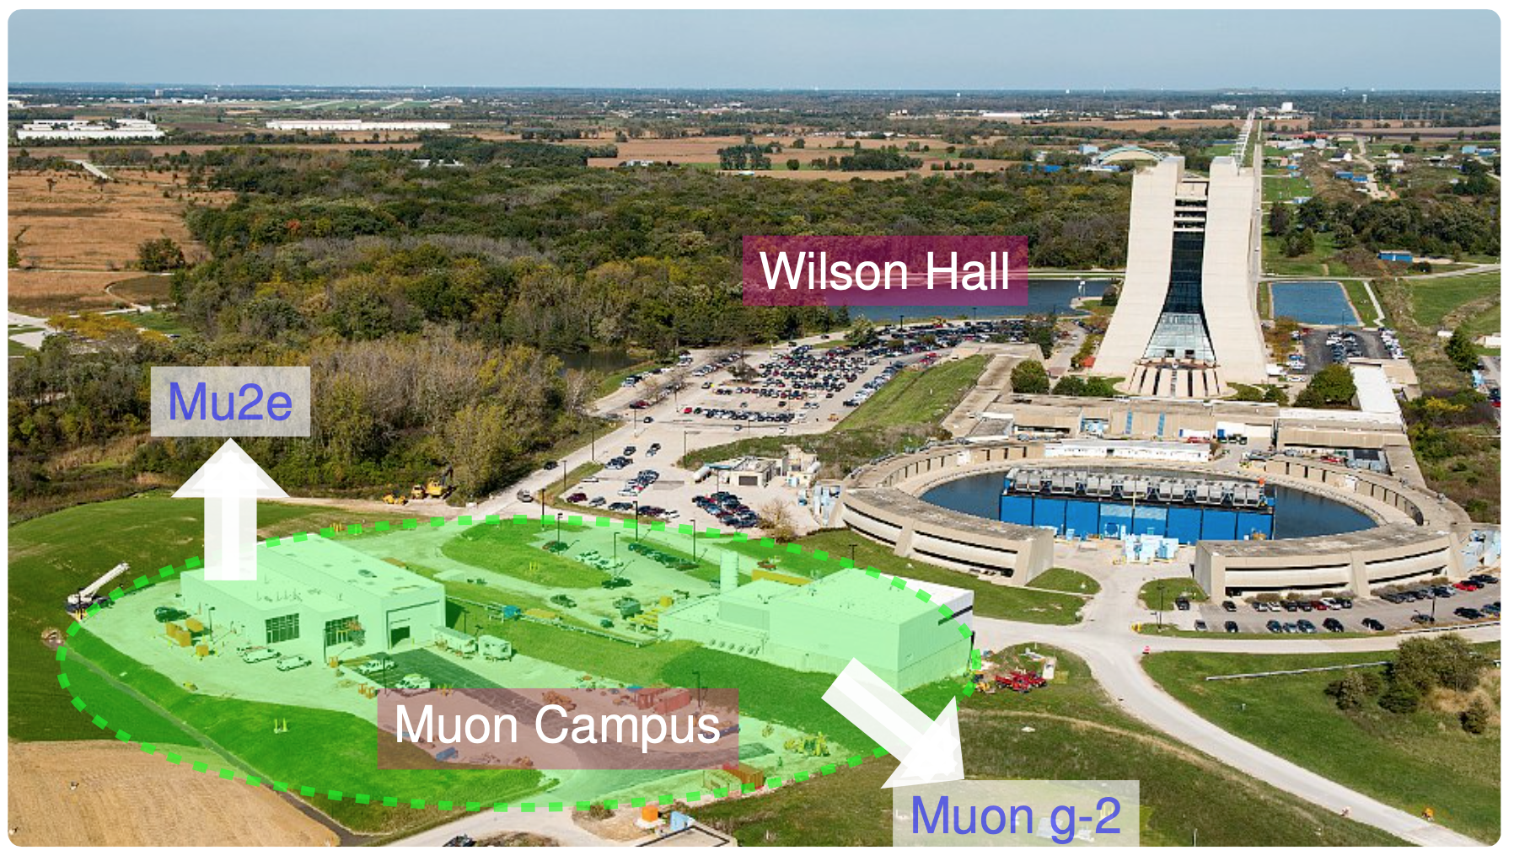
Mu2e Experiment
One of the U.S. Intensity Frontier top priority projects
Cost ~$270 M dollars
Figure from Yaqian Wang
Notes:
Mu2e experiment is located at fermilab, one of the muon campus experiment. It is the one of the US intensity frontier top priority project. The funding is about 270 million dollars

Slide 15
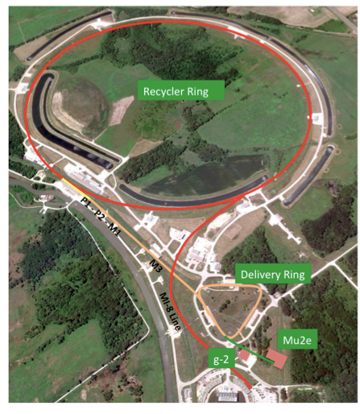
The Proton Beam
Use existing accelerator infrastructure
Booster provides 8 GeV protons
Recycler stacks protons into 4 bunches
Deliver Ring takes one bunch from Recycler
Run simultaneously with neutrino programs NOνA.
Notes:
Will use the existing proton beam, 8gev proton from the recycler ring, then the diliver ring taking one bunch from the recycler proton to the mu2e experiment

Slide 16
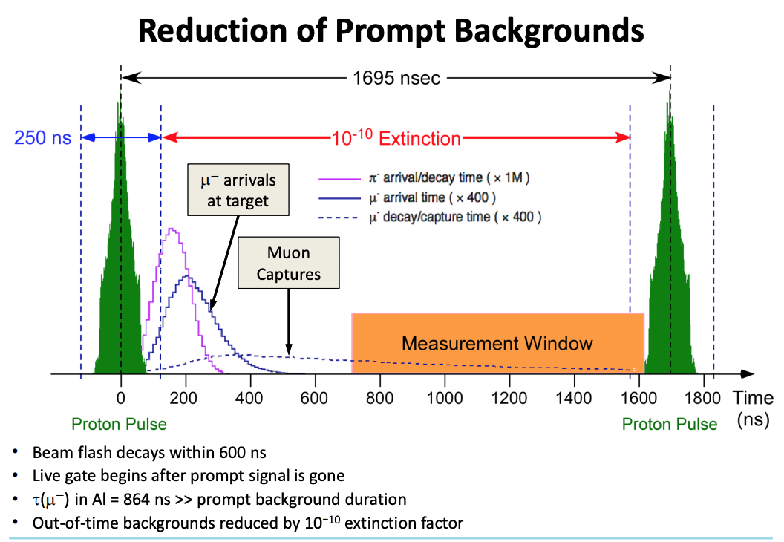
Beam Time Structure
1695 ns peak-to-peak
3×10⁷ proton
Prompt background
3x10⁷ protons per bunch, bunch spacing 1695 ns
700 ns delay before 1 ms live gate
Extinction factor (Out-Of-Time proton rate) < 10⁻¹⁰.
Notes:
This is the beam structure. Each bunch has 3 times 10 to (the power of) 7 protons, and each bunch has a signal window for pion to decay and muon to arrive on the stopping target.
The purple is the pion arrival/decay time in the DS
The blue is the muon arrival time also in the DS
and the red line is the decay/capture time of the muonic atoms
the pulsed beam structure enables us to set a DAQ gate far from the majority of the π’s interactions and and at the same time, provides us a fairly good acceptance for the muonic processes.
But all of this make sense only if you are sure that there are no protons arriving in between two bunches! So we use an extinction magnet that allow us to keep the ratio of the out-of-time proton w.r.t. the in-time protons below 1e-10.

Slide 17
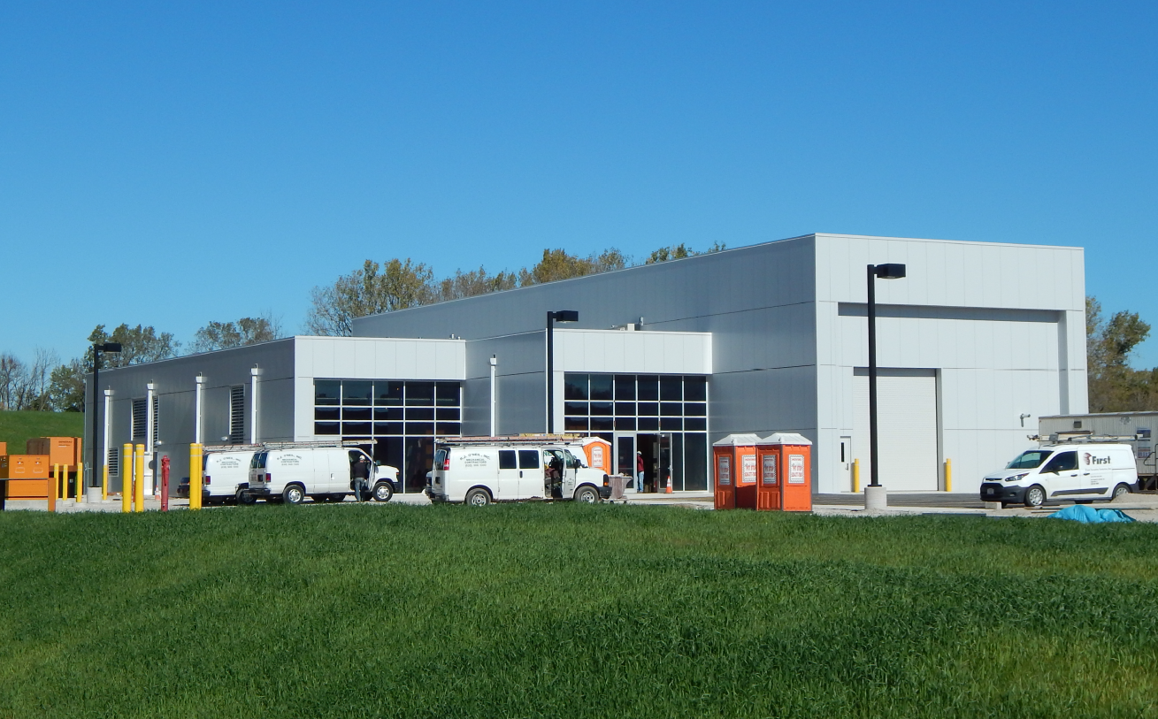
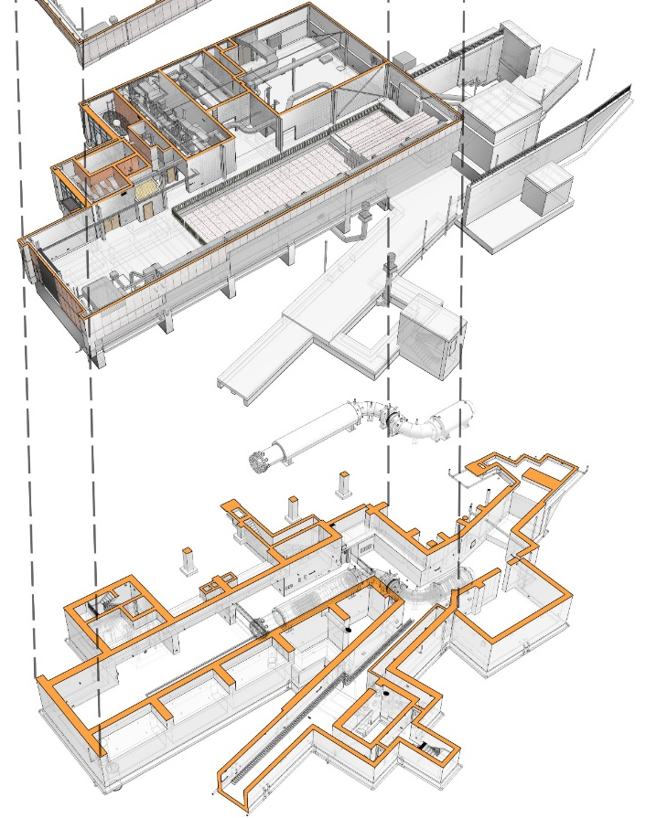
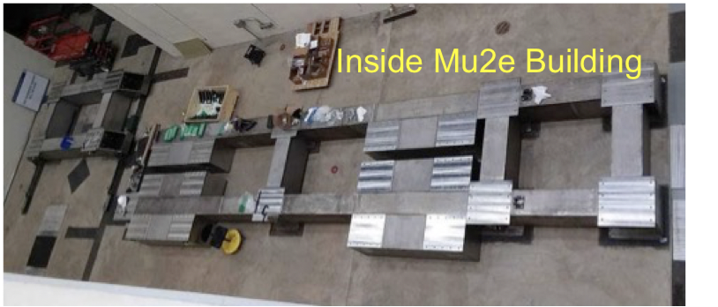
Mu2e Building
Civil construction completed (2019/6)
Notes:
This is the mu2e building which is built in 2016 and the inside for DS this year.

Slide 18
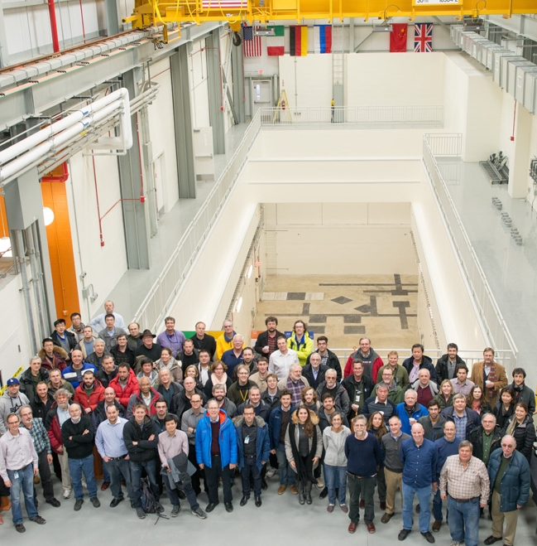






Mu2e Collaboration
Sun Yat-Sen University joined Mu2e in Feb. 2016
Over 200 scientists from 40 institutions
Argonne National Laboratory,
Boston University,
University of California Berkeley,
University of California Irvine,
California Institute of Technology,
City University of New York,
Joint Institute of Nuclear Research Dubna,
Duke University,
Fermi National Accelerator Laboratory,
Laboratori Nazionale di Frascati,
University of Houston,
Helmholtz-Zentrum Dresden-Rossendorf,
INFN Genova,
Institute for High Energy Physics, Protvino,
Kansas State University,
Lawrence Berkeley National Laboratory,
INFN Lecce, University Marconi Rome,
Lewis University,
University of Liverpool,
University College London,
University of Louisville,
University of Manchester,
University of Michigan,
University of Minnesota,
Muon Inc.,
Northwestern University,
Institute for Nuclear Research Moscow,
INFN Pisa,
Northern Illinois University,
Purdue University,
Rice University,
Sun Yat-Sen University,
University of South Alabama,
Novosibirsk State University
Budker Institute of Nuclear Physics,
University of Virginia,
University of Washington,
Yale University
Notes:
Mu2e

Slide 19
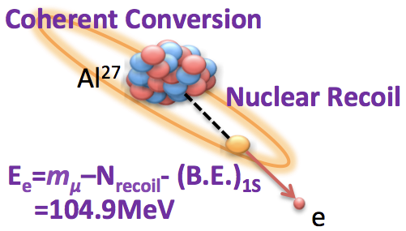
μN → eN Conversion
What to measure
The ratio of muon to electron conversions to the number of muon captures by nuclei
Signal: Neutrinoless conversion of a muon to electron in the field of a nucleus
Experimental signature
  Mono-energetic electron
  E_{e} = m_{μ} – E_{bind} – E_{recoil}
  For Al, E_{e} = 104.97 MeV
muon binding energy (0.48 MeV)
energy (0.21 MeV)
Notes:
The mu2e conversion channel is considering the reaction, when a muon captured by a nucleus , the muon exchanges a virtual particle with nucleus, and the recoiled electron will have a mono-energy 105 MeV.
The advantage of this reaction is the virtual particle can be any, not specified to be photon, then it is sensitive to broader models and have better chances to obeserve the CLFV signal.
If it is only virtual photon diople diagram, then the possiblity will be same. And the muon to e gamma can directly test that diagram

Slide 20
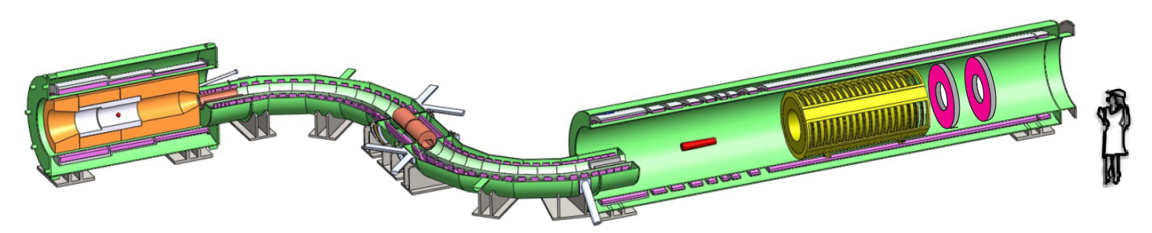
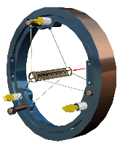
Mu2e Apparatus
Production Solenoid
8 GeV
Proton Beam
Calorimeter
Tracker
4.6 T
2.0 T
2.5 T
1.0 T
Production Target
Detector Solenoid
Transport Solenoid
Three functional solenoids with graded fields (4.5T – 1T)
Notes:
The Mu2e setup has 3 main parts: PS, TS, DS
PS is a superconducting solenoid, a 8 GeV p beam strikes a W target producing mostly π’s
then, using a graded B-field, focus majority of these π into a second solenoidTS,
In TS pion decay tunnel (>99.99% of them decay into µ)
and also will filte the high momentum and positive particles, by selecting only negative particles with low momenta by means of collimators
DS, the negative µ are delivered into the last solenoid inteact with the stoping target.
i will introduce each part in detail

Slide 21
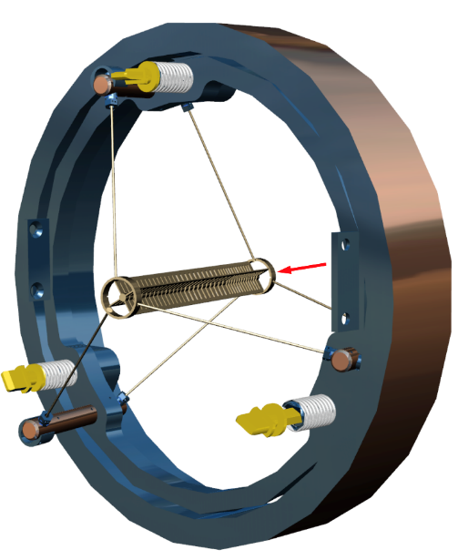
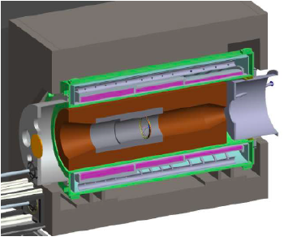
Target and Shield
Four 1mm thick × 13mm tall fins
New designed Production Target
  Protons + target → π + X; π decay into muons
  Variable length segmented core and fins to control longitudinal temperature profile
  Extended mounting bars on outside ring to minimize bending moment on target
  High melting temp, radiative cooling (~1130ºC), with 8kW beam (700w in target)
Heat Radiation Shield
  To protect superconductor of PS and upstream TS
  To limit heat load and radiation damage
  ~25 tons of Bronze
Notes:
It is gray, relatively heavy, and 200 millimeters (nearly 8 inches) long, with cylindrical rings on each end, fins that dissipate heat from the target core and brace against sag and empty space separating segments of the central rod.
We dump about 10% of beam power into the target. It heats up to ~1700 deg-C (~3100 deg-F).
the system is in vacuum, so the only way to dissipate the heat is thermal radiation. So the design and test wereconsidering most on these factors
Production Target size = 6.3 mm diameter, 160 mm long tungsten rod with hubs that flare out to 40mm diameter at each end
Stopping Target size = 34 foils, 100 um thick, separated by 2.5 cm, radius=8cm with a r=2cm hole in the middle to reduce beam flash.

Slide 22
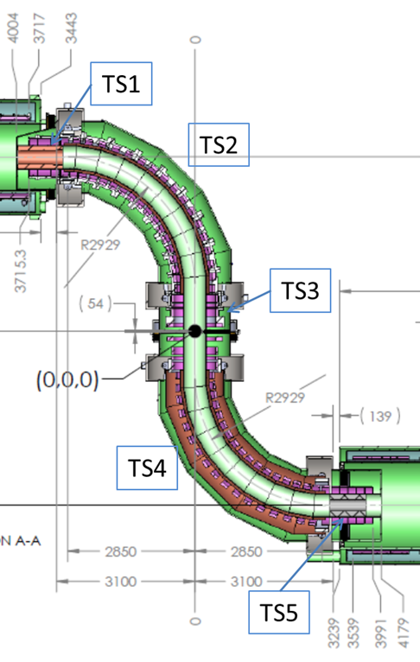
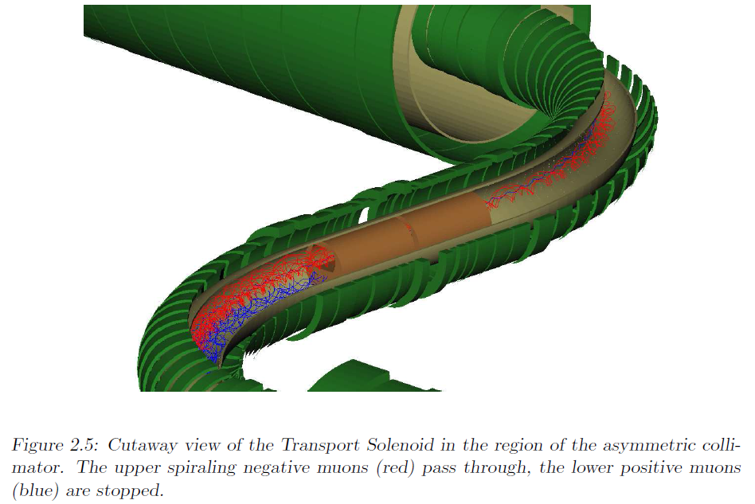
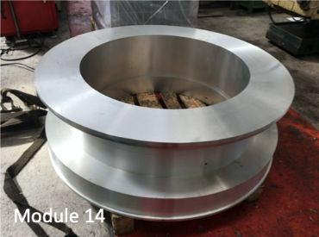
Transport Solenoid
Gradient magnetic field from 2.5 T to 2.0 T
S-shaped magnetic channel to transmit low-momentum negatively charged particles in helical trajectories
Collimators to remove positively charged and high-momentum particles
Notes:
Collimator selects low momentum, negative muons • Antiproton absorber • The S shape eliminates photons and neutrons.

Slide 23
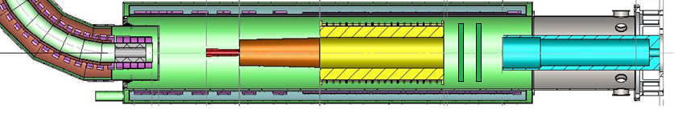
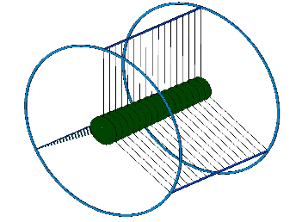
Detector Solenoid
Proton Absorber
μ absorber
μ Stopping target
Tracker
EM Calorimeter
Stopping target to capture muons
Graded magnetic field from 2 T to 1 T, captures conversion electrons with bigger acceptance
Tracker and Calorimeter in a uniform field to reconstruct and identify electrons.
Notes:
1. Stopping target: Capture muons on Al target,
Tracker for the reconstruction
Measure momentum in tracker and energy in calorimeter
Graded field “reflects” downstream conversion electrons emitted upstream, improving efficiency

Slide 24
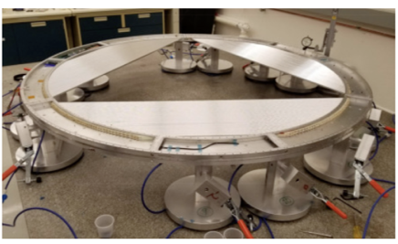
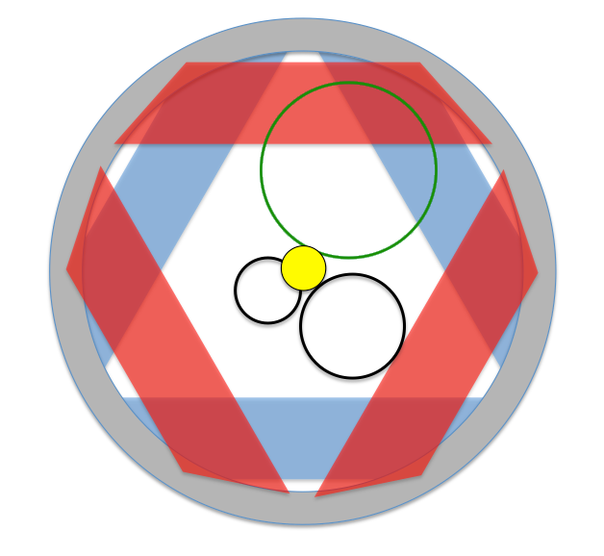
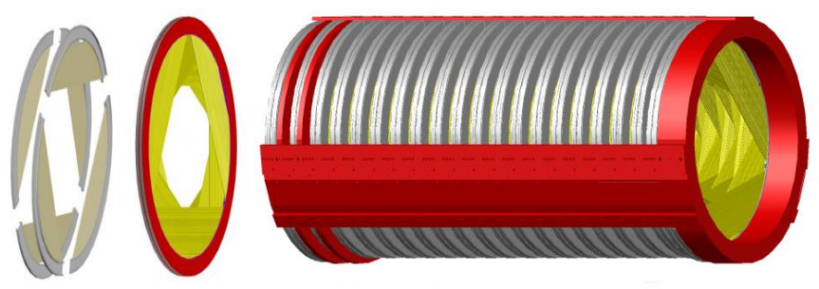
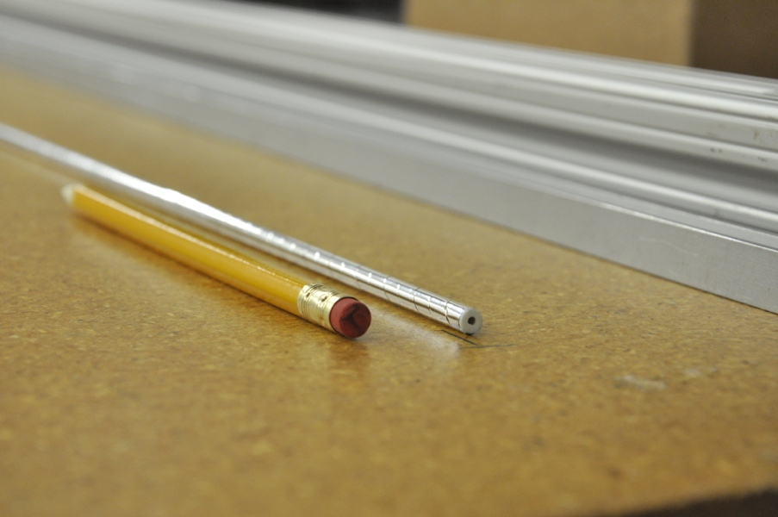
Tracker
105 MeV Conversion electrons
Tracker Structure
Half Tracker Plane comprised of 3 panels
DIO electrons
5 mm diameter straw drift tubes
15 μm Mylar walls, filled with Ar:CO₂ (80:20)
18 stations, 2 planes/station, 6 panels /plane
Blind to beam flash and >97% DIO
Expect 100 μm hit resolution
Momentum resolution < 180 keV/c (@105MeV/c)
Straw Tube
Notes:
We are going to build the largest, lowest density straw tube detector, ever to be held in vacuum!
The basic element of the tracker is a Mylar straw-tube; about 20k straws are then arranged into a series of rotated panels as who’s in the picture in the bottom to form the Tracker.
As you can see from the top left picture, the inner region of the Tracker is left un-instrumented; in this way all the charged particles with pT < ~60 MeV, which includes also µ unstopped in the Stopping Target do not even reach the active region!
We built several prototypes to prove that this technology was actually capable to meet our requirements; in the top picture, you can see a prototype developed at Berkeley Lab that was extensively used for test with cosmic rays and radioactive source.
These two plots on the bottom show on the left the measured resolution along the wire resulting just from the difference of the two times recorded at the sides of the straw, and on the right the single hit efficiency as a function of particle crossing-point distance from the wire.
The other pictures shows you a full assembled tracking plane and the electronics installation during the assembly process.
Decays-in-orbit can enter the Conversion Electron signal region in two ways:
Both DIO and CE lose energy by ionization and bremsstrahlung in the stopping target region
Roughly equal amount of radiation, ionization
Both CE and DIO lose an average of about 600 keV in a stochastic distribution; some DIO lose very little energy so some DIO near the endpoint stay in the signal region
A “high-side” tail in the momentum resolution promotes DIOs into the signal region and can dominate the DIO background. Therefore excellent tracker resolution is essential
and is why we use measured distributions and a “first-principles” simulation with charge-cluster formation and electronics included
5mm diameter straw drift tubes: mylar-epoxyAu-Al walls and Au-plated W wire. • Operates in a vacuum, Ar/CO2 gas at ~1.45 kV. • Ultra low mass- minimize multiple scattering. • Highly segmented to handle high rates. • Resolution less than 180 keV/c at 105 MeV. • 18 stations each having 12 × 120° panels = 216 panels ➔ ~21,000 straws.

Slide 25
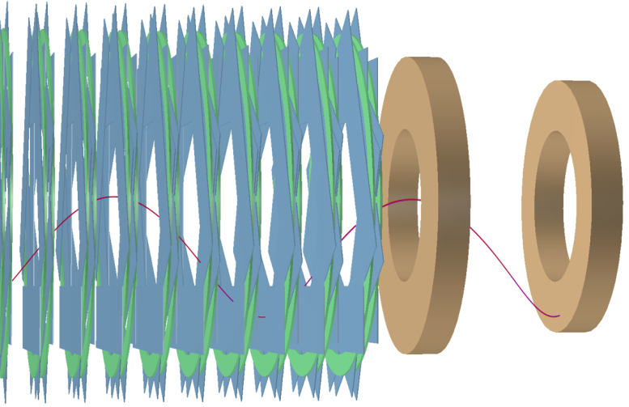
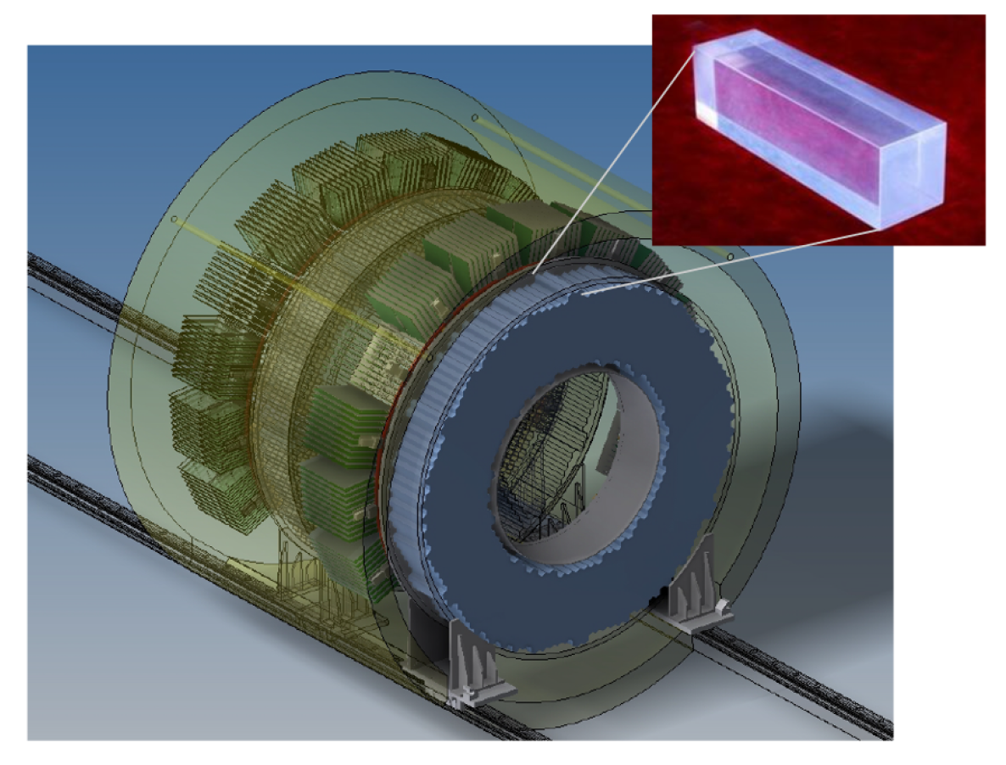
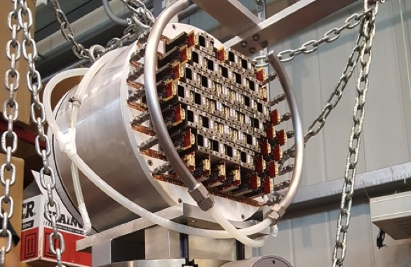
Calorimeter
1/2 λ
Two disks separated by 70 cm (1/2 λ), ~ 674 CsI crystals/disk
Provides independent energy (σ_{E}/E< 5%), time (σ_{t}<0.5ns) and position (σ_{pos} ~1cm) measurements
Particle ID, Cosmic Ray rejection, tracking seed
Independent trigger
Notes:
The calorimeter consists of 2 identical disks filled with pure CsI crystals read out by SiPM. As in the tracker case, also the calorimeter inner part is empty and in the disk separation corresponds to half-pitch of the CE helicoidal trajectory in order to maximize the geometrical acceptance.
These pictures were made in the clean room @ Fermilab where we are testing the crystals and photosensors
during the last year, we assembled a large scale prototype with 51 crystals and we successfully tested it at the Beat Test Facility in Frascati in Italy.
These plots on the bottom show you some of the results achieved from this test: On the left you can see the distribution of the reconstructed energy overlaid with the MC that nicely reproduces the data; on the middle you can see the energy resolution we measured at different energies in two cases: one with the beam impinging orthogonally into the prototype and another one where the beam was at 50 degrees. Why 50? because that is the MPV for the conversion electron in the experiment! The last plot on the right shows you instead the timing resolution as a function of the energy in the two configurations.
2 annular disks separated by half a track wavelength gives ~90% acceptance. • Each disk contains ~674 scintillating CsI crystals with SiPMs readout • Resolution ~5% at 105 MeV and ~1 ns.

Slide 26
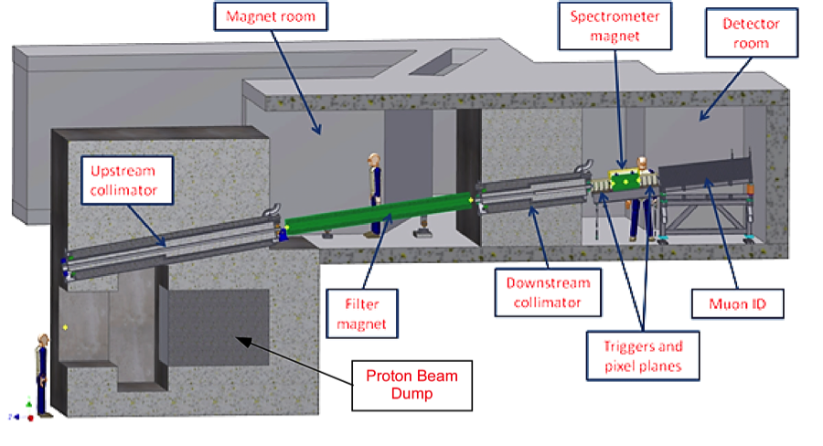
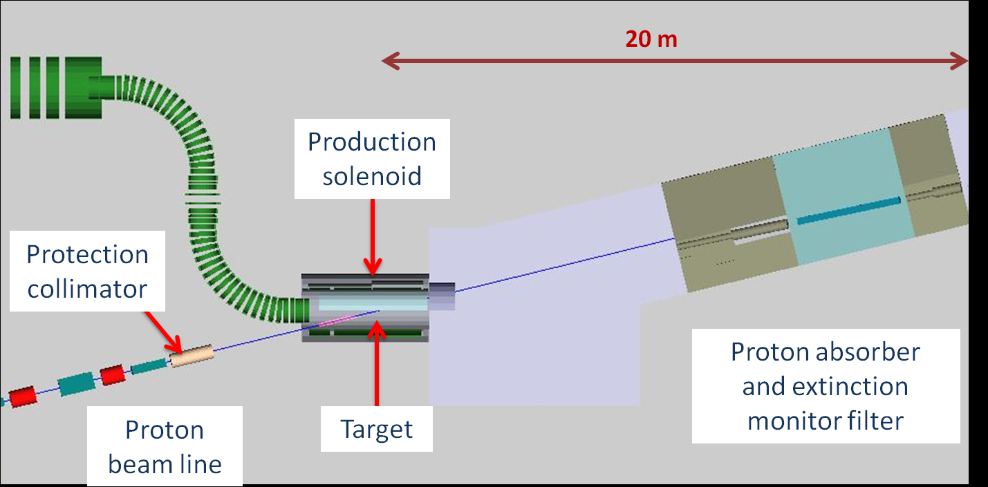
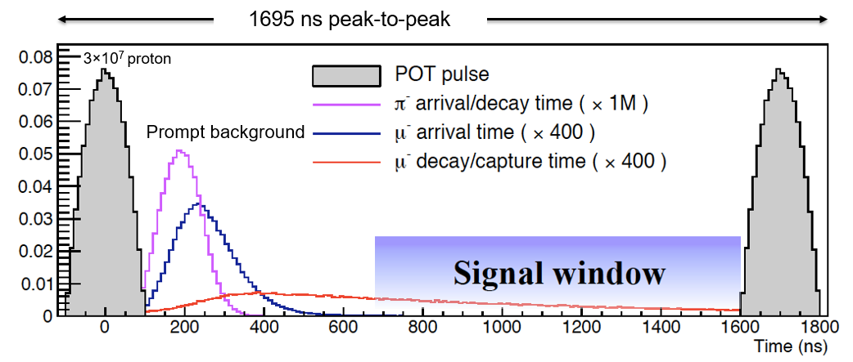
Extinction Monitor
Extinction definition: protons between pulses / protons in pulse
Extinction requirements < 10 ⁻¹⁰
Extinction measurement is important to success

Slide 27
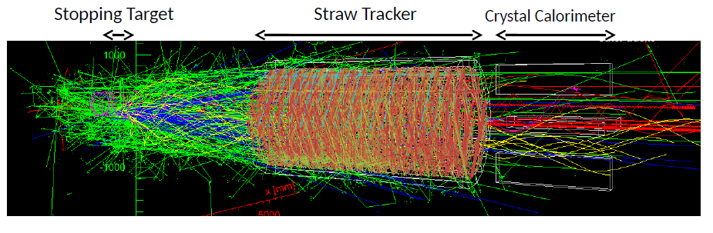
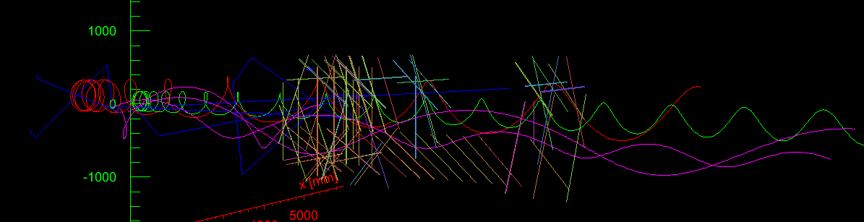
Mu2e Signal
Particles with trk hits within +/-40 ns of signal electron
signal e-
DIO e-
straws with hits
To find a signal electron near 105 MeV/c from a bunch of track candidates

Slide 28
All Backgrounds
8GeV
Radiative Pion Capture (RPC)
  π⁻ N → γ N’, γ → e⁺e⁻
  π⁻ N → e⁺e⁻ N’
Muon Decay-in-orbit (DIO)
  μ → eν_{μ} ν_{e}
Radiative Muon Capture (RMC)
  μ N → γ ν_{μ} N’*
Cosmic rays

Slide 29
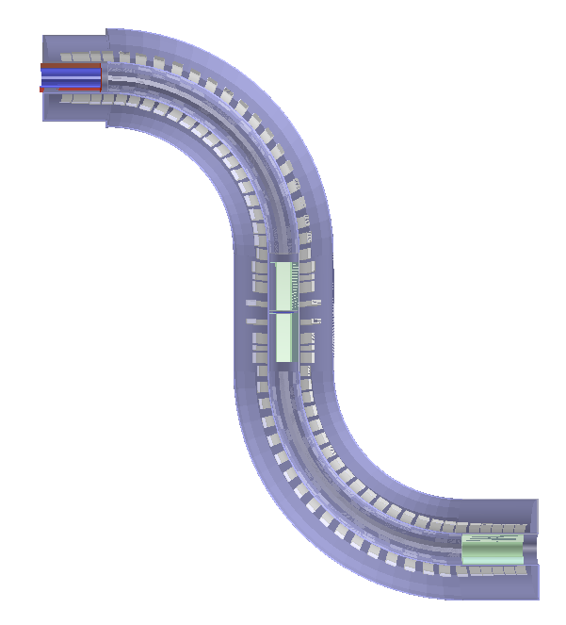
Background(1): Anti-protons
The 8GeV proton is above anti-proton production threshold
  pp → pppp,
  Anti-proton annihilate, produce π⁰→ e⁺e⁻,
  π⁻ contribute to RPC backgrounds
  Anti-protons travel 10x more slowly
  Do not decay, time rejection does not help
  _
Transport Solenoid
Add absorbers at some locations in the muon beamline to absorb anti-protons

Slide 30
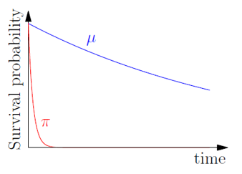
Background(2): Prompt
Radiative Pion Capture (RPC)
  π⁻ N → γ N’, γ → e⁺e⁻
  π⁻ N → e⁺e⁻ N’
  2% of captured π⁻
  Mitigate by waiting
Beam and free decays
  Beam Electrons
  Muon Decay In Flight
  Pion Decay In Flight
Delayed search time window help to mitigate prompt backgrounds

Slide 31
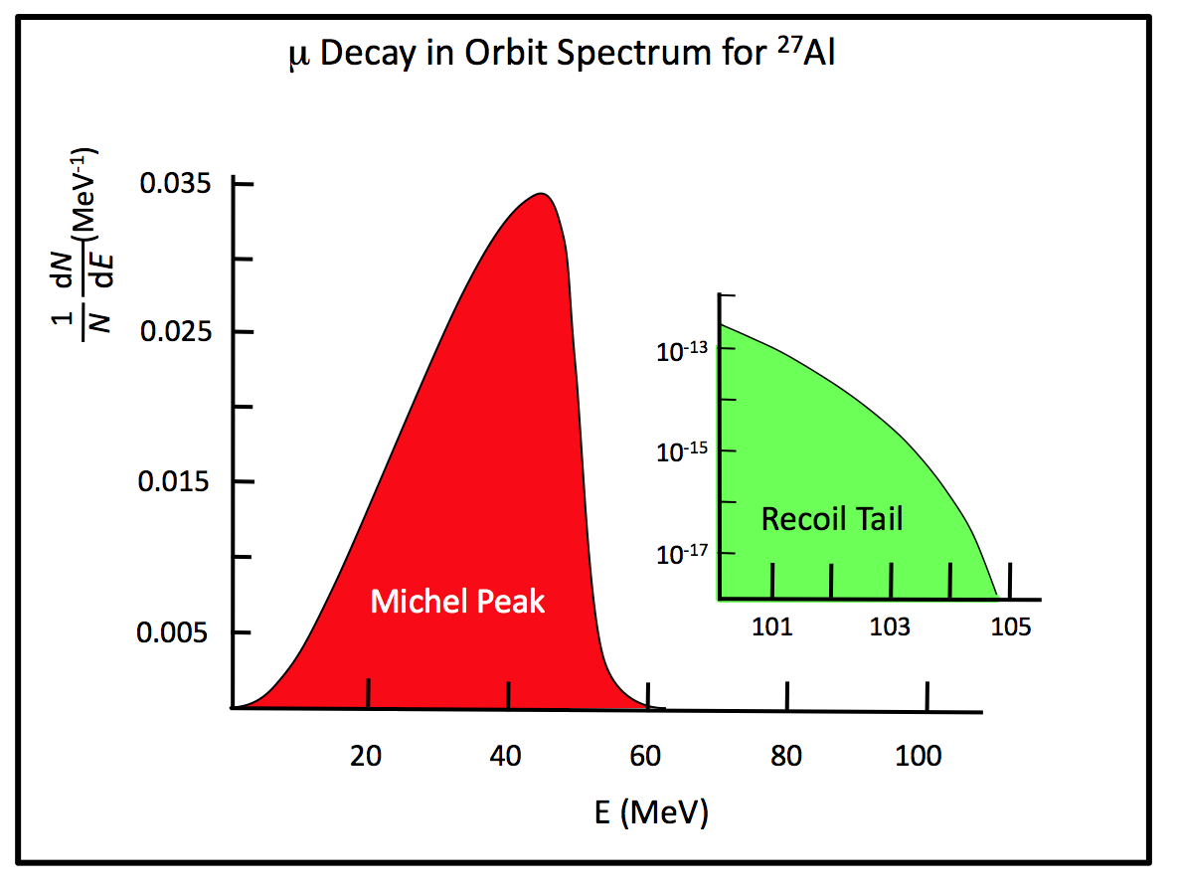


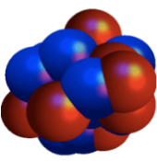


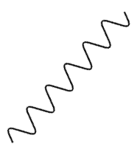
Background(1): Intrinsic
Muon Decay-in-orbit (DIO)
  μ → eν_{μ} ν_{e}
  Dominant background
  39% of stopped muons
  DIO Rate ∼ (E_{MAX} - E_{e})⁵, E_{MAX} ~105 MeV
  Requires good energy resolution
Radiative Muon Capture (RMC)
  μ N → γ ν_{μ} N’*
  61% of stopped muons
  3 MeV under DIO end point
  Small contribution
  _
(E_{conv} - E_{e})⁵
signal
E_{e} (MeV)
²⁷Al
²⁷Mg*
ν_{μ}
p
n

Slide 32

Background(4): Cosmic Rays
Cosmic ray background ~1 event / day
Requires <10⁻⁴ inefficiency → 0.1 event in 3 years
Cosmic Ray Veto (CRV) made of 4 layers of overlapping scintillators
Surrounding DS & part of TS area

Slide 33

All Backgrounds
Numbers normalized to 3 years run, 3.6 x 10²⁰ POT events

Slide 34
Signal and Backgrounds
Full Geant4 simulation and reconstruction, background overlaid with signal
Discovery sensitivity accomplished with 3 years of running and suppressing backgrounds to < 0.4 event total, (5σ) 2 x 10⁻¹⁶
Single event sensitivity 3 x 10⁻¹⁷
Null signal upper limit 8 x 10⁻¹⁷ @ 90% C.L.

Slide 35



Mu2e status PS&TS
FINAL designed production target
1st of three PS coils
More than half of TSu
delivered

Slide 36




Mu2e status DS
Full production is expected over next few months
Prototype Calorimeter crystals
75% of the CsI crystals received and tested
All SiPM’s received & tested
Notes:
Panels are being produced at University of Minnesota • Full production is expected over next few months • JINR Dubna will join Minn team • LBNL/UC Berkeley testing electronics • Panel Component fabrication and QC at Duke and York • Supports designed at Argonne • Wires X-rayed at Duke • Michigan- integration with DAQ • Houston- panel QC/QA • Tracker assembled at Fermilab
75% of the CsI crystals received and tested • All SiPM’s received & tested • Completion of DAQ and electronics progressing well • Large INFN contribution • Testing- Dubna, HZDR • QA/QC of crystals, calibration system- Caltech

Slide 37


Mu2e status DS
Scintillator and SiPMs all in hand
Electronics and DAQ in advanced state
Notes:
Covers all of DS, half of TS, better than 10-4 inefficiency with 3-fold coincidence • 4-layers of extruded scintillator bars, wavelength shifting fibers w/SiPM read out • Scintillator and SiPMs all in hand • Electronics and DAQ in advanced state • Virginia, Kansas, Argonne, Dubna

Slide 38

Timeline
Now

Slide 39

Mu2e Ⅱ
If NO signal:
Higher sensitivity search;
X10 improvement
  Proton source upgrade
  Detector upgrade
If signal:
Precision measurement;
Measure different target
materials to discriminate
between new physics models;
Expression of interest (EOI) submitted to Fermilab PAC in 2018
(arXiv:1802.02599)
M. Koike et al., J. Phys. G29 (2003) 2051-2054

Slide 40

Mu2e Ⅱ / PIP-Ⅱ
Fermilab PIP-II :
A superconducting LINAC for LBNF and the muon campus
800 MeV, ~100 kW protons for muons
Less background, no anti-proton backgrounds
Mu2e-II → 2030 ?

Slide 41
Summary
CLFV has great potentials to probe new physics at the Intensity Frontier
Mu2e will search for CLFV with μN→eN
  Address compelling science
  Single event sensitivity R_{μe} = 3 x 10⁻¹⁷
  Improve the current limits by a factor of 10⁴
  Search for New Physics with mass scale up to 10⁴ TeV
Project is going well
  Complete construction in 2022
  Progressing on schedule for data taking

Slide 42
Backup Slides

Slide 43




Mu2e Prototypes
Completed TS Module
Tests of a prototype tungsten
production target at RAL
Straw tracker fabrication
Prototype counter for cosmic veto
2 cm
5 cm

Slide 44

New Physics in μ→e
Loops
Contact Terms
Flavor physics of leptons and dipole moments, arXiv:0801.1826

Slide 45


Mu2e Status
TDR published in Oct. 2014
  http://arXiv.org/abs/1501.05241
DOE CD-2/3b received in March 2015
DOE CD-3 awarded in July 2016
First beam delivered in 2017 (Muon g-2)
Detector construction starts in 2018
Mu2e keeps as priority funding on DOE’s funding for large projects

Slide 46




SYSU work in Mu2e
Anti-proton background simulation
Muon beamline optimization
Simulation of the Stopping Target Monitor
SYSU Mu2e team
  PI: Prof. Zhengyun YOU (Work on Mu2e since 2011)
  Postdoc: Dr. Ying WANG (Fermilab Intensity Frontier Fellow 2018)
  A couple of students

Slide 47

Extinction monitor

Slide 48

stopping target

Slide 49

Stopping target

Slide 50

Proton absorber

Slide 51

Muon beam stop

