Slide 1
Status of the MEG Experiment
Stefan Ritt :: Head Muon Physics Group :: Paul Scherrer Institute, Switzerland
3rd Workshop “Physics at the high-intensity hadron accelerator in China”

Slide 2
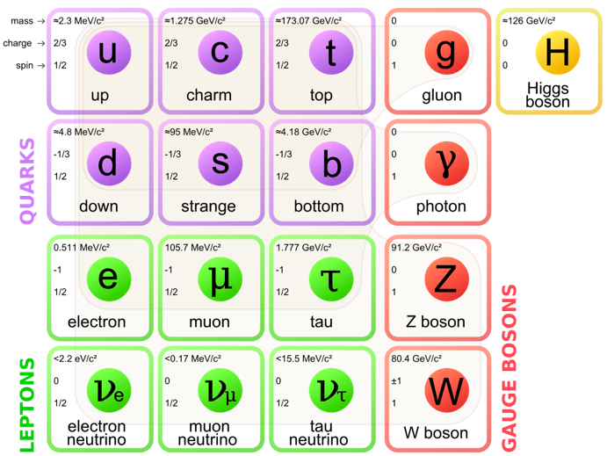
Motivation for cLFV searches
Standard Model (SM) of particle physics is very successful, but falls short on
  Dark matter
  Matter-antimatter asymmetry
  Mass hierarchy
  ...
Something is missing

Slide 3
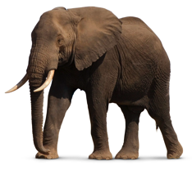

Searches for New Physics Beyond the SM
Energy Frontier – LHC
Real BSM
particles
“Direct” Searches Λ ~ 10 TeV
Intensity Frontier - cLFV
Virtual BSM
particles
“Indirect” Searches Λ > 1000 TeV

Slide 4
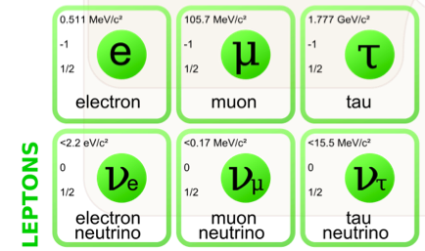
Neutral vs. Charged Sector
Lepton Flavor Violation
  observed in the neutral sector
  (neutrino oscillations)
  Not observed in the charged sector
  “accidental” symmetry!
Neutral Sector
Charged Sector
µ → e γ
µ → e e e
τ → e γ
…
ν_{e}
ν_{τ}
✓
X
ν_{µ}

Slide 5
cLFV in the SM
cLFV is possible in the SM through neutrino mixing,
but immeasurable small
γ
W⁻
μ⁻
ν_{μ}
ν_{e}
e⁻
“Beauty of cLFV”
γ
μ⁻
e⁻
⇒ A cLFV signal would be clear evidence for New Physics

Slide 6
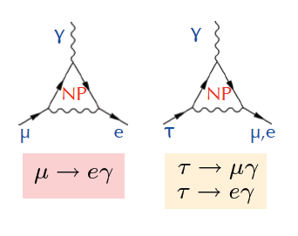
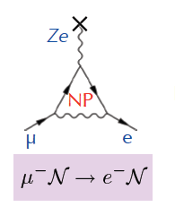
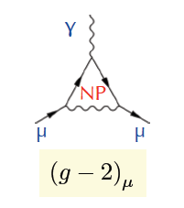
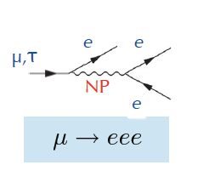
cLFV processes sensitive to New Physics (NP)
μ, τ “forbidden” decays
μ → e
conversion
Anomalous
magnetic
moment

Slide 7
cLFV processes sensitive to New Physics (NP)
μ, τ “forbidden” decays
μ → e
conversion
Anomalous
magnetic
moment
This talk
Next talk
Mu3e @ PSI

Slide 8
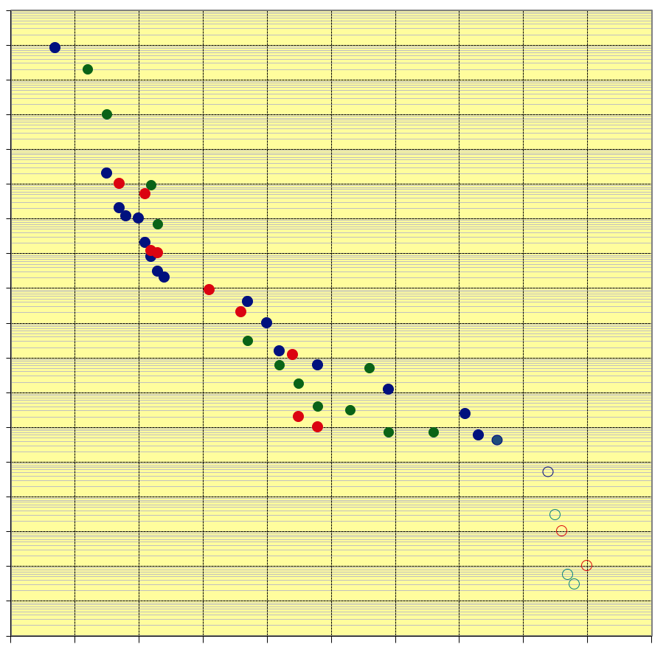
Long history of cLFV searches with muons
1
μ → e γ
10⁻¹
μA → eA
10⁻²
μ → eee
10⁻³
10⁻⁴
Started with
Pontecorvo & Hincks 1947
Currently all three limits
held by PSI experiments
MEG II experiment aims for
10x improvement
COMET, Mu2e and Mu3e
aim for > 100-1000x improvement
10⁻⁵
10⁻⁶
10⁻⁷
10⁻⁸
10⁻⁹
10⁻¹⁰
10⁻¹¹
MEG
10⁻¹²
4.2 x 10⁻¹³
10⁻¹³
MEGII
10⁻¹⁴
SINDRUM I/II
10⁻¹⁵
COMET
10⁻¹⁶
Mu3e
10⁻¹⁷
Mu2e
10⁻¹⁸
Exciting times ahead
1940 1950 1960 1970 1980 1990 2000 2010 2020 2030 2040

Slide 9


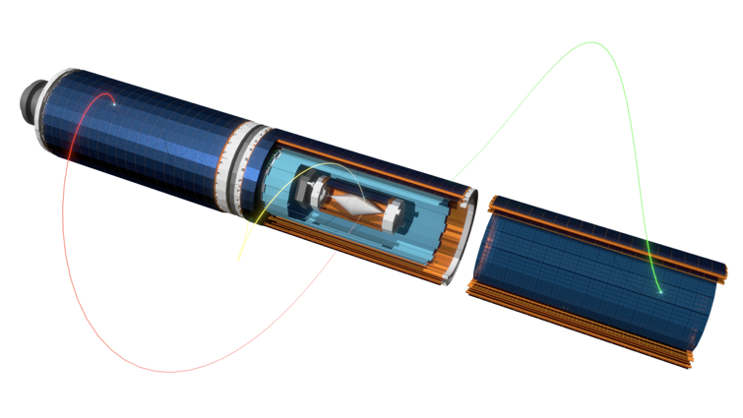
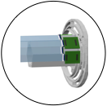
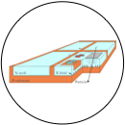
Mu3e Experiment at PSI
Scintillating tile detectors
70 ps resolution
μ⁺ → e⁺e⁺e⁻
Scintillating fibre detectors
500 ps resolution
< 0.3% X₀
Current limit μ→eee:
1 x 10⁻¹²
Mu3e Phase-I:
1 x 10⁻¹⁵
Mu3e Phase-II:
1 x 10⁻¹⁶
Commissioning:
~2022
Muon Beam
10⁸ μ/s
HVMAPS “MuPIX” detector
80 μm resolution
1 layer (50 μm): ~ 0.1% X₀

Slide 10
The MEG Experiment

Slide 11
Signal and Background μ → e γ
Signal
Prompt Background
Accidental Background
< 52.8 MeV
52.8 MeV
γ
γ
γ
ν
ν
ν
μ
μ
ν
μ
e
180º
ν
μ
e
e
e
52.8 MeV
< 52.8 MeV
< 52.8 MeV
ν
Data
Acc. BG
Prompt BG
Signal
Fit
μ→ e γ
θ_{γe} = 180º e and γ in time E_{e} = 52.8 MeV E_{γ} = 52.8 MeV

Slide 12
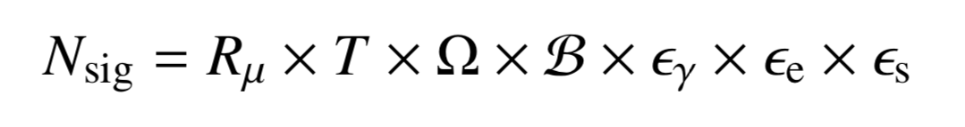
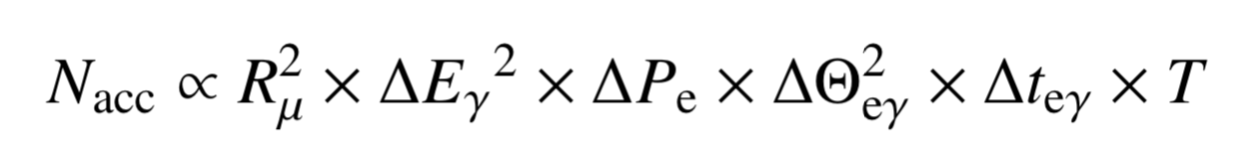
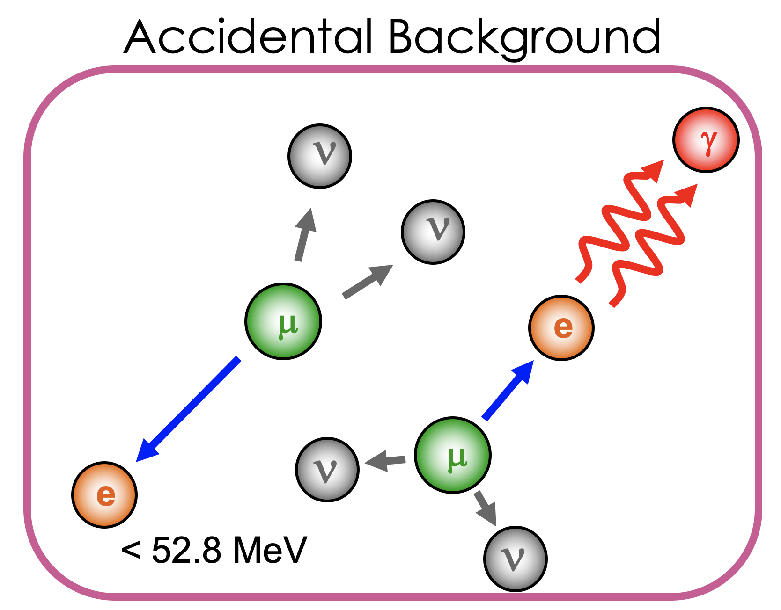
Signal and Background with Muon Rate
R_{μ} Muon stopping rate
T Measurement time
ΔE_{γ} Photon energy resolution
ΔP_{e} Positron momentum resolution
ΔΘ_{eγ} e⁺ - γ angular resolution
Δt_{eγ} e⁺ - γ timing resolution
Ω Solid angle
𝓑 μ → e γ branching ratio
ε_{γ}, ε_{e}, ε_{s} Efficiencies
optimal
signal / background
ratio
N
N_{acc}
N_{acc} << 1
efficiency-dominated
regime
N_{acc} >> 1
background-dominated
regime
N_{sig}
R_{μ}
At high muon rate, background dominates

Slide 13
DC muon beam
instantaneous muon rate
instantaneous muon rate
DC muon beam
time
Pulsed muon beam
time

Slide 14
DC muon beam
DC muon beam is better for MEG / Mu3e experiments!
Same number of muons, higher instantaneous rate
→ more background rate
instantaneous muon rate
instantaneous muon rate
DC muon beam
time
Pulsed muon beam
time

Slide 15
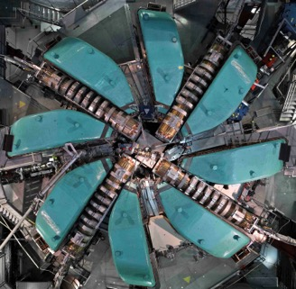
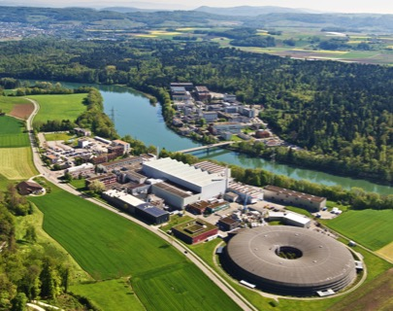
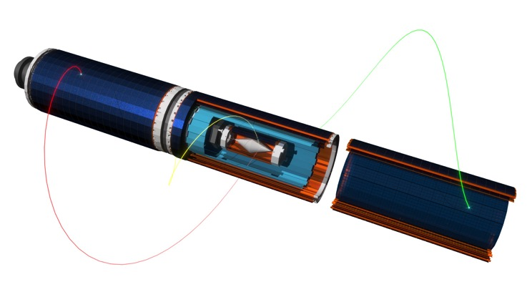
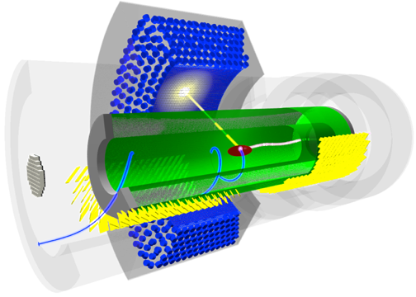
cLFV Experiments at PSI
High Intensity Proton Accelerator Facility
  590 MeV protons
  2.4 mA proton current
  1.4 MW beam power
MEG II
µ⁺ → e⁺ γ
Mu3e
µ⁺ → e⁺ e⁻ e⁺
Sensitivity Goal
≈ 4 x10⁻¹⁴
Sensitivity Goal
≈ 1 x10⁻¹⁶

Slide 16
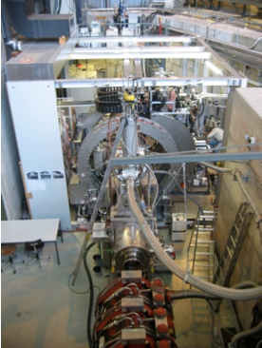
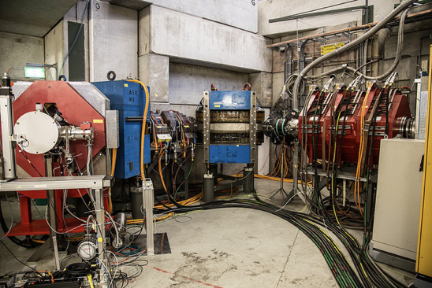
MEG II and Mu3e beam lines
MEG II and Mu3e (Phase I) have similar beam requirements:
  Intensity O(10⁸ μ⁺/s), low momentum p=28 MeV/c (surface muons)
  Stopped in few cm² target foil
  Low positron contamination
MEG
Muon
Beamline
Mu3e
Compact
Muon
Beamline

Slide 17
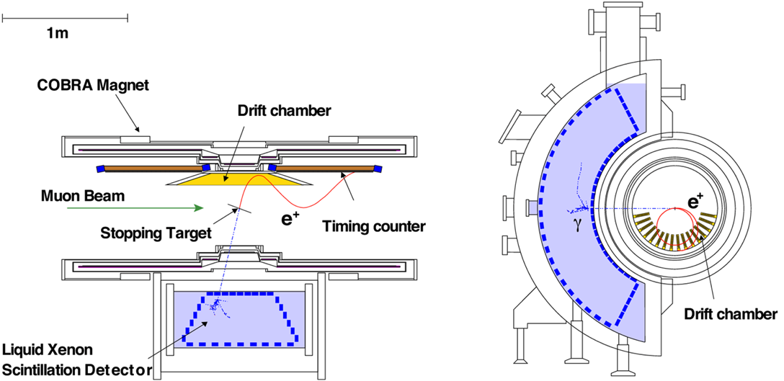
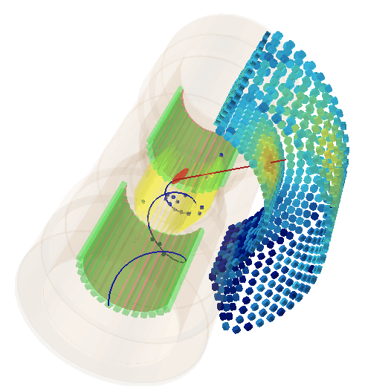
MEG Experiment Layout
Drift Chamber
Ultra-light material
Precise measurement
of e⁺ tracks
COBRA Magnet
Gradient field .27 T magnet
sweeps out “high p_{T}” e⁺ quickly
μ⁺
Muon Beam
Most intense DC
muon beam
up to 10⁸ μ⁺/s
on target
γ
Timing Counter
Resolution <100ps
in 1.4T B-field
e⁺
1m
Liquid Xenon Calorimeter
World’s largest LXe calorimeter
~900 l (2.7t) with 846 PMTs
immersed in Xenon
Lots of pioneering work

Slide 18
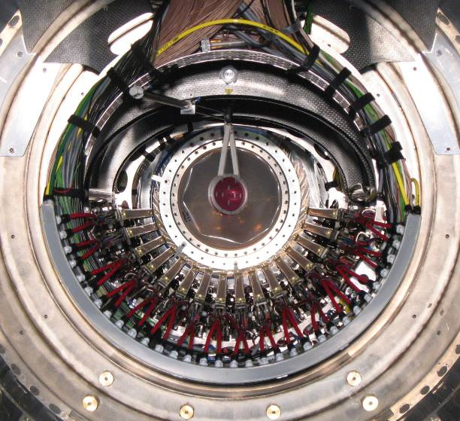
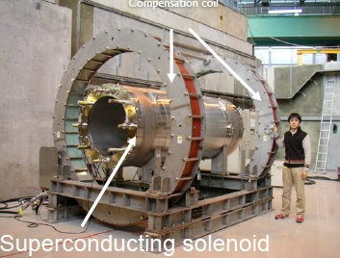
MEG: A few pictures
Muon stopping target
Liquid Xenon Calorimeter

Slide 19



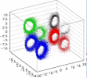

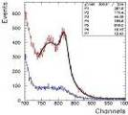


Calibrations
μ radiative decay
Laser
LED
γ
e
(rough) relative timing calib.
< 2~3 nsec
μ
Lower beam intensity
< 10⁷ to reduce pile-ups
A few days ~ 1 week to get enough statistics
PMT Gain
Higher V with light att.
Can be repeated frequently
ν
ν
π⁰→ γγ
π⁻ + p → π⁰ + n
π⁰ → γγ (55MeV, 83MeV)
π⁻ + p → γ + n (129MeV)
10 days to scan all
volume precisely
LH₂ target
Laser
MEG Detector
Standard
Calibrations
alpha
e⁺
γ
PMT QE & Att. Length
Cold GXe LXe
e⁻
Nickel γ Generator
9 MeV Nickel γ-line
Proton Acc
Li(p, γ0) at 17.6 MeV
Li(p,γ)Be
LiF target at COBRA center
17.6MeV γ
~daily calib.
Can be used also for initial setup
off
on
Li(p, γ1) at 14.6 MeV
NaI
Illuminate Xe from the back
Source (Cf) transferred by comp air → on/off
3 cm
20 cm
Polyethylene
0.25 cm Nickel plate
Absolute calibration – Long term stability – Continuous monitoring

Slide 20
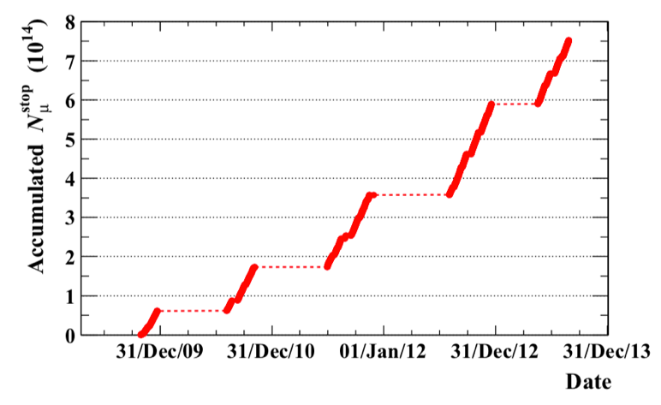
Full MEG Dataset
3 x 10¹⁴
2 x 10¹⁴
1 x 10¹⁴
Muons stopped on target
Total: 7.5 x 10¹⁴ stopped muons on target

Slide 21
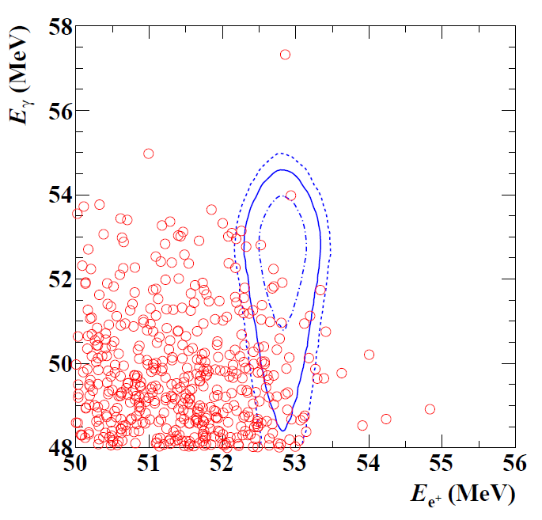
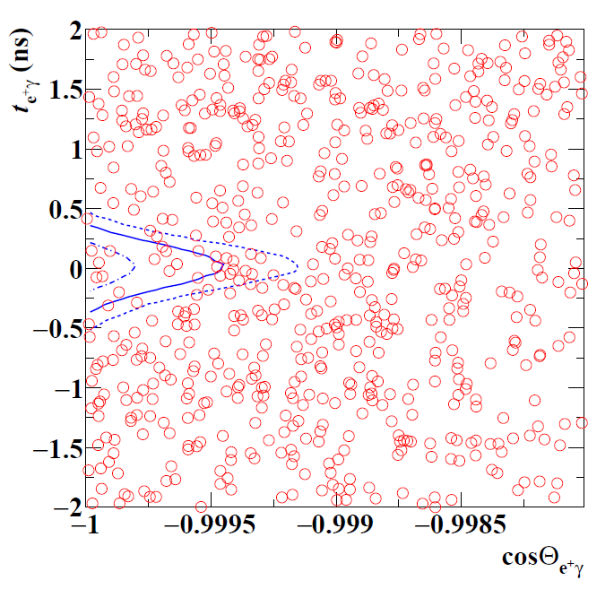
MEG Event Distribution
52.8 MeV
γ
μ
180º
e
52.8 MeV
1, 1.64 and 2σ
contours on
signal PDF
No indication of signal excess
90% signal efficiency cut for other two variables
Highest probability events differ in left and right plots.

Slide 22
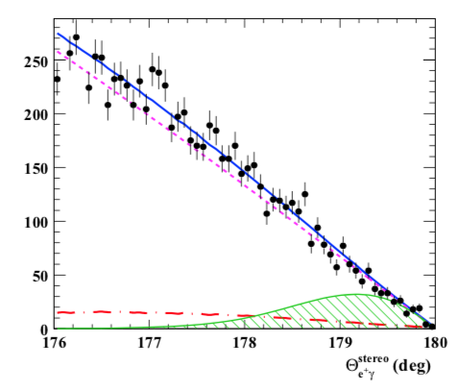
Final MEG Result
Best fit to Data
N_{RMD} =625 ± 28
N_{acc} = 7739 ± 38
Signal PDF
(upper limit magnified by 100)
Best fit: BR(μ→eγ) = -2.2 x 10⁻¹³, Upper Limit: BR(μ→eγ) ≦ 4.2 x 10⁻¹³

Slide 23
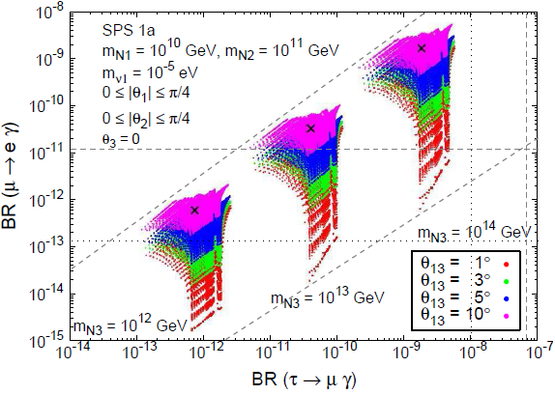
MEG Impact
Antusch et al.
JHEP 0611 (2006) 090
MEG 2016
MEG 2016
L. Calibbi et al.
Eur. Phys. J. C74
(2014) 1-20
Large parameter space for BSM models (SUSY) are already excluded by MEG

Slide 24
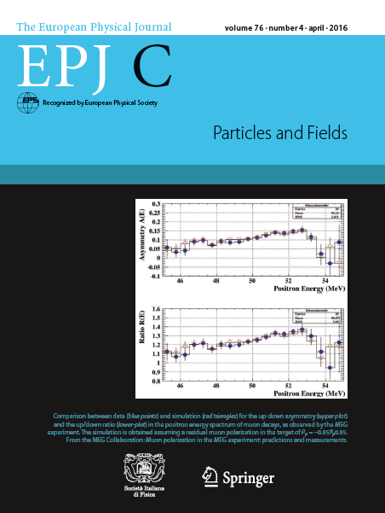
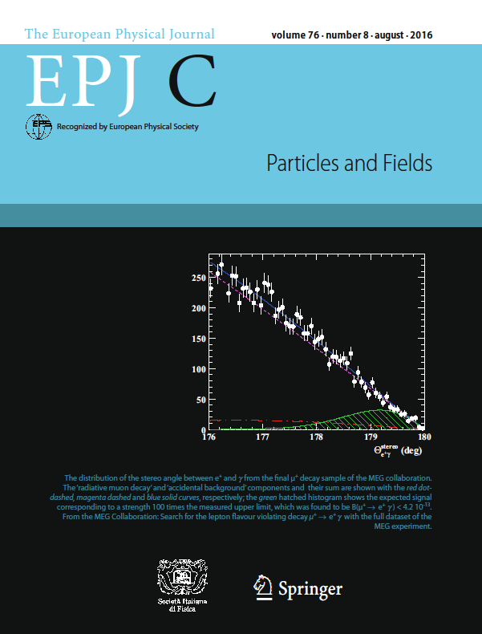
MEG: a “cover” experiment
Final MEG Result
Polarization Paper

Slide 25
The MEG II Experiment

Slide 26
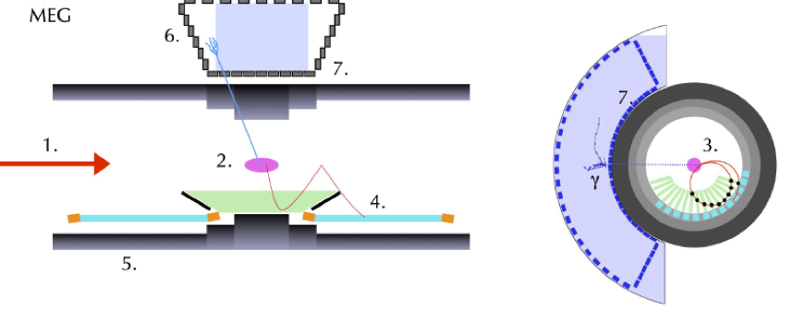
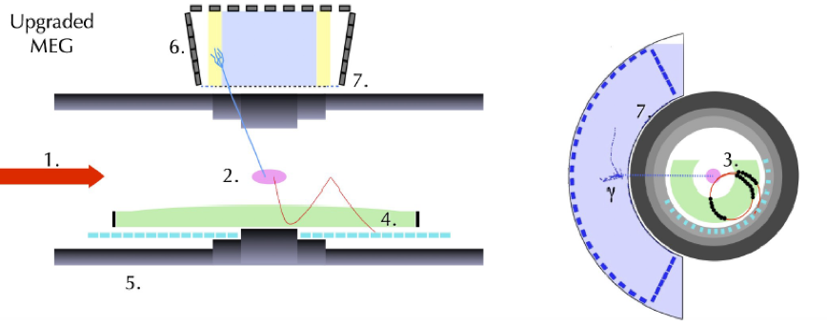
MEG II Experiment
MEG
Increased muon beam
Reduced target thickness
New positron tracker
Better acceptance
Pixelated timing counter
Extending γ-acceptance
Improved γ resolutions
New trigger & DAQ system
MEG II
Eight Improvements

Slide 27
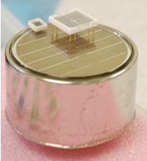
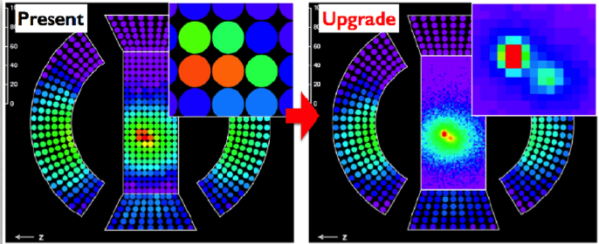
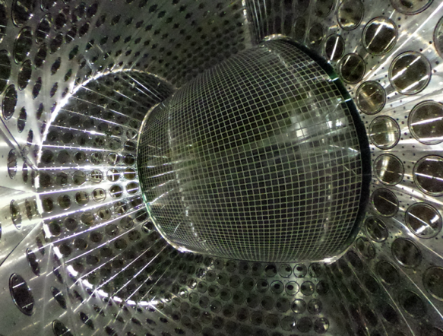
Upgraded LXe Calorimeter
new 12x12 mm² SiPM
for LXe (UV / cold)
216 x 2” PMT
4096 x 12x12mm² SiPM
(0.6 m²)
normal SiPM
2” PMT

Slide 28
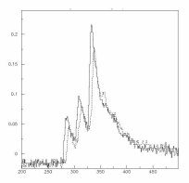
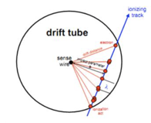
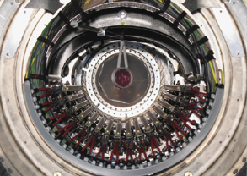
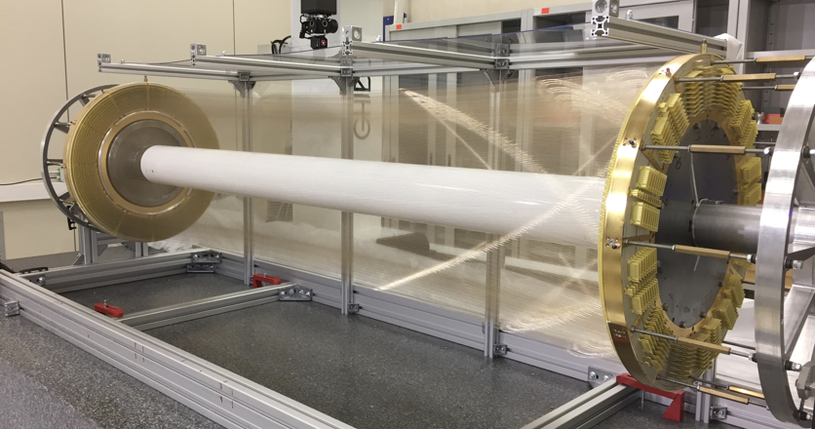
New single volume Drift Chamber
Higher granularity → more hits per track
Cluster counting technique
Higher acceptance → higher efficiency
~2 x better resolutions
2m

Slide 29
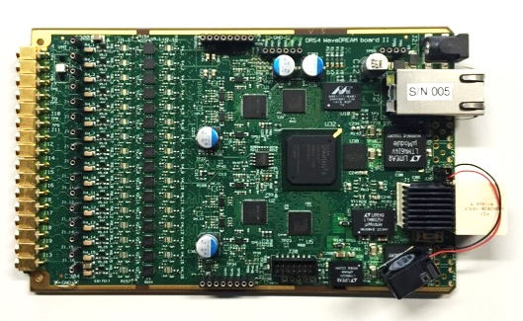
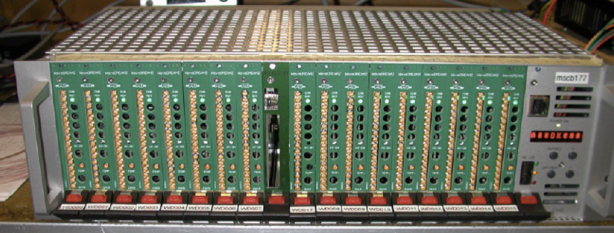
New WaveDAQ Trigger & DAQ System
9000 channels 5 GSPS / 12 bit waveform digitizing
Integrated bias voltage, amplifiers and shaping for SiPMs
Integrated global trigger system
(LXe calorimeter sum over 4000 channels every 12 ns)
WaveDREAM board (16 chn)
WaveDAQ crate (256 chn)
DRS4 Chip

Slide 30
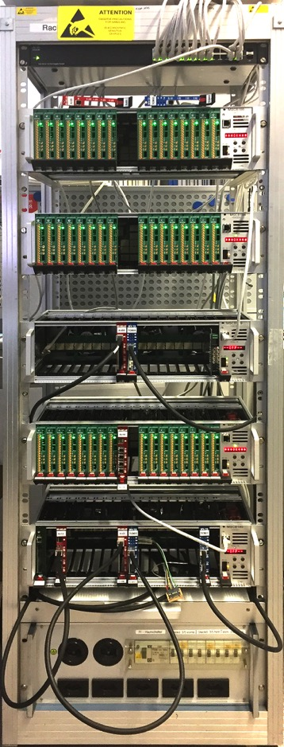
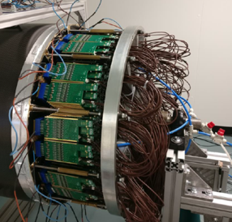
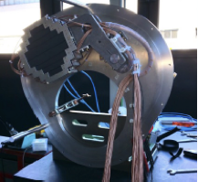
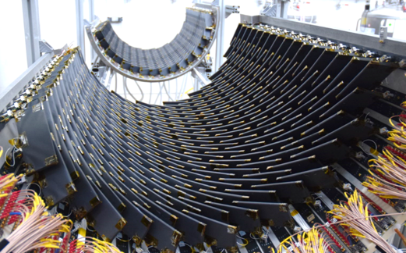
Status MEG II
Developments took much longer than anticipated
  Noise problems in mixed-signal electronics boards
  Wire breaking in drift chamber
  Low light yield in LXe calorimeter
  Ageing of SiPM in LXe calorimeter
First full engineering run planned for 2020
Data taking 2021-
Timing Counter
Drift Chamber End-Caps
Radiative Decay Counter
TDAQ

Slide 31
Resolutions and Efficiencies
Parameter | MEG | MEG II
e⁺ energy (keV) | 306 | 130
e⁺ θ (mrad) | 9.4 | 5.3
e⁺ φ (mrad) | 8.7 | 3.7
e⁺ vertex (mm) Z/Y | 2.4 / 1.2 | 1.6 / 0.7
γ energy (%) w<2cm/w>2cm | 2.4 / 1.7 | 1.1 / 1.0
γ position (mm) u/v/w | 5 / 5 / 6 | 2.6 / 2.2 / 5
γ-e⁺ timing (ps) | 122 | 84
Efficiency (%)
γ | 63 | 69
e⁺ | 40 | 88

Slide 32
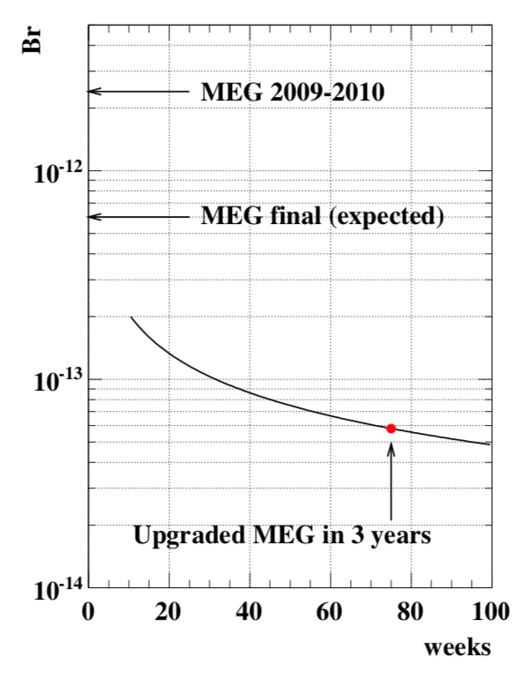
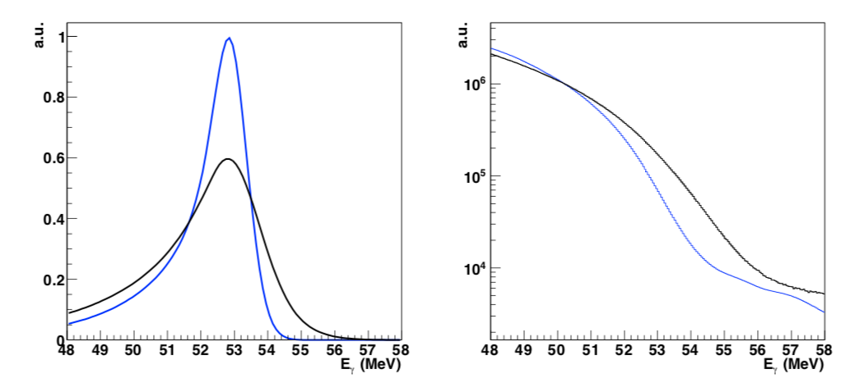
MEG II γ resolution and expected result
MEG
MEG II
4.2 x 10⁻¹³
MEG final (actual)
6 x 10⁻¹⁴
Signal Events
Accidental Background
R_{μ} : 3 x 10⁷ μ/s → 7 x 10⁷ μ/s

Slide 33

Future of MEG
Increase muon stopping rate
  Currently 10⁸ μ/s at PSI, 1.4 MW of DC proton beam
  HiMB project aims at 10¹⁰ μ/s with same proton beam
  CiADC project 1 MW 1 GeV (5 MW Phase-II) ?
Increase resolutions to suppress background
  x100 muon rate produces x100² background rate
  Calorimeter approach will break down at some point
G. Cavoto et al.
Eur.Phys.J. C 78 (2018) 37

Slide 34



Future of MEG
e - tracker
3 years measurement time
MEG Limit
MEG II Limit
G. Cavoto et al., Eur.Phys.J. C 78 (2018) 37
γ - calorimeter
γ - conversion
current
situation
(3 x 10⁷ m/s)
2 x 10⁻¹⁵
N_{acc} > 10
muon stopping rate
50 μm HVMAPS pixel
G. Cavoto et al., Eur.Phys.J. C 78 (2018) 37

Slide 35
Outlook – a personal guess
cLFV remains one of the most exciting places to search for new physics
Sensitivity:
10⁻¹⁵
10⁻¹⁷
10⁻¹⁸
10⁻¹⁹
μ⁻N → e⁻N
(7 x 10⁻¹³)
Mu2e
Mu2e-II with PIP-II
COMET Phase-I
COMET Phase-II
PRISM →
μ⁺ → e⁺e⁺e⁻
(1 x 10⁻¹²)
Sensitivity:
10⁻¹⁴
10⁻¹⁵
10⁻¹⁶
10⁻¹⁷
Mu3e Phase-I
Mu3e Phase-II
future options?
μ⁺ → e⁺γ
(4.2 x 10⁻¹³)
Sensitivity:
10⁻¹³
10⁻¹⁴
10⁻¹⁵
MEG II
future options?
2020
2025
2030
2035
Approved
Proposed

Slide 36






Thanks to my colleagues !
~70 researchers from 11 institutes

