Slide 1
Fundamental Composite Higgs
and
Phase Structure
2019.11.２３
at 中山大学
Michio Hashimoto
(Musashi U)
Work in progress

Slide 2
I will talk
Concept of Dynamical Symmetry Breaking Scenarios
Composite Higgs and related topics
Fundamental composite Higgs and phase structure
Summary

Slide 3
Concept of DSB Scenarios

Slide 4
Spontaneous Symmetry Breaking (SSB) and DSB
When a continuous group G spontaneously breaks down to H,
there appear Nambu-Goldstone Bosons (NGB’s) associated
with the broken currents J:
order parameter
→ If it is a composite operator, we may call this SSB
Dynamical Symmetry Breaking

Slide 5
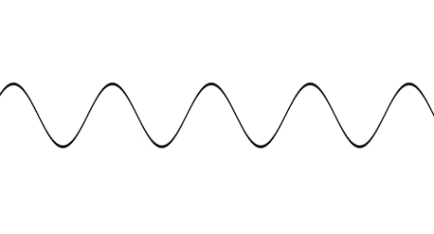
For the EW gauge symmetry breaking,
we know the scale is v=246 GeV, which corresponds to
v
v
The SM answers that the order param. is the elementary scalar field H,
so called the Higgs doublet:
Is this really elementary?
If composite,
there must exist more fundamental
theory beyond the SM!!

Slide 6
Note that
Nambu-Jona-Lasinio Model played
an important role at the first step of SSB.
For low-energy QCD:
NGB:
order param:
DSB!!
The NJL model is still useful.

Slide 7
Composite Higgs and related topics
There are many DSB approaches:
Technicolor/Walking TC
Little Higgs models
Pseudo Nambu-Goldstone Boson (pNGB)
Hint from vector-like quark models
etc.

Slide 8
1. Technicolor (TC)
S. Weinberg,PRD13,974(1976);PRD19,1277(1979);
L. Susskind, PRD20,2619(1979).
We may just scale up the QCD scale to the EW scale,
The experiments already have showed that
Nature is Not so Simple.
Existence of h(125)
Higgless/heavy Higgs
Precision Test, S < 0.1
Big S-parameter
No exotica
Many Technihadrons,
,
etc.

Slide 9
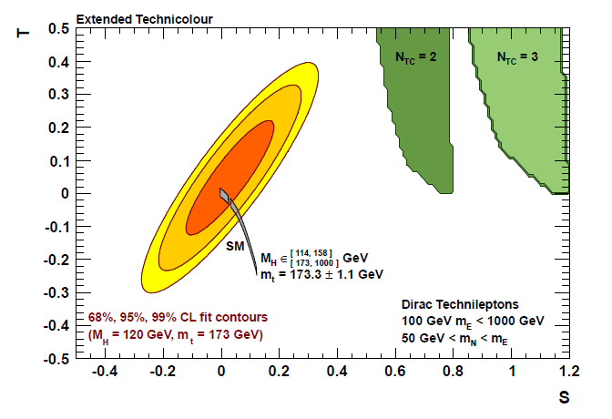
Constraint from Precision measurements
QCD-like TC
(1 Family type = 4 weak doublets)
Peskin & Takeuchi; Holdom & Terning, Gorden & Landall
For N
= 4
TC
S = 1.6 !!

Slide 10
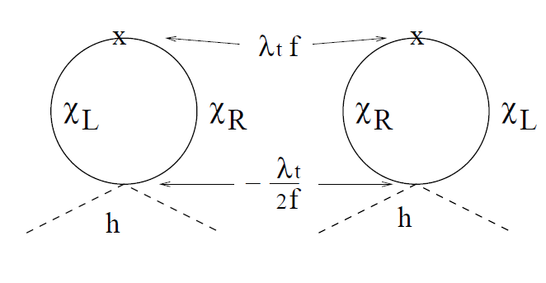
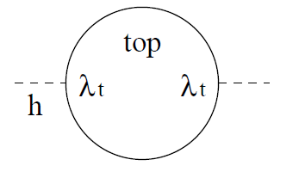
2. Little Higgs models
f: typical scale of LH
In the Little Higgs models, we introduce
(also W’ is introduced for cancellation of W loop)
Canceling mechanism of the top-loop quadratic divergence
No W’ and/or T severely constrain the LH models…

Slide 11
3. Higgs as pNGB
A composite Higgs doublet field can be realized as a pNGB.
Base on the DSB of several G → H, whose scale is f,
many Composite Higgs Models have been proposed.
Deviations from the SM:
Large f
Severe fine tuning
This idea is still viable, however.

Slide 12
4. Hint from VLQ models: Possibility of Enhanced Yt
The top Yukawa coupling is still unclear and thus
there is a room of BSM.
However, simple models cannot yield an enhanced top Yukawa
coupling consistently with the experimental constraints.
The Simplest Vector-like Quark model
Yt
Always suppressed!
Other Simple Cases
gg → h
inevitably enhanced when Yt is bigger.
Big Yt requires more extra fields!

Slide 13
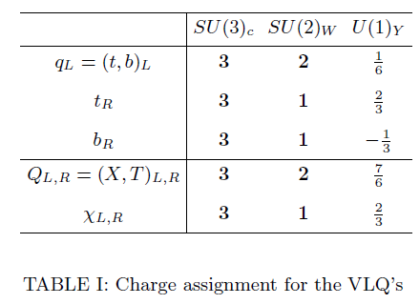
Recently, I studied the vector-like quark model with exotic hypercharge
assuming one composite Higgs doublet:
MH, Phys.Rev. D96 (2017) no.3, 035020 .

Slide 14
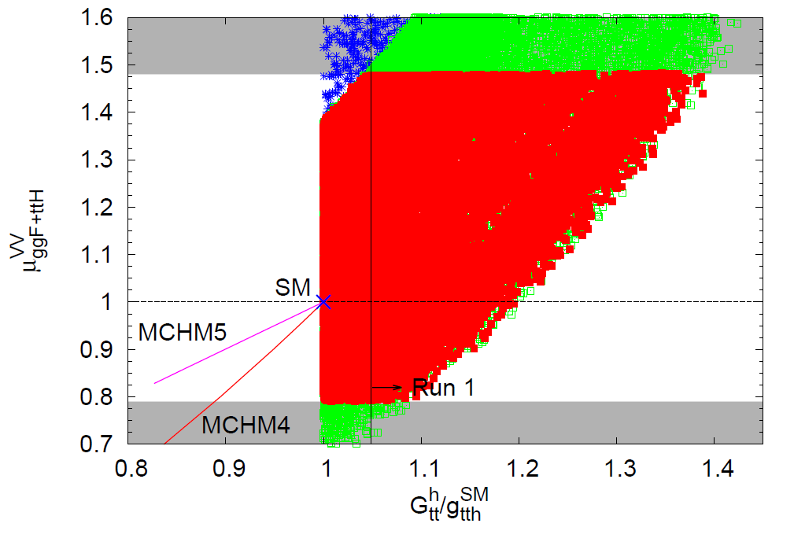
MH, Phys.Rev. D96 (2017) no.3, 035020 .

Slide 15
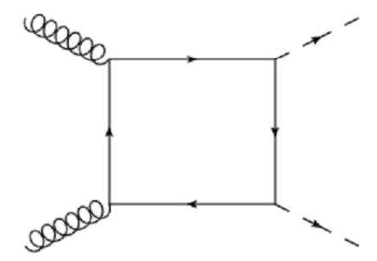
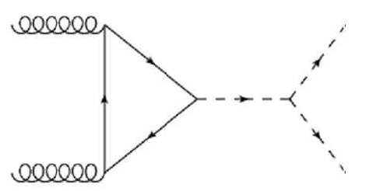
In the lowest order of the 1/M expansion,
In our case, we can show

Slide 16
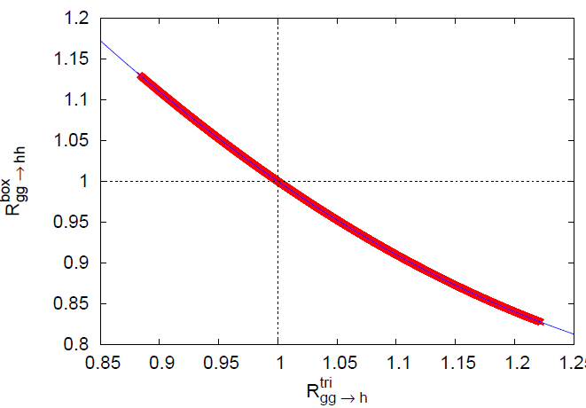

Slide 17
If an enhanced Yt is confirmed, the mass of VLQ must be

Slide 18
Fundamental composite Higgs
and phase structure
Work in progress
arXiv: 1402.0233
Composite Higgs based on
5 pNGBs =
It seems the phase structure and/or the effective potential
is not yet fully analyzed.

Slide 19
Previously, I calculated an effective potential from a walking
gauge theory:
MH, Phys.Rev. D83 (2011) 096003
From
we find
In the broken phase, it is
m: dynamical mass
For many Higgs fields, it becomes complicated…

Slide 20
Probably, a NJL approach is useful for the first step.
NJL model = linear sigma model + compositeness condition
Z=0, λ=0 at the compositeness scale → NJL model

Slide 21
Let us study a linear sigma model without the kinetic terms
in the fundamental composite Higgs model:
Antisymmetrc composite scalar
under SU(4)
+ (h.c.)
Q: fermions in the fundamental representation of SU(4)
After integrating out
we obtain a NJL model.
After integrating out Q, we obtain the effective potential.
★
How to introduce the top quark and Yt?

Slide 22
Summary
There is a longstanding problem concerning with the origin of
the Higgs field. The Higgs compositeness is still important issue.
Unfortunately, the phase structure and/or the effective potential
of the fundamental composite Higgs model is not yet fully
analyzed. Because a NJL approach is useful at the first step,
I discussed how to get the NJL model. But, many problems are
remaining: How to incorporate the top quark?
How about the partially compositeness?
etc.

Slide 23
Thank you!

