Slide 1
Bounds on Cosmic Ray-Boosted Dark Matter
WANG Wenyu
Beijing University of Technology
@GuangZhou, 2019.11
With Lei WU, Jin-Min YANG, Hang ZHOU, Bin ZHU

Slide 2


Slide 3
全书共13章，49万字，由科学出版社出版发行。
上篇：
暗物质观测证据
银河系暗物质分布
暗物质候选者
弱相互作用大质量粒子
轻暗物质粒子
暗物质直接、间接探测以及实验现状总结
下篇：
宇宙学基本知识简介
宇宙大爆炸核合成
玻尔兹曼输运方程和大质量粒子的冻结
宇宙微波背景各向异性和宇宙扰动理论

Slide 4


Slide 5
Content
Introduction of dark matter
Status of WIMP dark matter
Cosmic Ray-boosted dark matter
Bounds on the light dark matter in the simplified models

Slide 6
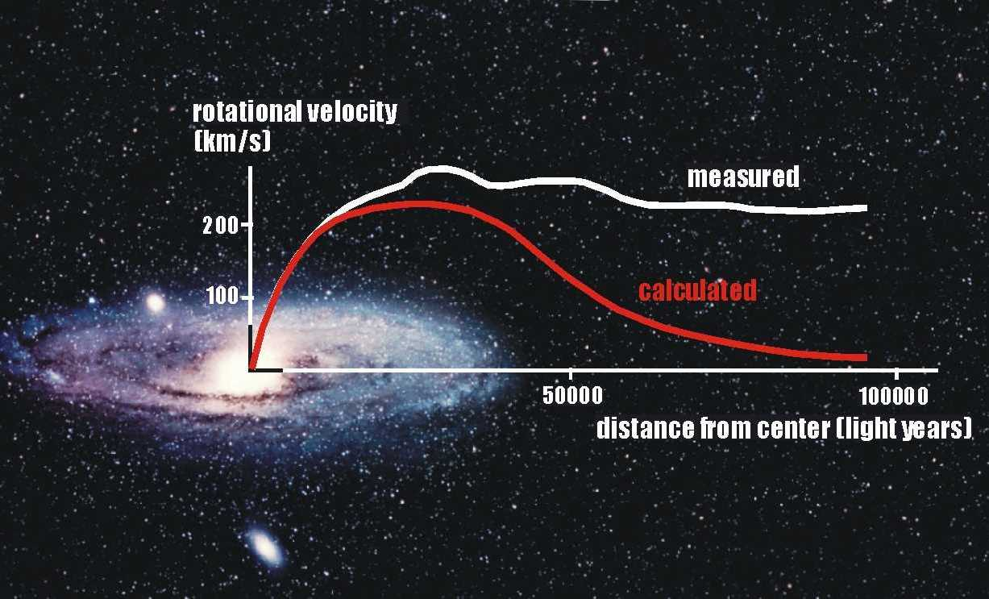
Evidence of Dark Matter

Slide 7
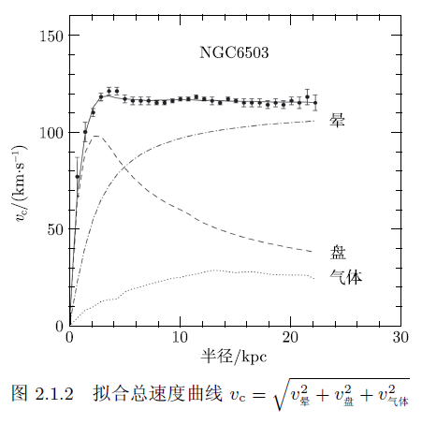

Slide 8
Observation methods
Optics for the stars
X-ray for the gas
Gravitational lensing for the dark matter

Slide 11
Anisotropy of CMB needs dark matter

Slide 12
Though existence of dark matter are believed in astrophysicists, we still need to identify it in the terrestrial laboratory !

Slide 13
Direct detection

Slide 16
Indirect detection

Slide 17

WIMP miracle

Slide 19
Summary
Less and less space for WIMP above 1GeV!
We are less sensitive to the light dark matter

Slide 20
Reasons of the less sensitivity
From PANDAX group arXiv:1802.06912

Slide 21
PANDAX constraints on light Mediator
From PANDAX group arXiv:1802.06912

Slide 22
A short introduction to Cosmic Rays

Slide 23
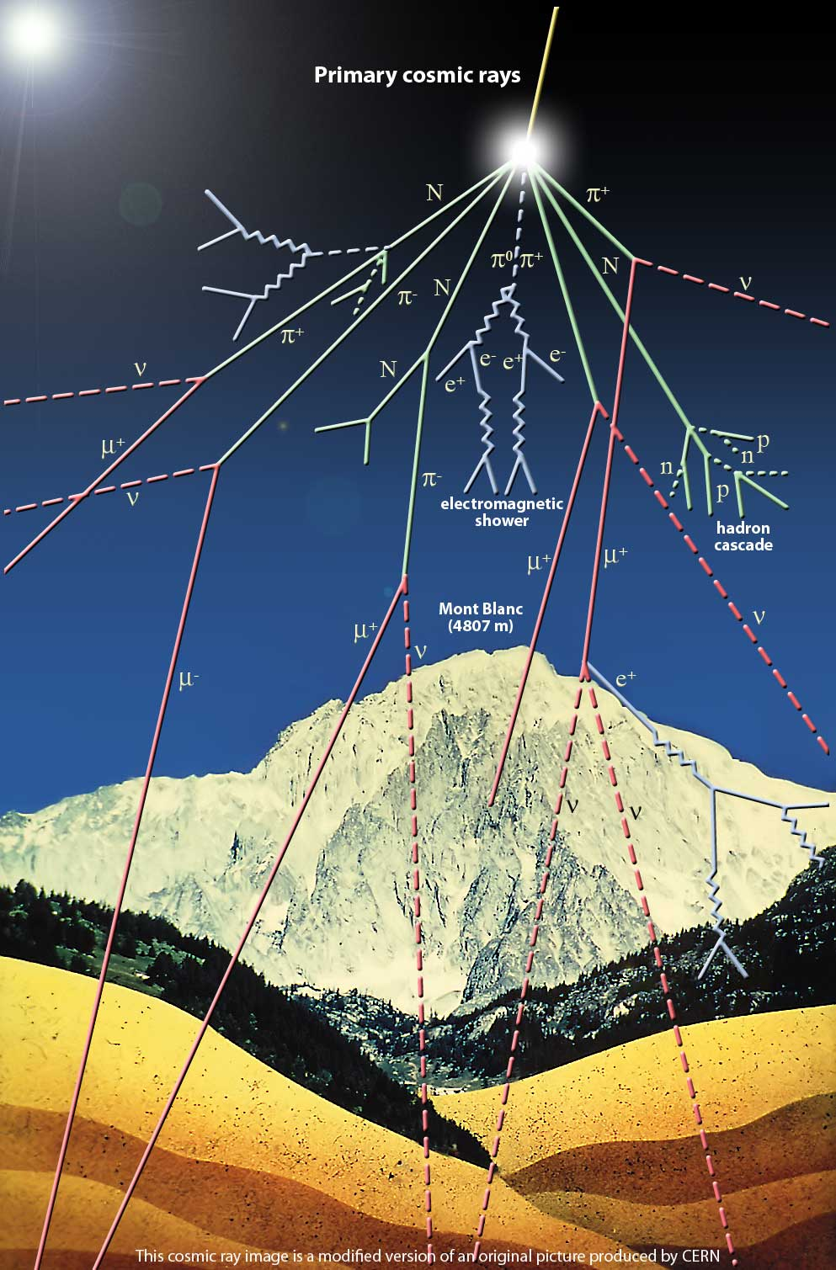

1000个粒子/平米/秒
90% 质子
9% $α$粒子
其它是重核
最高可达10²⁰eV
Where？How？

Slide 24
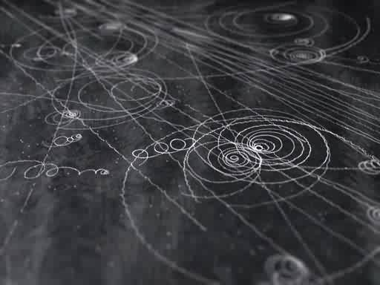
探测手段：云室

Slide 25

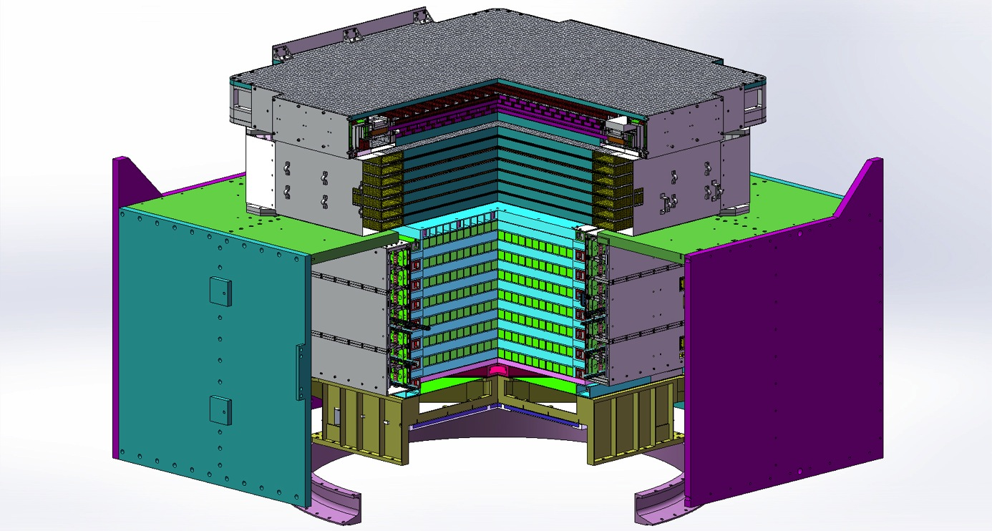
手段2:
Plastic Scintillator Detector (PSD)
Silicon-Tungsten Tracker (STK)
BGO Calorimeter
(BGO)
Neutron Detector
(NUD)
- Charge measurement (dE/dx in PSD, STK and BGO)
- Pair production and tracking (STK and BGO)
- Precise energy measurement (BGO bars)
- Hadron rejection (BGO and neutron detector)
Notes:
From the top to the bottom, we have the plastic scintillator detector (PSD), the silicon-tungsten tracker (STK), the BGO calorimeter (BGO) and the neutron detector (NUD), in total four sub-detectors. The charges are mainly measured by the PSD, STK and BGO. The energy will be recorded by the BGO. The electrons and protons, both have a charge number of 1, are distinguished by the BGO and NUD.

Slide 26
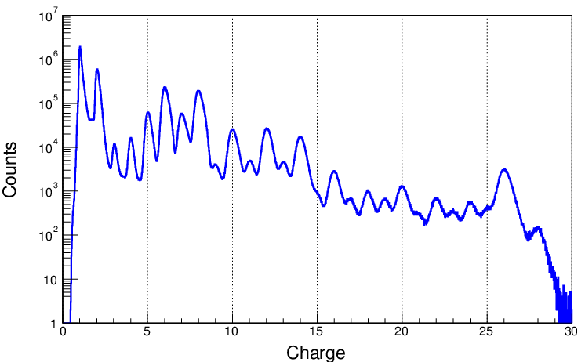
On-orbit performance:
Charge measurement
H
He
C
O
Ne
Si
Fe
Ca
Ni
For protons and Irons, the charge resolutions are 0.13e and 0.32e, respectively.
Notes:
The PSD can reliably measure the charges of the incident particles such as the Hydrogen or even Nickel. As shown in this plot, the main elements with charge numbers from 1 to 28 are clearly resolved.

Slide 27
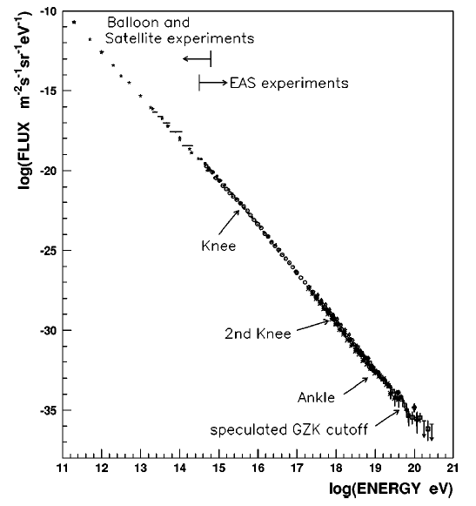
幂律谱

Slide 28
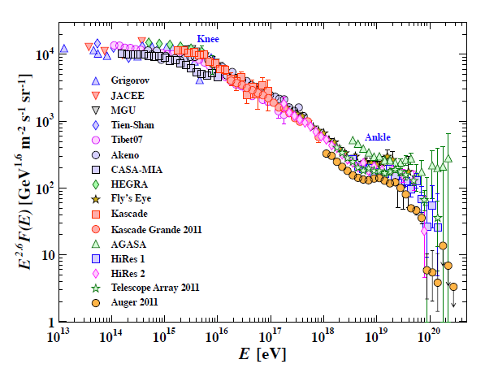

Slide 29
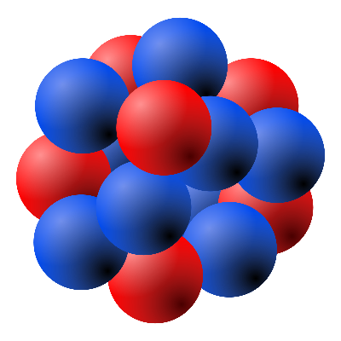
Story of CRDM
CR
DM
Nucleus

Slide 30

From CR to DM flux
After a single collision by the CR
The minimal incoming energy required for CR

Slide 31
CR i in a differential volume
Density of DM
Flux of CRs
Cross section between DM and CR
The CR induced DM flux
Effective scattering length
Integration in the sight

Slide 32
From T. Bringmann et. al. arXiv:1810.10543

Slide 33
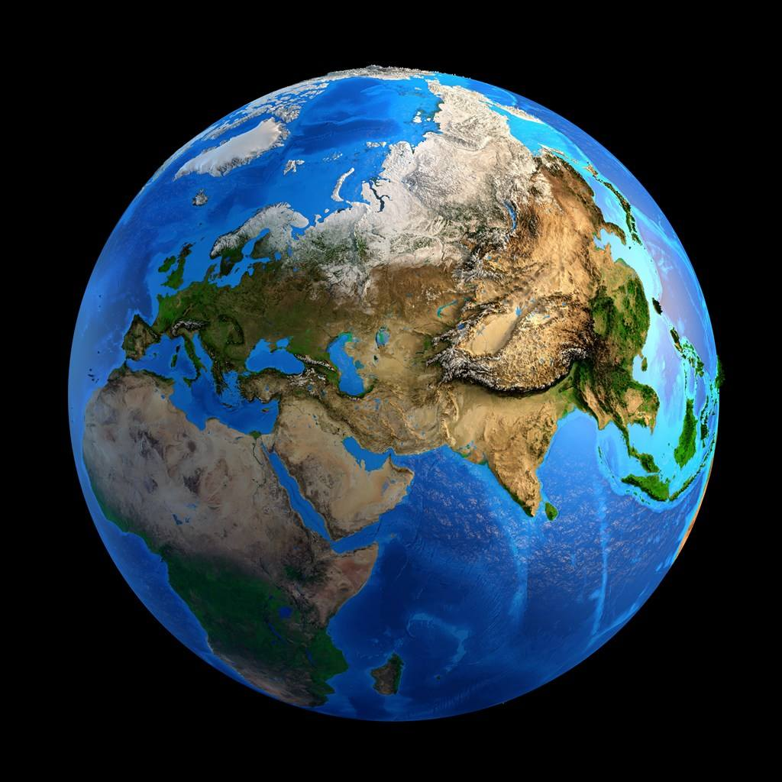
Attenuation of CRDM flux

Slide 35

DM flux at the depth z
in which
Cross section between DM and dense matter on earth
is the mean free path of a DM particle.

Slide 36

CRDM scattering in detectors
Cross section between DM and dense matter in detector
Recoil Energy of Target

Slide 37

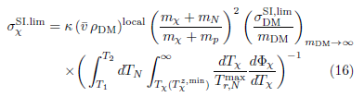
Comparison with the WIMP scattering
We can get

Slide 38
From T. Bringmann et. al. arXiv:1810.10543

Slide 39
Our work

Slide 40


Simplified models for scalar and vector mediator
Scalar：
Vector：
Tensor：
Energy scale

Slide 41
For the scalar

Slide 42


For the vector

Slide 43
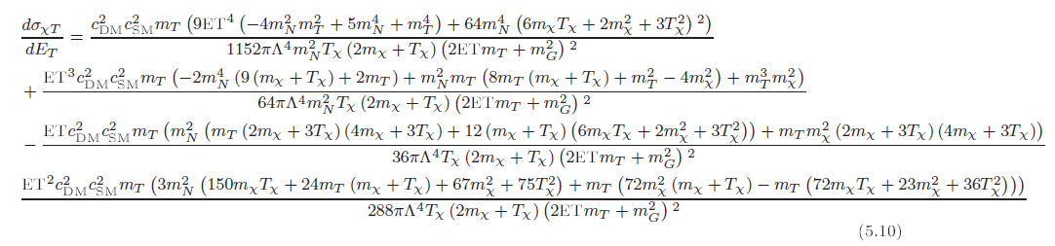
For the tensor

Slide 44
Flux of CRDM

Slide 45

We calculate the mean free path of a DM particle in the integral .

Slide 46

Three cross sections
Differential cross section between DM and CRs
Differential cross section between DM and dense matter on earth
Differential cross section between DM and matters in the detector
Our definition of the cross section

Slide 47
Implication of the cross section

Slide 50
From … T. Bringmann et. al. arXiv:1909.08632
Our work

Slide 51

$$σ^{SI}=\frac{4g^{4}μ^{2}}{{m_{φ}}^{4}}$$
Our work
From J. Dent et. al. arXiv:1907.03782

Slide 52
Note that: Definition of the cross section is also important!
The cross section in the fundamental theory is a differential form

Slide 53
CONCLUSION
Space in Dark Matter less than 1GeV has rich physics
CRDM is very good scenario for light DM
  The attenuation is important
  The definition of cross section is an issue

Slide 54
THANKS!

