Slide 1
IDEA detector status
Franco Bedeschi
CEPC meeting,
November 6, 2019
Outline
EU programs
IDEA 2019 activities
IDEA plans for 2020
Summary

Slide 2
EU program participation
CREMLIN+ (JINR,BINP, DESY, GSI/FAIR, INFN, Universita’):
    LE, BA with BINP (Novosibirsk) collaborate to build a prototype drift chamber for the Super Tau-Charm factory.
      Rescaled version of the IDEA drift chamber.
    FE, LNF and BINP collaborate on a cylindrical μRell chamber.
ATTRACT:
    Neutron detector with μRwell chambers
    BO, FE, LNF, Lund University and industrial partners TECHTRA and ELTOS
FEST (RISE 2019): call involving (BO, FE, TO, LNF, ……)
    Covers stay at IHEP for CEPC/BES-III - 4 duration
    26 man months in 2020
NSF Grant "AccelNet: Future Research Software for HEP"
    Software development for HL-LHC, FCC, CepC
    Italian participants INFN: BA, BO, FE, LE, MI, PD, PI, PV with endorsement of CSN1 and person in charge of INFN scientific computing
APPROVED
APPROVED
APPROVED
GOOD – WAITING FOR DECISION

Slide 3
EU program participation
AIDA++
  Priority of this call: R&D for future Higgs factories
  About 14 EoI’s related to the IDEA detector concept
    Pixels/Silicon: 3 EoI
    Drift Chamber: 2 EoI
    DR calorimeter: 3 EoI
    Muon Chambers: 5 EoI
    Software Infrastructure: 1 EoI
  Approval in 2020 very likely
Great source of grants for post-docs
Funds available in 2021

Slide 4
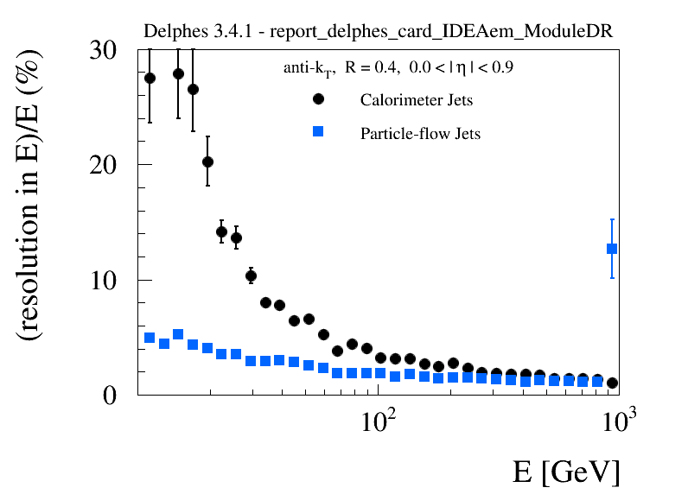
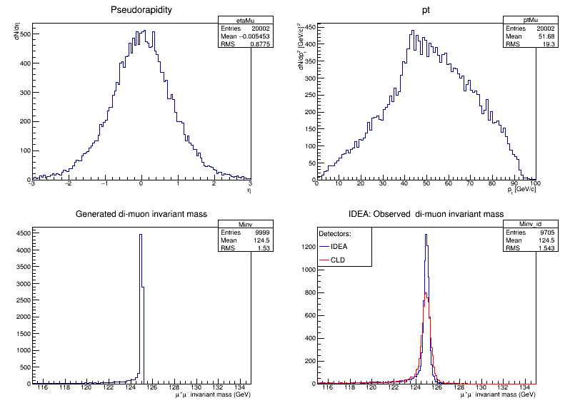
Software development 2019
IDEA in GEANT4 with DD4HEP
  Tracking
  Calorimeter
IDEA fast simulation
  IDEA card in DELPHES
Some benchmarks
Software workshop Bologna
  Started global collaboration on new tools for future colliders
H inv. mass
ZH→Z μμ
90 degree
Higgs recoil
HZ →H μμ

Slide 5
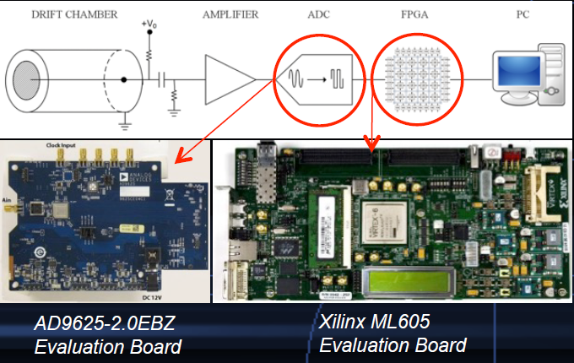
IDEA 2019 activities
R&D detector:
  Silicon: ARCADIA in FCCee/CepC (from CSN5)
  Drift Chamber: Study single channel of cluster counting
  DR calorimeter:
    Mechanics: Study of metal matrices
    Electronics: Study of Citiroc chip on various support boards
uRwell:
  Hi Rate single layer prototypes /test beam
Tested!
Under Test

Slide 6
Plans for 2020: Software
Getting ready to run IDEA in full and fast simulation
  See Patrizia talk
FEST provides potential for extensive stays at IHEP of Italian students and post-docs
  Great opportunity for common software developments

Slide 7
Plans for 2020: Silicon
Collaboration with ARCADIA (active pixels)
  DAQ software development
    Potential for collaboration with China on common DAQ for test beam
    Supported by FEST!
Evaluation of CMOS detectors for Si wrapper
  Continuation of ATLAS upgrade R&D in Milan
Collaborations:
  UK: Oxford, ETH, Zurich university, (IHEP-China?)

Slide 8
Plans for 2020: Drift Chamber
Drift chamber in CREMLIN2
  Collaboration (BINP, Novosibirsk)
  Work toward full length prototype
    Carbon fiber wires
    Cluster counting electronics
    Build small intermediate prototypes
    Study non-flammable gases
See talk by P. Giacomelli

Slide 9
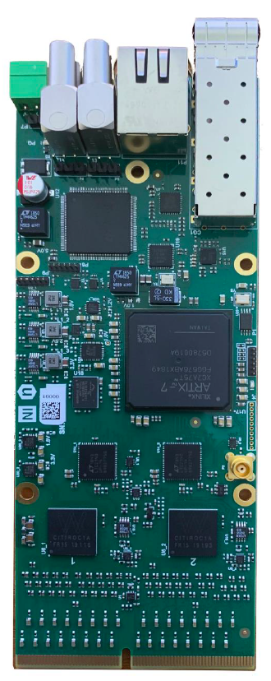
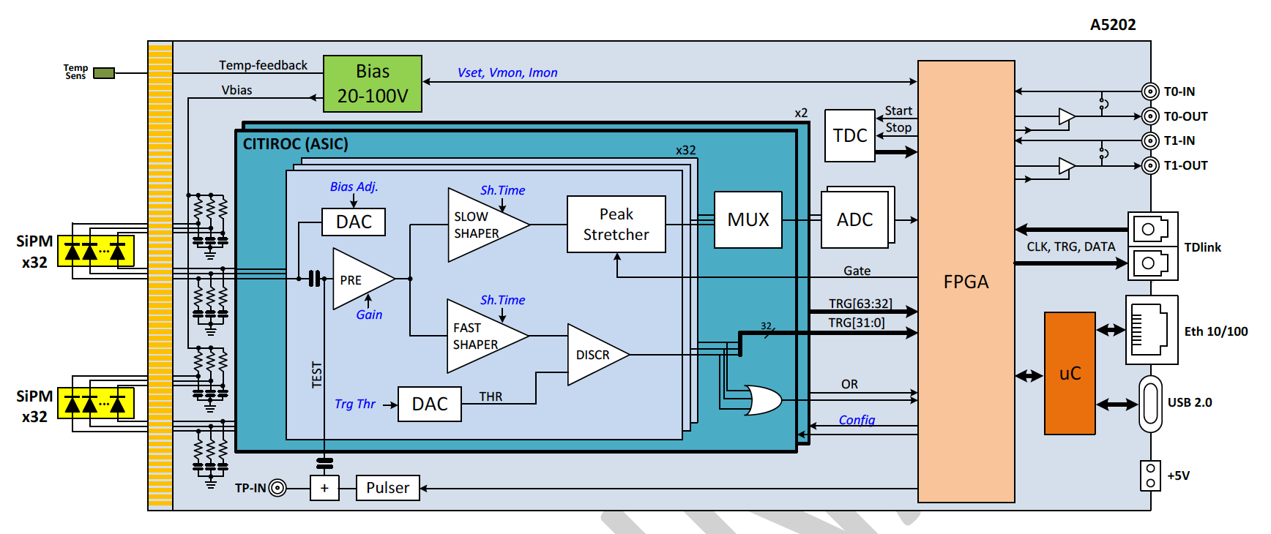
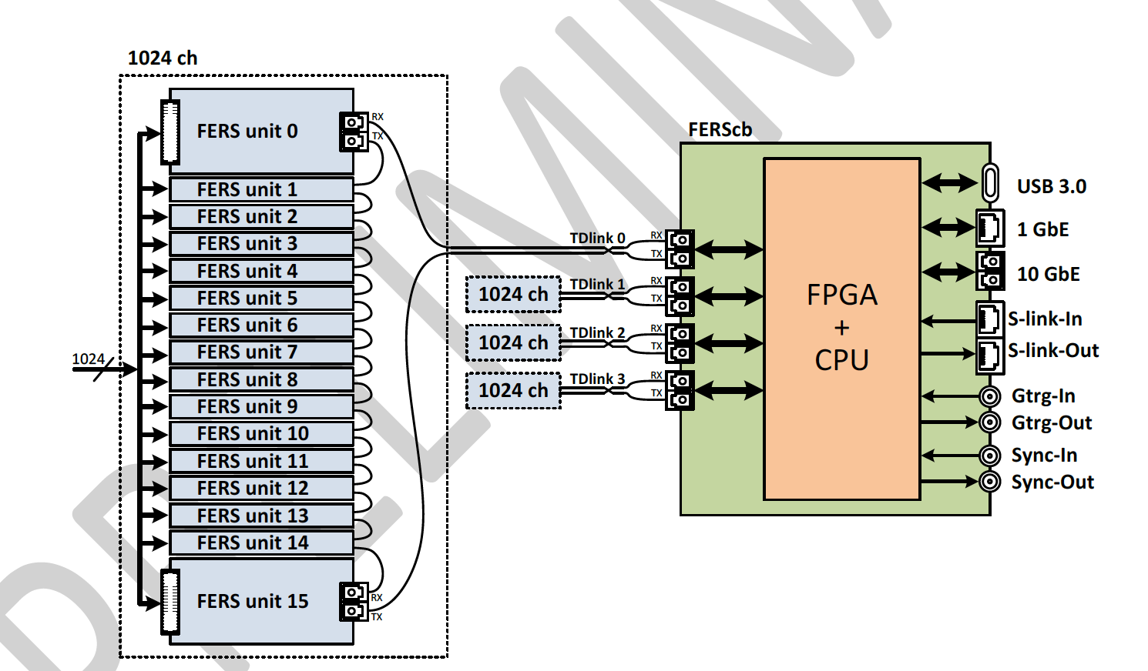
Plans 2020: DR calorimeter
Build and test new prototype
  Full containement EM: 10 cm x 10 cm x 100 cm
    Mechanics based on metal capillaries 2 mm OD, 1.1 mm ID
    9 towers 17x20 capillaries with 1.0 mm fibers
    Central tower SiPM readout – Remaining with PMT
    Alpha-tester compact CAEN electronics (Sistema FERS)
  Breakup and collaborations
    RBI, Croazia: QA tubes and tower fabrication
    U. Sussex, UK: QA fibers
    Pavia: Fiber insertion and readout PMT towers
    Milano: electronics and machanics SiPM
Working prototype by May
Test beam at DESY: Fall 2020
See talk by R. Santoro

Slide 10
Plans for 2020: μRwell chambers
R&D to develop large area hi rate chambers
  With industrial partners TECHTRA and ELTOS
Study recently built uRwell with 2D readout
Continue R&D on DLC+Cu sputtering with USTC (Cina)
Full simulation del pre-shower di IDEA
See Talk by P. Giacomelli

Slide 11
Summary
Progress in all areas
Good support from INFN
New collaborators start showing up
Potential for increased collaboration with China on offline and DAQ software
Much detector R&D in progress still open for additional collaborators

Slide 12
Additional slides

