Slide 1

Dual Readout calorimeter
R. Santoro
Università degli Studi dell’Insubria (COMO) and INFN (Milano)

Slide 2
Outline
Results from previous test beams
On-going activity in preparation to the next test beam scheduled at the end of 2020
The progress in the full simulation will not be covered in this talk

Slide 3
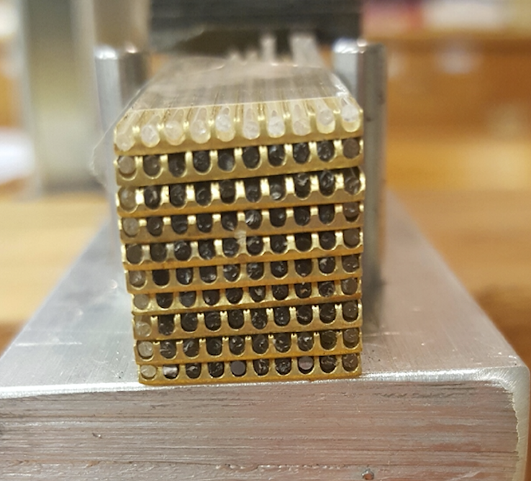
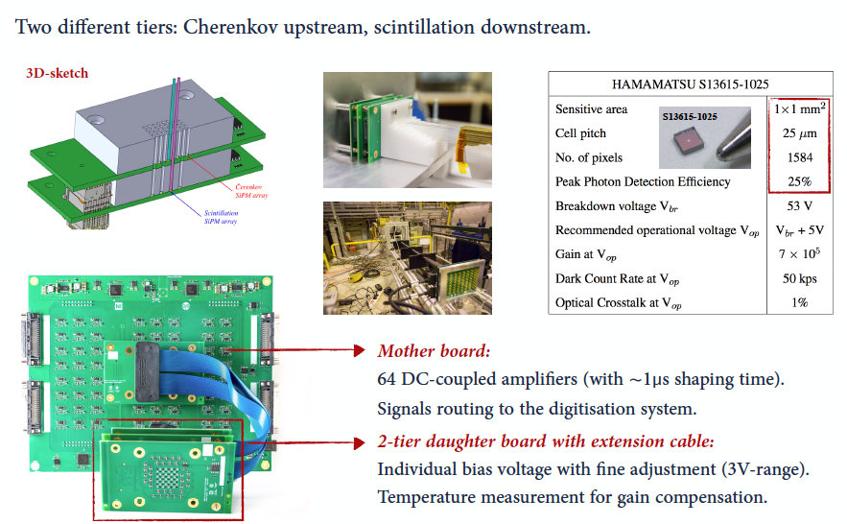
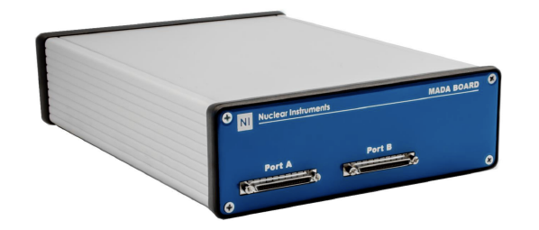
Test Beam 2017/18: SiPM readout
The module
The Front-end Board
8x8 fibers
A stack of 10 brass layers (112 cm long, X₀ = 29 mm) housing 1mm diameter clear & scintillating fibres with a pitch of 1.5 mm (R_{M} = 31 mm)
The Read-Out Board
2 MADA Boards: a 32 channel digitizer with a sampling rate of 80MSpS/14-bit ADC and an FPGA based charge integration algorithm

Slide 4
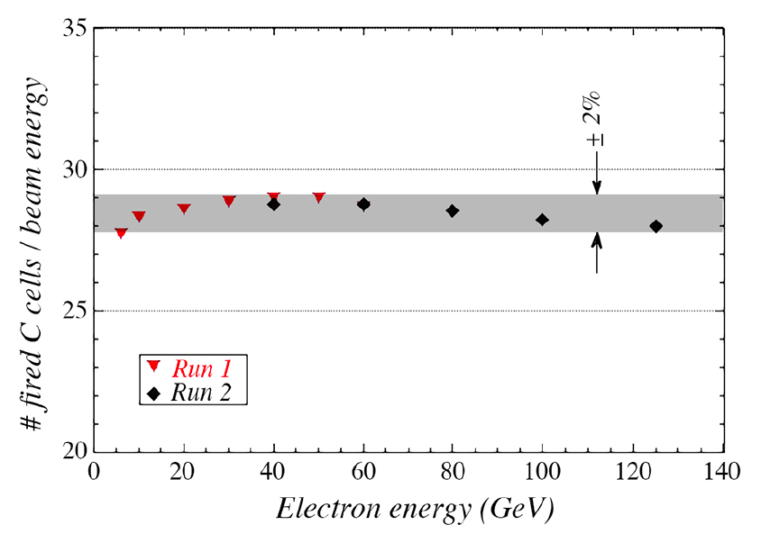

Cerenkov light yield: 2017
Light yield = 28.6 $±$ 0.4 ph-e/GeV
Detector operated at nominal bias voltage (PDE = 25%)
Temperature stability correction:
  < 0.5°C during a single run (negligible)
  < 2°C during the full scan (considered )
NIM-A, Vol. 899, 52 – 64 (2018)

Slide 5
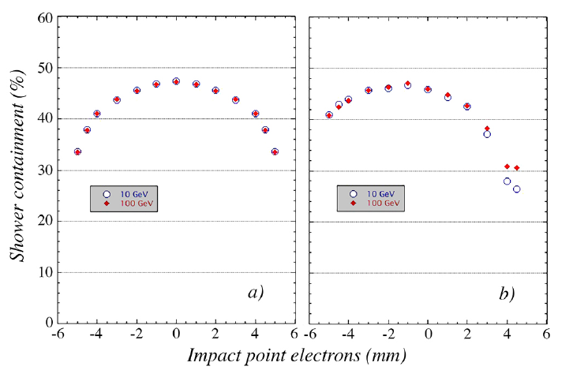

Cerenkov light yield: 2017
Light yield = 28.6 $±$ 0.4 ph-e/GeV
Detector operated at nominal bias voltage (PDE = 25%)
Temperature stability correction:
  < 0.5°C during a single run (negligible)
  < 2°C during the full scan (considered )
Energy containment predicted by simulation is 45%
It is independent from beam energy
It is almost constant when a geometrical cut of 3mm in the center is applied in the selection
Geant4
A full contained electron shower is expected to have a Light yield* = 54 $±$ 5 ph-e/GeV
* Number corrected for the measured scintillating contamination
0°
0.2°
NIM-A, Vol. 899, 52 – 64 (2018)

Slide 6
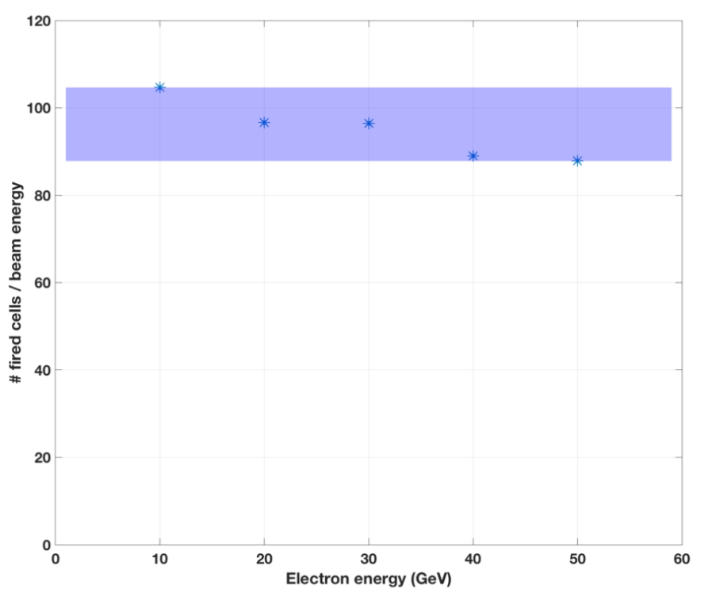

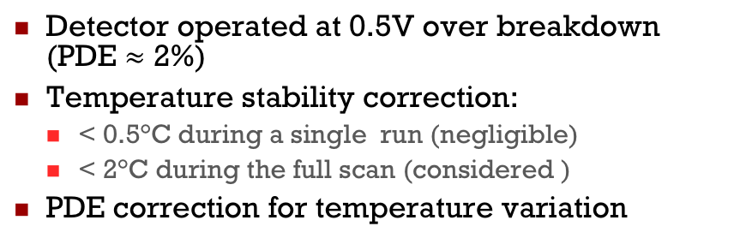
Scintillating light yield: 2017
Detector operated at 0.5V over breakdown (PDE $≈$ 2%)
Temperature stability correction:
  < 0.5°C during a single run (negligible)
  < 2°C during the full scan (considered )
PDE correction for temperature variation
$$± 8\%$$

Slide 7

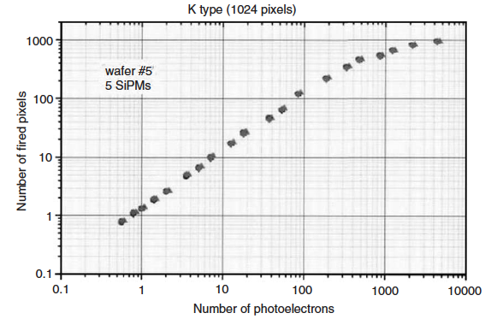
Scintillating light yield: 2017
Detector operated at 0.5V over breakdown (PDE $≈$ 2%)
Temperature stability correction:
  < 0.5°C during a single run (negligible)
  < 2°C during the full scan (considered )
PDE correction for temperature variation
$$± 8\%$$
The SiPMs operated at this voltage are not saturated but they are working in a strongly non linear regime: a correction is required to restore the linearity
D. Renker:
NIMA 567 (2006) 48–56
Valid as a first approximation: the light uniformly illuminate the SiPMs, all photons come at the same time and spurious effects are negligible

Slide 8
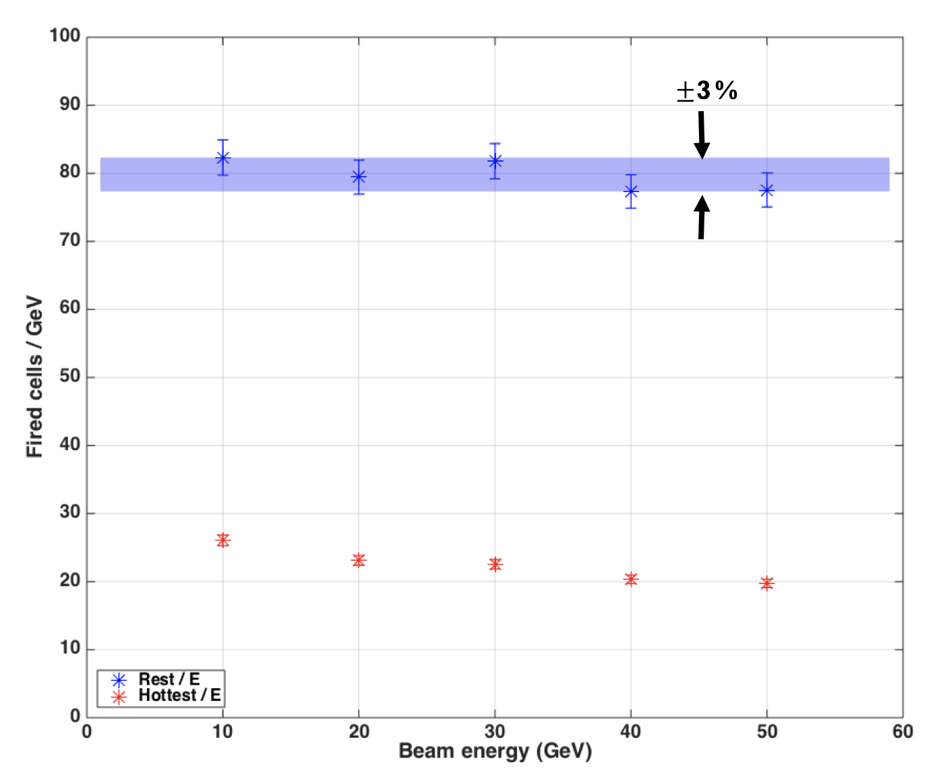
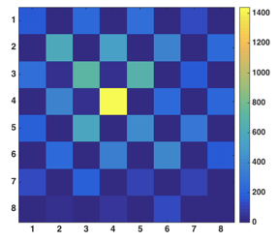
Scintillating light yield: 2017
Detector operated at 0.5V over breakdown (PDE $≈$ 2%)
Temperature stability correction:
  < 0.5°C during a single run (negligible)
  < 2°C during the full scan (considered )
PDE correction for temperature variation
$$± 8\%$$
Once the correction is applied, even if it is not perfect, the linearity is largely improved
A full contained electron shower is
expected to have a
Light yield* = 3200 ph-e/GeV
* The light yield is scaled to the typical SiPM PDE (25%)
The seed linearity is not yet fully restored
NIM-A, Vol. 899, 52 – 64 (2018)

Slide 9
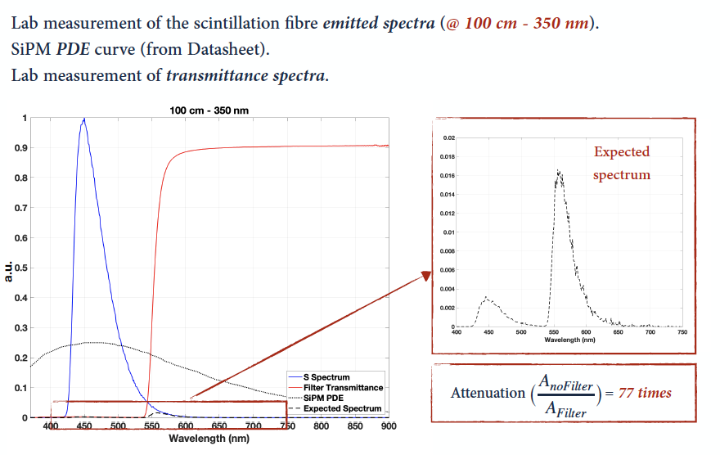
Scintillating light yield: 2018
To operate the SiPMs at nominal over-voltage, we interposed a yellow filter between the sensors and the fiber tips
A series of preliminary measurements has been performed in the lab in order to select the proper attenuation ratio
Yellow filter: transmittance spectrum (measured)
Expected spectrum and its attenuation
Scintillating fiber: emitted light spectrum (measured)
SiPM: Photodetector efficiency (from datasheet)

Slide 10
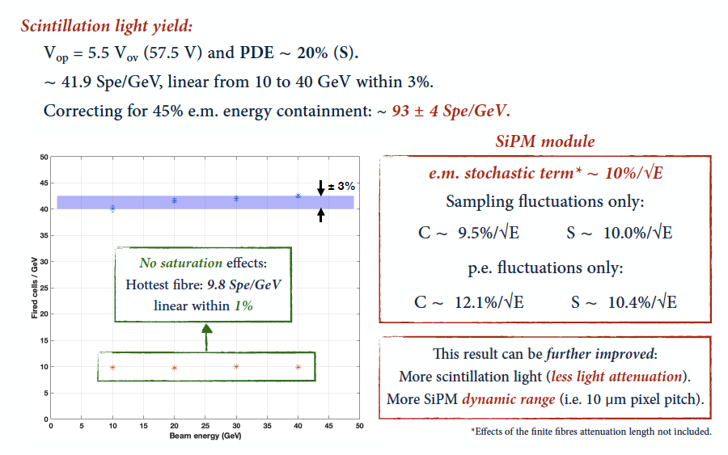
Scintillating light yield: 2018
To operate the SiPMs at nominal over-voltage, we interposed a yellow filter between the sensors and the fiber tips
A series of preliminary measurements has been performed in the lab in order to select the proper attenuation ratio
NIM-A (in press): https://doi.org/10.1016/j.nima.2019.04.090

Slide 11
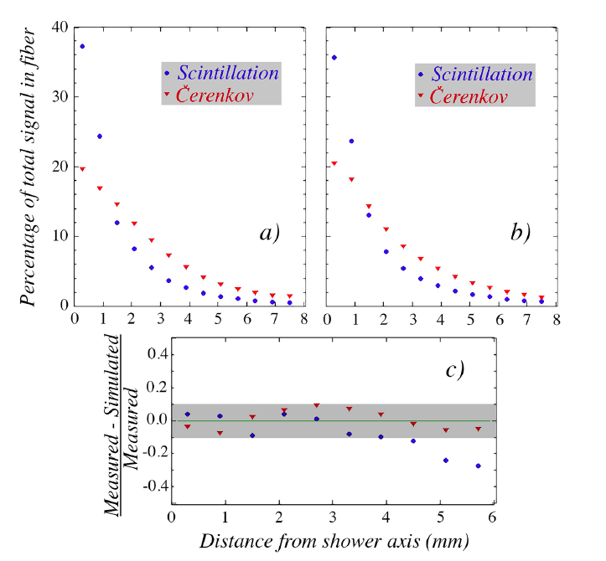
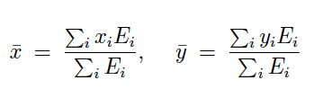

Lateral shower profile: 2017
In addition, this segmentation allowed to measure the electromagnetic lateral shower profile with an unprecedented granularity
Data
Geant4
Data VS Geant4
NIM-A, Vol. 899, 52 – 64 (2018)

Slide 12
Plans for the next test beam
The main goal for this test is the assembly and qualification of a large calorimeter readout with SiPM
  As an intermediate step will read only a part of it with SiPMs
This will push for a series of new challenges
  Improve the linearity response:
    SiPMs with larger dynamic range
    New SiPMs plus filters
  Readout of an increased number of channels
    The front-end board used in the previous tests doesn’t fit any more with the new requirements
    A new strategy is under investigation (ASIC)
  New strategy is required for the assembly
    Something scalable that goes beyond the prototype
    It is important to consider solutions that take into account the coasts and the quality assurance

Slide 13
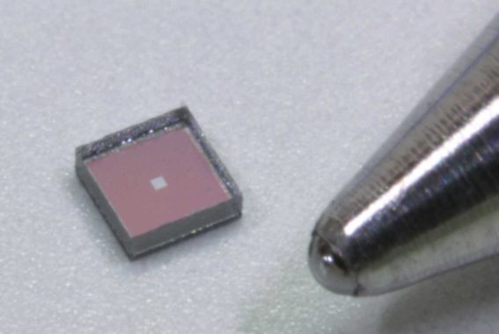
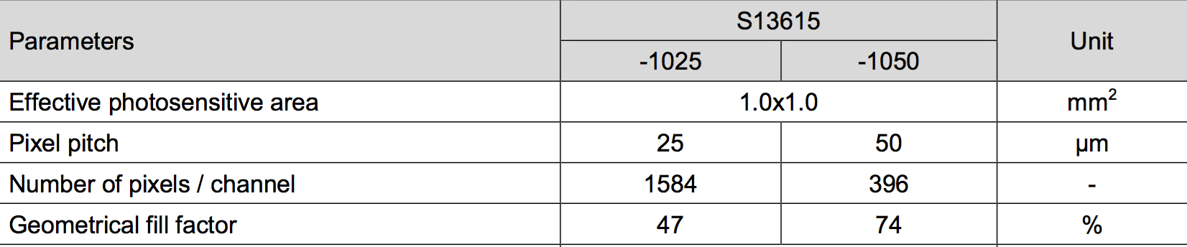
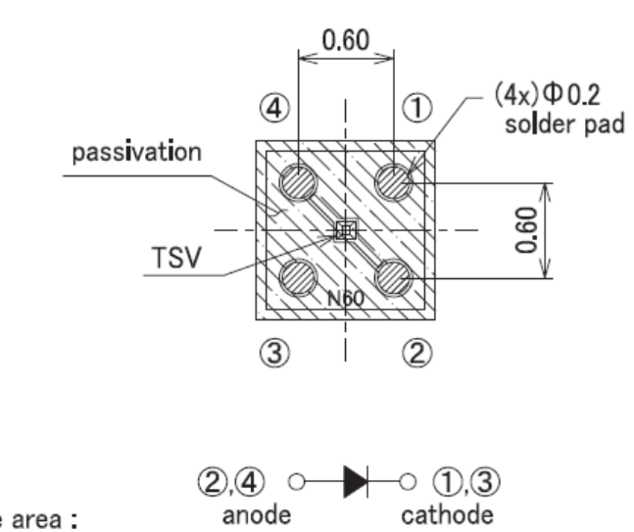
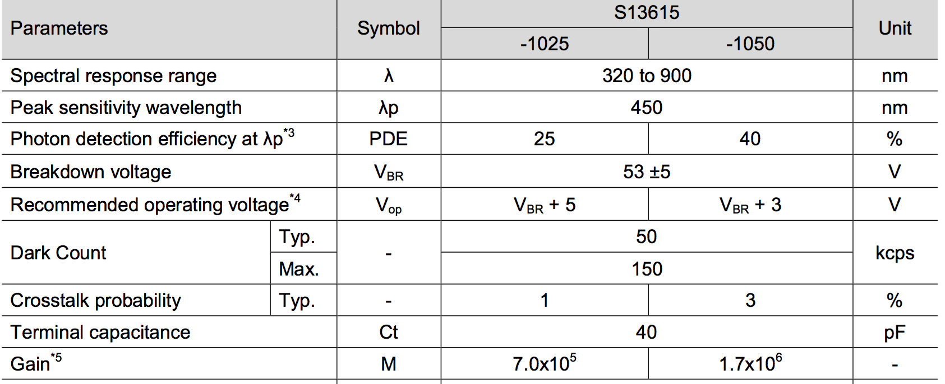
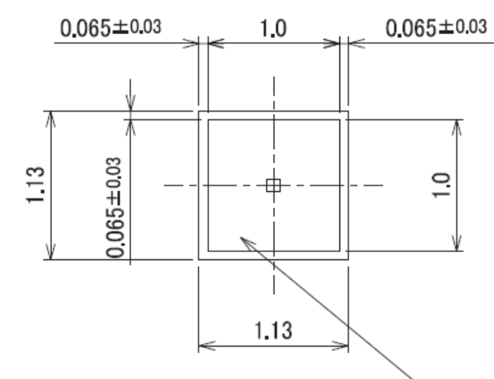
The SiPM used in the previous test beams
The sensors used were 25 μm cell pitch (S13615-1025)

Slide 14
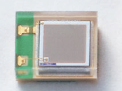
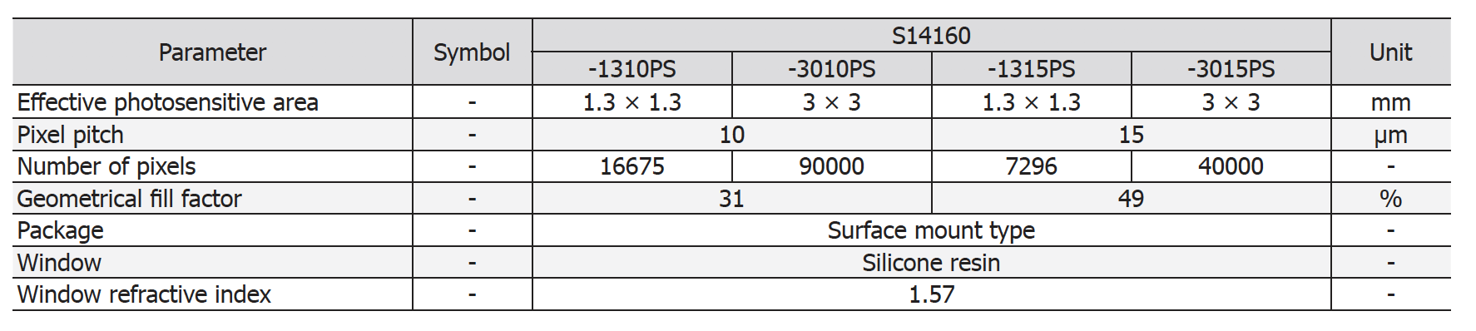
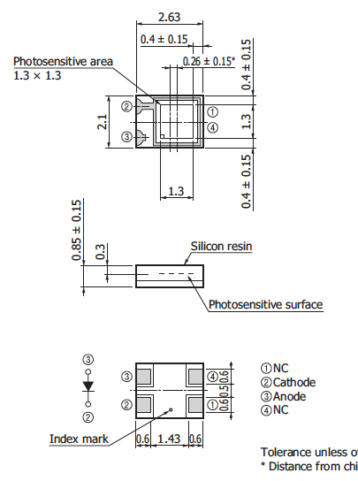
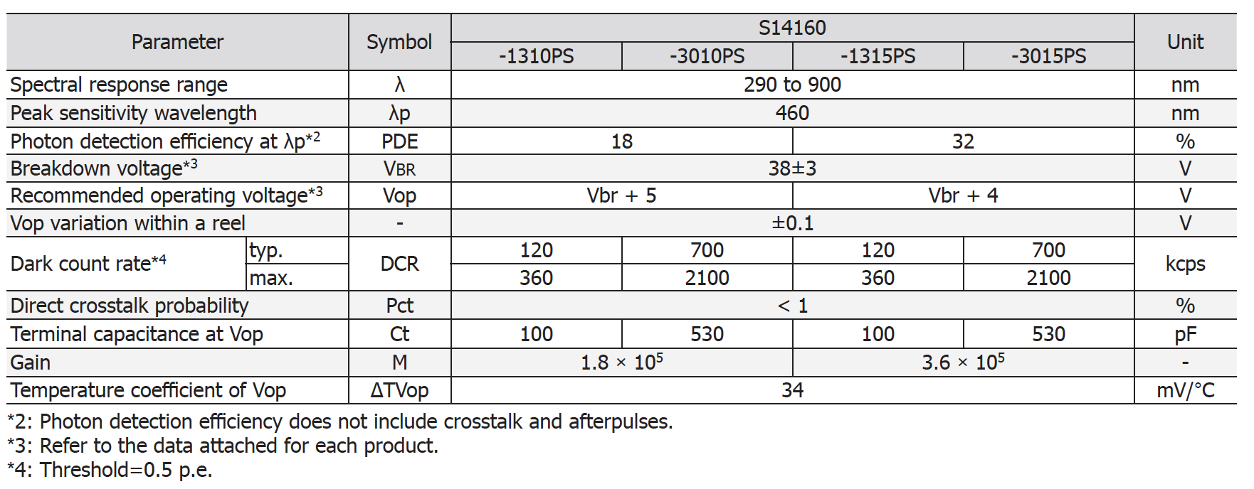
New SiPMs under test
New sensors: S14160-1310PS / S14160-1315PS

Slide 15
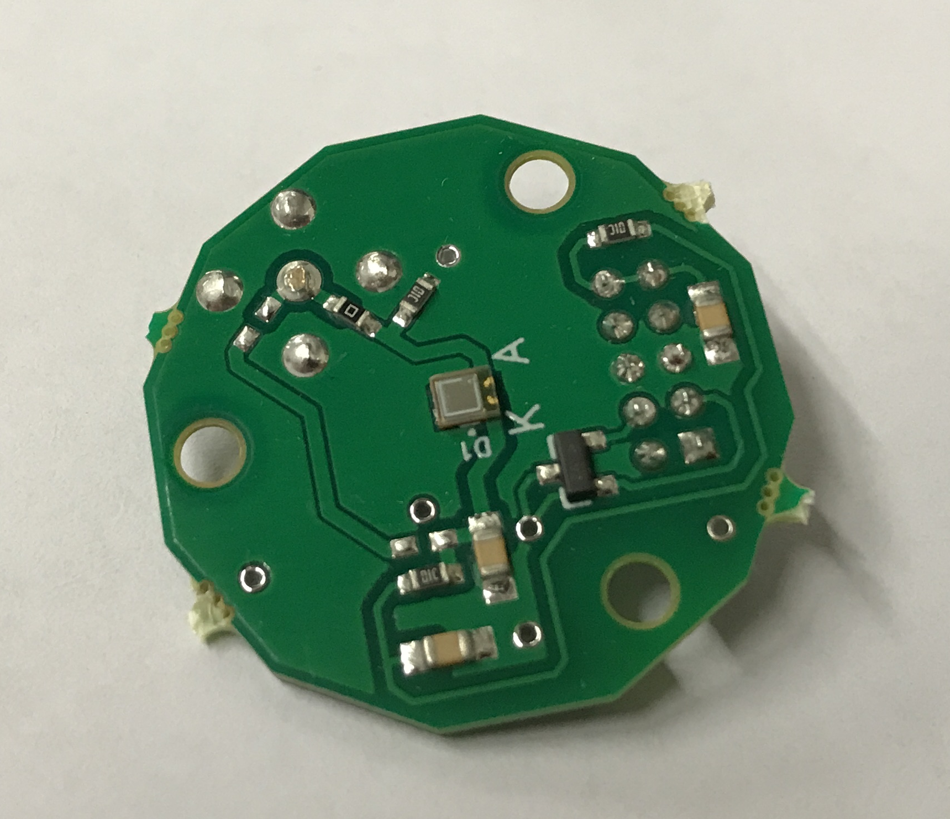
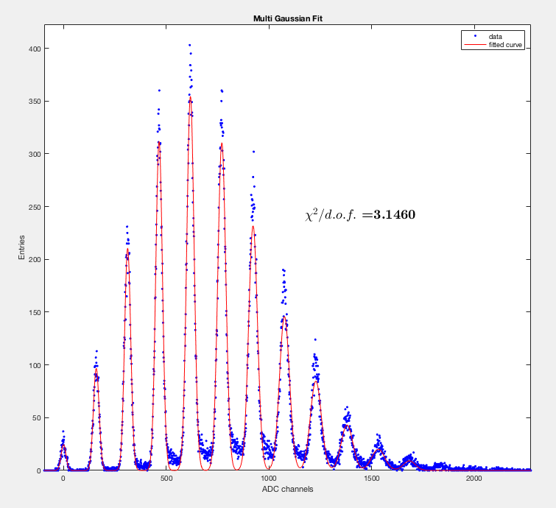
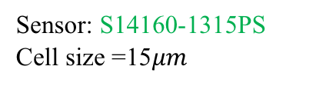
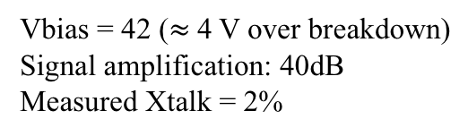
A first look at the SiPMs
We tested the new SiPMs using our standard equipment (SP5600 and DT5720A from Caen) together with an automatic software tool developed to characterize SiPMs (JINST 10, C08008)
Sensor: S14160-1315PS
Cell size =15$μm$
Vbias = 42 ($≈$4 V over breakdown)
Signal amplification: 40dB
Measured Xtalk = 2%

Slide 16
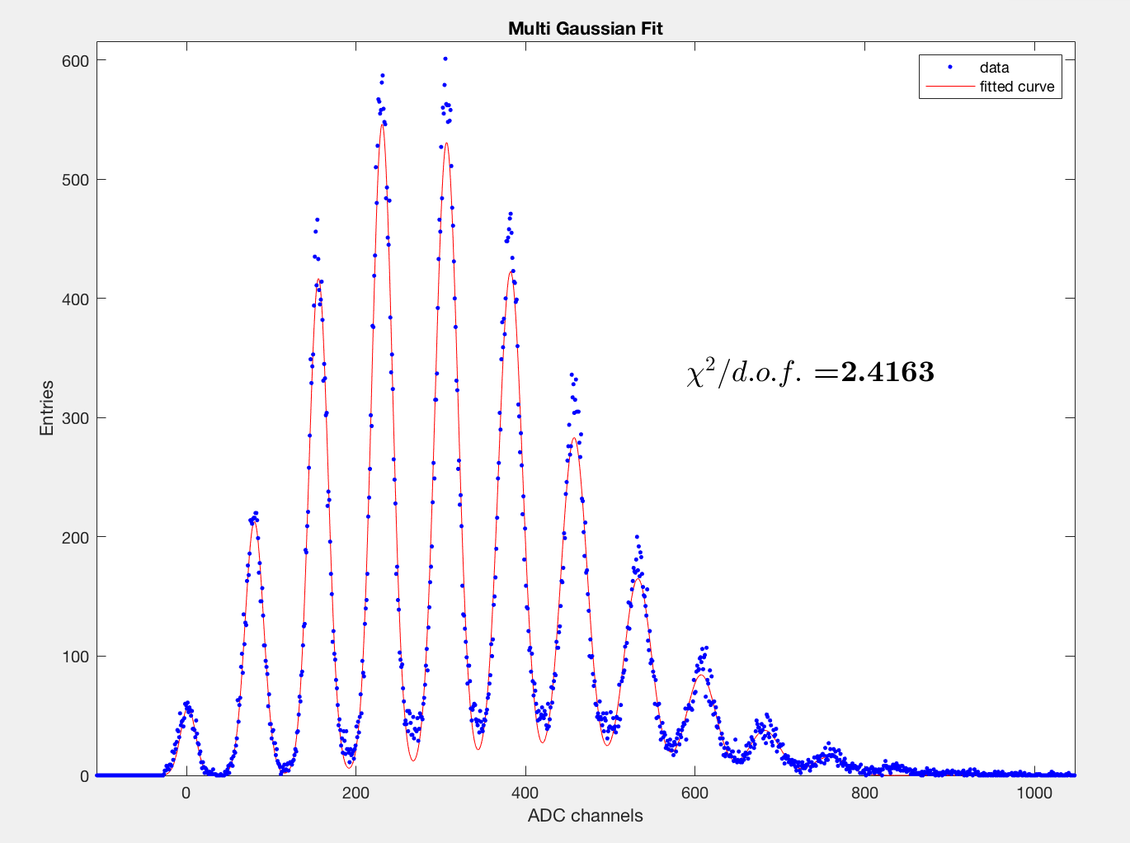
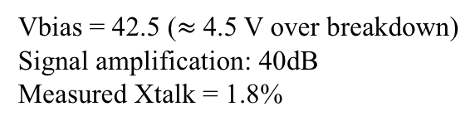
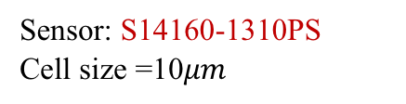
A first look at the SiPMs
We tested the new SiPMs using our standard equipment (SP5600 and DT5720A from Caen) together with an automatic software tool developed to characterize SiPMs (JINST 10, C08008)
Sensor: S14160-1315PS
Cell size =15$μm$
Sensor: S14160-1310PS
Cell size =10$μm$
Vbias = 42 ($≈$4 V over breakdown)
Signal amplification: 40dB
Measured Xtalk = 2%
Vbias = 42.5 ($≈$4.5 V over breakdown)
Signal amplification: 40dB
Measured Xtalk = 1.8%

Slide 17

Readout: Citiroc1A

Slide 18
Citiroc1A: block scheme

Slide 19
Citiroc1A: charge measurements

Slide 20
Citiroc1A: trigger and timing

Slide 21

The evaluation boards
The qualification:
Check the multiphoton with available SiPMs to assess the single photon capability (smaller pitch means larger dynRange but also smaller signal for ph-e)
Measure the full dynamic range using both amplification branches
Measure the front-end linearity
Tested
Under Test

Slide 22
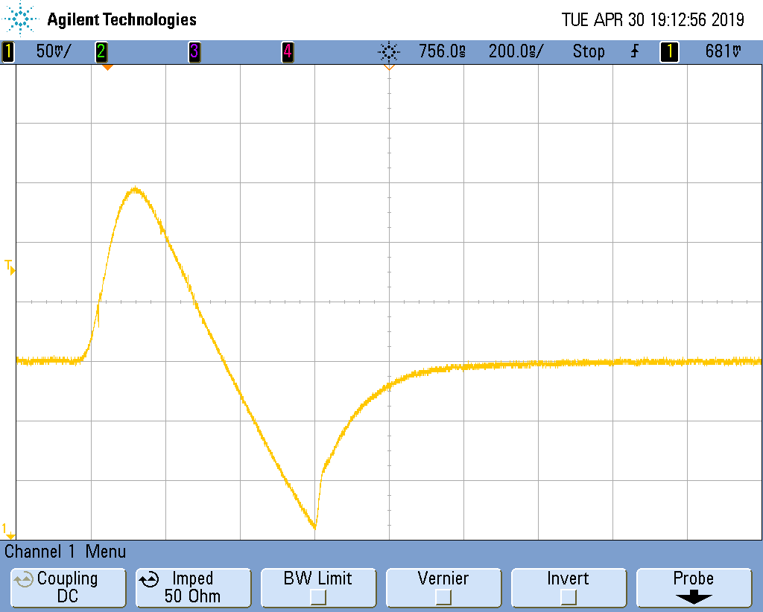

DT5702: SiPM qualification
Typical response to a fast LED
Hmamatsu SiPM:
1.3 x 1.3 mm²
50mu cell size
Signal after the shaper
High Gain branch
Multiphoton spectra with two different preamplifier settings
$≈$160 p.e. of DynRange

Slide 23
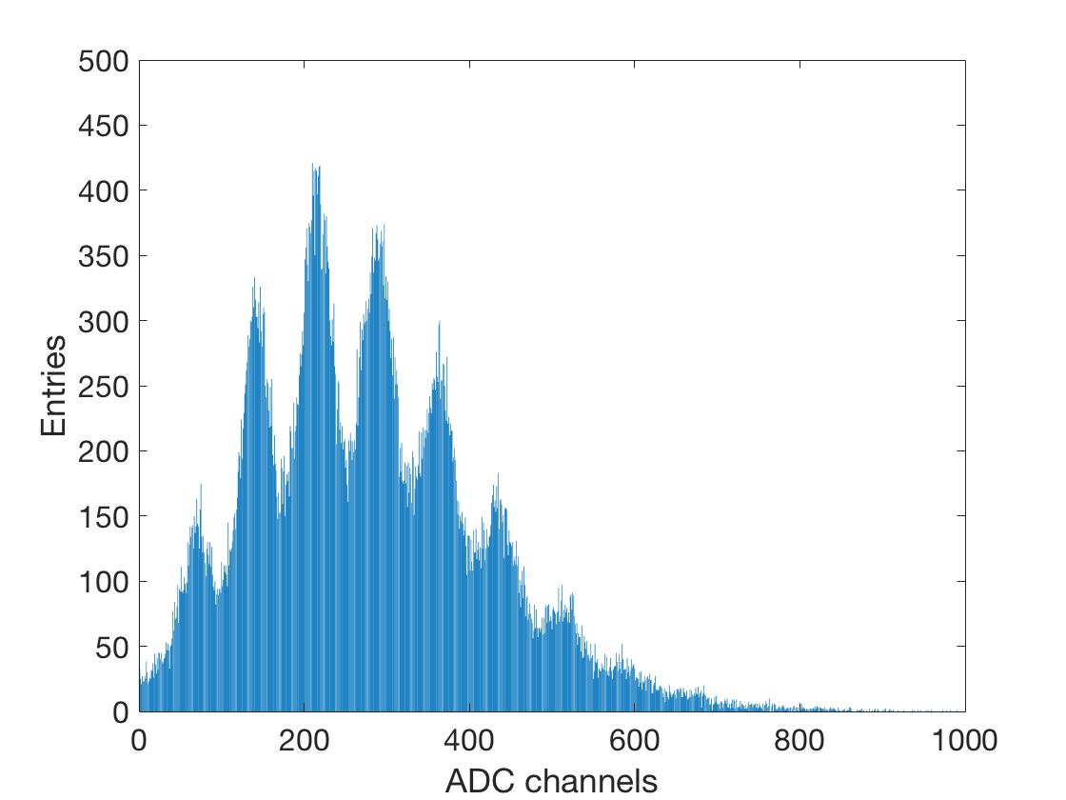


DT5702: SiPM qualification
High Gain branch
Sensor: S14160-1315PS
Cell size =15$μm$
Vbias = 42 ($≈$4 V over breakdown)
Signal amplification: 61 a.u.

Slide 24
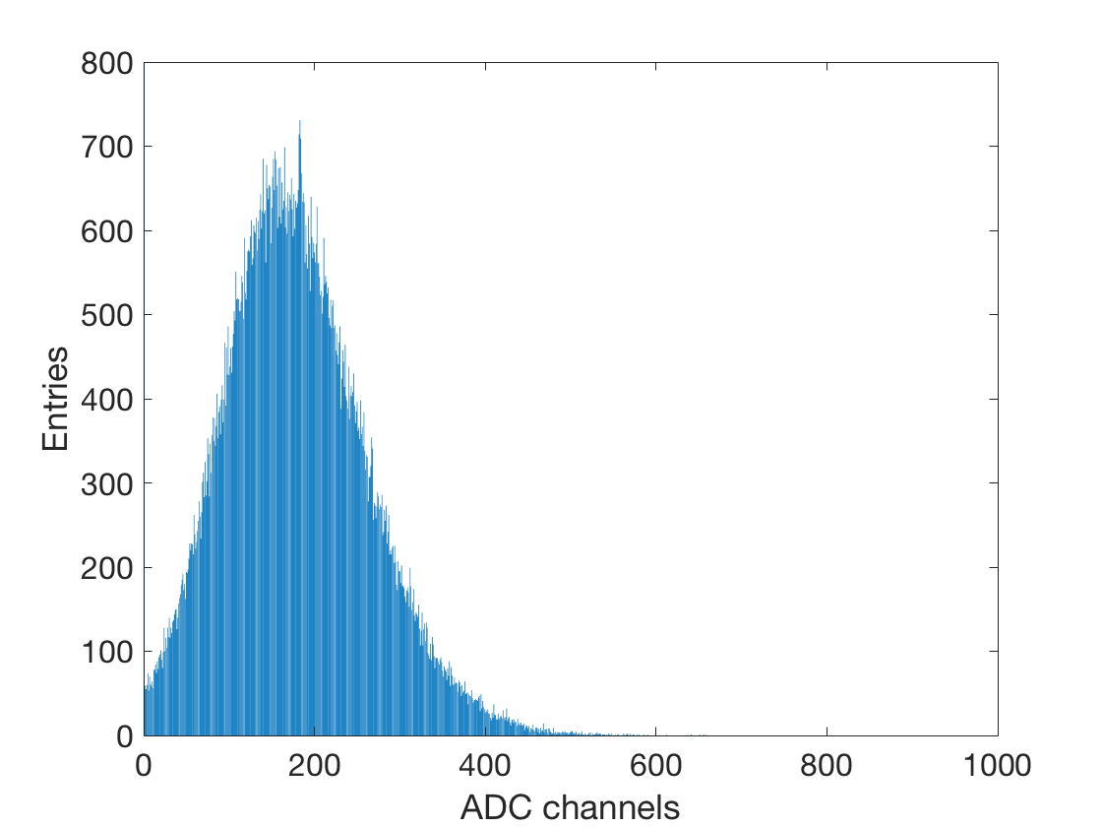


DT5702: SiPM qualification
Even if with temporary connections, we can assess the multi-photon also with a15mu pitch sensor
The reason why we don’t see the multiphoton using the 10mu pitch is under investigation (i.e. connections, gain, bit granularity …)
High Gain branch
Sensor: S14160-1315PS
Cell size =15$μm$
Sensor: S14160-1310PS
Cell size =10$μm$
Vbias = 42 ($≈$4 V over breakdown)
Signal amplification: 61 a.u.
Vbias = 42.5 ($≈$4.5 V over breakdown)
Signal amplification: 40dB

Slide 25
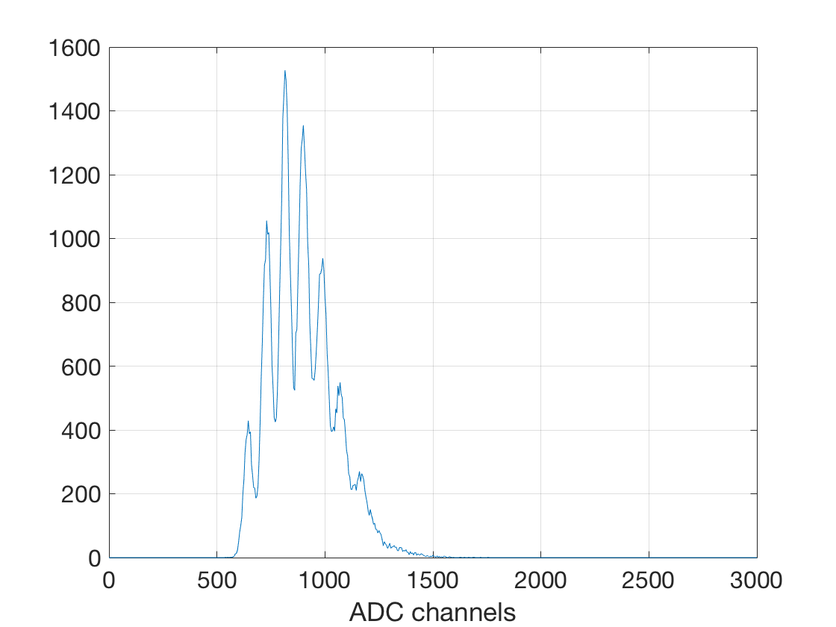
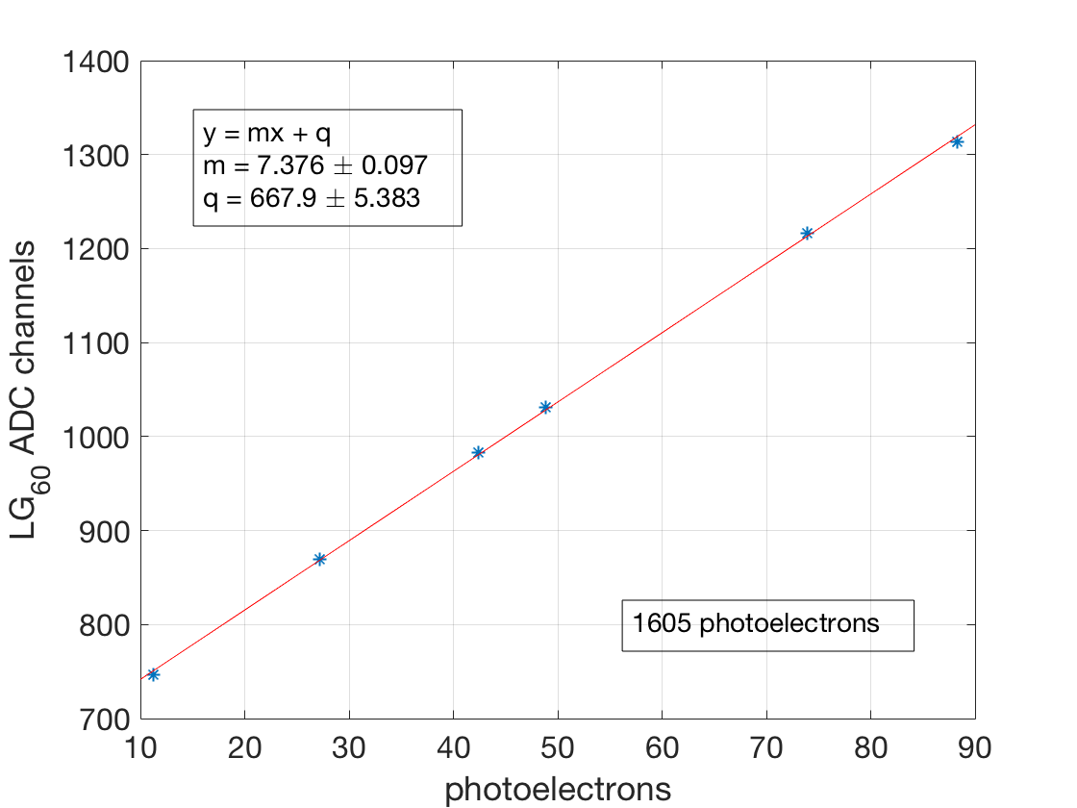
Dynamic range
Test performed using the DT550W and a matrix of 64 SiPMs S13615-1025 (1x1 mm², cell size = $25μ$m): same matrix used in the previous test beam
Measurement performed with a LED:
Dpp measured with the High Gain (setting 60 a.u.)
Low gain calibrated (ADC/ph-e) measuring the sensor response at different light intensities with both branches
Dyn-Range estimate ≈1600 ph-e: it fits with available number of cells
  The number increases if we reduce the low-gain amplification
  It ss crucial the measurement of the linearity: in this case with need a calibrated light intensity
High-Gain
Signal amplification: 60 a.u.
Low-Gain calibration
Signal amplification: 60 a.u.

Slide 26
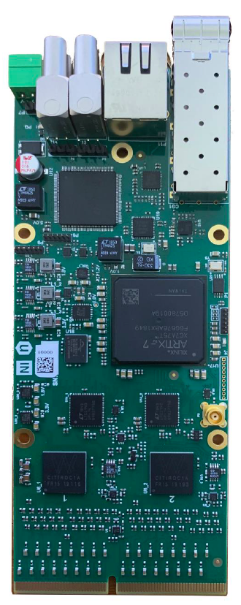
How to readout a “medium-size” calorimeter?
If the Citirorc1A qualification will fulfil our requirements we still need a compact and scalable solution for a test beam: the FERS-5200 system from CAEN could be a possible solution
FERS: A5202
The basic principle
2 Citiroc1A (64 ch)
Timing with a TDC implemented into the FPGA (≈ 0.5 ns)
2 ADC to measure the charge
1 HV power supply (20 – 100V) with temperature compensation
Interface for readout
60 mm
150 mm

Slide 27
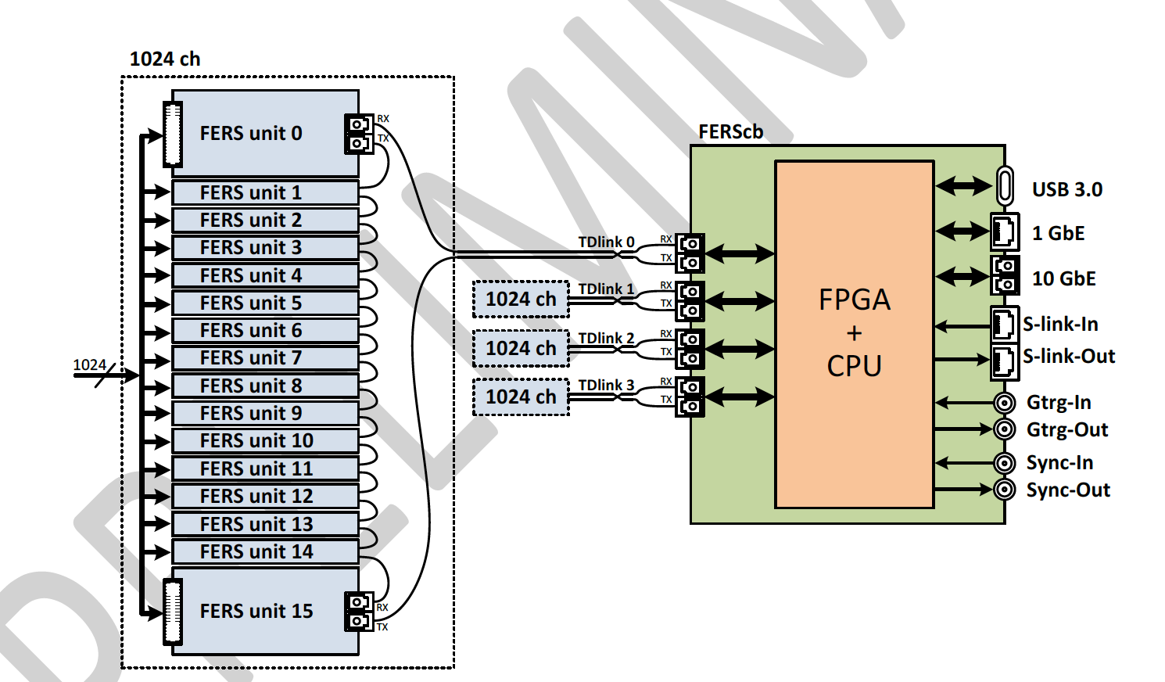
How to readout a “medium-size” calorimeter?
If the Citirorc1A qualification will fulfil our requirements we still need a compact and scalable solution for a test beam: the FERS-5200 system from CAEN could be a possible solution
The basic principle
FERS-unit can be used in standalone or connected to the system
Up to 16 FERS-unit can be connected in daisy-chain (FERSnet)
The FERSnet data throughput is up to 200 MB/s
The FERScb is a data collector housing 4 high speed optical link (TDLink)
The connection to the host PC is performed with a 10 Gbit ethernet
The FERScb has an embedded ARM processor (Quad Core) running Linux for data processing / data compression

Slide 28
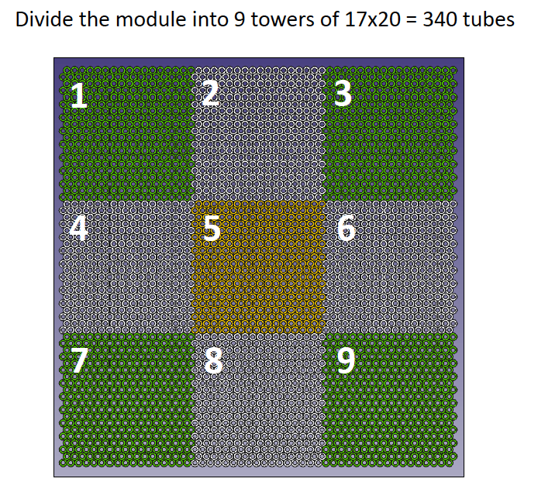
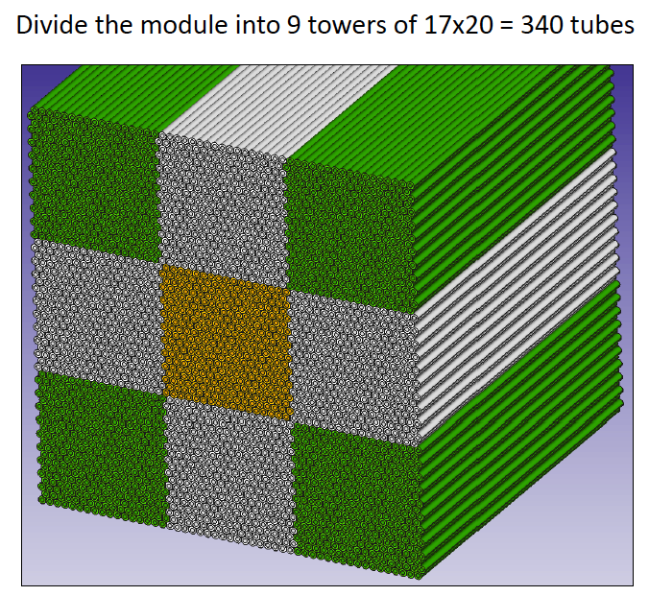
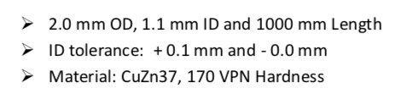
Test beam 2020
The prototype for the test beam
9 modules 16 x 20 tubes (2mm outer diameter) = 320 tubes
8 modules readout with PMTS
The central module equipped with SiPMs
  320 SiPMs to be readout
  5 FERS board + 1 Data collector

Slide 29

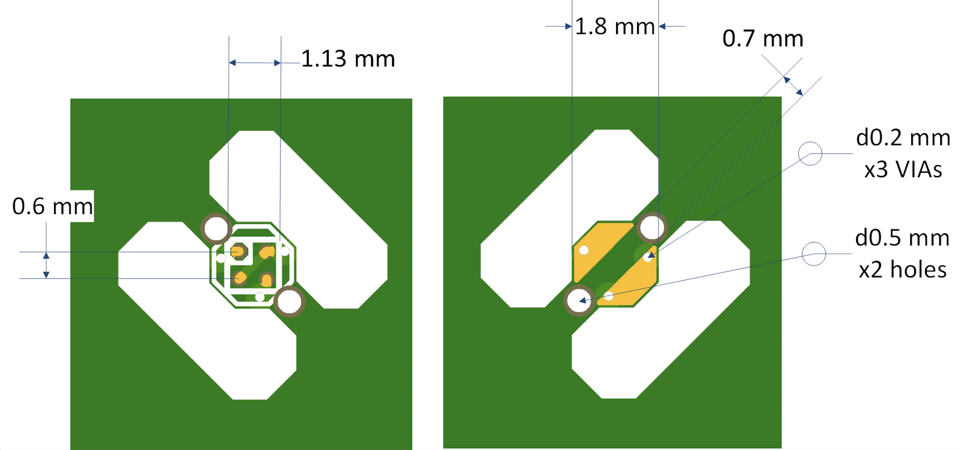
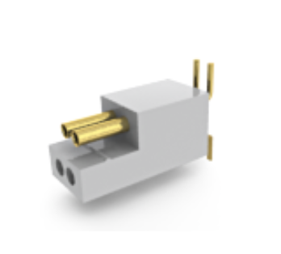
A possible strategy for the assembly
Front-view
Back-view
Vertical SMD connector
A79602-001 PZN-04-VV
We start with an array of small front-end boards (1.8 x 1.8 mm² each) designed to host 1 SiPM and a connector on the back side
Once the array is populated with all the components, each front-end board will be removed from the array and it will be qualified before the next step of the assembly

Slide 30
A possible strategy for the assembly
Front-end board + SiPM + connector
Fiber (inserted into the tube)
tube
The front-end board + SiPM will be glued to the tip of the fiber
Both the functionality and optical coupling for the basic unit will be qualified
Once all tubes, equipped with the SiPMs, will be qualified the module assembly starts

Slide 31
A possible strategy for the assembly
This approach is very preliminary and all the details has to be verified but, if feasible, it has a series of advantages
The design of the front-end board is easy and cheap: it doesn’t require any complex routing
The individual SiPM can be qualified at each step of the assembly procedure
We can guarantee a good contact between SiPMs and fibers:
  This can also be part of the quality assurance test
In principle, this strategy should be immune from cross-talk between fibres
Once all tubes are glued together, the prototype we will have on the back a forest of wires to be plugged into the FERS.

Slide 32
Conclusion
The results from old test beams are confirming all the potentiality of this calorimeter when it is readout with SiPMs
A lot of activities are on-going in order to prepare the new test beam
The next challenge is the design of a scalable prototype looking both at the cost and performances

Slide 33
Backup

Slide 34
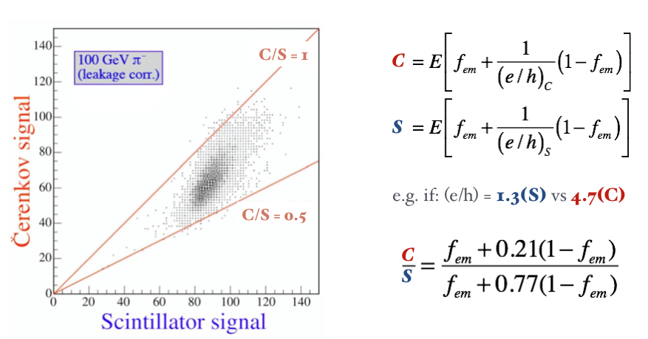
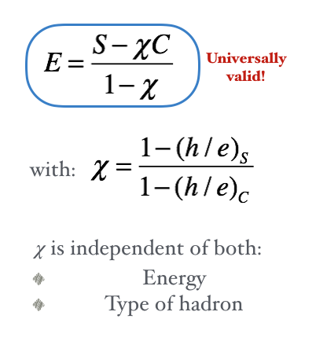
Dual-readout calorimetry
The concept is to measure the fem component event by event. This eliminates the fem fluctuation effect on calorimeter performance
The measurement is performed using two different sampling processes:
  Cherenkov light, produced by the relativistic particles, dominating in the e.m. shower component
  Scintillation light produced by the total deposited energy

Slide 35
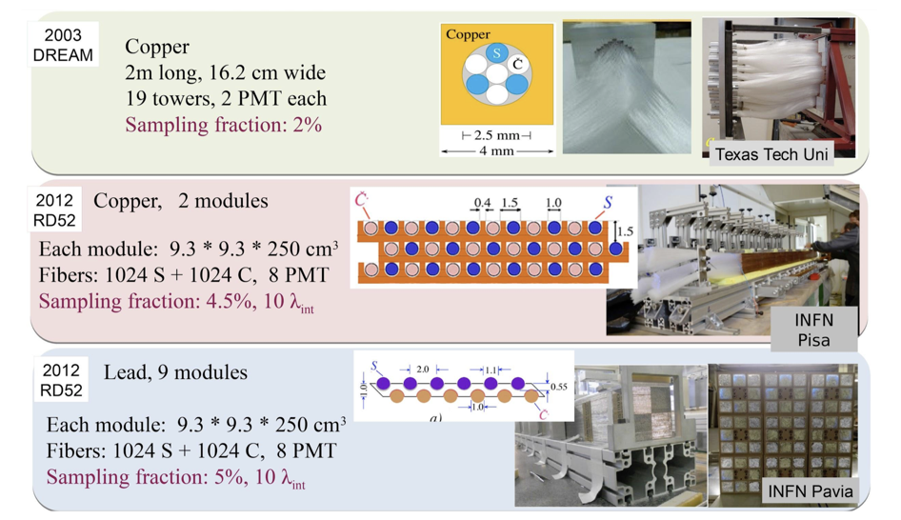
The history of Dual Readout Fiber Calorimeter
15 years of R&D qualified the dual-readout calorimetric technique
S. Lee, M. Livan, R. Wigmans, Dual-Readout Calorimetry, Rev. Mod. Phys. 90 (2018) 025002.

Slide 36
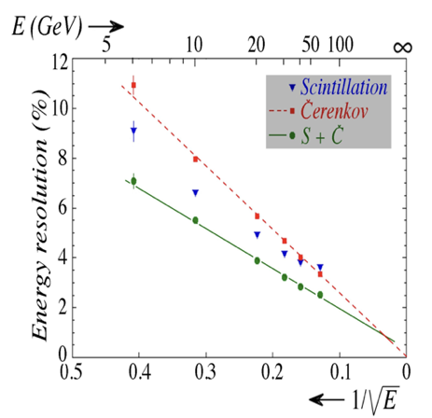
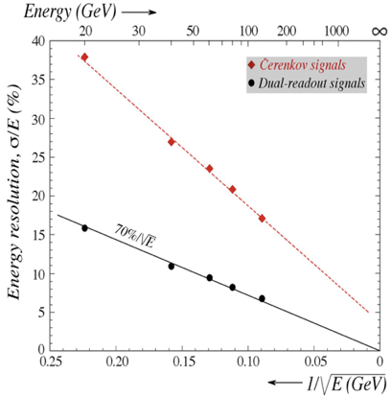
Energy resolution
Electromagnetic resolution:
Hadronic resolution:
Lateral
Leakage
Copper module
NIM A735, 130-144 (2014)
Lead module
NIM A537, 537-561 (2014)

Slide 37
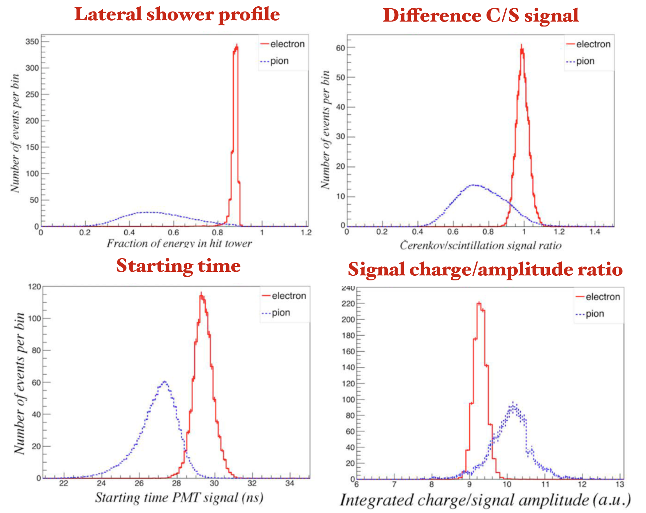
Particle Identification
Different methods allow hadron/electron separation:
RD52 lead calorimeter:
60 GeV e⁻/π⁻
A multivariate analysis reached a particle ID capability of:
ε(e⁻) = 99.8%
@ R(π⁻) ∼ 500
NIM A735, 210 (2014)

Slide 38
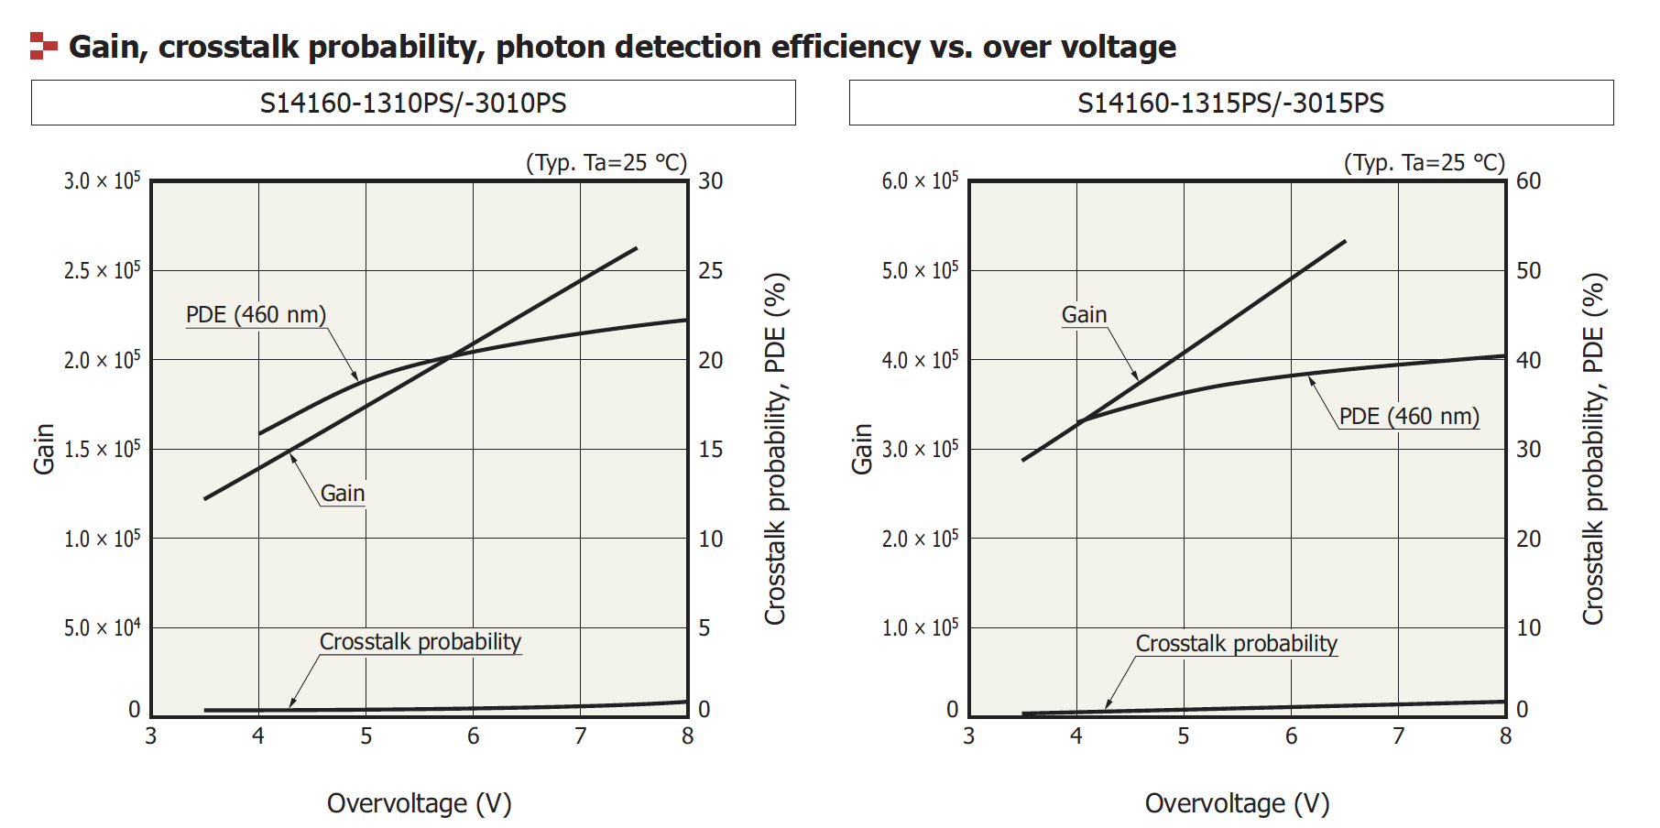
New SiPMs under test
New sensors: S14160-1310PS / S14160-1315PS

Slide 39
Citiroc1A: charge measurements (II)
Two techniques implemented to measure the amplitude:
Track & Hold and Peak Detector

Slide 40
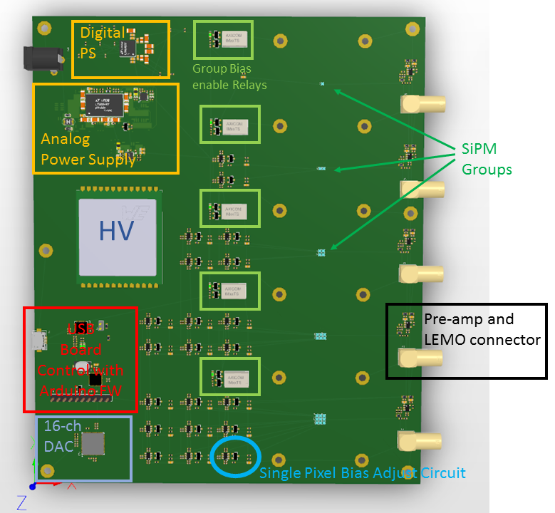





Signal Grouping
This board allows to investigate the SiPM performances when the signals are grouped analogically (from 1 to 9 SiPMs)
Each SiPM is individually biased
Same FEE used in the test beam
$$R= \frac{Peak distance}{\sqrt{σ_{0}^{2}−σ_{1}^{2}}}$$
From one SiPM to 8 SiPM
 | 1 SiPM | 4 SiPM | 8 SiPM
R = resolving power (ph-e) | 24.5 | 16.6 | 10.0
Space granularity (mm²) | $≈$4.5 | $≈$18 | $≈$36

