Slide 1
Study of the light axial-vector meson spectra
Meng-chuan Du (杜蒙川)
In collaboration with Prof. Qiang Zhao (赵强)
第十三届全国粒子物理学术会议
2021年8月18日

Slide 2
Content
Introduction
Production in $e^{+}e^{−}$ annihilation
Mixing angle
Decay processes
Vertex correction
Results

Slide 3
In quark model, the axial vector mesons are states with $^{2s+1}L_{J}= ^{3}P_{1}$ and$^{1}P_{1}$
$$J^{PC}=1^{+−}$$
$$J^{PC}=1^{++}$$
In PDG, the assignments and masses are
States | Mass [MeV]
$$a_{1}(1260)$$ | $$1230±40$$
$$f_{1}(1285)$$ | $$1281.9±0.5$$
$$f_{1}(1420)$$ | $$1426.3±0.9$$
$$b_{1}(1235)$$ | $$1229.5±3.2$$
States | Mass [MeV]
$$h_{1}(1170)$$ | $$1166±8$$
$$h_{1}(1415)$$ | $$1416±8$$
$$K_{1}(1270)$$ | $$1253±7$$
$$K_{1}(1400)$$ | $$1403±7$$
[1] L.Roca, E.Oset and J.Singh PRD 72,014002(2005),
[2] W. H. Liang, S. Sakai and E. Oset, PRD 99,094020(2019)
[3] X. G. Wu, J. J. Wu, Q. Zhao and B. S. Zou, Phys. Rev. D 87, 014023 (2013)
[4] M. G. Alexeev et al. [COMPASS], arXiv:2006.05342(2020)
[5] Jia-Jun Wu, Xiao-Hai Liu, Qiang Zhao, Bing-Song Zou, Phys.Rev.Lett. 108, 081803 (2012);
[6] Feng-Kun Guo, Xiao-Hai Liu, Shuntaro Sakai, Prog. Part. Nucl. Phys. 112,103757 (2020);
[7] Meng-Chuan Du, Qiang Zhao, Phys. Rev. D 100(2019)3,036005
[8] L.D.Landau, Nucl. Phys. 13(1959)1,181.

Slide 4
Production in $e^{+}e^{−}$ annihilation
$B.R.\left(J/ψ→γf_{1}\right)=\left(6.2±0.8\right)×{10}^{−4}$,
$B.R.\left(J/ψ→γf_{1}^{′}→γK\overline{K}π\right)=\left(7.9±1.3\right)×{10}^{−4}$
$f_{1}(f_{1}^{′})$ can be produced in $J/ψ→γf_{1}(f_{1}^{′})$
$$\frac{g_{f^{′}}}{g_{f}}=\frac{⟨f_{1}^{′}γ|\hat{H}|J/ψ⟩}{⟨f_{1}γ|\hat{H}|J/ψ⟩}=\frac{\sqrt{2}\cos{α_{f}}−\sin{α_{f}}}{\sqrt{2}\sin{α_{f}}+\cos{α_{f}}}$$
$$\left\langle {\left(s\overline{s}\right)}_{1^{++}}γ\left|\hat{H}\right|J/ψ\right\rangle ≃\left\langle {\left(u\overline{u}\right)}_{1^{++}}γ\left|\hat{H}\right|J/ψ\right\rangle =\left\langle {\left(d\overline{d}\right)}_{1^{++}}γ\left|\hat{H}\right|J/ψ\right\rangle$$
$J/ψ→γa_{1}$ is suppressed$. a_{1}$ can be searched in $ψ\left(3686\right)→γχ_{c1}→γπa_{1}→γ+4π$
$$B.R\left(ψ(2S\right)→γχ_{c1})=\left(9.79±0.2\right)\%$$
$b_{1}$ and $h_{1}(h_{1}^{′})$ can be searched in $J/ψ→πb_{1}$, and $J/ψ→η^{(′)}h_{1}^{(′)}$. They are constrained by SU(3) symmetry, i.e.
$$L_{ψBP}=g_{ψBP}ψ^{μ}⟨B_{μ}P⟩$$
$B.R\left(J/ψ→π^{±}b_{1}^{∓}\right)=\left(3±0.5\right)×{10}^{−3}$,
$B.R. \left(J/ψ→η^{′}h_{1}^{′}→η^{′}K^{∗}\overline{K}+c.c.\right)=\left(2.16±0.31\right)×{10}^{−4}$.
Double-OZI suppressed process is possible for $J/ψ→η^{(′)}h_{1}^{(′)}$

Slide 5
Mixing angles
$h_{1},h_{1}^{′},f_{1},f_{1}^{′},K_{1A},K_{1B}$ are mixing objects of physical states.
$$\left(\begin{matrix}K_{1}(1270) \\ K_{1}(1400)\end{matrix}\right)=\left(\begin{matrix}\cos{θ_{K_{1}}} & \sin{θ_{K_{1}}} \\ −sin{θ_{K_{1}}} & \cos{θ_{K_{1}}}\end{matrix}\right)\left(\begin{matrix}K_{1B} \\ K_{1A}\end{matrix}\right)$$
$$\left(\begin{matrix}f_{1}^{′} \\ f_{1}\end{matrix}\right)=\left(\begin{matrix}\cos{θ_{f}} & −\sin{θ_{f}} \\ \sin{θ_{f}} & \cos{θ_{f}}\end{matrix}\right)\left(\begin{matrix}{\tilde{f}}_{8} \\ {\tilde{f}}_{1}\end{matrix}\right)=\left(\begin{matrix}\cos{α_{f}} & −\sin{α_{f}} \\ \sin{α_{f}} & \cos{α_{f}}\end{matrix}\right)\left(\begin{matrix}f_{n} \\ f_{s}\end{matrix}\right)$$
$$\left(\begin{matrix}h_{1}^{′} \\ h_{1}\end{matrix}\right)=\left(\begin{matrix}\cos{θ_{h}} & −\sin{θ_{h}} \\ \sin{θ_{h}} & \cos{θ_{h}}\end{matrix}\right)\left(\begin{matrix}{\tilde{h}}_{8} \\ {\tilde{h}}_{1}\end{matrix}\right)=\left(\begin{matrix}\cos{α_{h}} & −\sin{α_{h}} \\ \sin{α_{h}} & \cos{α_{h}}\end{matrix}\right)\left(\begin{matrix}h_{n} \\ h_{s}\end{matrix}\right)$$
$$α=θ+\arctan{\sqrt{2}}$$
$${\tilde{f}}_{8},{\tilde{h}}_{8}=\frac{u\overline{u}+d\overline{d}−2s\overline{s}}{\sqrt{6}};{\tilde{f}}_{1},{\tilde{h}}_{1}=\frac{u\overline{u}+d\overline{d}+s\overline{s}}{\sqrt{3}}; f_{n}, h_{n}=\frac{u\overline{u}+d\overline{d}}{\sqrt{2}}; f_{s},h_{s}=s\overline{s}$$
Gell-Mann-Okubo relation
$$θ_{f}, α_{f}$$
${|θ}_{K_{1}}|∼{34}^{∘} or {57}^{∘}$,
$\left|θ_{K_{1}}\right|<{45}^{∘}$is favored ,
$$α_{f}≃{84.5}^{∘}, α_{h}≃{91.8}^{∘}$$
$$|θ_{K_{1}}|$$
$$θ_{h}, α_{h}$$
H. Y. Cheng, PLB 707,116

Slide 6
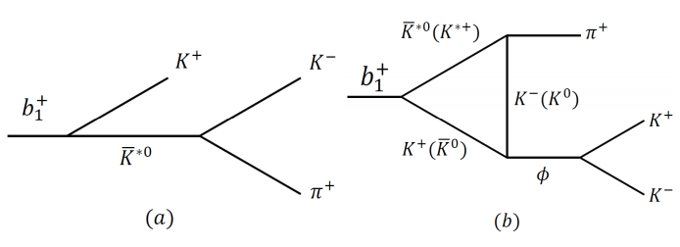
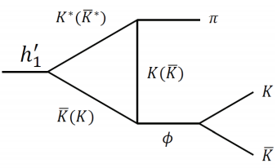
Decay processes
1. $f_{1}\left(f_{1}^{′}\right)→ηππ$
Interactions are
$A→SP:L_{ASP}=g_{ASP}⟨A^{μ}\left[S∂_{μ}P−P∂_{μ}S\right]⟩$,
$A→VP:L_{AVP}={ig}_{AVP}〈A^{μ}\left[V_{μ},P\right]〉$,
$B→VP:L_{BVP}=g_{BVP}⟨B^{μ}\left\{V_{μ},P\right\}⟩$,
$V→PP:L_{VPP}=ig_{VPP}〈V^{μ}\left[P,∂_{μ}P\right]〉$,
$S→PP:L_{SPP}=g_{SPP}⟨SPP⟩$.
SPP couplings can be extracted from Experiments [1,2].
2. $f_{1}\left(f_{1}^{′}\right)→K\overline{K}π$
[1] A.Aloisio et al. [KLOE], PLB537,21 (2002); [2] A.Aloisio et al. [KLOE], PLB536,209(2002)
Loop integrals are
$$I^{μ}=\int{\frac{d^{4}q}{{\left(2π\right)}^{4}}\frac{\left(−g^{μν}+\frac{q^{μ}q^{ν}}{q^{2}}\right){\left(q−2p_{b}\right)}_{ν}F(q^{2})}{\left(q^{2}−m_{1}^{2}+im_{1}Γ_{1}\right)\left[{\left(q−p_{b}\right)}^{2}−m_{2}^{2}\right][{\left(p_{0}−q\right)}^{2}−m_{3}^{2}]}}$$
$$I^{μα}=−i\int{\frac{d^{4}q}{{\left(2π\right)}^{4}}∗\frac{\left(−g^{μν}+\frac{q^{μ}q^{ν}}{q^{2}}\right){\left(q−2p_{b}\right)}_{ν}{\left(p_{c}+2p_{b}−2q\right)}_{α}F(q^{2})}{\left(q^{2}−m_{1}^{2}+im_{1}Γ_{1}\right)\left[{\left(q−p_{b}\right)}^{2}−m_{2}^{2}\right]\left[{\left(p_{0}−q\right)}^{2}−m_{3}^{2}\right]}}$$
3. $f_{1}\left(f_{1}^{′}\right)→π^{+}π^{−}π^{0}$
$$F\left(q^{2}\right)=\prod{\frac{m_{i}^{2}−Λ_{i}^{2}}{p_{i}^{2}−Λ_{i}^{2}}}, Λ_{i}=m_{i}+βΛ_{QCD}$$
Unitarized propagators for $a_{0}$ and $f_{0}$ [3,4],
4. $a_{1}→ρπ+f_{0}π→π^{+}π^{−}π^{−}$
[3] N.N. Achasov, A.V. Kiselev, PRD 70, 111901(2004)
[4] N.N. Achasov, A.A. Kozhevnikov, G.N. Shestakov , PRD 92,036003
1. Different patterns for $f_{1}$ and $f_{1}^{′}$.
2. $f_{1}\left(f_{1}^{′}\right)→3π$ is similar to $η\left(1405/1475\right)→3π$.
3. The triangle $a_{1}→f_{0}π$ produces $a_{1}(1420)$.
4. For $b_{1}\left(h_{1}^{′}\right)→φπ$, branching ratios can be estimated in $J/ψ$ decay.
5. $b_{1}→K^{∗}\overline{K}+c.c. +φπ→K\overline{K}π$, $h_{1}→φπ→K\overline{K}π$

Slide 7
Vertex correction
$$I^{μα}=−i\int{\frac{d^{4}q}{{\left(2π\right)}^{4}}∗\frac{\left(−g^{μν}+\frac{q^{μ}q^{ν}}{q^{2}}\right){\left(q−2p_{b}\right)}_{ν}{\left(p_{c}+2p_{b}−2q\right)}_{α}F(q^{2})}{\left(q^{2}−m_{1}^{2}+im_{1}Γ_{1}\right)\left[{\left(q−p_{b}\right)}^{2}−m_{2}^{2}\right]\left[{\left(p_{0}−q\right)}^{2}−m_{3}^{2}\right]}}$$
$$=Λ_{0}g^{μα}+Λ_{bb}p_{b}^{μ}p_{b}^{α}+Λ_{cb}p_{c}^{μ}p_{b}^{α}$$
$I^{μα}$ contains S and D-wave interactions.
$$I_{S}^{μα}=−i\left[Λ_{0}−\frac{\sqrt{s}E_{c}}{{\left|{\vec{p}}_{c}\right|}^{2}+3s_{c}}{\left|{\vec{p}}_{c}\right|}^{2}\left(Λ_{bb}−Λ_{cb}\right)\right]g^{μα}$$
$$I_{D}^{μα}=−i\frac{\sqrt{s}E_{c}}{{\left|{\vec{p}}_{c}\right|}^{2}+3s_{c}}{\left|{\vec{p}}_{c}\right|}^{2}\left(Λ_{bb}−Λ_{cb}\right)g^{μα}−i(Λ_{bb}p_{b}^{μ}p_{b}^{α}+Λ_{cb}p_{c}^{μ}p_{b}^{α})$$
The enhancement of $C_{0}$ is suppressed by phase space. Near-threshold condition allows us to approximate the numerator in non-relativistic limit.
$$−g^{μν}+\frac{q^{μ}q^{ν}}{q^{2}}→δ^{ij}$$
$$⇒num.\sim 4p_{b}^{μ}p_{b}^{α}−4p_{b}^{μ}q^{α}−2q^{μ}p_{b}^{α}+2q^{μ}q^{α}$$

Slide 8
Vertex correction
$$\frac{δΓ}{Γ}=\left\{\begin{aligned}+15\%, C=+ \\ −9.3\%, C=−\end{aligned}\right.$$
Fi$g.1 \overline{K}π$ spectra of $f_{1}\left(1420\right)→K^{∗}\overline{K}+c.c. →K\overline{K}π$ (left) and $h_{1}\left(1415\right)→K^{∗}\overline{K}+c.c.→K\overline{K}π$ (right). The solid, dashed and dotted liens represent the total, tree and triangle (multiplied by 50) contributions, respectively.
Fig.2 $\overline{K}π$ spectra of $f_{1}\left(1420\right)→K^{∗}\overline{K}+c.c. →K\overline{K}π$ (left) and $h_{1}\left(1415\right)→K^{∗}\overline{K}+c.c.→K\overline{K}π$ (right) from triangle diagrams only. The pure S-wave, D-wave and total amplitudes are represented by dashed, dotted solid lines, respectively.
Though there is triangle singularity, the triangle loop only weakly affects the S-wave interaction.
It is reasonable to take the constant $AVP$ and $BVP$ interaction
The SU(3) symmetry is weakly affected by TS on one-loop level

Slide 9
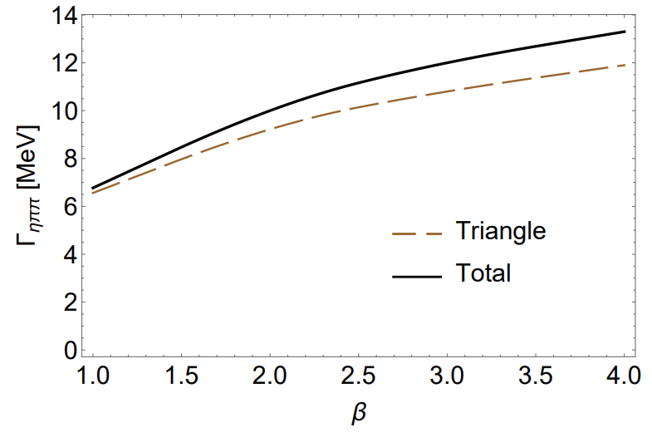
Partial widths of $f_{1}$ and $f_{1}^{′}$
Channels | $$f_{1}(1285)$$ | $$f_{1}(1420)$$
$a_{0}π→ηππ$ tree | $$7.5±1.7$$ | $$\left(1.7±0.4\right)×{10}^{−1}$$
$a_{0}π→ηππ$ tri. | $$\left(2.0±0.6\right)×{10}^{−1}$$ | $$9.2±3.0$$
$a_{0}π→ηππ$ total | $$9.7±2.4 (8.6±1.3)$$ | $$10±3.5$$
$a_{0}π→K\overline{K}π$ tree | $$\left(3.7±0.4\right)×{10}^{−1}$$ | $$\left(1.7±0.2\right)×{10}^{−2}$$
$a_{0}π→K\overline{K}π$ tri. | $$\left(2.4±0.5\right)×{10}^{−2}$$ | $$1.2±0.2$$
$a_{0}π→K\overline{K}π$ total | $$\left(5.0±0.5\right)×{10}^{−1}$$ | $$1.0±0.1$$
$$K^{∗}\overline{K}→K\overline{K}π$$ | $$\left(3.0±0.1\right)×{10}^{−1}$$ | $$49±1$$
$K\overline{K}π$ total | $$1.5±0.2(2.1±0.2)$$ | $$52±3$$
$f_{0}π→3π$ mixing | $$\left(3.6±1.2\right)×{10}^{−3}$$ | $$\left(9.0±2.9\right)×{10}^{−5}$$
$f_{0}π→3π$ tri. | $$\left(1.0±0.1\right)×{10}^{−3}$$ | $$\left(1.1±0.1\right)×{10}^{−1}$$
$f_{0}π→3π$ mixing via tri. | $$\left(1.4±0.4\right)×{10}^{−4}$$ | $$\left(8.0±2.6\right)×{10}^{−3}$$
$f_{0}π→3π$ total | $$\left(1.0±0.3\right)×{10}^{−2}$$ | $$\left(1.6±0.3\right)×{10}^{−1}$$
Fig.3 $β$ dependence of $Γ(f_{1}^{′}→a_{0}π→ηππ)$
Tab.1 Partial width in MeV, at $g_{AVP}=2.0$4 GeV , $β=2$. Only the uncertainties of $g_{VPP}$ and $g_{SPP}$ couplings are considered. The PDG averaged value are in round brackets.

Slide 10
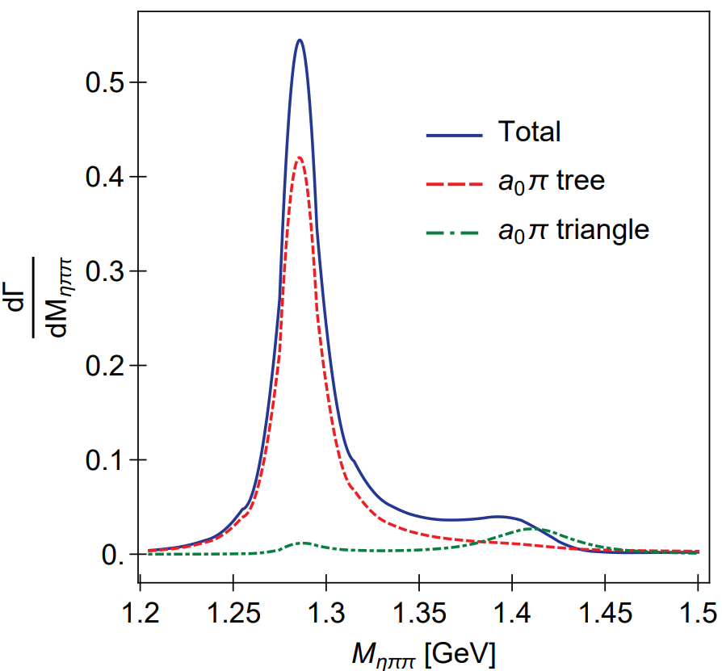
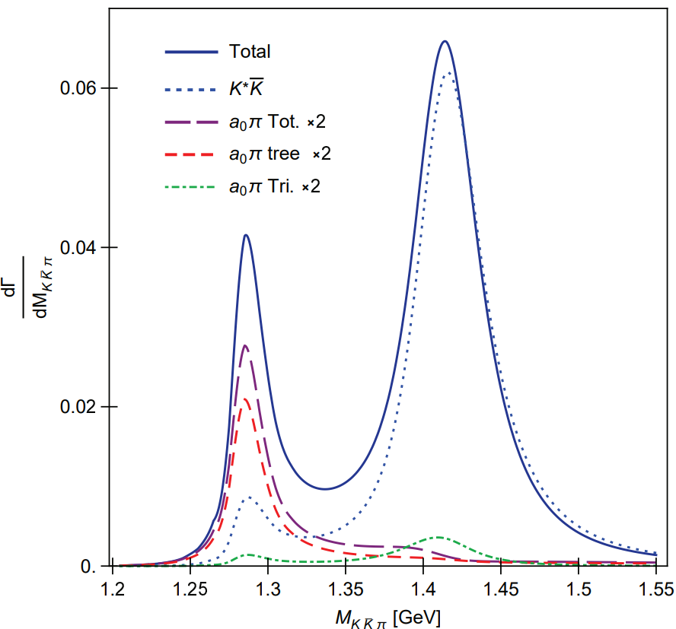
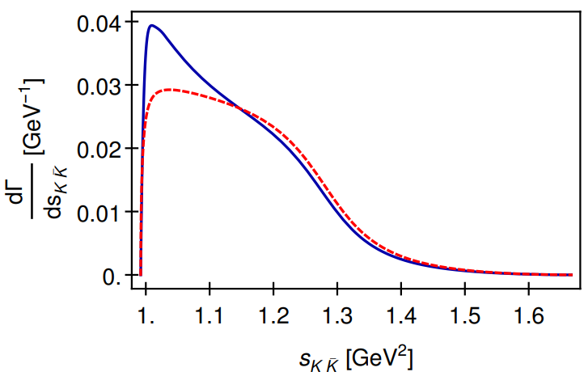
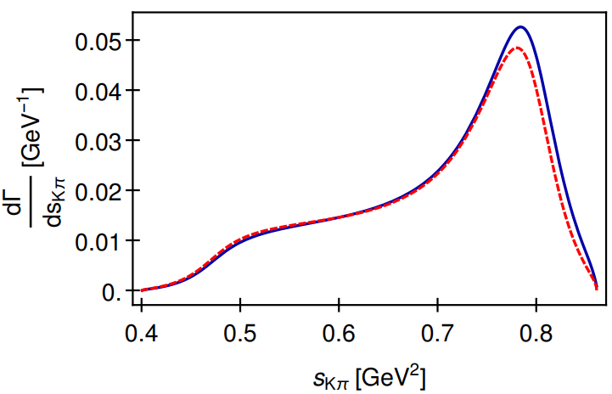
Spectra in $J/ψ$ decay
Fig.4 $ηππ$ (left) and $K\overline{K}π$ spectra of $J/ψ→γ\left(f_{1}+f_{1}^{′}\right)→γηππ,γK\overline{K}π$.
Fig.5 $K\overline{K}$ (left) and $Kπ$ (right) spectra of $f_{1}^{′}→K\overline{K}π$

Slide 11
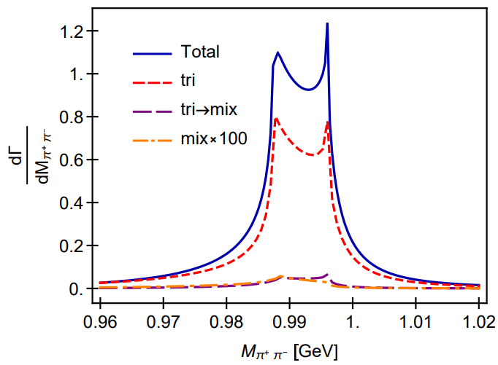
$$f_{1}(f_{1}^{′})→3π$$
$$R_{f_{1}→3π}^{total}=\frac{B.R.(f_{1}→f_{0}π→π^{+}π^{−}π^{0})}{B.R.(f_{1}→a_{0}π→ηπ^{0}π^{0})}∼0.3\%$$
$$R_{f_{1}→3π}^{mix}=\frac{B.R.(f_{1}→f_{0}π→π^{+}π^{−}π^{0})}{B.R.(f_{1}→a_{0}π→ηπ^{0}π^{0})}∼0.1\%$$
Our result is consistent with BESIII measurement [1]
$$R_{χ_{c1}→3π}=\frac{B.R.(χ_{c1}→a_{0}π→f_{0}π→π^{+}π^{−}π^{0})}{B.R.\left(χ_{c1}→a_{0}π→ηπ^{0}π^{0}\right)}$$
$$=\left(0.31±0.16\left(stat.\right)±0.14\left(sys.\right)±0.03\left(para.\right)\right)\%$$
The large isospin violation from Ref.[2] requires
$$R_{f_{1}→3π}=\frac{B.R.(f_{1}→π^{+}π^{−}π^{0})}{B.R.(f_{1}→a_{0}π→ηπ^{0}π^{0})}=\left(2.5±0.9\right)\%$$
Fig.6 $π^{+}π^{−}$ spectrum in $f_{1}^{′}→π^{+}π^{−}π^{0}$.
$R_{f_{1}^{′}→3π}=\frac{B.R.(f_{1}^{′}→f_{0}π→π^{+}π^{−}π^{0})}{B.R.(f_{1}^{′}→a_{0}π→ηπ^{0}π^{0})}∼5\%$.
Single specific mechanism ($a_{0}−f_{0}$ mixing, $κ\overline{K}$, $K^{∗}\overline{K}$ rescattering) cannot explain the large isospin violation of $f_{1}$ [3].
[1] M. Ablikim et al., PRD 83, 032003 (2011).
[2] V. Dorofeev et al., EPJ A47,68(2011).
[3] N.N. Achasov, G.N.Shestakov, Nucl.Part.Phys.Proc.287,89(2017).

Slide 12
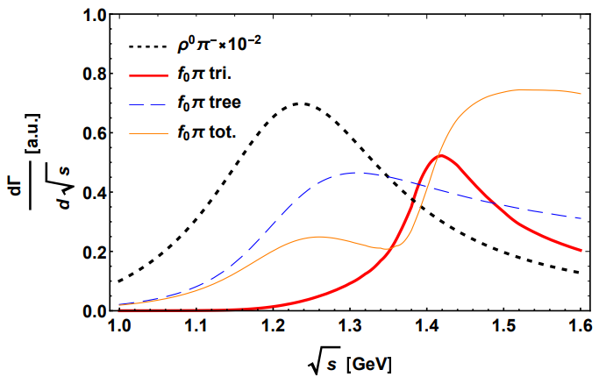
$$a_{1}→3π$$
Fig.8 $a_{1}$ spectrum of $χ_{c1}→πa_{1}$
$χ_{c1}→πa_{1}→4π$ can be factorized for the large momentum of the pion recoiling against $a_{1}$. The intensity and width of $a_{1}→f_{0}π$ through triangle mechanism are consistent with Ref. [1][2]
$$\frac{a_{1}→f_{0}π}{a_{1}→ρπ}≃0.6\%$$
$Γ≃150$ MeV
[1] M. Mikhasenko, B. Ketzer and A. Sarantsev, PRD 91,094015 (2015)
[2] F. Aceti, L.R.Dai and E. Oset, PRD 94,096015(2016)

Slide 13
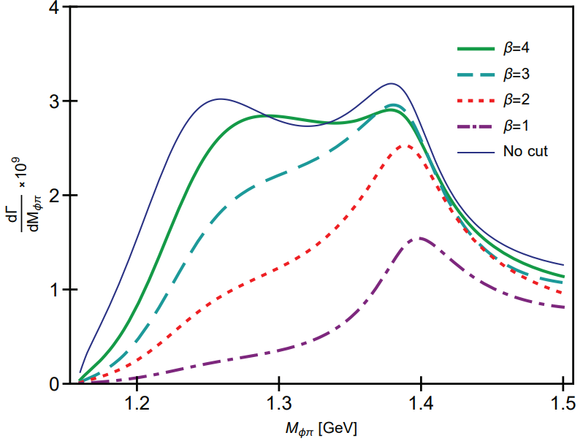
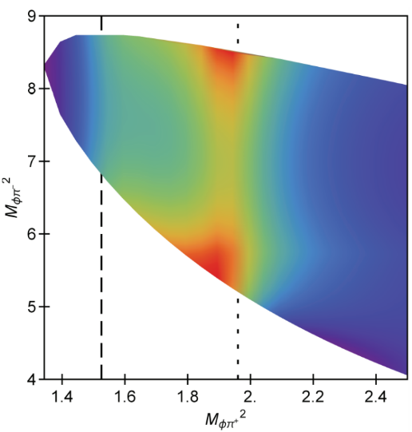
$$b_{1}→φπ$$
$$\sqrt{s}=m_{b_{1}}$$
$\sqrt{s}=1.4$ GeV
Fig.7 $K^{+}K^{−}$ spectra of $b_{1}^{+}→K^{+}K^{−}π^{+}$ evaluated at $\sqrt{s}=m_{b_{1}}$ (left) and $\sqrt{s}=1.4$ GeV (right). The $φπ^{+}$ signal is produced by OZI evading triangle mechanism.
On-shell branching ratio (at $β=2$)
$$\frac{B.R.(b_{1}^{+}→φπ^{+}→K\overline{K}π^{+})}{B.R.\left(b_{1}^{+}→ωπ^{+}\right)(S−wave)}=1.8×{10}^{−4}$$
Estimation without TS:
$$B.R.^{est.}\left(J/ψ→π^{±}b_{1}^{∓}→φπ^{+}π^{−}\right)≃1×{10}^{−6}$$
Actual branching ratio:
$$B.R.\left(J/ψ→π^{±}b_{1}^{∓}→φπ^{+}π^{−}\right)≃1×{10}^{−5}$$
Ref: $B.R\left(J/ψ→π^{±}b_{1}^{∓}\right)=\left(3±0.5\right)×{10}^{−3}$
Fig.8 $φπ^{+}$ spectrum (left) and the Dalitz plot (right) of $J/ψ→π^{±}b_{1}^{∓}→φπ^{+}π^{−}$

Slide 14
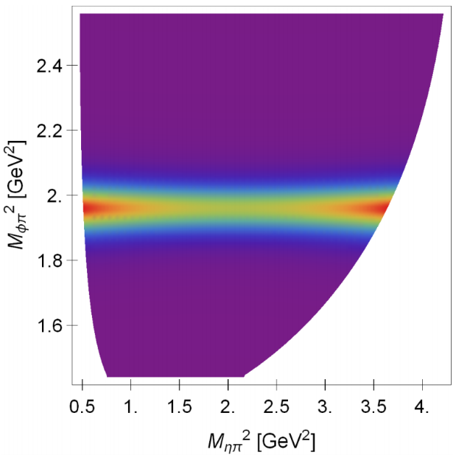
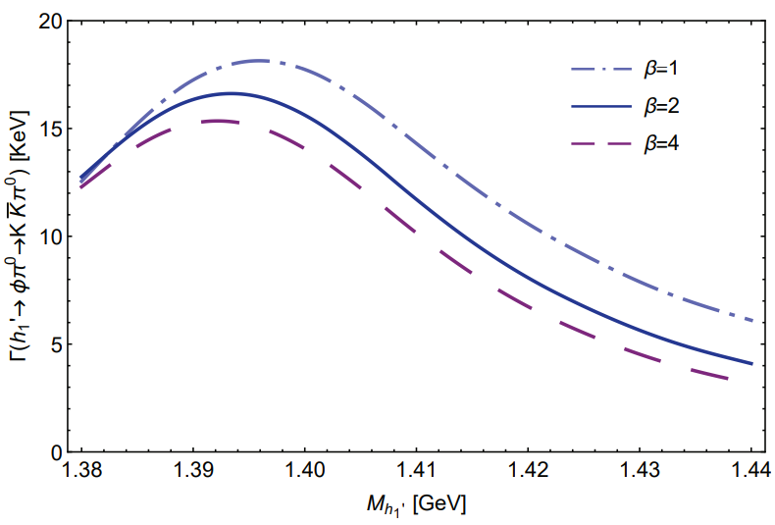
$$h_{1}^{′}→φπ$$
Fig.9 Partial width of $h_{1}^{′}→φπ^{0}→K\overline{K}π^{0}$ in unit of KeV
Fig.10 Dalitz plot of $J/ψ→ηh_{1}^{′}→ηφπ$ with the resonance of $h_{1}^{′}$,
Ref: $B.R. \left(J/ψ→η^{′}h_{1}^{′}→η^{′}K^{∗}\overline{K}+c.c.\right)=\left(2.16±0.31\right)×{10}^{−4}$.
$$B.R.\left(J/ψ→h_{1}^{′}η→ηφπ\right)=6.3×{10}^{−8}$$

Slide 15
Conclusion
Our combined study taken into account the TSM is consistent with taking the axial vector mesons as quark model states
Particularly, in our study, only TSM of $f_{1}(1285)$ cannot account for $f_{1}(1420)$, but the TSM of $a_{1}(1260)$ can produce $a_{1}\left(1420\right)$.
TSM produces non-trivial features in the spectra of $J/ψ→γ\left(f_{1}+f_{1}^{′}\right)→γηππ$ and $γK\overline{K}π$, in both the three-body and the two-body distributions.
The mechanism of the isospin violation of $f_{1}(1285)$ is pending studied.
TSM also plays a role in $C=−1$ sector, i.e. $b_{1}$ and $h_{1}$, where we predicted the branching ratio of OZI suppressed $J/ψ→b_{1}π→φππ$ and isospin violated $J/ψ→h_{1}\left(1415\right)η→φπη$ induced by TSM.

Slide 16
Thank you

