Slide 1
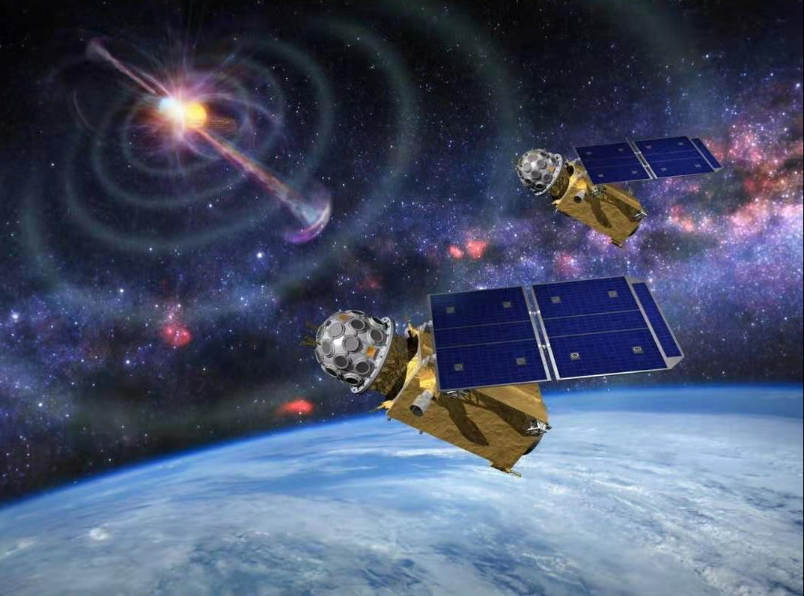
A dedicated SiPMs array for GRD of GECAM
孙希磊,安正华,张大力
高能所
第十三届全国粒子物理学术会议2021.08.16

Slide 2
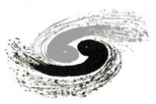

Contents
Introduction
Status of GECAM
Detectors solution
SiPMs array design
Performance
Radiation damage
Summary

Slide 3
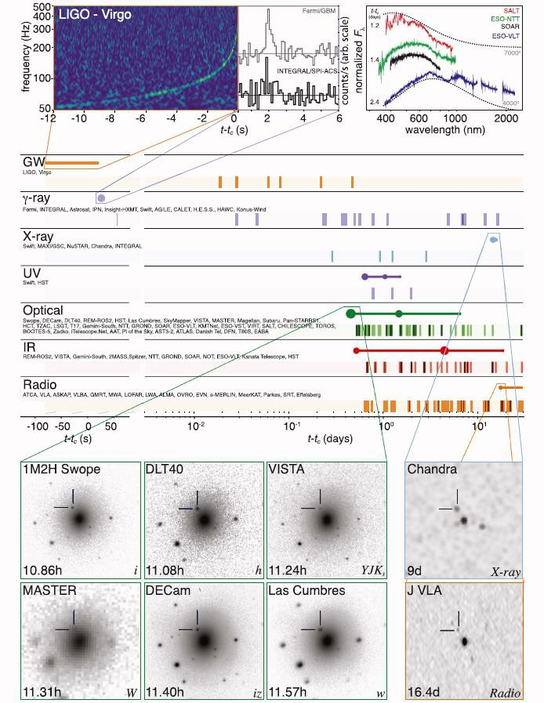
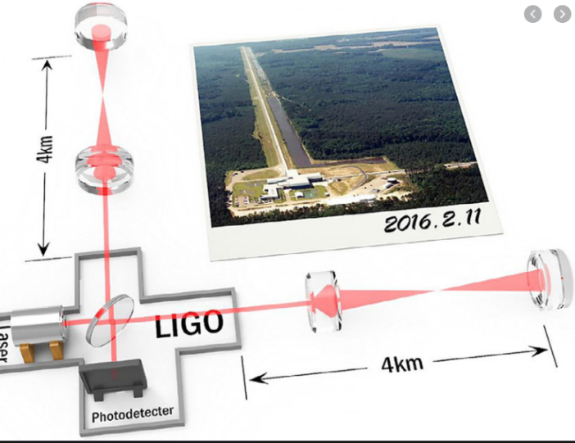
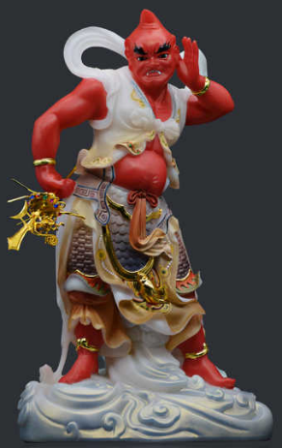

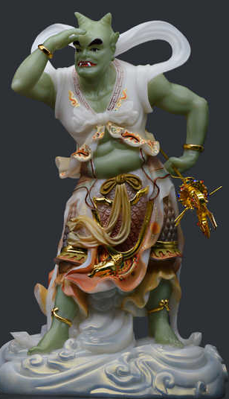
Multi-messenger astronomy
4π FOV eyes for X/gamma rays
GECAM
GW170817A

Slide 4
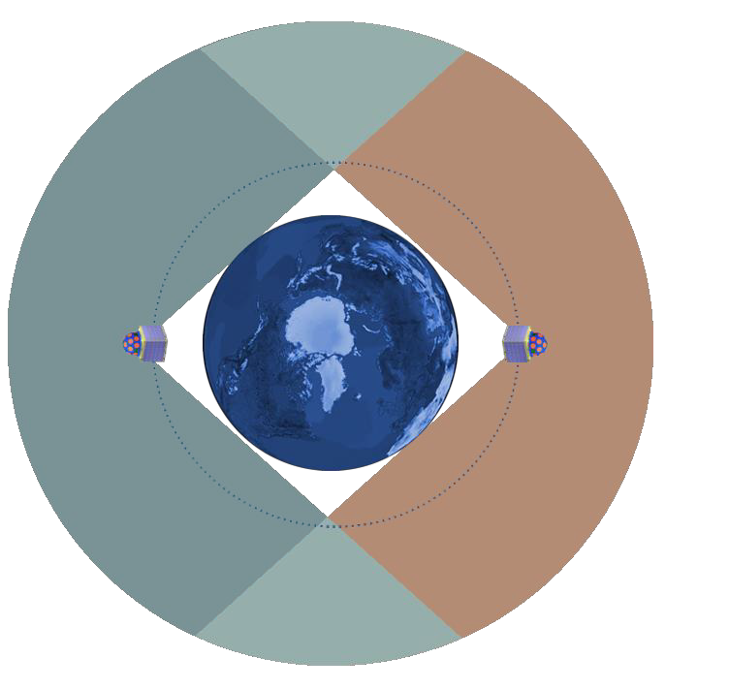
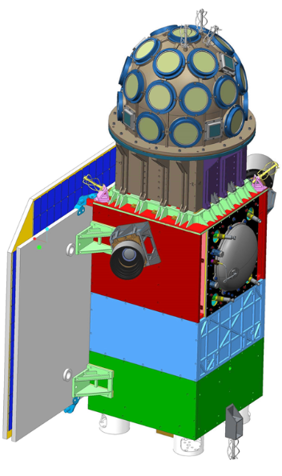
GECAM
Gravitational wave high-energy Electromagnetic Counterpart All-sky Monitor
600 km
Detectors
载荷探测器
GECAM-A
GECAM-B
Payload electronics
载荷电子学舱
Spacecraft electronics
Solar battery
Characteristics
  FOV： 100% all-sky
  Sensitivity：~2E-8 erg/cm²/s
  Localization：~1 deg
  Energy range：8 keV – 4 MeV
  GRB Broadcast: Near real-time
Power module
姿控舱
Attitude control
GECAM satellite (160 kg for each)

Slide 5
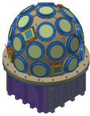
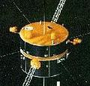


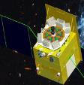
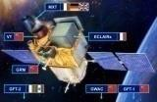
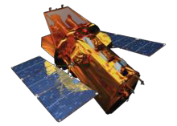

X/gamma-ray telescopes
Launch time
100
2020
GECAM
Konus-Wind （no localization）
1994
2002
Field of View (FOV)
50
all-sky (%)
INTEGRAL/SPI-ACS （no local.&spec）
2008
Fermi/GBM
HXMT/HE
2017
SVOM/GRM
~2021
Swift/BAT
2004
10
SVOM/ECLAIRs
~2021
5
20
200
Energy Band (keV)
5 000
20 000

Slide 6
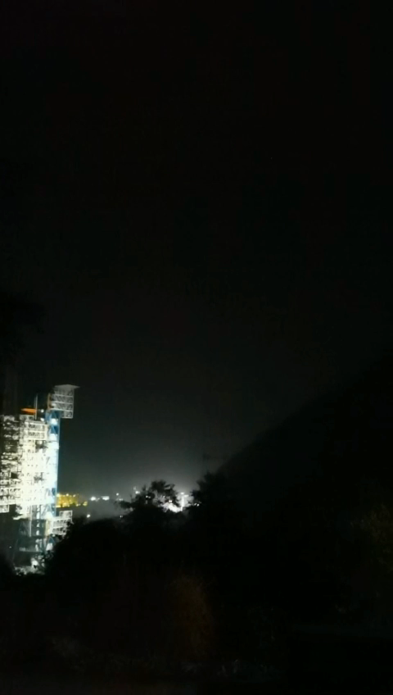
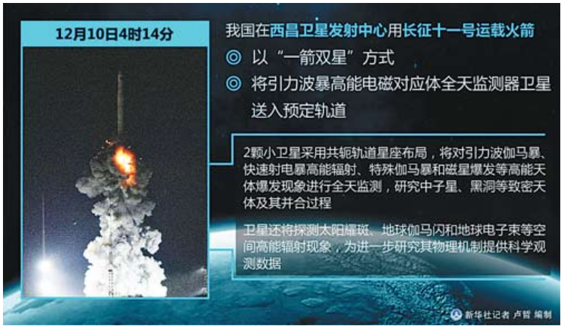
Launched at Xi Chang
2020.12.10

Slide 7
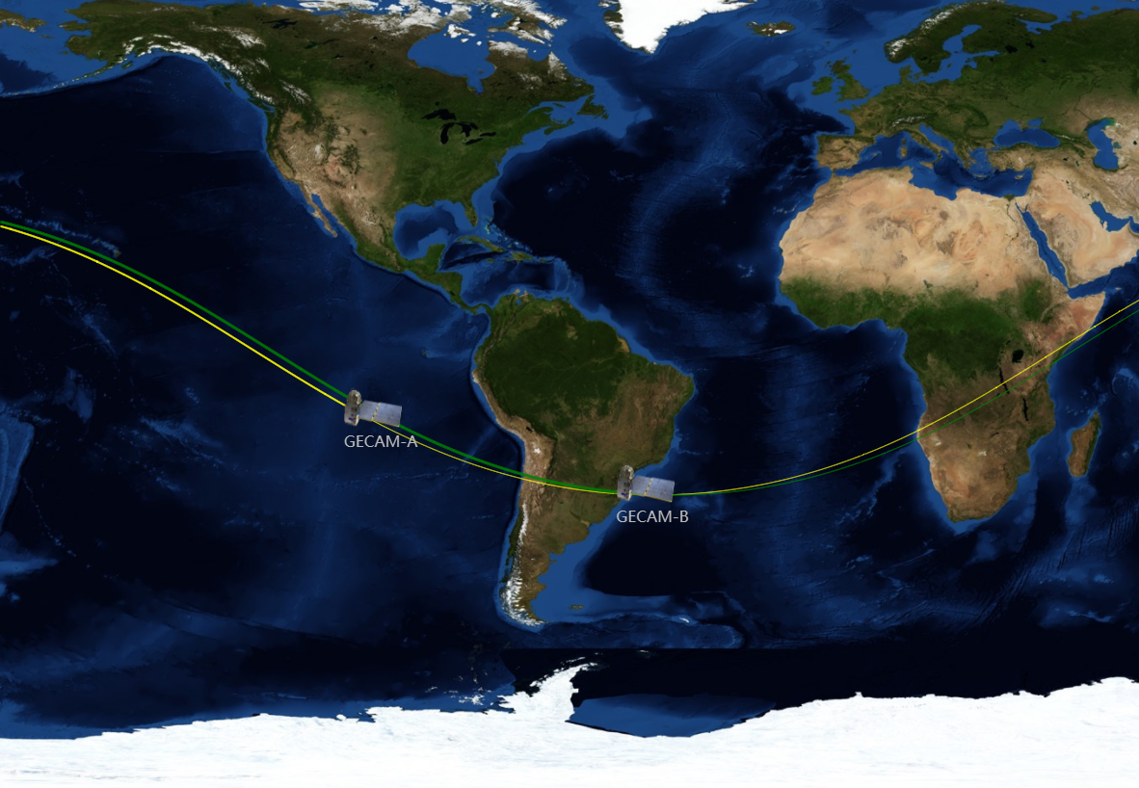
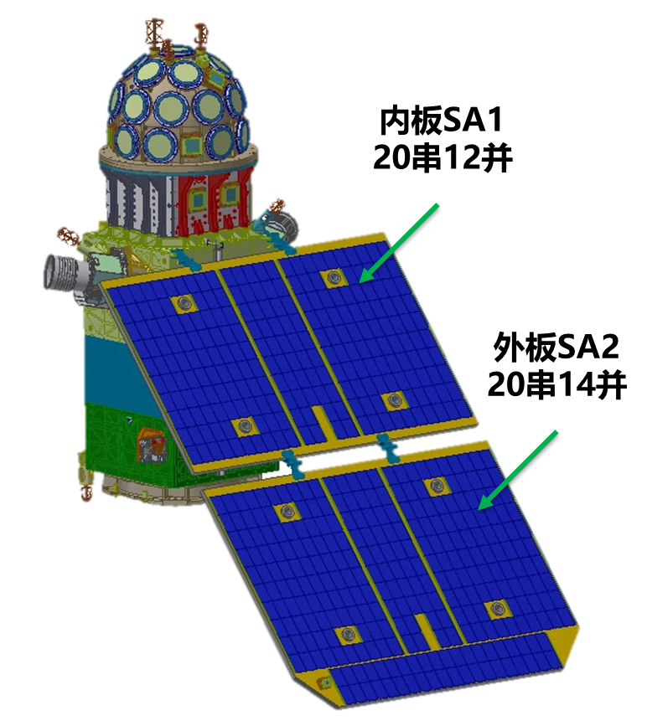
Status on orbit
Due to the issues of power supply system, GECAM-B can observe about 11 hours/day (FoV is about 70% of all-sky area), while GECAM-A has not started to observe yet.

Slide 8
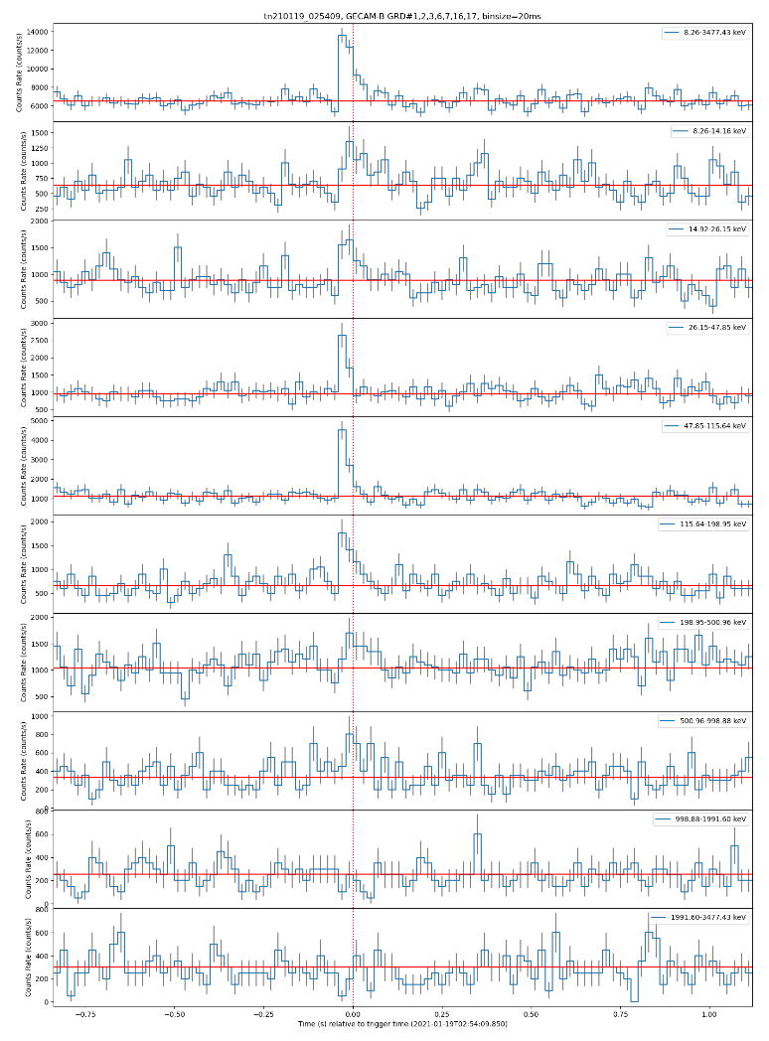
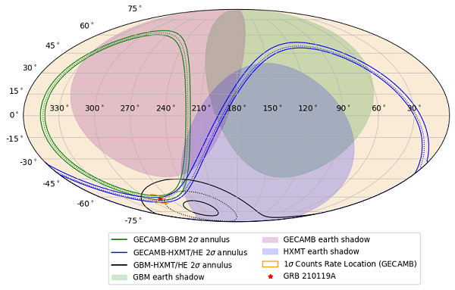
The first GRB published on GCN
2021.01.19
https://gcn.gsfc.nasa.gov/gcn3/29331.gcn3

Slide 9
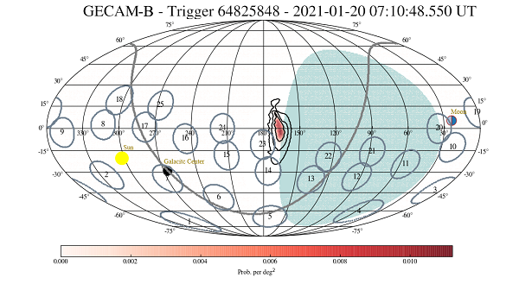
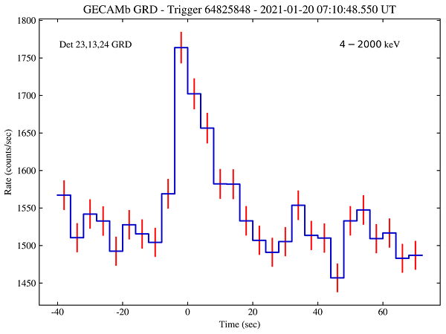
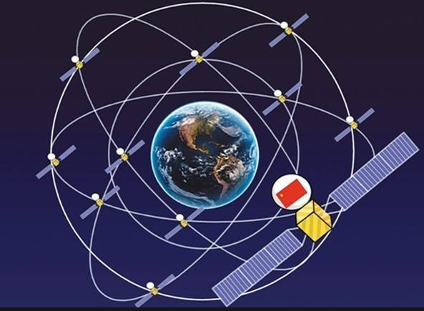
First GRB event via Short Message of Beidou Navigation Satellites
2021.01.20

Slide 10
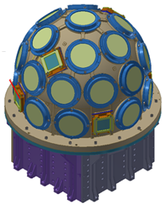
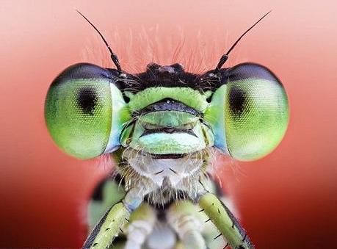
SiPMs based detectors
Detectors solution for microsatellite
GRB
Why microsatellites?
Cheap
Short period
Two satellites launched by one rocket
Constraints of microsatellites payload
Dimension <50 cm
Weight <50 kg
Power <50 W
Detector layout of each satellite
  25 GRDs, 3 inch, 15 mm thickness
  8 CPDs，16 cm²/cpd
  223°FoV， ~1 deg position error
  8 keV-4 MeV，75% efficiency@8keV
  Compact, HV-free,
Hemispherical compound eye design
damsel-fly

Slide 11
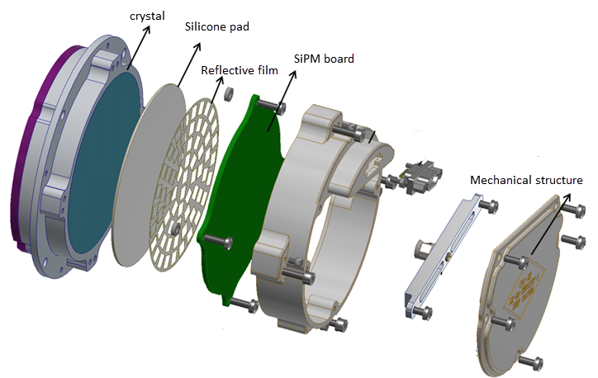
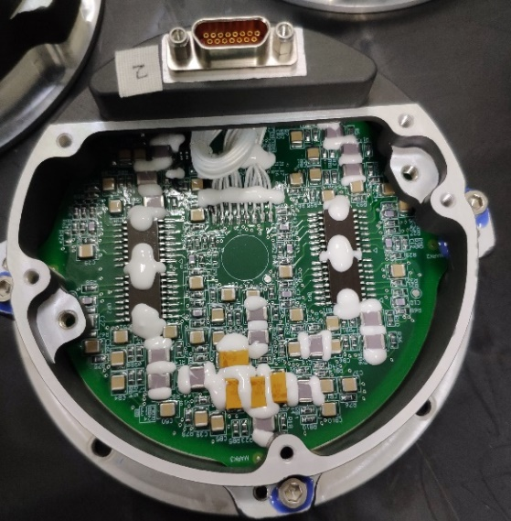
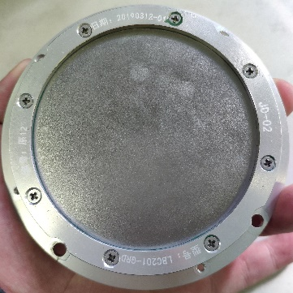
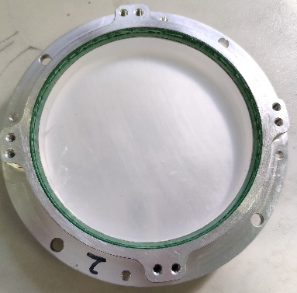
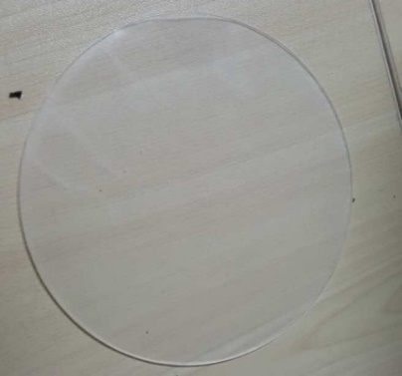
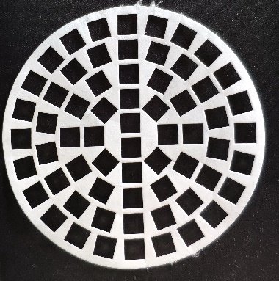
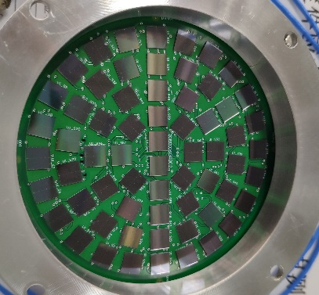
GRD Structure
Domestic crystal
Silicone pad
Reflective film
SiPM Array

Slide 12
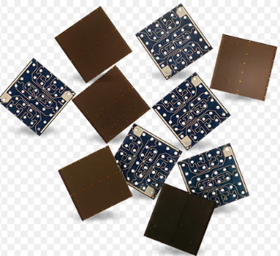
SiPM Characteristics
 | SensL | Hamamatsu | FBK
Type | MicroFJ-60035 | S14160 | NUV-HD
PDE (%) | 51 (Vbr+5V) | 50 (Vbr+2.7V) | 56 (Vbr+5V)
Dark count rate (kHz/mm²) | 70 (Vbr+5V) | 166 (Vbr+2.7V) | 150 (Vbr+5V)
Gain | 6.0X10⁶ (Vbr+5V) | 2.5X10⁶ (Vbr+2.7V) | 3.5X10⁶ (Vbr+4.5V)
Crosstalk probability (%) | 20 (Vbr+5V) | 7 (Vbr+2.7V) | 10 (Vbr+5V)
Break-down voltage (V) | 24.5 | 37 | 26
ΔTVop(mV/℃) | 21.5 | 34 | 20
Compact size
Large dynamic range
Single-photon sensitivity
High photon detection efficiency
Insusceptibility to magnetic fields
Solid, robust
However
Radiation damage
DCR ~100 kHz/mm²
Optimization design for arrays
Low temperature -20ºC
High light yield and fast crystals

Slide 13
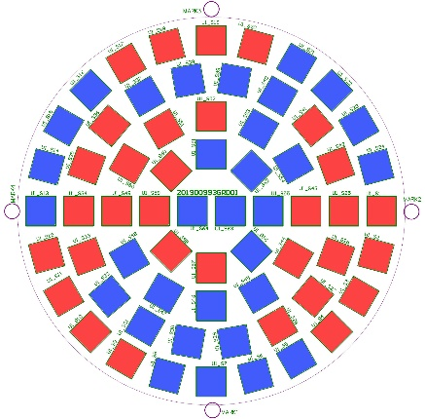
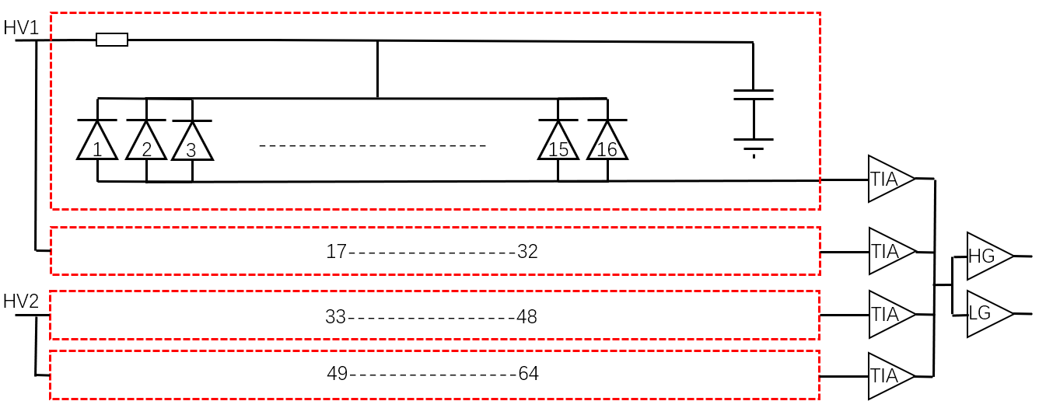
SiPMs array design
SiPMs Array design
Arranged evenly in a circular shape
Reflective film to improve photon collection efficiency
-20 ⁰C, to suppress the dark noise rate
PreAmp design
Parallel for 16 chips, Sum in 4 groups
High gain and low gain
Independent power supply in two groups
Temperature feedback for supply voltage

Slide 14
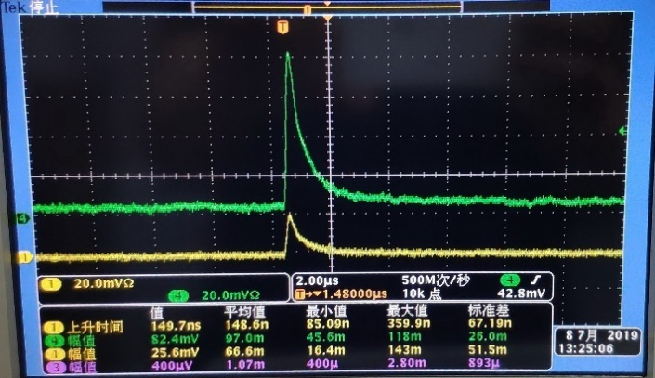
Waveform output

Slide 15
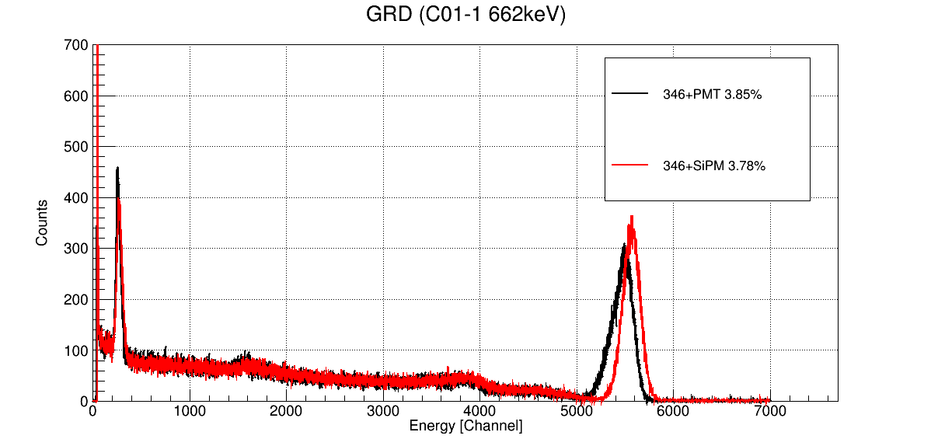
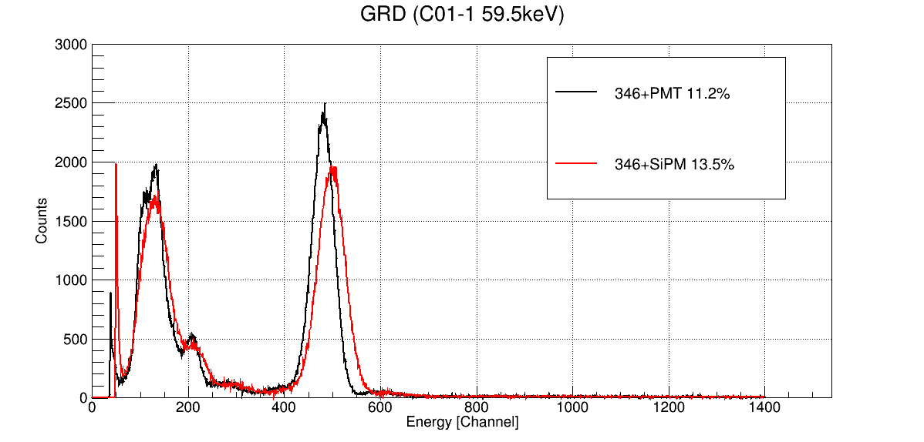
Energy Spectrum and resolution
VS PMT 6233
preliminary
preliminary

Slide 16
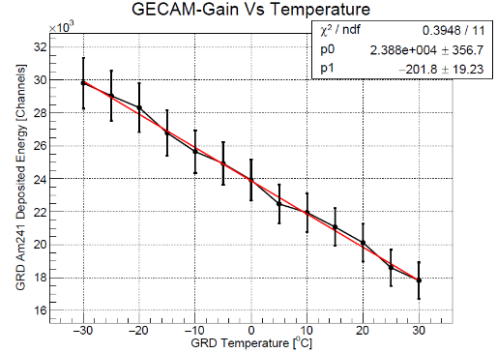
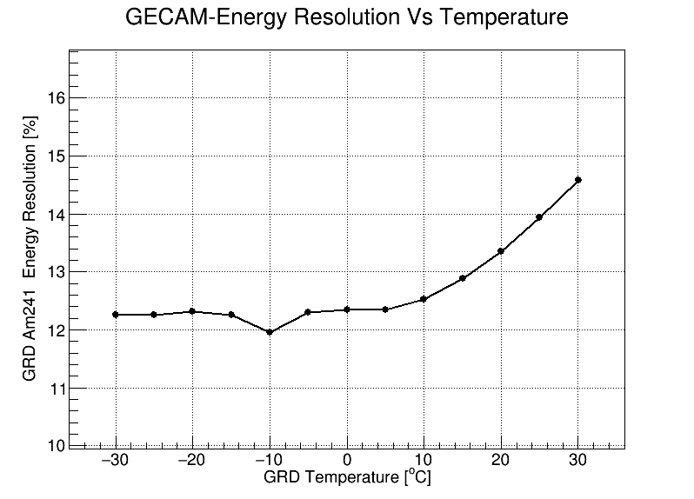
Low temperature performance
preliminary
preliminary

Slide 17
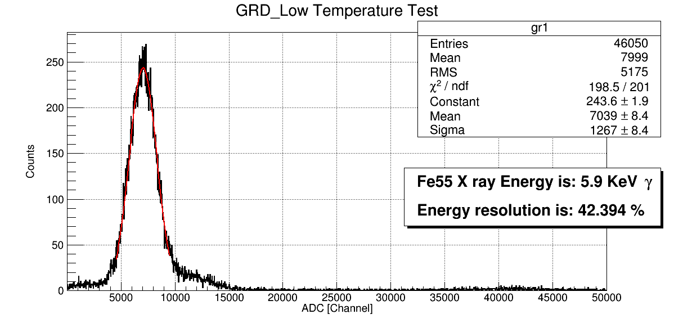
Energy Spectrum of 5.9 keV X-ray
preliminary

Slide 18
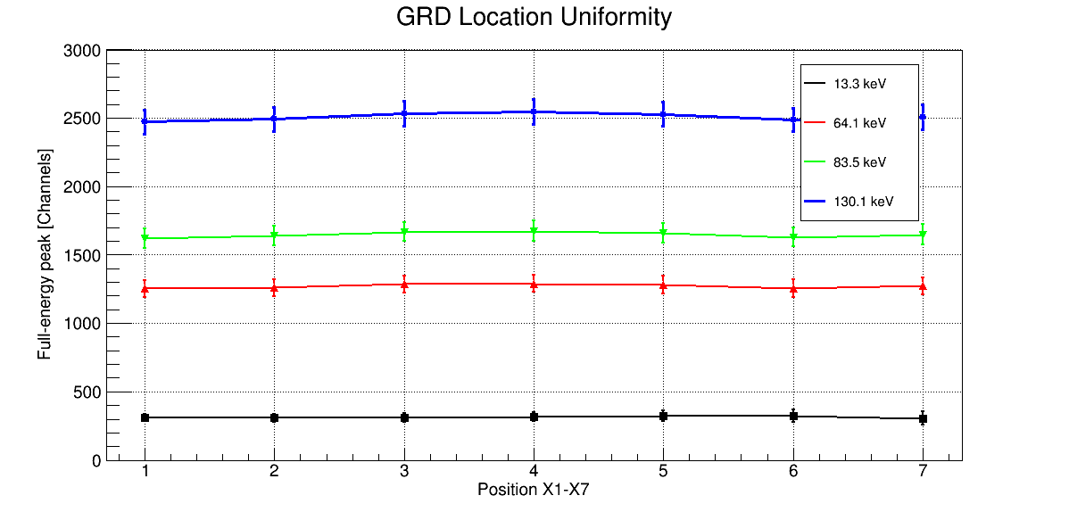
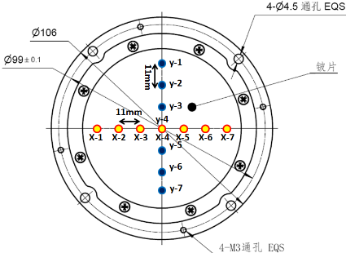
Uniformity performance
preliminary

Slide 19
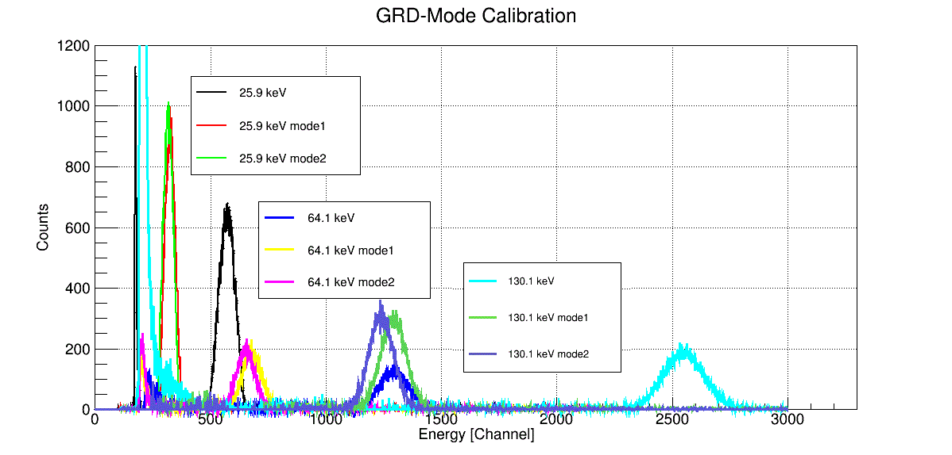
SiPM Full-array/Semi-array performance
preliminary

Slide 20
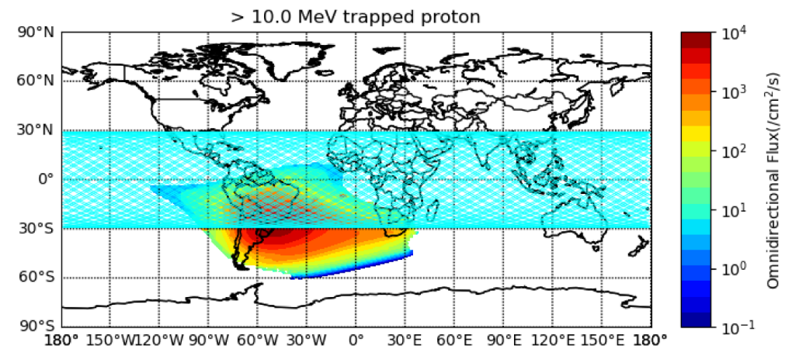
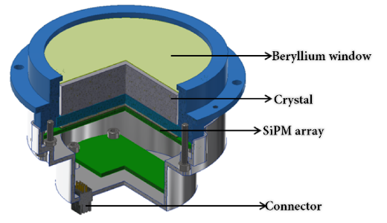
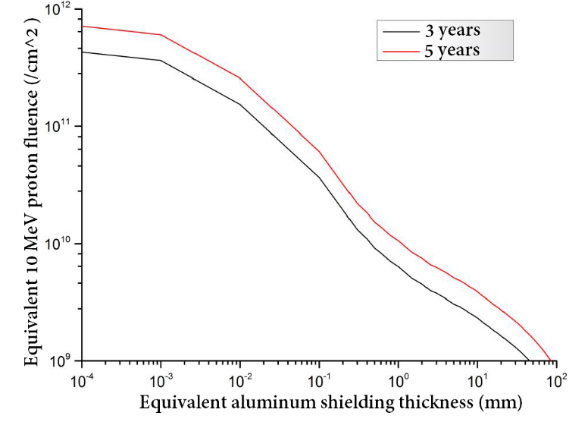
Radiation damage on orbit
Average equivalent Al thickness 21.5 mm
Equivalent 10 MeV proton fluence
1.5E+09 (cm⁻²) 3y
2.5E+09 (cm⁻²) 5y
DCR threshold current will increase

Slide 21
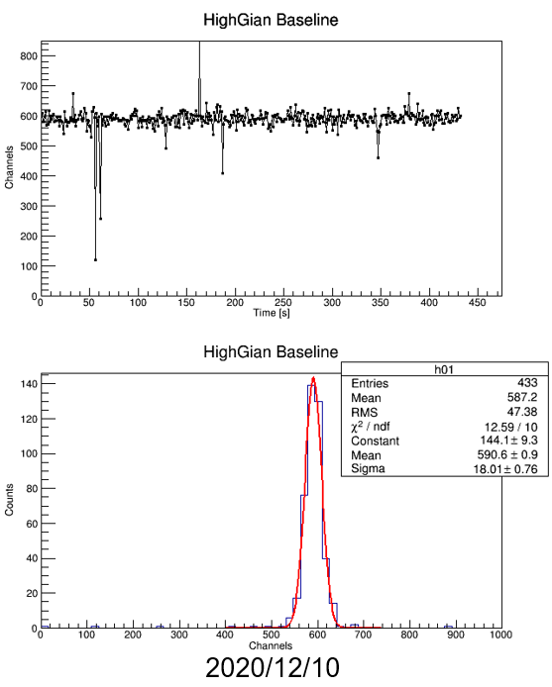
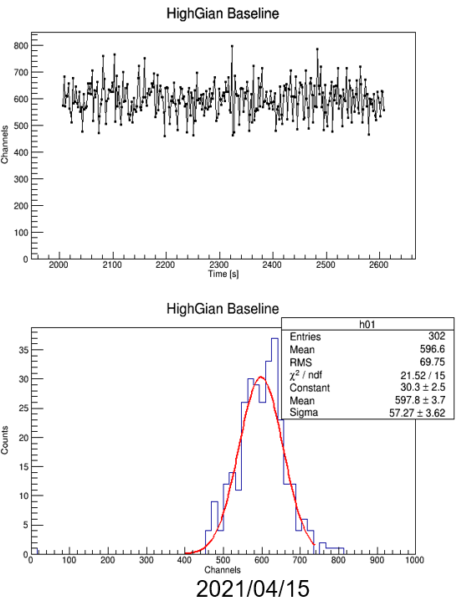
Baseline fluctuation increase
preliminary

Slide 22
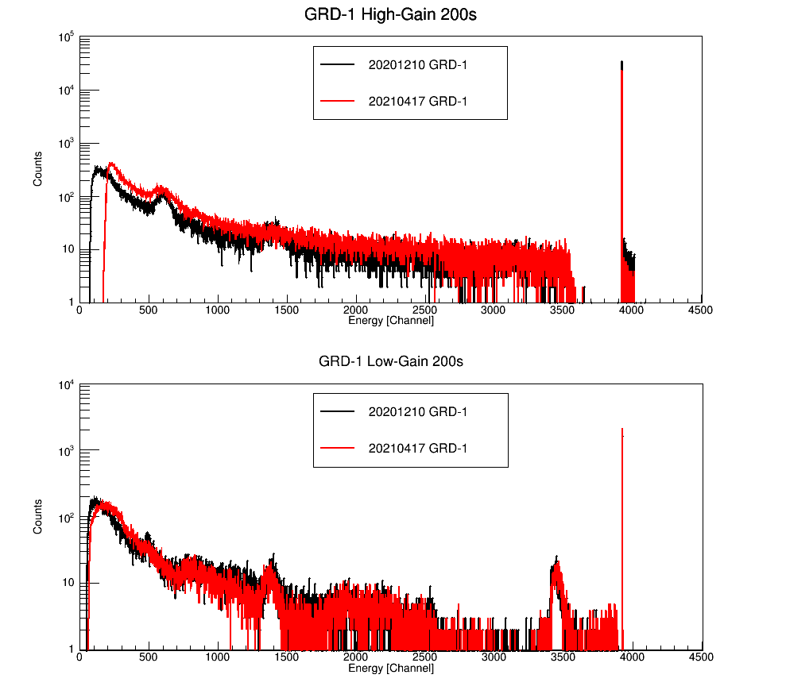
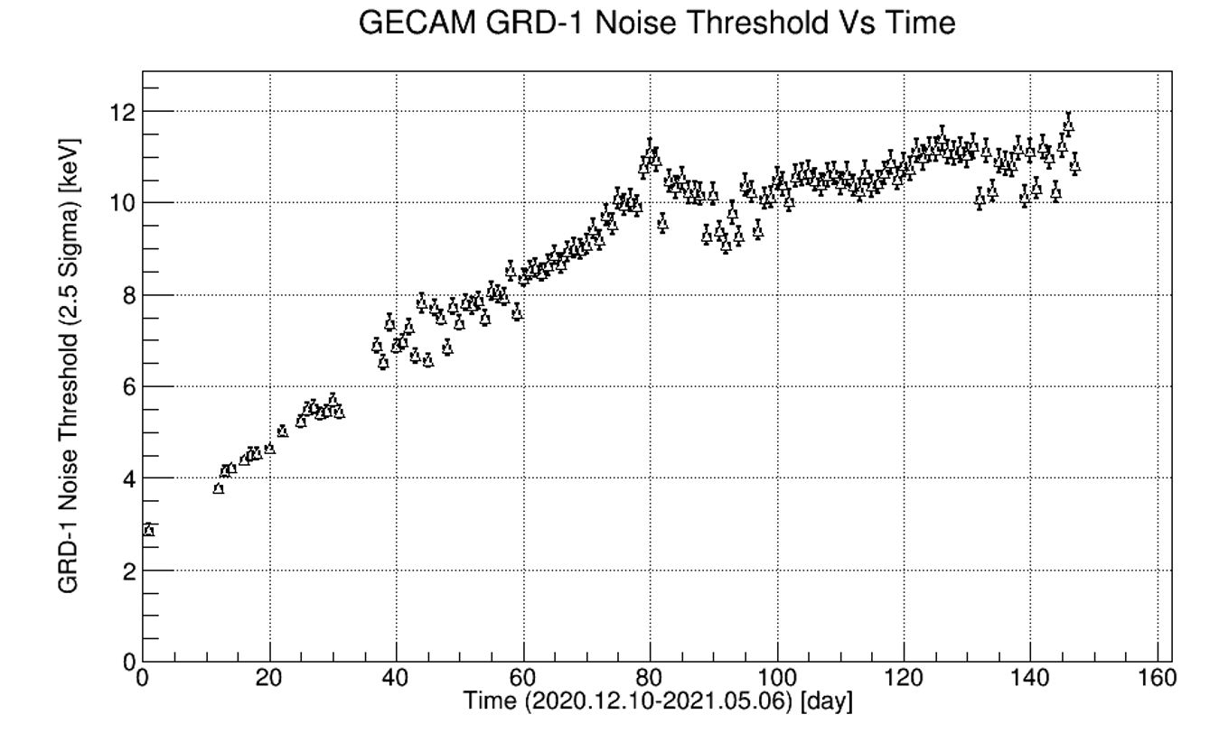
Threshold increase on-orbit
preliminary
25 keV/y increment
preliminary

Slide 23



Characterization of SiPMs with neutron

Slide 24

Current increases with the radiation
3-year
1-year
-20 ℃
3-year radiation dose
6.0x10^9 n/cm2
-20 ℃ 27.5V
Current ~0.2 mA
0.32 mA/day
preliminary

Slide 25

Current increase on-orbit
28.0 V
27.5 V
28.2 V
preliminary

Slide 26
Summary
GECAM has been launched
Power supply problem, one satellite part time running, 70% of all sky
Near real-time downlink capability
A dedicated SiPMs array designed for GRD
Performs well except for radiation damage issues
Threshold increase 25 keV/year @-20 ℃, 27.5 V

Slide 27
Thanks for your attention

Slide 28

Annealing effect and low temperature suppress
preliminary

