Slide 1
Determination of responses of liquid xenon to low energy electron and nuclear recoils using a PandaX-II detector
燕斌斌
上海交通大学

Slide 2
Outline
Introduction
PandaX-II calibration setup
Response model of low energy electron and nuclear recoil
Summary

Slide 3
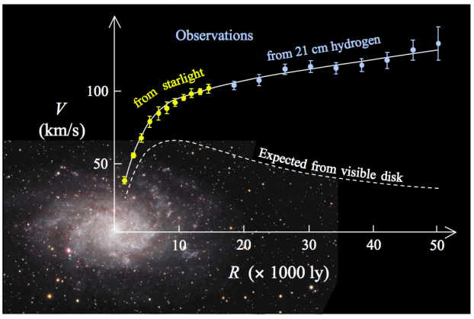

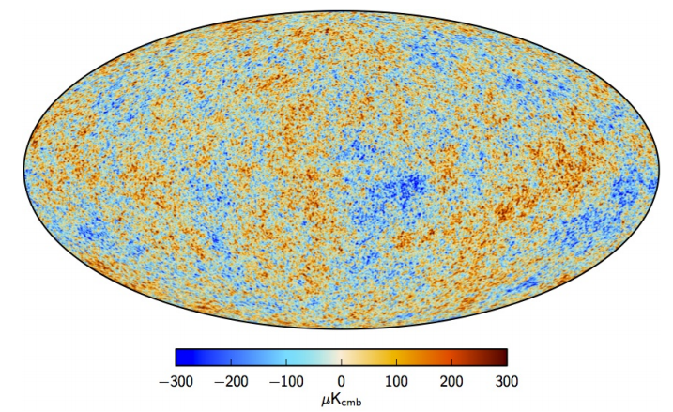
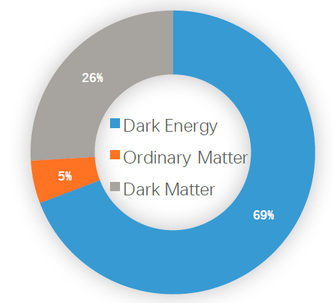
Brief introduction of Dark Matter
Galactic rotation curve(Data from M33 galaxy)
Bullet cluster
Cosmic microwave background,(Planck 2015)

Slide 4
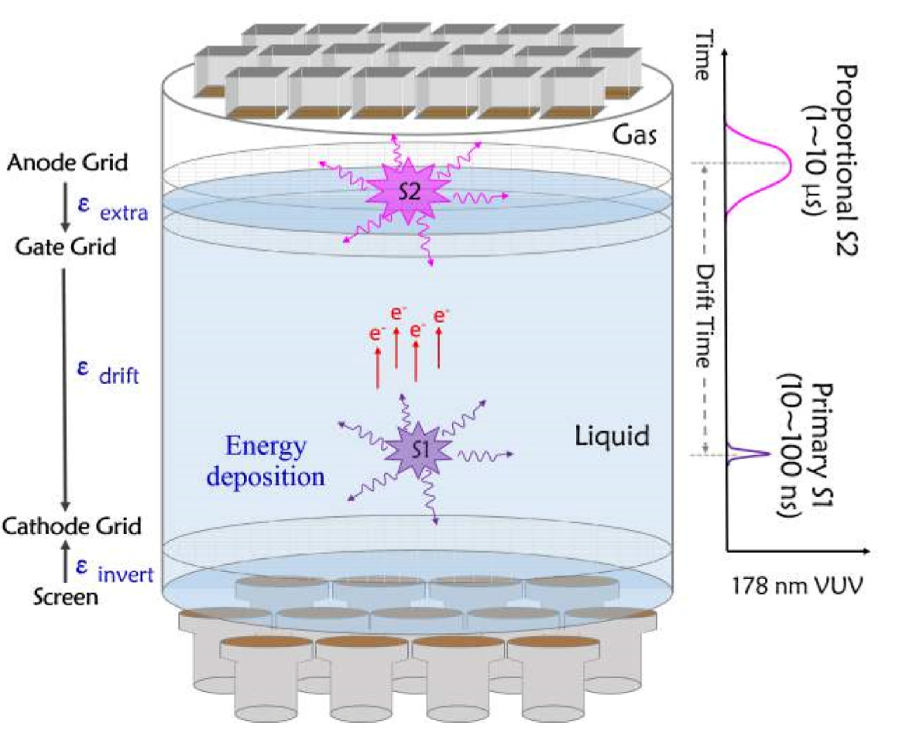
Dual-Phase Xenon detector
Advantages:
Large atomic number A=131.2(自旋无关散射几率~A²）
No long-lived isotopes, High density
Easy cooling(-100℃)
Good for self-shielding
Scaling is easy 10kg -100kg-500kg -4ton
Excellent scintillator

Slide 5
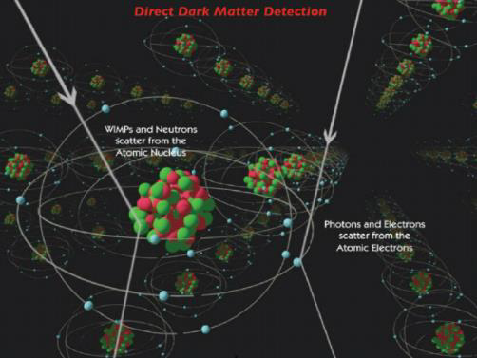
NR and ER discrimination in TPC
S1
S2
ER: Large S2/S1
S1
S2
NR: Small S2/S1
(S2/S1)_{NR}<<(S2/S1)_{ER}

Slide 6
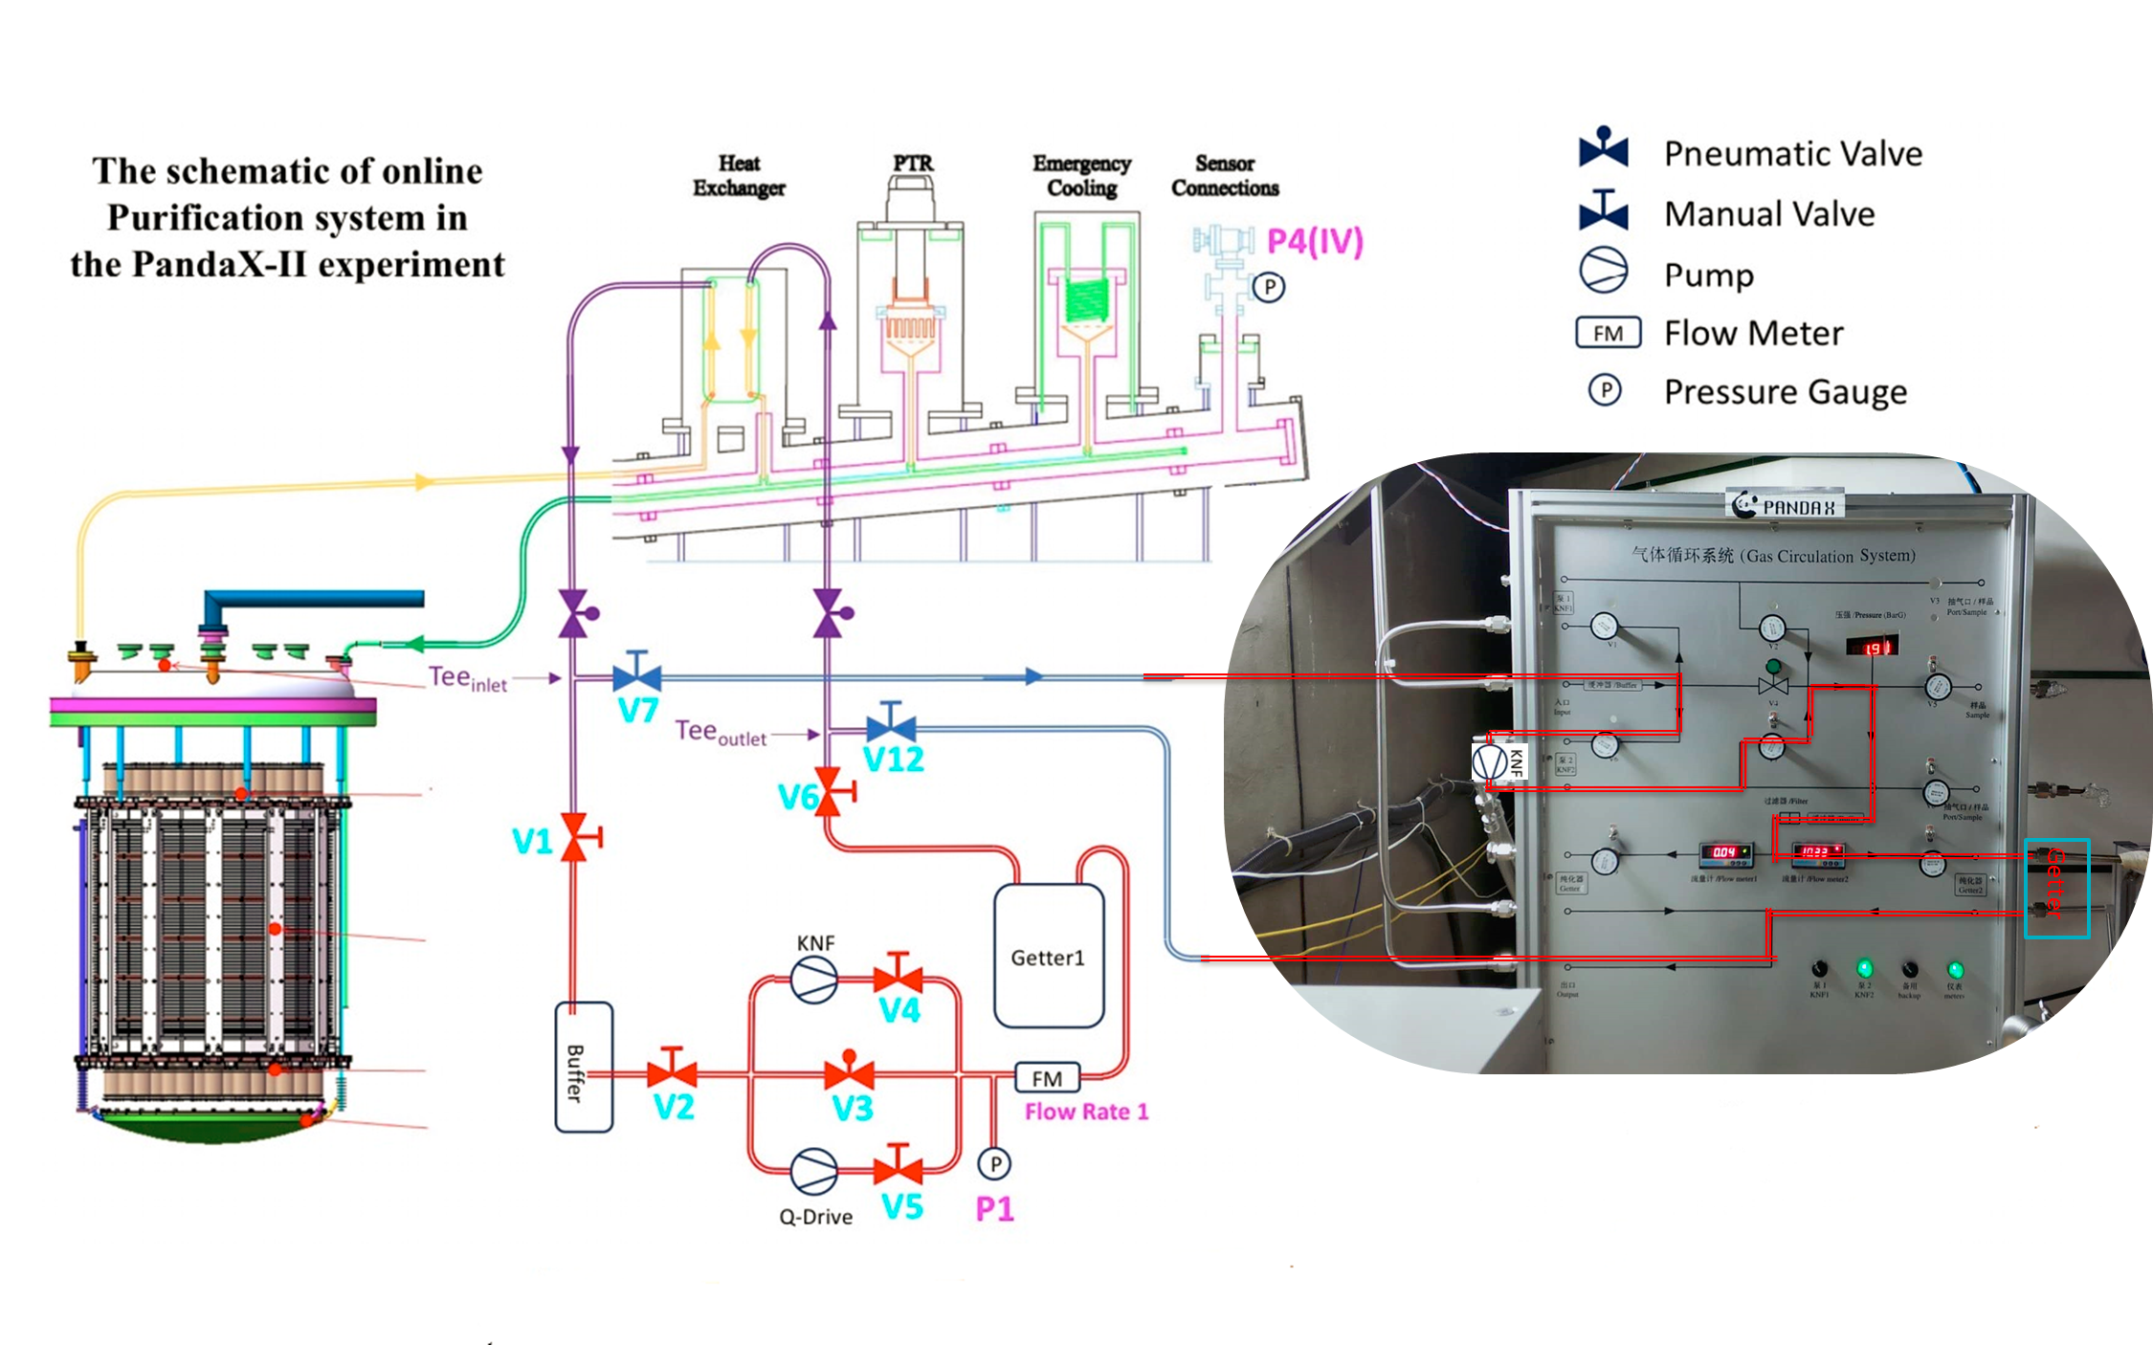
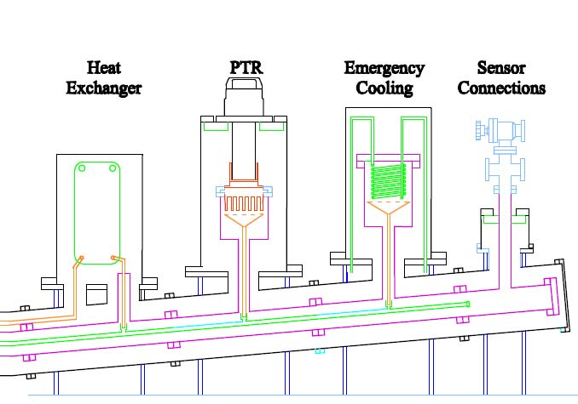
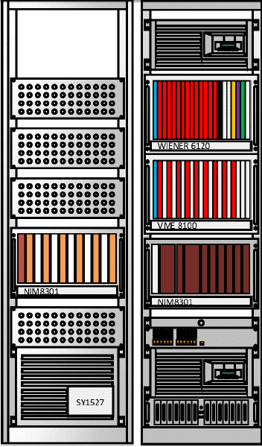
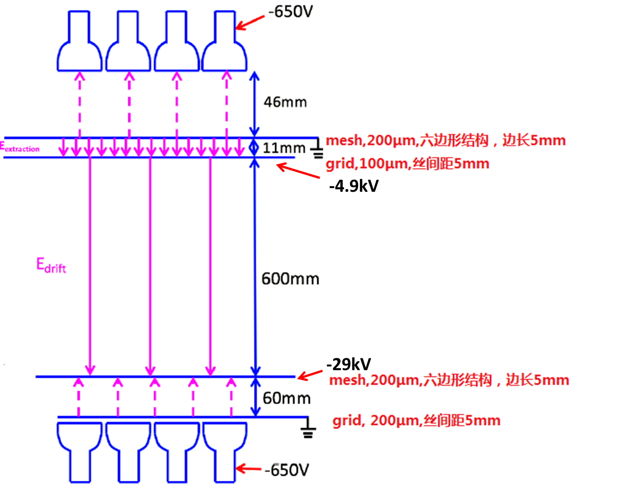
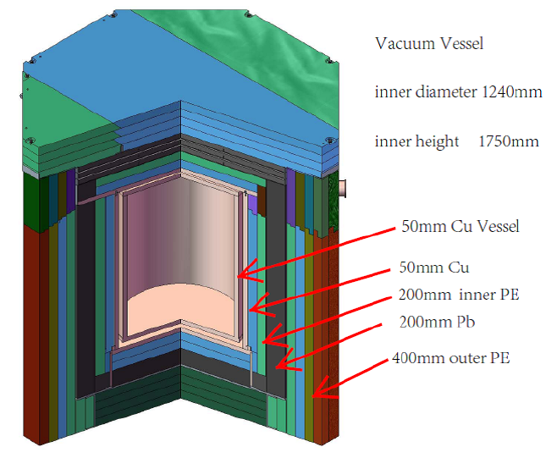
PandaX-II detector
My work

Slide 7
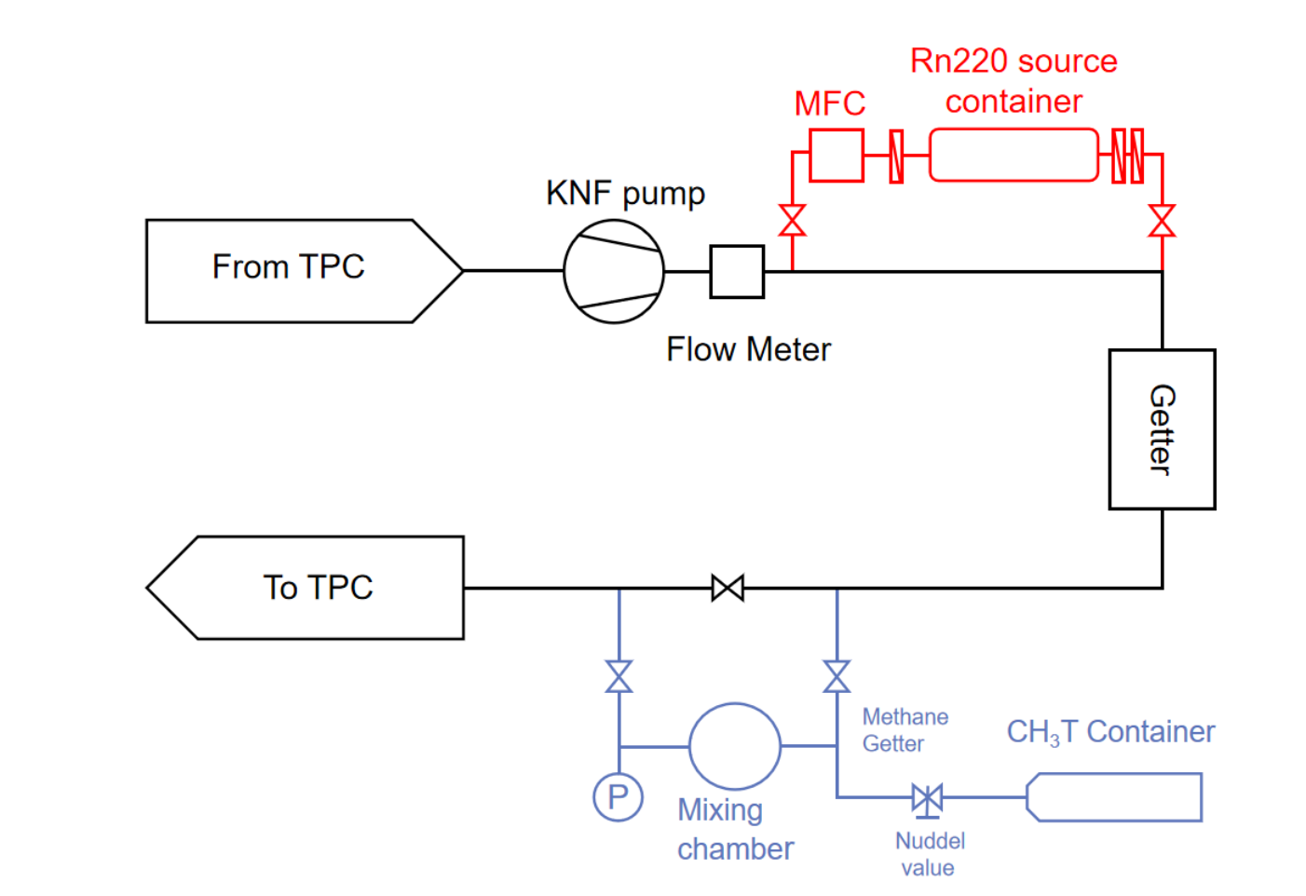
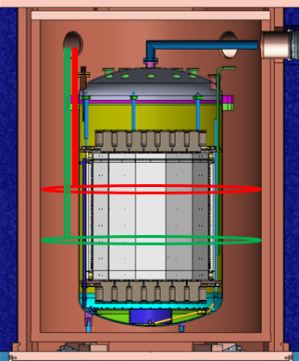
PandaX-II calibration setup
Injected sources CH₃T ,Rn²²⁰
External sources: Am-Be

Slide 8
PandaX-II model
PandaX-II was under operation from March 2016 to July 2019. The operation was partitioned into three runs, Run9, 10 /11. The TPC drift field in Run 9 was 400 and 317 V/cm in Runs 10/11
We build a model to describe the dark matter and background signals in data
For an given deposited energy, we build the model following
  Quanta generation
  Model of the detector
  Extraction of parameters in the response model

Slide 9
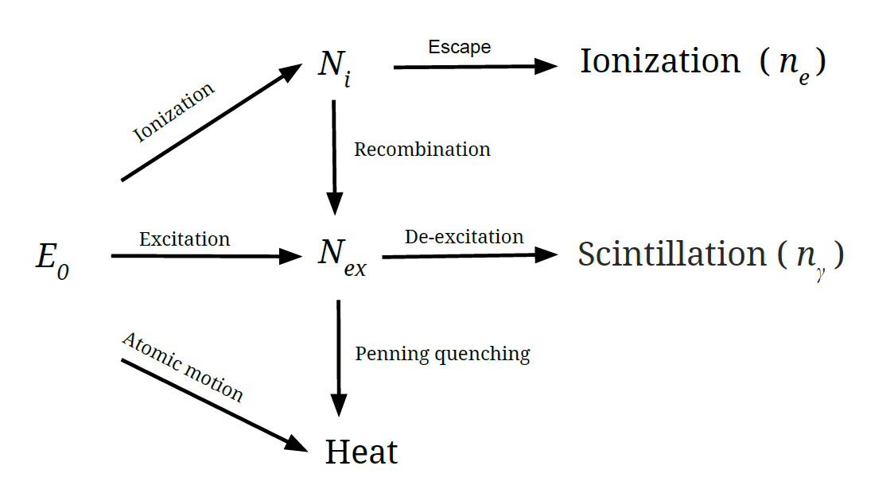




NSET 2.0 model
$$n_{q}≡n_{ph}^{0}+n_{e}^{0}=\frac{E0L}{W}$$
$$n_{ph}^{0}=LyE0,n_{e}^{0}=QyE0$$
$$ne=Gaus(n_{e}^{0},f(E0L)×n_{e}^{0})$$
$$nph=nq−ne$$
For the NRs, L is the so-called Linhard factor ,where L is the from 0.1 to 0.25 for less than 100keV_{NR}, For ER events, L is set to 1.0
f (E₀L)is adjusted to the data. The smearing includes intrinsic fluctuations of the model and other time dependent systematic fluctuations of the detector
NSET1.0 framework

Slide 10







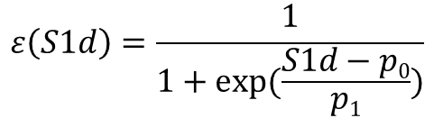
Model of detector
$$Ndph=Binom(nph,PDE/(1+p2pe))$$
$$N_{e}^{′}=Binom(ne,s)$$
$$NPE=Ndph+Binom(Ndph,p2pe)$$
$$N_{e}^{′′}=Binom(N_{e}^{′},EEE)$$
(1)
$$S1=Gaus(NPE,σSPE×\sqrt{NPE})$$
(2)
$$S2=Gaus(N_{e}^{′}×SEG,σSE×\sqrt{N_{e}^{′′}})$$
p_{2pe} the double-photoelectron emission probability by the 178 nm scintillation photons, 0.21±0.02
PED/(1+p_{2pe}) is probability to detect a photon
σSPE is single photoelectron resolution，~33%
s is the electron survival probability
σSE is single electron signal resolution，~8.3PE
(3)
$$S1d=S1×f1, S2d=S2×f2$$
f is inefficiency from the baseline suppression (BLS) firmware of the digitizers
(4)
$$ε\left(S1d\right)=\frac{1}{1+exp⁡(\frac{S1d−p0}{p1})}$$
This is the data selection efficiency

Slide 11
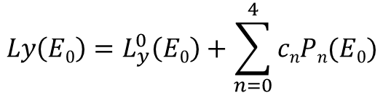

Extraction of parameters in the response model
For a given model, a two-dimensional probability density function (PDF) in (S1,S2) is produced, the parameters including:
  a) PDE, EEE and SEG constrained by their Gaussian priors with the anti-correlation between PDE and EEE embedded,
  b) parameters for data selection efficiency with a flat sampling of p₀(2-6) and p₁(0-1) respectively
  c) a 4th order Legendre polynomial expansion, with c_{n} uniformly sampled from -5 to 5
$$Ly\left(E0\right)=L_{y}^{0}\left(E0\right)+\sum_{n=0}^{4}{cnPn(E0)}$$
$$L_{y}^{0}（\frac{E_{rec}}{L}）= \frac{S1}{PDE×Erec/L}$$
$L_{y}^{0}$ is the initial approximation from data, where

Slide 12
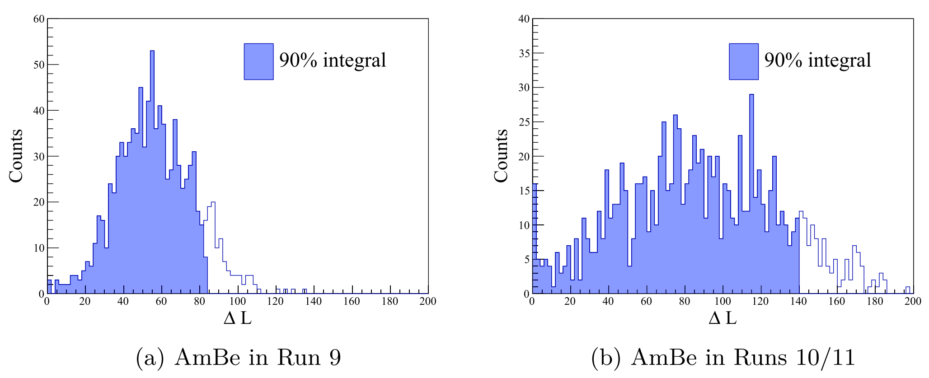
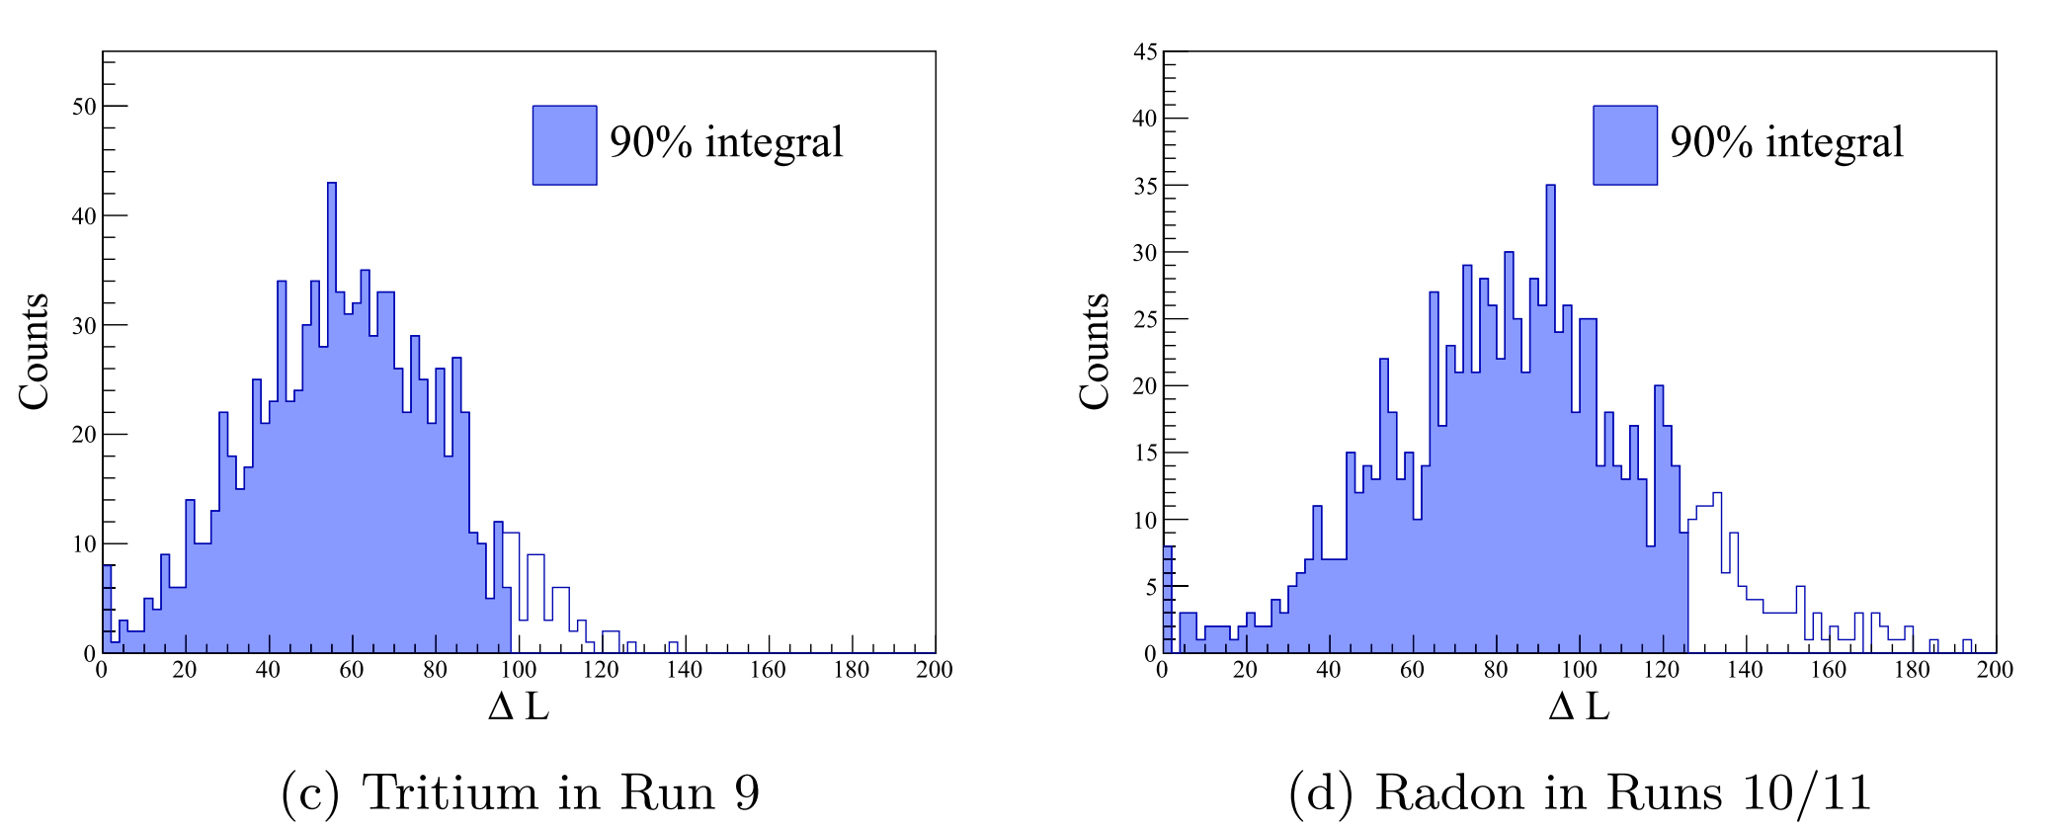

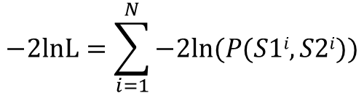
The best fit and allowable parameter space
To compare the data to the PDF, a standard un-binned log likelihood function is defined in the space of (S1,S2)
For each set of fixed parameters, 1000 mock data runs are produced with equal although Poisson fluctuated statistics as the calibration data
The blue dashed regions refer to the
90% integrals from zero
$$−2lnL=\sum_{i=1}^{N}{−2ln⁡(P(S1i,S2i))}$$
$$∆L=−2lnLfixed−(−2lnLmin)$$

Slide 13
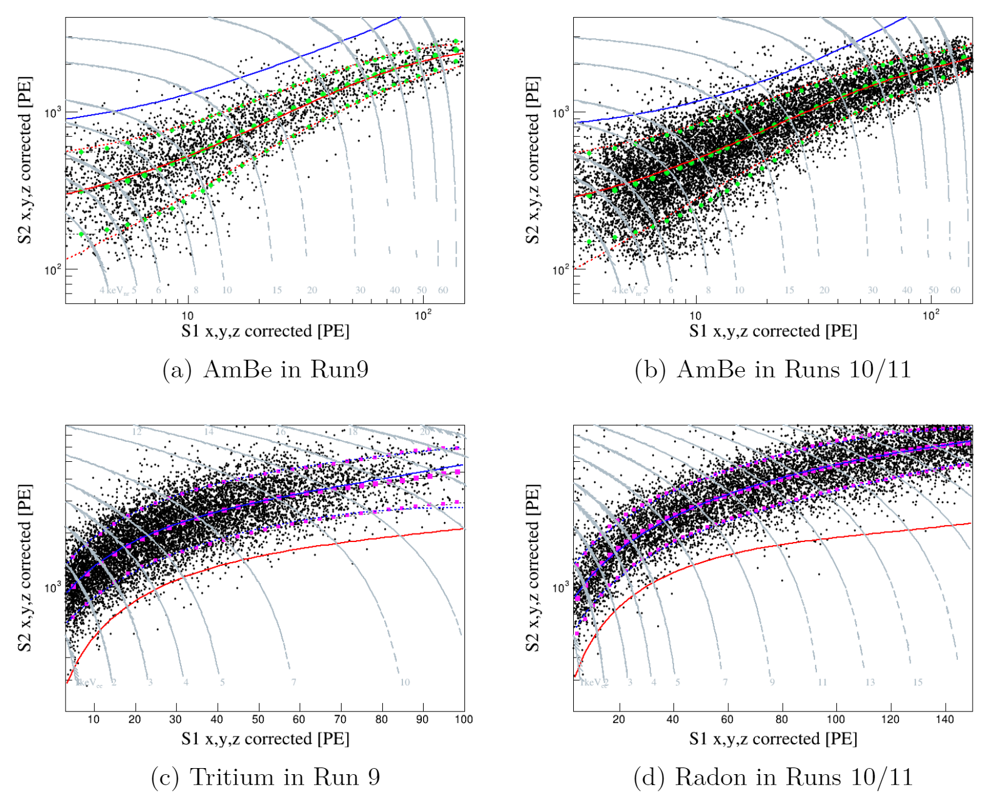
Band distribution of PandaX-II calibration data
Dots: data
Red lines: median and 90% quantile of NR data
Blue lines: median and 90% quantile of ER data
Green/purple points: median and 90% quantile of MC

Slide 14
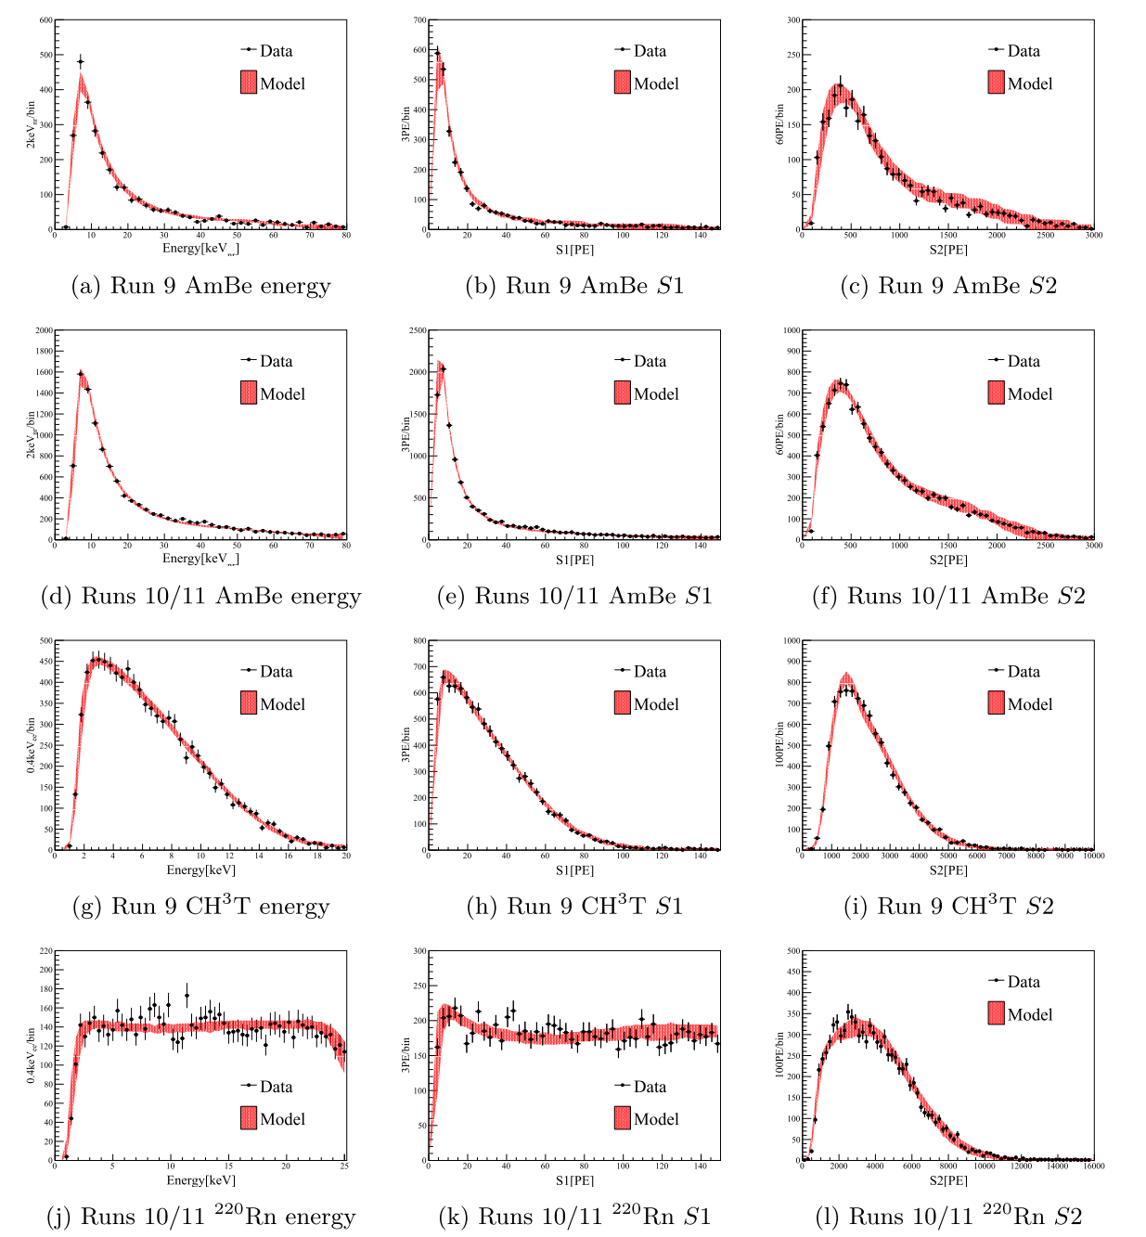
The comparison of calibration data and model
The real data is tested around the best fit, and the allowable space is defined by the 90% boundaries.
The corresponding allowable range of distributions in recoil energy, S1, and S2 are shown in the right figure
the models cover the entire PandaX-II data taking period, with extended energy ranges from 4 to 80 keVnr(NR) and 1 to 25keV (ER).

Slide 15
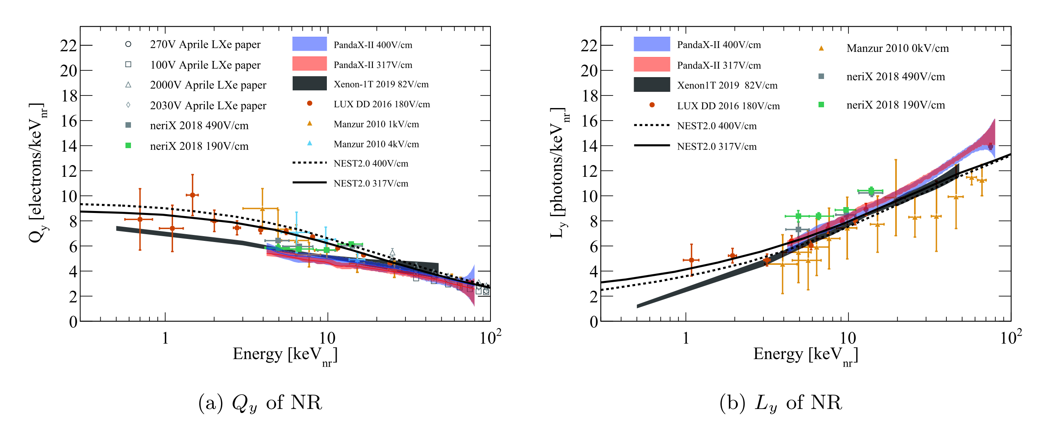
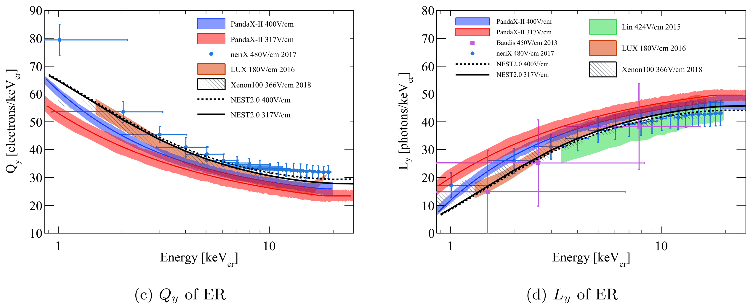
Comparison with world data
NR Q_{y} is significant spread among the world data within 15keVnr
NR L_{y} is consistent with most world data
For the ER models, our model at 400V/cm is consistent with several world data
However, our model at 317V/cm is higher (lower)L_{y} (Q_{y} ) in comparison to most world data

Slide 16
Summary
PandaX-II was under operation from March 2016 to July 2019.
The empirical best fits to the data and model uncertainties are obtained
the models cover the entire PandaX-II data taking period, with extended energy ranges from 4 to 80 keVnr(NR) and 1 to 25keV (ER).
Compared to some world data. Our NR models lie in the large global spread. For the ER
response, our model yields a higher (lower)L_{y} (Q_{y} ) in comparison to most world data, indicating some unaccounted systematic uncertainties in our or other measurements
Finally, our models determined from in situ calibrations are the most self-consistent models to be used in the PandaX-II dark matter search data and can be applied to similar noble liquid TPC experiments.
Thank you!

Slide 17
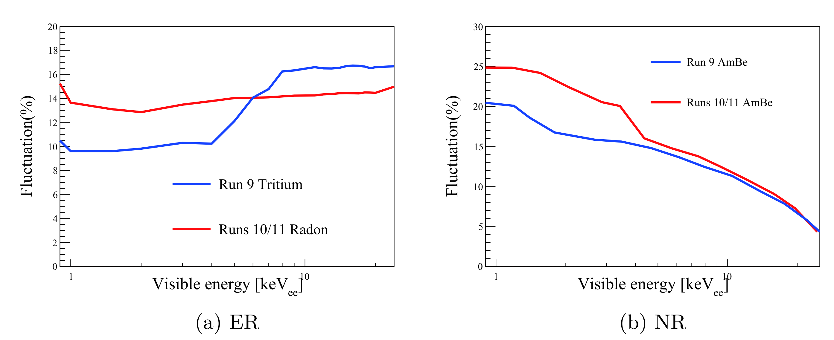
Backup
The empirical fluctuation parameter

