Slide 1
Lattice Ensemble Generation with Clover Action
Peng SuN
nJNU

Slide 2
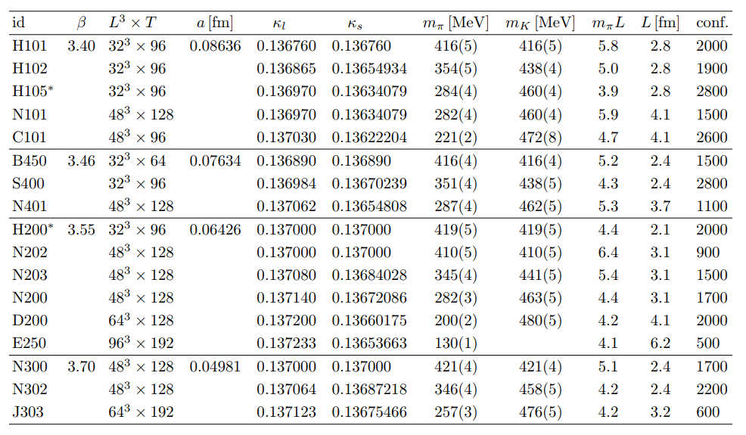
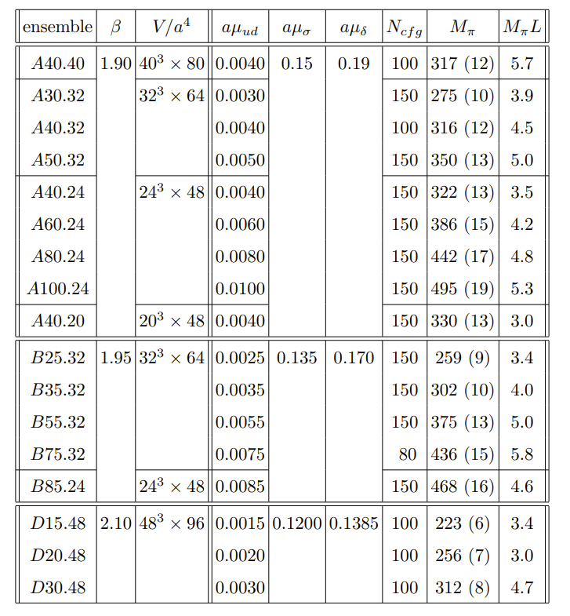
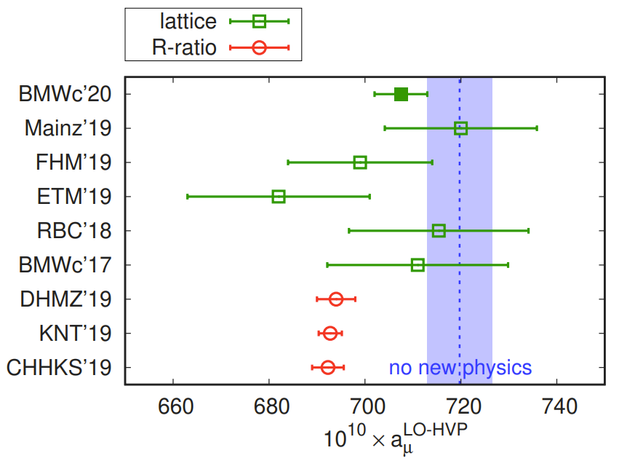
Lattice ensembles in Lattice studies
Mainz’19
ETM’19

Slide 3
Actions

Slide 4
Simulation setup

Slide 5
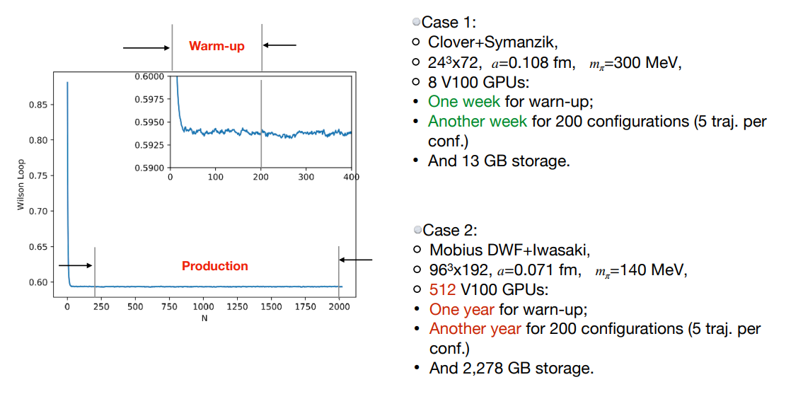
A brief introduction for ensemble generation

Slide 6
criteria
FLAG Review 2019: Flavour Lattice Averaging Group (FLAG) Eur.Phys.J.C 80 (2020) 2, 113

Slide 7
Current ensembles (zero temperature)
name | Volume | Lattice spacing | beta | Pion mass | Eta_s mass | L x M_pion | L | Trajectories
C11P29S | 24³x72 | 0.108fm | 6.20 | 290MeV | 640MeV | 3.8 | 2.6fm | 13000
C11P29M | 32³x64 | 0.108fm | 6.20 | 290MeV | 640MeV | 5.0 | 3.5fm | 10000
C11P22M | 32³x64 | 0.108fm | 6.20 | 220MeV | 640MeV | 3.9 | 3.5fm | 10000
C11P22L | 48³x96 | 0.105fm | 6.20 | 220MeV | 640MeV | 5.6 | 5.4fm | 1000
C11P12L | 48³x96 | 0.105fm | 6.20 | 120MeV | 700MeV | 3.1 | 5.4fm | 1000
C11P15L | 48³x96 | 0.105fm | 6.20 | 145MeV | 700MeV | 3.7 | 5.4fm | 400
C11P14L | 48³x96 | 0.105fm | 6.20 | 135MeV | 700MeV | 3.4 | 5.4fm | producing
C08P30S | 32³x96 | 0.08fm | 6.41 | 300MeV | 650MeV | 3.9 | 2.6fm | 11000
C08P22M | 48³x96 | 0.08fm | 6.41 | 210MeV | 650MeV | 4.1 | 3.8fm | 1000
C06P36S | 48³x144 | 0.055fm | 6.72 | 360MeV | 670MeV | 4.8 | 2.6fm | 650
C06P30S | 48³x144 | 0.055fm | 6.72 | 300MeV | 650MeV | 4.0 | 2.6fm | producing
Collaboration with LM Liu, YB Yang, W Sun and M Gong
Based on the machines of 南方核科学中心,IMP, IHEP and ITP

Slide 8
The Cost
volume | Lattice spacing | Pion mass | N_gpu used | 1000 trajectories | Cost (￥6/gpu_hour)
24x72 | 0.108fm | 290MeV | 4 | 240hour | ￥5,760
48x96 | 0.108fm | 135MeV | 32 | 3470hour | ￥666,240
32x96 | 0.08fm | 300MeV | 16 | 260hour | ￥24,960
48x144 | 0.055fm | 300MeV | 32 | 1390hour | ￥266,880
1000 trajectories only mean dozens of configurations, and one ensemble usually
needs several hundreds of configurations.
Besides, it takes a lot of computer time for tuning parameters as well.

Slide 9
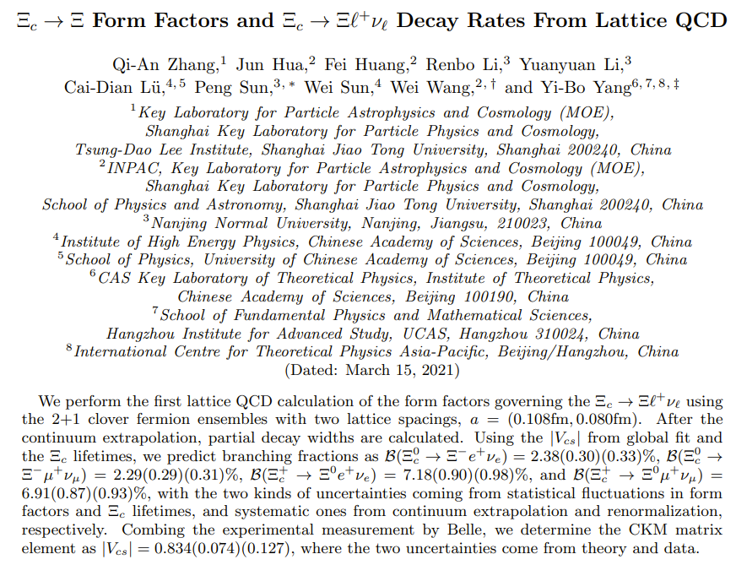
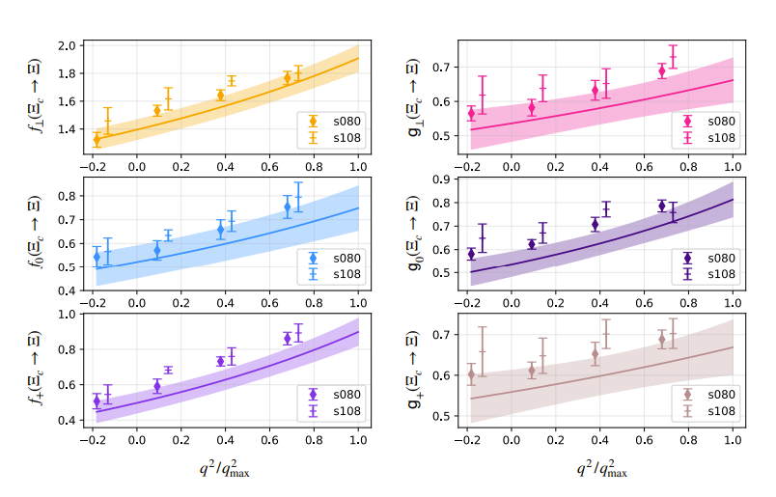
e-Print: 2103.07064 [hep-lat]

Slide 10
Outlook
In the future, we plan to produce more ensembles at different pion mass including physical point for these three latticing spacings.
All the Chinese HEP peers are welcome to use them.
These ensembles can free CLQCD from the foreign constraint on lattice ensembles.
We wish more works could happen based on these ensembles in the future.

Slide 11
Thank you for your patient !

Slide 12
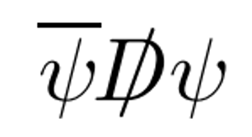
Clover Action
Naive fermion
Wilson fermion
Clover fermion

