Slide 1
Search for dark matter in effective field theory model with full PandaX-II exposure data
Ning Xuyang 宁旭阳
SJTU PandaX
2021.08.18
13th Conference on Particle Physics, Shan Dong University

Slide 2
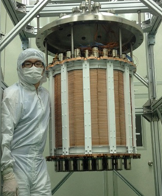
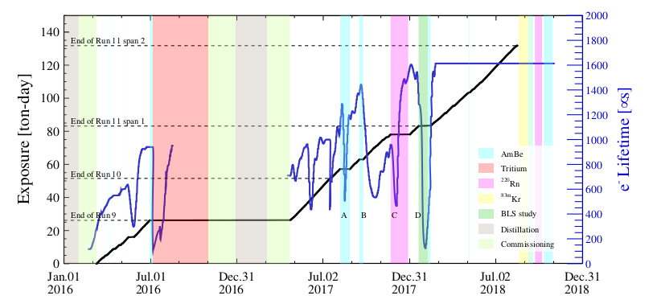
PandaX-II Experiment
Located China Jinping Underground Laboratory(CJPL)
Dual phase TPC
580 kg liquid xenon
S1 & S2 are collected and energy reconstructed via
Qiuhong Wang, et al[PandaX] arXiv:2007.15469

Slide 3
Why EFT
Many kinds of inteactions between dark matter and nucleons from many kinds of theories.
EFT is model independent, provide an aproach to search all probability for experiment.
Apart from traditional SI and SD interaction, we also interested in exchanging electric and magnetic dipole moment

Slide 4
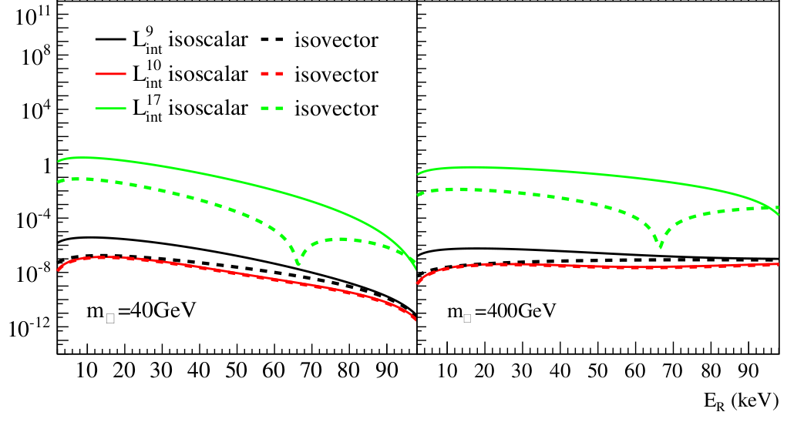
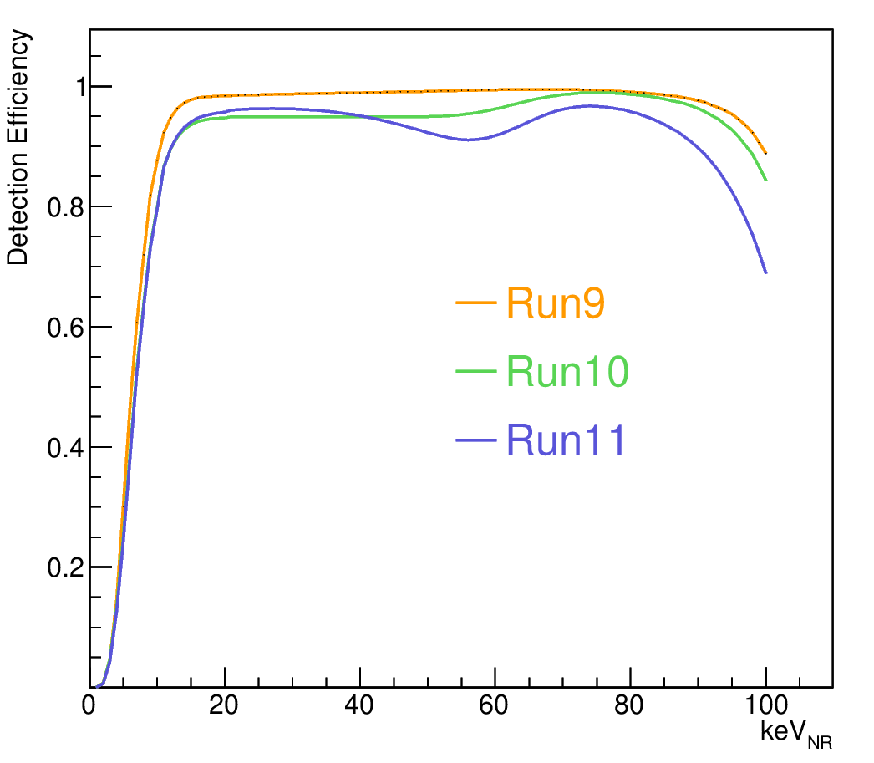
Data selection and Signal model
PandaX-II Full Exposure Data
Run9 + Run10 + Run11: 100 ton*day in total
Data selection:
Signal region: 0-25keVee
Narrow fiducial volume cut to r2<5.5e4, to avoid wall events
All Quality Cuts are applied
High detection efficiency for Nr signal up to 100keVnr
2200 data in total with 25 below NR mediam
Signal model:
Based on NEST2 with Nr &ER charge & light yield generated from Calibration data.[Yan Binbin et al [PandaX], arXiv:2102.09158]

Slide 5
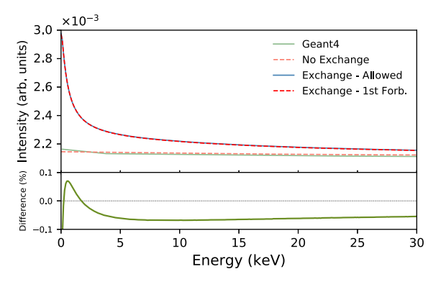
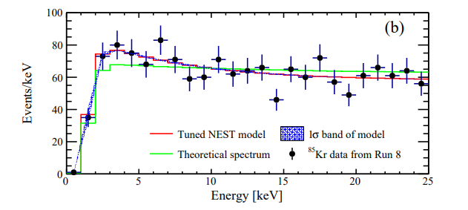
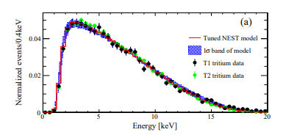
Background Component
ER: Tritium Kr85 Flat ER(Rn, Material) Xe127 Xe136
NR: Neutron
Accidental
Kr85 spectum:
New shape from theoretical result
Data Driven spectrum from Run8.
S. Haselschwardt, J. Kostensalo, X. Mougeot, and J. Suhonen, Phys. Rev. C 102, 065501 (2020)
Tritium spectum:
Perfect shape agreement from Signal model and Calibration reconstruction

Slide 6
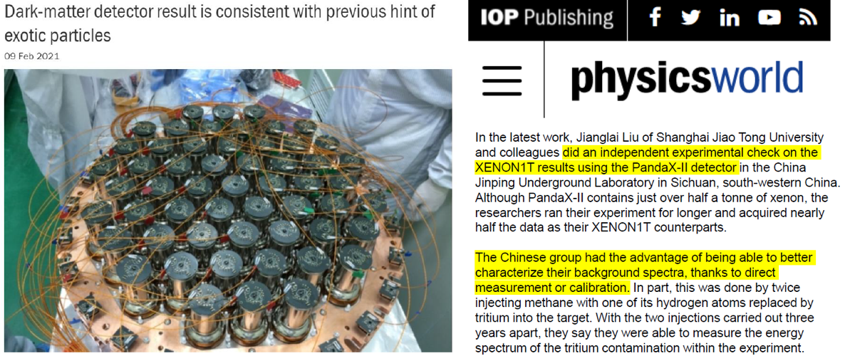
PandaX-II Axion and Neutrino Magnetic moment
Xiaopeng Zhou, et al [PandaX], 2008.06485
利用电子反冲信号，对XENON1T的疑似信号给出国际唯一同类型实验验证
英国物理学会《Physics World》杂志专门撰文报道我们的结果，评论说“PandaX-II实验对XENON1T的结果作出了独立检验，…，中国组通过直接刻度数据，对本底的能谱作出了更好的测量…”

Slide 7
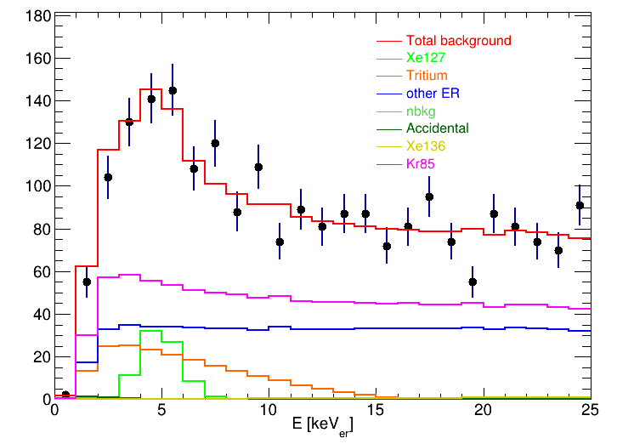
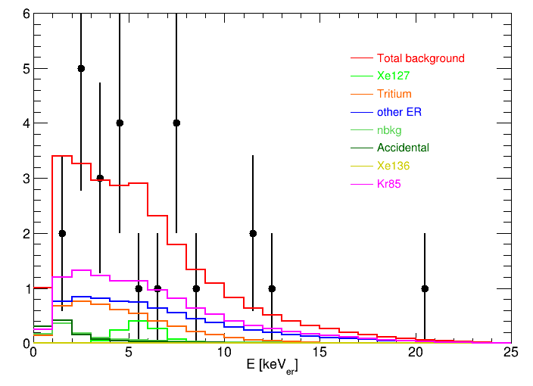
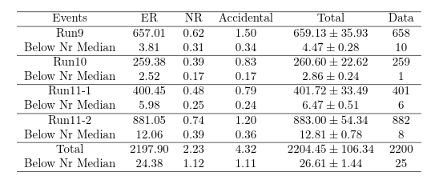
Background components
Background only fitting spectra
Below NR median Spectra

Slide 8
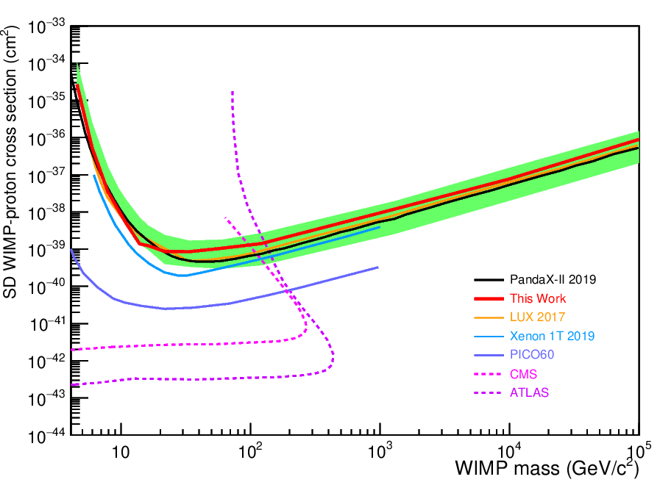
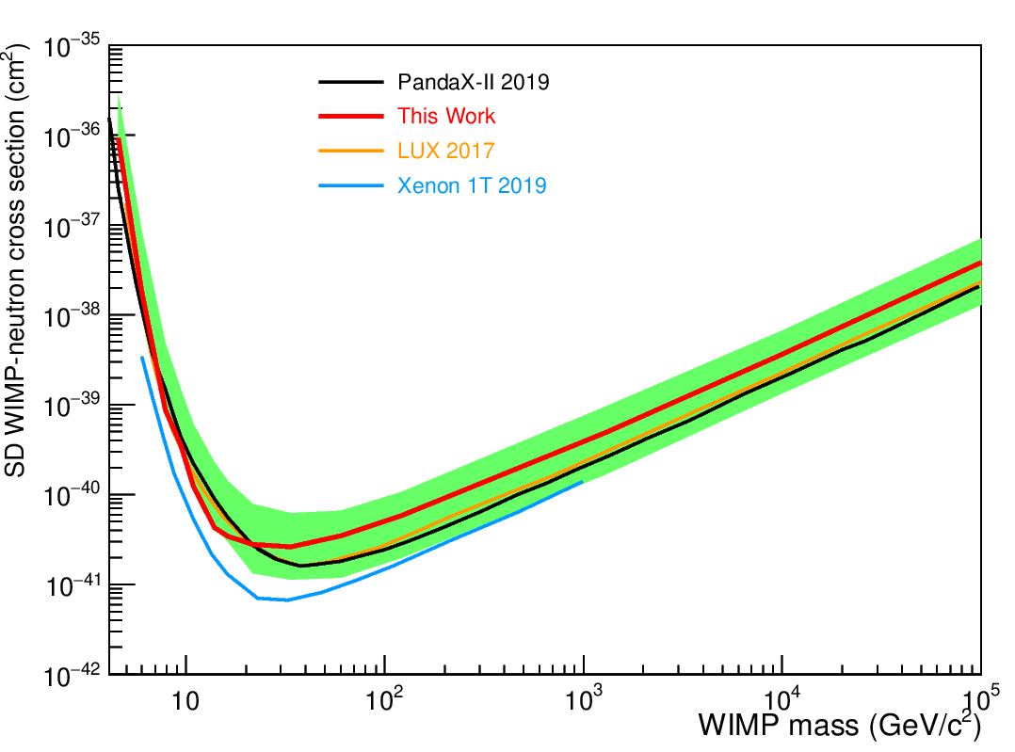
Spin Dependent
The often-used SD
PandaX-II full data constrains on SD interactions.
Better sensitivity compare to former PandaX-II result.
Not appealing due to relativitly high background level and insufficient exposure.
We are expecting a more stringent result with PandaX-4T Data

Slide 9
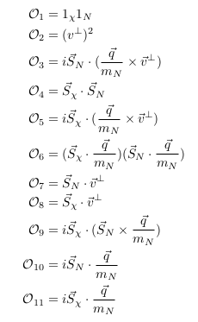
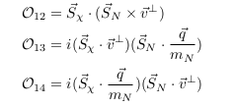
Effective Field Theory
Non-relativistic operators couple to Nucleon
EFT interaction
$c_{i}$are q dependent.
q dependent coefficient will affect the shape of the spectrum.
Anand, Fitzpatrick, Haxton, 1308.6288

Slide 10
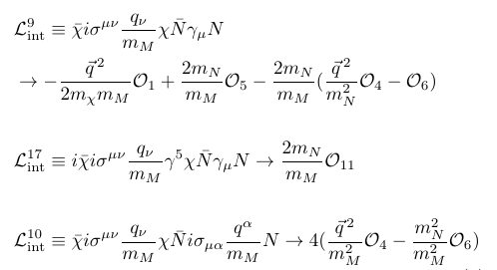
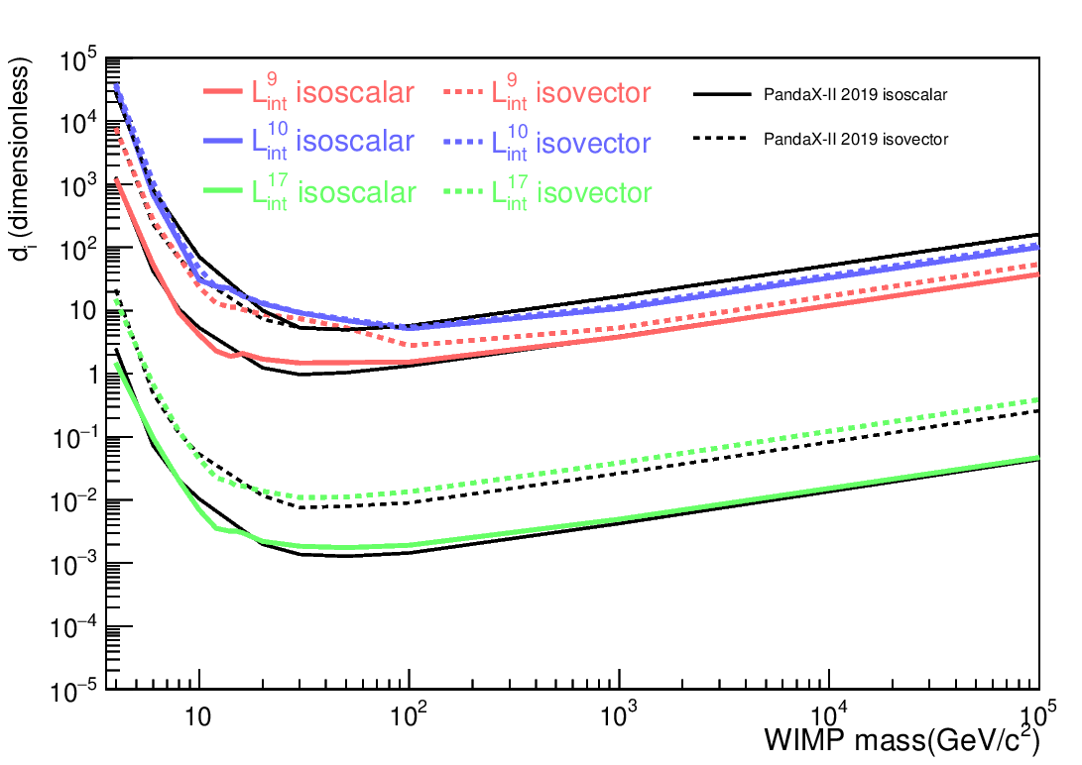
Effective Field Theory
Considerate spin-dependent relativistic operators
Considerate fermionic DM
Exchanging electric and magnatic dipole moment between DM and/or nucleons
Contribute large for large recoil energy
Each operater independently couple to proton and neutron. We choose to considerate isoscalar ($d_{i}^{0}$=0) or isovector ($d_{i}^{1}$=0)
Compared to PandaX-II former result:
Enlarged signal region lead to better constrain for several
operators.
Anand, Fitzpatrick, Haxton, 1308.6288
Xia Jingkai, et al [PandaX], 1807.01936

Slide 11
Conclusion
With PandaX-II full exposure data, we give constrains on Spin-Dependent intereactions and EFT model.
We extent region of interest to 25keV, for higher NR detection effenciency in large recoil energy region.
We give a better constrain on EFT relativistic operators L9 and L10 with extented signal region.
We are expecting a better constrain for Spin-Dependent intereactions as well as other EFT operators with PandaX-4T data.

