Slide 1
Development of the CMS-HGCAL silicon module center in Beijing
张华桥 (高能所)
17 Aug 2021@HEP-CPS, China

Slide 2
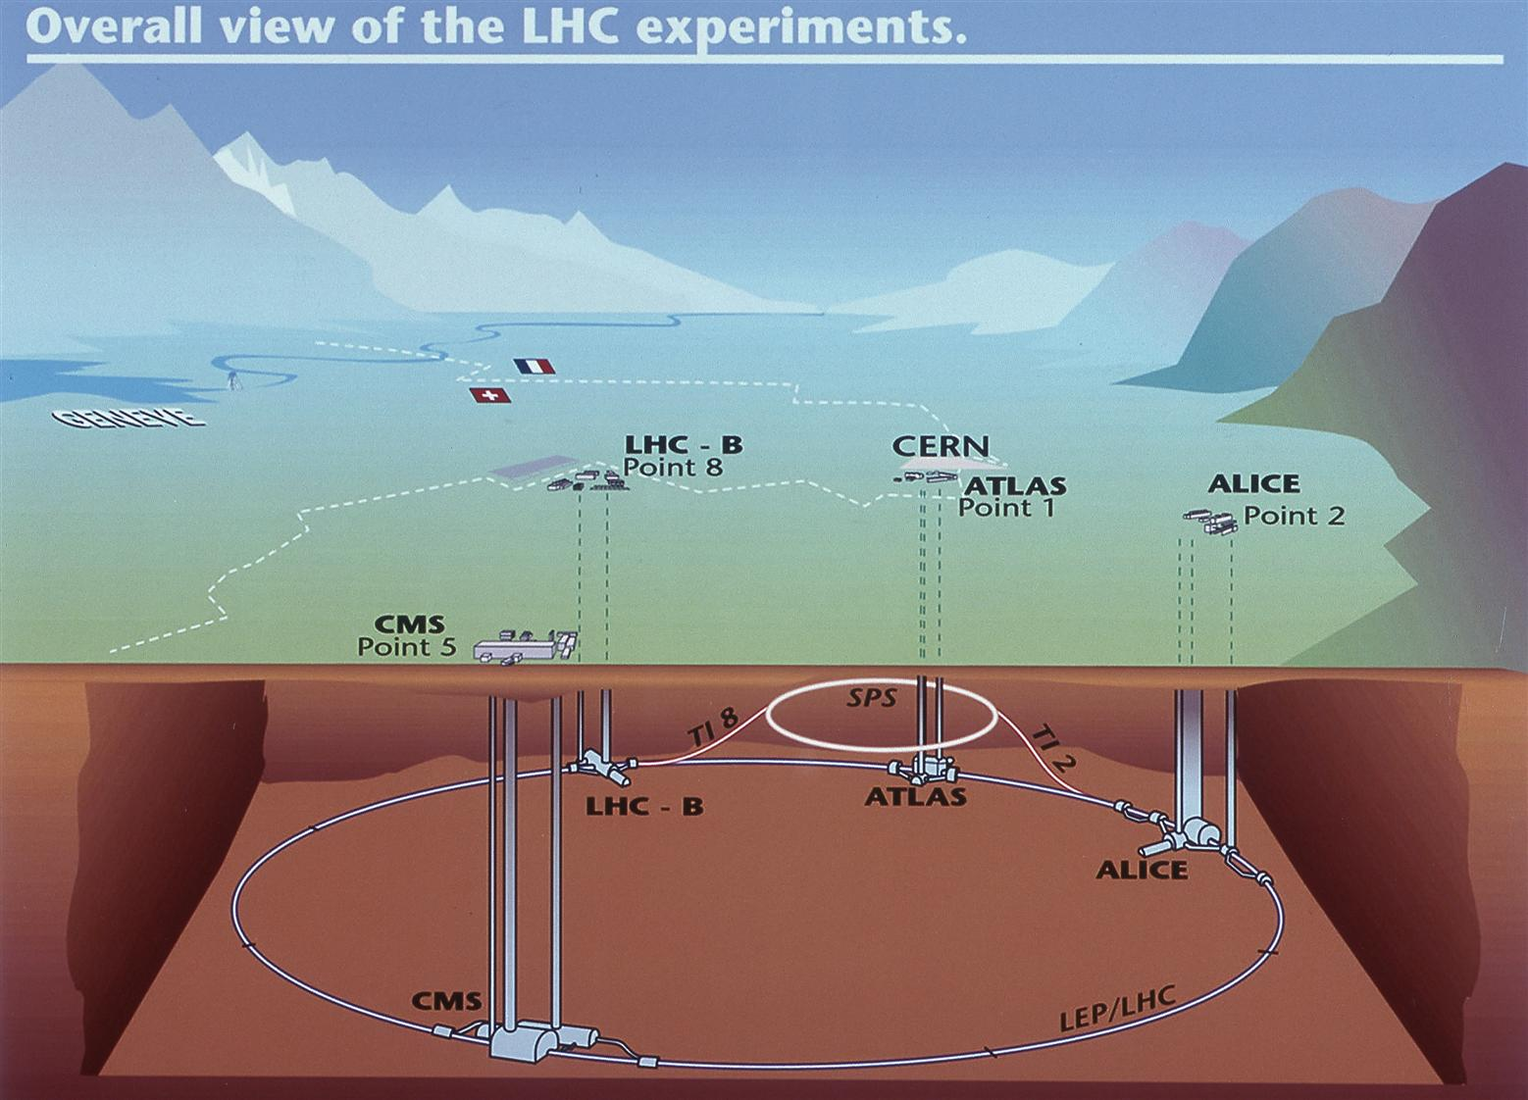
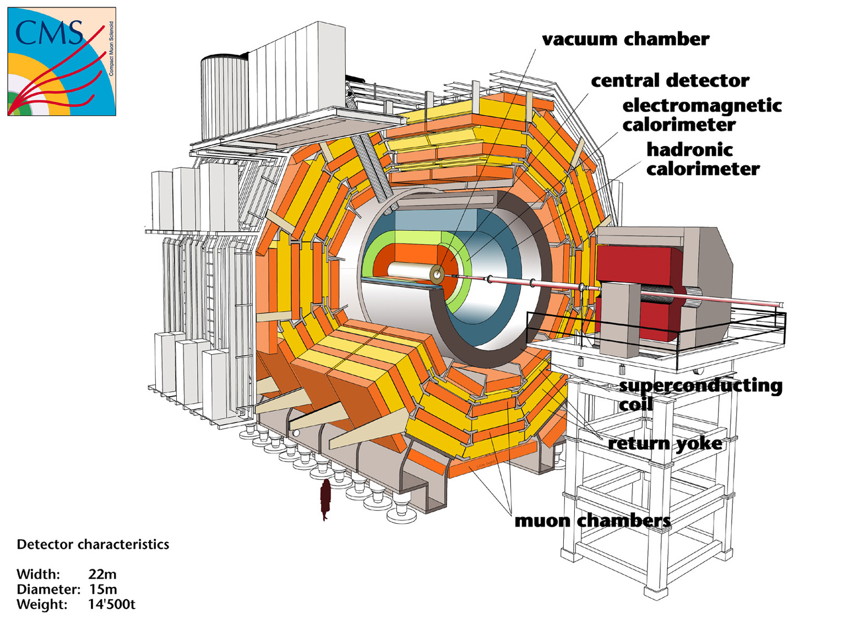
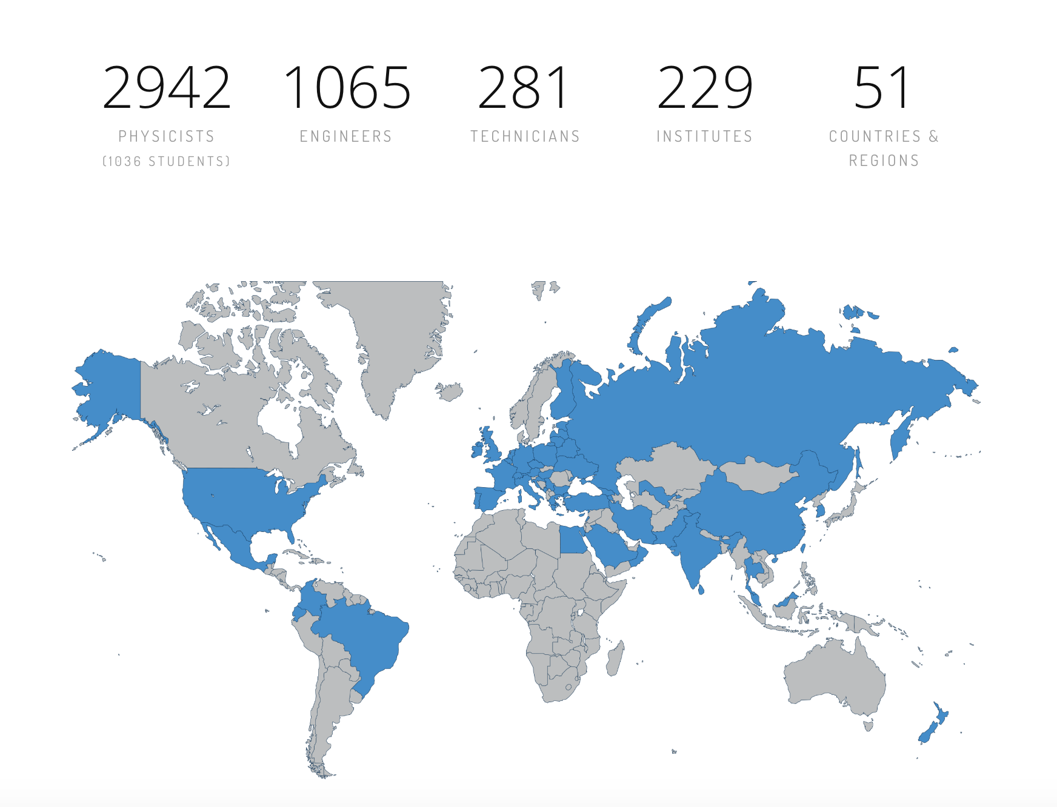
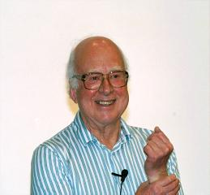
CMS (compact muon solenoid) experiment
14 TeV
最重的探测器
中国
RPC/CSC
GEM/Trigger/HGCal

Slide 3
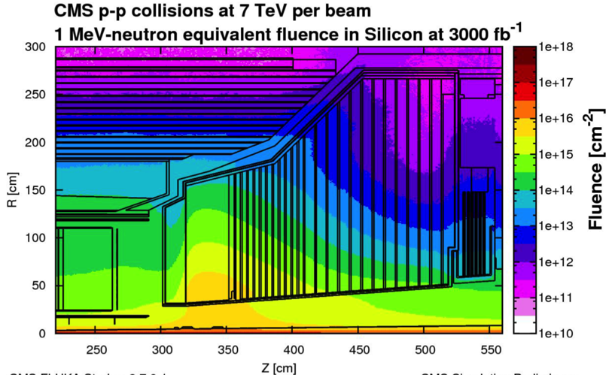
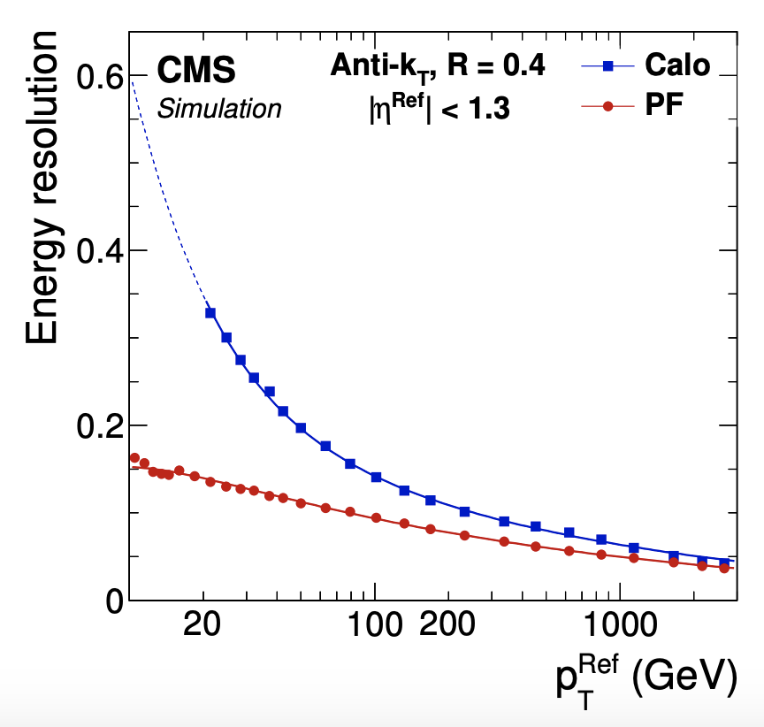
CMS endcap calorimeter phase II challenges
JINST 12（2017） P10003
Charged tracks：
Tracker（70%）；
photons：
ECAL（20%）；
Neutral hadrons ：
HCAL (10%)
CMS @ HL-LHC: ~1x10¹⁶ 1 MeV n_{eq} cm⁻² @ 3ab⁻¹
and up to 2 MGy absorbed dose in endcap calorimeters
140-200 pile up in HL-LHC
Considering these two requirement within the limited given budget…
CMS High Granularity Calorimeter
(HGCal)
CMS-TDR-019

Slide 4
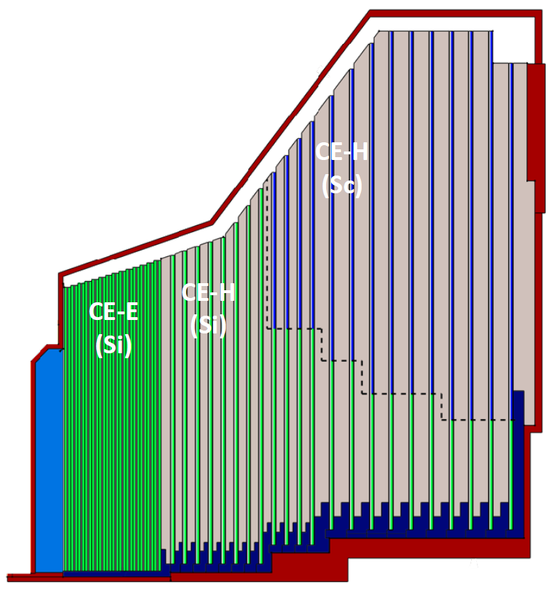
CMS High Granularity calorimeter
France/Prague/Japan/England
Similar idea
CMS HGC
Approved to be built 2015-2025
Years of R&D，
Application Not yet approved
Other future HEP experiments
advantage： radiation hard, one readout per cm³
Excellent energy, position, time res.：5D Calorimeter

Slide 5
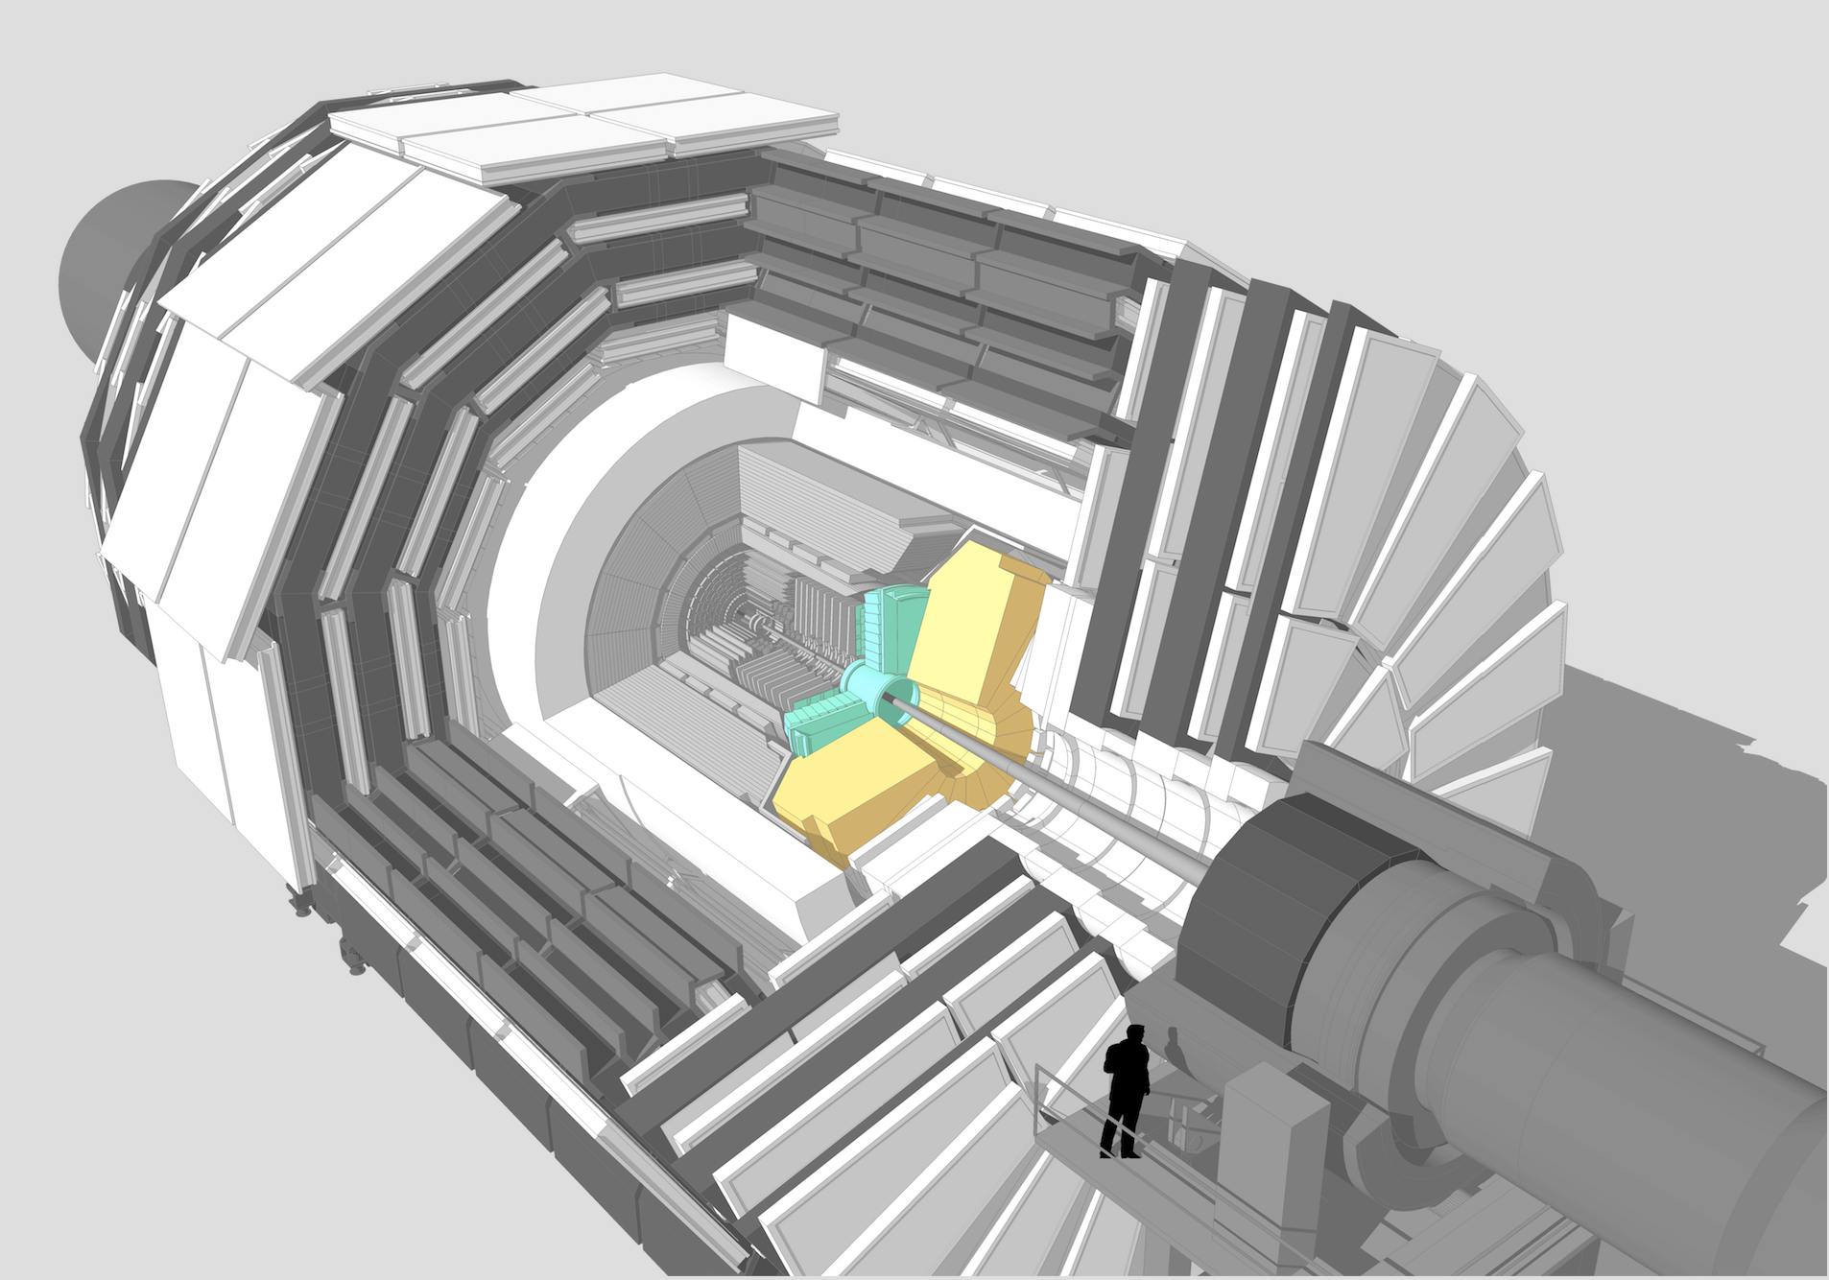
CMS HGCAL: 50-layer sampling calorimeter
Active Elements:
Hexagonal modules based on Si sensors in CE-E and high-radiation regions of CE-H
Scintillating tiles with SiPM readout in low-radiation regions of CE-H
2 m
mass ∼ 200 T
each endcap
Key Parameters: (updated from TDR)
HGCAL covers 1.5 < ｜η｜ < 3.0
Full system maintained at -30ºC
~640m² of silicon sensors
~370m² of scintillators
6M Si channels, 0.5 or 1.1 cm² cell size
Data readout from all layers
Trigger readout from alternate layers in CE-E and all layers in CE-H
~31000 Si modules including spares
η = 1.5
r = 2.62 m
η = 3
r = 0.28 m
Electromagnetic calorimeter (CE-E): Si,Cu/CuW/Pb absorbers,28 layers,25.5 X₀ & ~1.7λ
Hadronic calorimeter (CE-H): Si & scintillator, steel absorbers, 22 layers, ~9.5λ

Slide 6
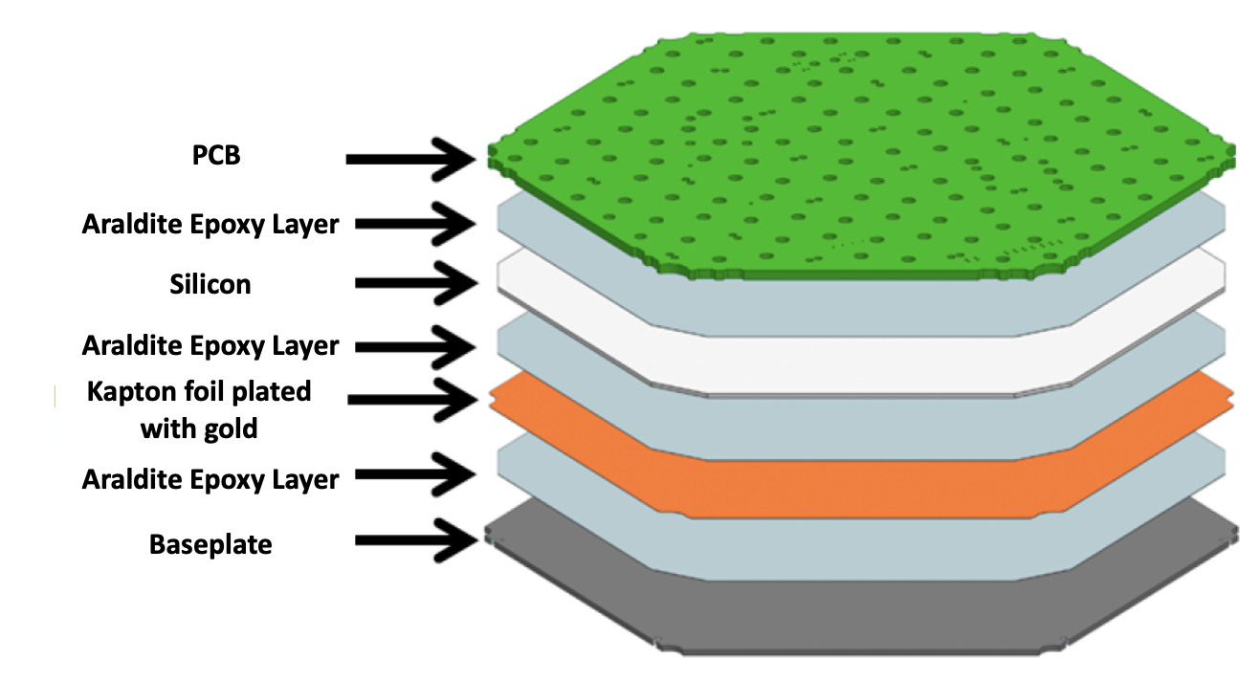
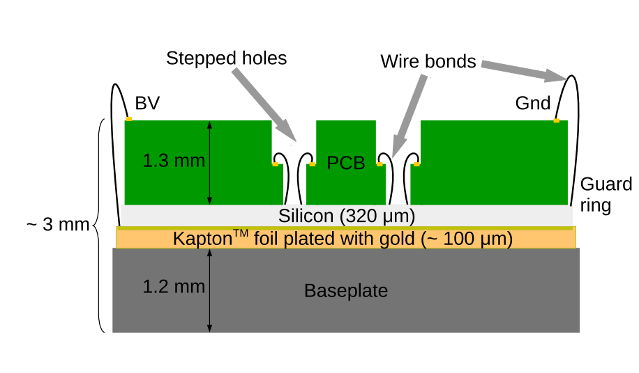
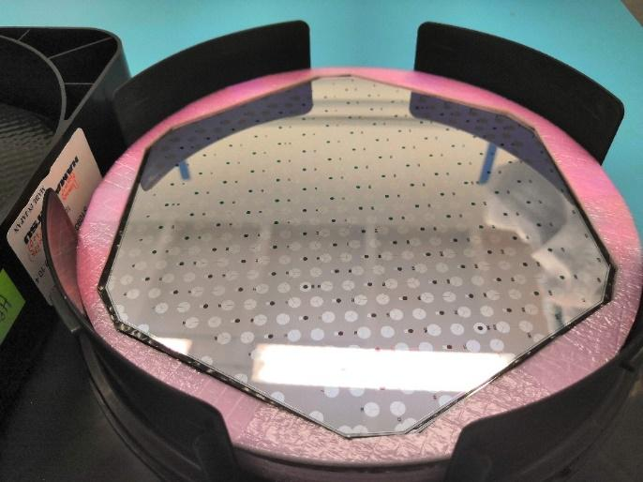
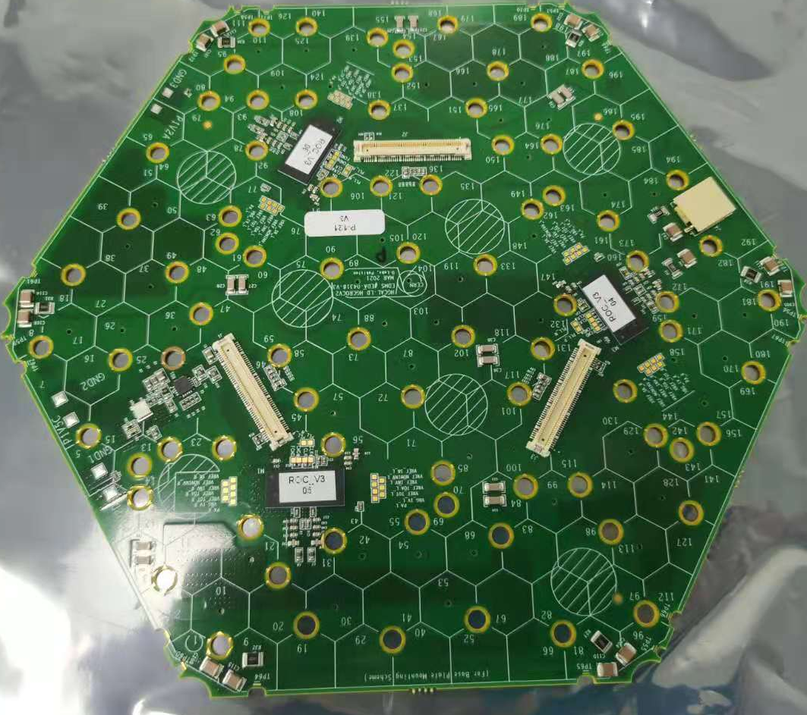
CMS HGCal Silicon active layer
120 μm, 200 μm, 300 μm for different radiation level
640 m² silicon/31000 module(3 times as CMS silicon tracker)
Working under -30 degrees
Very compact layers to integrate active materials
sensor
PCB
module

Slide 7
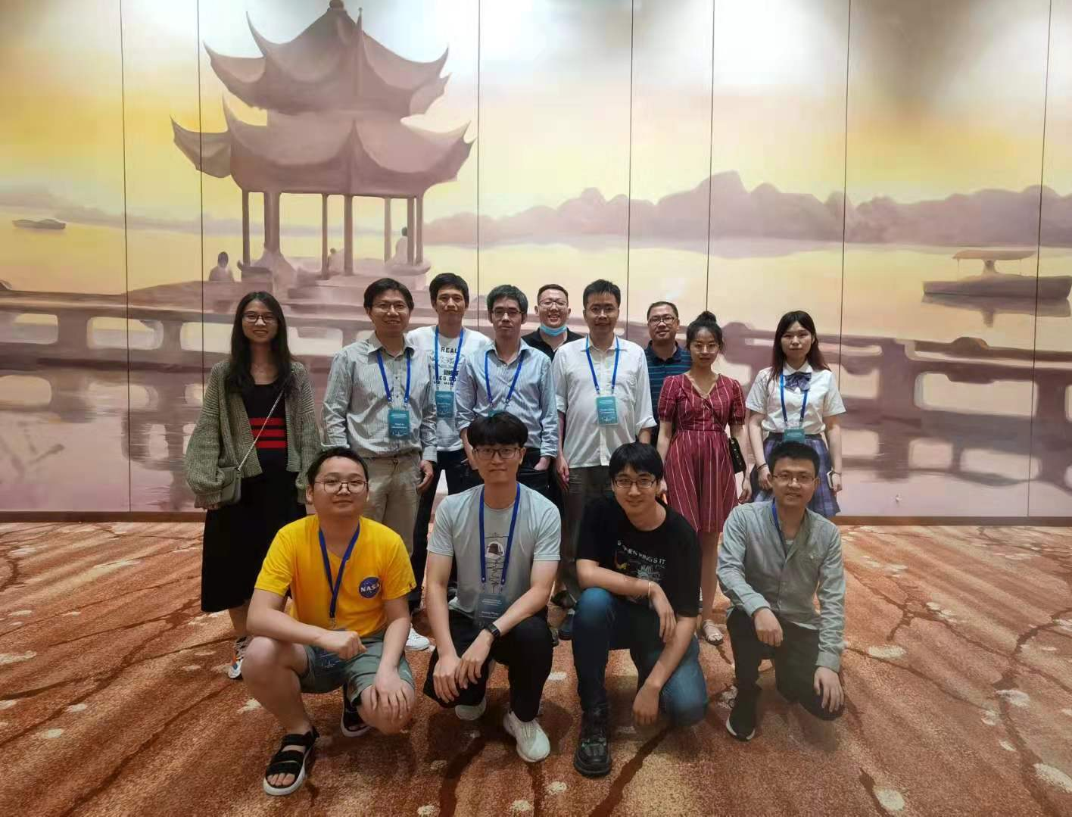
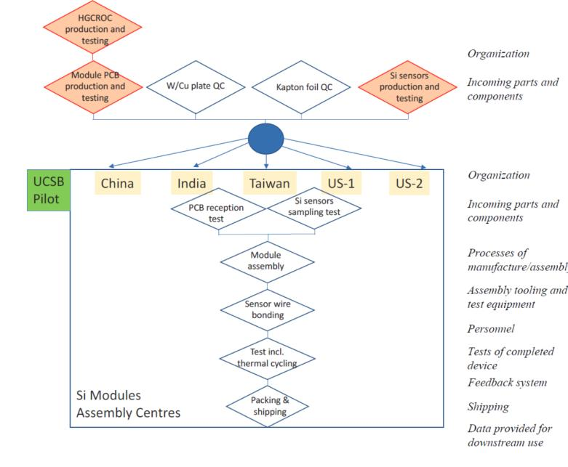
Tasks of silicon MAC
6 MACs: 3 in US, 3 in Aisa
Beijing IHEP host a MAC
Each MAC will on avarage produce ~5200 Modules
More than 100 m² silicons and 1M readout channels
May 2021
Beijing
Part of HGC team at IHEP

Slide 8
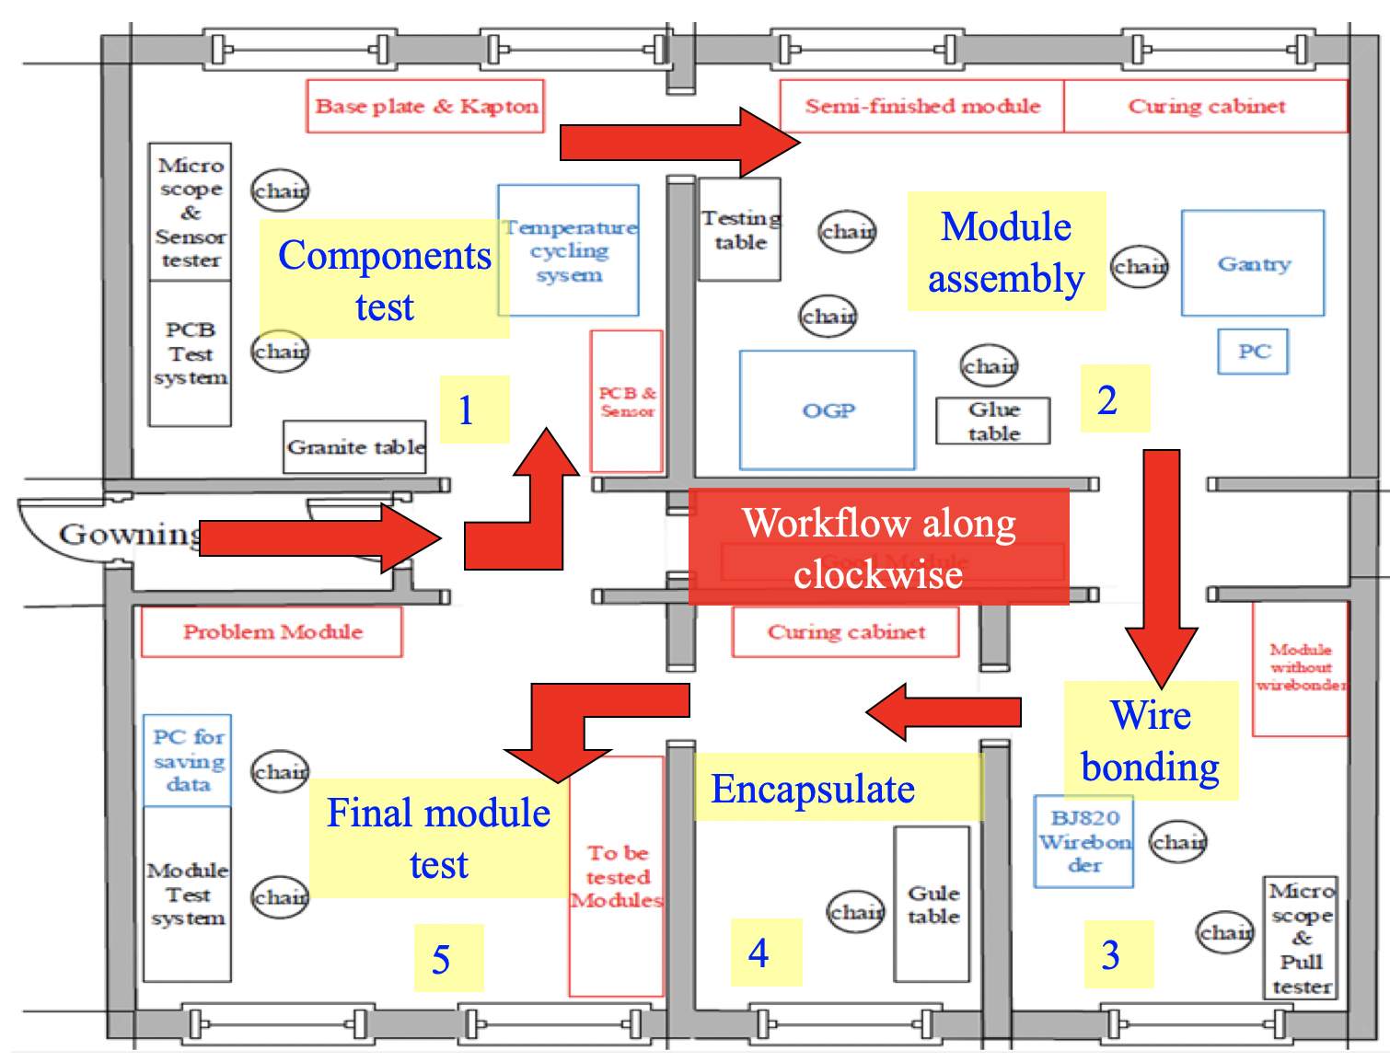
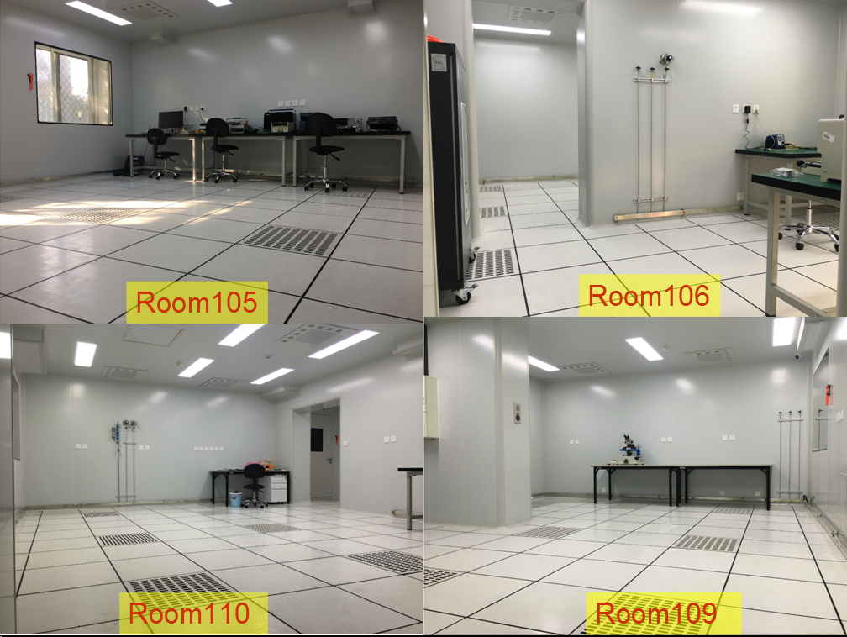
IHEP HGCal lab infrastructure: cleanroom
140m² dedicated cleanroom（Class 1000） ready：
Temperature：20ºC to 22ºC
Humidity：35% to 55%
Compressed/vacuum/dry air pipe installed
CMS/HGCal management visit IHEP MAC: 2019/09
绑定区

Slide 9
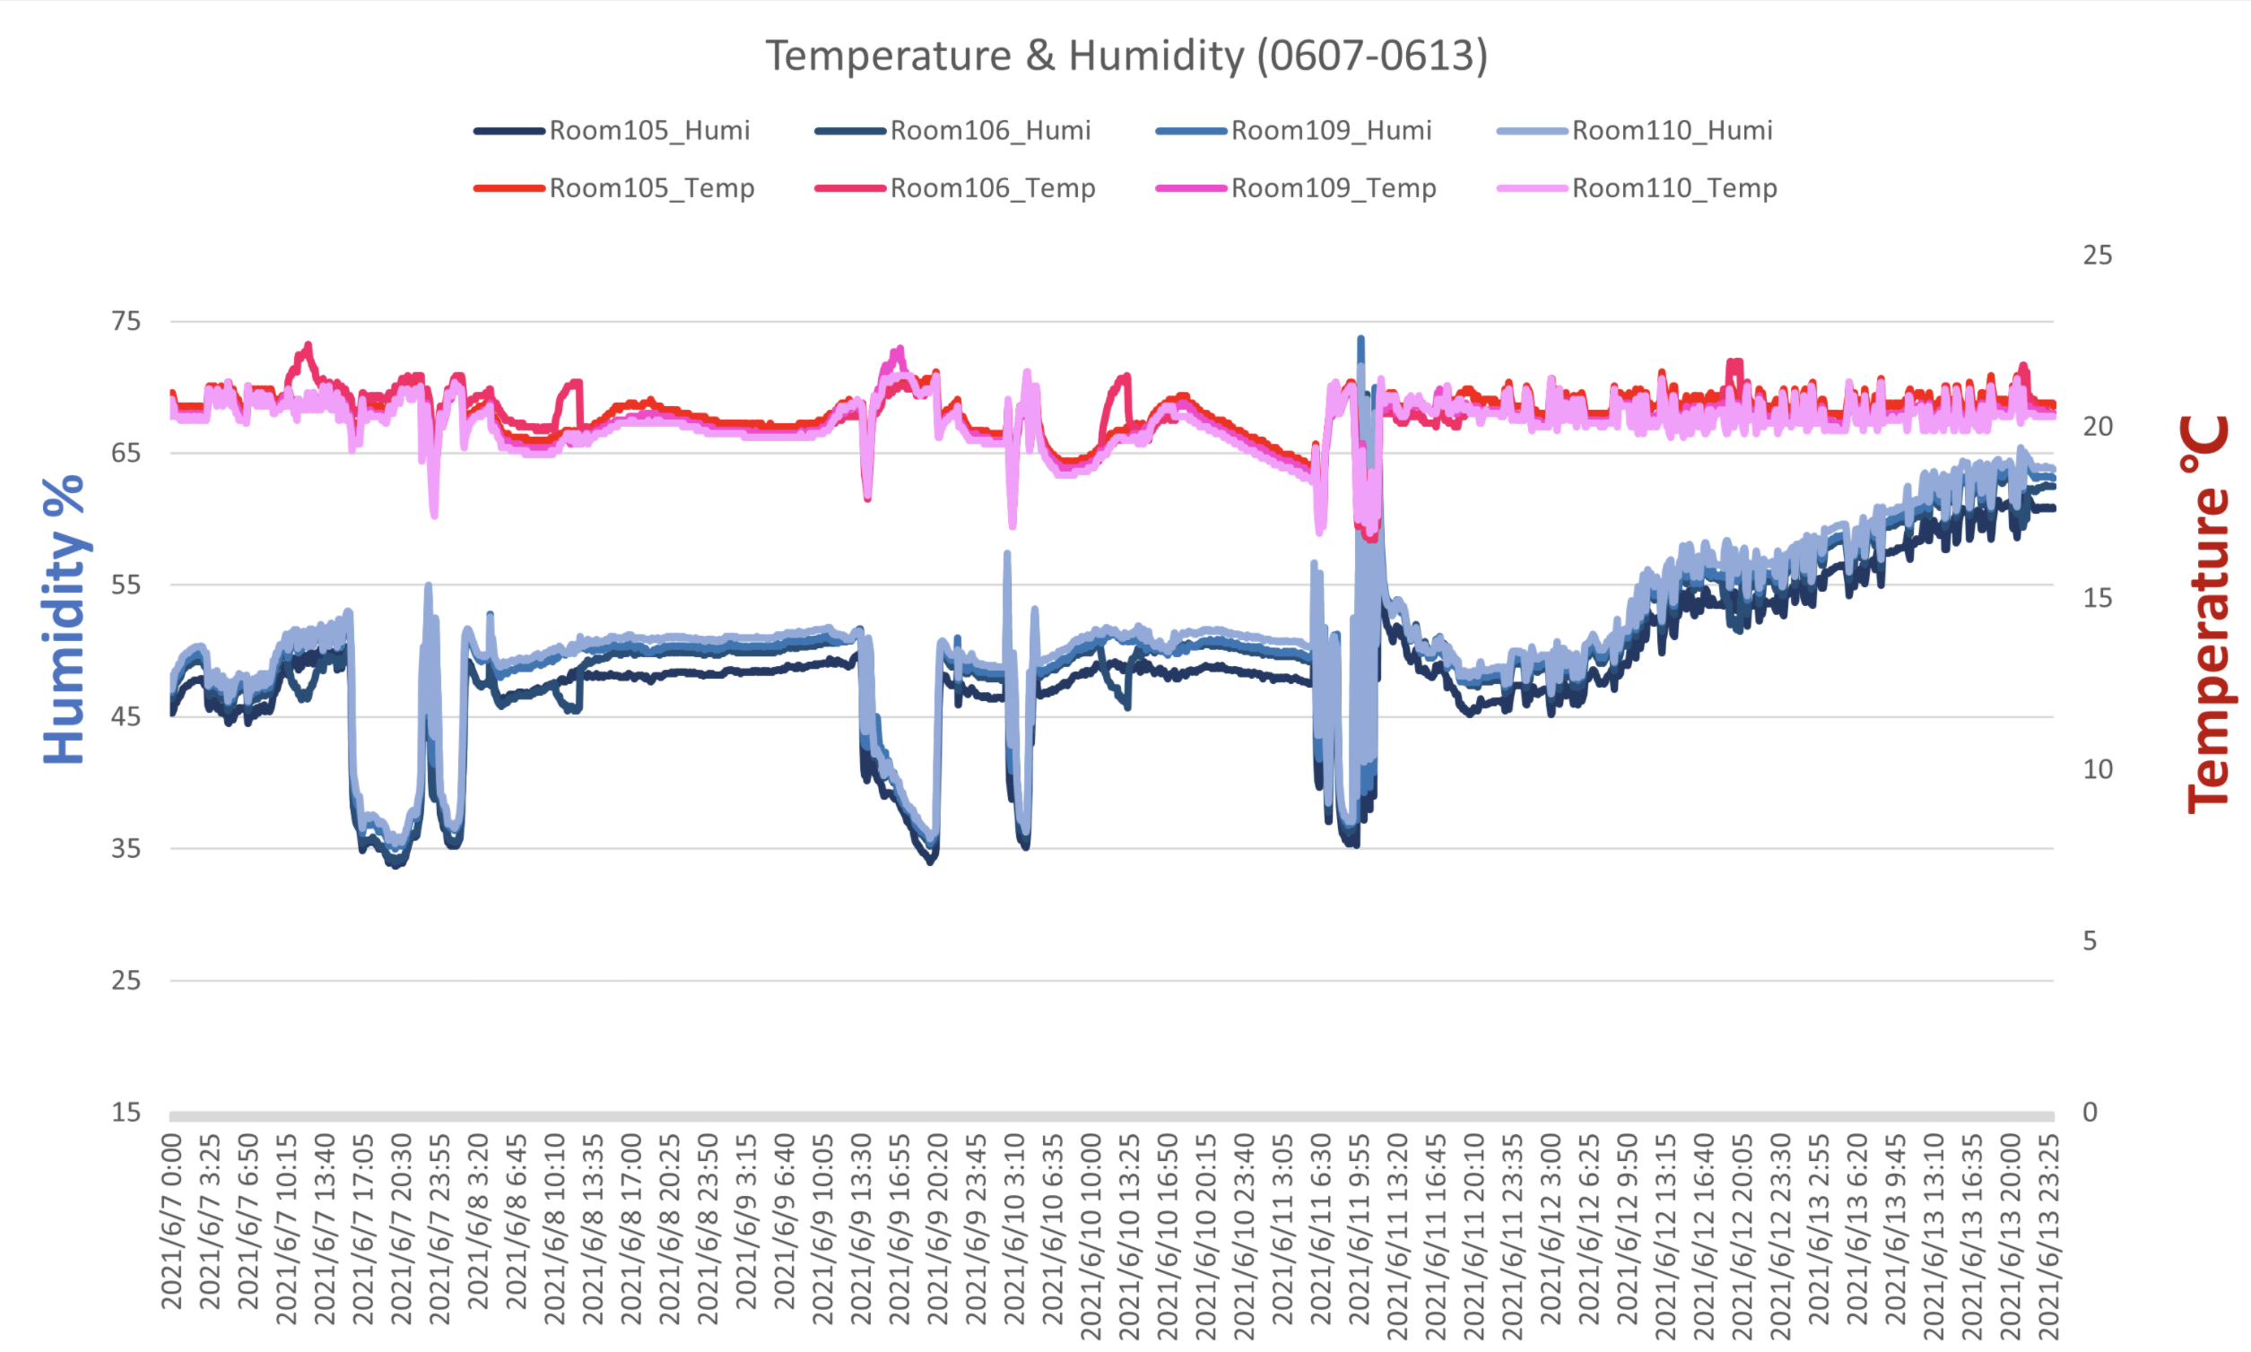
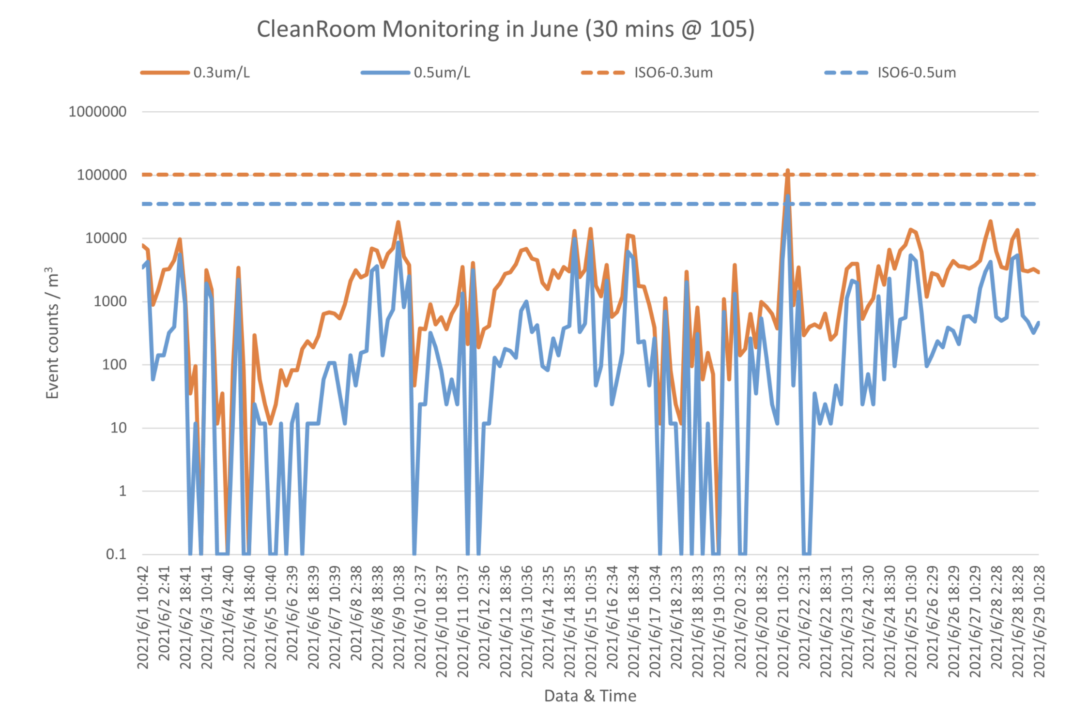
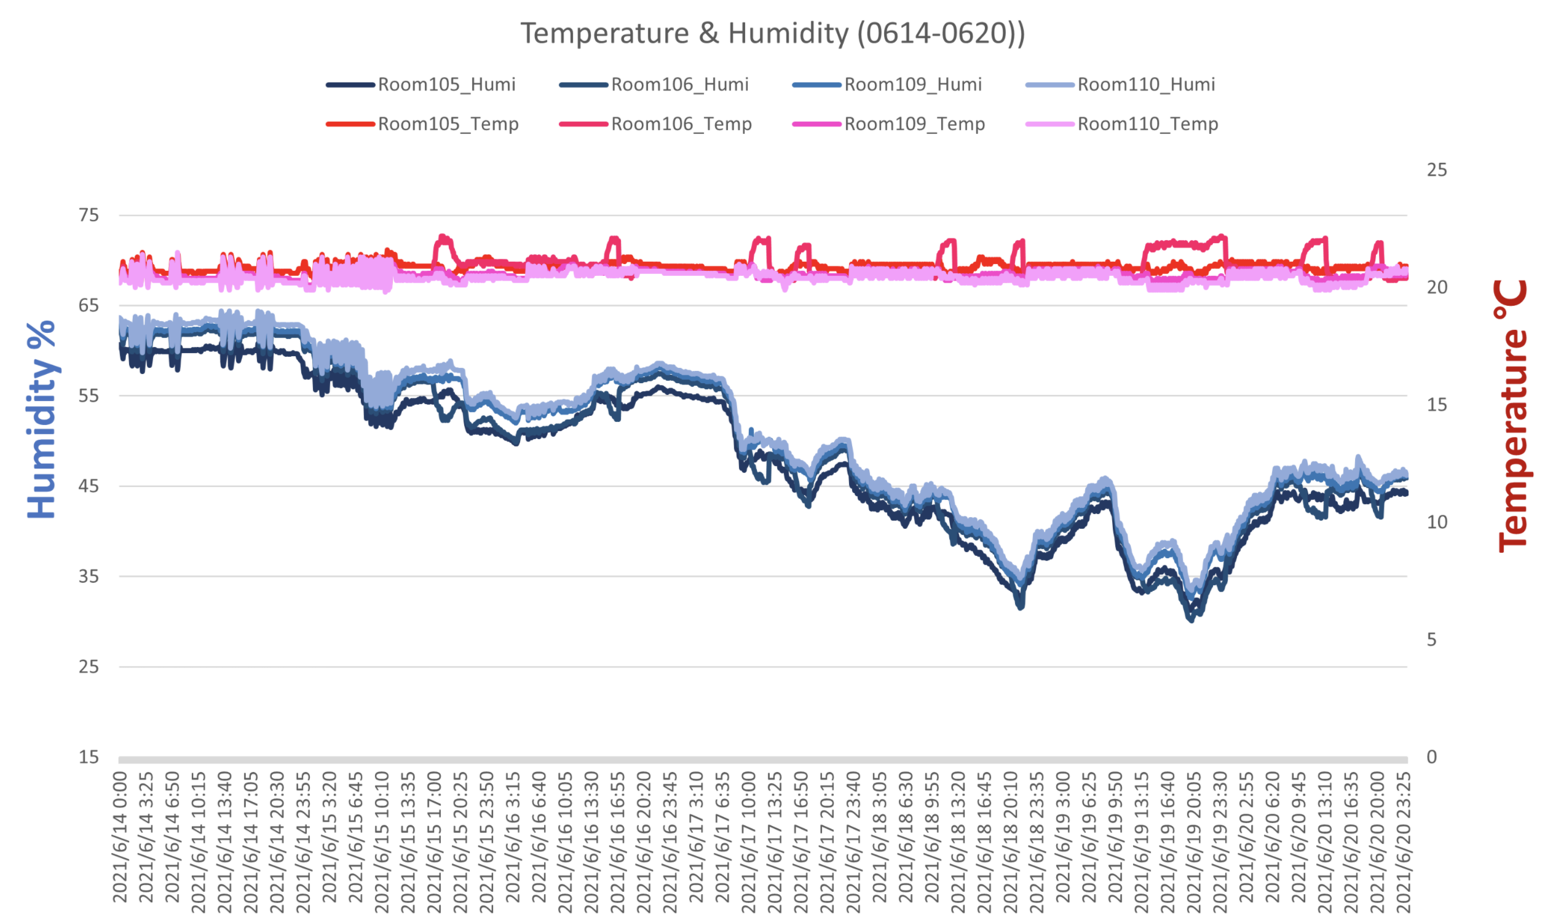
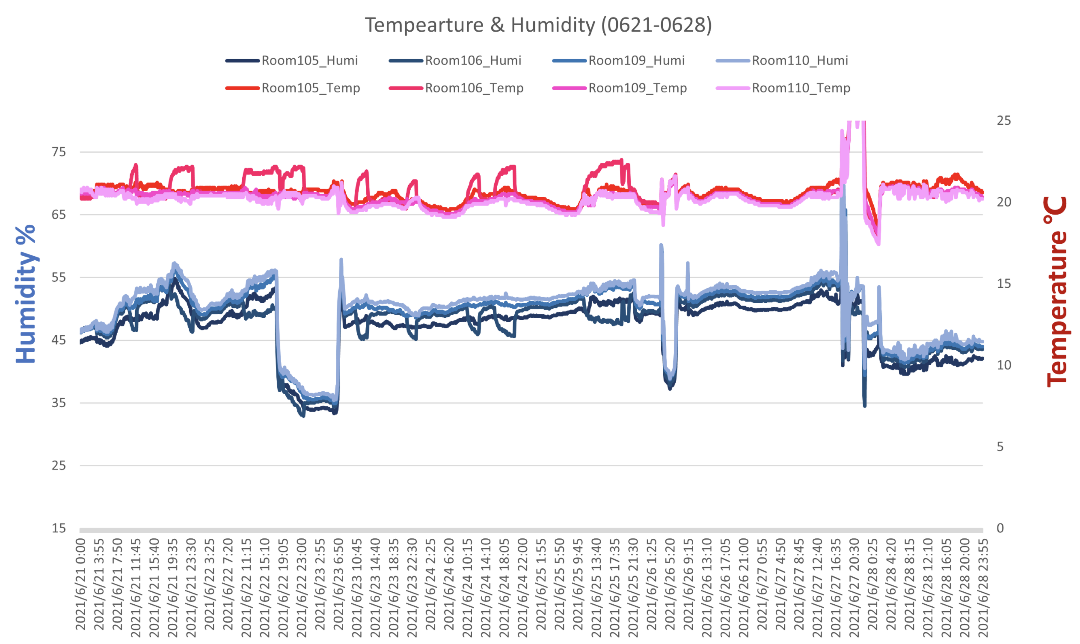
Operation of cleanroom
Continuous monintoring
Cleanness of June in HGC lab:
Better than class 1000
Tempeture and Huminity are under control (even some of variation due to work/tune of clean room)

Slide 10
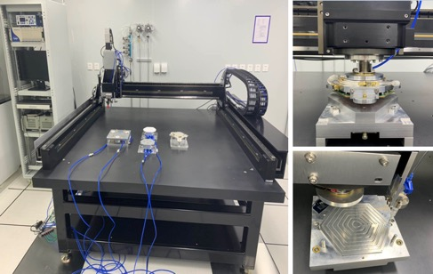
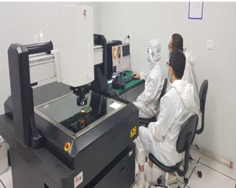
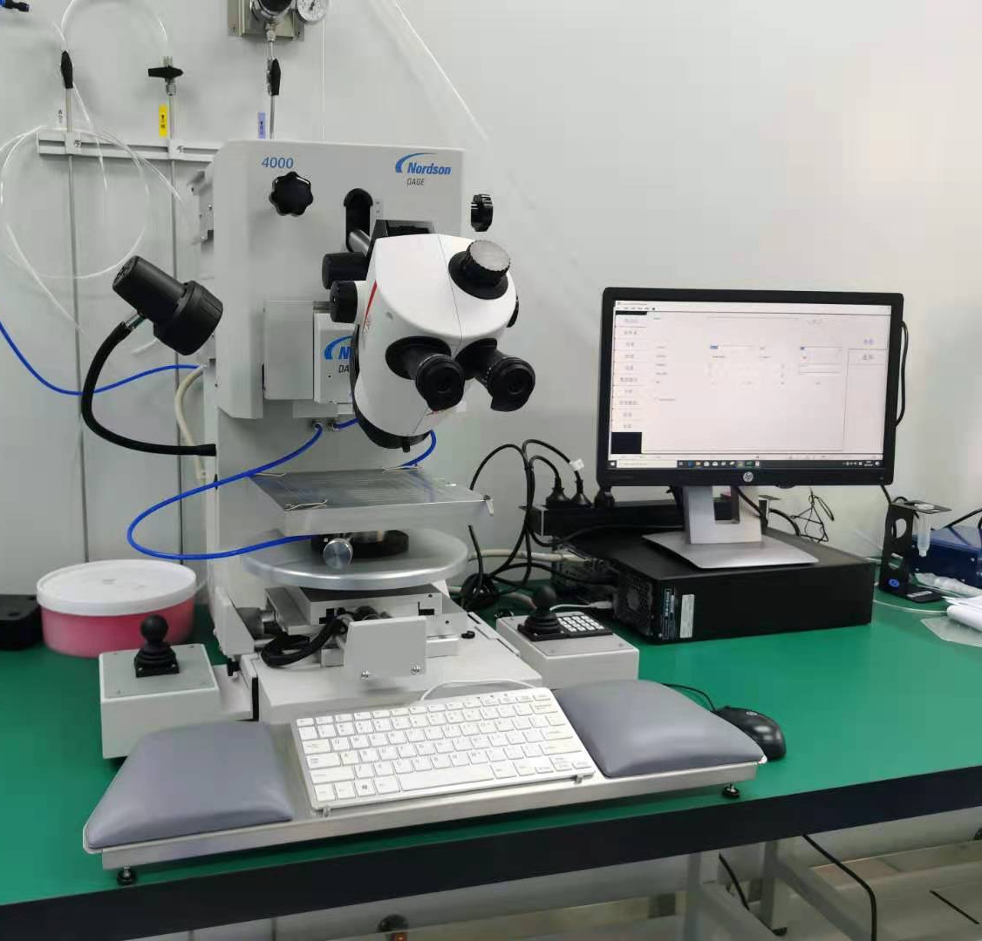
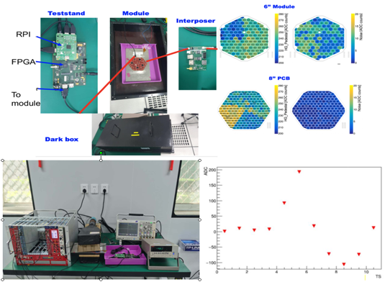
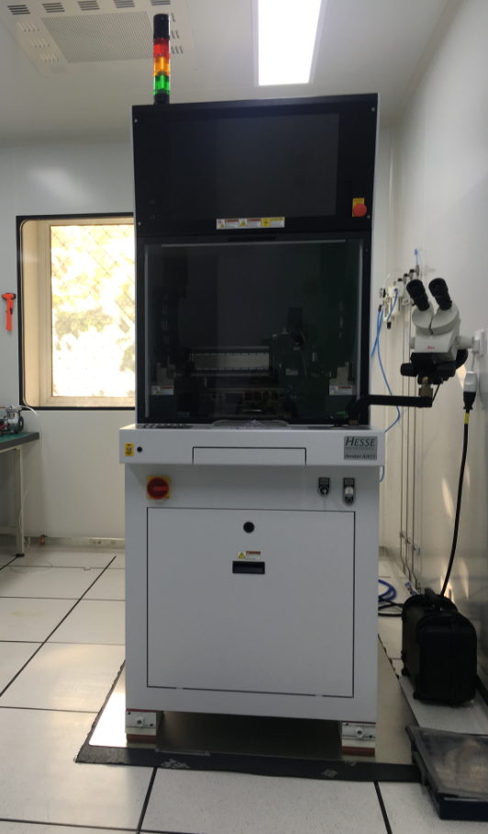
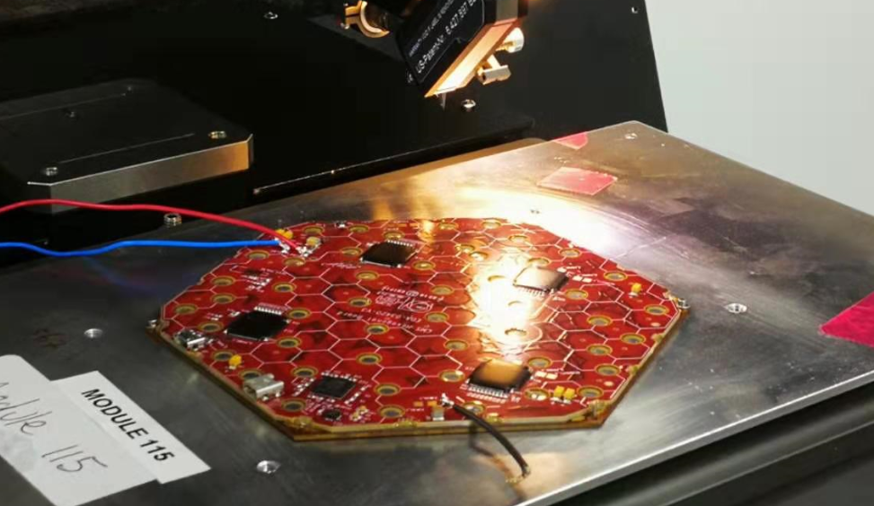
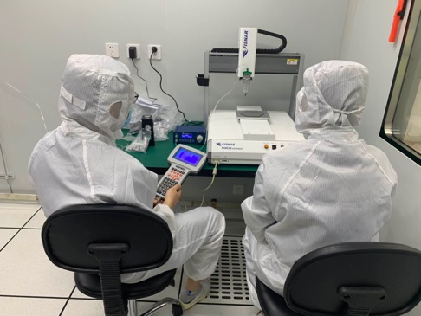
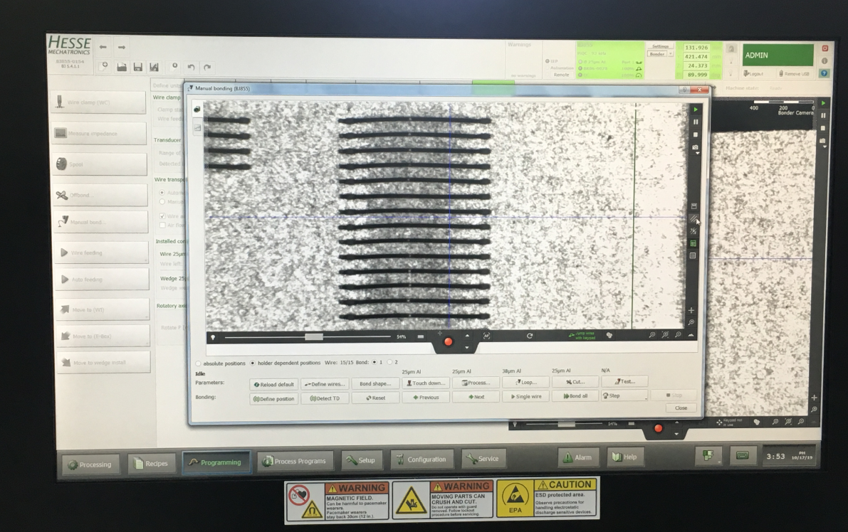
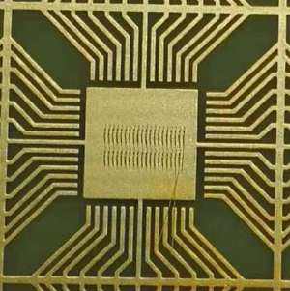
IHEP HGCal lab infrastructure: equipment/training done
Pick up
Dispense
OGP training
Pull tester
Gantry with assembly tools
Module test
Mini gantry training
Cosmic ray test
Bonder and test

Slide 11
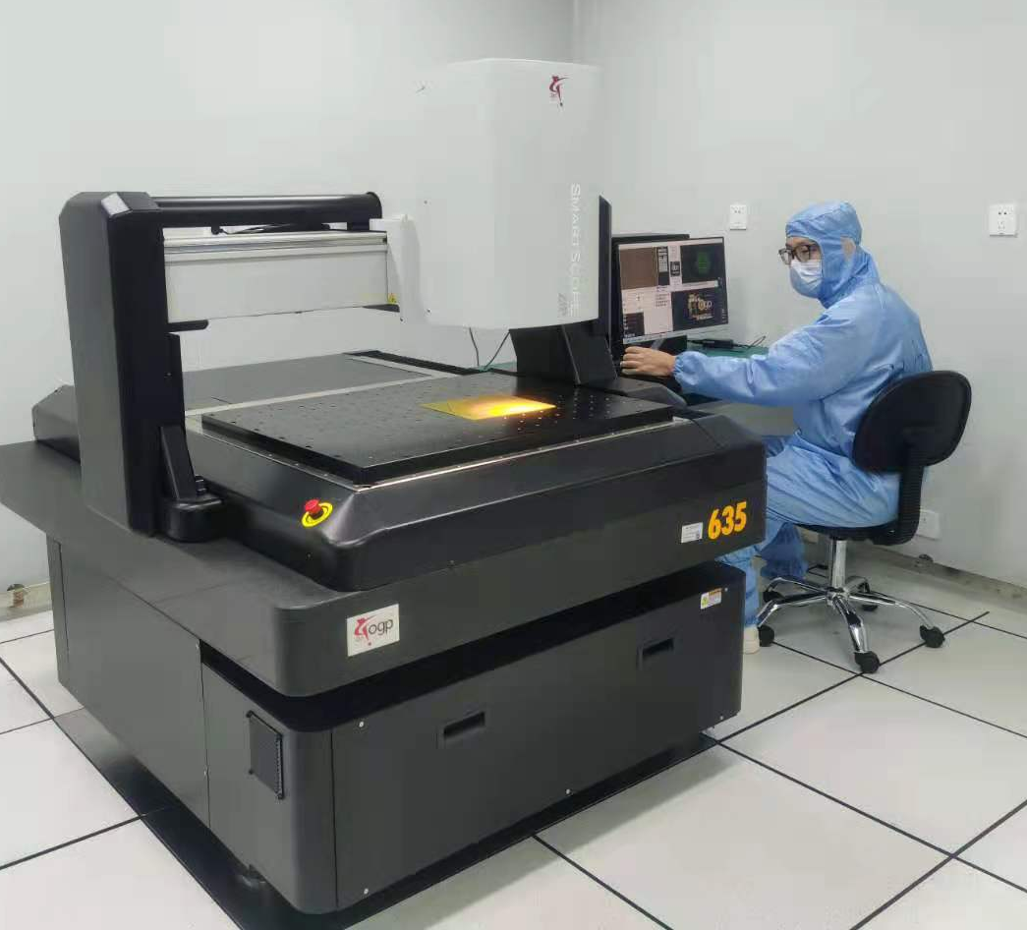
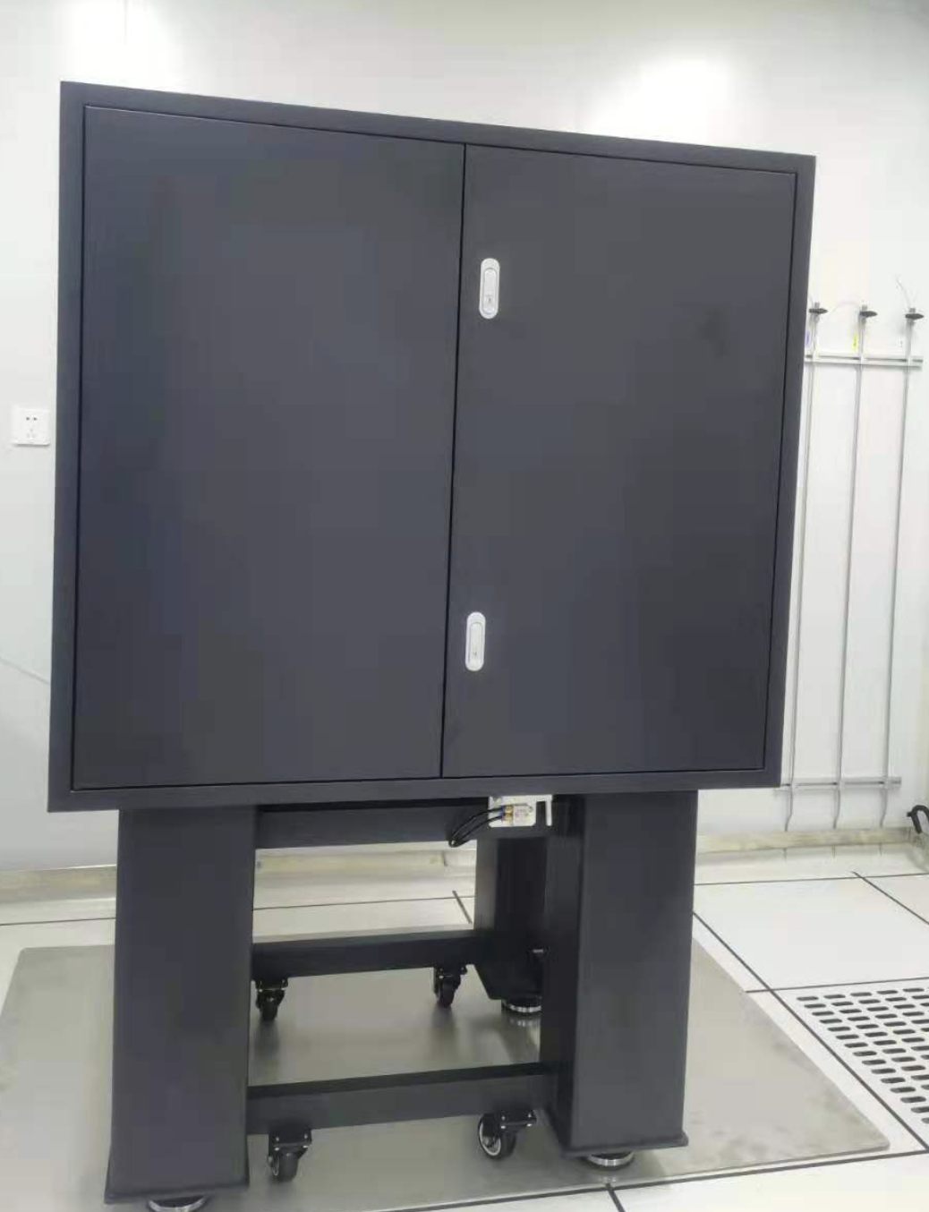
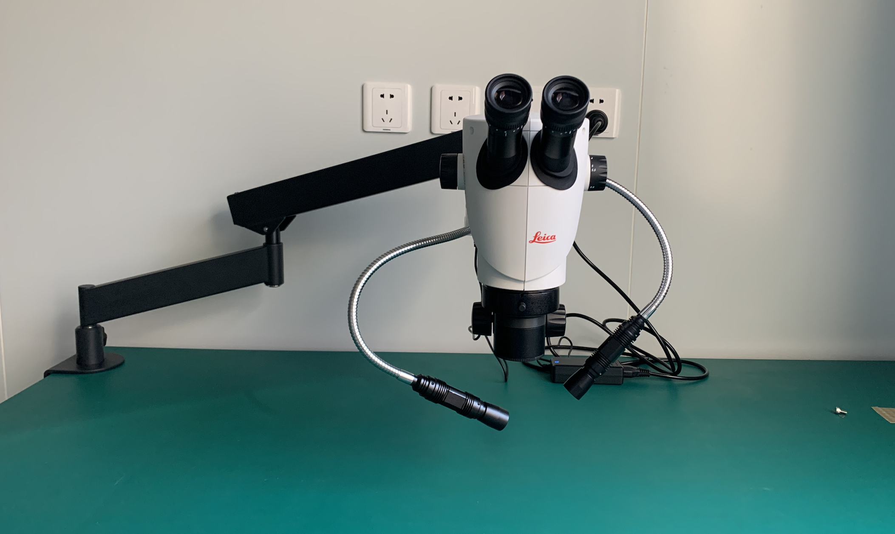
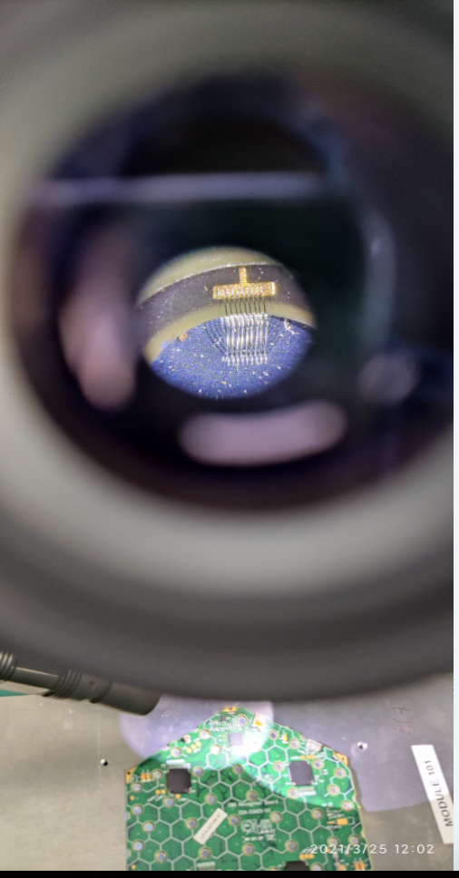
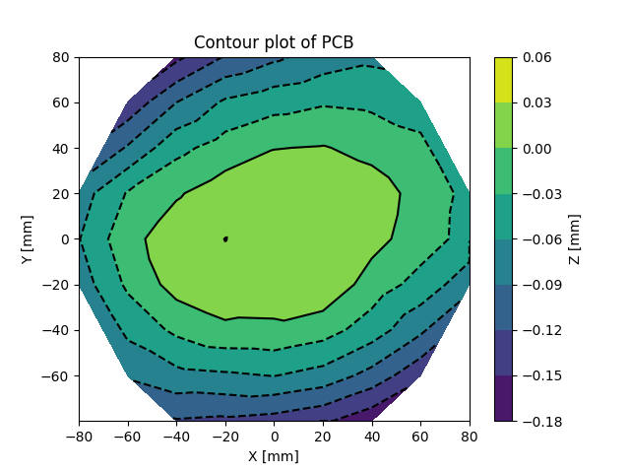
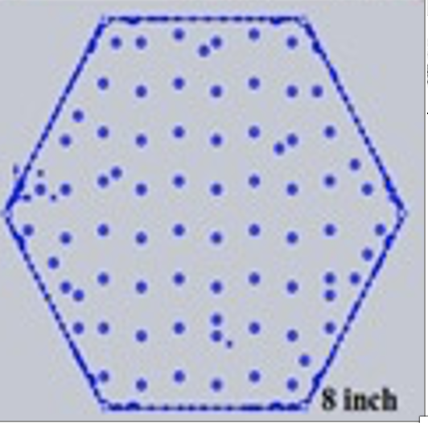
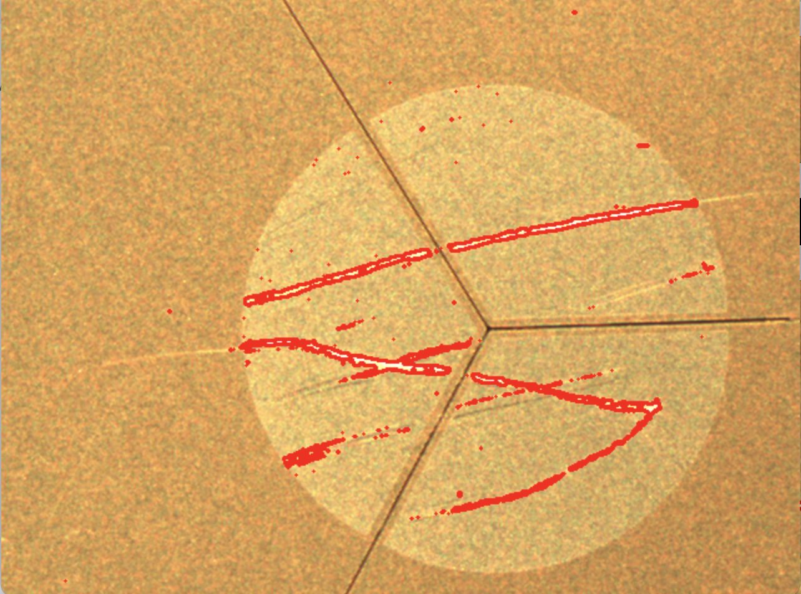
Componant checks
Optical gauge products ZIP 635
Automate meansurement without contact
Microscope:
Quick visual checks
Microscope
Bonding check
OGP ZIP 635
Silicon sensor probe station MPI TS200
Shape of PCB
Flatness of PCB
Scratches on sensor
划痕识别

Slide 12
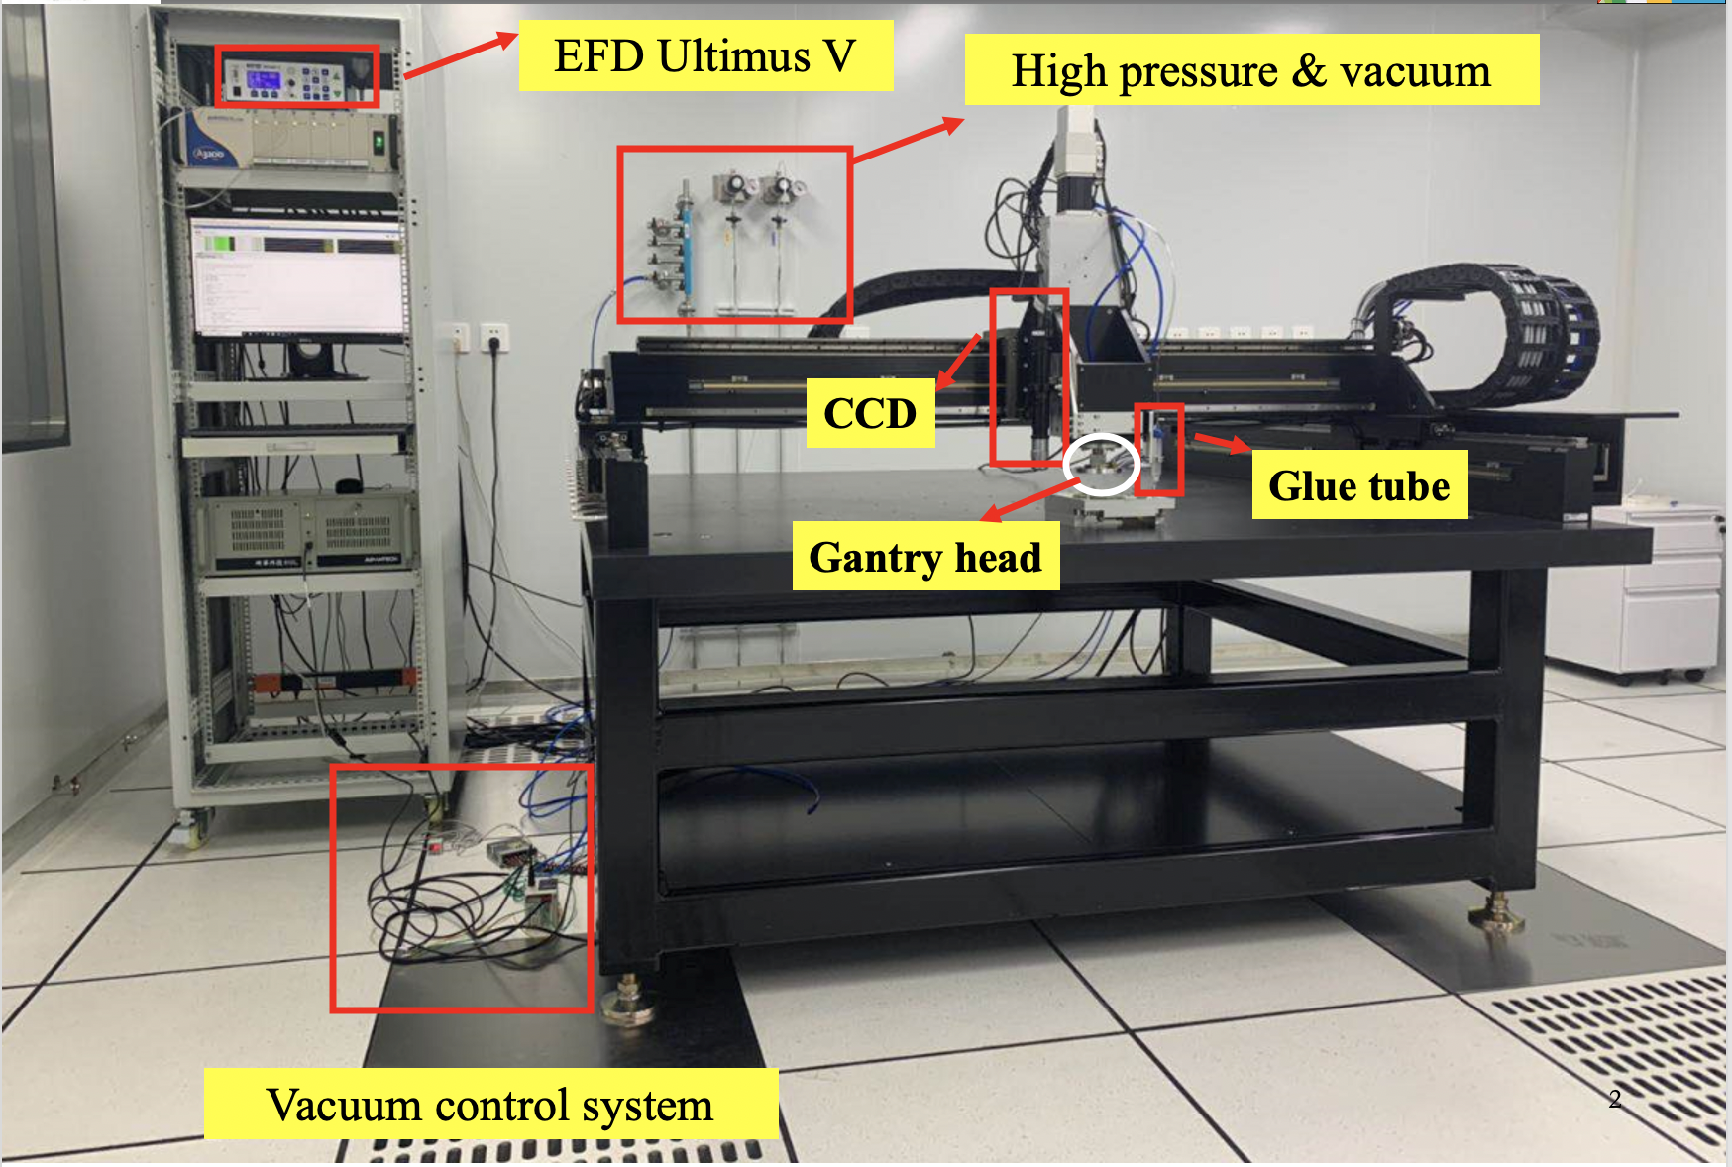
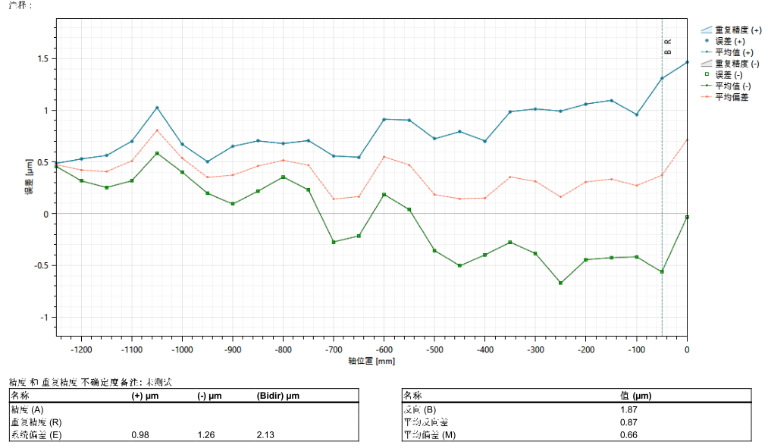
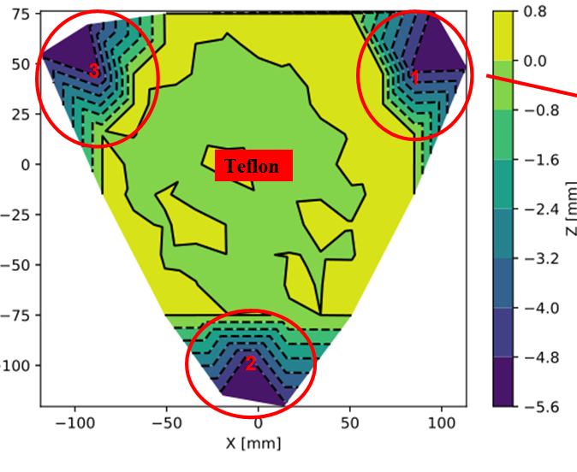
Module assembly (1)
Module assembly is done on 1.25m*1.25m gantry
Integrate vacum, high presure gas, vision system, dispensor
Automated and cordinated by dedicated software
Calibrated with ~10 micron precision
Gantry Repeadility: 1 𝝁 m
Flatness of gantry fixture

Slide 13
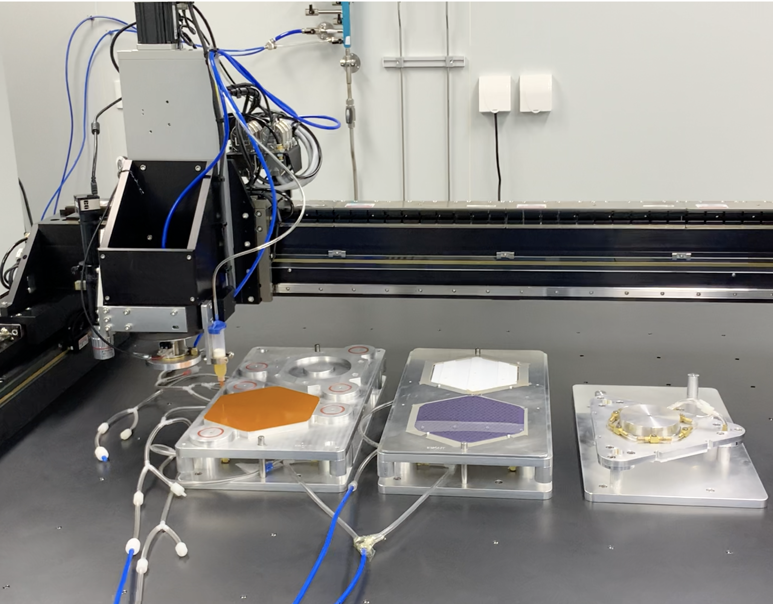
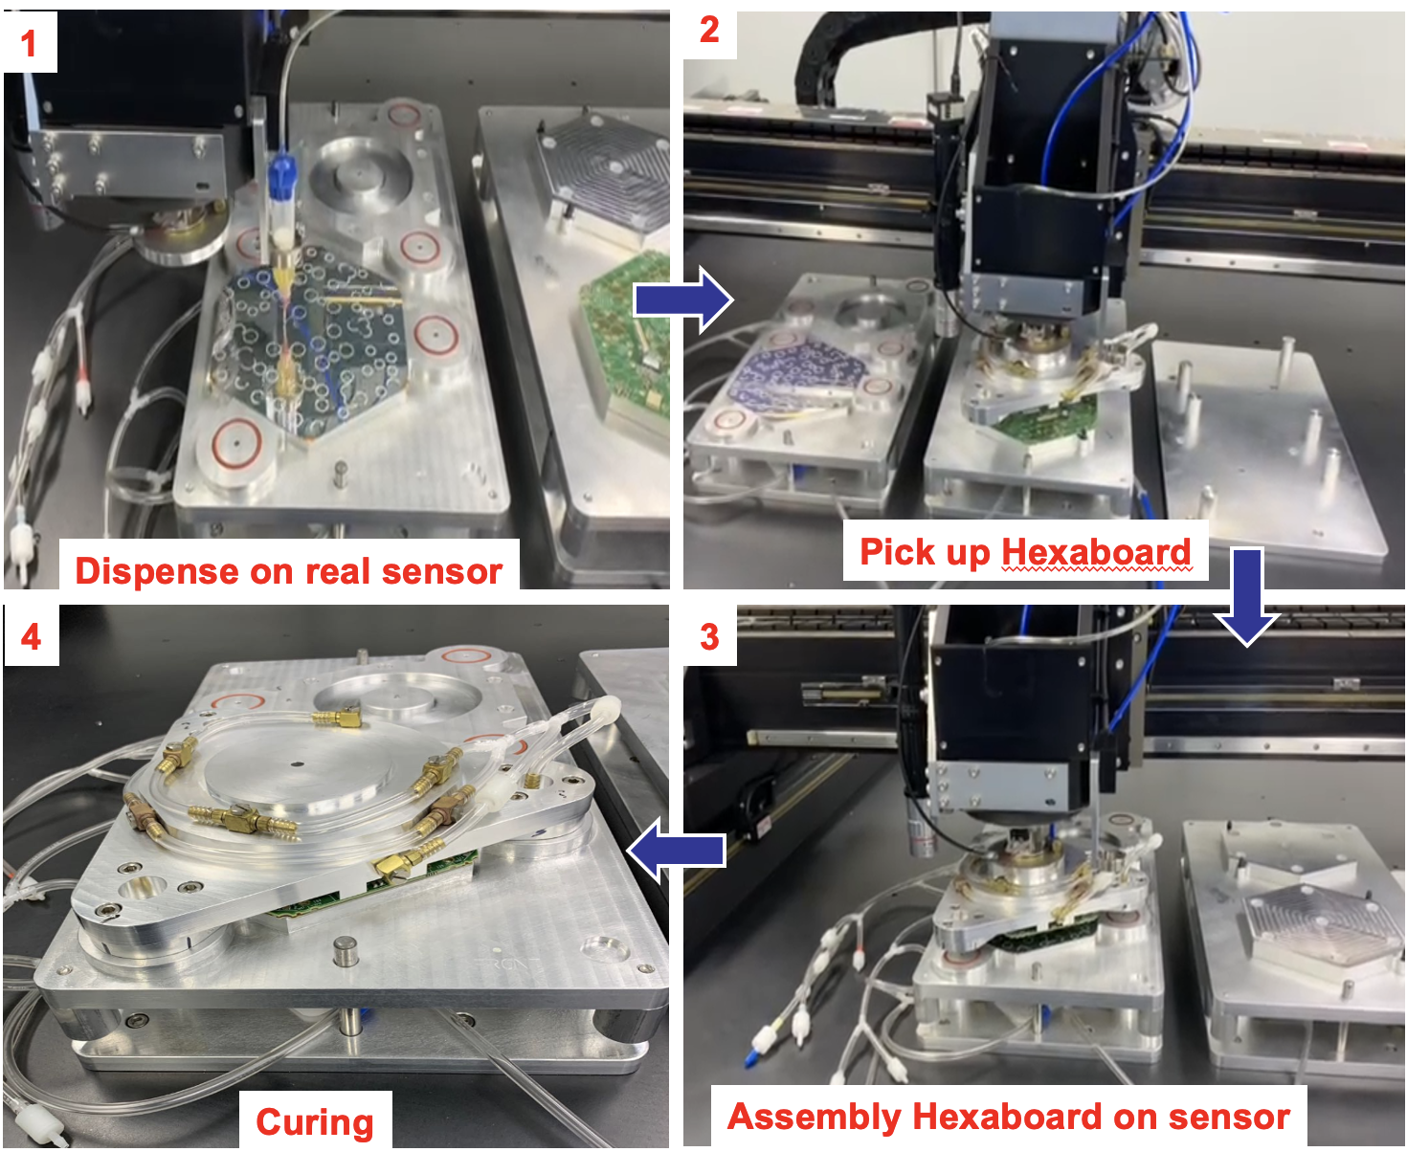
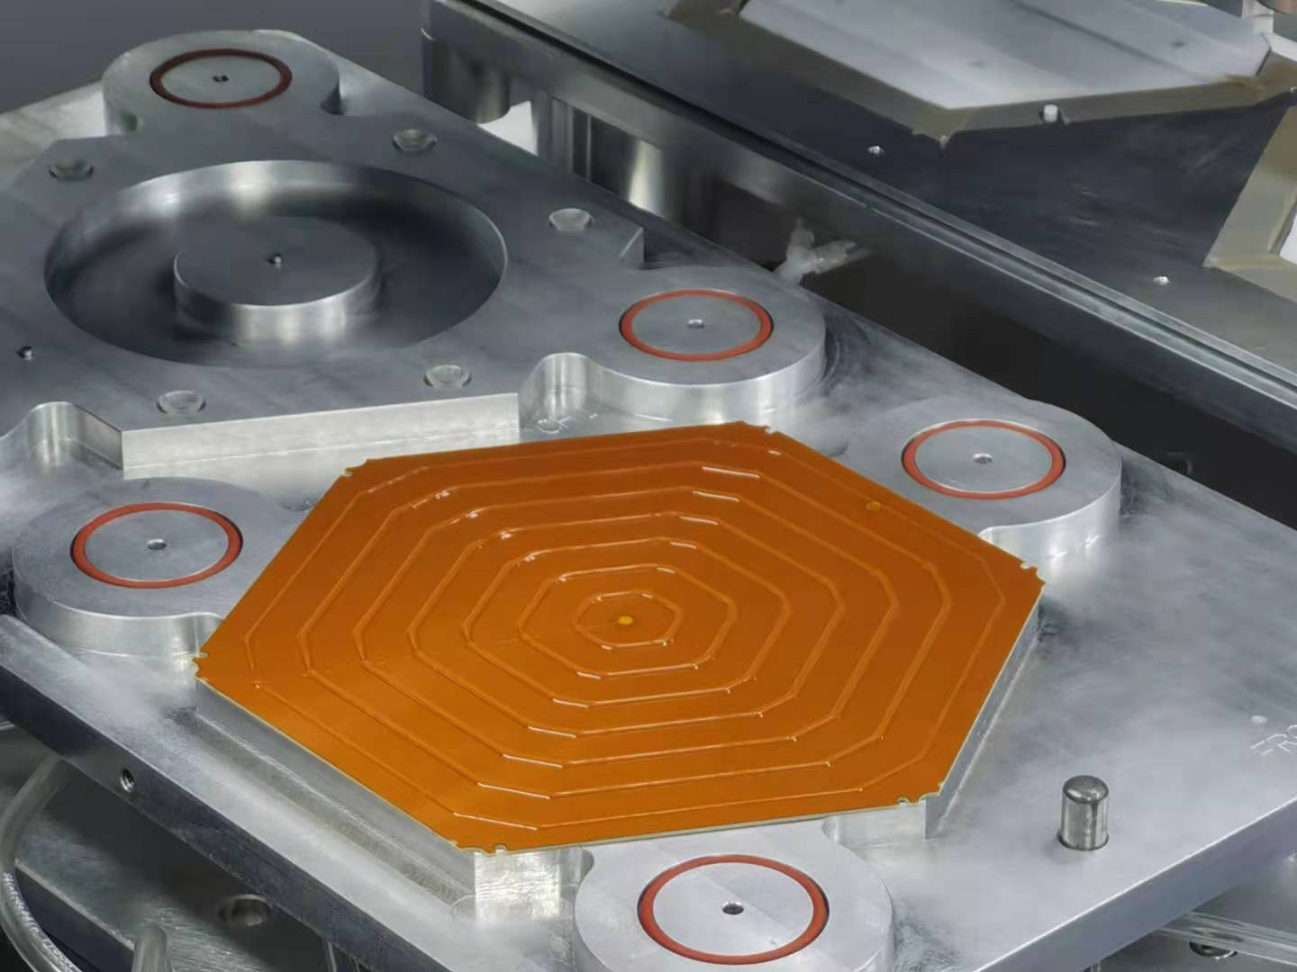
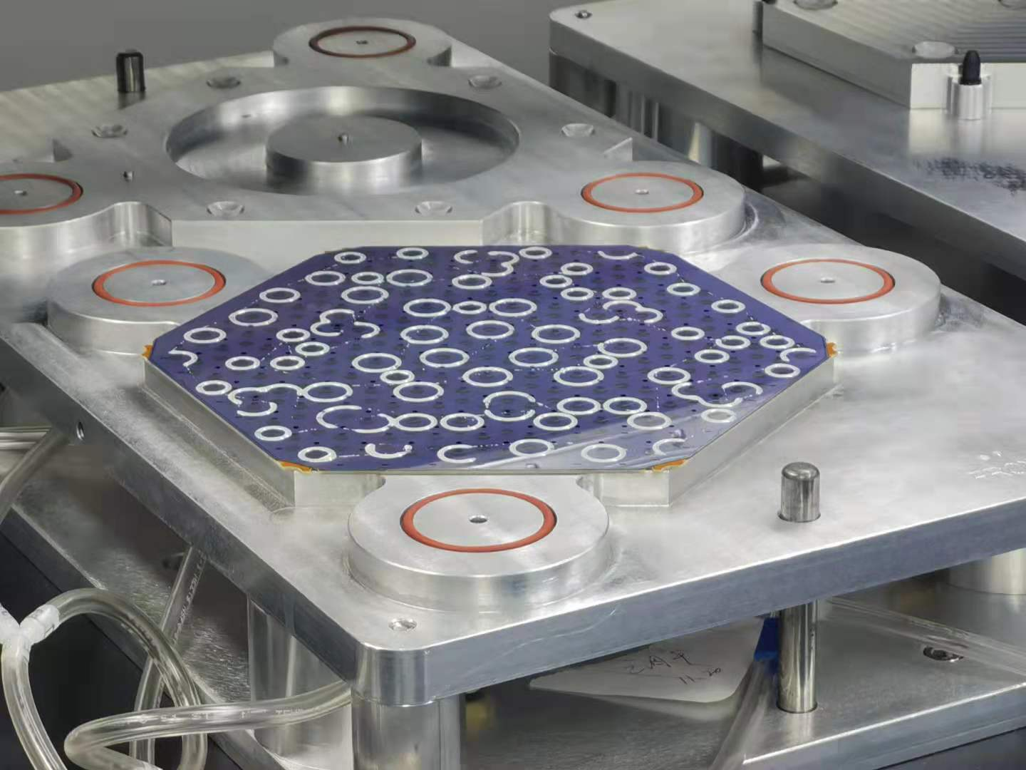
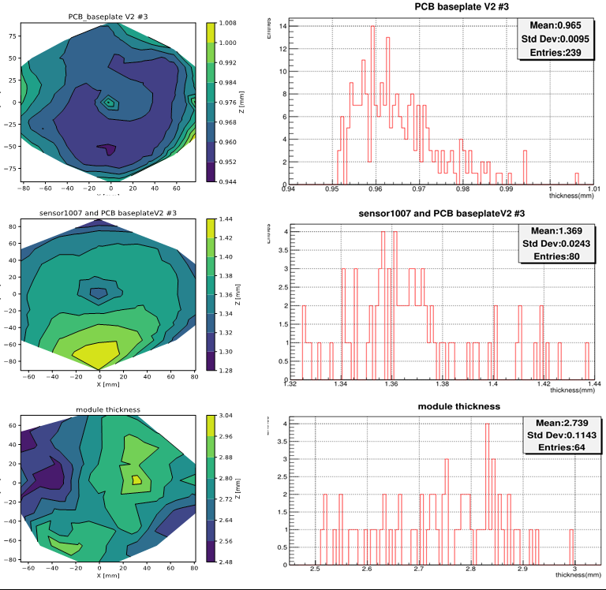
Module Assembly (2)
First 8 inch module successfully assemblied at IHEP
Gantry/fixture
Dispense on baseplate
Dispense on sensor
10𝝁m
Thickness control
24𝝁m

Slide 14
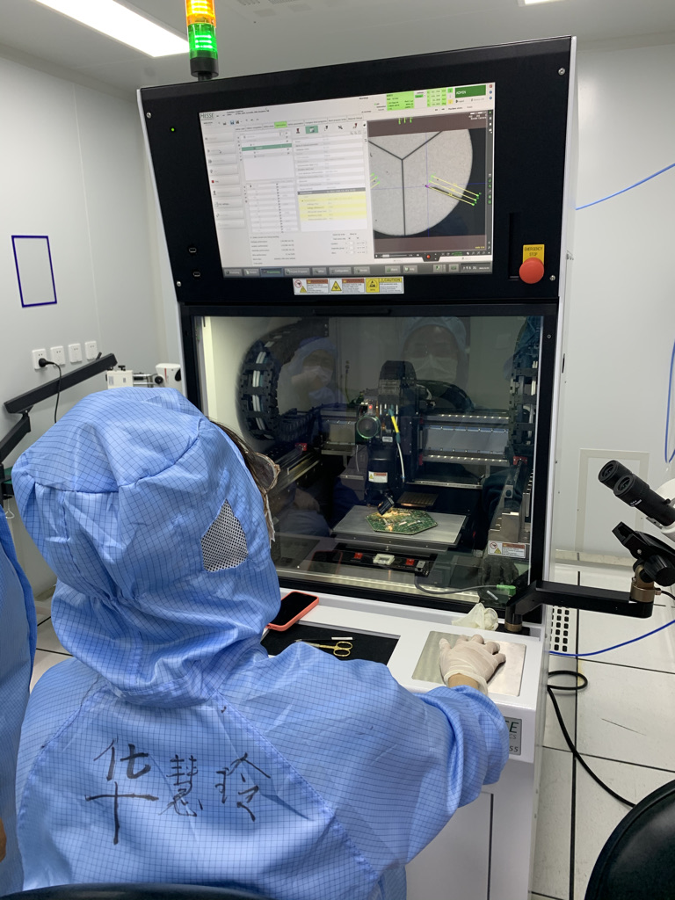
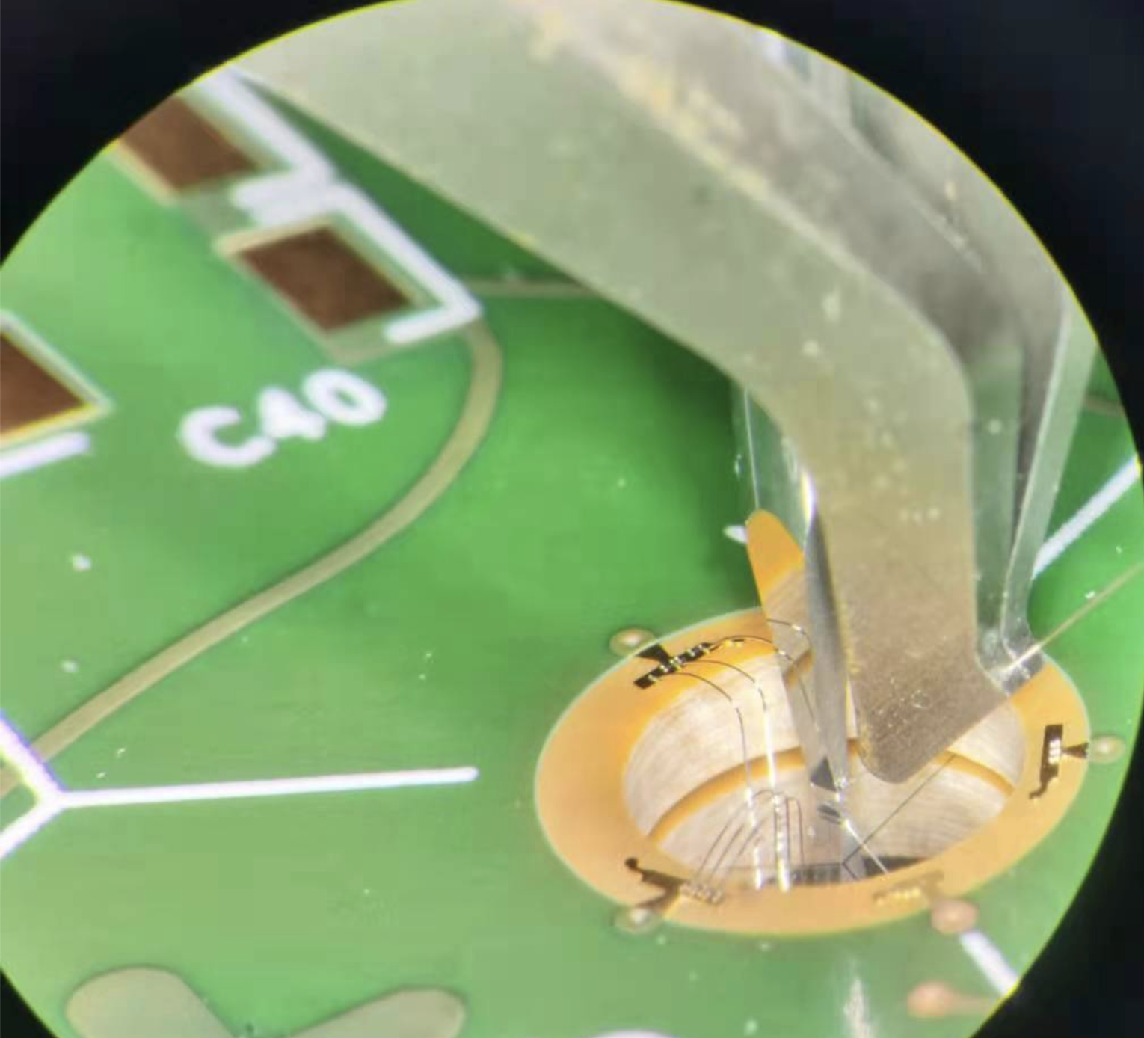
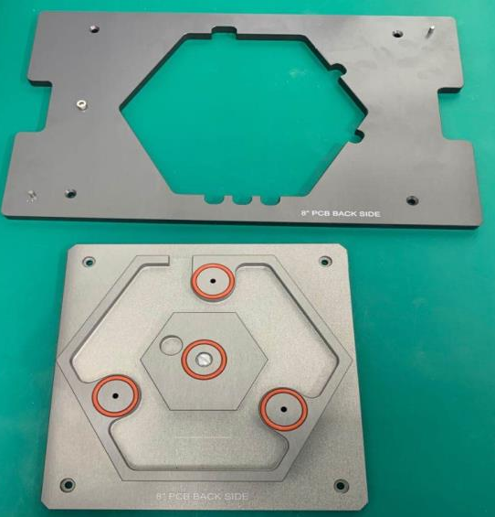
Wire bonding
Connect senor to electronics
~ 20 millions wires
BJ855 + Dage 4000
High speed and good pull strength

Slide 15
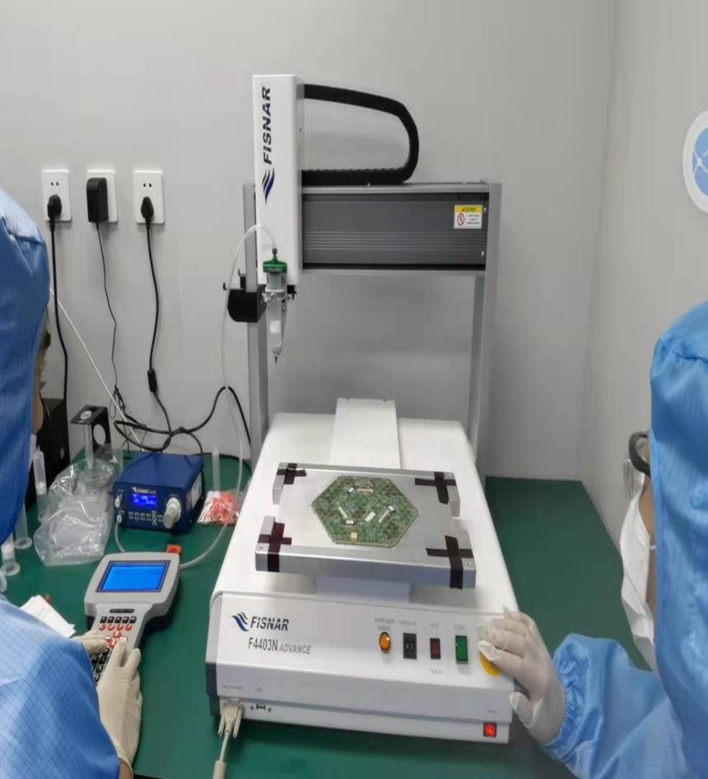
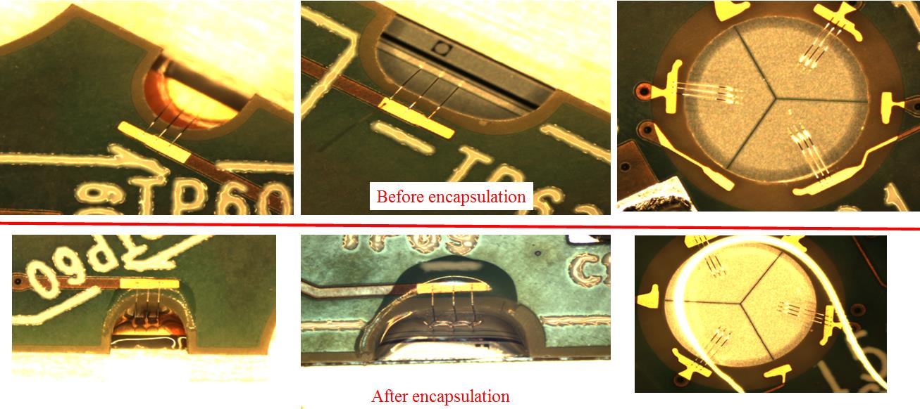
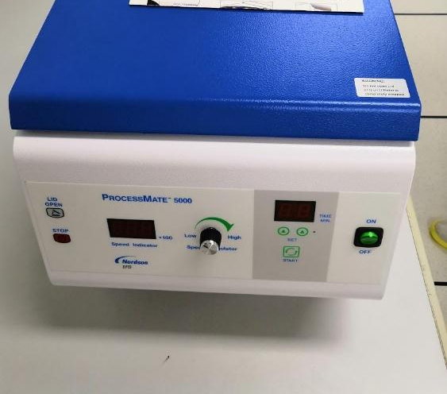
Encapsolution
Protect wire from moisture and mechanics with DOWSIL 186 glue
Done with mini-gantry + dispensor + centrifuge
Automated procedures

Slide 16
Module testing (1)
Single module test-stand(3 versions) + Cosmics setup
Pedestal, nosie, charge injection, leakage current, MIP…
Themal cycling testing box is under design
TS: Hexacontroller + trophy board + ZYNQ
Older version of test stand

Slide 17
Module testing (2): First 8 inch module
Test leakage, Pedestal, Noise, etc.
Sensor IV from CERN
Total leakage
Charge injection scan
Sampling scan
Module IHEP001
Pedestal Map
Noise Map
Noise before/after bonding

Slide 18
HGCal production database
HGCAL Database: an essential part of HGCAL construction
Record data of all steps in module production
GUI being developed: transmit information between MAC and CERN
Sensors, PCBs, baseplates, tooling; production testing results; shipping

Slide 19
Summary
The Module Assembly Center at IHEP are almost ready
Infrasture and main equipment are ready and qualified
First 8 inch module is produced (key requirement for MAC qualification)
Including 130 nm radiation hard ASICs (temporary export licence)
Testing shows very good performance
Shipped back to CERN for beam test in coming September
More details about the Si Module in Feng Wang’s poster
Moving to production stage (possible delay since 2020/6)
THU,FDU,ZJU joined HGC(MAC) efforts since 2020.
Thanks funding support from NSFC, MoST, IHEP,THU…
2021/9: MAC site qualification
2022/10: 5% production done
2023/10: 50% production done
2024/7: 100% production done
2027: ready for CMS data taken

Slide 20
Thanks
王峰
程华杰
刘勇
顾煜栋
郭佳林
苑超辰
王储
陶军全
张华桥
王泽炳
华慧玲
余涛哲
参与第一块模块制作的部分成员合影：2021/6

