Slide 1
A/E method in ⁷⁶Ge 0𝑣𝛽𝛽 experiment
Zhang Bingtao
Tsinghua University
CDEX collaboration
第十三届全国粒子物理学术会议，2021/8/16-2021/8/20

Slide 2
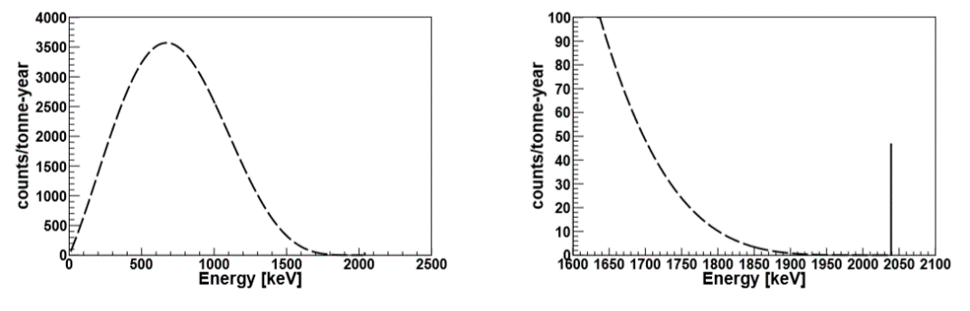
⁷⁶Ge 0𝑣𝛽𝛽 experiment
𝛽𝛽 decay
0𝑣𝛽𝛽 decay?
$$\left(A,Z\right)→\left(A, Z+2\right)+2e^{−}+2\overline{v_{e}}$$
$$\left(A,Z\right)→\left(A, Z+2\right)+2e^{−}$$
𝛽𝛽 decay occurs in several nuclide (e.g. ⁷⁶Ge, ¹³⁰Te, ¹³⁶Xe)
In 𝛽𝛽 decay, 2 anti-electron neutrinos are produced
What if the neutrino‘s antiparticle is itself? Can these 2 neutrinos be “annihilated” or even not be generated?
Are lepton numbers conserved?
There is far more positive matter than antimatter in the universe?
Neutrino mass levels?
Background control is very important
1

Slide 3
0𝑣𝛽𝛽 experiment bkg(γ) discrimination
In BEGe detector, 0𝑣𝛽𝛽 event is single site event (SSE), and site event (MSE) can be regarded as background
In ROI, γ event is an important background component
MSE / SSE discrimination is significant for removal γ event
X%
Anti-coincidence efficiency ：1/(1-X%)
MSE/SSE discrimination efficiency：1/(1-Y%)
Y%
2

Slide 4
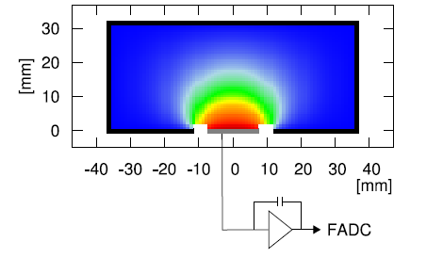
A/E method for SSE/MSE discrimination
The electric field intensity near the P + electrode of BEGe is the largest, so the signal current value reaches the maximum when the hole reaches near the P + electrode, and the amplitude value A is directly proportional to the amount of charge
Single site event(SSE): only one "hole cluster" is generated, and A/E is approximately a fixed value
Multi-site event (MSE): multiple "hole clusters" are generated and reach the P + electrode at different times. The maximum current value is smaller than that of a SSE under the same energy, so the A/E value is also small
Typical SSE example: Double escape peak (DEP)
Typical MSE example: Single escape event (SEP)
Liao.HenYi,2016
3

Slide 5
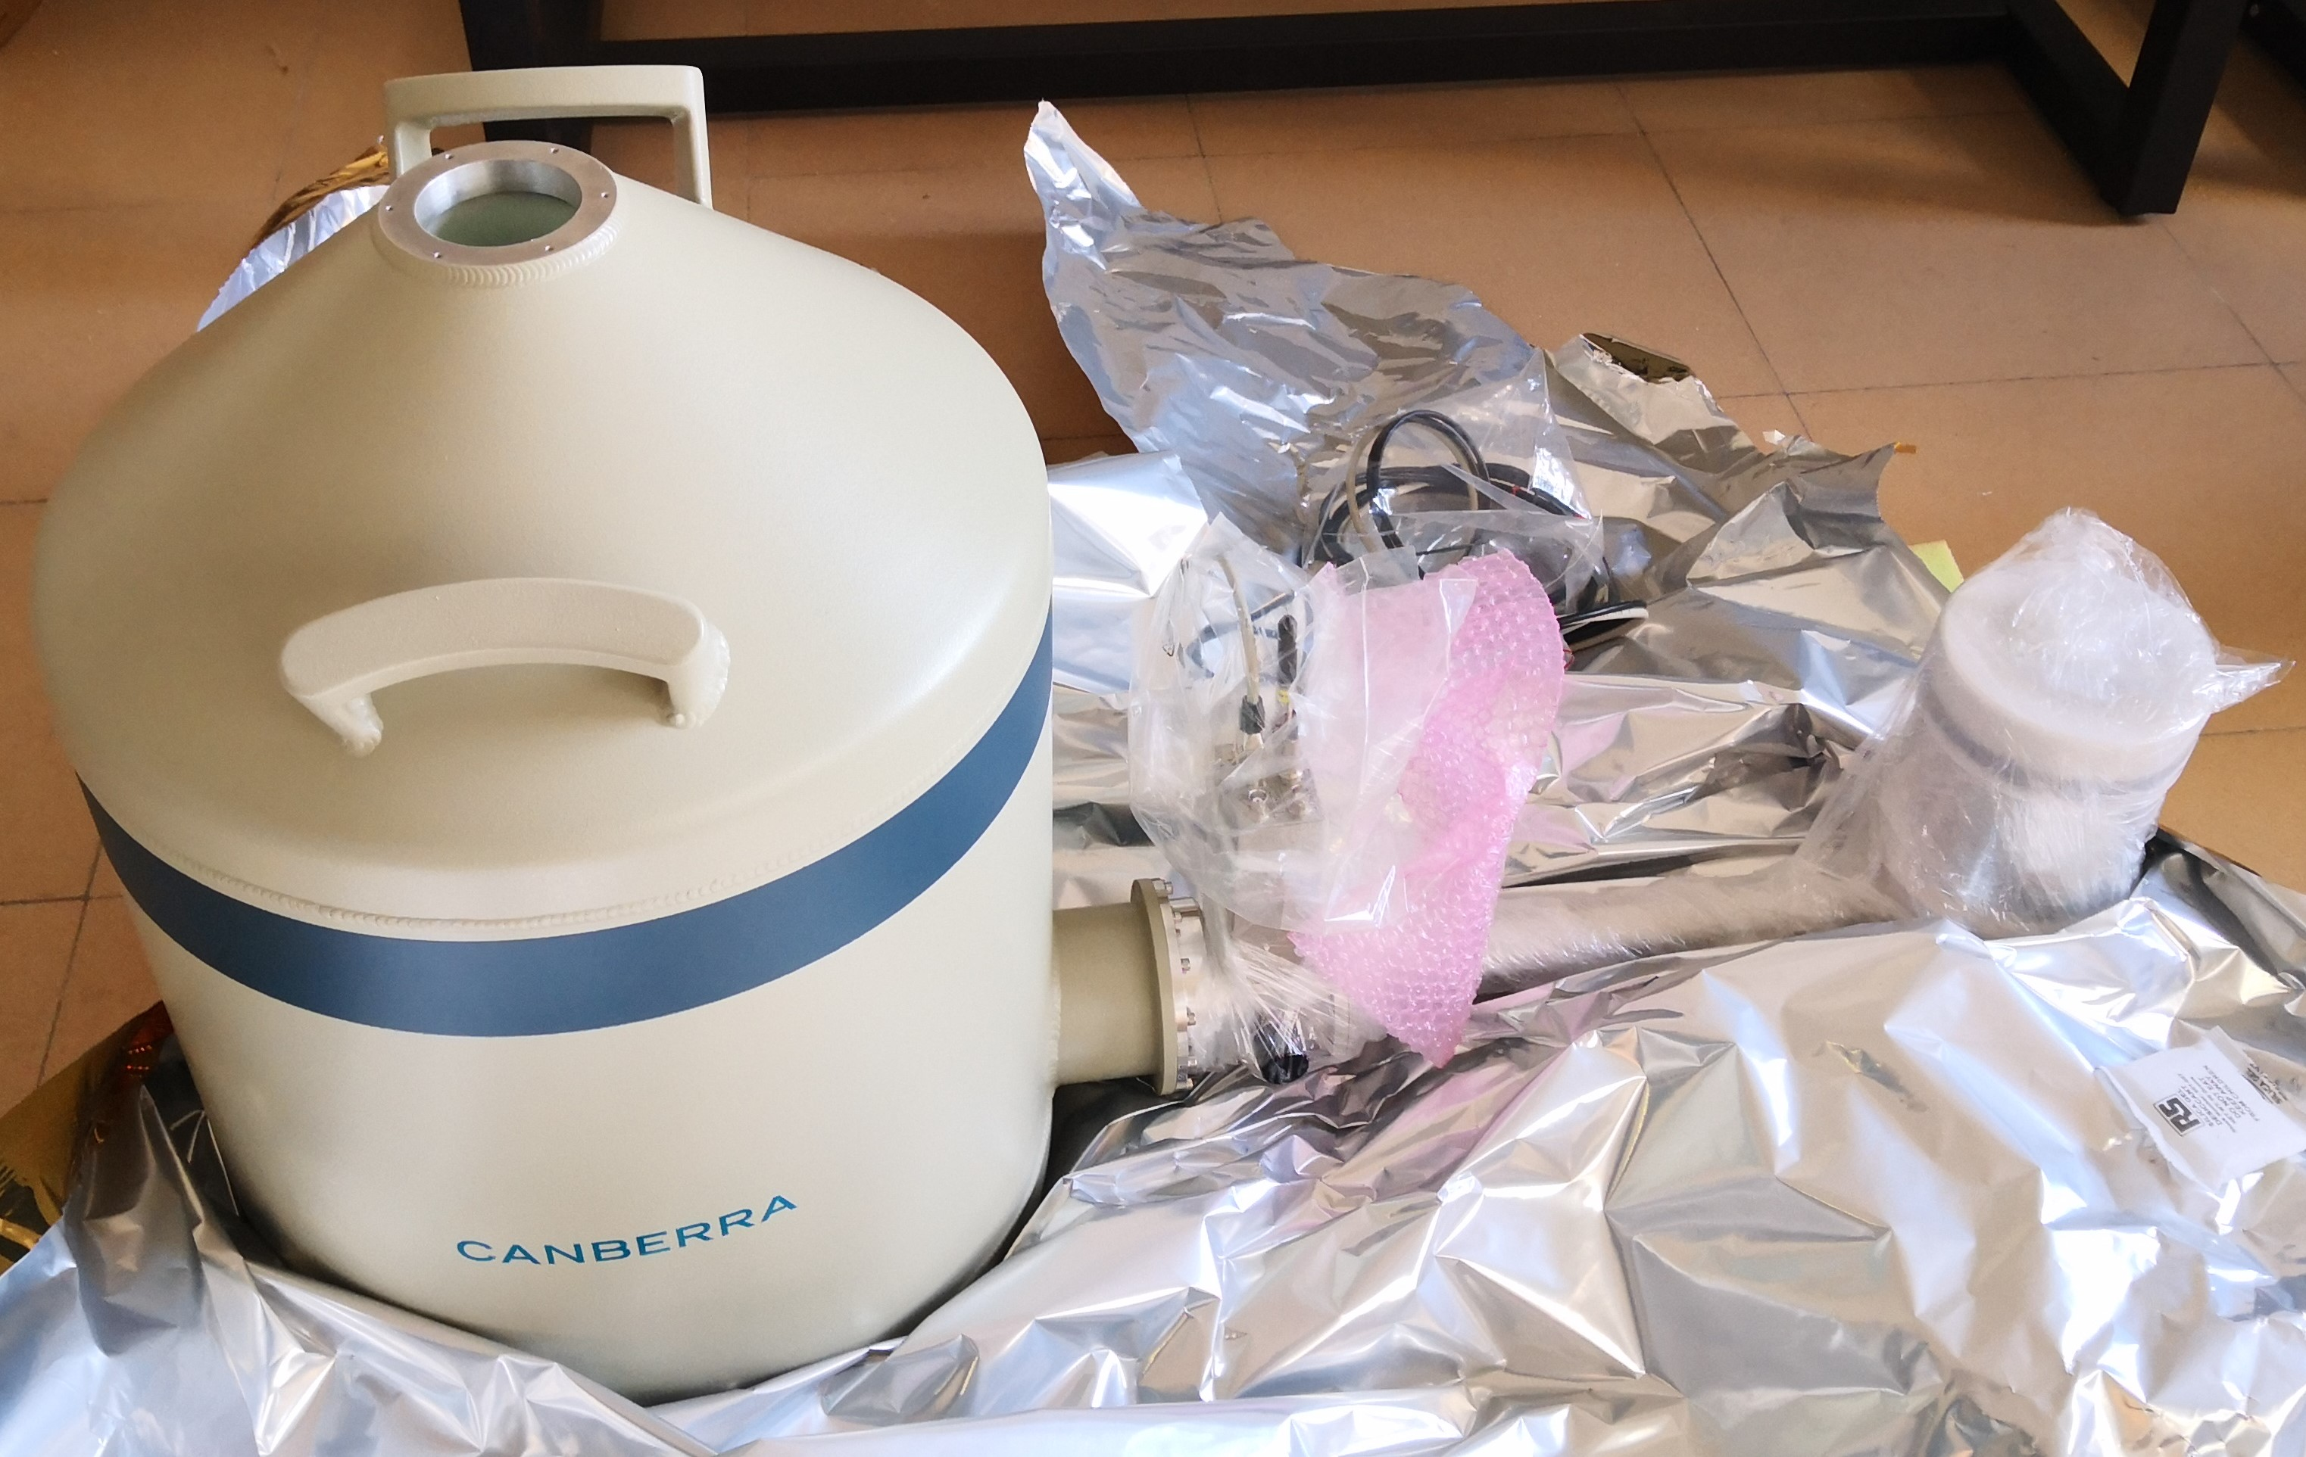
²²⁸Th calibration experiment
BEGe detector：
Crystal size：Ф90mm×h30mm
dynamic range：3keV~5MeV
Energy resolution：
122keV : 0.65keV
1332keV: 1.78keV
4

Slide 6
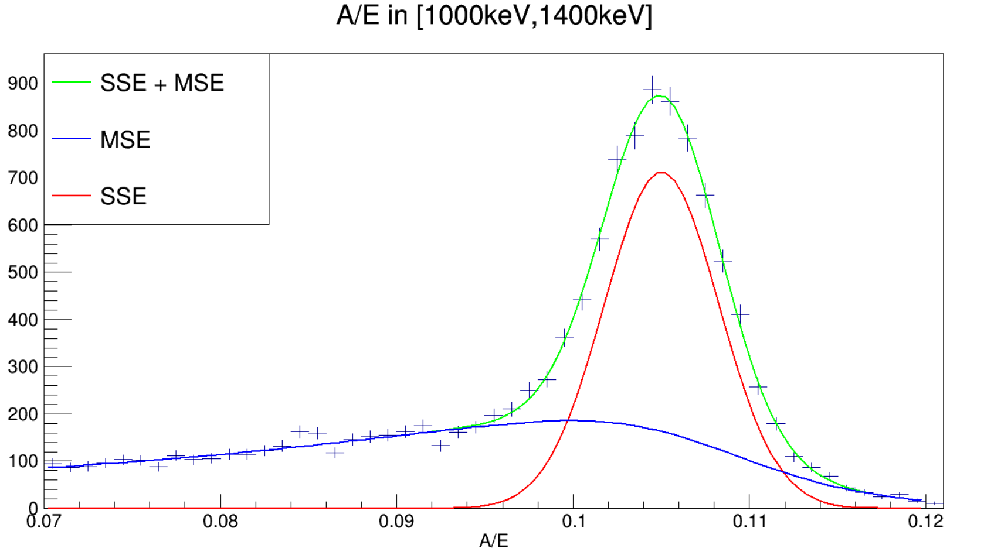
A/E distribution
Fit function：
The first term of the function describes the A/E distribution of SSE events, and the second term describes the MSE events
5

Slide 7
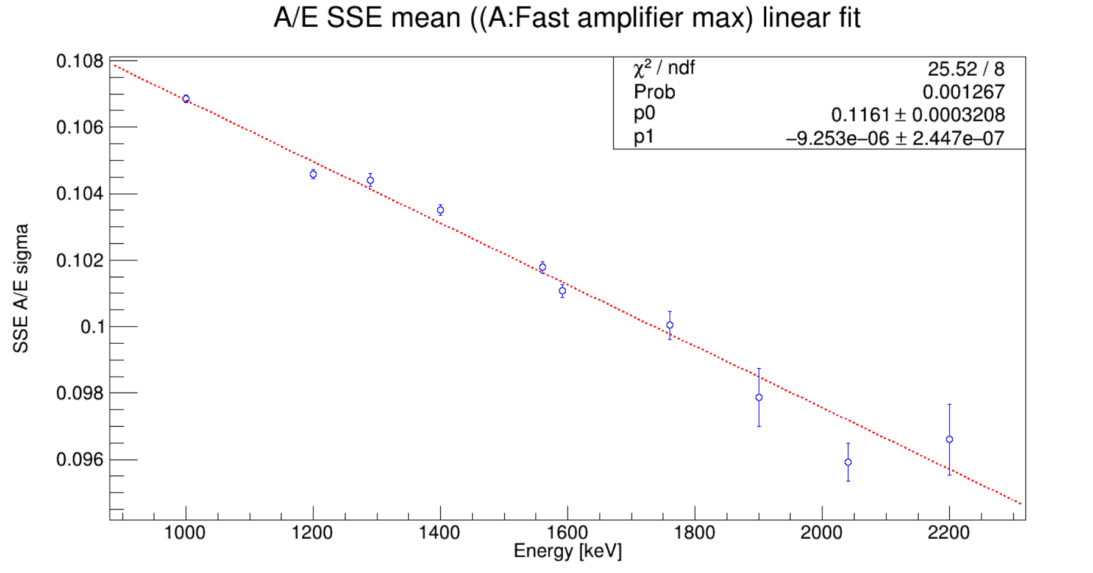
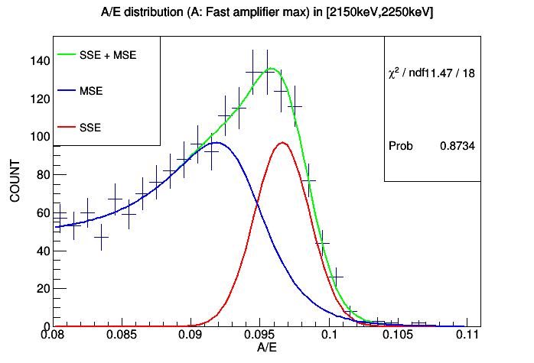
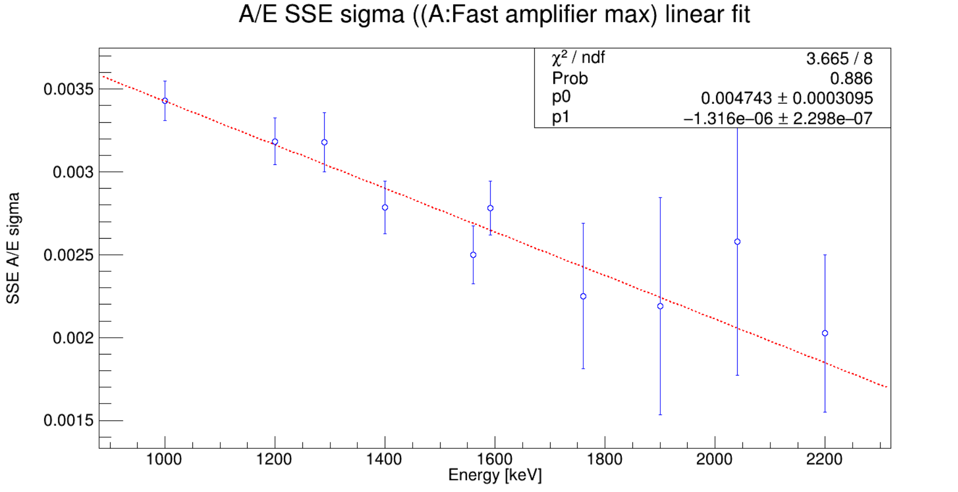
A/E distribution fit & parameter-E fit
6

Slide 8
²²⁸Th Source calibration data A/E distribution
7

Slide 9
"Survival" of DEP / SEP screened by A/E
8
Notes:
1592左边有一个很小的能峰（1588.2）,来源于Th衰变链上的核素

Slide 10
A/E PSD result
9

Slide 11
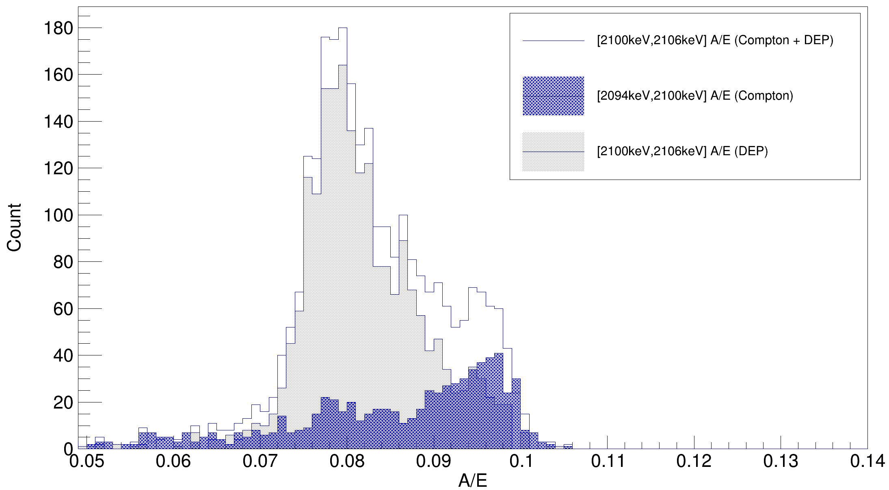
SSE/MSE discrimination
Cut range | SSE accept rate (1592keV DEP) | SSE accept rate (2103keV SEP)
[-2σ, +3σ] | 1423/(1423+134)=91.4% | 215/(1815+215)=10.6%
[-2σ, +2σ] | 1366/(1366+191)=87.7% | 208/(1822+208)=10.2%
[-3σ, +3σ] | 1456/(1456+101)=93.5% | 304/(1726+304)=15.0%
[-4σ, +4σ] | 1485/(1485 + 72)=95.4% | 430/(1600+430)=21.2%
10

Slide 12
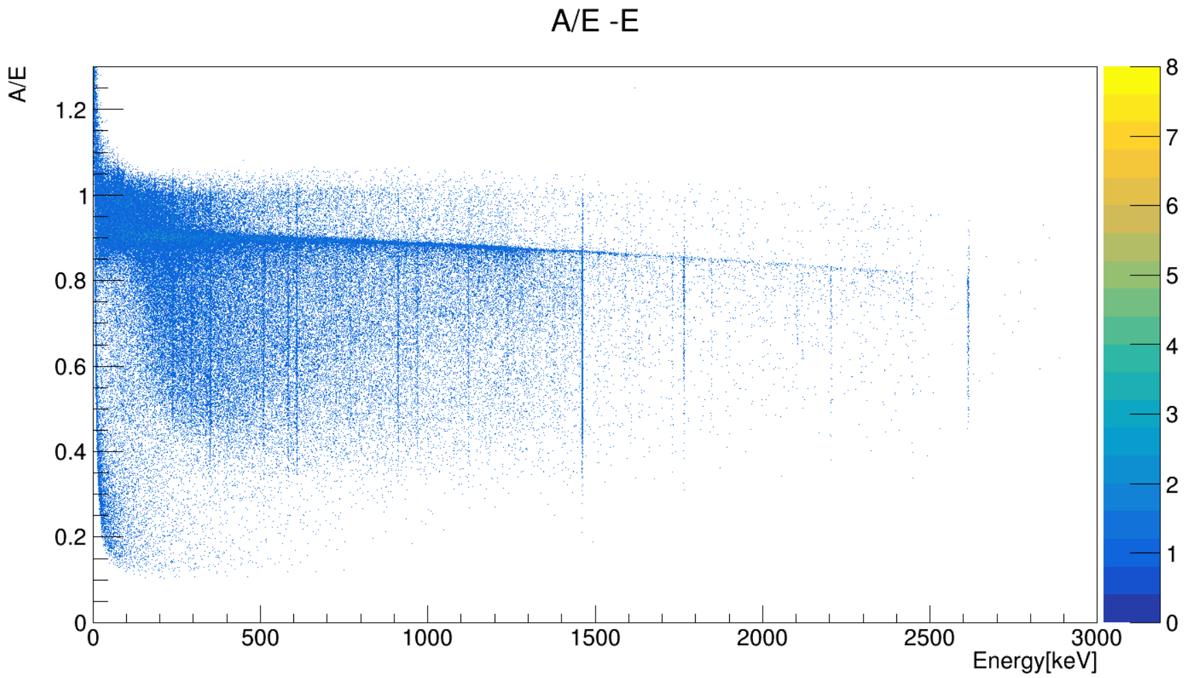
Application of A/E PSD in PPCGe data
Fit function:
The first/second term describe the A/E of distribution of SSE/MSE events, and the last term describes the near p-point events
11

Slide 13
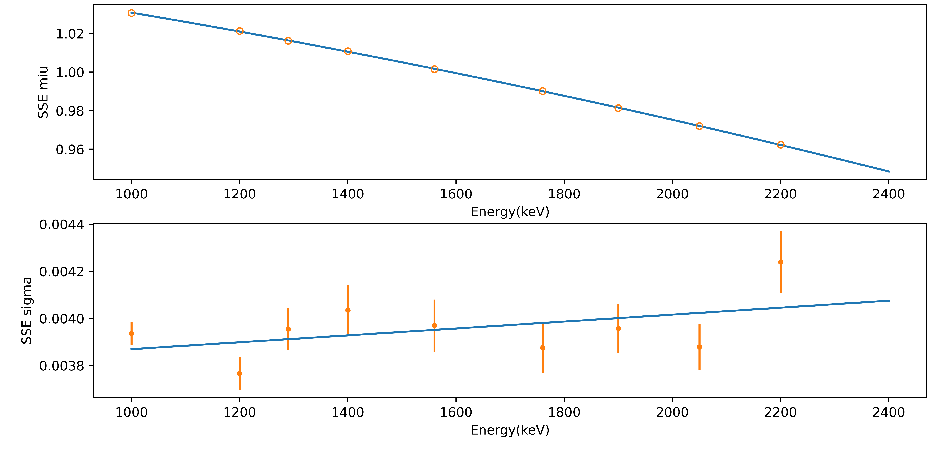
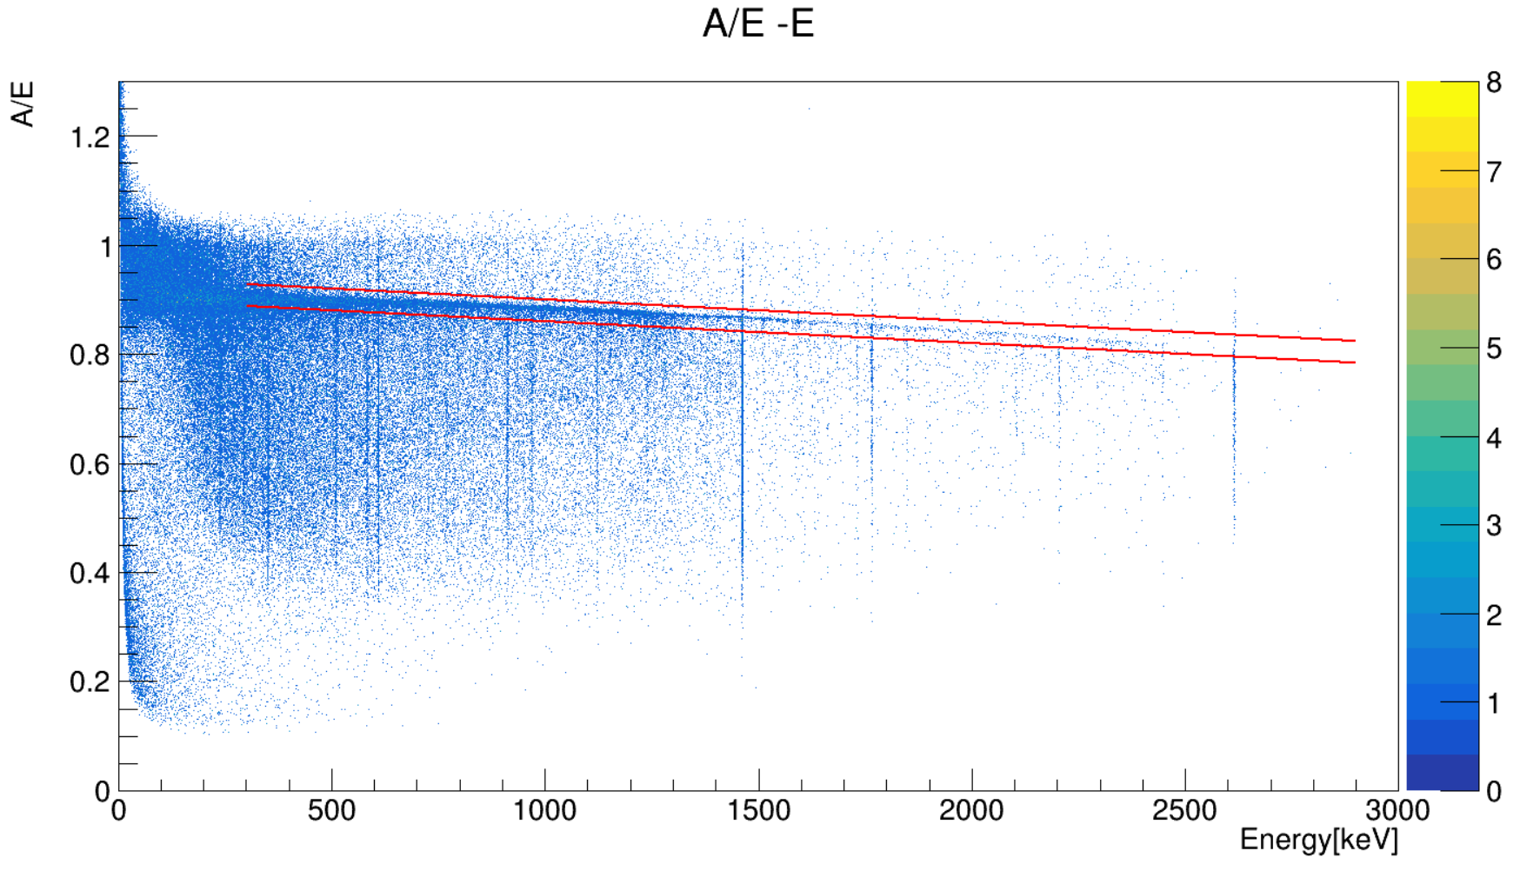
Application of A/E PSD in PPCGe data
Cut range | SSE accept rate (1592keV DEP) | SSE accept rate (2103keV SEP)
[-2σ, +2σ] | 85.2% | 19.3%
[-3σ, +3σ] | 91.4% | 24.8%
12

Slide 14
summary
MSE / SSE discrimination is significant for removal γ event in 0𝑣𝛽𝛽 experiment
Based on two types of HPGe detectors, BEGe and PPCGe, using the ratio A/E of maximum current parameter A and energy E as discriminate parameter, the single site/multi-site event discrimination is studied
The discrimination efficiency is tested by using the calibration data of radioactive sources. For BEGe and PPCGe, the SSE accept rate at (DEP, SEP) are (93.5% - 15.0%) and (91.4% - 24.8%) respectively, A/E method has a strong effect on reducing the background
13

Slide 15
Thanks!
14

