Slide 1


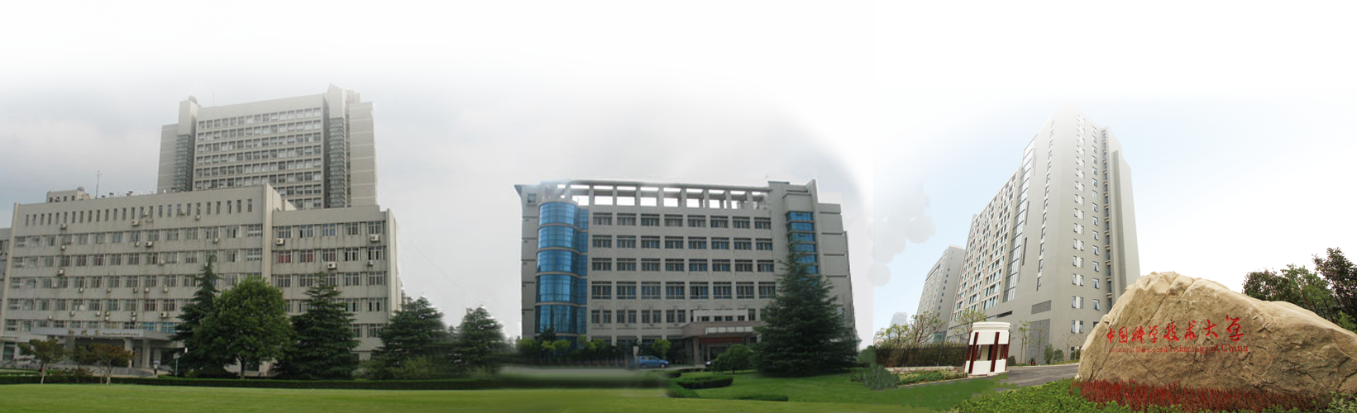
Design and Study of Electromagnetic Calorimeter for Super Tau-Charm Facility
Yong Song, Zekun Jia
State Key Laboratory of Particle Detection and Electronics, China
University of Science and Technology of China
On behalf of the STCF calorimeter working group
State Key Laboratory of Particle Detection and Electronics

Slide 2
Outline
Research Background
STCF ECAL
  ECAL Design
  Performance Study
  Some Test Results
Summary

Slide 3
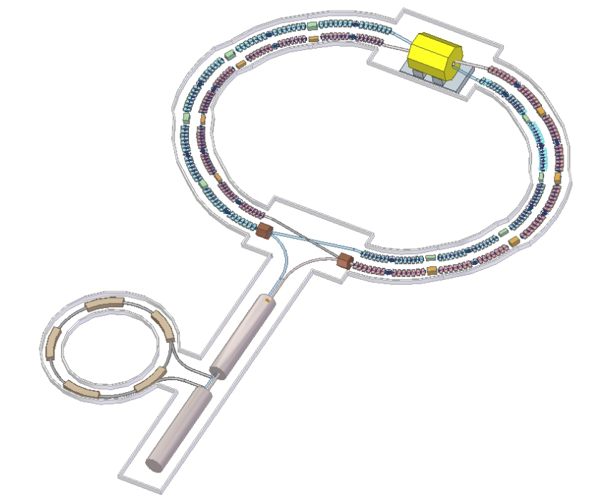
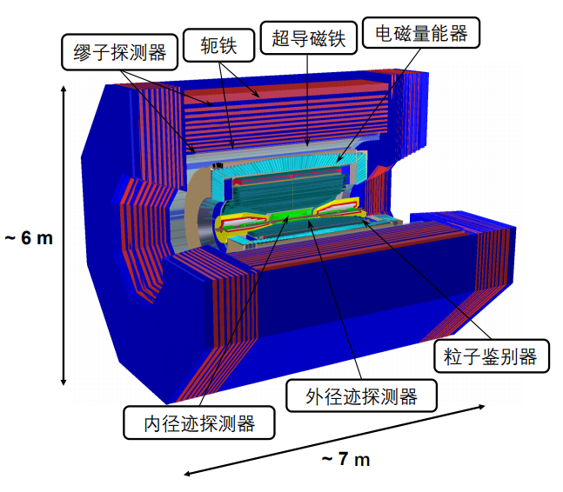
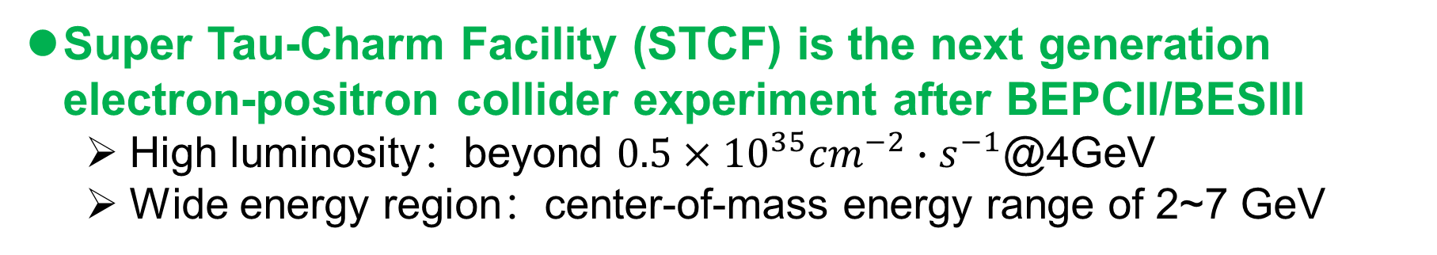
Research Background
Super Tau-Charm Facility (STCF) is the next generation electron-positron collider experiment after BEPCII/BESIII
  High luminosity：beyond $0.5×{10}^{35}{cm}^{−2}∙s^{−1}$@4GeV
  Wide energy region：center-of-mass energy range of 2~7 GeV
Symmetrical design
of dual storage ring

Slide 4
Research Background
Design goals of Electromagnetic Calorimeter (ECAL)
  High precision
  Fast time response
STCF ECAL Requirements
    High Luminosity
    High event rate (400kHz)
    Extremely high background
  Energy resolution
Better than 2.5% @1 GeV
  Position resolution
  Better than 6 mm @1 GeV
  Time resolution
  Better than 300 ps @1 GeV
Energy distribution for photons

Slide 5
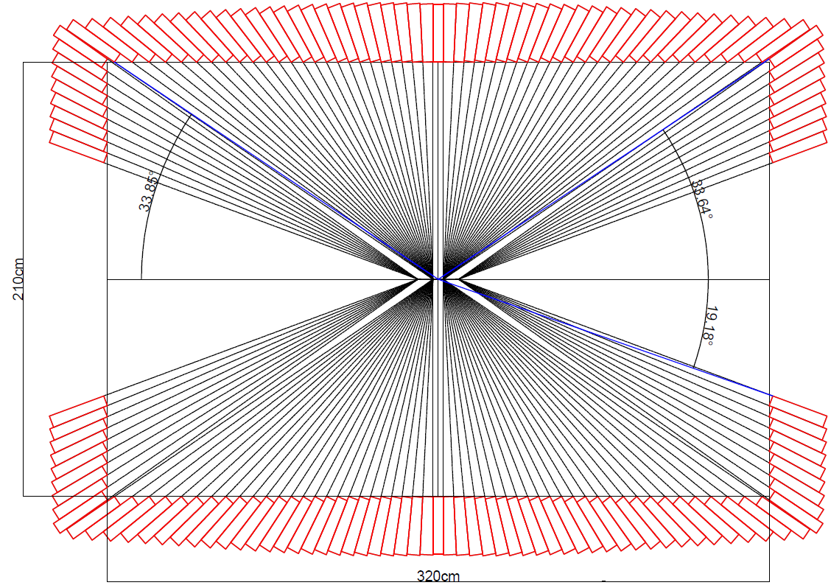
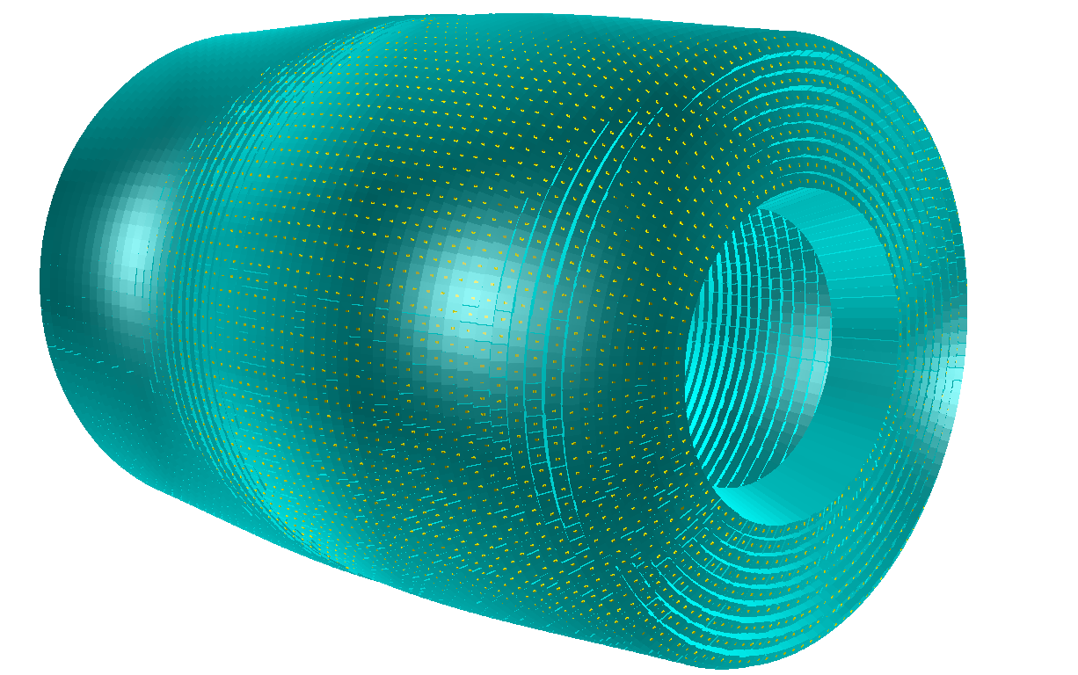
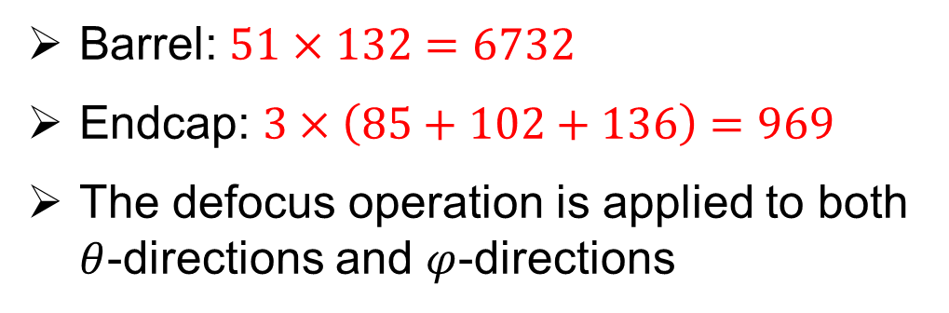
ECAL Design —— Geometry Model
Total absorption calorimeter
Barrel: $51×132=6732$
Endcap: $3×\left(85+102+136\right)=969$
The defocus operation is applied to both $θ$-directions and $φ$-directions
Defocus
The Defocus operation completely avoids the particles passing directly between the crystals.
Visualized by DD4Hep

Slide 6
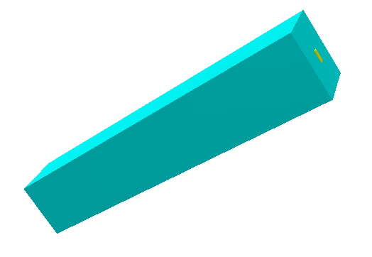
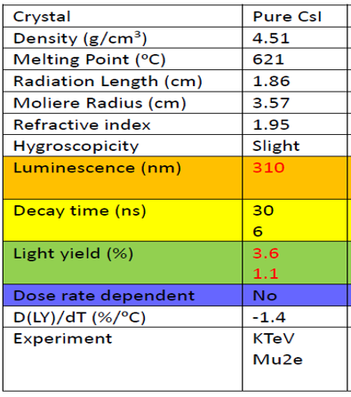
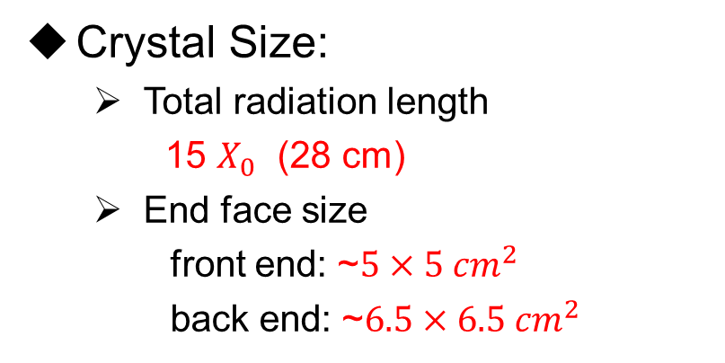
ECAL Design —— Sensitive Unit
Pure CsI crystal + APD photo-device
APD
pCsI
Crystal Size:
    Total radiation length
    15 $X_{0}$ (28 cm)
  End face size
front end: ~$5×5 {cm}^{2}$
back end: ~$6.5×6.5 {cm}^{2}$
ECAL pCsI crystal unit
Wrapping and support materials:
    Carbon fiber: 200 um
    Teflon film : 150um
    Al film : 75 um
    Polyethylene film : 75um

Slide 7
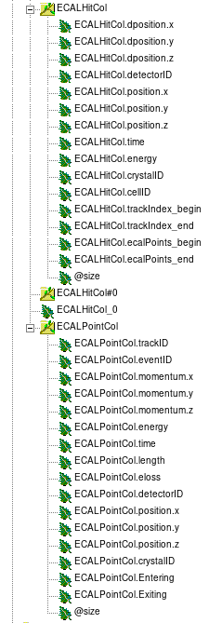
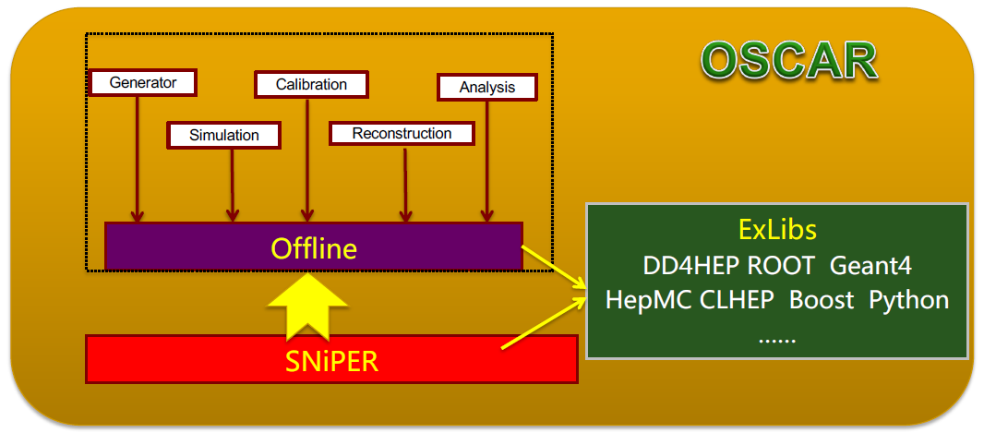
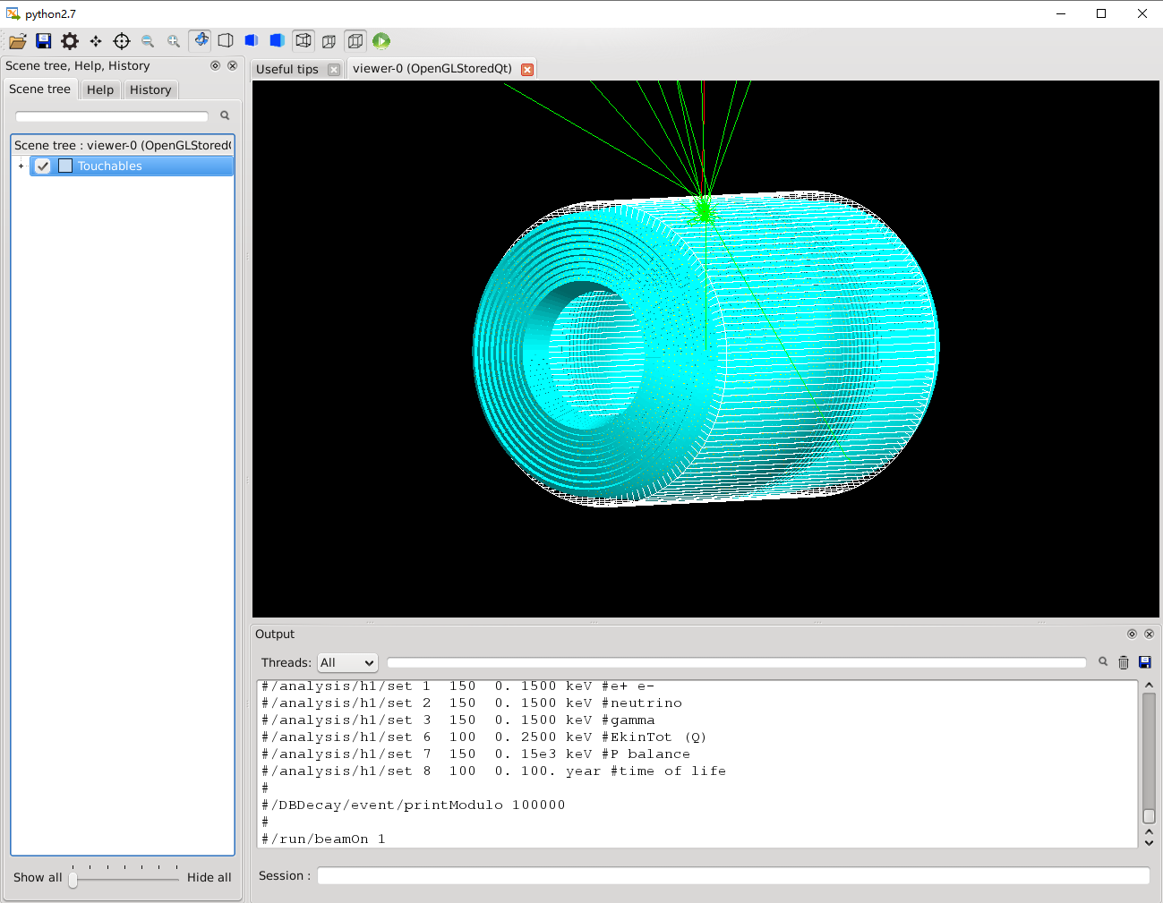
Performance Study Based on OSCAR
OSCAR: Offline Software of Super Tau-Charm Facility
ECALEvent
ECALPoint
ECALHit
Event Data Model based on PODIO

Slide 8
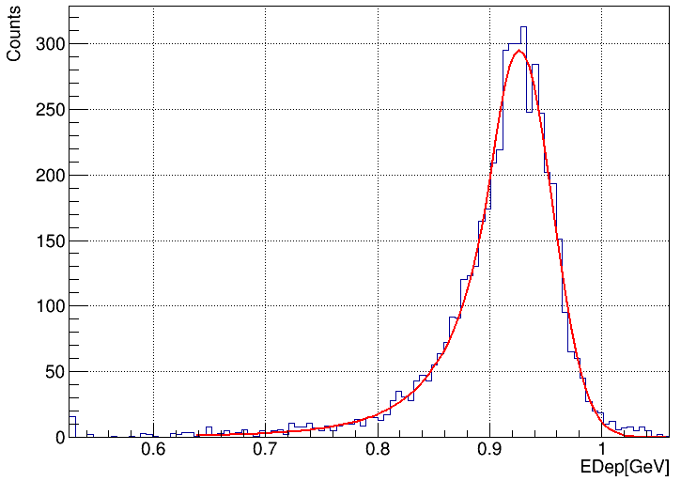



Reconstruction Algorithm
A preliminary reconstruction algorithm of ECAL is developed
Cluster search
Seed search
$π^{0}$Cluster (two photons)
ECALRecAlg
Clusters split into Showers
$$σ_{E}=2.25\%@1GeV$$
Calculation and correction of shower energy and position
1GeV $γ$ energy reconstruction

Slide 9
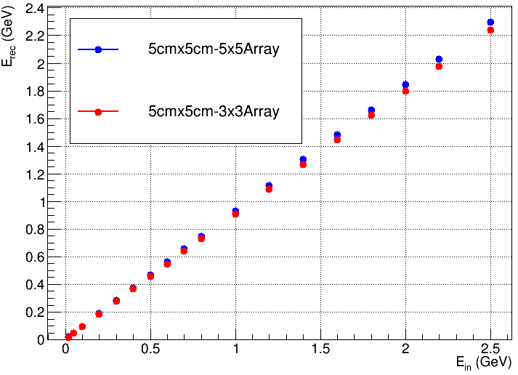
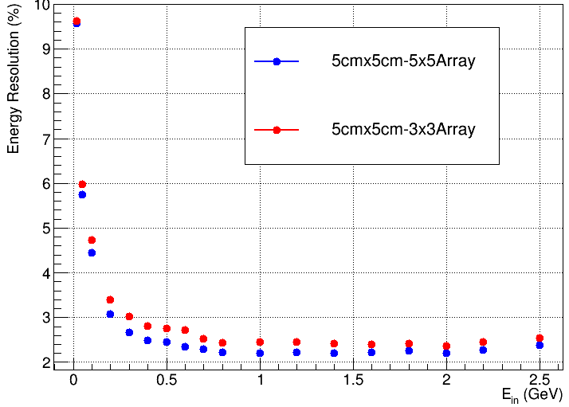
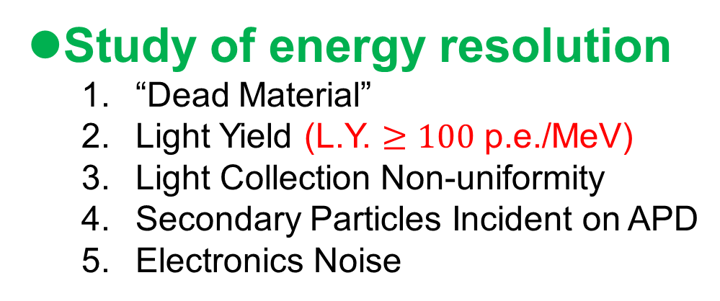
Performance Simulation
Study of energy resolution
  “Dead Material”
  Light Yield (L.Y. $≥100$ p.e./MeV)
  Light Collection Non-uniformity
  Secondary Particles Incident on APD
  Electronics Noise
Good energy linearity is maintained
in the energy range of 20MeV~2.5GeV
The energy resolution is
2.25% @ 1 GeV ,which meets the performance requirement.

Slide 10
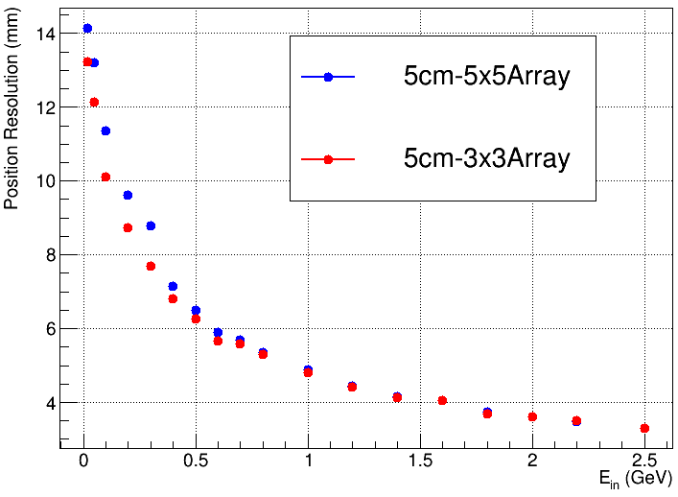
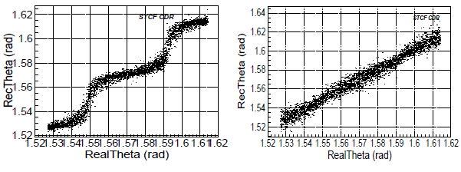
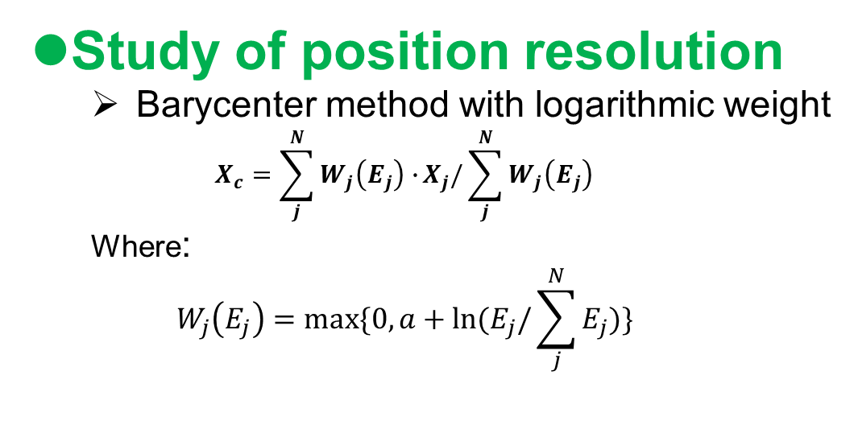
Performance Simulation
Study of position resolution
  Barycenter method with logarithmic weight
  $$X_{c}=\sum_{j}^{N}{W_{j}\left(E_{j}\right)∙}X_{j}/\sum_{j}^{N}{W_{j}\left(E_{j}\right)}$$
  Where:
  $$W_{j}\left(E_{j}\right)=max⁡\{0,a+ln⁡(E_{j}/\sum_{j}^{N}{E_{j}})\}$$
Linear-Weight
Log-Weight
The position resolution is
4.9 mm @ 1 GeV ,which meets the performance requirement.

Slide 11
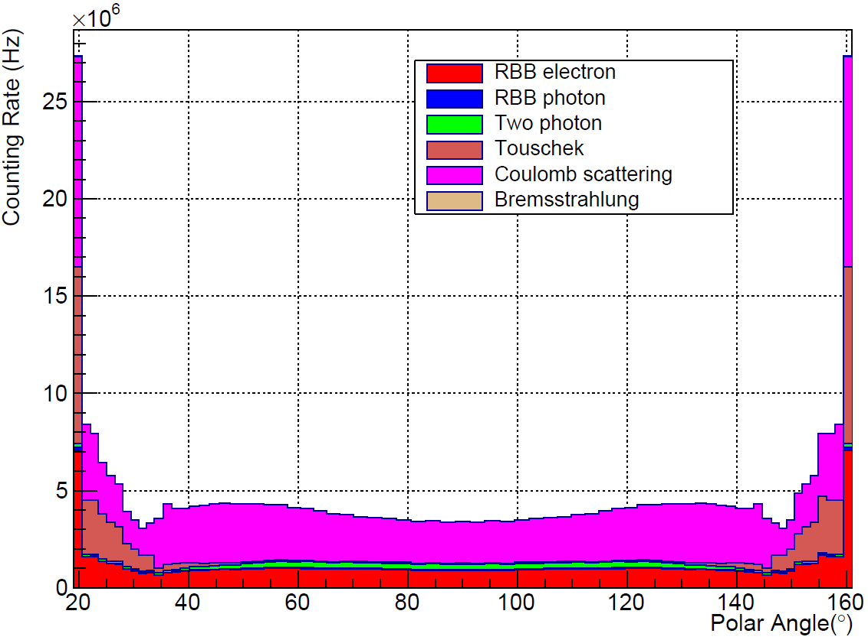
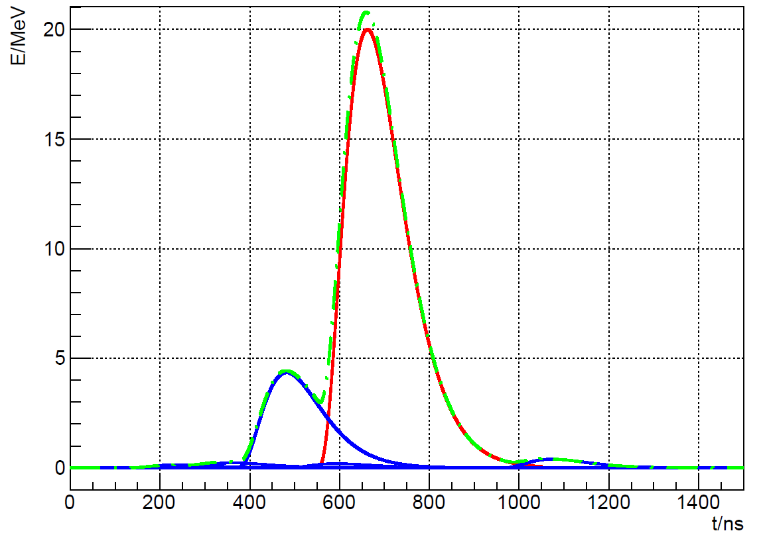
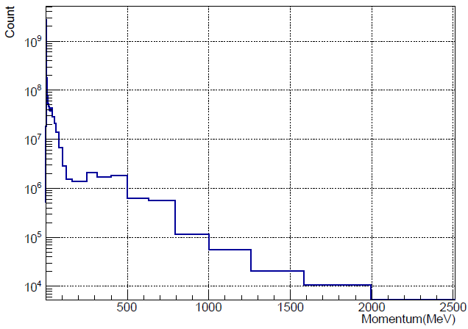
Background Level
Background Sources
  Luminosity-related Background
    Radiative BhaBha Scattering (RBB)
    Two Photon Process
  Beam-related Background
    Thouschek Effect
    Coulomb Scattering
    Bremsstrahlung
Counting rate reaches
the magnitude of MHz
Real signal
Background signal
Superimposed signal
Most background particles
have very low momentum
Most background particles
have very low momentum

Slide 12
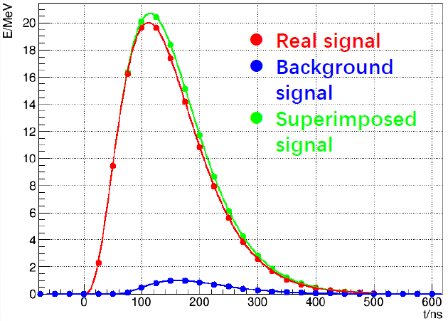
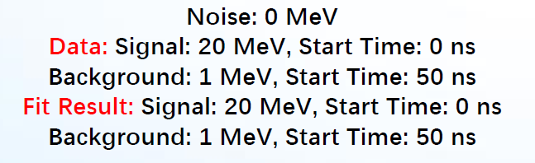
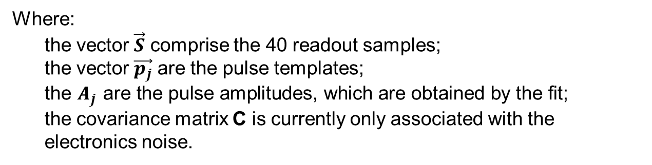

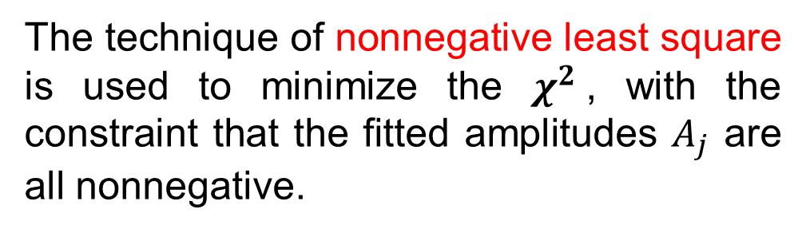
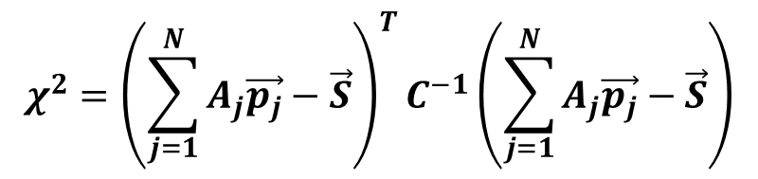
Multi Pulse Fit Algorithm
The multi-pulse fit method use a template fit with N parameter.
  The fit minimizes the $χ^{2}$ defined as:
$$χ^{2}={\left(\sum_{j=1}^{N}{A_{j}\vec{p_{j}}−\vec{S}}\right)}^{T}C^{−1}\left(\sum_{j=1}^{N}{A_{j}\vec{p_{j}}−\vec{S}}\right)$$
Where:
the vector $\vec{S}$ comprise the 40 readout samples;
the vector $\vec{p_{j}}$ are the pulse templates;
the $A_{j}$ are the pulse amplitudes, which are obtained by the fit;
the covariance matrix C is currently only associated with the
electronics noise.
The technique of nonnegative least square is used to minimize the $χ^{2}$, with the constraint that the fitted amplitudes $A_{j}$ are all nonnegative.

Slide 13
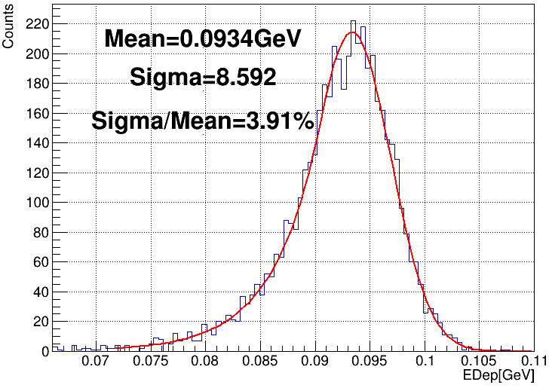
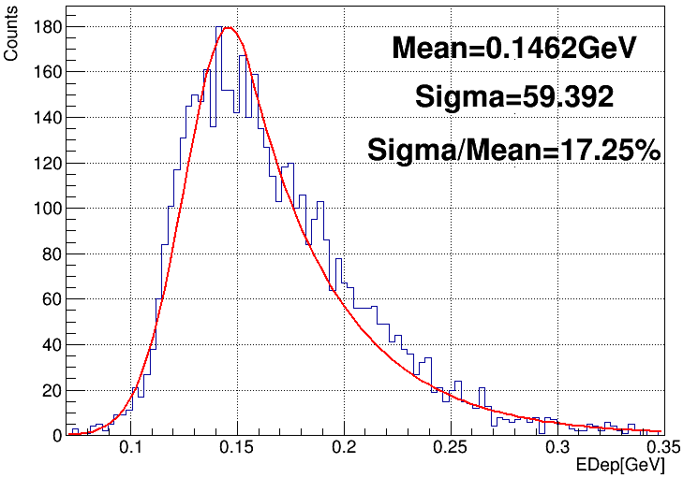
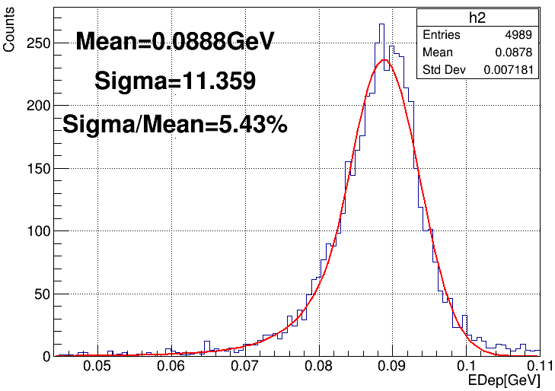
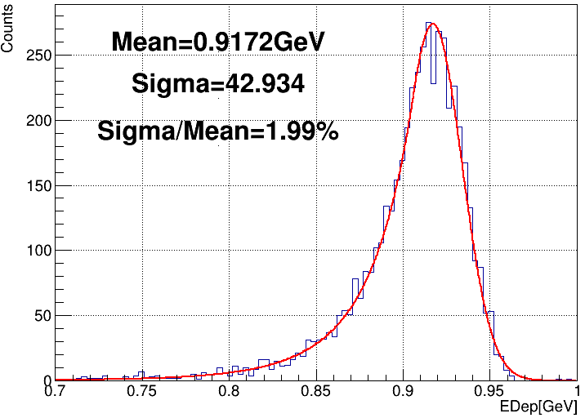
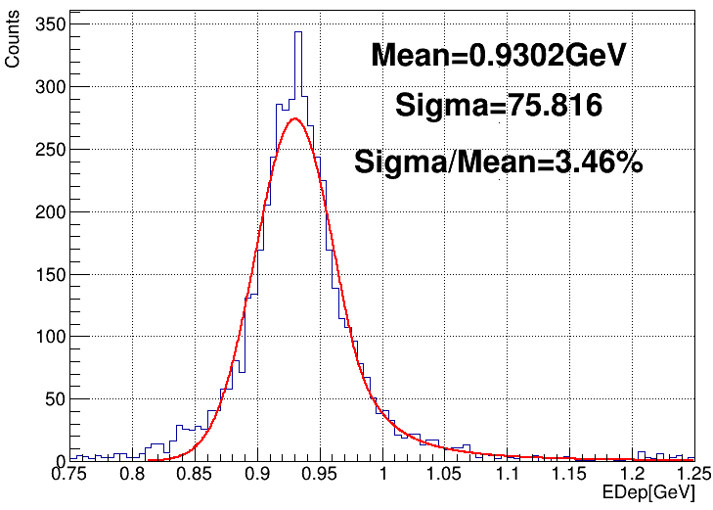
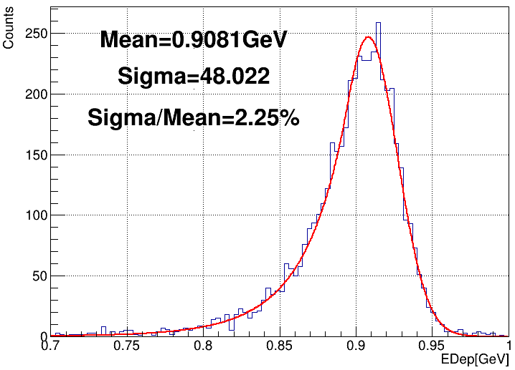

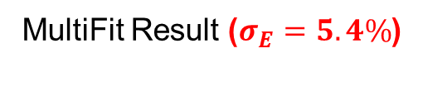


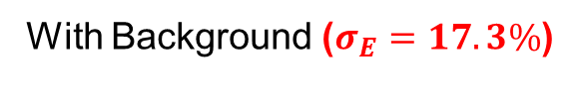
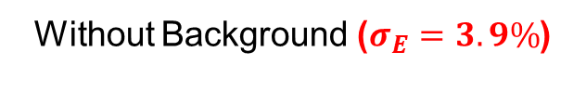
Multi Pulse Fit Algorithm
Add Background
MultiFit
Without Background ($σ_{E}=3.9\%$)
With Background ($σ_{E}=17.3\%$)
MultiFit Result ($σ_{E}=5.4\%$)
100 MeV Gamma (5MHz Background)
Add Background
MultiFit
Without Background ($σ_{E}=1.99\%$)
With Background ($σ_{E}=3.46\%$)
MultiFit Result ($σ_{E}=2.25\%$)
1.0 GeV Gamma (5MHz Background)

Slide 14
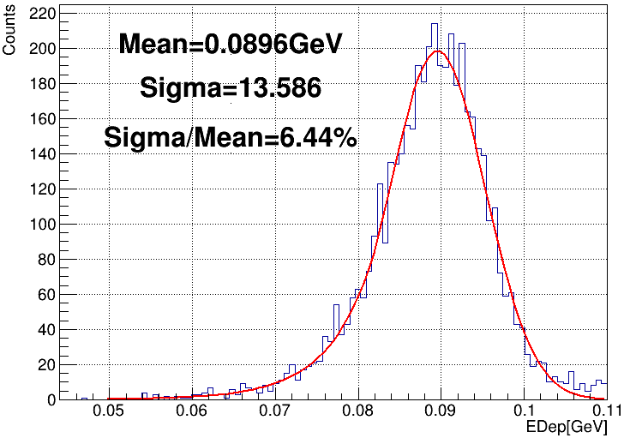
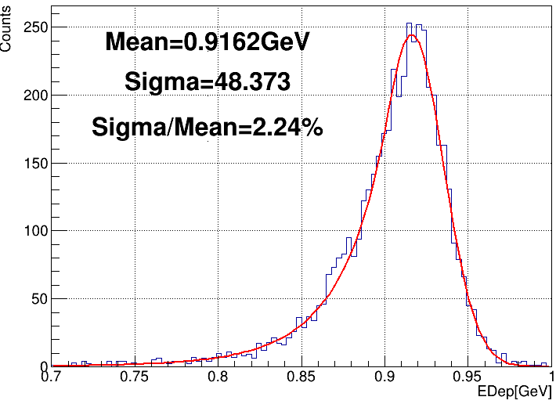
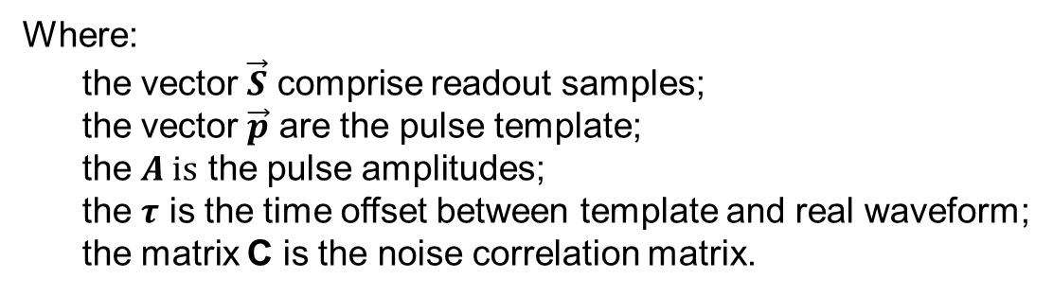


One Pulse Fit Algorithm
The fit minimizes the $χ^{2}$ defined as:
$$χ^{2}={\left(A∙\vec{p}\left(t−τ\right)−\vec{S}\right)}^{T}C^{−1}\left(A∙\vec{p}\left(t−τ\right)−\vec{S}\right)$$
Where:
the vector $\vec{S}$ comprise readout samples;
the vector $\vec{p}$ are the pulse template;
the $A is$ the pulse amplitudes;
the $τ$ is the time offset between template and real waveform;
the matrix C is the noise correlation matrix.
OnePulseFit Result (100 MeV $γ$)
Compared with MultiFit:
  No huge computing power is required
  No accurate trigger is required
OnePulseFit Result (1 GeV $γ$)

Slide 15
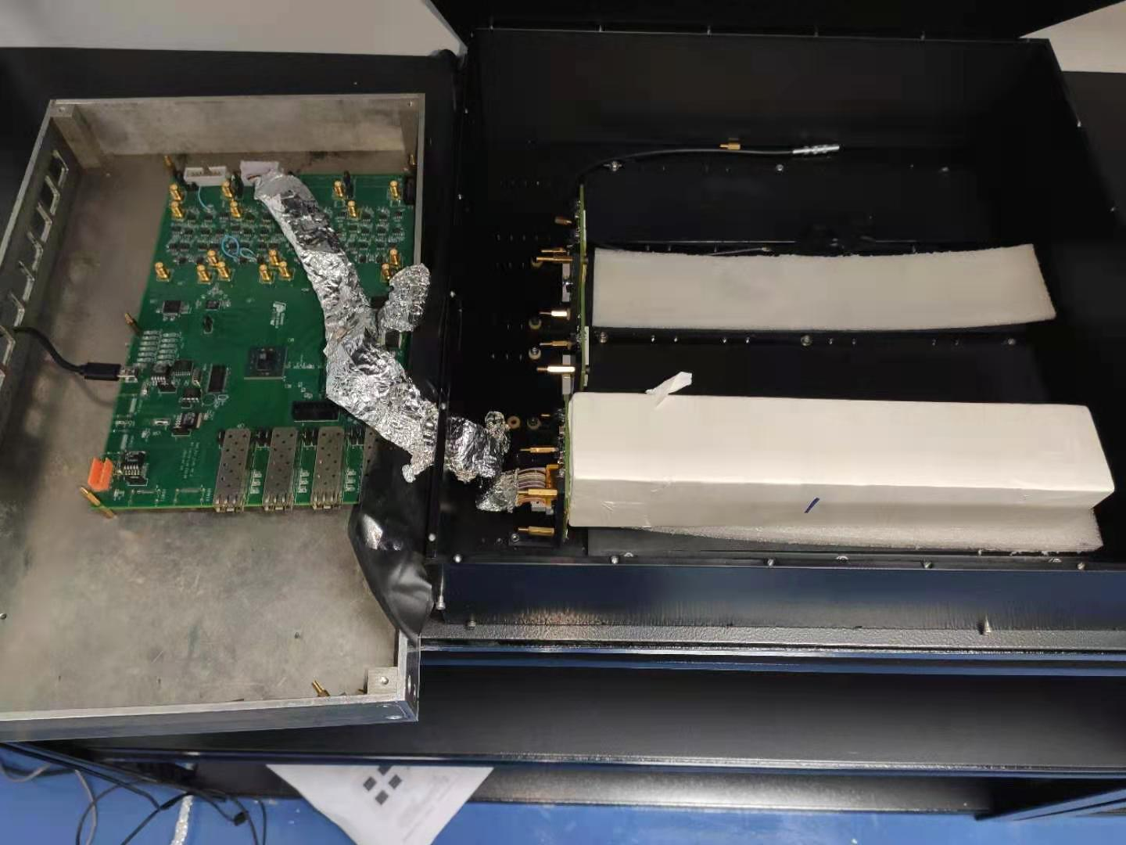
pCsI Light Yield Test
pCsI + 4 APD
  Using cosmic ray to test sensitive unit
  4 APD for high L.Y. and redundancy
  Front end: CSA-based readout design
  Back end: CR-RC² shaper and digitizer

Slide 16
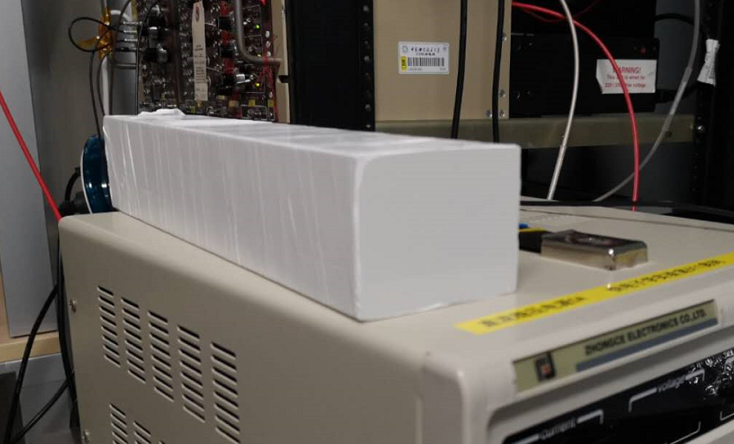
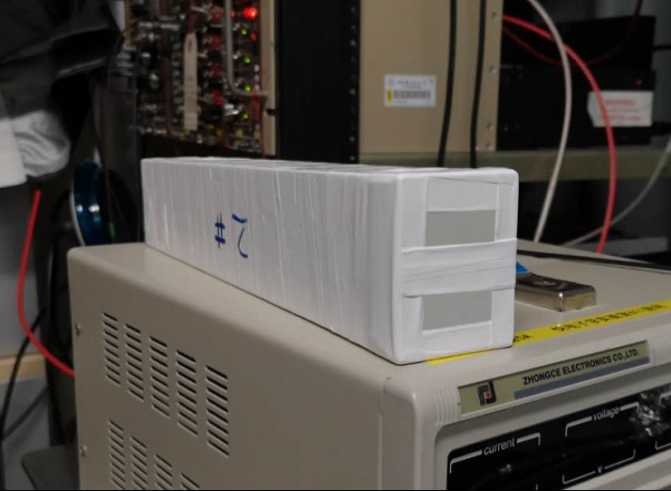
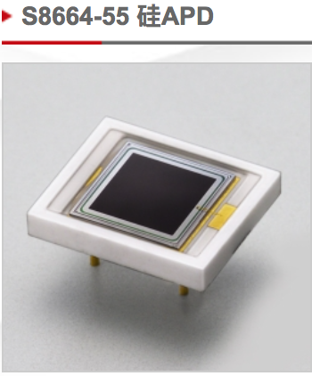
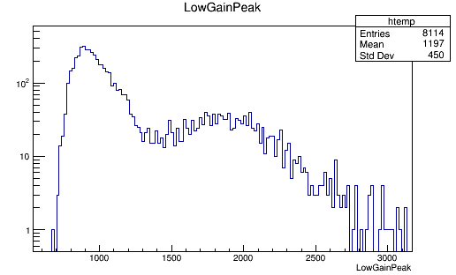
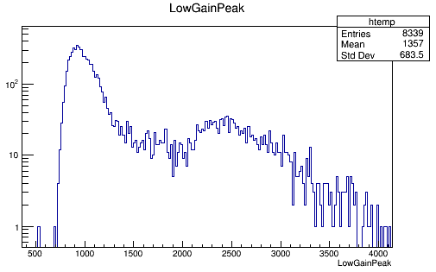
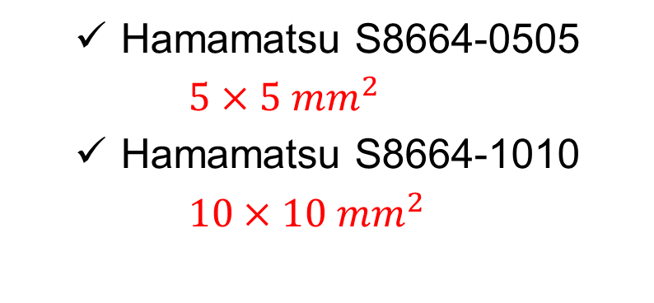
pCsI Light Yield Test
Wrapping situation
Model of APD
    Hamamatsu S8664-0505
    $5×5 {mm}^{2}$
    Hamamatsu S8664-1010
    $10×10 {mm}^{2}$
APD | Light Yield (p.e./MeV)
S8664-0505 | 54
S8664-1010 | 156
1100道，~34 p.e./MeV
1700道，~54 p.e./MeV
Whether the back end face is wrapped has a great impact.

Slide 17
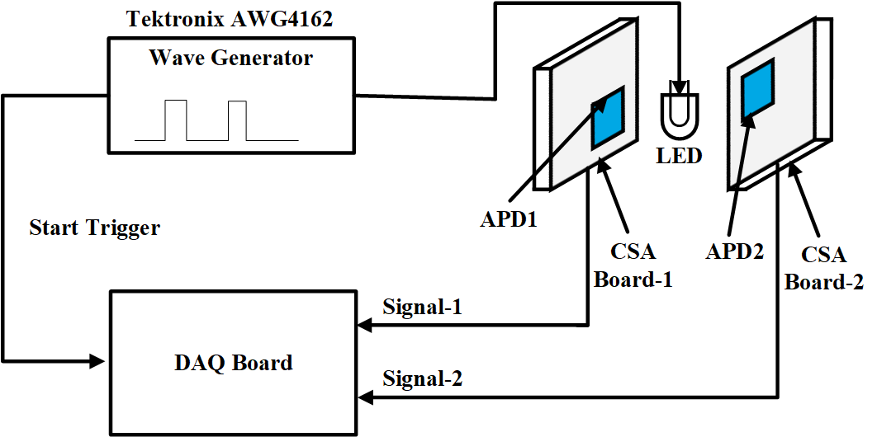
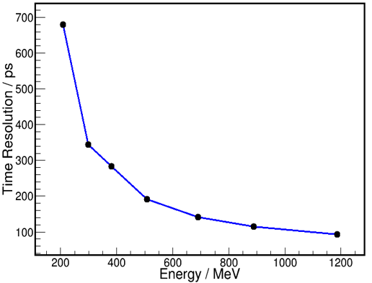
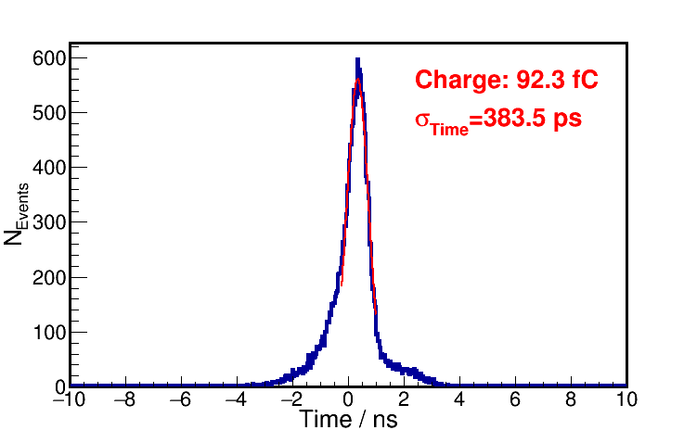
Time Resolution Test
LED + APD
  CSA Leading edge timing
Diagram of the LED test
Time resolution vs. equivalent deposited energy
See reference https://indico.ihep.ac.cn/event/10906/session/2/contribution/229

Slide 18
Summary
High precision ECAL with fast time response characteristics
  High luminosity, good energy resolution, good time resolution
The baseline design of ECAL was done
  pCsI + APD
  A Compact design of ECAL geometry model with defocus operation was completed
The key performance of ECAL was studied based on OSCAR
  The construction of software framework, including simulation, reconstruction and EDM, was done based on OSCAR.
  The MC results shows that the design of ECAL could meet the requirements
  The MultiFit and OnePulseFit methods are helpful in solving the problem of high background rate
Some test results
  pCsI + 4 1010-APD : 156 p.e./MeV
  LED + APD : Better than 150 ps@1GeV
Thanks!

Slide 19
Back Up

Slide 20

ECAL Design —— Crystal Selection
Total absorption calorimeter
  Pure CsI crystal + APD photo-device

Slide 21




ECAL Design —— Crystal Size Design
Total radiation length
  Absorb the electromagnetic shower
  as much as possible
  About 95% of energy will deposit
  in ECAL with 15$X_{0}$
  When the length is increased after 15$X_{0}$, the “cost performance” decreases rapidly
Thickness | 10$X_{0}$ (18.6cm) | 12$X_{0}$ (22.3cm) | 15$X_{0}$ (27.9cm) | 20$X_{0}$ (37.2cm)
Ratio (%) | 76.3 | 86.3 | 94.3 | 98.7
3 GeV γ-ray Shower profile

Slide 22







ECAL Design —— Crystal Size Design
End face size
  The minimum angle between the two $γ$ produced by the decay of $π^{0}$ decreases with the increase of the energy of $π^{0}$
  For 1.5GeV $π^{0}$, the minimum angle is about ${10}^{°}$, which require the end face size is not greater than $6×6 {cm}^{2}$
$$θ_{min}=ArcCos(1−2{(\frac{m_{π0}}{E_{π0}})}^{2})$$
= $ArcCos(1−2{(\frac{m_{π0}}{m_{π0}+E_{kin}})}^{2})$
Minimum opening angle vs. $E_{π0}$
The cell size of $5×5{cm}^{2}$ can meet the performance requirement well.

Slide 23

Nonnegative Least Square (NNLS)

