Slide 1
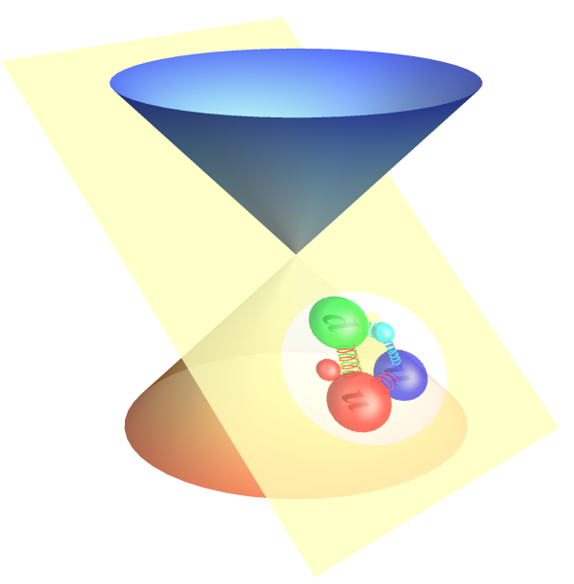
Light-front Approach to
Nucleon Structure
Xingbo Zhao（赵行波）, Siqi Xu（徐思琦）,
Zhi Hu（胡致）, Chandan Mondal,
Yang Li（李阳）, James P. Vary
Institute of Modern Physics, Chinese Academy of Sciences
中科院近代物理研究所
第13届全国粒子物理学术会议 2021年8月17日
Based on 2108.03909 [hep-ph]

Slide 2
Outline
Light-front Quantization
Basis Light-front Quantization
Application to nucleon
Summary

Slide 3
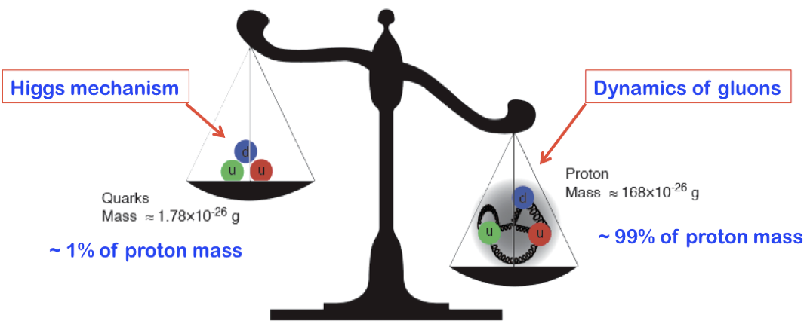
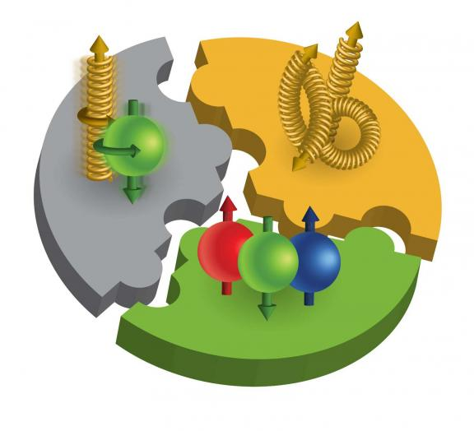
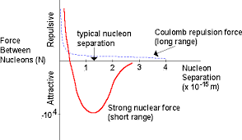
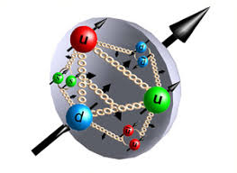
Major Questions in Nuclear Physics
Origin of nucleon mass
Origin of nucleon spin
Origin of nuclear force
Nucleon structure

Slide 4
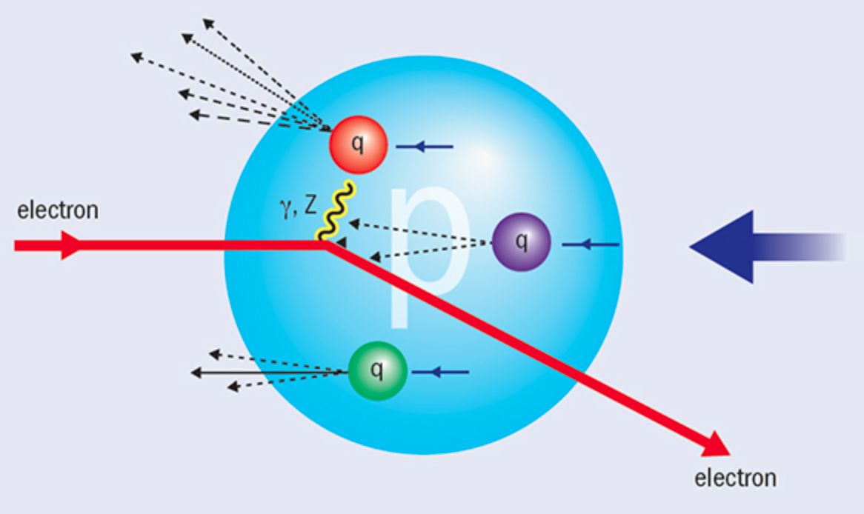

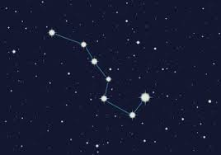

Light-front Time
Hadron structure is measured by (virtual) photon
We "see” the world at fixed light-front time ($t=x^{0}$ + $x^{3}$)

Slide 5




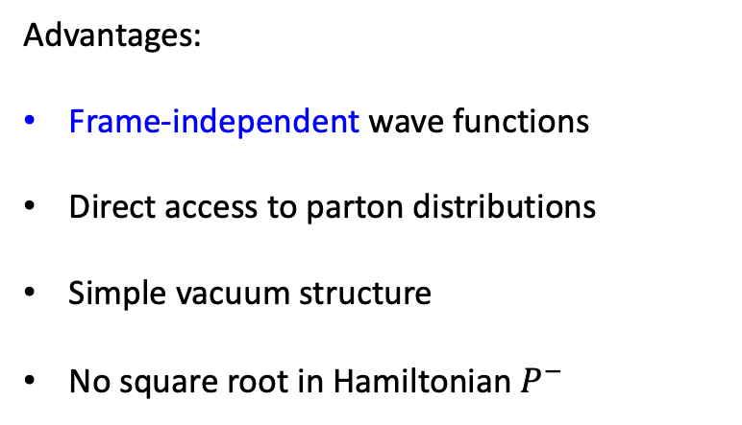


Light-front Quantization
[Dirac, 1949]
Equal time quantization
Light-front quantization
Advantages:
Frame-independent wave functions
Direct access to parton distributions
Simple vacuum structure
No square root in Hamiltonian $P^{−}$
$$x^{1},x^{2},x^{3}$$
$${x^{−}=x}^{0}−x^{3},$$
$$x^{⊥}=x^{1,2}$$
$$P^{0},\overset{⃑}{P}$$
$${P^{−}=P}^{0}−P^{3},$$
${P^{+}=P}^{0}+P^{3}$,$P^{⊥}=P^{1,2}$
$\vec{P}$, $\vec{J}$
${\vec{P}}^{⊥}$, $P^{+}{,\vec{E}}^{⊥},E^{+}, J_{z}$
4
Notes:
Light front was first proposed by Dirac, at 1949.
1. First, what is light-front. Different from equal time theory. We define light-front time as a linear combination of the regular time and one of the spatial coordinate, usually we choose z direction.
So our field quantized at this equal light-front time plane. Where in equal time quantization, they quantized at this equal time plane.
X minus is longitudinal coordinate. P minus is light front Hamiltonian. P plus is longitudinal momentum.
This is light front version of schordinger equation.
Please note that it is not just a coodernate transformation, it is a new theory in a different quantization.
Why go to light front? For we can get Frame Independent wavefunction. Which encods all the information of the bound state structure. It has simple vacuum structure. The theory is boost invariant. And there is no square root in Hamiltonian p minus.

Slide 6
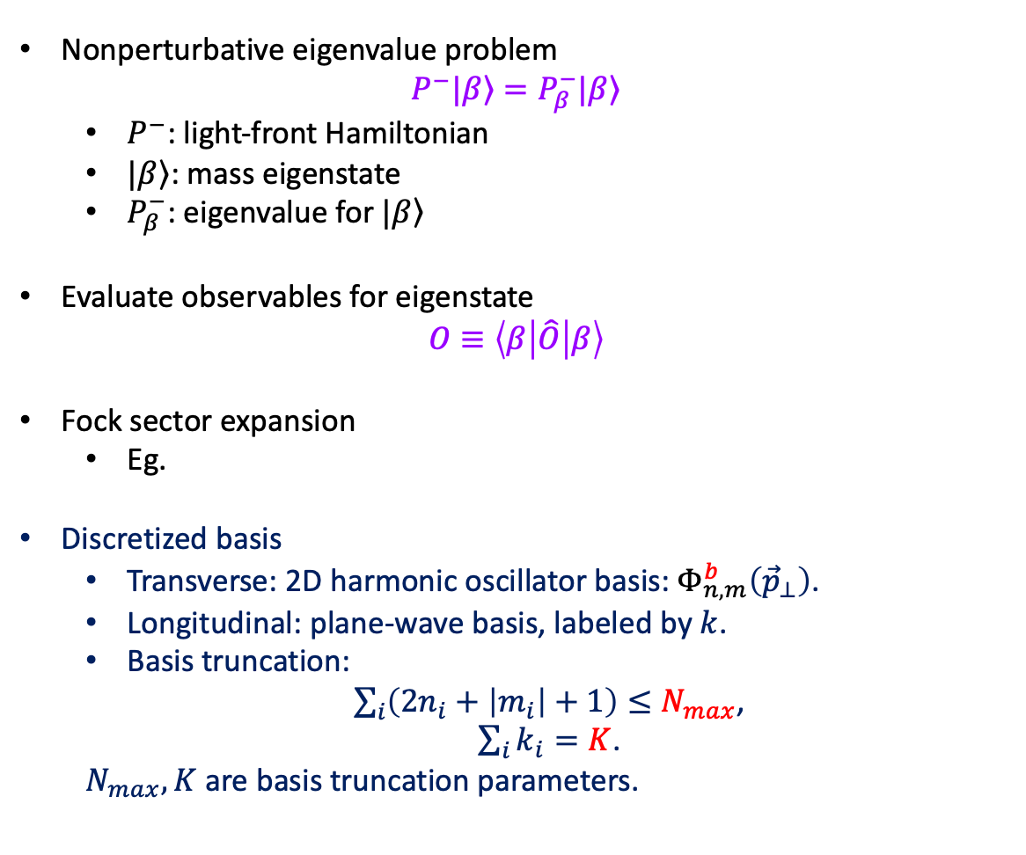
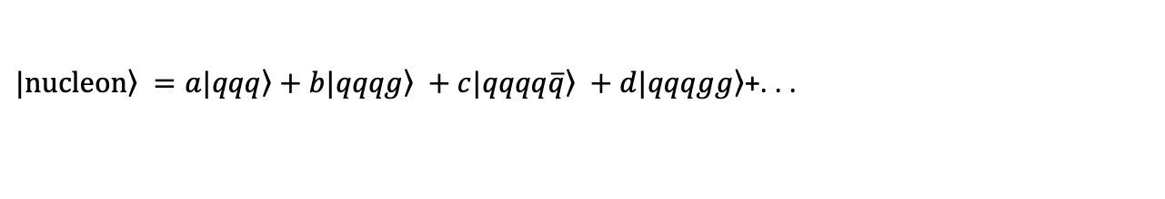
Basis Light-front Quantization
[Vary et al, 2008]
Nonperturbative eigenvalue problem
$$P^{−}|\left.β\right\rangle =P_{β}^{−}|\left.β\right\rangle$$
  $P^{−}$: light-front Hamiltonian
  $|\left.β\right\rangle$: mass eigenstate
  $P_{β}^{−}$: eigenvalue for $|\left.β\right\rangle$
Evaluate observables for eigenstate
$$O≡\left\langle β | \hat{O} | β\right\rangle$$
Fock sector expansion
  Eg.
Discretized basis
  Transverse: 2D harmonic oscillator basis:${ Φ}_{n,m}^{b}\left({\vec{p}}_{⊥}\right)$.
  Longitudinal: plane-wave basis, labeled by $k$.
  Basis truncation:
  $\sum_{i}{\left(2n_{i}+\left|m_{i}\right|+1\right)}≤N_{max}$,
  $\sum_{i}{k_{i}}=K$.
  $N_{max}, K$ are basis truncation parameters.
$\left.|nucleon\right\rangle =a\left.|qqq\right\rangle +b\left.|qqqg\right\rangle +c\left.|qqqq\overline{q}\right\rangle +d\left.|qqqgg\right\rangle$+. . .
Large $N_{max}$ and $K$ : High UV cutoff & low IR cutoff
Notes:
1.

Slide 7
Light-front QED Hamiltonian
QED Lagrangian
QED Light-front Hamiltonian
kinetic energy terms
vertex interaction
instantaneous photon interaction
instantaneous fermion interaction

Slide 8
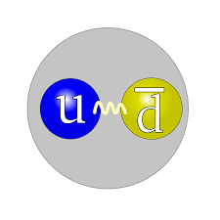
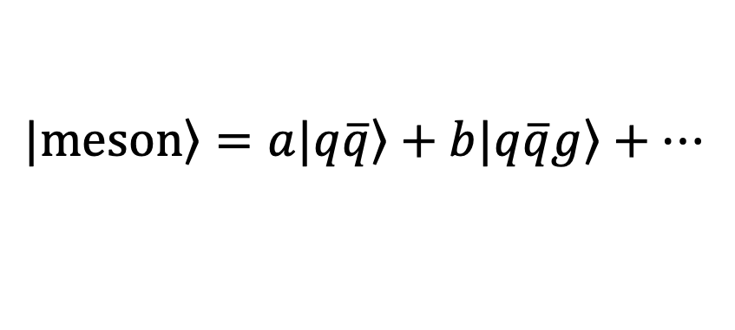
Application: Mesons
$$\left.|meson\right\rangle =a\left.|q\overline{q}\right\rangle +b\left.|q\overline{q}g\right\rangle +…$$

Slide 9






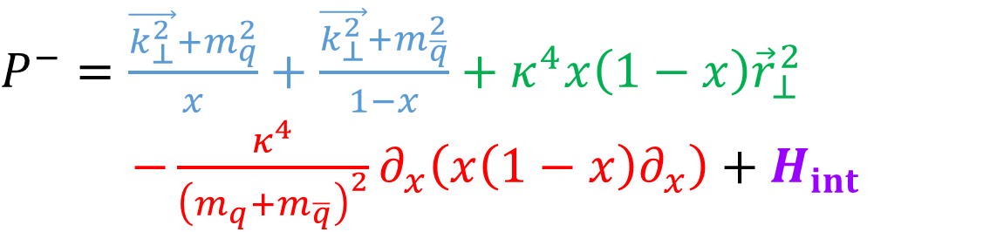
Interaction Part of Hamiltonian
$$\left.|π\right\rangle =a\left.|q\overline{q}\right\rangle +b\left.|q\overline{q}g\right\rangle +…$$
 |  | 0
$$H_{int}$$
$$\left.|q\overline{q}\right\rangle$$
$$\left.|q\overline{q}g\right\rangle$$
$$\left\langle q\overline{q}|\right.$$
$$\left\langle q\overline{q}g|\right.$$
$P^{−}=\frac{\vec{k_{⊥}^{2}}+m_{q}^{2}}{x}+\frac{\vec{k_{⊥}^{2}}+m_{\overline{q}}^{2}}{1−x}+κ^{4}x\left(1−x\right){\vec{r}}_{⊥}^{2}$
$−\frac{κ^{4}}{{\left(m_{q}+m_{\overline{q}}\right)}^{2}}∂_{x}\left(x\left(1−x\right)∂_{x}\right)+H_{int}$

Slide 10
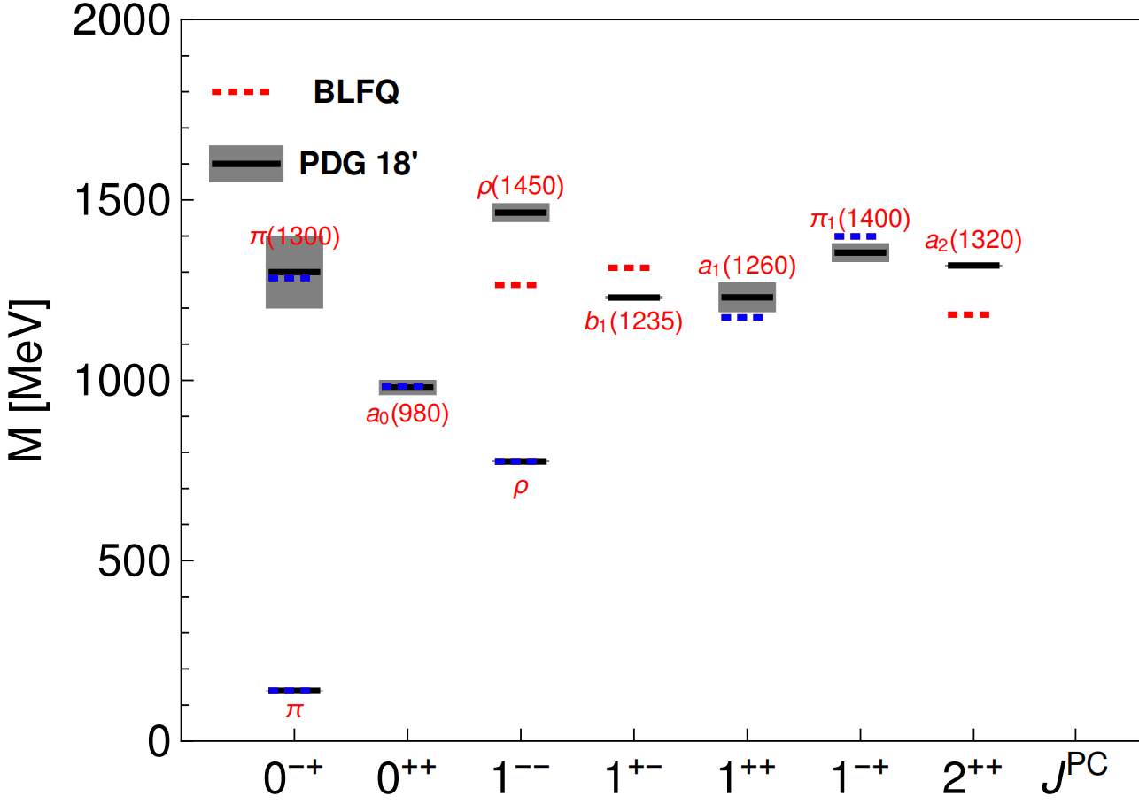
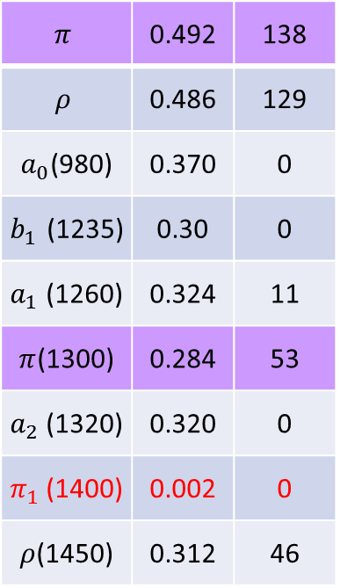
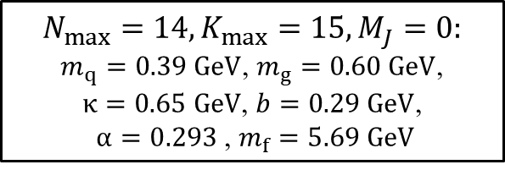

Mass Spectrum
norm$q\overline{q}$
DC[MeV]
$$π$$ | 0.492 | 138
$$ρ$$ | 0.486 | 129
$a_{0}$(980) | 0.370 | 0
$b_{1}$(1235) | 0.30 | 0
$a_{1}$(1260) | 0.324 | 11
$π$(1300) | 0.284 | 53
$a_{2}$(1320) | 0.320 | 0
$π_{1}$(1400) | 0.002 | 0
$ρ$(1450) | 0.312 | 46
$$N_{max}=14,K_{max}=15, M_{J}=0:$$
$m_{q}=0.39 GeV$, $m_{g}=0.60 GeV$,
$κ=0.65 GeV$, $b=0.29 GeV$,
$α=0.293$, $m_{f}=5.69 GeV$
Fix the parameters by fitting six blue states
[Lan, Fu, Mondal, Zhao, Vary, arXiv 2106.04954]

Slide 11
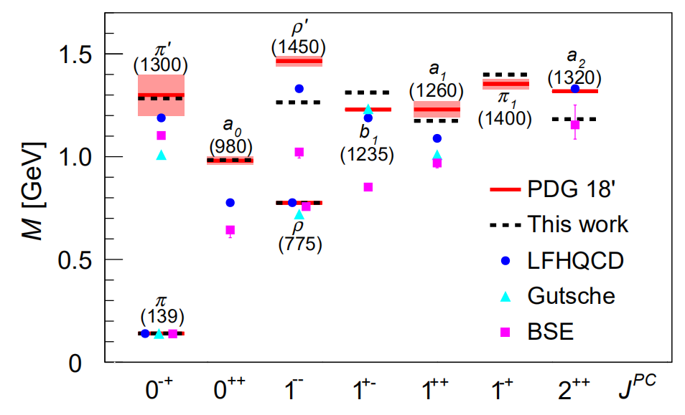

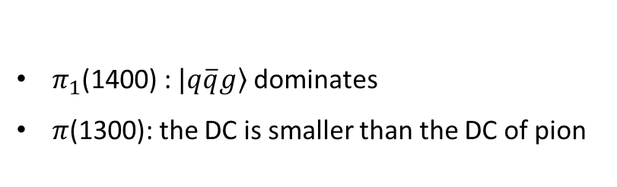
Mass Spectrum
norm$q\overline{q}$
DC[MeV]
$$π$$ | 0.492 | 138
$$ρ$$ | 0.486 | 129
$a_{0}$(980) | 0.370 | 0
$b_{1}$(1235) | 0.306 | 0
$a_{1}$(1260) | 0.324 | 11
$π$(1300) | 0.284 | 53
$a_{2}$(1320) | 0.320 | 0
$π_{1}$(1400) | 0.002 | 0
$ρ$(1450) | 0.312 | 46
$π_{1}$(1400) : $\left.|q\overline{q}g\right\rangle$dominates
$π$(1300): the DC is smaller than the DC of pion
[Lan, Fu, Mondal, Zhao, Vary, arXiv 2106.04954]

Slide 12
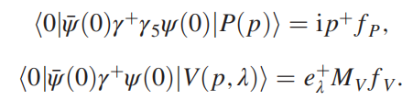
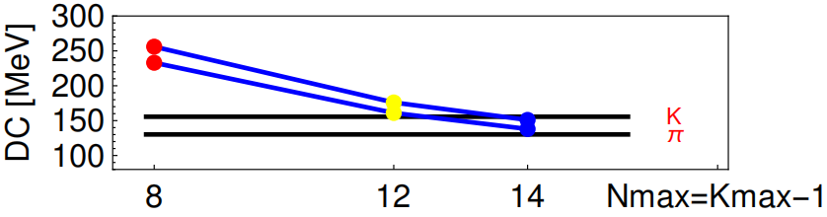
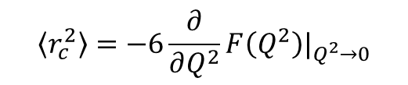
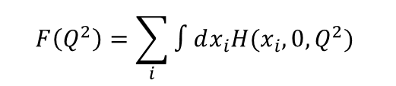
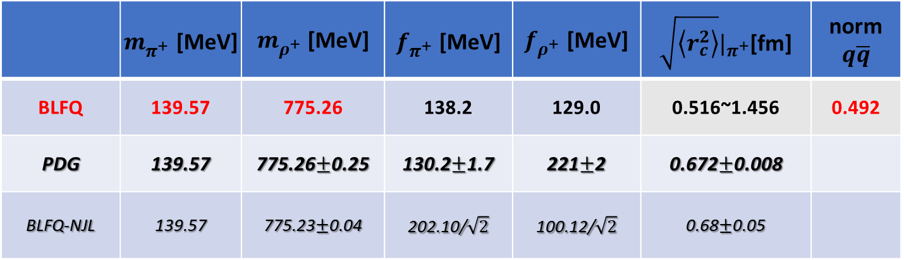
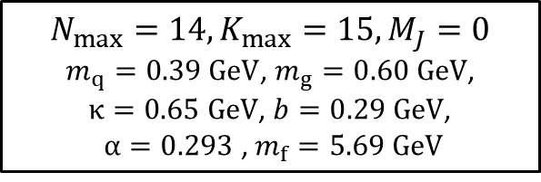
Pion mass, DC, Radii
$$\left\langle r_{c}^{2}\right\rangle =−6\frac{∂}{∂Q^{2}}F\left(Q^{2}\right)|_{Q^{2}→0}$$
$$F\left(Q^{2}\right)=\sum_{i}{∫dx_{i}H(x_{i},0,Q^{2}) }$$
 | $m_{π^{+}}^{}$[MeV] | $m_{ρ^{+}}^{}$ [MeV] | $f_{π^{+}}^{}$ [MeV] | $f_{ρ^{+}}^{}$ [MeV] | $\sqrt{\left\langle r_{c}^{2}\right\rangle }|_{π^{+}}$[fm] | norm$q\overline{q}$
BLFQ | 139.57 | 775.26 | 138.2 | 129.0 | 0.516~1.456 | 0.492
PDG | 139.57 | 775.26$±$0.25 | 130.2$±$1.7 | 221$±$2 | 0.672$±$0.008
BLFQ-NJL | 139.57 | 775.23$±$0.04 | 202.10/$\sqrt{2}$ | 100.12/$\sqrt{2}$ | 0.68$±$0.05
[Tanabashi, et al, PRD(2018)]
[Jia, Vary, PRC(2018)]
BLFQ
$$N_{max}=14,K_{max}=15, M_{J}=0$$
$m_{q}=0.39 GeV$, $m_{g}=0.60 GeV$,
$κ=0.65 GeV$, $b=0.29 GeV$,
$α=0.293$, $m_{f}=5.69 GeV$
[Lan, Fu, Mondal, Zhao, Vary, arXiv 2106.04954]

Slide 13
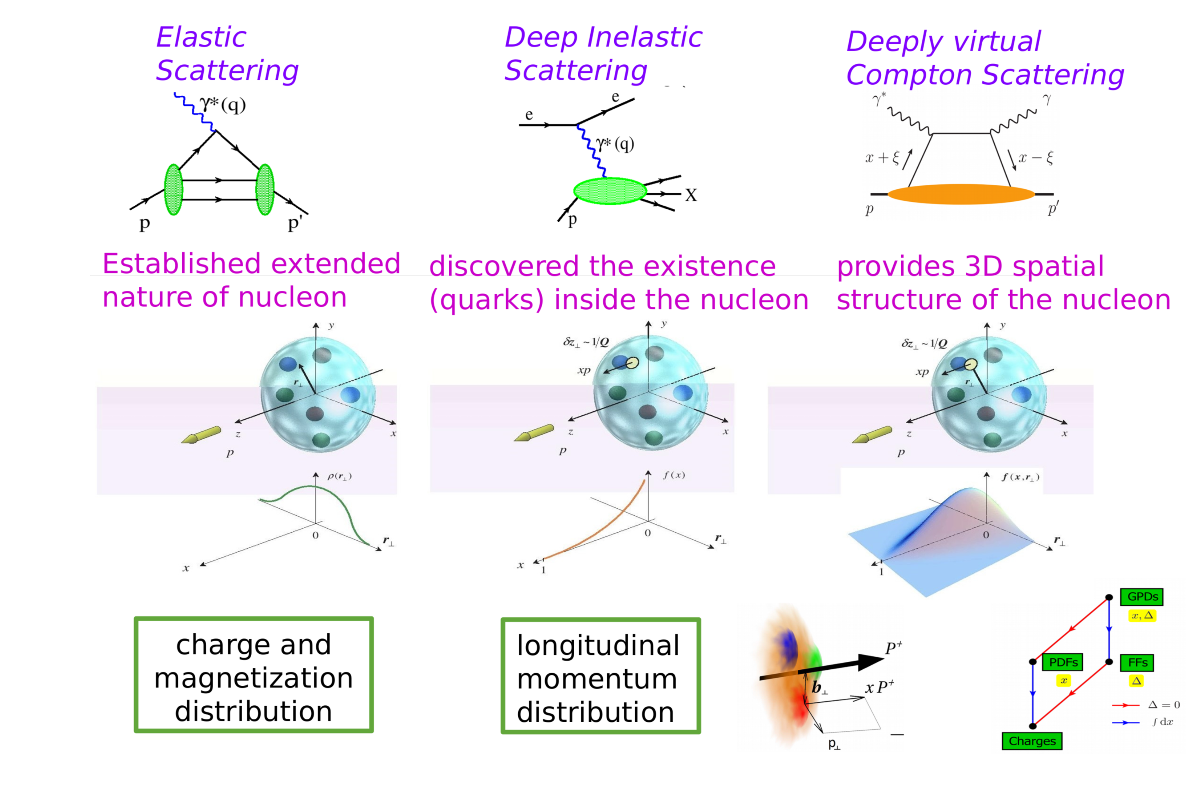
Distribution Functions

Slide 14
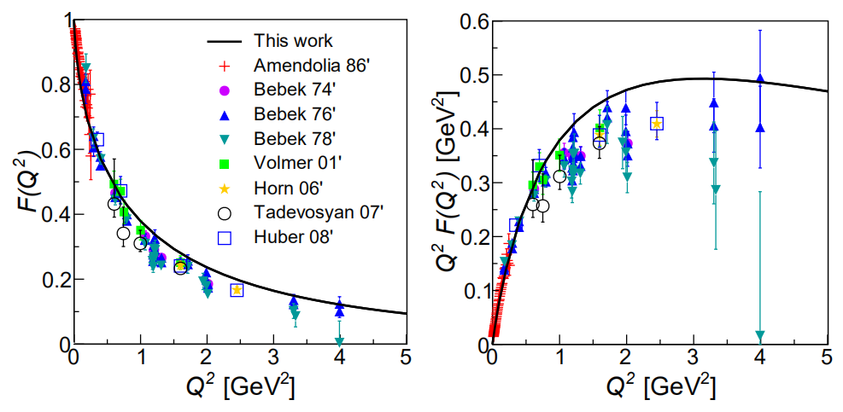

Pion Electromagnetic Form Factor
F(Q²) $∝$ 1/ Q² for large Q², consistent with pQCD
[Lan, Fu, Mondal, Zhao, Vary, arXiv 2106.04954]

Slide 15
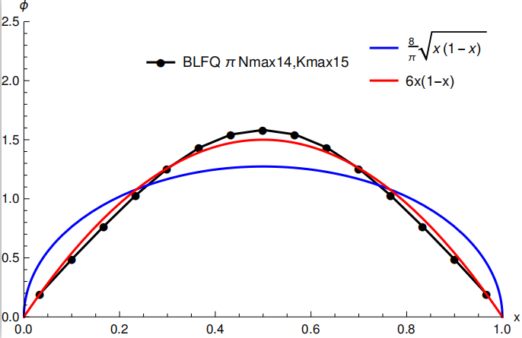
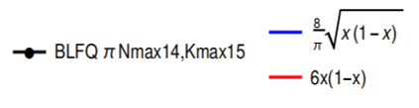
Pion Parton Distribution Amplitude
Ads/QCD
pQCD
Endpoint behavior agrees with pQCD
[Jia and Vary, PRC 99, 035206 (2019]

Slide 16
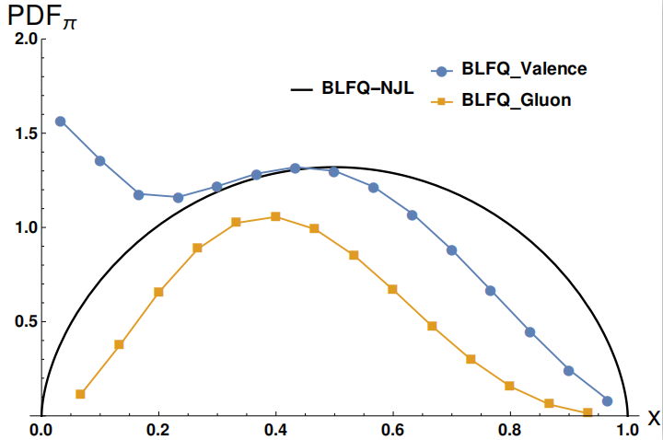

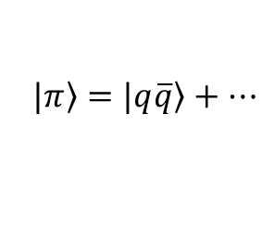





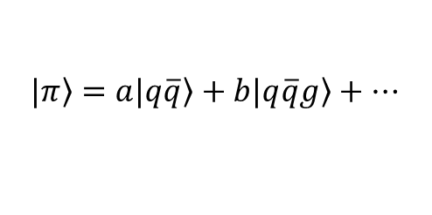

Pion PDF at Initial Energy Scale
$$\left.|π\right\rangle =\left.|q\overline{q}\right\rangle +…$$
$$\left.|π\right\rangle =a\left.|q\overline{q}\right\rangle +b\left.|q\overline{q}g\right\rangle +…$$
large $x$
$$μ_{0BLFQ−NJL}^{2}=0.240 {GeV}^{2}$$
${\left\langle x\right\rangle }_{gluon}=0$; ${\left\langle x\right\rangle }_{valence u}=0.5$
${(1−x)}^{0.596}$
$$μ_{0BLFQ}^{2}=0.34 {GeV}^{2}$$
${\left\langle x\right\rangle }_{gluon}=0.216$; ${\left\langle x\right\rangle }_{valence u}=0.392$
${(1−x)}^{1.4}$
[Lan, Fu, Mondal, Zhao, Vary, arXiv 2106.04954]

Slide 17
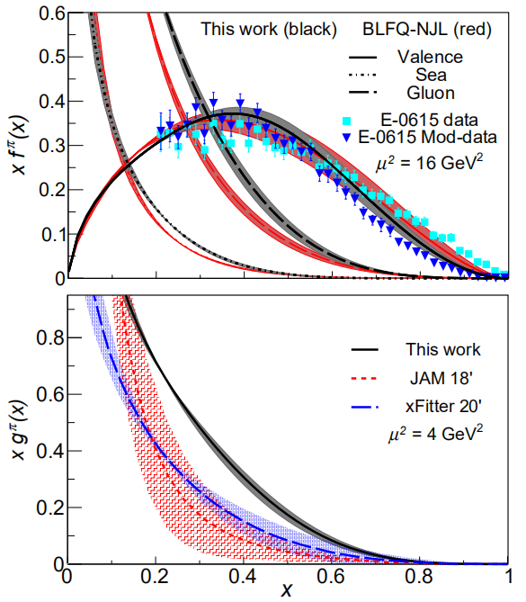
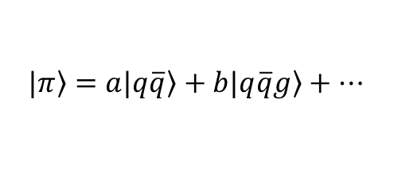
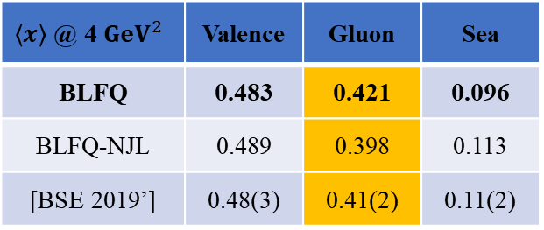
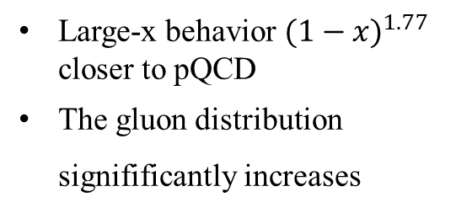
Pion PDF after DGLAP Evolution
$$\left.|π\right\rangle =a\left.|q\overline{q}\right\rangle +b\left.|q\overline{q}g\right\rangle +…$$
Large-x behavior ${(1−x)}^{1.77}$ closer to pQCD
The gluon distribution signifificantly increases
$\left\langle x\right\rangle$ @ 4 ${GeV}^{2}$ | Valence | Gluon | Sea
BLFQ | 0.483 | 0.421 | 0.096
BLFQ-NJL | 0.489 | 0.398 | 0.113
[BSE 2019’] | 0.48(3) | 0.41(2) | 0.11(2)
[Lan, Fu, Mondal, Zhao, Vary, arXiv 2106.04954]

Slide 18
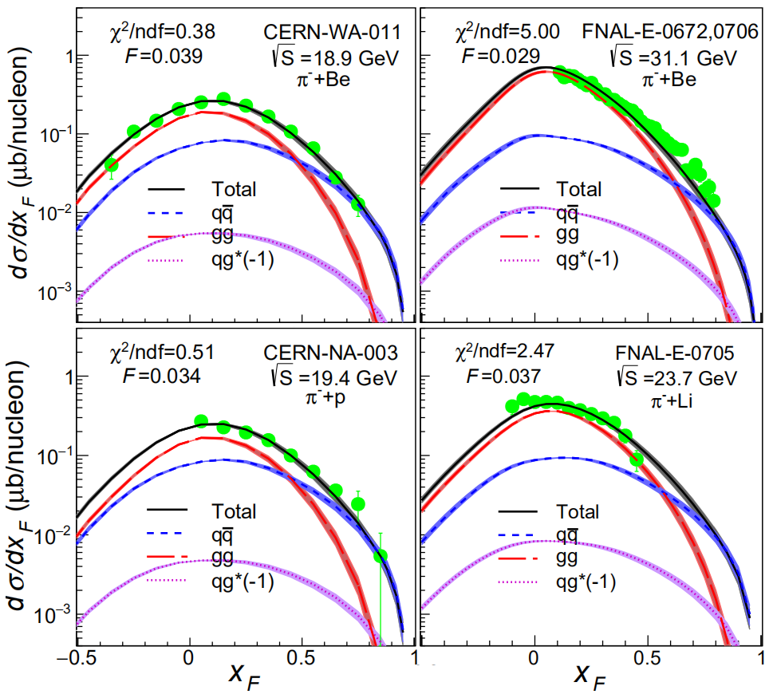
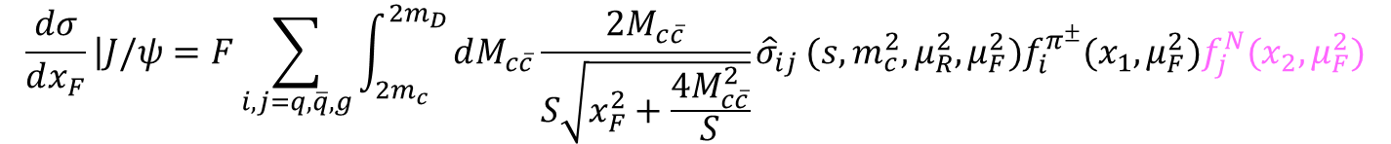
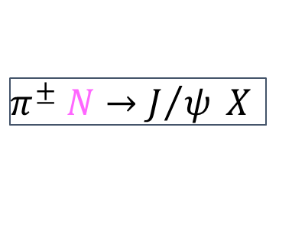
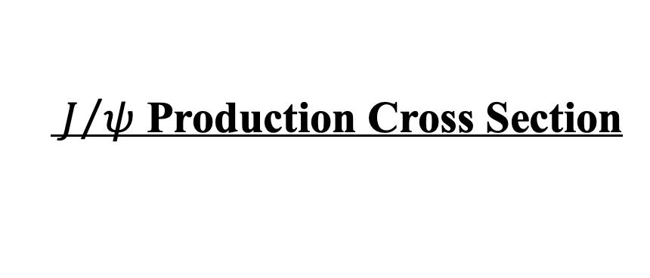
$J/ψ$ Production Cross Section
$π^{±} N→J/ψ X$
$$\frac{dσ}{dx_{F}}\left|J/ψ\right.=F\sum_{i,j=q,\overline{q},g}{\int_{2m_{c}}^{{2m}_{D}}{dM_{c\overline{c}}\frac{2M_{c\overline{c}}}{S\sqrt{x_{F}^{2}+\frac{4M_{c\overline{c}}^{2}}{S}}}{\hat{σ}}_{ij}}(s,m_{c}^{2},μ_{R}^{2},μ_{F}^{2})f_{i}^{π^{±}}(x_{1},μ_{F}^{2})f_{j}^{N}(x_{2},μ_{F}^{2})}$$
[nCTEQ 2015]
CEM
[Chang, et al, PRD 102 (2020) 054024];
[Nason, et al, NPB 303 (1988) 607];
[Mangano, et al, NPB 405 (1993) 507]
Agree with experimental data (FNAL E672, E706, E705, CERN NA3,WA11).
[Lan, Fu, Mondal, Zhao, Vary, arXiv 2106.04954]

Slide 19
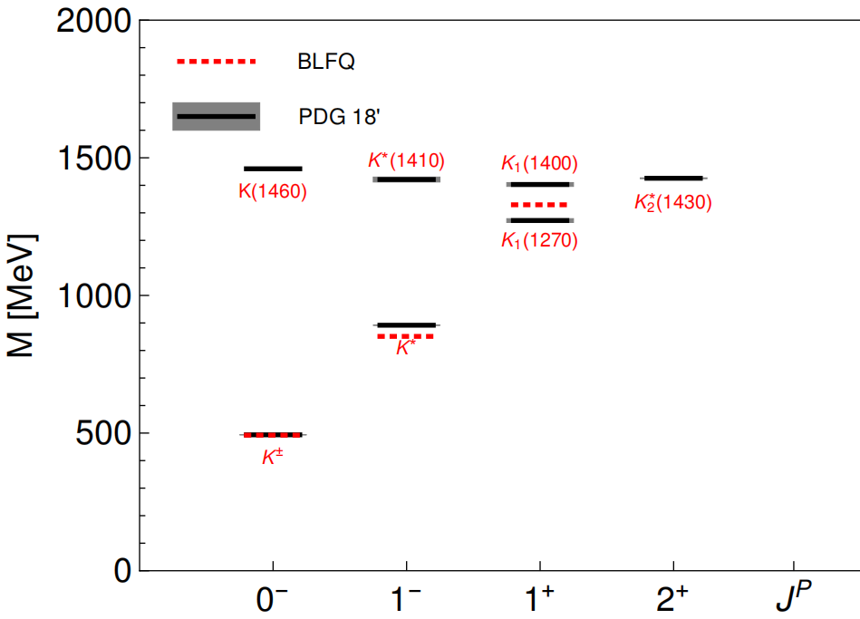

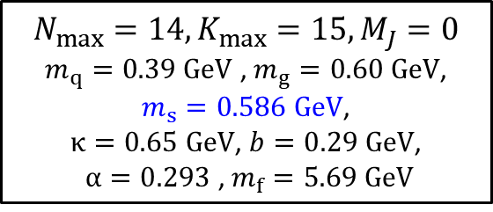
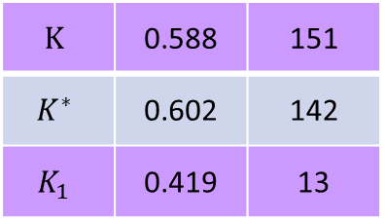
Kaon Mass Spectrum
$$\left.|K\right\rangle =a\left.|u\overline{s}\right\rangle +b\left.|u\overline{s}g\right\rangle +…$$
Norm1
DC[MeV]
$$K$$ | 0.588 | 151
$$K^{∗}$$ | 0.602 | 142
$$K_{1}$$ | 0.419 | 13
$$N_{max}=14,K_{max}=15, M_{J}=0$$
$m_{q}=0.39 GeV$ , $m_{g}=0.60 GeV$,
$m_{s}=0.586 GeV$,
$κ=0.65 GeV$, $b=0.29 GeV$,
$α=0.293$, $m_{f}=5.69 GeV$
Preliminary

Slide 20
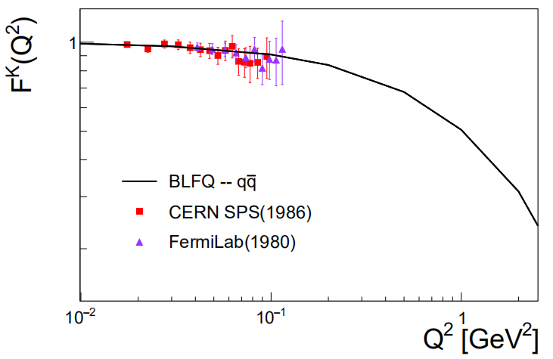
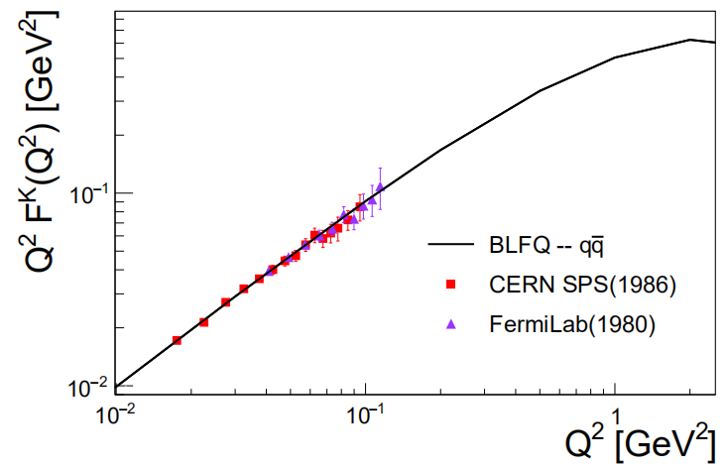
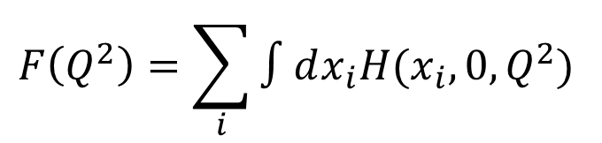
Kaon Form Factor
$$F\left(Q^{2}\right)=\sum_{i}{∫dx_{i}H(x_{i},0,Q^{2}) }$$
Preliminary: based on leading Fock Sector WF
[Lan, et al, in progress ]

Slide 21
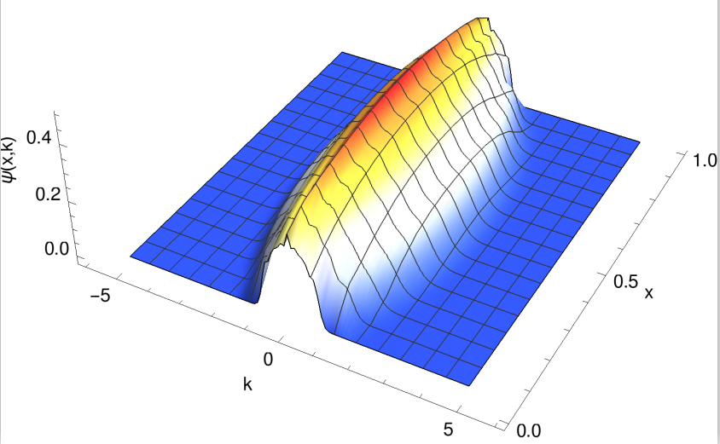
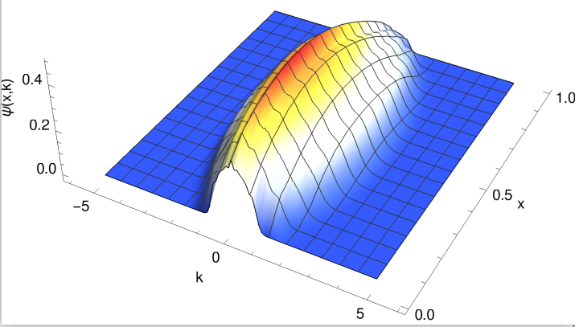
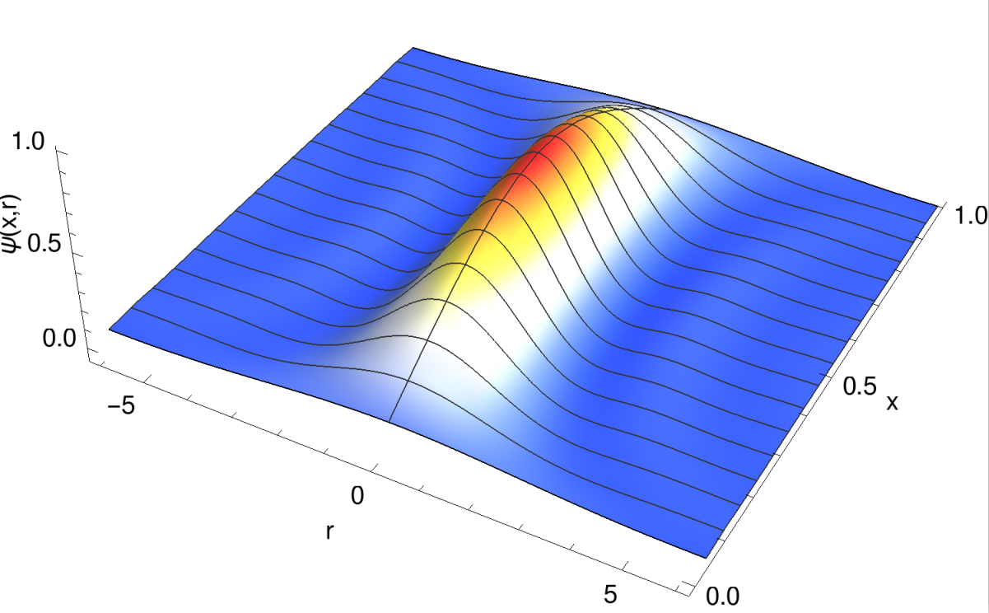
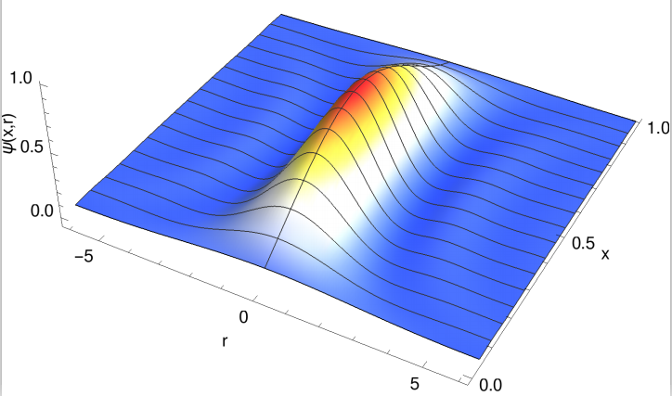
Wave function
Pion
Kaon
k
k
r
r

Slide 22

Application: nucleon
$\left.|nucleon\right\rangle =a\left.|qqq\right\rangle +b\left.|qqqg\right\rangle +c\left.|qqqq\overline{q}\right\rangle +$. . .
21

Slide 23


Light-front QCD Hamiltonian
$$P_{LFQCD}^{−}$$
22

Slide 24






Light-Front Hamiltonian
$$P^{−}=H_{K.E.}+H_{trans}+H_{longi}+H_{Interact}$$
$$H_{K.E.}=\sum_{i}{\frac{p_{i}^{2}+m_{q}^{2}}{p_{i}^{+}}}$$
$H_{trans} \sim κ_{T}^{4}r^{2}$
-- Brodsky, Teramond arXiv: 1203.4025
$$H_{longi} \sim −\sum_{ij}{κ_{L}^{4}∂_{x_{i}}\left(x_{i}x_{j}∂_{x_{j}}\right)}$$
---Y Li, X Zhao , P Maris , J Vary, PLB 758(2016)
  $$|\left.P_{baryon}\right\rangle =|\left.qqq\right\rangle +\left|qqqg\right\rangle +\left|qqq q\overline{q}\right\rangle + ⋅⋅⋅⋅⋅⋅$$
Only include first Fock sector
$$H_{Interact}=−\frac{C_{F}4πα_{s}}{Q^{2}}\sum_{i,j(i<j)}{{\overline{u}}_{s_{i}^{′}}\left(k_{i}^{′}\right)γ^{μ}u_{s_{i}}\left(k_{i}\right){\overline{u}}_{s_{j}^{′}}\left(k_{j}^{′}\right)γ_{μ}u_{s_{j}}(k_{j}) }$$
Include the first and second Fock sector
$$H_{Interact}=H_{Vertex}+H_{inst}=g\overline{ψ} γ^{μ}T^{a} ψ A_{μ}^{a}+\frac{g^{2}C_{F}}{2} j^{+}\frac{1}{{\left(i∂^{+}\right)}^{2}}j^{+}$$

Slide 25




Electromagnetic Form Factor
Elastic scattering of proton
[ R. Hofstadter, Nobel Prize 1961 ]
$$e\left(p\right)+h\left(P\right)→e\left(p^{′}\right)+h(P^{′})$$
Elastic electron scattering established the extended nature of the proton (proton radius).
The Fourier transformation of these form factors provide spatial distributions (charge and magnetization distributions).
Dirac Form Factor
Pauli Form Factor

Slide 26
Nucleon Form Factor
proton
neutron
neutron
proton
With increasing the basis size, the nucleon form factors approximately agree the data
[ 2108.03909 [hep-ph], Siqi Xu, C. Mondal, et.al ]

Slide 27
Nucleon Form Factor
The ratio of nucleon Form Factor has a good agreement with experimental data.
[ 2108.03909 [hep-ph], Siqi Xu, C. Mondal, et.al ]

Slide 28
Density for proton and neutron
For charge and magnetic density, BLFQ qualitatively agrees with fits.
[ 2108.03909 [hep-ph], Siqi Xu, C. Mondal, et.al ]

Slide 29



Sachs Form Factor
$G_{E}(Q^{2})=\sum_{q}{e_{q}F_{1}^{q}(Q^{2})}−\frac{Q^{2}}{4M^{2}}$ $\sum_{q}{e_{q}F_{2}^{q}(Q^{2})}$ ,
$G_{M}(Q^{2})=\sum_{q}{e_{q}F_{1}^{q}(Q^{2})}+$ $\sum_{q}{e_{q}F_{2}^{q}(Q^{2})}$.
neutron
proton
Anomalous magnetic moment
Proton : $μ_{N}=2.44$ (Exp. : 2.79)
Neutron : $μ_{N}=−1.41$ (Exp. : $−1.91$)
proton
neutron
[ 2108.03909 [hep-ph], Siqi Xu, C. Mondal, et.al ]

Slide 30




Axial Form Factor of The Proton
Axial form factor of the proton can be measured by ordinary muon capture (OMC)
$$μ^{−}\left(l\right)+p\left(r\right)→ν_{μ}\left(l^{′}\right)+n(r^{′})$$
Provide information on spin-isospin distributions
$$G_{A}\left(Q^{2}\right)=G_{u}\left(Q^{2}\right)−G_{d}(Q^{2})$$
we consider only the valence quark in our calculation, and neglect the sea quark and gluon contributions.
[ 2108.03909 [hep-ph], Siqi Xu, C. Mondal, et.al ]
[Chandan Mondal, EPJC 2017]

Slide 31



Nucleon Radii and Axial Charges
The magnetic moment of the proton and neutron
The radii of the proton and neutron
The axial charge and axial radius
[ 2108.03909 [hep-ph], Siqi Xu, C. Mondal, et.al ]

Slide 32





Parton Distribution Functions (PDF)
Deep Inelastic Scattering (SLAC 1968)
$$X$$
$$e\left(p\right)+h\left(P\right)=e^{′}\left(p^{′}\right)+X(P^{′})$$
$$X$$
Discovery of spin ½ quarks and partonic structure
Parton distribution functions (PDFs) are extracted from DIS processes.
$$Φ^{\left[γ^{+}\right]}\left(x,Q^{2}\right)=\int{\frac{dz^{−}}{8π}} e^{ixP^{+}z^{−}/2}⟨P,Λ\left|\overline{ψ}\left(x\right)γ^{+}ψ\left(0\right)\right|P,Λ⟩$$
PDFs encode the distribution of longitudinal momentum and polarization carried by the constituents

Slide 33

Unpolarized PDFs and Helicity PDFs
Unpolarized PDFs:
Helicity PDFs:
Helicity PDFs overestimate the data below $x∼0.3$ for up quark.
Results correspond to the leading Fock sector only, missing higher Fock sectors.
[ 2108.03909 [hep-ph], Siqi Xu, C. Mondal, et.al ]

Slide 34


Helicity PDFs with Valence and Sea Quark
$$q^{+}(x)=q(x)+\overline{q}(x)$$
The differential contribution between up and down quark more or less agree with NNPDF data.
The helicity asymmetry is an observable for investigating the spin structure of the proton in experiments.
up quark
Considering the valence and sea quark contribution, our results have overestimate at small x region.
$$g_{1}^{q^{+}}(x)/f_{1}^{q^{+}}(x)$$
At least, The gluon contribution at initial scale is needed for BLFQ.
down quark
[ 2108.03909 [hep-ph], Siqi Xu, C. Mondal, et.al ]

Slide 35


Transversity PDFs
[ 2108.03909 [hep-ph], Siqi Xu, C. Mondal, et.al ]
Transversity PDFs：
Up quark distribution deviates at low $Q^{2}$ region.
Down quark distribution is in accord with the global analyses.
Results correspond to the leading Fock sector only, missing higher Fock sectors.
Soffer Bound (Green line):
$$|h_{1}\left(x\right)|≤\frac{1}{2}|f_{1}\left(x\right)+g_{1}\left(x\right)|$$

Slide 36





The quark tensor charge in the proton
The first moment of the transversity PDF
$$μ^{2}=2.4 GeV^{2}$$
The BLFQ predicts the tensor charges for the down quark in good agreement with the global QCD qnqlysis
The second moment of the transversity PDF
$$μ^{2}=2.4 GeV^{2}$$
The BLFQ prediction for ${\left\langle x\right\rangle }_{T}^{u−d}$agrees reasonably well with the lattice data.
[ 2108.03909 [hep-ph], Siqi Xu, C. Mondal, et.al ]

Slide 37









Generalized Parton Distribution Functions
[ 2108.03909 [hep-ph], Siqi Xu, C. Mondal, et.al ]
Encode the information about three dimensional spatial structure the spin and orbital angular momentum
With increasing momentum transfer ($t$), the peaks of distributions shift to larger $x$;
$$t=Δ^{2},x=\frac{k^{+}}{P^{+}}, ζ=\frac{Δ^{+}}{P^{+}}=0$$
$$b_{⊥}\underset{→}{FT} Δ_{⊥}$$
Impact parameter distribution ($b_{⊥}$):

Slide 38





Generalized Parton Distribution Functions
$$t=Δ^{2},x=\frac{k^{+}}{P^{+}}, ζ=\frac{Δ^{+}}{P^{+}}=0$$
$$Δ \underset{→}{Fourier Transform}b$$
[ 2108.03909 [hep-ph], Siqi Xu, C. Mondal, et.al ]

Slide 39




Impact parameter distribution
The $x$ dependent squared radius of the quark density
$${\left\langle b_{⊥}^{2}\right\rangle }^{q}\left(x\right)=\frac{∫d^{2}{\vec{b}}_{⊥}b_{⊥}^{2}ρ_{ch}^{q}\left(x,b_{⊥}\right)}{∫d^{2}{\vec{b}}_{⊥}ρ_{ch}^{q}(x,b_{⊥})}$$
The proton’s transverse squared radius:
BLFQ prediction:
$$\left\langle b_{⊥}^{2}\right\rangle =0.40±0.04 {fm}^{2}$$
Experimental data:
$$\left\langle b_{⊥}^{2}\right\rangle =0.43±0.01 {fm}^{2}$$
[ 2108.03909 [hep-ph], Siqi Xu, C. Mondal, et.al ]

Slide 40





Transverse momentum dependent parton distribution functions (TMDs)
Two Point correlation functions:
$$Φ_{ij}\left(x,k_{⊥};P,S\right)=\int{\frac{dξ^{−}d^{2}ξ_{⊥}}{{\left(2π\right)}^{3}}}e^{ik⋅ξ}\left\langle P,S | {\overline{ψ}}_{j}\left(0\right)ψ_{i}(ξ) | P,S\right\rangle$$
Physical meaning：the probability to find a quark with longitudinal momentum fraction $x$ and transverse momentum $k^{⊥}$ insidea proton.

Slide 41

TMD for the quarks in the proton
Integrating over the transverse momentum ($k_{⊥}$), the TMDs reduce to the PDF.
[Work in progress, Zhi Hu, Siqi Xu C. Mondal, et.al ]

Slide 42






TMD for d quark in Proton
[Work in progress, Zhi Hu, Siqi Xu C. Mondal, et.al ]

Slide 43






TMD for u quark in Proton
[Work in progress, Zhi Hu, Siqi Xu C. Mondal, et.al ]

Slide 44




Collins Asymmetry of Proton
[Work in progress, Zhi Hu, Siqi Xu C. Mondal, et.al ]
Definition of Collins Asymmetry:
$$A_{UT}^{sin⁡(φ_{h}+φ_{s})}=\frac{F_{UT}^{\sin\left(φ_{h}+φ_{s}\right)}}{F_{UU}}$$
$F_{UT}^{\sin\left(φ_{h}+φ_{s}\right)}$ is spin-dependent structure functions
$F_{UU}$ is spin averaged structure functions
Using the TMD results, we can calculate the Collins Asymmetry of the proton.
experimental data:[Airapetian, N. Akopov,Z. Akopov, E. Aschenauer, et al.2010]

Slide 45


Quark and Gluon
Quark and gluon in the proton
In the experiments, we can identify the gluons and quarks contribution from the different final states.

Slide 46
Form Factor with dynamical gluon
[In preparetion, Siqi Xu, C. Mondal et.al ]

Slide 47
Unpolarized parton distribution functions
Preliminary results
Without second Fock sector $\left|qqqg\right\rangle$, the gluon contributions all come from the DGLAP evolution。
Including the second Fock sector, the contribution of gluon more close to the global fit results.
[Work in progress, C. Mondal, Siqi Xu, et.al ]
[PhysRevD. 102. 016008, C. Mondal, Siqi Xu, et.al ]

Slide 48
Summary
Light-front dynamics
  Hamiltonian formalism for relativistic bound states
  Mass spectrum structure
Rich picture on nucleon structure
  Form factor, PDF, GPD, TMD...
Systematically expandable
  Higher Fock sectors

Slide 49
Outlook
Other hadron systems
  Meson, tetraquark, pentaquark, deuteron...
More observables
  GTMD, double parton distribution function...
Higher Fock sectors
  Gluon distribution, sea quark distribution
Thank you!
xbzhao@impcas.ac.cn

