Slide 1
Cosmic Ray Boosted Dark Matter
search in PandaX-II
Xiangyi Cui (崔祥仪)
On behalf of the PandaX-II collobration
2021/08/18 第十三届全国粒子物理学术会议

Slide 2
1
CRDM introduction
2
PandaX-II and Data selection
3
Signal and Background distribution
4
Final fitting and exclusion limit

Slide 3
Dark Matter
Samuel Velasco/Quanta Magazine

Slide 4
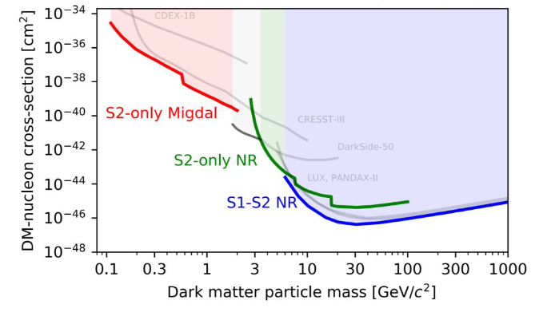
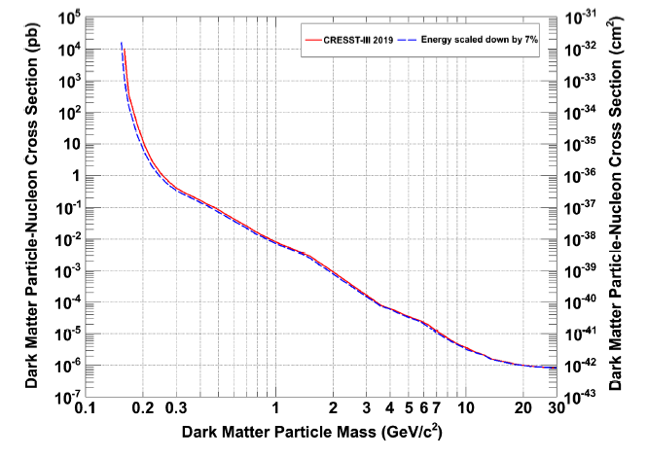
WIMPs and Low mass dark matter
$$m_{χ}^{min}\sim m_{T}/(\sqrt{2m_{T}v_{max}^{2}/E_{th}}−1)$$
10⁻⁴⁷cm² excluded cross section for >10GeV WIMPs, but limited in the sub-GeV mass;
The minimum probe DM mass in the direct detection experiment is related to the target mass and the energy threshold;
Many specific analysis working for the low mass range search, but still not enough;
PRD.100.102002
CRESST-III result

Slide 5
Boosted Dark Matter - for light DM or XENON1T excess
CR boosted
Semi-Annihilation
Sun Accelerate
Boosted DM
DM-induced
Nuclear decay
Multi-component
more ... ...

Slide 6
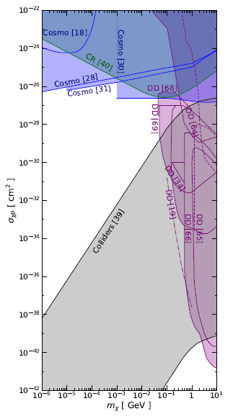
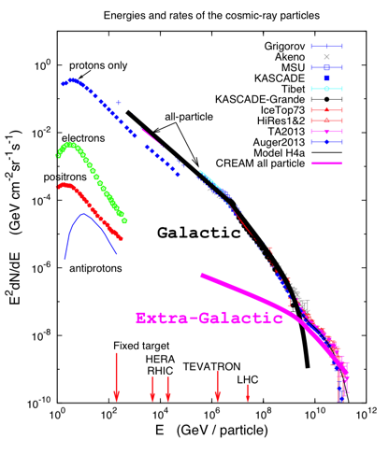
Cosmic Ray Boosted Dark Matter
arXiv:2008.07116
B. Zhang et al.
DM-N transferred momentum non-related cross section is considered;
Similar as DD principle, DM will scatter with cosmic ray and extend to higher energy;

Slide 7
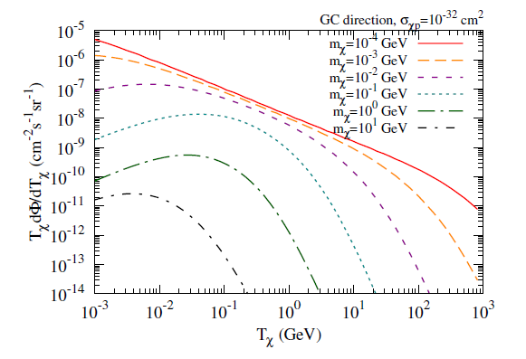
CRDM flux
PRL.126.091804
Main CRDM flux coming from the Galaxy Center;
CRDM flux positively related to the cross section, and inversely related to the DM mass;

Slide 8
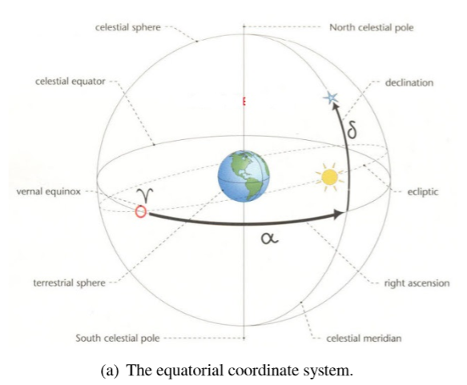
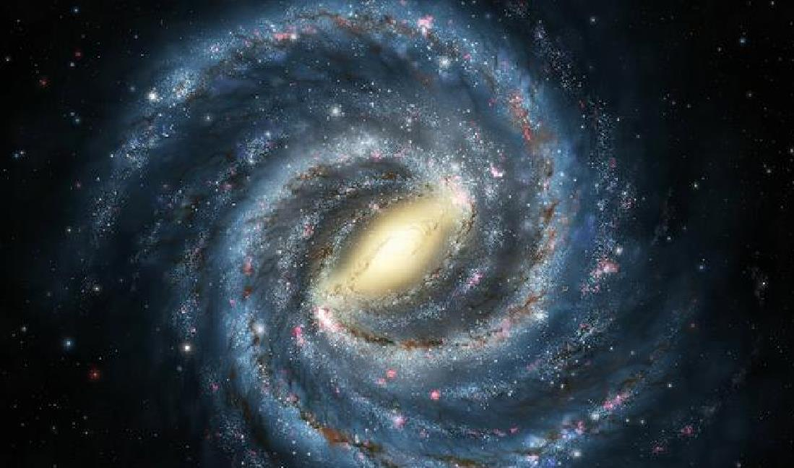
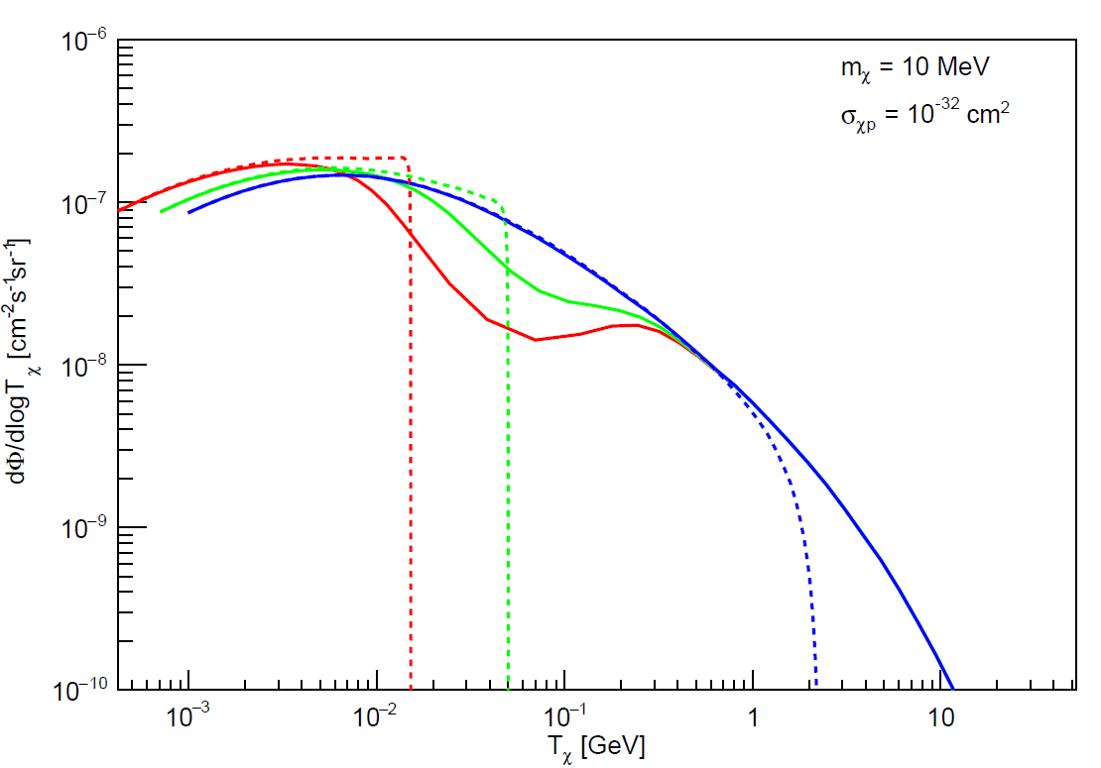
Earth attenuation
nadir angle = 30
nadir angle = 60
nadir angle = 90
Different travel length in earth will shift the energy distribution, so called attenuation;
Ballistic-Trajectory approximation was used for attenuated flux calculation, consistent with the MC result;

Slide 9
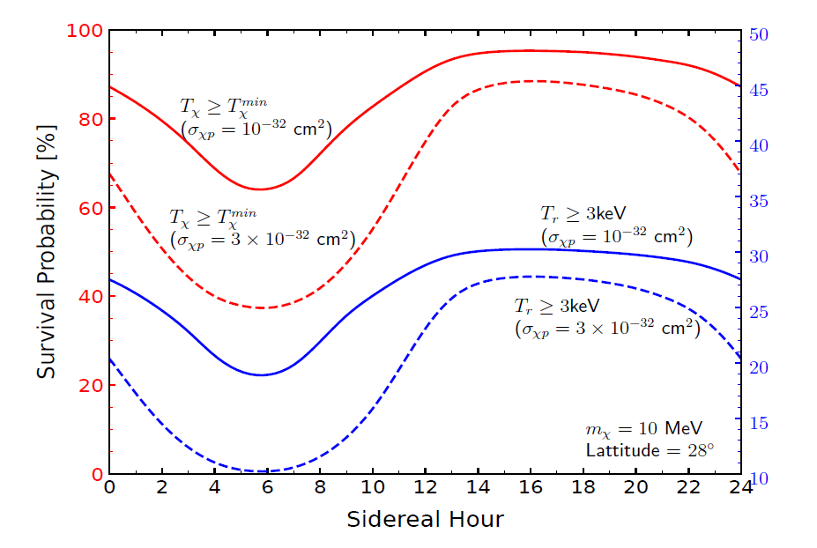
Signal typical sidereal diurnal modulation
Same NR scatter condition with WIMPs;
CRDM signal have the typical diurnal effect as the direction changes as the earth rotation;
Key information separate the signal with the background;
PRL.126.091804

Slide 10
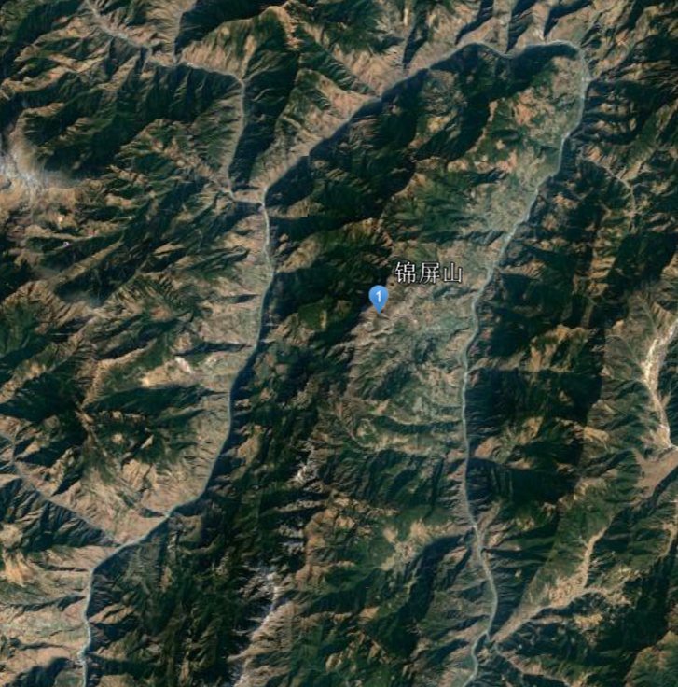
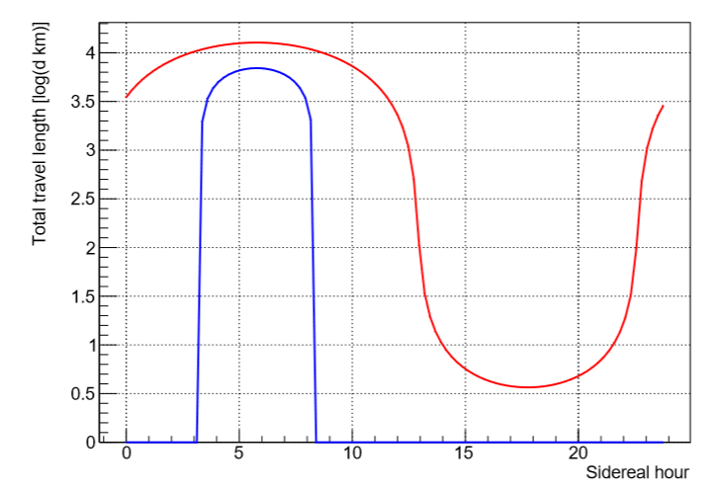
CJPL location and travel length
101.7E
28N
Lab location is related to the CRDM sidereal hour distribution;
Elevation points in 50km is extracted from Database, and smooth the length to the point of tangency;

Slide 11
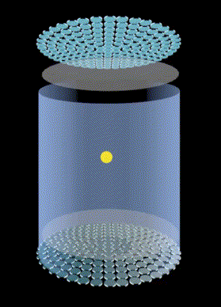
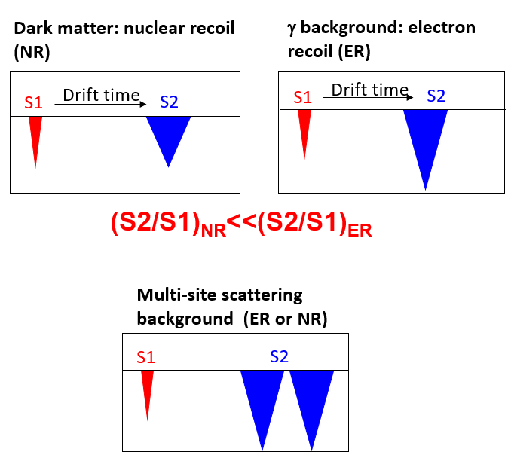
PandaX DM direct detection experiment
PandaX-II stable data taking from 2016 to 2019, have been pulished some important DM result, including WIMPs, axions and e-WIMP ...

Slide 12
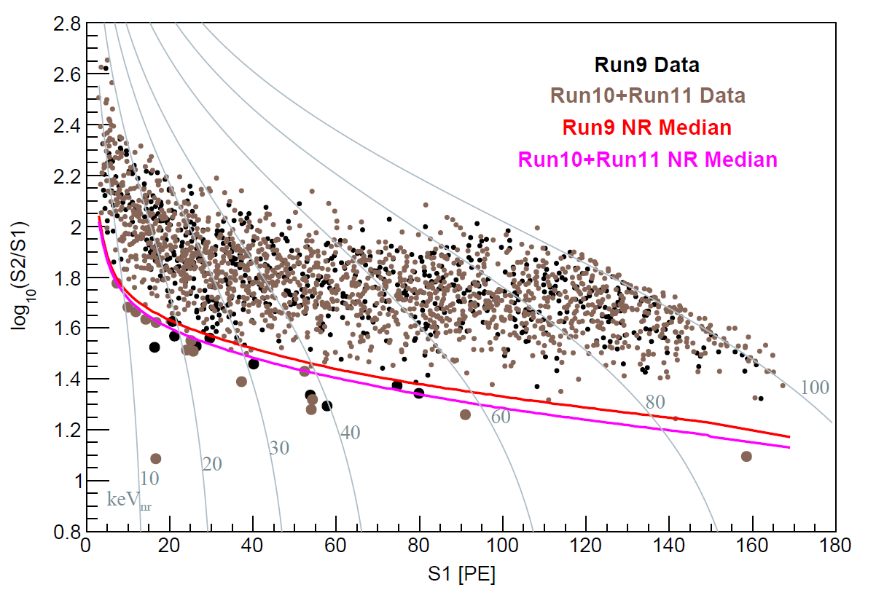
Candidates selection
100 Ton·Day
R²<5.5e4 with 250.556 kg liquid xenon, in order to reduce the wall background;
S1>3PE, S2>100PE and E_{com}<25keV_{ee};
Study the different selection conditions, below NR median as the final candidates selection;
Different Runs are seperated and transfer the event time to the sidereal time;

Slide 13
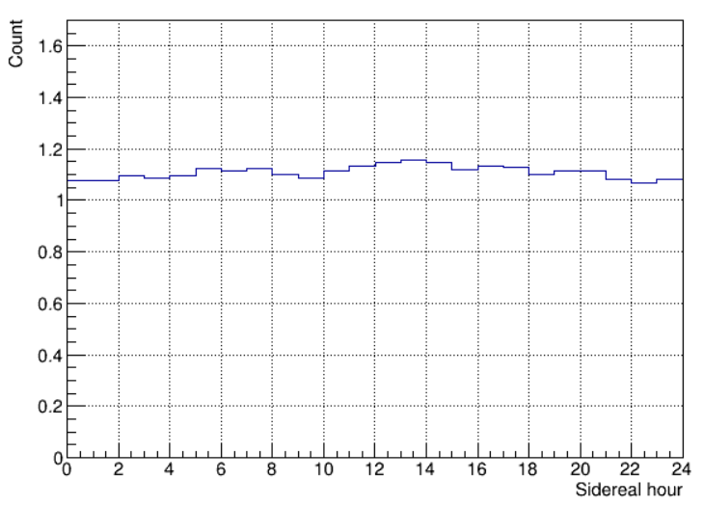
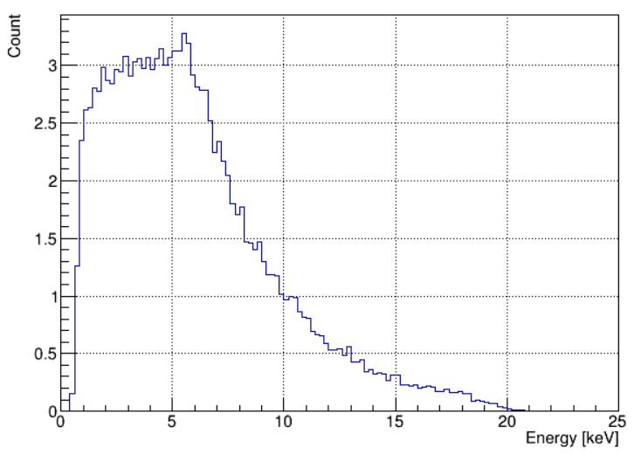
Background table
Run No. | Run9 | Run10 | Run11 | Total | Data
Counts | 4.49 | 2.86 | 19.27 | 26.62 | 25
BKG No. | Xe127 [xe136] | Other_ER [Kr85] | Tritium | nBKG | Acc
Counts | 1.05 [0.03] | 7.62 [11.08] | 4.61 | 1.11 | 1.11
No obvious diurnal effect is shown, the fluctuation is from the data taking time;

Slide 14
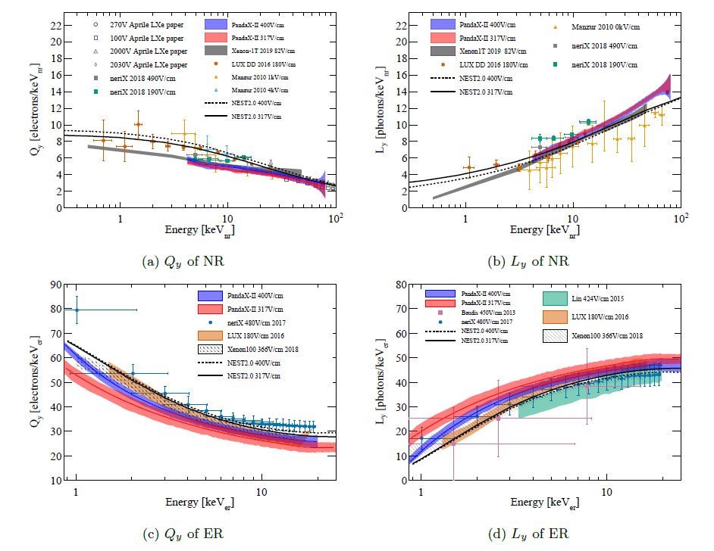
Uncertainty applied
LY and CY uncertainty from the calibration data is used for the signal and background PDFs generation;
NR and ER are considered separately;
Two conditions are considered with LY high+CY Low, LY low+CY high;
arXiv:2102.09158

Slide 15
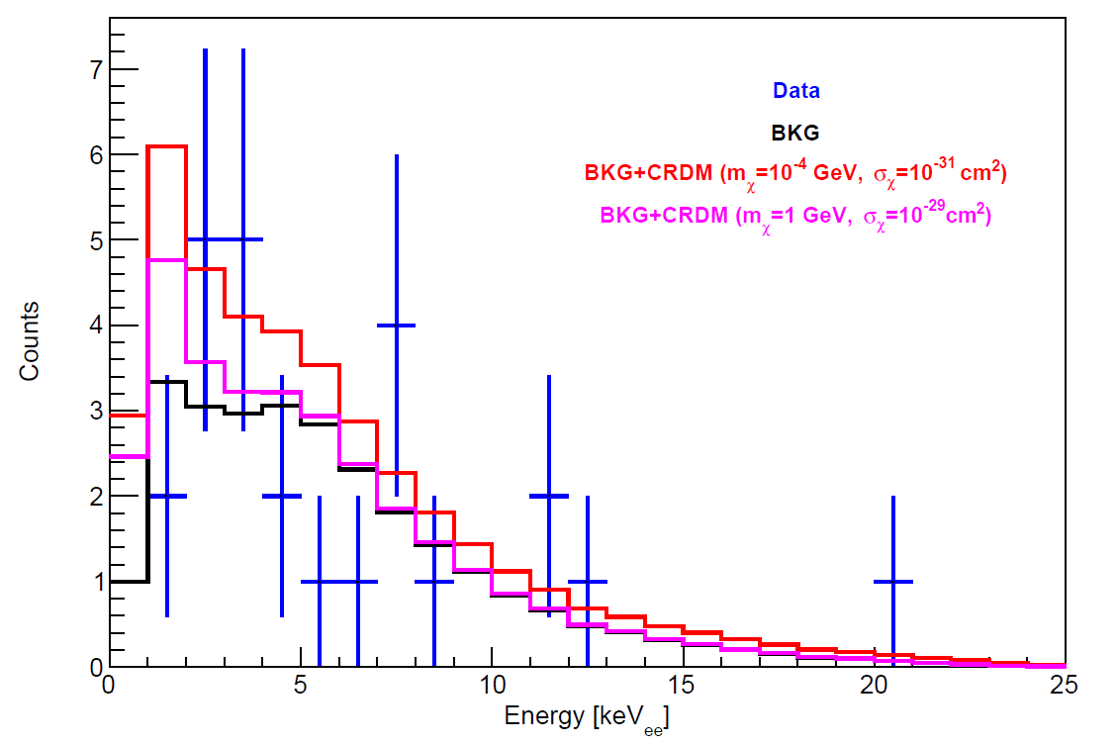
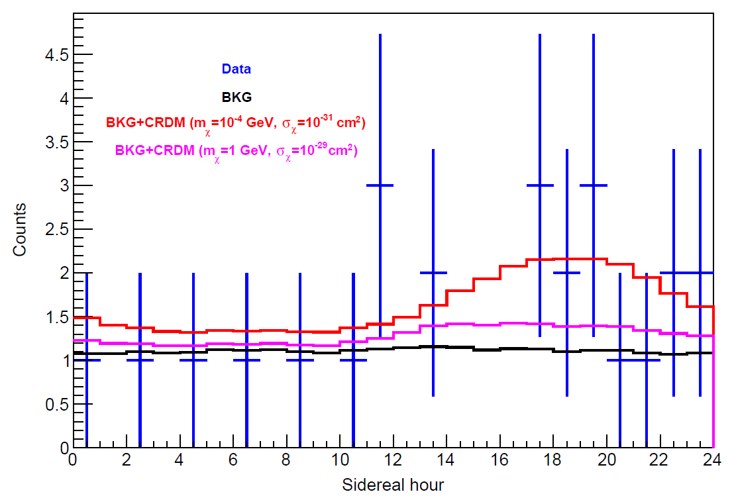
Data&BKG&Signal
BKG only goodness fit p-value is 0.62;
No evidence for the signal excess;

Slide 16
Fitting method - 2D profile likelihood
Sidereal hour and Energy as two dimensions;
No runs information, signal PDFs combined before fitting;

Slide 17
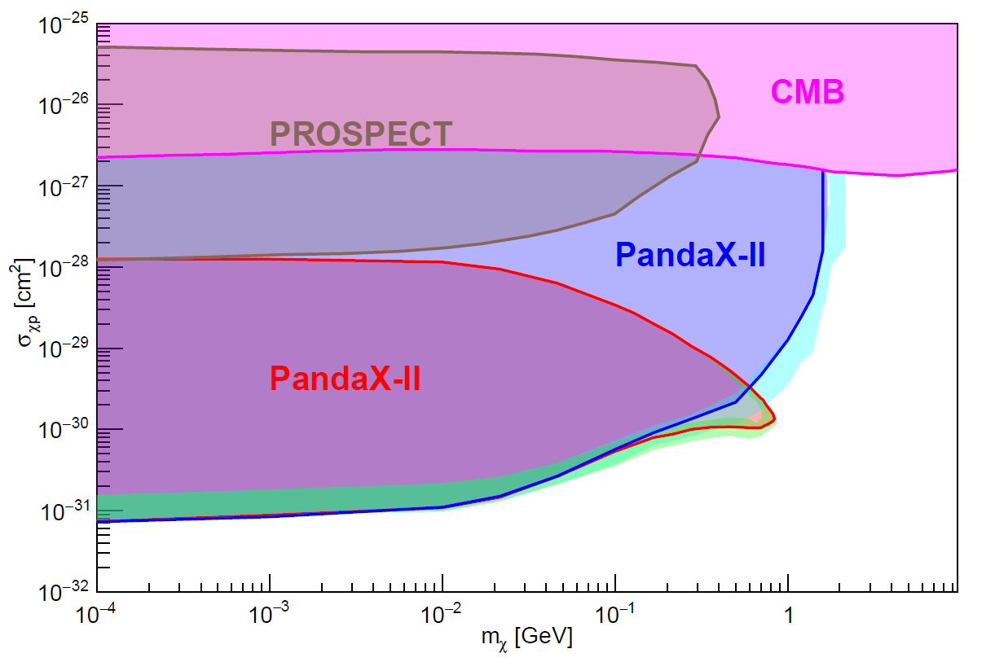
Final Result
First DD experiment data analysis with the CRDM;
Exclusion range from 0.1MeV to 1GeV, may extend to eV range by the CR asummption;
~10⁻³¹cm² below 1MeV and cover new area below the CMB curve;
preliminary

Slide 18
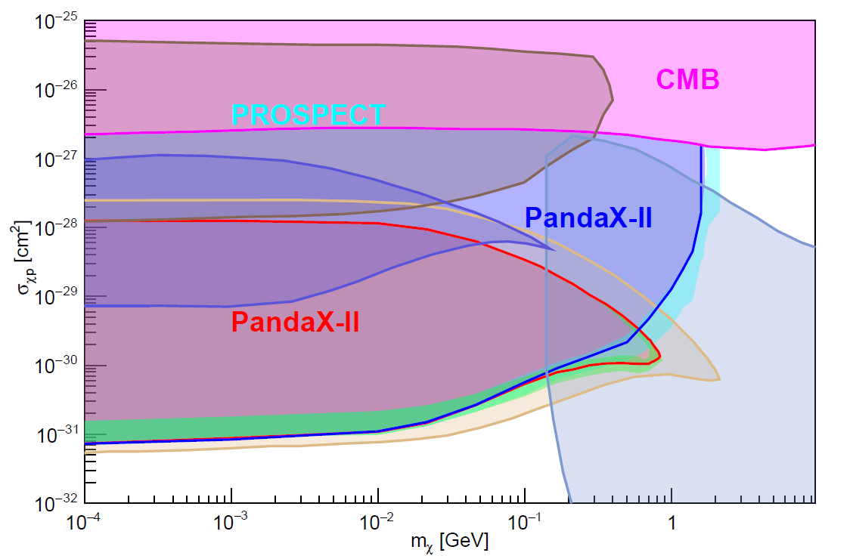
Compare all other limits
CDEX-10
CRESST2017
XENON1T

Slide 19
Summary
Cosmic ray boosted dark matter is model weak correlated, along with the specific diurnal modulation;
Sidereal time and energy information are used for the analsyis, with PandaX-II 100Ton*Day result achieve a impressed result in sub-GeV range;
More exposure and improved analysis in PandaX-4T should be improve the range more, even close to the DD result;

Slide 20
THANKS FOR YOUR ATTENTION！

Slide 21
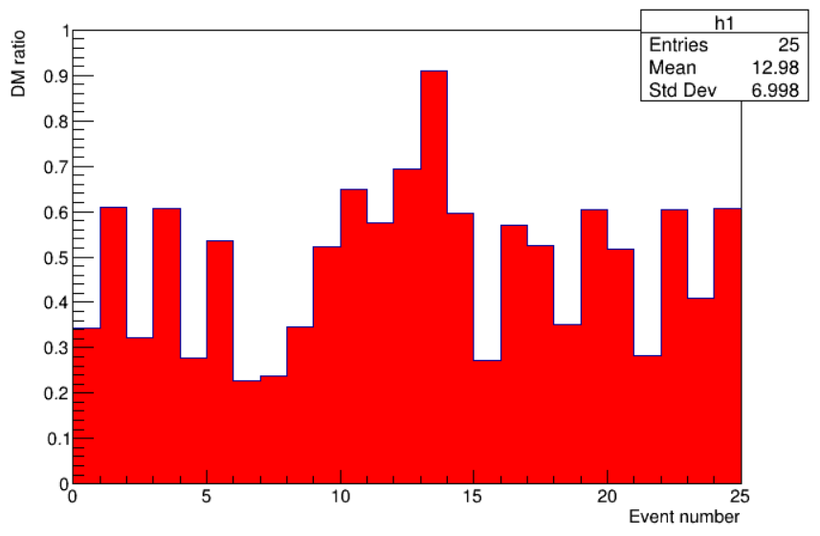
25 candidates DM/BKG ratio

