Slide 1


Data analysis and key science results of LHAASO-WCDA
Shicong Huª, Guangman Xiang^{b}, Zhen Wang^{c}, Yanjin Wang^{d},Ran Wang^{e}, Chuandong Gao^{e}, Huicai Liª, Bo Gaoª, Xiurong Liª, Hao Zhou^{c}, Min Zhaª, Zhiguo Yaoª, for the LHAASO collaboration
ª Institute of High Energy Physics, Chinese Academy of Sciences, 100049, Beijing, China
^{b} Shanghai Astronomical Observatory, Chinese Academy of Sciences, 200030, Shanghai, China
^{c} Tsung-Dao Lee Institute, SHANGHAI JIAO TONG UNIVERSITY , 200240, Shanghai, China
^{d} Northeastern University, 110819, Mukden, China
^{e} SHANDONG University, 266237, Qingdao, China
16 Aug. 2021, Online

Slide 2
Outline
Introduction
Physics of LHAASO-WCDA
  Gamma-ray astronomy
  Cosmic ray
Data analysis and key science results
  Calibration
  Performance : observation of Crab nebula
  TeV gamma ray source survey
  Moon shadow

Slide 3
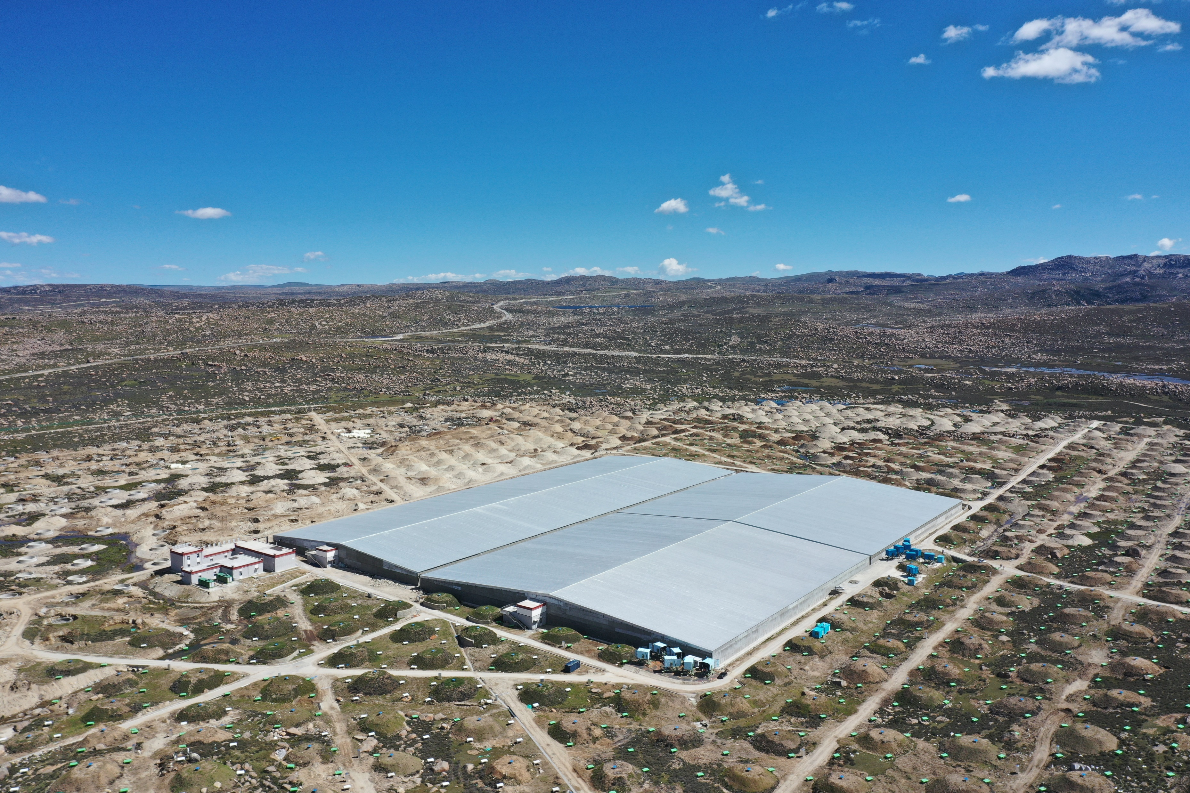
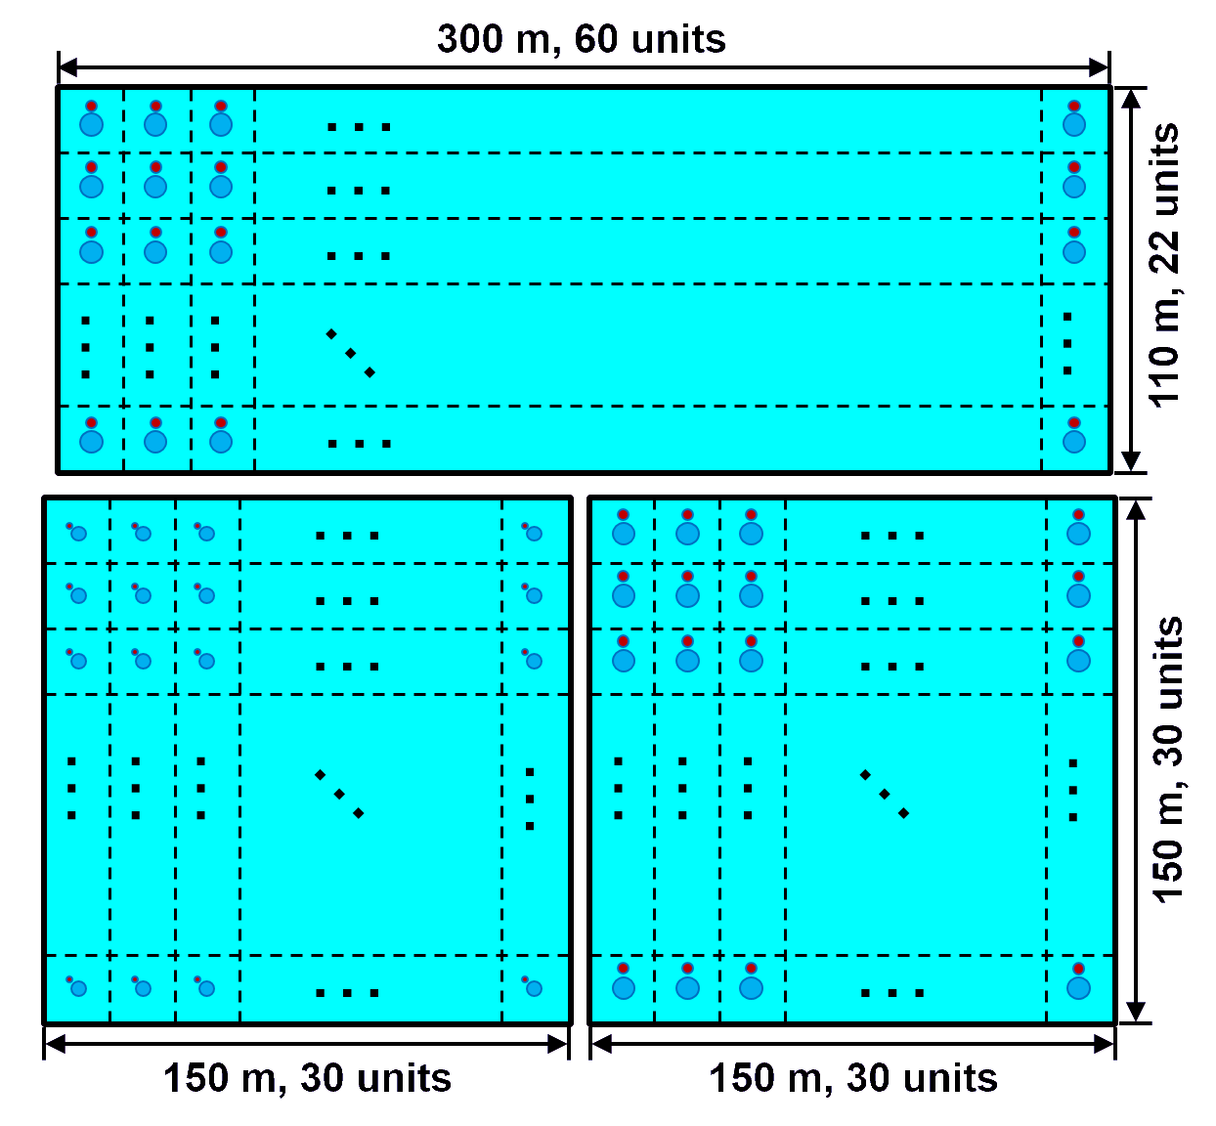
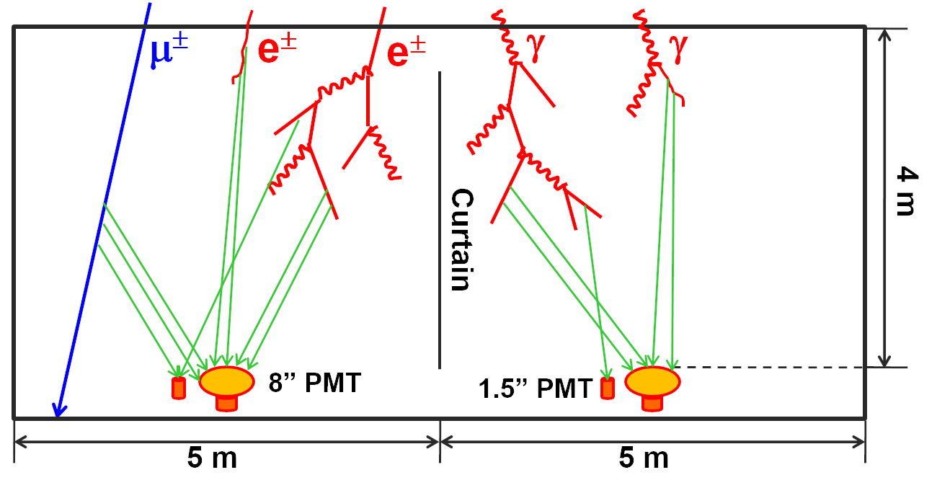
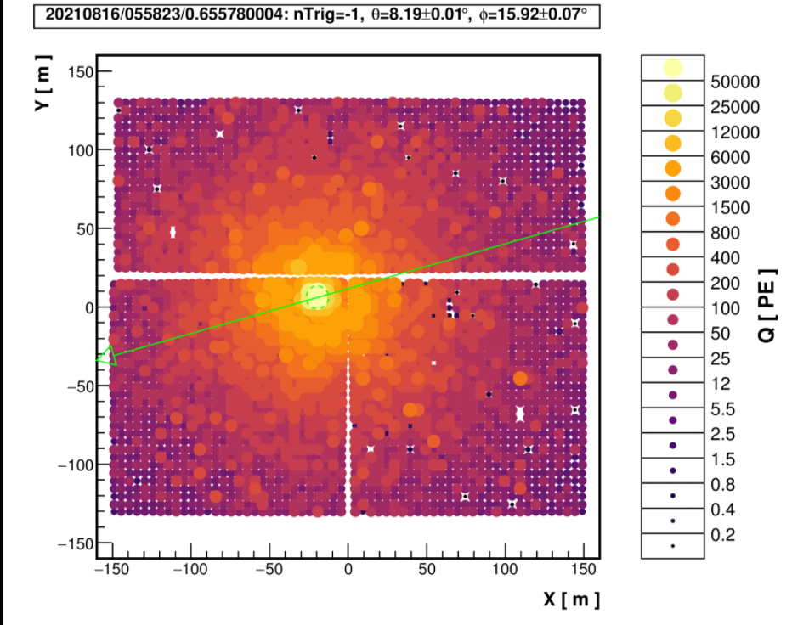
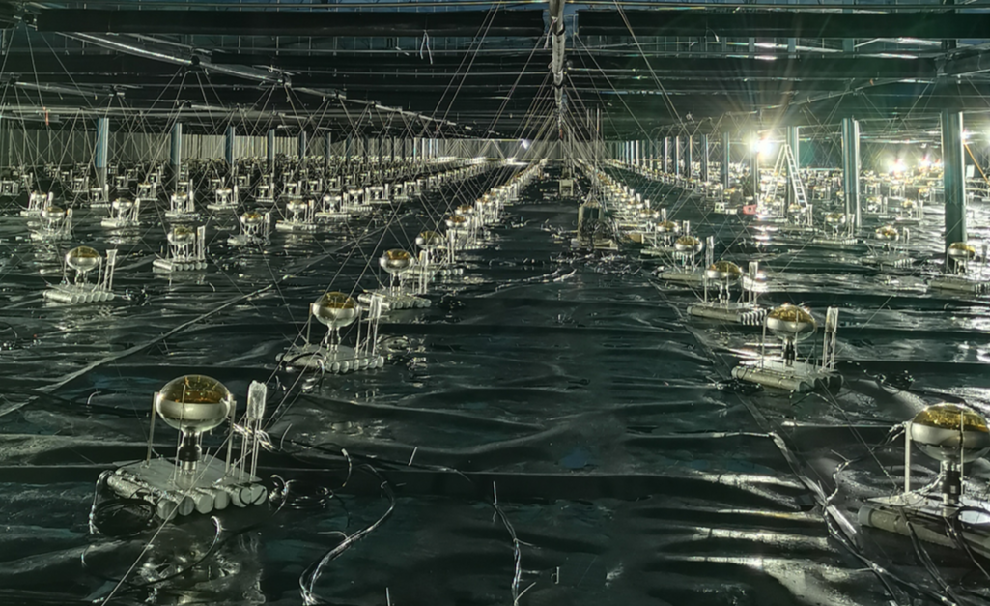
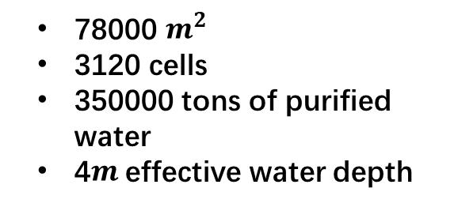
LHAASO-WCDA
2020.05
Wcda-U (1+2)
2021.03
Fullarray
WCDA-3
2019.04
Wcda-1 starts to operate
WCDA-1
WCDA-2
4410m a.s.l.
WCDA-3
WCDA-2
WCDA-1
78000 $m^{2}$
3120 cells
350000 tons of purified water
4$m$effective water depth

Slide 4
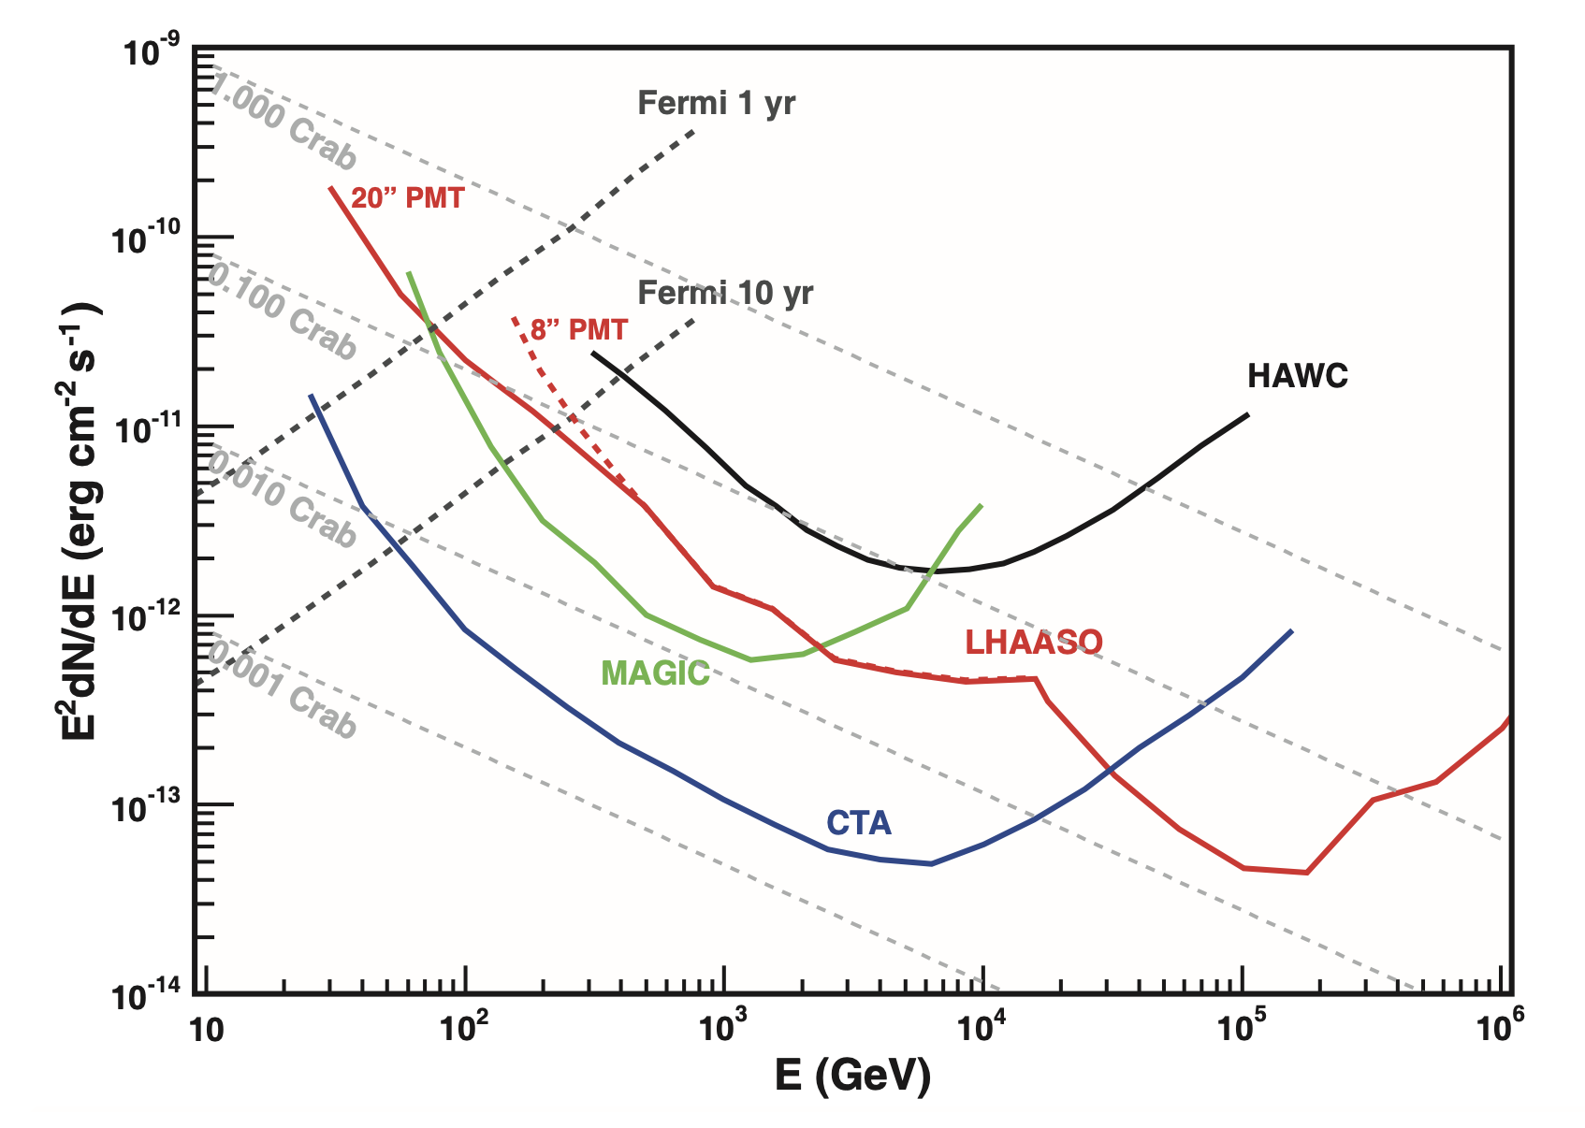
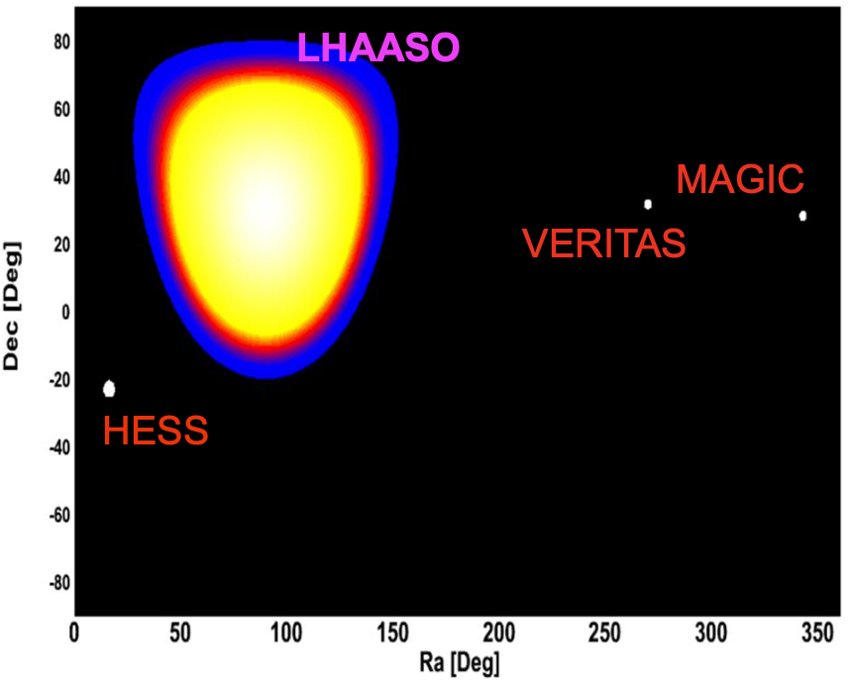
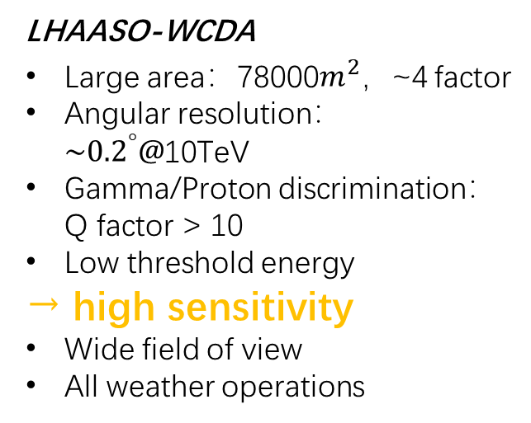
LHAASO-WCDA
VHE gamma-ray astronomy
Ground-based
Milagro
HAWC
As-γ
ARGO-YBJ
…
IACT
HESS
MAGIC
VERITAS
Future CTA
…
High sensitivity
LHAASO-WCDA
Large area：78000$m^{2}，$~4 factor
Angular resolution：${\sim 0.2}^{°}@$10TeV
Gamma/Proton discrimination：Q factor > 10
Low threshold energy
→ high sensitivity
Wide field of view
All weather operations
Wide field of view

Slide 5
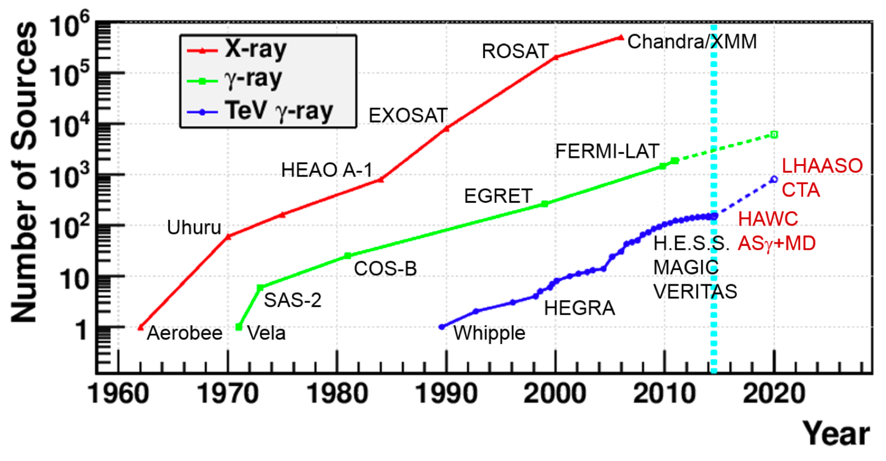
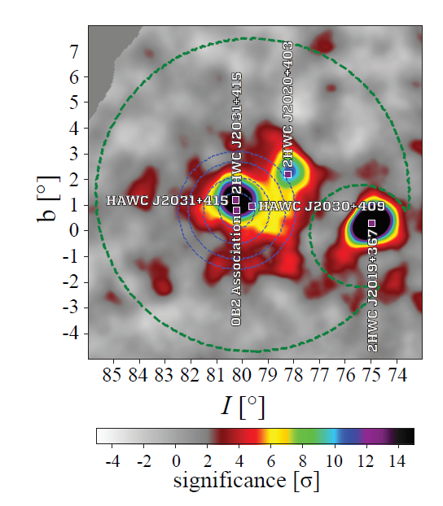
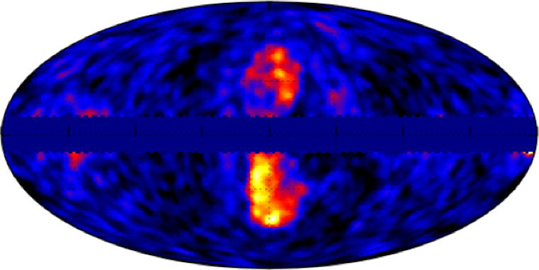
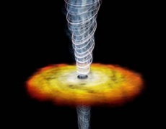
Physics of LHAASO-WCDA
Gamma-ray astronomy
Galactic
  Steady : spectra, morphology
    Geminga, Cygnus Cocoon …
    Origin of galactic cosmic ray
Extra-galactic
  Observation of star-forming / starburst galaxies
  AGN : Mrk421, Mrk501 … → extragalactic background light (EBL)
  VHE emission of GRB, GW EM counterpart
Large-scale structure
  Origin of fermi bubble
Multi-messenger
Cosmic ray
Acceleration of cosmic rays in supernova remnants
Sun shadow
  Solar physics
  Space weather
[1]
[2]
[1] Abeysekara, et al. Nat Astron 5, 465–471 (2021).
[2] https://fermi.gsfc.nasa.gov/science/eteu/diffuse/

Slide 6
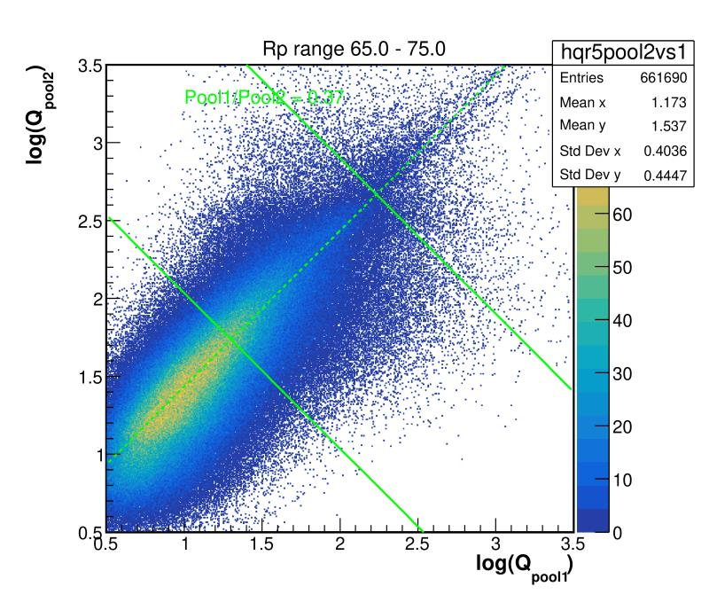


Data analysis and key science results
Calibration
Time calibration
  Q-T effect
  Time offset between cells
  Method
    Hardware
    Offline method
Charge calibration
  Ratio between different types of PMT
  Method
    Offline method
Calibration system setup
WCDA-1
Sigma =
$$0.051±0.0015 ns$$
WCDA-2
Sigma =
$$0.047±0.0014 ns$$
Calibration result of WCDA-1 and WCDA-2
Schematic view of cross calibration
[1] Bo Gao et al., Time calibration of the LHAASO-WCDA detectors, ICRC 2021.
[2] Shicong Hu et al., The Charge Calibration of LHAASO-WCDA, ICRC 2021.

Slide 7
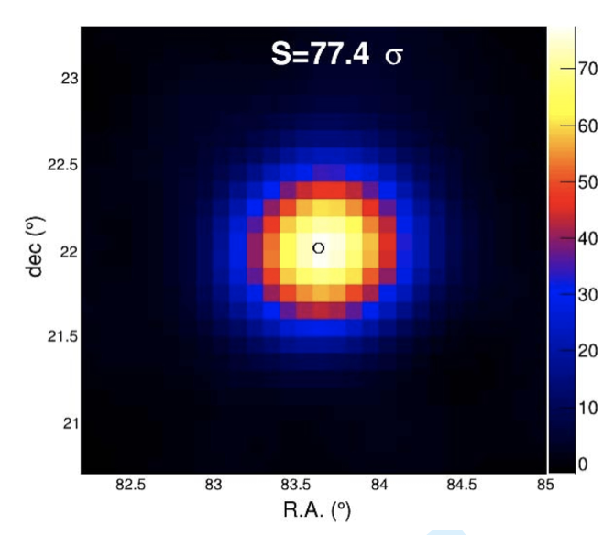
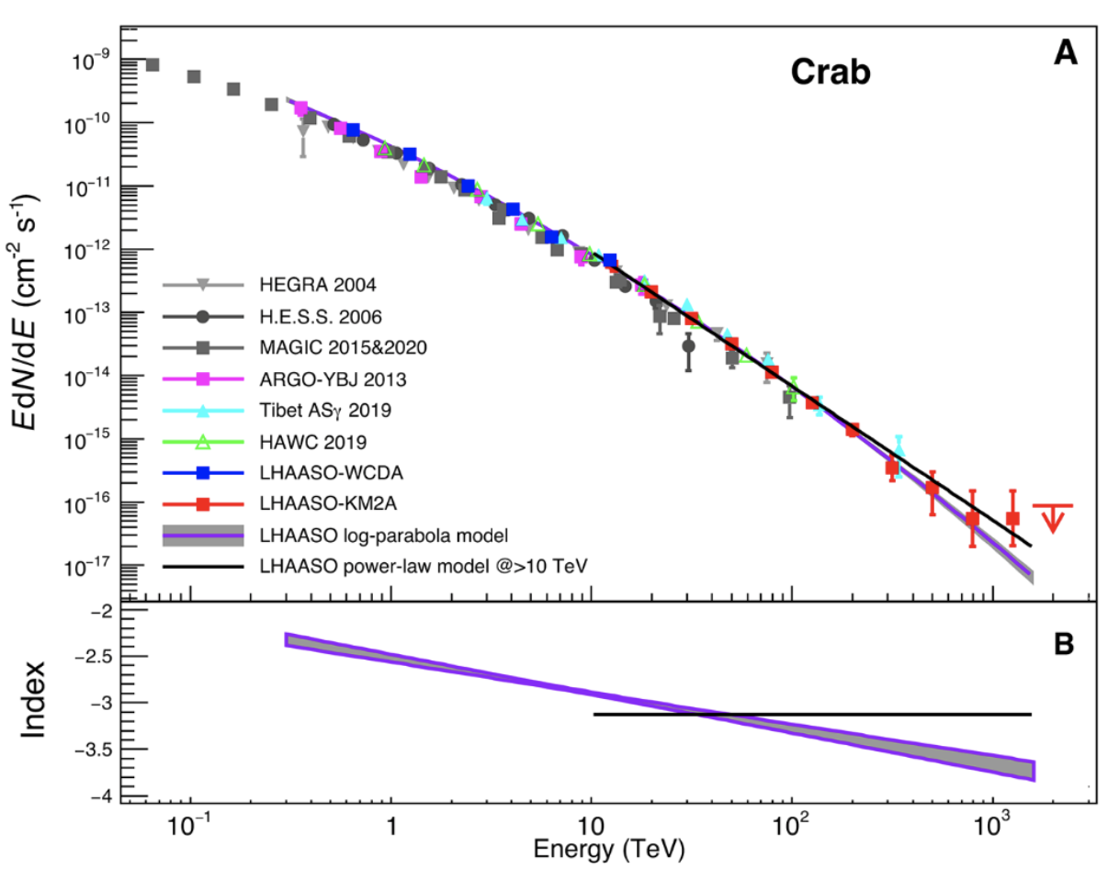
Performance of LHAASO-WCDA
Observation of the standard candle, Crab nebula
Only LHAASO-WCDA-1
The crab has been found at the expected posi-tion with an accessible angular resolution . (top right figure)
The crab spectrum measured by LHAASO-WCDA-1 is consistent with the observation results of other experiments, such as HAWC and ARGO-YBJ. (bottom figure)
The spectrum connects well with that of LHAASO-KM2A.
WCDA-1
Top figures : Zhen Cao, et al., Chinese Phys. C, 2021.
Bottom figure : The LHAASO Collaboration, Science 10.1126.

Slide 8
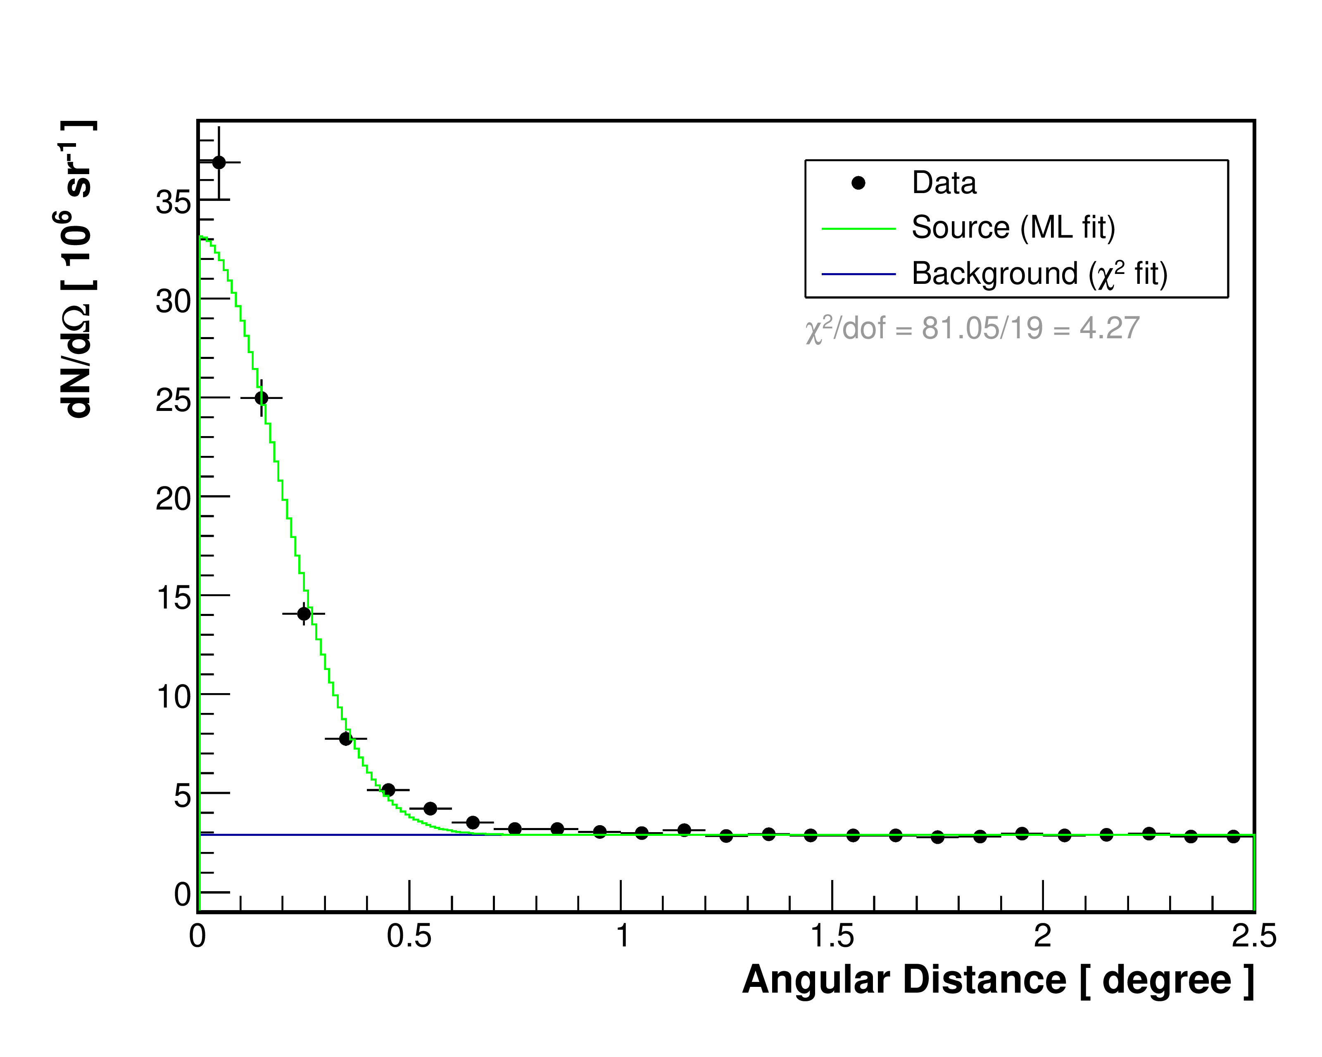
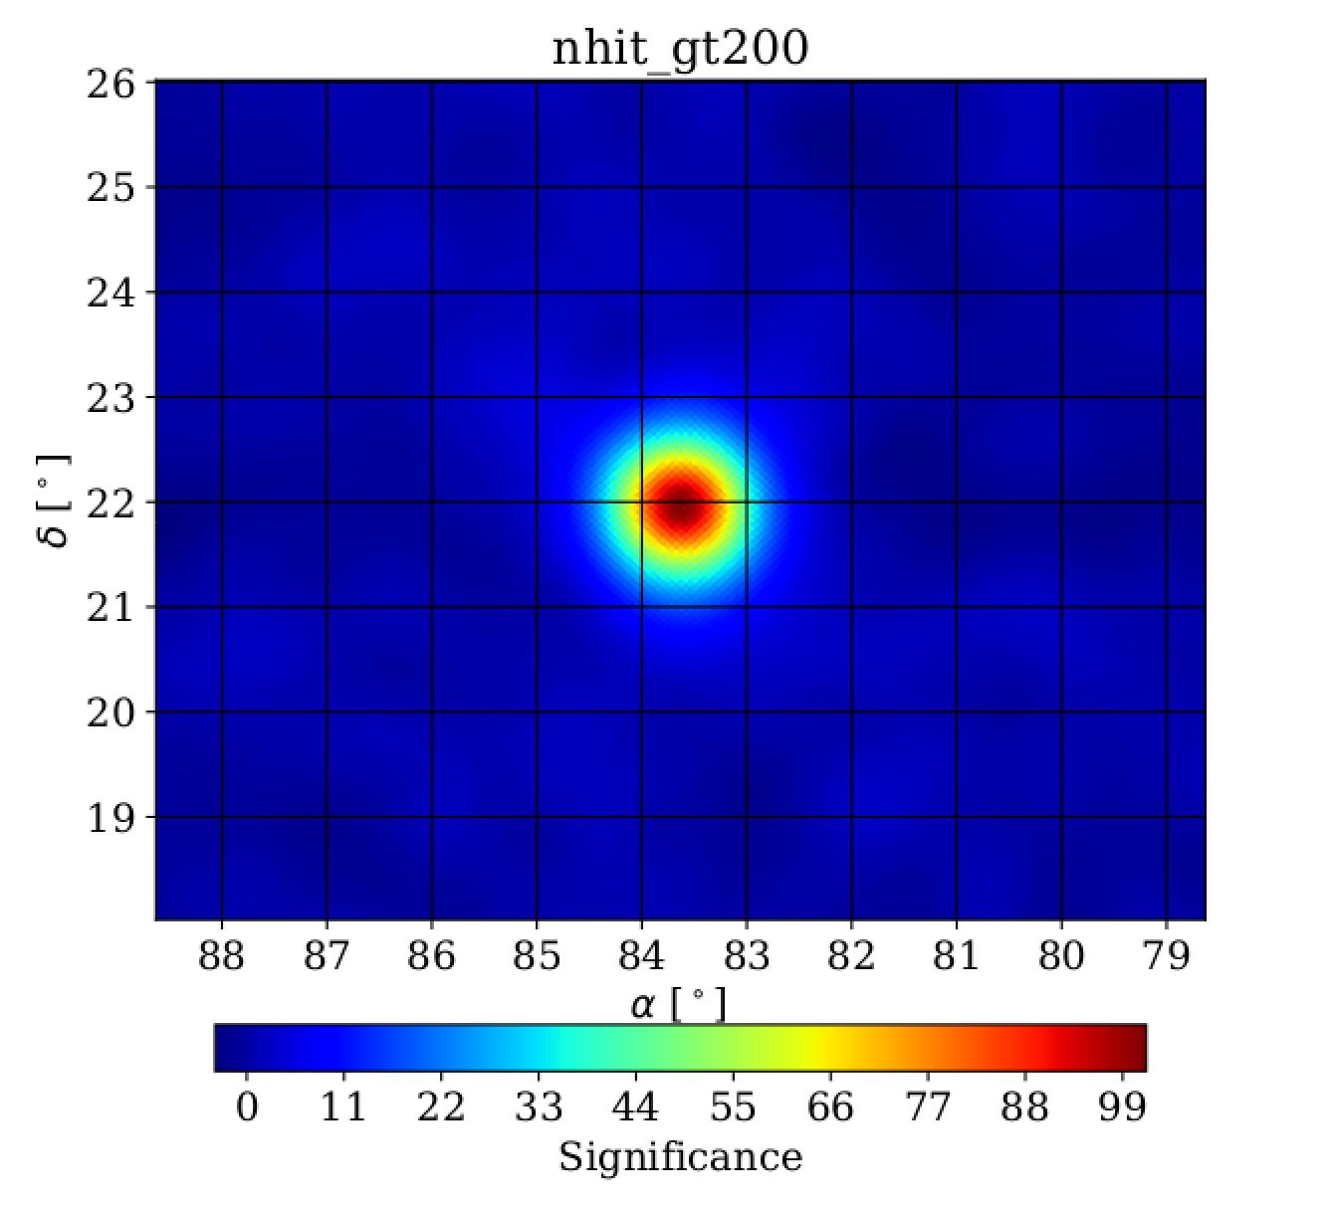
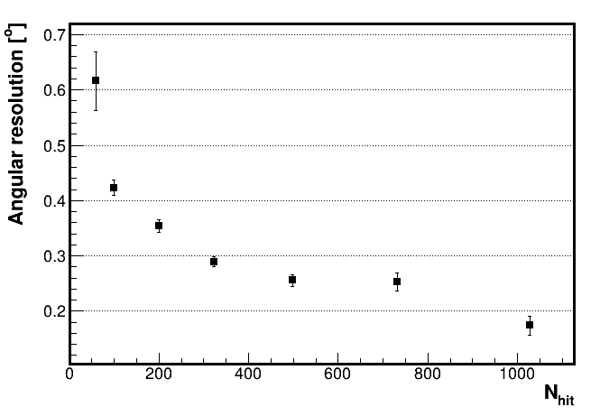
Observation of Crab nebula with fullarray
Single gaussian fit
PRELIMINARY
PRELIMINARY
PRELIMINARY

Slide 9
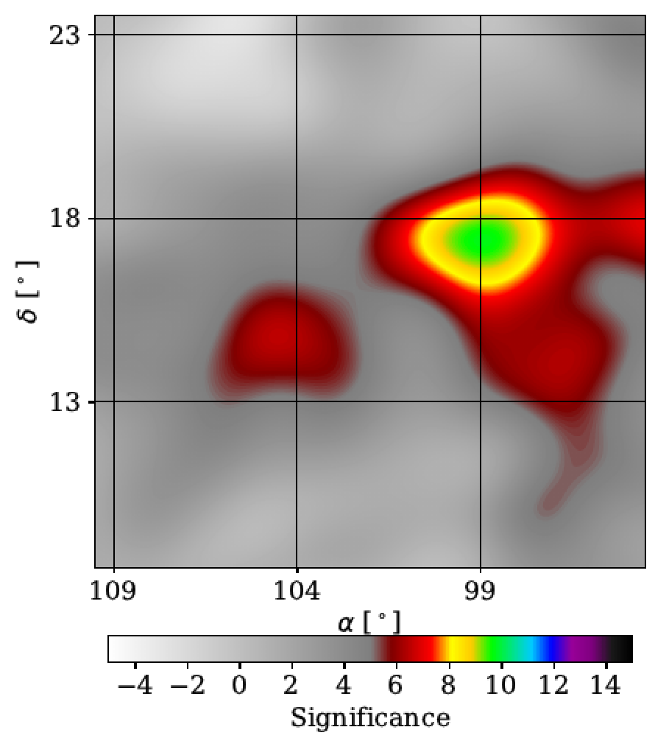
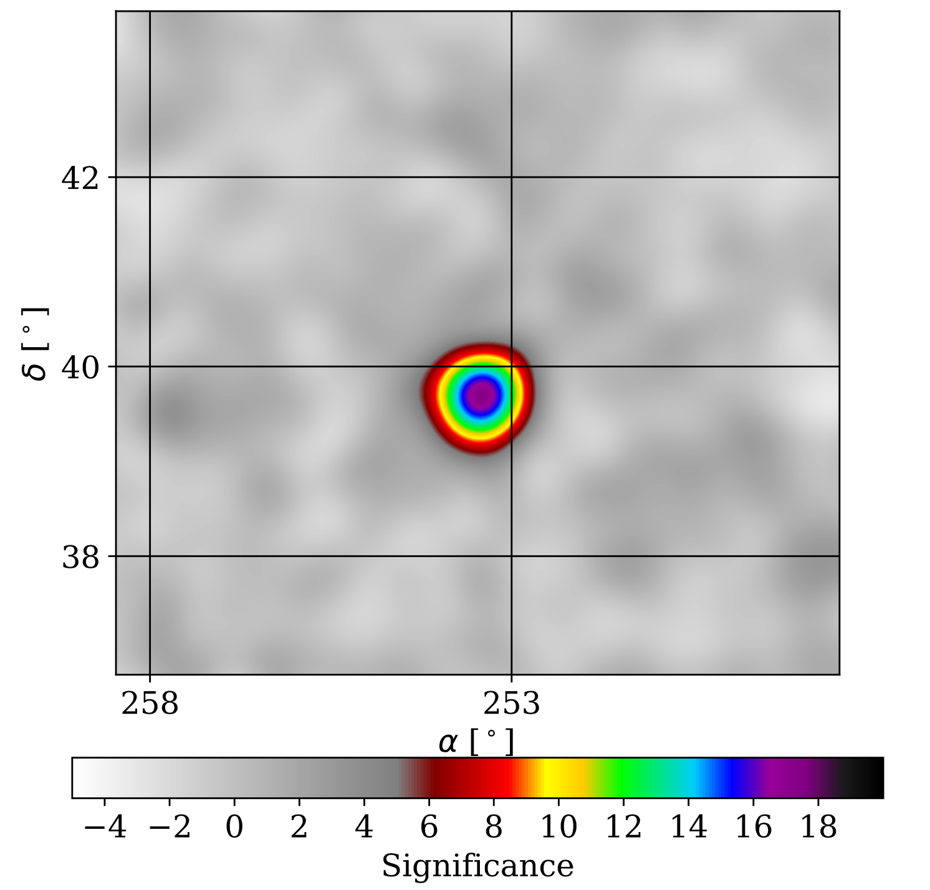
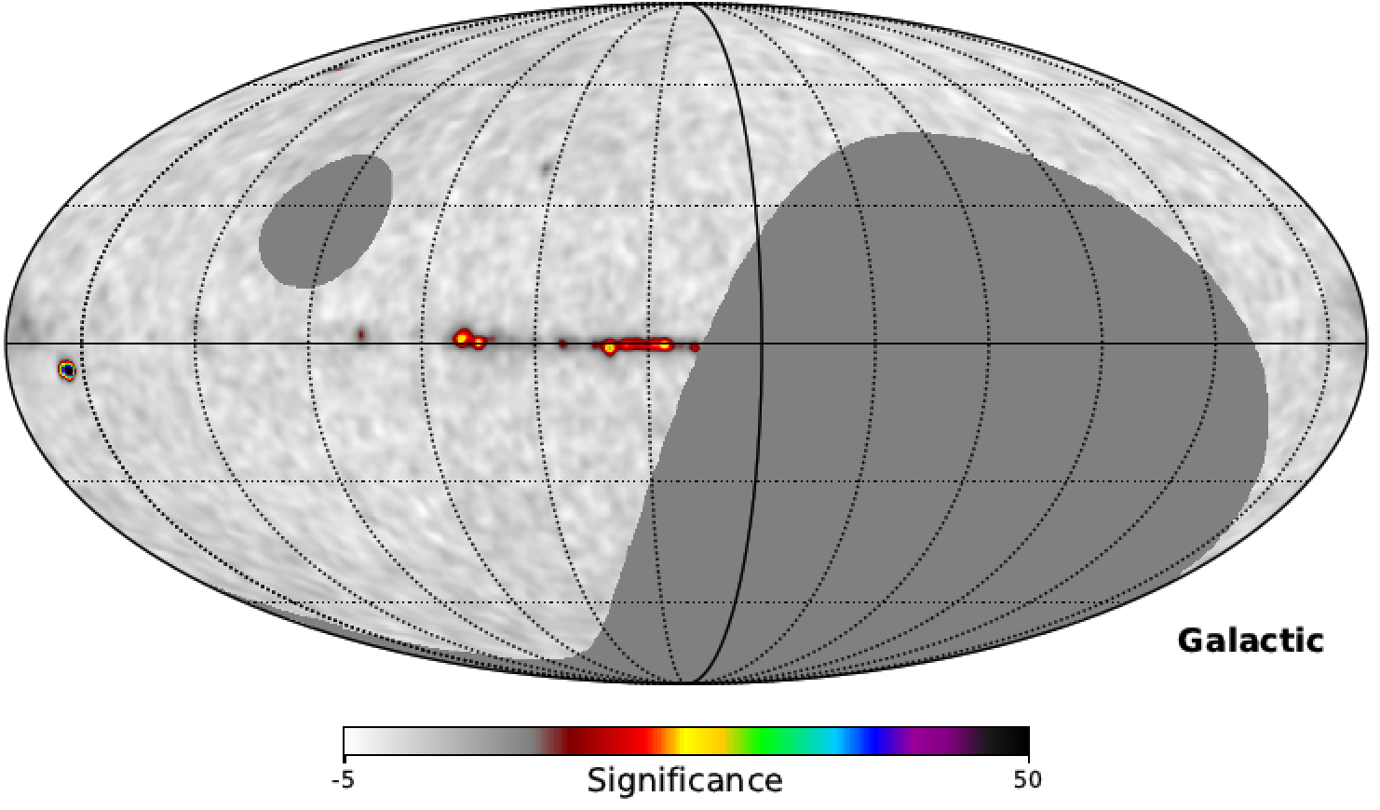
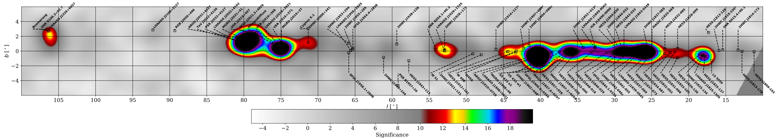
TeV gamma ray source survey
Geminga
Mrk501
PRELIMINARY
PRELIMINARY
PRELIMINARY
PRELIMINARY
9

Slide 10
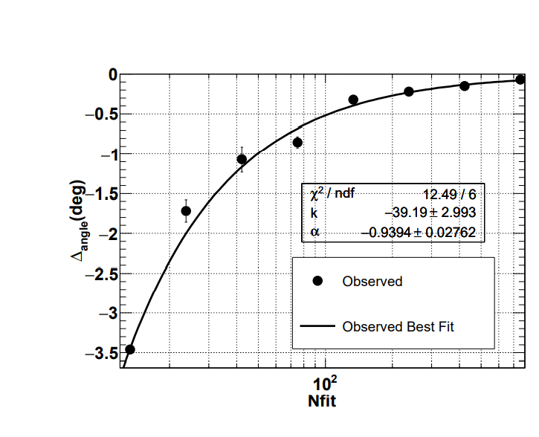
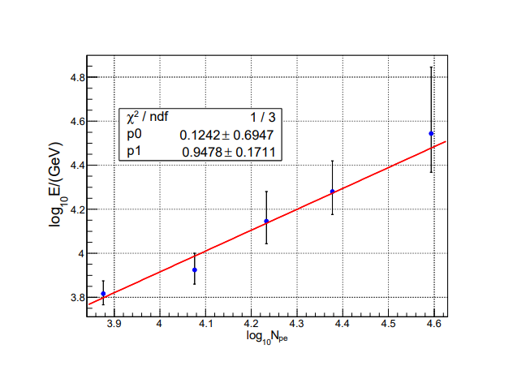
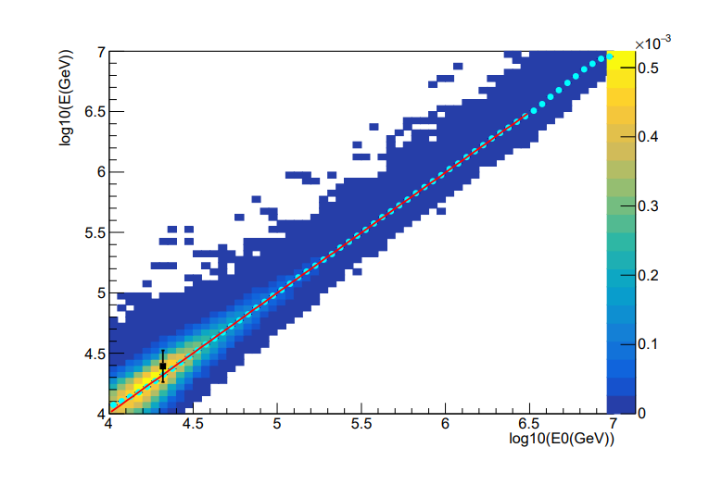
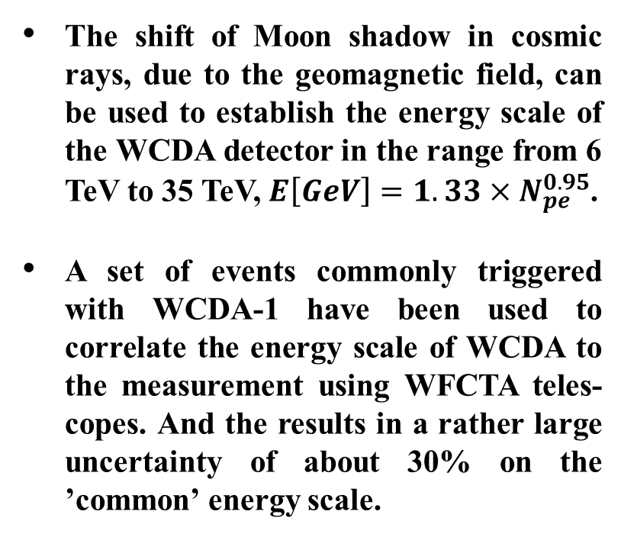
Moon shadow : absolute energy scale
The shift of Moon shadow in cosmic rays, due to the geomagnetic field, can be used to establish the energy scale of the WCDA detector in the range from 6 TeV to 35 TeV, $E\left[GeV\right]=1.33×N_{pe}^{0.95}$.
A set of events commonly triggered with WCDA-1 have been used to correlate the energy scale of WCDA to the measurement using WFCTA teles- copes. And the results in a rather large uncertainty of about 30% on the ’common’ energy scale.
Zhen Cao, et al., Calibration of the Air Shower Energy Scale of the Water and Air Cherenkov Techniques in the LHAASO experiment, arXiv:2104.04965.

Slide 11
Summary
A complete calibration method, which can accurately give the time offset between cells and connect signals of four types of PMTs, is developed to achieve the purpose of combining three pools into one detector array.
Performance:
  LHAASO-WCDA full array started to testing operate on Mar 5th, 2021. And on April 20th, it turned to be operating stably and continuously.
  The pointing and angular resolutions of LHAASO-WCDA match with the designation guideline well.
The majority of TeV gamma ray sources, which have been reported by HAWC, have been observed by LHAASO-WCDA, including the LHAASO-KM2A reported 12 gamma sources @ >100TeV.
MUCH more new sources will be discovered by LHAASO-WCDA.
More interesting analyses are underway…
Stay tuned !

