Slide 1
Observation of Horizontal Air Showers with LHAASO-KM2A
Quanbu Gou^{1, 2}, Zhuo Li³, Giuseppe Di Sciascio⁴, Chao Hou^{1, 2}, Jiangtao Liu¹, Xiaochuan Chang¹, Hongkui Lv^{1,2}, Lili Yang⁵, Sujie Lin⁵ , Andrea Addazi⁶, Xuewen Liu⁶, Mingming Kang⁶, Antonino Marciano⁷, Jinsheng Gou⁸, Shiyu Yin⁹ , Yaping Wang¹, Zihan Yang¹, Xishui Tian³, Qinyuan Zhang³, Chengyu Shao⁵, Jie Dou⁶, Xuwei Ou⁶, Yukun Xue⁶, Lingyi Fu⁶, Qianxun Zuo⁶, Zhiheng Wang⁶,Yuanqing Wang⁶, Chenyang Gong⁶, Zhibo Yu⁷, Jiaming Li⁷ , Qunfeng Jiang⁷, Lin Liu⁹
1 Key Laboratory of Particle Astrophysics, Institute of High Energy Physics, Chinese Academy of Sciences, P.O. Box 918, 100049 Beijing, China
2 TIANFU Cosmic Ray Research Center, 610065 Chengdu, Sichuan, China
3 Department of Astronomy, School of Physics, Peking University, 100871 Beijing, China
4 INFN – Sezione Roma Tor Vergata, I-00133 Roma, Italy
5 School of Physics and Astronomy, Sun Yat-sen University, 519000 Zhuhai, Guangdong, China
6 College of Physics, Sichuan University, 610065 Chengdu, Sichuan, China
7 Department of Physics, Fudan University, 200438 Shanghai, China
8 College of Materials Science and Technology, Beijing Forestry University, 100083 Beijing, China
9 School of Mechanical and Material Engineering, North China University of Technology, 100144 Beijing, China

Slide 2
Contents
Introduction
The first experimental results
Summary

Slide 3
Introduction
The observation of HAS provides a “well shielded laboratory” for the detection of penetrating particles: high energy muons, cosmic neutrinos, possible weakly interacting particles produced in the decays of cosmological super heavy particles, will leave a clear signature.
The showers with significant muon component could be further rejected by underground muon detector of LHAASO-KM2A.
The goal of this analysis is to study muon content in EAS and search for neutrino-induced EAS from flaring phenomena like GRBs.

Slide 4
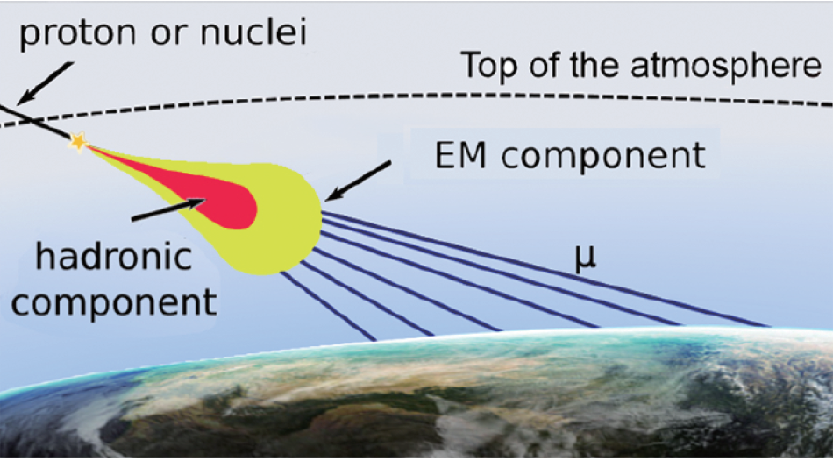
Horizontal Air showers (HAS)
Cosmic Rays can initiate a HAS in the atmosphere.
The hadronic and EM components are absorbed and only muons reach the Earth.

Slide 5
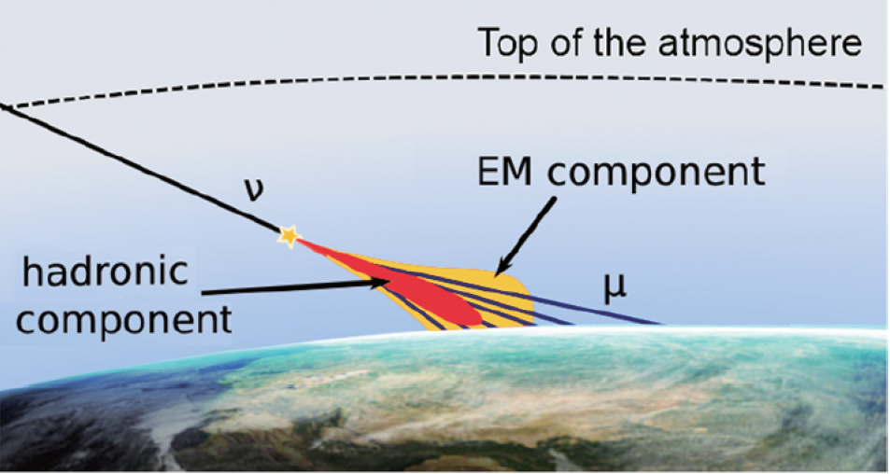
Neutrinos can initiate a HAS in the atmosphere
In this kind of events both the EM and the muonic components reach the surface.

Slide 6
Left: Atmospheric depth as a function of the zenith angle. The amount of matter increases quickly after 60°.
Right: A horizontal shower goes through 36 times more mass than a vertical shower.

Slide 7
First experimental results

Slide 8
Data Selection
Reconstructed data of 2020 was used
Theta >= 0;
dr > 0;
NuM2 > 0;
age > 0.6 && age < 2.2;
size > 20000;
NtrigE >= 10;
There are 218.85 live days out of 323 duty days in the year of 2020 after data selection.
The layout of LHAASO-KM2A detectors. The area enclosed by the dotted black line outlines the fiducial area of the current KM2A half-array used in this analysis. The central green squares indicate the LHAASO-WCDA array region.

Slide 9
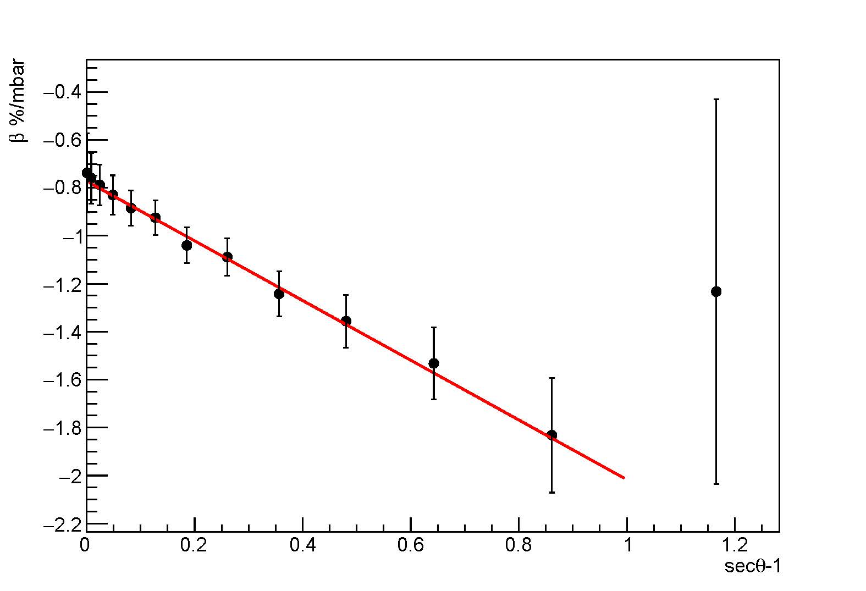
The barometric coefficient at different zenith angles
The dependence of the barometric effect on the zenith angle clearly shows a deviation for sec𝜃 >2.
sec𝜃 =2 corresponds to 𝜃=60º. Above 60º,the electromagnetic component is completely absorbed.
The barometric coefficient β = (1 /n) (dn/dx) (n = counting rate, x = atmospheric pressure) is related to the zenith angle as: β(θ) = β(0◦) secθ.

Slide 10
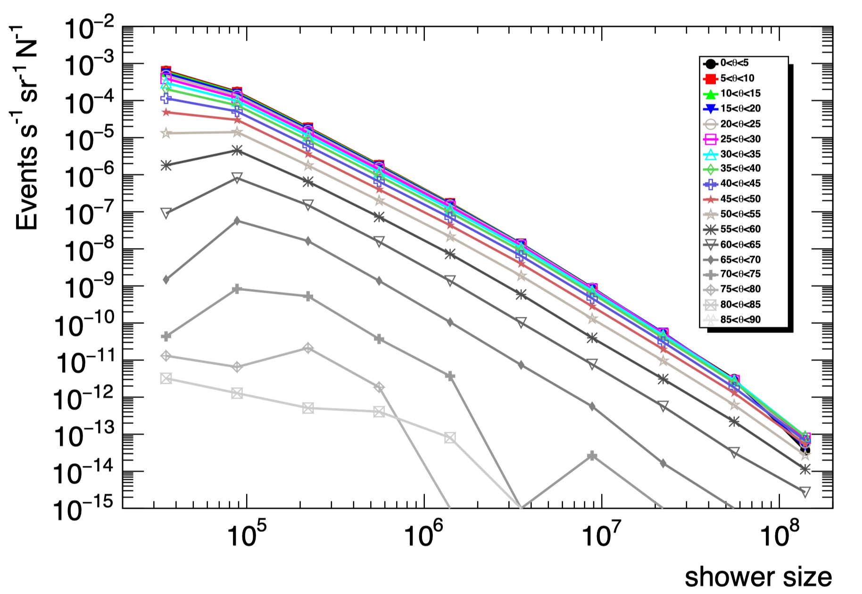
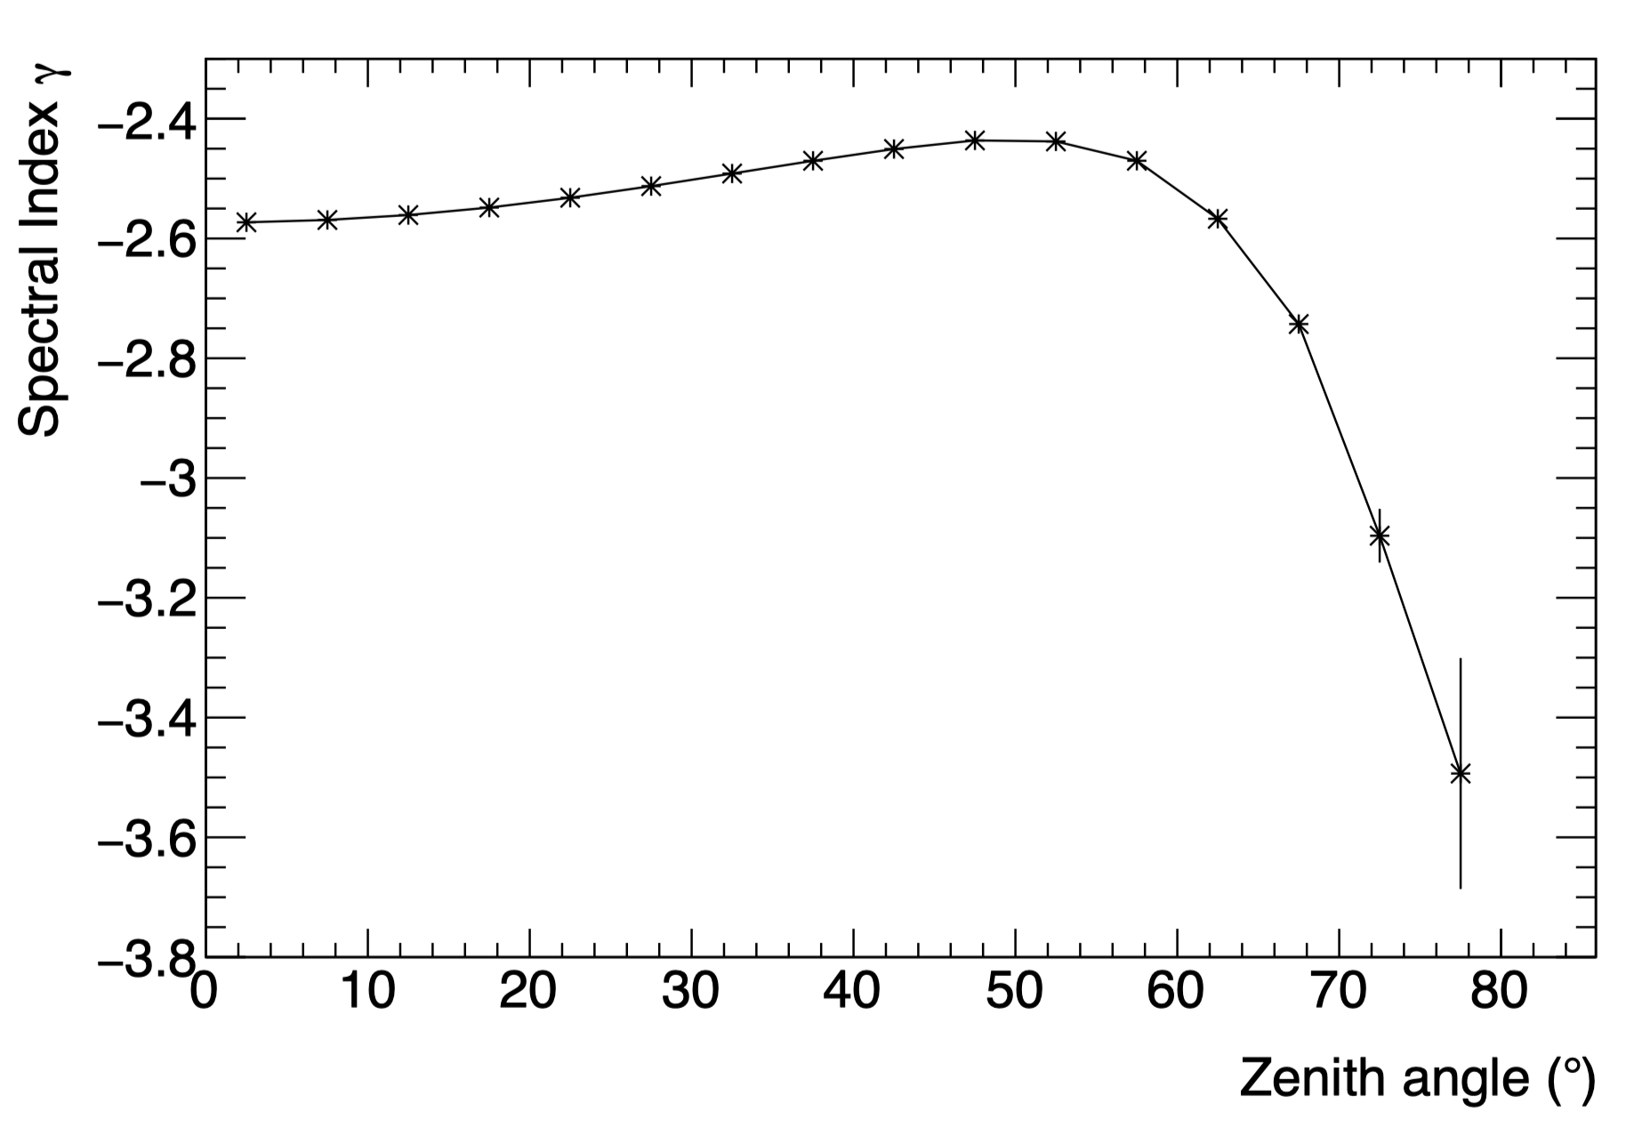
Event rates and Spectral index
Distribution of size at different zenith angle range
Best-fit spectral indices calculated from the spectra of size
Fitting Range (1e5, 1e7)
The muon dominated spectrum is puzzled by statistics at present above 80 Deg

Slide 11
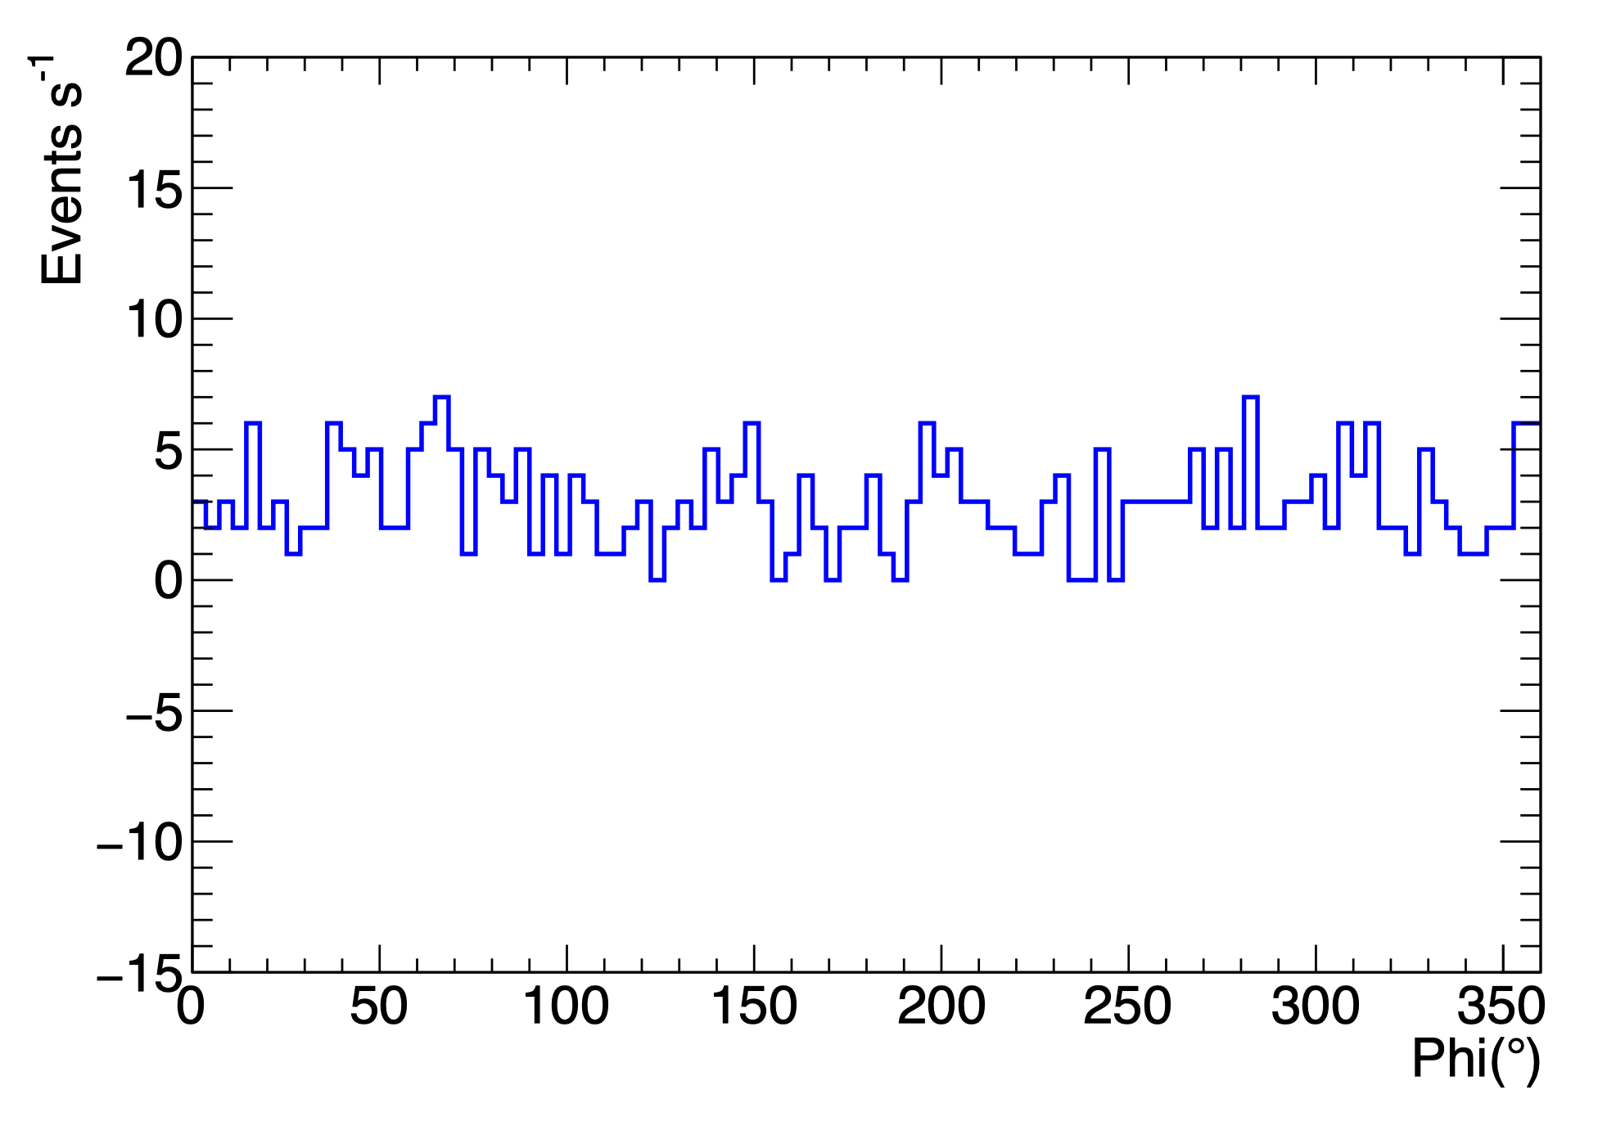
Event rates Change with azimuth angle （Theta > 70 )
It is consistent with the flat landscape around the LHAASO experiment.

Slide 12
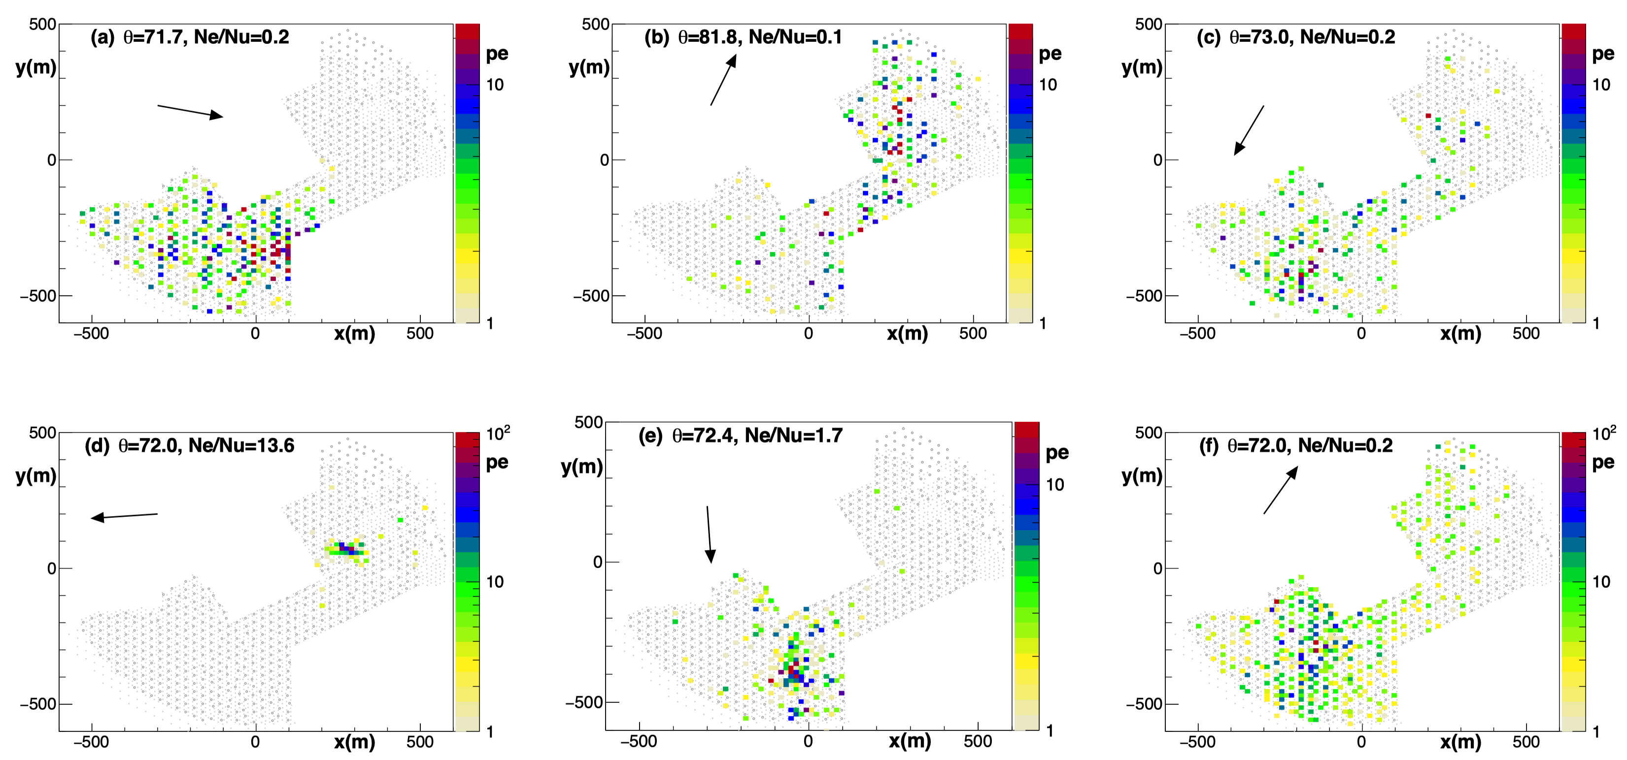
In figures (a), (b), (c) and (f), the events show that the ratio of Ne/Nu is ≤ 1 as expected in HAS. In figures (d) and (e), the ratio of Ne/Nu is greater than one. They are rare events, selected for comparison and data selection.

Slide 13
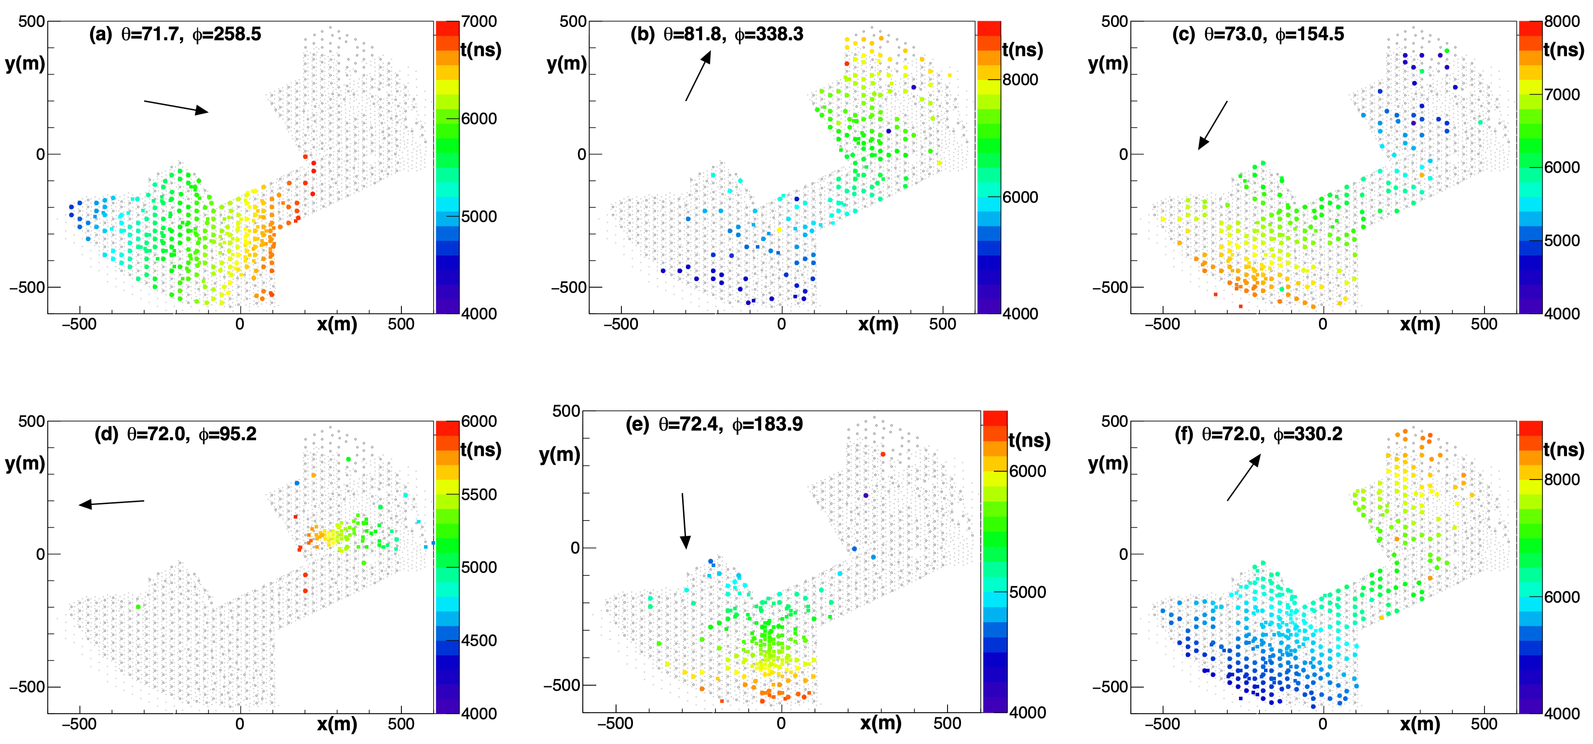
The arrival time of the shower observed by LHAASO-KM2A with a reconstructed zenith angle 𝜃 >70◦. The reconstructed zenith and azimuth angles of different events are shown in the displays.

Slide 14
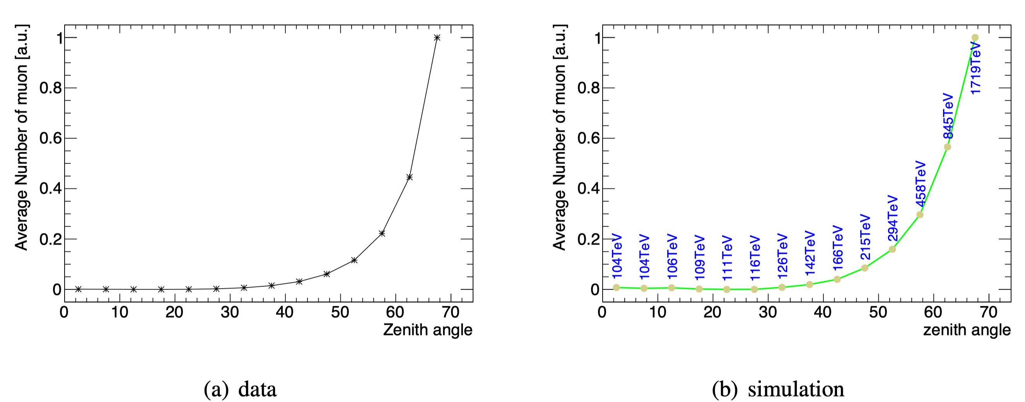
A comparison of muon number between data and MC simulations is shown. From simulations we can see that the energy range under investigations with HAS is above 500 TeV.

Slide 15
Summary
1. The first observations of HAS with LHAASO-KM2A are presented.
2. The zenith and azimuth angle distribution of EAS and the transition from electromagnetic-dominated showers to muon-dominated ones above a zenith angle of 60 degree are observed.
3. Half array’s data has shown that LHAASO is able to observe HAS and can be used to study muon content in EAS and search for neutrino-induced EAS from flaring phenomena like GRBs.

Slide 16
The purpose of this talk
That is to attract young students to participate this interesting work.
Thanks for your attention!

Slide 17
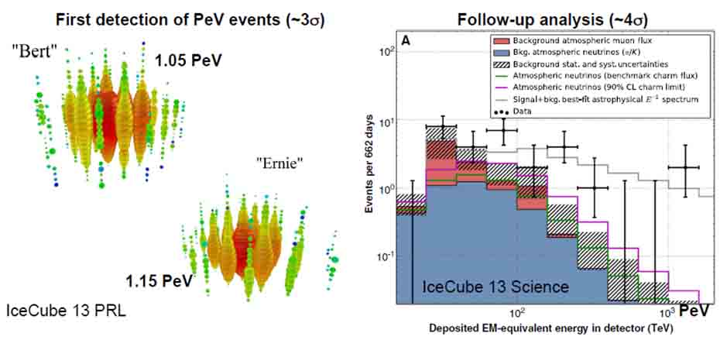
IceCube : Diffuse neutrinos discovery

Slide 18
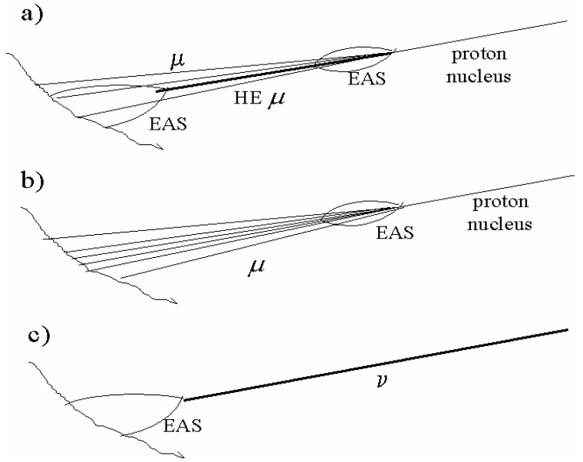
Different topologies of the µ/ν events
Possible sources of Horizontal Air Showers:
a) ”local” high energy muon interactions, b) muon dominated showers, residuals from an UHE c.r. interaction at very large distance, c) neutrino events.

