Slide 1
Second order charge currents and energy momentum tensor in chiral system
Yang Shi-Zheng (杨诗正)
Shandong University
SZY, J. H. Gao, Z. T. Liang, Q. Wang, Phys. Rev. D 102, 116024 (2020).
中国物理学会高能物理分会第十三届全国粒子物理学术会议

Slide 2
Outline
1. Introduction
2. First order charge currents and energy momentum
tensor from Wigner function
3. Second order charge currents and energy momentum
tensor from Wigner function
4. Summary

Slide 3
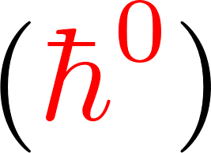
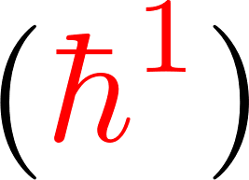
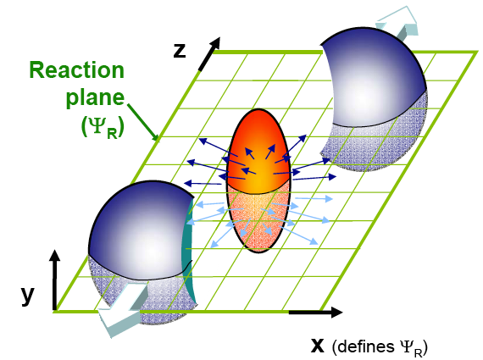
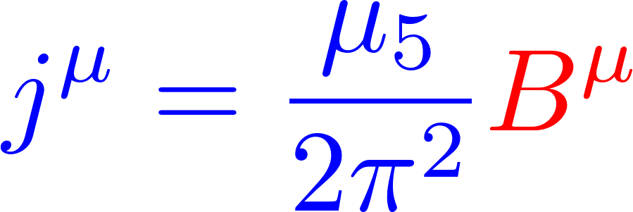
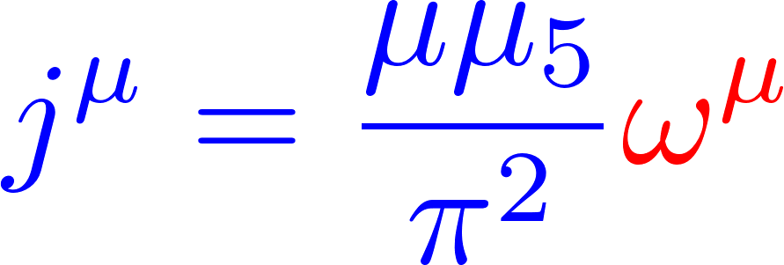
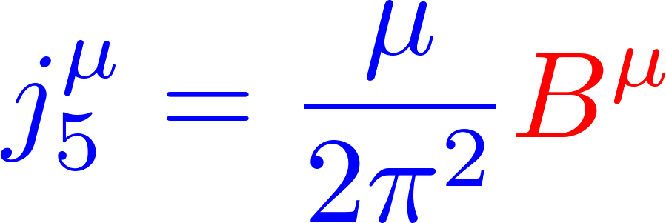
First order chiral effects in heavy ion collisions
Zeroth order ideal fluid
First order anomalous fluid
Chiral magnetic effect
Chiral vortical effect
Chiral separation effect
Local polarization effect

Slide 4
Wigner function and equation
Wigner function
Wigner equation
under constant EM field
Decomposition in Clifford algebra
Chiral components
The Wigner equation by semi-classical expansion
in the chiral limit.
Transport equation
On-shell equation
Iterative equation
D. Vasak, M. Gyulassy, and H. T. Elze, Ann. Phys. (N.Y.)173, 462 (1987).

Slide 5
Zeroth order and first order Wigner function
Zeroth order solution
Fermi-Dirac distribution
Global equilibrium with constant thermal vorticity
First order solution
J. H. Gao, Z. T. Liang, S. Pu, Q. Wang, and X. N. Wang, Phys. Rev. Lett. 109, 232301 (2012).

Slide 6
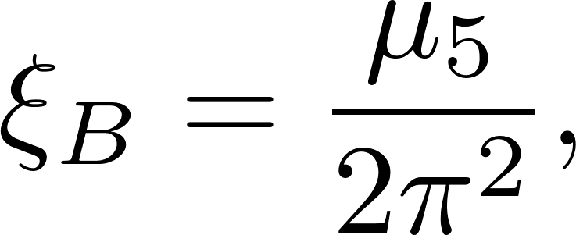
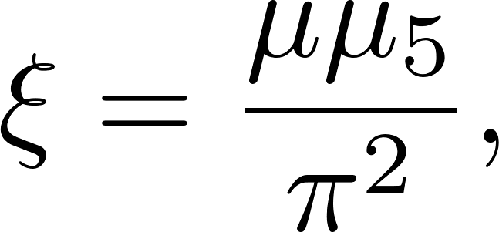
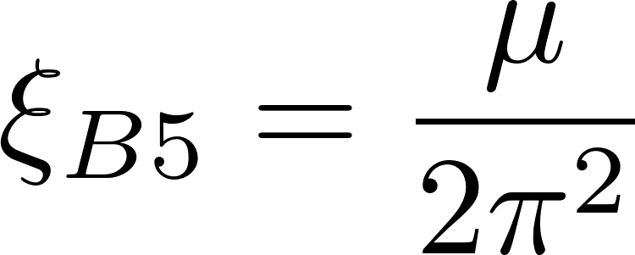
Charge currents and energy momentum tensor up to first order
Charge currents
Zeroth order results
First order results
Energy momentum tensor
Zeroth order results
First order results

Slide 7
Motivation for high order
1. More precise:
Vorticity and EM field are very strong in heavy ion collision.
2. Other quantum effects?
Coupling term between vorticity and EM field appears at second order.
3. Causality problem:
Causal issue in first order relativistic hydrodynamics.

Slide 8
Second order Wigner function
Second order Wigner equation
Second order solution
vorticity
vorticity-EM
EM

Slide 9
Second order RH/LH currents
Second order right-handed/left-handed currents
K. Hattori and Y. Yin, PRL (2016)
Charge density
Hall currents
N. Yamamoto and D. L. Yang,
PRD (2021)
S. Lin and L. X. Yang,
PRD (2020)
(Strong B field)

Slide 10
Second order vector/axial currents
Second order vector currents
Charge density
Hall currents
Second order axial currents
Charge density
Hall currents

Slide 11
Hall currents
Hall currents of EM part
$$≈0.45$$
$$≈2$$
Vector Hall currents
Axial Hall currents

Slide 12
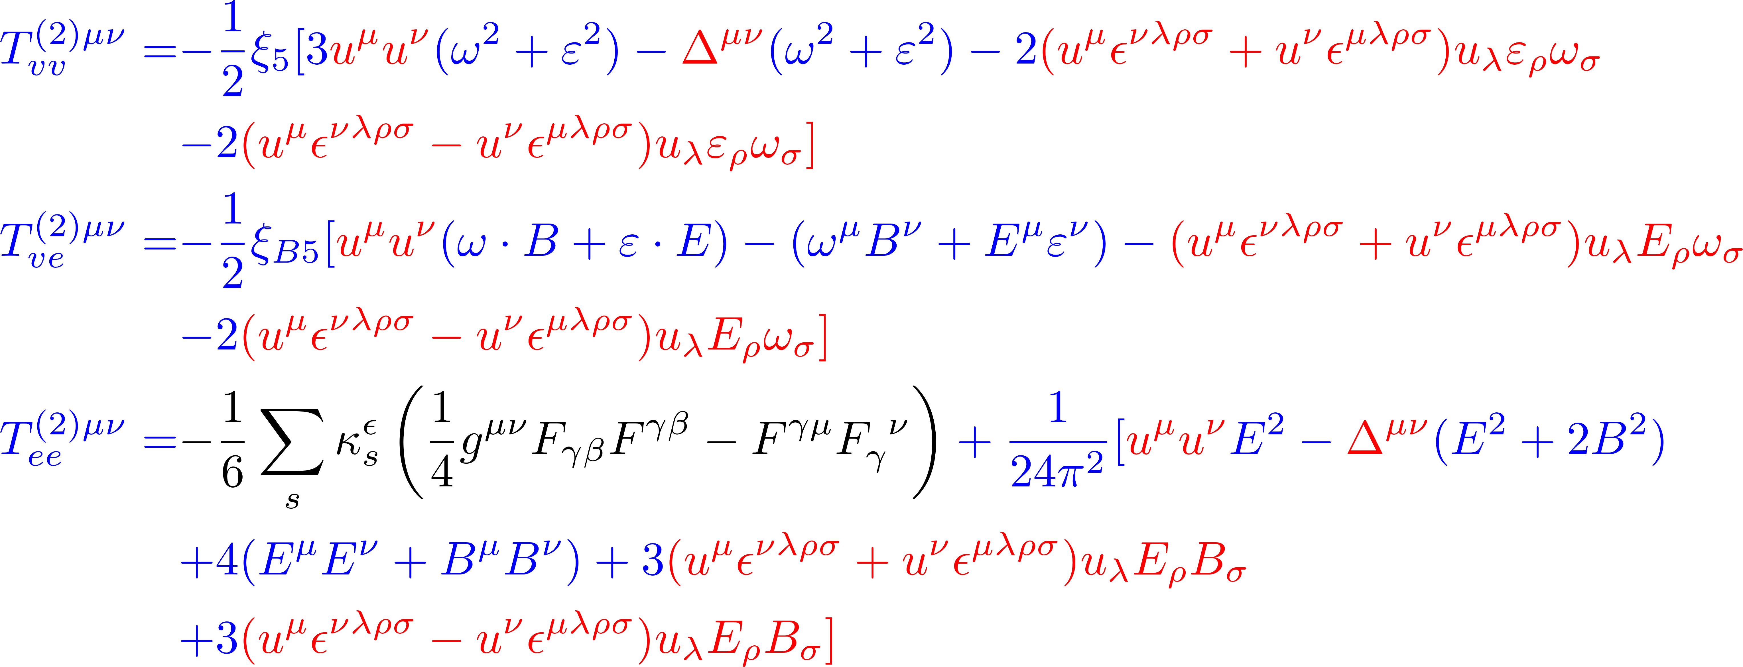
Second order energy momentum tensor
Second order energy moment tensor
Dimensional regularization

Slide 13
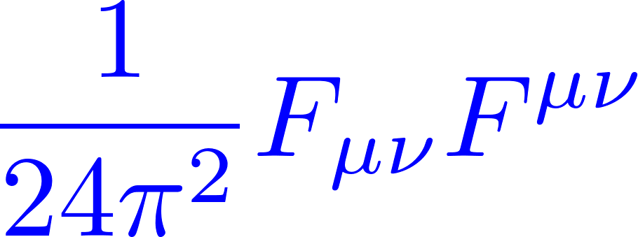
Trace anomaly
Trace up to second order
Trace of EM part
Trace
Trace
After renormalization by introducing the quantum correction from EM field
Trace

Slide 14
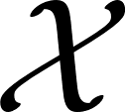
General Lorentz structure
General expansion of from Lorentz invariance with the C/P/T invariance
All are function of

Slide 15
General solution
General solution in global equilibrium, satisfying

Slide 16
Conservation laws
Currents conservation
Axial Currents conservation
Energy momentum conservation
Symmetric and antisymmetric part

Slide 17
Summary
We have derived the complete second order currents and energy momentum tensor in global equilibrium with constant EM field:
1. The charge and energy density and the pressure have contribution
from the vorticity and EM field at second order.
2. The EM field and vorticity can induce Hall currents orthogonal to
the EM field and vorticity.
3. Our results automatically satisfy currents and energy momentum
conservation. The trace anomaly appears if we introduce the
quantum correction from EM field.
Thank You

