Slide 1
Distribution Amplitudes of K* and φ
from Lattice QCD
Jun Hua
Shanghai Jiao Tong University
PRL.127.062002(2021)
(Lattice Parton Collaboration)
第十三届粒子物理学术会议（2021）
1
Notes:
各位老师大家上午好，首先非常感谢会务组给我这个机会和大家分享一下我们前段时间的一个工作。我是来自上海交通大学的博士后华俊。那我的报告的题目是“Distribution Amplitudes of K∗ and φ from Lattice QCD”。那这个工作也是我们LPC合作组共同完成的一个工作。

Slide 2
OUTLINE
OUTLINE
Motivation
LCDA by Large-Momentum effective theory
Numerical results
Summary
2
Notes:
这是我报告的outline。我将介绍这个工作的movivation，为什么我们需要K*和phi的波函数。报告的主要部分是，我们如何在格点上通过大动量有效理论来计算光锥波函数。最后我会展示一下我们的计算结果。

Slide 3
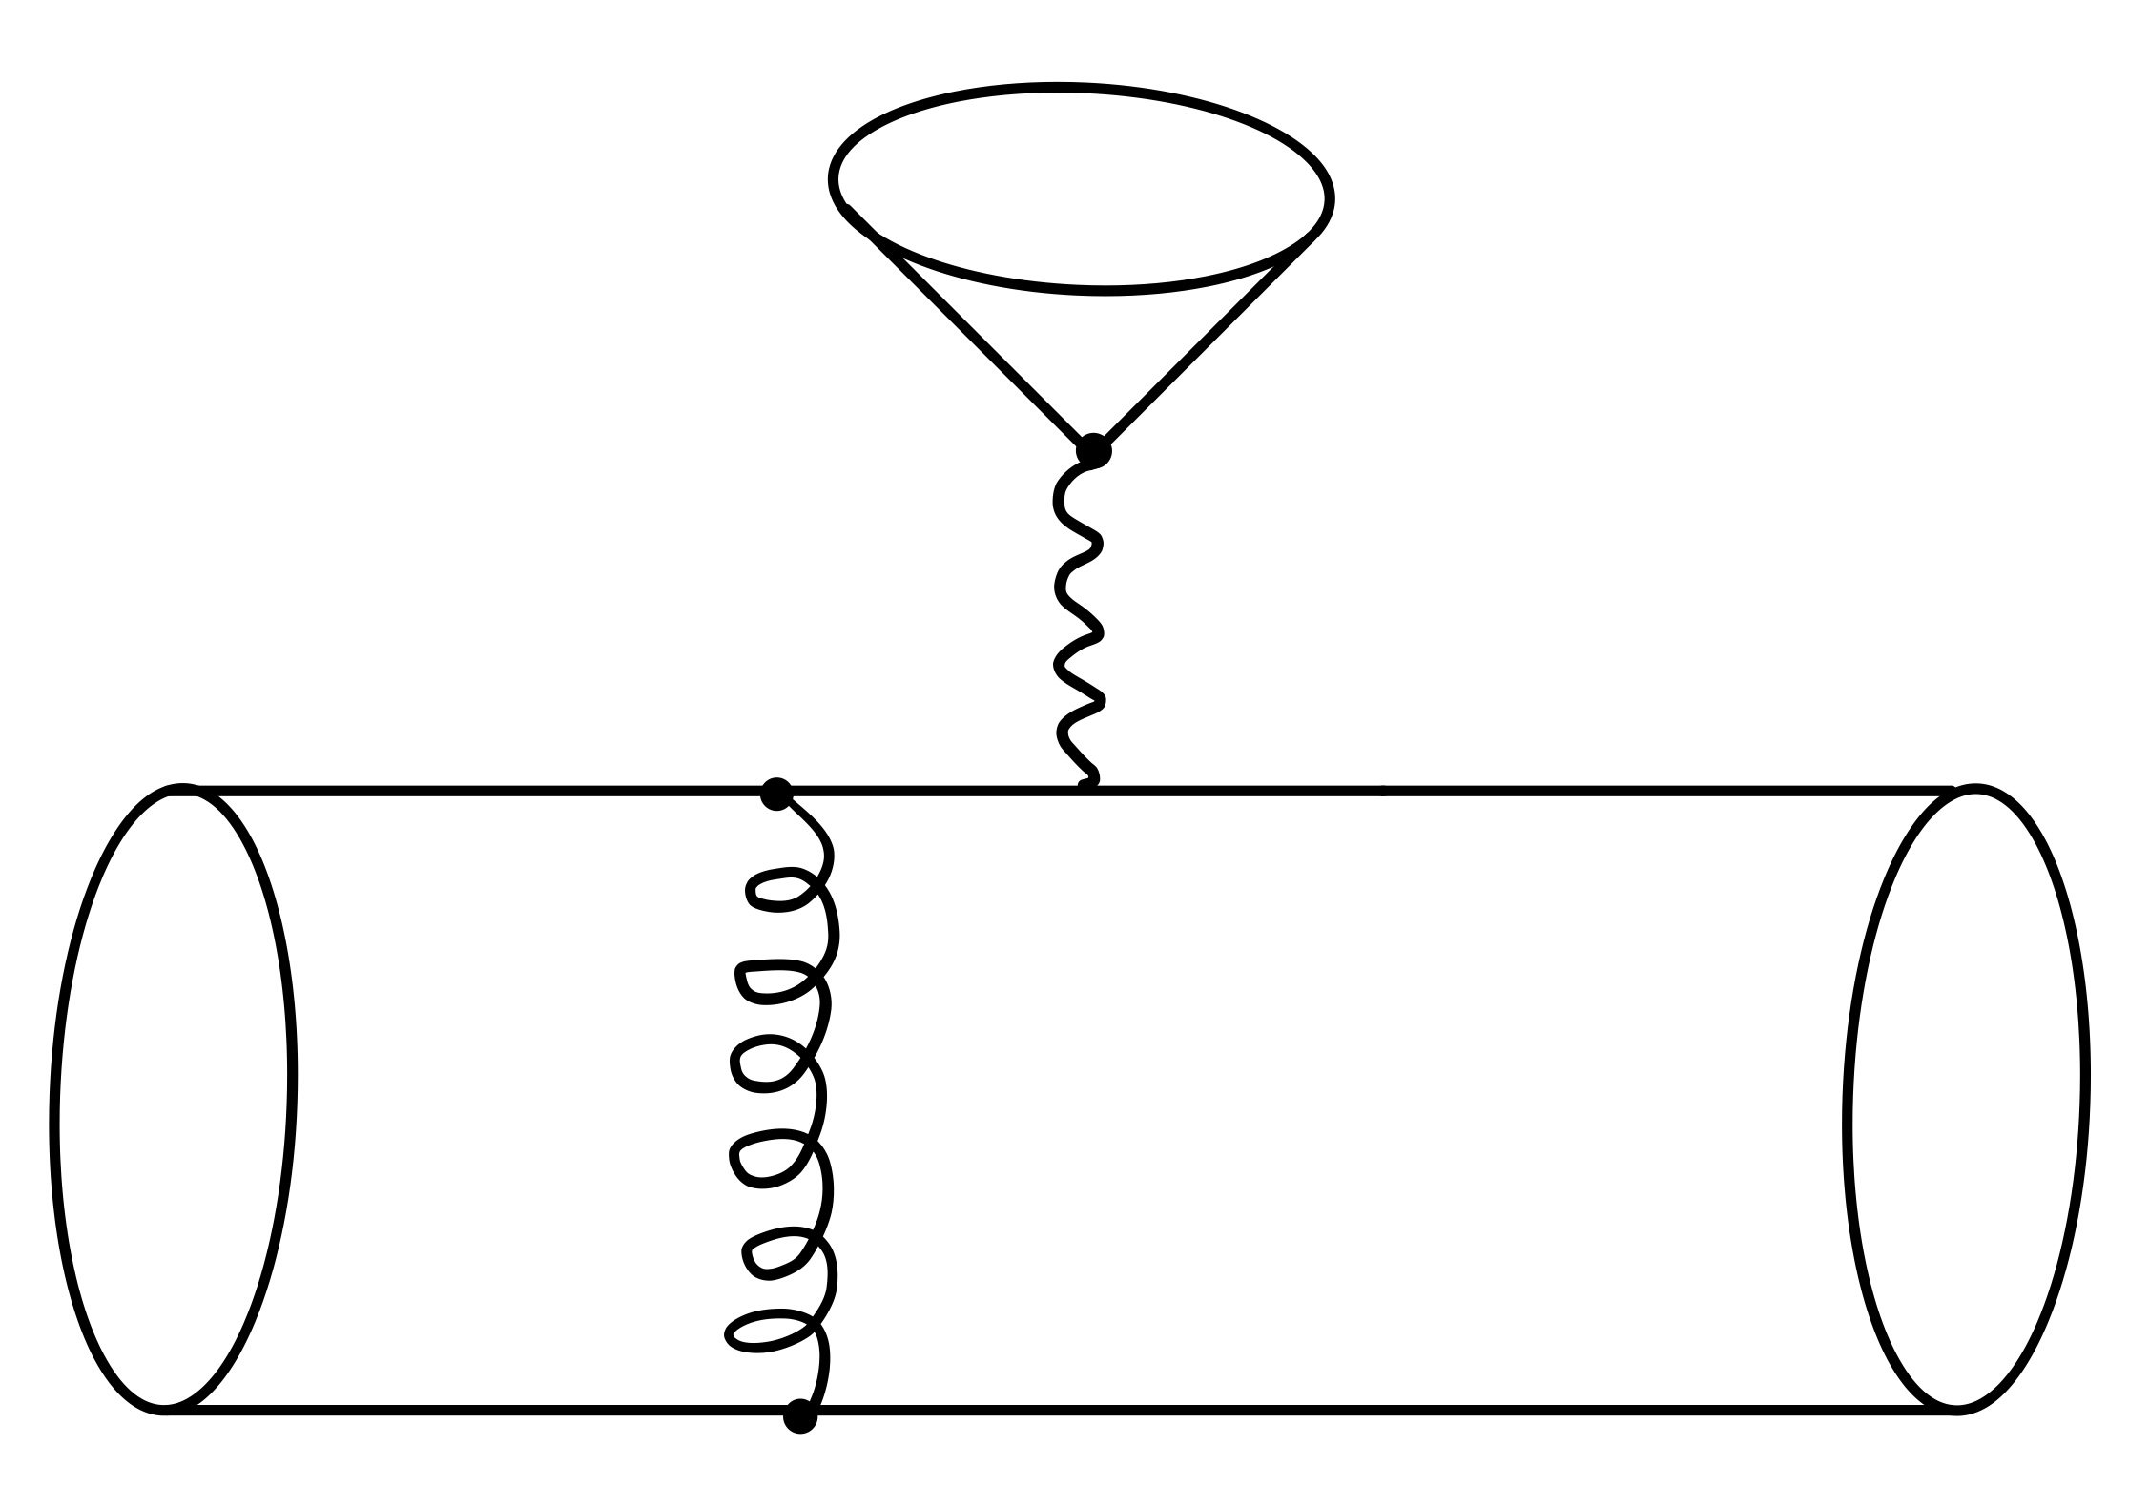
Motivation
OUTLINE
Consider a B meson decay process
$$π^{+}$$
$$B^{0}→π^{+}+π^{−}$$
$$W^{+}$$
QCD factorization: separating the processes with different energy scales
$$\overline{b}$$
$$\overline{u}$$
$$B^{0}$$
$$g$$
$$π^{−}$$
$$d$$
$$d$$
$$Λ_{QCD}$$
$$M_{W}$$
$$M_{B}$$
Perturbative!
Wilson coefficients
Non-perturbative, but UNIVERSAL DA
3
Notes:
To emphasise the importance of DA, the theory that must be discussed is factorization. Consider an exclusive B meson decay process in heavy flavor physics, there are several scales from lambda QCD scale to Mb scale and to Mw scale. These different scales need to be handled separately. By applying OPE and integrating, the Mw scale physics can be absorbed into Wilson coefficients. Then according to factorization, the physics below nlambda QCD scale can be absorbed into Non-perturbative but universal distribution amplitudes, and the physics above lambda QCD scale can be calculated perturbatively as a high-energy hard kernel.
那聊到光锥波函数的重要性，我们一定会涉及到的是因子化理论。考虑任意一个B介子的遍举过程，那这个衰变过程会涉及到多个能标。从最低的lambda QCD能标，到B介子质量的Mb能标，以及更高的Mw的能标。这3个能标的物理需要被明确的区分开进行处理才能计算完整的过程。通过算符乘积展开和积分掉重的波色子，我们可以把Mw标度的物理系收到wilson系数当中去。而通过因子化定定理

Slide 4
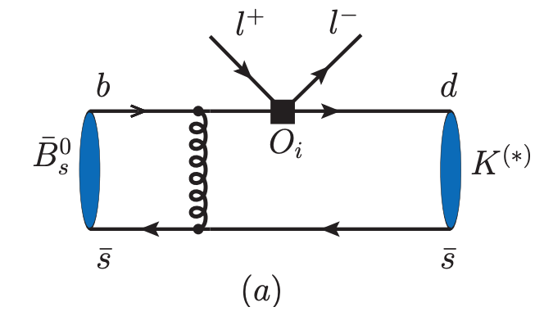
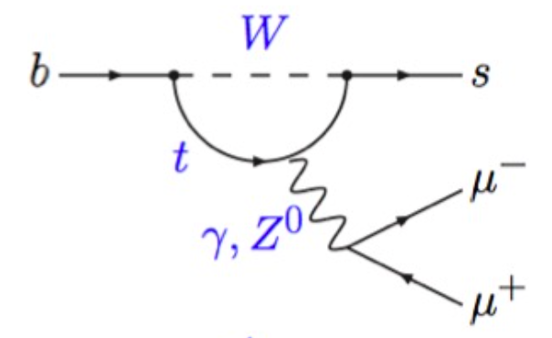
Motivation
OUTLINE
Important inputs for exclusive processes in factorization theory
Relevant flavor physics
Providing information on the CKM matrix
New physics, flavor-changing neutral current processes ($B→K^{∗}l^{+}l^{−},B_{s}→φl^{+}l^{−}$)
$B^{0}→K^{∗0}μ^{+}μ^{−}$ LHCb-Paper-2021-007
4
Notes:
Thus, the distribution amplitudes of light mesons are very important inputs for exclusive processes in factorization theory for these relevant flavor physics. Especially, these exclusive processes may provide information on the CKM matrix. For the K* distribution amplitudes, these relevant flavor-changing neutral current processes are highly suppressed in standard model, which are more likely to search for new physics. The LHCb collaboration also try to find new physics by rates and angular distributions of B0 to K* u plus u minus process, in recent research.

Slide 5
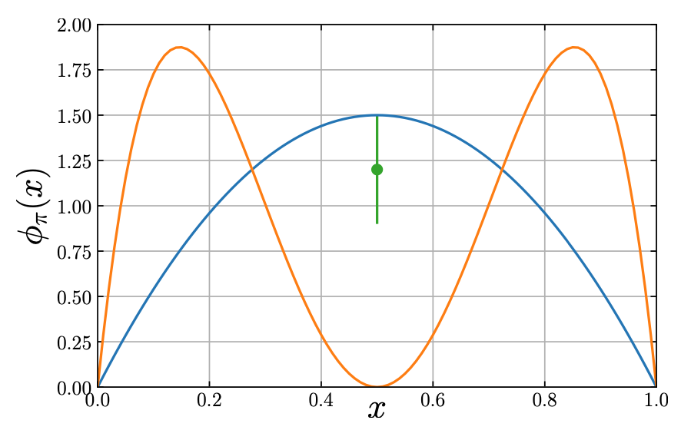
Research of LCDA
OUTLINE
Hadron light-cone distribution amplitudes (LCDAs) have been introduced four decades ago in the context of the QCD description of hard exclusive reactions.
—— : Asymptotic 6x(1-x)
—— : CZ model
—— : Light-cone sum rule
Asymptotic LCDA —Theor. Math. Phys. 42 (1980) 97
QCD sum rules (CZ model)—Nucl. Phys. B201 (1982) 492
Light-cone sum rule —Z. Phys. C44 (1989) 157
Lattice calculations —Phys. Lett. B190 (1987) 151
QCD sum rules— JHEP. 08 (2007), 090
Light-front quark model —Phys.Rev. D75 (2007) 034019
Dyson-Schwinger equations —Phys.Rev. D90 (2014) 014011
……
—JHEP08.065(2019)
5
Notes:
There is a long history of light-cone distribution amplitudes. The hadron light-cone distribution amplitudes (LCDAs) have been introduced four decades ago in the context of the QCD description of hard exclusive reactions. Early studies of the various approaches include the Asymptotic LCDA in 1980s, a controversial results from CZ model in 1982, the early calculation from Light-cone sum rule and lattice. While, decades have passed, we are still trying to obtain the more accurate results of LCDAs. Recent years, these approaches include QCD sum rules, Light front quark model, DS equations and so on.

Slide 6
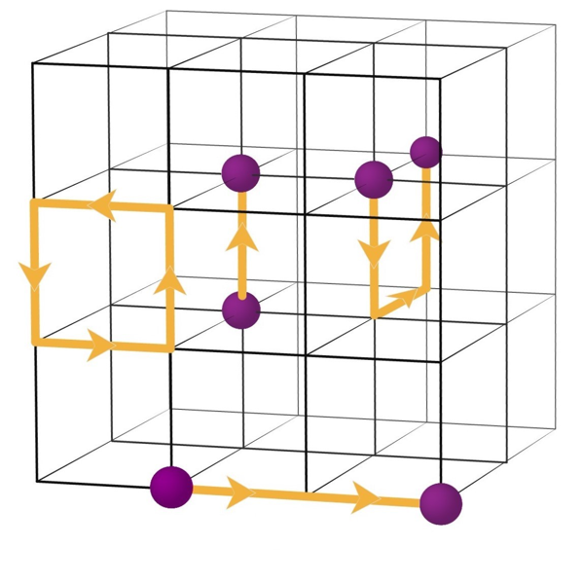
Lattice QCD
OUTLINE
$$a$$
$${\left(a⋅n_{S}\right)}^{3}$$
$$t$$
quarks
$$a$$
gluons
$$0$$
$$n_{T}$$
Target LCDA — defined via a meson-to-vacuum matrix element
gluons
quarks
Credit: M. Savage@NNPSS2015
Mellin moments by OPE PRD.92.014504(2015), JHEP04.082 (2017), JHEP08.065(2019)……
Large-momentum effective theory(LaMET__PRL.110.262002 (2013)) PRD.102.094519(2020), arXiv:2011.09788(2020)……
6
Notes:
As a calculation from first principle, lattice QCD is the most promising method for obtaining accurate LCDAs. To get the LCDA on lattice, one can defined a meson-to-vacuum matrix element of a renormalized nonlocal quark-antiquark light-ray operator. The most common approach on the lattice has been to calculate the moments of LCDAs as the matrix elements of local operators. How-ever, it has been difficult to calculate the matrix elements of higher moments. Recent years, based on the large momentum effective theory (LaMET) proposed by Xiang-Dong Ji in 2013, we can finally do a direct calculation of the entire distribution.

Slide 7
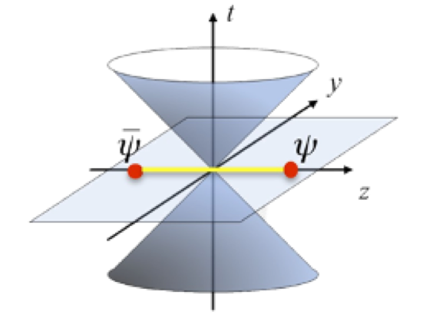
Large-Momentum effective theory
OUTLINE
Define a new matrix element with an equal-time correlator, named quasi-PDF/DA:
$$\overset{\sim }{q}(x,P^{z},μ)=∫\frac{dz}{4π}e^{ixP^{z}z}⟨P|\overline{ψ}(z)γ^{z}exp\left(−ig∫_{0}^{z}dz^{′}A^{z}(z^{′})\right)ψ(0)|P⟩$$
Can be calculated on lattice directly!
X. Ji. Parton Physics on a Euclidean Lattice, Phys.Rev.Lett. 110, 262002 (2013).
For large $P^{z}$, the leading power of quasi-PDF/DA under the expansion of $Λ^{2},M^{2}/(P^{z})^{2}$ can be factorized into PDF/DA:
$$\overset{\sim }{q}(x,P^{z},μ)=∫\frac{dy}{|y|}C\left(\frac{x}{y},yP^{z},μ\right)q(y,μ)+𝒪\left(\frac{Λ^{2},M^{2}}{(P^{z})^{2}}\right)$$
X.Ji. et al. —arXiv:2004.03543(2020)
7
Notes:
In large momentum effective theory, one can define a new matrix element with an equal-time correlator, named quasi-DA. This quasi-DA can be calculated on lattice directly. For large Pz, the leading power of DA under the expansion can be factorized into light-cone DA. Thus, the light-cone DA can be derived by an inverse matching from Quasi-DA.

Slide 8
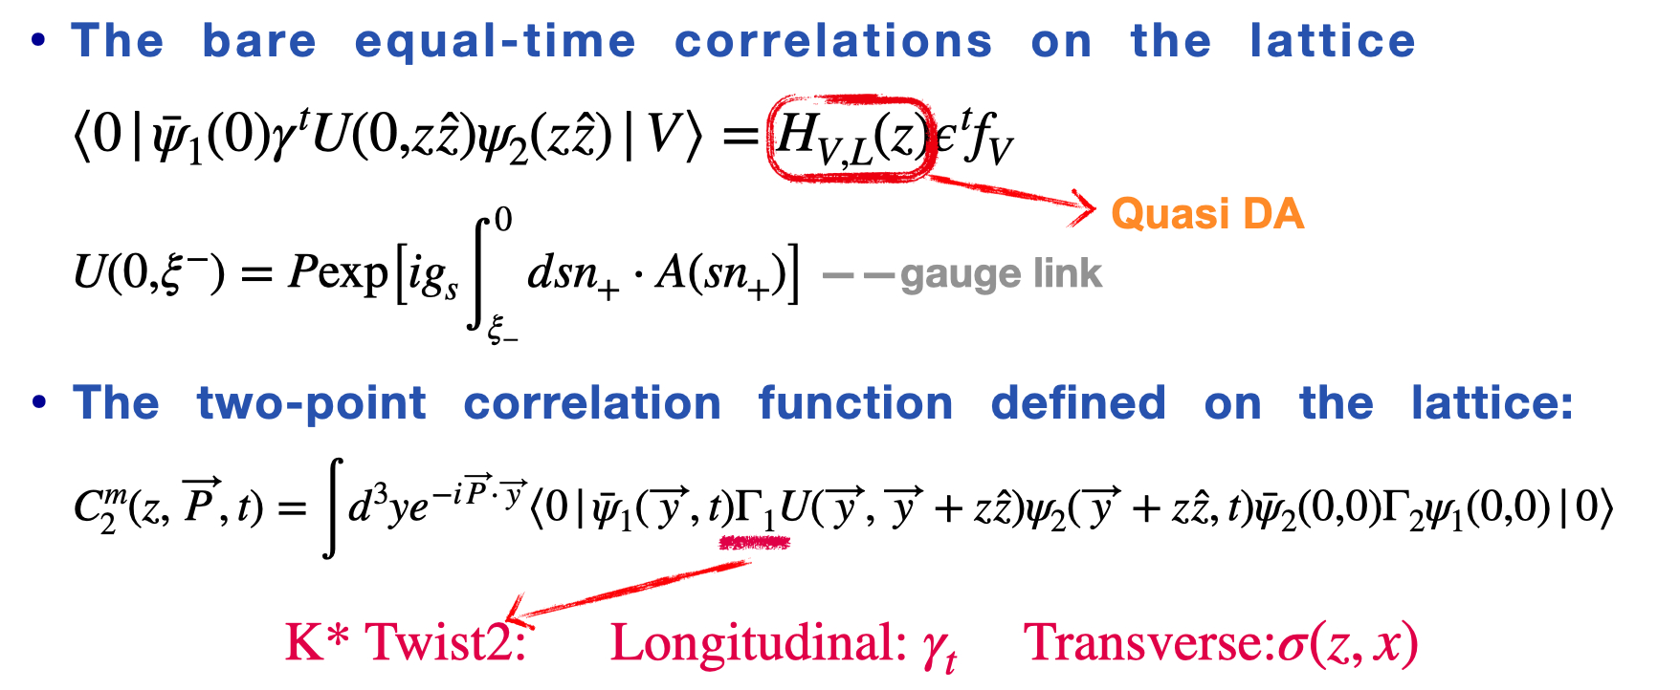
LCDA in LaMET
OUTLINE
$$K^{∗}(t=0)$$
$$S^{(s)}$$
$$⟨$$
$$⟩$$
$$K^{∗}(t)$$
$$S^{(d)}$$
time
$$t$$
8
Notes:
According to LaMET, the LCDAs can be obtained by calculating the bare equal-time correlations on the lattice, here H represents the Quasi-DA and U represents the gauge links. The corresponding two-point correlation function defined on the lattice follows this form. Where the gamma one is gamma t for longitudinally-polarized K* and sigma(z,x) for transversely-polarized K*. The quasi DA then can be extracted by fitting the ratio of nonlocal two-point function and local two point function.

Slide 9
LCDA in LaMET
OUTLINE
This work is based on 2+1+1 flavor ensembles generated with tree level tadpole improved clover fermion action and tadpole improved Symanzik gauge action;
Basic informations of three ensembles used in this calculation:
9
Notes:
Here are our calculation platform and simulation setup. We use the 2 plus 1 plus 1 flavors of highly improved staggered quarks (HISQ) ensembles generated by MILC collaboration，with physical pion mass at 130MeV and three different lattice spacings.

Slide 10
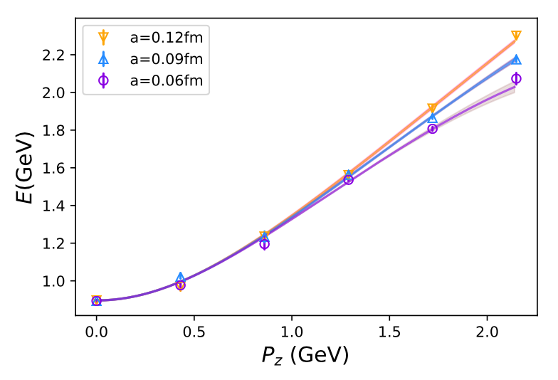
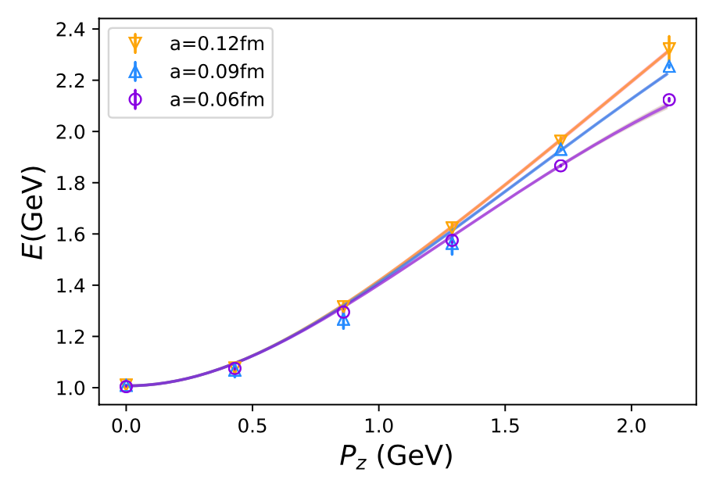
LCDA in LaMET
OUTLINE
Simulation checks: The dispersion relation of $K^{∗},φ$
$$E^{2}=m^{2}+c_{2}(P_{z})^{2}+c_{3}(P_{z})^{4}a^{2}$$
Light speed term
Discretization effects
$K^{∗}$ Fitted Chi2/dof = 1.2
$φ$ Fitted Chi2/dof = 1.7
$$m=0.8961±0.0025$$
$$m=1.0070±0.0011$$
$$c_{2,K^{∗}}=1.062±0.016$$
$$c_{2,φ^{∗}}=1.092±0.089$$
$$c_{3,K^{∗}}=−0.178±0.024$$
$$c_{3,φ^{∗}}=−0.158±0.010$$
10
Notes:
Firstly, check the dispersion relation. The largest momenta we used in our calculation is 2.15GeV. According to this two diagram, the cutoff effects or the discretization effects can be described well by the ‘a’ square term especially for the two smaller lattice spacing.

Slide 11
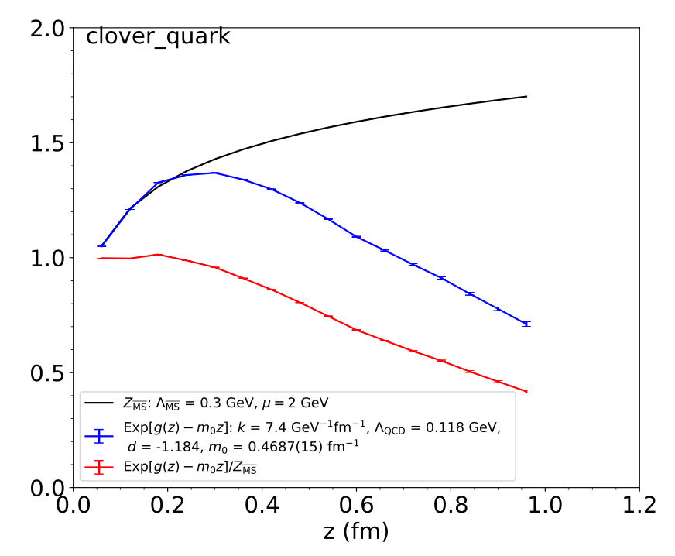
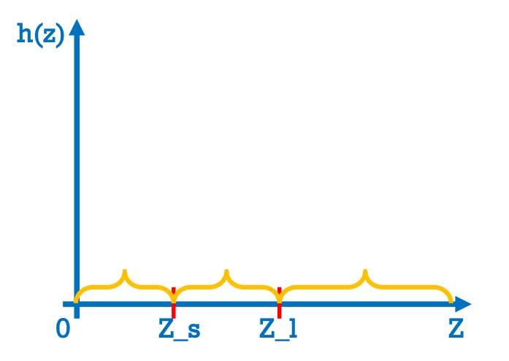
Hybrid renormalization
OUTLINE
Work range ?
RI/MOM renormalization scheme
Y.K.Huo et al. aXriv: 2103.02965
(0 ≤ |z| ≤ Z_s ), RI/MOM renormalization
(Z_s ≤ |z| ≤ Z_l ), modified mass renormalization
(|z|≥ Z_s ), physics-based extrapolation
X.~Ji, et al. Nucl.Phys.B964, 115311 (2021)
11
Notes:
Before presenting any numerical results, let me present the Hybrid renormalization first. As we know, the RI/MOM renormalization scheme can well renormalize the local operator. While in non-local part, here in large z area, the RI/MOM renormalization results become much different with the perturbative results, which means we need a more appropriate renormalization scheme for non-local operator. Here we used the hybrid renormalization scheme proposed recently. In small distance, we can still use RI/MOM renormalization. In the medium distance, we will use the modified mass renormalization. When beyond lattice signal’s reach, we will use a physical based extrapolation.

Slide 12
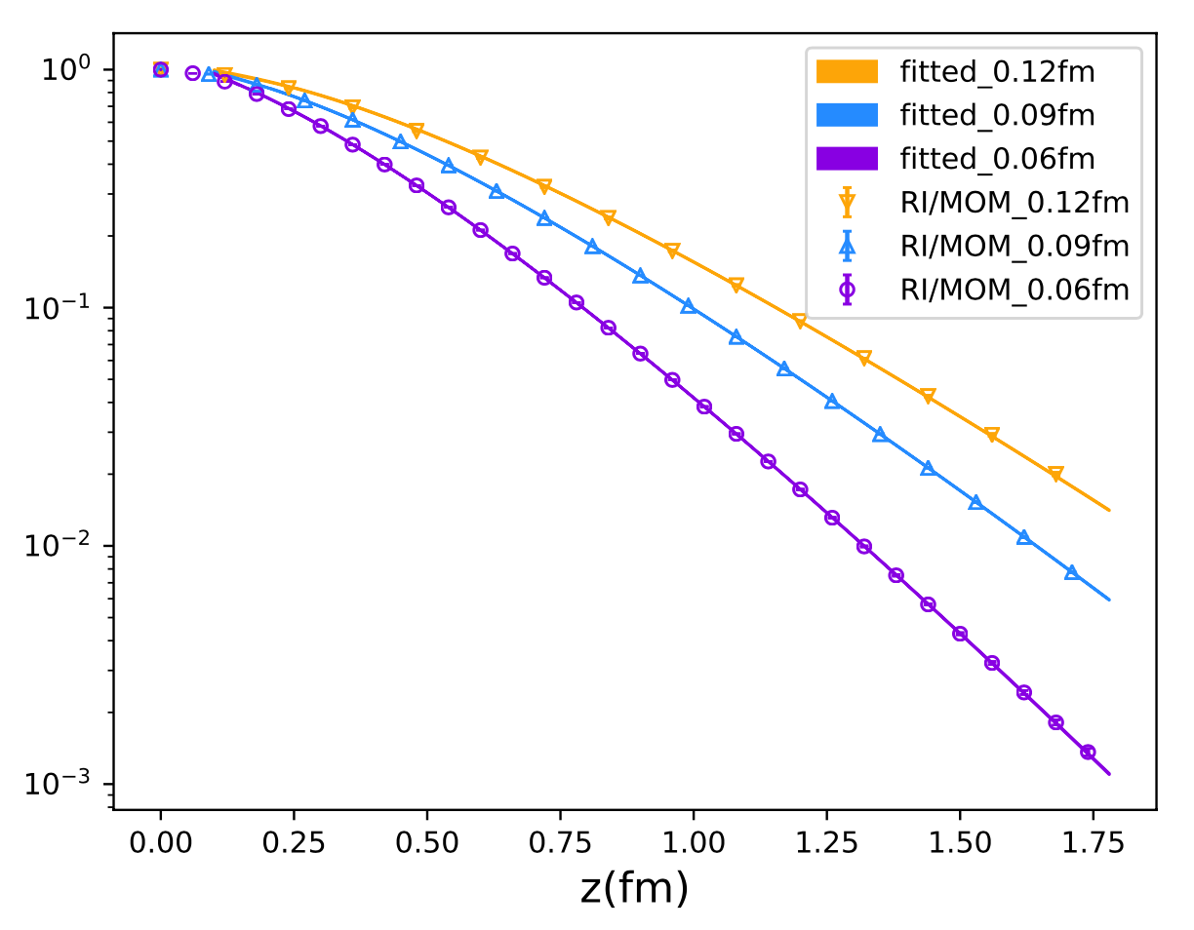
LCDA in LaMET
OUTLINE
(Z_s ≤ |z| ≤ Z_l )
Fitted Chi2: 0.15
$$m_{−1}=0.1683(15),c_{1}=0.4988(56),$$
$$m_{0}=0.1557(29),c_{2}=0.2378(74).$$
m-1: The coefficient of the power divergence
m0: a. Renormalon effect
b. Pole mass
c. Finite P^{z} effects
d. Fitting effect.
c1,c2: ln(z) scale infrared divergence
c0: overall factor
12
Notes:
To apply the modified mass renormalization in the medium distance. We fit the RI/MOM factor with such a modified expression. The m-1 term in expression is the coefficient of the power divergence which we should keep in Hybrid. The c1,c2 term is the ln(z) scale infrared divergence which we should drop in Hybrid. The m0 term is somehow a little tricky one, including several possible factors. For safety, we will set m0=0 in following analysis. Here, the right side are the fitting diagram and fitting results.

Slide 13
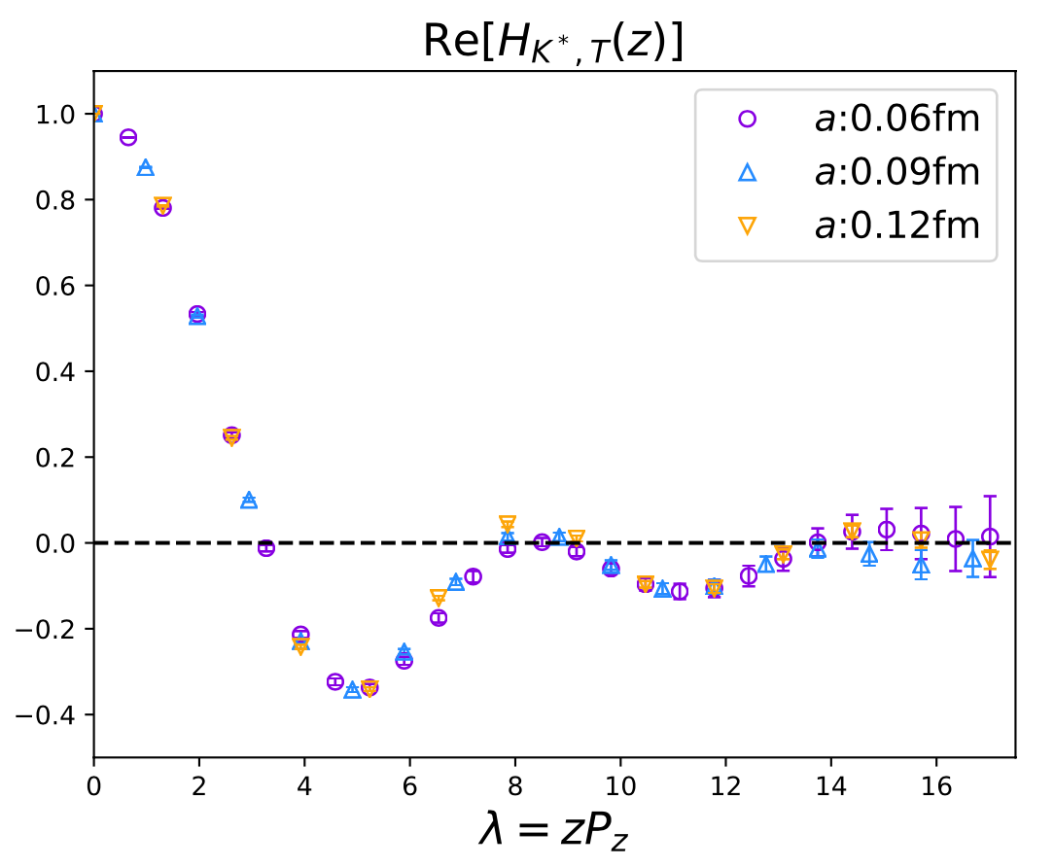
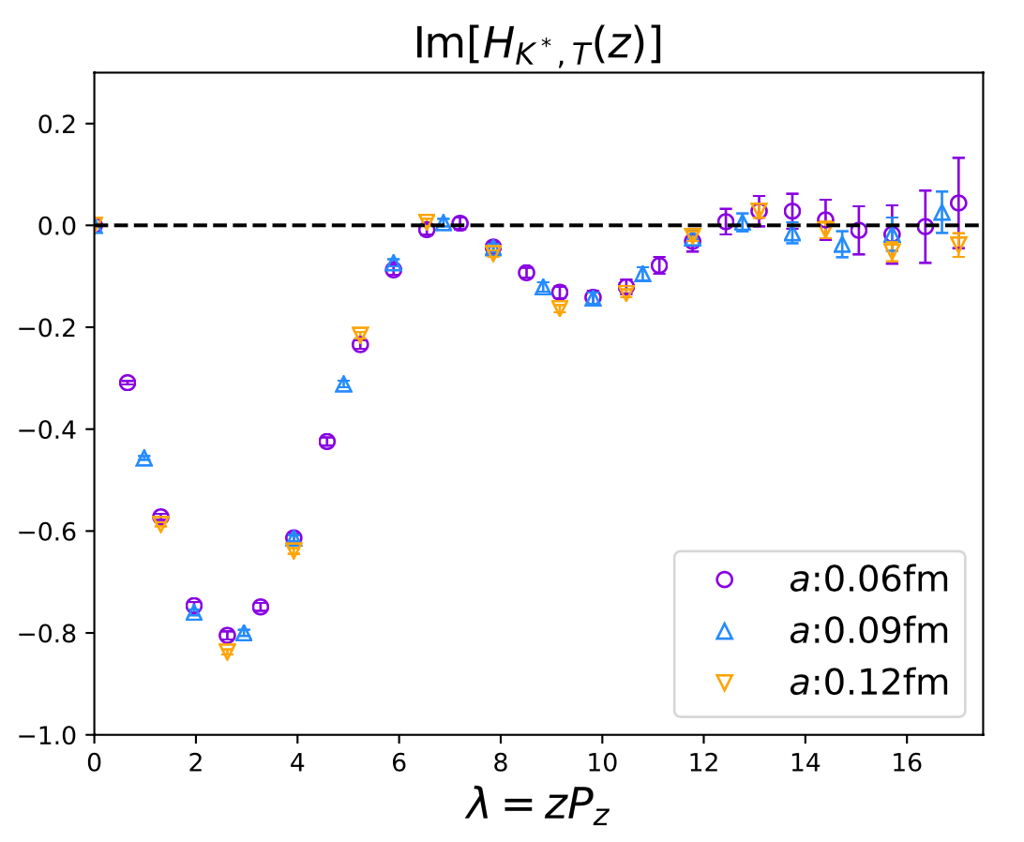
Hybrid renormalized Quasi DA
OUTLINE
The real part and the imaginary part of quasi DA in coordinate space after Hybrid renormalization:
13
Notes:
Then after RI/MOM renormalization in short distance and modified mass renormalization in medium distance, the real part and imaginary part of quasi-DA in coordinate space can be derived.

Slide 14
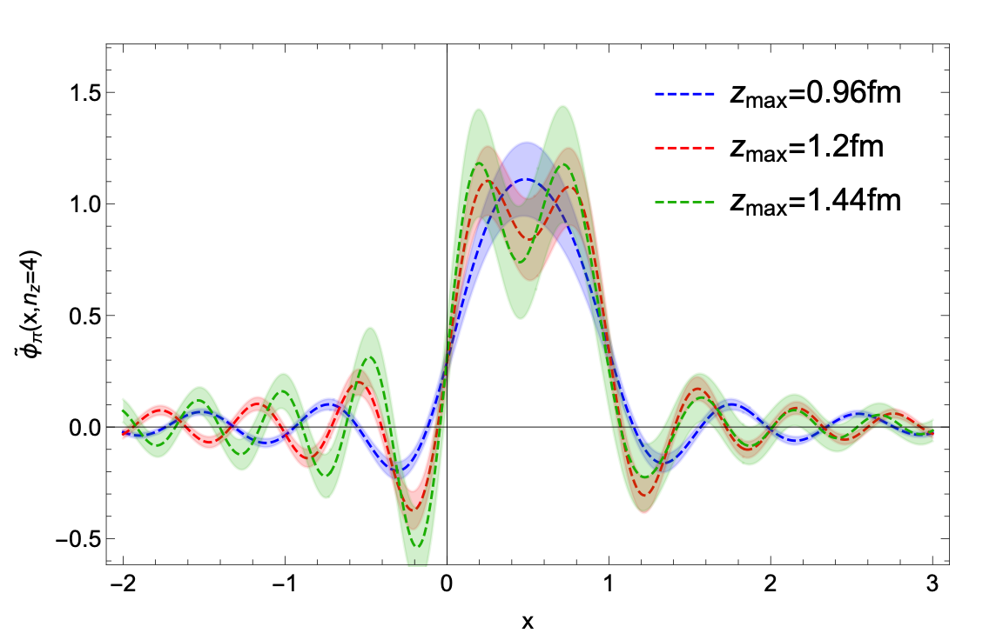
Why extrapolation?
OUTLINE
The Fourier transformation and inverse problem
$$∫dxe^{−ixzP_{z}}\overset{\sim }{φ}(x)$$
Cutoff
R. Zhang et al —arXiv:2005.13955(2020)
Possible Solutions:
Backus-Gilbert method
Maximum Entropy method
Bayesian Reconstruction
—J.Liang et al. ($χ$QCD) arXiv:1906.05312(2019)
14
Notes:
The normally next step is the Fourier transformation to get the quasi-DA in momentum space. While if we directly cutoff beyond lattice signal’s reach, we may suffer the so-called inverse problem. Here in DA cases, it will result to unphysical oscillations in momentum space. There are several possible solutions on the inverse problem discussed in the previous papers.

Slide 15
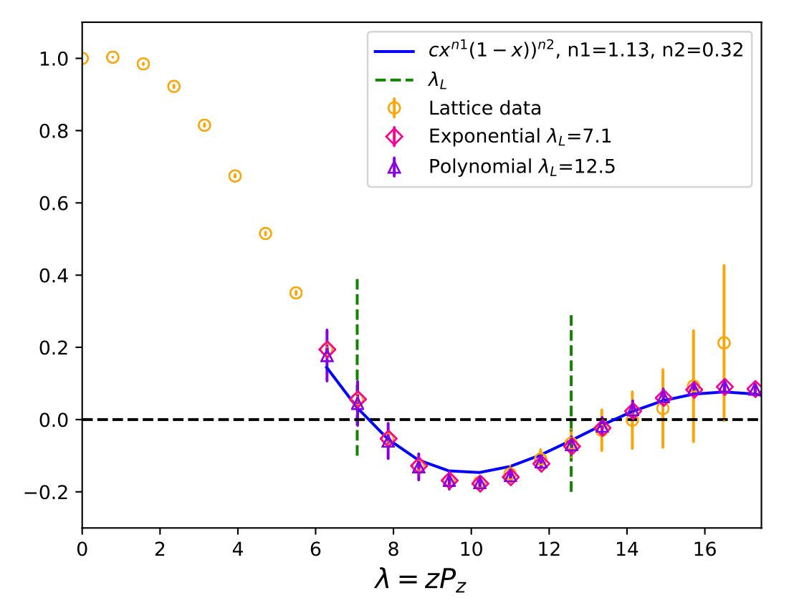
Why extrapolation?
OUTLINE
The cutoff problem of quasi DA without large z extrapolation:
Asymptotic behavior at x~0,1:
$$∼x^{a}(1−x)^{b}$$
Coordinate space:
At large $λ$:
$$λ=zP_{z}$$
15
Notes:
In our study, we use the physics-based extrapolation at large z area to avoid this problem. In this approach, we begin with the a form that incorporates the asymptotic behavior of parton distributions at x → 0 or 1. After Fourier transformation, we will use the large z behaves or the phase rotation formular. This approach removes unphysical oscillations in a naive truncated Fourier transform, but with the price of altering the endpoint distribution.

Slide 16
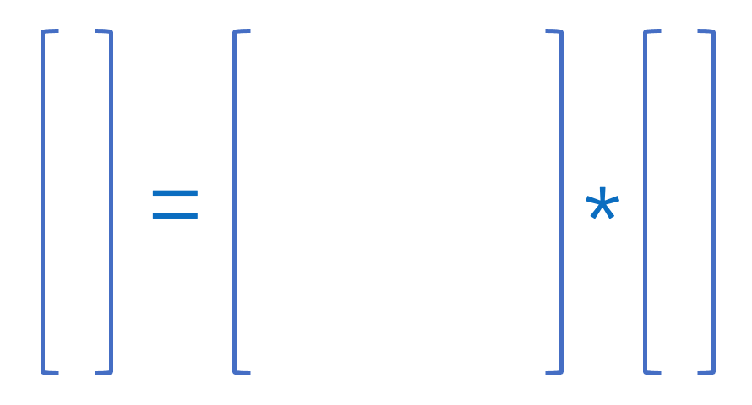
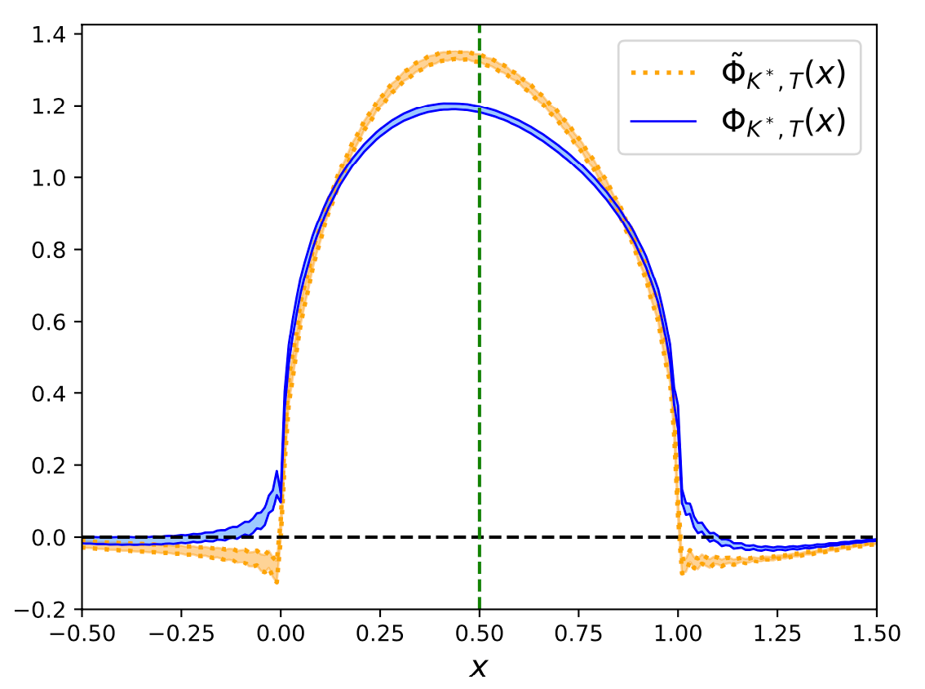
Inverse matching from quasi to LCDA
OUTLINE
$$\overset{\sim }{q}(x,P^{z},μ)=∫\frac{dy}{|y|}C\left(\frac{x}{y},yP^{z},μ\right)q(y,μ)+𝒪\left(\frac{Λ^{2},M^{2}}{(P^{z})^{2}}\right)$$
Matching kernel
—Y.S.Liu, W.Wang, J.Xu, Q.A.Zhang…PRD99(2019).094034
Delta function
Plus function
Discretization
Quasi DA
$$a=0.09fm,P_{z}=2.15GeV$$
$$q$$
$$C^{−1}\left(\frac{x}{y},yP^{z},μ\right)$$
$$\overset{˜}{q}$$
LCDA
500*500
16
Notes:
At last step, we derive the LCDA from quasi-DA by an inverse matching. As we said, for large Pz, the leading power of DA under the expansion can be factorized into light-cone DA. The matching kernel from light cone to quasi is calculated at this paper in 2019. Thus, neglecting the high power corrections, the light cone DA can be derived by an inverse matching from quasi DA. To minimize systematic errors in this matching process, we discretize the matching kernel and inverse the kernel matrix numerically. Then, we can get the LCDA of any lattice spacing and any momentum.

Slide 17
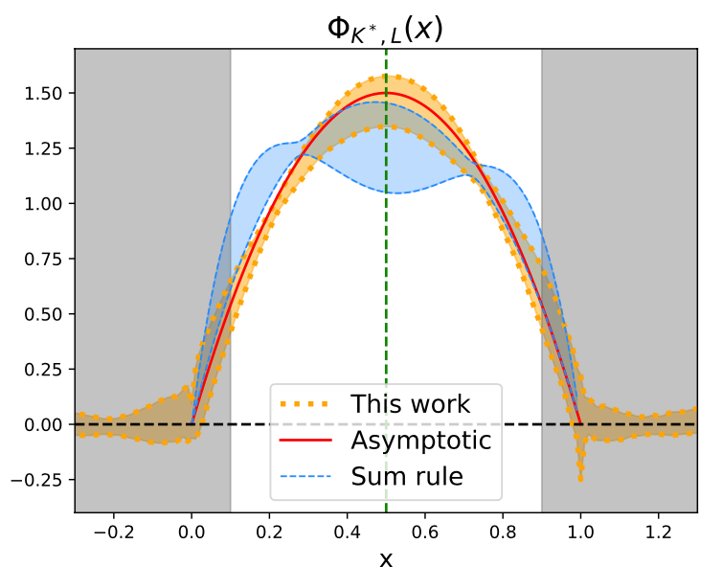
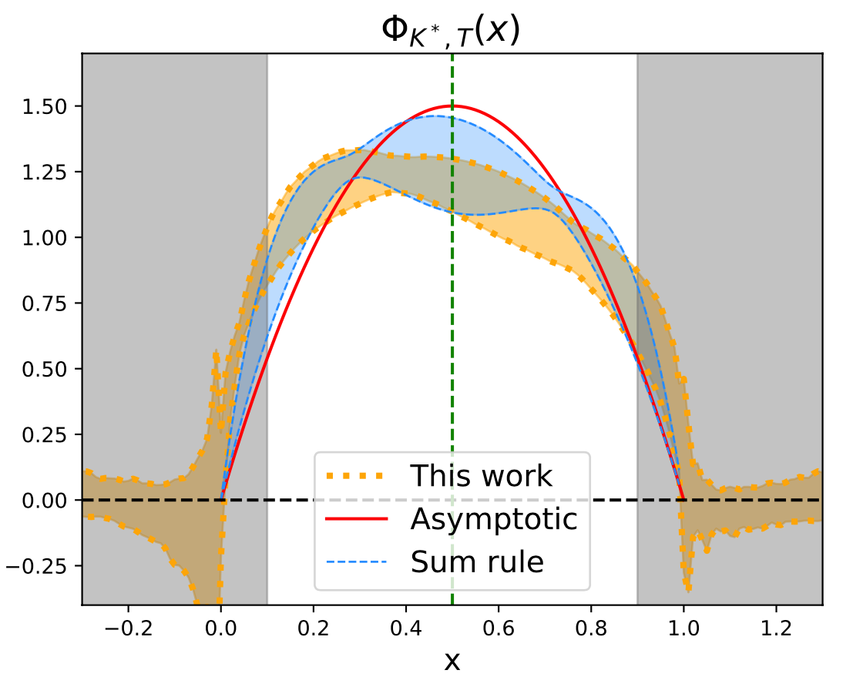
LCDA in LaMET
OUTLINE
Our final result after matching from DA Quasi DA to LCDA:
One can extract Gegenbauer moments from LCDAs by:
17
Notes:
After continuum extrapolation and infinite momentum limit, we finally get the entire distribution of K* and phi, both the longitudinally-polarized one and the transversely-polarized one. Here the x is momentum fraction. We also give the compassion with Asymptotic form and the results from sum rule. And here are some numerical Gegenbauer moments extracted from our results.

Slide 18
Summary
OUTLINE
We present the first lattice QCD calculation of LCDAs of vector mesons K* and φ using Large-Momentum effective theory.
The hybrid renormalization scheme including modified mass renormalization and physical based extrapolation is firstly adopted to avoid extra nonperturbative effects in renormalizing non-local operator.
The entire LCDAs of K* and φ are given and the Gegenbauer moments are also extracted from our results.
Thank you very much !
18
Notes:
Here are my summaries, maybe I don't need to repeat them. Thank you for your listening.

