Slide 1
Observation of tW in lep + jets
and
ttH in multilepton channel
张华桥(高能所)
(16-19,Aug,2021, online, China)

Slide 2
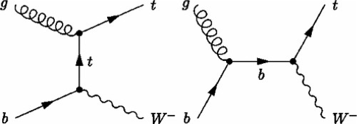
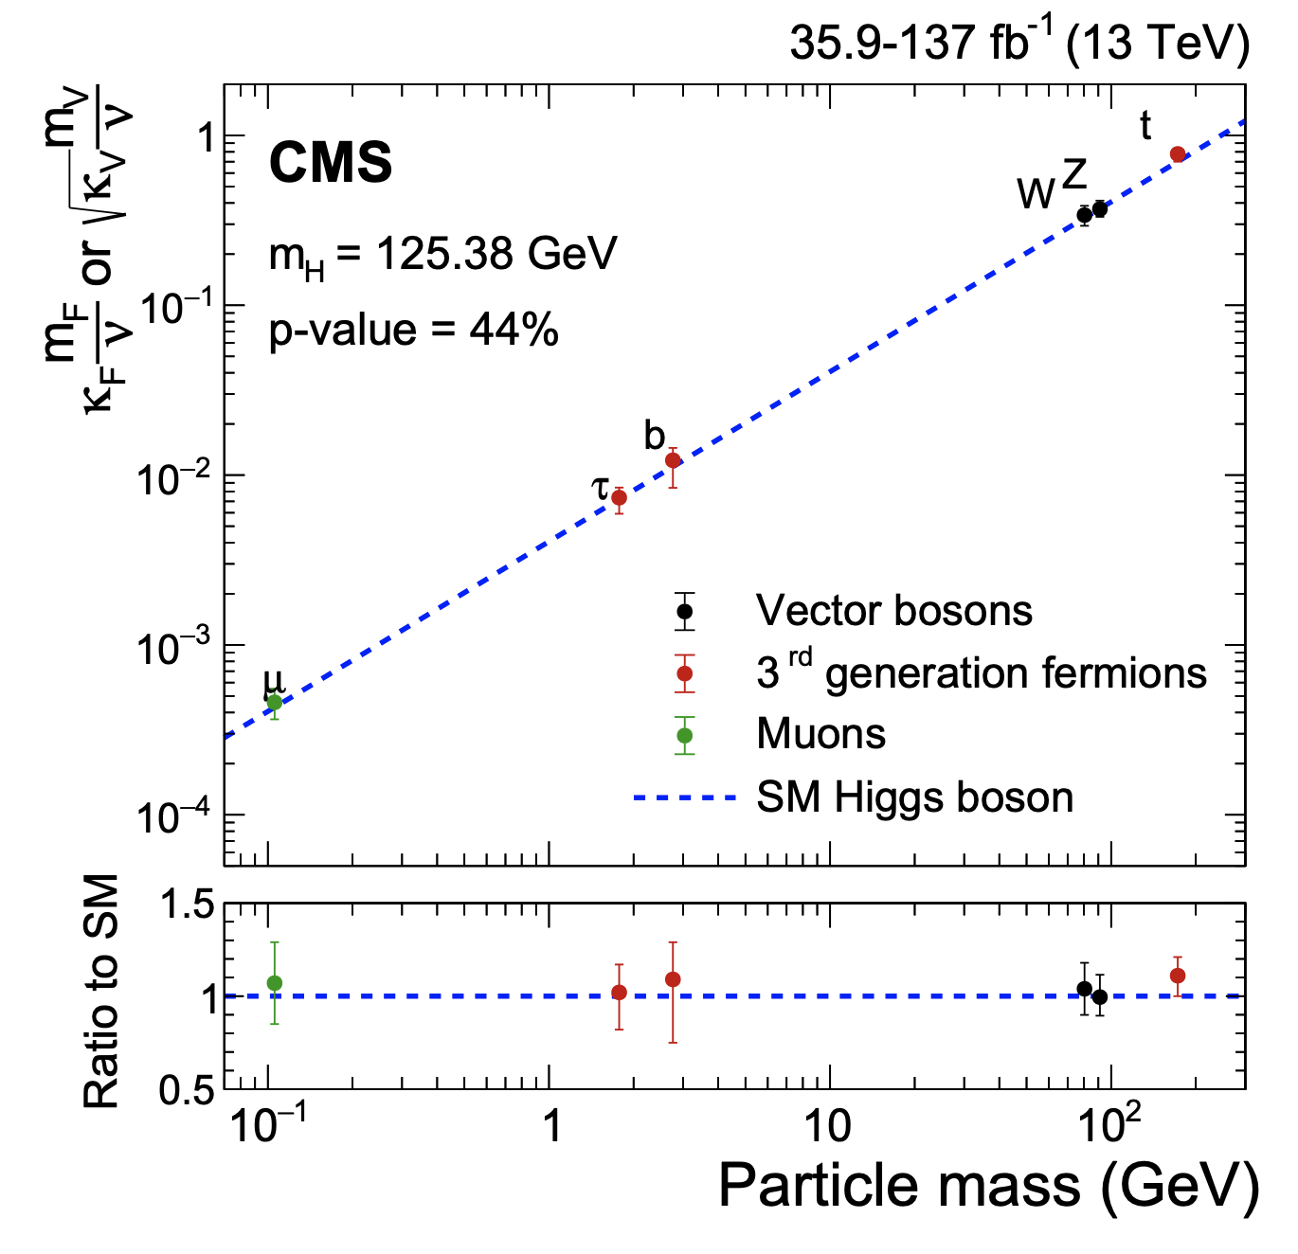
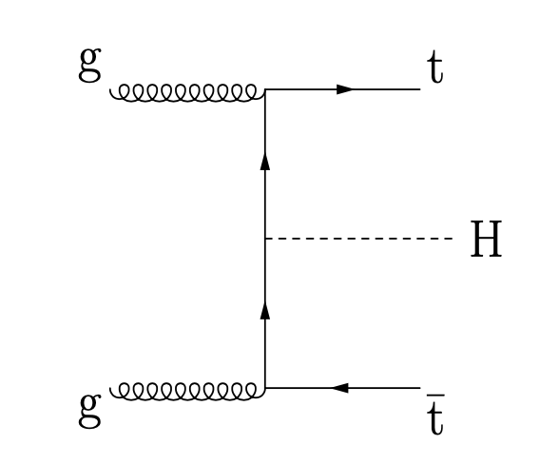
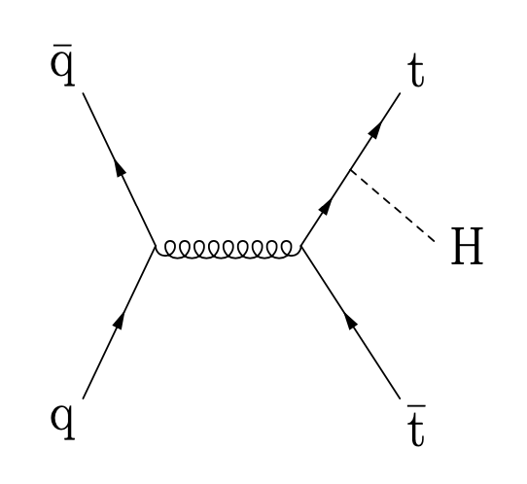
Motivation
tW:
Electroweak production of top quark
Direct Probe of |V_{tb}|
Sensitive to new physics
ttH:
Direct detection of top-Higgs Yukawa coupling
CMS-PAS-TOP-20-002
EPJC 81 (2021) 378
Observation in new channel！

Slide 3
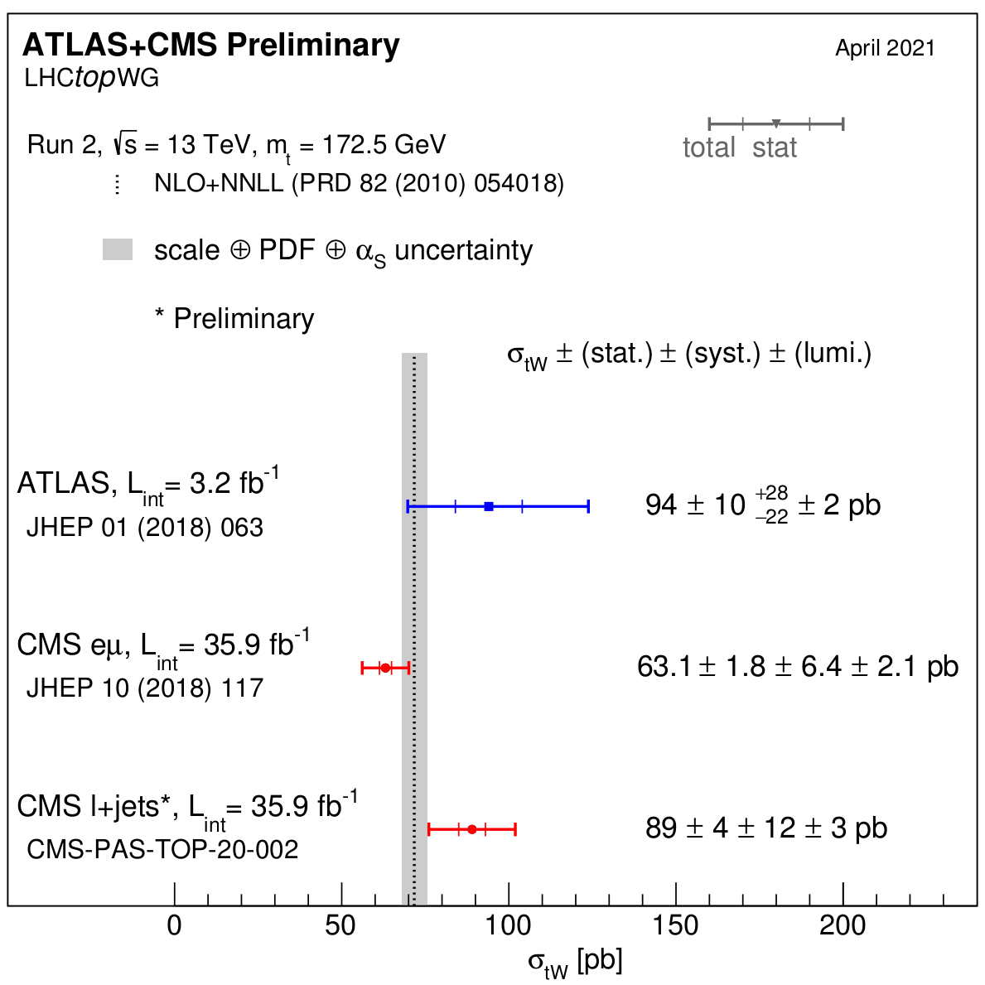
Introduction of tW
LHC Run1 results:
PLB 716 (2012)142-159
Phys. Rev. Lett. 112, 231802
First observation at LHC
LHC Run 2 results
JHEP10(2018)117
Eur. Phys. J. C 78, 186
Differential cross section studies
Lepton + jets measurement
Larger signal events, can reconstruct tW for property study / Worse S/B
No public results until recently
Arxiv:2007.01554 (ATLAS, evidence)
CMS-PAS-TOP-2020-002 (This work)

Slide 4
Modeling of tW
tW signal interferes with tt at NLO, causing conceptual and computational problems in signal definition
Diagram Removal (DR) : remove doubly resonant diagrams from signal definition
Diagram Subtraction (DS) : subtract gauge-invariant term to cancel interference.
Unified WWbb sample that incorporates both tW/tt processes
Some NLO tW feyman diagram

Slide 5
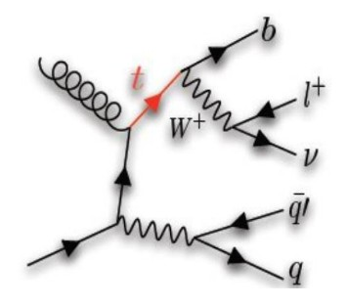
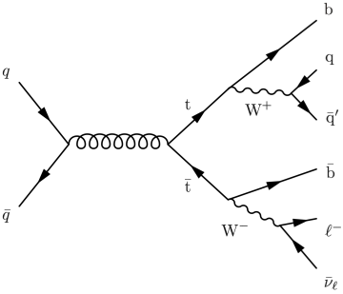
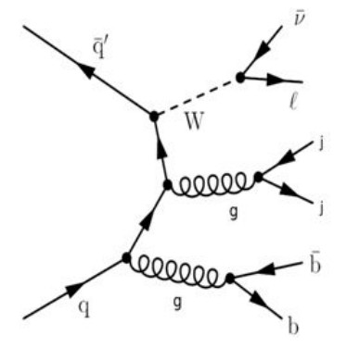
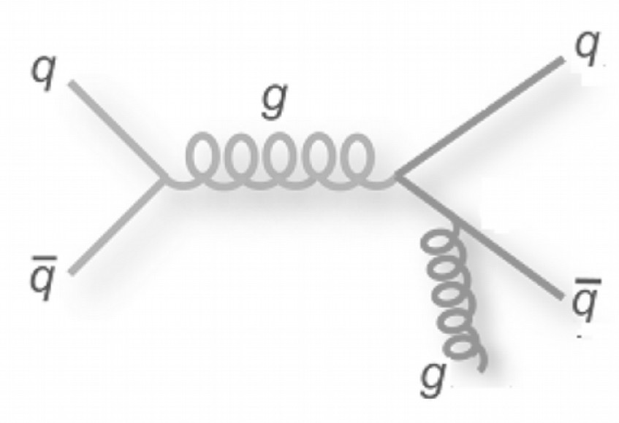
Signature and backgrounds
Signal definition
One lepton (muon or electron)
Missing energy from associated neutrino
Three jets, one originating from a b quark
Main background
ttbar: indistinguishable at NLO
W+jets and QCD with fake b-tags,
QCD: fake leptons
Small contributions from DY and other single top processes
ttbar
QCD
W+jets
This result use 36 fb⁻¹ pp collisions collected in 2016 by CMS at √s = 13 TeV

Slide 6
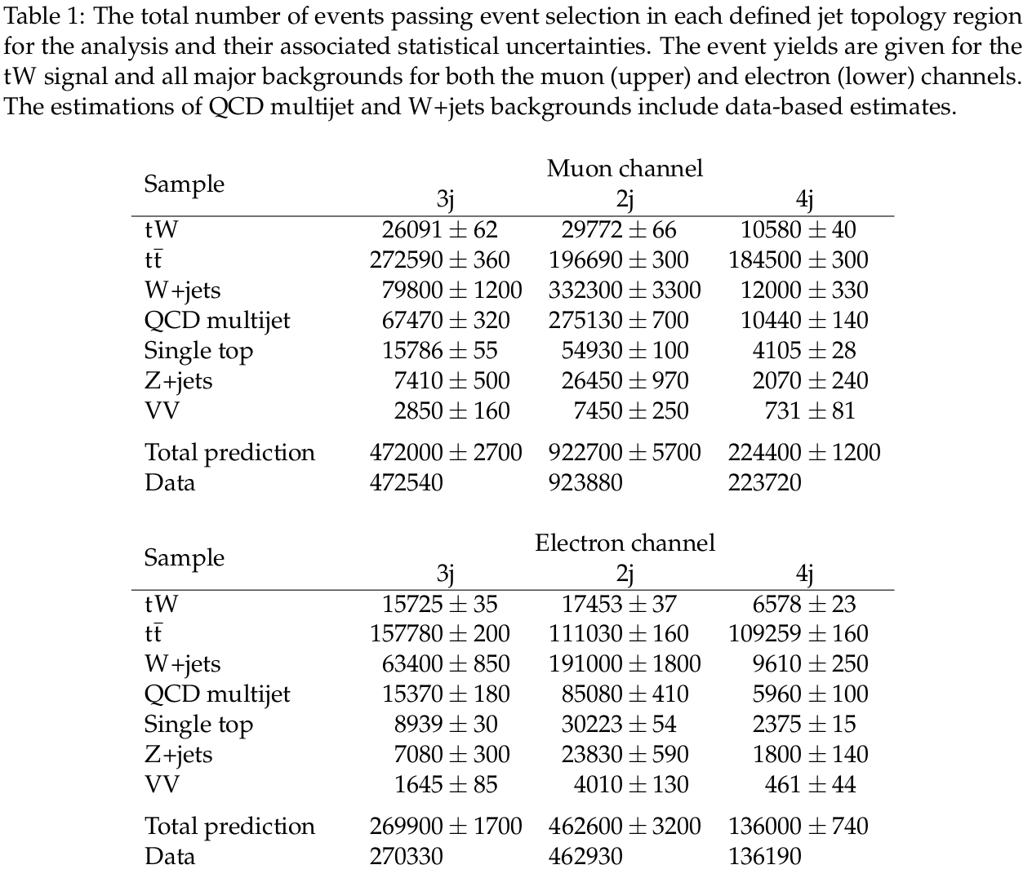
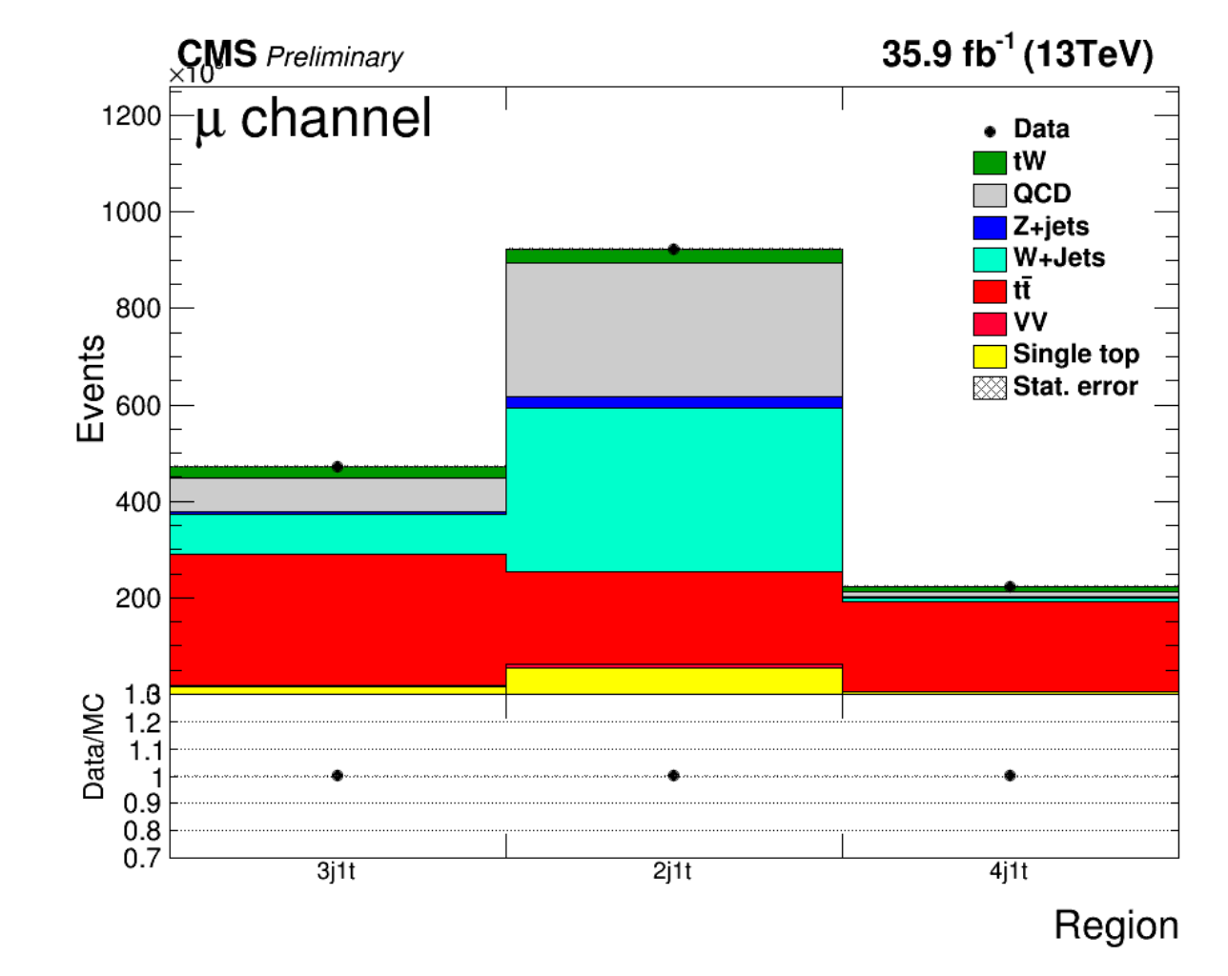
Background estimation
Data-driven QCD estimation;
Shape taken from inverted isolation requirement on lepton,
Normalization estimated from a 0 b-tagged jet control region.
Other backgrounds estimated from MC simulation

Slide 7
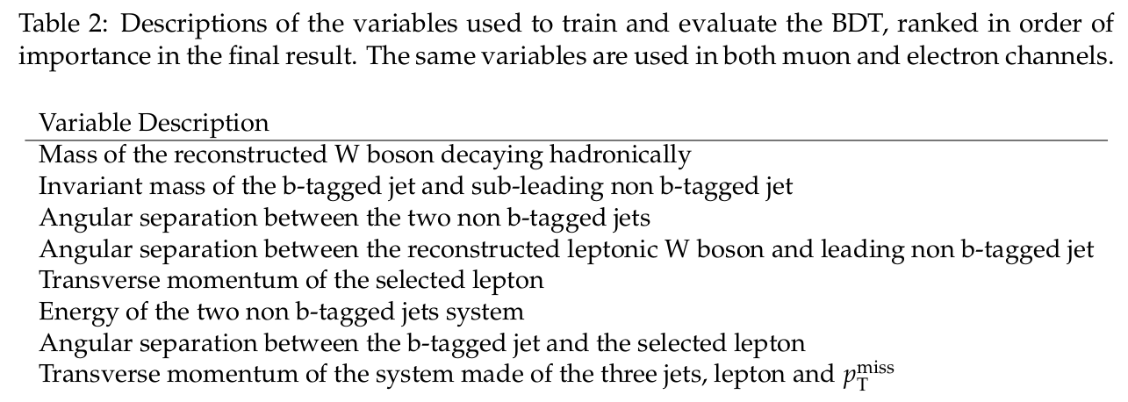
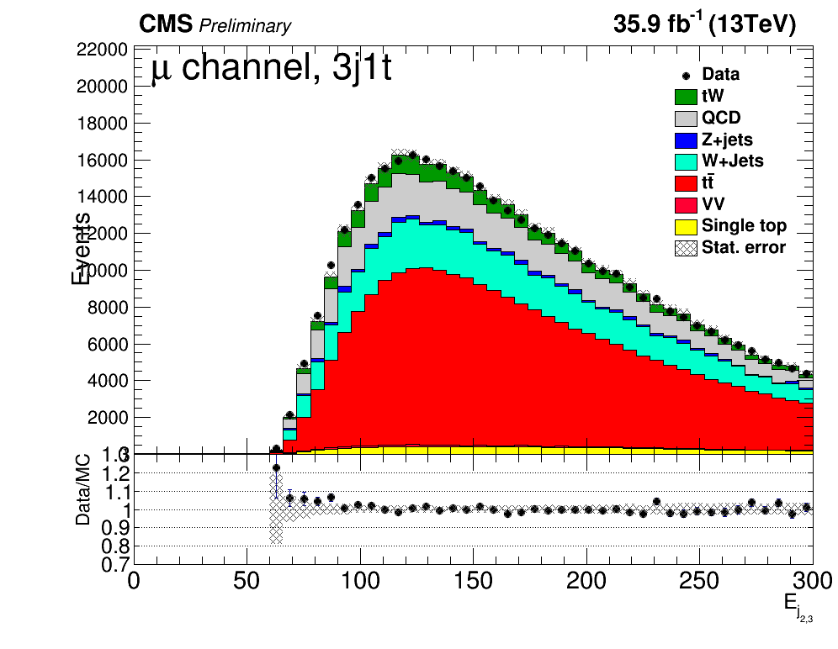
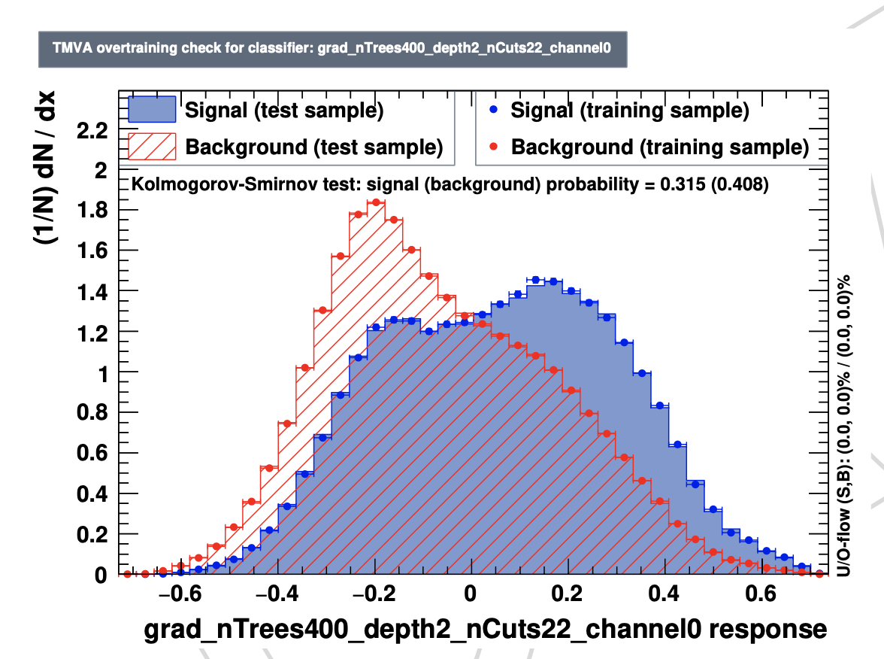
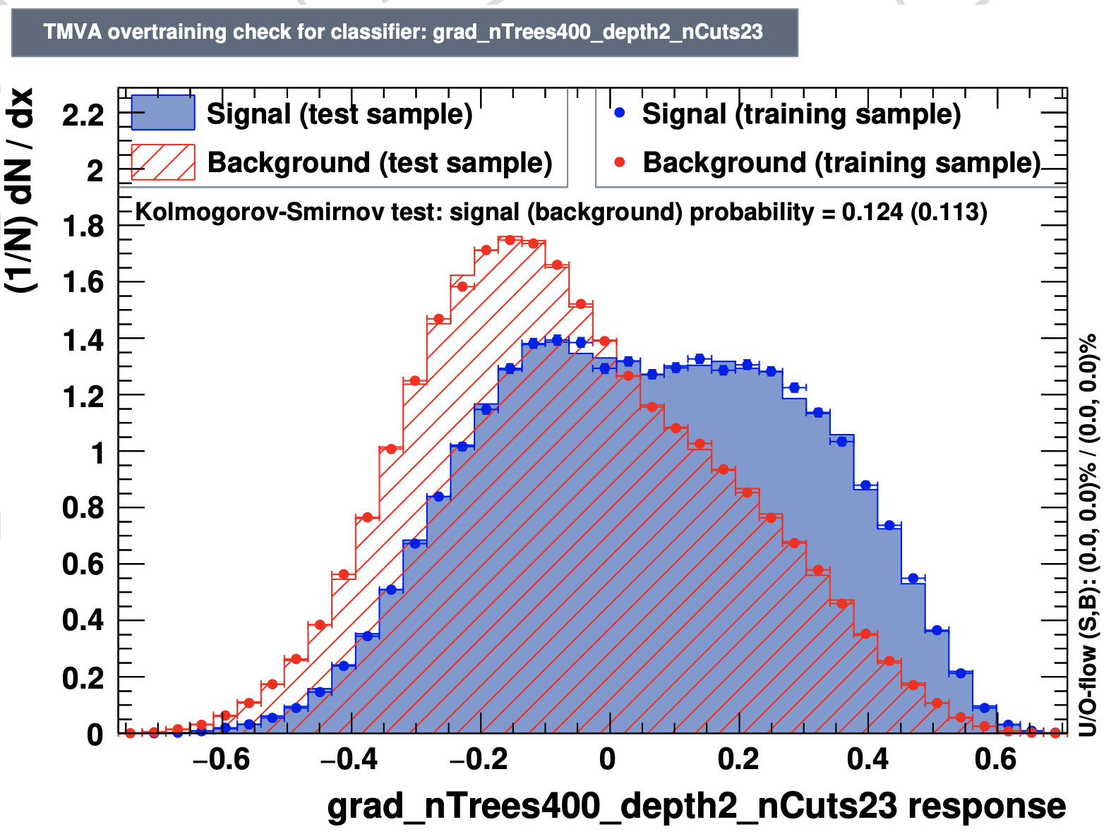
Seperation between tW and ttbar
BDT is used to discriminate tW from leading ttbar background
Training carried out in signal region and applied to all regions

Slide 8
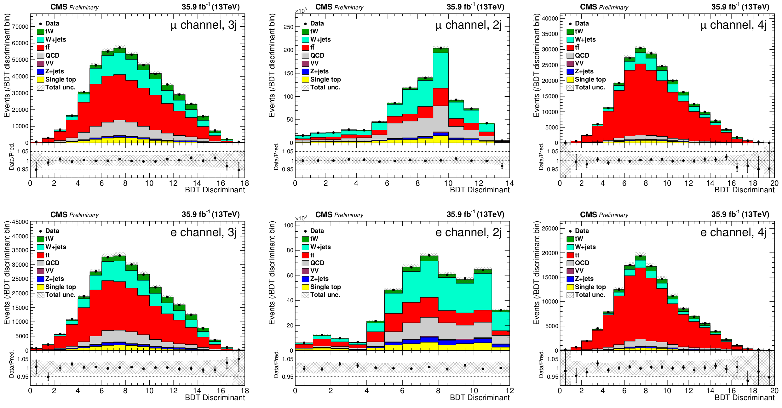
tW singal extraction
Categorize regions based on Jet mutiplicity
3j: Signal region
2j: W+jets and QCD enriched region
4j: ttbar enriched region
Binned Simutanousely fitting of 3 regions
Constrains on systematics to improve sensitivity

Slide 9
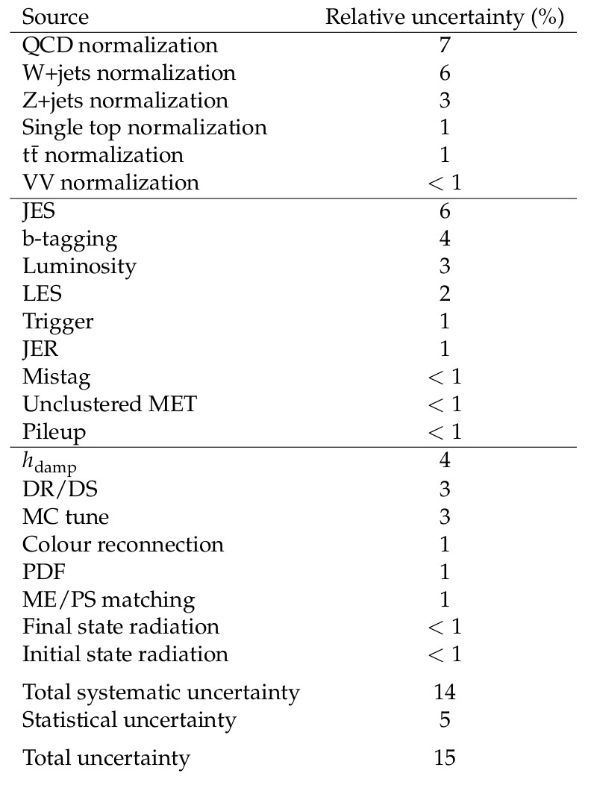
Results
Measured tW cross-section
15% relative uncertainty
Correspond 7.4 sigma
First observation in this channel
Dominate uncertainty from
QCD estimation
W+Jets normalization
Jet energy scale
Very challenge to extract tW signal from syst. dominate reg.
~100 k signal selected

Slide 10
Introduction to ttH
First observation in 2018 by combine all channels
Establish production in seperated channel
H-t CP/ EFT/Differential XS study
 | ATLAS |  | CMS
t/ttH,H→bb | ATLAS-CONF-2020-058 | Run2(1.3/3.0) | CMS-PAS-HIG-18-030 | 2016+2017
t/ttH,H→WW | ATLAS-CONF-2019-045 | 2016+2017 | EPJC 81 (2021) 378 | Run2
t/ttH,H→𝛕𝛕 | ATLAS-CONF-2019-045 | 2016+2017 | EPJC 81 (2021) 378 | Run2
t/ttH,H→ZZ | ATLAS-CONF-2019-045 arXiv:2004.03969 (4l) | 2016+2017 run2 | EPJC 81 (2021) 378 | Run2
t/ttH,H→𝛾𝛾 | PRL 125 (2020) 061802 | Run2(5.2/4.4) | PRL 125 (2020) 061801 | Run2(6.6/4.7)
ttH,H→inv | ATLAS-CONF-2020-052 | run2 | CMS-PAS-HIG-18-008 | 2016(re-interp)
My focus: CMS run2 ttHH multilepton analysis

Slide 11
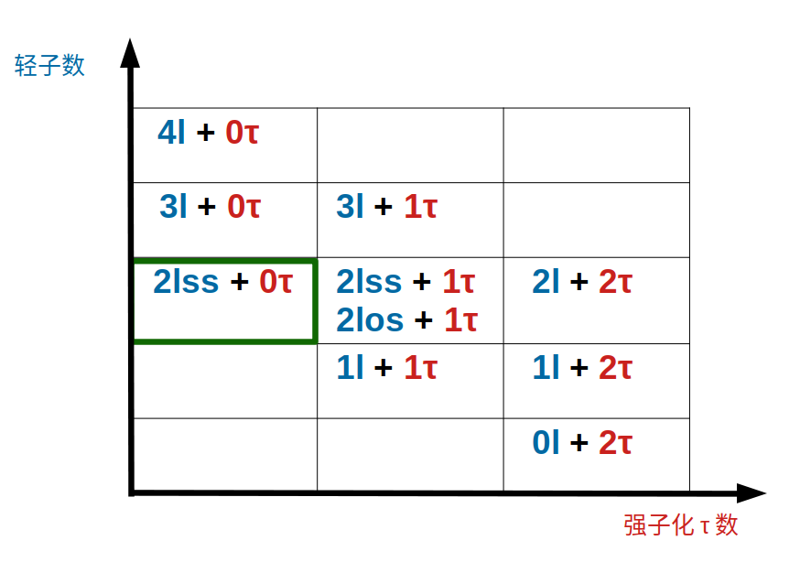
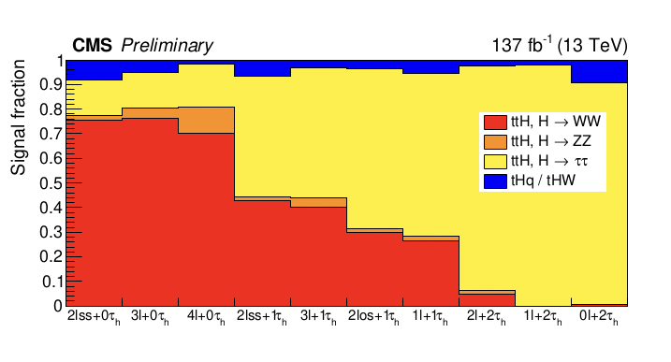
Signal region definition
Main decay modes in multilepton final states
ttH, H→WW : Largest BR and selected signal events
ttH, H→𝛕𝛕 : Enriched in hadronic 𝛕 region
ttH, H→ZZ (no 4l) : Small contribution with excellent mass resolution
tHq/tHW : Small but critical for interference studies
Signal categarized by the presence of leptons
10 signal region defined
Different composition of ttH, tHq/tHW

Slide 12
Overview of multilepton analysis strategy
36 var
41 var
15 var
16 var
Fakes are the dominate background in many channels

Slide 13
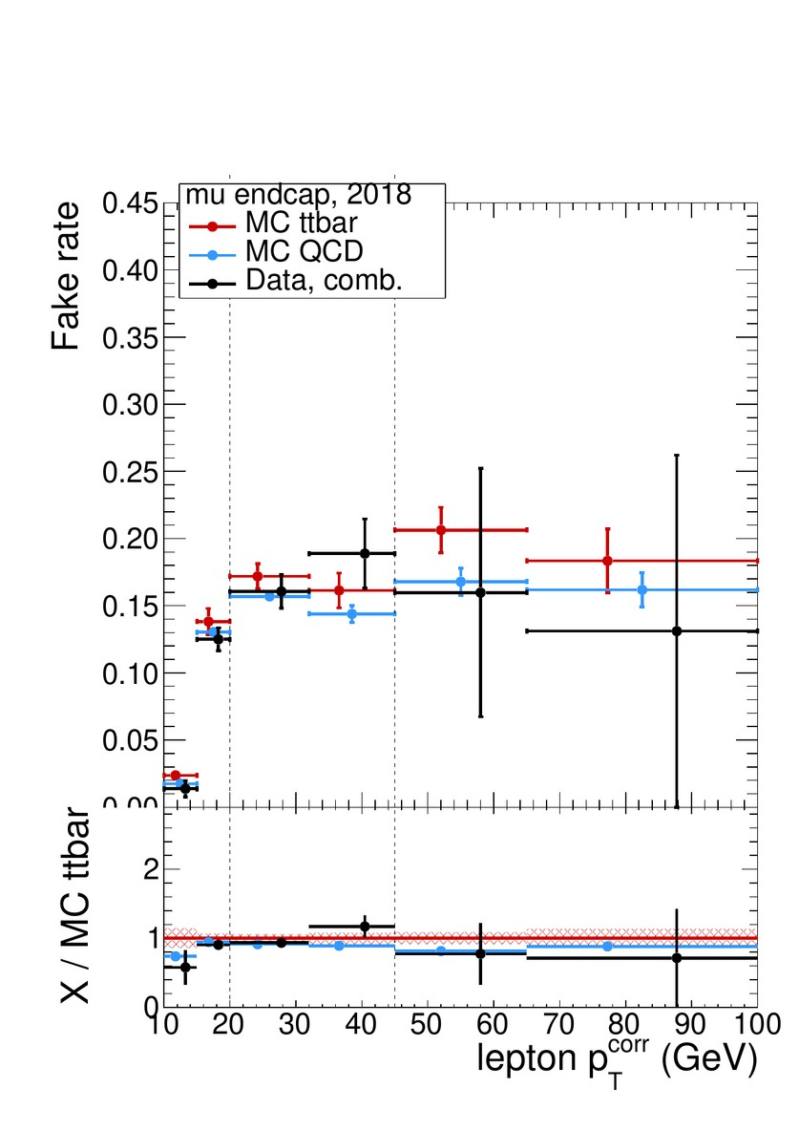
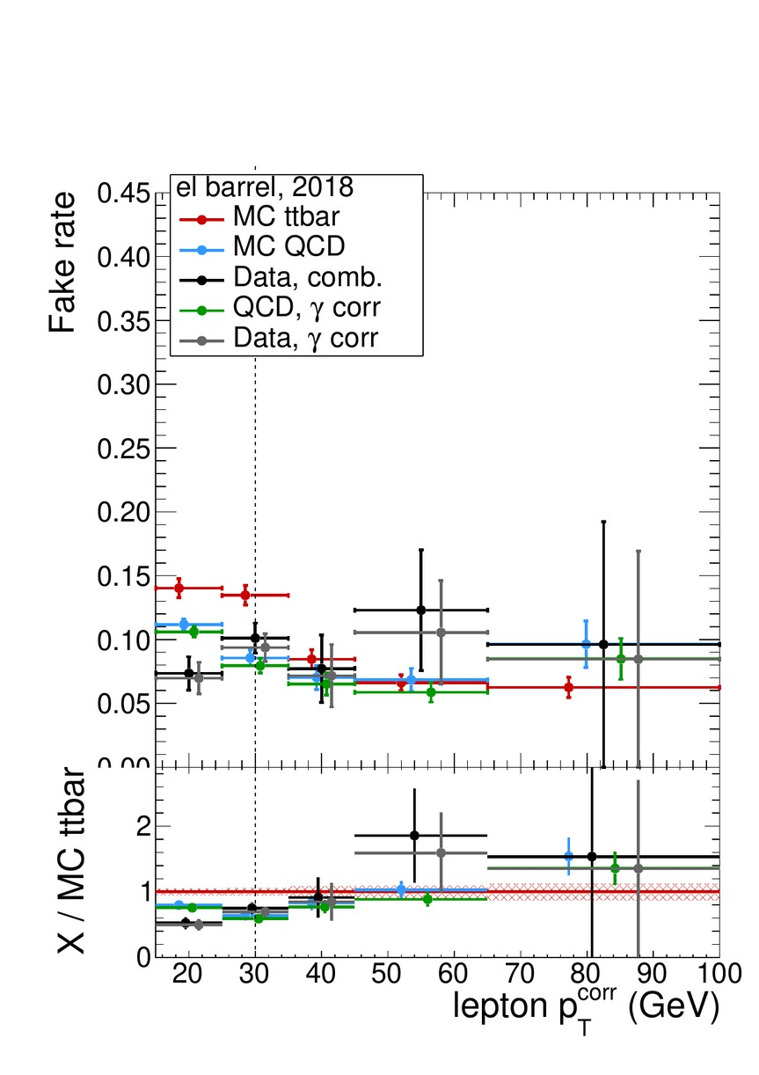
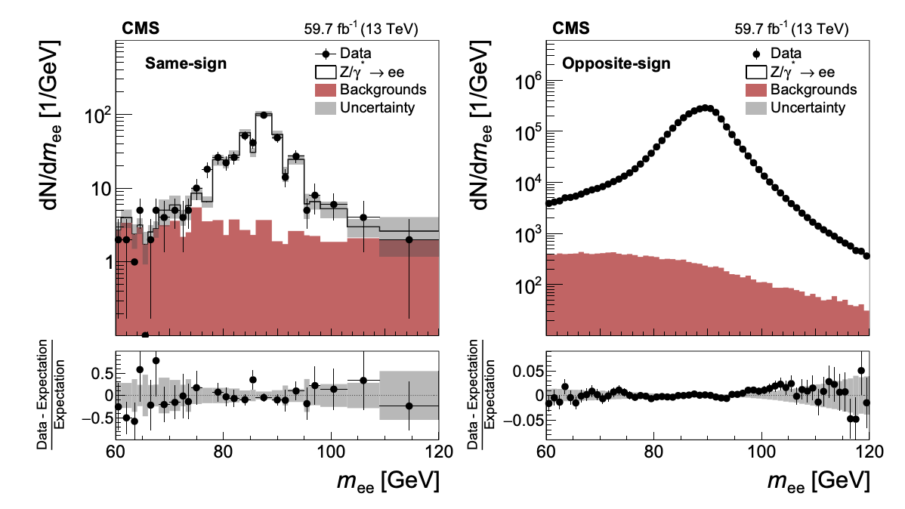
Data driven fake background estimation
Fake estimation
Fake rate estimated using QCD in MR
In binning of pt, η
Validate in signal region like Application Region
Estimation with uncertainties including mismodeling
Charge flip
Electron charge flip rates estimated from Z/→ee events in the 2l OS/SS
Negnigible from muon

Slide 14
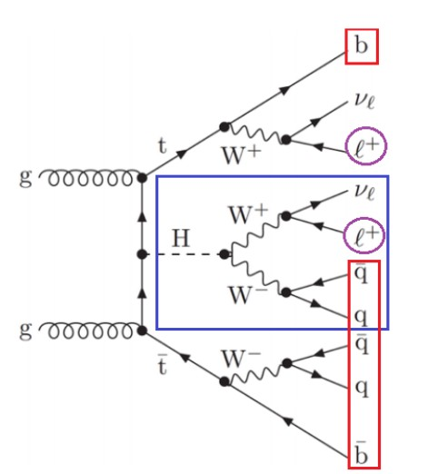
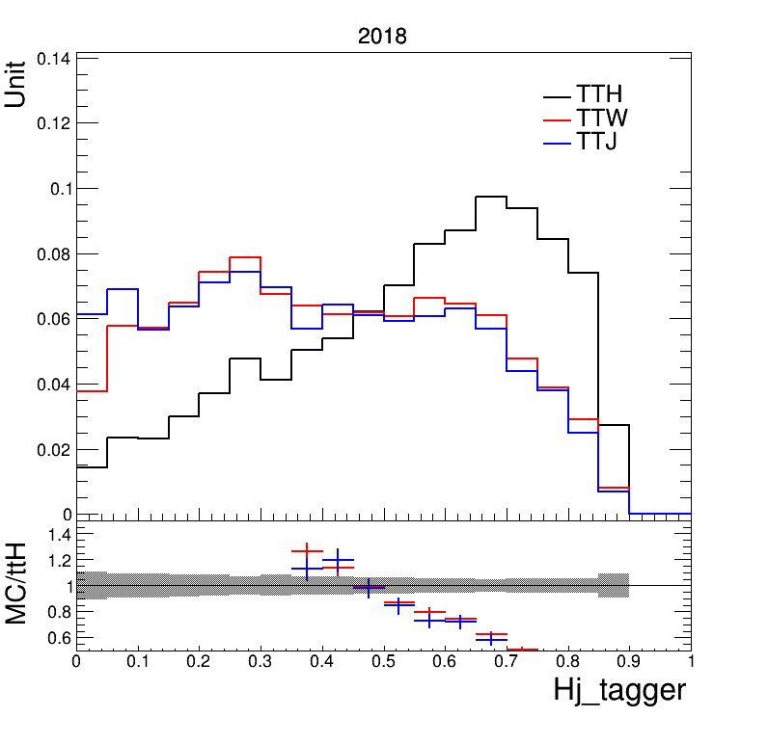
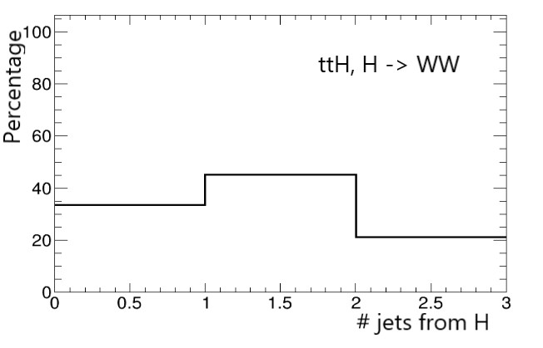
Higgs-jet tagger
Main differnce of background and signal: The Higgs
Very challenge to reconstruct Higgs in multilepton FS
At least 2 neutrinos, 1 from Higgs system, 1 from top system
Missing Jets due to geo/Pt acceptance
Combinataries
Tag jets from Higgs decays based on relations to other obj.
Powerful to seperate ttH from Backgrounds
2L SS

Slide 15
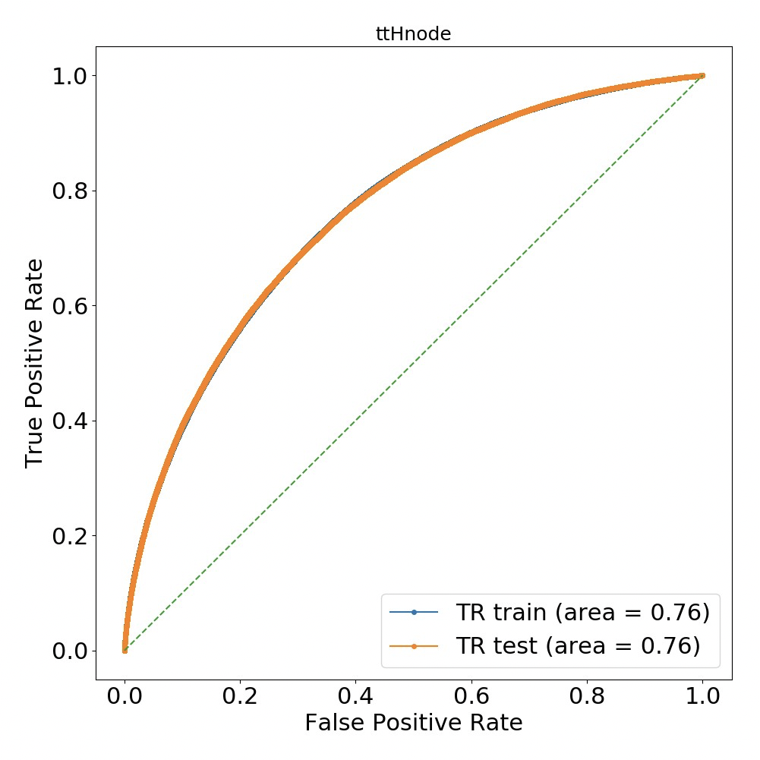
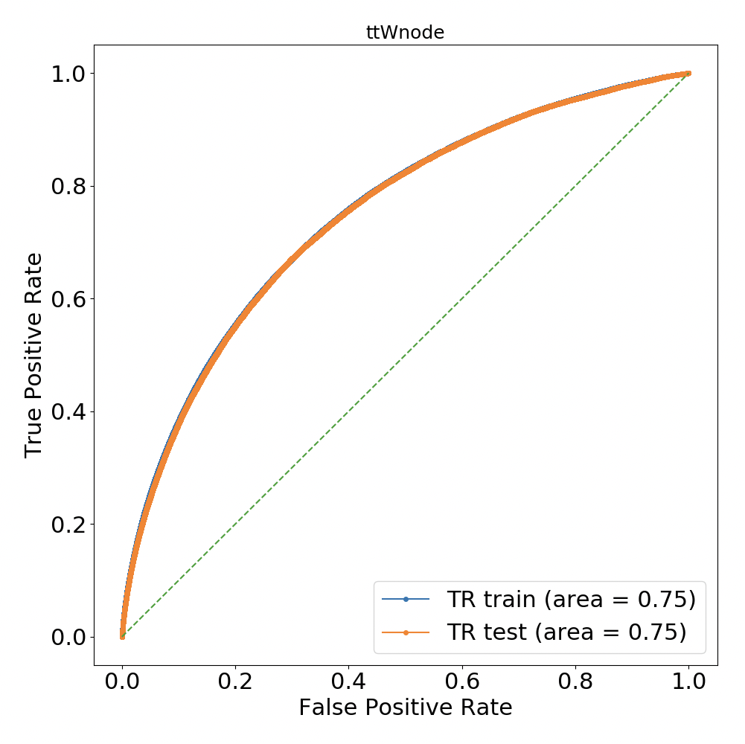
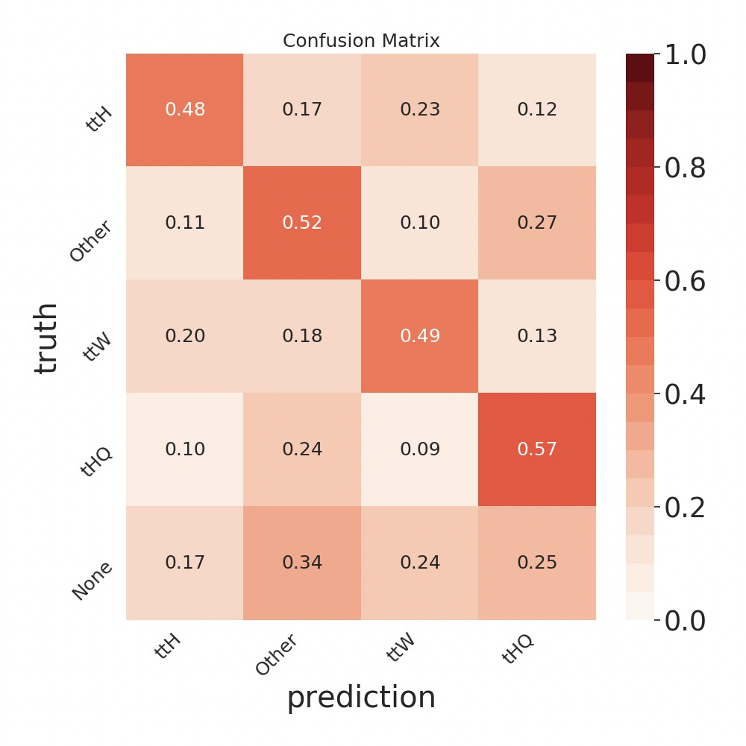
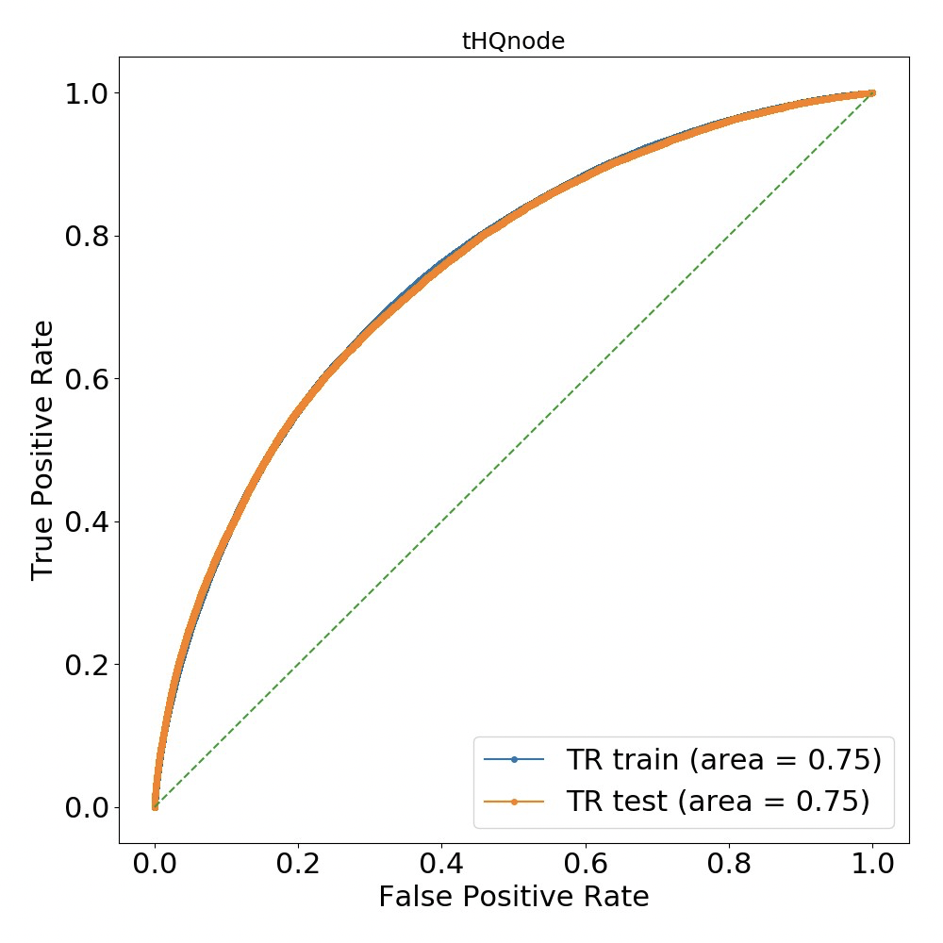
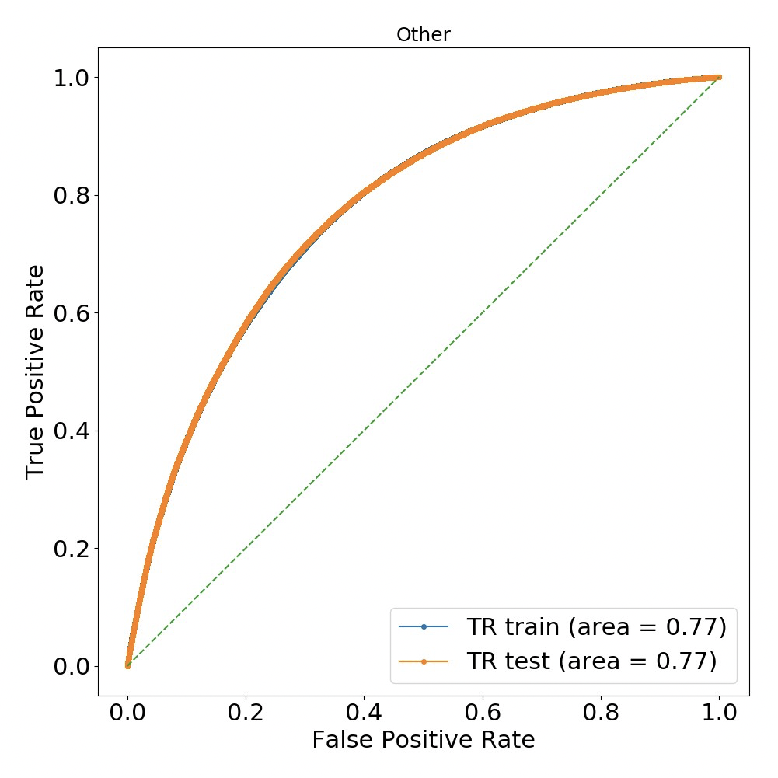
Signal extraction: DNN performance
Input features: obj. 4vec., H-j tagger, top tagger + others
4 output nodes: ttH, tHQ, ttW, others
2L SS
~10% improvement than 2D BDT

Slide 16
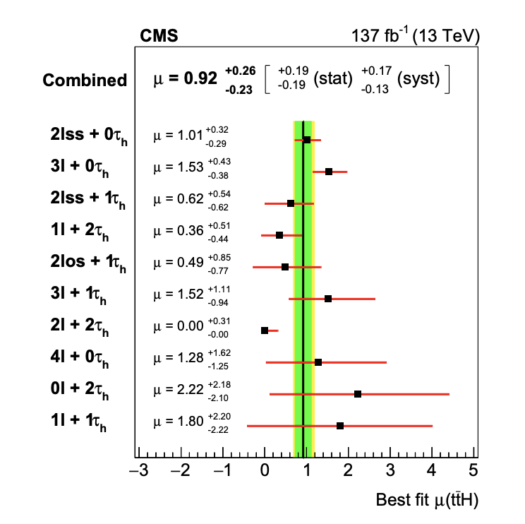
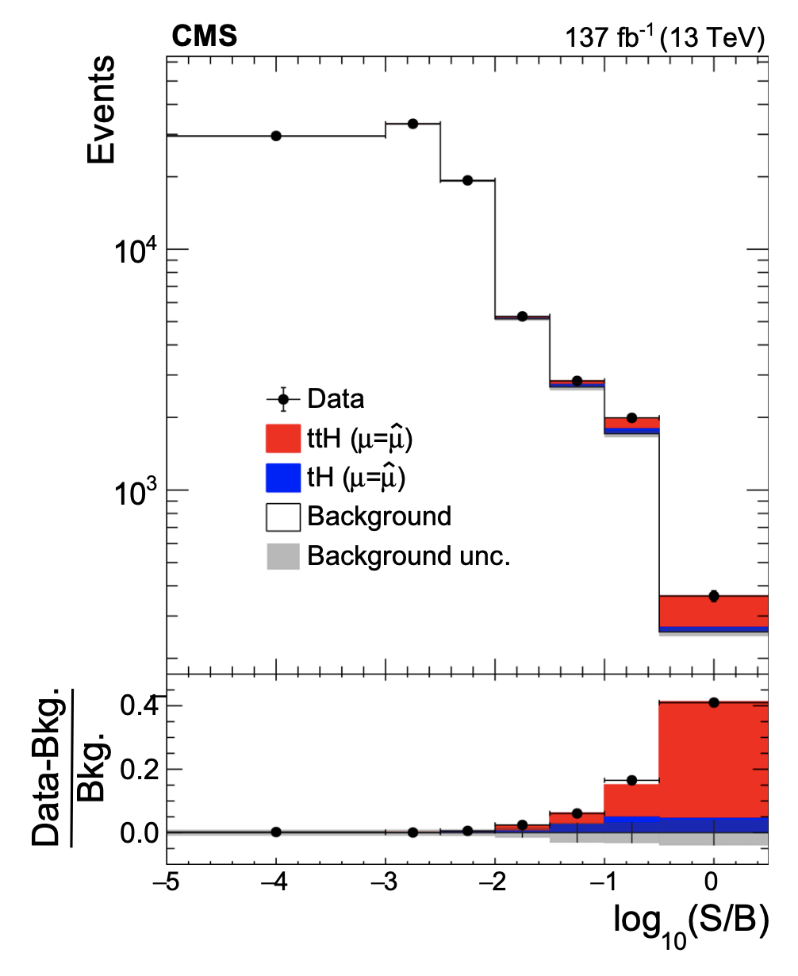
ttH measurement in multilepton
Combined likelyhood fitting including contral regions
Normalization of ttW,ttZ are floating
Fix tH signal to SM while estimate the other
4.7 (5.2) σ

Slide 17
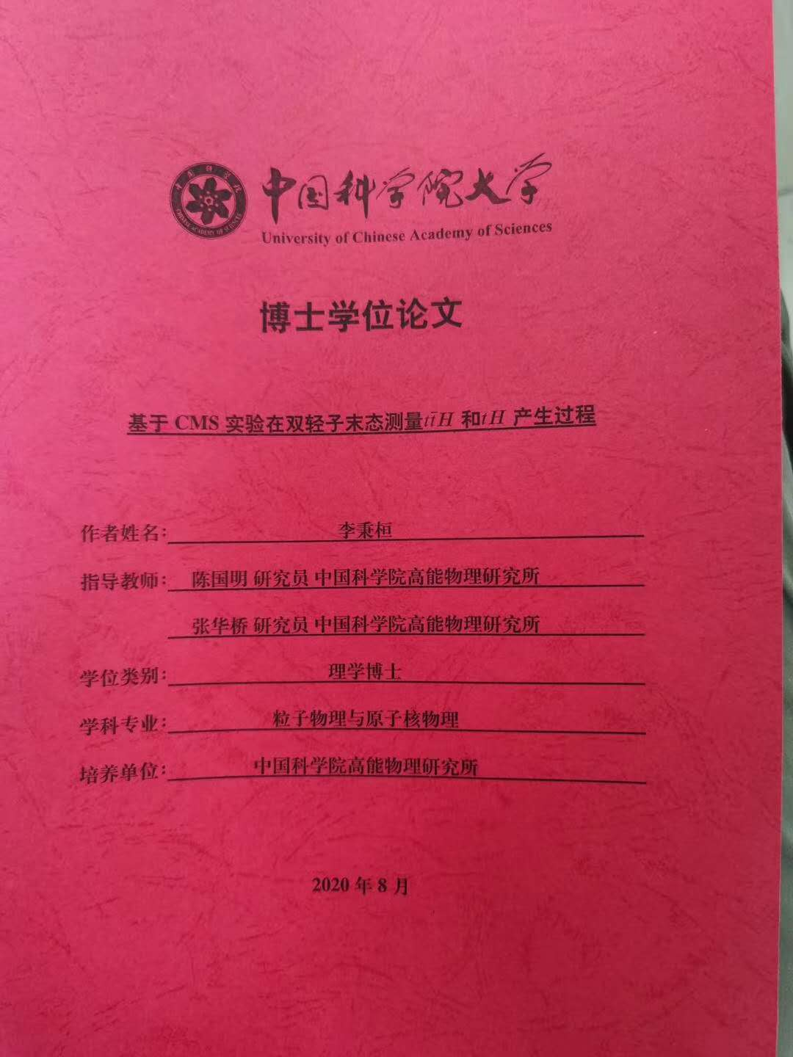
Summary
Report of observation of tW and ttH in lepton+jets channel
First observation of the tW process in the lepton+jets channel
Measnure tW cross-section:
tW:
Latest Theory prediction（JHEP 05 (2021) 278）:
79.5 +1.9−1.8 (scale) +2.0−1.4 (PDF) pb
ttH analysis in the multi-lepton final states
Most sensitive to ttH so far at LHC
Measured ttH crossection:
ttH:
Next steps:
CP/EFT/Differential study of ttH
Collaborate within IHEP and 16 other institutes

