Slide 1
Testbeam schedule
Zhijun Liang
(IHEP, Chinese Academy of Sciences)
Notes:
Annual strategy planning session for the joint Key Lab for Particle Detectors and Electronics.
You can present an overview of the CEPC Detector design, the R&D program, and go over the key technologies to be pursued during the next five years for CEPC. Aim for about 30‘+10’ approximately.

Slide 2
Introduction
Goal: Measurement the spatial resolution in beam test
Requirement
Beam type: electron/pion/proton
Beam energy >2GeV
Rate >1kHz
Timeline
Schedule 1~2 test beam every year from 2020 to 2023
2020 : Beam test for 1st MPW chip
2021: Beam test for 2nd /3rd MPW chip
2022: Beam test for prototype

Slide 3
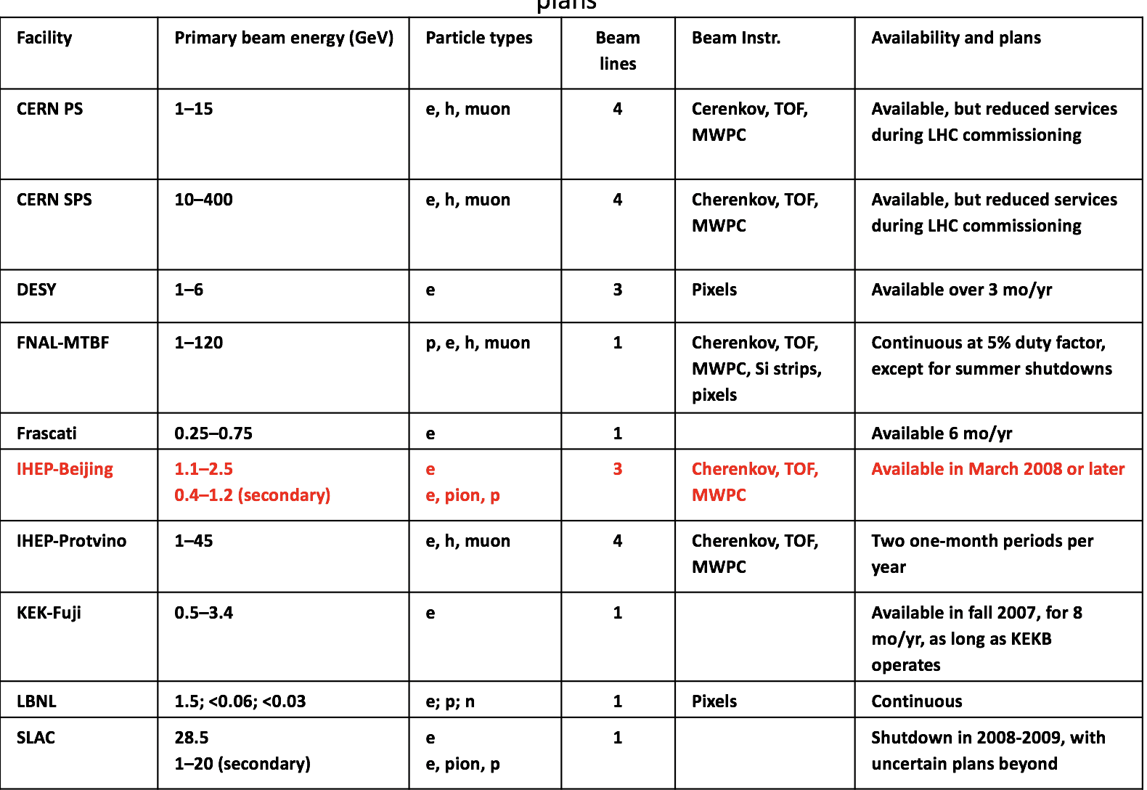

Slide 4
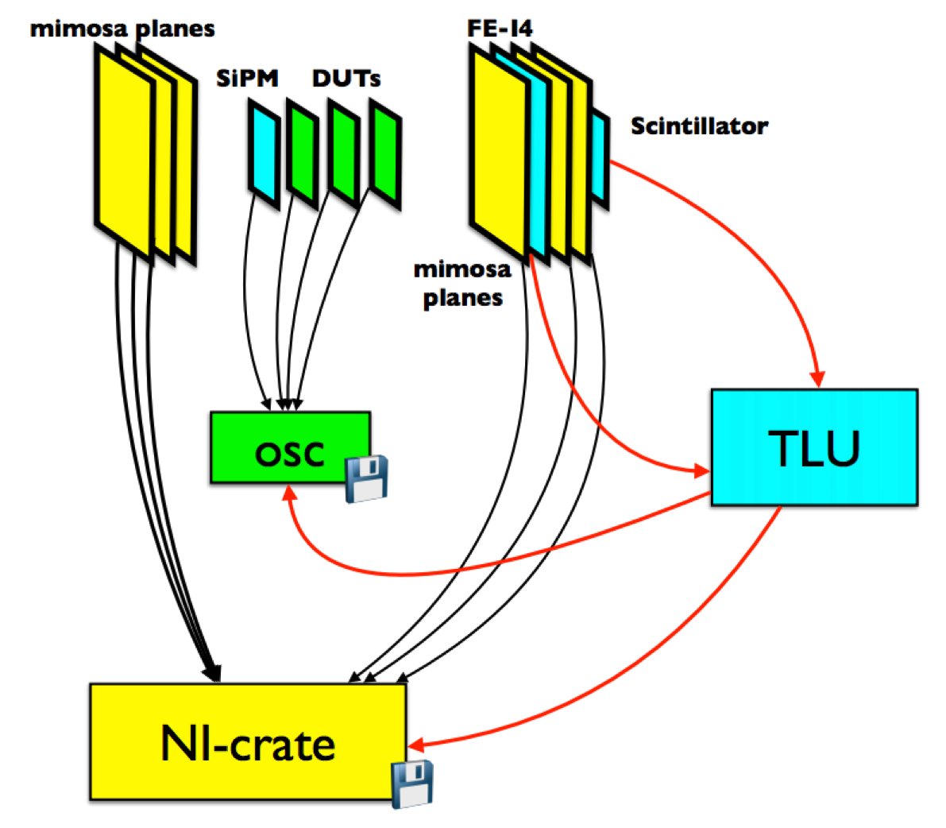
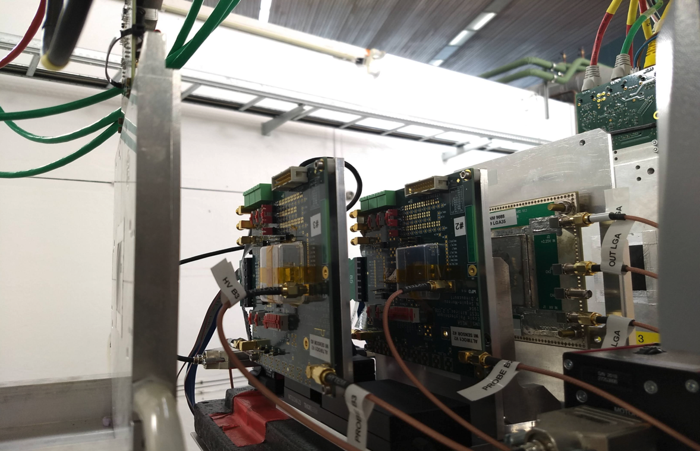
First test beam for MOST2
Expect to have first beam test on summer 2020
Aim to test 1st MPW chip
Minosa telescope for tracking (position information)
3~4GeV , 10kHz electron beam
Test 2~3 chips each time
Compare performance before and after irradiation
Typical setup in DESY testbeam
Typical setup in DESY testbeam

Slide 5
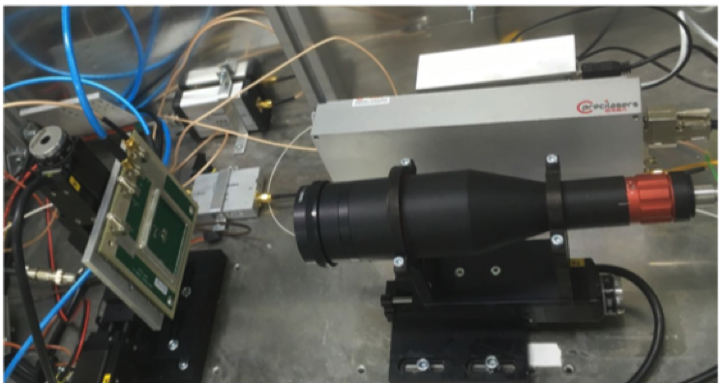
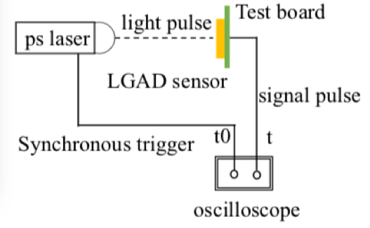
First test beam for MOST2: laser test
To prepare the beam test , we need to do laser test
Test trigger system, synchronize the laser trigger signal with the chip
and simulate MIP response.
Two pulse laser (infra-red laser )
Laser Pulse Frequency can vary from 100Hz ~100kHz

Slide 6
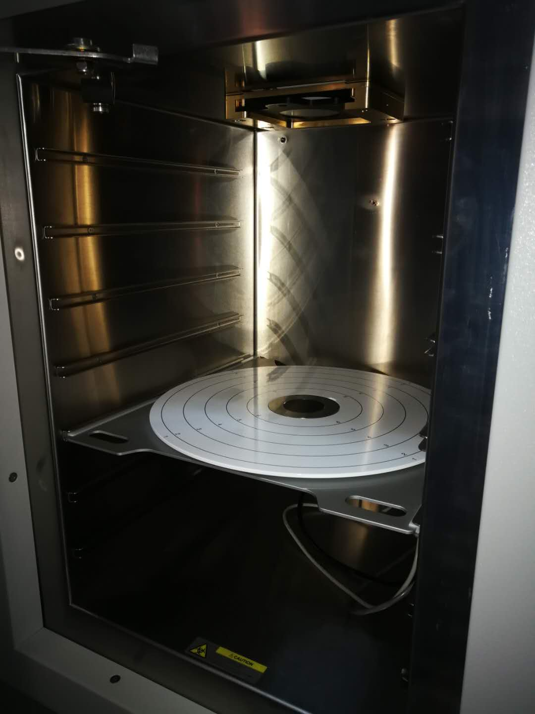
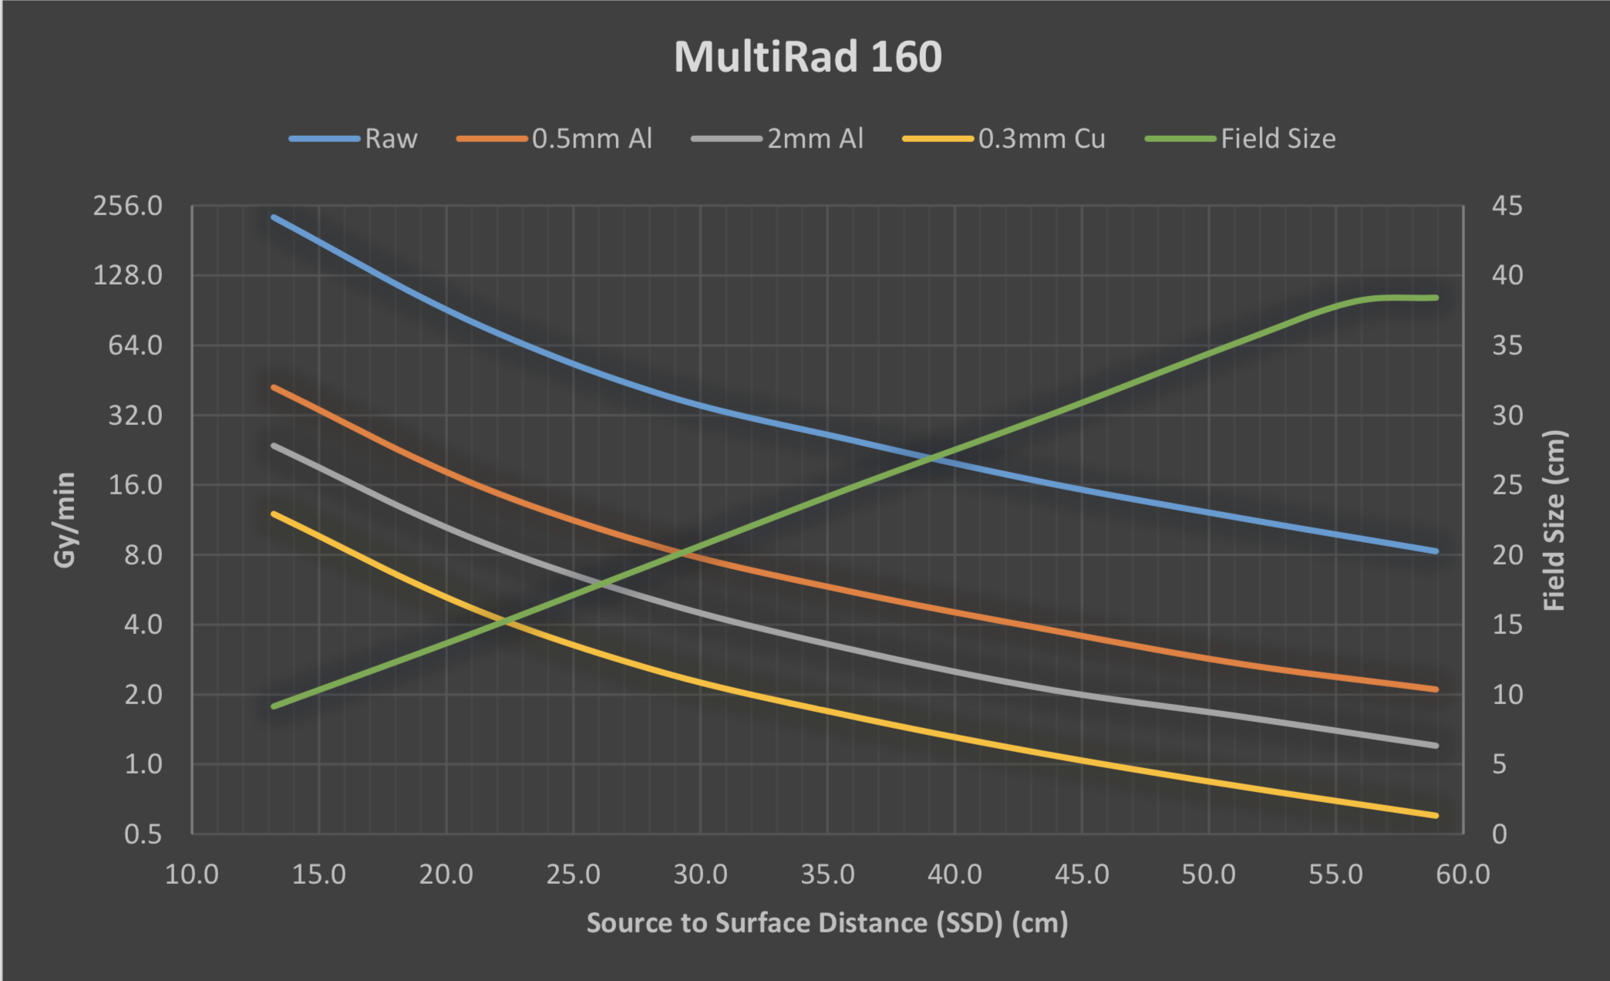
First test beam for MOST2: X ray tests
X ray irradiator in IHEP
Can reach 1MRad in one afternoon

Slide 7
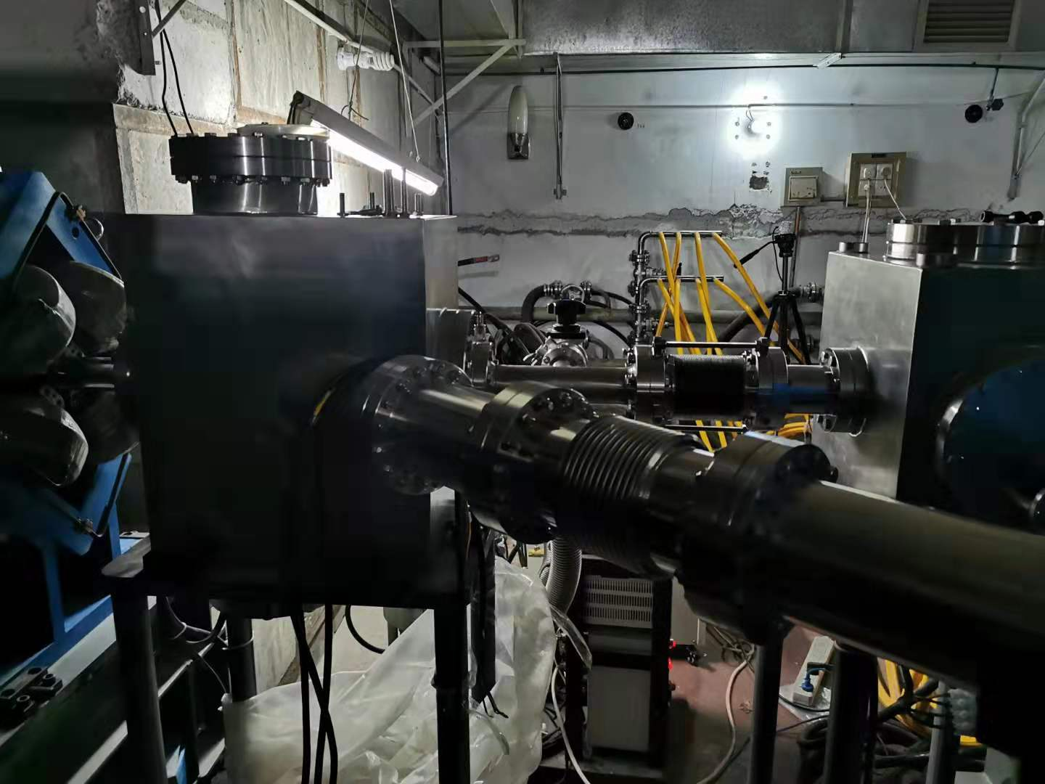
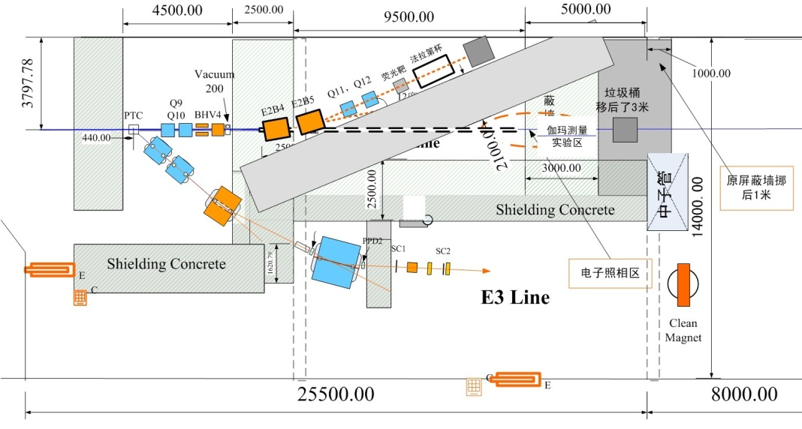
First test beam for MOST2: IHEP beam test
Two beam line available in IHEP
E2 line: 2.5GeV， 10~20Hz, electron beam, 10⁴~10⁹ electrons per bunch
E3 line: 1~2GeV, 1~4Hz, electron/pion/K, single particle
Plan to use E3 line for some beam test

Slide 8
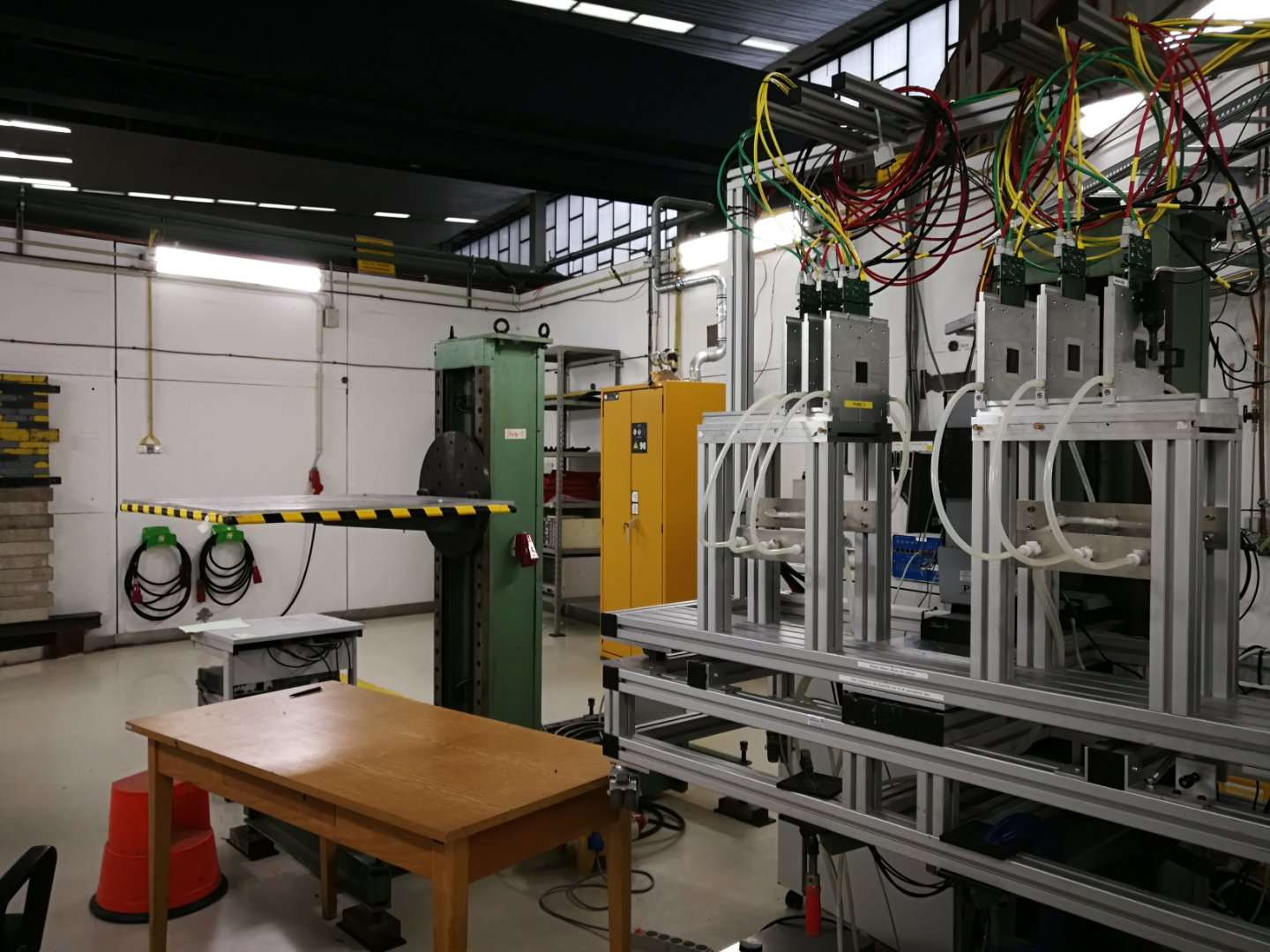
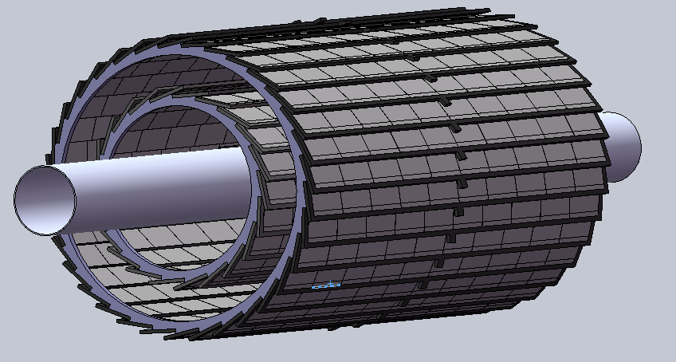
Test beam for prototype
Two possibilities
3~4GeV , 10kHz electron beam in DESY
Standalone tracker prototype
tracker prototype + Minosa telescope combined tracking

Slide 9
Summary
Expect First beam test in DESY in summer 2020
To prepare for it :
Laser test
IHEP beam test
X ray irradiation
Proton irradiation
Timeline
Schedule 1~2 test beam every year from 2020 to 2023
2020 : Beam test for 1st MPW chip
2021: Beam test for 2nd /3rd MPW chip
2022: Beam test for prototype

