Slide 1
Migration of the Silicon tracking algorithm to Gaudi (temporary version)
Yao ZHANG, Chengdong FU, Sheng-Sen SUN
(on behalf of CEPCSW workgroup)
2019 International Workshop on the CepC
Nov 18, Beijing

Slide 2
Contents
Introdution/Motivation
Realization
Progress
Comparison (usages and results)
Discussion and Plan

Slide 3
Introduction/Motivation

Slide 4
Implement Tracking from Marlin into CEPCSW
Pixel: SimTrackerHit → TrackerHit → SiliconTracking
Strip: SimTrackerHit → TrackerHit → SpacePoint → SiliconTracking
Tracking processes:
SiliconTracking_MarlinTrk ⎯
↓
TrackSubsetProcessor→ FullLDCTracking_MarlinTrk
↑
ForwardTracking ⎯
ClupatraProcessor ⎯↑
Package dependencies → module package (by module classes)
MarlinTrk
KalDet
KalTest
Data model dependencies
LCIO to plcio
EVENT::TrackerHit → plcio::TrackerHit
EVENT::TrackerHitPlane → plcio::TrackerHitPlane

Slide 5
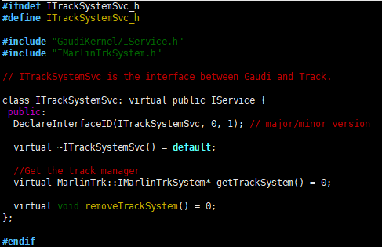
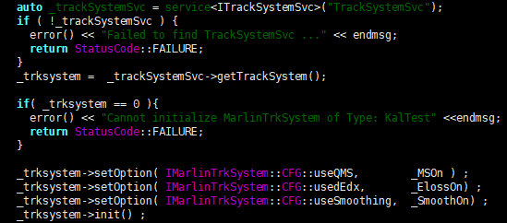
MarlinTrk
Fitter and interface to fitter in Marlin, as temporary for CEPCSW before itself ready
Interface migrated as a Gaudi service and fitter as a depedented library
gaudi_add_library(TrackSystemSvcLib ${TrackSystemSvcLib_srcs} …)
gaudi_add_module(TrackSystemSvc ${TrackSystemSvc_srcs} …)

Slide 6
KalDet & KalTest
KalDet is a geometry support package in Marlin
KalTest provides base Kalman filter support, dependent on KalDet with each other
Migrated as two external packages
KalDet: change data model dependency from LCIO to plcio
class ILDVMeasLayer
virtual ILDVTrackHit* ConvertLCIOTrkHit( plcio::TrackerHit* trkhit) const = 0 ;
class ILDVTrackHit
ILDVTrackHit(const TVMeasLayer &ms, Double_t *x, Double_t *dx, Double_t bfield , Int_t dim, plcio::TrackerHit* trkhit)
plcio::TrackerHit* getLCIOTrackerHit() const { return _trkhit; }
…
KalTest: compile and link in CEPCSW environment

Slide 7
From SiliconTracking_Marlin to SiliconTrackingAlg
Since MarlinTrk, KalDet and KalTest are all migrated and kept in CEPCSW at first step, less modification needed
Parameters input
Gaudi::Property<bool> _MSOn{this, "MultipleScatteringOn", true};
Gaudi::Property<bool> _ElossOn{this, "EnergyLossOn", true};
Gaudi::Property<bool> _SmoothOn{this, "SmoothOn", true};
Gaudi::Property<bool> _useSIT{this, "UseSIT", true};
…
Data input and output
DataHandle<plcio::TrackerHitCollection> _inVTXColHdl{"VXDTrackerHits", Gaudi::DataHandle::Reader, this};
DataHandle<plcio::TrackCollection> _outColHdl{"SiTracks", Gaudi::DataHandle::Writer, this};
const plcio::TrackerHitCollection* hitFTDPixelCol = nullptr;
try {
hitFTDPixelCol = _inFTDPixelColHdl.get();
}
catch ( GaudiException &e ) {
debug() << "Collection " << _inFTDPixelColHdl.fullKey() << " is unavailable in event " << _nEvt << endmsg;
success = 0;
}
if(hitFTDPixelCol){
for(auto hit : *hitFTDPixelCol){
…
}
}
Histogram: from AIDAProcessor::histogramFactory to Gaudi supported
At first step, remove DiagnosticsHistograms output
As temporary
keep some nonstandard use for Gaudi
_fastfitter = new MarlinTrk::HelixFit();
Keep LCIO’s UTIL dependency for cell id encoder

Slide 8
Issues and Solutions (Temporary)
Can’t get relative object directly in plcio data model
Remove relative object usage in tracking and after fitting, influence some following analysis based on MC truth particles
Going to extend plcio with a service to handle the object relations
Can’t convert pointers of data objects each other
Fix data type in algorithm and use template in codes of module classes
Only use one type tracker hit as temporary, saving U,V directions and resolutions into CovMatrix
std::array<float, 6> cov;
cov[0] = u_direction[0];
cov[1] = u_direction[1];
cov[2] = resU;
cov[3] = v_direction[0];
cov[4] = v_direction[1];
cov[5] = resV;
trkHit->setCovMatrix(cov);
Geometry service during the transition from Marlin to Gaudi
Keep the GEAR package in Marlin at present
Load GEAR by a Gaudi service (GearSvc)
auto _gear = service<IGearSvc>("GearSvc");
if ( !_gear ) {
error() << "Failed to find GearSvc ..." << endmsg;
return StatusCode::FAILURE;
}
gear::GearMgr* gearMgr = _gear->getGearMgr();
Will be replaced by the new service with DD4hep

Slide 9
Progress
package | Component of CEPCSW | Type | status
MarlinTrk | TrackSystemSvc TrackSystemSvcLib | Service Library | √
KalDet | KalDet | Independent | √
KalTest | KalTest | Independent | √
SpacePointBuilder | SpacePointAlg | Algorithm | ongoing
SiliconTracking_MarlinTrk | SiliconTrackingAlg | Algorithm | Working
ForwardTracking | ForwardTrackingAlg | Algorithm | In plan
TrackSubsetProcessor | TrackSubsetAlg | Algorithm | In plan

Slide 10
Usage Changes
From xml file options to python options
from Configurables import SiliconTracking
tracking = SiliconTracking("SiliconTracking")
tracking.HeaderCol = "EventHeader"
tracking.VTXHitCollection = "VXDTrackerHits“
tracking.UseSIT = 0
tracking.LayerCombinations = [5,3,1, 5,3,0, 5,2,1, 5,2,0, 4,3,1, 4,3,0, 4,2,1, 4,2,0]
tracking.SmoothOn = 0
From TrackerHit pointer to TrackerHit object
Plcio::TrackerHit hit = hitFTDPixelCol->at(iHit);
Hit object does not have data member, just only data object pointer
In order to keep pointer usage in KalDet and TrackSystemSvc, build temporary object vector for each event
_allHits.reserve(100000);
…
_allHits.push_back(hit); // &hit can be used as plcio::TrackerHit* before clear()
…
_allHits.clear();
Will be updated to object transmition
From processor reusing to one by one algorithm
<marlin>
<execute>
<processor name="VXDPlanarDigiProcessor"/>
<processor name=“SITPlanarDigiProcessor"/>
<processor name="MySiliconTracking_MarlinTrk"/>
<processor name="MyLCIOOutputProcessor"/>
</execute>
<processor name="VXDPlanarDigiProcessor" type="PlanarDigiProcessor">
…
<processor name=“SITPlanarDigiProcessor" type="PlanarDigiProcessor">
…

Slide 11
Comparison of tracking and fitting
Single particle (muon, 10GeV)
same input (simulated by MokkaC with only VXD)
same reconstruction options
CEPCSW
Marlin
Difference is caused by different random number in digitization (gaussian smear), if testing by set space resolution as 0

Slide 12
Tracking efficiency

Slide 13
Resolution

Slide 14
CPU Time
DEBUG mode
CEPCSW
total time (skipping 1st evt) 203768009 ns
Marlin
Total: 2.100000e-01 s in 10 events ==> 2.100000e-02 [ s/evt.]
→Run mode
Single particle
Physical events

Slide 15
Discussion and Plan
TrackStatus
plcio::Track
plcio::TrackState getTrackStates(unsigned int) const;
LCIO::EVENT::Track
virtual const TrackState * getTrackState(int location) const = 0;
Dependent on plcio’s data model and LCIO’s encoder, create ourselves’ cell id encoder in future?
Replace MarlinTrk, KalDet, KalTest with ?
Replace GEAR with ?
Migrate more reconstruction package

Slide 16
Thanks!

