Slide 1
Identification of multi-jet events at the CEPC
zhu Yongfeng
IHEP

Slide 2
Contents:
Motivation
Sample
Event-shape variables:
thrust
heavy mass
wide and total broadening
C and D parameter
energy-energy correlation
jet transition variable
Summary

Slide 3
Motivation :
At the CEPC, about 37.84% of two fermions final state is $q\overline{q}$, 67.41 of W decay to $q\overline{q}$, 69.91% of Z to $q\overline{q}$, 69.18% of Higgs to $q\overline{q}$(gg), and 11.06% of Higgs to 4-quarks.
For the two-jet, $α_{s}$ measurement can be done with event shape variables. We also can measure the Higgs branching ratio and Triple Gauge Coupling. Since the number of the two-jet is large, these events can be used as detector monitoring and calibration.
For the four-jet, we can study Color Reconnection effect and measure the Higgs branching ratio.
For the six-jet, we also can measure the Higgs branching ratio.

Slide 4
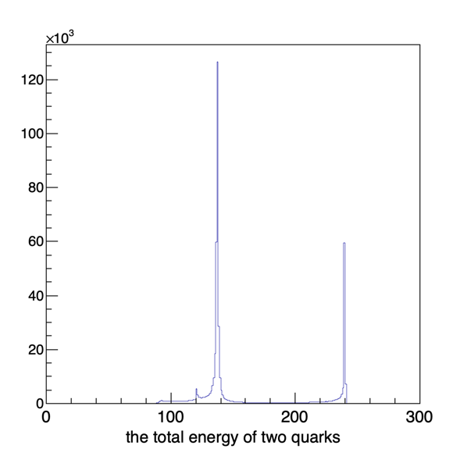
Sample:
cross section (fb)
2 jets: $e^{+}e^{−}→q\overline{q}$ 54106.86 $×$ 0.22 = 11976.12
4 jets: $e^{+}e^{−}→WW(ZZorZH)→4q$ 4436.77
6 jets: $e^{+}e^{−}→q\overline{q}H,H→WW^{∗}(ZZ^{∗})→4q$ 15.13
220 GeV

Slide 5
thrust:
$T=max_{n_{T}}(\frac{1}{∑_{j=1}^{N_{particles}}|P_{j}|}\overset{N_{particles}}{\underset{i=1}{∑}}|P_{i}⋅n_{T}|)$
$P_{i}$ : 3-momentum
$n_{T}$ : a unit vector
the direction of $n_{T}$ : the thrust axis

Slide 6
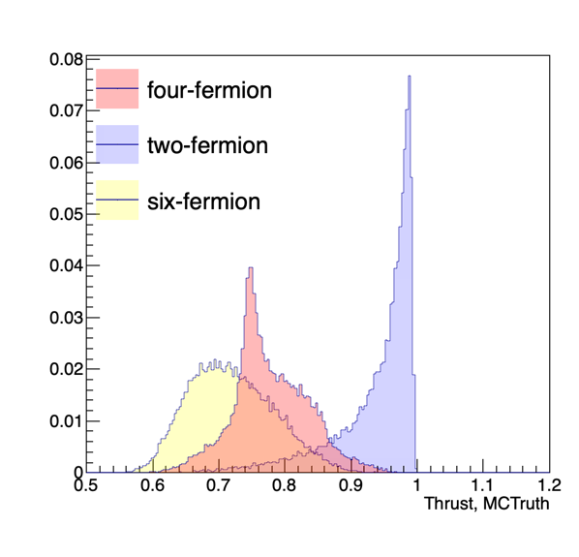
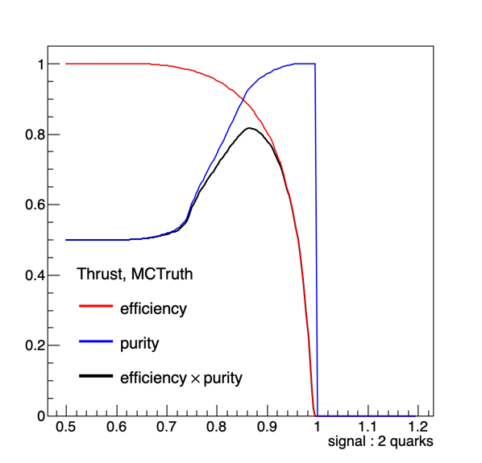
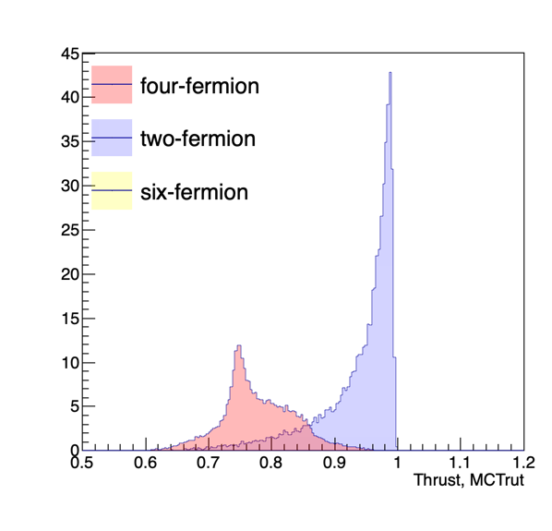
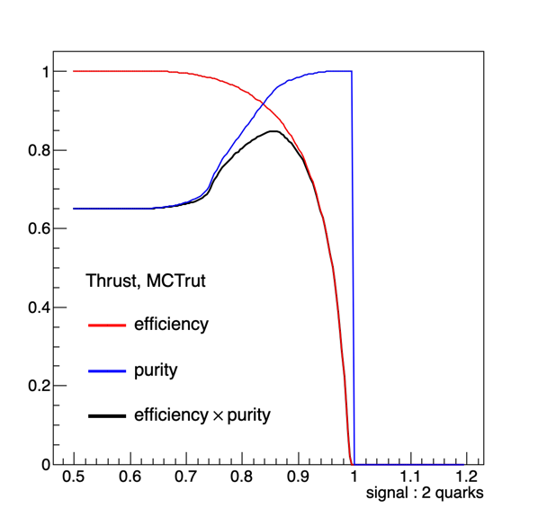
thrust
normalized to unit one
MC: 0.815994
Reco: 0.810917
normalized to X-section
MC: 0.853088
Reco: 0.851713

Slide 7
hemisphere masses:
$M_{1}^{2}/s=\frac{1}{E_{vis}^{2}}(\overset{N_{particles}}{\underset{i=1,P_{i}⋅n_{T}>0}{∑}}P_{i})^{2}$
$M_{2}^{2}/s=\frac{1}{E_{vis}^{2}}(\overset{N_{particles}}{\underset{i=1,P_{i}⋅n_{T}<0}{∑}}P_{i})^{2}$
$E_{vis}$ : total energy of final state particles
$P_{i}$ : 4-momentum
heavy jet mass : ${M_{h}^{2}}/s$ = max(${M_{1}^{2}}/s$, ${M_{2}^{2}}/s$)
normalized to unit one:
MC : 0.76392
Reco : 0.758934
normalized to Xsection:
MC : 0.815345
Reco : 0.812466

Slide 8
jet broadening:
$B_{1}=\frac{1}{2∑_{j=1}^{N_{particles}}|P_{j}|}\overset{N_{particles}}{\underset{i=1,P_{i}⋅n_{T}>0}{∑}}|P_{i}×n_{T}|$
$B_{1}=\frac{1}{2∑_{j=1}^{N_{particles}}|P_{j}|}\overset{N_{particles}}{\underset{i=1,P_{i}⋅n_{T}<0}{∑}}|P_{i}×n_{T}|$
$P_{i}$ : 3-momentum
total jet broadening : $B_{T}=B_{1}+B_{2}$
wide jet broadening : $B_{w}=max(B_{1},B_{2})$
$$×$$
$$×$$
max efficiency*purity | normalized to unit one |  | normalized to Xsection
 | MC | Reco | MC | Reco
wide jet broadening | 0.734528 | 0.731371 | 0.80235 | 0.800644
total jet broadening | 0.787802 | 0.784472 | 0.836156 | 0.834205

Slide 9
C and D parameter:
$L^{ab}=\frac{1}{∑_{j=1}^{N_{particles}}|P_{j}|}\overset{N_{particles}}{\underset{i=1}{∑}}\frac{P_{i}^{a}P_{i}^{b}}{|P_{i}|}$
$P_{i}$ : 3-momentum
$P_{i}^{a}$ : the component a of the 3-momentum of the particle i
C parameter : C = $3(λ_{1}λ_{2}+λ_{1}λ_{3}+λ_{2}λ_{3})$
$λ$ : the eigenvalue of $L^{ab}$
D parameter : D = $27×λ_{1}×λ_{2}×λ_{3}$
max efficiency*purity | normalized to unit one |  | normalized to Xsection
 | MC | Reco | MC | Reco
C parameter | 0.803537 | 0.80004 | 0.848953 | 0.847589
D parameter | 0.804263 | 0.800682 | 0.849227 | 0.848108

Slide 10
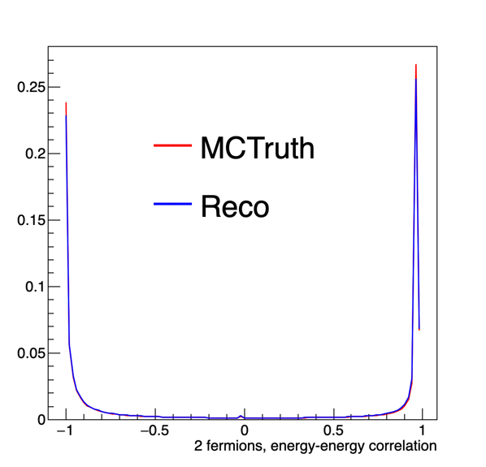
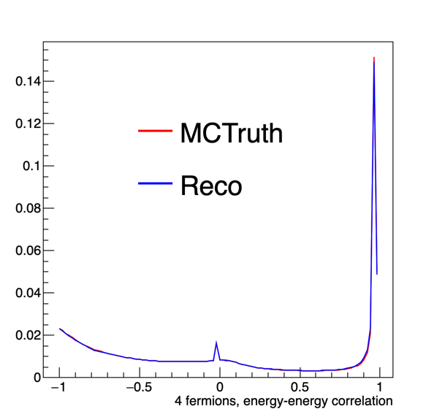
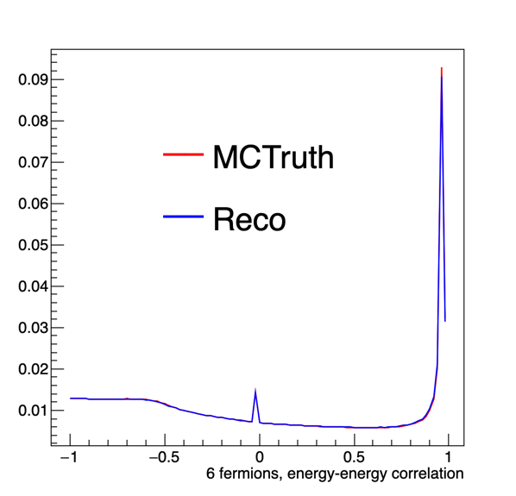
energy-energy correlation
$EEC=\frac{1}{σ_{tot}}\underset{ij}{∑}∫dσ\frac{E_{i}E_{j}}{Q^{2}}δ(cosχ−cosθ_{ij})$

Slide 11
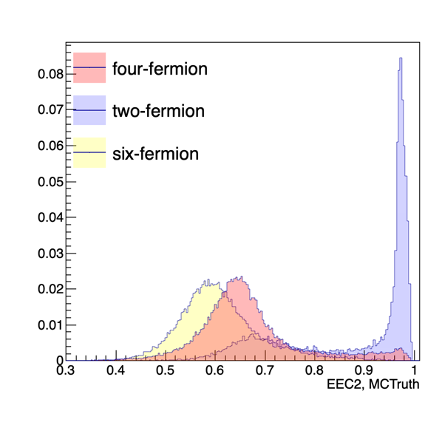
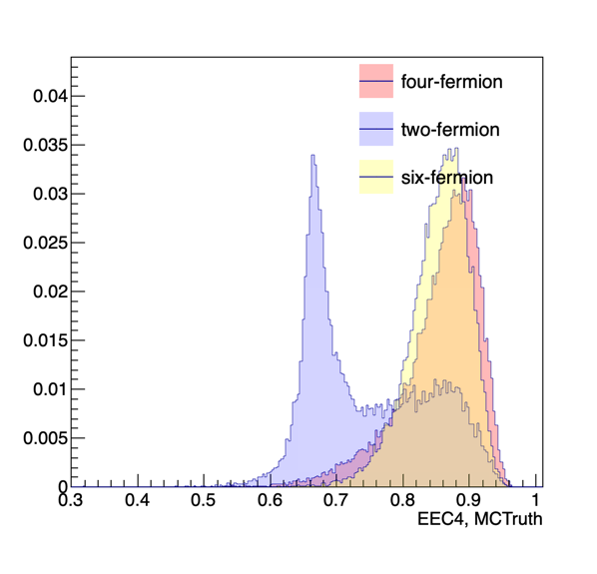
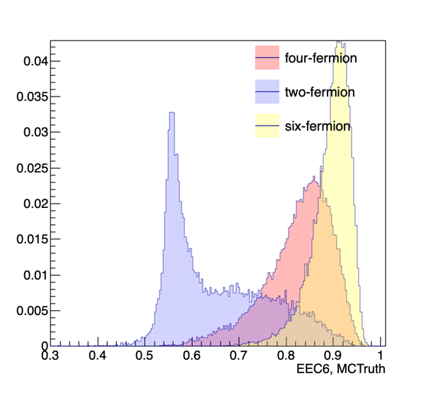
EEC:
$likelihood=\frac{∑(P1_{i})×P2_{i}}{\sqrt{∑(P1_{i}×P2_{i})×∑(P2_{i}×P2_{i})}}$
$P1$ : the histogram of each event
$P2$ : the statistic distribution of each kinds of samples
i : i’th bin
max efficiency*purity | normalized to unit one |  | normalized to Xsection
 | MC | Reco | MC | Reco
EEC2 | 0.639785 | 0.639467 | 0.744905 | 0.742189
EEC4 | 0.557497 | 0.691678 | 0.691678 | 0.696338

Slide 12
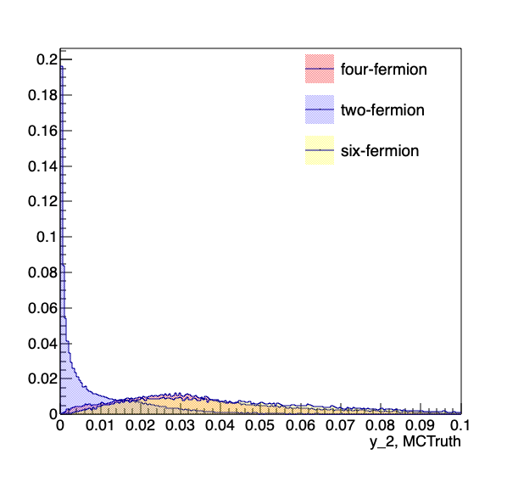
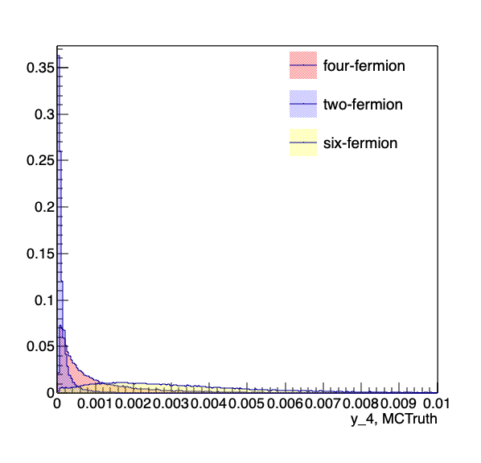
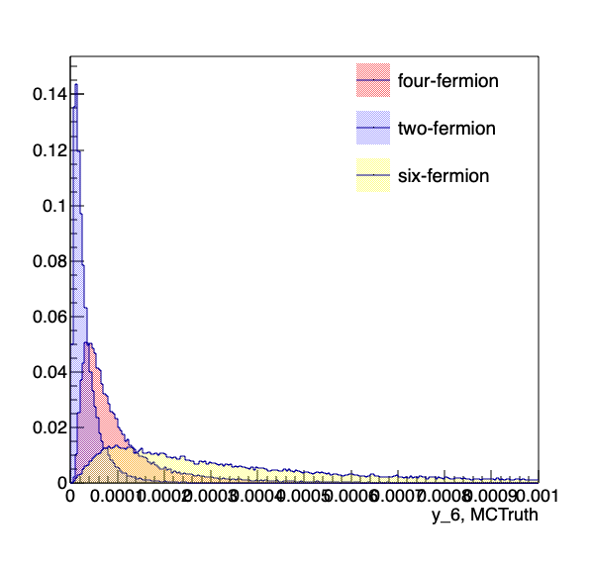
jet transition variable :
ee_kt_algorithm
$y_{ij}=2min(E_{i}^{2},E_{j}^{2})(1−cosθ_{ij})$
max efficiency*purity | normalized to unit one |  | normalized to Xsection
 | MC | Reco | MC | Reco
 | 0.642008 | 0.710959 | 0.75294 | 0.783771
 | 0.640101 | 0.616687 | 0.762077 | 0.751312
$$y_{23}$$
$$y_{45}$$

Slide 13
$$y_{23}$$
$$y_{45}$$
max efficiency $×$ purity
normalized to unit one :
eff * purity |  | thrust | heavy mass | W-B | T-B | C | D | EEC2 | EEC4
MC | 4 | 0.82698 | 0.782413 | 0.752157 | 0.80513 | 0.817299 | 0.817931 | 0.675149 | 0.630466 | 0.670569 | 0.634444
 | 2 | 0.815994 | 0.76392 | 0.734528 | 0.787802 | 0.803537 | 0.804263 | 0.639785 | 0.557497 | 0.642008 | 0.640101
Reco | 4 | 0.821949 | 0.77758 | 0.750942 | 0.80077 | 0.813922 | 0.814498 | 0.673515 | 0.458078 | 0.739163 | 0.605496
 | 2 | 0.810917 | 0.758934 | 0.731371 | 0.784472 | 0.800047 | 0.800682 | 0.639467 | 0.691678 | 0.710959 | 0.616687
$$y_{23}$$
$$y_{45}$$
normalized to Xsection :
eff * purity |  | thrust | heavy mass | W-B | T-B | C | D | EEC2 | EEC4
MC | 4 | 0.725126 | 0.662227 | 0.626333 | 0.689816 | 0.710484 | 0.711881 | 0.518468 | 0.458078 | 0.515794 | 0.496913
 | 2 | 0.853088 | 0.815345 | 0.80235 | 0.836156 | 0.848953 | 0.849227 | 0.744905 | 0.691678 | 0.75294 | 0.762077
Reco | 4 | 0.719017 | 0.656155 | 0.622944 | 0.687122 | 0.706065 | 0.706444 | 0.515967 | 0.470759 | 0.602634 | 0.460444
 | 2 | 0.851713 | 0.812466 | 0.800644 | 0.834205 | 0.847589 | 0.848108 | 0.742189 | 0.696338 | 0.783771 | 0.751312
$$y_{23}$$
$$y_{45}$$

Slide 14
BDT Results

Slide 15
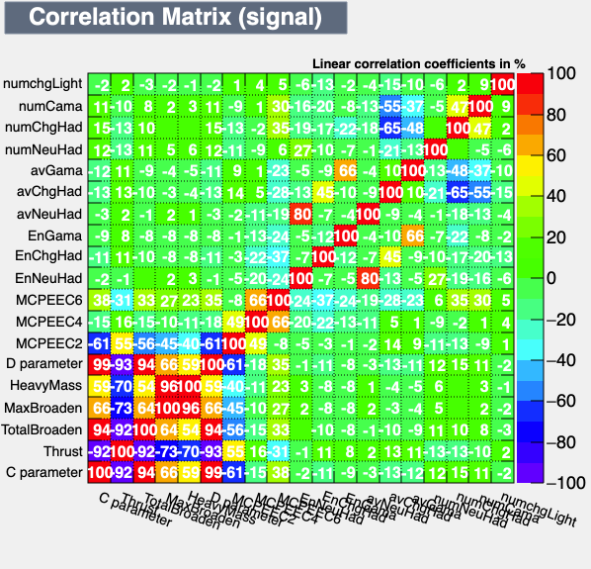
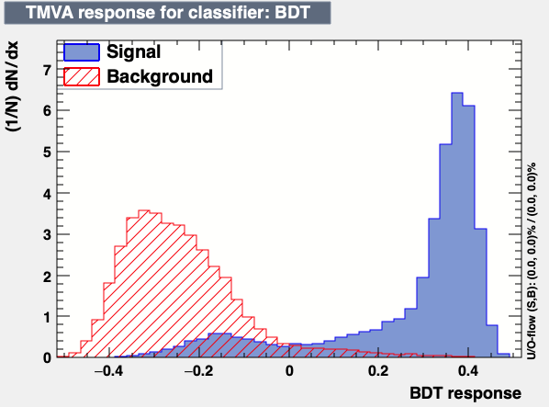
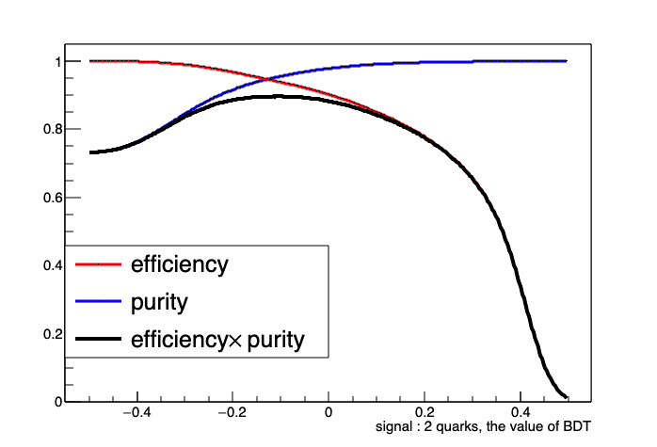
separation of 2-jet from 4-jet
max efficiency $×$ purity
MC : 0.896342
Reco : 0.890765

Slide 16
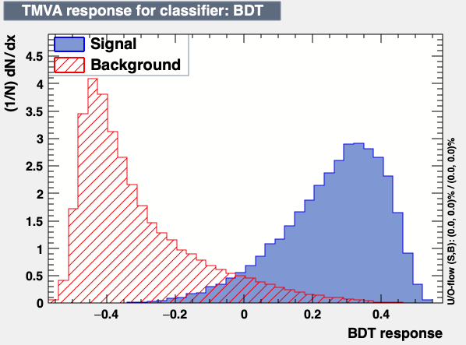
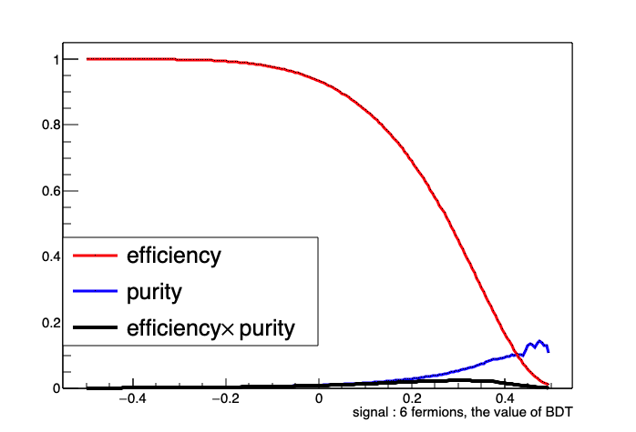
Identify the six-fermion from the background of the two-fermion and the four-fermion
MC : 0.0241703 Reco : 0.018606

Slide 17
Summary :
At the CEPC, the events with multi-jet final state occupy large part and various analysis can be done with these kinds of events.
The event shape variables can efficiently separate the two-jet from the four-jet.
The event shape variables plus multiplicity variables can identify six fermions from the background of two fermions and four fermions to some extent.

Slide 18
Backup

Slide 19
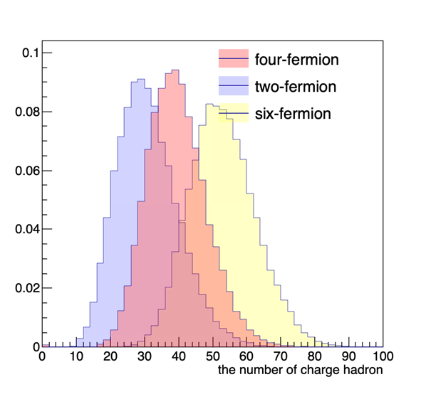
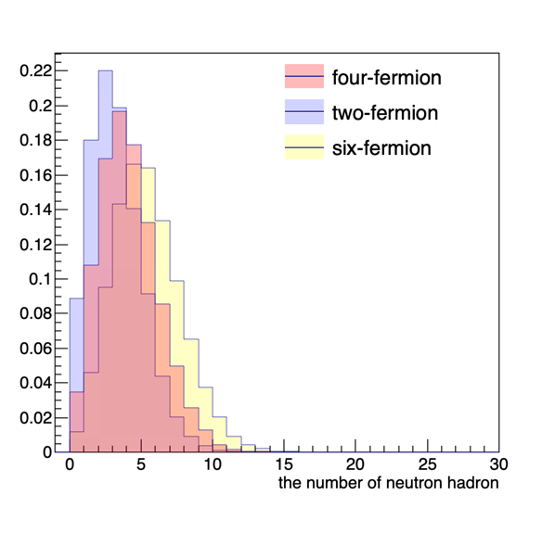
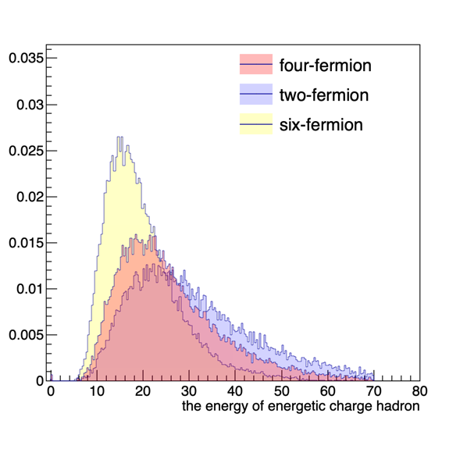
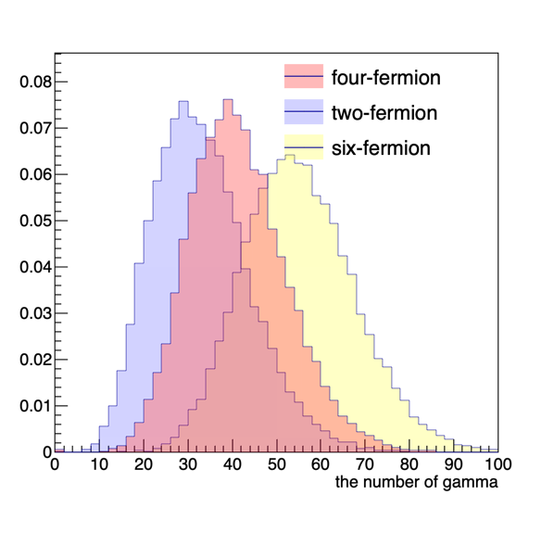
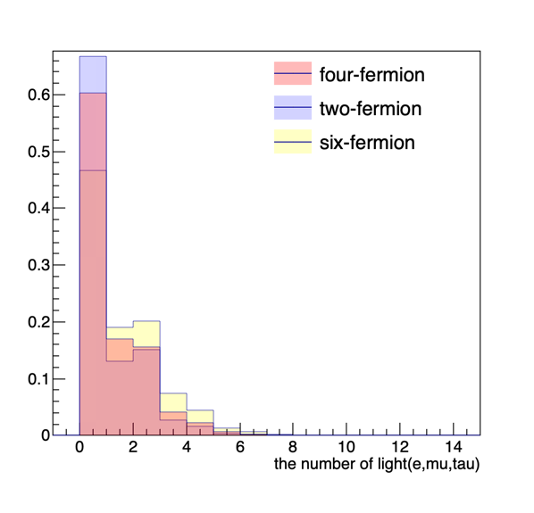
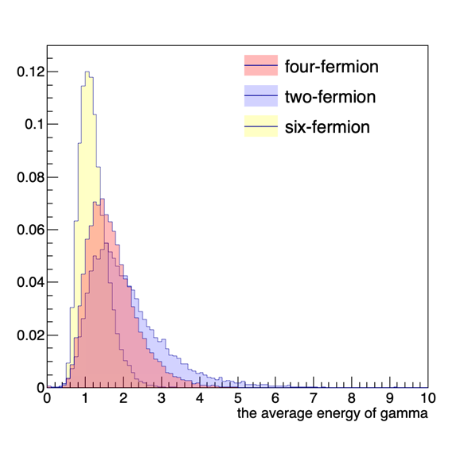
Multiplicity variables :
the number of neutron hadron, charge hadron, gamma and light (e, $μ$)
the energy of energetic neutron hadron, charge hadron, gamma and light (e, $μ$)
the average energy of neutron hadron, charge hadron, gamma and light (e, $μ$)

