Slide 1
qqH-mumu
作为Benchmark channel
测量精度随着Tracker动量分辨率的变化趋势
2019 11 15
崔瀚化

Slide 2
01
sig and bkg data
02
fit sig and bkg
03
accuracy
CONTENTS

Slide 3
Sig and bkg
Sig: ZH, Z-qq, H-mumu, Mmumu=124GeV
Bkg: ZZ, Z-qq, Z-mumu , Mmumu=91.2GeV

Slide 4
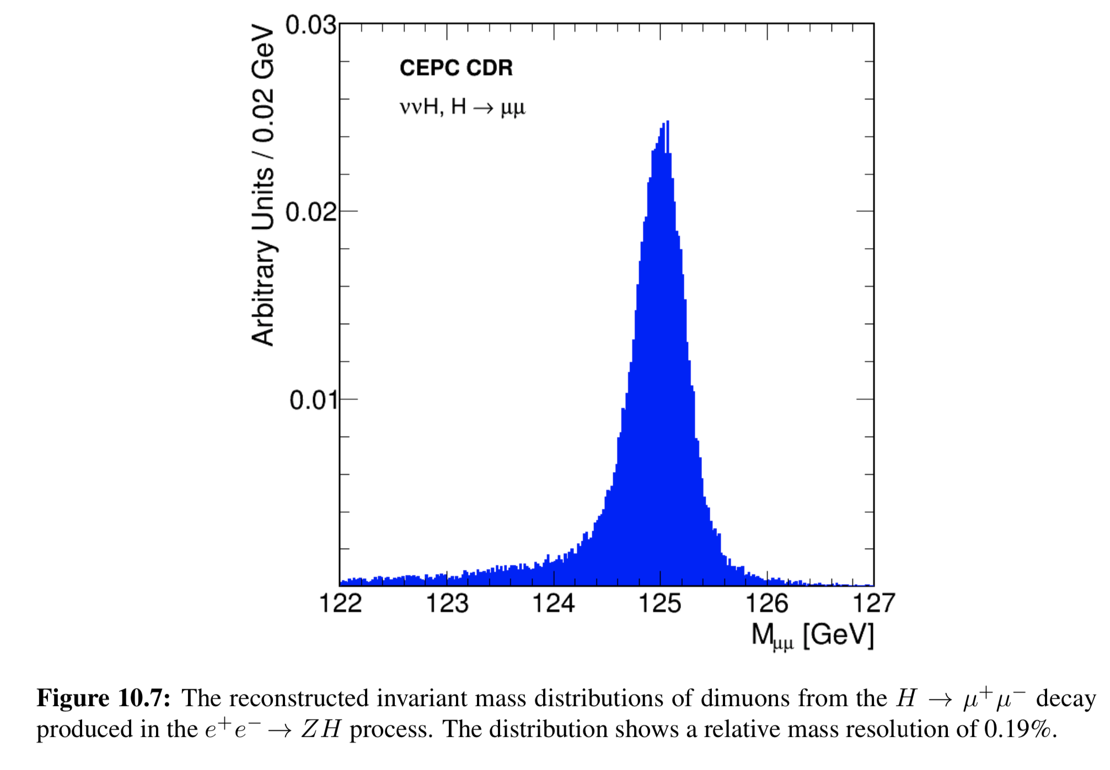
Sig of (qqH, H-mumu) from CDR

Slide 5
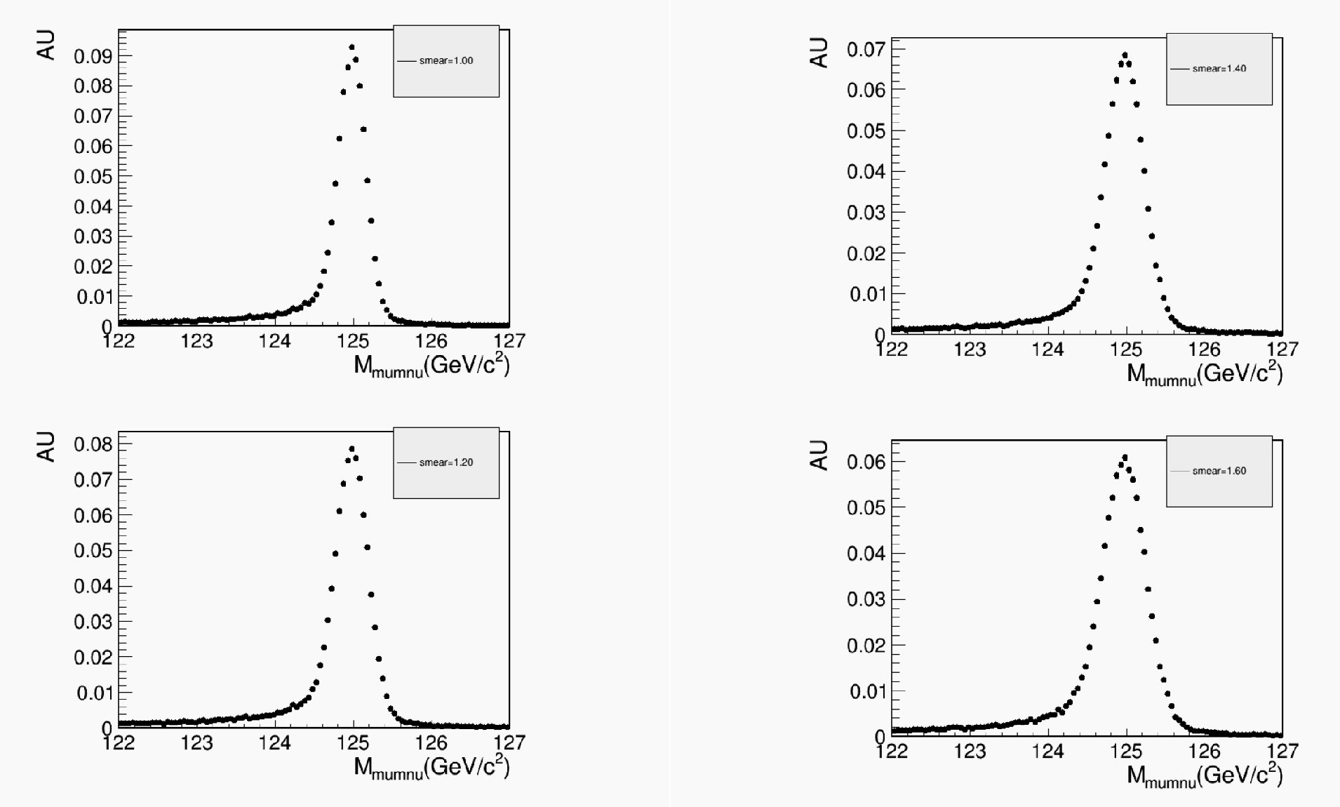
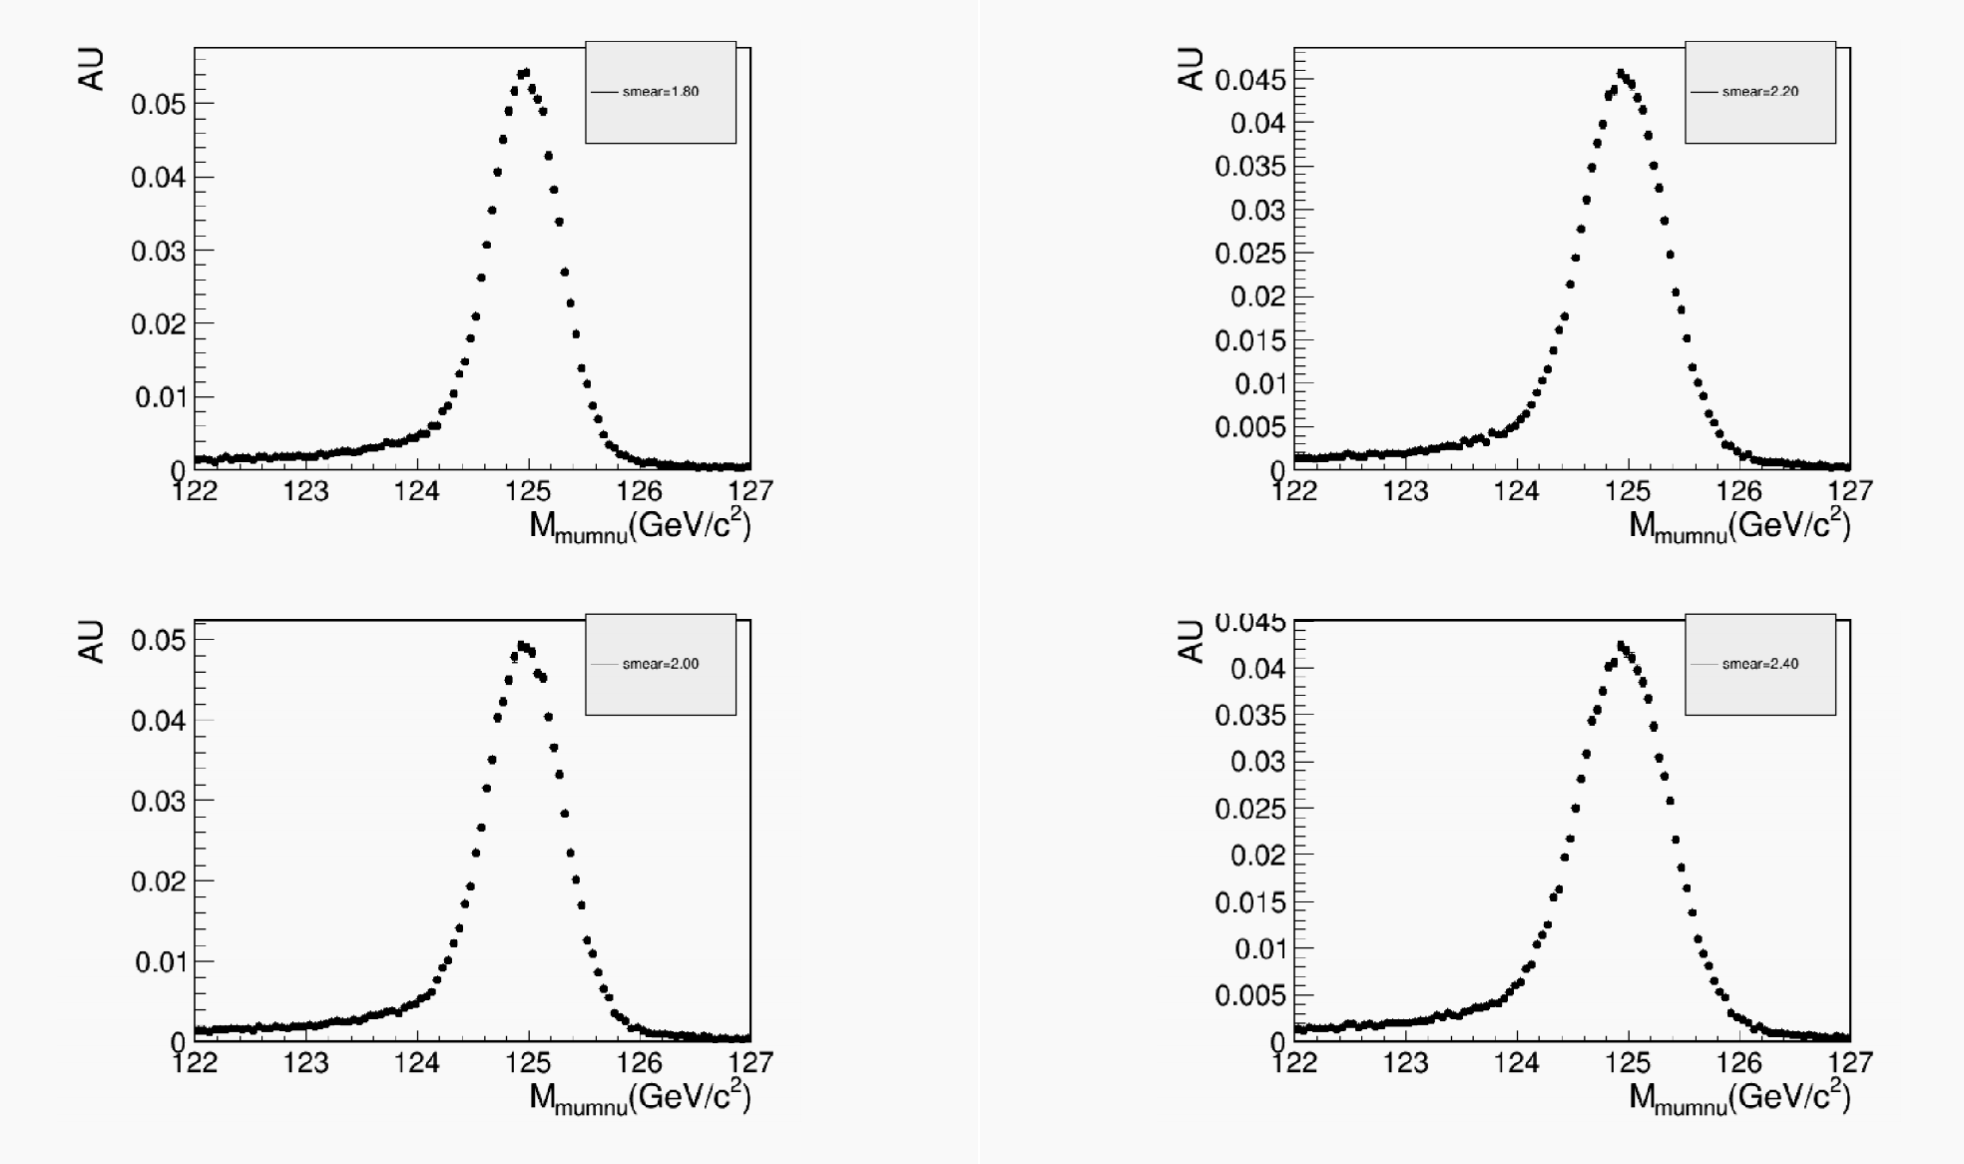
Sig (fast simu)

Slide 6
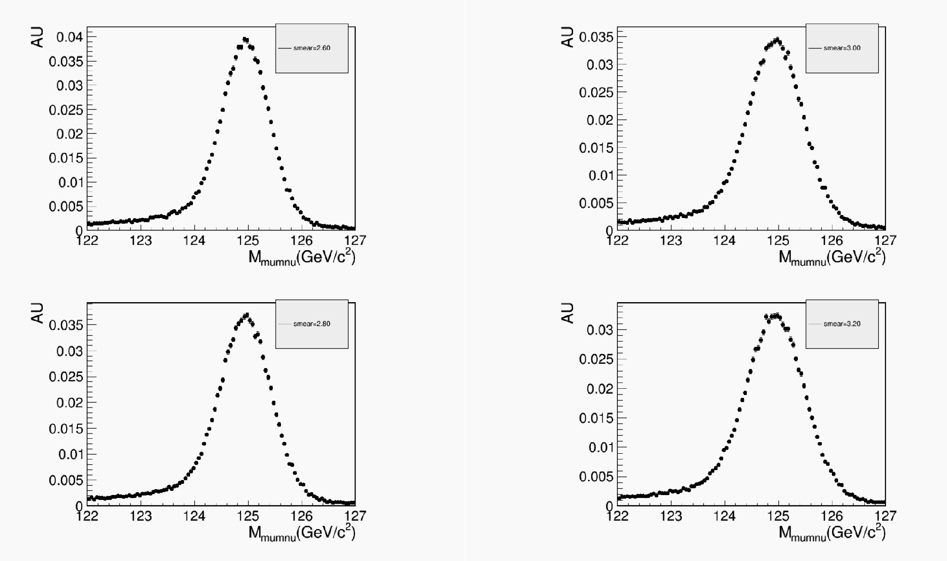
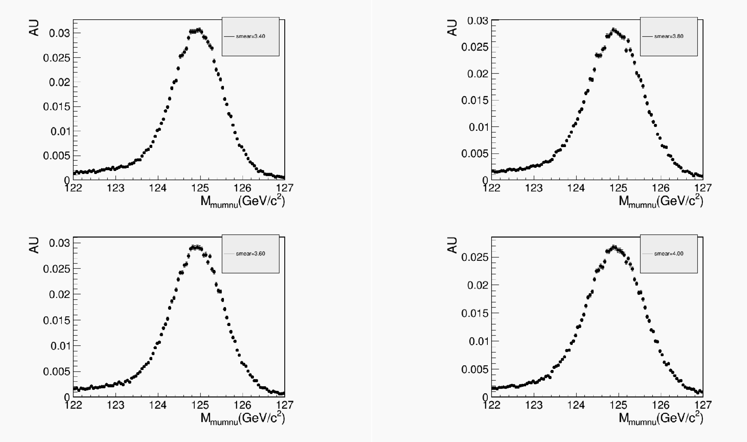
Sig (fast simu)

Slide 7
Bkg from Ran kunlin

Slide 8
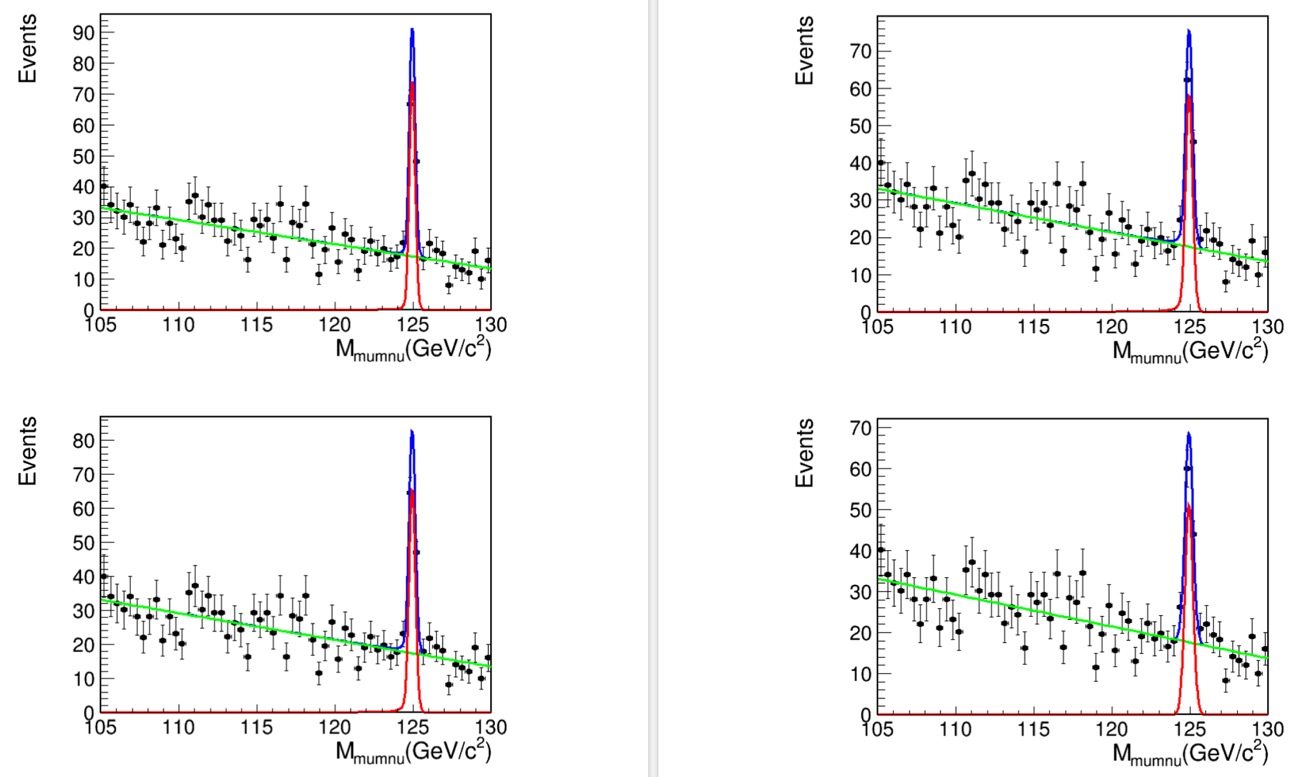
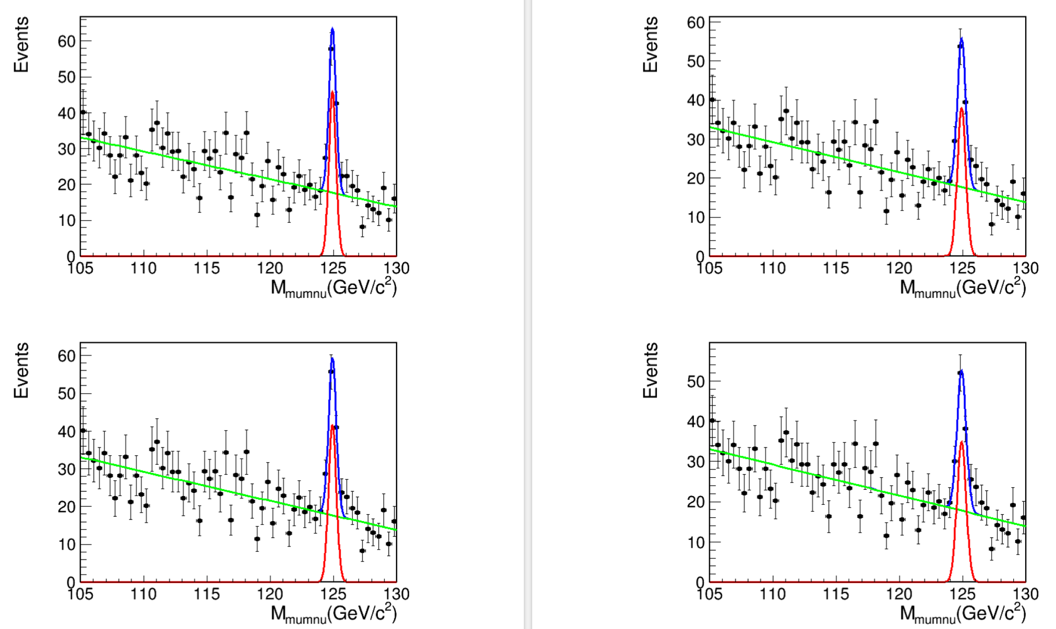
fit sig and bkg

Slide 9
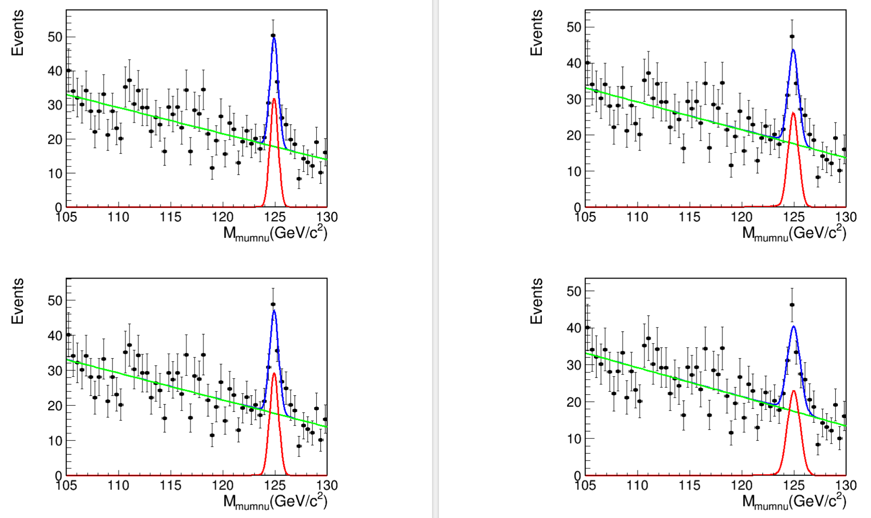
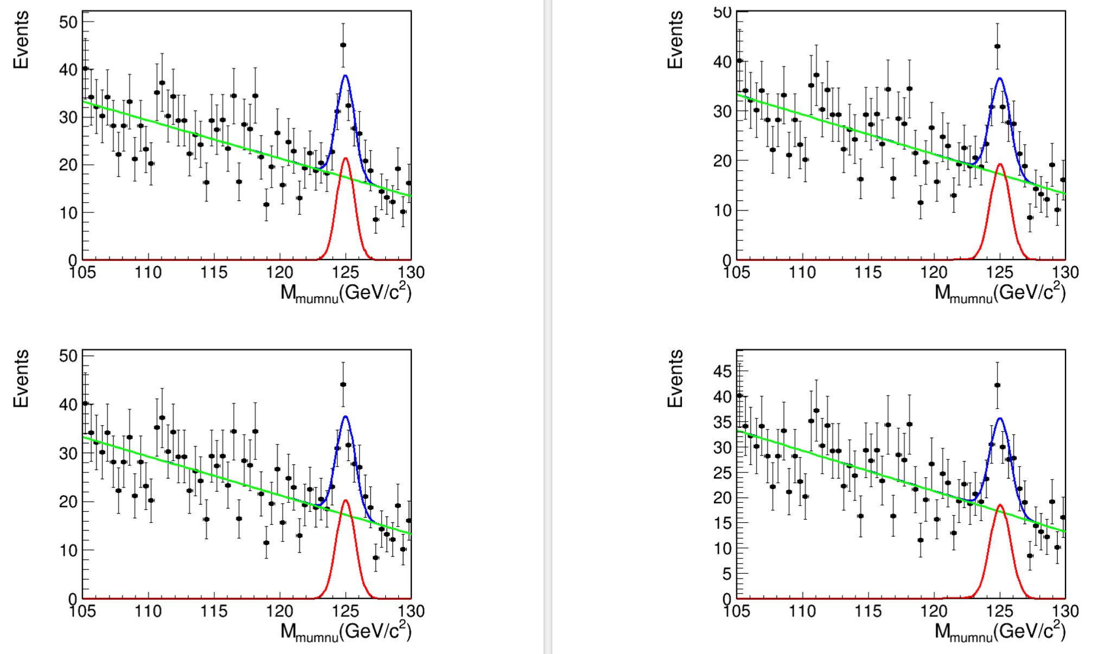
fit sig and bkg

Slide 10
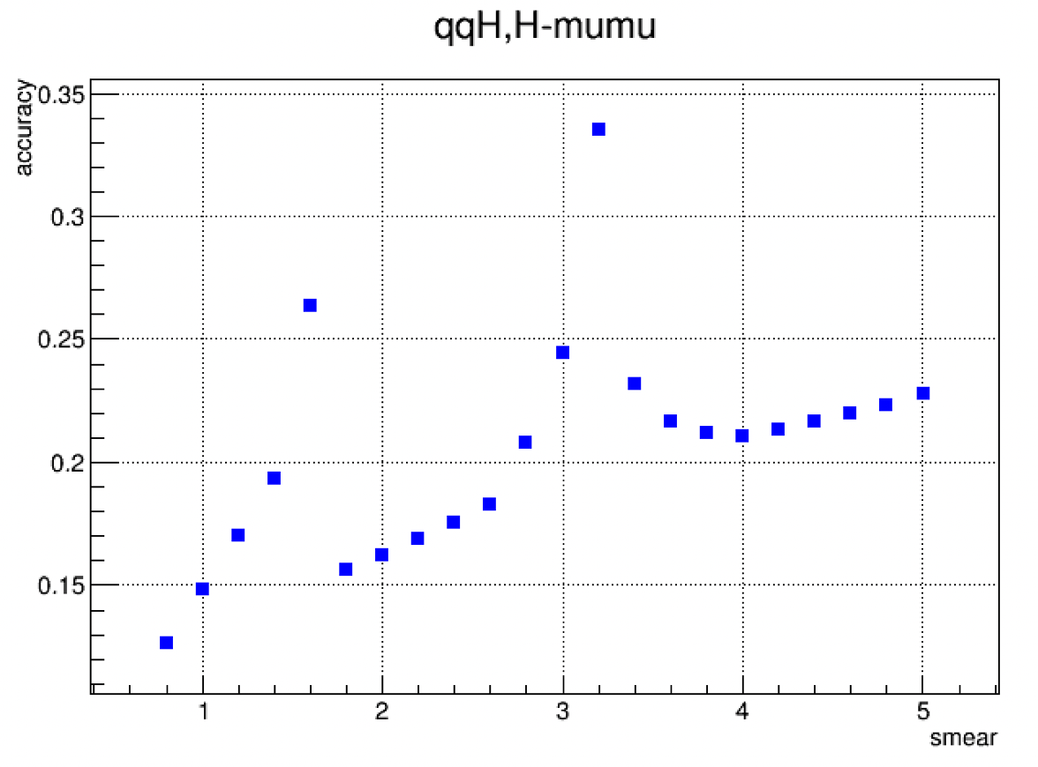
accuracy

Slide 11
THANK YOU FOR WATCHING

