Slide 1
Summary from Charm workshop
Yangheng Zheng

Slide 2
提纲
近期的两个粲强子物理会议：
Joint Workshop on Charmed Hadron Decays @ BESIII, BELLE, LHCb 2019 （31 October 2019 to 3 November 2019，山西师范大学）
2019年理论与实验联合专题研讨会：粲物理（22-24 November 2019，暨南大学）

Slide 3
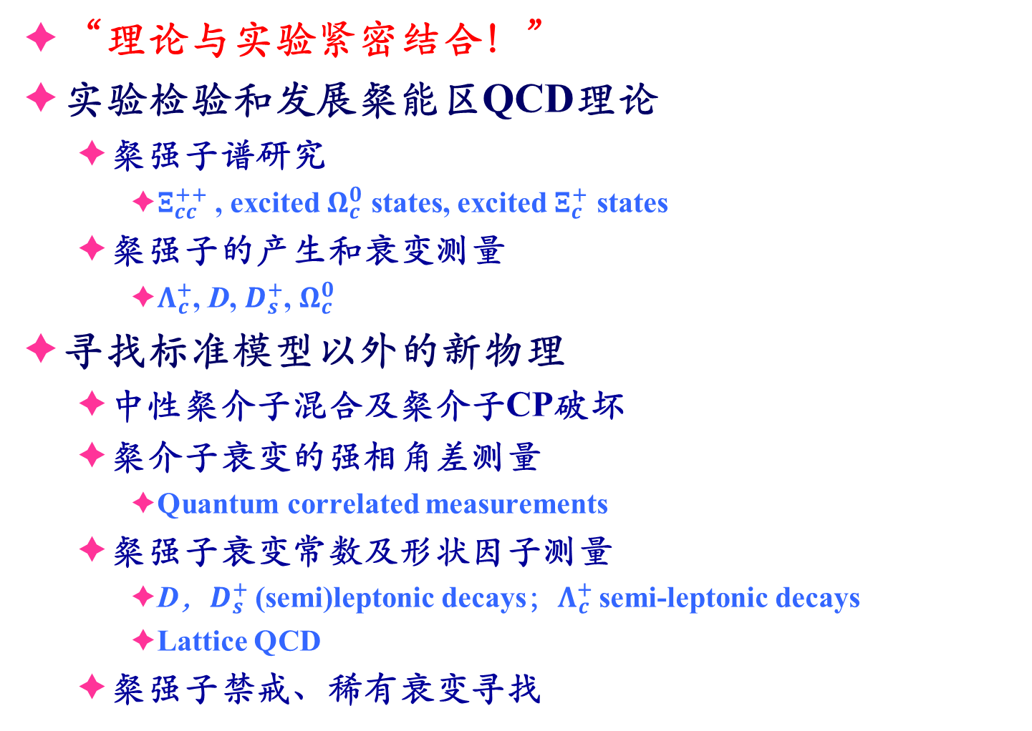
粲强子物理研究
“理论与实验紧密结合！”
实验检验和发展粲能区QCD理论
  粲强子谱研究
    $Ξ_{cc}^{++}$ , excited $Ω_{c}^{0}$ states, excited $Ξ_{c}^{+}$ states
  粲强子的产生和衰变测量
    $Λ_{c}^{+}$, D, $D_{s}^{+}$, $Ω_{c}^{0}$
寻找标准模型以外的新物理
  中性粲介子混合及粲介子CP破坏
  粲介子衰变的强相角差测量
    Quantum correlated measurements
  粲强子衰变常数及形状因子测量
    D，$D_{s}^{+}$ (semi)leptonic decays；$Λ_{c}^{+}$ semi-leptonic decays
    Lattice QCD
  粲强子禁戒、稀有衰变寻找
Notes:
重大科学问题

Slide 4
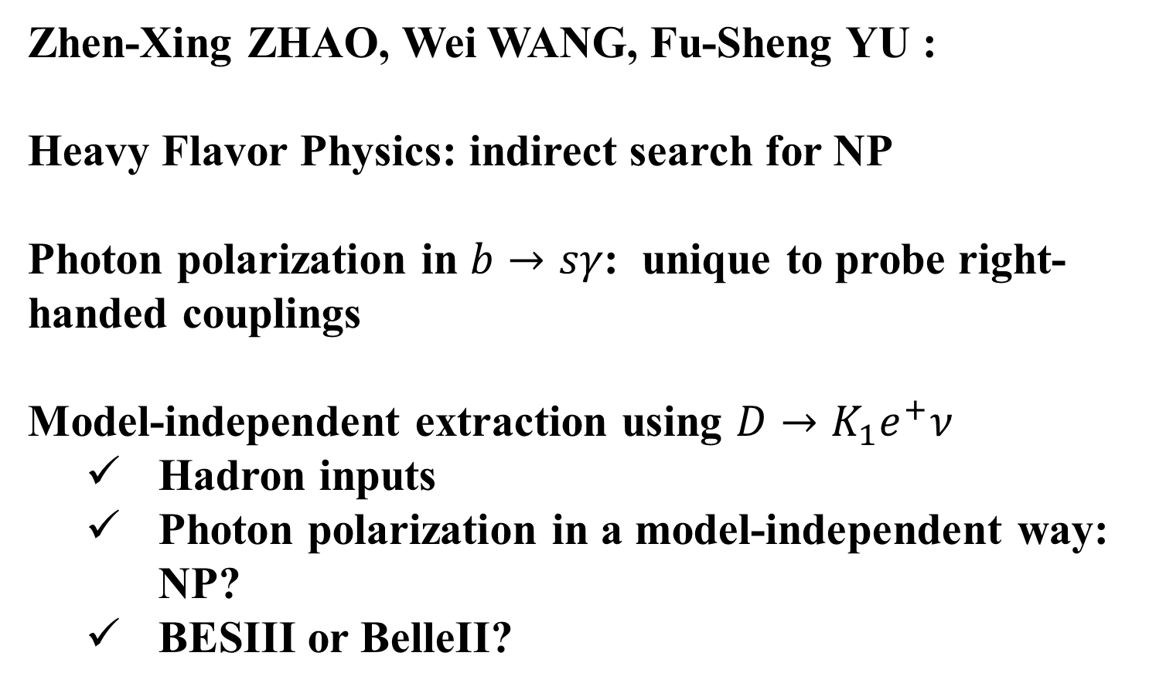

Photon polarization in $b→sγ$
Zhen-Xing ZHAO, Wei WANG, Fu-Sheng YU :
Heavy Flavor Physics: indirect search for NP
Photon polarization in $b→sγ$: unique to probe right-handed couplings
Model-independent extraction using $D→K_{1}e^{+}ν$
  Hadron inputs
  Photon polarization in a model-independent way: NP?
  BESIII or BelleII?

Slide 5
a₀ : a tetraquark hadron
萧佑国、柯百谦

Slide 6
Calculate the decay amplitude of hadron?
蒋华玉、于福升、李润辉

Slide 7
粲工厂 -- LHCb实验
强子对撞实验（粲强子产生截面巨大，能量Boost）
~3 fb⁻¹：60 x 10¹¹ 个cc，未来将 > 50 fb⁻¹
在长寿命带电径迹末态衰变中，优势巨大（电子末态除外）
部分重建 ⇒ 可重建ν（半轻衰变）
劣势：测量包含中性末态粒子γ, π⁰的衰变道，电子末态，顶点不能太远
Notes:
在举了一个例子后，为了充分理解阈值产生实验的优势、劣势，我们比较一下现有的粲物理实验装置

Slide 8
LHCb实验 （mixing & CPV）

Slide 9
LHCb实验（Spectroscopy）

Slide 10
粲工厂 -- Belle/Belle-II实验
正负电子对撞实验（触发效率接近100%）
Belle （亮度世界纪录：2.1 x 10³⁴ 积分亮度： ~1000 fb⁻¹）：1.3 x 10⁹ 个粲介子
  cc的统计量少于LHCb，但多于BESIII
能量Boost ⇒ 粲强子衰变顶点重建
Belle-II的亮度再提高了40倍！
ISR ⇒ 对撞质心系能量覆盖τ-Charm能区
Notes:
在举了一个例子后，为了充分理解阈值产生实验的优势、劣势，我们比较一下现有的粲物理实验装置

Slide 11
Belle实验

Slide 12
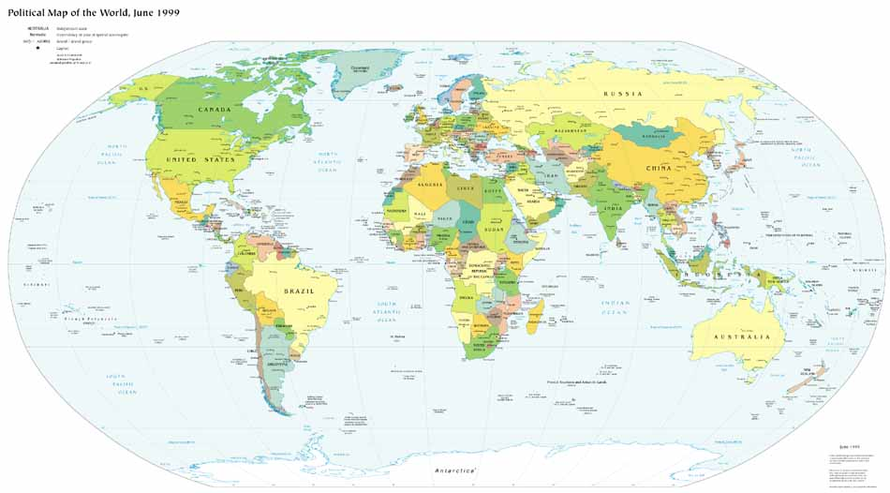
BESIII实验合作组
Europe (16)
Germany: Univ. of Bochum,
Univ. of Giessen, GSI
Univ. of Johannes Gutenberg
Helmholtz Ins. In Mainz
Russia: JINR Dubna; BINP Novosibirsk
Italy: Univ. of Torino，Frascati Lab，
Univ. of Ferrara
Netherland：KVI/Univ. of Groningen
Sweden: Uppsala Univ.
Turkey: Turkey Accelerator Center
US (5)
Univ. of Hawaii
Univ. of Washington
Carnegie Mellon Univ.
Univ. of Minnesota
Univ. of Rochester
Univ. of Indiana
Mongolia (1)
Institue of P&T.
Korea (1)
Seoul Nat. Univ.
Japan (1)
Tokyo Univ.
China(43)
IHEP, CCAST, UCAS, Shandong Univ.,
USTC, Zhejiang Univ., Huangshan Coll.
Huazhong Normal Univ., Wuhan Univ.
Zhengzhou Univ., Henan Normal Univ.
Peking Univ., Tsinghua Univ. ,
Zhongshan Univ.,Nankai Univ.
Shanxi Univ., Sichuan Univ., Univ. of South China
Hunan Univ., Liaoning Univ.
Nanjing Univ., Nanjing Normal Univ.
Guangxi Normal Univ., Guangxi Univ.
Suzhou Univ., Hangzhou Normal Univ.
Lanzhou Univ., Henan Sci. and Tech. Univ.
Beihang Univ., Fudan Univ., IMP, Univ. of Jinan
SYSU
Thailand (1)
SUT
Pakistan (3)
Univ. of Punjab
COMSAT CIIT
India (1)
IIT
来自15个国家的76个合作单位合作成员约500人

Slide 13
BES实验的部分亮点
τ质量测量
R scan
X(1835)
Zc系列
Λc产生衰变测量
CKM & Decay constants & δ
Polarization of Baryons in J/ψ
…
Threshold

Slide 14
Charm facilities
Hadron colliders (Huge cross-section, energy boost)
  LHC (LHCb)
e⁺e⁻ Colliders (more kinematic constrains, clean environment, ~100% trigger efficiency)
  B-factories (Belle, BaBar)
    Prompt D* decays & B decays
    High Luminosity ⇒ double tag technique possible
  Threshold production (CLEOc, BESIII)
    Can not compete in statistics with Hadron colliders & B-factories！
    Only Charm hadron pairs, no extra CM Energy for pions
    Quantum Correlations (QC) and CP-tagging are unique
    Systematic uncertainties cancellations while applying double tag technique

Slide 15
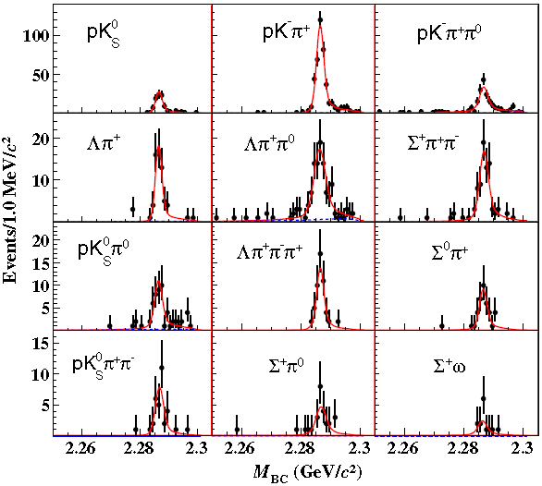
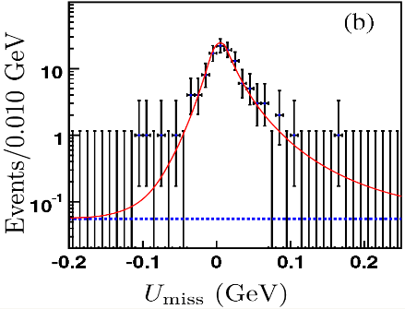
Λ_{c} 衰变相关的物理结果产出
基于BESIII实验35天采集的Λ_{c}数据，发表了16篇文章 (7 PRLs)
代表性成果如下：
PRL,116,052001) (2016)
PRL,115,221805(2015)
PRL 118, 112001 (2017)
PLB,767,42 (2017)
测量了一系列近20个衰变道的模型无关绝对分支比
刷新了实验测量精度 ⇒ BESIII实验为强子QCD理论工具的开发提供了重要的实验数据
Notes:
截止目前为止，基于。。。

Slide 16
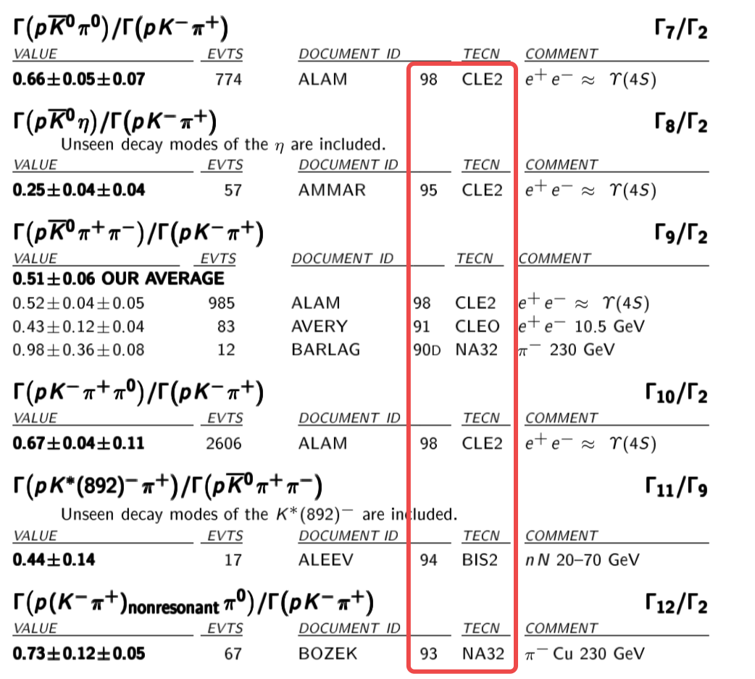
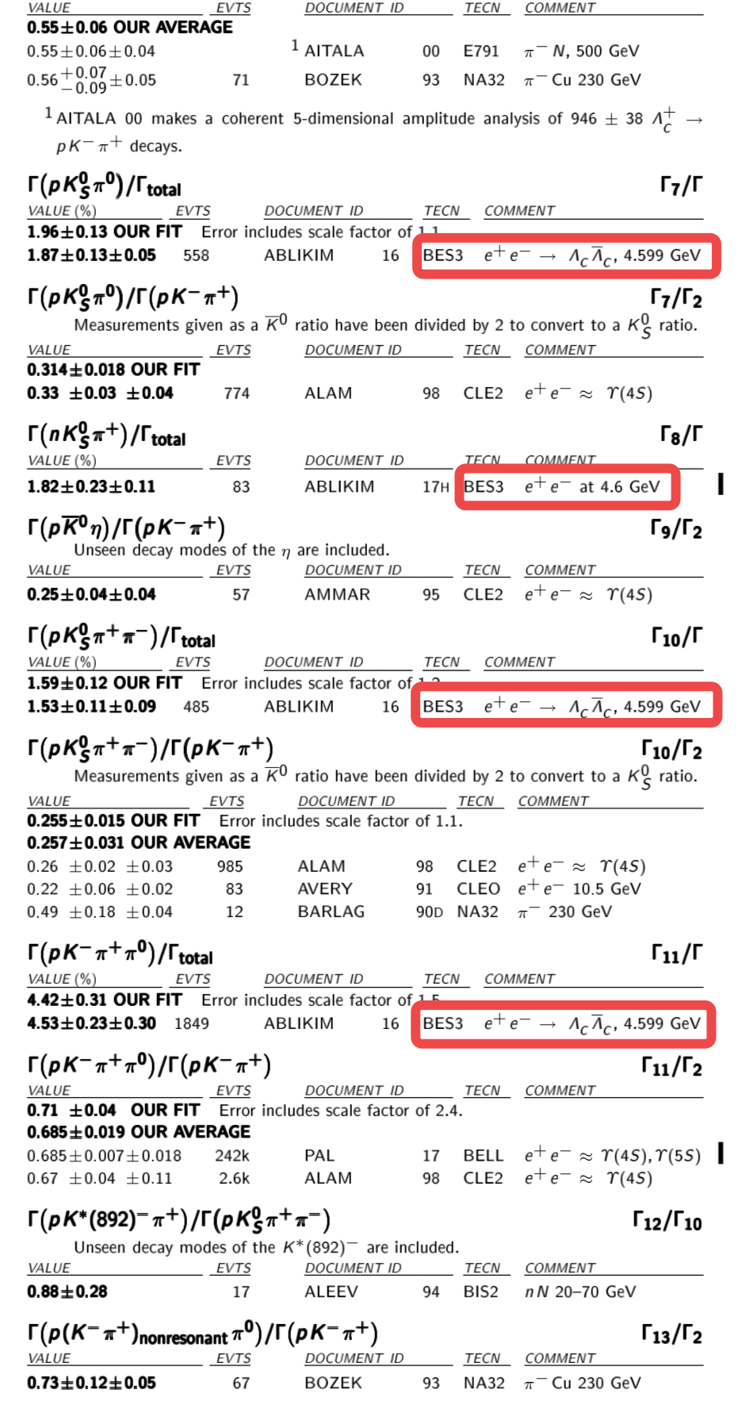

分支比测量精度大幅度改善
PDG2014
PDG2019
BESIII的贡献使得多数分支比结果由相对测量改为绝对测量。
BESIII对黄金道$Λ_{c}^{+}→$pKπ的测量 ⇒ “模型依赖”变为“模型无关”。
BESIII贡献发现了更多以前没发现的衰变道(比如含中子末态的衰变)。
Notes:
下面我们介绍一下这35天数据的具体有哪些影响。。。

Slide 17

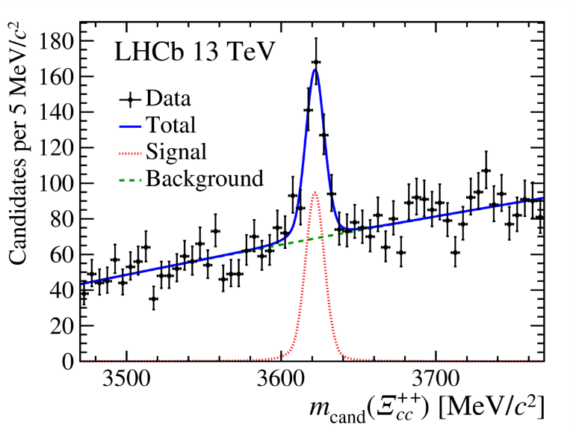
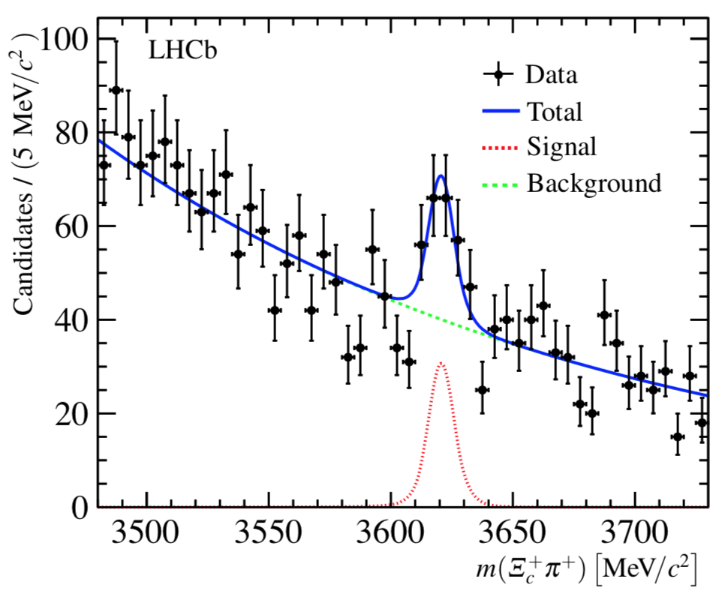
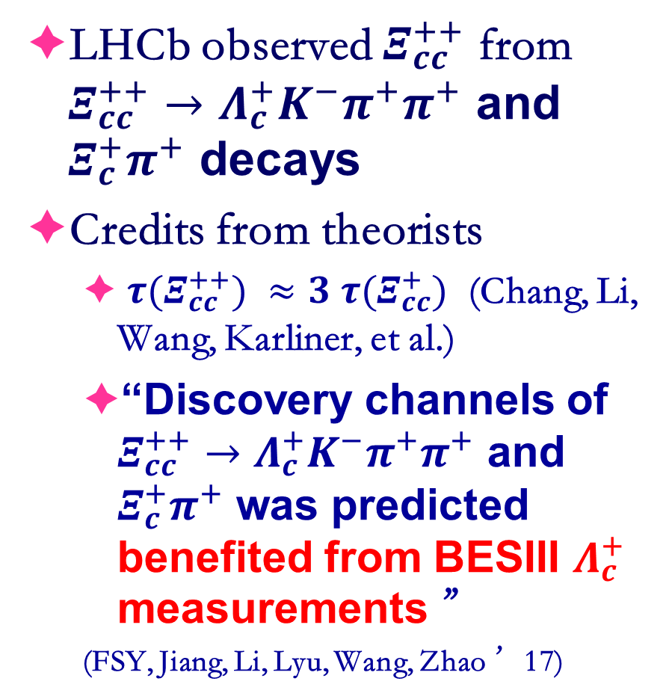

Contributions to $Ξ_{cc}^{++}$observation
LHCb observed $Ξ_{cc}^{++}$ from $Ξ_{cc}^{++}→Λ_{c}^{+}K^{−}π^{+}π^{+}$ and $Ξ_{c}^{+}π^{+}$ decays
Credits from theorists
  ${τ(Ξ}_{cc}^{++}) ≈3 {τ(Ξ}_{cc}^{+})$ (Chang, Li, Wang, Karliner, et al.)
  “Discovery channels of $Ξ_{cc}^{++}→Λ_{c}^{+}K^{−}π^{+}π^{+}$ and $Ξ_{c}^{+}π^{+}$ was predicted benefited from BESIII $Λ_{c}^{+}$ measurements ”
  (FSY, Jiang, Li, Lyu, Wang, Zhao ’17)
PRL 119, 112001 (2017)
PRL 121, 162002 (2018)

Slide 18
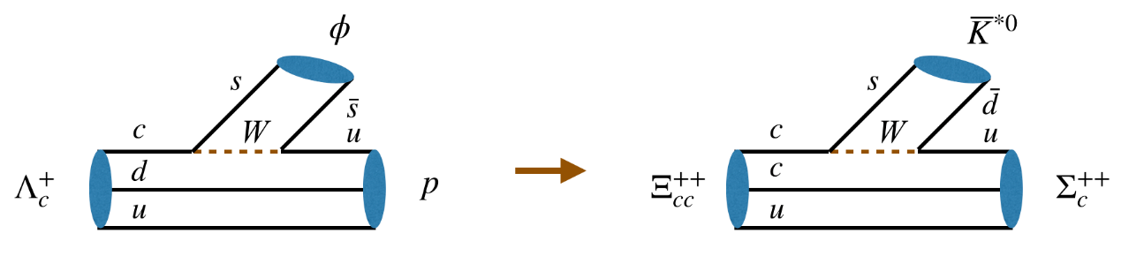
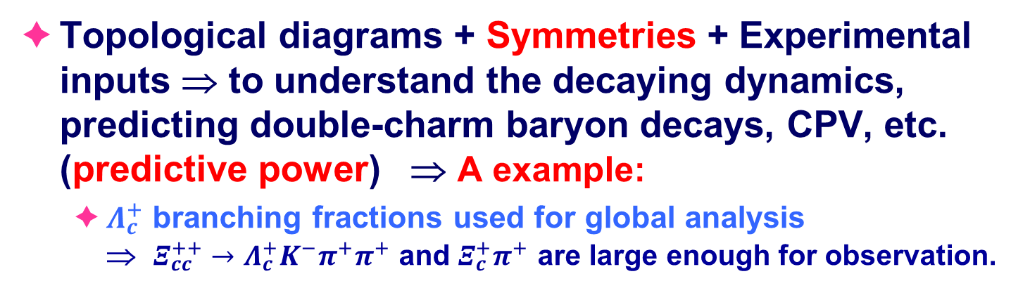



A theoretical Framework for Charmed Hadrons
Topological diagrams + Symmetries + Experimental inputs ⇒ to understand the decaying dynamics, predicting double-charm baryon decays, CPV, etc. (predictive power) ⇒ A example:
  $Λ_{c}^{+}$ branching fractions used for global analysis
  ⇒ $Ξ_{cc}^{++}→Λ_{c}^{+}K^{−}π^{+}π^{+}$ and $Ξ_{c}^{+}π^{+}$ are large enough for observation.
$Br(Λ_{c}^{+}→pφ)/|V_{us}|^{2}$ = 2 %
$Br\left(Ξ_{cc}^{++}→Σ_{c}^{++}{\overline{K}}^{∗0}\right)$= O(%)
$$Ξ_{cc}^{++}→Λ_{c}^{+}{π^{+}K}^{−}π^{+}$$
Large enough for observation
$Λ_{c}^{+}$ BFs from BESIII  Stronger predictive power

Slide 19
BESIII实验（粲重子）

Slide 20
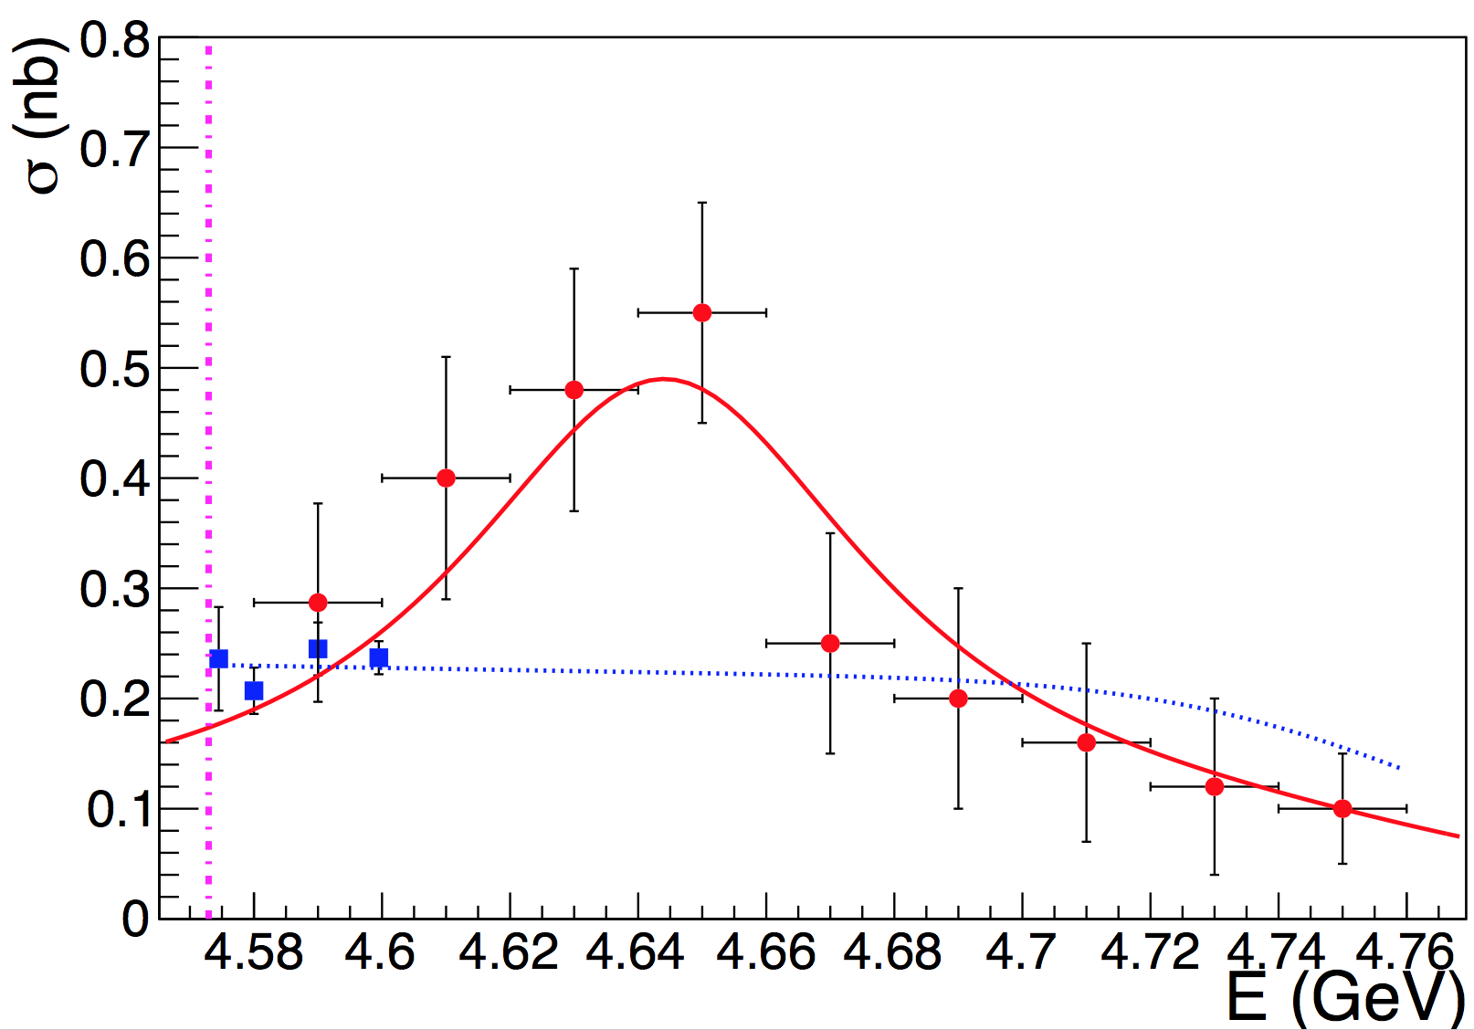
Λ_{c} 衰变的下一步研究展望
北京正负电子对撞机BEPCII 2018年夏季停机检修：最高束流能量升级4.6 GeV → 4.7 GeV （感谢加速器同行们的努力）
2019年7月2日BESIII实验执行委员会正式批准2019年年底开始在能量4.6 GeV - 4.7 GeV区间采集5 fb⁻¹数据（1 – 1.5 M Λ_{c}对，>10倍现有Λ_{c}统计量）
郑阳恒获得基金委重点项目“北京正负电子对撞机BESIII实验上粲重子Λc研究”支持，2020.1 – 2024.12
4.6GeV
Λ_{c}对产生截面

Slide 21
BESIII实验（粲介子非轻末态）

Slide 22
BESIII实验（粲介子含轻子末态）

Slide 23
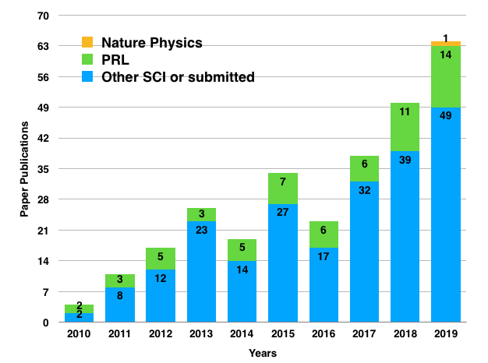
Publication of BESIII
Up to November, 2019: 286 publications, 62 PRL，
Excellent in both number and quality
http://bes3.ihep.ac.cn/pub/physics.htm
~20 PhD / year

Slide 24
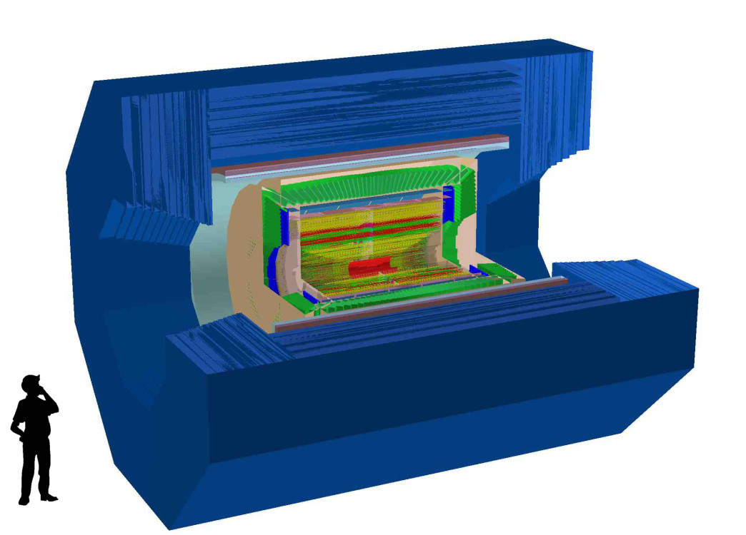
STCF and Detector
Designed STCF
Peak luminosity 0.5-1×10³⁵ cm⁻²s⁻¹ at 4 GeV
Energy range E_{cm} = 2−7 GeV
Single Beam Polarization (Phase II)
Notes:
We also have very preliminary conception design for the Detector, a very BESIII like symetry
Detectors is proposed.

Slide 25

总结与展望
LHCb实验c$\overline{c}$产生截面巨大!最终将有50 fb⁻¹。
Belle-II在2019年开始采集数据，相关统计量将在几年内超过Belle实验现有统计量一个量级，最终将有50 ab⁻¹的积分亮度。
BESIII实验特色：粲强子阈值附近成对产生，量子关联效应
  BESIII实验正在准备升级提高对撞质心系能量，研究提高对撞亮度、极化束流的可行性。
  BESIII实验结束后，超级τ-粲工厂？

Slide 26
Backup
Notes:
26
If you miss this chance, you might miss forever
Change title

Slide 27
Λ_{c} 衰变展望
目前的数据
500 pb⁻¹ @4.6GeV
能否在4.63GeV
峰上采集数据?
20倍现有数据：10fb⁻¹
在超级-粲工厂上只需要几天！

Slide 28
Summary
Super τ-c Facility (STCF): nature extension and a viable option for a post-BEPCII project
Status of STCF project in China:
Physics: Rich & unique for physics with c quark and τ leptons.
Detector & Electronics: Significant progress in R&D at USTC
Accelerator: Design group is formed and working hard, progress are ongoing. More experts are needed.
Funding: 10M RMB for initial R&D from USTC; More communication to CAS and Local governments
An international collaboration is under preparing
Strategy & Plan
Complete CDR in 2 years, TDR in 6 years
Construction site: Currently open

Slide 29
Candidate site 1: 广东
Institute of Modern Physics, CAS, proposed building HIAF-EicC in Huizhou, Canton
STCF Share the
design effort of the
electron accelerator
of EicC?

Slide 30
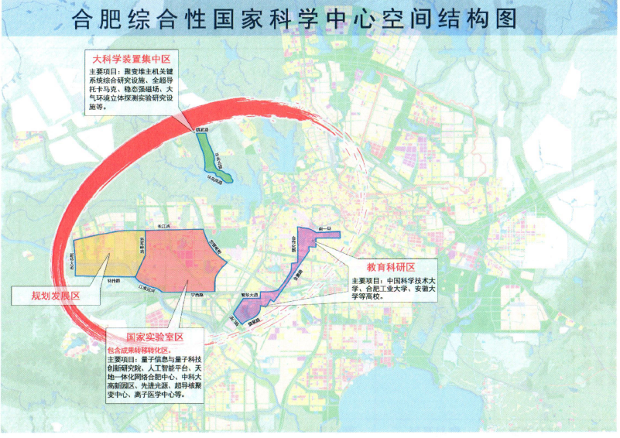
Candidate site 2: 安徽合肥
One of three integrated national science centers, which will play important role in ‘Megascience’ of China in near future
University of Science and Technology of China (USTC)
National Synchrotron Radiation Lab and Hefei Light Source, operated by USTC
The only National Lab operated by University in China. (Totally Four officially approved National Labs in China)
Hefei Integrated National Science Center
Pay a lot of attention on accelerator facilities
Hefei Advanced light source is under design
STCF is listed in future plan

