Slide 1
Photon polarization study at LHCb
Yuehong Xie （华中师范大学）
第一届LHCb前沿物理研讨会
北京大学，2019年11月22-24日

Slide 2
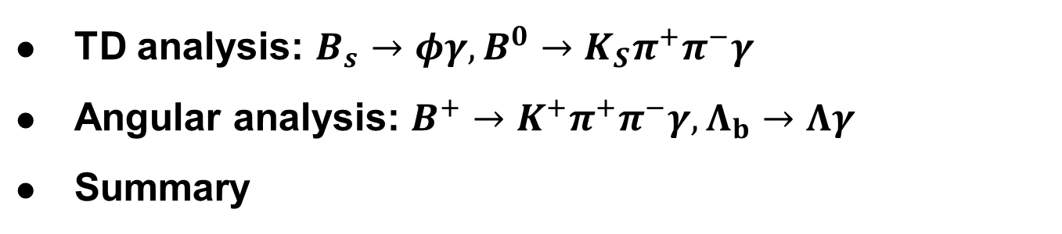
Outline
TD analysis: $B_{s}→φγ, B^{0}→K_{S}π^{+}π^{−}γ$
Angular analysis: $B^{+}→K^{+}π^{+}π^{−}γ, Λ_{b}→Λγ$
Summary
2

Slide 3

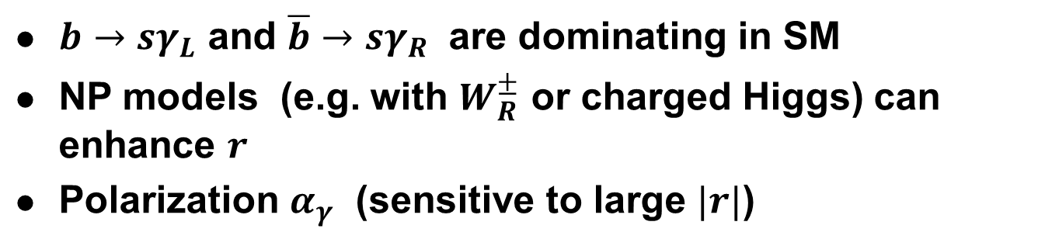

Photon polarization in $b→sγ$
$∼0$ in SM
$b→sγ_{L}$ and $\overline{b}→sγ_{R}$ are dominating in SM
NP models (e.g. with $W_{R}^{±}$ or charged Higgs) can enhance $r$
Polarization $α_{γ}$ (sensitive to large $|r|$)
3

Slide 4
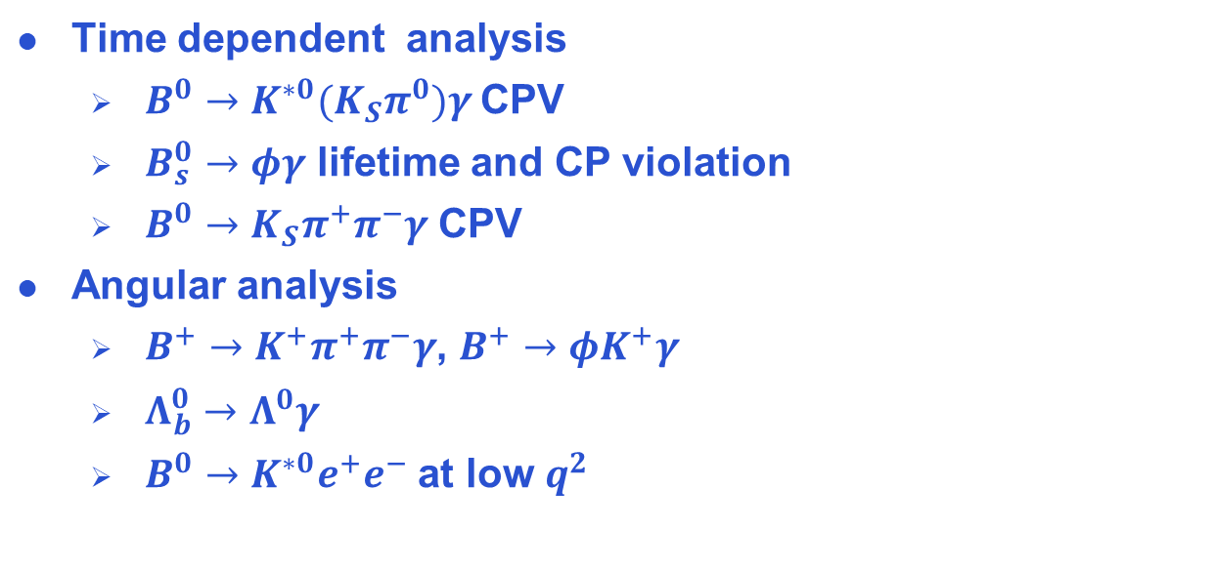
Photon polarization measurements
Time dependent analysis
  $B^{0}→{K^{∗0}(K}_{S}π^{0})γ$ CPV
  $B_{s}^{0}→φγ$ lifetime and CP violation
  $B^{0}→K_{S}π^{+}π^{−}γ$ CPV
Angular analysis
  $B^{+}→K^{+}π^{+}π^{−}γ$, $B^{+}→φK^{+}γ$
  $Λ_{b}^{0}→Λ^{0}γ$
  $B^{0}→K^{∗0}e^{+}e^{−}$ at low $q^{2}$
4

Slide 5
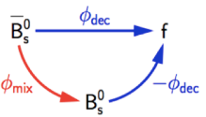

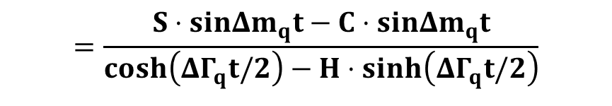




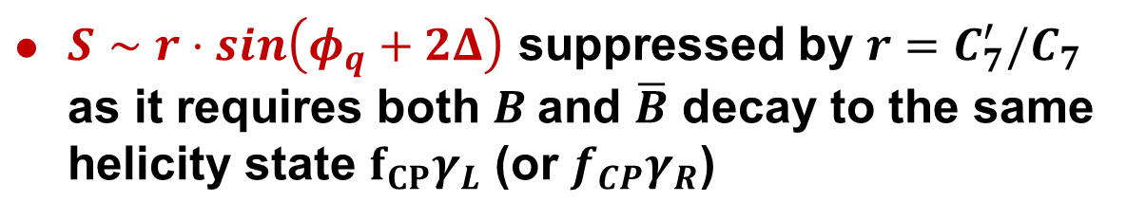



Mixing induced CPV in $B→f_{CP}γ$
$${Ae}^{+iΔ}$$
$$B_{q}$$
$$f_{CP}γ$$
$$e^{−iφ_{q}}$$
$${\overline{B}}_{q}$$
$${r⋅Ae}^{−iΔ}$$
$$A_{CP}\left(t\right)≡\frac{Γ\left(B\left(t\right)→f_{CP}γ\right)−Γ(\overline{B}\left(t\right)→f_{CP}γ)}{Γ\left(B\left(t\right)→f_{CP}γ\right)+Γ(\overline{B}\left(t\right)→f_{CP}γ)}$$
$$=\frac{S⋅sinΔm_{q}t−C⋅sinΔm_{q}t}{cosh\left(ΔΓ_{q}t/2\right)−H⋅sinh\left(ΔΓ_{q}t/2\right)}$$
$S∼r⋅sin\left(φ_{q}+2Δ\right)$ suppressed by $r=C_{7}^{′}/C_{7}$ as it requires both $B$and $\overline{B}$ decay to the same helicity state $f_{CP}γ_{L}$ (or ${f_{CP}γ}_{R}$)
5

Slide 6
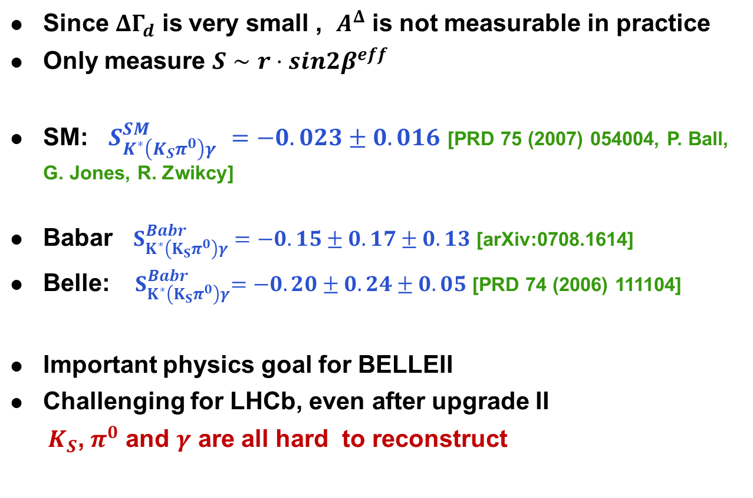
$$B^{0}→{K^{∗0}(K}_{S}π^{0})γ$$
Since $ΔΓ_{d}$ is very small , $A^{Δ}$ is not measurable in practice
Only measure $S∼r⋅sin2β^{eff}$
SM: $S_{K^{∗}\left(K_{S}π^{0}\right)γ }^{SM}=−0.023±0.016$ [PRD 75 (2007) 054004, P. Ball, G. Jones, R. Zwikcy]
Babar $S_{K^{∗}\left(K_{S}π^{0}\right)γ}^{Babr}=−0.15±0.17±0.13$ [arXiv:0708.1614]
Belle: ${ S}_{K^{∗}\left(K_{S}π^{0}\right)γ}^{Babr}=−0.20±0.24±0.05$ [PRD 74 (2006) 111104]
Important physics goal for BELLEII
Challenging for LHCb, even after upgrade II
$K_{S}$,${ π}^{0}$ and $γ$ are all hard to reconstruct
6

Slide 7

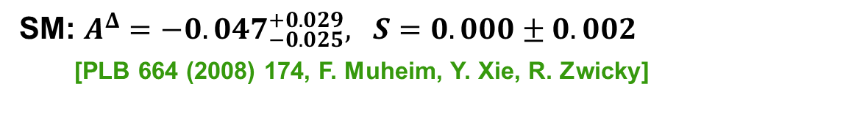
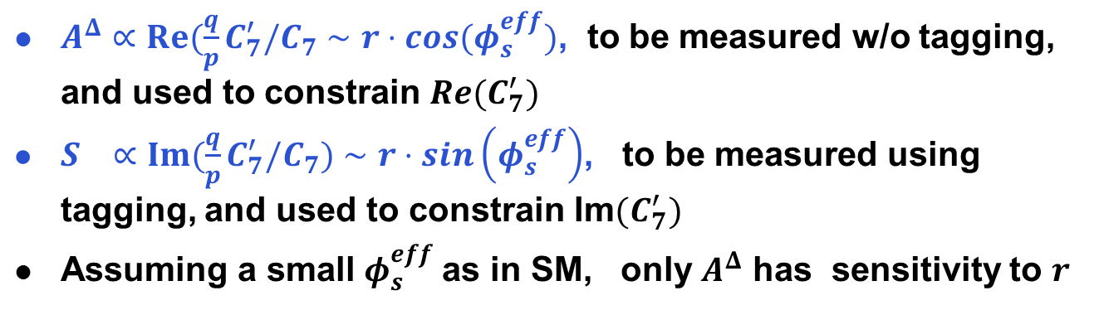
LHCb golden mode $B_{s}^{0}→φγ$
New observable $H≡−A^{Δ}$ in addition to $S$, due to large $ΔΓ_{s}$
$A^{Δ}∝Re(\frac{q}{p}C_{7}^{′}/C_{7}∼r⋅cos(φ_{s}^{eff})$, to be measured w/o tagging, and used to constrain $Re(C_{7}^{′})$
$S ∝Im(\frac{q}{p}C_{7}^{′}/C_{7})∼r⋅sin\left(φ_{s}^{eff}\right)$, to be measured using tagging, and used to constrain Im$(C_{7}^{′})$
Assuming a small $φ_{s}^{eff}$as in SM, only $A^{Δ}$ has sensitivity to $r$
SM: $A^{Δ}=−0.047_{−0.025}^{+0.029}, S=0.000±0.002$
[PLB 664 (2008) 174, F. Muheim, Y. Xie, R. Zwicky]
7

Slide 8



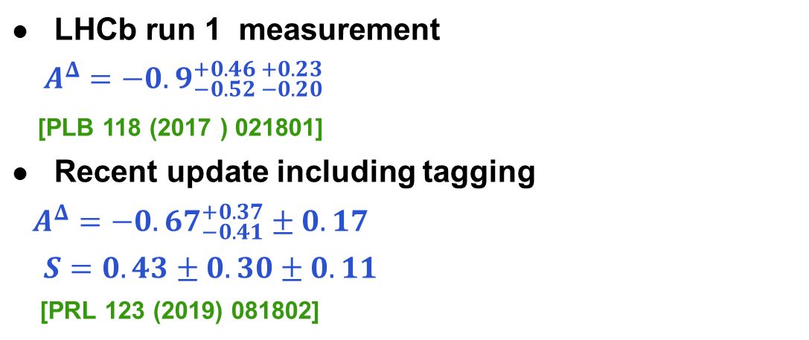
$B_{s}^{0}→φγ$ results
LHCb run 1 measurement
$A^{Δ}=−0.9_{−0.52 −0.20}^{+0.46 +0.23}$
[PLB 118 (2017 ) 021801]
Recent update including tagging
$$A^{Δ}=−0.{67}_{−0.41}^{+0.37}±0.17$$
$S=0.43±0.30±0.11$
[PRL 123 (2019) 081802]
$$B_{s}$$
$${\overline{B}}_{s}$$
Run 2 analysis in progress and
Very promising prospect with
8

Slide 9



CPV in $B^{0}→K_{S}π^{+}π^{−}γ$
Measure phase space integrated CPV
[Babar, PRD 93 (2016) 052013]
Only interested in CP-conjugate model $f_{CP}γ=K_{S}ρ^{0}γ$ among the complex resonance structure
Extract dilution factor using $B^{+}→K^{+}π^{+}π^{−}γ$assuming isospin symmetry
9

Slide 10

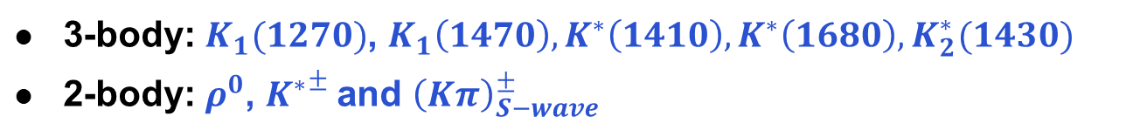
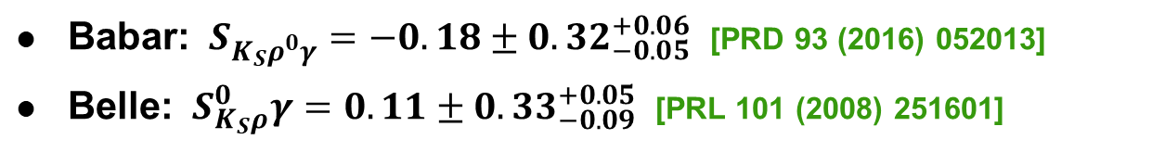
Resonances in $B^{+}→K^{+}π^{+}π^{−}γ$
3-body: $K_{1}(1270)$, $K_{1}\left(1470\right), K^{∗}\left(1410\right), K^{∗}\left(1680\right), K_{2}^{∗}(1430)$
2-body: $ρ^{0}$, ${K^{∗}}^{±}$and ${\left(Kπ\right)}_{S−wave}^{±}$
Babar: $S_{K_{S}ρ^{0}γ}=−0.18±0.32_{−0.05}^{+0.06}$ [PRD 93 (2016) 052013]
Belle: ${ S}_{K_{S}ρ}^{0}γ=0.11±0.33_{−0.09}^{+0.05}$ [PRL 101 (2008) 251601]
10

Slide 11


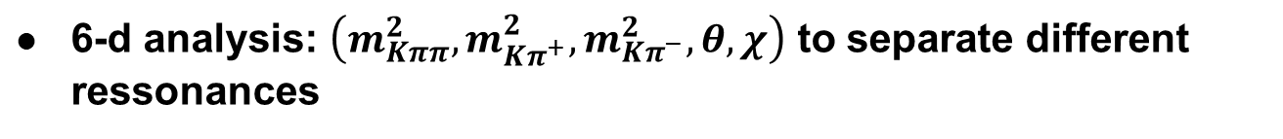
New strategy for $B^{0}→K_{S}π^{+}π^{−}γ$
[PLB 763 (2016) 66, E. Kou et al.]
Extract $C_{7}^{′}$ from a tagged time-dependent amplitude analysis, instead of measuring phase-integrated CPV
Sum over all resonances
6-d analysis: $\left(m_{Kππ}^{2},m_{Kπ^{+}}^{2},m_{Kπ^{−}}^{2},θ,χ\right)$ to separate different ressonances
11

Slide 12

$B^{0}→K_{J}γ$ weak amplitudes
Wilson coefficients $C_{7}^{′}$ and $C_{7}$ enter $A(B→K_{J}V$)
[JHEP 04 (2017) 027, A. Paul and D. Straub]
theoretical inputs: FFs $T(0)$, complex numbers $h_{L} \& h_{R}$
Spin factors
12

Slide 13

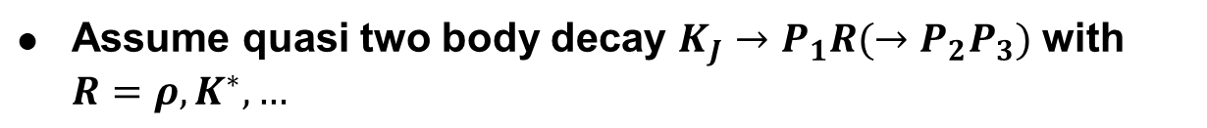
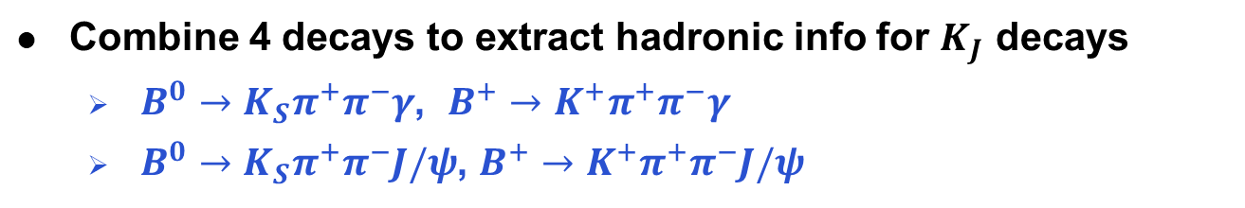
$K_{J}→Kππ$ amplitudes
Properties of $K_{J}→Kππ$ poorly known
Assume quasi two body decay $K_{J}→P_{1}R(→P_{2}P_{3})$ with $R=ρ, K^{∗}, …$
Combine 4 decays to extract hadronic info for $K_{J}$ decays
  $B^{0}→K_{S}π^{+}π^{−}γ$, $B^{+}→K^{+}π^{+}π^{−}γ$
  $B^{0}→K_{S}π^{+}π^{−}J/ψ$, $B^{+}→K^{+}π^{+}π^{−}J/ψ$
13

Slide 14
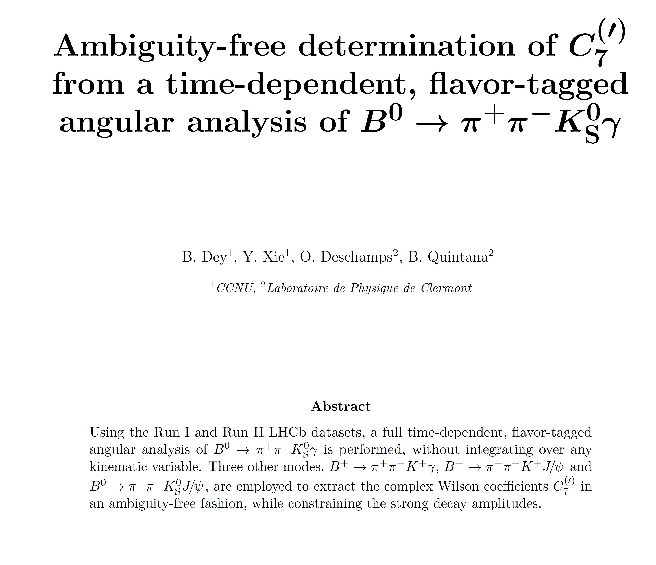

$B^{0}→K_{S}π^{+}π^{−}γ$ status at LHCb
An initial study is ongoing with run 2 data: ~5000 signals
Ultimate goal: physics case for phase 2 upgrade
14

Slide 15

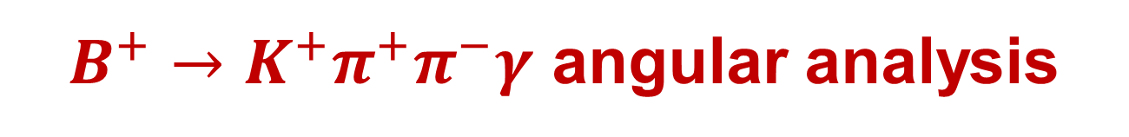


$B^{+}→K^{+}π^{+}π^{−}γ$ angular analysis
angular analysis to measure
photon polarization = $K_{res}$ polarization
Up-down asymmetry
$$=kλ_{γ}$$
The decay factor $k$ needs be estimated in theory or using a control mode (see talk by W. Wang)
15

Slide 16
$B^{+}→K^{+}π^{+}π^{−}γ$ angular analysis
[PRL 112 (2014) 161801]
Observation of photon polarization at 5.2 $σ$ significance
16

Slide 17
$$Λ_{b}^{0}→Λ^{0}γ$$
Angular distribution
First observation
[PRL 123 (2019) 031801]
17

Slide 18

$B^{0}→K^{∗0}e^{+}e^{−}$ at low $q^{2}$
Angular distribution
Observables
18

Slide 19

$B^{0}→K^{∗0}e^{+}e^{−}$ results
[JHEP 04 (2015) 064]
19

Slide 20
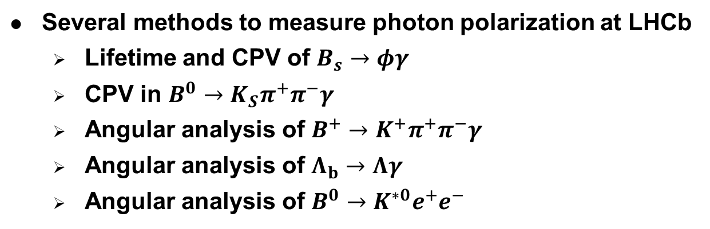
Summary
Several methods to measure photon polarization at LHCb
  Lifetime and CPV of $B_{s}→φγ$
  CPV in $B^{0}→K_{S}π^{+}π^{−}γ$
  Angular analysis of $B^{+}→K^{+}π^{+}π^{−}γ$
  Angular analysis of $Λ_{b}→Λγ$
  Angular analysis of $B^{0}→K^{∗0}e^{+}e^{−}$
20

Slide 21
Backup slides
21

Slide 22
c
M
22

