Slide 1



Physics potential for top threshold run at e⁺e⁻ collider
Yaquan Fang (IHEP) on behalf of colleagues
working on physics for top run
CEPC Day
Dec 30, 2019

Slide 2
Motivation
CLIC/ILC/FCC-ee did include the studies of top measurement:
  0.5 ab⁻¹ around 350 GeV -> Scan for top mass/width measurement.
  1.5 ab⁻¹ at 365 GeV -> Coupling measurement
Request from IAC to consider the top threshold running at CEPC
Accelerator colleagues ask us to evaluate the scientific benefits for such run:
  e.g. which energy is preferred?
  What precision we can achieve for the mass and coupling measurement?
  New physics?
Fcc-ee

Slide 3

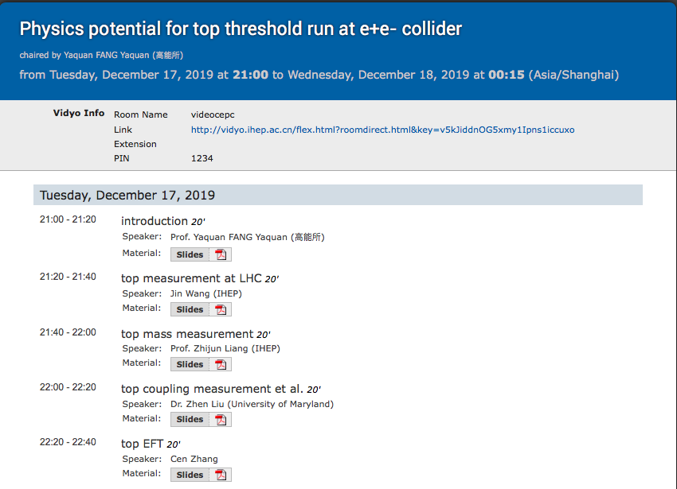
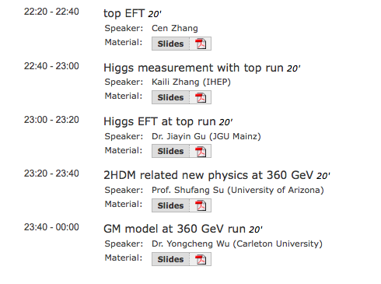
An informal meeting to discuss these
https://indico.ihep.ac.cn/event/11160/

Slide 4
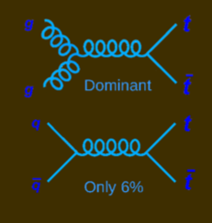
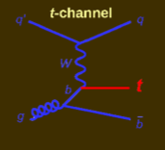
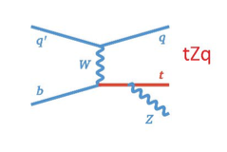
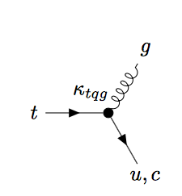
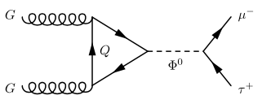
Top at LHC
Jin Wang
ttbar
Single top
Top mass:
  Currently reach ~0.5 GeV precision
  High Lumi expectation: ~200 MeV
  Tevetron ~ 1GeV
Cross section:
  2.4% (ATLAS/36.1 fb⁻¹)
  HL-LHC top Yukawa coupling : ~10%
Search for new physics:
  Flavor changing neutral currents (FCNC)
  Charged Lepton-flavor violation (cLFV)
tZq: Recent observation
in 2018
/γ/z/H⁰

Slide 5
top mass measurement

Slide 6
Top mass measurement at e⁺e⁻ with energy scan around 340-350 GeV
Zhijun Liang
NNLO theoretical computation of the xsection shows a peak with the energy scan around 340-350 GeV
ISR reduces the xsection with 40%; Luminosity Spectrum (LS) dilutes the peak.

Slide 7
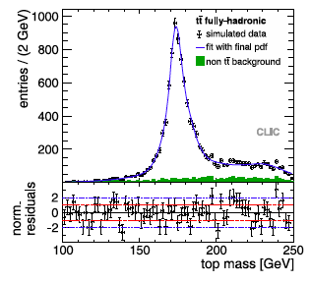
Top mass measurement at e⁺e⁻ with energy scan around 340-350 GeV
Top mass can be well reconstructed with the kinematic fit on W mass constraint.
10 energy points (1 GeV step) are scanned with a global fit to measure the top mass.
More aggressively, 4 energy points can be scanned to fit the mass.

Slide 8
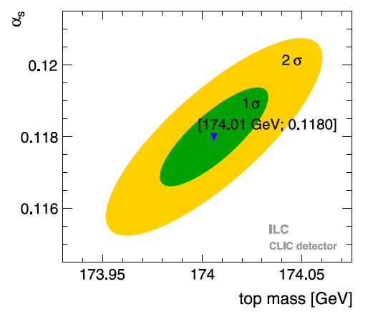
top mass measurement : results
We can rescale the precision of the mass measurement
as a function of Luminosity.
LS has be to recomputed for our case.
E.g. aim for ~15 MeV precision with Luminosity around
200-400 fb⁻¹.

Slide 9
measurements of top coupling

Slide 10
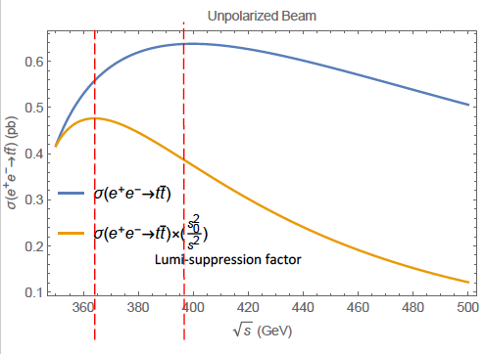
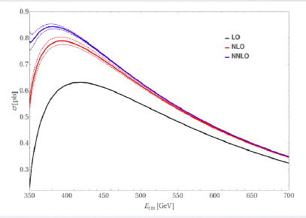
Top coupling measurements: why FCC-ee choosing 365 GeV?
Zhen Liu, Liantao Wang et al.
LO
365 GeV
Jurgen R.Reuter
Maximal NNLO xsection: @381.3GeV
With the NNLO calcuation, the highest xsection is at the energy of 381.3 GeV
Considering the Lumi-suppression factor when going to higher energy, the effective highest xsection is around 365 GeV.
The effective xsection from 360 GeV is not much different from that of 365 GeV.
If we choose higher order correction, the peak could be even lower than 360 GeV.

Slide 11
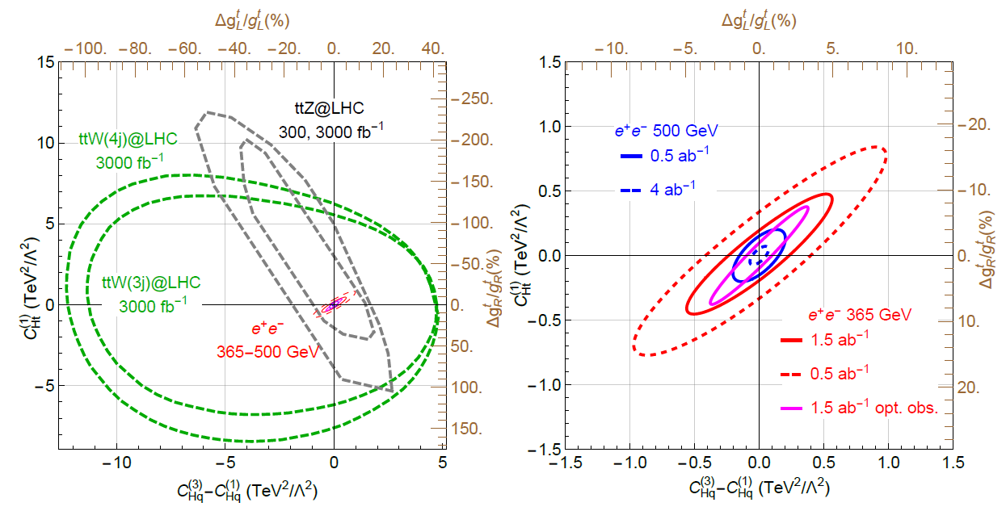
Measurement of the coupling
Zhen Liu, Liantao Wang et al
More can be found at : 1510.09056, 1809.03520, 1807.02121, 1907.10619, 1303.3758, 1310.0563,1505.06020

Slide 12
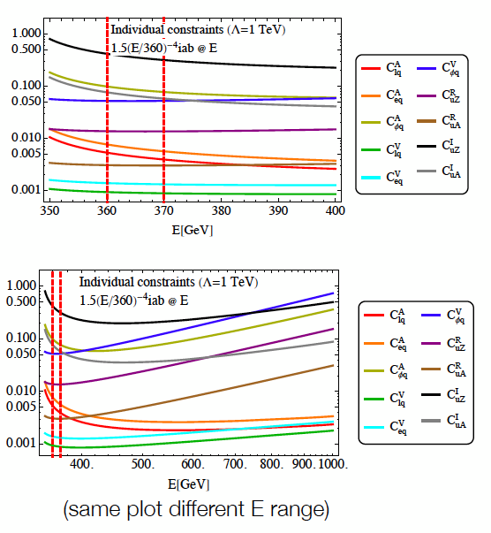
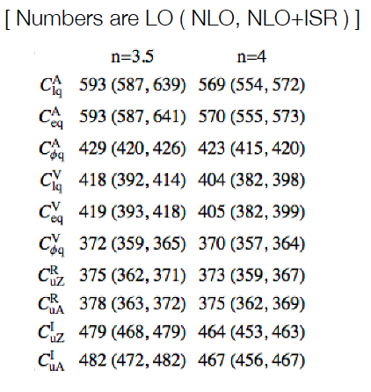
Best energies for the measurements of EFT operators
Cen Zhang

Slide 13
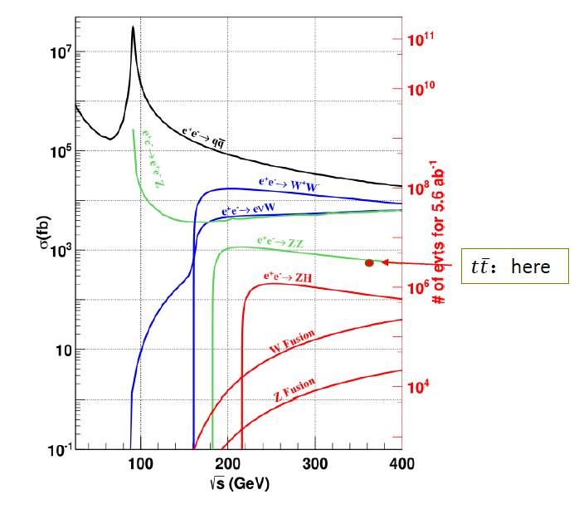
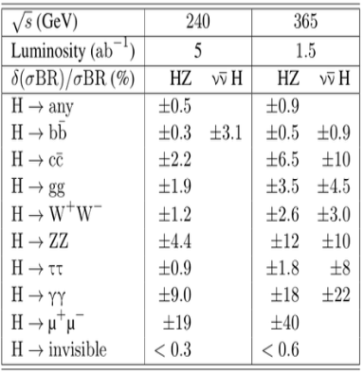
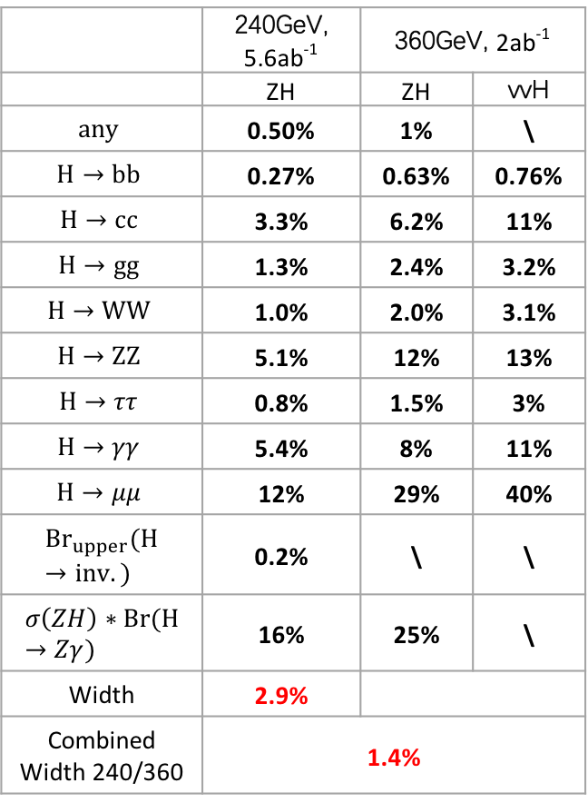
Additional sensitivity on Higgs measurement
Kaili Zhang
 | 240GeV, 5.6ab⁻¹ | 360GeV, 2ab⁻¹
 | ZH | ZH | vvH
$$any$$ | 0.50% | 1% | \
$$H→bb$$ | 0.27% | 0.63% | 0.76%
$$H→cc$$ | 3.3% | 6.2% | 11%
$$H→gg$$ | 1.3% | 2.4% | 3.2%
$$H→WW$$ | 1.0% | 2.0% | 3.1%
$$H→ZZ$$ | 5.1% | 12% | 13%
$$H→ττ$$ | 0.8% | 1.5% | 3%
$$H→γγ$$ | 5.4% | 8% | 11%
$$H→μμ$$ | 12% | 29% | 40%
$${Br}_{upper}(H→inv.)$$ | 0.2% | \ | \
$$σ\left(ZH\right)∗Br(H→Zγ)$$ | 16% | 25% | \
Width | 2.9%
Combined Width 240/360 | 1.4%
Fcc-ee 240 GeV/365 GeV:
CERN-ACC-2018-0057
combined width: 1.3%
For Higgs physics results, there are no significant different for the colliding energy with 360 GeV or 365 GeV.

Slide 14
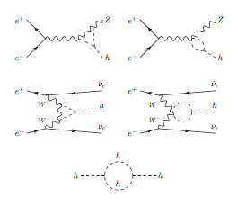
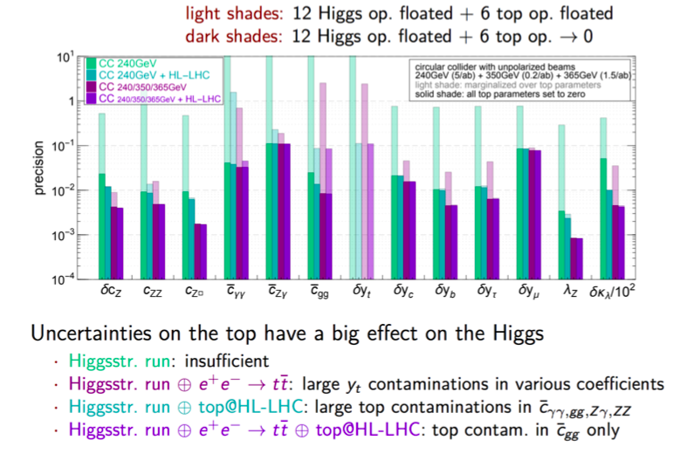
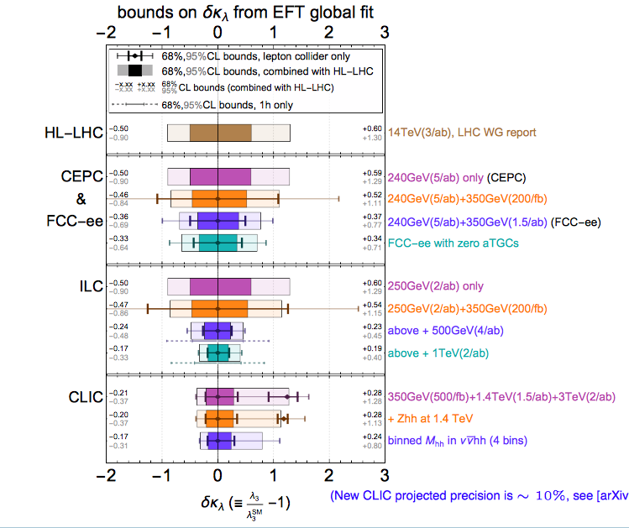
Impact on Higgs
Triple Higgs coupling:
Jiayin Gu, Cen Zhang

Slide 15
New physics

Slide 16
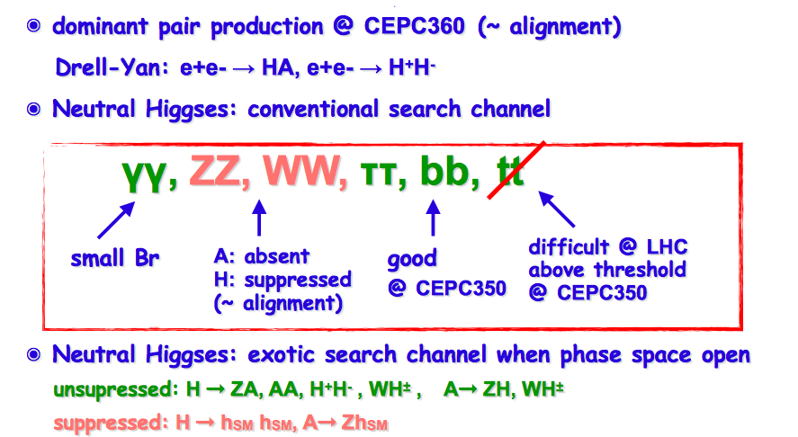
2HDM model
Shufang Su

Slide 17
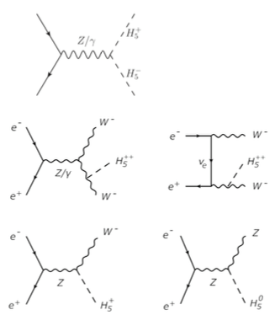
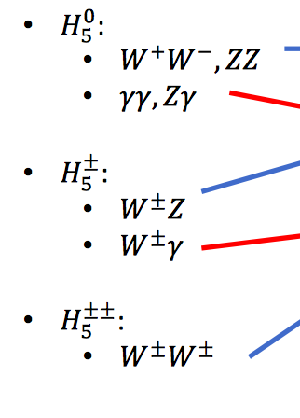
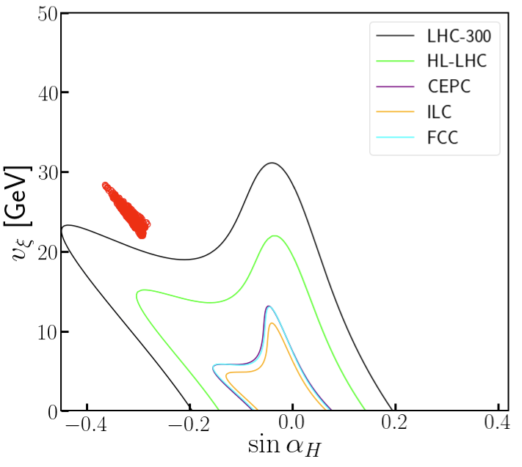
Georgi-Machacek (GM) models
Yongcheng Wu
GM Models: SM + one complex triplet + one real triplet

Slide 18
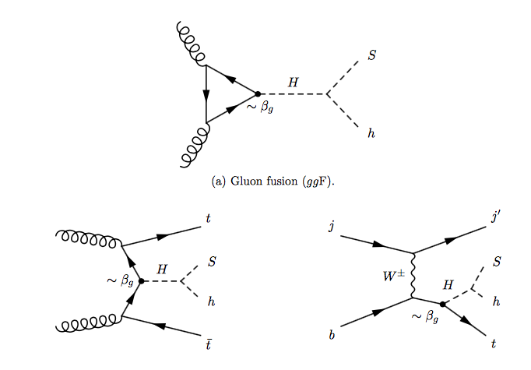
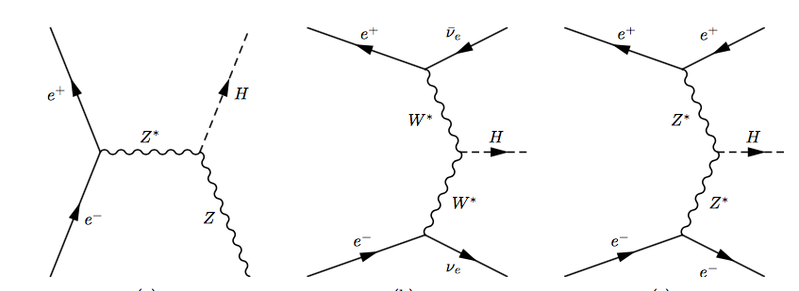
H→sh （2HDM+S） study and its impact on top mass measurement at e⁺e⁻ collider
LHC:
e⁺e⁻:
H: 260-270 GeV
360-365 GeV run at e+e- will be an ideal place to search for this
Bruce Mellado and Yaquan Fang :
JHEP 1910 (2019) 157

Slide 19
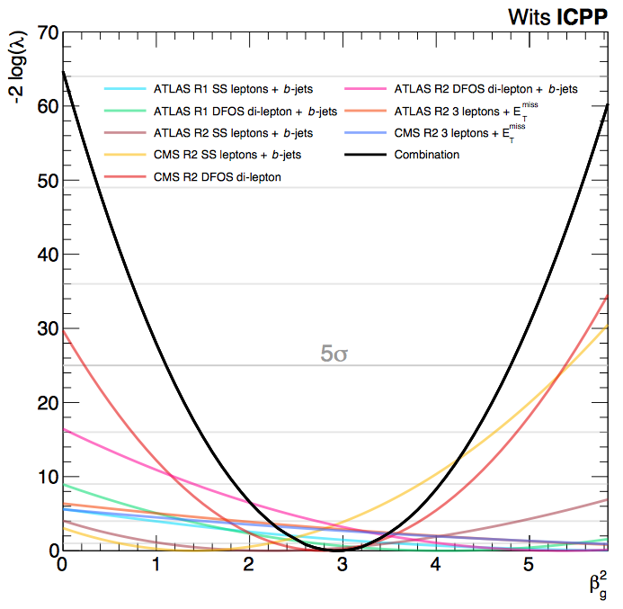
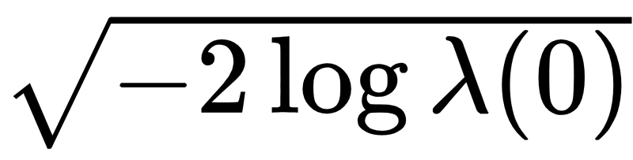
Multi-lepton anomalies at the LHC
JHEP 1910 (2019) 157
Simultaneous fit for all measurements:
To the right: (-2 log) profile likelihood ratio for each individual result and the combination of them all
The significance for each fit is calculated as
Best-fit: β_{g}² = 2.92 ± 0.35
Corresponds to 8.04σ
Interpretation: Measure of the inability of current MC tools to describe multiple-lepton data and how a simplified model with H→Sh is able to capture the effect with one parameter
6

Slide 20
Excesses in di-leptons with full-jet veto not included above
Run 2
arXiv:1909.04370
Overall, MCs do a good job describing data except for m_{ll}<100 GeV
Run 1, J.Phys. G45 (2018) no.11, 115003
QCD NNLO to qq→WW, NLO QCD to gg→WW and NLO EW corrections applied

Slide 21
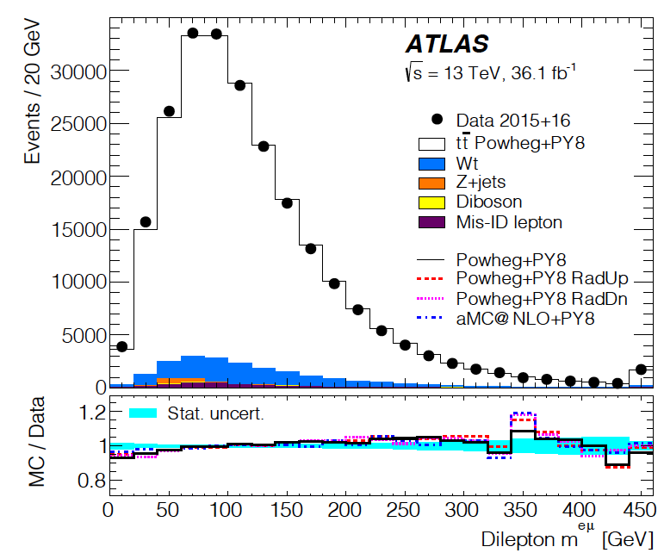
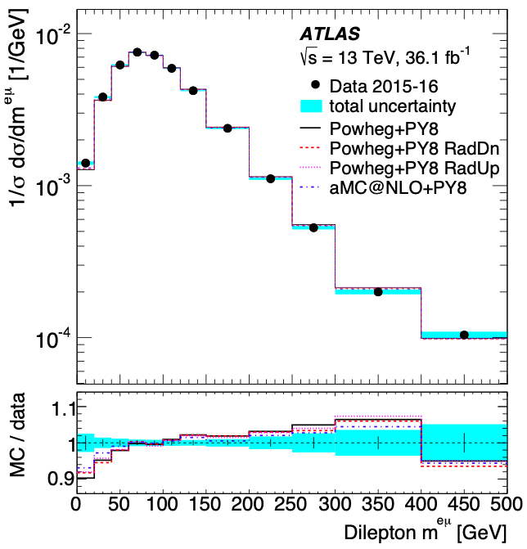
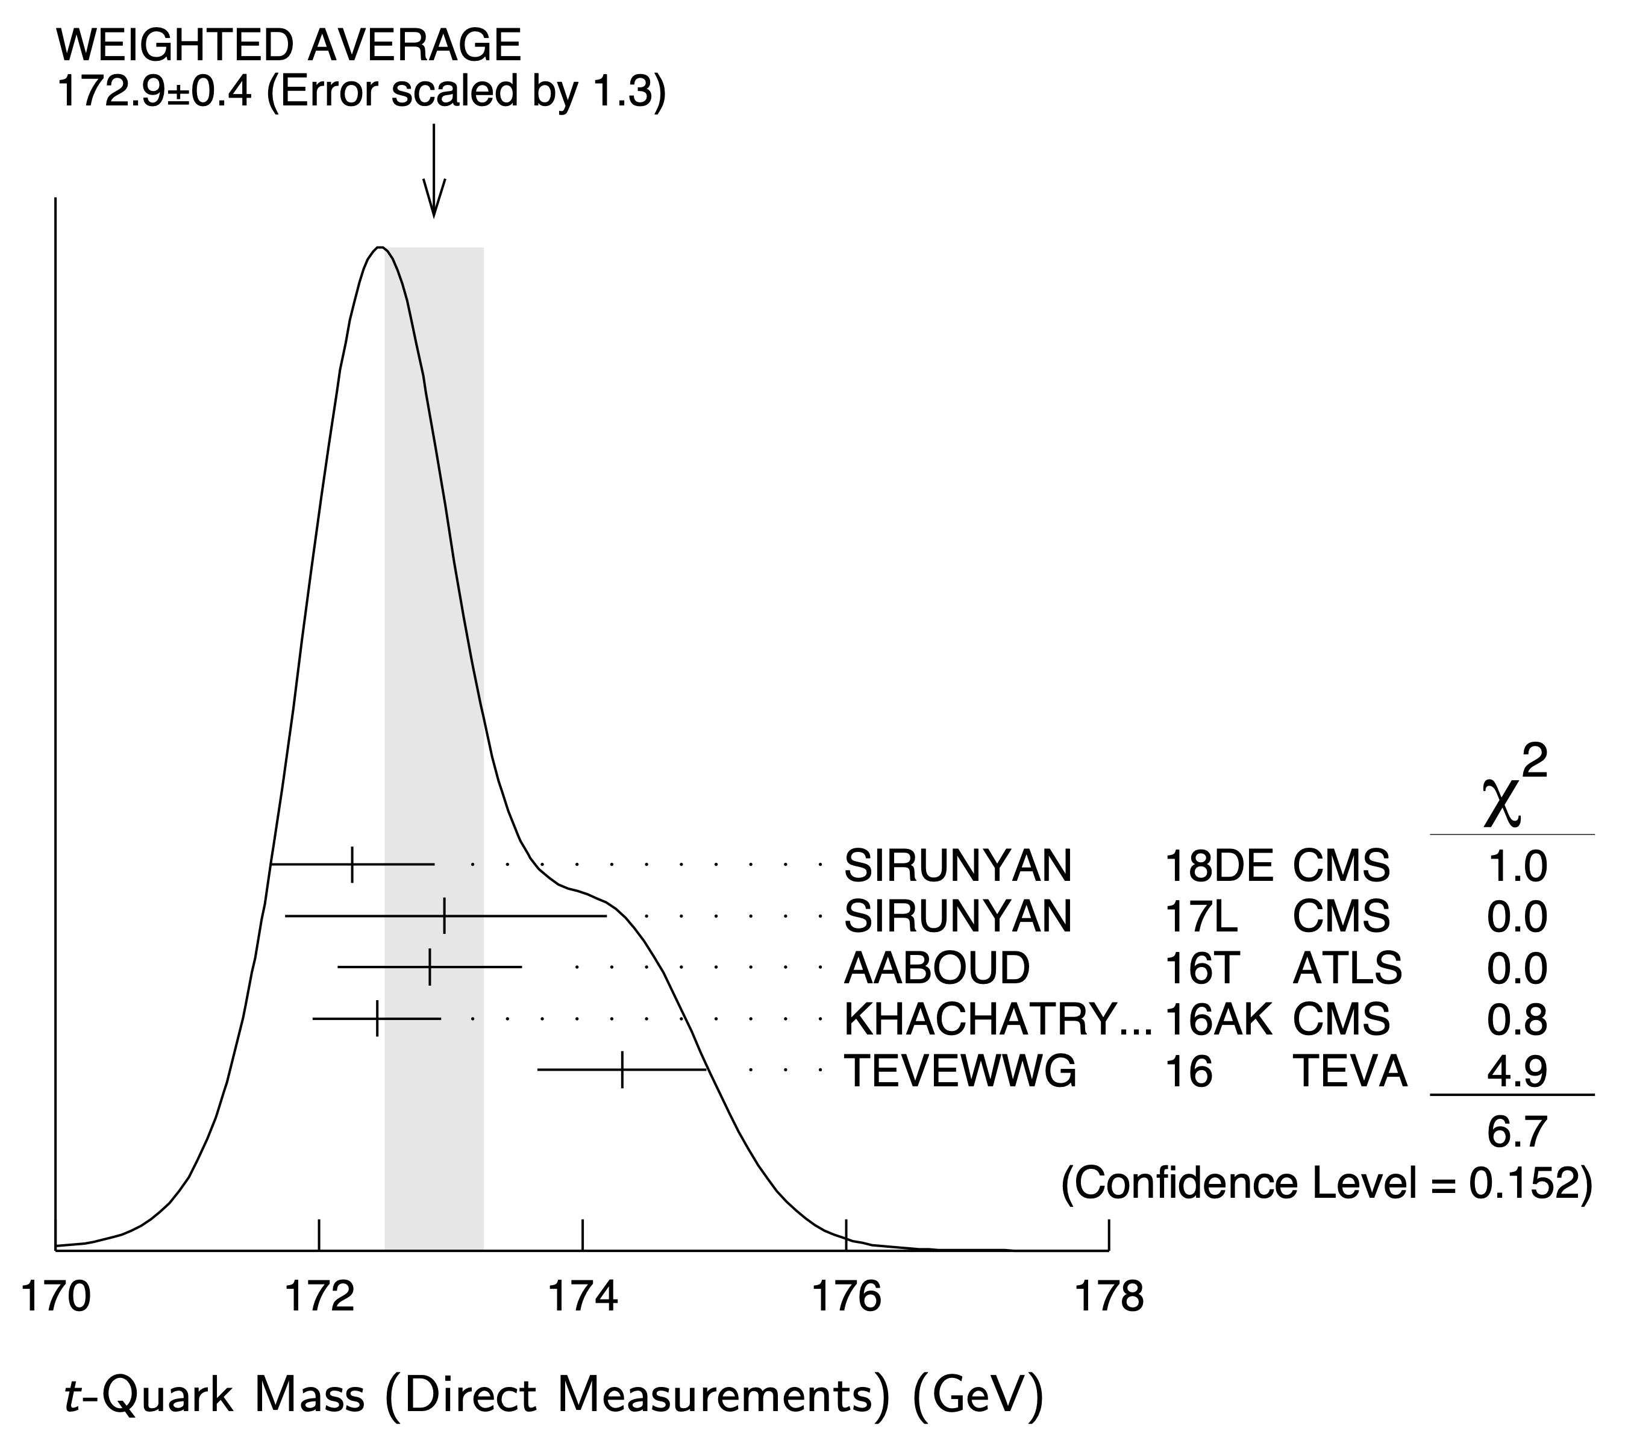
Recent results from di-leptons with b-jets
arXiv:1910.08819
Residual discrepancies at high m_{ll} will be fixed with missing NNLO QCD and NLO EW corrections
Excess at low m_{ll} remains prevalent, indicating that effects seen in Run 1 were not statistical fluctuations. Preliminary NNLO QCD corrections do not fix the issue (see Mitov et al. below)

Slide 22

Conclusion
The target accuracy of e⁺e⁻ for top mass measurement is O(10) MeV and in a model independent way.
Considering the run for top coupling measurement at CEPC, 360 GeV should be safe.
  Need to investigate the feasibility of running with a lower energy.
  The expected precision for the coupling is much better than LHC.
360 GeV run is helpful for the Higgs width measurement.
  The results are not much different from the running of 365 GeV.
Some thoughts of new physics with 360 GeV are addressed.
finalize the studies with a white paper eventually?
Welcome to join the
efforts

Slide 23
backup slides

Slide 24



Measurement of Higgs width
Method 1: Higgs width can be determined directly from the measurement of σ(ZH) and Br. of (H->ZZ*)
  But the uncertainty of Br(H->ZZ*) is relatively high due to low statistics.
Method 2: It can also be measured through:
These two orthogonal methods can be combined to reach the best precision.
Precision : 5.1%
3.0%
Precision : 3.5%
Precision : 2.8%

Slide 25
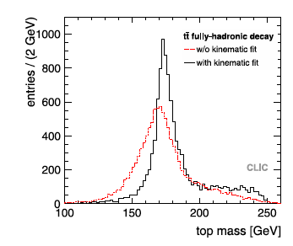
the impact of Kinematic fit on top mass measurement

Slide 26
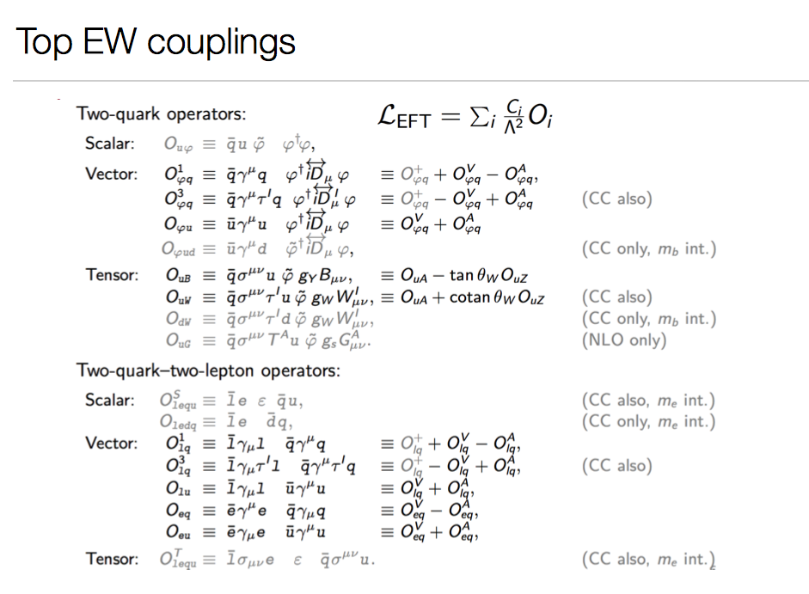
EFT Operators

Slide 27
Multi-lepton anomalies at the LHC
JHEP 1910 (2019) 157
Simultaneous fit for all measurements:
To the right: (-2 log) profile likelihood ratio for each individual result and the combination of them all
The significance for each fit is calculated as
Best-fit: β_{g}² = 2.92 ± 0.35
Corresponds to 8.04σ
Interpretation: Measure of the inability of current MC tools to describe multiple-lepton data and how a simplified model with H→Sh is able to capture the effect with one parameter
6

Slide 28
Top mass measurement: LHC vs Tevetron
It has been noted by few authors that the top mass measurements at the LHC (~172 GeV) are systematically lower than that of the Tevatron (~174 GeV)
See e.g., https://iopscience.iop.org/article/10.1088/1361-6471/44/6/063001
Measurement in e⁺e⁻ is essential to understand the top mass with precision.

Slide 29
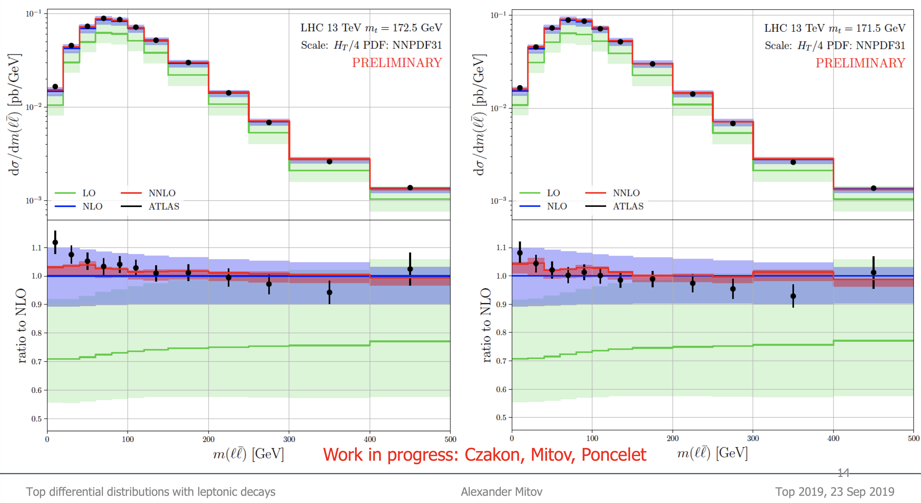
Shape of m_{ll} differential distribution is not described with NNLO QCD corrections. The description (specially at low m_{ll}) improves with lowering the top mass diverging away even more from the Tevatron measurement. The anomalies at low m_{ll} pull the top mass measurements towards lower values.

