Slide 1
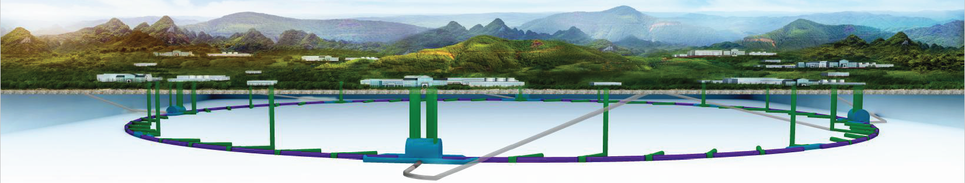
CEPC injection extraction hardware R&D status
CEPC day，Dec. 30, 2019 at IHEP in Beijing
Jinhui Chen, X.H. Cui, D. Wang, Yiwei Wang, Lei Wang, Yuwen Wu, Hua Shi
Injection group
2019-12-30

Slide 2
Outline
1
Overview of CEPC Inj./Ext. systems
2
Inj./Ext. systems layout preliminary design
3
Hardware design consideration
4
Summary

Slide 3
Overview of the CEPC injection and extraction systems

Slide 4
CEPC injection and extraction systems
There are 9 injection and extraction sub-systems in CEPC accelerator complex, including:
DR injection and Extraction system(e+)
Booster LE injection system (e+,e-)
Booster Extraction system1 (e+,e-)
Collider off-axis injection system (e+,e-)
Booster Extraction system2 (e+,e-)
Booster HE injection system (e+,e-)
Collider swap out injection system (e+,e-)
Collider swap out extraction system (e+,e-)
Collider beam dump system(e+,e-)
Off-axis injection
(in W and Z mode)
On-axis injection
(only in Higgs mode)
③
④
⑤
⑦
①
②
Linac
Booster
⑥
⑧
Collider
⑨
dump
1.1GeV
10~120GeV
120GeV
DR

Slide 5
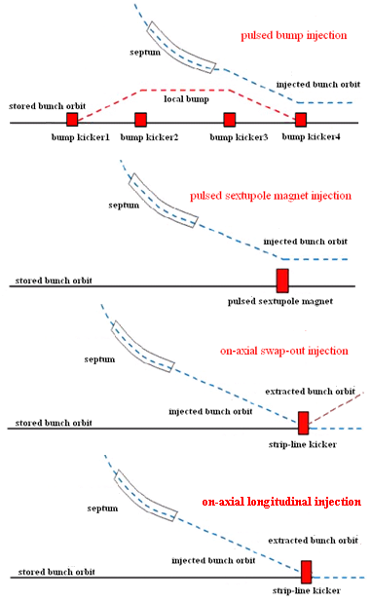
Injection Schemes Considerations
Top-up injection schemes for low emittance rings:
  Off-axis injection (need larger DA)---accumulating injection
    Pulsed local bump injection
    Pulsed septum field injection
      multi-pole magnet injection
      Nonlinear kicker injection
  On-axis injection (need smaller DA)
    Transverse swap-out injection
    Longitudinal accumulating injection
  For the CEPC, from the Linac to the damping ring then to the booster and the collider rings, the beams are injected and extracted all by on-axis scheme.
  In the collider rings，the both off-axis accumulating injection schemes are applicable for W and Z mode due to larger DA. On-axis swap-out injection scheme is the baseline one for Higgs mode for smaller DA. In this mode, the beams are accumulated by off-axis injection in the booster ring.

Slide 6
Injection components design considerations
Injection and extraction components: Kicker and septa
Lambertson magnet is the first choice for the septa, since there is height difference between the machines. Lambertson is more reliable than other types of septa with typical septum width of from 2mm to 10mm.
Which type of Kicker to choose is usually determined by the injection scheme, the waveform of pulse and required kick strength.
The waveform of kicker pulse is determined by injection scheme, filling pattern and revolution period.
The width of septum, kick strength and length of injection straight section should be considered together.
A reasonable injection and extraction region layout design is very important for hardware design. This part is not available in CEPC CDR.
In the past 3 months， the preliminary injection layout design was done. So far, we just figured out what kind type of the components needed in all subsystems. And we just proposed a hardware R&D plan in the coming years.

Slide 7
CEPC injection and extraction systems layout preliminary design

Slide 8
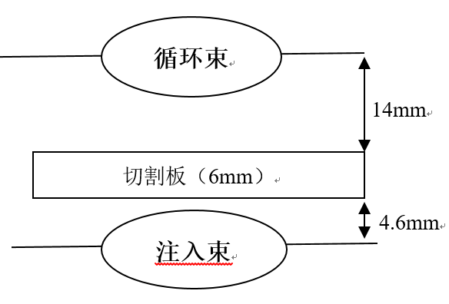
Damping Ring injection and extraction
On-axis bunch-by-bunch injection
Injection and extraction systems are totally occupied 2 long straight sections.
1.1GeV，75.4m
Inj.& ext. straight sections
125ns
10ms
250ns
Side view
ϴ_{v}=1.5mrad
21.95mm
21.2mm
17.45mm?
Storage Beam
Q
Q
Q
0.25m
7.6mm
1.25m
0.5m
2.5m
4.5m
Septum Plate 6mm
Top view
Injection Beam
7.6mm
ϴ_{H}=100mrad
150mm
Q
25mm
Q
Q
Lambertson
kicker
Lambertson: length=0.5m, deflection angle=100mrad, B=0.72T
thickness of septum sheet=6mm Leakage field=<5E-4(0.8mm) Beam-Stay-clear(HxV)=25x15mm
Fast kicker: pulse width<250ns, repetition rate=100Hz, length=0.25m, deflection angle=1.5mrad, B=0.02T, Beam-Stay-clear(HxV)=32x18.8mm (slotted pipe kicker)

Slide 9
Parameters of Hardware of DR
Kicker: Slotted pipe kicker
Septa: horizontal Lambertson magnet
 | Injection | extraction
Energy（GeV） | 1.1 | 1.1
Bunch number | 2 | 2
Bunch spacing（ns） | 125 | 125
Injection（extraction）mode | Bunch by bunch | Bunch by bunch
Kicker repetition rate (Hz) | 100 | 100
Kicker pulse width (ns) | <250 | <250
Kicker rise（fall）time (ns) | <125 | <125
Timing delay(ns) | <125 | <125
Kick angle (mrad) | 1.5 | 1.5
Kicker Integral magnetic field strength (Tm) | 0.006 | 0.006
Length of kicker（m） | 0.25 | 0.25
Kick strength（T） | 0.024 | 0.024
Kicker Beam-Stay-clear(HxV)（mm） | 32x18.8 | 32x18.8
Kicker good field region (HxV)（mm） | 38x22？ | 38x22？
Kicker field uniformity（%） | 1 | 1
Septa deflection angle（mrad） | 100 | 100
Septa Integral magnetic field strength （Tm） | 0.36 | 0.36
Septa board thickness（mm） | 6 | 6
Septa Circulating Beam-Stay-clear(HxV)（mm）
Septa Injected beam-stay-clear（HXV）（mm）
Septa good field region (HxV)（mm）
septa field uniformity（%）

Slide 10
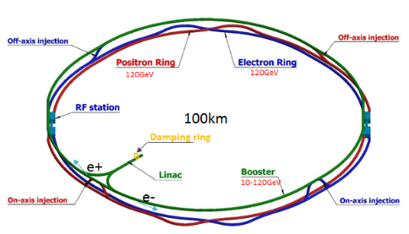
Booster LE injection
On-axis bunch-by-bunch injection
Side view
ϴ_{V}=0.11mrad
30.22mm
30mm
11.19mm
Q
Q
22.5m
2m
171m
1m
Storage Beam
196m
10mm
Top view
12.7mm
Septum Plate 10mm
300mm
10mm
Q
Q
Injection Beam
ϴ_{H}=12.7mrad
Lambertson
Q
Q
Q
kicker
50ns,100Hz
Kicker: vertical strip-line kicker driven by DSRD pulser
Septa: horizontal Lambertson magnet

Slide 11
Booster HE extraction for CR off-axis injection
Train by train or bunch-by-bunch extraction
Top view
ϴ_{H}=0.2mrad
0.07mm
30mm
33mm
Q
Q
0.7m
156m
15m
24m
Storage Beam
Side view
196m
10mm
ϴ_{V}=9.5mrad
300mm
Septum Plate 10mm
Q
Q
Q
Q
71mm
Q
Injection Beam
10mm
Dipole kicker
Lambertson
1kHz
40~2000ns
200ns
200ns
Kicker: horizontal out-vacuum delay-line dipole kicker(coating ceramic vacuum chamber) driven by PFN-based solid-state pulser
Septum: vertical Lambertson magnet

Slide 12
Collider ring off-axis injection
Top view
pulsed local bump scheme
Storage Beam
ϴ_{H}=0.1mrad
10mm
10mm
?mm
5mm
Q
Q
0.7m
35m
0.7m
Septum Plate 2mm
Injection Beam
3mm
Side view
300mm
?mm
ϴ_{V}=28mrad
Dipole kicker: horizontal out-vacuum delay-line kicker+coating ceramic chamber+PFN-based solid-state pulser
NLK kicker: horizontal out-vacuum delay-line NLK kicker+coating ceramic chamber+PFN-based solid-state pulser
Septa: Vertical Lambertson magnet
Q
Q
kicker
Lambertson
Dipole kicker
pulsed multipole injection scheme
Top view
ϴ_{H}=0.1mrad
13.5mm
10mm
?mm
Q
Q
35m
0.7m
Side view
ϴ_{V}=28mrad
?mm
1kHz
40~2000ns
Q
Lambertson
NLK
Q
200ns
200ns

Slide 13
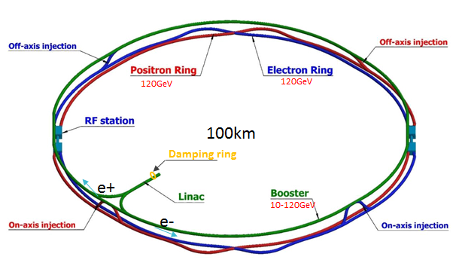
On-axis swap-out injection layout
Off-axis injection is used in the process of the booster high-energy re-injection. Both puled multipole injection and pulsed bump injection are suit.
On-axis swap out injection is applied in CR. A set of dipole kicker can serve both injection and extraction process.
Dipole kicker: horizontal ferrite core out-vacuum kicker+coating ceramic chamber+LC resonance pulser
Inj. NLK: horizontal NLK or Pulsed sextupole+coating ceramic chamber+LC resonance pulser
Septum: Vertical Lambertson magnet
NLK or Pulsed sextupole magnet+ ceramic vacuum chamber
Dipole kicker+ ceramic vacuum chamber
0.333ms,1kHz
1360ns,1kHz
NLK
LMS
LMS
Kicker
Booster
Side view
down
up
down
Kicker
up
E- CR
Storage Beam
LMS
LMS
5mm
NLK
Kicker
Booster
LMS
Septum Plate 10mm
Top view
1360ns,1kHz
LMS
Injection Beam
5mm
out
in
out
E- CR
LMS
LMS
Kicker

Slide 14
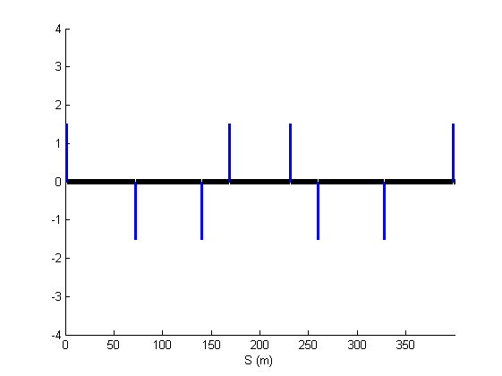
Dump extraction
Train by train or bunch-by-bunch extraction
Top view
ϴ_{H}=0.11mrad
23.85mm
20mm
?mm
Q
Q
?m
35m
125m
0.7m
25m
?m
Side view
?mm
Storage Beam
ϴ_{V}=26mrad
Q
5mm
Q
450mm
Lambertson
kicker
Septum Plate 10mm
1kHz
Injection Beam
5mm
40~2000ns
200ns
200ns
Dipole kicker: horizontal out-vacuum delay-line kicker+coating ceramic chamber+PFN-based solid-state pulser
Septa: Vertical Lambertson magnet

Slide 15
Booster Ring
Booster operating mode | Higgs |  |  | W |  | Z
Beam energy（GeV） | 10 | 120 |  | 10 | 80 | 10 | 45.5
Function | Injection （both） | Extraction （off-axis） | Inj./Ext. （on-axis） | Injection （off-axis） | Extraction （off-axis） | Injection （off-axis） | Extraction （off-axis）
Bunch number | 242（in half ring） |  | 7（in half ring） | 1524（uniform） |  | 6000
Min. bunch spacing （ns） | 680 |  | 23800 | 220 |  | 25
Bunch number per train× train number | - |  | - | - | - | 80×75
Train spacing （ns） | - |  | - | - | - | 2460
Injection（extraction）mode | Bunch by bunch |  |  | Bunch by bunch |  | Bunch by bunch | Train by train
Kicker repetition rate (Hz) | 100 | 1000 |  | 100 | 1000 | 100 | 1000
Kicker pulse width (ns) | 1360 |  |  | 440 |  | 50 | <6900
Kicker flat top（ns） | - |  |  | - |  | - | >1980
Kicker rise（fall）time (ns) | <680 |  |  | <220 |  | <25 | <2460
Timing delay(ns) | <680 |  | <23800 | <220 |  | <2460 | <4400
injection（extraction）period (s) | 2.42 | 0.242 | 0.007 | 15.24 | 1.5 | 60 | 0.075
Kick angle (mrad) | 0.11 | 0.2 | 0.1 | 0.11 | 0.2 | 0.11 | 0.2
Kick Integral field strength (Tm) | 0.004 | 0.08 | 0.04 | 0.004 | 0.05 | 0.004 | 0.03
Beam pipe aperture Φ（mm） | 55
Considering the compatibility of three operating modes:
Function | LE-Injection （both） | HE-Extraction （off-axis） | HE-Inj./Ext. （on-axis）
Kicker repetition rate (Hz) | 100 | 1000 | 1000
Kicker pulse width (ns) | 50 | 440~2420(Adjustable) | 1360
Kicker flat top（ns） | - | 0~1980(Adjustable) | -
Kicker rise（fall）time(ns) | <25 | <220 | <680
injection（extraction）period (s) | 60 | 1.5 | 0.007
Kick angle (mrad) | 0.11 | 0.2 | 0.1
Kick Integral field strength (Tm) | 0.004 | 0.08 | 0.04
Beam pipe aperture Φ（mm） | 55 | 55 | 55
40~2000ns
1kHz
50ns,100Hz
200ns
200ns
1360ns,1kHz

Slide 16
Collider ring
Booster operating mode | Higgs |  |  | W |  | Z
Beam energy（GeV） | 120 |  |  | 80 |  | 45.5
Function | Injection （off-axis） | Injection （on-axis） | Extraction （dump） | Injection （off-axis） | Extraction （dump） | Injection （off-axis） | Extraction （dump）
Bunch number | 242（in half ring）- 7 |  |  | 1524（uniform） |  | 12000
Min. bunch spacing （ns） | 680 |  |  | 220 |  | 25
Bunch number per train× train number | - |  |  | - |  | 80×150
Train spacing （ns） | - |  |  | - |  | 245
Injection（extraction）mode | Bunch by bunch |  |  | Bunch by bunch |  | Train by train
Kicker repetition rate (Hz) | 1000 |  |  | 1000 |  | 1000
Kicker pulse width (ns) | 1360 |  |  | 440 |  | <2460
Kicker flat top（ns） | - |  |  | - |  | >1980
Kicker rise（fall）time (ns) | <680 |  |  | <220 |  | <245
Timing delay(ns) | <680 | <23800 | <680 | <220 |  | <4400
injection（extraction）period (s) | 0.242 | 0.007 | 0.242 | 1.5 |  | 0.15
Kick angle (mrad) | 0.1 | 0.2 | 0.2 | 0.1 | 0.2 | 0.1 | 0.2
Kick Integral field strength (Tm) | 0.04 | 0.08 | 0.08 | 0.027 | 0.05 | 0.015 | 0.03
Beam pipe aperture HxV（mm） | 75×56
Considering the compatibility of three operating modes:
Function | Injection （on-axis） | Injection （off-axis） | Extraction （dump）
Kicker repetition rate (Hz) | 1000 | 1000 | 1000
Kicker pulse width (ns) | 1360 | 440~2420(Adjustable) | 440~2420(Adjustable)
Kicker flat top（ns） | - | 0~1980(Adjustable) | 0~1980(Adjustable)
Kicker rise（fall）time(ns) | <680 | <220 | <220
injection（extraction）period (s) | 0.007 | 1.5 | 1.5
Kick angle (mrad) | 0.2 | 0.1 | 0.2
Kick Integral field strength (Tm) | 0.08 | 0.04 | 0.08
Beam pipe aperture HxV（mm） | 75×56 | 75×56 | 75×56
40~2000ns
1kHz
40~2000ns
1kHz
1360ns,1kHz
200ns
200ns
200ns
200ns

Slide 17
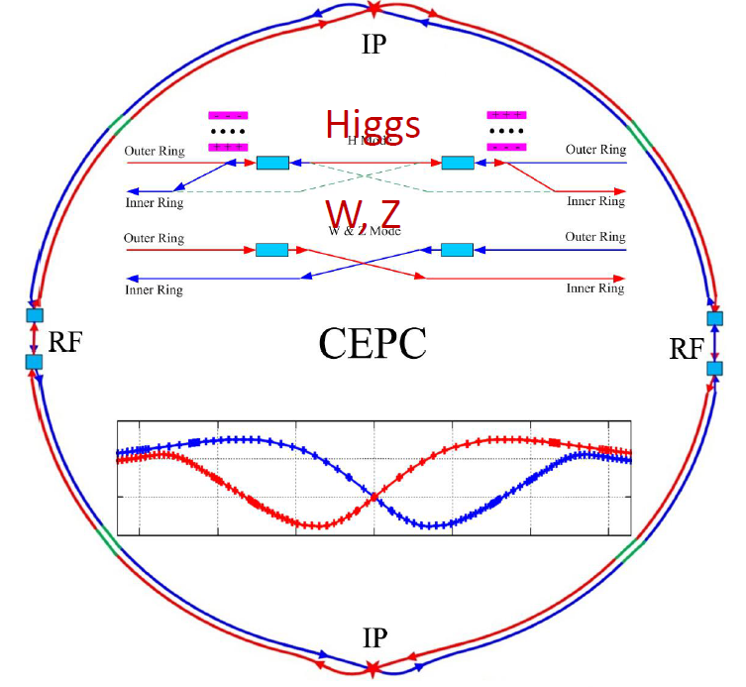
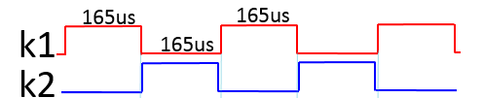
Alternative scheme of RF region beam separating system
In Higgs mode，e- /e+ beams only fill half ring respectively. So, it is possible to separate beams by kickers.
Compared with electrostatic separator, kicker magnet is stronger and contributes lower beam impedance.
4 sets of kicker locate at both sides of RF region, K1 and k4 applied for e+ beam,K2 and K3 for e- beam;
The waveform of kicker pulsers is square wave with duty cycle of 50%, pulse width of 165 us and frequency of 6.06 kHz;
The phase difference between K1 (K3) and K2(K4) is π.
k1
k3
k2
165us
165us
k4
k1
165us
k2
k3
k4
CW=6.06kHz, 50%
RFC
RFC
K2
K1
Yiwei Wang
 | Kicker | Septa
Intergrated strength BL [T*m] | 0.1624 | 1.4
Strength B [Guass] | 203 | 1000
Effective length Leff [m] | 8 | 14
Half width of good field region Hgf/Vgf [mm] | 10.1/3.8 @ 5E-4 | 18.9/3.8 @ 5E-4
Half width of beam stay clear Hbsc/Vbsc [mm] | 9.6/3.6 | 9.2/3.6
Septum width width [mm] | - | 10
k1
DC septas
Last e+ Bunch
First e- Bunch
Top view
Delay-line kickers

Slide 18
Hardware design consideration for CEPC injection and extraction systems

Slide 19
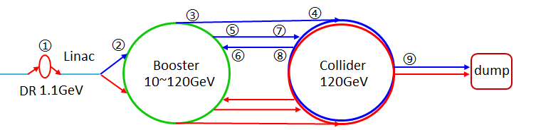
Main types of hardware
 | Sub-system | Kicker Type | Kicker waveform | Septa Type
1 | Damping ring inj./ext. | Slotted-pipe kicker | Half-sine/250ns | Horizontal LMS
2 | Booster LE inj. | Strip-line kicker | Half-sine/50ns | Horizontal LMS
3 | Booster ext. for CR off-axis inj. | Delay-line dipole kicker | Trapezoid /440-2420ns | Vertical LMS
4 | Collider off-axis inj. | Delay-line NLK kicker | Trapezoid /440-2420ns | Vertical LMS
5 | Booster ext. for CR on-axis inj. | Ferrite core dipole kicker | Half-sine/1360ns | Vertical LMS
6 | Booster HE inj. | NLK or Pulsed sextupole | Half-sine/0.333ms | Vertical LMS
7 | Collider swap out inj. | Ferrite core dipole kicker | Half-sine/1360ns | Vertical LMS
8 | Collider swap out ext. | Ferrite core dipole kicker | Half-sine/1360ns | Vertical LMS
9 | Collider beam dump | Delay-line dipole kicker | Trapezoid /440-2420ns | Vertical LMS
10 | RF region beam separating | Delay-line dipole kicker | CW square / 165us,50% | Horizontal Copper septa

Slide 20
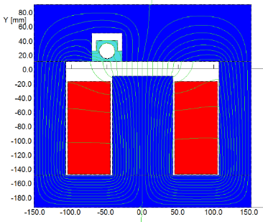
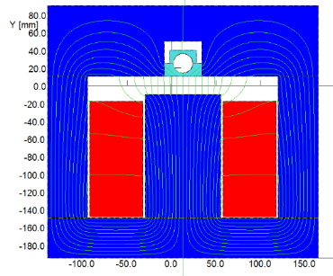
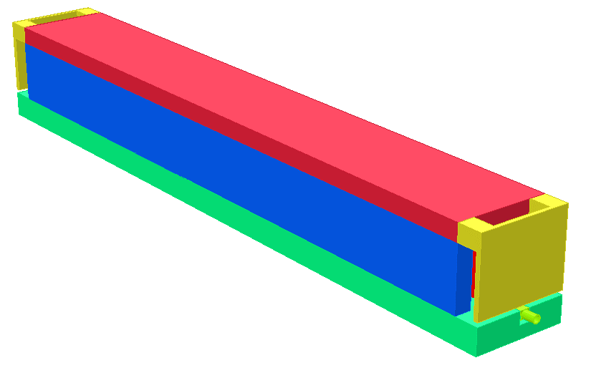
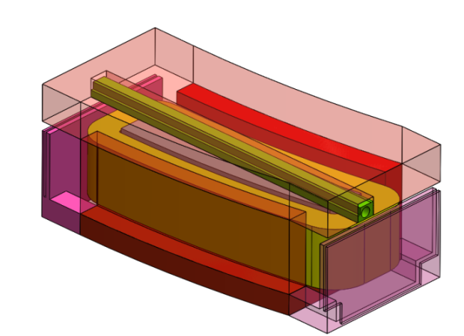
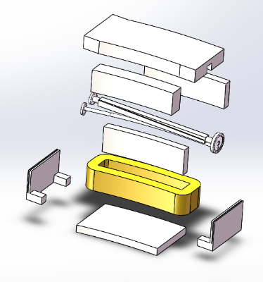
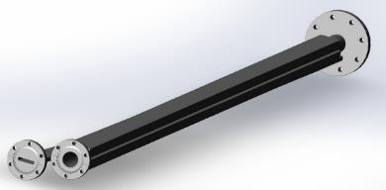
Lambertson septa design
The similar hardware was developed in HEPS, CSNS, BEPC
Higher reliability and stability
The width of septum wall might be in the range from 2mm to 20mm.
US
DS

Slide 21
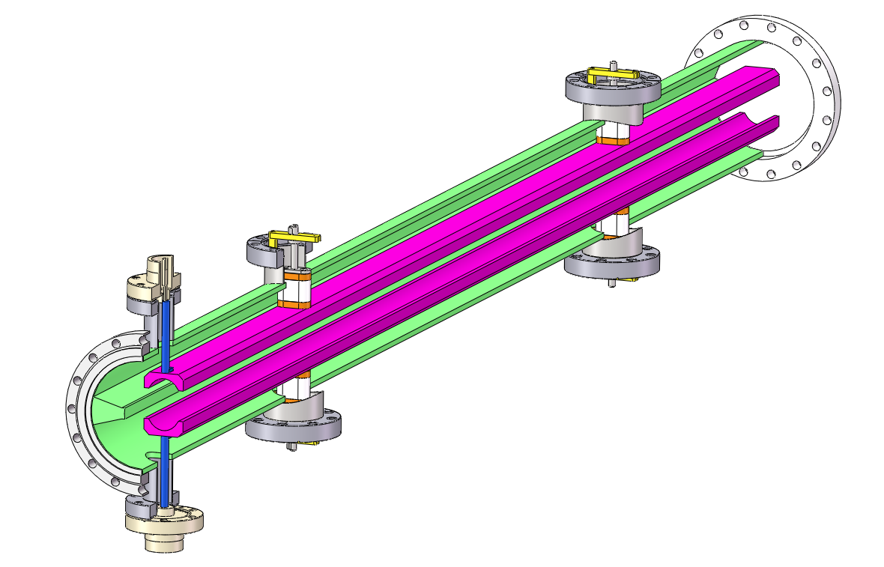
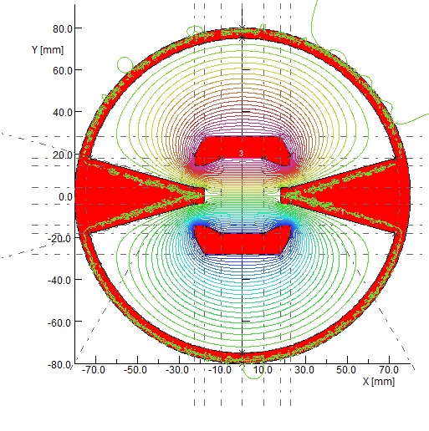
Slotted-pipe kicker design for DR
  Similar design was done in HEPS project(The HEPS Booster kicker)
  E=1.1GeV，Total kick angle: θ=1.5mrad
  Kick strength=0.024T，length of kicker=0.25m，distance between two electrodes=44mm，pulse width<250ns
  U=dɸ/dt=0.024*0.044*0.25/(100*10⁻⁹)=2640V。
250ns
Outer body (316L)
HV feedthrough
Busses (FOC)
+
insulation support (ceramic)
-
To vacuum pump
Cooling water hole

Slide 22
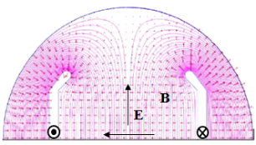
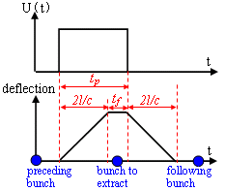
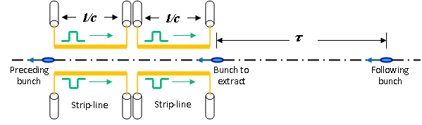
Strip-line kicker design for booster LE inj.
Kick strength
  Total kick angle: θ=0.11mrad
  E=10GeV, d=55mm, g=1 =>U*L>30.25kV∙m
  Total strip-line kicker electrode length L=1m =>U>30.25kV(or ±16kV)
50ns,100Hz
Here, θ is kick angle(rad)；E is beam energy(eV)；U is applied pulse voltage for both electrodes(V)；l is strip-line length；d is the distance between the electrodes，g is the geometry factor, determined by the shape of the electrode. w is the strip-line width.
Kick speed
  Min bunch spacing - τ=25ns
    Electrode length l<3.75m => l= 1m
    Electrical pulse Width 6.7ns< t_{p} <43.3ns =>Flat-top t_{top} >6.7ns, Rise/fall Time t_{r}/t_{f} <18.3ns

Slide 23
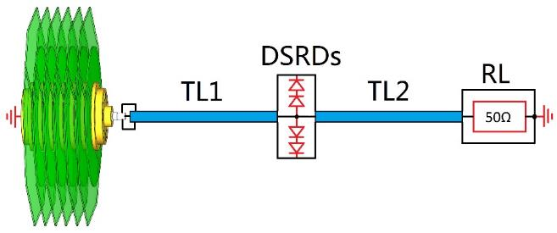
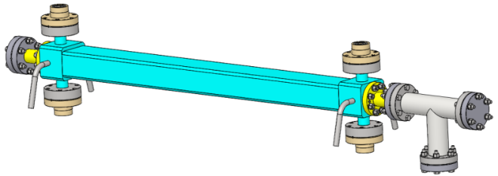
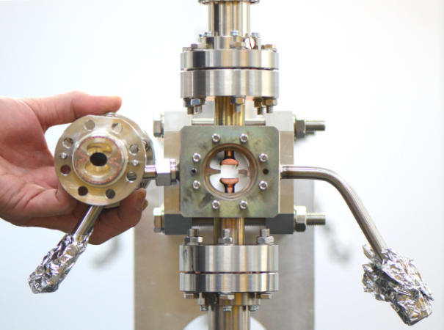
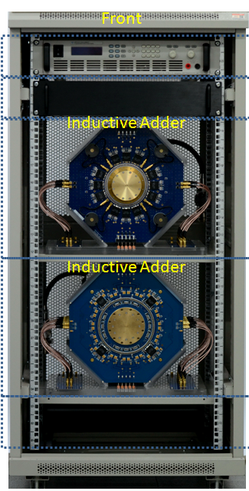
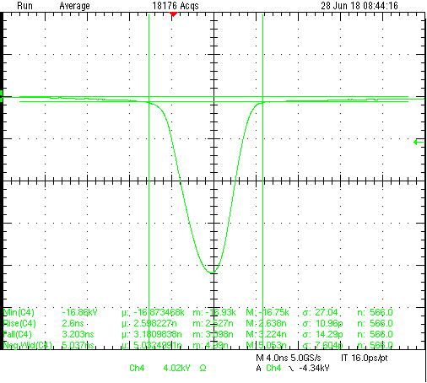

Strip-line kicker design for booster LE inj.
Strip-line kicker and DSRD based short pulsed PS
The similar hardware was developed in HEPS-TF progress.
1000mm
Strip-line kicker
fast pulser
PFL=0.3m
Feed through
End cover
D shape blades
4ns
Cooling water tube
V=17kV,
FWHM=5ns,
T_{r}(10-90%)<2.6ns,
T_{f}(90-10%)<3.2ns,
Bottom width(3%-3%)<10ns
Outer body

Slide 24
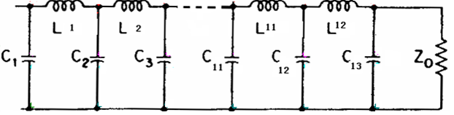
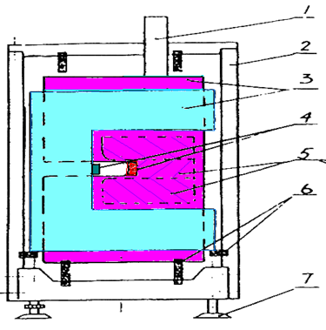
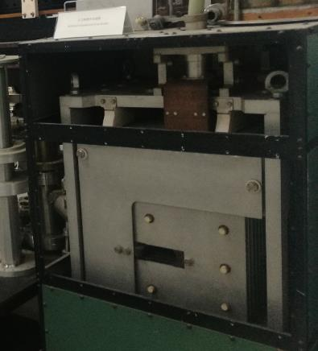
Distributed parameter (delay-line) dipole kicker
Features:
Out-vacuum kicker with metallic coating ceramic vacuum chamber
Solid-state adjustable pulse width PFN based Pulser
The structure of delay-line kicker is complicated; the kind of kicker helps to achieve ideal trapezoid waveform.
40~2000ns
1kHz
200ns
200ns
Delay-line kicker magnet
Solid-state switches
PFN
need a R&D progress for us
By IHEP，1978
CEARN,SPS

Slide 25
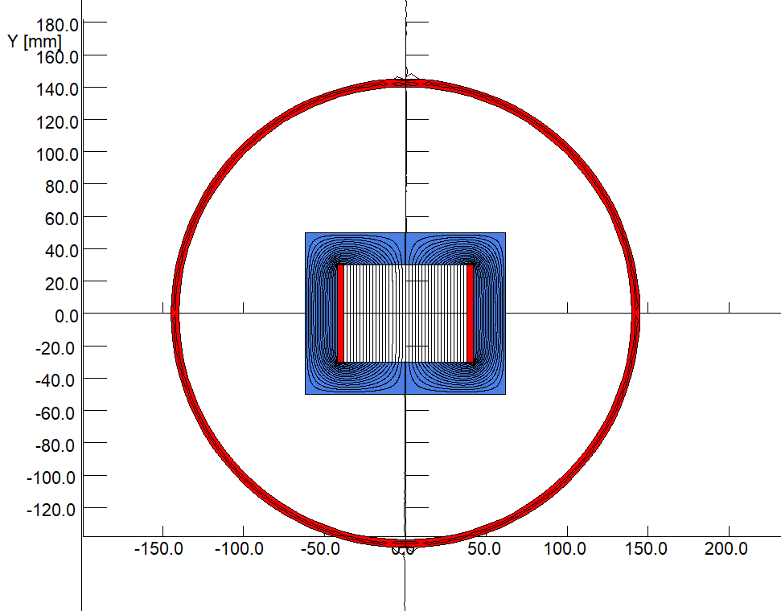
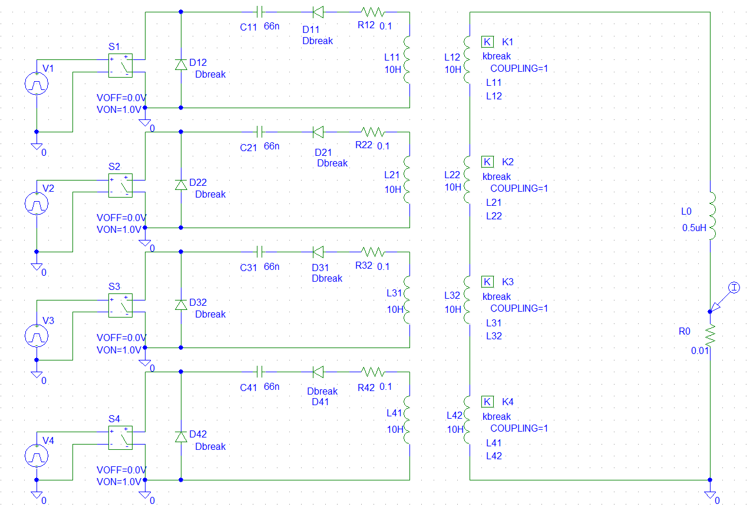
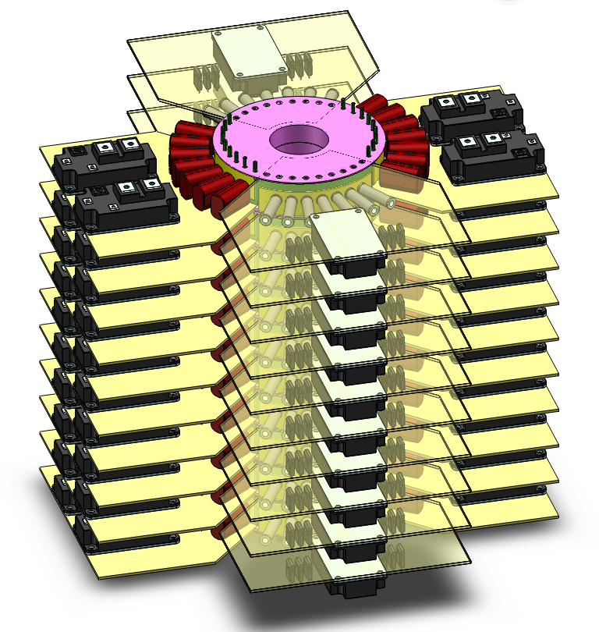
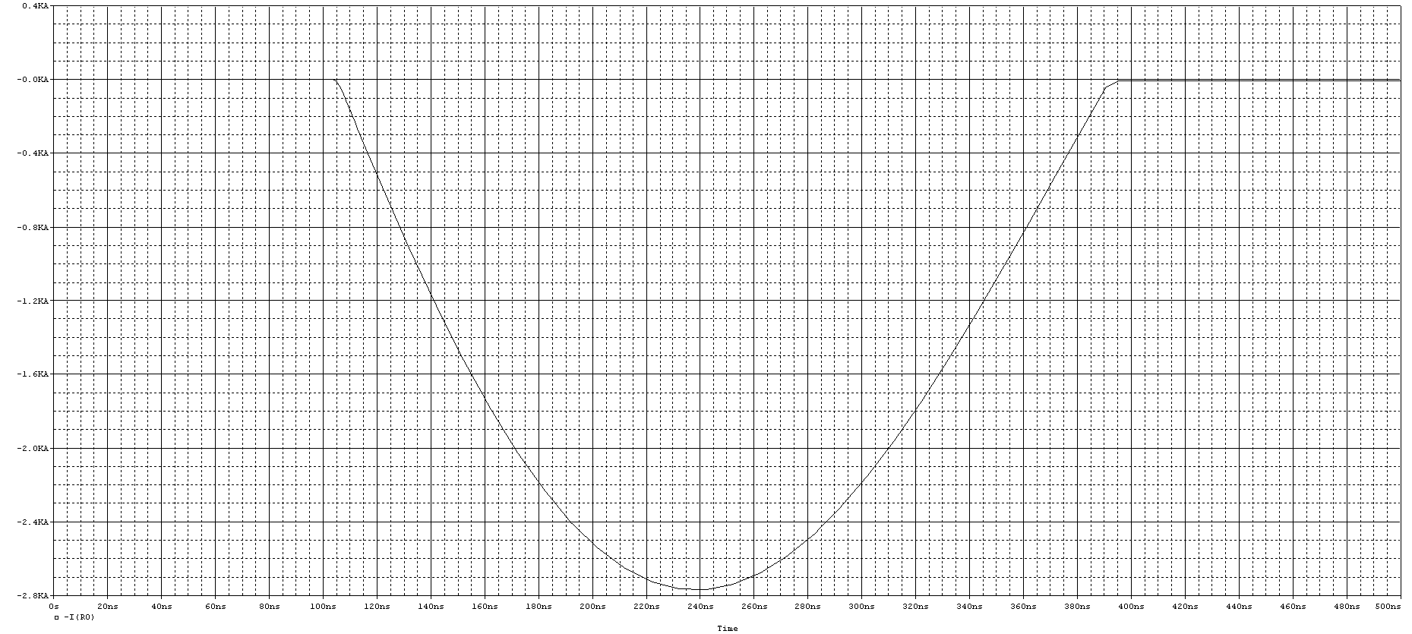
Lumped parameter dipole kicker magnet
Features:
Out-vacuum kicker with metallic coating ceramic vacuum chamber
Solid-state LC discharge half-sine Pulser
It is easier than last type one.
C
L_{s}
L_{M}
metallic coating ceramic vacuum chamber
C-type ferrite blocks
1360ns,1kHz
Inductive adder based on IGBTs

Slide 26
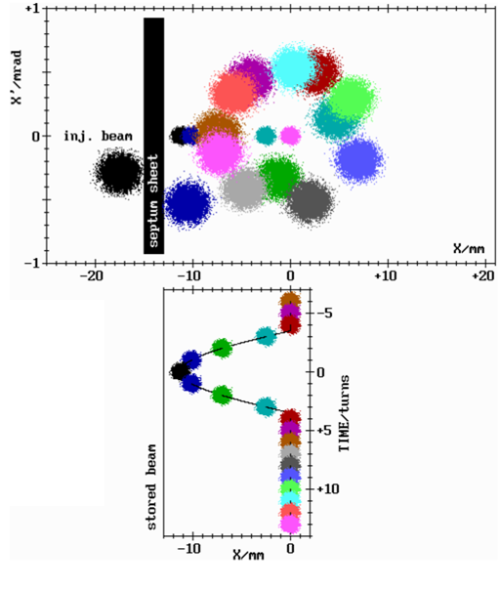
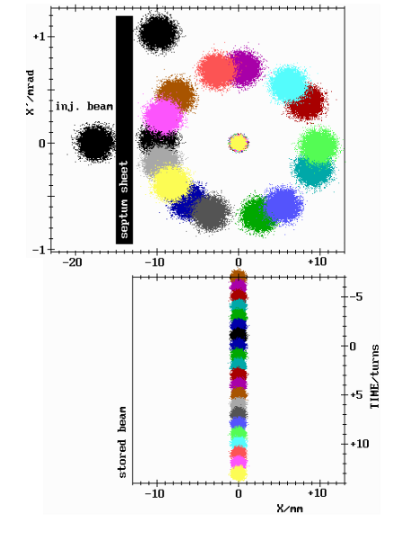
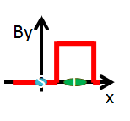
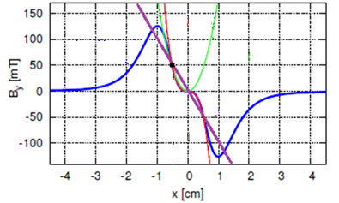
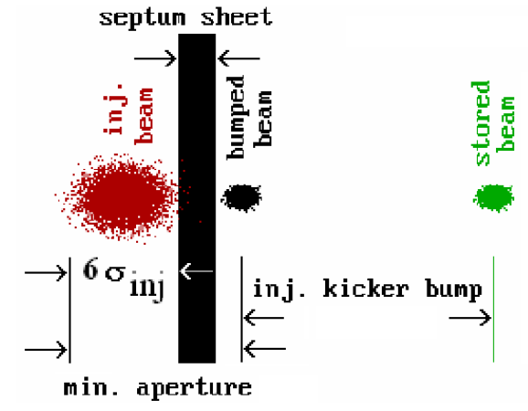
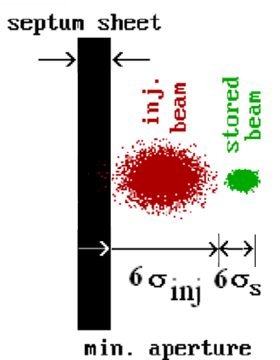

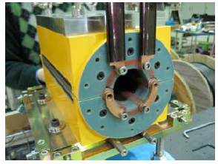
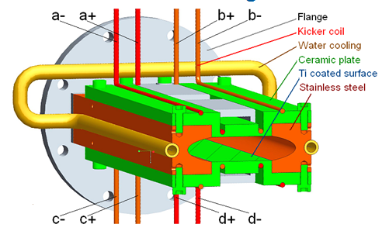


Why use nonlinear kicker injection?
Pulsed Local Bump Injection
Nonlinear Kicker Injection
The advantages of NLK injection:
Off-axis injection, able to accumulate beam
Less disturbance to the stored beam for TOP-UP injection
Need smaller DA
KEK Pulsed sextupole
BESSYII NLK
Peter Kuske, Proposal for a Transparent off-axis Injection scheme for BESSYII

Slide 27
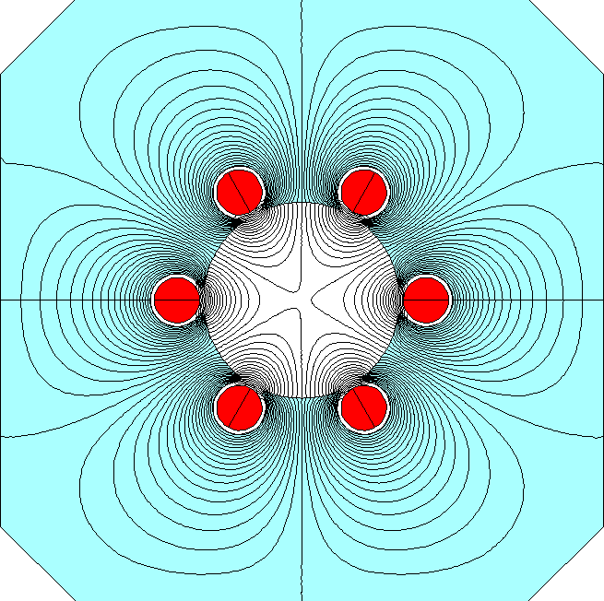
Pulsed sextupole and NLK
Pulsed sextupole magnet:
metallic coating ceramic vacuum chamber + Solid-state LC discharge half-sine Pulser .
Out-vacuum lumped parameter NLK:
metallic coating ceramic vacuum chamber + Solid-state LC discharge half-sine Pulser
Out-vacuum distributed parameter NLK:
metallic coating ceramic vacuum chamber + Solid-state adjustable pulse width PFN based Pulser
It need to push the accelerator physics group to study if NLK is better choice for CEPC off-axis injection.
40~2000ns
  New proposed
1kHz
0.333ms,1kHz
200ns
200ns
？
Kang wen
Pulsed sextupole magnet
lumped parameter NLK
Distributed parameter dipole kicker
Distributed parameter NLK

Slide 28
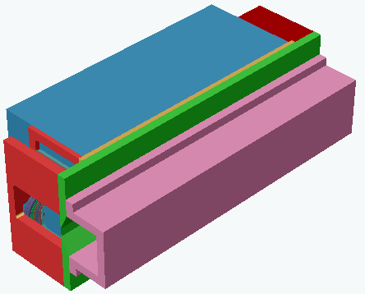
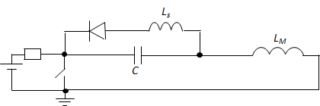
Challenge of new beam separating system
Septa: horizontal vacuum out DC Cu septum magnet（septum wall=10mm）
Dipole kicker and pulser: ？？
septa
Kicker pulser requirements are special:
  Flat-top dropping
  Amplitude long term stability
compensate topology
Energy recycling
  High average power
  High repetition rate
controlling technique
CW square wave
High repletion rate short wave
165us
165us
242,1.5MHz
Ideal
waveform ：
165us
Top-drop
CW=6.06kHz,50%
overshoot
Amplitude drift
Practical
waveform：
Tail
Delay-line kicker model
5MW
Lumped dipole kicker

Slide 29

Hardware R&D Plan
Component | description | Number(set) | schedule
Vacuum chamber | Coated ceramic vacuum chamber | 1 | 24 Mon.
Dipole kicker | Vacuum out distributed parameter dipole kicker magnet | 1 | 24 Mon.
NLK | Vacuum out distributed parameter NLK magnet | 1 | 12 Mon.
Trapezoid pluser | Solid-state pulse width adjustable trapezoid pulser | 1 | 36 Mon.
CW pulser | continuous square wave pulser | 1 | 36 Mon.
Year | 2019 | 2020 |  |  |  | 2021 |  |  |  | 2022 |  |  |  | 2023
Quarter | 4th | 1st | 2nd | 3rd | 4th | 1st | 2nd | 3rd | 4th | 1st | 2nd | 3rd | 4th | 1st | 2nd | 3rd | 4th
Vacuum chamber
Dipole kicker
NLK
Trapezoid pluser
CW pulser

Slide 30
Summary
There are 9 injection and extraction sub-systems in CEPC accelerator complex.
Very preliminary injection layout design was done.
We just figured out what kind of components needed in all sub-systems so far. We still need more input parameters for more detail design.
Hardware R&D plan in the coming years was just proposed .

Slide 31
END
Thank you for attentions!!!

Slide 32
Backup slides

Slide 33
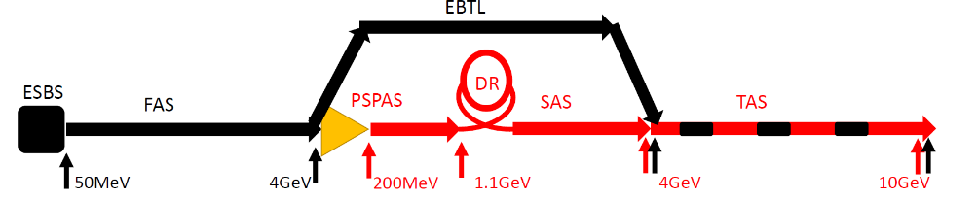
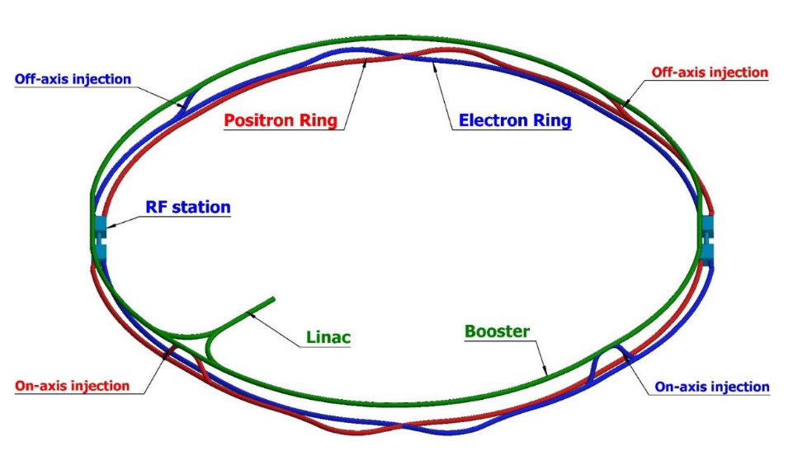
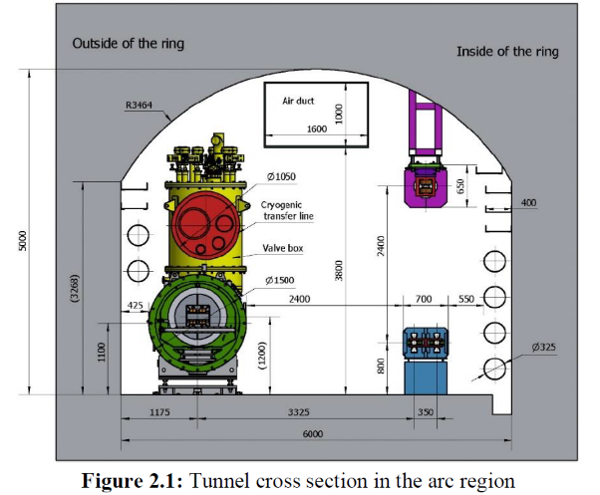
Layout of the accelerator complex
The CEPC accelerator complex consists of a Linac, which including a small damping ring for positron beams, several transport lines, a booster ring and 2 storage rings, all 3 of which are in a single tunnel.
1.2km
120GeV
120GeV
100km
Dump
Damping ring
Dump
e+
e-
10-120GeV

