Slide 1
CEPC booster 1.3 GHz 9-cell cavity measurement results and 650MHz single-cell large grain cavity surface treatment and test result 沙鹏，20191230 on behalf of CEPC SRF team

Slide 2
Outline
N-doping, EP
1.3GHz 9-cell cavities
650MHz 1-cell large-grain cavities
CEPC 650 MHz Test Cryomodule
Summary

Slide 3
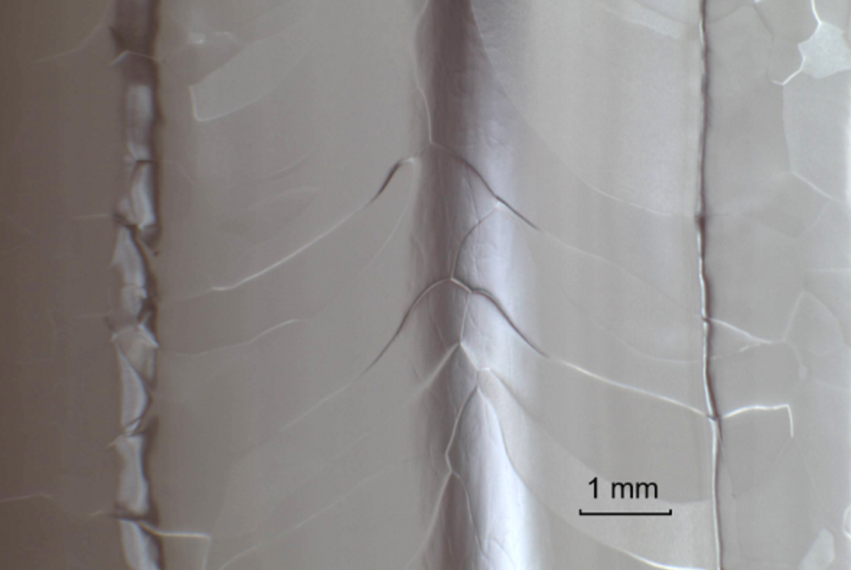
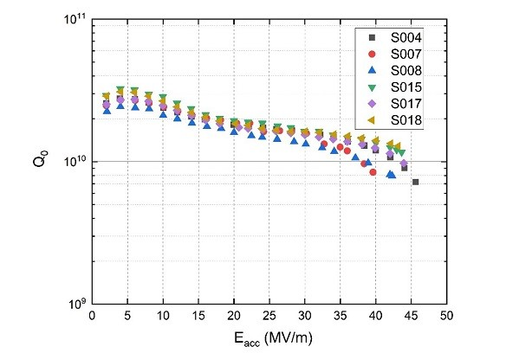
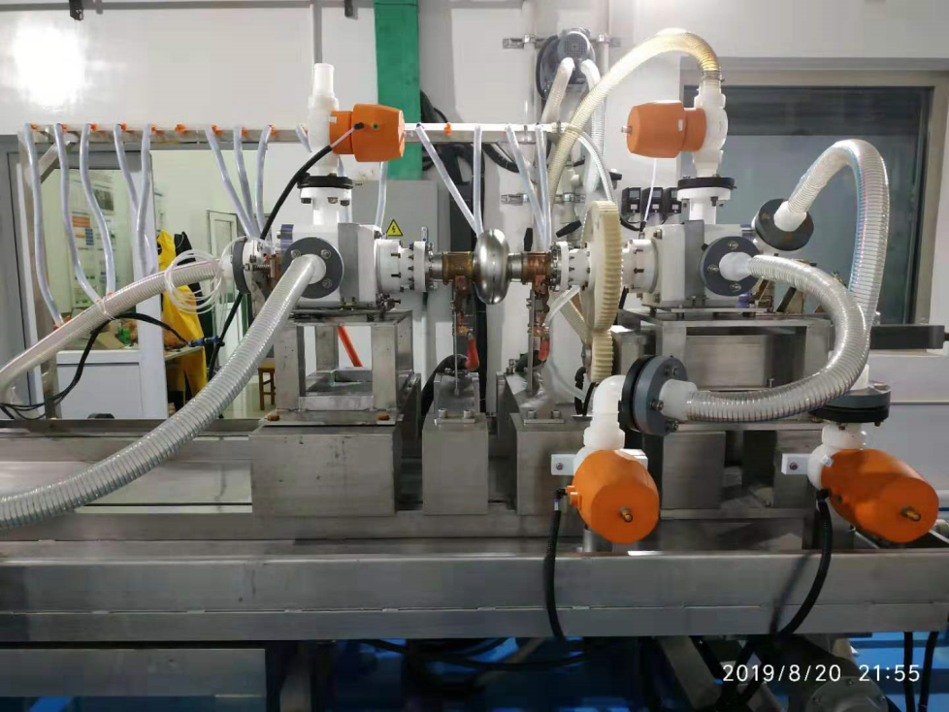
EP of 1.3GHz 1-cell cavity
超导腔焊缝（EP后）
EP研制成功、投入使用：六只细晶粒纯铌1.3GHz单cell超导腔，2K垂直测试加速梯度均达到或超过了40MV/m，达到国内最高水平。其中，S008腔最高加速梯度45.6MV/m，已接近1.3GHz超导腔的理论极限；且S018腔在43MV/m梯度下的Q达到国际领先的1.3E10水平。
EP设备

Slide 4
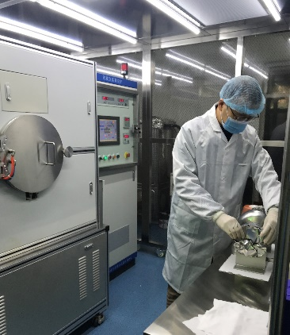
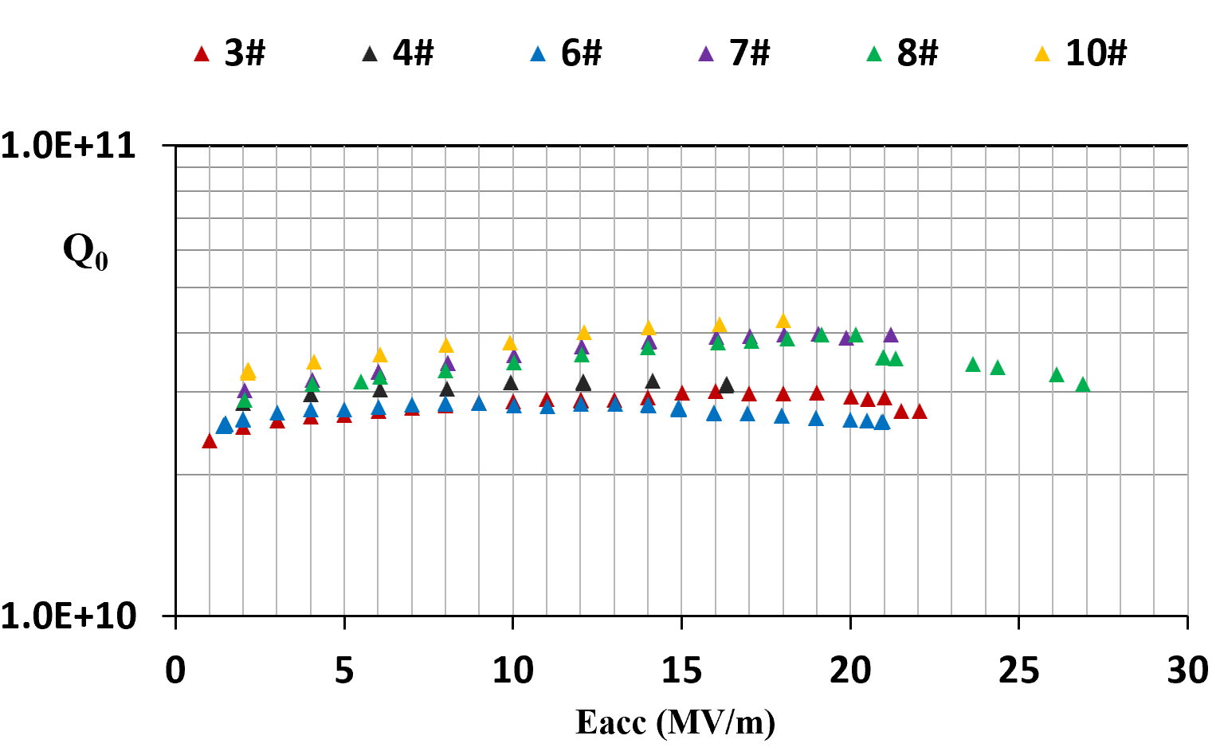
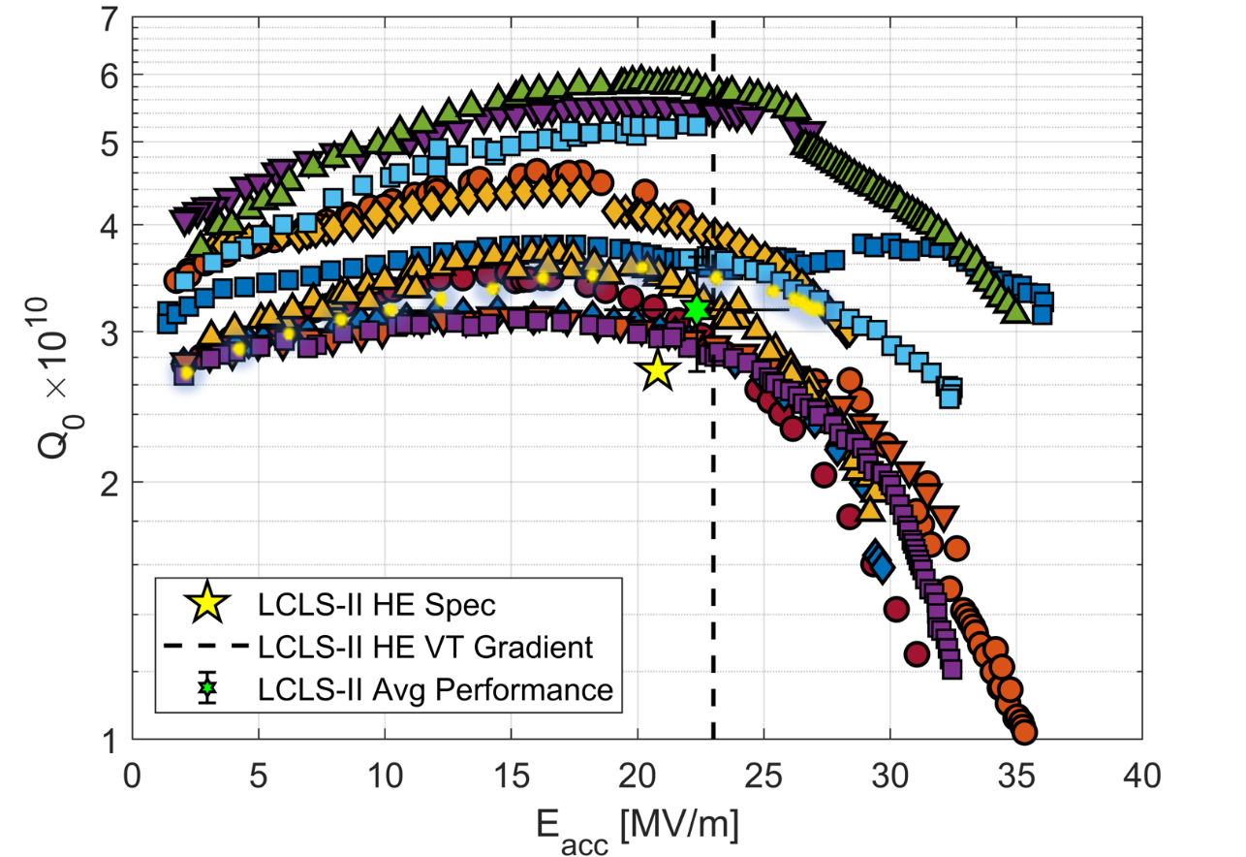
N-doping of 1.3GHz 1-cell cavity
超导腔掺氮取得小批量成功：6只1.3GHz 1-cell超导腔超过了LCLS-II/SHINE的设计指标（2.7E10@16MV/m）；8#腔达到3.1E10@27MV/m 。
1.3GHz 1-cell超导腔的掺氮
LCLS-II Spec.
VT goal of CEPC
LCLS-II Spec.
CEPC operation Spec.
1.3 GHz 1-cell cavities for LCLS-II HE

Slide 5
Outline
N-doping, EP
1.3GHz 9-cell cavities
650MHz 1-cell large-grain cavities
CEPC 650 MHz Test Cryomodule
Summary

Slide 6
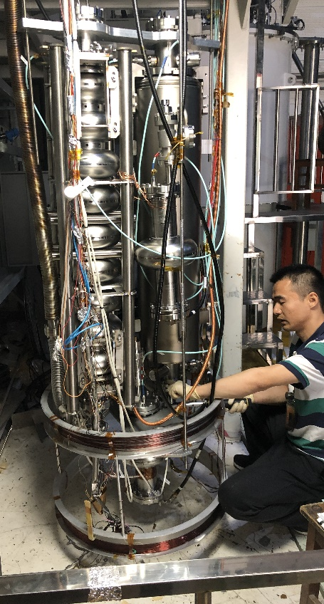
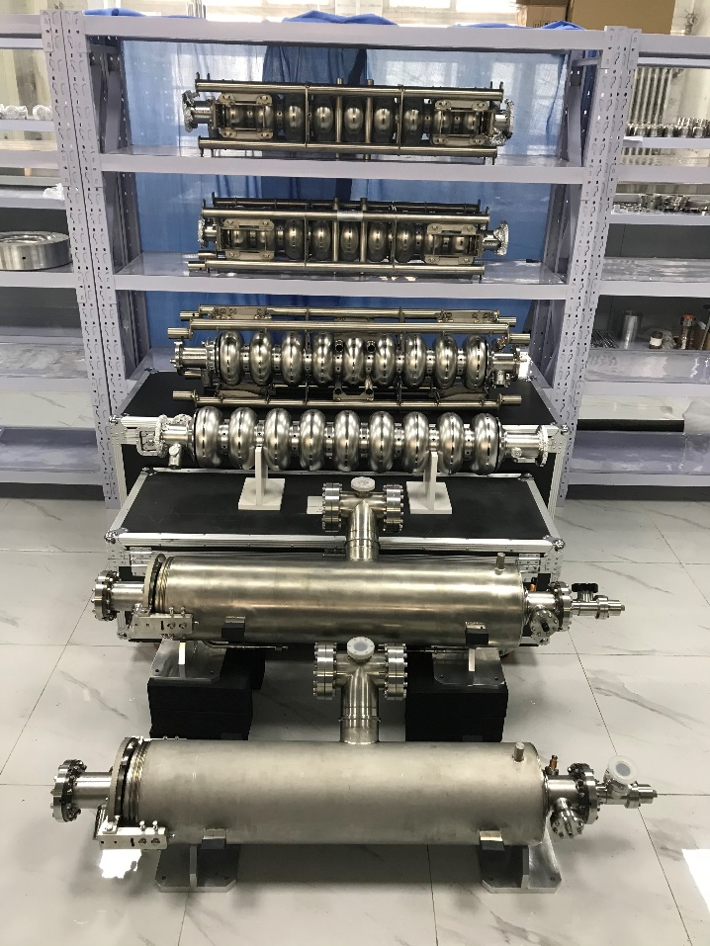
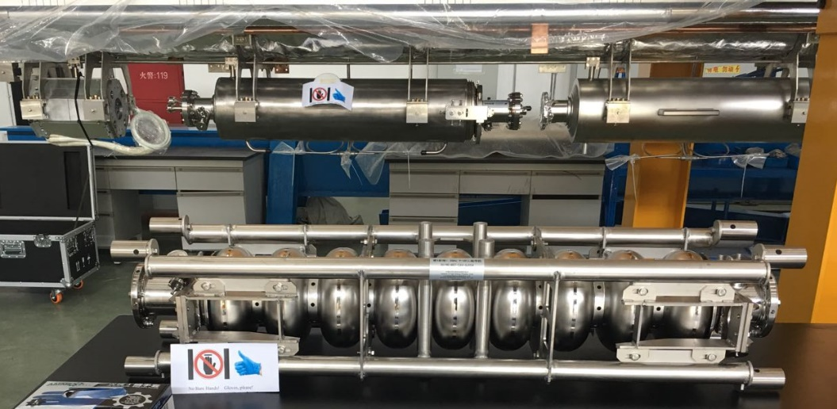
1.3GHz 9-cell cavity
Eight 9-cell cavities already made for SHINE R&D. 4 cavities BCP and vertical tested.
首批四只1.3 GHz9-cell带液氦槽超导腔主要性能已达到了上海硬X射线自由电子激光装置项目（SHINE）的第一阶段目标要求，并成为该项目首批交付的超导腔。

Slide 7
1.3GHz 9-cell Cavities w&w/o Helium Vessel (BCP)
VT goal of CEPC

Slide 8
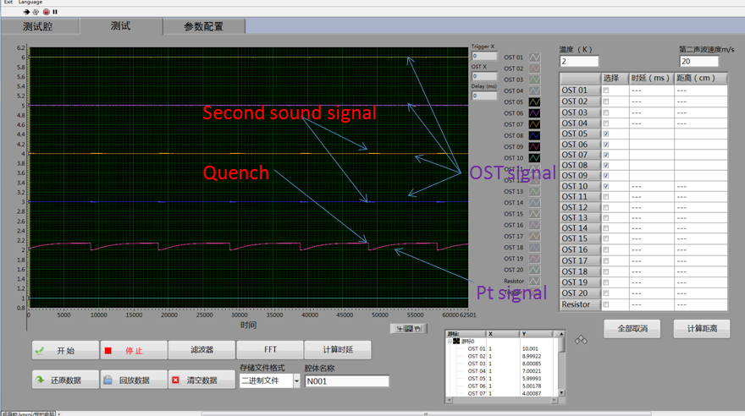
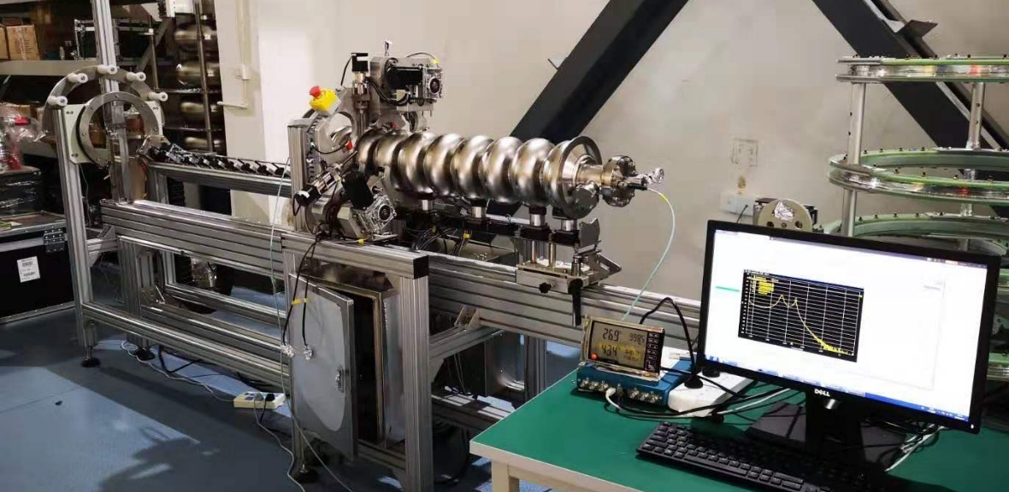
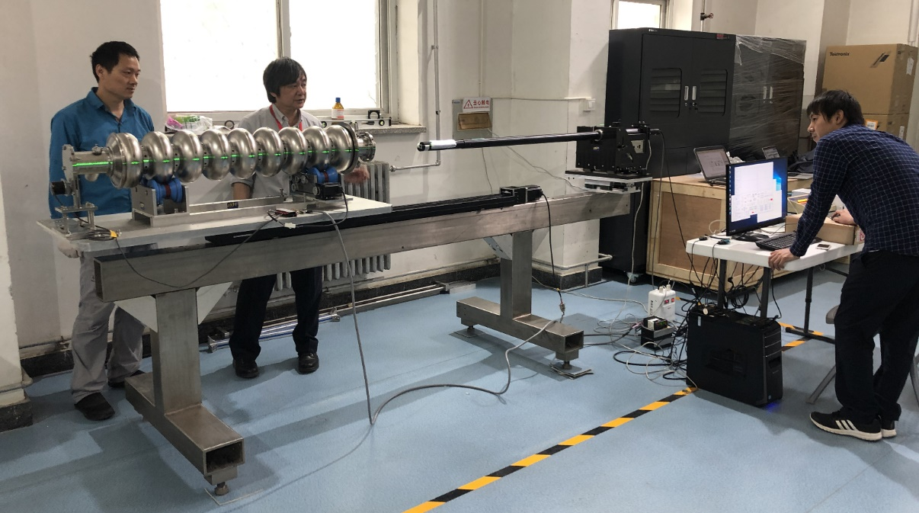
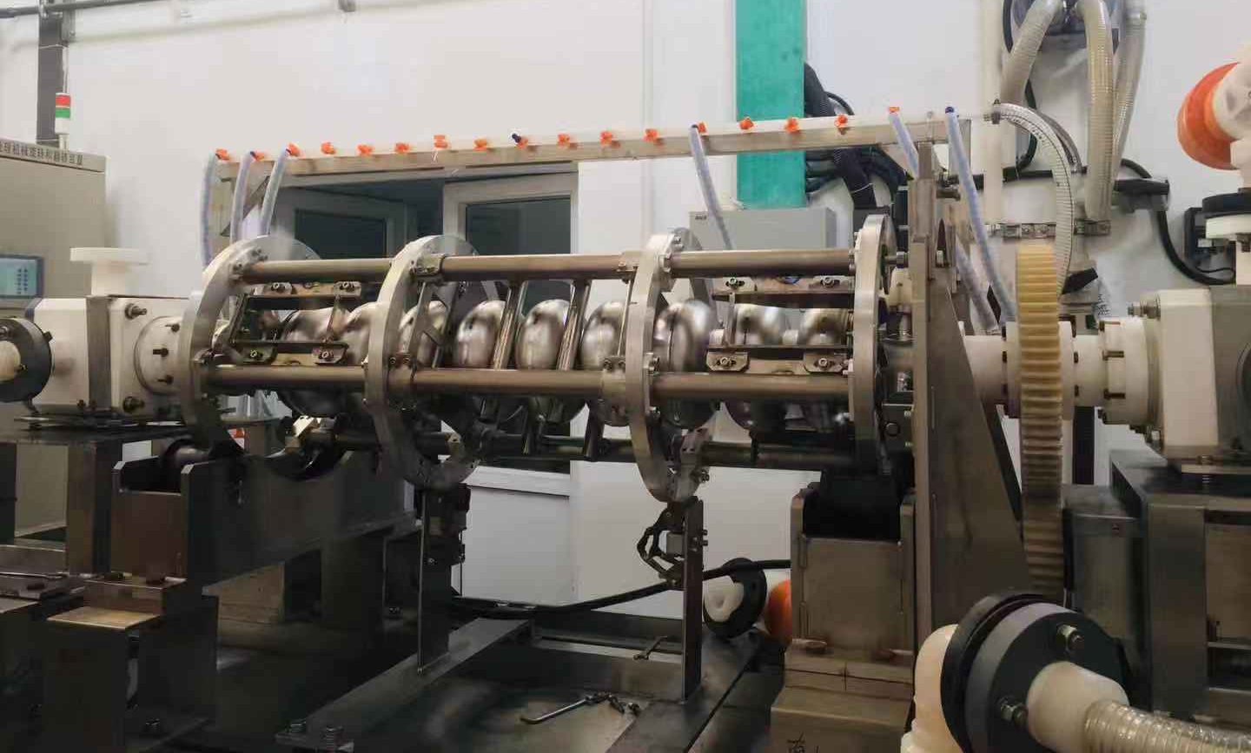
Preparation of mass cavities
1.3 GHz 9-cell腔的预调谐
二次声探测超导腔失超位置（国内首次）
1.3 GHz 9-cell腔的内窥镜检查
1.3GHz 9-cell腔电抛光的机械调试

Slide 9
Quality Control of 1.3GHz 9-cell Cavity
 | Specification | 1300-N001 | 1300-N002 | 1300-N003 | 1300-N004
Dumbbell shape error | ≤ +/- 0.5 mm | ± 0.4 | ± 0.4 | ± 0.4 | ± 0.4
Cavity length (after pre-tuning) | 1283.40 +/- 3.0 mm | 1284.55 mm | 1283.19 mm | / | /
Cavity length in helium vessel | 1283.40 +/- 3.0 mm | 1283.56 mm | 1282.30 mm | 1280.94 mm | to be measured
Eccentricity (radius) | ≤ 0.4 mm | no adjustment | no adjustment | no adjustment | no adjustment
Frequency bare cavity (vacuum, RT) | 1298.2 +/- 0.1 MHz | 1298.210 MHz | 1298.160 MHz | 1298.162 MHz | /
Frequency bare cavity (2K) | 1300.2 +/- 0.1 MHz | 1300.252 MHz | 1300.199 MHz | 1300.318 MHz | 1300.280 MHz
Frequency dressed cavity (2K) | 1300.2 +/- 0.1 MHz | 1299.870 MHz | 1300.018 MHz | 1300.062 MHz | 1300.200 MHz
Field flatness bare cavity | ≥ 95 % | 95% | 98% | 97% | 96%
Field flatness dressed cavity | ≥ 90 % | 85% | 94% | 98% | 98%
Leak rate | ≤ 1.0e-8 Pa l/s | OK | OK | OK | OK
HOM coupler FM Q_{e} (2K) | > 2.7E11 | 1.5E12, 3.5E13 | 3.7E12, 4.7E11 | 1.6E11, 2.1E12 | to be measured
Dressed cavity gradient (BCP) | > 19 MV/m | 20 MV/m | 19.5 MV/m | 23.2 MV/m | to be measured
Dressed cavity Q₀ (BCP) | > 1.0×10¹⁰ @16 MV/m | 1.50E+10 | 1.40E+10 | 1.90E+10 | to be measured
Dressed cavity gradient (EP+N-dope) | > 19 MV/m | / | / | / | /
Dressed cavity Q₀ (EP+N-dope) | > 2.7×10¹⁰ @16 MV/m | / | / | / | /

Slide 10
Outline
N-doping, EP
1.3GHz 9-cell cavities
650MHz 1-cell large-grain cavities
CEPC 650 MHz Test Cryomodule
Summary

Slide 11
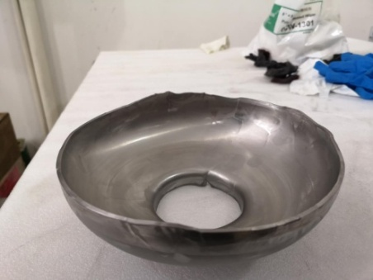
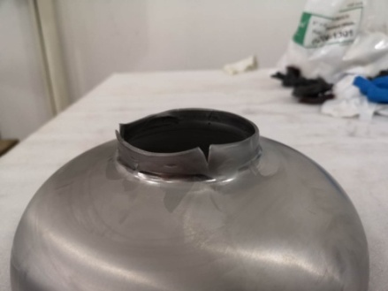
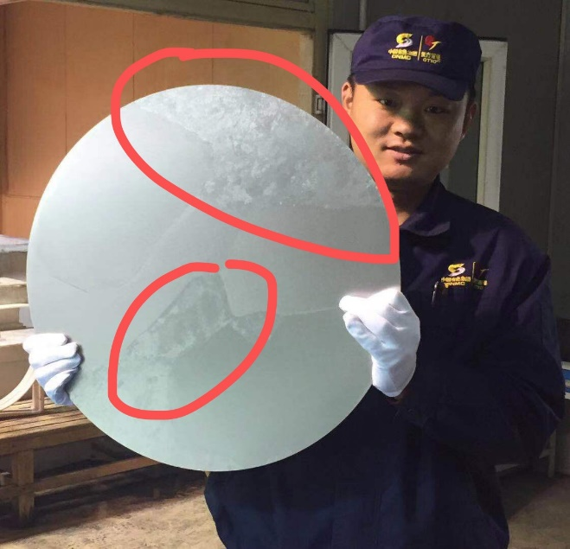
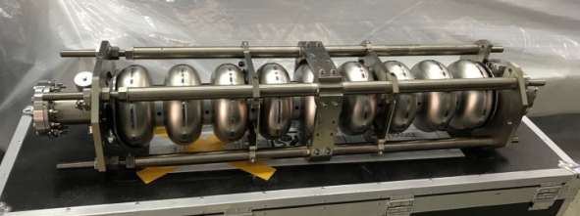
Large-grain sheet for 650 MHz cavity
Large grain is favorable for HL-Z, which have higher Q and gradient than fine grain. But it’s more difficult to fabricate (thinning at grain boundary, crack).
At first, because the large-grain Nb sheet is too large (Φ540mm), the quality of sheet is poor.
Half cell of 1.3GHz (Large grain)
650 MHz 2-cell (fine grain)
Nb ingot (Φ280mm)
1.3 GHz 9-cell (fine grain)
Grain crack
Φ540mm large-grain Nb sheet for 650 MHz 1-cell cavity
1.3 GHz 9-cell (large grain, PKU)

Slide 12
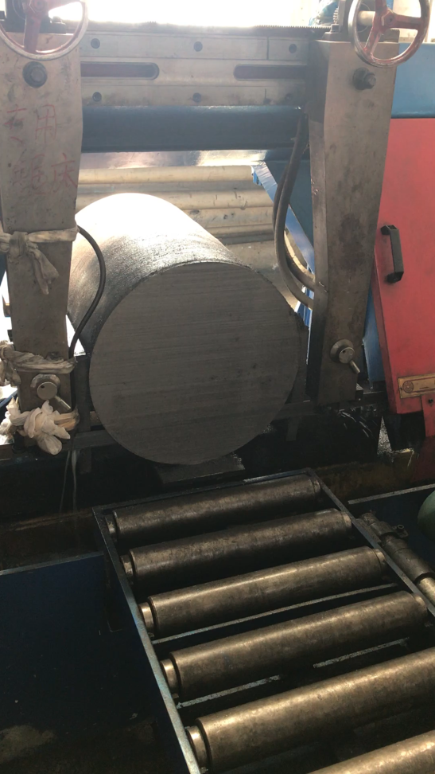
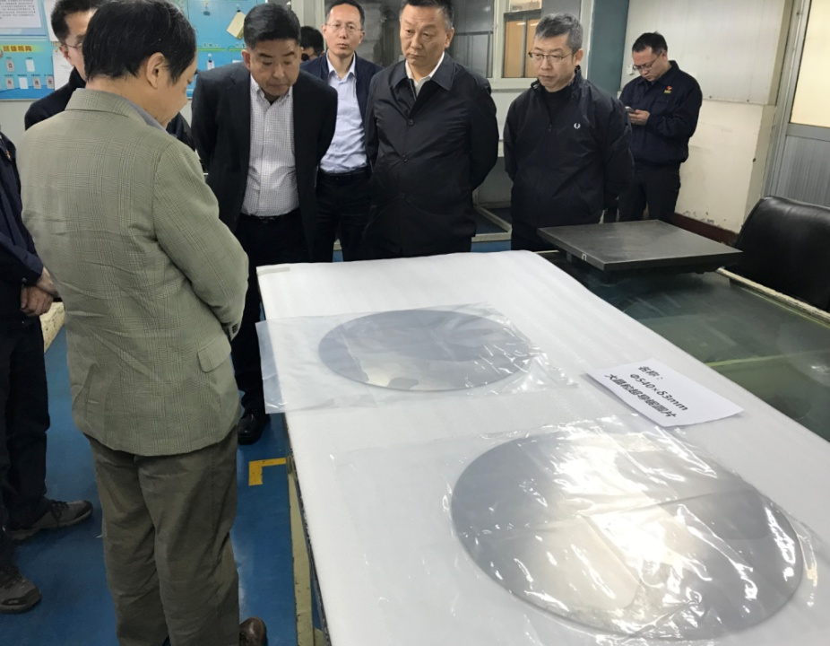
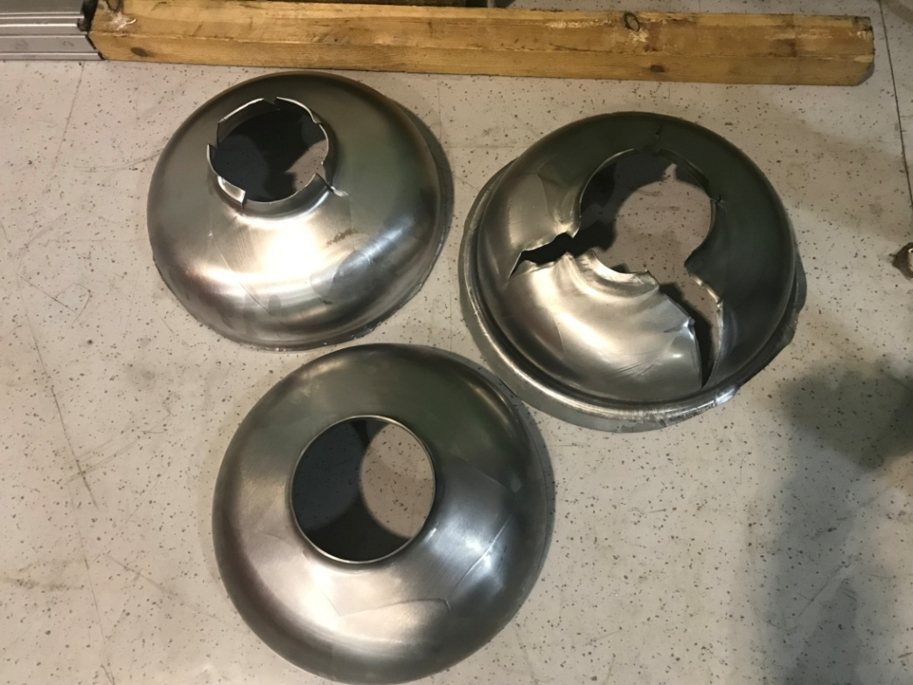
Large-grain sheet for 650 MHz cavity
Then, OTIC made a new Nb ingot (Φ480mm, still too small) for us, which was used for half cells of 650MHz cavity.
Many half cells were broken during deep-drawing.
Large grain Nb sheets made by OTIC
Half cell after deep-drawing
Nb ingot (Φ480mm)

Slide 13
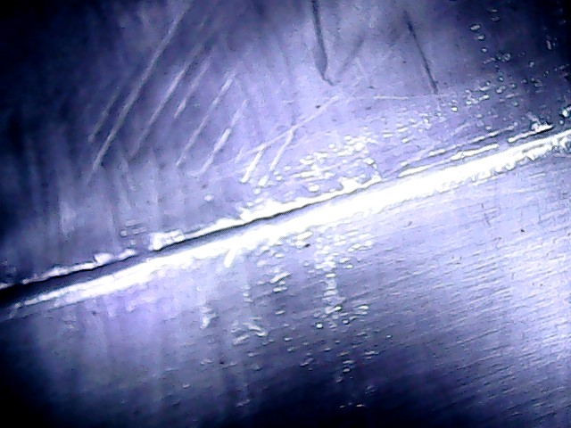
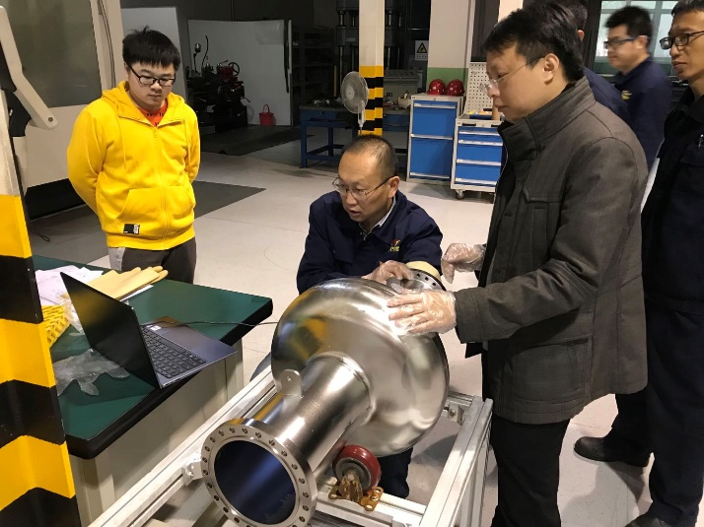
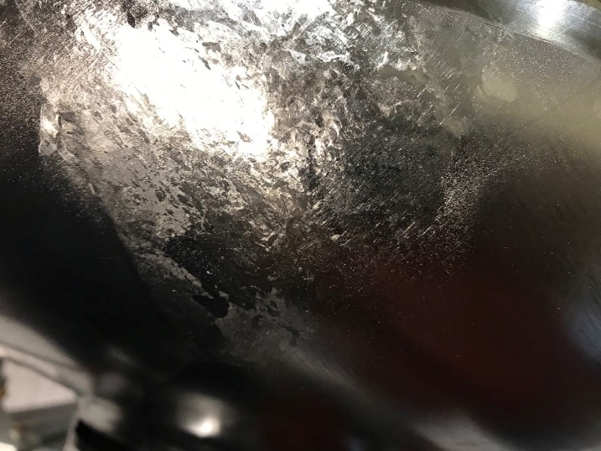
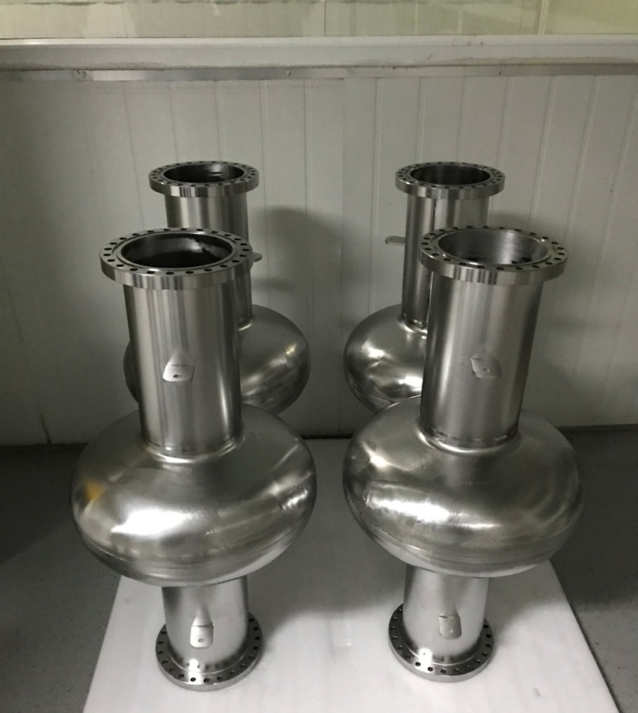
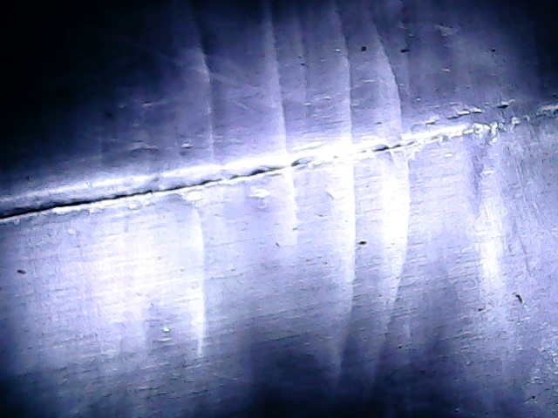
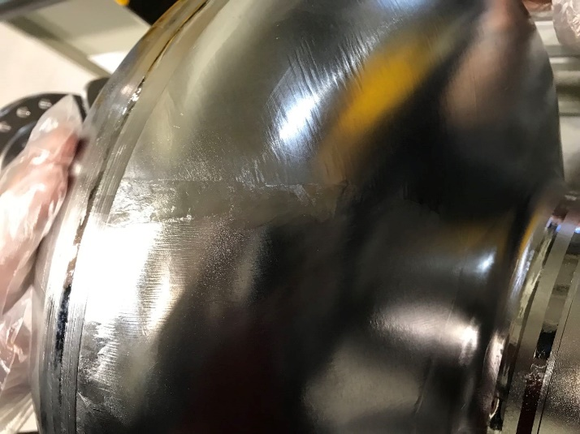
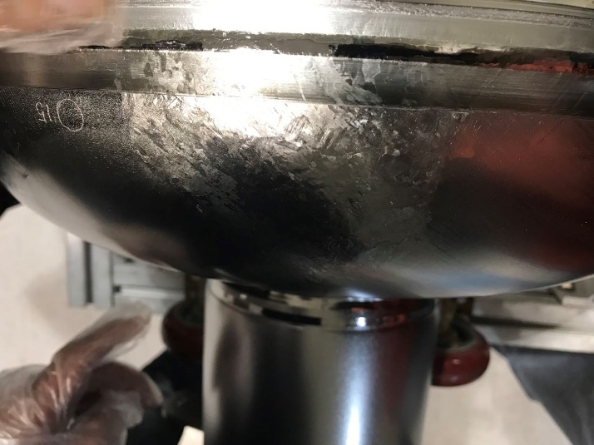
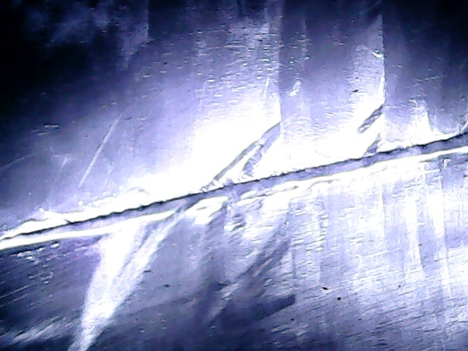
Post processing
Four 650 MHz 1-cell LG cavities were completed in Oct, 2020.
Both the outer and inner surface of cavities are poor.
Four cavities

Slide 14
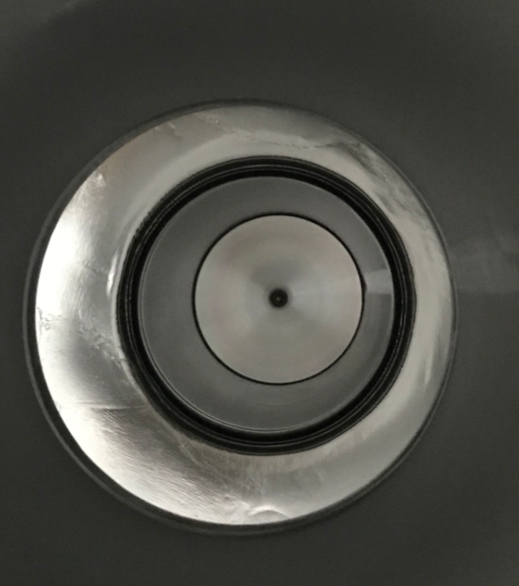
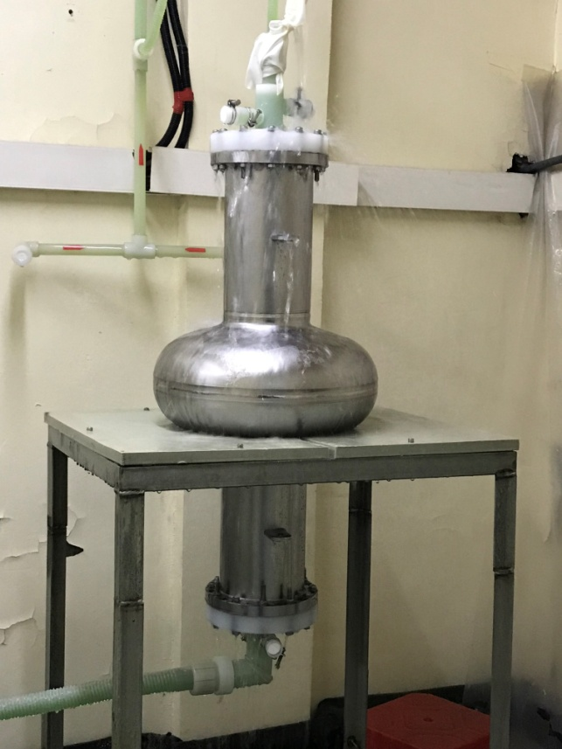
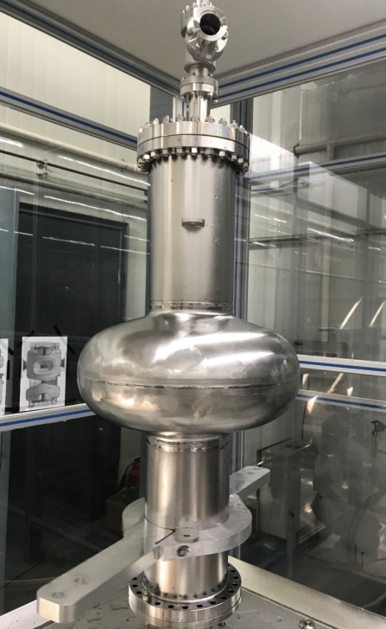
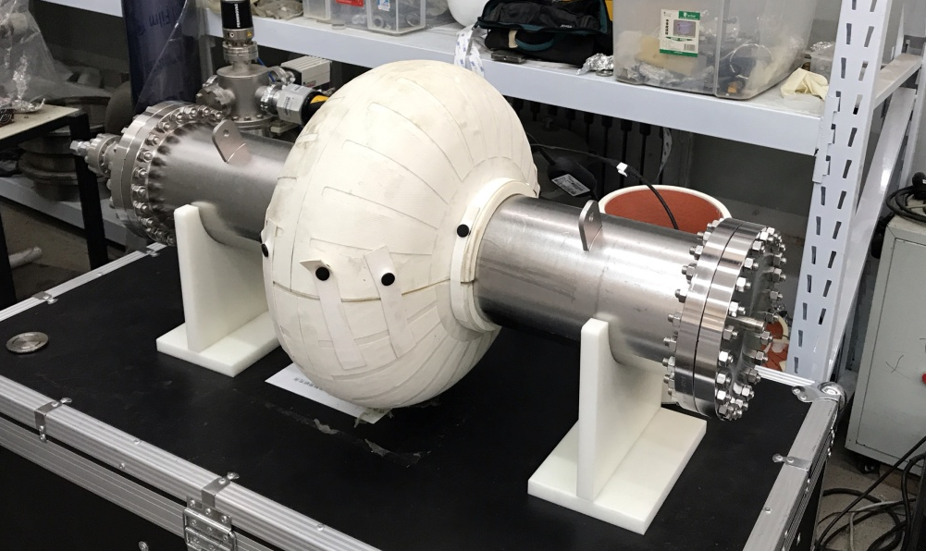
Post processing
Two cavities have finished post processing , which include BCP, annealing, High Pressure Rinse, 120 C baking, etc.
Inner surface after High pressure Rinse
High Pressure Rinse
BCP
120 C baking

Slide 15
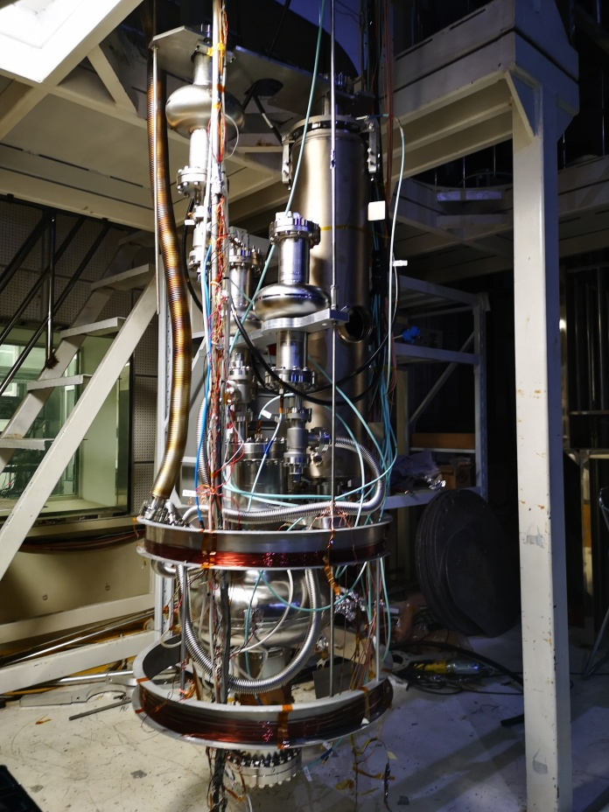
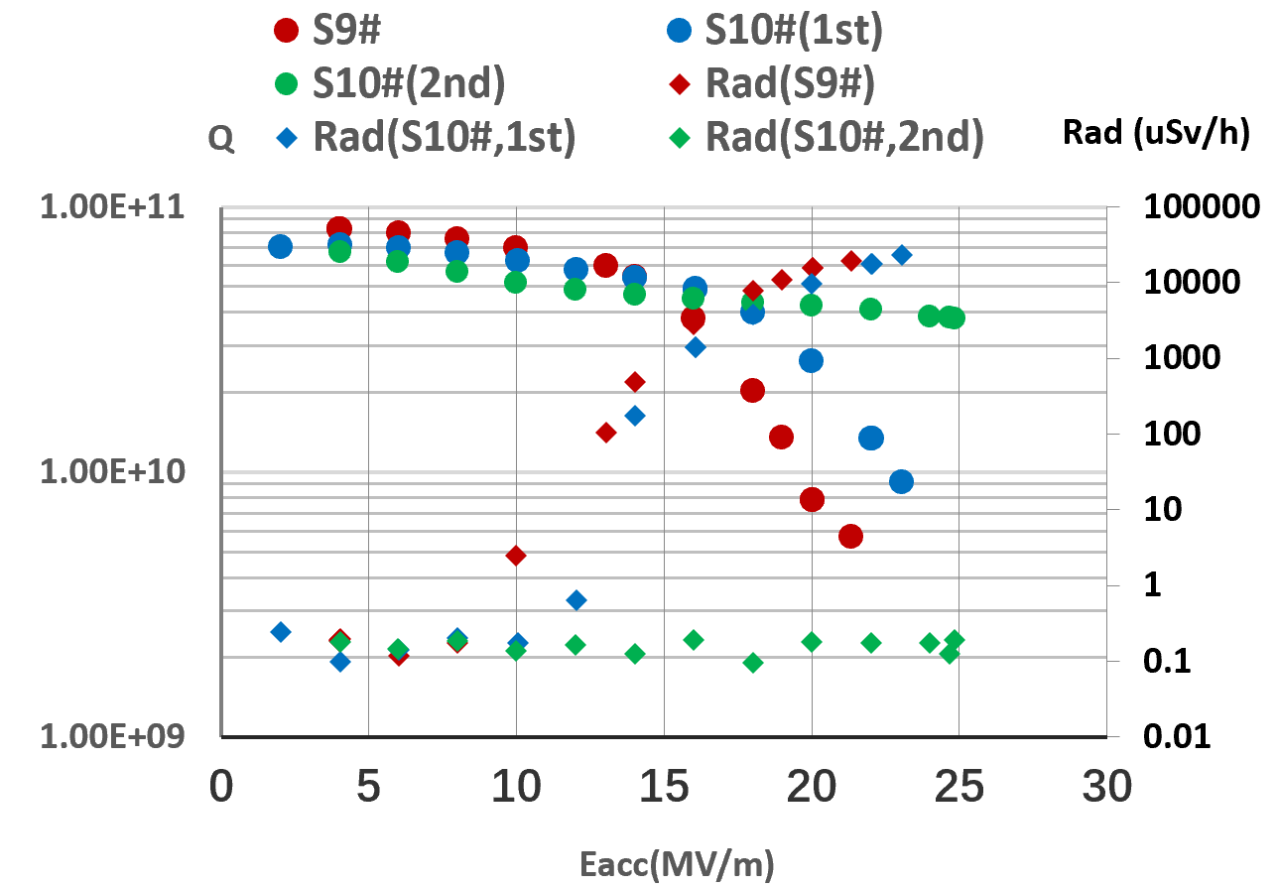
Vertical test
Several vertical tests have been carried out during Nov and Dec, 2019.
The results are not so good because of the poor inner surface.
Quench
Vertical test of 650 MHz 1-cell LG cavity, 1.3 GHz 9-cell cavity with Helium Vessel and 3 1.3 GHz 1-cell cavities (20191109)

Slide 16
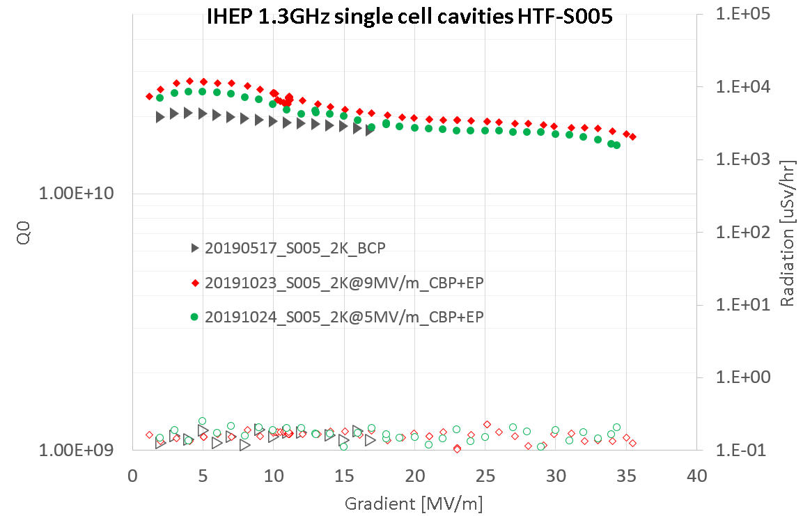
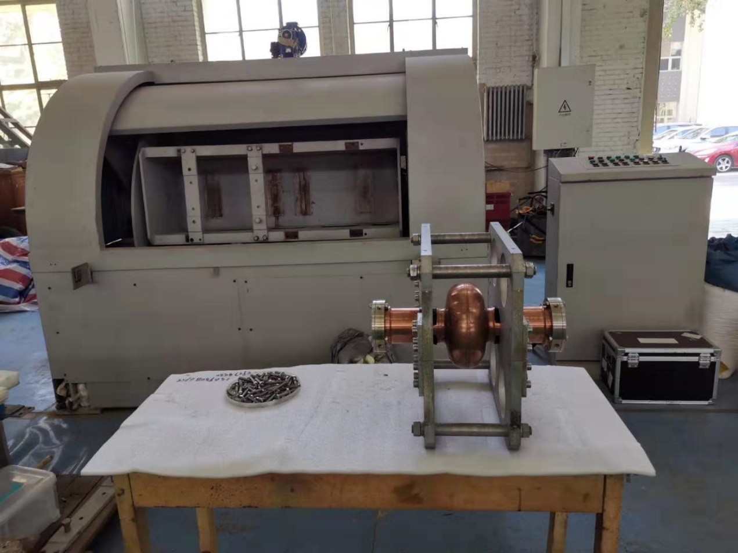
Next
采用滚磨抛光（CBP），改善腔的内表面状况，再重新进行垂测；并考虑进行电抛光（EP）。
CBP Machine and 1.3 GHz 1-cell Cu cavity
CBP of 1.3 GHz 1-cell Nb cavity succeed!

Slide 17
Outline
N-doping, EP
1.3GHz 9-cell cavities
650MHz 1-cell large-grain cavities
CEPC 650 MHz Test Cryomodule
Summary

Slide 18
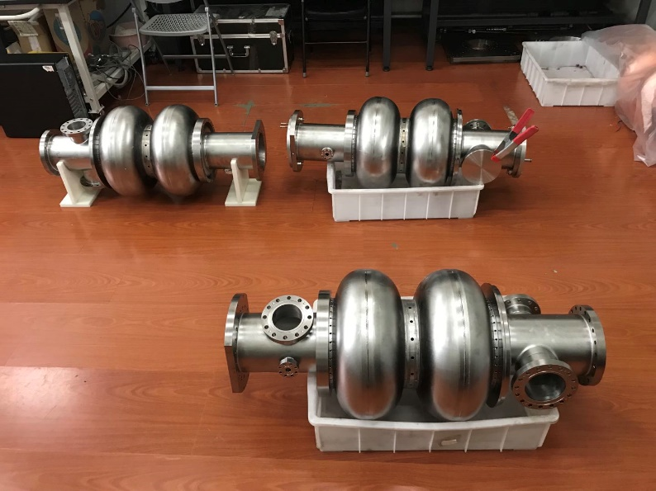
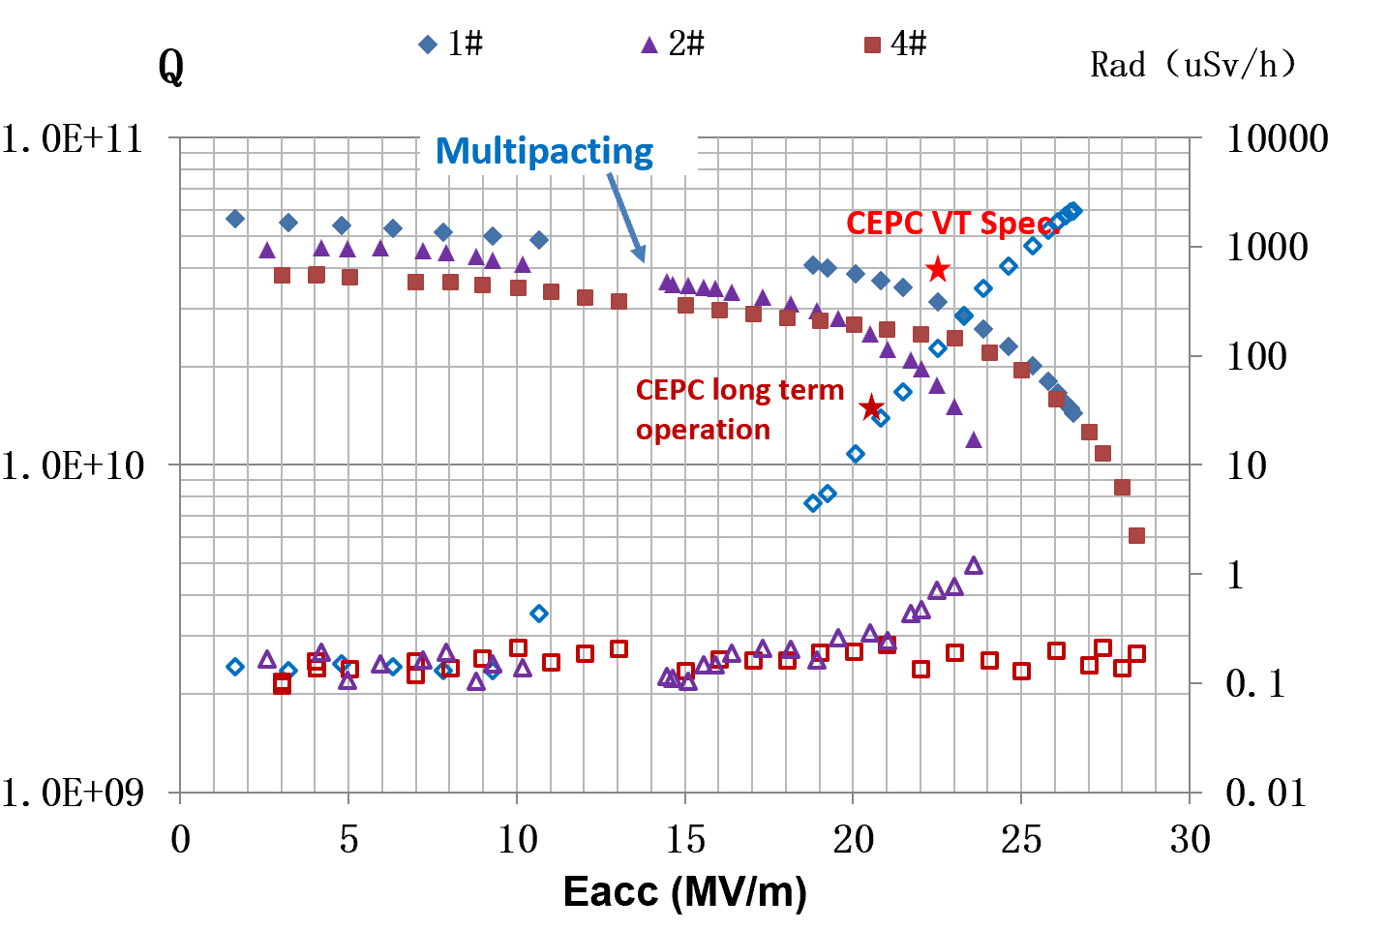
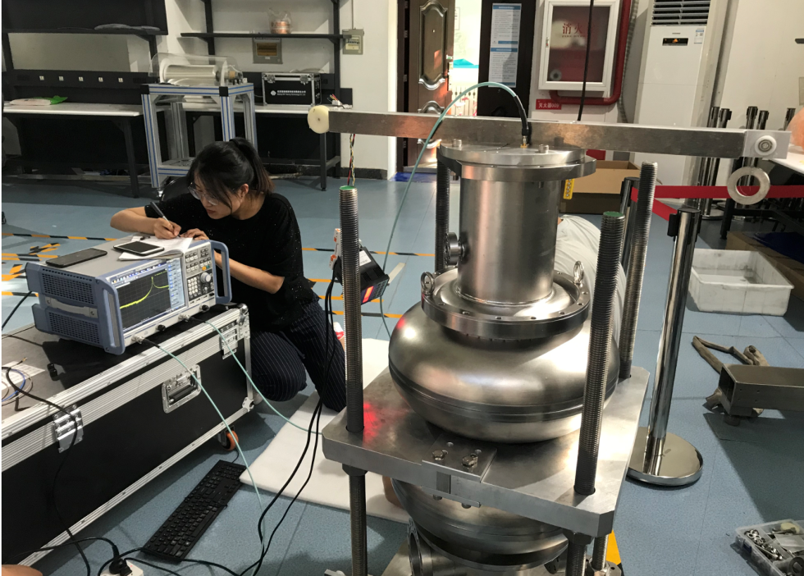
650MHz 2-cell cavity
今年，新完成了3只腔（4#、5#、6#）的研制和后处理，4#腔完成了测试，6#腔正在高能所测试，1#腔正在北大测试。
与旧腔型（1#、2#、3#）相比，Multipacting有很大改进。
4#、5#、6#超导腔
场平坦度调节

Slide 19
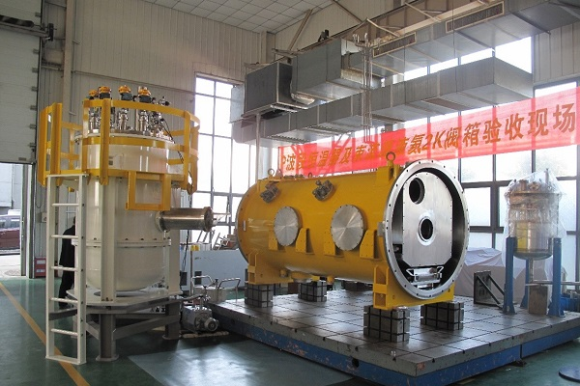
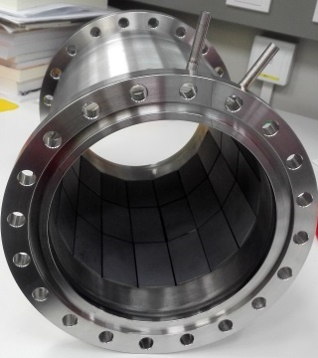
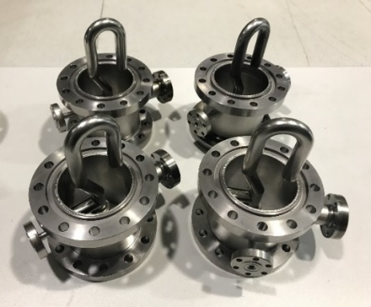
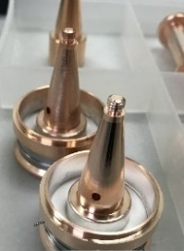
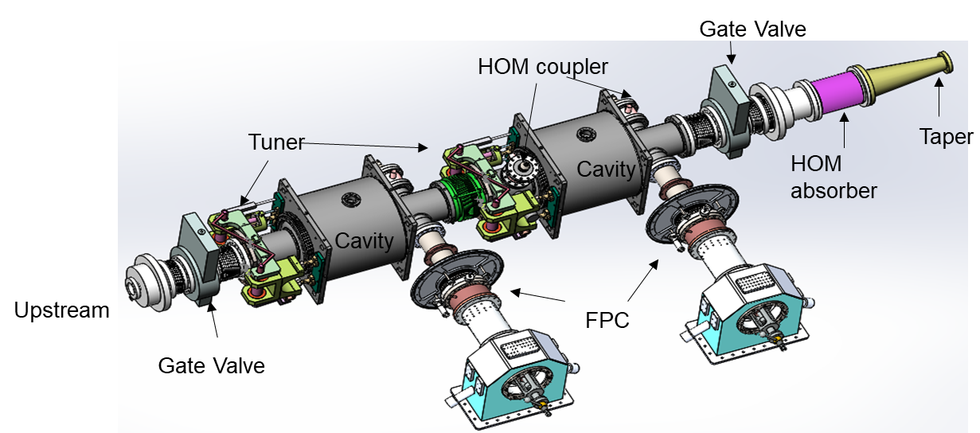
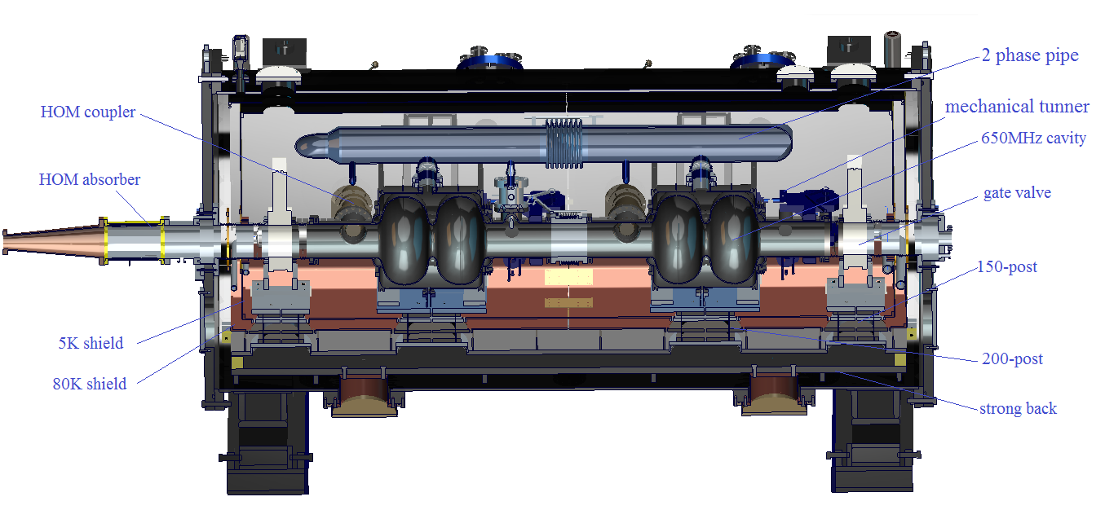
650MHz Test Cryomodule for CEPC
Cryomodule with two 650 MHz 2-cell cavities: under development, assemble in 2020.
国内首个SiC/AlN复合材料宽带高阶模吸收器
国内首个超导腔大功率高阶模耦合器
恒温器完成出厂验收

Slide 20
Outline
N-doping, EP
1.3GHz 9-cell cavities
650MHz 1-cell large-grain cavities
CEPC 650 MHz Test Cryomodule
Summary

Slide 21
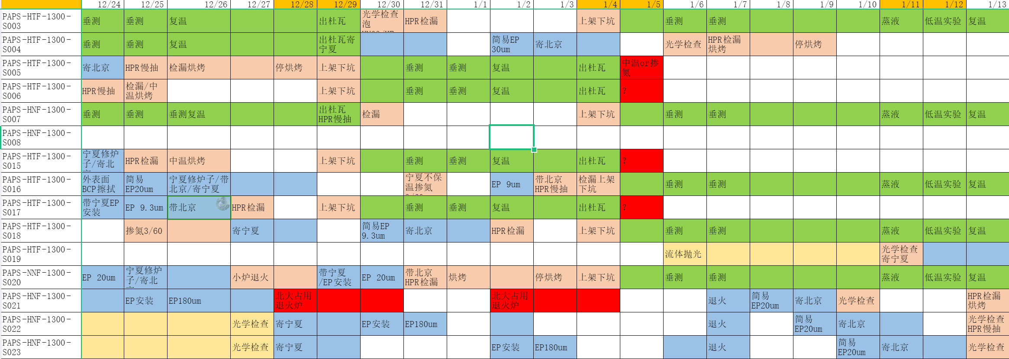

Slide 22
2019年发表的期刊文章
Dianjun Gong, Jie Gao, Hongjuan Zheng, Jiyuan Zhai, Peng Sha. Beam‑induced HOM power in CEPC collider ring cavity, Radiation Detection Technology and Methods, 2019 MAR.
Jiyuan Zhai, Dianjun Gong, Hongjuan Zheng, Peng Sha, Qiang Ma, etc. Design of CEPC superconducting RF system, International Journal of Modern Physics A, Vol. 34, Nos. 13 & 14 (2019) 1940006.
Hong-Juan Zheng, Jie Gao, Ji-Yuan Zhai, Peng Sha, Fei-Si He, etc. RF design of 650 MHz 2-cell cavity for CEPC collider, Nuclear Science and techniques, 2019, 30 (10): 564.
Hongjuan Zheng, Jiyuan Zhai, Fanbo Meng, Peng Sha, Jie Gao. HOM damping requirements and measurements for CEPC. Radiation Detection Technology and Methods, 2019 Nov.
董超，沙鹏，刘佰奇，李中泉，杨际森等，1.3GHz超导腔的掺氮实验，强激光与粒子束，第32卷第3期，2020年3月。
张若舟, 秦明阳, 张露, 董超, 沙鹏等，超导薄膜磁场穿透深度的双线圈互感测量，物理学报，2020年 Vol. 69, No. 4。
Hongjuan Zheng, Jiyuan Zhai, Fanbo Meng, Peng Sha, Jie Gao. Higher Order Mode Coupler for the Circular Electron Positron Collider, Nuclear Inst. and Methods in Physics Research, A. Volume 951, 21 January 2020.
米正辉, 杨际森, 沙鹏, 董超, 王洪磊等，1.3 GHz超导腔磁通排出效应研究，强激光与粒子束，第32卷第1期，2020年1月。 。

Slide 23
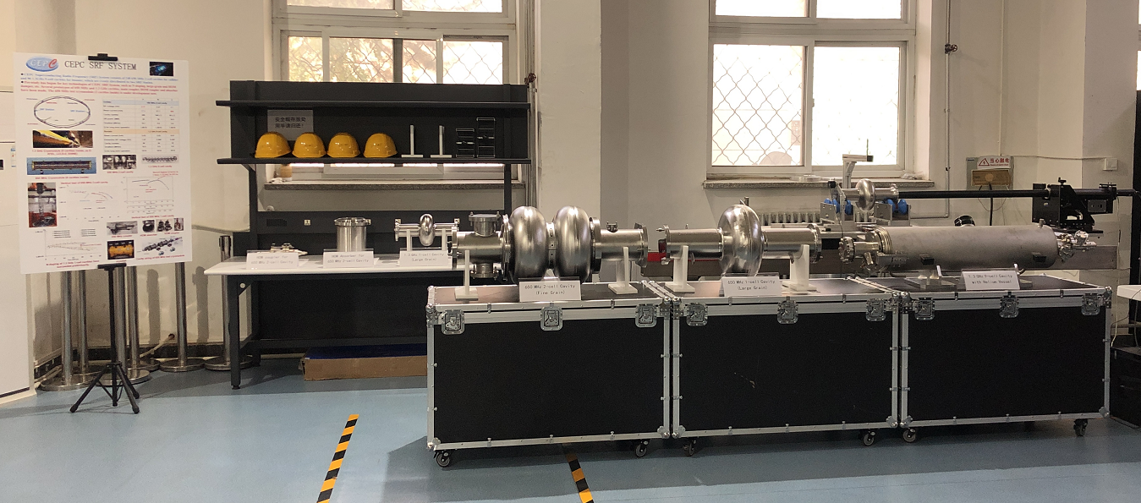
Work in 2020
完成CEPC 650MHz Test cryomodule的系统集成。
在1.3GHz 1-cell超导腔成功的基础上，对1.3GHz 9-cell、650MHz超导腔进行电抛光和掺氮。
对650MHz 1-cell大晶粒超导腔进行CBP、EP等后处理，重新测试。

Slide 24
Thanks for your attention!

