Slide 1
CEPC collider design at tt bar energy
Yiwei Wang
for the CEPC Accelerator Physics Group
CEPC day, 30 Dec. 2019

Slide 2
Outline
Based on CDR lattice (3.0E34/cm^2/s)
Higgs (120GeV) -> tt (up to 182.5GeV)
Based on high luminosity lattice (5.2E34/cm^2/s)
Higgs (120GeV) -> tt (up to 182.5GeV)
Collider design at tt bar
Parameters of magnets, RF, separation devices et al.

Slide 3
Based on CDR lattice (3E34/cm^2/s)

Slide 4
 | Higgs (CDR) | tt | tt
Number of IPs | 2 | 2 | 2
Beam energy (GeV) | 120 | 175 | 182.5
Circumference (km) | 100 | 100 | 100
Synchrotron radiation loss/turn (GeV) | 1.73 | 7.61 | 9.0
Crossing angle at IP (mrad) | 16.5×2 | 16.5 | 16.5
Piwinski angle | 3.48 | 0.91 | 0.89
Number of particles/bunch N_{e} (10¹⁰) | 15.0 | 24.15 | 26.7
Bunch number (bunch spacing) | 242 (0.68μs) | 34 | 26
Beam current (mA) | 17.4 | 3.95 | 3.3
Synchrotron radiation power /beam (MW) | 30 | 30 | 30
Bending radius (km) | 10.7 | 10.9 | 10.9
Momentum compact (10⁻⁵) | 1.11 | 1.14 | 1.14
β function at IP β_{x}* / β_{y}* (m) | 0.36/0.0015 | 1.2/0.0037 | 1.2/0.0037
Emittance ε_{x}/ε_{y} (nm) | 1.21/0.0024 | 2.24/0.0068 | 2.46/0.0074
Beam size at IP σ_{x} /σ_{y} (μm) | 20.9/0.06 | 51.8/0.16 | 54.4/0.17
Beam-beam parameters ξ_{x}/ξ_{y} | 0.018/0.109 | 0.077/0.105 | 0.076/0.103
RF voltage V_{RF} (GV) | 2.17 | 8.93 | 10.3
RF frequency f _{RF} (MHz) (harmonic) | 650 (216816) | 650 (217500) | 650 (217500)
Natural bunch length σ_{z} (mm) | 2.72 | 2.54 | 2.62
Bunch length σ_{z} (mm) | 4.4 | 2.87 | 2.93
HOM power/cavity (2 cell) (kw) | 0.46 | 0.53 (5cell) | 0.49
Energy spread (%) | 0.134 | 0.14 | 0.15
Energy acceptance requirement (%) | 1.35 | 1.57 | 1.7
Energy acceptance by RF (%) | 2.06 | 2.67 | 2.48
Photon number due to beamstrahlung | 0.082 | 0.19 | 0.15
Beamstruhlung lifetime /quantum lifetime* (min) | 80/80 | 60 | 1.0
Lifetime (hour) | 0.43 |  | 0.7
F (hour glass) | 0.89 | 0.89 | 0.88
Luminosity/IP L (10³⁴cm⁻²s⁻¹) | 2.93 | 0.38 | 0.32
CEPC parameters
D. Wang et al.

Slide 5
Lattice design based on CDR lattice
CEPC is optimized at Higgs energy. Margins for tt running have been reserved.
The tt bar running will be based on the hardware for Higgs except adding RF cavities.
No much challenges on the accelerator physics design as not high luminosity is required at tt bar for CEPC.

Slide 6
Based on high luminosity lattice (5.2E34/cm^2/s)

Slide 7
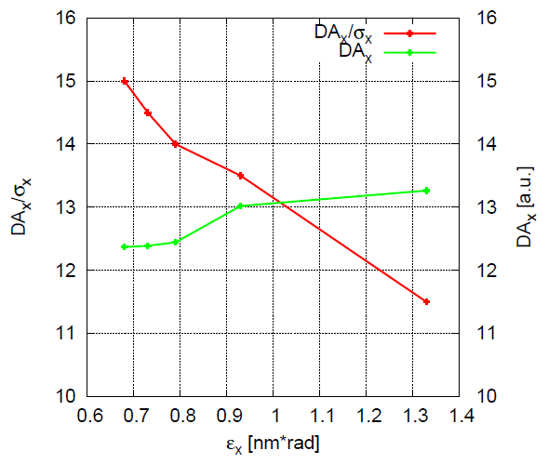
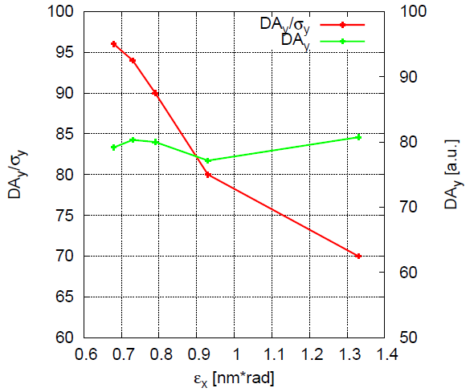
 | Higgs (CDR) | tt | tt | Higgs (high)
Number of IPs | 2 | 2 | 2 | 2
Beam energy (GeV) | 120 | 175 | 182.5 | 120
Circumference (km) | 100 | 100 | 100 | 100
Synchrotron radiation loss/turn (GeV) | 1.73 | 7.61 | 9.0 | 1.68
Crossing angle at IP (mrad) | 16.5×2 | 16.5 | 16.5 | 16.5×2
Piwinski angle | 3.48 | 0.91 | 0.89 | 3.78
Number of particles/bunch N_{e} (10¹⁰) | 15.0 | 24.15 | 26.7 | 17.0
Bunch number (bunch spacing) | 242 (0.68μs) | 34 | 26 | 218 (0.76μs)
Beam current (mA) | 17.4 | 3.95 | 3.3 | 17.8
Synchrotron radiation power /beam (MW) | 30 | 30 | 30 | 30
Bending radius (km) | 10.7 | 10.9 | 10.9 | 10.7
Momentum compact (10⁻⁵) | 1.11 | 1.14 | 1.14 | 0.91
β function at IP β_{x}* / β_{y}* (m) | 0.36/0.0015 | 1.2/0.0037 | 1.2/0.0037 | 0.33/0.001
Emittance ε_{x}/ε_{y} (nm) | 1.21/0.0024 | 2.24/0.0068 | 2.46/0.0074 | 0.89/0.0018
Beam size at IP σ_{x} /σ_{y} (μm) | 20.9/0.06 | 51.8/0.16 | 54.4/0.17 | 17.1/0.042
Beam-beam parameters ξ_{x}/ξ_{y} | 0.018/0.109 | 0.077/0.105 | 0.076/0.103 | 0.024/0.113
RF voltage V_{RF} (GV) | 2.17 | 8.93 | 10.3 | 2.4
RF frequency f _{RF} (MHz) (harmonic) | 650 (216816) | 650 (217500) | 650 (217500) | 650 (216816)
Natural bunch length σ_{z} (mm) | 2.72 | 2.54 | 2.62 | 2.2
Bunch length σ_{z} (mm) | 4.4 | 2.87 | 2.93 | 3.93
HOM power/cavity (2 cell) (kw) | 0.46 | 0.53 (5cell) | 0.49 | 0.58
Energy spread (%) | 0.134 | 0.14 | 0.15 | 0.19
Energy acceptance requirement (%) | 1.35 | 1.57 | 1.7 | 1.7
Energy acceptance by RF (%) | 2.06 | 2.67 | 2.48 | 3.0
Photon number due to beamstrahlung | 0.082 | 0.19 | 0.15 | 0.104
Beamstruhlung lifetime /quantum lifetime* (min) | 80/80 | 60 | 1.0 | 30/50
Lifetime (hour) | 0.43 |  | 0.7 | 0.22
F (hour glass) | 0.89 | 0.89 | 0.88 | 0.85
Luminosity/IP L (10³⁴cm⁻²s⁻¹) | 2.93 | 0.38 | 0.32 | 5.2
tt lattice design based on high luminosity Higgs lattice
Beam energy: 182.5GeV
Emittance: 0.68nm*(182.5/120)^2
Beta y at IP: 3.7mm (tentative)

Slide 8
Collider design at tt bar
CEPC is optimized at Higgs energy. The tt bar running will be based on the hardware for Higgs except adding RF cavities.
Lattice design:
In the arc and most part of interaction region, magnets strength margin reserved for running at tt bar; just need to make re-matching to keep the same beam size at the 4 final quadrupoles.
Error correction: same scheme as normalized strength is the same with Higgs mode
Dynamic aperture: The optimization of the DA at tt should be done for asymmetric momentum acceptance in order to match the distribution with beamstrahlung.
MDI: The critical energy of radiated photon will be 3.5 times (i.e. 91keV and 130keV from last bends of upstream and downstream) but the power will be a bit lower.
RF cavity: space of 5-cell RF cavities is reserved for running at tt bar

Slide 9
Parameters of magnets
Magnets
Field maximum: “tt” operation field used
Good field region
In all regions except final doublet, Max[Rgf(tt), Rgf(higgs)] used for tt option

Slide 10
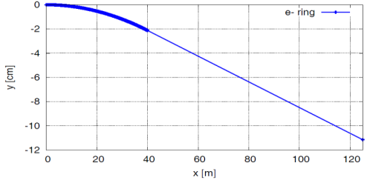
Parameters of hardware
RF cavity
240 two cell cavities (for higgs) + 347 cavities five cell cavities (extra cavities for tt)
beam
separation
devices
separation
devices
tt
H
H
tt
Separation devices
Higgs: electro-static separator (2.0MV/m, (4+1) m*8*4 )
tt: electro-static separator (2.0MV/m, (4+1) m*8*4 ) + septum
The design of scheme with kicker + septum is undergoing.

Slide 11
Summary
CEPC is optimized at Higgs energy. The tt bar running will be based on the hardware for Higgs except adding RF cavities.
No much change on the collider design and no much challenges on the accelerator physics design if not high luminosity is required at tt bar for CEPC.
Two issues of the physics and detector people may concern:
a asymmetric momentum acceptance in order to match the distribution with beamstrahlung.
In the interaction region, the critical energy of radiated photon will be 3.5 times (i.e. 91keV and 130keV from last bends of upstream and downstream) but the power will be a bit lower.
tt bar energy and luminosity goal?

Slide 12
backup

Slide 13
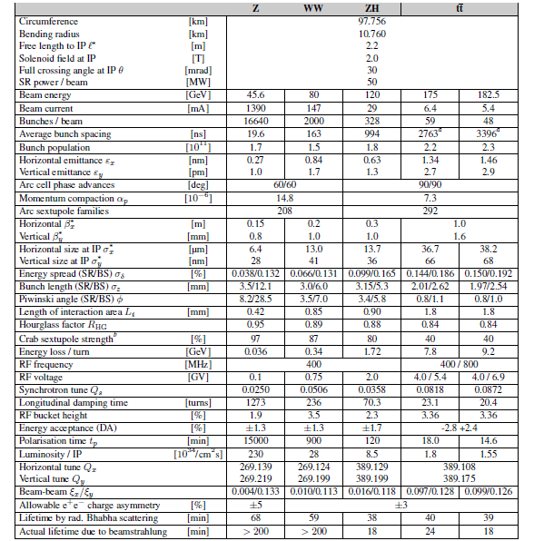
FCC-ee parameter
Ref: FCC-ee CDR

