Slide 1


Hard Probes in the Precision Era of Heavy-Ion Physics
Urs Achim Wiedemann
22 Sep 2026, Wuhan, China

Slide 2




Heavy Ion Physics: 5 decades of discoveries and surprises
1973 QCD
Asymptotic freedom
1974 – 78
QGP
1978 - ….
QGP signatures
QCD thermodynamics
QCD hydrodynamics
QCD kinetic theory
Politzer; Gross+Wilczek
T.D. Lee, Cabbibo+Parisi,
Collins+Perry, Shuryak
Bjorken, Baym, McLerran,
Kajantie, Gyulassy, many more
TH ⬄ EXP
interplay
Bevalac
BNL AGS
CERN SPS
BNL RHIC
CERN LHC
1974 , E/m ~ 1
1987
1987-
2000-26
2010
Kinetic Equilibration:
Chemical Equilibration:
In-medium dissociation & hadronization:
QGP radiation:
Inner workings of the QGP:
Flow v2 v2 v2, v3 v2,v3,v4,v5, …
----- Strangeness enhancement ------------- + charm sector + beauty
J/Psi suppression J/Psi enhancement Ypsilon & J/Psi
el mag radiation ………………………………………………………………
hard probes, jet quenching, jet substructure …
Much more!
Systematic Exploration of the QGP
X.N.Wang & U.A.Wiedemann: QGP@50: More than Four Decades of Jet Quenching, arXiv:2508.18794
Yayun He et al, arXiv:2201.08408

Slide 3
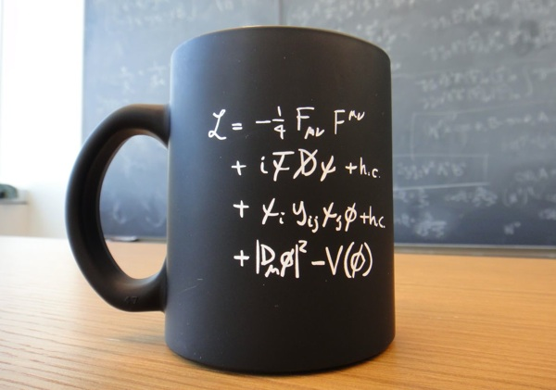
Heavy Ion Physics @ LHC ⬄ High Energy Physics
HEP
What are the fundamental constituents of matter and the laws governing their interactions?
Aim:
origin of mass, matter-antimatter asymmetry, dark matter …
HIP
How do non-abelian quantum field theories give rise to equilibrium and non-equilibrium properties? How do collective phenomena arise from fundamental interactions?
HIP ⬄ HEP
Sociologically
HEP and HIP in same collaborations
Future-oriented
common trajectories throughout HL-LHC
Technologically
Common detectors, common R&D
Scientifically
(this talk)
U.A. Wiedemann, plenary ICHEP 2020, arXiv:2101.01971

Slide 4
Recall
Generic phenomena
Yayun He et al, arXiv:2201.08408

Slide 5
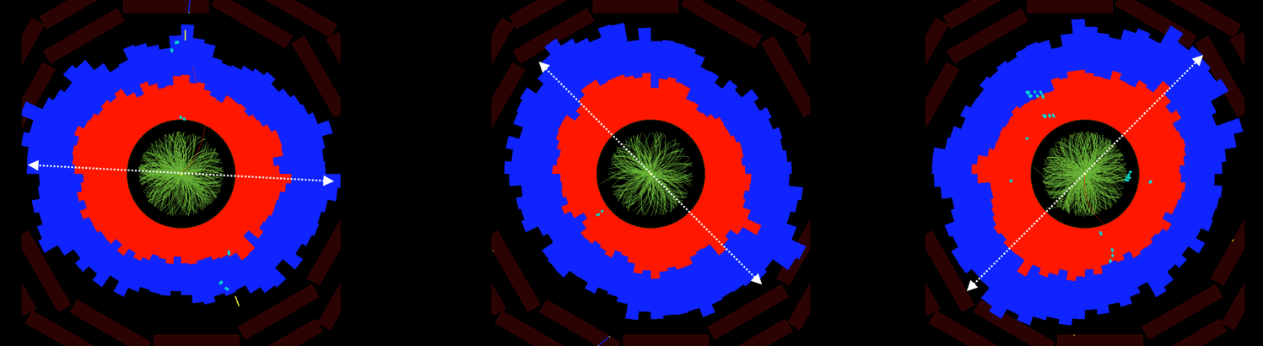
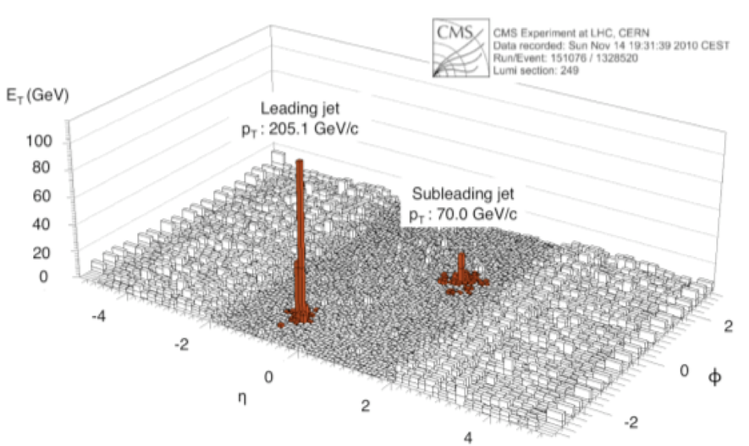
Heavy-ions: generic & large emergent phenomena
FLOW
Collective Motion of essentially all soft hadrons.
Jet Quenching
These phenomena are:
Numerically large
Generic
Quantified on top of pp baseline.
Allows for detailed experimentation of collective phenomena.
Yayun He et al, arXiv:2201.08408

Slide 6
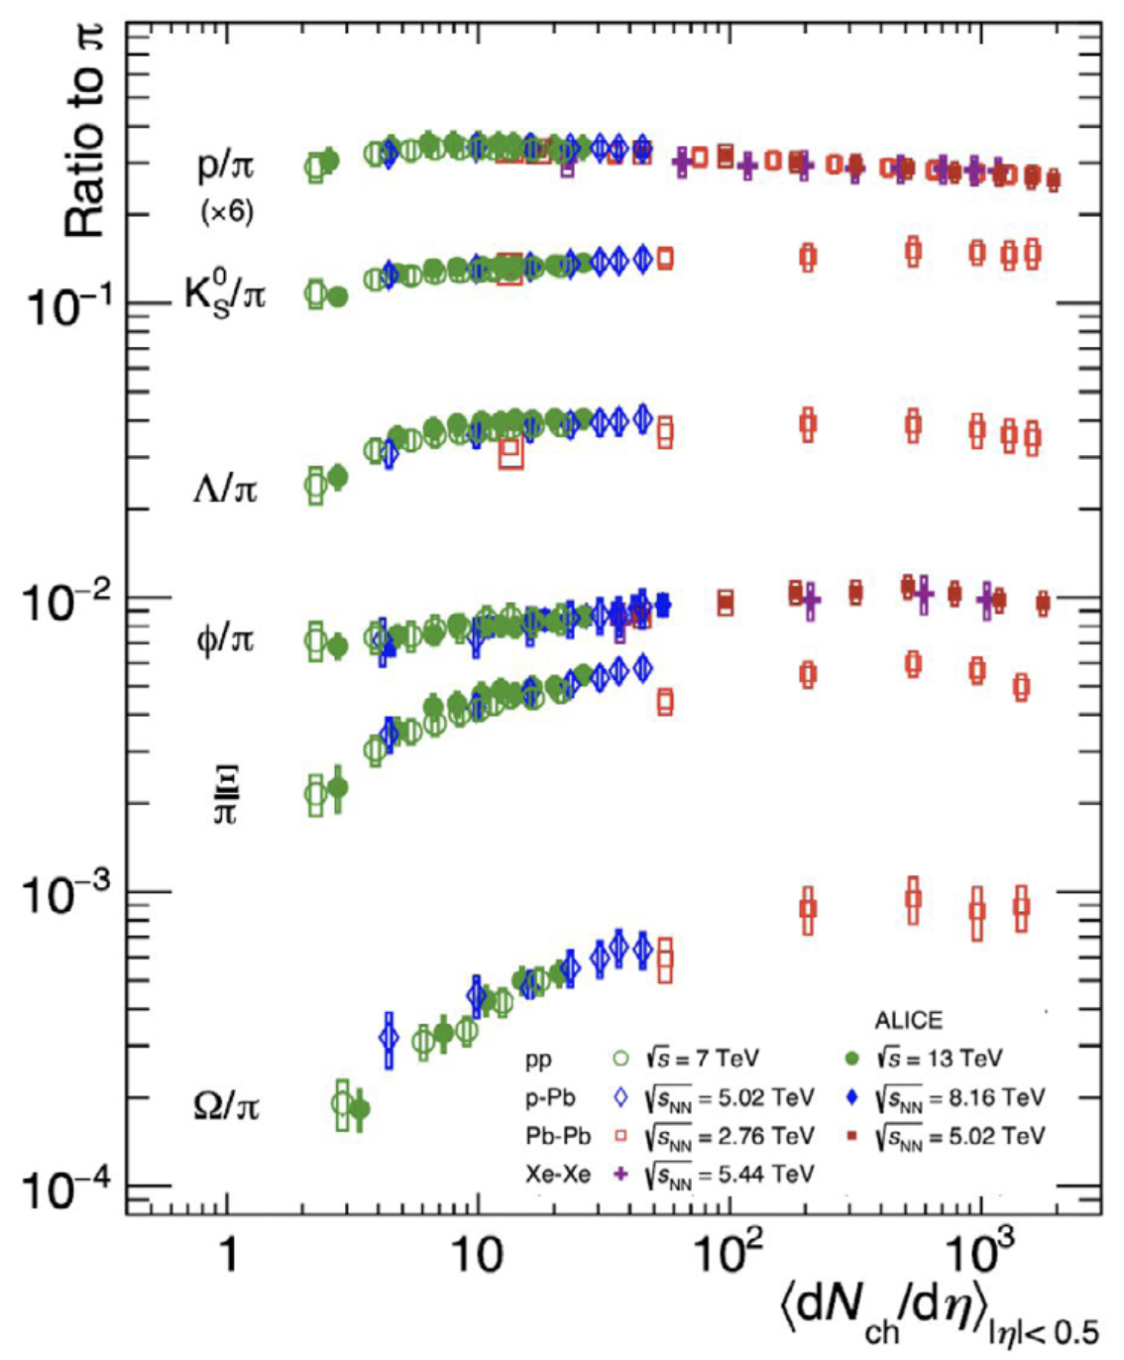
… continued
Strangeness enhancement
“Hadrochemistry” changes generically with system size.
“ Collective effects are observed in high-multiplicity pp events, similar to the signals traditionally attributed to the formation of a Quark Gluon Plasma in heavy ion collisions … there is still not a unified framework.”
Torbjörn Sjöstrand, “Collective Effects, the viewpoint of HEP MC Codes” 1808.03117
ALICE Coll, arXiv:2211.04384
Yayun He et al, arXiv:2201.08408

Slide 7
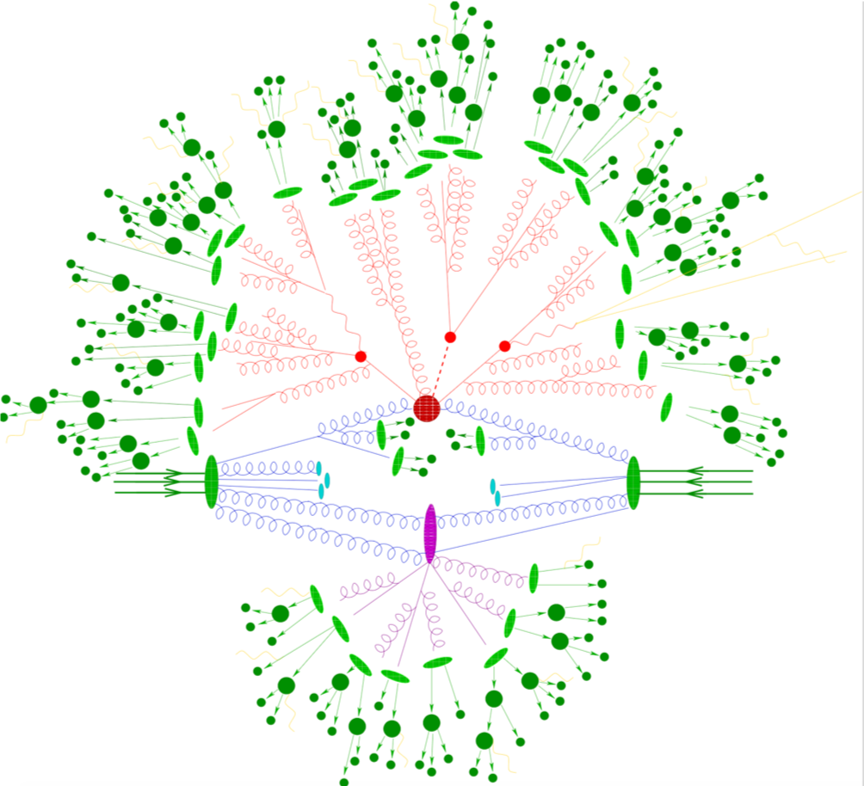
These emergent phenomena are not accounted for in the
default (MC) picture of proton-proton collisions
A free-streaming but fragmenting “gas”
Included:
Multiple Parton Interactions
Hard Processes
Parton Showers
Hadronization
Hadronic decays
Electroweak processes
BSM
Not included:
any notion of “medium-dependence”, such as jet quenching, flow, hadrochemistry
Yayun He et al, arXiv:2201.08408

Slide 8
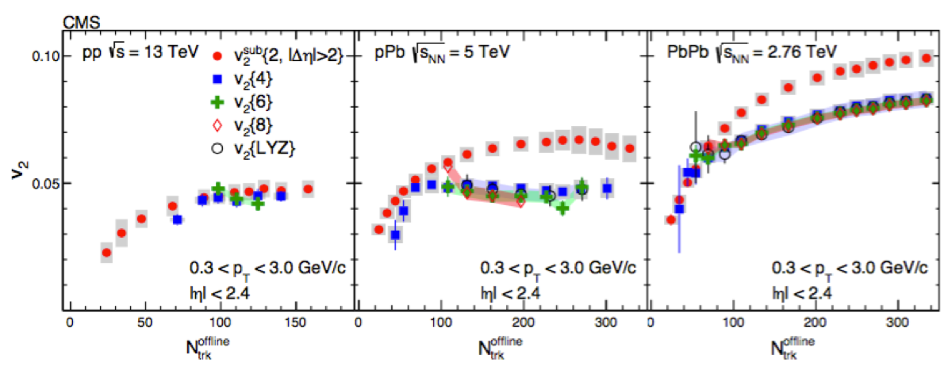
and yet, collective phenomena
smoothly extend to proton-proton collisions
CMS, Phys. Lett. B765 (2017) 193
Yayun He et al, arXiv:2201.08408

Slide 9
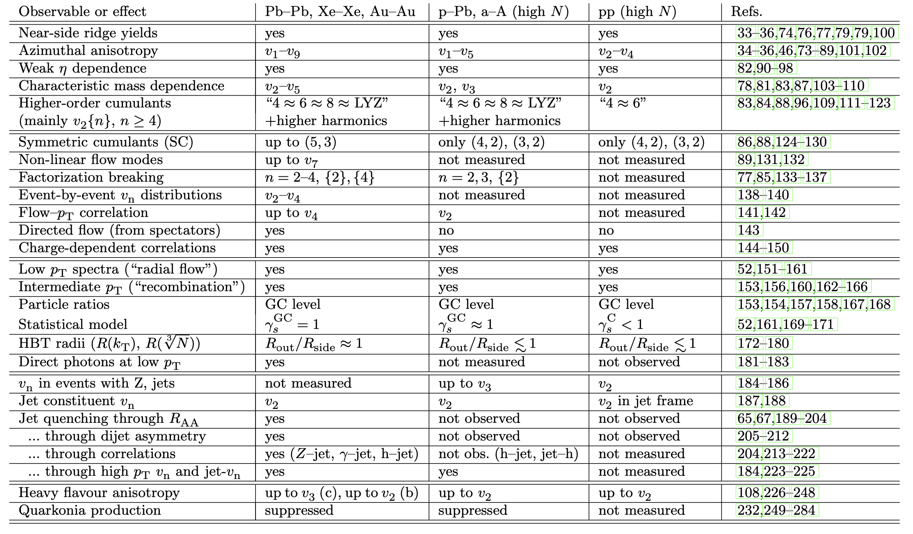
… smoothly extend to proton-proton collisions
200 publications from all LHC and RHIC collaborations:
Precursor phenomena of collectivity seen in pp and pA.
Table from: Jan Fiete Grosse-Oertringhaus & UAW, arXiv:2407.07484
Yayun He et al, arXiv:2201.08408

Slide 10
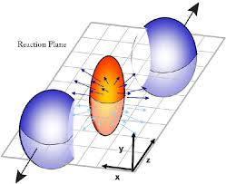
Why is quantifying fluid dynamics in AA-collisions of fundamental interest?
Flow translates spatial gradients into momentum gradients.
Fluid dynamics gives access to QGP
properties that can be calculated from
1st principles in quantum field theory.
… in more detail ….
Yayun He et al, arXiv:2201.08408

Slide 11
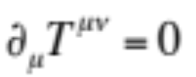
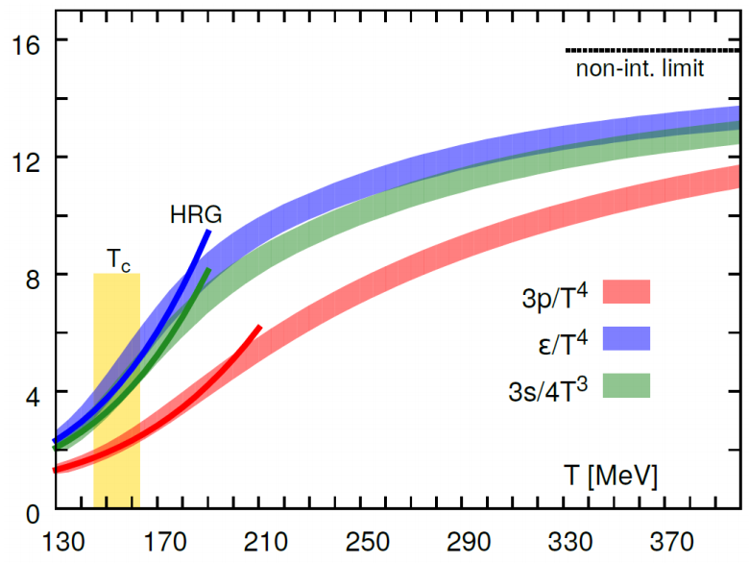
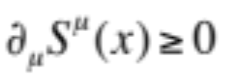


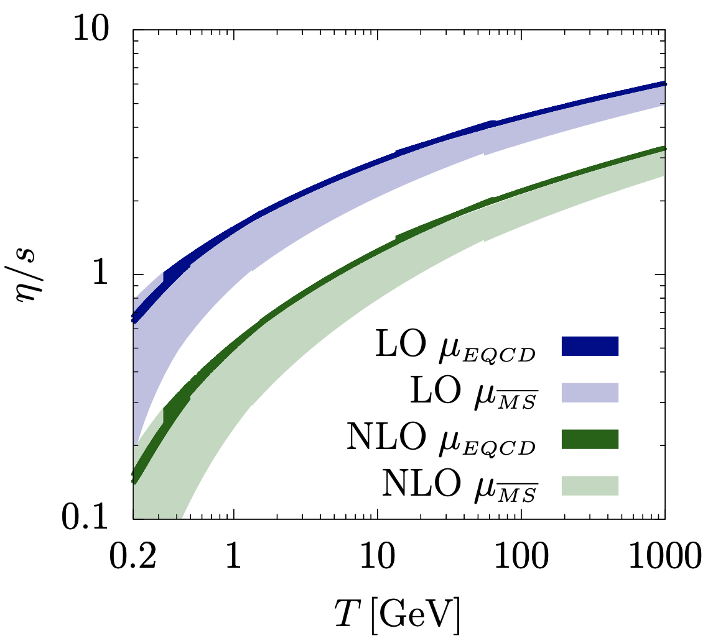


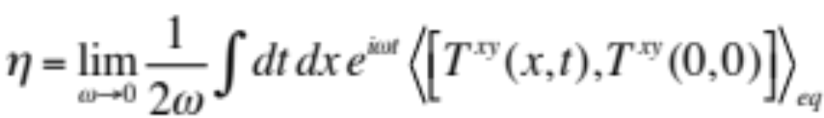


Fluid dynamics ⬄ access to QGP properties calculable from 1st principles in QCD
based only on: E-p conservation:
2nd law of thermodynamics:
sensitive only to properties of matter that are
calculable from first principles in quantum field theory
- EOS: and sound velocity
- transport coefficients: shear , bulk viscosity, …
- relaxation times: , , …
Lattice QCD =>
Finite Temp pQCD =>
AdS/CFT =>
J. Ghiglieri, G. Moore, D. Teaney, QCD Shear Viscosity at (almost) NLO, JHEP 03 (2018) 179
D. Bazavov et al, The equation of state in (2+1)-flavor QCD, Phys. Rev. D90 (2014) 094503
S. Borsanyi et al, JHEP 09 (2010) 073

Slide 12
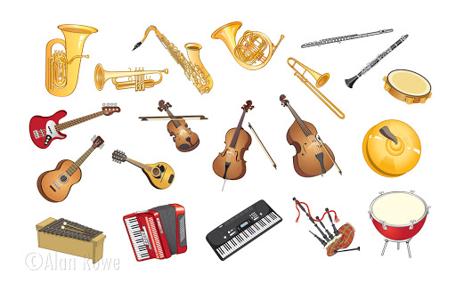

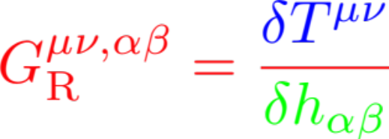

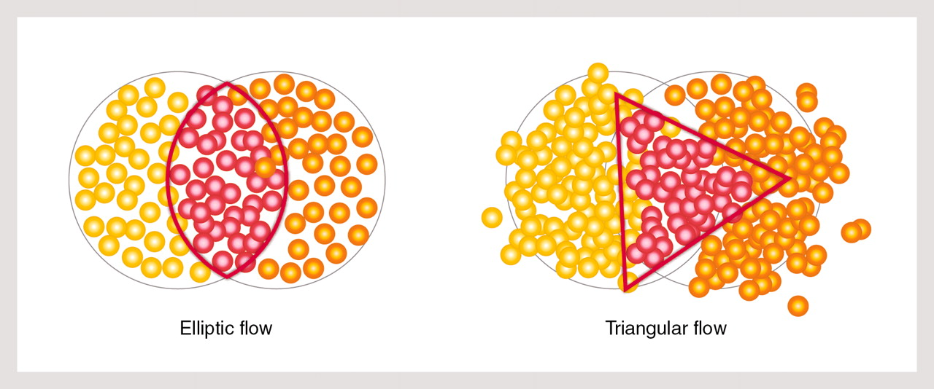
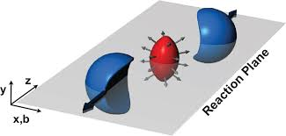


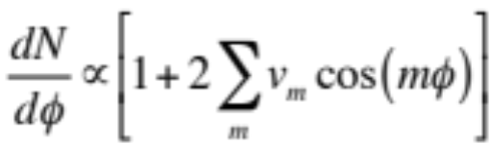
Concept: testing medium properties via fluid response
Excite medium
Listen to response
Analyze
In theory:
In experiment:
Prepare different excitations measure their response

Slide 13
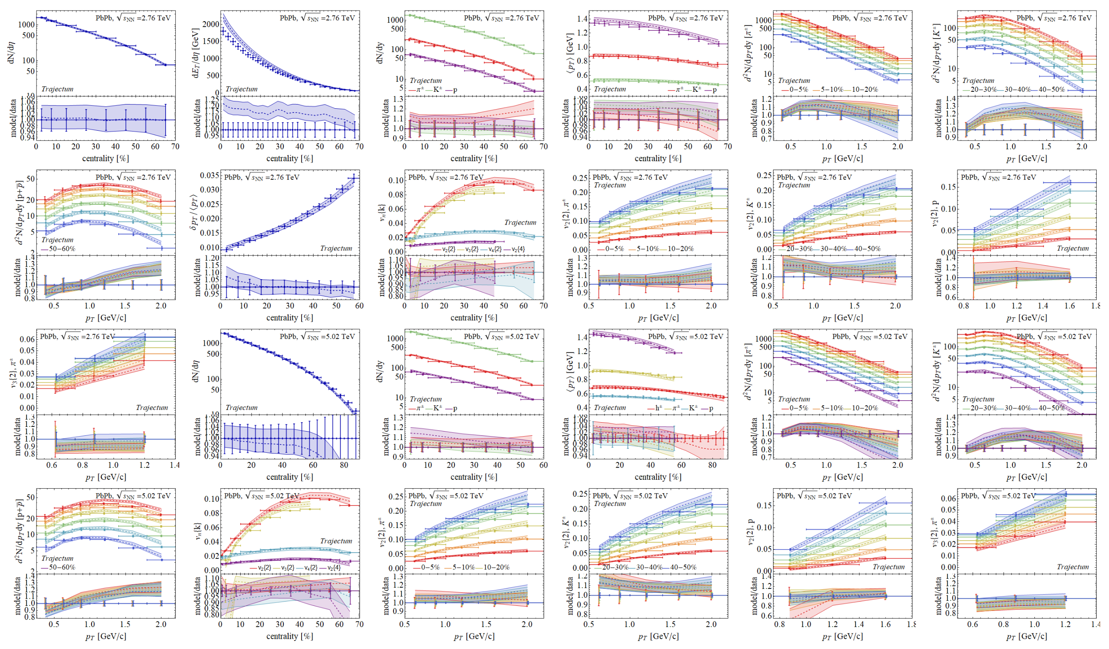
Comparison to Hydro-Models
Quantifies QGP properties and QGP evolution
Largely restricted to light-flavored hadron species so far.
Bayesian inference analysis involving 670 LHC data points.
* G. Nijs, W. van der Schee, 2304.06191.
Yayun He et al, arXiv:2201.08408
Notes:
In little bangs as in the Big Bang, material properties are accessed by fluctuation studies

Slide 14
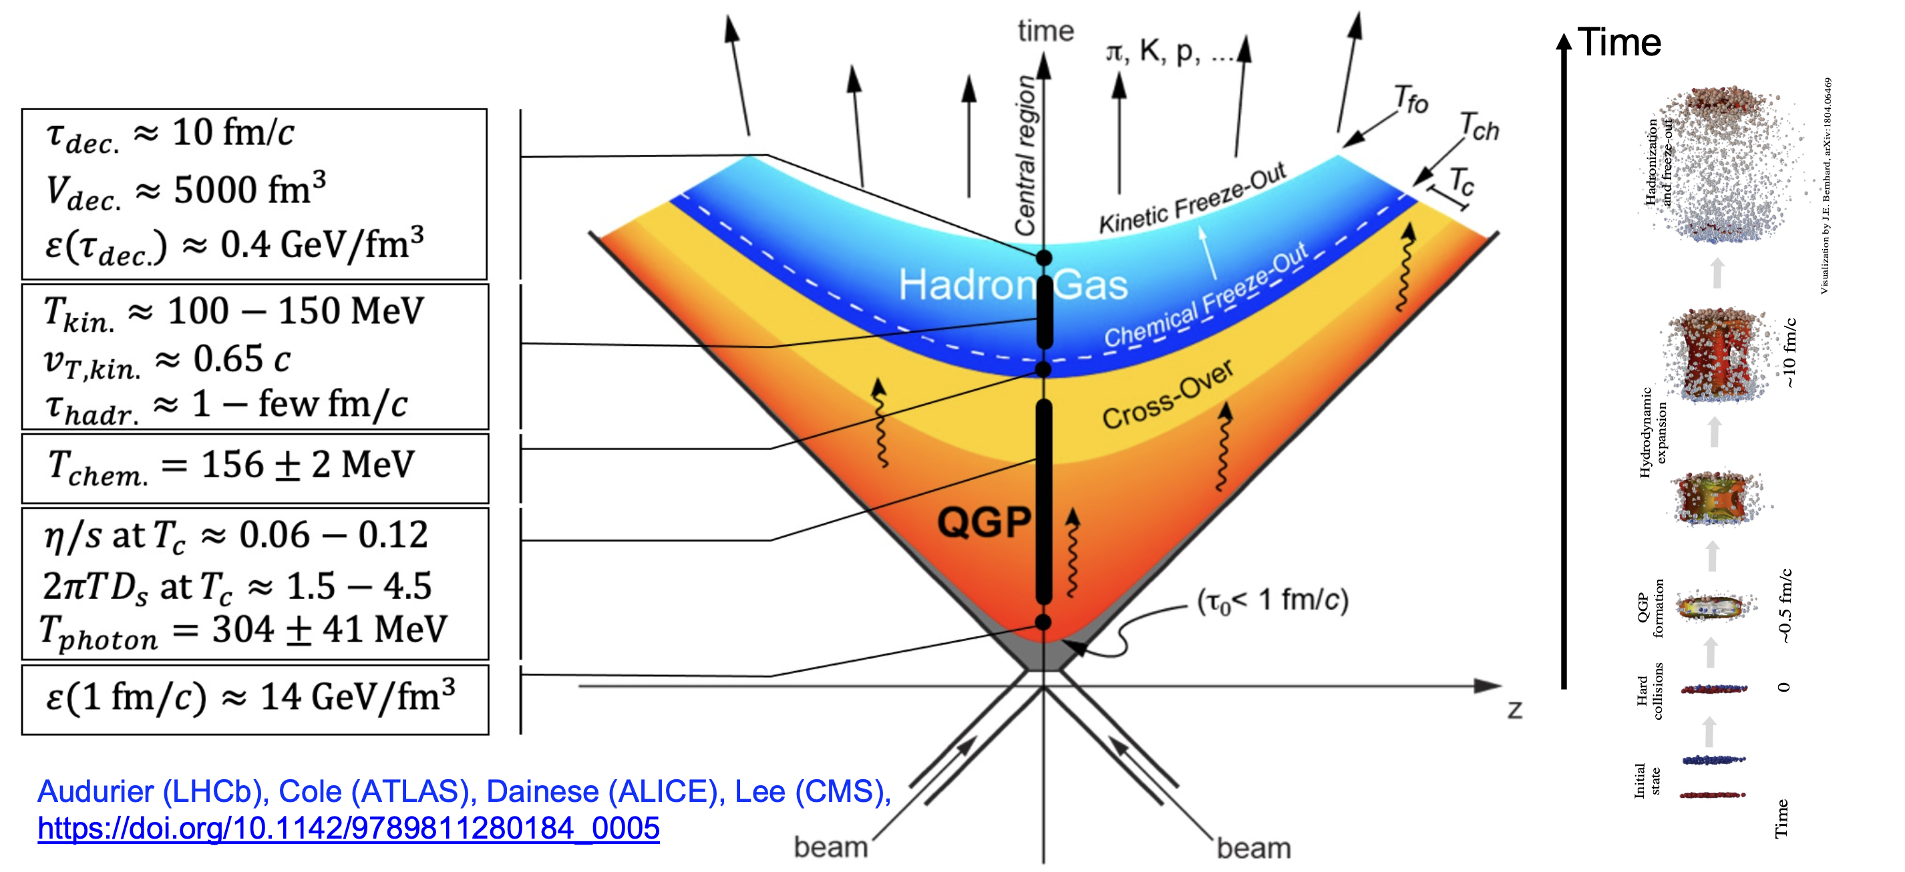
Quantitative support for a default picture of AA
Yayun He et al, arXiv:2201.08408
Notes:
In little bangs as in the Big Bang, material properties are accessed by fluctuation studies

Slide 15
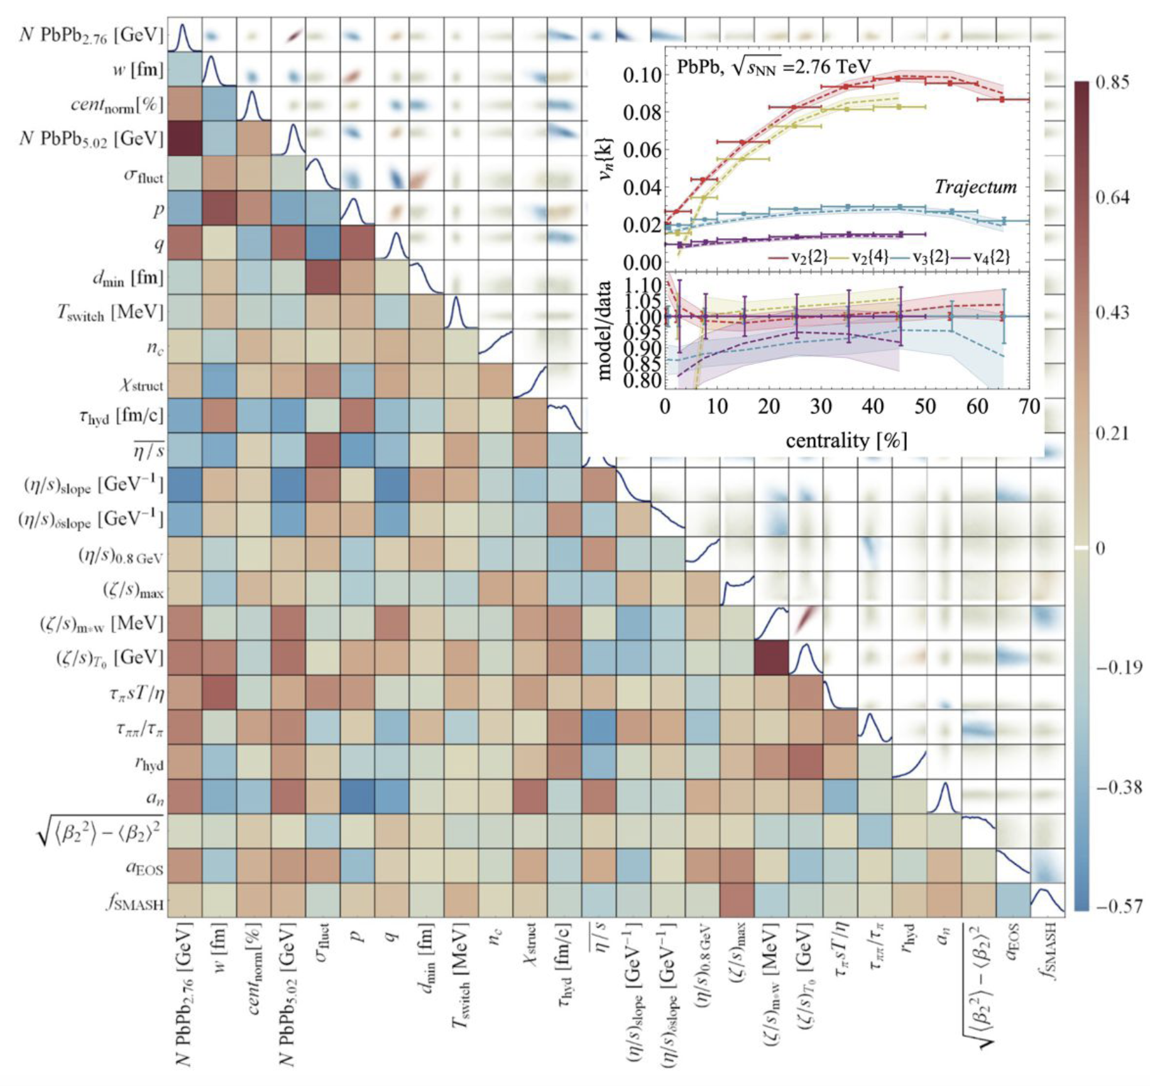
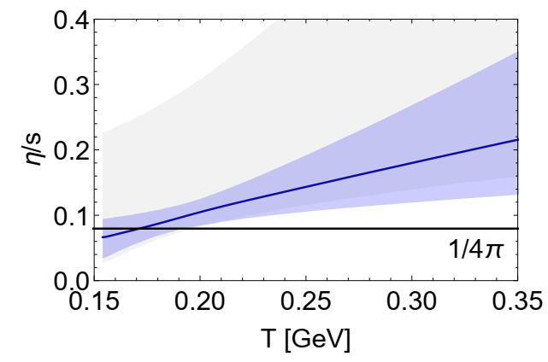
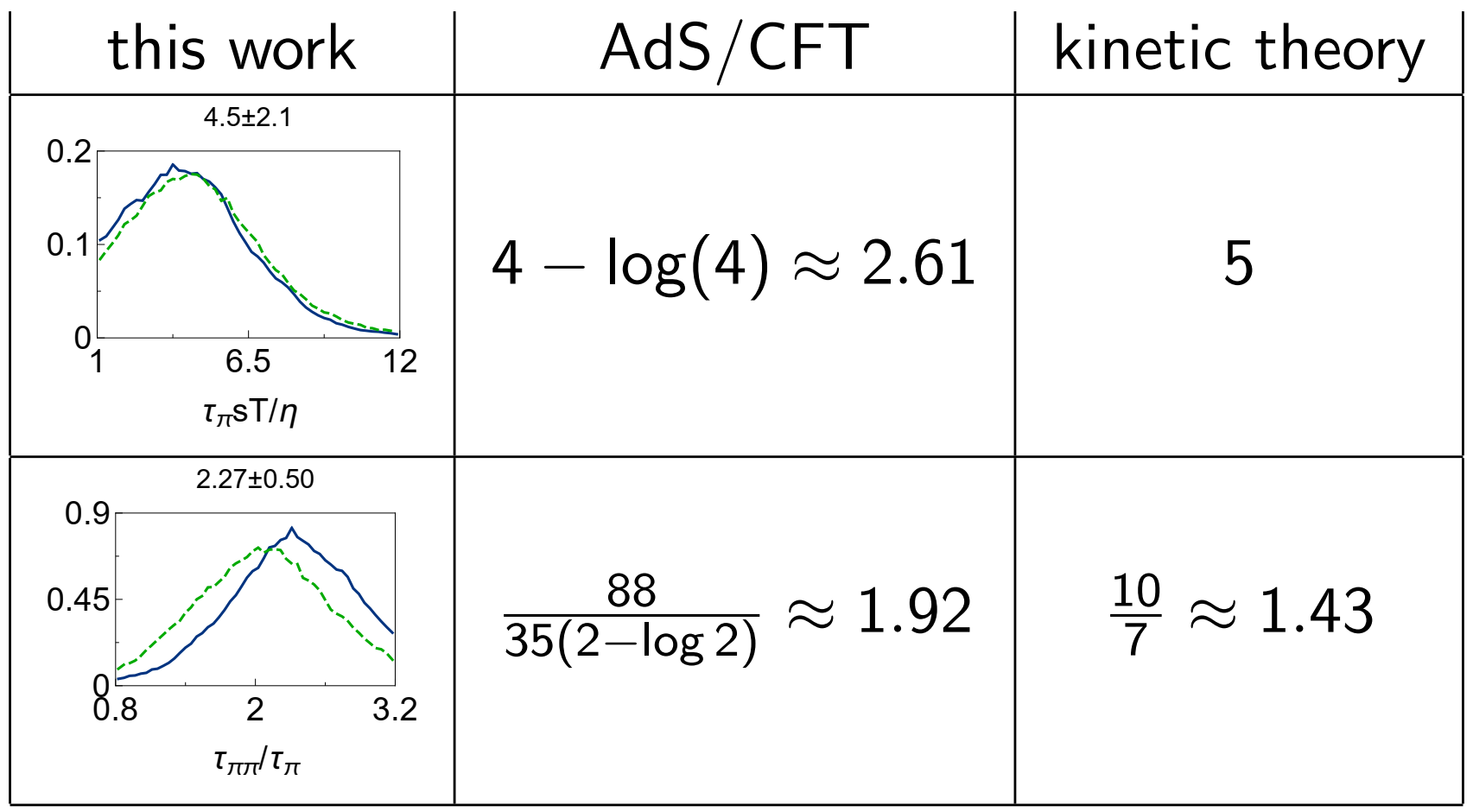
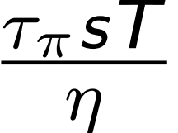
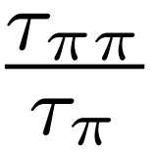
Bayesian Inference
Shear viscosity over entropy
NGSS*
Relaxation times
NGSS*
H. Song, S. Bass, U. Heinz, T. Hirano, C. Shen, Phys. Rev. Lett. 106 (2011) 192301
Giacalone, Nijs, van der Schee, Phys.Rev.Lett.131 (2023) 20, 20
*G. Nijs, U. Gursoy, W. v.d. Schee, R. Snellings, arXiv:2010.15130, arXiv:2010.15134

Slide 16
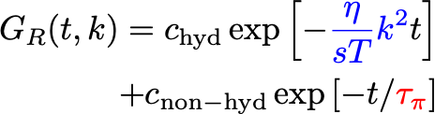
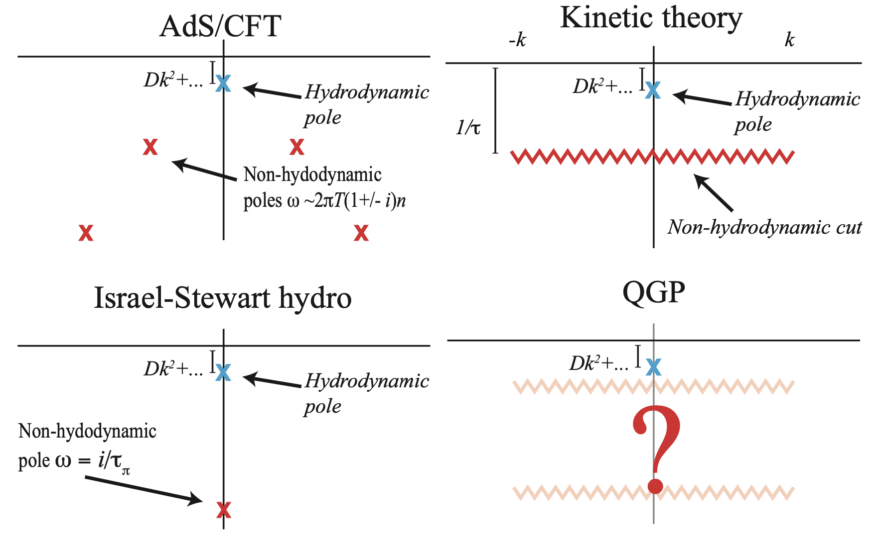
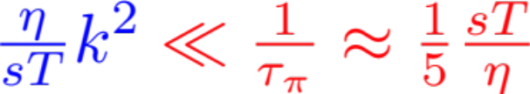
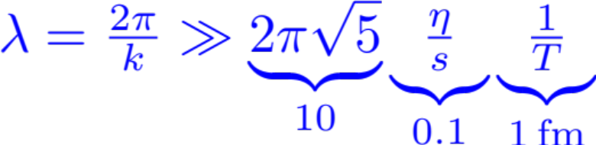
Limits of fluid dynamic behavior?¹
Hydrodynamic excitations
Non-hydro excitations, e.g.
Universal in QFTs
Consequence of conservation laws
No QFTs without non-hydro modes
Consequence of causality
Excitations of various plasmas:
Hydro-modes dominate if
Hydro-dominated wavelengths satisfy
The emergence of collectivity as function of system size is not yet understood.
Such wavelengths do not fit into a proton !
Dynamical origin of collectivity in pp rests under debate.²
1. A. Kurkela, UAW, B. Wu, Eur. Phys. J.C79 (2019) 11, 965
2. Jan Fiete Grosse-Oertringhaus & UAW, arXiv:2407.07484
Yayun He et al, arXiv:2201.08408
Notes:
In little bangs as in the Big Bang, material properties are accessed by fluctuation studies

Slide 17
New Detectors and Detector Upgrades
to address open questions
Yayun He et al, arXiv:2201.08408

Slide 18
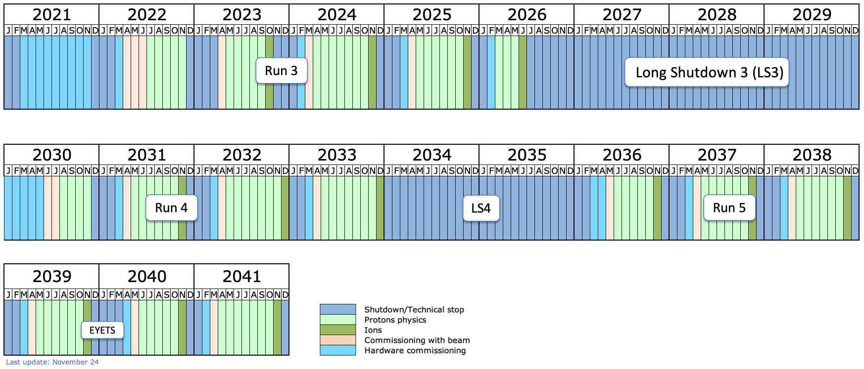
Future of experimental HI-LHC heavy-ion program
Yayun He et al, arXiv:2201.08408

Slide 19
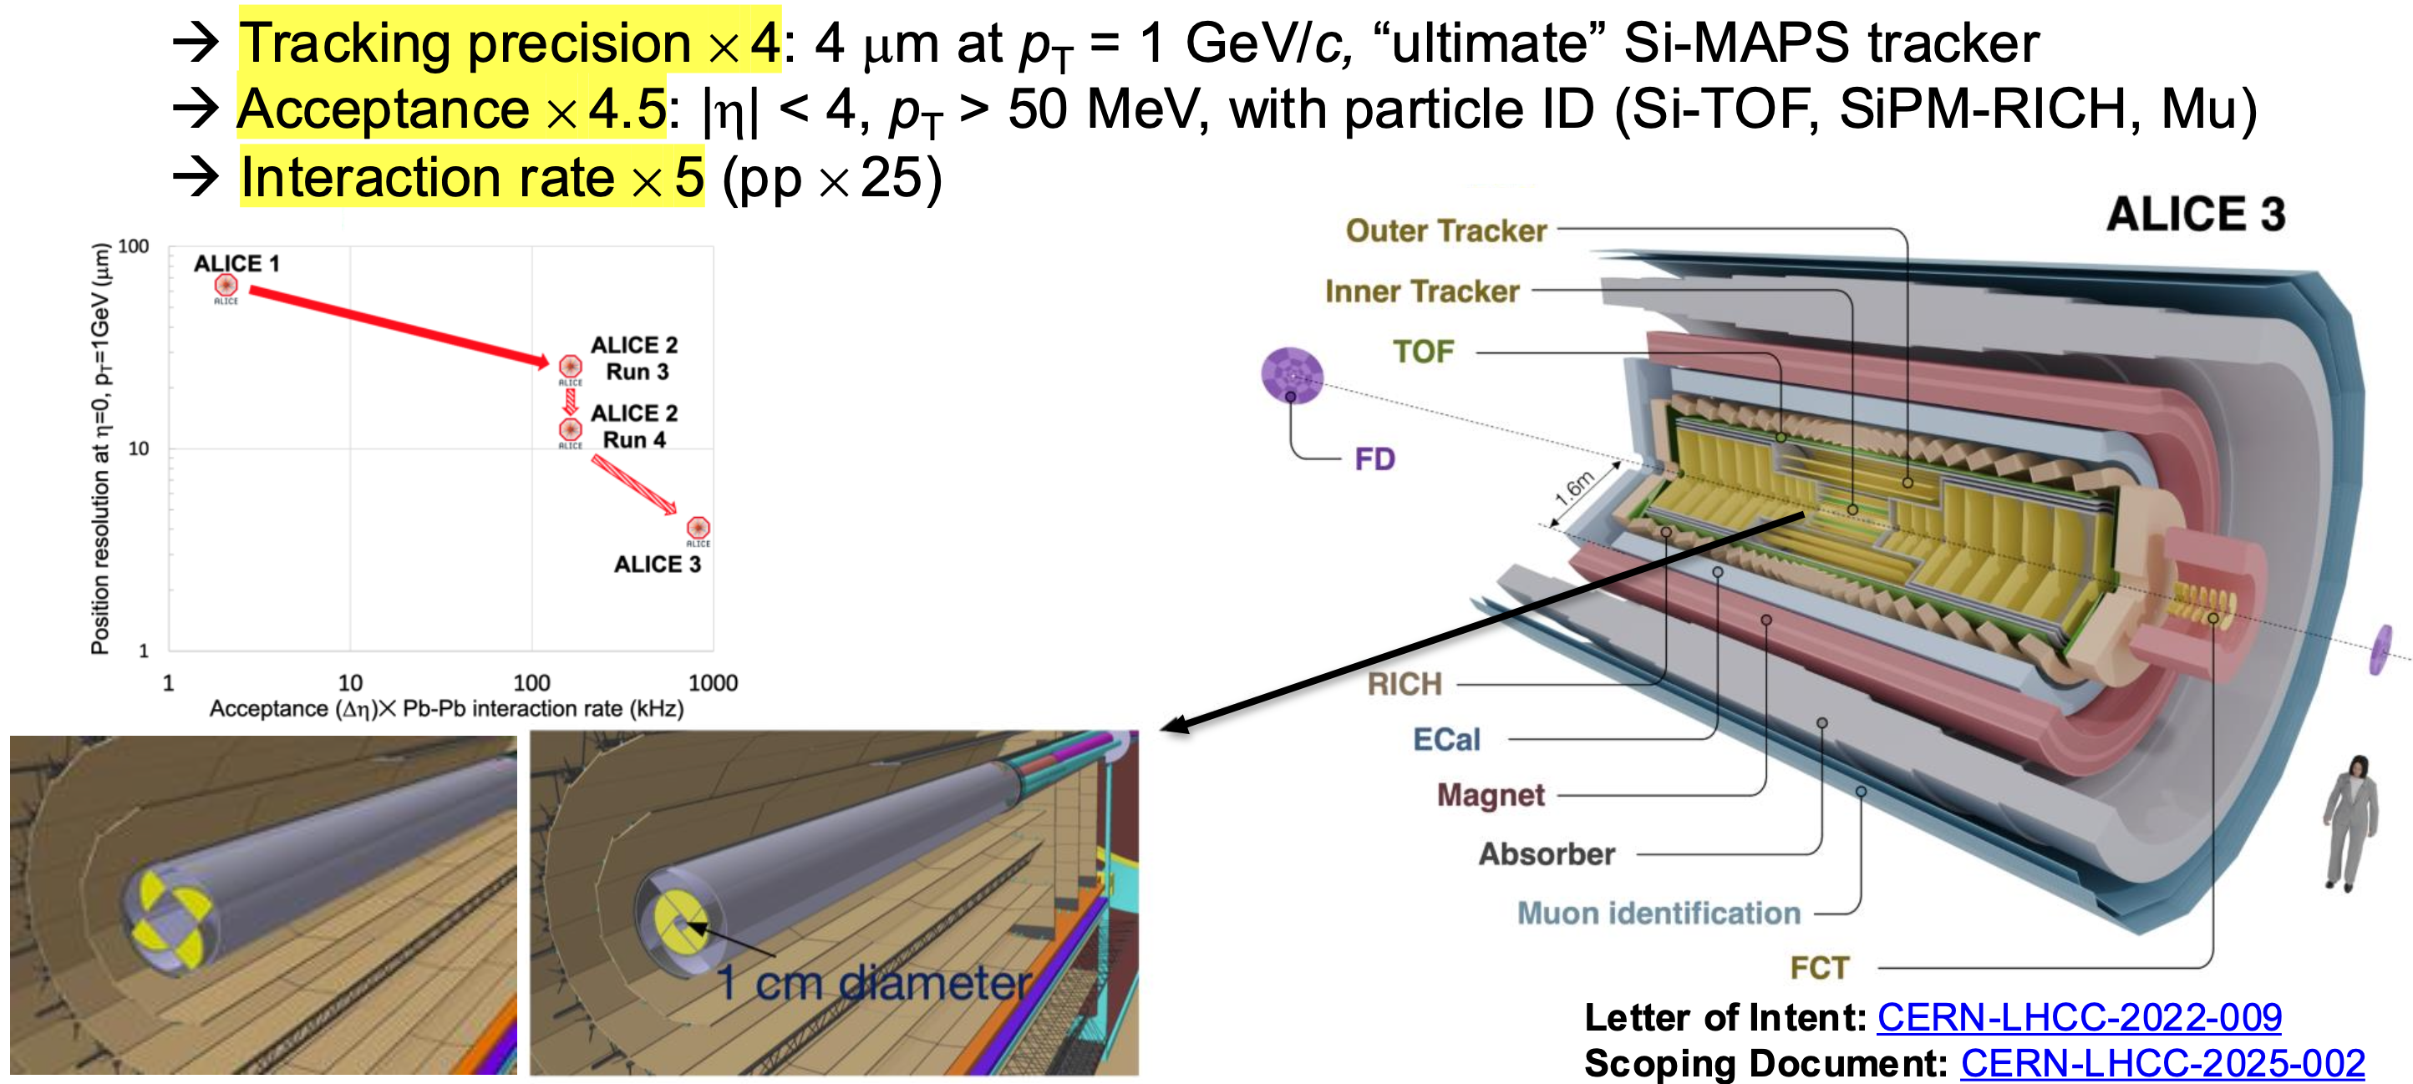
ALICE 3
Yayun He et al, arXiv:2201.08408

Slide 20
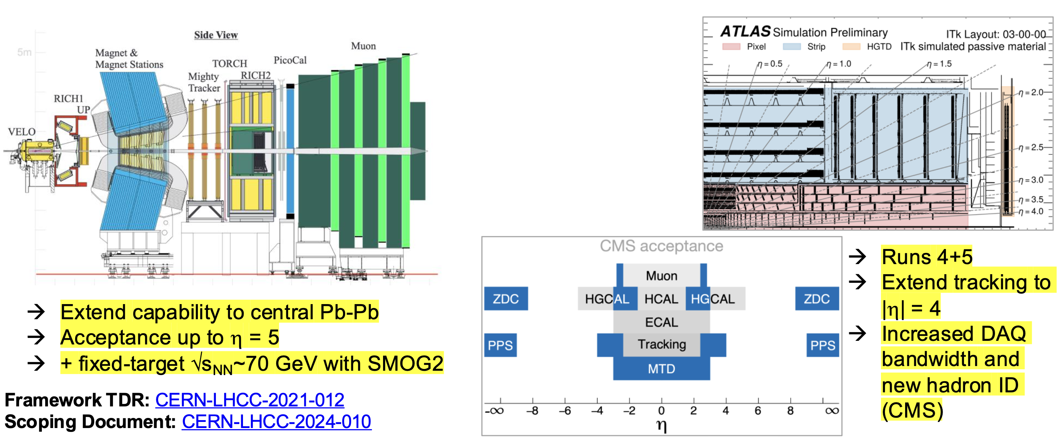
LHCb
ATLAS, CMS
Yayun He et al, arXiv:2201.08408

Slide 21
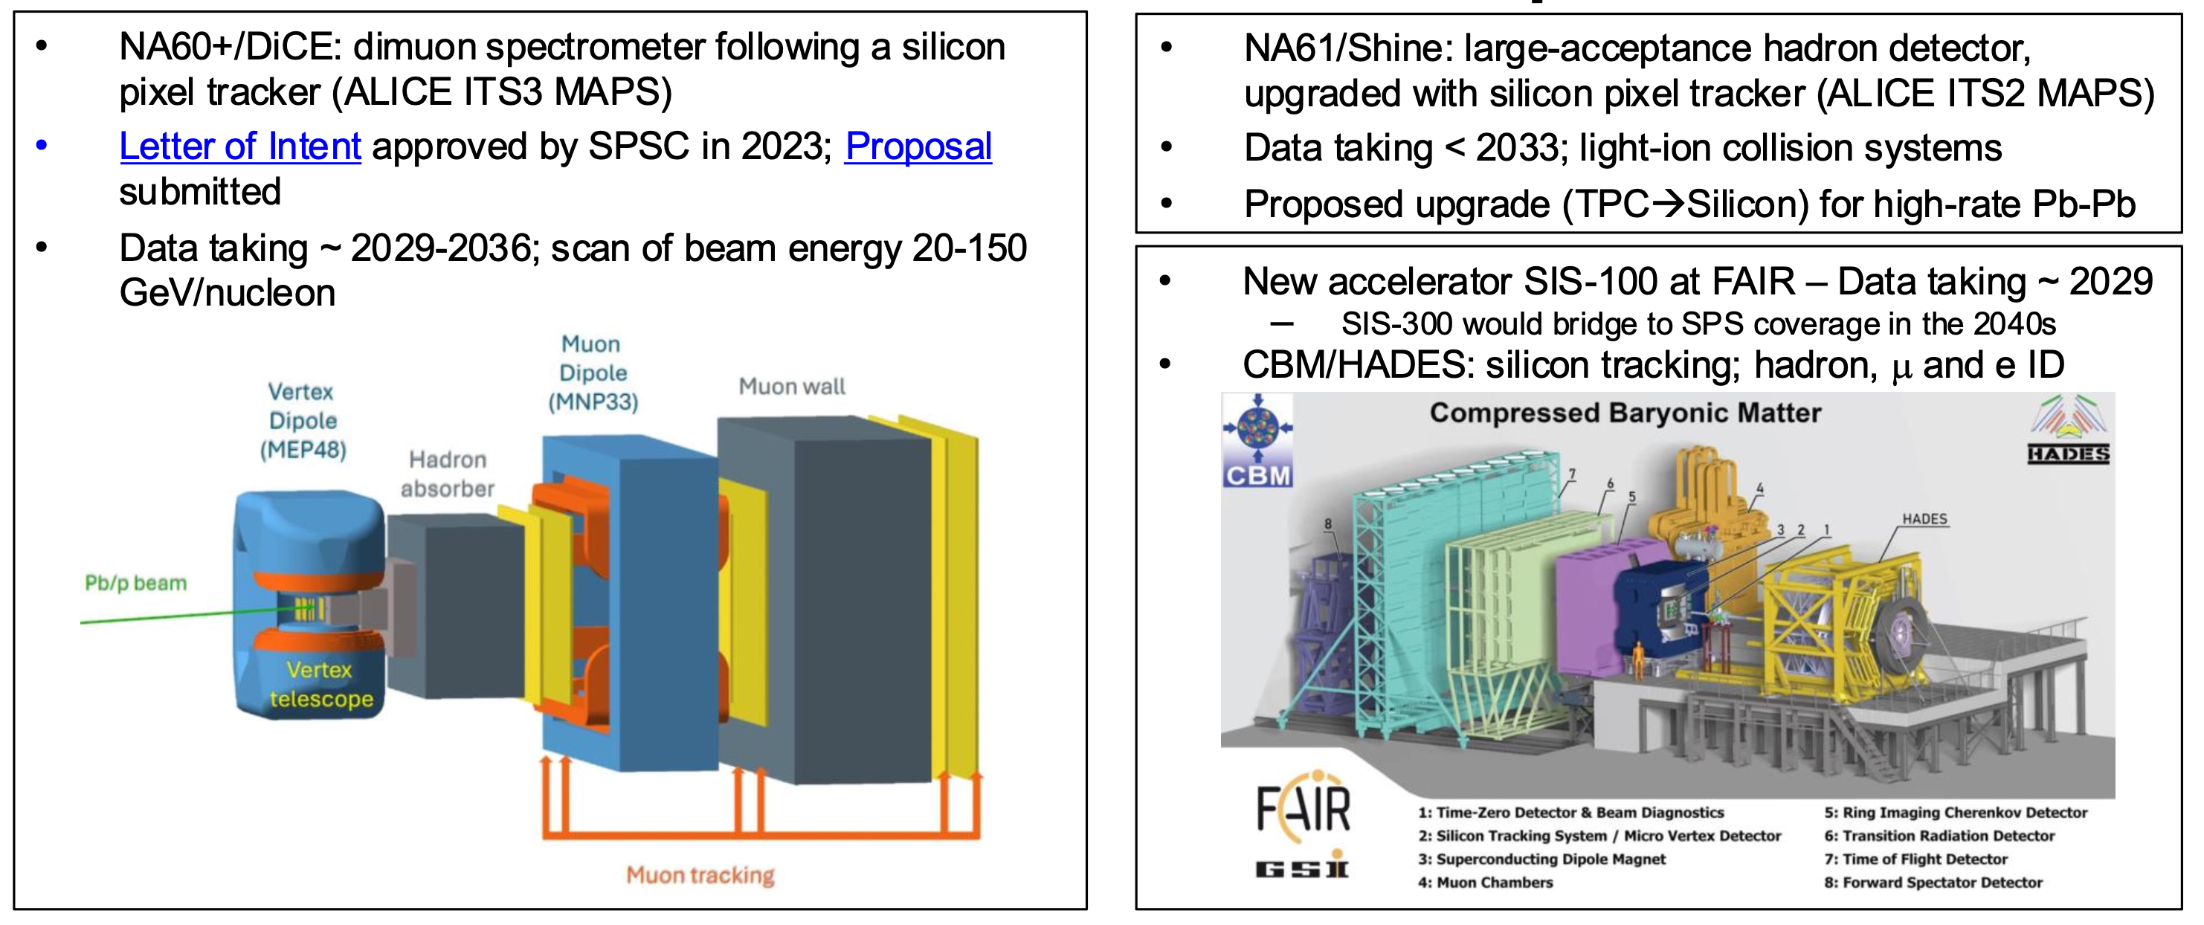
NA60+/DICE
NA61/SHINE
accepted 2026
Yayun He et al, arXiv:2201.08408

Slide 22
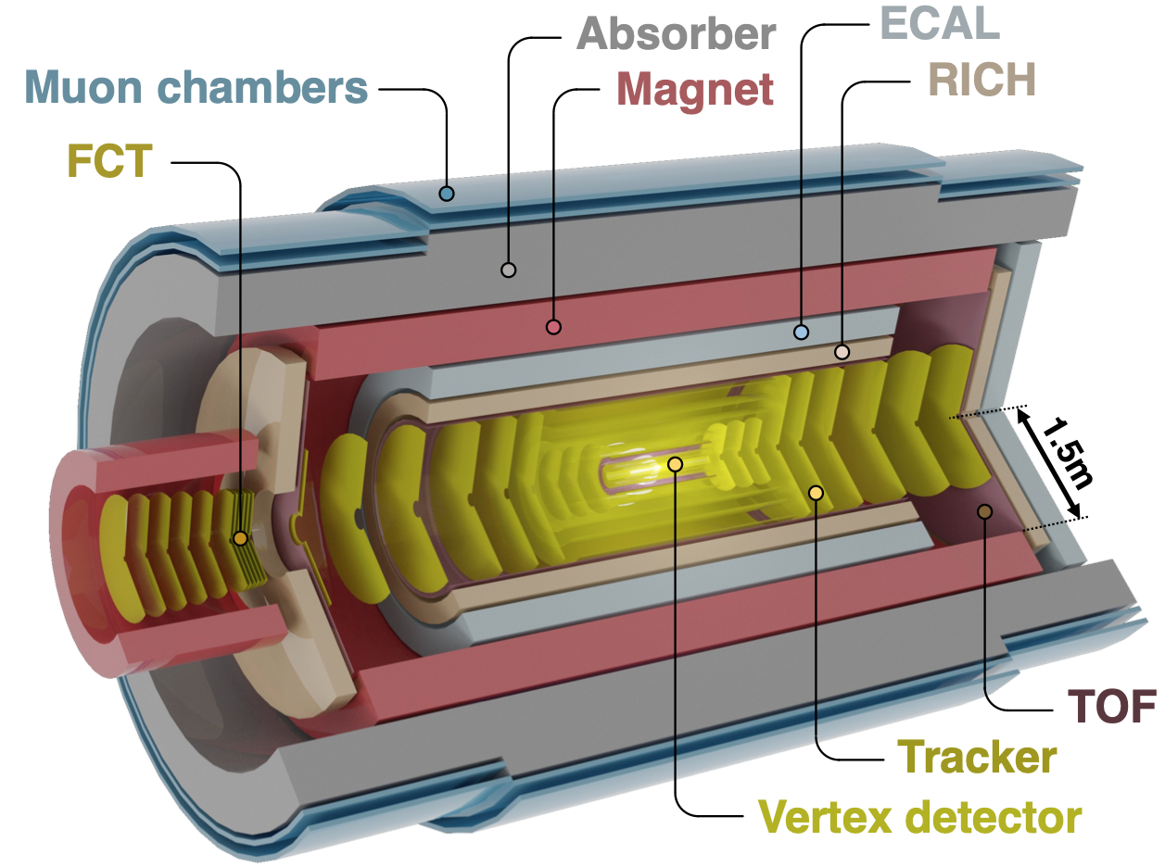
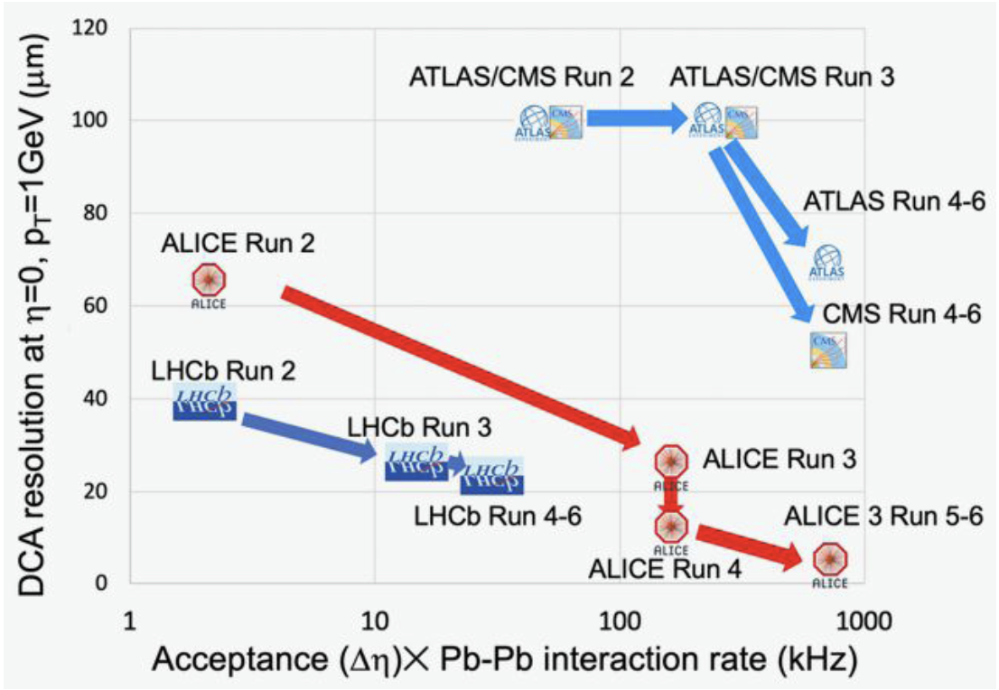
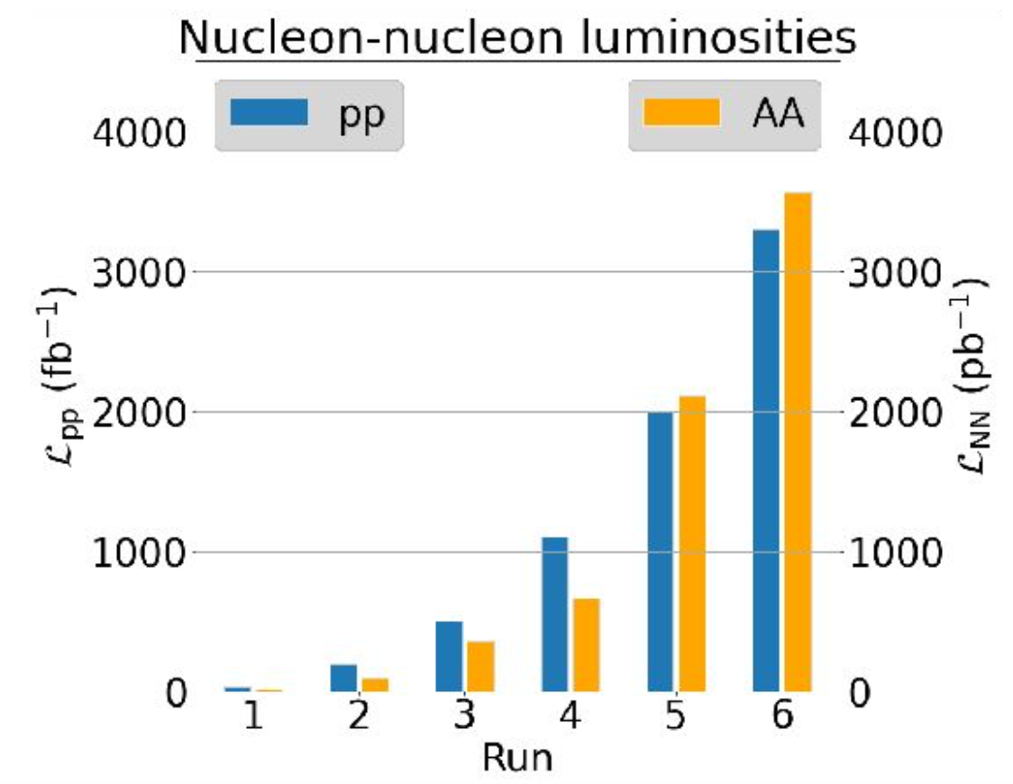
Novel experimental opportunities in the 2030s
ALICE 3 LoI: CERN-LHCC-2022-009
Large quantitative and qualitative gains after run 4
20 x luminosity: unique access to rare probes
How do heavy quarks thermalize ?
How does the QGP shine ?
QGP temp. via dileptons
Discovering charmed hadrons & hypernuclei
Hadron correlation functions
Yayun He et al, arXiv:2201.08408
Notes:
Interplay between system size and scattering length can lead to a size-dependent modification of the correlation function in presence of a bound state
.

Slide 23
Open Questions
that drive future experimentation
Microscopic mechanisms of quark interactions in the QGP
Quark-mass dependence of thermal equilibration
Mechanisms of hadron formation in high-density QCD environment
QGP electromagnetic radiation throughout its temporal evolution
Mechanism of chiral symmetry restoration in the QGP
Inner workings of the QGP
QGP substructure and medium-response via jets and rare probes
Yayun He et al, arXiv:2201.08408

Slide 24
Open Question
Microscopic mechanisms of quark interactions in the QGP
Quark-mass dependence of thermal equilibration
Mechanisms of hadron formation in high-density QCD environment
QGP electromagnetic radiation throughout its temporal evolution
Mechanism of chiral symmetry restoration in the QGP
Inner workings of the QGP
QGP substructure and medium-response via jets and rare probes
Yayun He et al, arXiv:2201.08408

Slide 25
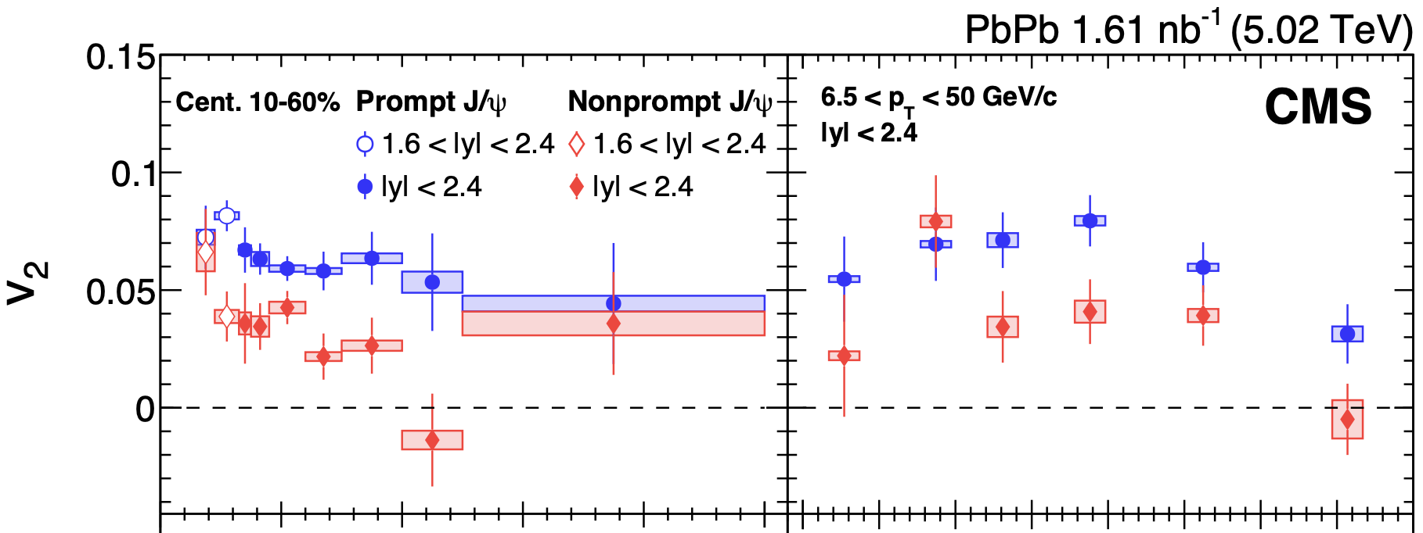
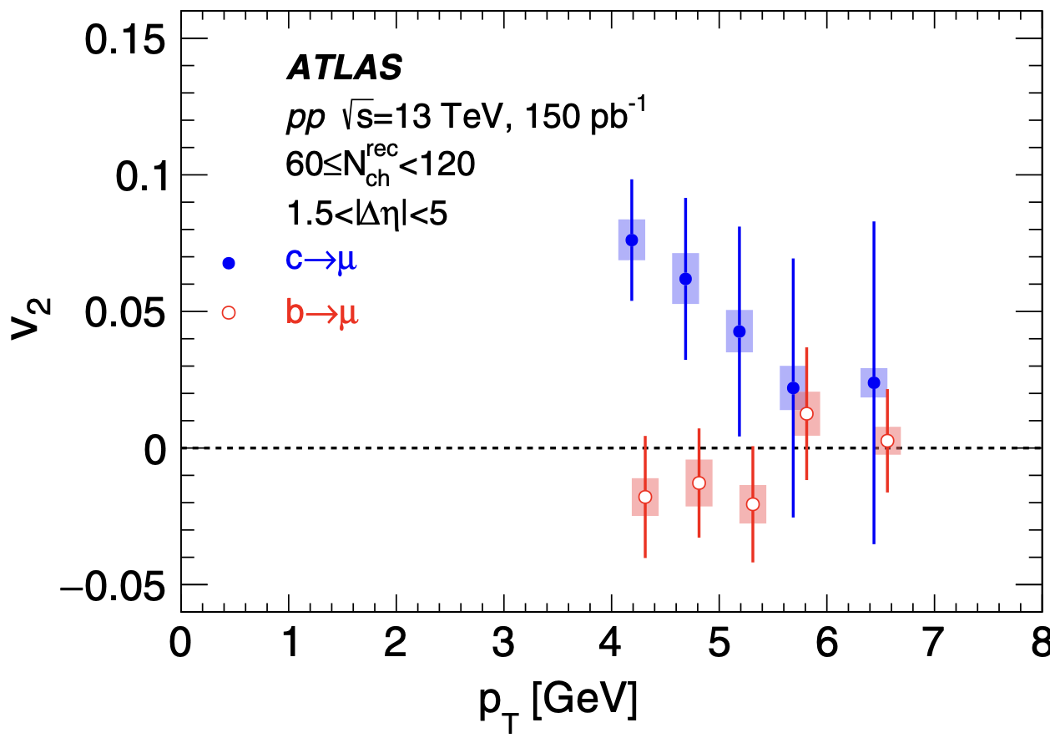
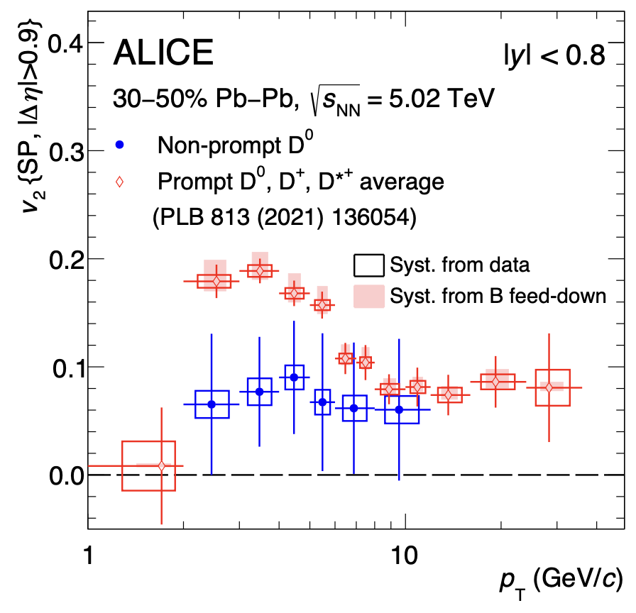
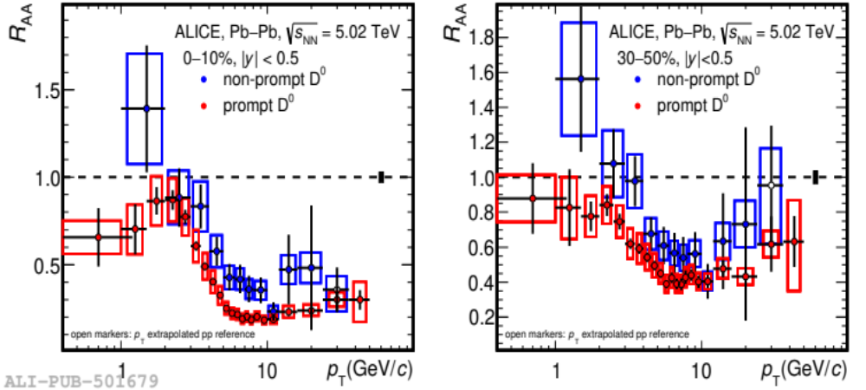
Heavy Flavor – unique opportunities
EXP: evidence that beauty flows less¹ and is less quenched than charm.
CMS
CMS
Mass hierarchy of incomplete kinetic equilibration ?
b presents interesting mass scale for testing QCD transport
Precision down to p_{T} = 0 needed!
CMS, JHEP10 (2023) 115; ATLAS PRL 124, 082301 (2020)
2. R. Rapp et al Nucl.Phys.A 979 (2018) 21-86;

Slide 26
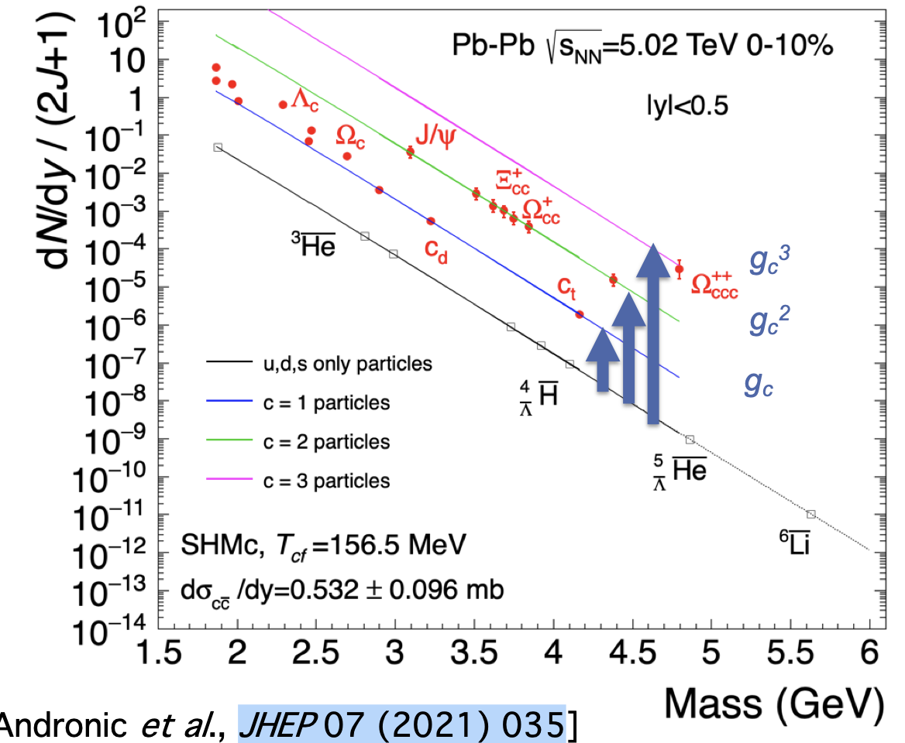

Heavy flavor – chemical equilibrium
Charm is not produced thermally, but it can be distributed statistically in hadronization.¹
Hadronization via fragmentation versus hadronization via recombination.
Multi-charmed baryons (accessible in run 5) particularly important since negligible production rate in single parton scatterings.
In reach of HL-LHC runs 3-5.
Huge enhancements predicted, up to factor 10³ w.r.t. pp for .^{2,3}
1. A. Andronic et al. JHEP 07 (2021) 035
2. F. Becattini, Phys.Re.Lett. 95 (2005) 022301
3. V. Minissale et al., Eur.Phys.J. C. 84 (2024) 3, 228

Slide 27
Open Question
Microscopic mechanisms of quark interactions in the QGP
Quark-mass dependence of thermal equilibration
Mechanisms of hadron formation in high-density QCD environment
QGP electromagnetic radiation throughout its temporal evolution
Mechanism of chiral symmetry restoration in the QGP
Inner workings of the QGP
QGP substructure and medium-response via jets and rare probes
Yayun He et al, arXiv:2201.08408

Slide 28


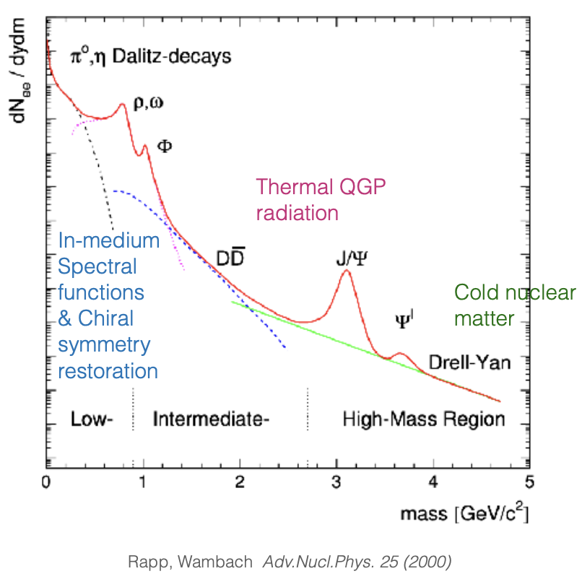

Electromagnetic radiation of QGP
TH: thermal production sensitive to EM spectral function and bkg QGP evolution.
Photon spectrum:
Blue-shifted spectrum!
Difficult to disentangle early and late time contributions.
Dilepton spectrum:
Varying invariant mass M_{ee} => disentangling contributions
from different times.
Dilepton invariant mass spectrum needs excellent knowledge of background to address QGP-induced electromagnetic signals.

Slide 29
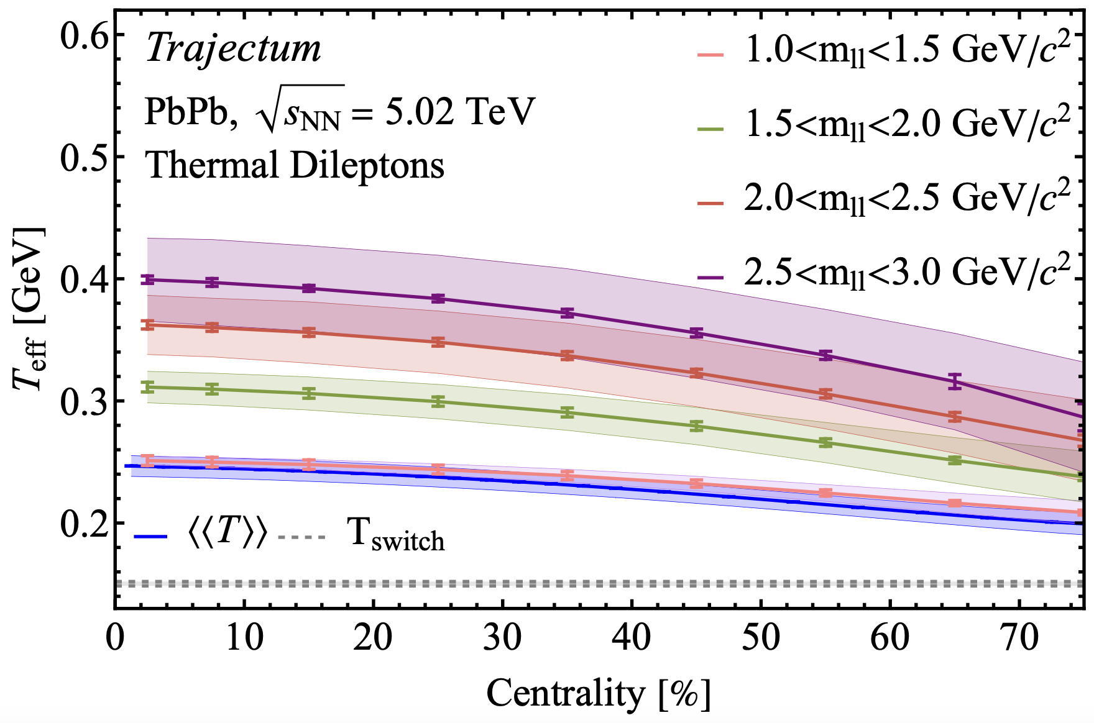
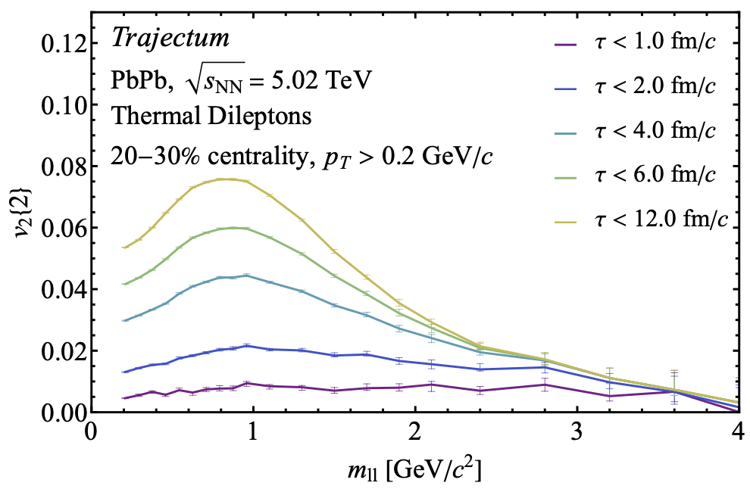
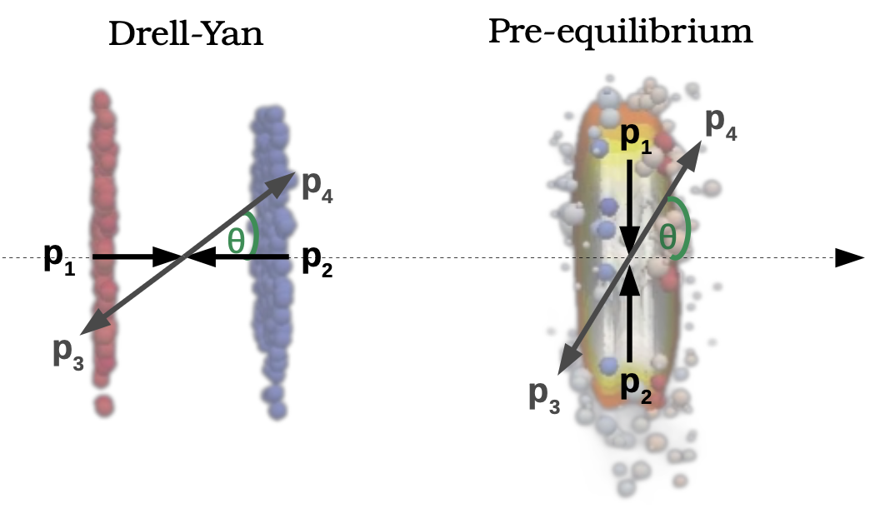
Dilepton flow and spectrum
Dileption spectrum and flow can provide differential picture of QGP time evolution.^{1,2}
Later
Later
High-precision di-lepton measurements:
access to signatures of chiral symmetry restoration.
There is room for more ambition:
In dileption rest frame, opening angle of dilepton pair preferentially aligned with opening angle of quark pair.
This polarization³ in Collins-Soper frame is sensitive to the QGP bulk anisotropy at early times.
O. Massen et al. arXiv:2412.09671;
Kasmaei et al, PRD 99 (2019) 3
3. Coquet et al, Phys.Rev.Lett. 132 (2024) 23, 232301

Slide 30
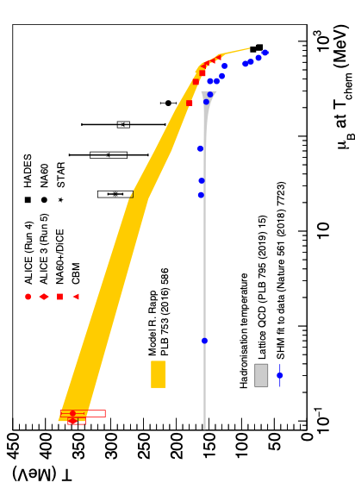
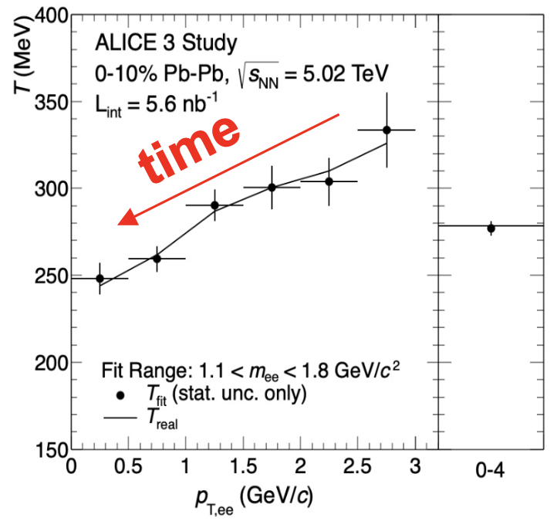
QGP time evolution via dileptons in reach of ALICE 3

Slide 31
Open Question
Microscopic mechanisms of quark interactions in the QGP
Quark-mass dependence of thermal equilibration
Mechanisms of hadron formation in high-density QCD environment
QGP electromagnetic radiation throughout its temporal evolution
Mechanism of chiral symmetry restoration in the QGP
Inner workings of the QGP
QGP substructure and medium-response via jets and rare probes
Yayun He et al, arXiv:2201.08408

Slide 32
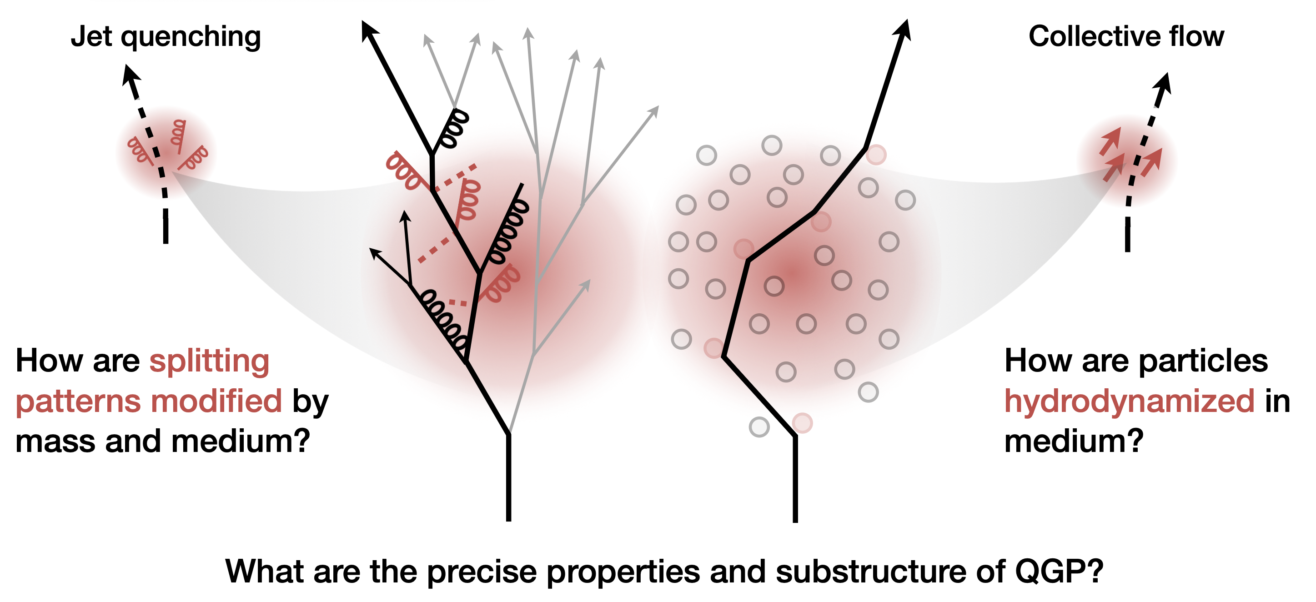
Open questions
Inner Working of the QGP?
J. Wang (CMS) in Town Meeting on Heavy Ion and QGP Physics, 17 Feb 2025, https://indico.cern.ch/event/1483832/
Yayun He et al, arXiv:2201.08408

Slide 33
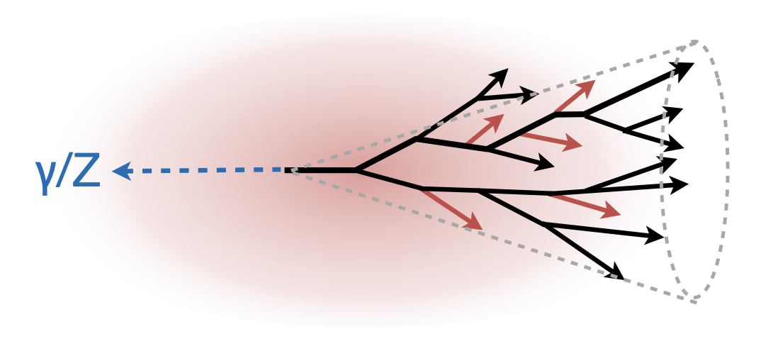
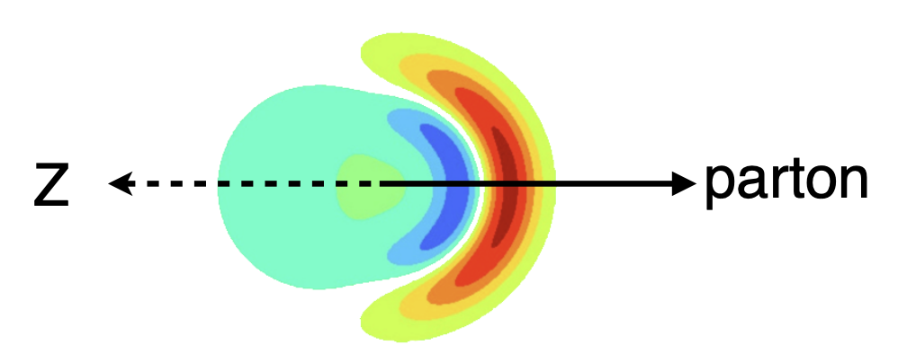



Rare hard probes¹
Precision in heavy flavor quenching
J. Wang (CMS) in Town Meeting on Heavy Ion and QGP Physics, 17 Feb 2025, https://indico.cern.ch/event/1483832/
Yayun He et al, arXiv:2201.08408

Slide 34





Heavy flavor - continued
Back-to-back open charm correlations
  Access to QGP constituents via
  Rutherford-like experiment.
  Constrains e-loss and angular decorrelation simultaneously.
Near-side open charm correlations¹
  Access to medium-modified splitting function
  Unique enhancement as a consequence of quenching
  Requires > 10 nb⁻¹ PbPb
1. M. Attems, J. Brewer, G.M. Innocenti, A. Mazeliauskas, S. Park, W. v.d.Schee, G. Soyez, UAW, Phys. Rev. Lett. 132 212301 (2024) .

Slide 35


QCD formation time via quenched jets
To measure , determine E_{g}, z and k_{c}
Strategy:
  reconstruct kinematics by tracing c and cbar to common vertex.
  compare kinematic -distribution in medium and vacuum.
QGP is unique in providing a spatial reference scale against which the QCD formation time can be measured.
J. Brewer, W. v.d.Schee, U.A. Wiedemann, 2503.11764

Slide 36




Testing QGP evolution with time-delayed quenching
. : time-delayed hard partons in QGP¹. Quenching changes reconstructed W-mass.
CMS expects first 3.8 modification in run2.
Luminosity-limited throughout HL-LHC.
Much better @ FCC-hh.
1 Apolinario et al., PRL 120 (2018) 23, 232301
Yayun He et al, arXiv:2201.08408

Slide 37
Conclusion
Nuclear beams will continue to enrich the HL-LHC programme scientifically, technologically and sociologically.
Novel opportunities in the next decade include
  Determining the transport properties of heavy flavor.
  Determining how the QGP radiates throughout its evolution.
  Determining the inner workings of the QGP via hard probes.
Full exploitation of HL-LHC as a heavy ion collider requires new detectors with frontier technology (ALICE3, LHCbUpg2, rate capabilities of ATLAS and CMS upgrades). High integrated luminosities during runs 4 and 5 are essential.
The fruitful interplay between TH and EXP is guaranteed for the next two decades.
Yayun He et al, arXiv:2201.08408

Slide 38
… for discussion after colloquium? …
New theoretical ideas
needed to exploit these opportunities
… one example …
Yayun He et al, arXiv:2201.08408

Slide 39

Heavy Flavor flow and quenching
EXP: evidence that beauty flows less¹ and is less quenched than charm.
CMS
CMS
Mass hierarchy of incomplete kinetic equilibration ?
TH: Does charm equilibrate a factor
faster than b?
EXP: Precision at small p_{T} needed
CMS, JHEP10 (2023) 115; ATLAS PRL 124, 082301 (2020)
2. R. Rapp et al Nucl.Phys.A 979 (2018) 21-86;

Slide 40






Langevin Dynamics of Heavy Flavor Transport
Diffusion time scale
Charges subject to drag. Random force leads to momentum broadening
Solution:
Requiring thermal equipartition, one finds the fluctuation-dissipation theorem
Spatial diffusion coefficient D
Spatial probability distribution
for diffusion from x(t=0)=0

Slide 41



Fokker-Planck Dynamics
Equivalent to Langevin dynamics. Momentum distribution of HQs satisfies
Ansatz:
Consider 1-dimensional isotropic case to leading order in T/M
FP admits a stationary solution of equilibrium form if
“Einstein relation”

Slide 42





What is known about HQ transport coefficients in QCD?
pQCD: (start from Boltzmann eq, linearize collision kernel, match to FP)
Parametric LO:
HTL resummed LO^{2,3} :
Einstein relation violated at finite v.³
HTL resummed NLO⁴ :
NLO correction⁴
2506.11958
Non-perturbative (lattice QCD):
“formally straightforward”
Calculate Euclidean correlator
Spectral function from analytic continuation
D from slope of spectral function at origin
B. Svetitsky PRD 37 (1988), 2484
E. Braaten & M. Thoma, PRD 44 (1991)
3. G. Moore & D. Teaney, PRC71 (2005) 064904
4. S. Caron-Huot & G. Moore, JHEP 02 (2008) 081
5. HotQCD, L. Altenkort et al, PRL 132 (2024) 5, 051902
6. TUMQCD, N. Brambilla et al. PRD 102 (2020) 7, 074503
Notes:
At LO, HQ interacts via 2->2, dominant contribution from t-channel gluon exchange regulated by m_D^2 \sim g^2 T^2. Scale separation of hard modes of order T and soft modes of order gT leads to logarithms

Slide 43




HQ transport coefficients in strongly coupled N=4 SYM
Calculation of drag force via trailing string^{1,2}
Fluctuations on trailing string^{3,4}
“Because of the dramatic failure of the Einstein relation, it doesn’t make sense to plug the trailing string predictions into a Langevin description … “ Gubser 2006
1. Gubser hep-th/0605182
2. HKKKY hep-th/0605158
3. Casalderrey-Solana & Teaney hep-ph/0605199, hep-th/0701123
4. Gubser hep-th/0612143
5. R. Rapp et al Nucl.Phys.A 979 (2018) 21-86

Slide 44

Momentum transfer probability in strongly coupled N=4 SYM
consistent with Gubser
K. Rajagopal, B. Scheihing-Hitschfeld, U.A. Wiedemann, 2501.06289

Slide 45

Kolmogorov equation
We have calculated the momentum transfer probability:
This yields the evolution equation for the HQ distribution
Kolmogorov
equation
Truncating S at second order in d/dp (or in moments) yields Fokker-Planck equation,
and violates Einstein relation.
Kolmogorov equation as an all-order expression equilibrates ……
K. Rajagopal, B. Scheihing-Hitschfeld, UAW, PRL 135 (2025) 24, 24

Slide 46








Kinetic equilibrium of Kolmogorov equation
PT-invariance
& KMS:¹
Stationary
solutions
satisfy:¹
recall that in equilibrium
S(L,v) is the logarithm of P(k,v) and thus the generating functional of connected momentum moments.
For isotropic case, equilibrium condition reads
If then
Kolgmogorov eq = FP eq, Einstein relation holds.
This solves Gubser’s problem.
But, for N=4 SYM, one finds³ for v -> 1:
All truncations violate equilibrium condition.
K. Rajagopal, B. Scheihing-Hitschfeld, UAW, PRL 135 (2025) 24, 24

Slide 47

The problem we have solved turns out to be generic for quantum field theories including QCD
Jean F Du Plessis
Bruno Scheihing-Hitschfeld
arXiv: 2604.21895

Slide 48


Numerical solution of Kolmogorov eq.
For b-like parameters
with Einstein-relation imposed artificially
At low p_{T}: Kolmogorov and FP approach equilibrium similar
At high p_{T}: Kolmogorov equilibrates characteristically slower and differently.

Slide 49


Heavy Flavor Transport
(How) does heavy flavor flow?
Bruno Scheihing-Hitschfeld
Kavli Institute, Santa Barbara
Krishna Rajagopal
MIT
KR, BSH & UAW, JHEP 07 (2025) 013 [2501.06289]
PRL 135 (2025) 24 [2504.21139]
arXiv:2606.02693
Yayun He et al, arXiv:2201.08408

Slide 50
Back-up
Yayun He et al, arXiv:2201.08408

Slide 51
The strongly ordered limits
of medium-modified
parton showers
Yayun He et al, arXiv:2201.08408

Slide 52


Strongly ordered limits of collinear splitting functions
In vacuum, collinear splitting functions factorize in strongly ordered limits. Example:
This factorization is key for modelling parton showers as Markovian processes.
We ask: Does a similar factorization hold for medium-modified 1->3 splitting functions?
Qualitative considerations:
  No, such factorization cannot hold.
  Vacuum factorization is only proven to logarithmic ordered.
  Medium-interactions are a subleading (“higher twist”) power correction.
  Yes, such factorization should hold
  Parametrically smaller invariant masses imply parametrically larger distances / formation times.
To know, we need to calculate fully differential 1-> 3 splitting.

Slide 53


Collinear 1->3 to first order in opacity
Schematically: we calculate without kinematic constraints
+ virtual contributions

Slide 54





Catani-Grazzini formula as starting point
General parametrization of collinear momenta:
Invariant masses:
In terms of transverse bost-invariant momenta.
Catani-Grazzini: 1-> m collinear splittings given by dispersive parts of quark and gluon two-point function
Example:
Key: Calculation requires light-cone gauge
with gluon polarization tensor

Slide 55


Time-ordering and in-medium interactions
Trade small light-cone momentum for light-cone time:
Gyulassy-Wang model of medium
Density of scattering centers:
After in-medium average, result

Slide 56

The simplest calculation - already complicated
but can be automatized
Analytical integral
For symbolic algebra packages (FeynCalc)

Slide 57

Collinear 1->3 to first order in opacity

Slide 58




Main observations
vacuum
Inverse fromation times of first and second splitting
Vacuum Dirac term: complicated

