Slide 1

The electron-ion collider –
A collider to unravel the mysteries of hadron structure
E.C. Aschenauer
BNL
Papers on EIC Science:
https://wiki.bnl.gov/eic/index.php/Presentations#Publications

Slide 2
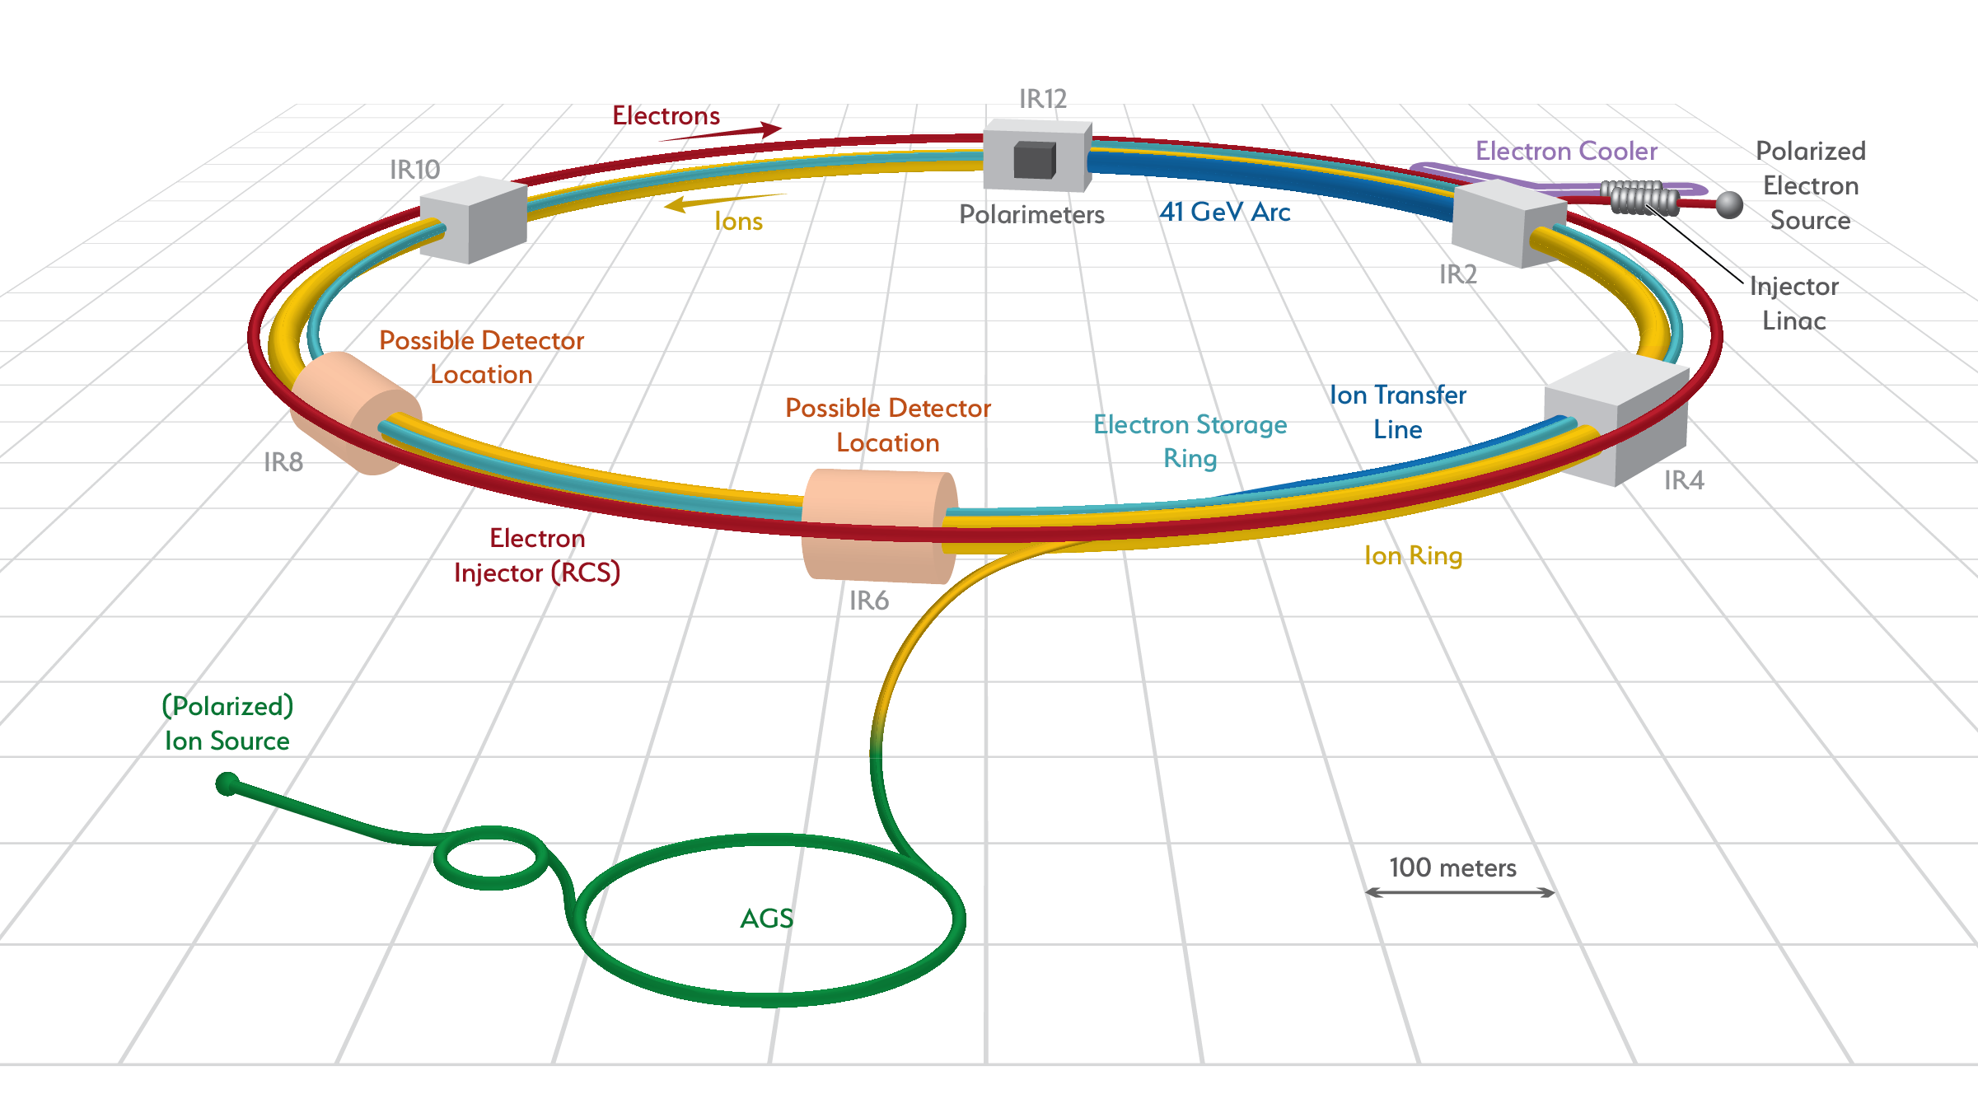
Facts about the EIC
What is the EIC:
A high luminosity (10³³ – 10³⁴ cm⁻²s⁻¹) polarized electron proton / ion collider
with √s_{ep} = 20 – 140 GeV
What is new/different:
Hera: factor 100 to 1000 higher luminosity
both electrons and protons / light nuclei polarized
nuclear beams: d to U
Fixed Target Facilities i.e.:
at minimum > 2 decades increase in kinematic coverage in x and Q²
EIC at BNL
Add electron beam 5 GeV to 18 GeV to RHIC hadron beams
25 mrad crossing angle
9 ns bunch spacing
2 interaction regions
Documents on EIC:
Physics: arXiv: 1212.1701 and arXiv:1708.01527
Summary on EIC accelerator design:
http://icfa-bd.kek.jp/Newsletter74.pdf

Slide 3
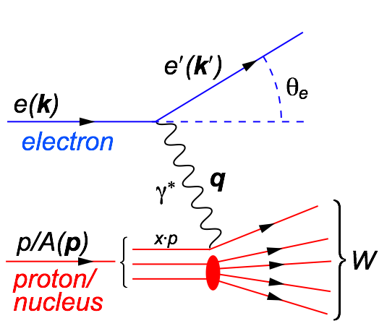
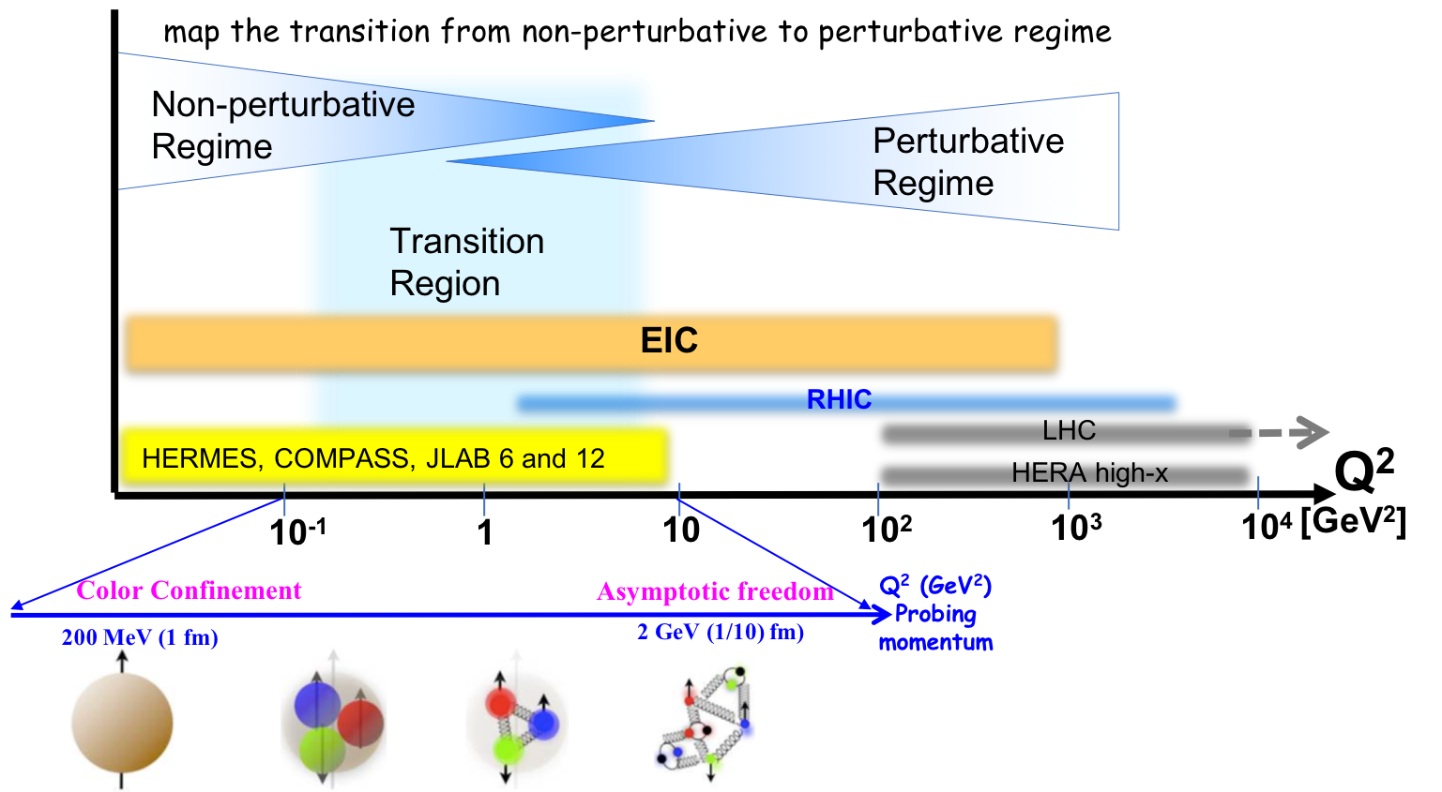
Deep Inelastic Scattering
Kinematics:
Measure of resolution power
Measure of inelasticity
Measure of momentum fraction of struck quark
center-of-mass energy of electron-hadron system
Deep Inelastic Scattering (DIS):
As a probe, electron beams provide unmatched precision of the electromagnetic interaction
Direct, model independent determination of parton kinematics of physics processes through scattered lepton

Slide 4
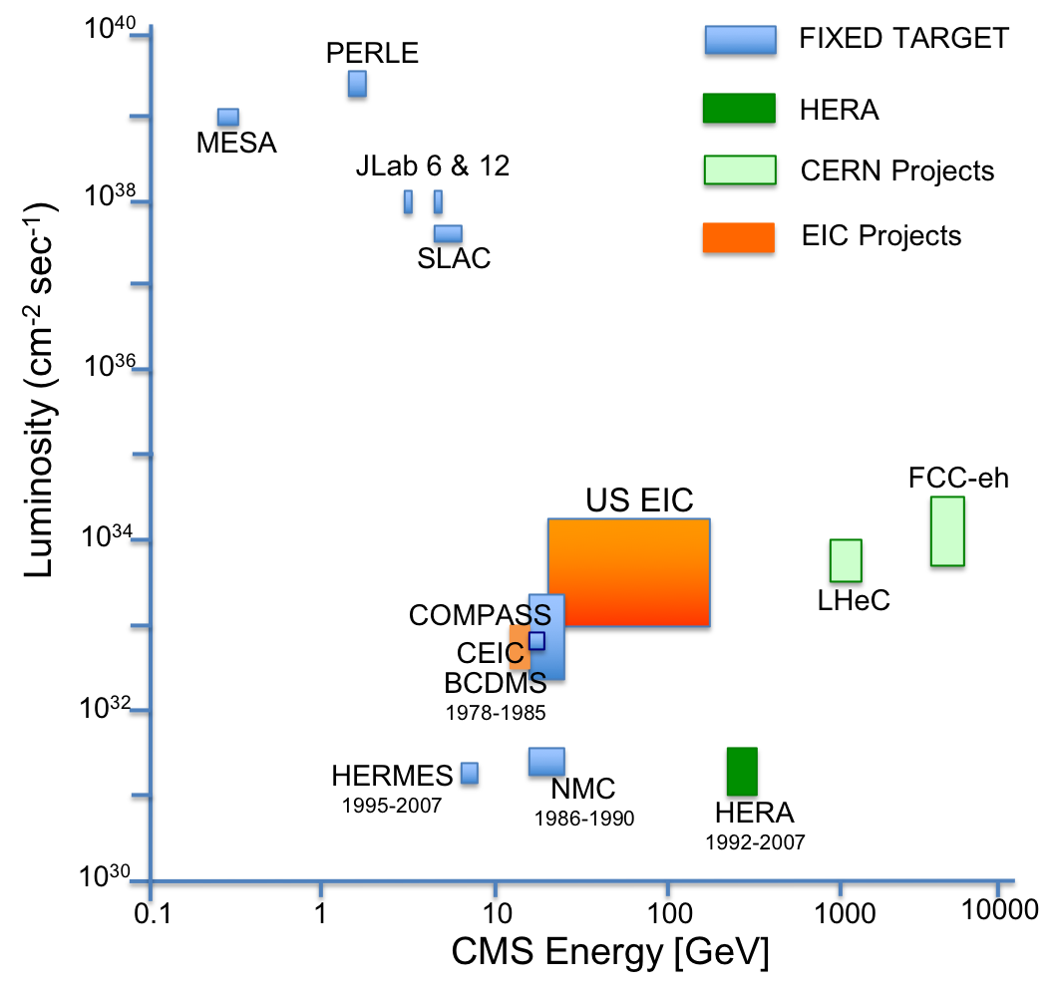
EIC’s kinematic reach in x and Q²
ep:
eA:
EIC extends kinematic coverage for data with polarised beams and nuclei by 2 decades in x at a fixed Q² and by 2 decades in Q² at a fixed x
US-EIC:
polarization, ion species together with its luminosity and √s coverage makes it a completely unique machine worldwide.

Slide 5
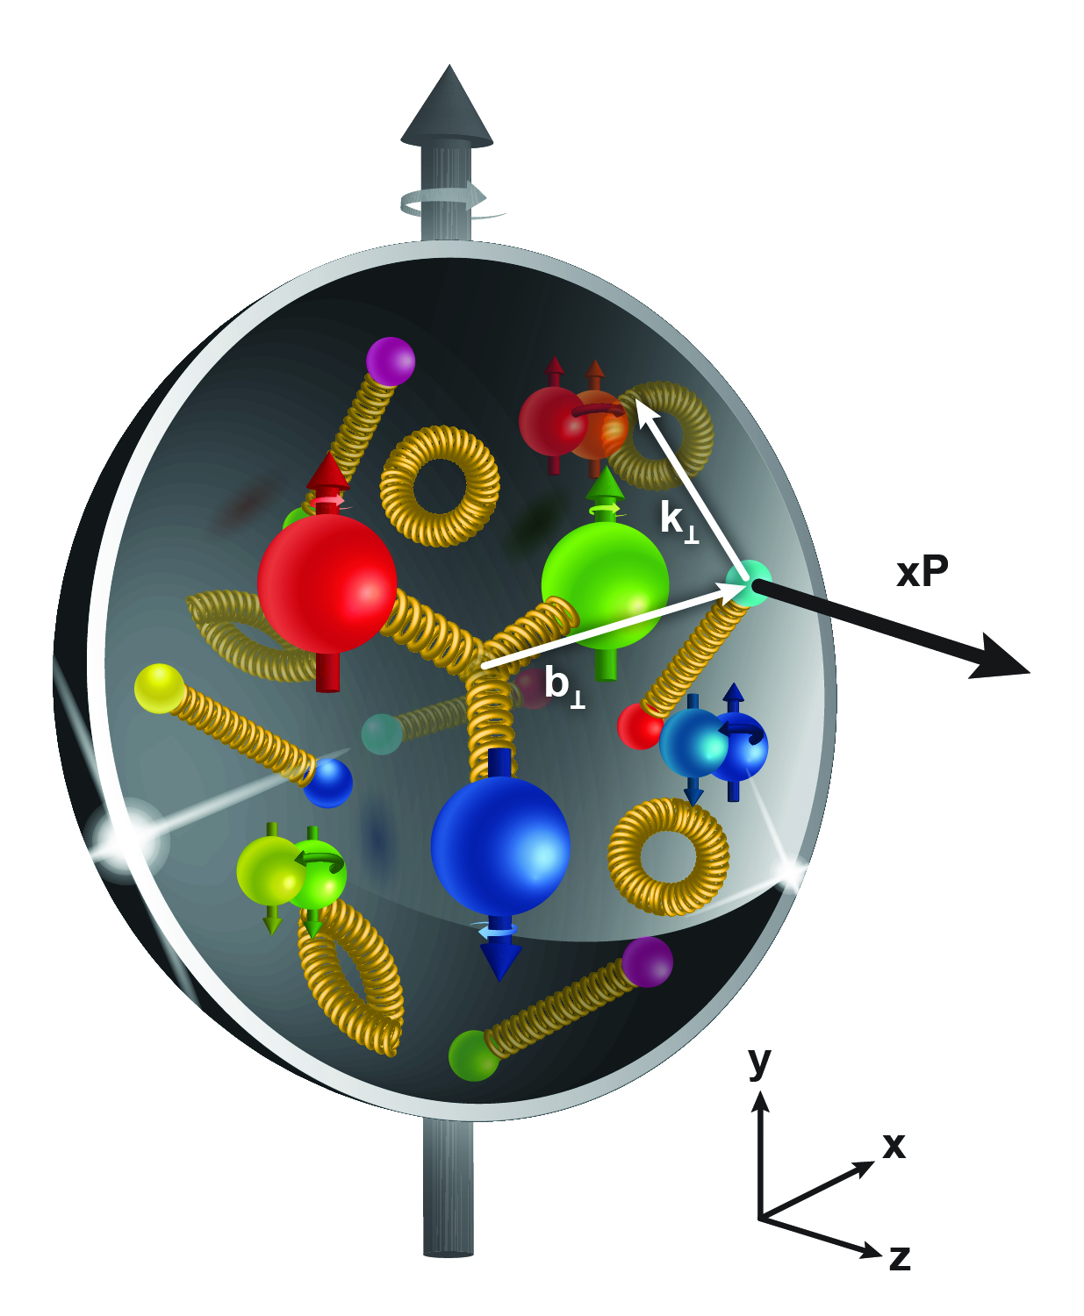
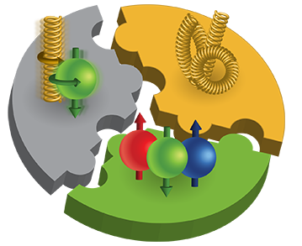

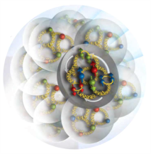
The EIC Physics
How are the sea quarks and gluons, and their spins, distributed in space and momentum inside the nucleon?
How do the nucleon properties emerge from them and
their interactions?
How do color-charged quarks and gluons, and colorless jets, interact with a nuclear medium?
How do the confined hadronic states emerge from these quarks and gluons?
How do the quark-gluon interactions create nuclear binding?
How does a dense nuclear environment affect the quarks and gluons, their correlations, and their interactions?
What happens to the gluon density in nuclei? Does it saturate at high energy, giving rise to a gluonic matter with universal properties in all nuclei, even the proton?
gluon
emission
gluon recombination
?
=

Slide 6
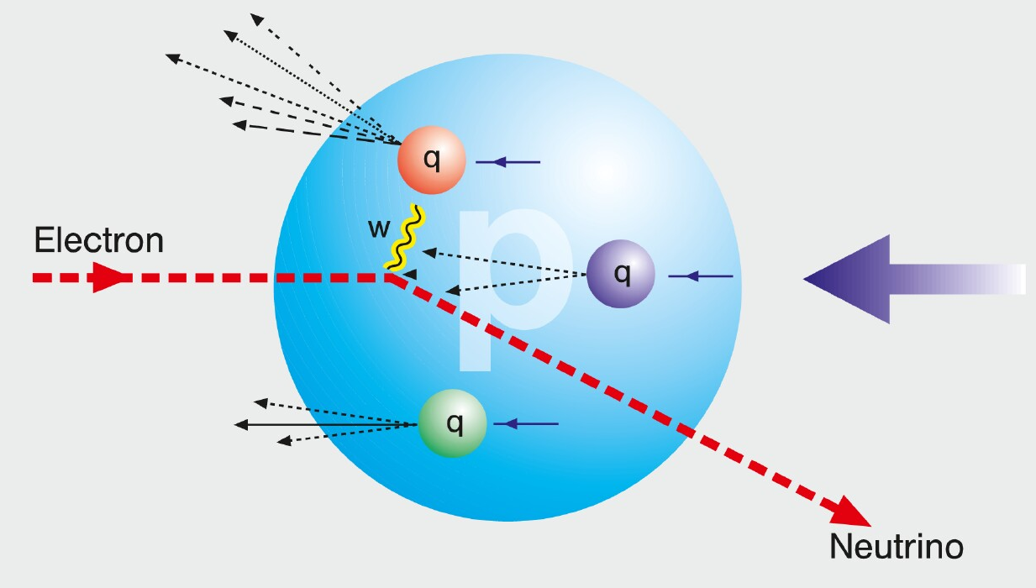
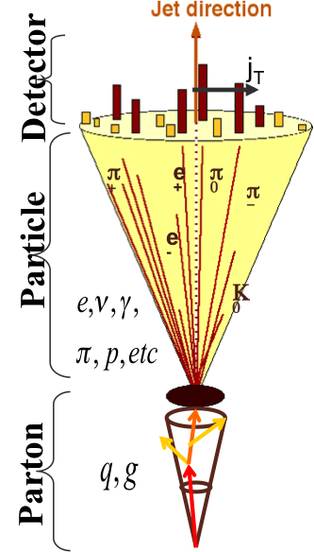
HOW TO ACCESS PARTONS IN DIS
SIDIS:
Detect scattered lepton (DIS) in coincidence with identified hadrons (SIDIS)
one can measure the correlation between different
hadrons as fct. of p_{t}, z, η
needs fragmentation functions to correlate
hadron type with parton
→ Detector: PID over a wide range of η and p
Charge Current:
W-exchange: direct access to the quark flavor
no FF – complementary to SIDIS
→ Detector: large rapidity coverage and large √s
Jets:
best observable to access parton kinematics
tag partons through the sub-processes and
jet substructure
di-jets: relative p_{t} → correlated to k_{t}
tag on PGF
→ Detector: large rapidity coverage and PID

Slide 7
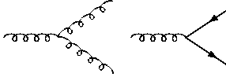
How to access Gluons in DIS
Gluons manifest themselves through
the behavior of the cross section as function of x and Q²
quark+anti-quark
momentum distributions
gluon momentum
distribution
without gluons the cross section depends only on x, no dependence on Q² → F₂(x)
Bjorken scaling
BUT:
Observe strong rise of cross section
with both x and Q²
Because of gluon initiated processes
Cross Section
Scaling violation
Gluon Distribution:
dσ(x,Q²)/dlnQ²
Resolution (Q² / GeV²)

Slide 8
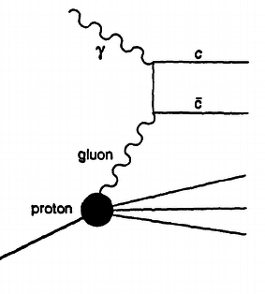

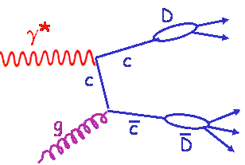
How to access Gluons in DIS
Gluons manifest themselves through
the scaling violation of the cross section as function of x and Q²
dF2(x,Q²)/dlnQ² → G(x,Q²)
Directly through the measurement of F_{L}
Through tagging of the photon gluon fusion process
  Di-jets
  charm production
quark+anti-quark
momentum distributions
gluon momentum
distribution
All these process need a wide coverage in x and Q²

Slide 9

The inner life of hadrons
Parton distribution functions

Slide 10


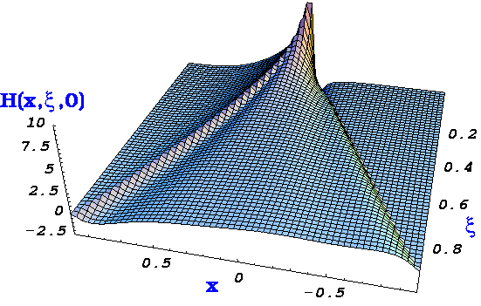

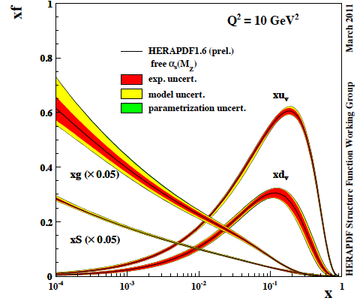

The Path to Imaging Quarks and Gluons
Wigner function
QCD genetic map of nucleons
4+1-D
not related by
Fourier transf.
2+1-D
transv. mom. dep. PDF
impact par. dep. PDF
generalized PDF
semi-inclusive DIS
exclusive processes
1-D
parton densities
form factor
There are many reasons why one wants to have a 3d picture of nucleons and nuclei
collective effects is one of them.
Obtaining a full picture is definitely one

Slide 11

Access the Flavor Structure: SIDIS

Slide 12
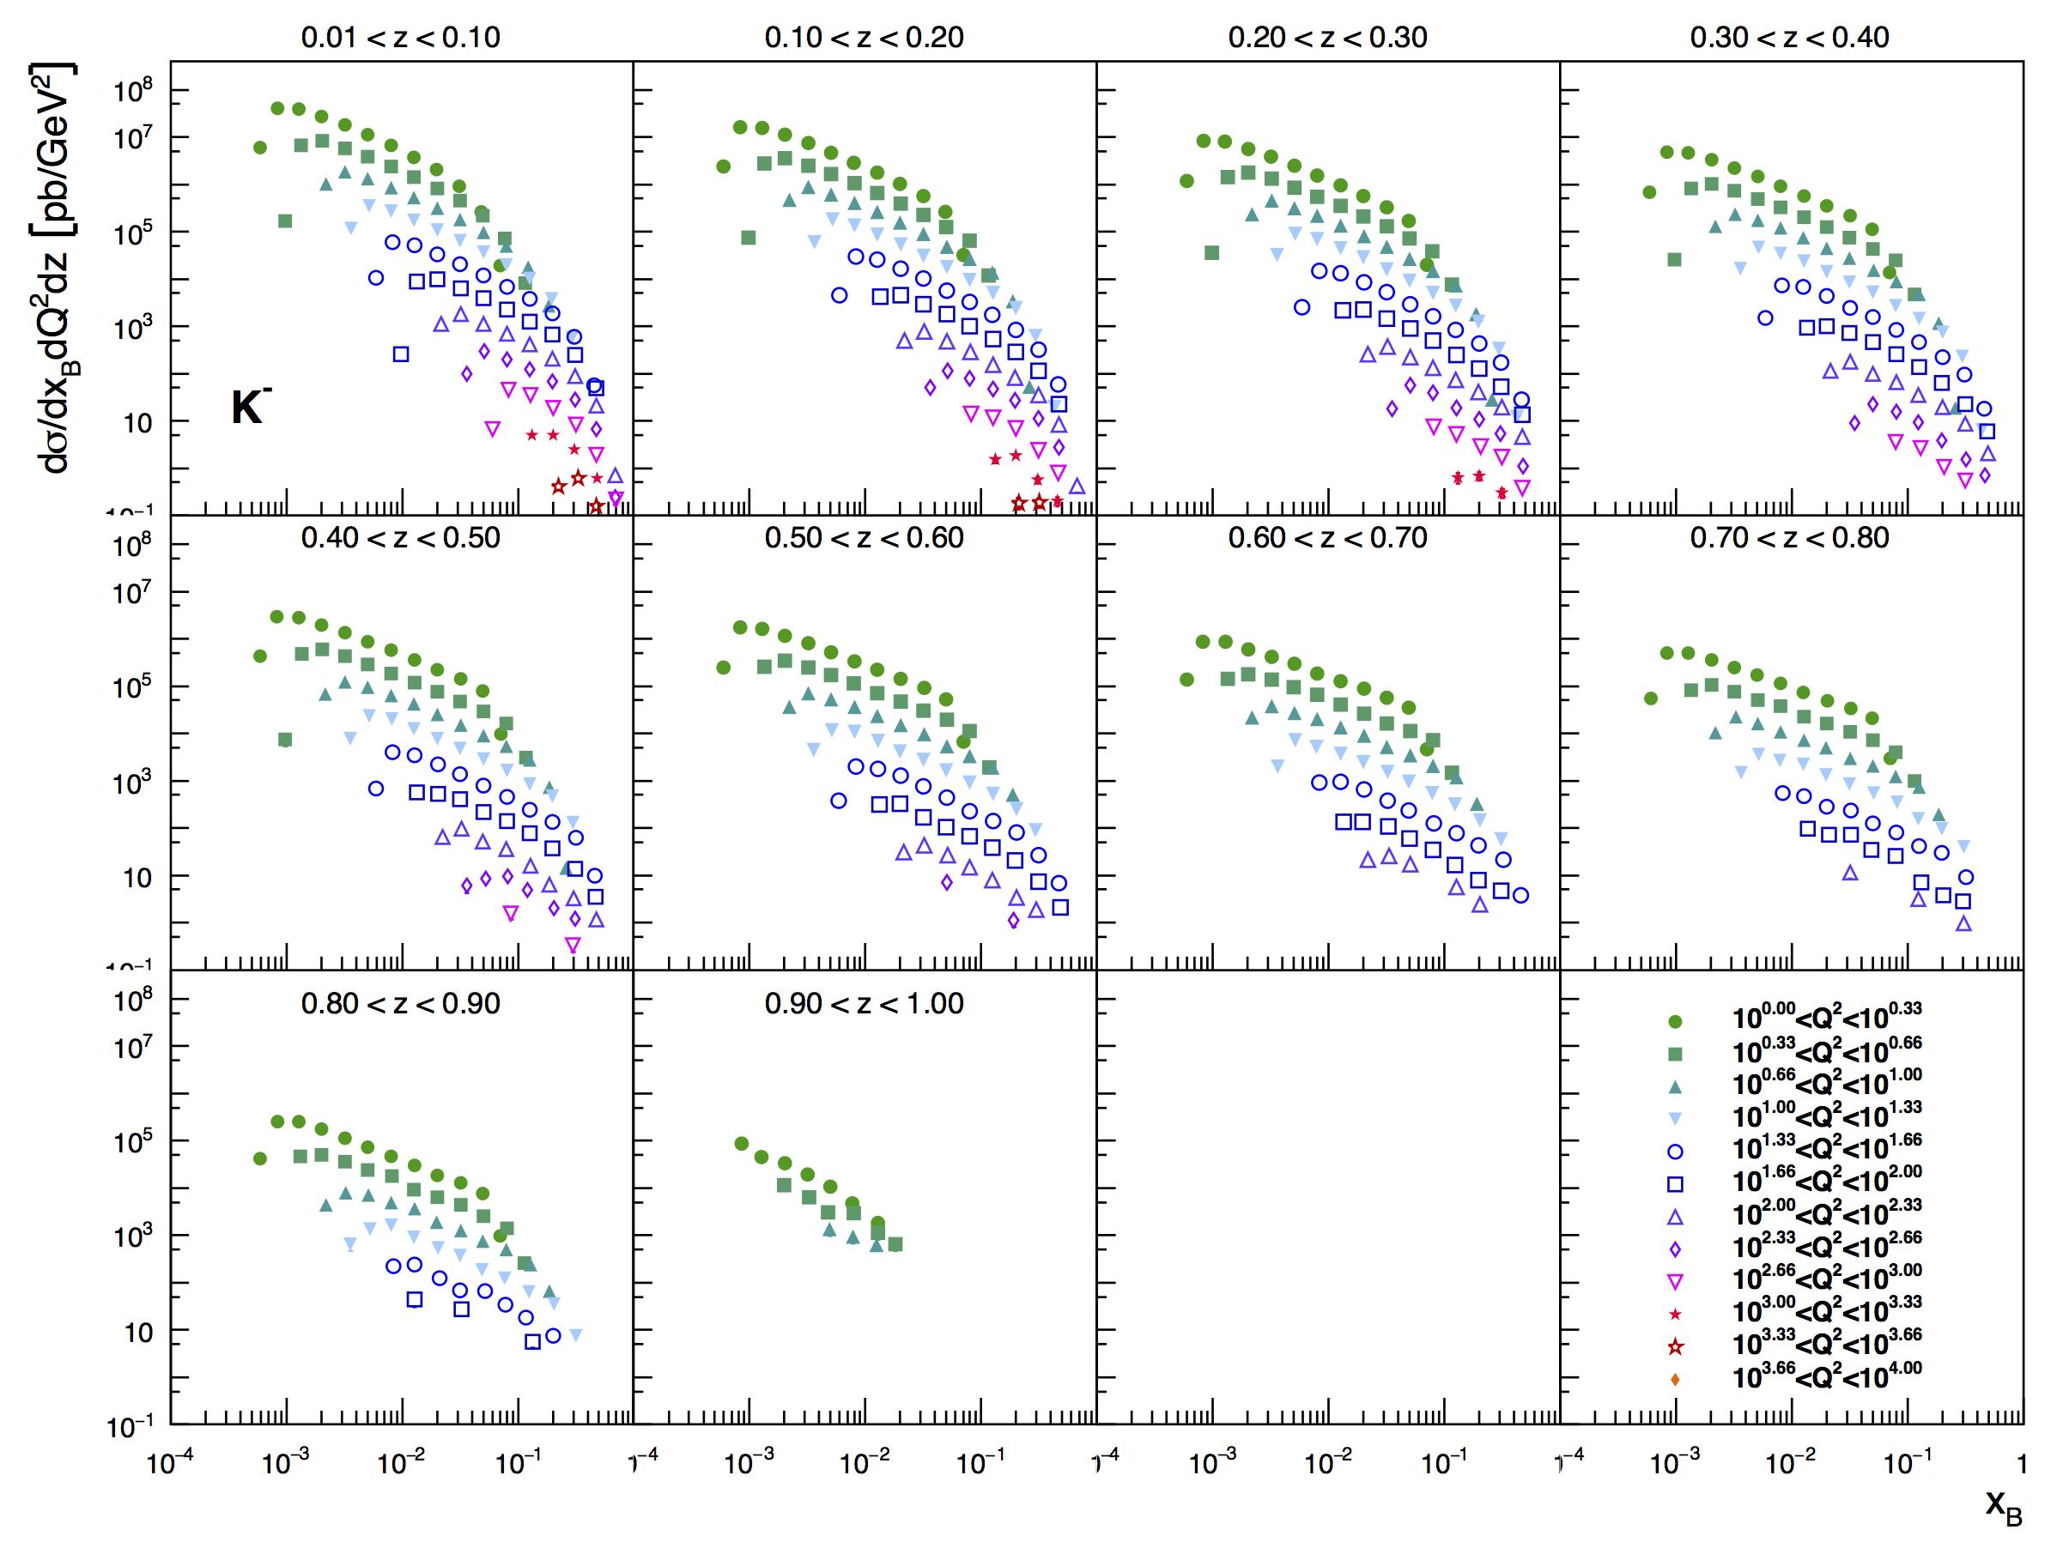
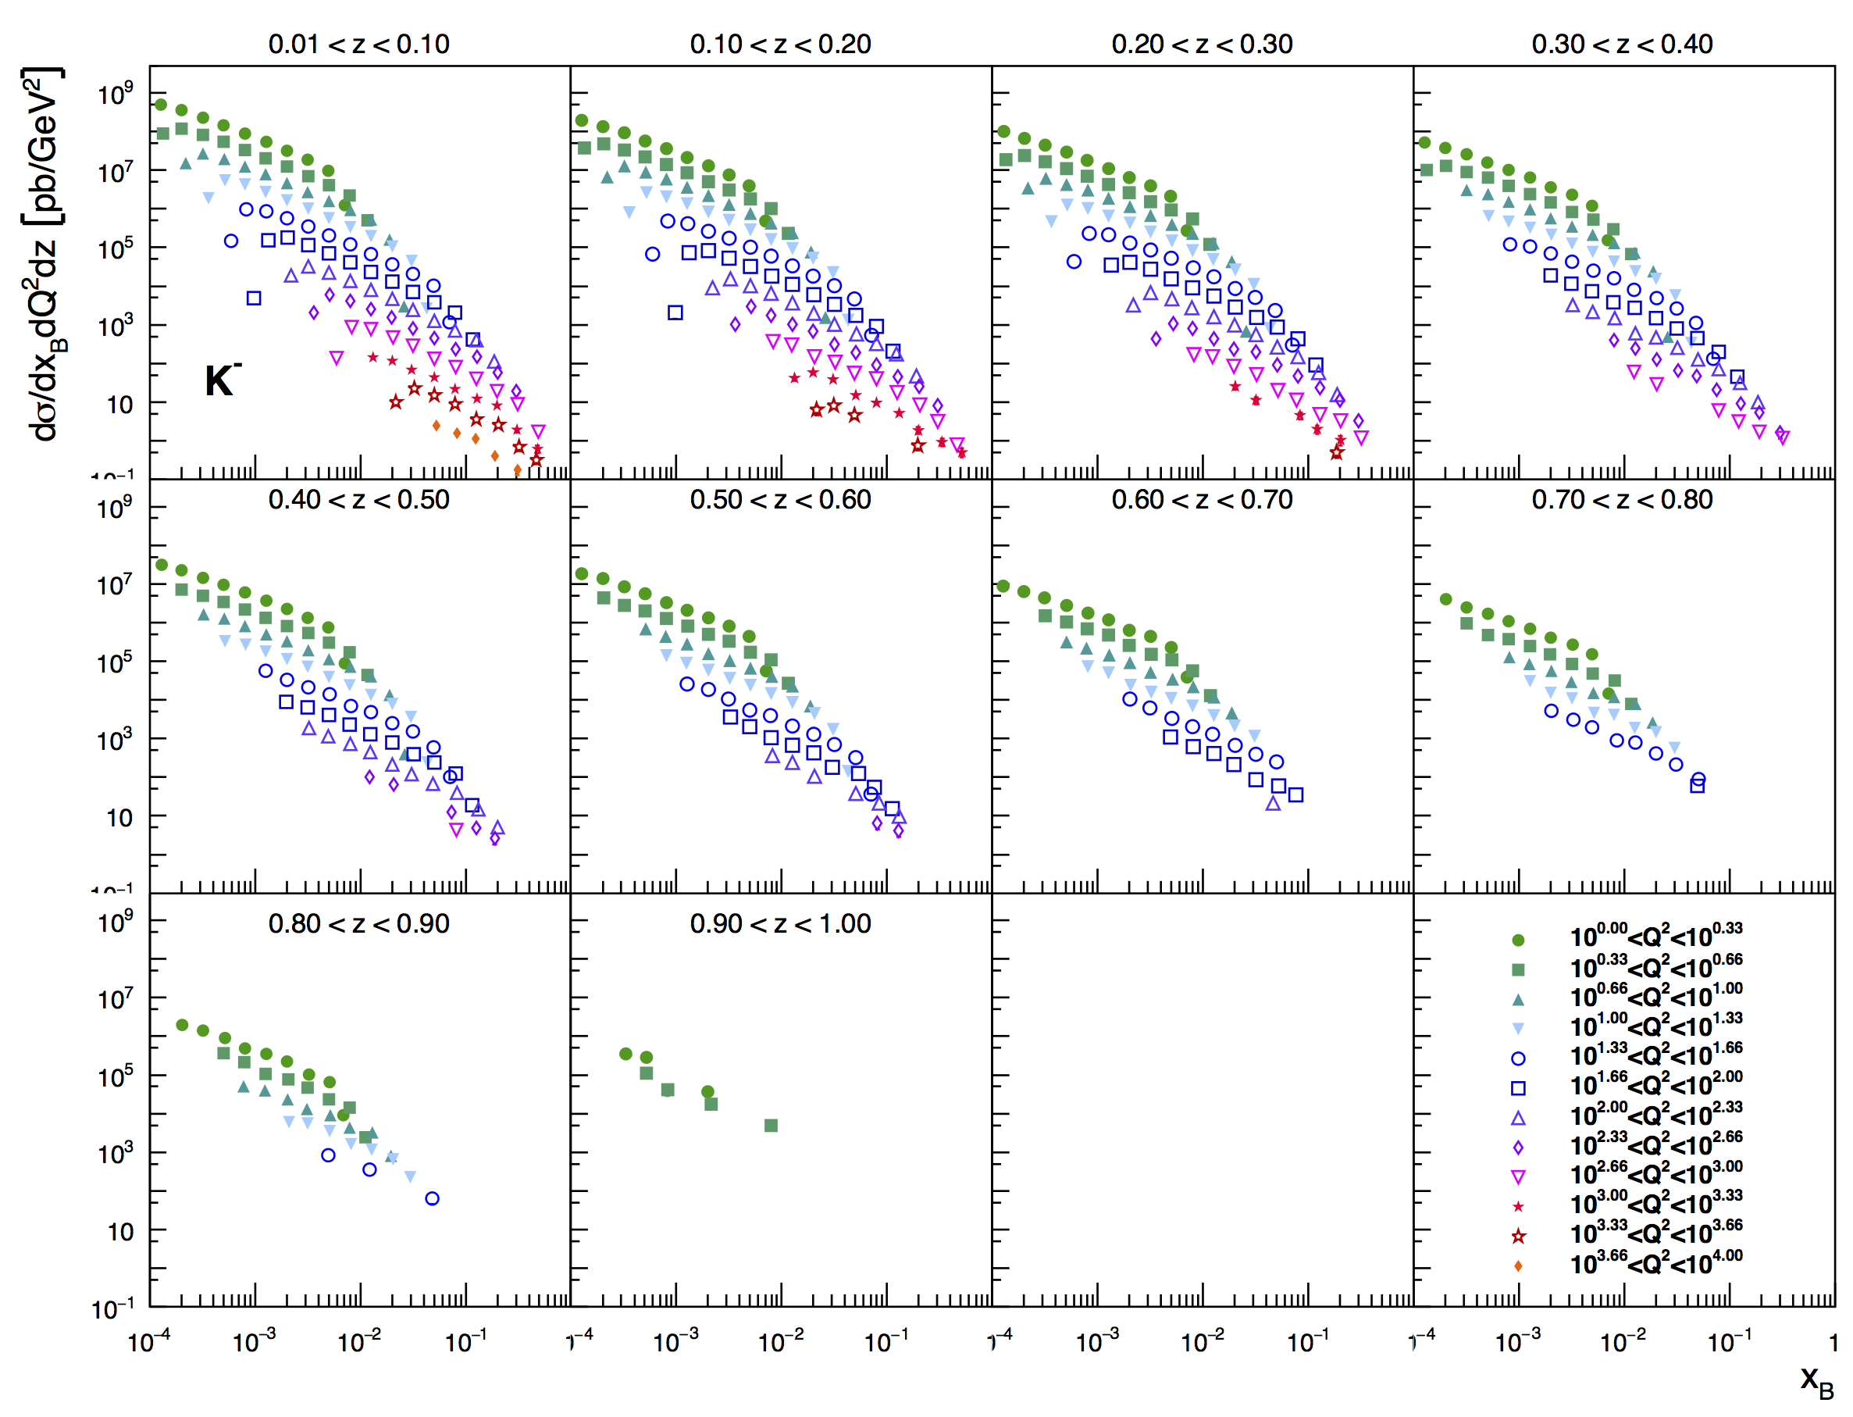
What can SIDIS@EIC Teach us
very precise 3d cross section
covering a wide kinematics in
z,x,Q²
5 GeV x 100 GeV
20 GeV x 250 GeV

Slide 13
PDF Constrain from SIDIS@EIC
√s=45 GeV
Use reweighting method to define EIC SIDIS data impact on collinear unpolarized PDFs and Fragmentation functions
Correlation factor of observable 𝓞 to a flavor i
account for
uncertainties
δ𝓞 : exp. uncertainty
Observable
Δ PDF in Observable
√s=145 GeV
If you want to know
s-PDF ask the EIC
→ impact grows with √s

Slide 14
What forms the Spin of the Proton
SPIN is one of the fundamental properties of matter
all elementary particles, but the Higgs carry spin
Studying Spin revealed many surprises in physics
proton anomalous magnetic moment → substructure
Spin cannot be explained by a static picture of the proton
It is more than the number ½ ! It is the interplay between
the intrinsic properties and interactions of quarks and gluons
total
quark spin
gluon
spin
angular
momentum
What do we know:
⟼
⟼
data
data
1/2 -
Gluon
-
Quarks
=
orbital angular
momentum
40%
30%

Slide 15
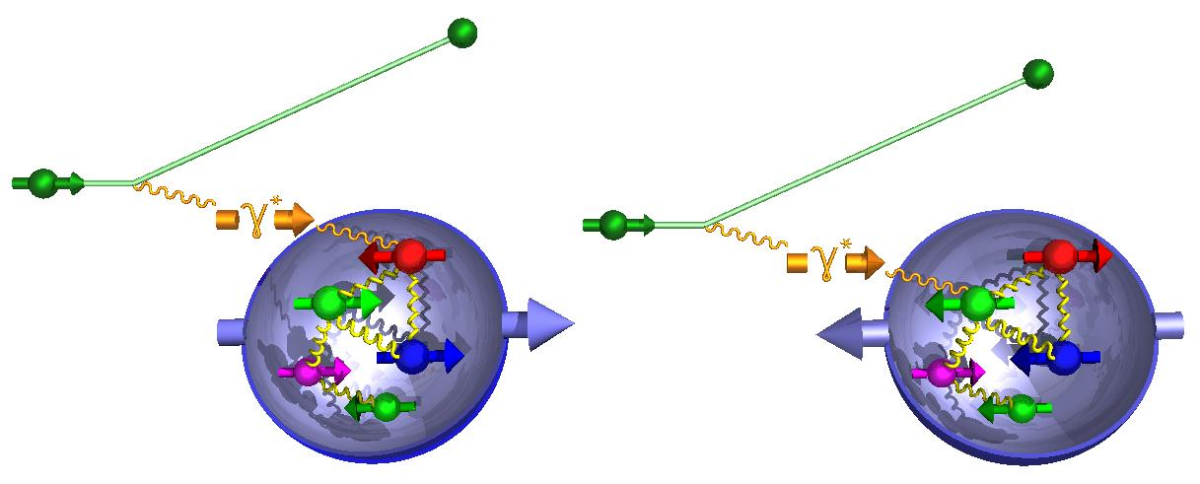
How to decompose the Spin of the Proton
To determine the contribution of quarks and gluons
to the spin of the proton, one needs to measure
the cross section difference g₁ as function of x and Q²
The current knowledge about g₁
as function of x at Q²=10 GeV²
g₁ ~
-
quark contribution:
The integral of g₁ over x from 0 to 1
gluon contribution:
dg₁(x,Q²)/dlnQ² → Δg(x,Q²)

Slide 16
What forms the Spin of the Proton
The polarized SF g₁(x,Q²) as
measured by EIC for low to high √s
The polarized SF g₁(x,Q²) as
measured by EIC for low √s
Only with the center-of-mass energies
available at EIC the different contributions
to the spin of the proton can be disentangled
arXiv:1509.06489
PRD 92, 094030

Slide 17
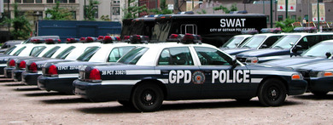

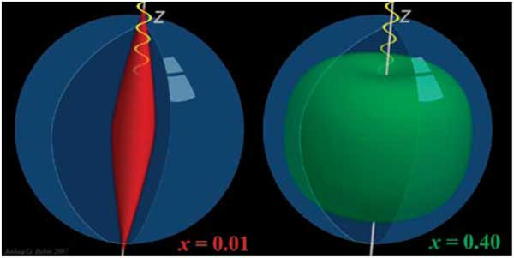
Generalized Parton Distributions (GPDs)
or

Slide 18


Beyond form factors and PDFs
Generalized Parton Distributions
X. Ji, D. Mueller, A. Radyushkin (1994-1997)
Proton form factors, transverse charge & current densities
Structure functions,
quark longitudinal
momentum & helicity
distributions
Correlated quark momentum
and helicity distributions in
transverse space - GPDs

Slide 19
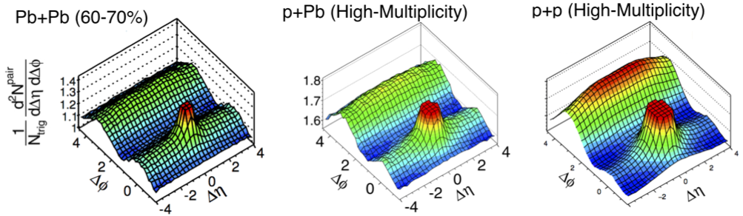
Proton structure important for QGP in small systems
Collective phenomena seen in pA collisions, i.e. ATLAS & CMS
H. Mäntysaari & B. Schenke
arXiv:1607.01711
In a hydro-picture (used in AA)
fluctuations in the proton are
crucial to understand the seen
pA@LHC behaviors
EIC can map out the spatial quark and gluon structure of the proton in x and Q²
Study
coherent
and
incoherent
J/Ψ prod.
Examples of proton density
profiles at x ~ 10⁻³
Notes:
make simpler

Slide 20
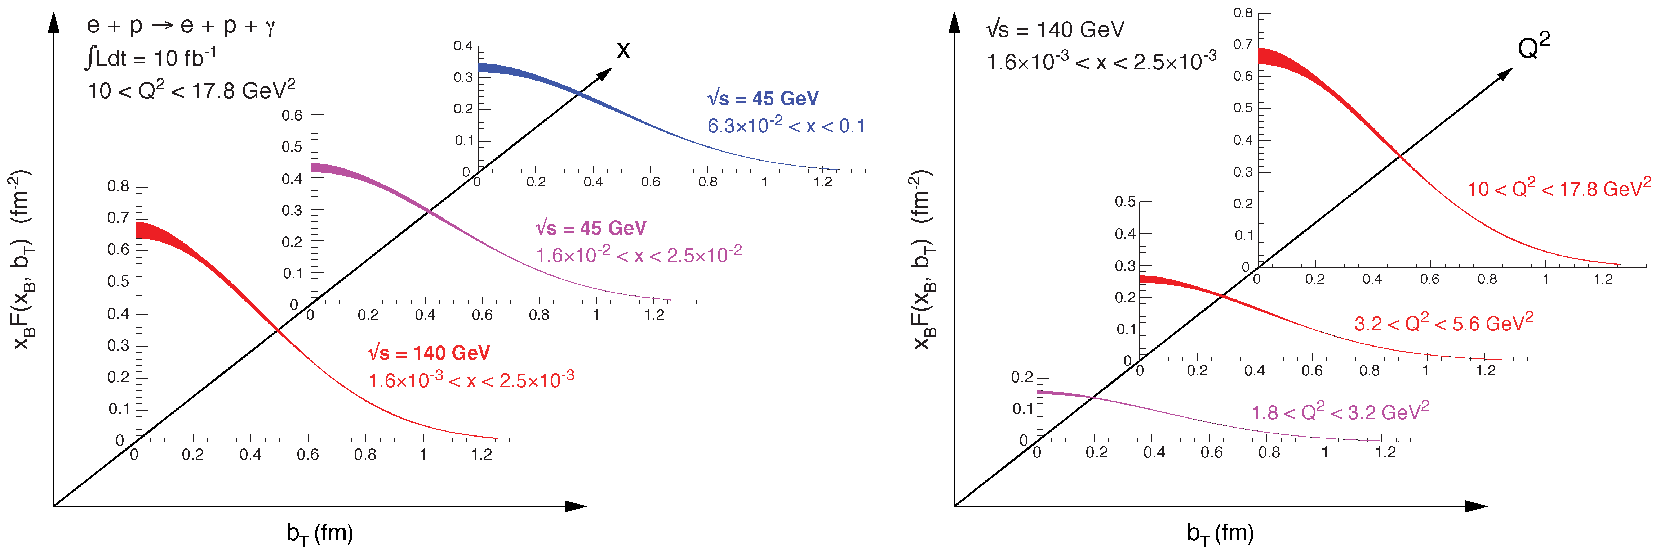

2+1d-Imaging in coordinate space
High precision
imaging at EIC
at low and high x
Golden channel:
DVCS
e’
e
γ_{L}*
γ
(Q²)
x+ξ
~
x-ξ
~
p
H, H, E, E (x,ξ,t)
p’
t
pion cloud
effects seen
at high b_{T}

Slide 21
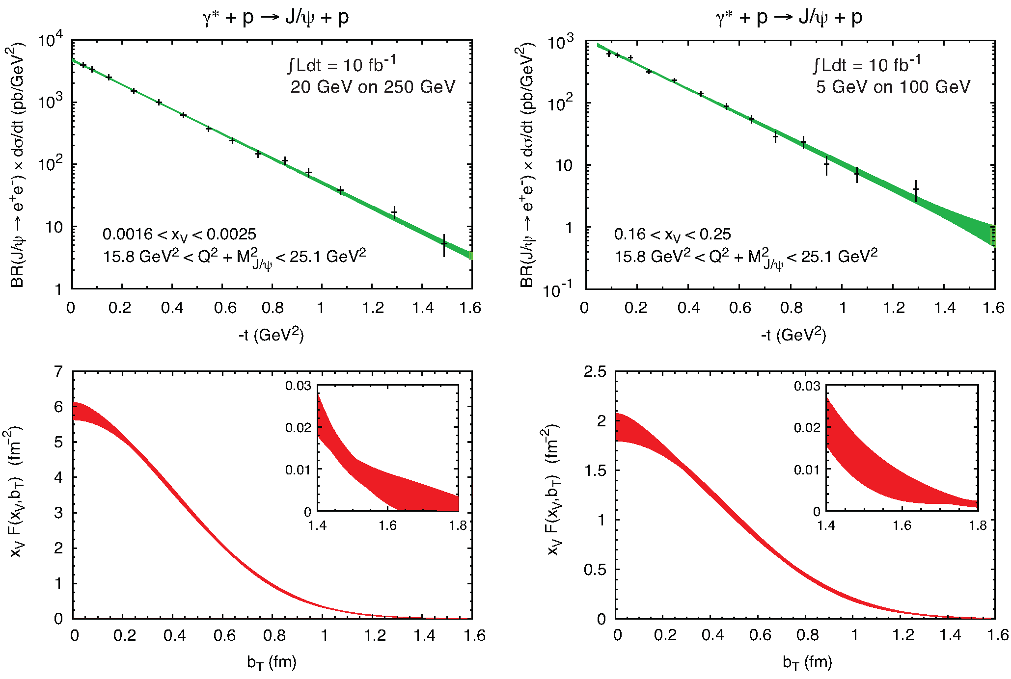
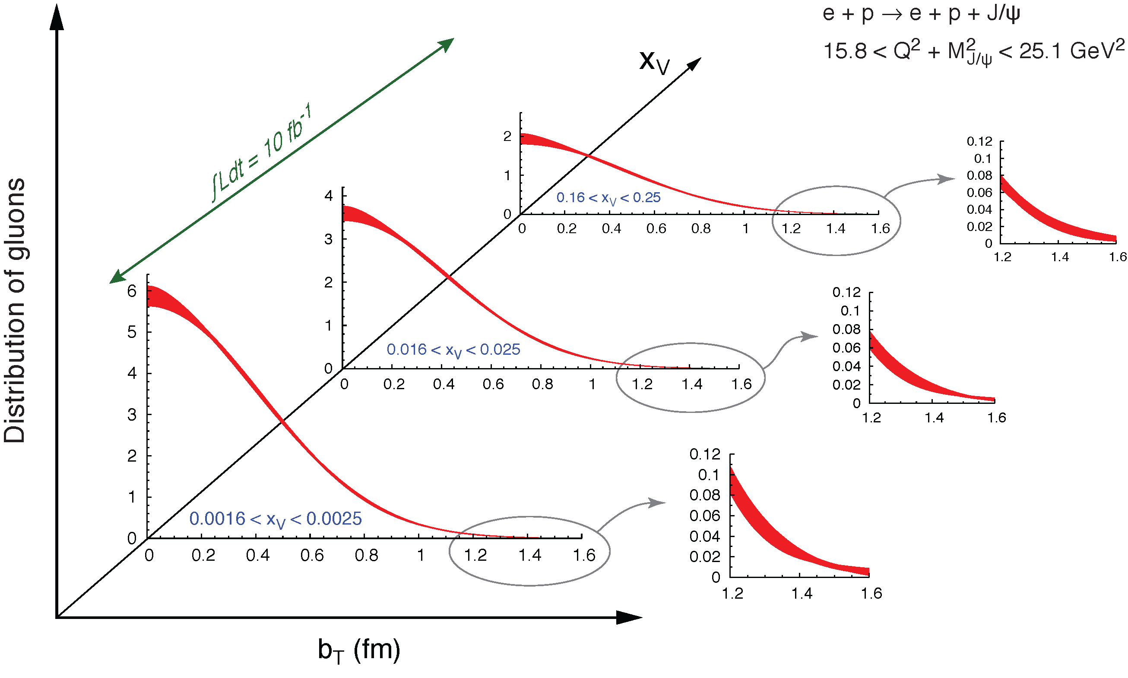
What about the gluon: J/ψ
To improve imaging on gluons
add J/ψ observables
cross section
A_{UT}
…..

Slide 22
What about Nuclei?

Slide 23
nPDFs before and after EIC
Ratio g(x,Q²)_{pb} /g(x,Q²)_{p}
DGLAP:
predicts Q² but not A-dependence and x-dependence
Saturation models:
predict A-dependence and x-dependence but not Q²
→ Need: large Q² lever-arm for fixed x, A-scan
LHC
RHIC
Measure different structure function in eA → constrain nPDF:
quark+anti-quark
momentum distributions
gluon momentum distribution
or tag on charm → F₂^{C}

Slide 24
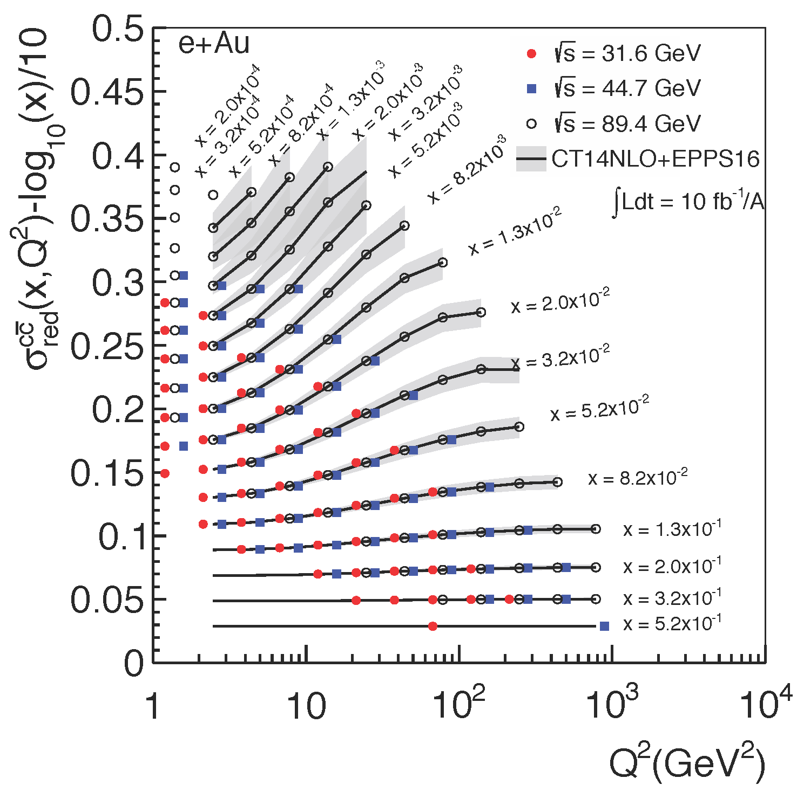
Inclusive Cross-Sections in eA
arXiv:1708.05654
Direct Access to gluons at
medium to high x by tagging
photon-gluon fusion through
charm events
Gluon distribution ~ dσ(x,Q²)/dlnQ²

Slide 25
EIC: Impact on the Knowledge of 1D Nuclear PDFs
√s < 45 GeV
√s < 90 GeV
Ratio of PDF of Pb over Proton
Without EIC, large
uncertainties
→ With EIC significantly
reduced uncertainties
Complementary to RHIC
and LHC pA data.
Provides information on
initial state for heavy ion
collisions.
Does the nucleus behave
like a proton at low-x?
→ relevant to very
high-energy cosmic
ray studies
→ critical input to AA
arXiv:1708.05654

Slide 26
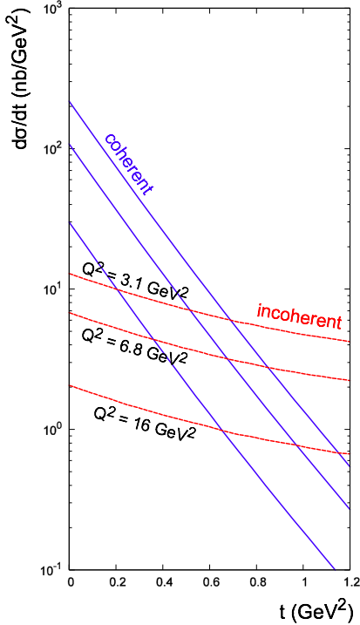
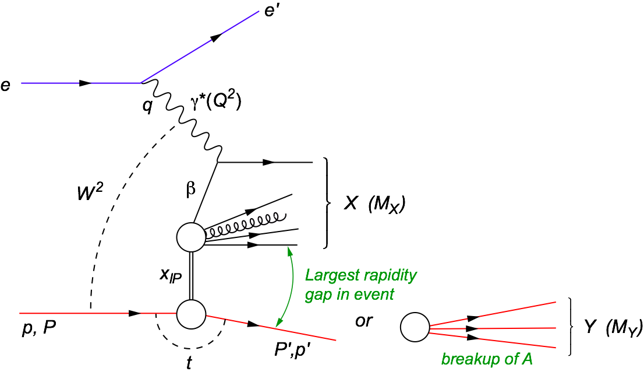
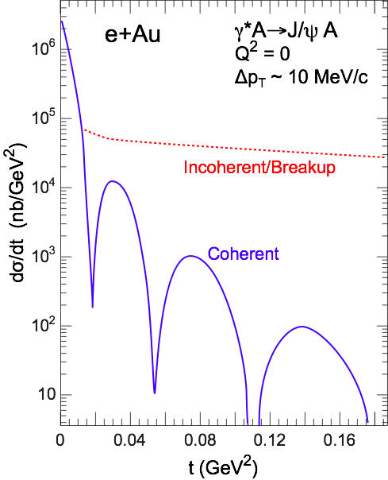
Diffraction in DIS at Small x
e+p
t = (p-p’)²
β is the momentum fraction of the struck parton w.r.t. the Pomeron
x_{IP} = x/β: momentum fraction of the exchanged object (Pomeron) w.r.t. the hadron
Diffraction in e+p:
  coherent ⇔ p intact
  incoherent ⇔ breakup of p
  HERA: 15% of all events are hard diffractive
Diffraction in e+A:
coherent diffraction (nuclei intact)
breakup into nucleons (nucleons intact)
incoherent diffraction
Predictions: σdiff/σtot in e+A ~25-40%

Slide 27
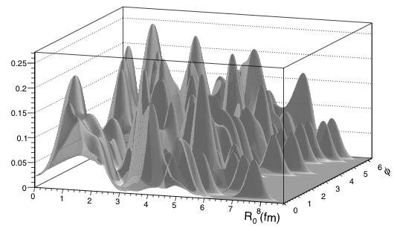
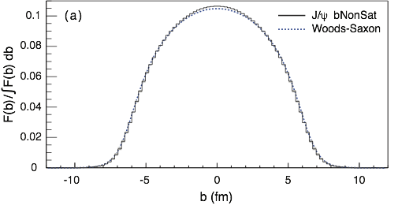
EIC: Spatial Gluon Distribution from dσ/dt
1950-60: Measurement of charge (proton) distribution in nuclei
Ongoing: Measurement of neutron distribution in nuclei
EIC ⇒ Gluon distribution in nuclei
Diffractive vector meson production:
e + Au → e′ + Au′ + J/ψ, φ, ρ
Method:
Fourier Transform
Diffractive vector meson production:
possible Source distribution with b_{T}^{g} = 2 GeV⁻²
e + Au → e′ + Au′ + J/ψ, φ, ρ
Momentum transfer t = |pAu-pAu′|² conjugate to bT
  Hot topic:
      Lumpiness?
      Just Wood-Saxon+nucleon g(b_{T})
      coherent part probes “shape of black disc”
      incoherent part (large t)
      sensitive to “lumpiness” of the source
      (=proton) (fluctuations, hot spots, ...)
PRC 87 (2013) 024913
Converges to input F(b) rapidly: |t| < 0.1 almost enough
Recover accurately any input distribution used in model used to generate pseudo-data (here Wood-Saxon)
  Systematic measurement requires ∫Ldt >> 1 fb⁻¹/A
  dσ/dt: diffractive pattern known from wave optics
  φ sensitive to saturation effects, smaller J/ψ shows no effect
  J/ψ perfectly suited to extract source distribution
Notes:
spin-dependent gluon distribution

Slide 28
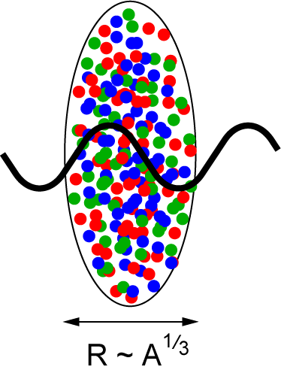
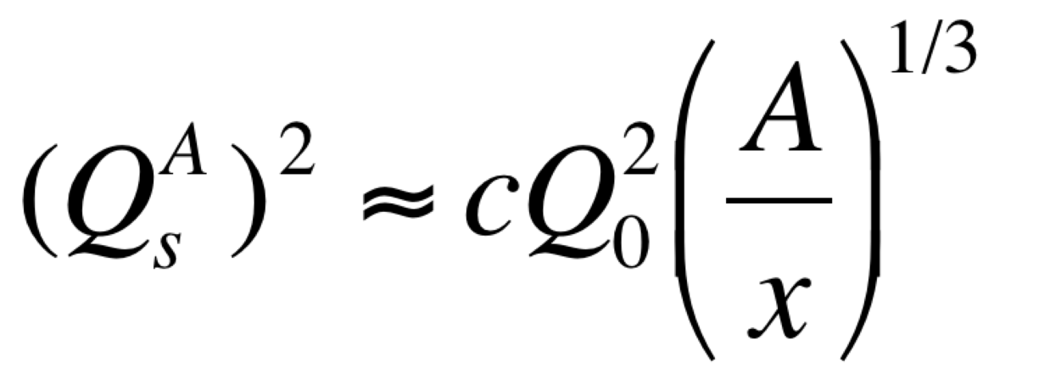
Studying non-linear effects
Scattering of electrons off nuclei:
Probes interact over distances L ~ (2m_{N} x)⁻¹
For L > 2 R_{A} ~ A^{1/3} probe cannot distinguish between nucleons in front or back of nucleon
Probe interacts coherently with all nucleons
Nuclear “Oomph” Factor
Pocket Formula:
Enhancement of Q_{S} with A ⇒ non-linear QCD regime reached at significantly lower energy in A than in proton

Slide 29
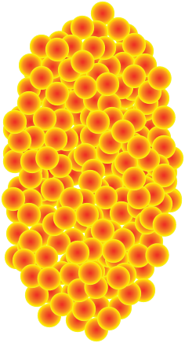
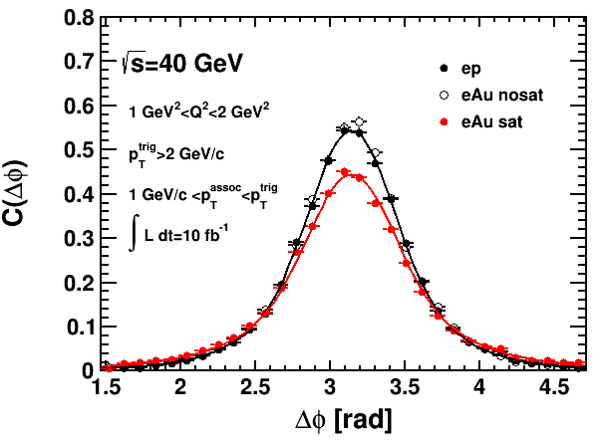
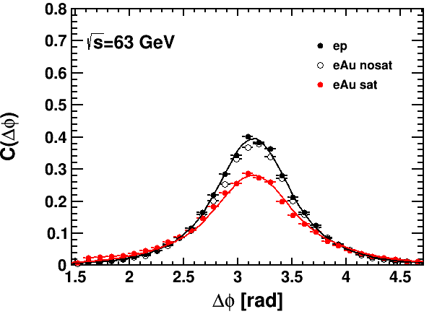
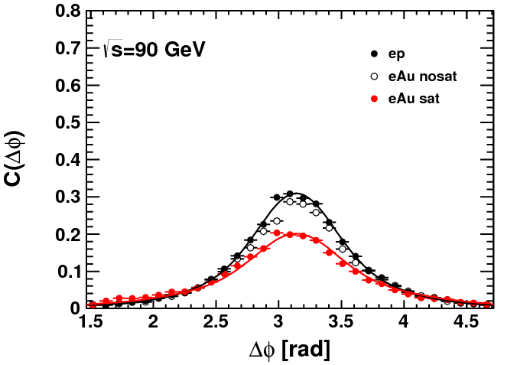
Key Observables for Saturation
Di-Hadron Correlations:
side-view:
jet-1
beam-view:
p
A
π
High gluon density (eA):
2 → many process
⇒ expect broadening of away-side
jet-2
Low gluon density (ep):
pQCD predicts 2→2 process
⇒ back-to-back di-jet
EIC allows to study the evolution of Q_{s} with x
x
Ratio

Slide 30
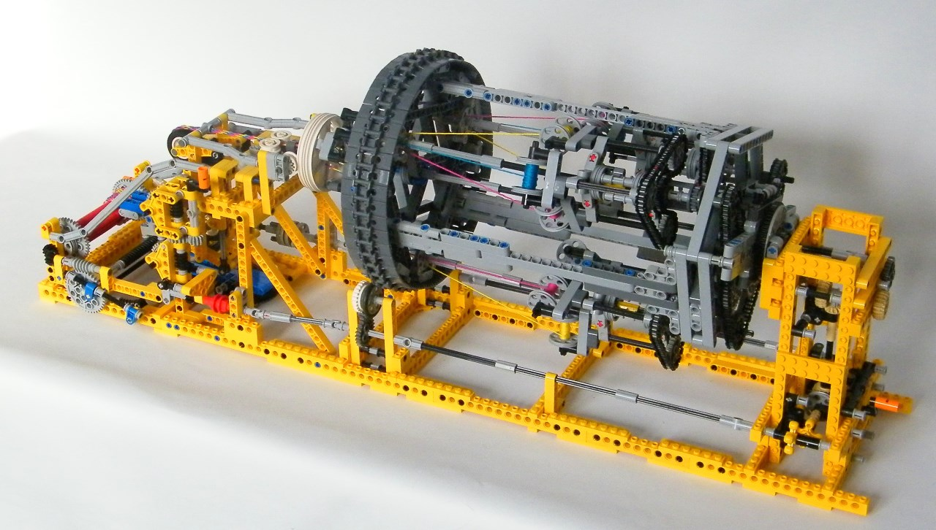
EIC Detector Concept

Slide 31


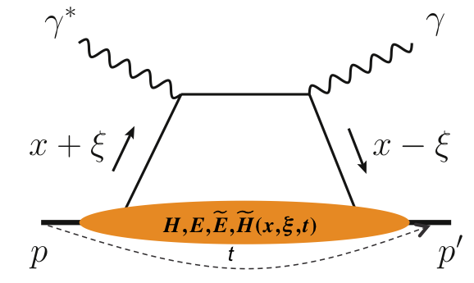
What is needed experimentally?
experimental measurements categories to address EIC physics:
Parton Distributions in nucleons and nuclei
Spin and
Flavor structure of nucleons and nuclei
Tomography Transverse Momentum Dist.
QCD at Extreme Parton Densities - Saturation
Tomography
Spatial Imaging
inclusive DIS
semi-inclusive DIS
exclusive processes
measure scattered lepton
multi-dimensional binning: x, Q²
reach to lowest x, Q² impacts
Interaction Region design
measure scattered lepton
and hadrons in coincidence
multi-dimensional binning:
x, Q², z, p_{T}, Θ
particle identification over entire region is critical
measure all particles in event
multi-dimensional binning:
x, Q², t, Θ
proton p_{t}: 0.2 - 1.3 GeV
  cannot be detected in main detector
  strong impact on Interaction Region design
∫Ldt:
1 fb⁻¹
10 fb⁻¹
10 - 100 fb⁻¹
machine & detector requirements

Slide 32

EIC General Purpose Detector: Concept
p/A beam
electron beam
high Q²
lepton
medium x
hadrons
Θ = 90º
scattered
hadrons
Θ = 135º
Θ = 45º
low Q²
low x
high x
Lepton
Endcap
Central
Detector
Hadron
Endcap
Θ = 178º
Θ = 2º
z
and all the detectors integrated in the IR along the beam line

Slide 33
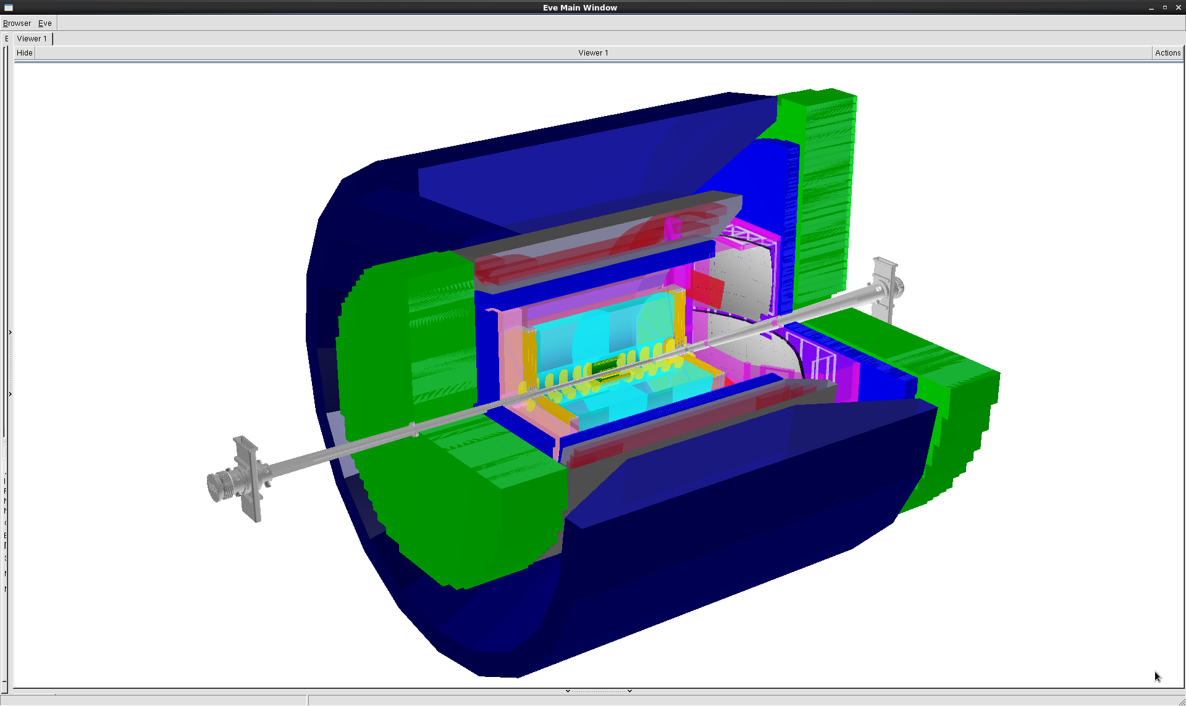
EIC General Purpose Detector
One possible EIC general purpose Detector realization
-4<η<4: (2º < Θ < 178º ) Tracking & e/m Calorimetry (hermetic coverage)
hadronic calorimeters
e/m calorimeters
RICH detectors
Overall detector requirements:
large acceptance: -4.0 ≲ η ≲ 4.0
high precision low mass tracking
equal coverage of tracking and EM-calorimetry
high performance PID to separate π, K, p on track level
high control on systematic effects → auxiliary detectors from the beginning:
→ critical for physics program and to control systematics
  luminosity monitors
  large acceptance for diffractive protons and neutrons from nuclear breakup
  electron & hadron polarimetry
  low Q²-tagger
9.0m
Hadron PID:
-1<η<1: proximity focusing
RICH/DIRC + TPC: dE/dx
1<η<3: Dual-radiator RICH
-1<η<-3: Aerogel RICH
Lepton-ID:
-3 <η< 3: e/p
1<|η|<3: in addition HCal response
& γ suppression via tracking
|η|>3: ECal+Hcal response &
γ suppression via tracking
-4<η<4: Tracking (TPC+GEM+MAPS)
electrons
hadrons
MAPS: CMOS Monolithic Active Pixel Sensors
silicon trackers
TPC
GEM trackers
3T solenoid coils
Design based on EIC Detector R&D technologies developed by EIC-UG members

Slide 34


EIC Project Status
The EIC received in the 2015 Long Range
Planning of the NSAC the following recommendation
“We recommend a high-energy high-luminosity
polarized EIC as the highest priority for new
facility construction following the completion of FRIB”
http://science.energy.gov/~/media/np/nsac/pdf/2015LRP/2015_LRPNS_091815.pdf
“… In summary, the committee finds a compelling scientific case for such a facility (the EIC). The science questions that an EIC will answer are central to completing an understanding of atoms as well as being integral to the agenda of nuclear physics today. In addition, the development of an EIC would advance accelerator science and technology in nuclear science; it would as well benefit other fields of accelerator based science and society, from medicine through materials science to elementary particle physics.”
Released July 24, 2018
January 2020: CD-0 & site selection → BNL
Next Step: Spring 2021 CD-1

Slide 35
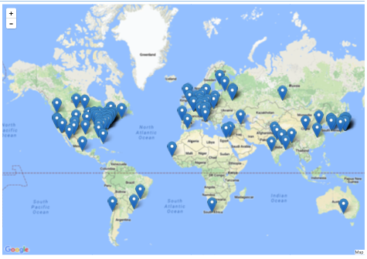
EIC User community
Currently ~1062 members from 217 institutions from 31 countries from
6 world regions
US: 61% Europe: 25% Asia: 10%
continuously growing
Please sign up and join us
http://www.eicug.org
Yellow Report Initiative is to advance the state and detail of the documented physics and detector concepts in preparation for the realization of the EIC (http://www.eicug.org/web/content/yellow-report-initiative)
Very active generic EIC detector R&D program:
https://wiki.bnl.gov/conferences/index.php/EIC_R%25D
37 groups collaborate in tracking, calorimeter, PID consortia and …….
Next EIC user group meeting:
3rd to 7th of August 2020 Miami, Florida
EIC Conference series: POETIC (Physics Opportunities at an ElecTron-Ion Collider)
next conference in spring 2021 in Brazil

Slide 36

Summary
EIC will provide highest precision data to constrain
the inner structure of nucleons and nuclei
Let’s get to work
and built EIC

Slide 37


Slide 38
Deep Inelastic Scattering
Kinematics:
Measure of resolution power
Measure of inelasticity
Measure of momentum fraction of struck quark
center-of-mass energy of electron-hadron system
Deep Inelastic Scattering (DIS):
As a probe, electron beams provide unmatched precision of the electromagnetic interaction
Direct, model independent determination of parton kinematics of physics processes through scattered lepton

Slide 39
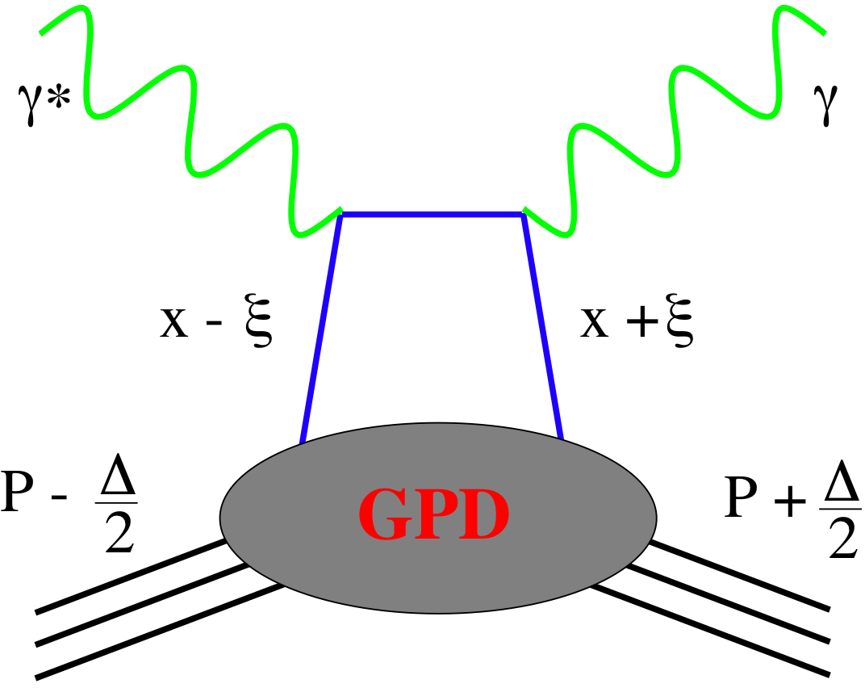
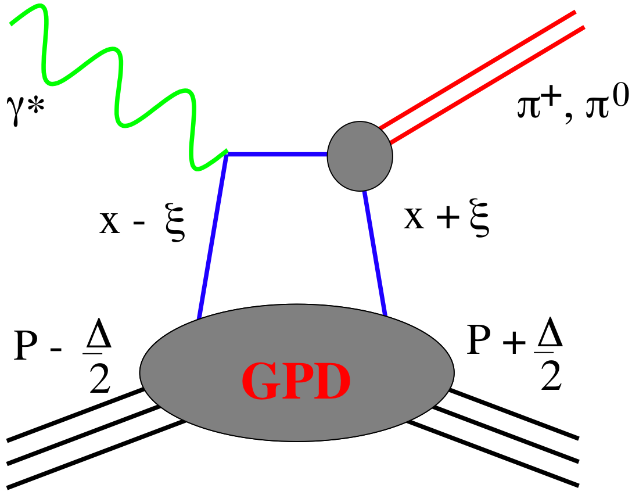
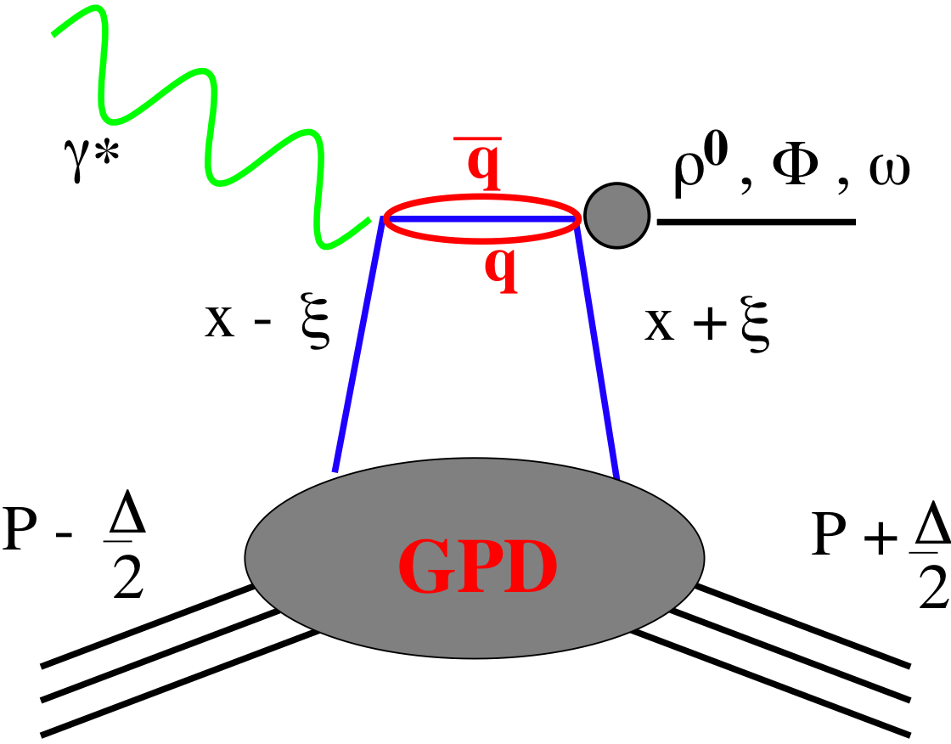
SMALL GPD Primer
How are GPDs characterized?
unpolarized polarized
conserve nucleon helicity
flip nucleon helicity
not accessible in DIS
quantum numbers of final state select different GPD
the way to 3d imaging of the proton and access the orbital angular momentum
Spin-Sum-Rule in PRF:
DVCS
pseudo-scaler mesons
vector mesons
responsible for orbital angular momentum
π⁰ | 2Δu+Δd
η | 2Δu−Δd
ρ⁰ | 2u+d, 9g/4
ω | 2u−d, 3g/4
φ | s, g
ρ⁺ | u−d
J/ψ | g
Q²= 2E_{e}E_{e}’(1-cosθ_{e’})
x_{B} = Q²/2Mν ν=E_{e}-E_{e’}
x+ξ, x-ξ long. mom. fract.
t = (p-p’)²
ξ ≅ x_{B}/(2-x_{B})

Slide 40
The DVCS Phase Space
HERA results on GPDs
very much limited by
lack of statistics
imaging in
valence region
but limited t-range
X
quantum numbers of final state → selects different GPD
DVCS: wide range of observables (σ, A_{UT}, A_{LU}, A_{UL}, A_{C}) to disentangle GPDs

Slide 41


DVCS at EIC
e’
γ
e
γ_{L}*
(Q²)
DVCS: Golden channel
theoretically clean
wide range of observables
(σ, A_{UT}, A_{LU}, A_{UL}, A_{C})
to disentangle different GPDs
x+ξ
x-ξ
~
~
p
H, H, E, E (x,ξ,t)
p’
t
DVCS data at end of HERA
D. Mueller, K. Kumericki
S. Fazio, and ECA
arXiv:1304.0077

Slide 42
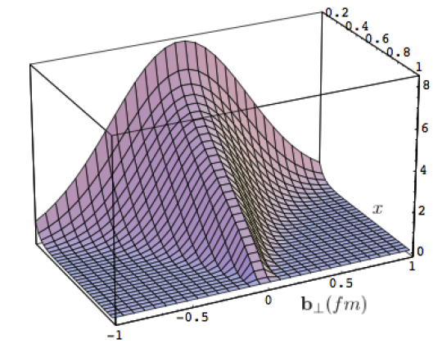
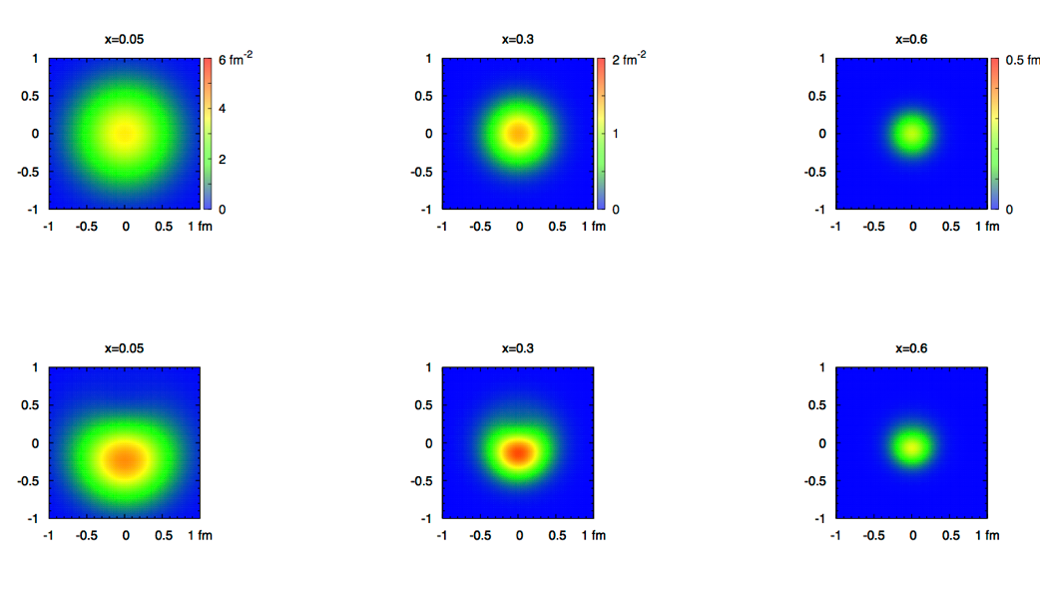
What can we learn
Model of a quark GPD
x
down valence quark
b_{T} (fm)
b_{T} decreasing as a function of x
x
EIC
Valence (high x) quarks at the center → small b_{T}
Sea (small x) quarks
at the périphérie → high b_{T} ?
GLUONS ???

Slide 43
Disentangle different GPDs
Vary electron and proton beam spin directions:
electron
beam
longitudinal
polarised
proton
beam
transverse
polarised
proton
beam
longitudinal
polarised
Δσ_{UT}
beam target

Slide 44
What will we learn about 2d+1 structure of the proton
GPD H and E 1d+1
arXiv:1304.0077
GPD H and E as function of t, x and Q²
A global fit over all pseudo data was done, based on the GPDs-based model:
[K. Kumerički, D Müller, K. Passek-Kumerički 2007]
Known values q(x), g(x) are assumed for H^{q}, H^{g}
(at x=0, t=0 forward limits E^{q}, E^{g} are unknown)
Excellent reconstruction of H^{sea}, H^{sea} and good reconstruction of H^{g} (from dσ/dt)
GPD H and E 2d+1 structure for sea-quarks and gluons

Slide 45
Key Observables for Saturation
Diffraction:
Diffractive events are indicative of a color neutral exchange between the virtual photon and the proton or nucleus over several units in rapidity.
M_{X}²: Squared mass is the diffractive final state
x_{IP}: Momentum fraction of the “Pomeron” with respect to the hadron.
The rapidity gap between produced particles and the proton or
nucleus is Y ~ ln(1/x_{IP} )

Slide 46
Inclusive Diffraction
HERA observed: ~14% of all events are diffractive
Saturation models (CGC) predict up to σdiff/σtot ~ 25% in eA
Ratio enhanced for small M_{X} and suppressed for large M_{X}
Standard QCD predicts no M_{X} dependence and a moderate suppression due to shadowing.
It would be nice to have equally
rigorous extraction of diffractive
PDF as the “std. PDFs”
→ both for proton and nuclei

Slide 47
How to access Gluons in DIS
Several different complementary channels to access gluons
Indirect: the scaling violation of the cross section as function of x and Q²
dF2(x,Q²)/dlnQ² → G(x,Q²)
Direct: the measurement of F_{L}
Direct: tagging the photon gluon fusion process
    Di-jets
    charm production, i.e. F₂^{CC}
quark+anti-quark
momentum distributions
gluon momentum
distribution
All these process need a wide coverage in x and Q²

Slide 48
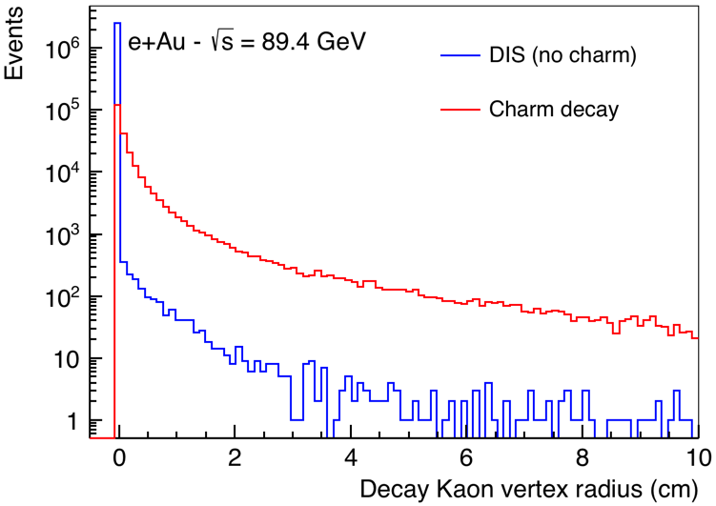
Tagging Charm
Standard charm tagging through displaced leptons → 6.5%
EIC:
advantage: Detector with π, K, p PID over a wide range in rapidity (-3.5 < η < 3.5)
combined with excellent vertex resolution
Kaon vertex distribution
Cut: 0.01 cm < vtx < 3 cm
momentum spectrum of K from
charmed mesons
→ excellent fit to PID with dE/dx
and aerogel RICH
Charm efficiency: 30%
Bckg. from non-charm < 2%

Slide 49
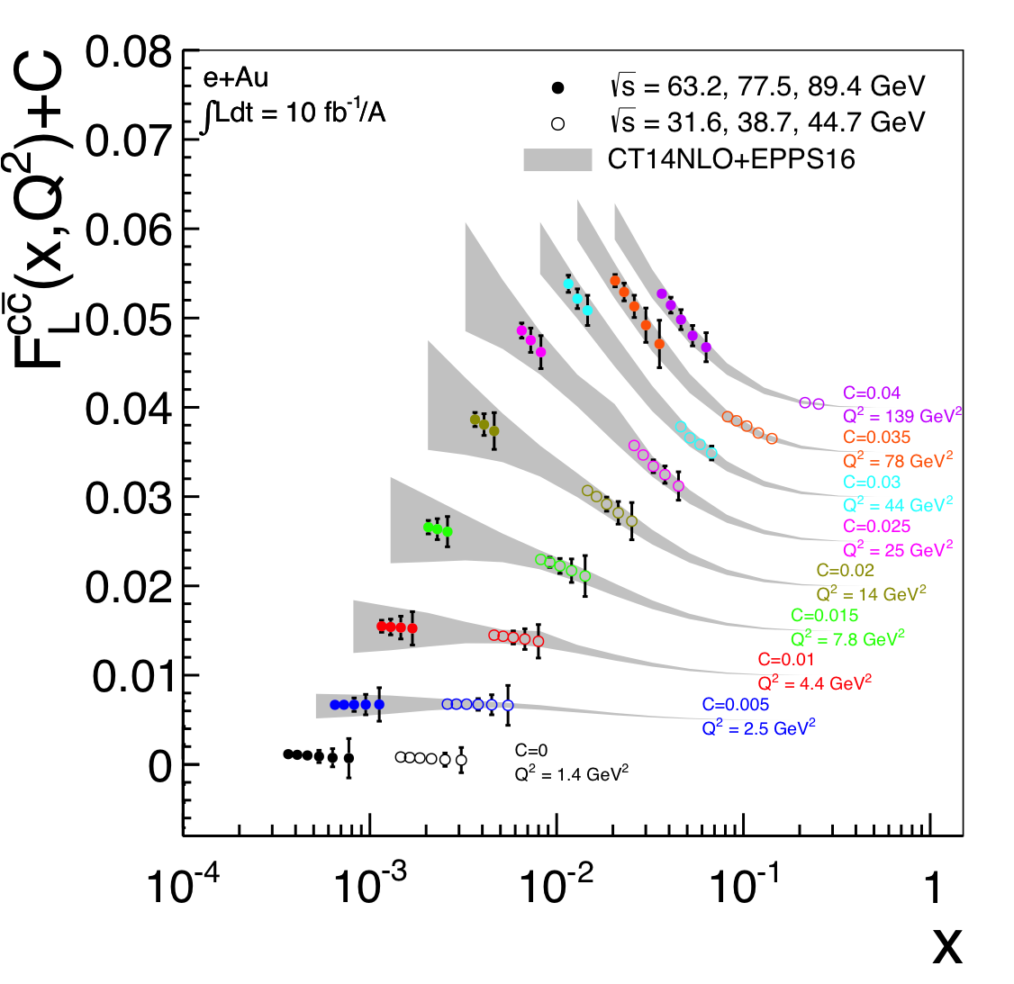
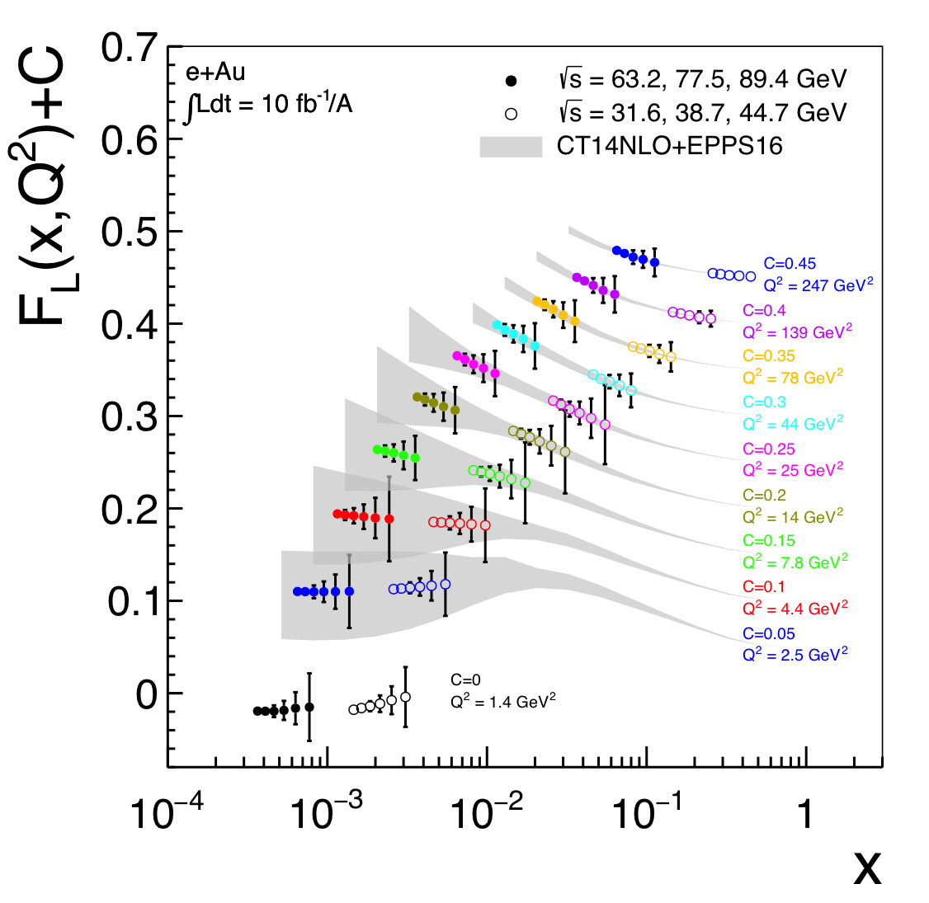
Direct Access to Gluons in eA
For Details: arXiv:1708.05654
Direct Access to gluons at
medium to high x by tagging
photon-gluon fusion through
charm events
high precision F_{L}^{charm} will offer an
opportunity to benchmark different
GM-VFNS schemes with an
unprecedented precision.

Slide 50
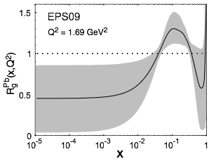
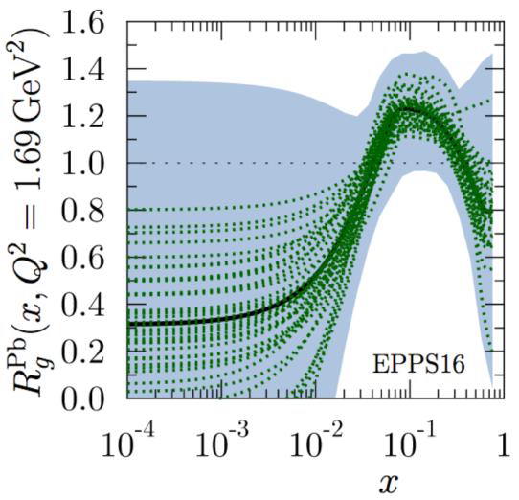
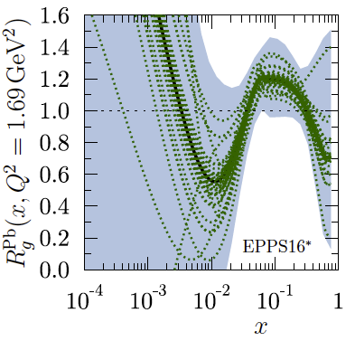
Impact Study of EIC Pseudo-Data
Impact study
based on EPPS-16 framework
  LHC pA data are included in baseline & reduced weight of PHENIX π⁰-data
  Quark flavors are now fitted separately
  EPPS16* → functional form with less constraints (for gluons) in extrapolating for x < x_{data}
  → critical to study the impact of the high precision EIC data!
EPS-09
EPPS-16
EPPS-16*
Remove extra
weight on
PHENIX
R_{dA}(π⁰)
change
of
functional
form
EPPS-16
EPPS-16*

Slide 51


EIC Detector Concepts
eRHIC
JLEIC
BeAST
hadronic calorimeters
e/m calorimeters
Overall detector requirements:
large acceptance: -4.0 ≲ η ≲ 4.0
high precision low mass tracking
equal coverage of tracking and EM-calorimetry
high performance PID to separate π, K, p on track level
high control on systematic effects
RICH detectors
TPC
GEM trackers
silicon trackers
magnet yoke
Micromegas barrel
3T solenoid cryostat
Current emphasis on the design of a multipurpose detector
Both (EIC & JLEIC) IR-designs integrate
auxiliary detectors from the beginning:
→ critical for physics program and to control systematics
luminosity monitors
large acceptance for diffractive proton detection and neutrons from nuclear breakup
electron & hadron polarimetry
low Q²-tagger

Slide 52
IR Requirements from Physics
Exclusive Reactions in ep/eA:
Exclusivity criteria:
  eA: large rapidity coverage → rapidity gap events
    HCal for 1<η<4.5
  ep: reconstruction of all particles in event
    wide coverage in t (=p_{t}²) → Roman pots
eA: large acceptance for neutrons from nucleus break-up
  Zero Degree Calorimeter
    veto nucleus breakup
    determine impact parameter of collision
→ Poses stringent requirements on IR design
γ, ρ, Φ, J/Ψ, Jets
t=p_{t}²
γ, ρ, Φ, J/Ψ, Jet
scattered
electron
not seen in main detector
scattered
proton
Proton
Beam
Note:
the kinematics of the scattered
proton is the same for all
diffractive processes
and known from HERA

Slide 53
Scattered Proton Kinematics
scattered protons
Remember:
Detector -4 to 4 in η
35 mrad from beam line
so not seen in main detector
need different detection technology
p_{T} of proton critical for physics
p_{T} = p’ sin(Θ)
p’_{L} > 97% of p_{Beam}
ZEUS Coll, JHEP 06 (2009) 074
Note:
high energy colliders (HERA, Tevatron, LHC, RHIC) use Roman Pots to detect
these proton
Θ < 10 mrad
  impact on large p_{T}-acceptance
small p_{T}-acceptance limited by
beam divergence and emmitance
→ rule of thumb keep 10σ between RP and beam
non-diffractive events
⟻
X_{L}=p’_{L}/p_{Beam}

Slide 54
Very forward scattered particles
Very forward scattered particles critical to detect for elastic/diffractive physics
Not detectable in main detector
Breakup Neutrons
Au
Requirement:
Need +/- 4 mrad beam element free
cone before the zero degree
calorimeter to detect the breakup
neutrons from heavy Ions
small nuclear dependence on scattering angle
these neutrons are also critical to
reconstruct collisions geometry
peripheral to central arXiv:1407.8055
  precision neutron energy
  transv. size of ZDC

Slide 55

IR layout
main emphasis on integrating requirements for hadron beam direction
  B0Fp: Forward Spectrometer (6 - 22 mrad)
  Neutron Detector (0 to ±4 mrad)
  Roman pots (Sensitive 1 to 5 mrad)
B1Re and B2Re: separate BH photons from beam, separate low Q² electrons from beam
and lepton beam from SR-fan
JLEIC similar concept with some differences due to different design choices/emphasis

