Slide 1
(威 海)
WEIHAI
Second Order Non-dissipative Currents
In a Chiral System
Gao Jian-Hua 高建华
Shandong University, Weihai, China
1. arXiv:2003.04517 S.Z. Yang, J.H. Gao, Z.T. Liang, Q. Wang
2. arXiv:2005.08512 C. Zhang, R.H. Fang, J.H. Gao, D.F. Hou
3. arXiv:1802.06216 J.H. Gao, Z.T. Liang, Q. Wang, X.N. Wang
The 138th HENPIC seminar, Apr. 22 2021

Slide 2
Outline
Introduction
Wigner functions up to 2nd order
Non-dissipative Currents up to 2nd order
General solution up to 2nd order
Summary

Slide 3
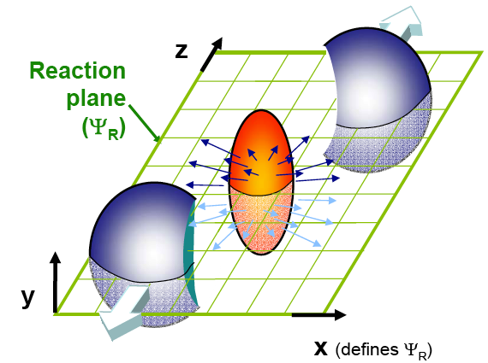
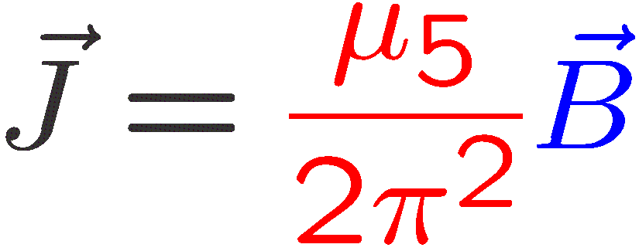
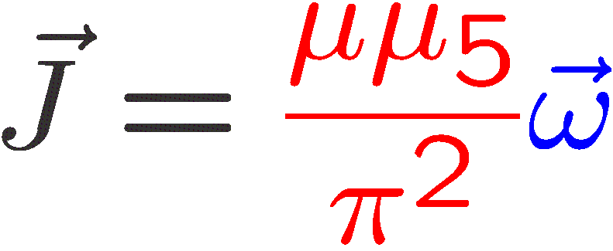
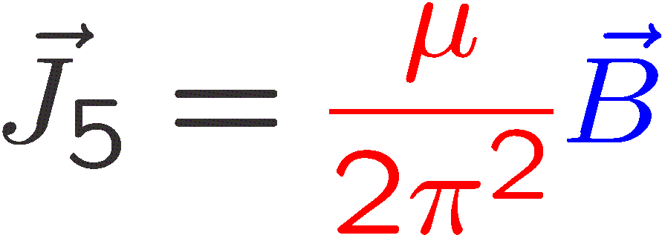
Chiral effects in HIC
First order currents !
Chiral Magnetic Effect
Chiral Vortical Effect
/
Made by Chun Shen
Chiral Separate Effect
Local Polarization Effect
Non-dissipative !
Kharzeev, Prog.Part.Nucl. (2014) arXiv:1312.3348 ; Kharzeev, Liao, Voloshin, Prog.Part.Nucl. (2016) arXiv:1511.04050 ;
Huang, Rept. Prog. Phys. (2016) arXiv:1509.04073 ; Hattori, Huang, Nucl.Sci.Tech. (2017) arXiv: 1609.00747
JHG, Ma, Pu, Wang , Nucl.Sci.Tech. (2020) arXiv:2005.10432 ……
Notes:
3
3

Slide 4
Theoretical methods
Kharzeev PRD(2009), Landsteiner PRL(2011), Fukushima NPA(2010), Hou JHEP(2011) … …
Quantum Field Theory
Anomalous Hydrodynamics
Gauge/Gravity Duality
Son PRL(2009)
Yee PRC(2014)
Yin PLB(2016)
Hongo PLB(2017) … …
Made by Chun Shen
first order
currents
Erdmenger JHEP(2009)
Yee JHEP(2009)
Rebhan JHEP(2010);
Lin PRD(2013) … …
Chiral Kinetic theory
Wigner function approach
Stephanov PRL(2012)
Son PRD (2013)
Manuel PRD (2014)
Huang PLB(2018)… …
Gao PRL(2012)
Chen PRL (2013)
Hidaka PRD(2017)
Yang PRD(2018)… …
Notes:
4
4

Slide 5
Why second order ?
Large vorticity and magnetic fields in heavy ion collisions!
Causal issue in first order relativistic hydrodynamics!
Coupling terms between vorticity and electromagnetic fields!
Check the perturbation formalism in Wigner function approach!
Made by Chun Shen
Notes:
5
5

Slide 6
Previous research
Jimenzez-Alba PRD(2015) Hattori PRL(2016)
Becattini JHEP (2017) JHEP (2018)
Quantum Field Theory
Anomalous Hydrodynamics
Gauge/Gravity Duality
Kharzeev PRD(2011)
S. Li 2011.12318
Yamamoto 2103.13208
Made by Chun Shen
second order
currents
Banerjee JHEP(2012)
Bhattacharyya JHEP(2014)
Megias JHEP (2014)
Y. Bu EPJC (2020)
Chiral Kinetic theory
Wigner function approach
Satow PRD(2014)
Gorbar PRD(2017) PRD(2017)
Abbasi JHEP(2019)
Hidaka PRD(2018) PRD(2018)
Hayata 2012.12494
Yang PRD(2020) : this talk
S. Lin 2103.11577
Notes:
6
6

Slide 7
Wigner function and equation
Density matrix in QED:
Gauge link / Wilson line:
Wigner operator
Wigner function
Wigner equation in background field:
Heinz, PRL 1983; Elze NPB 1986; Vasak AP1987

Slide 8
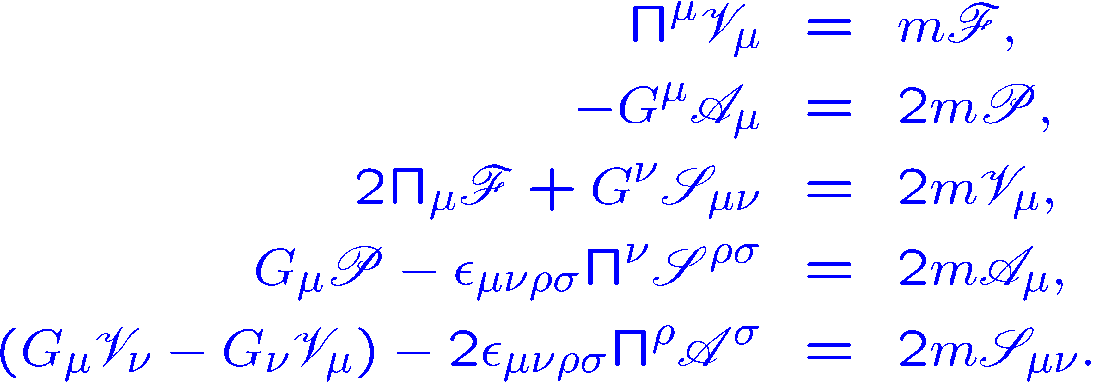
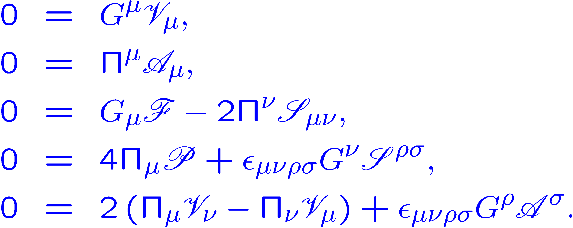
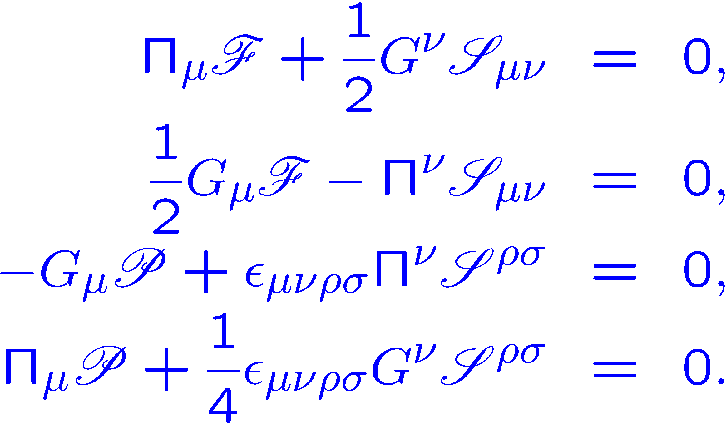
Chiral limit
16 Wigner functions:
scalar pseudo vector axial tensor
32 Wigner equations:
Chiral limit
$m$=0
8 functions +16 equations
8 functions +16 equations

Slide 9
Right/Left-handed Basis
Chirality basis:
Right-handed:$s=+1$
Left-handed:$s=−1$
4 independent functions + 8 coupled equations

Slide 10
DWF Theorem
Semiclassical expansion:
Only is independent:
General on-shell condition:
Theorem of disentanglement for chiral Wigner function (DWF theorem):
1 distribution function 1 kinetic equation
10

Slide 11
Global-equilibrium condition
Nondissipative currents can exist in global equilibrium !
Constant EM field：
Global equilibrium condition：
constant thermal vorticity
integrability condition
Find Wigner function order by order from Wigner equation?
n^{th} transport equation
n^{th} on-shell equation
Iterative equation

Slide 12
How to solve Wigner equation
Iterative equation:
General form:

Slide 13
The zeroth-order solution
The 0th order equations:
The 0th order solution:
Fermi-Dirac distribution:
Global equilibrium condition
Vlasov equation

Slide 14
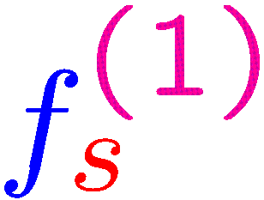
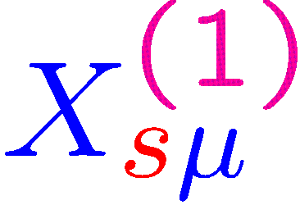
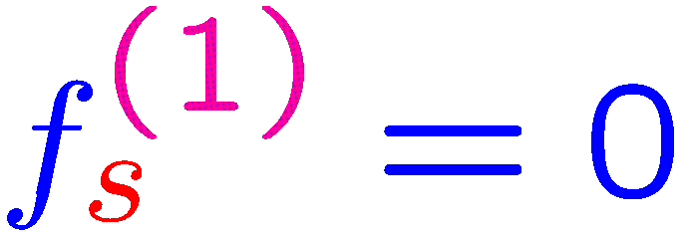
The first-order solution
General form for the 1st order solution:
Further determine and :
set
The 1st order solution:

Slide 15
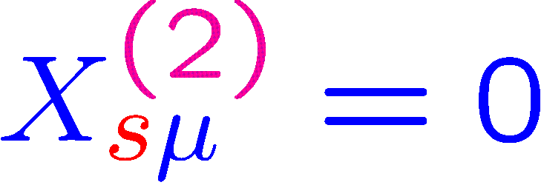
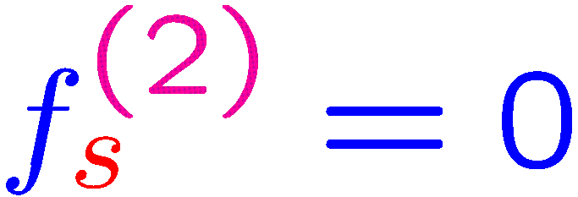
The second-order solution
General form for the 2nd order solution:
Similar to 1st order, we can determine and set
The 2nd order solution:

Slide 16
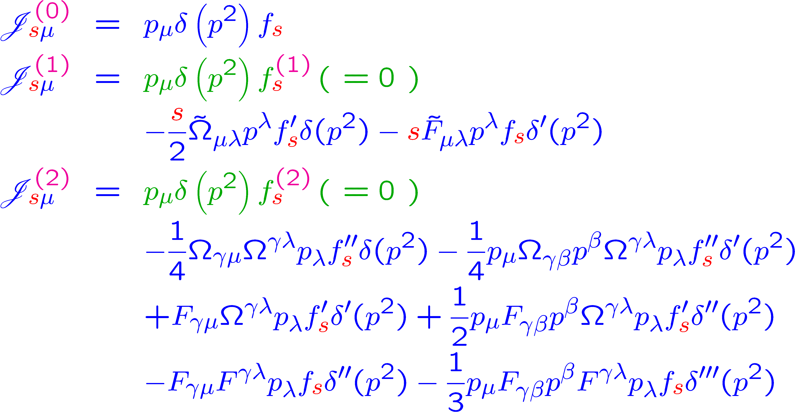
Solution up to 2nd order
A special solution under global equilibrium with constant $F^{μν}$and $Ω^{μν}$:

Slide 17
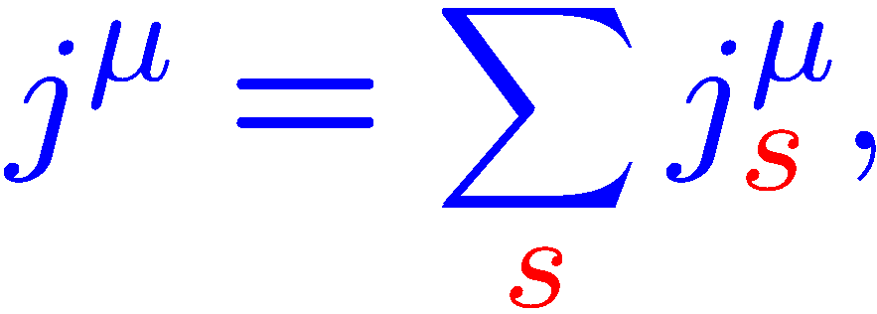
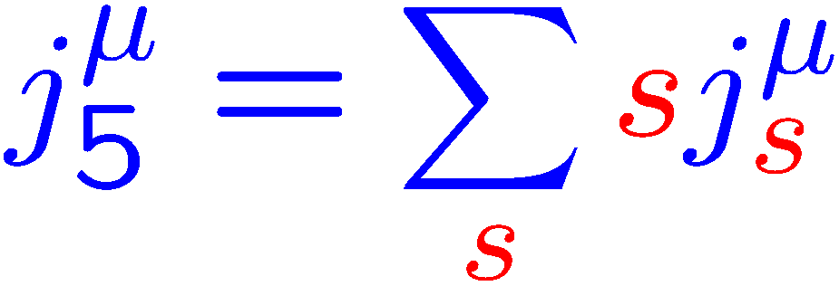
Charge currents at 0th order
Left-handed or right-handed current:
Vector current and axial current:
Charge currents at 0th order:
LH/RH:
Vector:
Axial:

Slide 18
Charge currents at 1st order
Charge currents at 1st order:
LH/RH:
Vector:
Axial:
Electric part and magnetic part decomposition:

Slide 19
LH/RH currents at 2nd order
Left-handed/Right-handed currents at 2nd order:
Anomalous magneto-vorticity coupling K. Hattori, Y. Yin PRL2016
Charge density
Hall currents
N. Yamamoto, D.L. Yang 2103.13208
S. Lin, L. Yang PRD2020:
strong B
?

Slide 20
Vector/Axial currents at 2nd order
Charge currents at 2nd order:
Vector:
Charge
density
Hall current
Axial:
Charge density
Hall current

Slide 21
Hall currents from EM field
LH / RH Hall coefficient from EM field:
$|μ_{s}≪T$|:
$|μ_{s}≫T$|:
Vector and axial Hall coefficient:

Slide 22
Stress tensor at 0th and 1st order
Canonical stress tensor:
Total stress tensor up to 1st order:
Symmetric
Antisymmetric
Energy density:

Slide 23
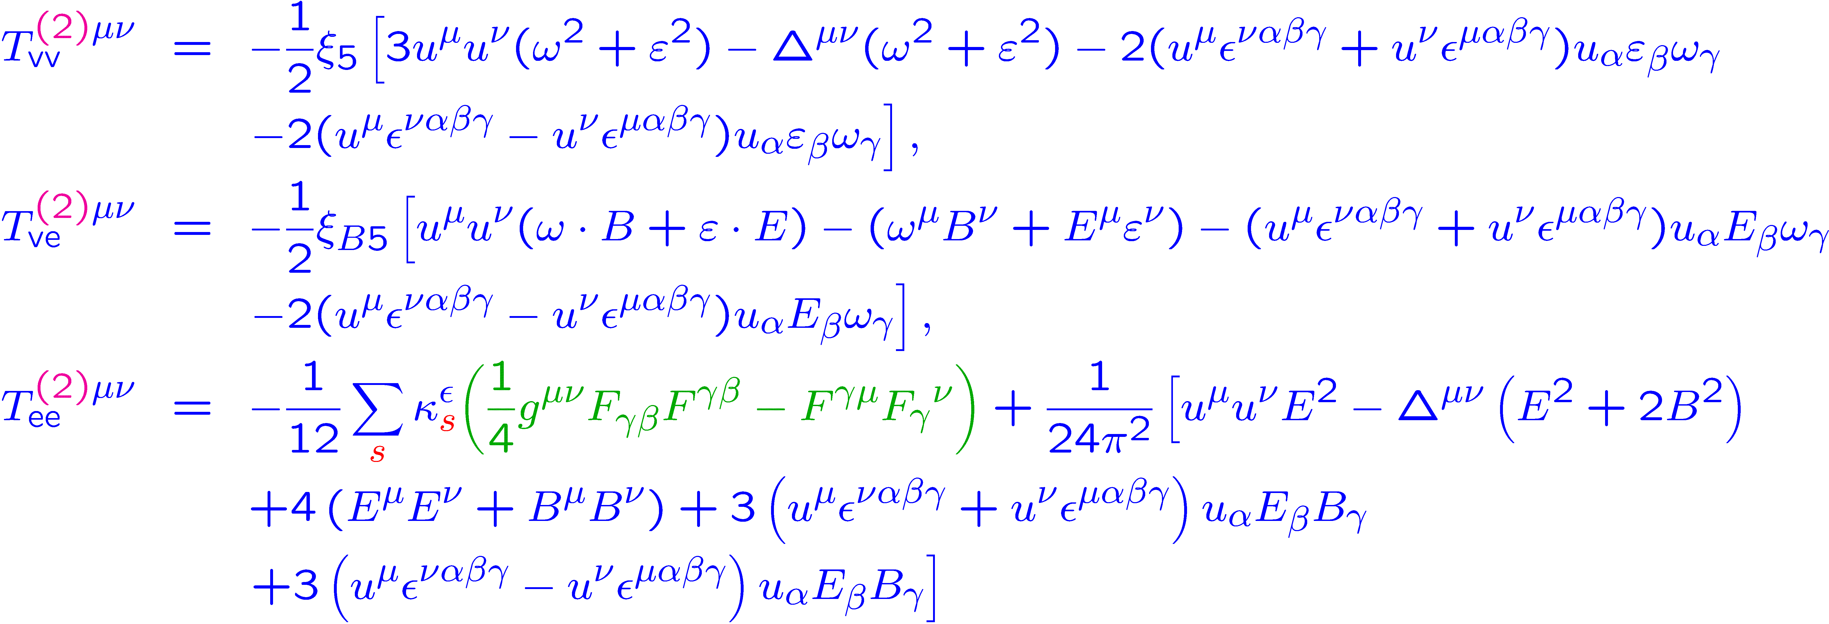
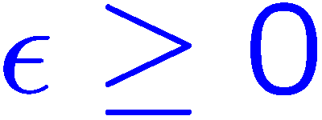
Stress tensor at 2nd order
Total stress tensor at 2nd order:
v: vorticity tensor
e: EM tensor
Dimensional regularization:
UV divergence

Slide 24
The conservation Laws
Global equilibrium conditions:
Charge conservation
Chiral anomaly
Energy-momentum conservation
Symmetric and antisymmetric part of stress tensor:

Slide 25
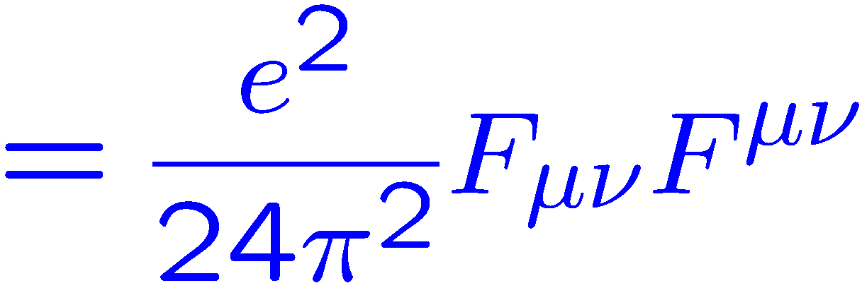
Trace of stress tensor
Traceless stress tensor order by order:
Separate contribution from pure electromagnetic field:

Slide 26
EM field contribution
The divergence part:
Trace anomaly for QED:
The total stress tensor by including the quantum correction from gauge field:
Trace anomaly:

Slide 27
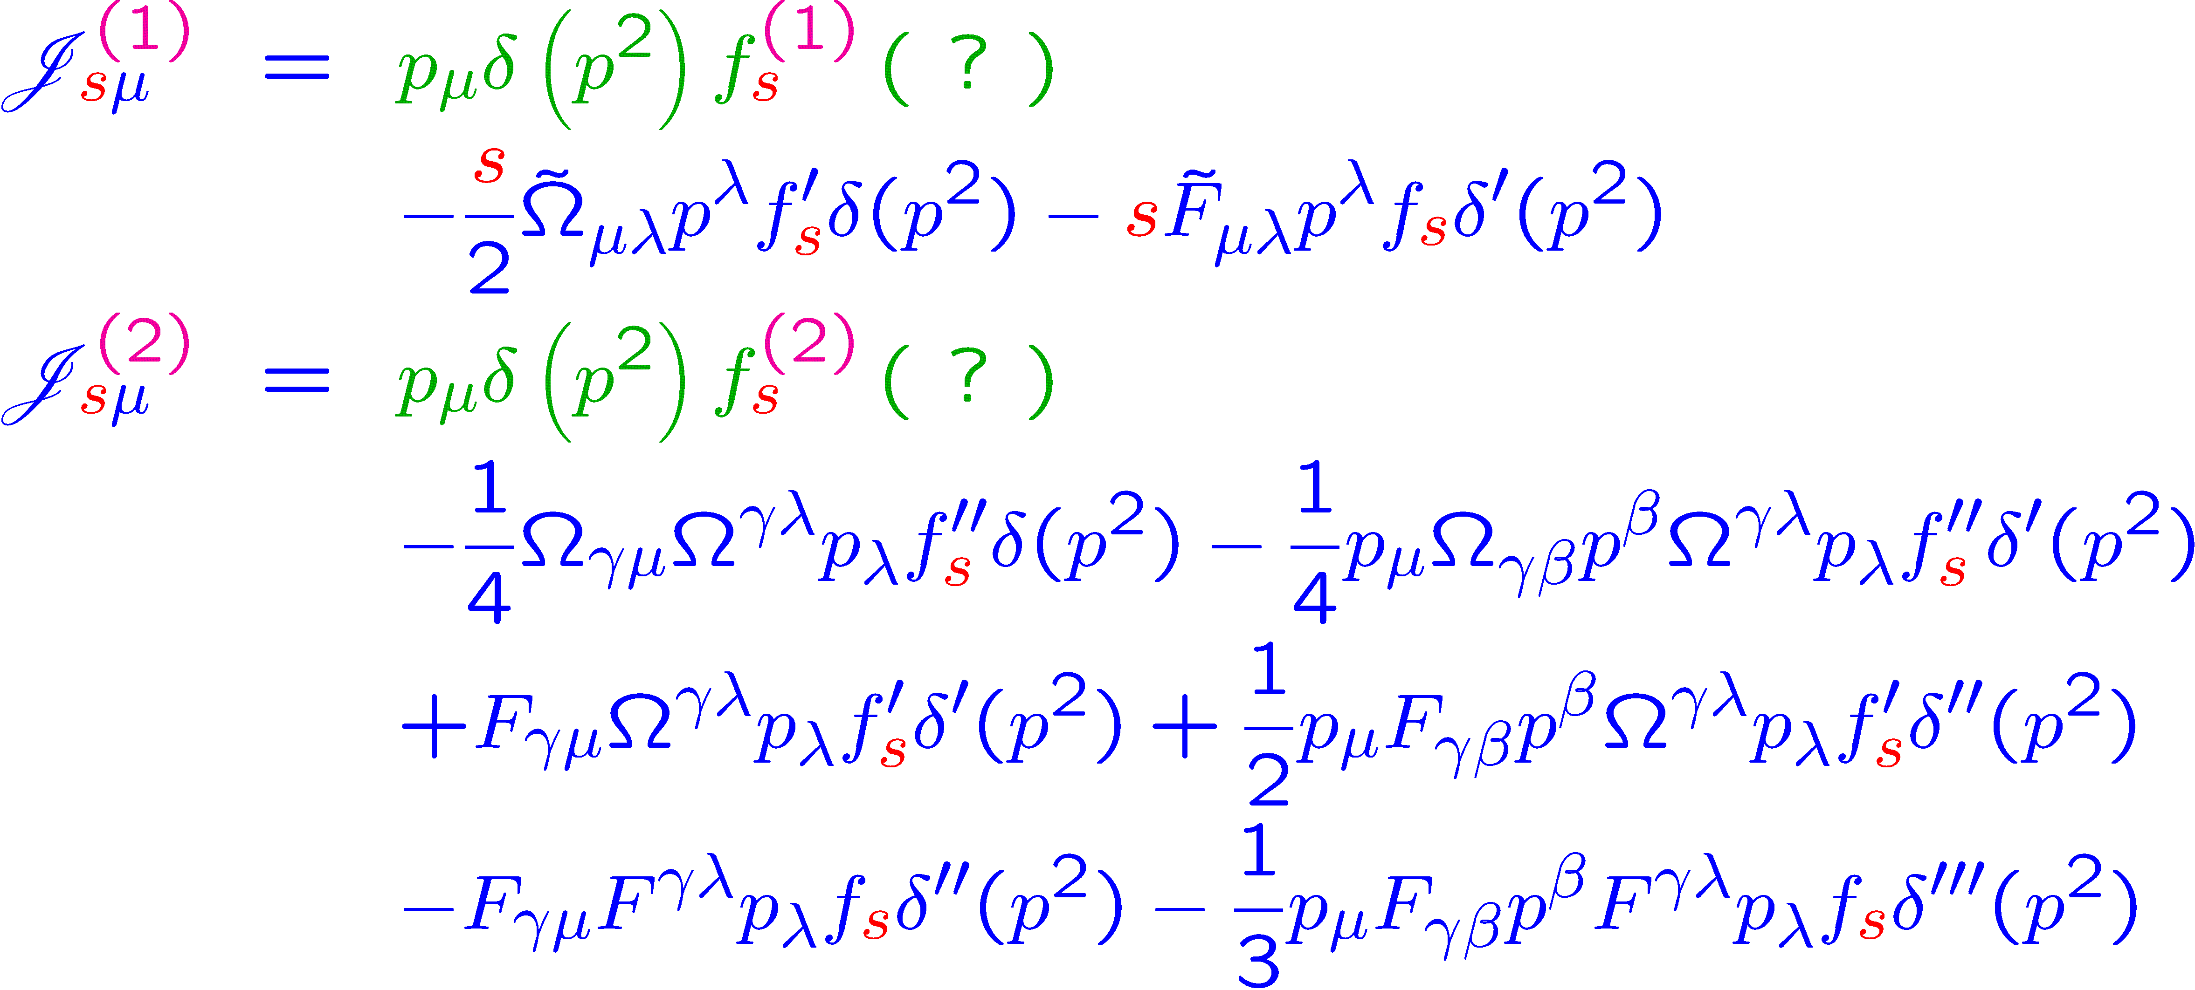
Other possible solutions
Revisit the possible missed contribution in Wigner functions :
The only constraint is from :

Slide 28
General Lorentz structure
General expression from the Lorentz invariance and C/P/T invariance:

Slide 29
General solution
Impose the constraint:
Global equilibrium conditions:
No EM field :
With EM field :

Slide 30
Charge Currents and stress tensor
Additional contribution for the charge currents and stress tensor:
Choose $A_{T}$ and $D_{T}$ as the independent variables:
Compare with the results in JHEP(2017,2018) by Becattini et al:

Slide 31
Nonperturbative calculation
Chiral fermion in uniform magnetic field.
Normal ordered energy density for the righthand:
“Unnormal ordered” energy density for the righthand:
C. Zhang , R.H. Fang, JHG, D.F. Hou, Phys.Rev.D 102 (2020) arXiv:2005.08512

Slide 32
Summary
The Wigner functions of chiral systems have been obtained in global equilibrium
up to 2nd order ℏ .
The charge currents and energy-momentum tensor have been obtained
from Wigner function up to 2nd order ℏ .
The charge and energy densities and the pressure have contributions from the vorticity and EM field at 2nd order.
The vector and axial Hall currents can be induced along the direction orthogonal
to the vorticity and EM field at 2nd order.
The 2nd energy-momentum tensor from EM field includes ultraviolent
divergence. Renormalized energy-momentum tensor satisfies trace anomaly.
Thanks for your attention!

