Slide 1
Linear Response Theory and Its Application in the Heavy-ion Collisions
Feng Li

Slide 2
Theory Review:
Evolution under a perturbation
Linear approxi- -mation
Example
Evolution of the density matrix (Schordinger Pic.):
$$ρ\left(t\right)=U\left(t,t_{0}\right)ρ\left(t_{0}\right)U^{+}(t,t_{0})$$
Time evolution operator:
$$U\left(t,t_{0}\right)≡Te^{−i\int_{t_{0}}^{t}{dτ(H_{0}+H^{′}(τ))}} \\ =U_{0}\left(t,t_{0}\right)U_{I}\left(t,t_{0}\right) \\ U_{0}\left(t,t_{0}\right)≡Te^{−i\int_{t_{0}}^{t}{dτH_{0}}} \\ U_{I}\left(t,t_{0}\right)≡Te^{−i\int_{t_{0}}^{t}{dτH_{I}^{′}}}$$
Evolution of the observable: $〈O\left(t\right)〉≡tr\left(ρ\left(t\right)O_{S}\right)=tr[ρ\left(t_{0}\right)U_{I}^{+}\left(t,t_{0}\right)O_{I}U_{I}\left(t,t_{0}\right)]$

Slide 3
Theory Review:
Unitarity Break
Evolution under a perturbation
Linear approxi- -mation
Example
For $H^{′}≪H_{0}$ $$U_{I}\left(t,t_{0}\right)≡Te^{−i\int_{t_{0}}^{t}{dτH_{I}^{′}}}≈1−i\int_{t_{0}}^{t}{dτH_{I}^{′}}$$
$$〈O\left(t\right)〉=tr\left[ρ\left(t_{0}\right)U_{I}^{+}\left(t,t_{0}\right)O_{I}U_{I}\left(t,t_{0}\right)\right] \\ ≈O_{0}\left(t\right)+i\int_{t_{0}}^{t}{dτtr[ρ\left(t_{0}\right)[H_{I}^{′}\left(τ\right),O_{I}(t)]]}$$
$$〈δO\left(t\right)〉≈i\int{dτθ\left(t−τ\right){〈\left[H_{I}^{′}\left(τ\right),O_{I}\left(t\right)\right]〉}_{0}}$$
The fluctuations are proportional to the perturbations applied to the system.

Slide 4
Theory Review:
Evolution under a perturbation
Linear approxi- -mation
Example
For a box of electrons drifting under an electrical field E:
$$H^{′}=∫d^{3}x\vec{j}⋅\vec{A}$$
Under temperal gauge:
$$\vec{E}=∂_{t} \vec{A}$$
If $E\left(t\right)=\tilde{E}\left(ω\right)e^{iωt}$, then $\vec{A}=\vec{E}/(iω)$
Which leads to a current density
$$〈δ\vec{j}\left(x\right)〉≈i\int{d^{4}x^{′}θ\left(t−t^{′}\right){〈\left[j_{I}^{′}\left(x^{′}\right),{\vec{j}}_{I}\left(x\right)\right]〉}_{0}E(x^{′})/(iω)}$$

Slide 5
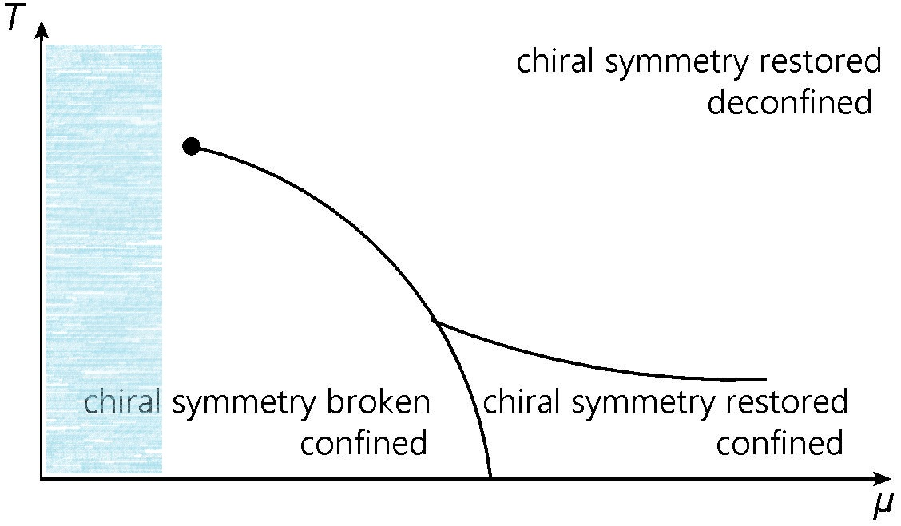
Spinodal Instablity of QM
Y. Aoki, etc. Nature 443, 675 (2006)

Slide 6
Spinodal Instablity of QM
The perturbation is also proportional to the fluctuations.
$$H\left(t\right)=H\left[σ\left(t\right),⋯\right], H_{0}\left(t\right)=H\left[σ_{0},⋯\right]$$
$$H^{′}\left(t\right)=∫d^{3}x\left(\frac{δH}{δσ}\right)δσ+⋯$$
Homogeneous linear equations about the fluctuations:
$$δσ\left(x\right)=∫d^{4}x^{′}{θ(t−t^{′})[\left(\frac{δH}{δσ}\right)}_{I},σ_{I}(x)]δσ(x^{′})+⋯$$
After Fourier trans.
$$\left(1−χ\left(k\right)\right)δσ\left(k\right)=0 \\ χ_{Retarded}\left(k\right)=χ_{Matsubara}(k^{0}+iε, \vec{k})$$
Dispersion relation:
$$1−χ\left(k\right)=0$$
General Model
NJL & PNJL
NJL with magnetic field
$$χ(x−x^{′})$$

Slide 7
Spinodal Instablity of QM
General Model
NJL & PNJL
NJL with magnetic field

Slide 8
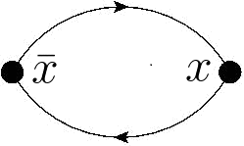
Spinodal Instablity of QM
General Model
NJL & PNJL
NJL with magnetic field

Slide 9
Spinodal Instablity of QM
General Model
NJL & PNJL
NJL with magnetic field
After Fourier Transformation
is the root of
Sound wave solution:
If is imaginary, the fluctuating mode with the wavenumber k will grow exponentially with time. It is thus called the unstable mode with being the growth rate.

Slide 10
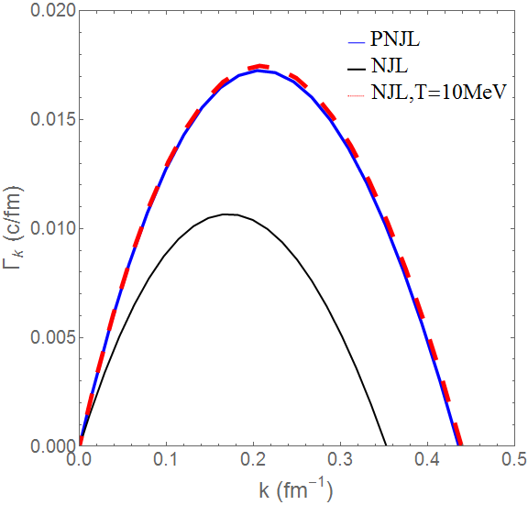
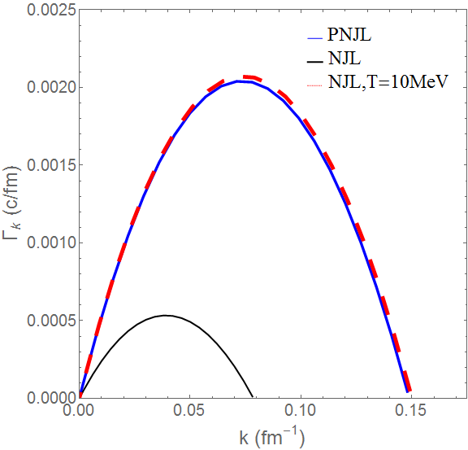
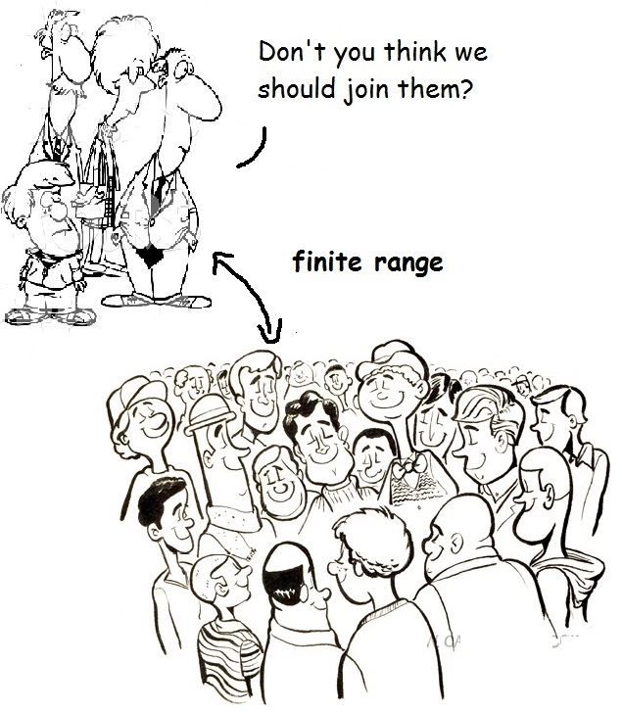
Dispersion Relation
Gv=0
Gv=0.2Gs
Why bend down
Gv=0
Gv=0.2Gs
Why bend down
Gv=0
Gv=0.2Gs
Why bend down

Slide 11
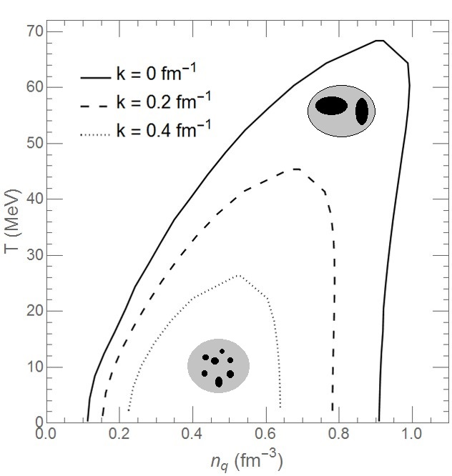
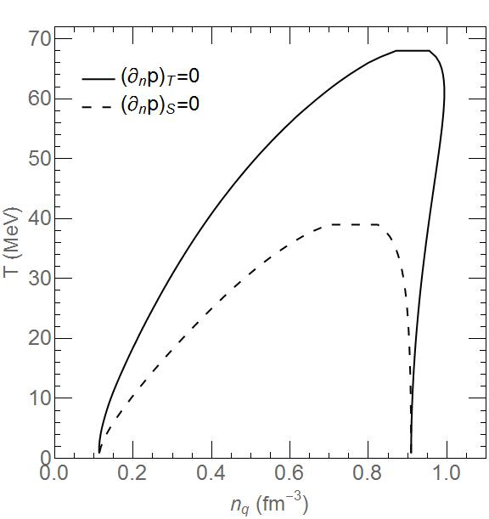
Spinodal Boundaries:
NJL, Gv=0 Unstable modes of short-wavelength survive in the center of the spinodal instability region
Comparison with the isothermal boundary
PNJL, Gv=0
NJL, Gv=0.2 Gs Supressed by the vector interaction
PNJL, Gv=0.2 Gs
NJL, Gv=0 Unstable modes of short-wavelength survive in the center of the spinodal instability region
Comparison with the isothermal boundary
PNJL, Gv=0
NJL, Gv=0.2 Gs Supressed by the vector interaction
PNJL, Gv=0.2 Gs
F. Li, and C. M. Ko, Phys. Rev. C 93, 035205 (2016)

Slide 12
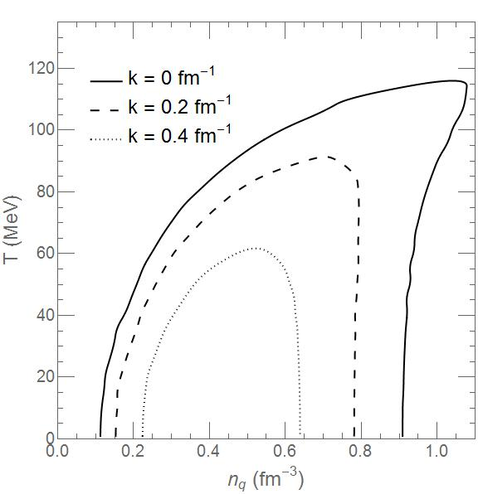
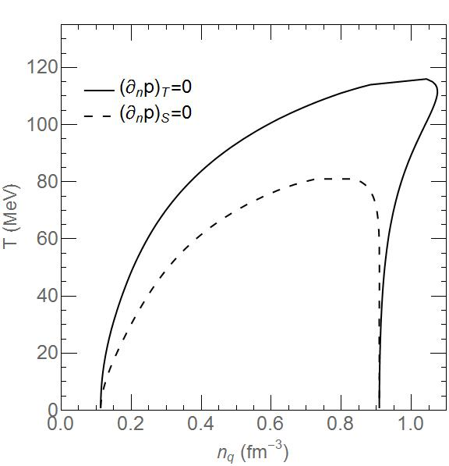
Spinodal Boundaries:
NJL, Gv=0 Unstable modes of short-wavelength survive in the center of the spinodal instability region
Comparison with the isothermal boundary
PNJL, Gv=0
NJL, Gv=0.2 Gs Supressed by the vector interaction
PNJL, Gv=0.2 Gs
NJL, Gv=0 Unstable modes of short-wavelength survive in the center of the spinodal instability region
Comparison with the isothermal boundary
PNJL, Gv=0
NJL, Gv=0.2 Gs Supressed by the vector interaction
PNJL, Gv=0.2 Gs
F. Li, and C. M. Ko, Phys. Rev. C 93, 035205 (2016)

Slide 13
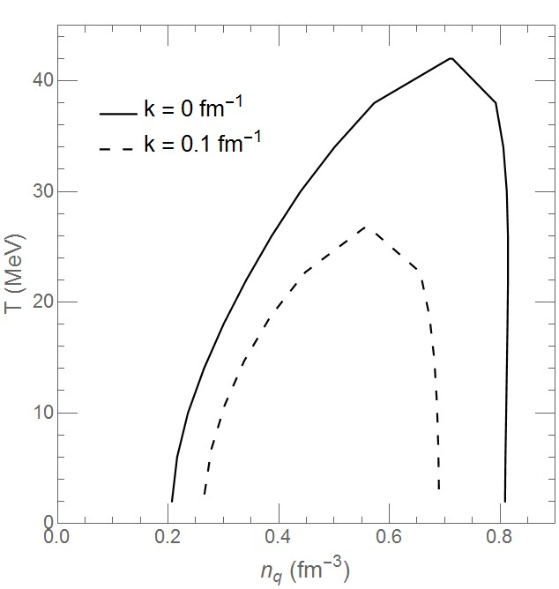
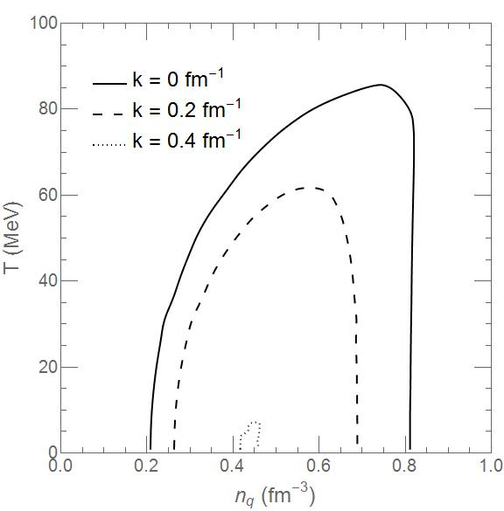
Spinodal Boundaries:
NJL, Gv=0 Unstable modes of short-wavelength survive in the center of the spinodal instability region
Comparison with the isothermal boundary
PNJL, Gv=0
NJL, Gv=0.2 Gs Supressed by the vector interaction
PNJL, Gv=0.2 Gs
NJL, Gv=0 Unstable modes of short-wavelength survive in the center of the spinodal instability region
Comparison with the isothermal boundary
PNJL, Gv=0
NJL, Gv=0.2 Gs Supressed by the vector interaction
PNJL, Gv=0.2 Gs
F. Li, and C. M. Ko, Phys. Rev. C 93, 035205 (2016)

Slide 14
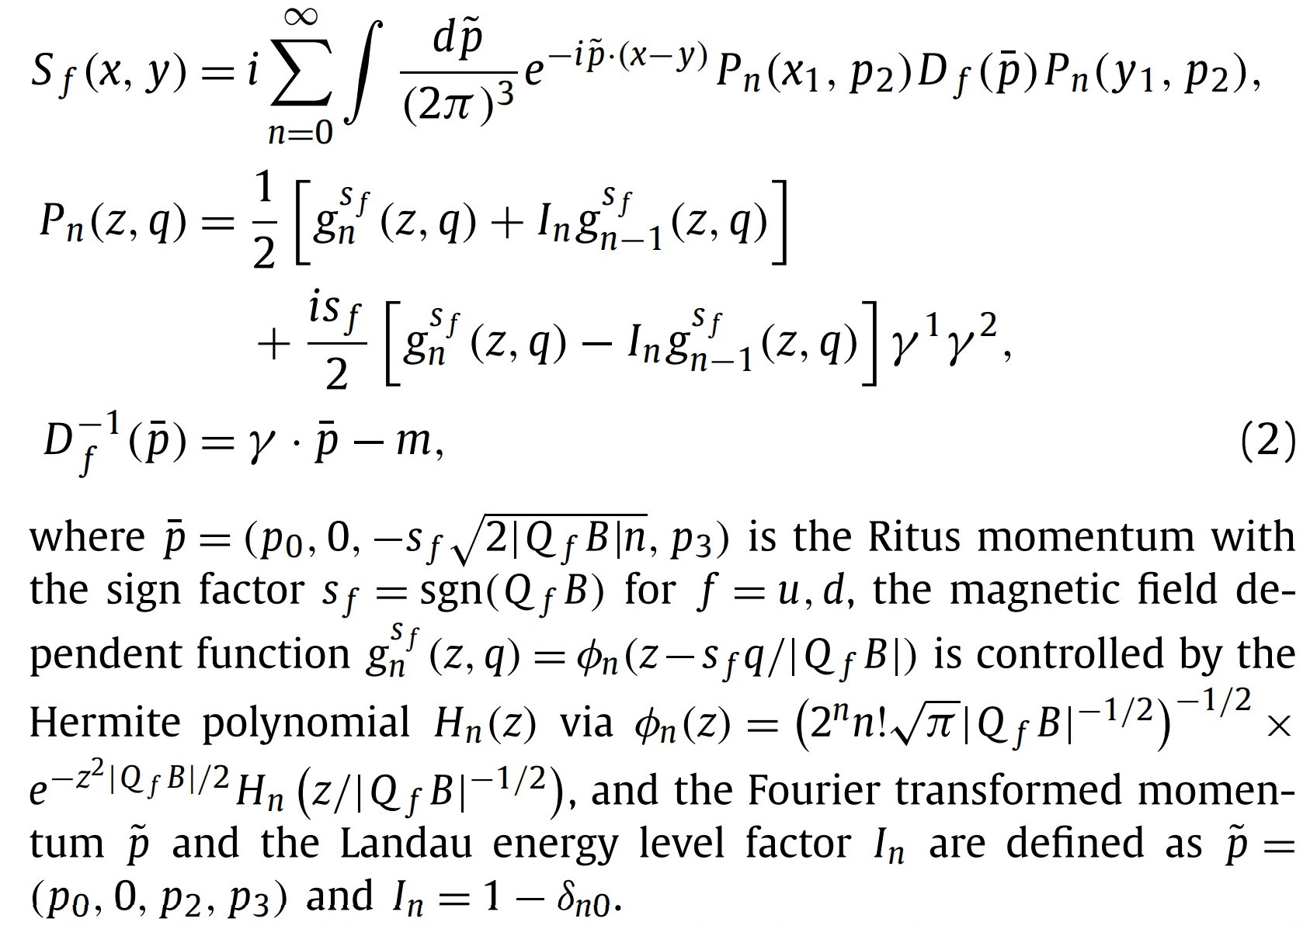
Spinodal Instablity of QM
General Model
NJL & PNJL
NJL with magnetic field
Shijun Mao, PLB 758, 195

Slide 15
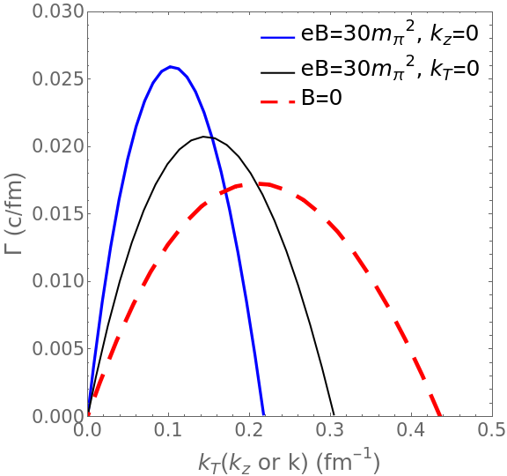
Dispersion Relation (Preliminary)

Slide 16
Summary
Study of the spinodal instability using a linear response theory
Tc might be increased by confinement
The vector interaction suppress the spinodal instability.
The instabilities of smaller wavelengths grow less rapidly, and survive only under lower temperature due to the quantum long-range effect
Growth rates of the unstable modes seems larger in the presence of magnetic field.
The transverse modes grow faster, and they are of shorter wavelengths, while the longitudinal modes grow slower, and are of longer wavelengths.

Slide 17
Outlooks
A full calculation on the spinodal unstable modes in the presence of the B field
Calculate the evolution of the spatial correlation functions using the linear response theory
Redo the calculation using the other models (Dyson-Schwinger)
Vorticity as a perturbation, polarization as a fluctuation
TKNN invariant in QCD
Go beyond linear order

