Slide 1


Equilibration and jets in the quark–gluon plasma
Jasmine Brewer
Current
Future
HENPIC Seminar

Slide 2
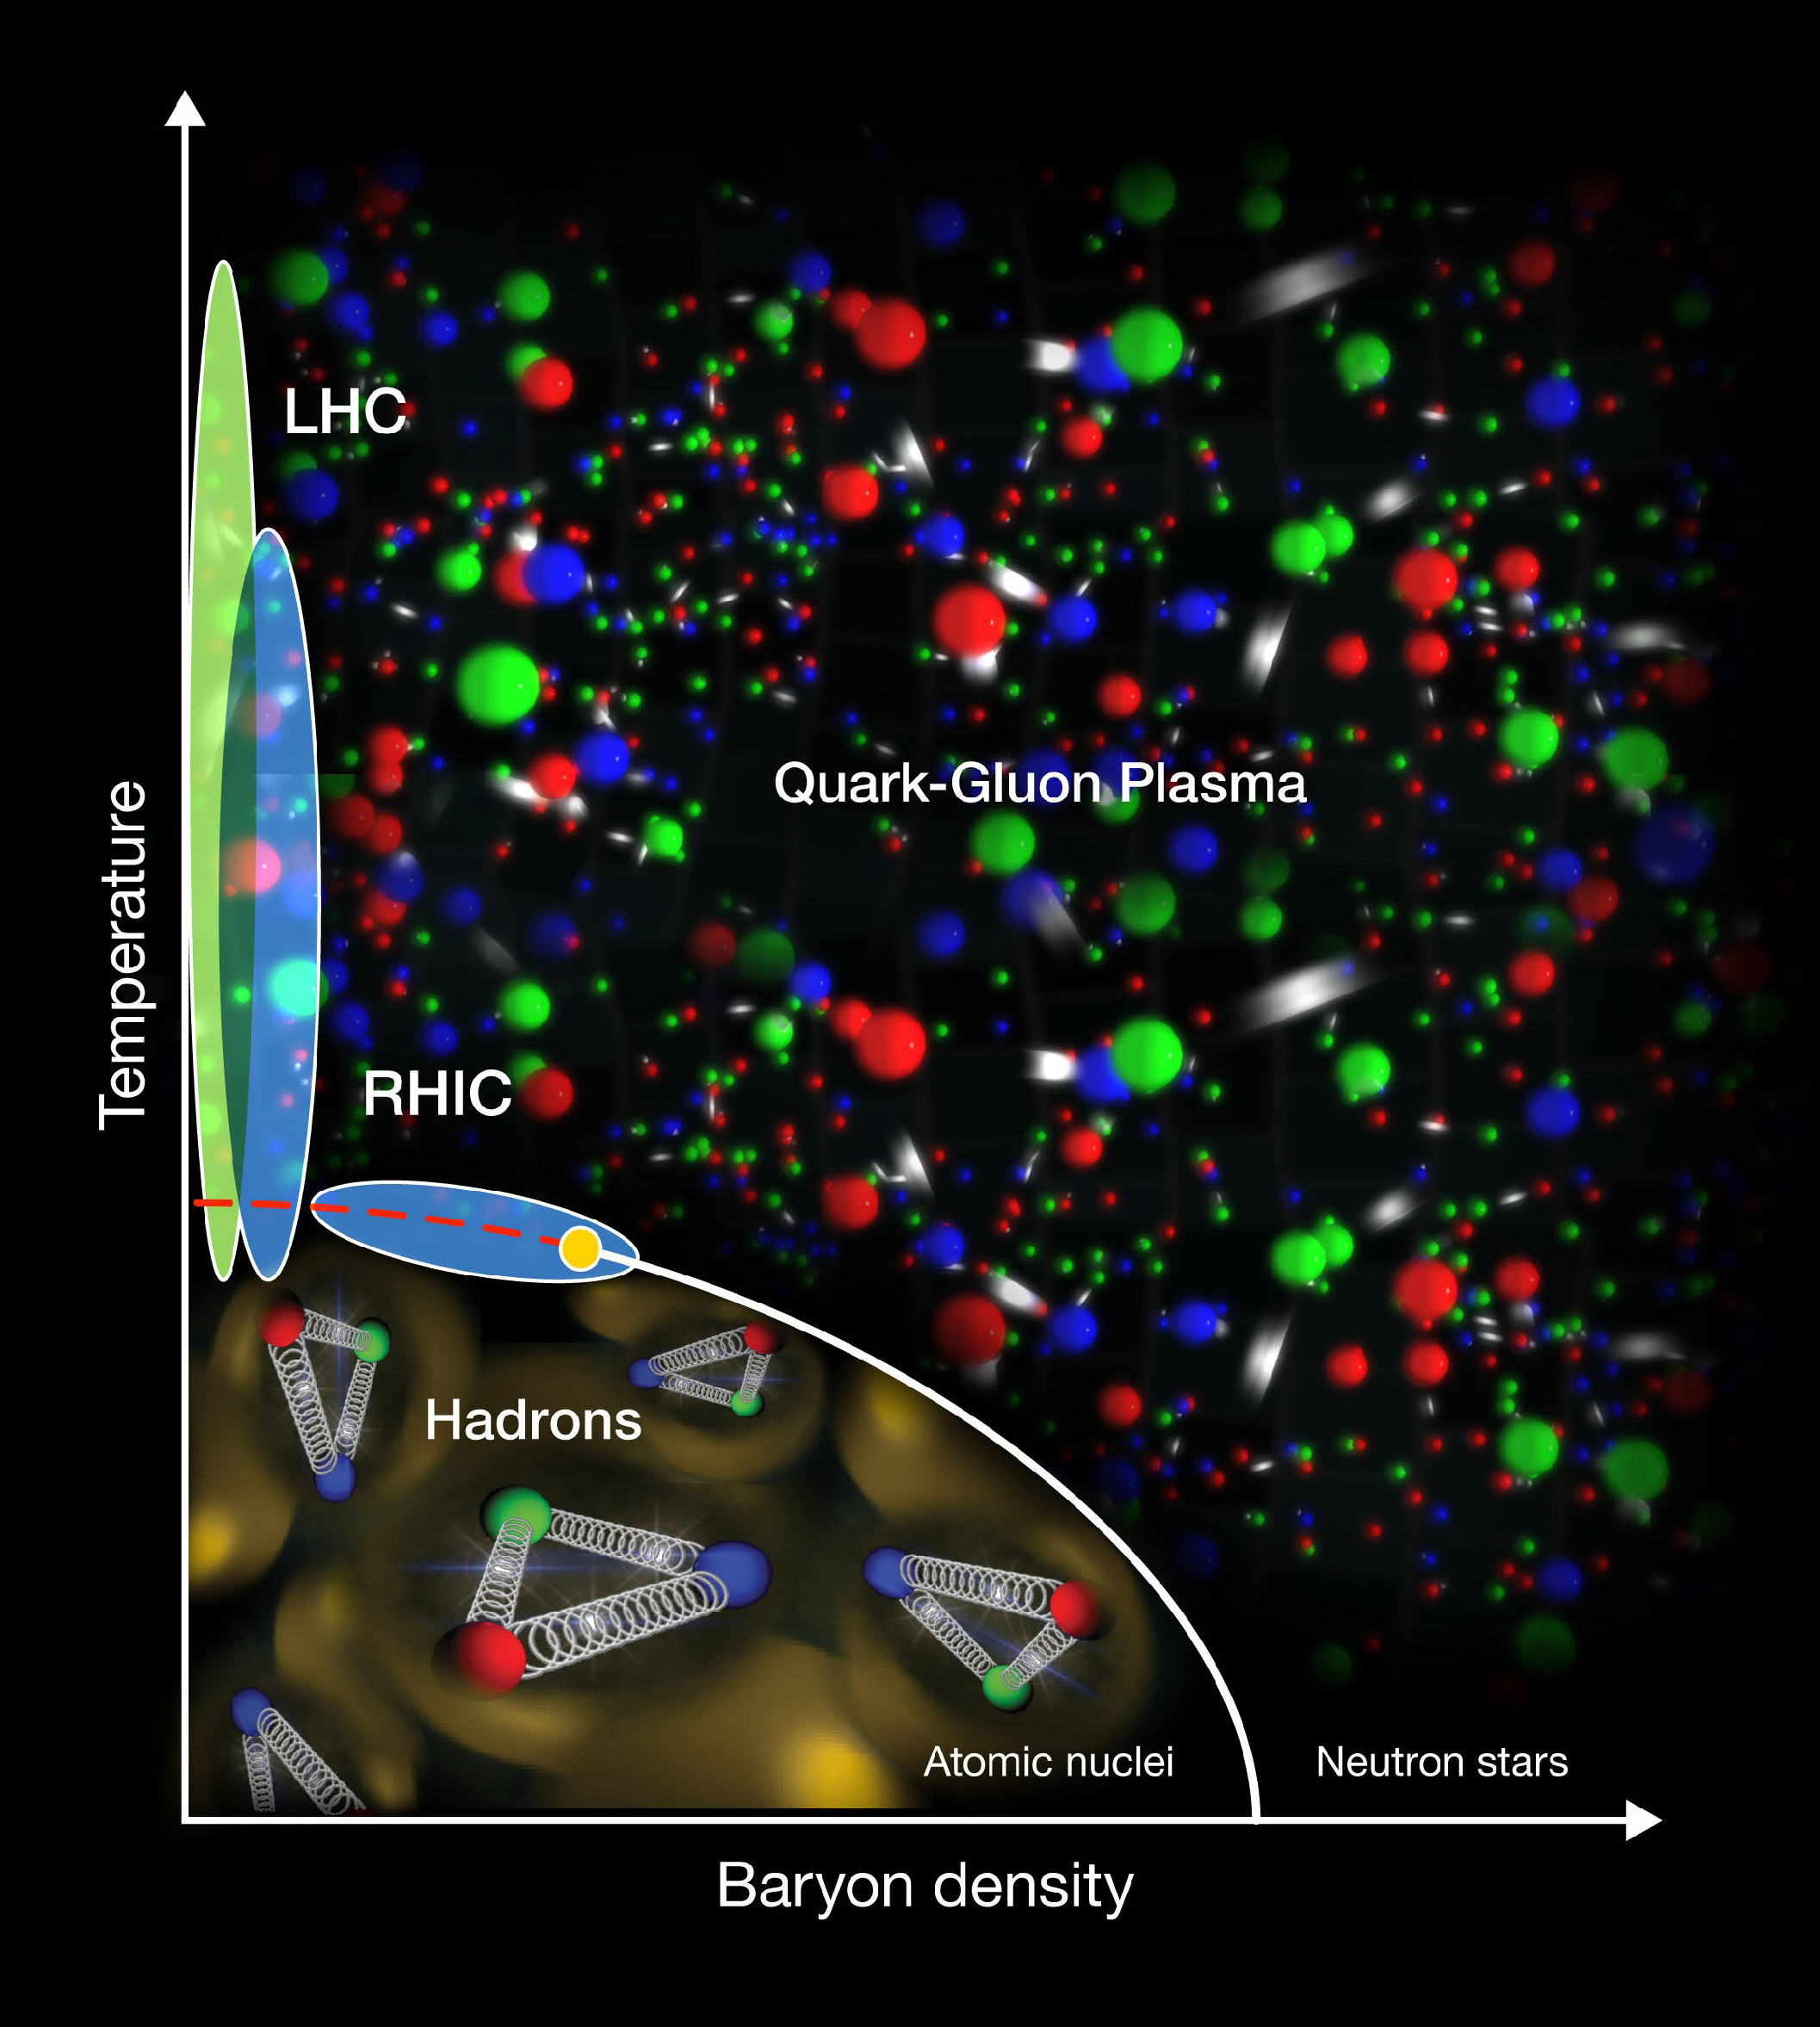
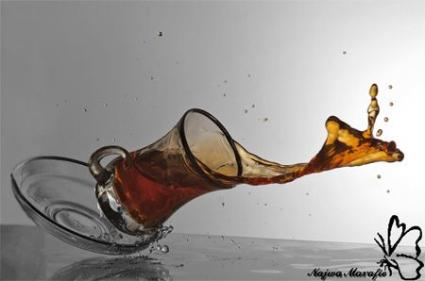
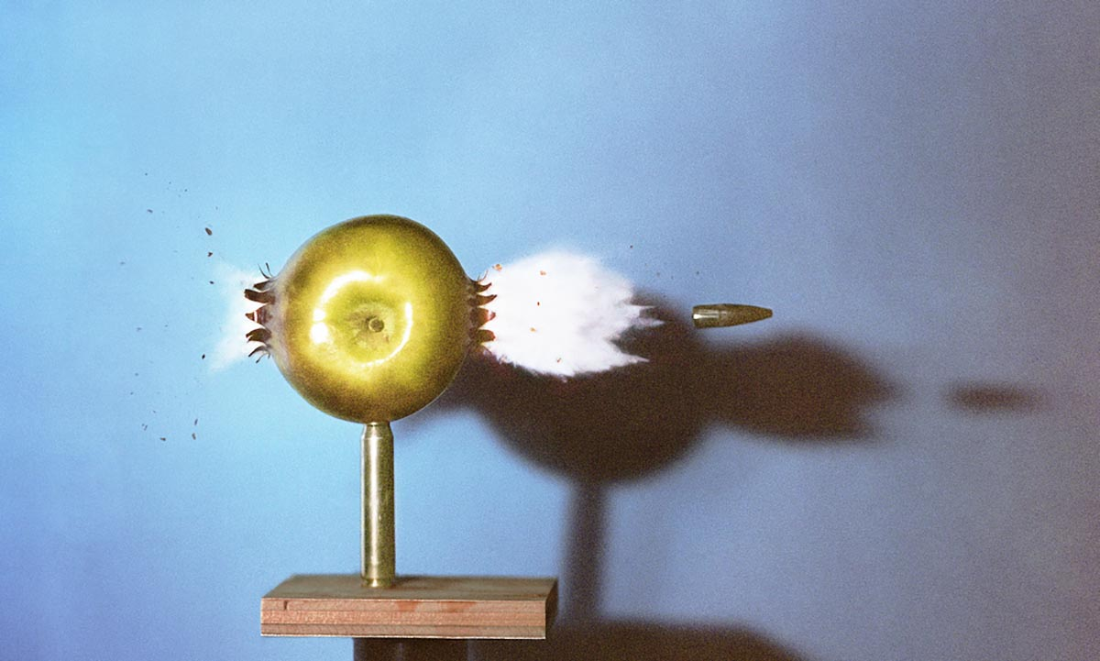
  Flow measurements
  Hard probes
Notes:
There have been a multitude of nice measurements quantifying the differences between the properties of p-p and A-A jets through jet modification observables, for example the dijet asymmetry and jet shape modifications. The aim in this program is to use jet modification observables to make direct inferences about how the quark-gluon plasma interacts with partons traversing through it.

Slide 3
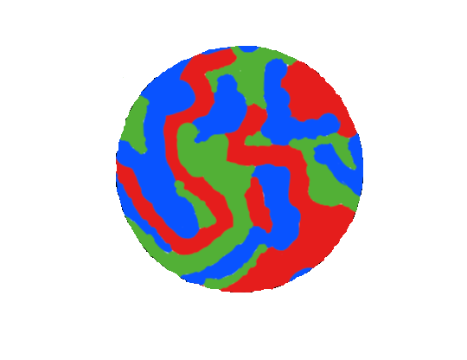
  Perfect liquid
  $$∼T$$
  momentum
  transfer
  Suggestive of strong interactions
Notes:
There have been a multitude of nice measurements quantifying the differences between the properties of p-p and A-A jets through jet modification observables, for example the dijet asymmetry and jet shape modifications. The aim in this program is to use jet modification observables to make direct inferences about how the quark-gluon plasma interacts with partons traversing through it.

Slide 4
  Asymptotic
  freedom
  Perfect liquid
  $$∼T$$
  momentum
  transfer
  Suggestive of strong interactions
  Weak interactions
Notes:
There have been a multitude of nice measurements quantifying the differences between the properties of p-p and A-A jets through jet modification observables, for example the dijet asymmetry and jet shape modifications. The aim in this program is to use jet modification observables to make direct inferences about how the quark-gluon plasma interacts with partons traversing through it.

Slide 5
  Asymptotic
  freedom
  Perfect liquid
  $$∼T$$
  momentum
  transfer
  Suggestive of strong interactions
  Weak interactions
  How does hydrodynamic behavior emerge?
Notes:
There have been a multitude of nice measurements quantifying the differences between the properties of p-p and A-A jets through jet modification observables, for example the dijet asymmetry and jet shape modifications. The aim in this program is to use jet modification observables to make direct inferences about how the quark-gluon plasma interacts with partons traversing through it.

Slide 6
  Asymptotic
  freedom
  Perfect liquid
  $$∼T$$
  momentum
  transfer
  ???
  Suggestive of strong interactions
  Weak interactions
  How does hydrodynamic behavior emerge?
  How do the degrees of freedom depend on length scale?
Notes:
There have been a multitude of nice measurements quantifying the differences between the properties of p-p and A-A jets through jet modification observables, for example the dijet asymmetry and jet shape modifications. The aim in this program is to use jet modification observables to make direct inferences about how the quark-gluon plasma interacts with partons traversing through it.

Slide 7
  Two pictures of the quark–gluon plasma
  Emergence of hydrodynamic behavior
“Adiabatic hydrodynamization in rapidly-expanding quark–gluon plasma”
JB, Li Yan, Yi Yin [1910.00021]
  Jet modification
“Data-driven quark and gluon jet modification in heavy-ion collisions”
Jasmine Brewer, Jesse Thaler, Andrew Turner [2007.xxxxx]
Jasmine Brewer (MIT)
Notes:
Unfortunately, the interpretation of jet modification observables often depends crucially on which proton–proton jets are taken to be a comparable baseline for a given heavy-ion measurement. In di-jet and inclusive jet studies, the standard answer is to compare heavy-ion jets to a proton–proton baseline with the same reconstructed pT. For example, comparing the jet production spectra for p-p and HI at the same reconstructed pT (as illustrated by the blue arrows) gives rise to the famous jet RAA.

Slide 8
  Two pictures of the quark–gluon plasma
  Emergence of hydrodynamic behavior
“Adiabatic hydrodynamization in rapidly-expanding quark–gluon plasma”
JB, Li Yan, Yi Yin [1910.00021]
  Jet modification
“Data-driven quark and gluon jet modification in heavy-ion collisions”
Jasmine Brewer, Jesse Thaler, Andrew Turner [2007.xxxxx]
Jasmine Brewer (MIT)
Notes:
Unfortunately, the interpretation of jet modification observables often depends crucially on which proton–proton jets are taken to be a comparable baseline for a given heavy-ion measurement. In di-jet and inclusive jet studies, the standard answer is to compare heavy-ion jets to a proton–proton baseline with the same reconstructed pT. For example, comparing the jet production spectra for p-p and HI at the same reconstructed pT (as illustrated by the blue arrows) gives rise to the famous jet RAA.

Slide 9



  Hydrodynamics
  Effective theory of long time/ long wavelength dynamics governed by conservation laws
Non-equilibrium initial conditions
Hydrodynamic modes dominate
Many modes are important
$$τ_{Hydro}$$
$$τ$$
  Far from equilibrium
  Near equilibrium

Slide 10
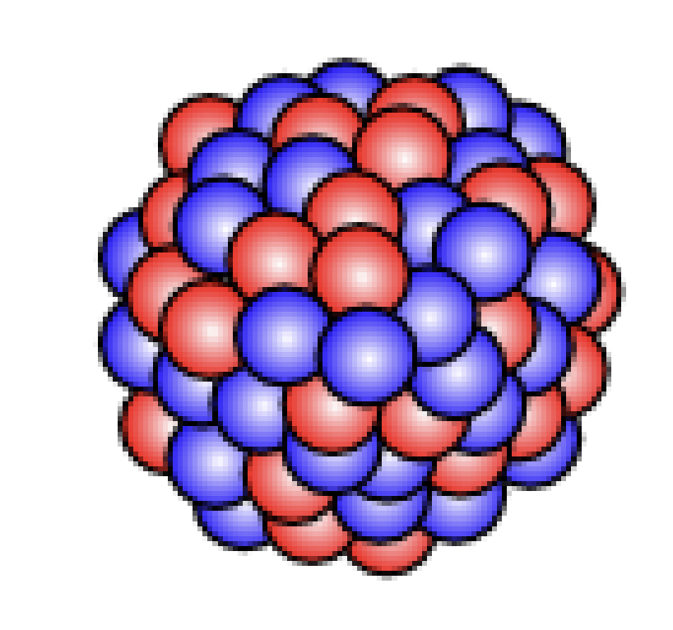
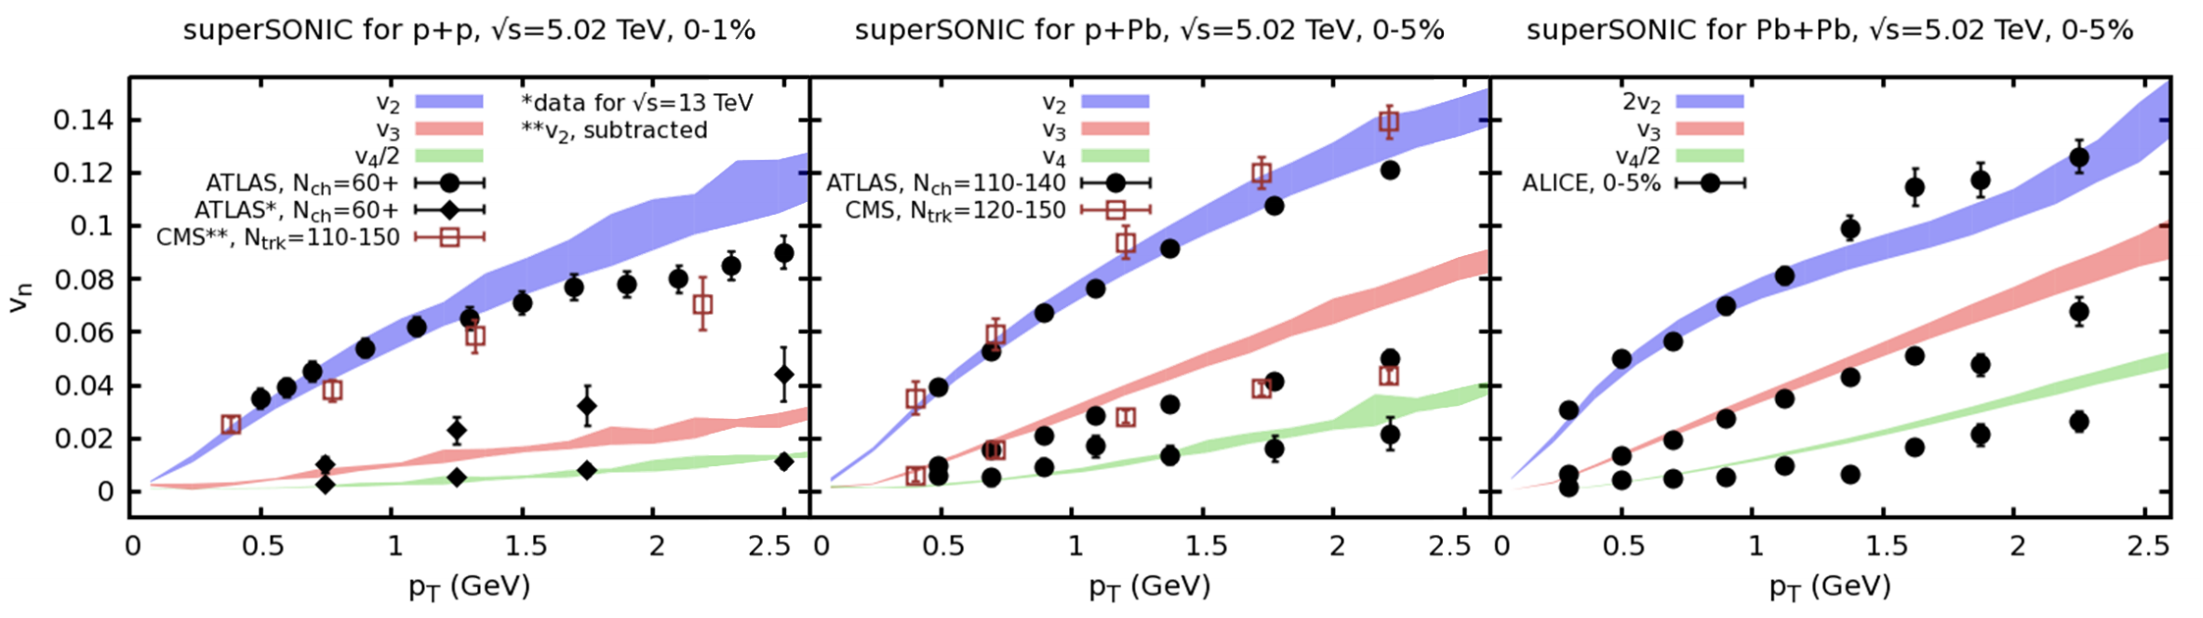
  Flow of quark–gluon plasma is well-described by relativistic hydrodynamic modeling
Jasmine Brewer (MIT)
Weller, Romatschke [1701.07145]
Notes:
Unfortunately, the interpretation of jet modification observables often depends crucially on which proton–proton jets are taken to be a comparable baseline for a given heavy-ion measurement. In di-jet and inclusive jet studies, the standard answer is to compare heavy-ion jets to a proton–proton baseline with the same reconstructed pT. For example, comparing the jet production spectra for p-p and HI at the same reconstructed pT (as illustrated by the blue arrows) gives rise to the famous jet RAA.

Slide 11
  Flow of quark–gluon plasma is well-described by relativistic hydrodynamic modeling
  Further from equilibrium
Jasmine Brewer (MIT)
Weller, Romatschke [1701.07145]
Notes:
Unfortunately, the interpretation of jet modification observables often depends crucially on which proton–proton jets are taken to be a comparable baseline for a given heavy-ion measurement. In di-jet and inclusive jet studies, the standard answer is to compare heavy-ion jets to a proton–proton baseline with the same reconstructed pT. For example, comparing the jet production spectra for p-p and HI at the same reconstructed pT (as illustrated by the blue arrows) gives rise to the famous jet RAA.

Slide 12
  Flow of quark–gluon plasma is well-described by relativistic hydrodynamic modeling
  Further from equilibrium
  Very unexpected that hydrodynamics would apply!
Jasmine Brewer (MIT)
Weller, Romatschke [1701.07145]
Notes:
Unfortunately, the interpretation of jet modification observables often depends crucially on which proton–proton jets are taken to be a comparable baseline for a given heavy-ion measurement. In di-jet and inclusive jet studies, the standard answer is to compare heavy-ion jets to a proton–proton baseline with the same reconstructed pT. For example, comparing the jet production spectra for p-p and HI at the same reconstructed pT (as illustrated by the blue arrows) gives rise to the famous jet RAA.

Slide 13
  Flow of quark–gluon plasma is well-described by relativistic hydrodynamic modeling
  Further from equilibrium
  Why does hydrodynamics seem to apply far from equilibrium?
Jasmine Brewer (MIT)
Weller, Romatschke [1701.07145]
Notes:
Unfortunately, the interpretation of jet modification observables often depends crucially on which proton–proton jets are taken to be a comparable baseline for a given heavy-ion measurement. In di-jet and inclusive jet studies, the standard answer is to compare heavy-ion jets to a proton–proton baseline with the same reconstructed pT. For example, comparing the jet production spectra for p-p and HI at the same reconstructed pT (as illustrated by the blue arrows) gives rise to the famous jet RAA.

Slide 14
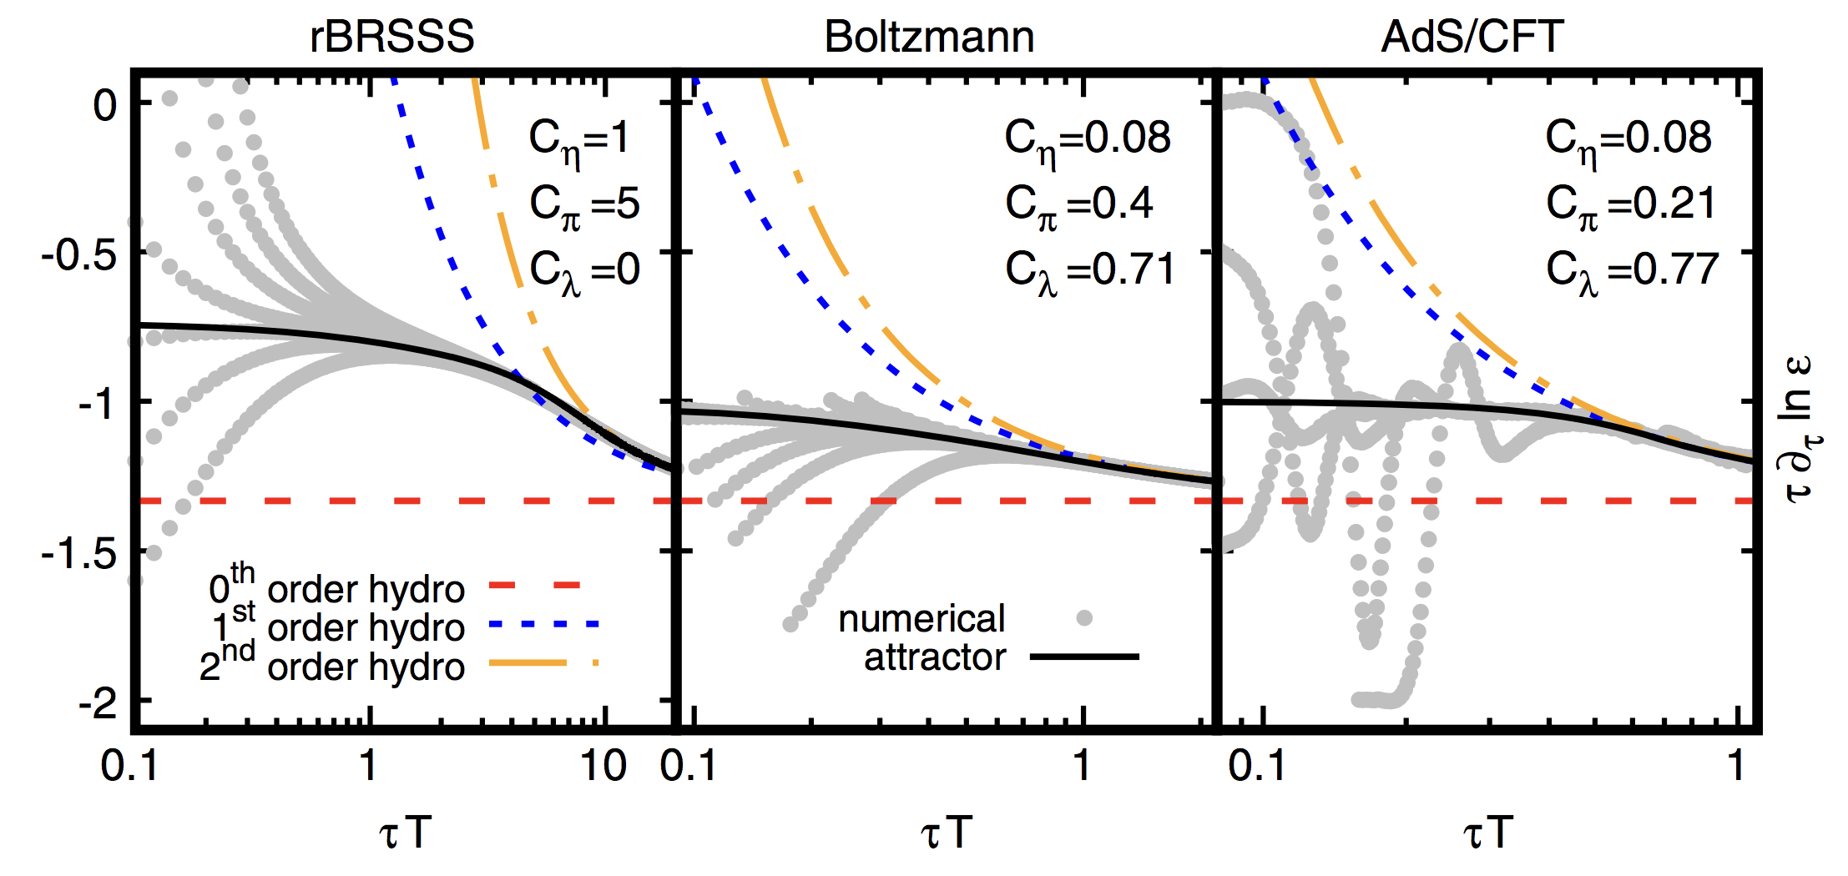
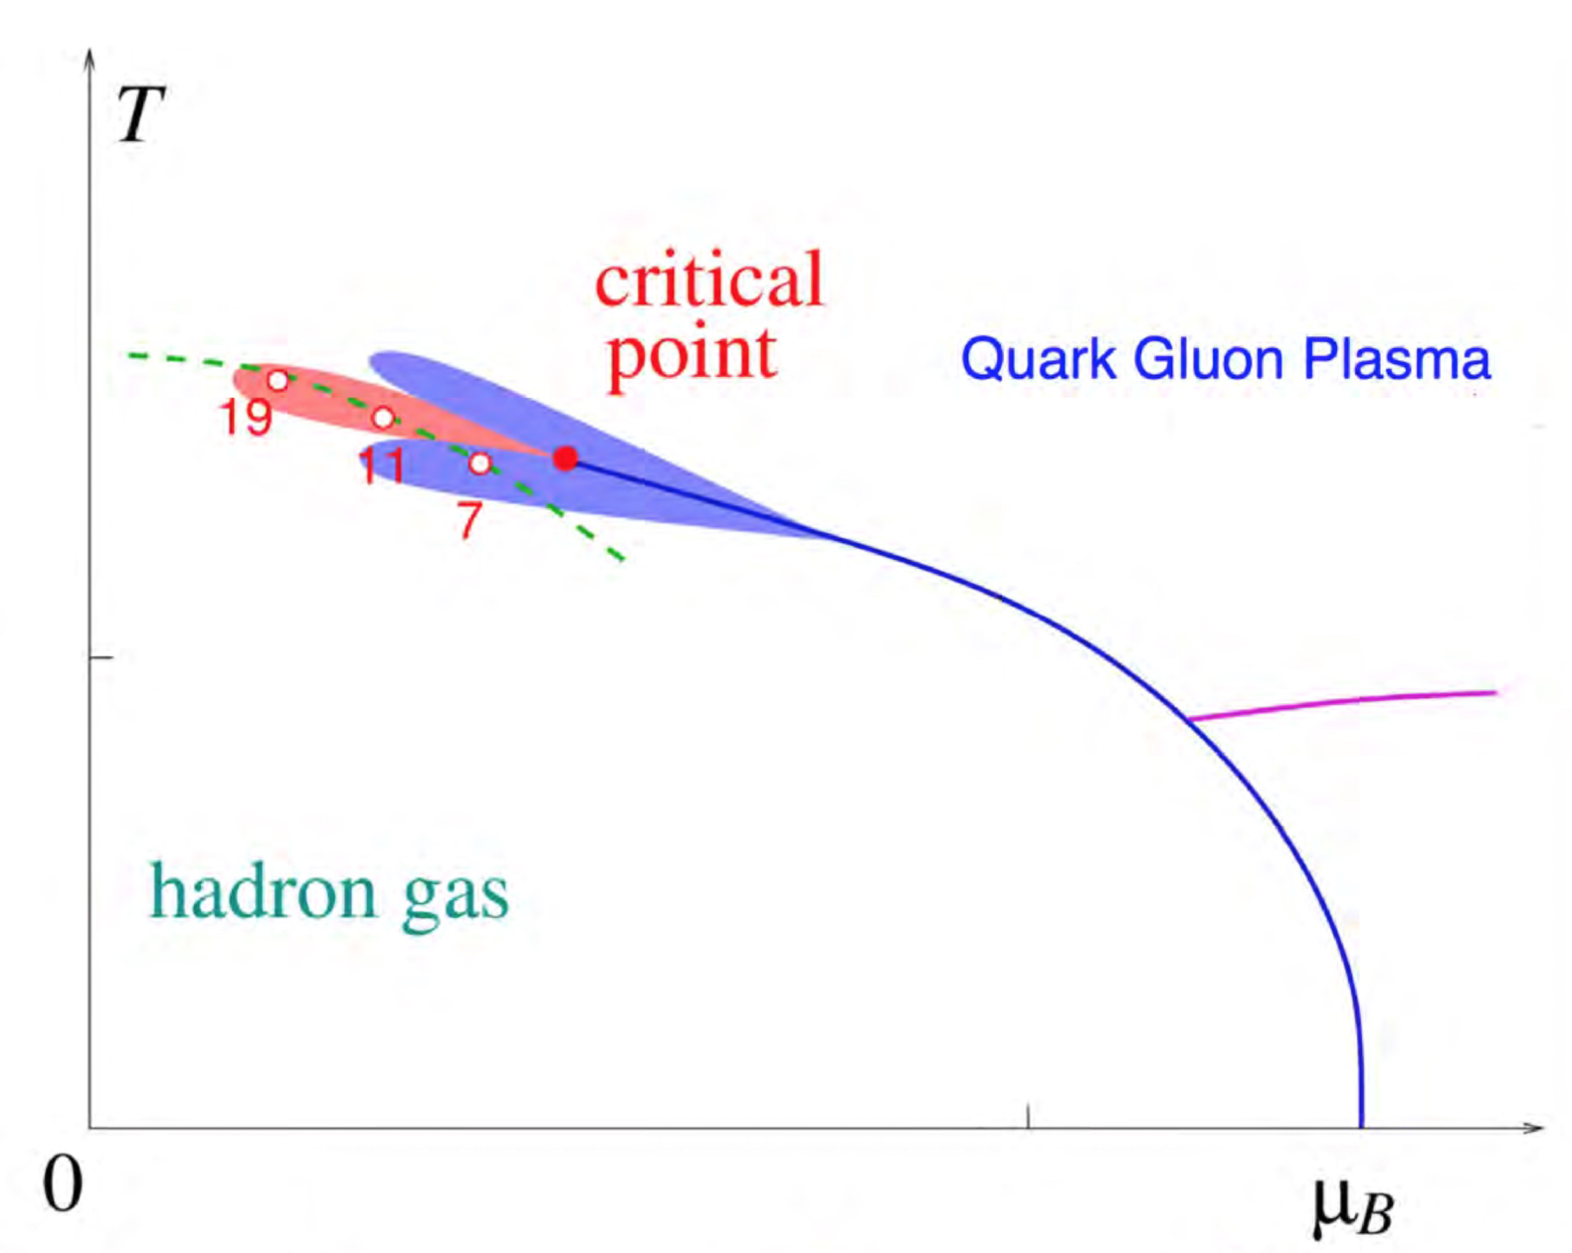
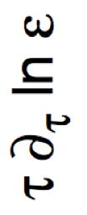
  “Attractor” behavior in models of expanding systems
  Heller and Spalinski [1503.07514], many follow-ups
(~ longitudinal pressure / energy density)
equilibrium
(time)
Romatschke [1704.08699]

Slide 15
  “Attractor” behavior in models of expanding systems
  Heller and Spalinski [1503.07514], many follow-ups
Romatschke [1704.08699]

Slide 16
  “Attractor” behavior in models of expanding systems
  Heller and Spalinski [1503.07514], many follow-ups
  What is the physical origin of the simplification far from equilibrium?
Romatschke [1704.08699]

Slide 17
  “Attractor” behavior in models of expanding systems
  Heller and Spalinski [1503.07514], many follow-ups
  What is the physical origin of the simplification far from equilibrium?
Romatschke [1704.08699]

Slide 18
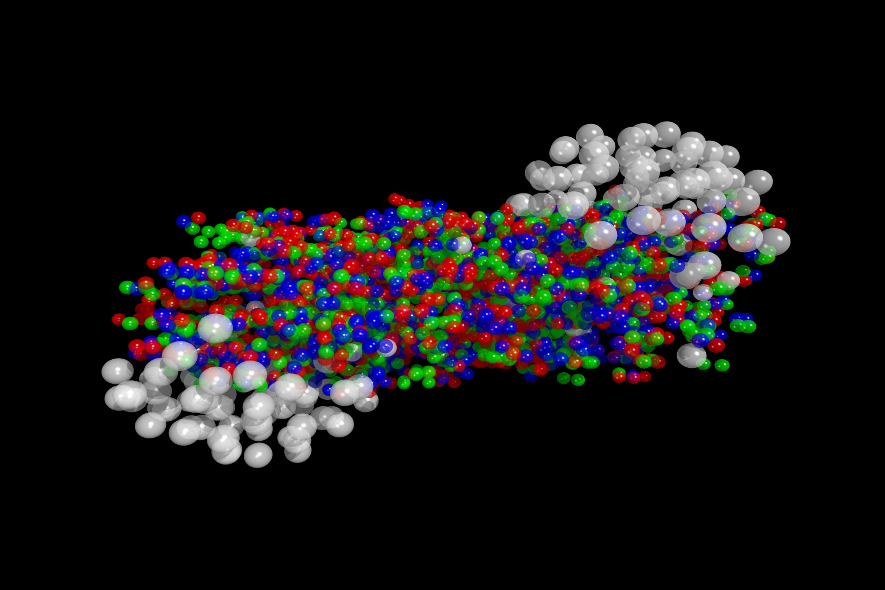
  Bjorken-expanding kinetic theory
  x
  z
  longitudinal expansion
  collisions

Slide 19
  Bjorken-expanding kinetic theory in the relaxation time approximation
  longitudinal expansion
  single relaxation/ collision timescale
  collisions

Slide 20
  Bjorken-expanding kinetic theory in the relaxation time approximation
  longitudinal expansion
  single relaxation/ collision timescale
  collisions
equilibrium

Slide 21
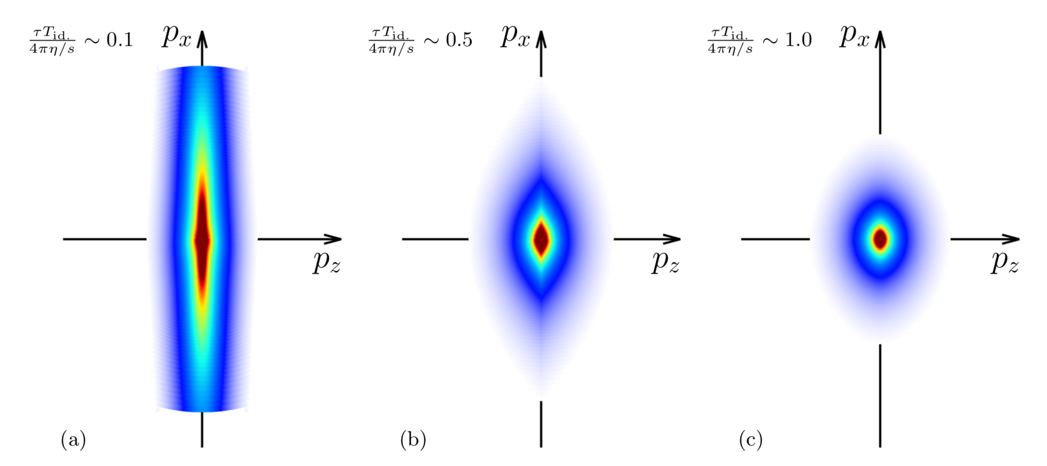
  Bjorken-expanding kinetic theory in the relaxation time approximation
  Evolution of moments contributing to the energy density can be rewritten
  longitudinal expansion
  collisions
JB, Li Yan, Yi Yin [1910.00021]
  hydrodynamization
Fig adapted from [1805.00961]

Slide 22
  Do hydrodynamic modes dominate the evolution far from equilibrium?
  ?

Slide 23

  Do hydrodynamic modes dominate the evolution far from equilibrium?
  ?
  Contribution from (evolving) ground state of $ℋ$
JB, Li Yan, Yi Yin [1910.00021]

Slide 24
  Do hydrodynamic modes dominate the evolution far from equilibrium?
  ?
  LO contribution from excited states of $ℋ$
JB, Li Yan, Yi Yin (upcoming work)

Slide 25

  Single “pre-hydrodynamic” mode
JB, Li Yan, Yi Yin [1910.00021]
Many modes are important
“Pre-hydrodynamic” modes dominate
Hydrodynamic modes dominate
$$τ$$
$$τ_{Redu}$$
$$τ_{Hydro}$$

Slide 26
  Adiabatic theorem:
  “A system prepared in its (instantaneous) ground state will remain in its (instantaneous) ground state under adiabatic evolution of the Hamiltonian”

Slide 27
  Is the system prepared in the instantaneous ground state?
  At early times

Slide 28
  Is the system prepared in the instantaneous ground state?
  (gapped from longitudinal expansion)
  At early times
Contribution from eigenstates
Gap drives system to ground state

Slide 29

  Is the system prepared in the instantaneous ground state?
  (gapped from longitudinal expansion)
  At early times
Contribution from eigenstates
Gap drives system to ground state
Contribution from many eigenstates
Ground state
of $ℋ_{F}$
Similar conclusion to Kurkela, van der Schee, Wiedemann, Wu [1907.08101]

Slide 30
  Implication for physics of the attractor
  At early times
  No collisions
Contribution from many eigenstates
Ground state
of $ℋ_{F}$
Similar conclusion to Kurkela, van der Schee, Wiedemann, Wu [1907.08101]

Slide 31
  Implication for physics of the attractor
  At early times
  No collisions
  Attractor behavior need not imply collectivity or equilibration
Contribution from many eigenstates
Ground state
of $ℋ_{F}$
Similar conclusion to Kurkela, van der Schee, Wiedemann, Wu [1907.08101]

Slide 32
  Why does the subsequent evolution approximately leave the system in the ground state?

Slide 33
  Why would the rapidly-expanding quark–gluon plasma be adiabatic?
  Relaxation-time approximation:
  Transition rate between ground and excited states:
  Grandi, Polkovnikov [0910.2236]

Slide 34
  Why would the rapidly-expanding quark–gluon plasma be adiabatic?
  Relaxation-time approximation:
  Transition rate between ground and excited states:
  Hamiltonian evolves slowly compared to energy gap
  small near hydro limit
  Grandi, Polkovnikov [0910.2236]

Slide 35
  Why would the rapidly-expanding quark–gluon plasma be adiabatic?
  Relaxation-time approximation:
  Transition rate between ground and excited states:
  Hamiltonian evolves slowly compared to energy gap
Small overlap between ground and excited states
  small near hydro limit
  small at early times
  Grandi, Polkovnikov [0910.2236]

Slide 36
  A new perturbative expansion
  Contributions from the excited states to the evolution at leading order are a small correction
JB, Li Yan, Yi Yin (upcoming work)

Slide 37
  Including transverse expansion
  Pre-hydrodynamic modes = modes with lowest eigenvalue
  Preliminary
  More complex interplay between pre-hydrodynamic and hydrodynamic modes
JB, Weiyao Ke, Li Yan, Yi Yin (upcoming work)

Slide 38
  Single “pre-hydrodynamic” mode
JB, Li Yan, Yi Yin [1910.00021]
Many modes are important
“Pre-hydrodynamic” modes dominate
Hydrodynamic modes dominate
$$τ$$
$$τ_{Redu}$$
$$τ_{Hydro}$$

Slide 39
  Two pictures of the quark–gluon plasma
  Emergence of hydrodynamic behavior
“Adiabatic hydrodynamization in rapidly-expanding quark–gluon plasma”
JB, Li Yan, Yi Yin [1910.00021]
  Jet modification
“Data-driven quark and gluon jet modification in heavy-ion collisions”
Jasmine Brewer, Jesse Thaler, Andrew Turner [2007.xxxxx]
Jasmine Brewer (MIT)
Notes:
Unfortunately, the interpretation of jet modification observables often depends crucially on which proton–proton jets are taken to be a comparable baseline for a given heavy-ion measurement. In di-jet and inclusive jet studies, the standard answer is to compare heavy-ion jets to a proton–proton baseline with the same reconstructed pT. For example, comparing the jet production spectra for p-p and HI at the same reconstructed pT (as illustrated by the blue arrows) gives rise to the famous jet RAA.

Slide 40
  Probing the quark–gluon plasma using jets

Slide 41
  Probing the quark–gluon plasma using jets
  Unfortunately, too short-lived to use external probes…

Slide 42
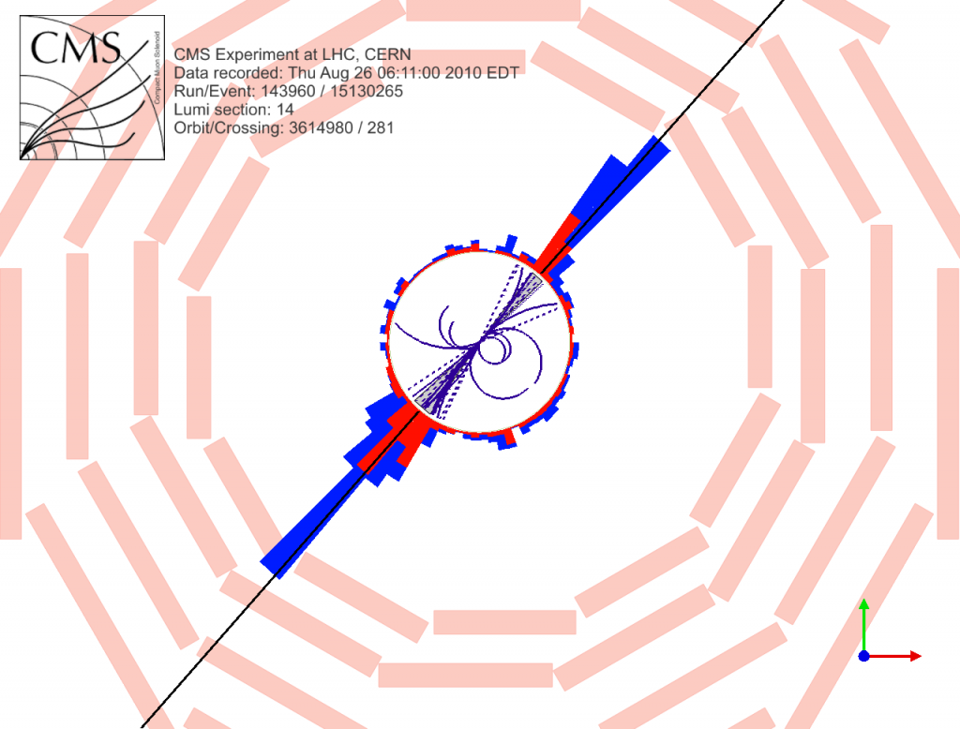
  Jets are natural probes produced in the collision
  “baseline” jet properties
Notes:
There have been a multitude of nice measurements quantifying the differences between the properties of p-p and A-A jets through jet modification observables, for example the dijet asymmetry and jet shape modifications. The aim in this program is to use jet modification observables to make direct inferences about how the quark-gluon plasma interacts with partons traversing through it.

Slide 43
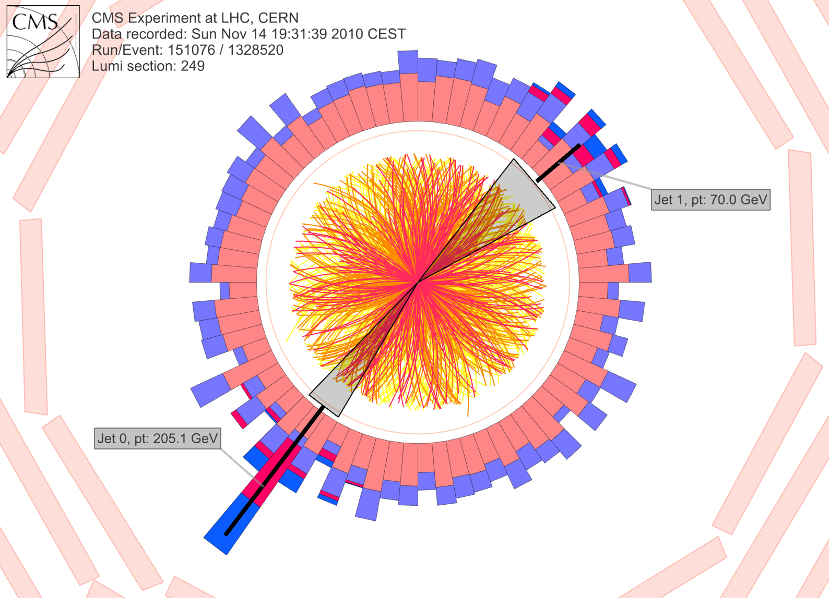
  Jets are natural probes produced in the collision
  “baseline” jet properties
  jet modification
Notes:
There have been a multitude of nice measurements quantifying the differences between the properties of p-p and A-A jets through jet modification observables, for example the dijet asymmetry and jet shape modifications. The aim in this program is to use jet modification observables to make direct inferences about how the quark-gluon plasma interacts with partons traversing through it.

Slide 44
  How does the modification depend on the probe?
  quark-initiated
  gluon-initiated
Notes:
There have been a multitude of nice measurements quantifying the differences between the properties of p-p and A-A jets through jet modification observables, for example the dijet asymmetry and jet shape modifications. The aim in this program is to use jet modification observables to make direct inferences about how the quark–gluon plasma interacts with partons traversing through it.

Slide 45
  How does the modification depend on the probe?
  quark-initiated
  gluon-initiated
  How does the quark–gluon plasma see the color structure of a jet?
Decreasing resolution
Notes:
There have been a multitude of nice measurements quantifying the differences between the properties of p-p and A-A jets through jet modification observables, for example the dijet asymmetry and jet shape modifications. The aim in this program is to use jet modification observables to make direct inferences about how the quark–gluon plasma interacts with partons traversing through it.

Slide 46
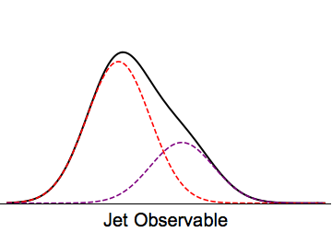
  Jet measurements are an unknown mixture of contributions from quark and gluon jets
  q
  g
Notes:
There have been a multitude of nice measurements quantifying the differences between the properties of p-p and A-A jets through jet modification observables, for example the dijet asymmetry and jet shape modifications. The aim in this program is to use jet modification observables to make direct inferences about how the quark–gluon plasma interacts with partons traversing through it.

Slide 47
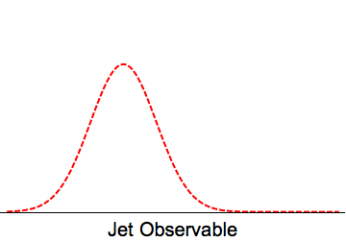
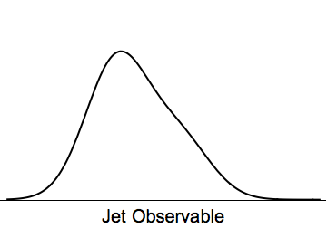
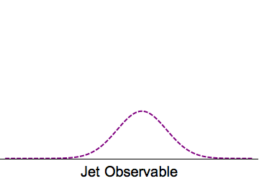
  Jet measurements are an unknown mixture of contributions from quark and gluon jets
  Ideally…
  q
  g
Notes:
There have been a multitude of nice measurements quantifying the differences between the properties of p-p and A-A jets through jet modification observables, for example the dijet asymmetry and jet shape modifications. The aim in this program is to use jet modification observables to make direct inferences about how the quark–gluon plasma interacts with partons traversing through it.

Slide 48
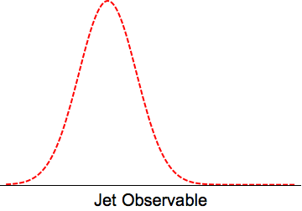
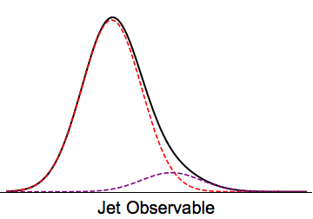
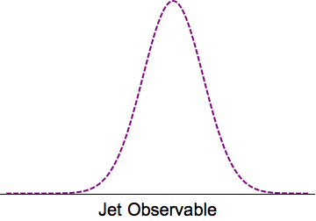
  Turns out it is easy* to decompose two mixture distributions into two components
  Done in p–p: Metodiev and Thaler [1802.00008]
  Komiske, Metodiev, Thaler [1809.01140]
Notes:
There have been a multitude of nice measurements quantifying the differences between the properties of p-p and A-A jets through jet modification observables, for example the dijet asymmetry and jet shape modifications. The aim in this program is to use jet modification observables to make direct inferences about how the quark–gluon plasma interacts with partons traversing through it.

Slide 49

  Disentangling mixture distributions into “quark” and “gluon”
  example
  Requires…
  dijets
  $γ$+jet
  Sample
  independence:
Notes:
There have been a multitude of nice measurements quantifying the differences between the properties of p-p and A-A jets through jet modification observables, for example the dijet asymmetry and jet shape modifications. The aim in this program is to use jet modification observables to make direct inferences about how the quark–gluon plasma interacts with partons traversing through it.

Slide 50
  Disentangling mixture distributions into “quark” and “gluon”
  example
  Requires…
  dijets
  $γ$+jet
  Sample
  independence:
  Mutual
  Irreducibility:
  samples are pure quark and pure gluon in some limits
  Above: base distributions are completely separated at $±∞$
  Quark and gluon constituent multiplicity distributions are mutually irreducible in the high-energy limit
Frye et al [1704.06266]
Notes:
There have been a multitude of nice measurements quantifying the differences between the properties of p-p and A-A jets through jet modification observables, for example the dijet asymmetry and jet shape modifications. The aim in this program is to use jet modification observables to make direct inferences about how the quark–gluon plasma interacts with partons traversing through it.

Slide 51
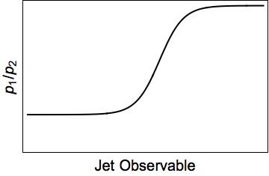
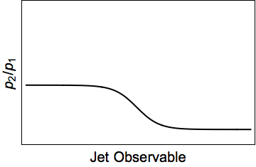
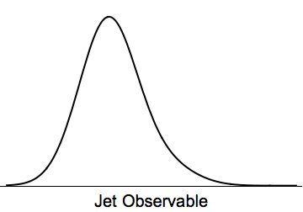
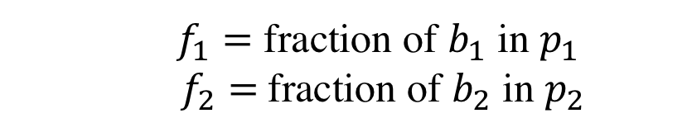




  Disentangling mixture distributions into “quark” and “gluon”
$$p_{1}$$
$$p_{2}$$
$$κ_{12}$$
$$κ_{21}$$
  $f_{1}=$ fraction of $b_{1}$ in $p_{1}$
  $f_{2}=$fraction of $b_{2}$ in $p_{2}$
  gives fractions
  “Topics”
Notes:
There have been a multitude of nice measurements quantifying the differences between the properties of p-p and A-A jets through jet modification observables, for example the dijet asymmetry and jet shape modifications. The aim in this program is to use jet modification observables to make direct inferences about how the quark–gluon plasma interacts with partons traversing through it.

Slide 52
  How are quark- and gluon-initiated jets modified by the quark–gluon plasma?
  Separately extract quark and gluon jet fractions and the modification of quark and gluon jets in proton–proton and heavy-ion collisions
Notes:
There have been a multitude of nice measurements quantifying the differences between the properties of p-p and A-A jets through jet modification observables, for example the dijet asymmetry and jet shape modifications. The aim in this program is to use jet modification observables to make direct inferences about how the quark–gluon plasma interacts with partons traversing through it.

Slide 53
  How are quark- and gluon-initiated jets modified by the quark–gluon plasma?
  proton–proton
  heavy-ion
  Comparatively limited statistics of $γ$+jet available in Run 4 of the LHC
JB, Jesse Thaler, Andrew Patrick Turner [2007.xxxxx]
Notes:
There have been a multitude of nice measurements quantifying the differences between the properties of p-p and A-A jets through jet modification observables, for example the dijet asymmetry and jet shape modifications. The aim in this program is to use jet modification observables to make direct inferences about how the quark–gluon plasma interacts with partons traversing through it.

Slide 54


  Primary difficulty: extracting fractions is sensitive to tails of the distribution where statistics are low
  proton–proton
$$κ_{12}$$
$$κ_{21}$$
Notes:
There have been a multitude of nice measurements quantifying the differences between the properties of p-p and A-A jets through jet modification observables, for example the dijet asymmetry and jet shape modifications. The aim in this program is to use jet modification observables to make direct inferences about how the quark–gluon plasma interacts with partons traversing through it.

Slide 55


  Primary difficulty: extracting fractions is sensitive to tails of the distribution where statistics are low
  proton–proton
$$κ_{12}$$
$$κ_{21}$$
  heavy-ion
$$κ_{12}$$
$$κ_{21}$$
Notes:
There have been a multitude of nice measurements quantifying the differences between the properties of p-p and A-A jets through jet modification observables, for example the dijet asymmetry and jet shape modifications. The aim in this program is to use jet modification observables to make direct inferences about how the quark–gluon plasma interacts with partons traversing through it.

Slide 56
  Primary difficulty: extracting fractions is sensitive to tails of the distribution where statistics are low
  proton–proton
$$κ_{12}$$
$$κ_{21}$$
  heavy-ion
$$κ_{12}$$
$$κ_{21}$$
Notes:
There have been a multitude of nice measurements quantifying the differences between the properties of p-p and A-A jets through jet modification observables, for example the dijet asymmetry and jet shape modifications. The aim in this program is to use jet modification observables to make direct inferences about how the quark–gluon plasma interacts with partons traversing through it.

Slide 57
  Extracting quark/gluon contributions to constituent multiplicity
  proton–proton
Notes:
There have been a multitude of nice measurements quantifying the differences between the properties of p-p and A-A jets through jet modification observables, for example the dijet asymmetry and jet shape modifications. The aim in this program is to use jet modification observables to make direct inferences about how the quark–gluon plasma interacts with partons traversing through it.

Slide 58
  Extracting quark/gluon contributions to constituent multiplicity
  heavy-ion
Notes:
There have been a multitude of nice measurements quantifying the differences between the properties of p-p and A-A jets through jet modification observables, for example the dijet asymmetry and jet shape modifications. The aim in this program is to use jet modification observables to make direct inferences about how the quark–gluon plasma interacts with partons traversing through it.

Slide 59
  Extracting quark/gluon contributions to constituent multiplicity
  heavy-ion
Notes:
There have been a multitude of nice measurements quantifying the differences between the properties of p-p and A-A jets through jet modification observables, for example the dijet asymmetry and jet shape modifications. The aim in this program is to use jet modification observables to make direct inferences about how the quark–gluon plasma interacts with partons traversing through it.

Slide 60
  Extracting quark/gluon contributions to constituent multiplicity
Notes:
There have been a multitude of nice measurements quantifying the differences between the properties of p-p and A-A jets through jet modification observables, for example the dijet asymmetry and jet shape modifications. The aim in this program is to use jet modification observables to make direct inferences about how the quark–gluon plasma interacts with partons traversing through it.

Slide 61
  Two pictures of the quark–gluon plasma
  Emergence of hydrodynamic behavior
“Adiabatic hydrodynamization in rapidly-expanding quark–gluon plasma”
JB, Li Yan, Yi Yin [1910.00021]
  Jet modification
“Data-driven quark and gluon jet modification in heavy-ion collisions”
Jasmine Brewer, Jesse Thaler, Andrew Turner [2007.xxxxx]
Jasmine Brewer (MIT)
Notes:
Unfortunately, the interpretation of jet modification observables often depends crucially on which proton–proton jets are taken to be a comparable baseline for a given heavy-ion measurement. In di-jet and inclusive jet studies, the standard answer is to compare heavy-ion jets to a proton–proton baseline with the same reconstructed pT. For example, comparing the jet production spectra for p-p and HI at the same reconstructed pT (as illustrated by the blue arrows) gives rise to the famous jet RAA.

Slide 62
  Backup

Slide 63
  Hamiltonian formulation from kinetic theory
  Bjorken-expanding kinetic theory
  longitudinal expansion
  collisions

Slide 64
  Hamiltonian formulation from kinetic theory
  Bjorken-expanding kinetic theory
  longitudinal expansion
  collisions
  Moments of kinetic equation give evolution of more macroscopic quantities
  Energy density
  Angular distribution contributing to energy density

Slide 65
  Hamiltonian formulation from kinetic theory

Slide 66
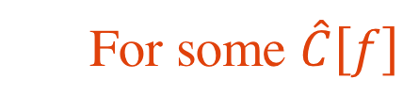
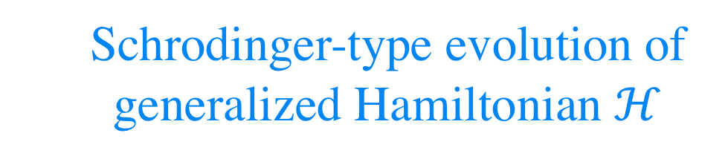
  Hamiltonian formulation from kinetic theory
  For some $\hat{C}\left[f\right]$
  Schrodinger-type evolution of generalized Hamiltonian $ℋ$

Slide 67
  Hamiltonian formulation from kinetic theory
  Expand F in Legendre polynomials
  For RTA
  Blaizot and Yan [1712.03856]
Notes:
“To describe the isotropic distribution you only need the lowest component, whereas to describe highly anisotropic distributions you clearly need higher moments

Slide 68
  Hamiltonian formulation from kinetic theory
  Expand F in Legendre polynomials
  For RTA
  Blaizot and Yan [1712.03856]
Notes:
“To describe the isotropic distribution you only need the lowest component, whereas to describe highly anisotropic distributions you clearly need higher moments

Slide 69
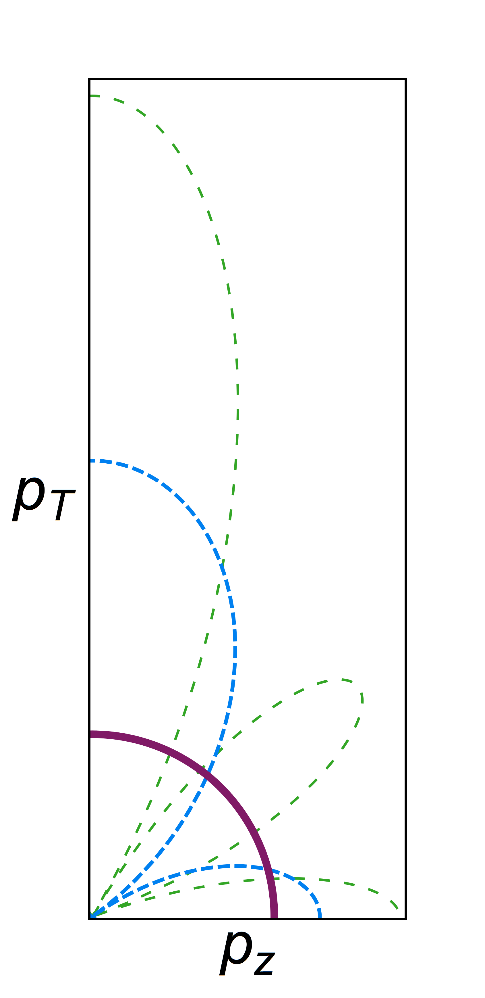
Notes:
“To describe the isotropic distribution you only need the lowest component, whereas to describe highly anisotropic distributions you clearly need higher moments

Slide 70
  hydrodynamization
Fig adapted from KMPST [1805.00961]
Notes:
“To describe the isotropic distribution you only need the lowest component, whereas to describe highly anisotropic distributions you clearly need higher moments

Slide 71
  Is the system prepared in the ground state?
  At early times

Slide 72
  Is the system prepared in the ground state?
  At early times

Slide 73
  Is the system prepared in the ground state?
  At early times
  gives time scale for decay of initial conditions
Similar result to Kurkela, van der Schee, Wiedemann, Wu [1907.08101]

Slide 74
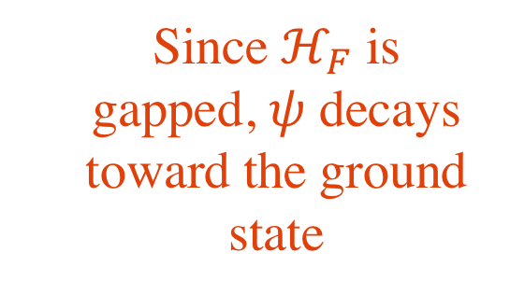
  Is the system prepared in the ground state?
  At early times
  Since $ℋ_{F}$ is gapped, $ψ$ decays toward the ground state
  gives time scale for decay of initial conditions
Similar result to Kurkela, van der Schee, Wiedemann, Wu [1907.08101]

Slide 75
  Definition of adiabatic hydrodynamization:
  System evolution determined by the instantaneous ground state

Slide 76
  Definition of adiabatic hydrodynamization:
  System evolution determined by the instantaneous ground state
  Predicts non-trivial relations between components of $ψ$
e.g.
  Test extent to which these relations are satisfied!

Slide 77
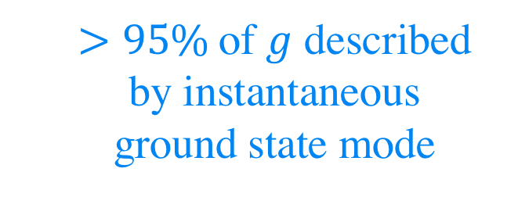
  Implies presence of a small “adiabatic” parameter that suppresses contributions from other modes
  $>95\%$of $g$ described by instantaneous ground state mode

Slide 78
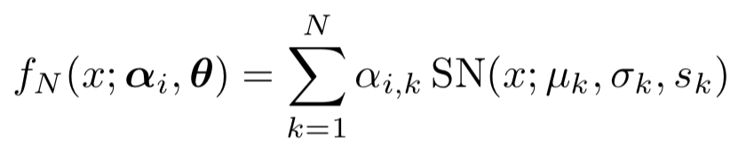
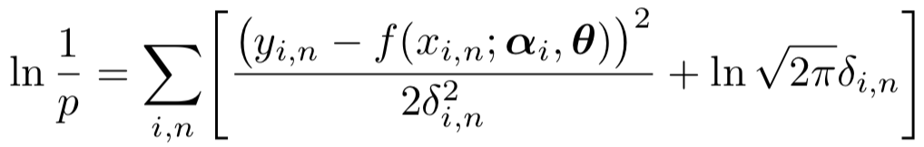
  Fit function:
  proton–proton
  heavy-ion
  Likelihood function:

