Slide 1
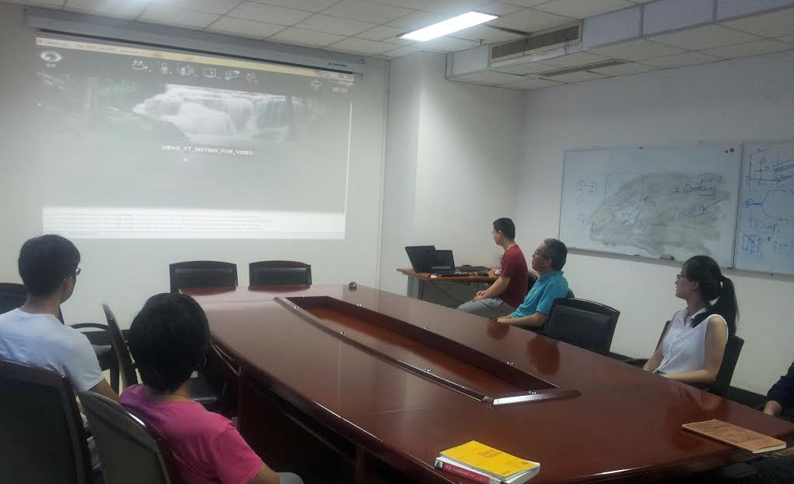
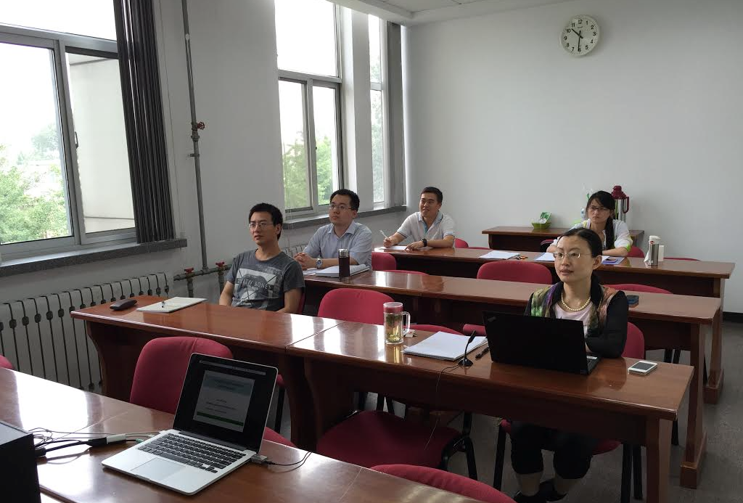
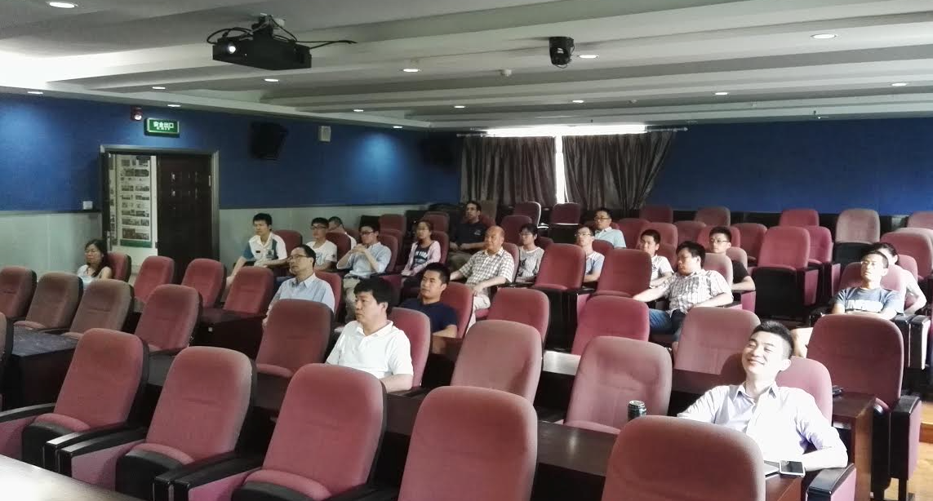
中国高能核物理网络论坛
HENPIC: High-energy Nuclear Physics in China e-Forum
(since 2012）
USTC
IHEP
CCNU

Slide 2
中国高能核物理网络论坛
HENPIC: High-energy Nuclear Physics in China e-Forum
(since 2012）
HENPIC e-Forum Organizing Committee:
陈金辉 Jinhui Chen (SINAP) chenjinhui-at-sinap.ac.cn 黄 梅 Mei Huang (IHEP) huangm-at-mail.ihep.ac.cn 黄旭光 Xu-Guang Huang ( Fudan) huangxuguang-at-fudan.edu.cn 黄焕中 Huan Zhong Huang (Fudan) huang-at-physics.ucla.edu 梁作堂 Zuo-tang Liang ( SDU) liang-at-sdu.edu.cn 刘玉鑫 Yuxin Liu (PKU) yxliu-at-pku.edu.cn
罗晓峰 Xiaofeng Luo (CCNU) xfluo-at-mail.ccnu.edu.cn (current chair) 马余刚 Yugang Ma (SINAP) ygma-at-sinap.ac.cn 宋慧超 Huichao Song (PKU) huichaosong-at-pku.edu.cn 唐泽波 Zebo Tang （USTC) zbtang-at-ustc.edu.cn 王 群 Qun Wang (USTC) qunwang-at-ustc.edu.cn 王新年 Xin-Nian Wang (CCNU) xnwang-at-iopp.ccnu.edu.cn 徐庆华 Qinghua Xu (SDU) xuqh-at-sdu.edu.cn
庄鹏飞 Pengfei Zhuang (THU) zhuangpf-at-mail.tsinghua.edu.cn 朱相雷 Xianglei Zhu (THU) zhux-at-tsinghua.edu.cn

Slide 3
Past HENPIC Speakers
( 99 Seminars since 2012）
LG Pang 6/7/12 | Kai Zhou 2/28/13 | JY Chao 12/12/13 | Li Yan 10/23/14 | M Gyulassy 9/24/15 | Toro Kojo 8/11/16 | XM Zhang 8/10/17 | JL Zhang 7/26/18 | Z M Liu 5/30/19 | J Zhou 2/17/20
Xuan Li 6/21/12 | SS Shu 3/21/13 | M Huang 1/16/14 | Zhe Xu 11/13/14 | SS Cao 10/22/15 | A H Tang 9/8/16 | L G Pang 9/14/17 | H J Xu 8/23/18 | L J Ruan 6/20/19 | Shuai Liu 2/20/20
Shi Pu 7/12/12 | XB Zhao 4/16/13 | XF Luo 2/20/14 | GL Ma 12/23/14 | YX Zhang 11/12/15 | Bin Wu 10/13/15 | Chi Wang 10/19/17 | Tan Luo 9/13/18 | X. L Xia 7/25/19 | N Sahoo 2/27/20
GL Ma 8/9/12 | Jun Xu 3/9/13 | Shu Lin 3/13/14 | Li Yi 1/15/15 | BC Huang 12/10/15 | J F Liao 11/10/16 | H X Xing 11/16/17 | Z Y Chen 10/18/18 | K J Sun 8/22/19 | Min He 3/5/20
DN Li 9/13/12 | SQ Tuo 6/20/13 | ZB Tang 4/10/14 | XR Zhu 3/26/15 | GQ Cao 1/14/16 | Yin Yi 12/8/16 | QY Shou 12/14/17 | Y Zhao 11/15/18 | G N Xie 9/19/19 | BW Xiao 3/12/20
C Shen 9/27/12 | XL Zhu 7/25/13 | BW Xiao 5/15/14 | Jian Zhou 4/22/15 | X Dong 3/10/16 | WM Zha 1/5/17 | B Y Chen 1/18/18 | X L Zhu 12/27/18 | Jie Zhao 12/12/19 | H N Li 3/19/20
F. Karsch 10/10/12 | B Muller 8/16/13 | Nan Su 6/19/14 | YF Zhang 5/21/15 | Min He 4/14/16 | Y Hirono 3/7/17 | C Shen 3/22/18 | W Y Ke 1/17/19 | Feng Li 12/26/19 | H J Xu 3/26/20
YH Zhu 11/8/12 | Shi Pu 9/18/13 | XM Zhang 7/17/14 | H Hattori 6/18/15 | J Deng 5/12/16 | G Y Qin 4/11/17 | Li Yi 4/26/18 | W J Fu 2/28/19 | Q P Hu 1/16/20 | Z C Ye 4/2/20
XG Huang 12/13/12 | JY Jia 10/17/13 | Jie Zhao 8/14/14 | JH Gao 7/10/15 | L J Jiang 6/23/16 | H T Ding 5/16/17 | You Zhou 5/31/18 | Hao Qiu 3/28/19 | X J Yao 2/6/20 | D Oliinychenko 4/9/20
YF Zhang 1/10/13 | M Shao 11/21/13 | Yan Zhu 9/11/14 | JH Chen 8/17/15 | G Wang 7/21/16 | Wei Li 6/20/17 | S Yang 6/28/18 | Y X Mao 4/18/19 | Yi Yin 2/13/20

Slide 4
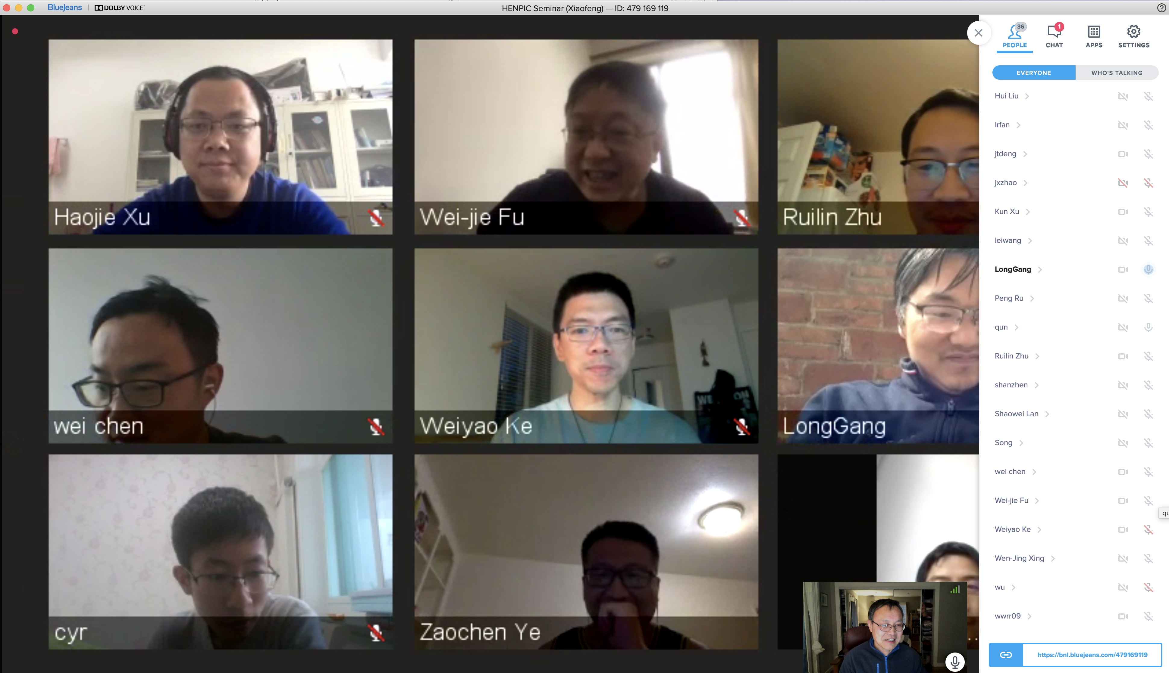
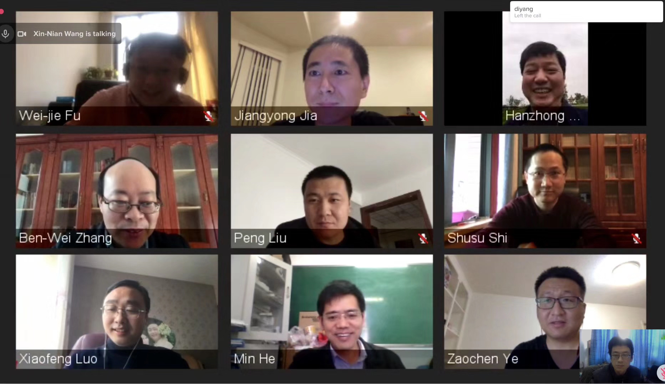
Science research in the near future

