Slide 1
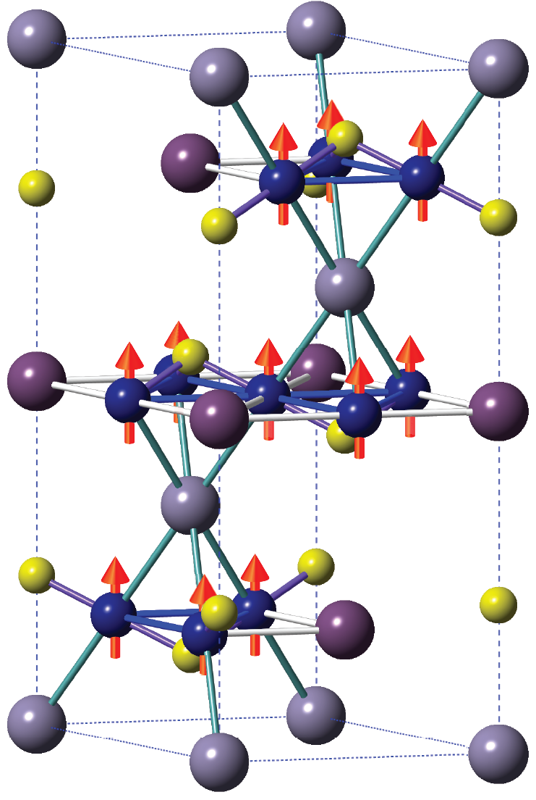
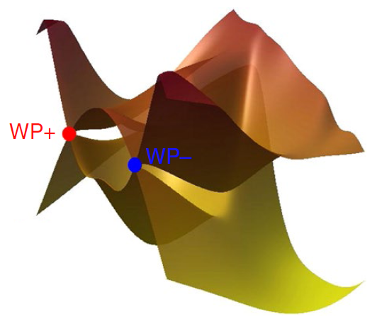
第二届CSNS缪子源多学科应用研讨会
μSR study on a doped magnetic
Weyl semimetal Co_{3-x}Ni_{x}Sn₂S₂
Huiqian Luo (罗会仟)
Institute of Physics, CAS
2019.12.13 Hefei

Slide 2
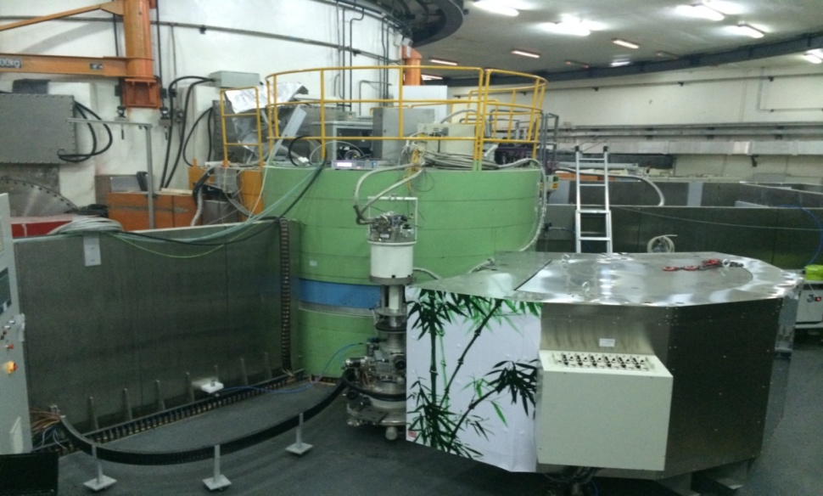
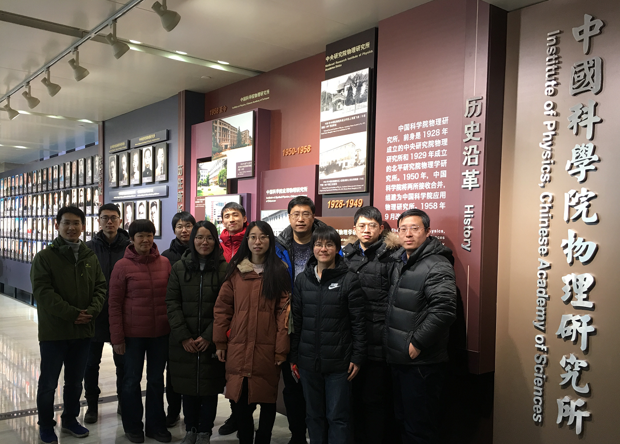
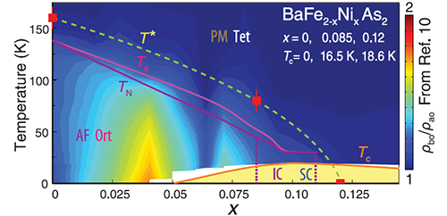
中国科学院物理所 SC8 组
Neutron scattering on correlated electron materials
http://sc8.iphy.ac.cn/
2009-2019
翠竹
Bamboo
Science 345, 657(2014)

Slide 3



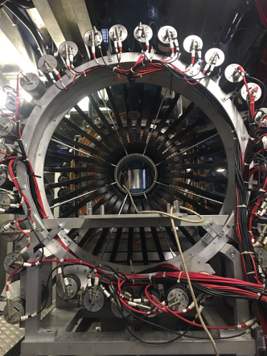
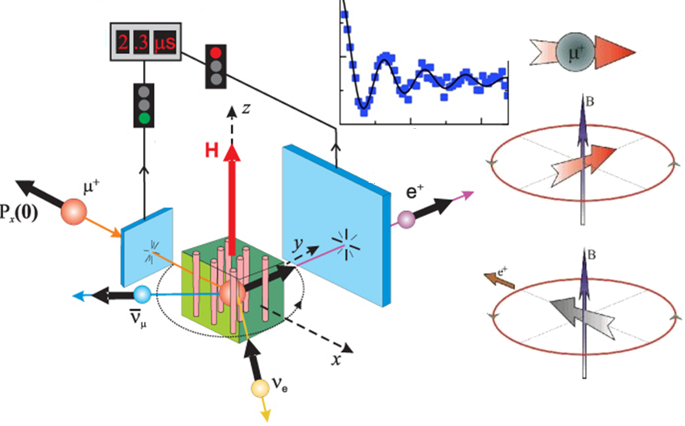






Collaborators
IOP，CAS: Chang Liu, Xiaoyan Ma, Jianlei Shen,
Enke Liu, Hongming Weng, Youguo Shi
Instrument Scientists :
Pabitra Biswas、D.T. Adroja (ISIS, RAL, UK)
MUSR

Slide 4
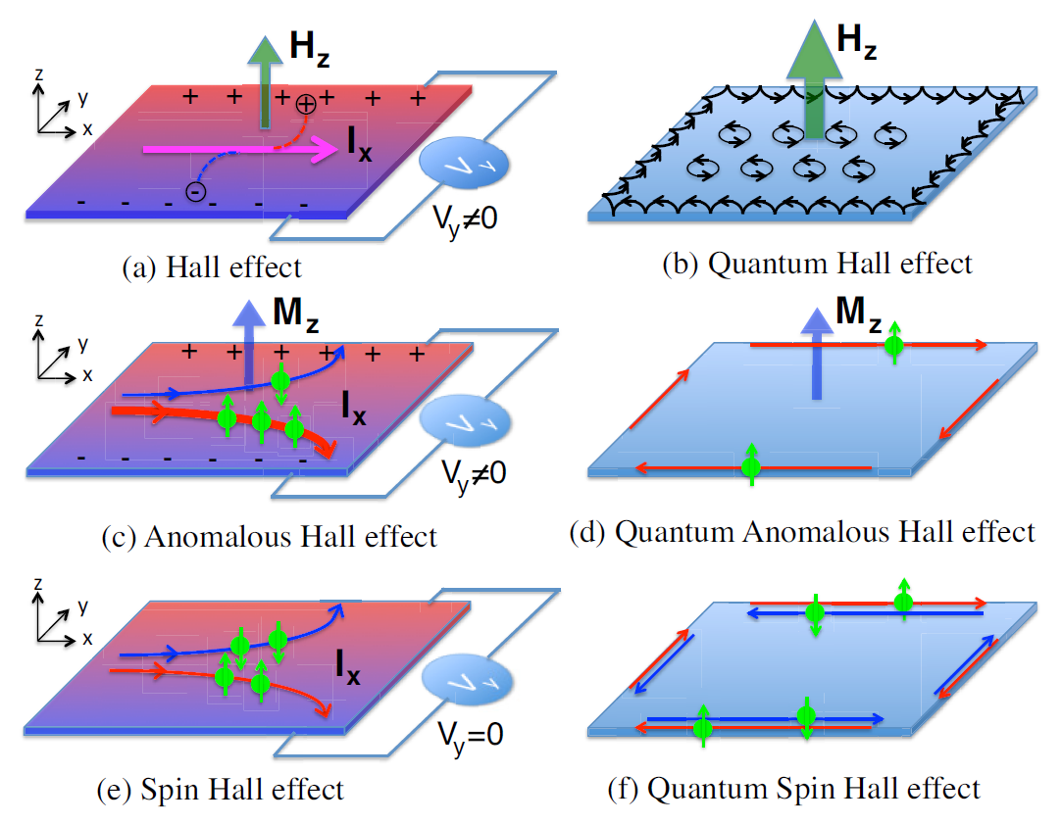
Background: Hall effect
H. Weng et al., Adv. Phys. 64, 227 (2015)

Slide 5
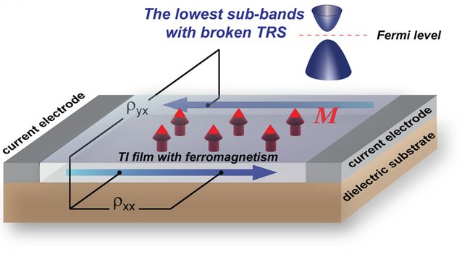
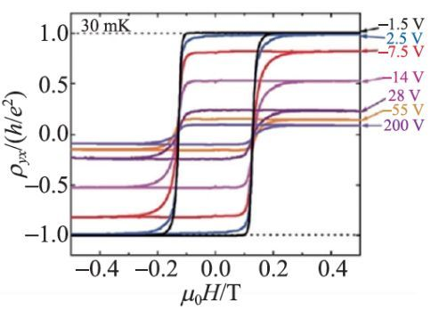
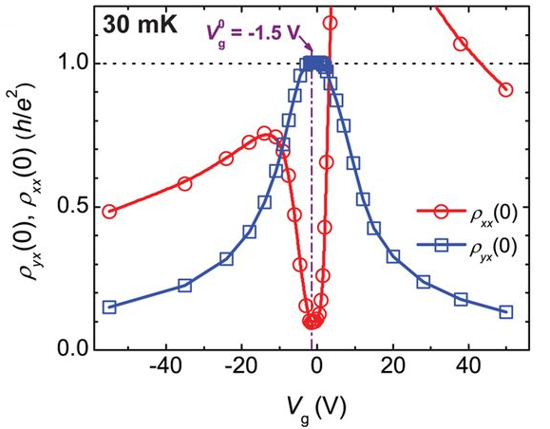
Quantum anomalous Hall effect
Cr doped (Bi,Sb)₂Te₃
Science 329, 61 (2010), Science 340, 167 (2013)

Slide 6
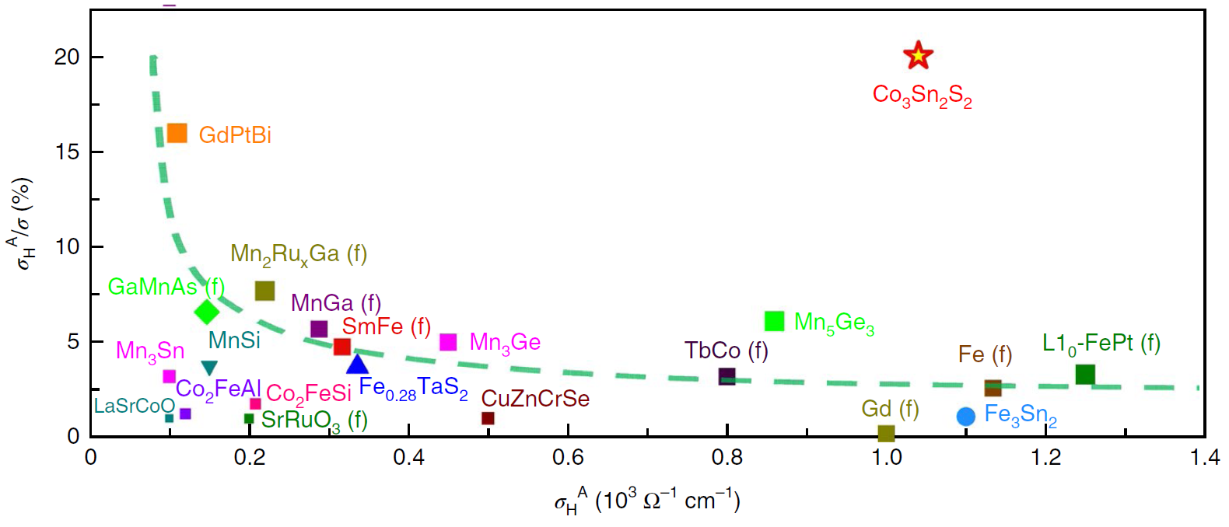
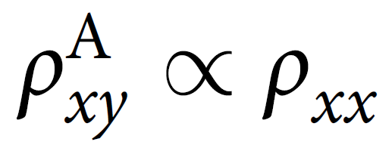
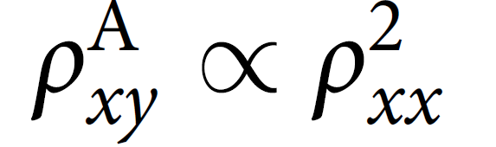
Anomalous Hall effect
anomalous Hall angle (AHA)
vs.
anomalous Hall conductivity (AHC)
Extrinsic mechanism: skew scattering side jump mechanisms
Intrinsic Kaplus–Luttinger mechanism
E. Liu et al., Nature Phys. 14, 1125 (2018)
Q. Wang et al., Nature Commun. 9, 3681 (2018)

Slide 7
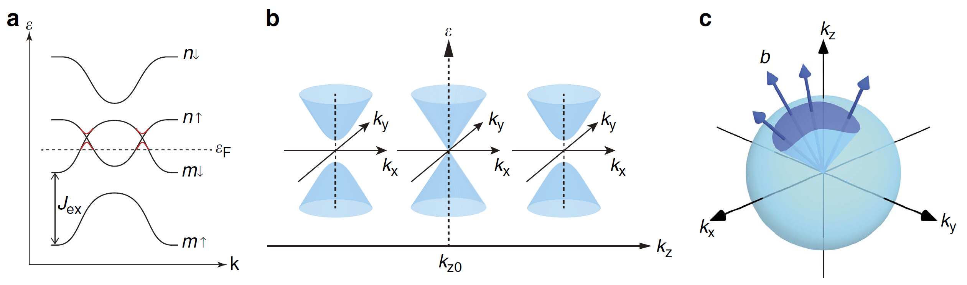
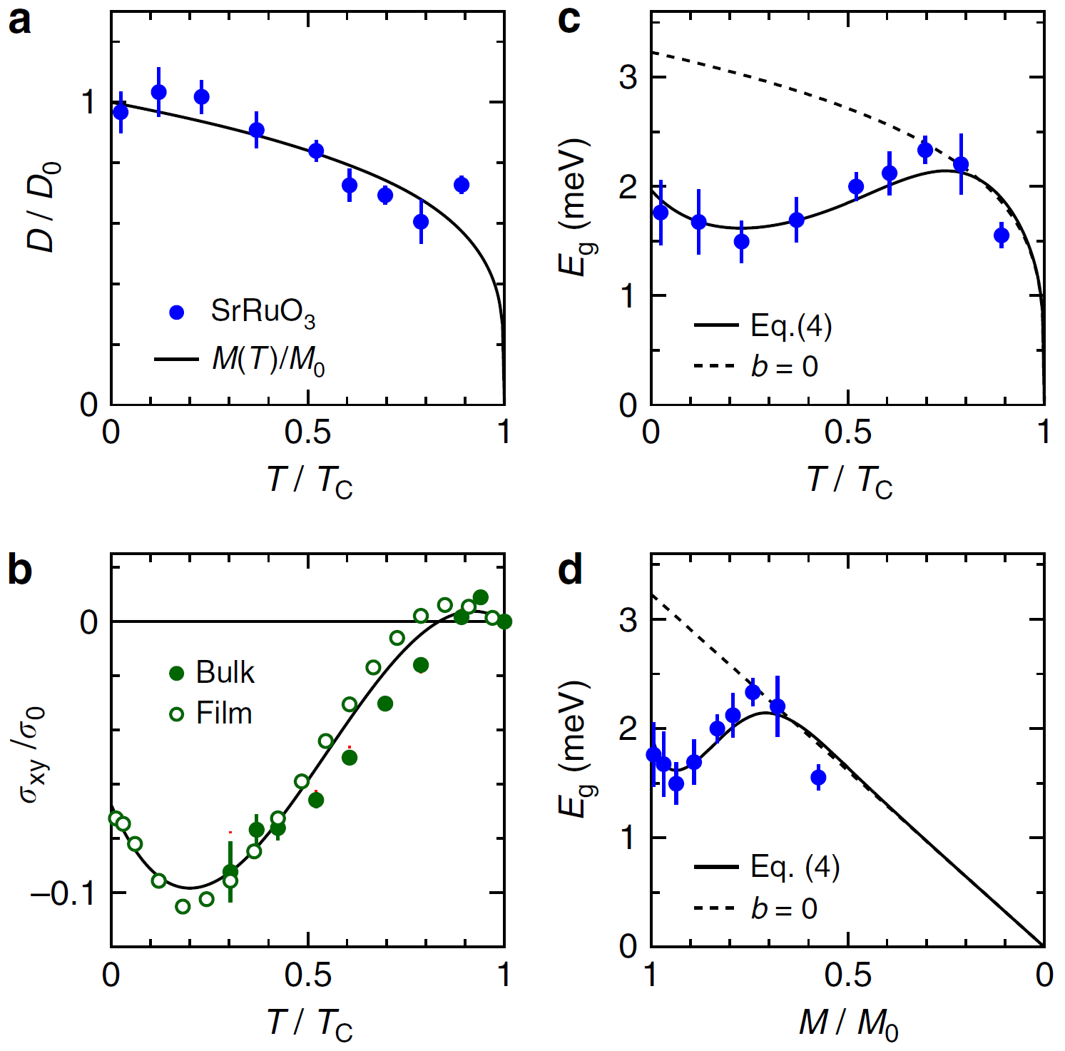


Magnetism and AHE
S. Itoh et al., Nat. Commun. 7, 11788 (2016)

Slide 8
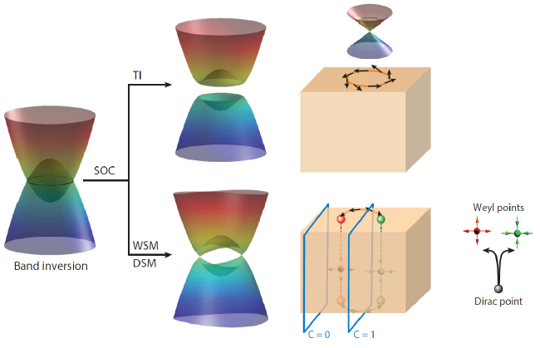
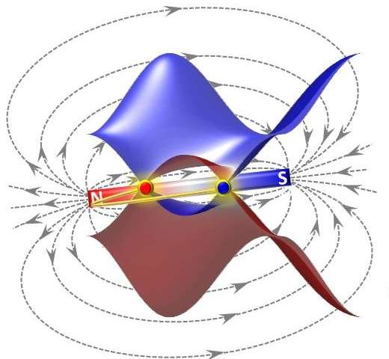
From Tl to magnetic WSM

Slide 9
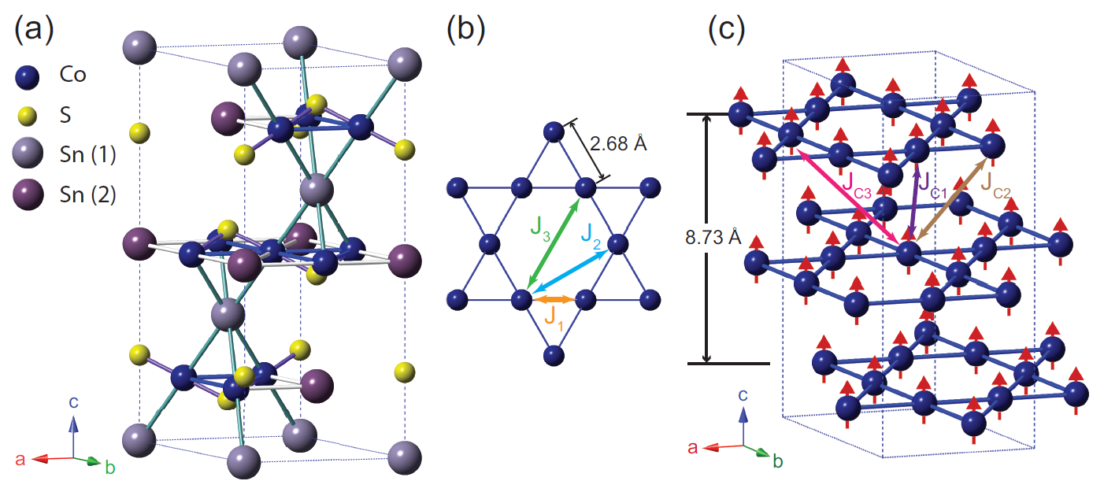
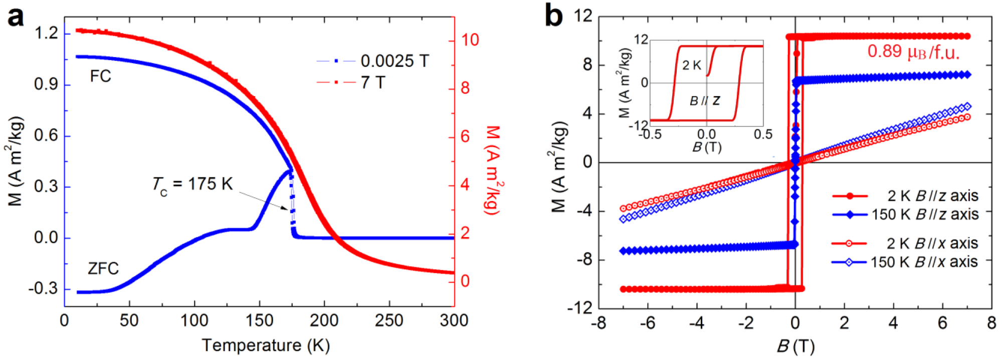
Co₃Sn₂S₂
Ferromagnetic half metal
Layered structure
Ordered moment 0.3 μ_{B}/Co
M// c on Co kagome lattice
Strong magnetic anisotropy
B//c ~0.1 T
B//ab ~26 T
E. Liu et al., Nature Phys. 14, 1125 (2018)

Slide 10
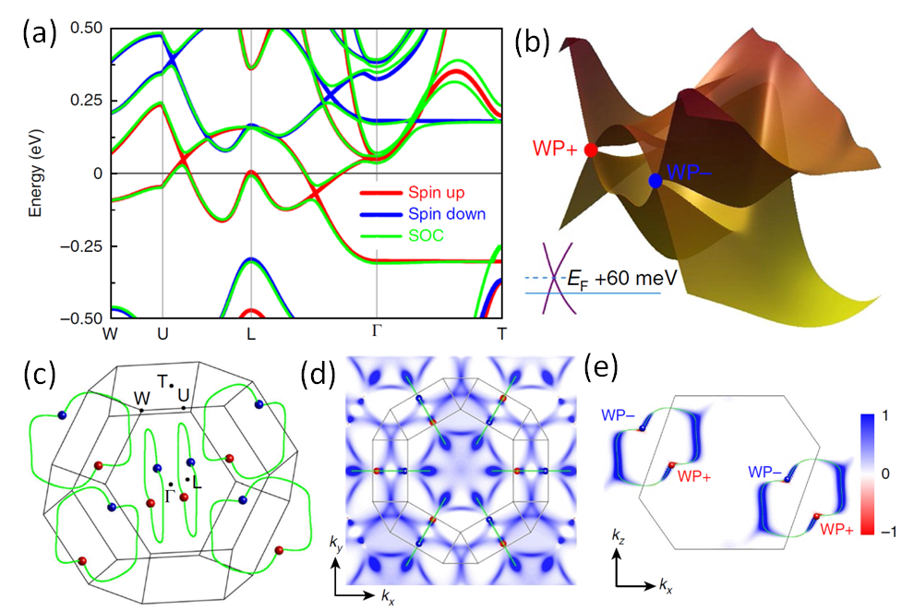
Band structure and Weyl nodes
Only spin up cross E_{F}
Weyl points are 60 meV above E_{F}
6 pairs of Weyl ferminon
Strong Berry curvature
E. Liu et al., Nature Phys. 14, 1125 (2018)

Slide 11
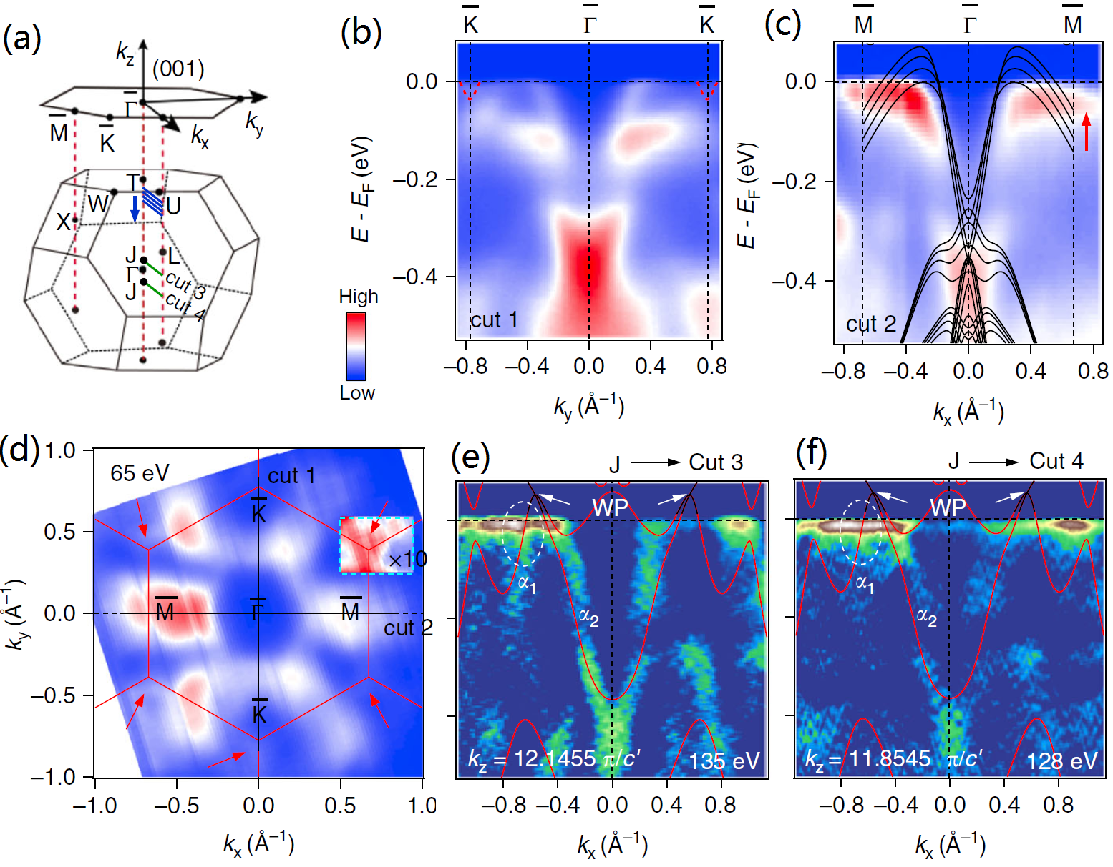
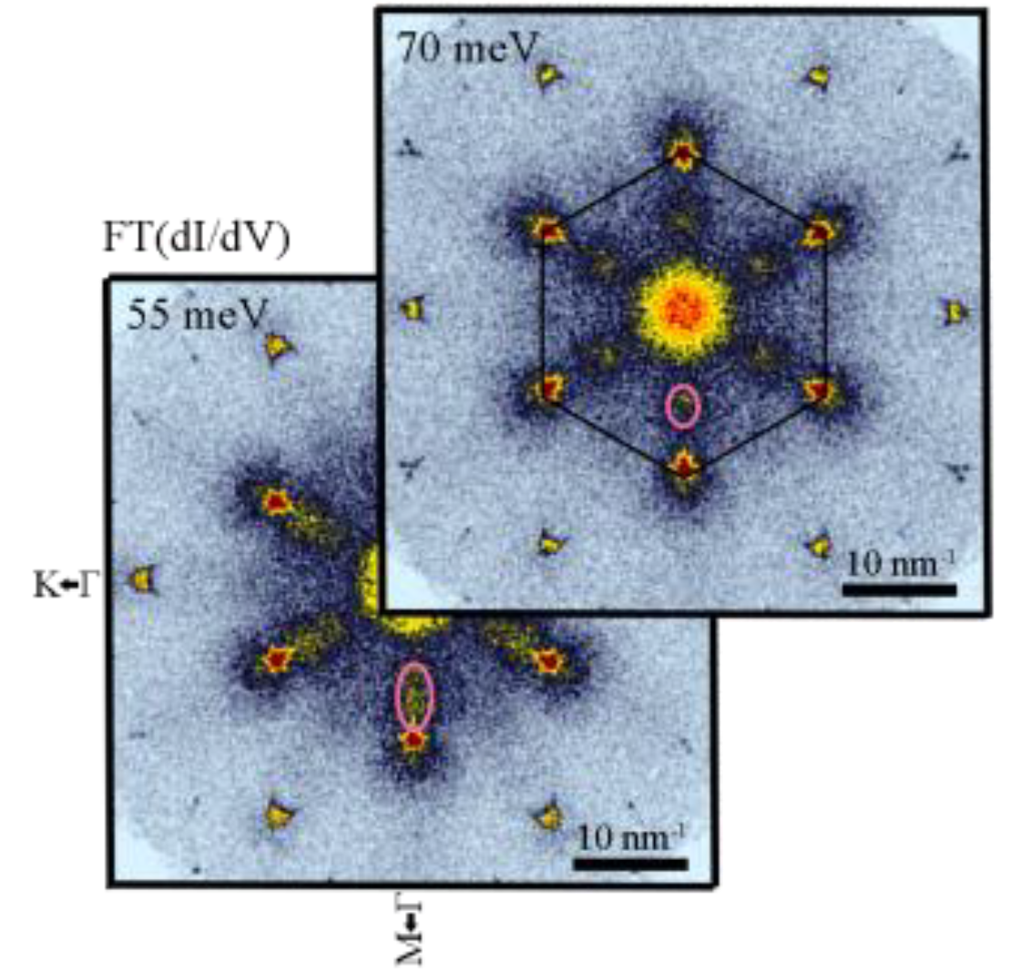
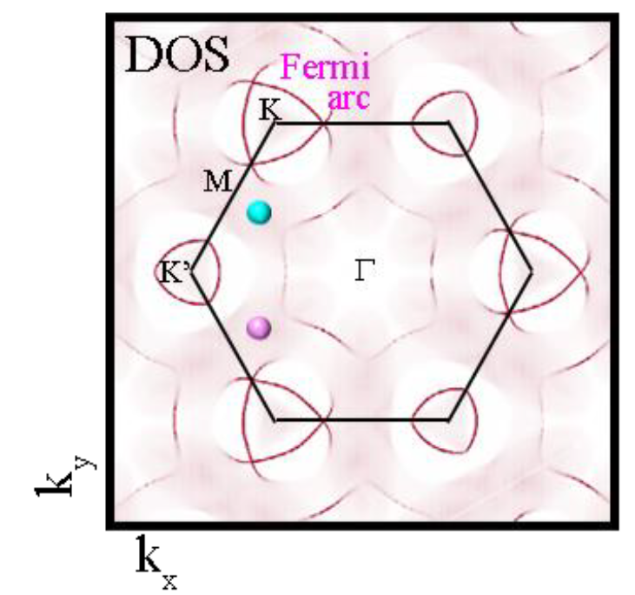
ARPES and STM results
Fermi arc on
surface state
Negative
magnetism
Q. Wang et al., Nature Commun. 9, 3681 (2018), N. Morali et al., ArXiv: 1903.00509, J.-X Yin et al., Nature Phys. 15,443 (2019)

Slide 12
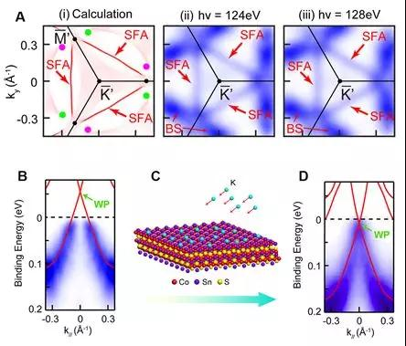
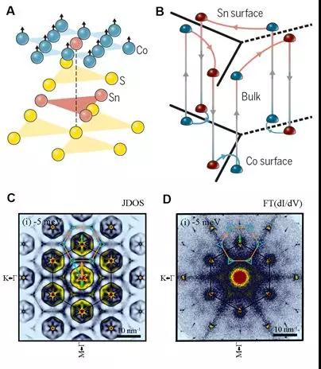
ARPES and STM results
Science 365, 1282 (2019). Science 365, 1286 (2019).

Slide 13
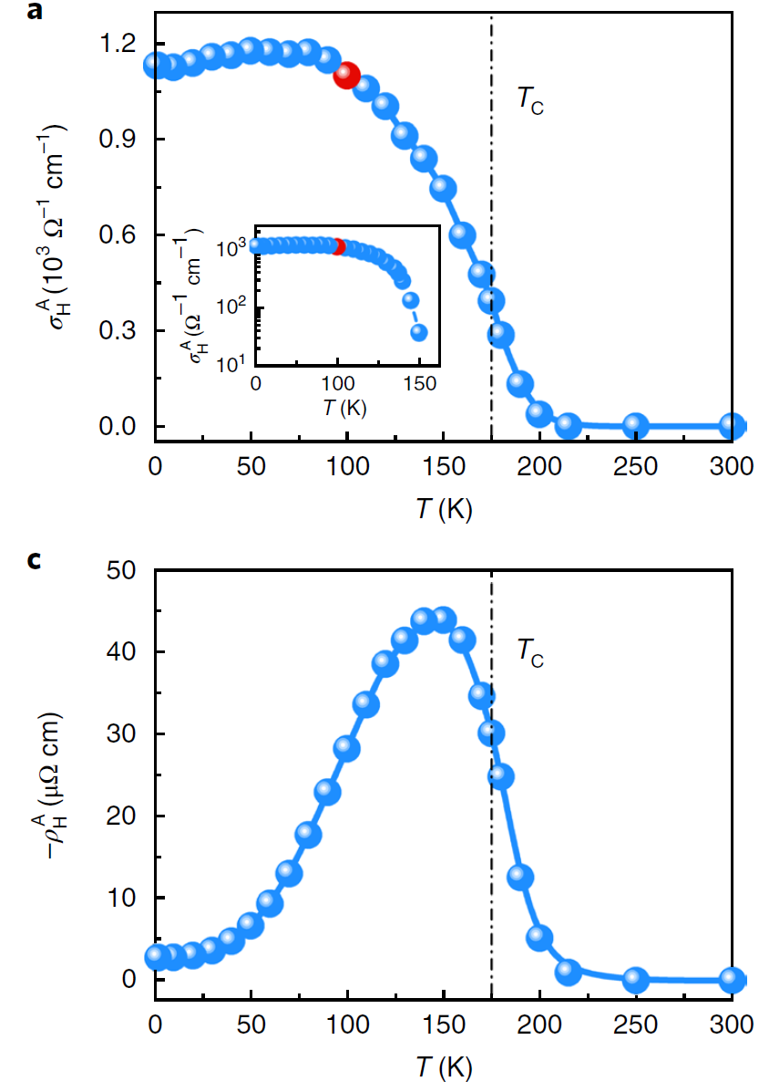
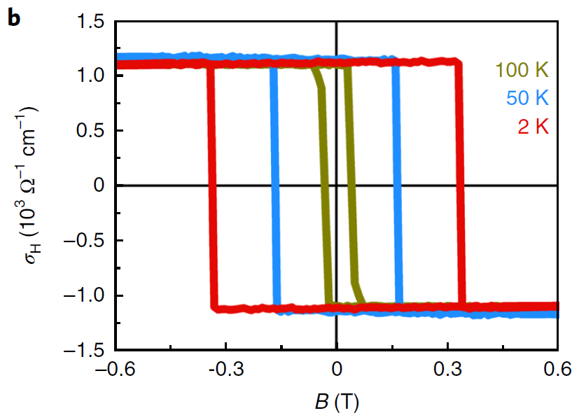
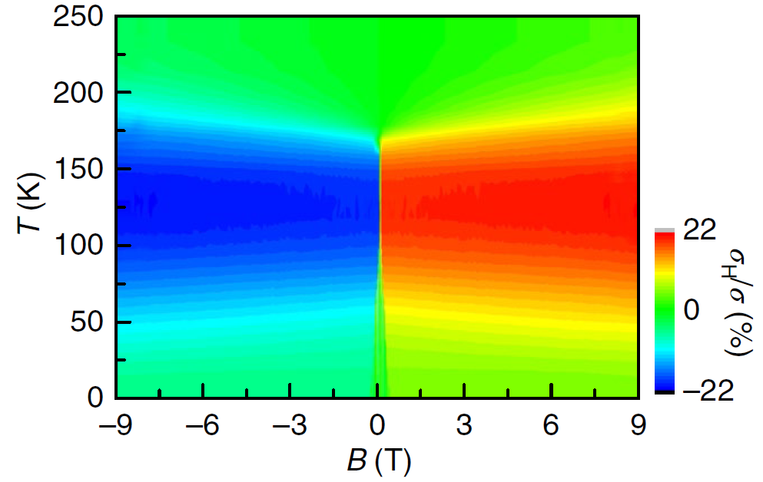
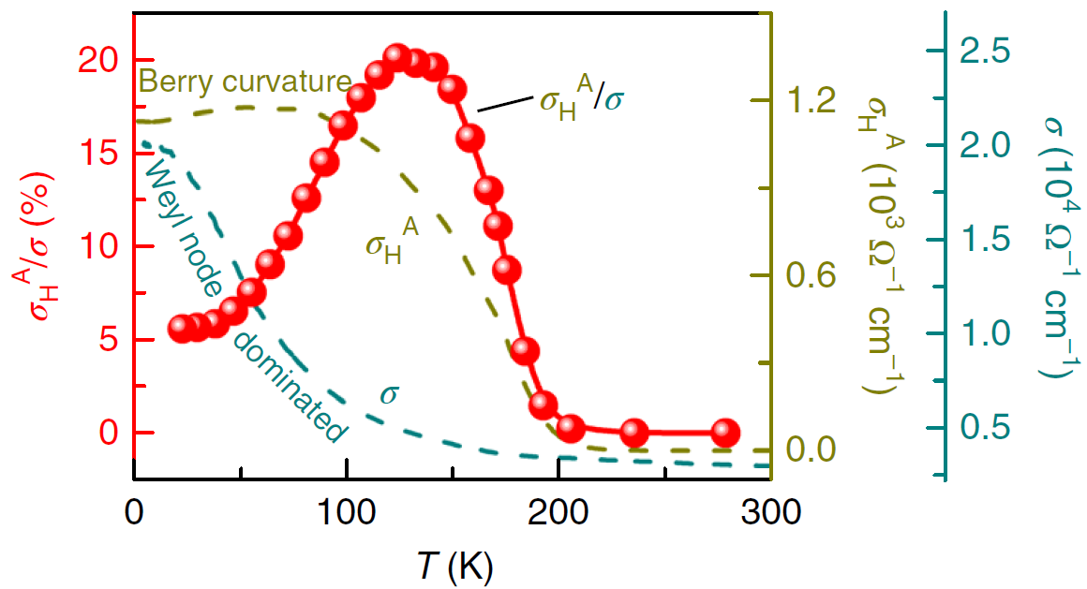
Anomalous Hall effect
E. Liu et al., Nature Phys. 14, 1125 (2018)

Slide 14
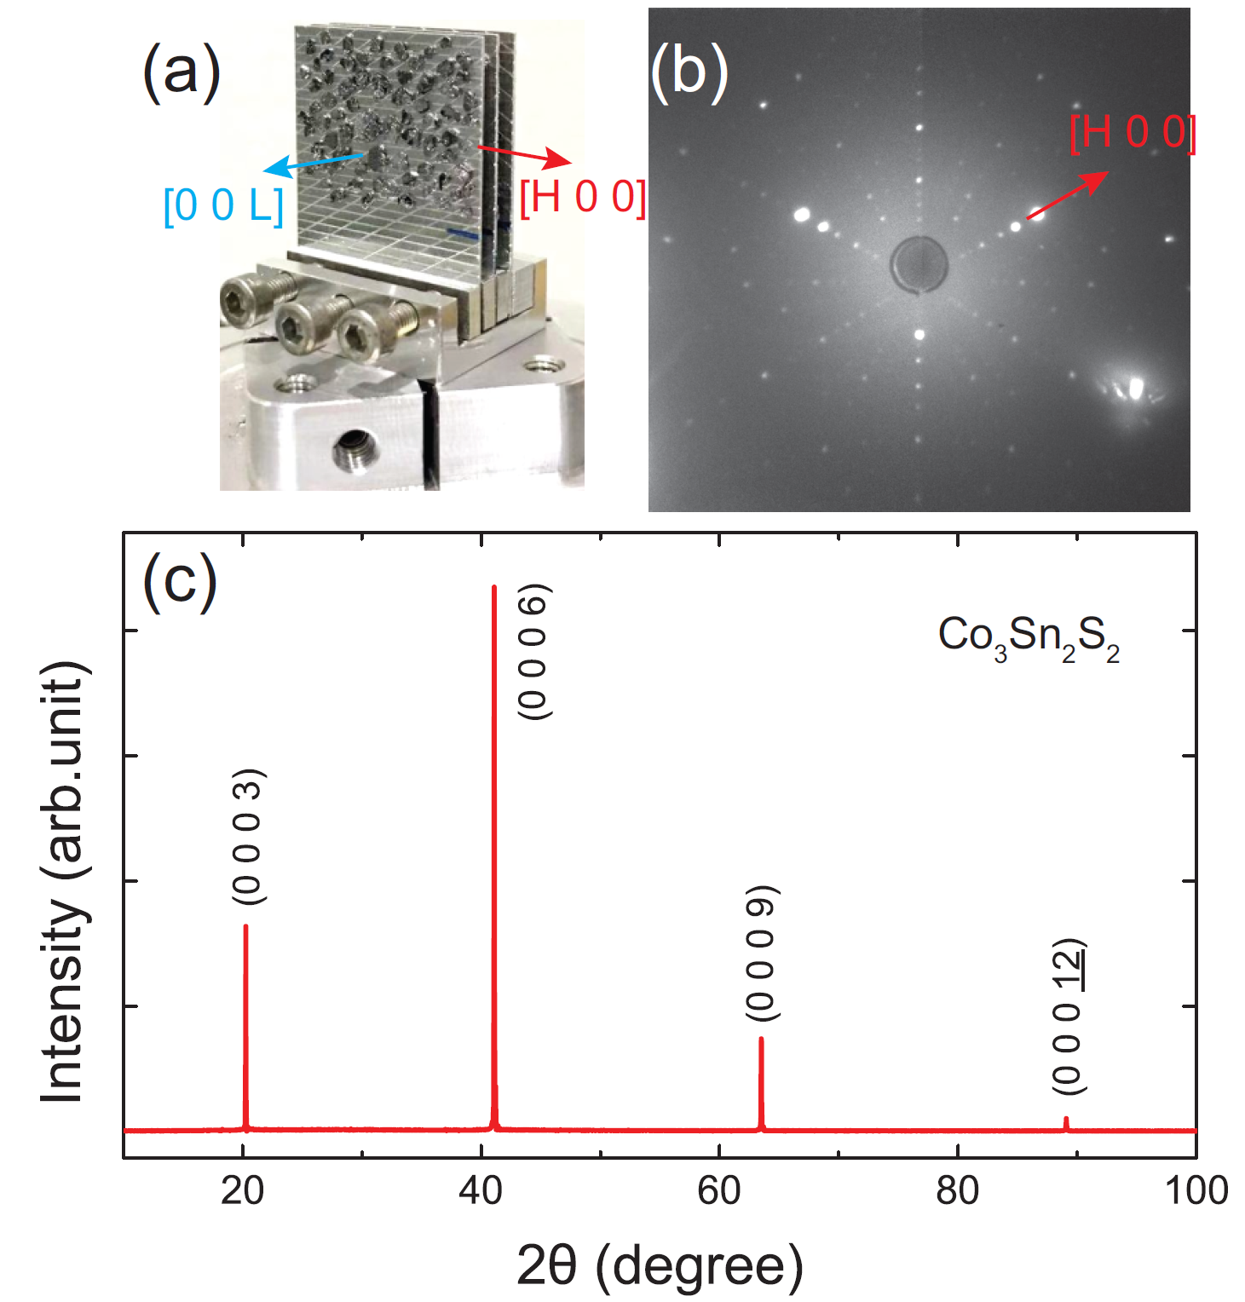
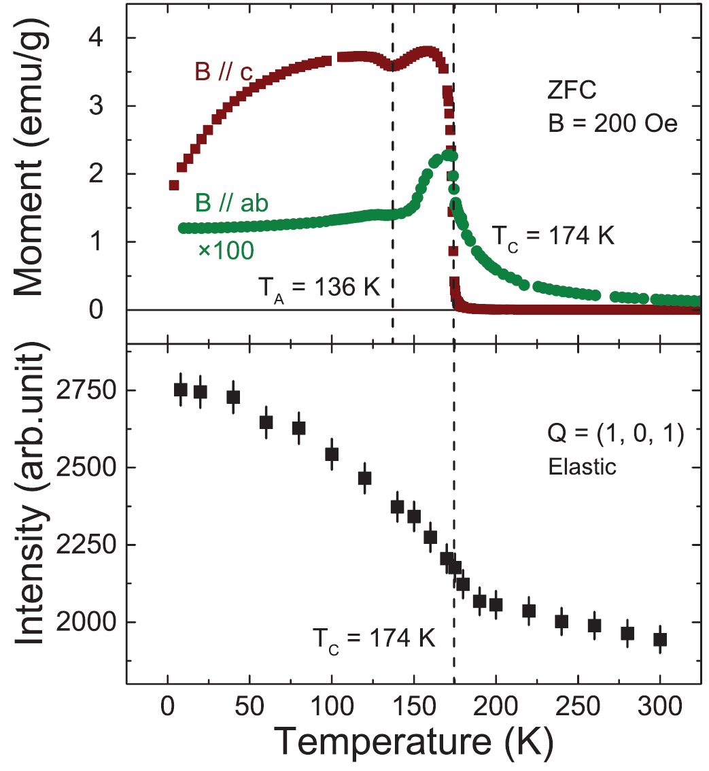
Elastic neutron scattering on single crystal
1.5 g
Liu, Shen, Gao et al., unpublished manuscript

Slide 15
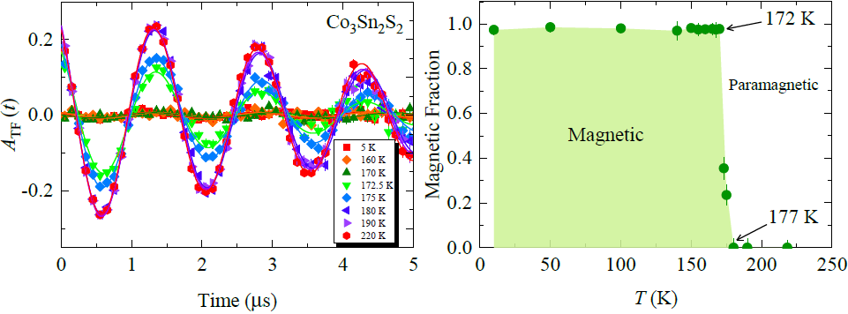
What can μSR do in this material ?
arXiv: 1904.09353

Slide 16
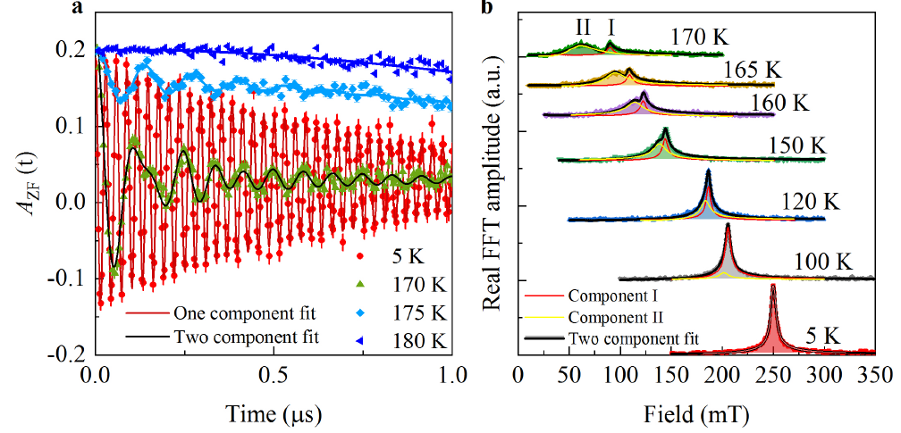
What can μSR do in this material ?
arXiv: 1904.09353

Slide 17
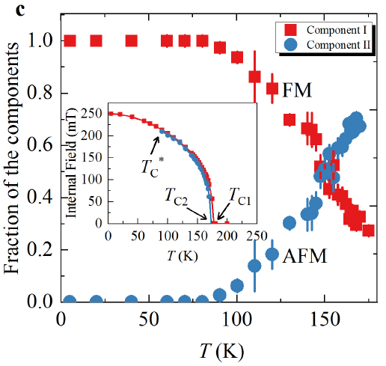
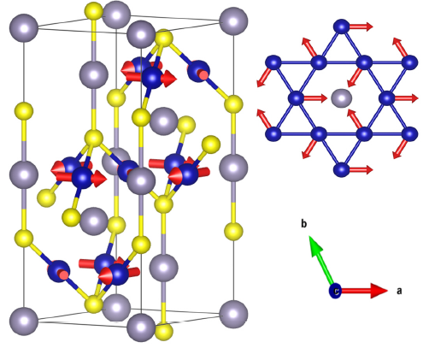
What can μSR do in this material ?
arXiv: 1904.09353
In-plane antiferromagnetic order ?

Slide 18
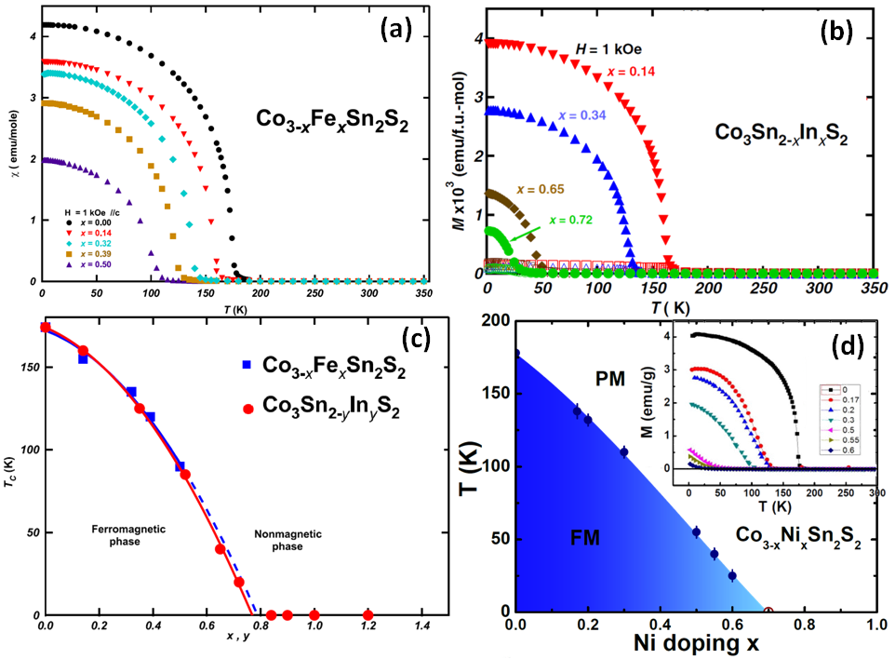
Doping effect on magnetism
PhD. Dissertation of Dr. M. A. Kassem, Kyoto University (2017).

Slide 19
Doping effect on magnetism
J. Cryst. Growth. 426, 208 (2015). J. Solid State Chem. 233, 8 (2016).
Physica B 378, 1142 (2006). Physica Status Solidi 10, 1130(2013).

Slide 20
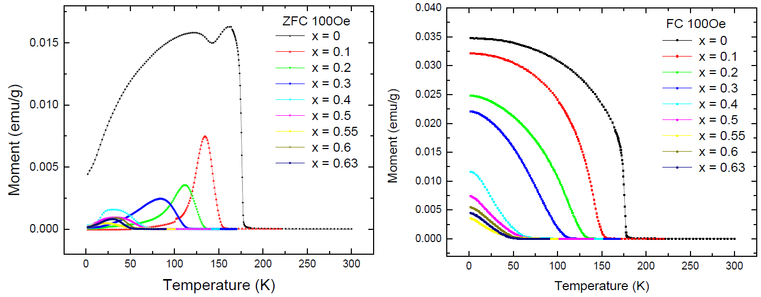
Doping effect on Co_{3-x}Ni_{x}Sn₂S₂
Liu, Shen, et al., unpublished manuscript

Slide 21
Conclusion
Co_{3-x}Ni_{x}Sn₂S₂ MWSM
3D ferromagnetic interactions with strong SOC;
Complex magnetic structure between T_{c} and T_{A} ;
Doping suppress ferromagnetism and affect on AHE;
AF order vanishes above x=0.7 (possible FM QCP ?);

Slide 22


Thanks
http://sc8.iphy.ac.cn/
hqluo@iphy.ac.cn

