Slide 1
Time reversal symmetry breaking in fully-gapped superconductors
Michael Smidman
Center for Correlated Matter and Department of Physics
Zhejiang University, China

Slide 2
Acknowledgements
Zhejiang University
Z. F. Weng
J. Chen
G. M. Pang
J. L. Zhang
T. Shang
L. Jiao
W. B. Jiang
Y. Chen
L. Yang
F. Steglich
H. Q. Yuan
M. Nicklas
(MPI-Dresden)
T. Shang
J. Verezhak
T. Shiroka
(PSI Facility)
D. Hillier
D. T. Adroja
(ISIS Facility)
G. Balakrishnan
D. M. Paul
(Warwick)
R. P. Singh
(IISER-Bhopal)
Theory
S. K. Ghosh
J. Quintanilla
(U. Kent, UK)
J. F. Annett
(U. Bristol, UK)

Slide 3
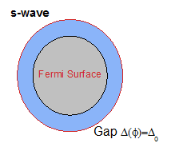
Broken symmetry in unconventional superconductors
In the superconducting state, U(1) gauge symmetry is broken
below T_{c}
In unconventional superconductors additional symmetries are often broken, e.g.
Rotational symmetry
Time reversal symmetry

Slide 4
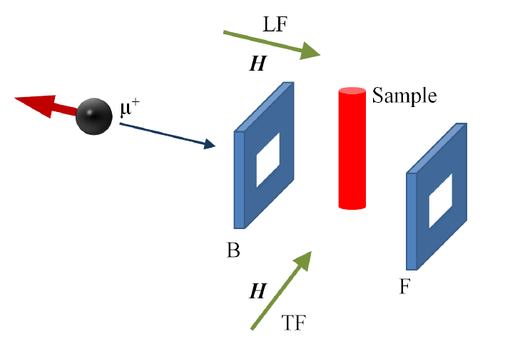
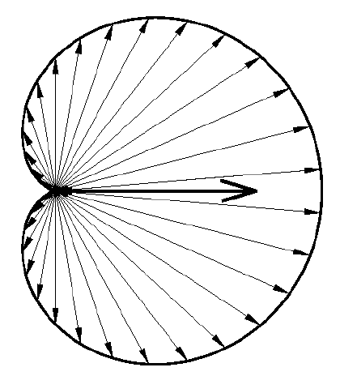
Detecting TRS breaking: μSR
Static Gaussian field distribution P(B) of width σ/γ_{μ}
ZF-spectra analyzed considering Lorentzian and Gaussian relaxation

Slide 5
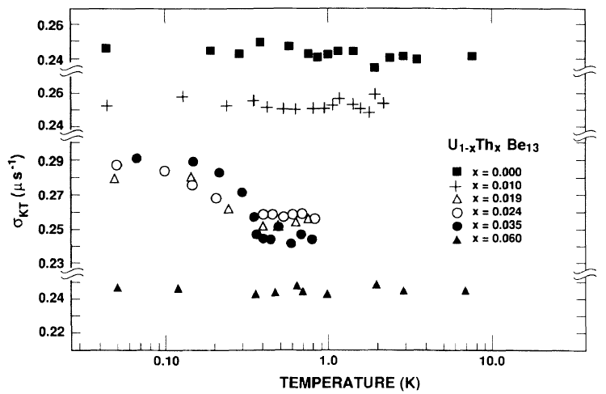
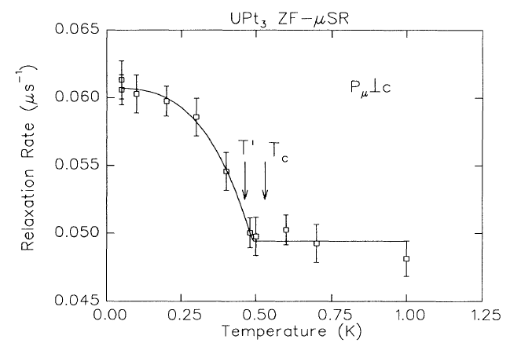
TRS breaking: ‘Classic examples’
U_{1-x}Th_{x}Be₁₃
Heffner et al. PRL 65, 2816 (1990)
UPt₃
Luke et al. PRL 71, 1466 (1993)

Slide 6
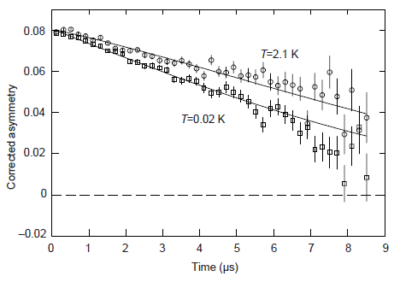
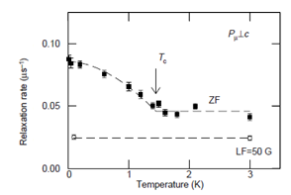
TRS breaking: ‘Classic examples’
Sr₂RuO₄
Luke et al. Nature 394, 558-561 (1999)

Slide 7
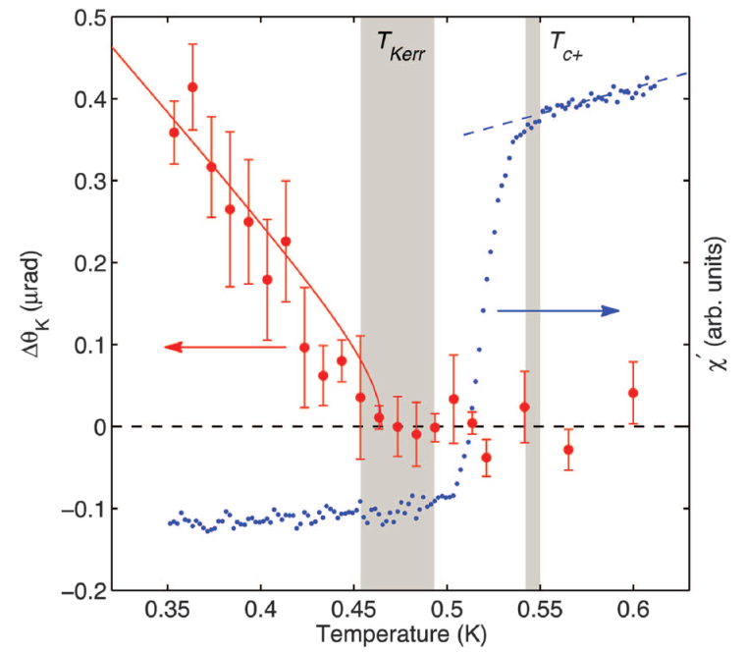
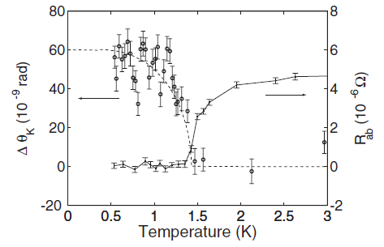
TRS breaking: ‘Classic examples’
Sr₂RuO₄
Xia et al. PRL 97, 167006 (2006)
UPt₃
E. R. Schemm et al. Science 345, 6193 (2014)
Evidence for TRS breaking in Sr₂RuO₄ and UPt₃ from both μSR and Kerr effect
Strongly correlated magnetic systems: unconventional SC anticipated

Slide 8
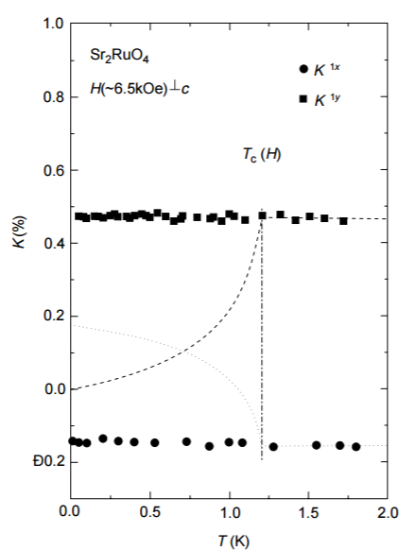
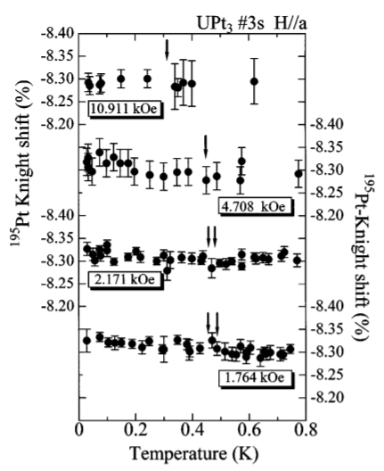
Nodal triplet superconductivity: Sr₂RuO₄ and UPt₃
Sr₂RuO₄
K. Ishida et al. Nature 396, 658 (1998)
UPt₃
H. Tou et al. PRL 80, 3129 (1998)
Knight shift measurements indicate triplet pairing

Slide 9
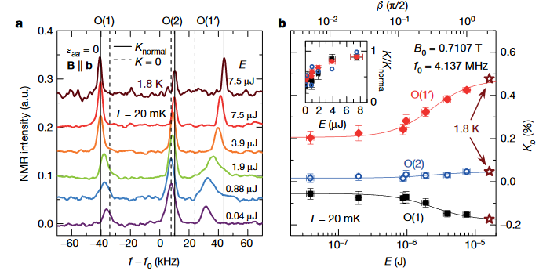
Or do they?
Sr₂RuO₄
A. Pustogow et al. Nature 574, 72–75(2019)

Slide 10
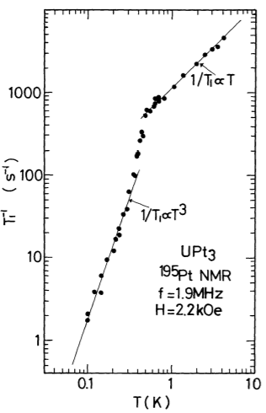
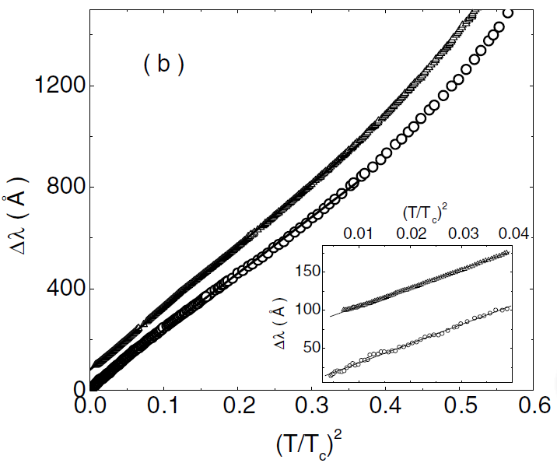
Nodal superconductivity: Sr₂RuO₄ and UPt₃
Bonalde et al. PRL 85, 4775 (2000)
Kohori et al. JPSJ 57, 395 (1988)
Sr₂RuO₄: Penetration depth: Δλ~T².
UPt₃: T³ dependence of 1/T₁.
Evidence for nodal superconductivity

Slide 11
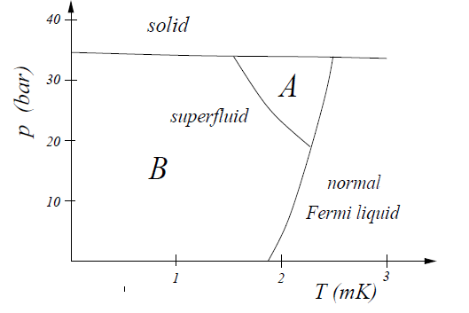
TRS breaking and triplet superconductivity
Triplet order parameter:
Unitary:
Not all unitary triplet states break TRS!
Sr₂RuO₄: chiral p-wave (E_{u})
Non-zero orbital moment L = +/-1
e.g Balian – Werthamer phase
c.f. B-phase of ³He
UPt₃: E_{2u} state
N.B. Singlet E_{1g} also break TRS (see also s+id)
R. Balian and N. R. Werthamer Phys. Rev. 131, 1553 (1963)
AIP Conf. Proc. 789, 165 (2005)

Slide 12
TRS breaking and triplet superconductivity
Triplet order parameter:
Non-unitary:
E.g. A₁ phase of ³He
AIP Conf. Proc. 789, 165 (2005)

Slide 13
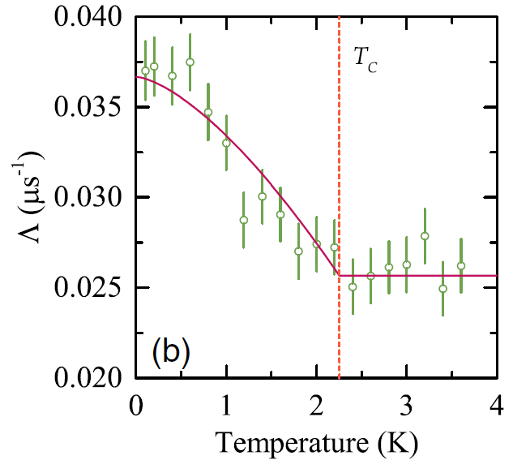
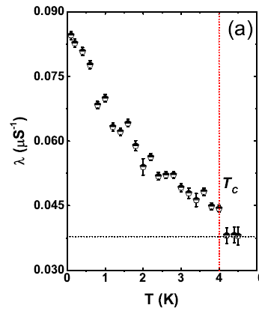
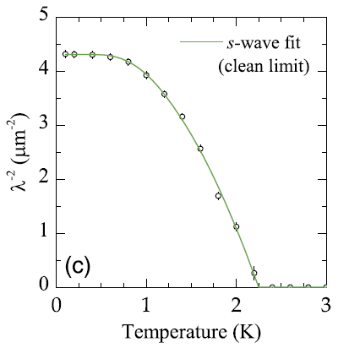
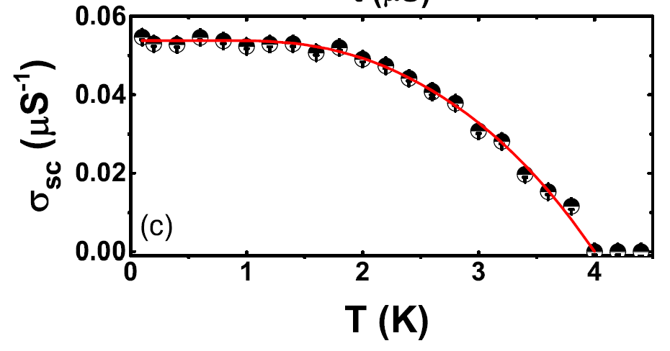
TRS breaking with fully open gaps
ZF-μSR
ZF-μSR
TF-μSR
TF-μSR
Re₆Zr
Singh et al. PRL 112, 107002 (2014)
Lu₅Rh₆Sn₁₈
Bhattacharyya et al. PRB. 91, 060503(R) (2015)
La₇Ir₃
Barker et al. PRL 115, 267001 (2015)
Non-centrosymmetric
Non-centrosymmetric
Centrosymmetric

Slide 14
Two nodeless gaps in LaNiC₂ and LaNiGa₂ – triplet pairing with even parity

Slide 15
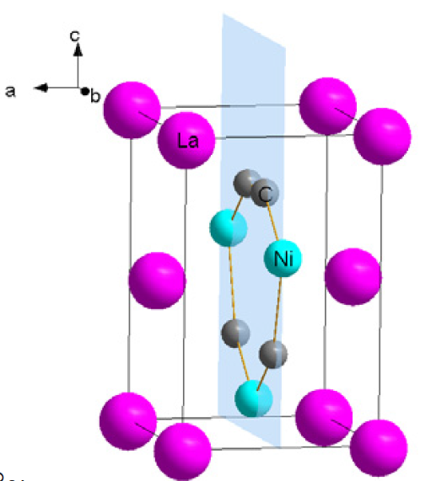
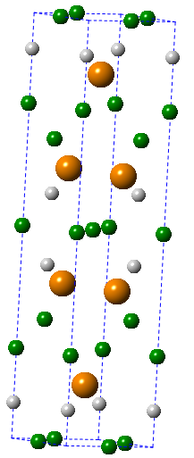
The case of LaNiC₂ and LaNiGa₂
LaNiC₂
Orthorhombic noncentrosymmetric
LaNiGa₂
Orthorhombic centrosymmetric

Slide 16
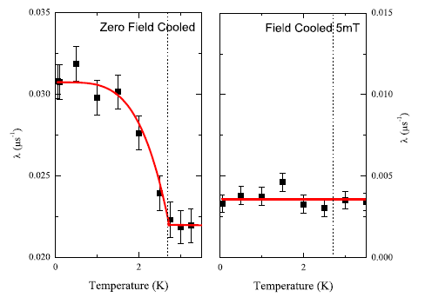
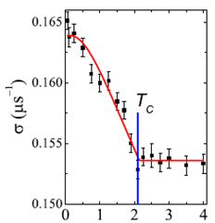
TRS breaking in LaNiC₂ and LaNiGa₂
LaNiC₂
Hillier et al. PRL 102, 117007 (2009)
LaNiGa₂
Hillier et al. PRL 109, 097001 (2012)
Zero field μSR indicates that TRS is broken in both LaNiC₂ and LaNiGa₂

Slide 17
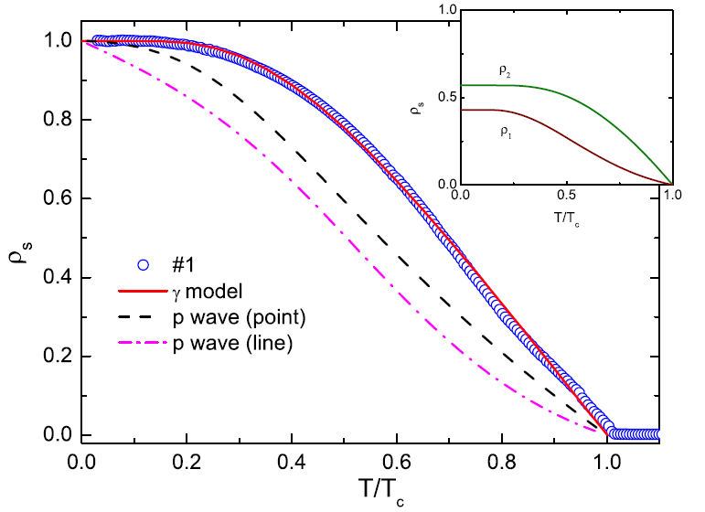
Penetration depth and superfluid density
TRS breaking and nodeless, two gap superconductivity are common features of LaNiC₂ and LaNiGa₂
J. Chen et al. New J. Phys. 15, 053005 (2013)
Z. F. Weng et al. Phys. Rev. Lett. 117, 027001 (2016)

Slide 18
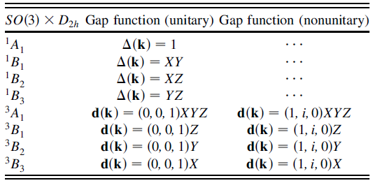
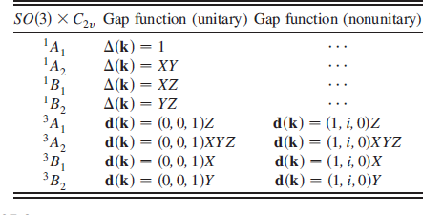
TRS breaking in LaNiGa₂ and LaNiC₂
TRS breaking spin-singlet or unitary triplet pairing
Symmetry analysis of the point group:
All the irreps of G_{c} are one dimensional and the TRS breaking states are all non-unitary triplet
[PRL 102, 117007 (2009), PRL 109, 097001 (2012)]
2. Odd parity, non-unitary spin triplet states.
All the odd parity, triplet TRS breaking states have nodes

Slide 19
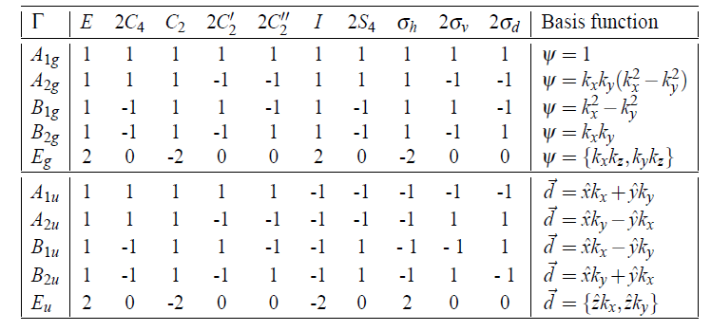
TRS breaking in LaNiGa₂ and LaNiC₂
Cf. Unitary chiral p-wave state in Sr₂RuO₄ – point group D_{4h}
AIP Conf. Proc. 789, 165 (2005)
Two dimensional E_{u} representation:
TRS breaking chiral p-wave state: (a₁,a₂) = (1,i)

Slide 20
TRS breaking in LaNiGa₂ and LaNiC₂
3. Multiband superconductivity with a non-trivial phase difference, e.g. s+id, d+id
Two-bands
Multidimensional order parameter required to break TRS
Need a 2D or higher dimensional irrep
Orthorhombic structures of LaNiC₂ and LaNiGa₂:
G_{c} only has 1D irreps
SC state must correspond to 3D triplet irrep of SO(3)

Slide 21
TRS breaking in LaNiGa₂ and LaNiC₂
4. Singlet-triplet mixing due to ASOC
For LaNiC₂ with significant ASOC:"double group"
Irreps of the "double group" have the same dimensions as irreps of G_{c} - all are 1D
TRS breaking at T_{c} implies that the effect of ASOC in LaNiC₂ is very weak - negligible singlet-triplet mixing.
LaNiGa₂ is centrosymmetric - singlet-triplet mixing is forbidden
Quintanilla et al. PRB 82, 174511 (2010)

Slide 22
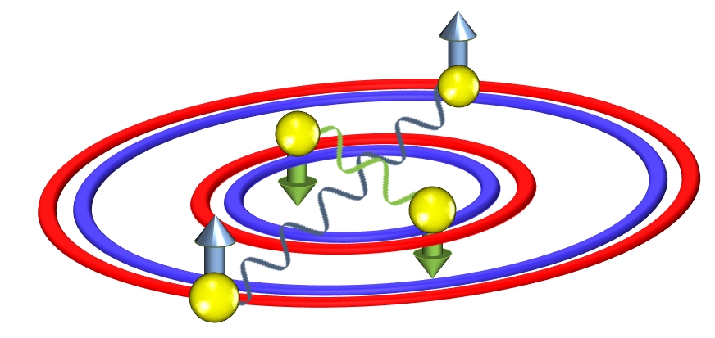
Reconciling TRS breaking and two fully open gaps in LaNiC₂ and LaNiGa₂
Conventional multiband superconductivity
Non-unitary triplet with even parity
Same spin pairing between orbitals: Two fully open gaps
Orbital: antisymmetric
Spin: symmetric
Parity: even
Z. F. Weng et al. Phys. Rev. Lett. 117, 027001 (2016)

Slide 23
What about when there are higher symmetries?

Slide 24
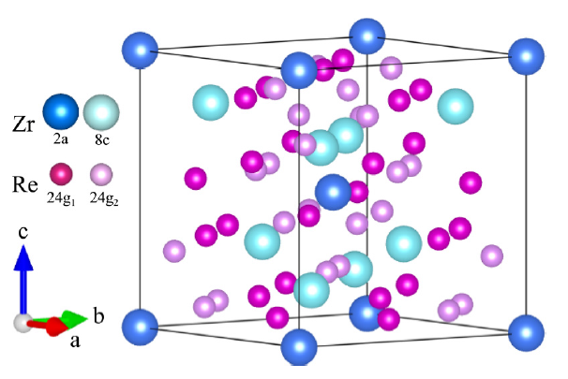
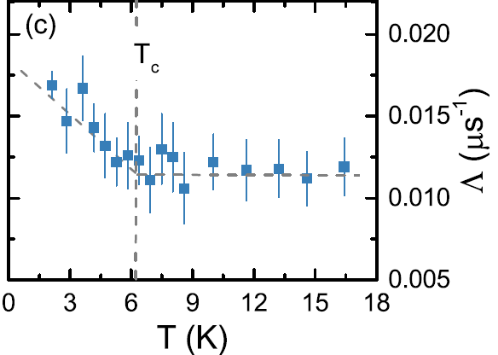
Re-based noncentrosymmetric superconductors
Cubic Re-based NCS (α-Mn structure):
TRSB + Singlet-triplet mixing not forbidden
Re₆Zr
Re₂₄Ti
Singh et al. PRL 112, 107002 (2014)
T. Shang et al. PRB 97 020502 (2018)

Slide 25
Re-based noncentrosymmetric superconductors
Re₆Zr: Superfluid density consistent with single-gap s-wave superconductivity.
G. M. Pang et al. PRB 97, 224506 (2018)

Slide 26
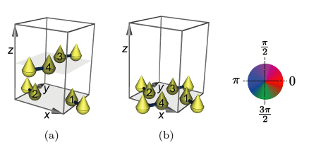
TRS breaking with conventional pairing?
More than two atoms per cell related by certain symmetries
Onsite conventional electron-phonon pairing interaction
Change of phase of pairing wavefunction in real space
Circulating loop currents => broken TRS
S. K. Ghosh et al. arXiv:1803.02618

Slide 27
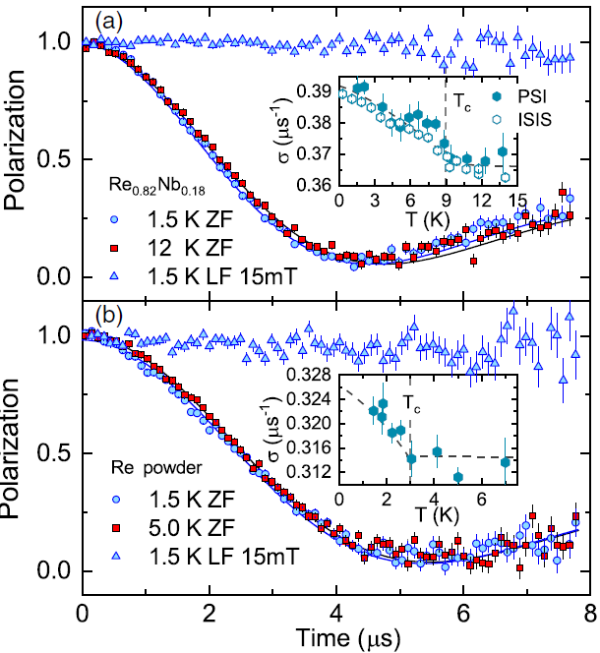
Importance of Re element?
Nb_{0.18}Re_{0.82} (α-Mn structure) and Re element:
Broken TRS below T_{c}
Re is centrosymmetric and loop current cannot explain TRS breaking
Local electronic structure of Re important?
T. Shang et al., PRL. 121, 257002 (2018)

Slide 28
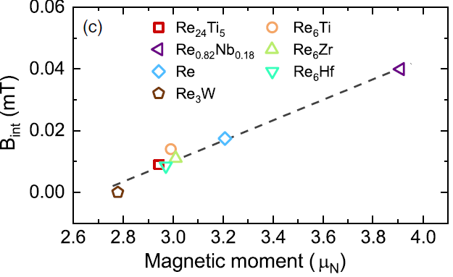
Correlation with nuclear moments?
T. Shang et al., PRL, 121, 257002 (2018)

Slide 29
Summary
Growing number of materials show evidence for broken TRS with a fully open gap
Open questions:
What is the origin of the TRS breaking?
What is the nature of the pairing state?
Are the pairing states/mechanism conventional?
Low symmetry of LaNiC₂/LaNiGa₂ means that broken TRS at T_{c} implies non-unitary triplet pairing => even-parity triplet state
Other systems have more possibilities, e.g. cubic Re-based NCS, can these be explained by a conventional pairing mechanism?

Slide 31
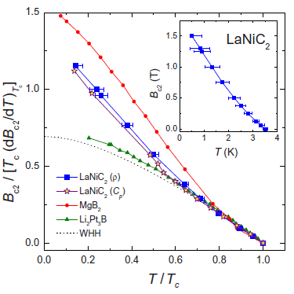
LaNiC₂: Specific heat and upper critical field
Specific heat and B_{c2}(T) also indicate two-gap superconductivity
J. Chen et al. New J. Phys. 15, 053005 (2013)

Slide 32
LaNiGa₂: Specific heat and upper critical field
Specific heat and B_{c2}(T) further support two-gaps
 | Δ₁ | Δ₂ | x
LaNiC₂ | 1.2k_{B}T_{c} | 2.0k_{B}T_{c} | 0.3
LaNiGa₂ | 1.29k_{B}T_{c} | 2.04k_{B}T_{c} | 0.43

Slide 33
Further evidence for unconventional superconductivity
Prediction of spontaneous magnetization below T_{c}
Some evidence for this in measurements of LaNiC₂ single crystals but no reports yet of LaNiGa₂ single crystals

Slide 34
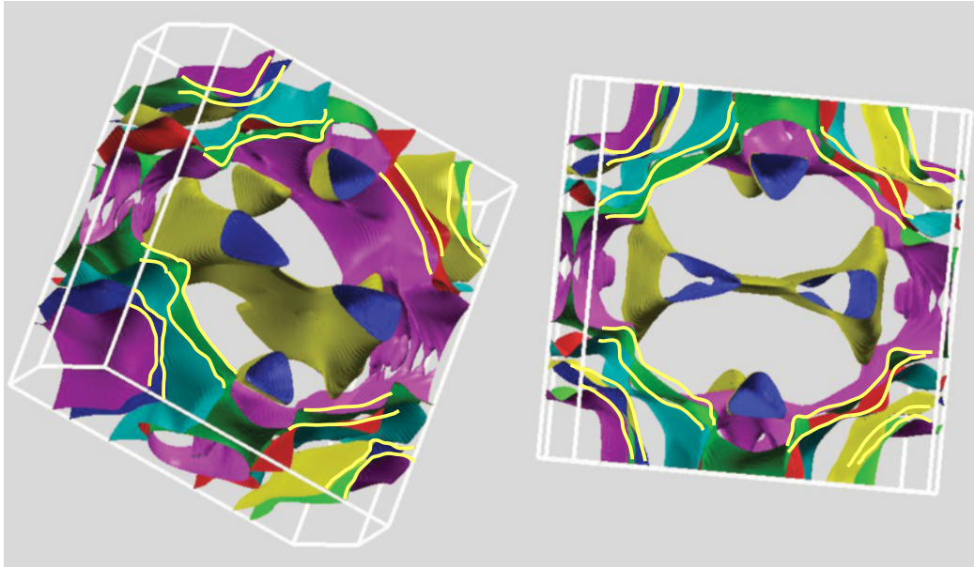
Fermi surface of LaNiGa₂
D. Singh PRB 86, 174507 (2012)

Slide 35
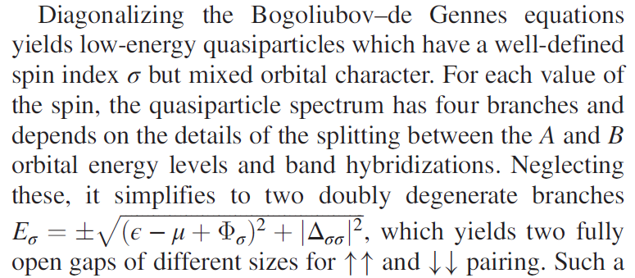
Mean field theory
Two mean fields:
Z. F. Weng et al. Phys. Rev. Lett. 117, 027001 (2016)

Slide 36
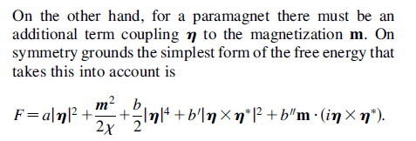
GL theory for paramagnetic non-unitary triplet
Condition for non-unitary triplet:
Hillier et al. PRL 109, 097001 (2012)

Slide 37
T. Shang et al., PRL, 121, 257002 (2018)

Slide 38
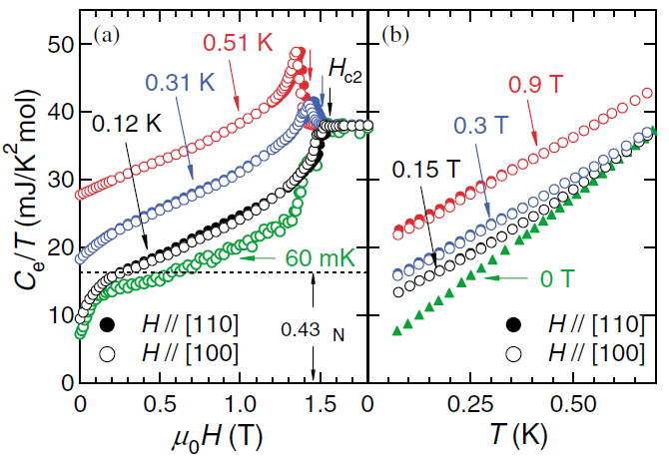
Classic examples of SC with broken TRS: Sr₂RuO₄
Penetration depth
Specific heat
I. Bonalde et al. PRL 85.4775 (2000)
K. Deguchi et al. PRL 92.047002 (2004)
Penetration depth: Δλ~T².
Specific heat: C_{e}/T~T.
Evidence for nodal SC in Sr₂RuO₄.

Slide 39
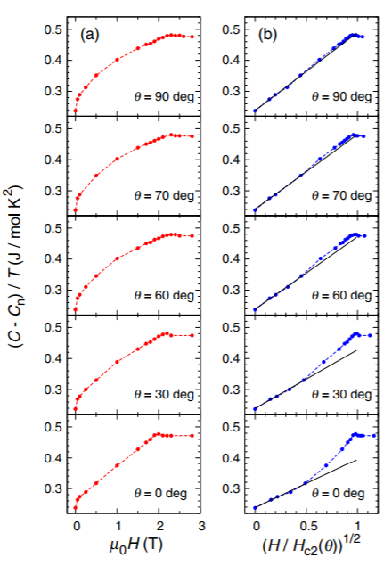
Classic examples of SC with broken TRS: UPt₃
NMR
Specific heat
Y. Kohori et al. JPSJ.57.395 (1988)
T³ dependence of 1/T₁.
H^{1/2} field dependent specific heat at low temperatures.
➔ Evidence for line nodes in UPt₃.
S. Kittaka et al. JPSJ.82.024707 (2013)

Slide 40
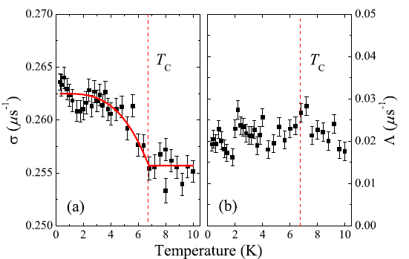
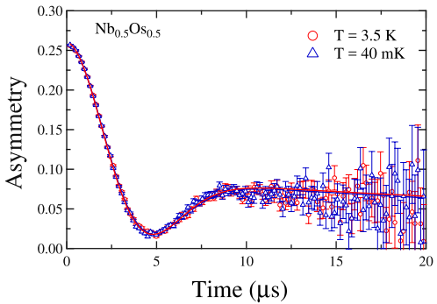
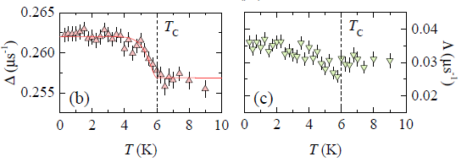
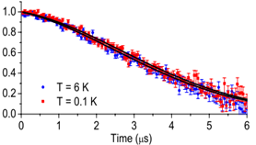
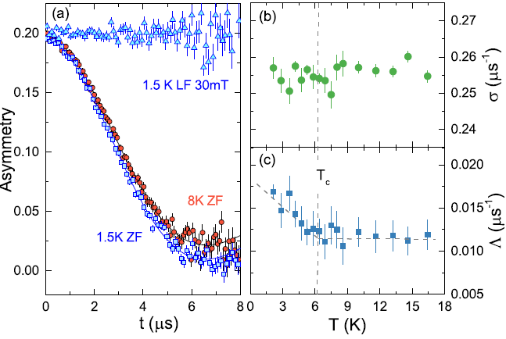
Re₂₄T₅ (T=Zr, Ti, Nb, Hf…) :
A family of TRS breaking Non-centrosymmetric SCs
Re₆Zr
Nb_{0.5}Os_{0.5}
Singh, PRL 112, 107002 (2014)
Singh, JPCM, 30 075601 (2018)
Re₆Hf
Mg₁₀Ir₁₉B₁₆
Asymmetry
Singh, Phys. Rev. B 96, 180501 (2017)
Re₂₄Ti₅
Aczel, PRB, 82, 024520(2010)
Onset of spontaneous magnetic field at T_{c} in Re₂₄T₅.
TRS is preserved in some isostructural compounds!
Local electronic structure is crucial for TRS breaking.
Shang, Phys. Rev. B 97, 020502 (2018)

