Slide 1
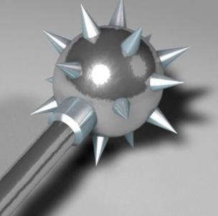
Muonium to antimuonium conversions at EMuS
Jian Tang (唐 健)
Dec. 14, 2019
The second workshop on CSNS Muon Source Multidisciplinary applications
In collaboration with
Jing-Yu Tang, Yu Bao, Hai-Bo Li, Ye Yuan, Yao Zhang, Tian-Yu Xing
Yu Chen, Zi-Xin Wang, Sampsa Vihonen, Tse-Chun Wang, etc.
?
e⁻
e⁺
μ⁺
μ⁻
MACE
狼牙棒
Muonium to Antimuonium Conversion Experiment(MACE)

Slide 2
Table of contents
High-intensity frontier with accelerator muons
Progress of the first accelerator muons source in China
Search for muonium → antimuonium at EMuS
Summary

Slide 3
Table of contents
High-intensity frontier with accelerator muons
Progress of the first accelerator muons source in China
Search for muonium → antimuonium at EMuS
Summary

Slide 4
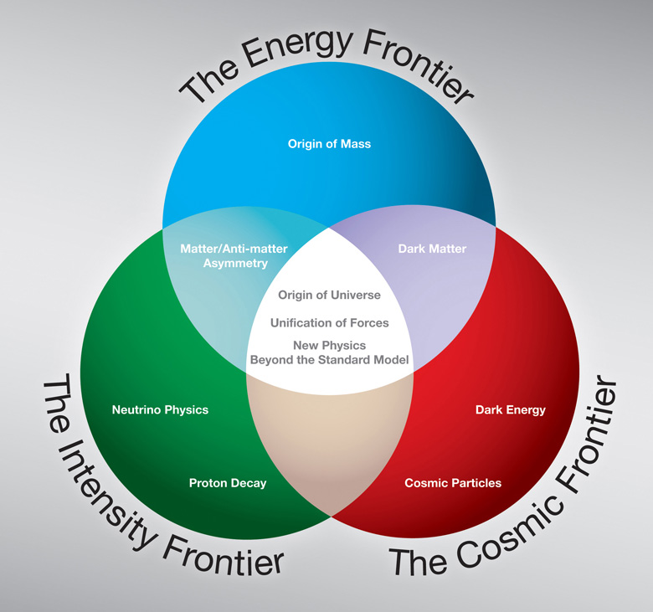
Three frontiers in Particle Physics
High-energy frontier
High-intensity frontier
Cosmic Frontier
Search for new physics beyond SM:
What's the origin of mass?
Matter-antimatter asymmetry?
What is DM?
……

Slide 5
High-intensity/high-precision frontier
Neutrino experiments
  T2K, NOvA, T2HK, DUNE…
  JUNO, MOMENT…
cLFV：
  Mu2e(美国)
  COMET(日本)
  MEG(瑞士)
LNV：
  Mu3e(瑞士)
Precision measurements of µ：
  MuLan&FAST at PSI: µ lifetime.
  MuCap at PSI: couplings for µ captures.
  MuSun to measure electroweak interactions and polarizations.
  TWIST at TRIUMF to measure parameters in weak decays.
  g-2 at FNAL to measure magnetic moment.
  MeuSEUM at J-PARC to measure muonium hyper-fine structure.

Slide 6
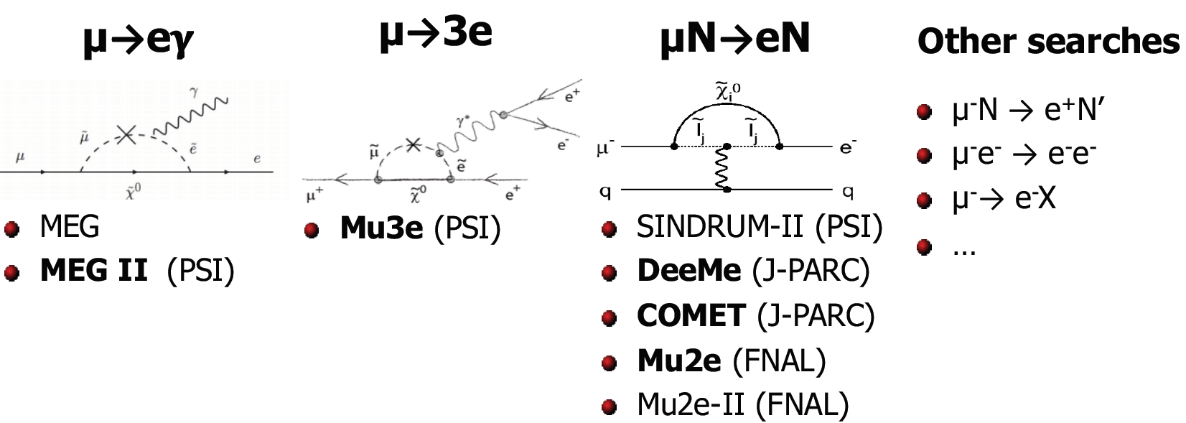
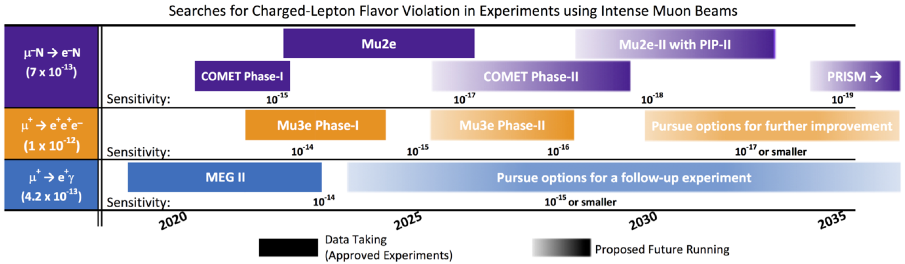
Global accelerator muon-based experiments：cLFV

Slide 7
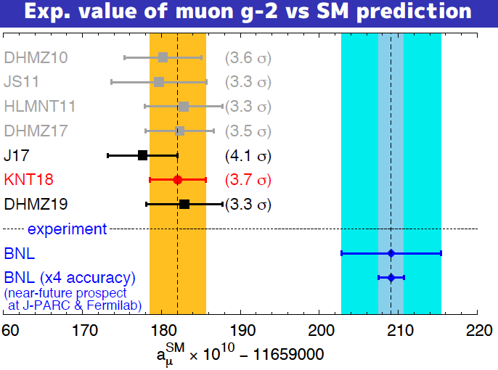
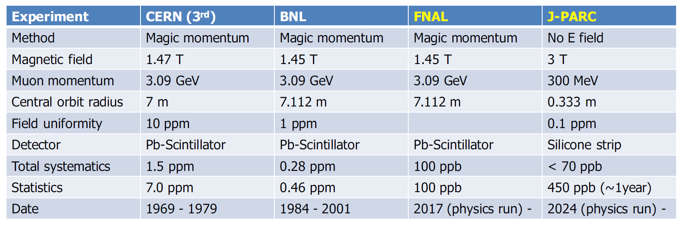
Global accelerator muon-based experiment: g-2
Exp. v.s SM
Ref:
D. Nomura,
@NuFact2019

Slide 8
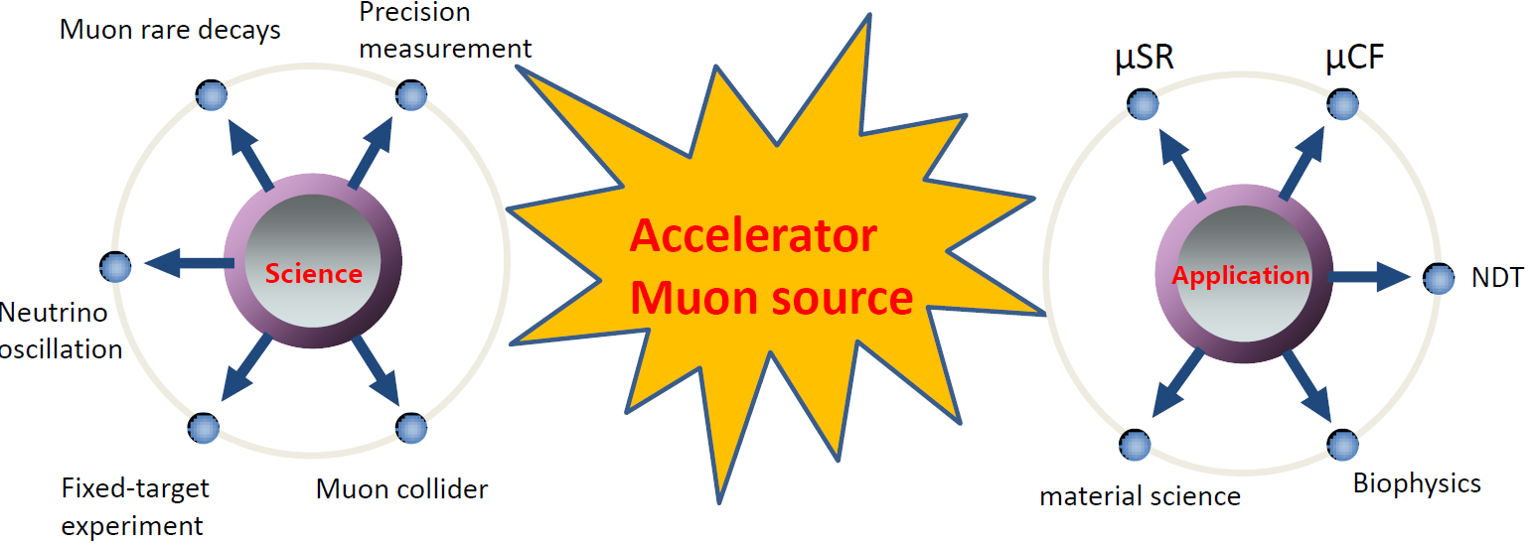
Science and technology with an acceletor muon source
μSR: Muon Spin Relaxation, Rotation and Resonance.
µCF: µ Catalyzed Fusion.

Slide 9
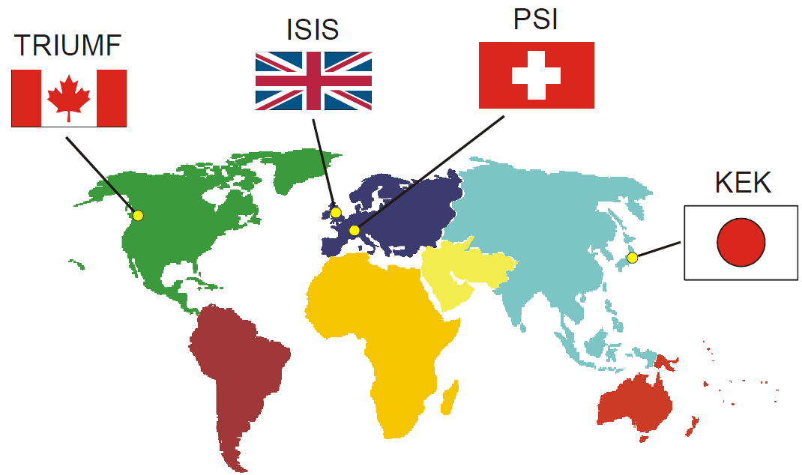

Accelerator muon souces all over the world
USA
There are lots of accelerator muon sources for almost every accelerator center.

Slide 10
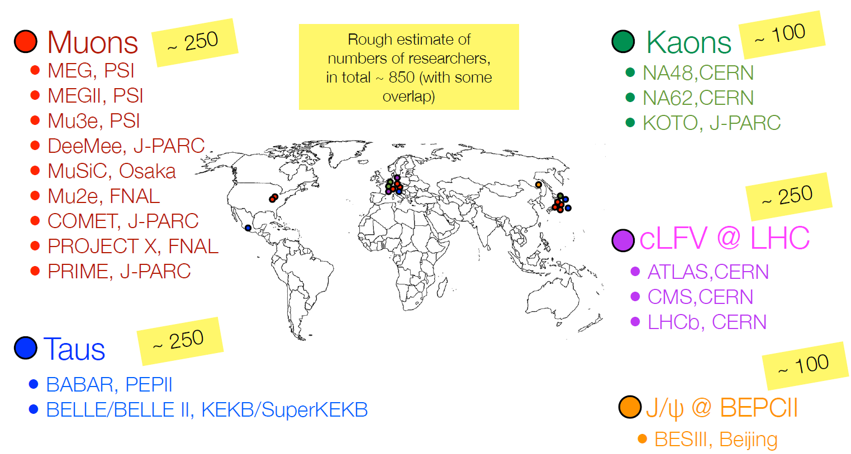
Status of cLFV
Credits: A. Papa@PSI2019

Slide 11
Table of contents
High-intensity frontier with accelerator muons
Progress of the first accelerator muons source in China
Search for muonium → antimuonium at EMuS
Summary

Slide 12

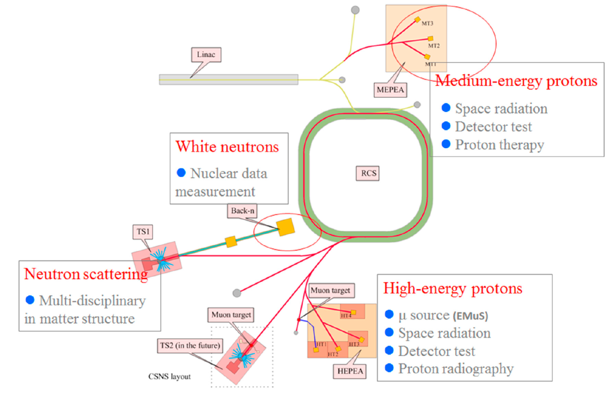
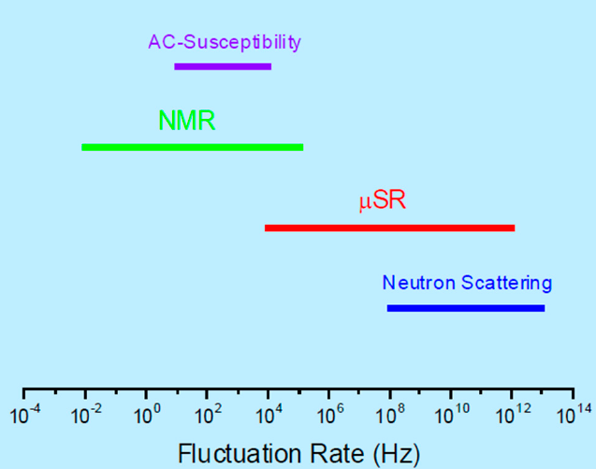
EMuS based on CSNS
Build the first accelerator muon source in China?
Courtesy Group Bernhard,
U. of Fribourg
USA
Courtesy: Jiang-Yu Tang

Slide 13
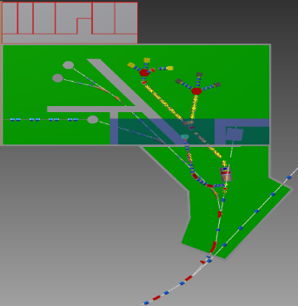
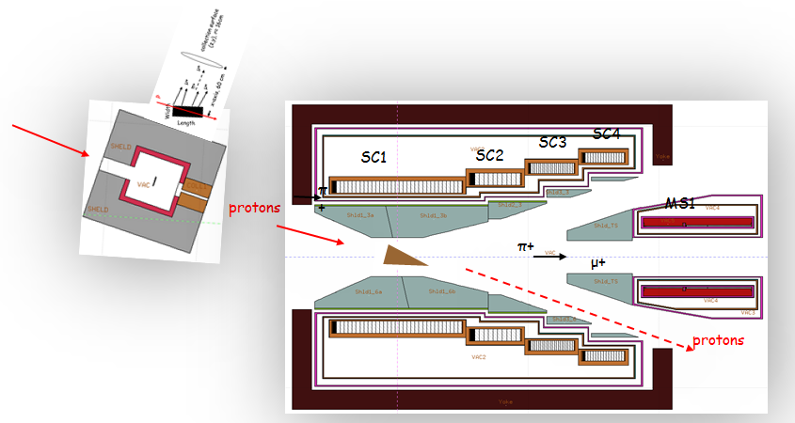
Overview of EMuS
EMuS
CDR
USA
Target station
Courtesy: IHEP唐靖宇团队
Courtesy:
IHEP袁野，Nikos，赵光等

Slide 14
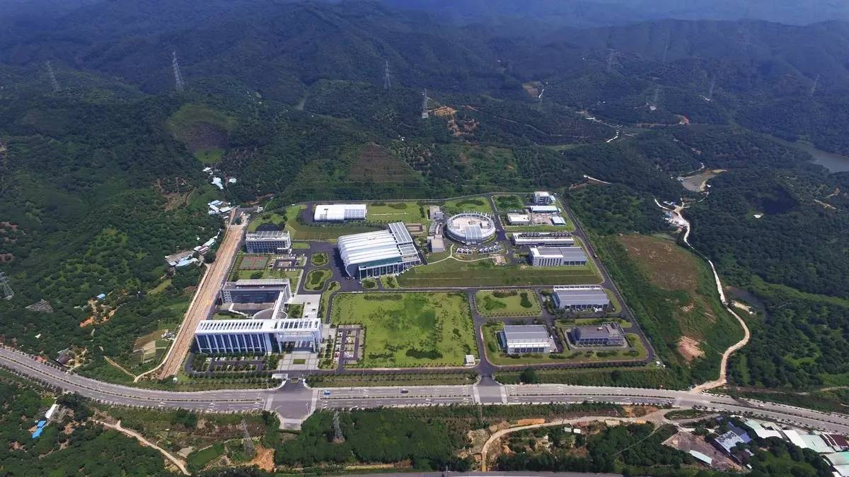
Overview of EMuS
Vertical beamline
Decay muons
Surface muons
Conceptual design of EMuS is almost done. Part of proposal in CSNS-II upgrade plan.
Superconductor solenoid might help to reach intensity 10⁹/s: X100 of PSI at 1999.
Muonium physics can be also conducted at ADS&HIAF with an even higher muon intensity.
Ref: slides@EMuS2019

Slide 15
EMuS in a comprison with international muon sources
 | Proton driver [MW] | Surface muons |  |  | Decay muons
 |  | Intensity [1E6/s] | Polarization [%] | Spread [%] | energy [MeV/c] | Intensity [1E6/s] | Spread [%]
PSI | 1.3 | 420 | 90 | 10 | 85-125 | 240 | 3
ISIS | 0.16 | 1.5 | 95 | <15 | 20-120 | 0.4 | 10
RIKEN/RAL | 0.16 | 0.8 | 95 | <15 | 65-120 | 1 | 10
JPARC | 1 | 100 | 95 | 15 | 33-250 | 10 | 15
TRIUMF | 0.075 | 1.4 | 90 | 7 | 20-100 | 0.0014 | 10
EMuS | 0.005 | 83 | 50 | 10 | 50-450 | 16 | 10
Baby EMuS | 0.005 | 1.2 | 95 | 10
×5 CSNS-II upgrade
Better extraction efficiency with SC solenoid.
Better muon sources with higher energy.
Plan to optimize the beamline for better polarization and higher intensity
Ref: slides @2019EMuS&MOMENT workshop in SYSU

Slide 16
Table of contents
High-intensity frontier with accelerator muons
Progress of the first accelerator muons source in China
Search for muonium → antimuonium at EMuS
Summary

Slide 17
High-intensity frontier
New physics with accelerator muon sources：
  Mu2e in US
  COMET in Japan
  MEG-II/Mu3e in Switzerland
  Muonium to Antimuonium Conversion Experiment(CSNS)
MACE
狼牙棒
Proposed at the international Review of EMuS last November.

Slide 18
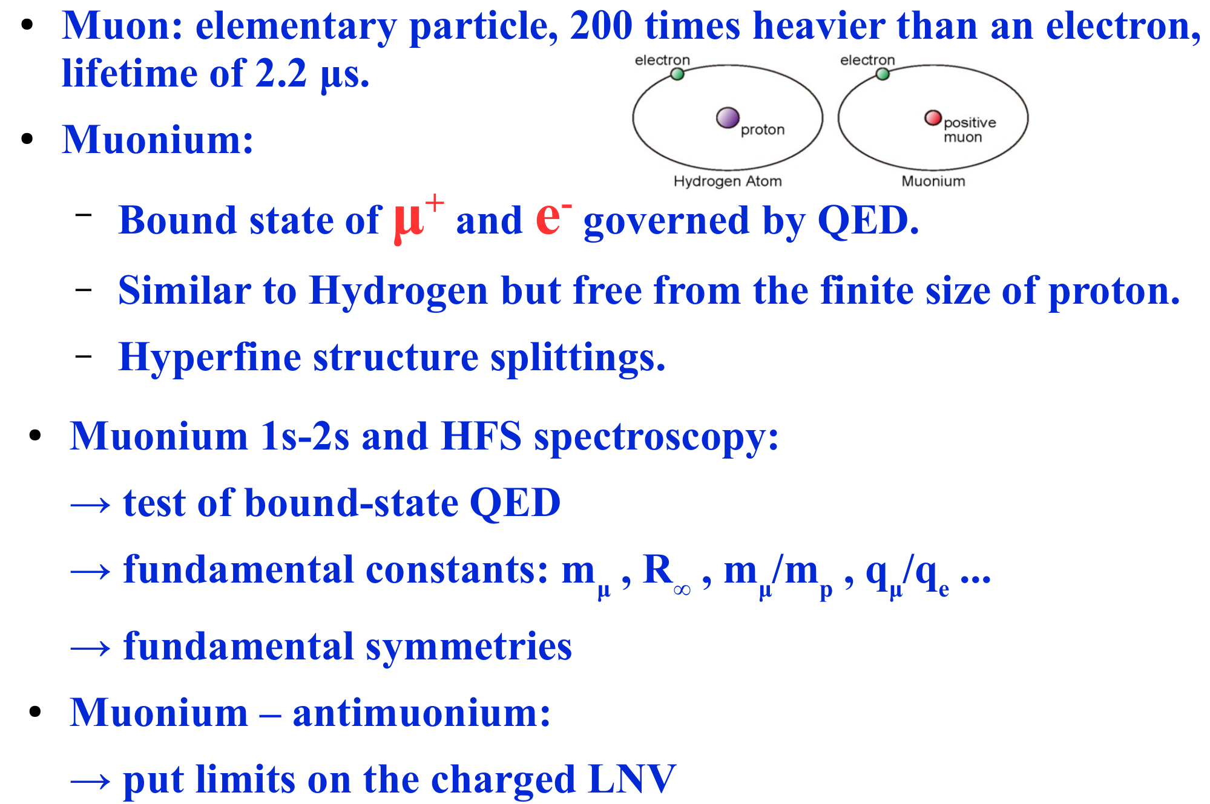
Why shall we choose Muonium?

Slide 19
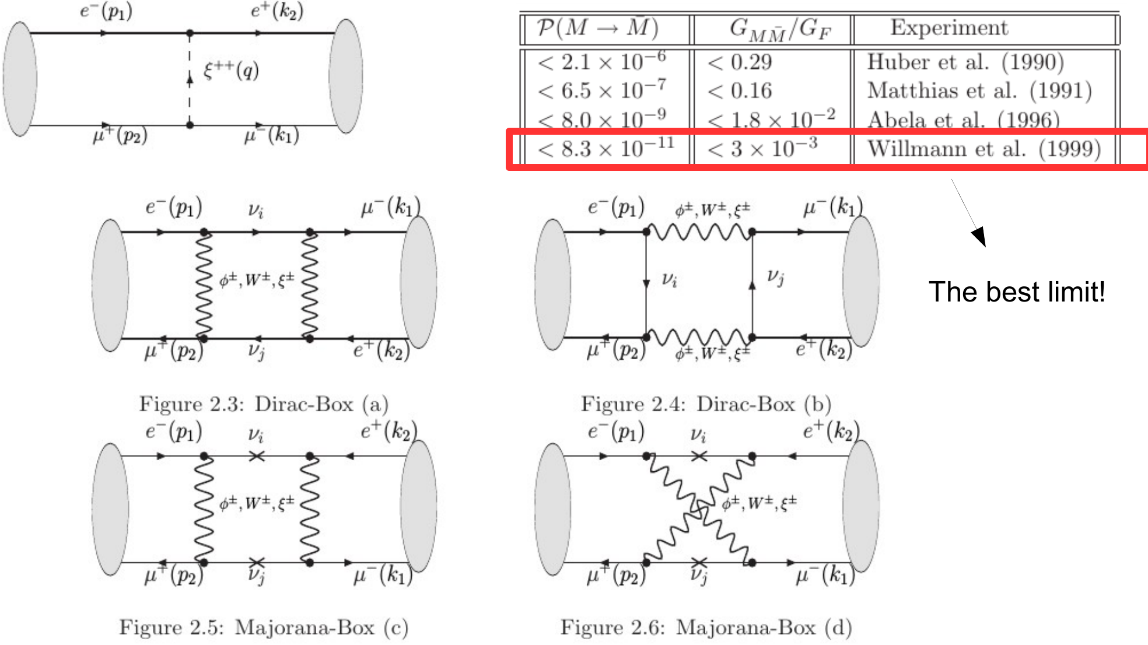
Muonium to antimuonium beyond SM.
Lepton flavour violation process beyond SM.
For example, predicted by type-II seesaw model.
Results 20 ago!!!

Slide 20
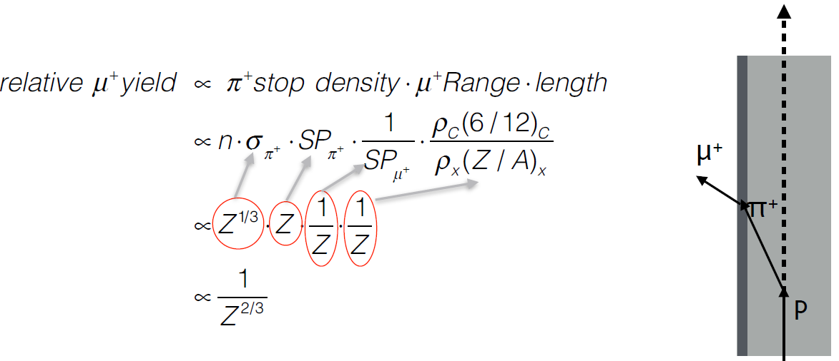
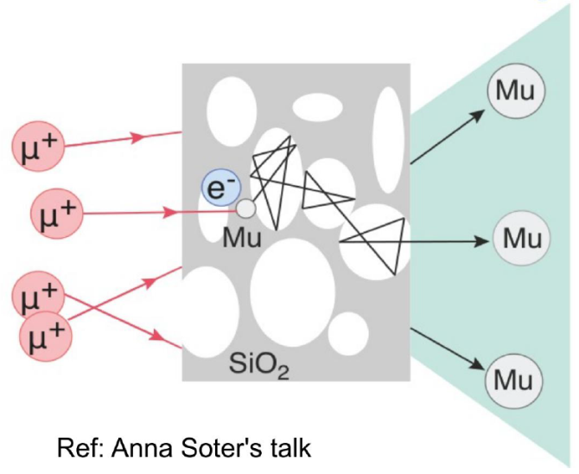
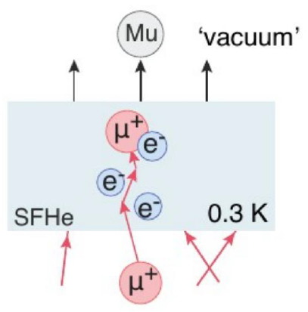
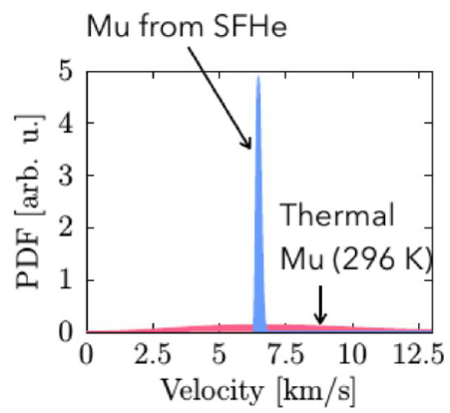
Muon and muonium productions
Silica powder
Super Fluid Helium
Increase efficiency

Slide 21
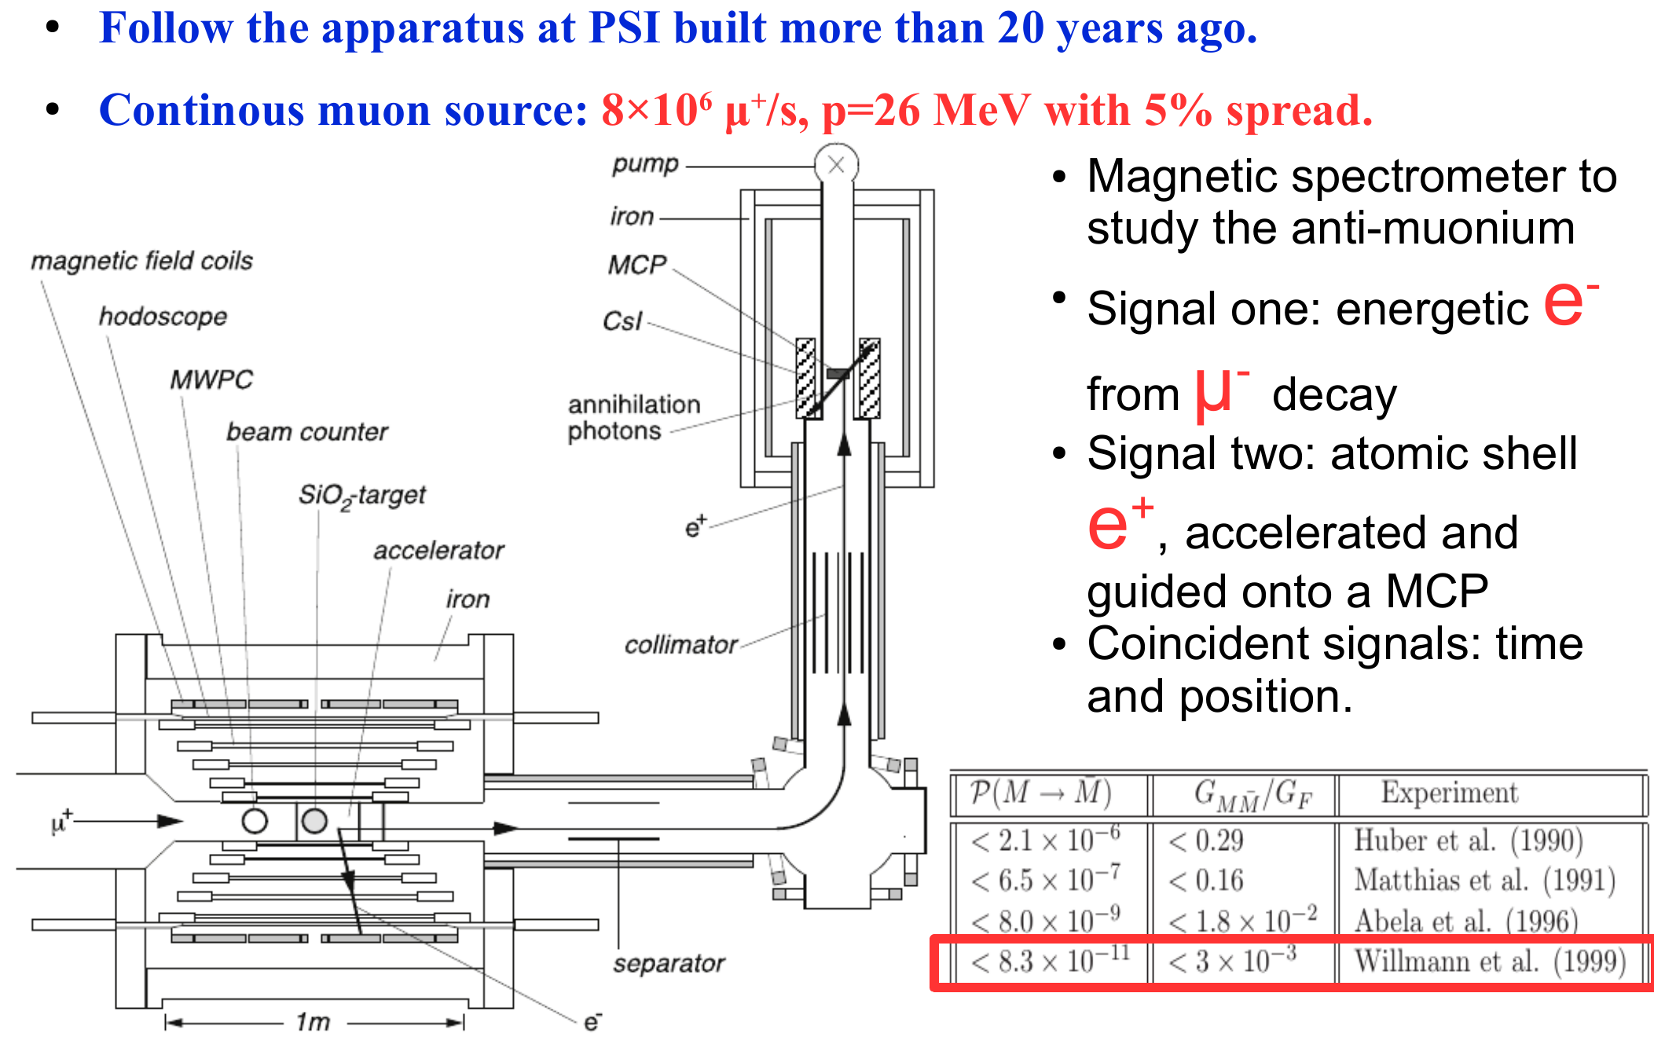
How to detect such a process?

Slide 22
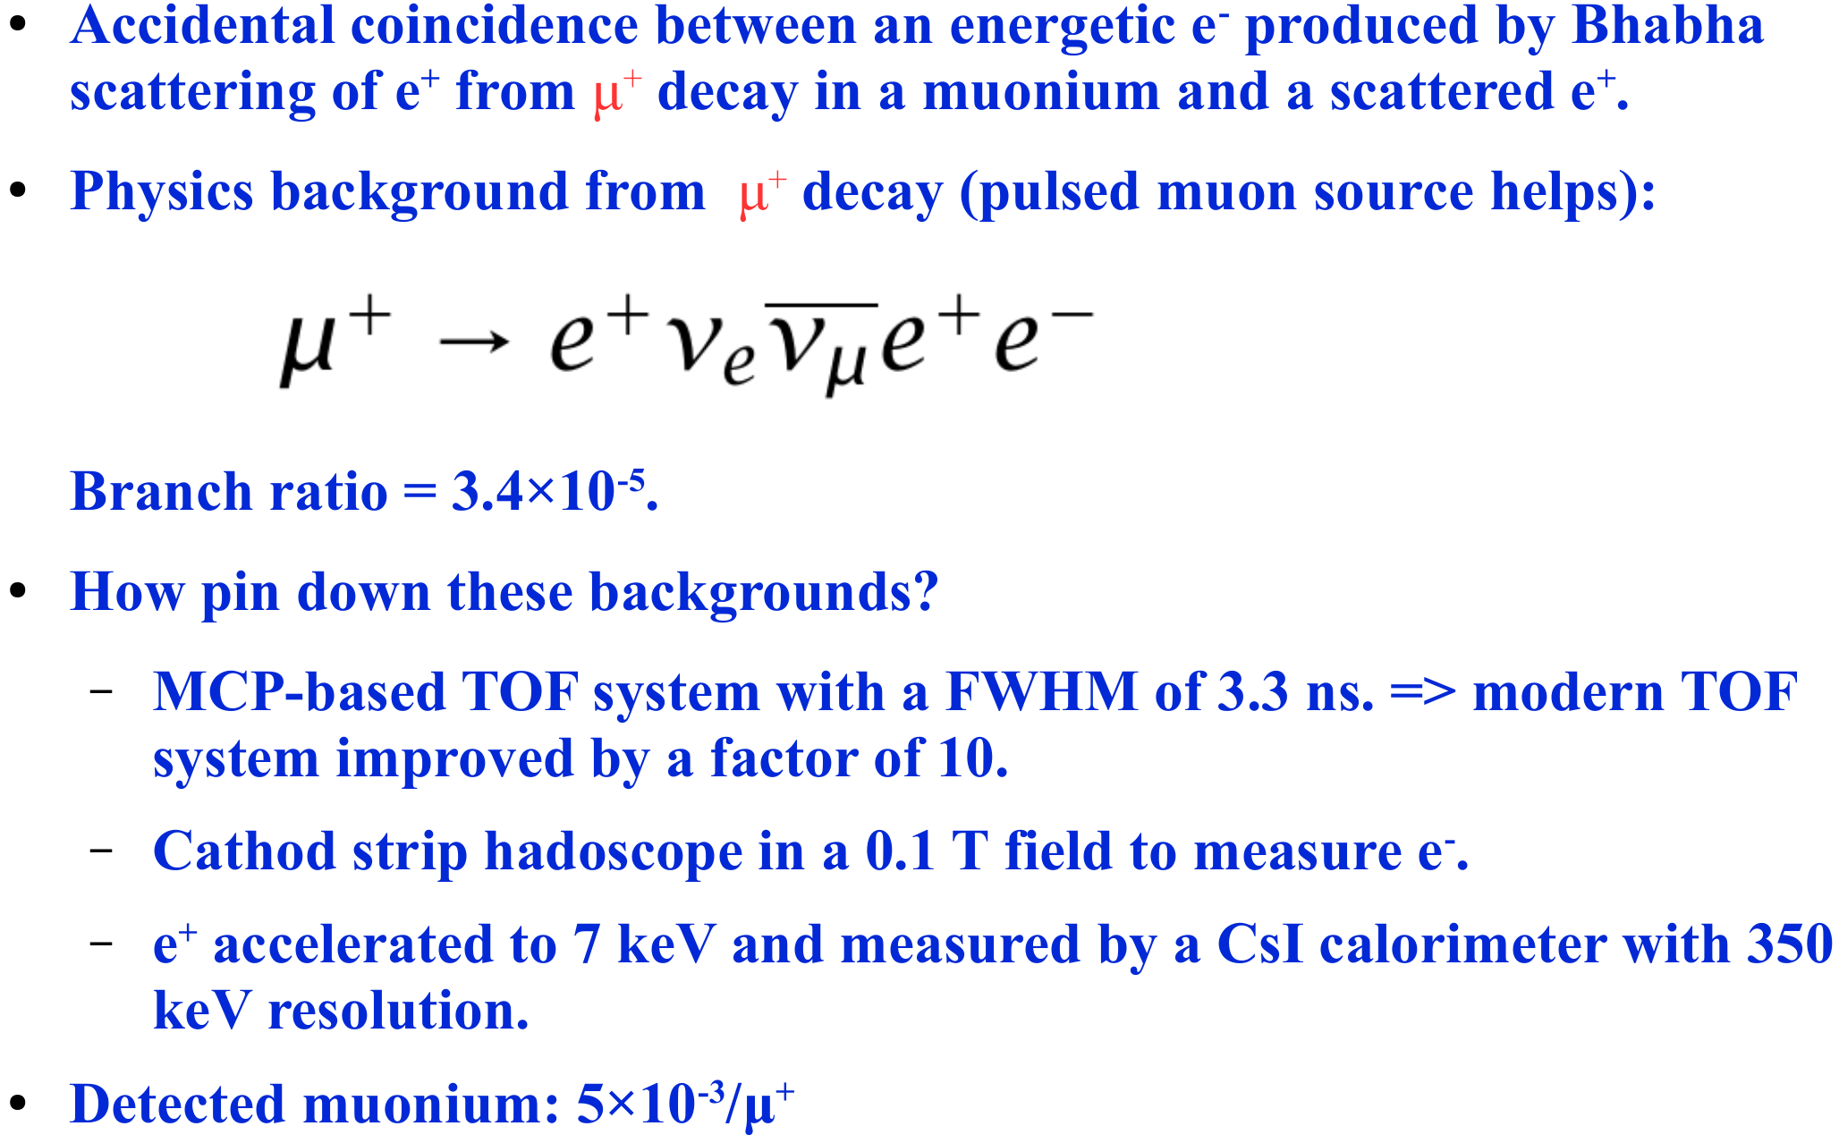
Major backgrounds in the latest measurements

Slide 23
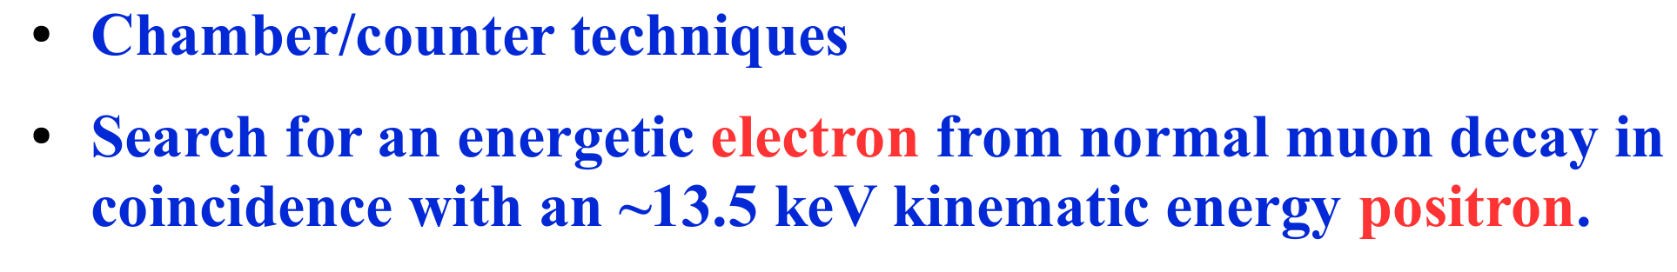
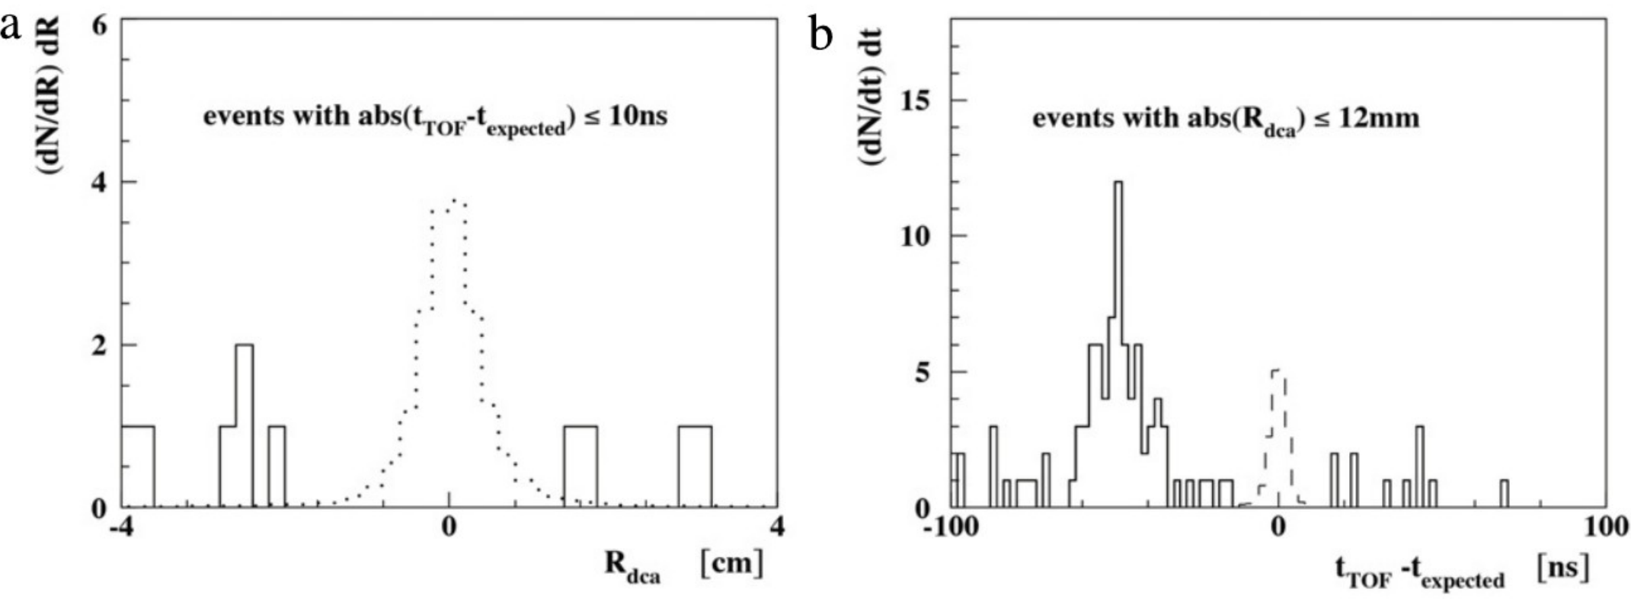
The analysis at PSI 20 years ago

Slide 24
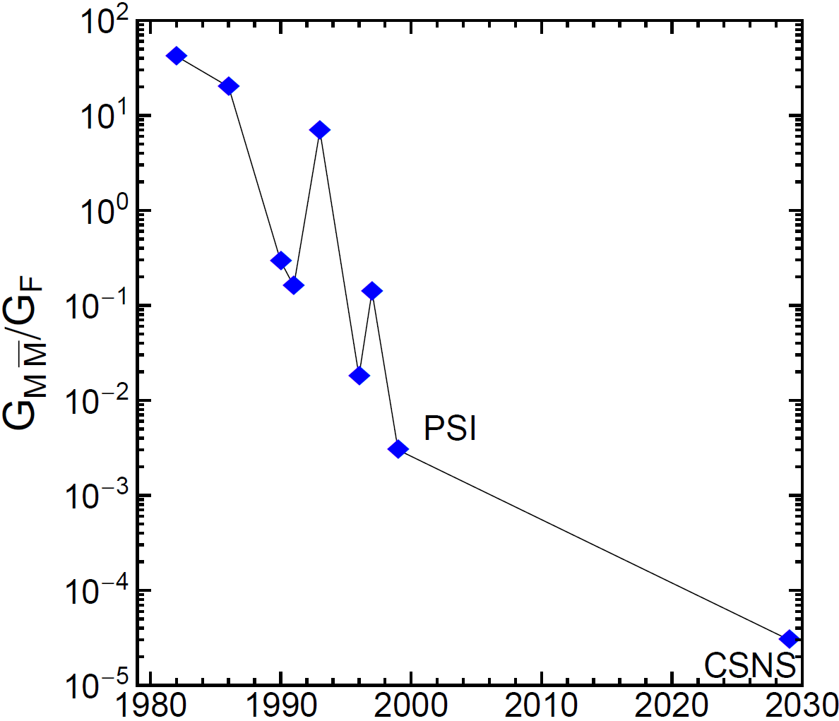
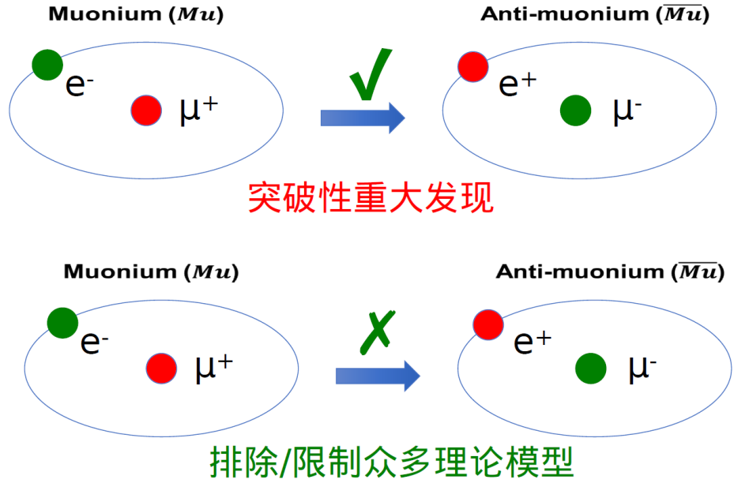
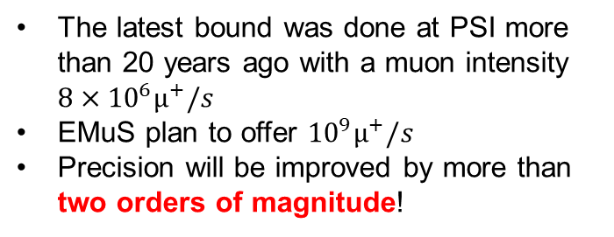
Fundamental science with EMuS
The latest bound was done at PSI more than 20 years ago with a muon intensity $8×{10}^{6}μ^{+}/s$
EMuS plan to offer ${10}^{9}μ^{+}/s$
Precision will be improved by more than two orders of magnitude!
No competitive experiments in other places.
We have a chance to make a breakthrough at the high intensity frontier.
24

Slide 25
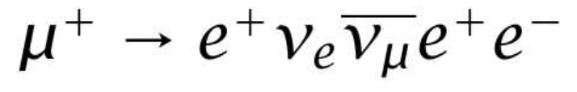
Preliminary design for the detector
Backgrounds:
μ⁺ decays to e⁺, Bhabha scattering to generate high-energy e⁻ in coincident with low-energy e⁺
μ⁺ decays:
Signal identifications:
High-energy electrons from μ⁻ decays
-- TPC
Thermal released low-energy positron:
-- BGO
MACE
狼牙棒
Preliminary design by Yu Bao

Slide 26
Recent progress in the R&D
Preliminary study:
  CDR of EMuS at CSNS was reviewed by international experts last November.
  R&D of muonium productions was first tested at PSI.
  Simulation tool for muon beamlines is almost finished.
  Cooperation with PSI, ISIS in RAL, RIKEN and Osaka U.
Platform support:
  CSNS will provide the high-intensity proton driver.
Team support:
  IHEP has a team of experts in R&D of the accelerator and detector.
  Accelerator physicists: Jing-Yu Tang, Han-Tao Jin, Yu Bao…
  Detector and physics: Hai-Bo Li, Ye Yuan, Yao Zhang…
  Sun Yat-Sen University team: Jian Tang(physics and detector), Yu Chen(electronics), Zi-Xing Wang (electronics), Jing-Kun Chen(MC simulations in Tianhe-II supercomputer).
  Welcome all to joining the project to achieve the best results in the world.
Funding support:
    CAS fundamental science program: 2019.9-2024.9, 3 million CNY.
    Apply for the NSFC funding to support R&D.
    Apply for the natural science foundation in Guangdong province to support R&D.

Slide 27
Roadmap and milestones
CDR
TDR
Data taking
MACE
狼牙棒
*
*Expected to get support from local province.

Slide 28
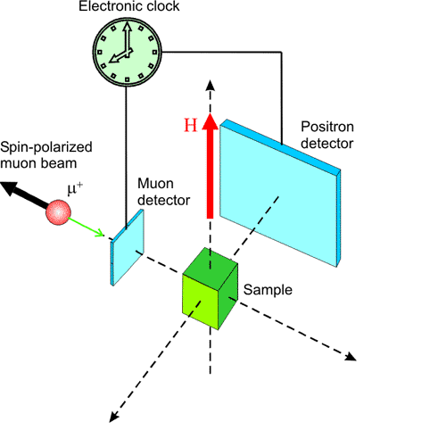
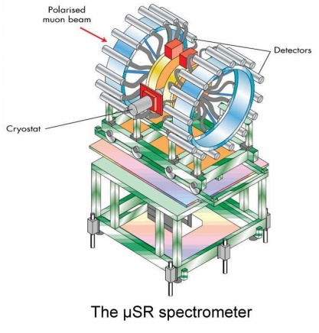
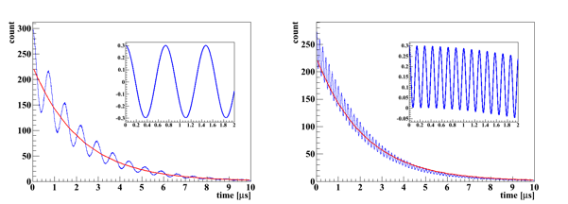
μSR applications
magnetism
superconductivity
Surface physics
Fundamental physics
Molecule dynamics
Oxide
Muonium
Monomer
Semi-conductor
Hydrogen storage material
protein
DNA
Nature Materials 16, 467–473 (2017)
Major spectrometers: ZF-μSR, TF-μSR, LF-μSR, μSE, RF- μSR, Level Crossing (μACLR)… Cutting-edge detectors come from fundamental science.

Slide 29
Table of contents
High-intensity frontier with accelerator muons
Progress of the first accelerator muons source in China
Search for muonium → antimuonium at EMuS
Summary

Slide 30
Summary
Hot topics to do precision measurements of QED and search for new physics with accelerator muon sources.
Welcome all to pushing forward the first accelerator muon source EMuS.
We proposed an experiment to search for Muonium to antimuonium conversions: aim at the best result in the world, a potential breakthrough in the intensity frontier.
The local muonium experiment will boost the innovative creations in muon beamlines, muonium productions and high time and spatial resolution detectors. Two orders of magnitude better than the current limit.
The fundamental science project will boost the muSR technology and its applications in China.
MACE
狼牙棒
感谢IHEP唐靖宇、袁野、鲍煜等共同推动加速器缪子源(EMuS)及其应用。
感谢中大陈羽博士和王自鑫老师积极参加预研。
感谢光电材料与技术国家重点实验室提供有效支持！
感谢中大优秀本科生和教学经费对本地实验室研发的支持！
请各位专家批评和指正，谢谢先！

