Slide 1
Design of EMuS μSR spectrometers and prototype development
Ziwen Pan, Jingyu Dong, Bangjiao Ye
14/12/2019, 2nd workshop on CSNS Muon Source Multidisciplinary Applications
State Key Laboratory of Particle Detection and Electronics, USTC

Slide 2
Outline
Design of μSR spectrometers (Day-one and Super-μSR)
Development of the first Chinese μSR spectrometer prototype

Slide 3
Outline
Design of μSR spectrometers (Day-one and Super-μSR)
Development of the first Chinese μSR spectrometer prototype

Slide 4
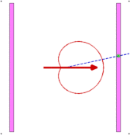
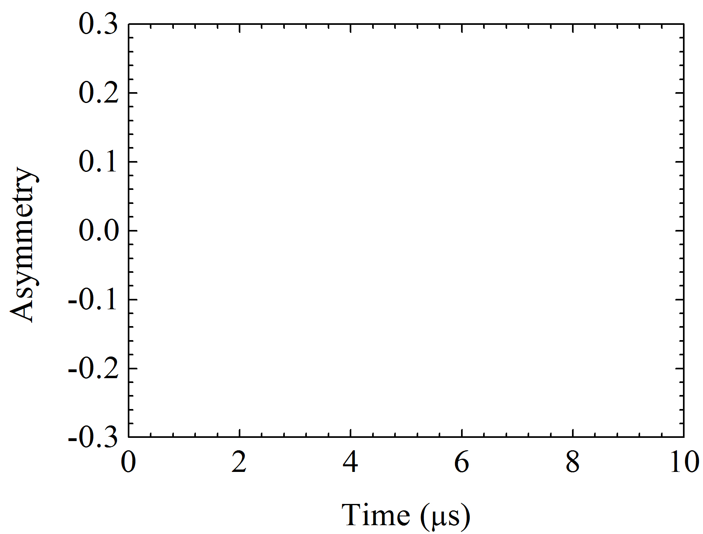
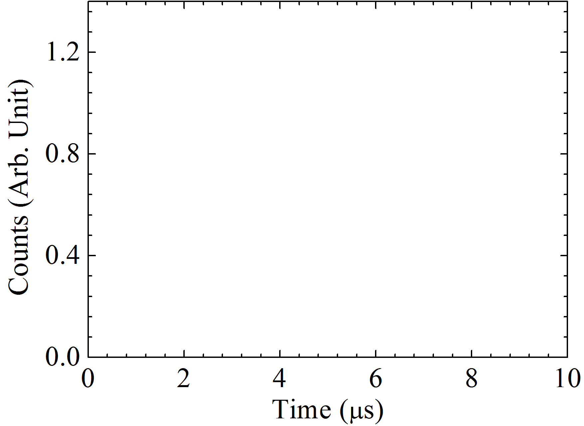
1 Design of muSR spectrometers
Procedure
Asymmetrical
decay
Polarized muons
Positron detection
Sample
Magnetism
Superconductivity
Semiconductor
Diffusion
Physical chemistry
Thin films
…
Probing
Spectrum
unfolding
Fit & analysis
μSR spectrum

Slide 5
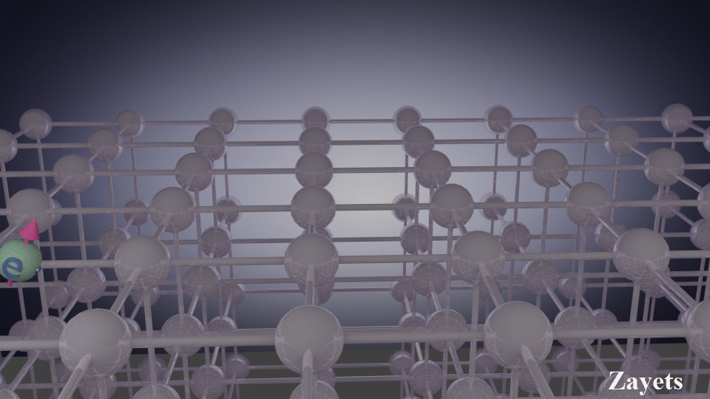
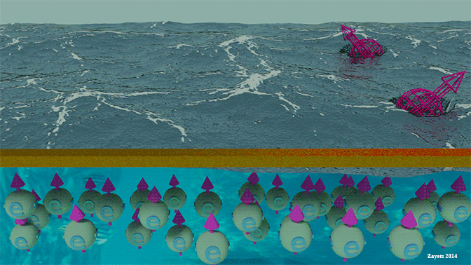
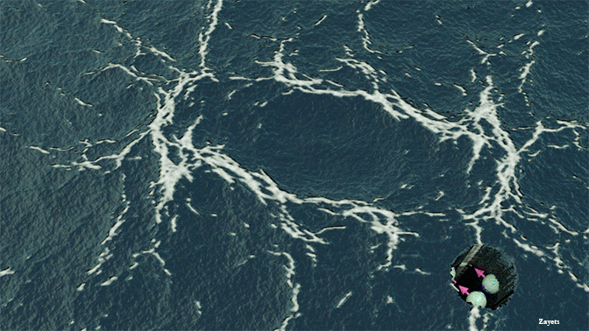
1 Design of muSR spectrometers
Advantages
Very weak effects (small moment magnetism ~ 10⁻³ µ_{B}/Atom)
Random magnetism (e.g. spin glasses).
Short range order (where neutron scattering is not sensitive).
Full polarization in zero field (unique measurements without disturbance of the system)
Single particle detection (with extremely high sensitivity)
No restrictions (in choice of materials to be studied)
µSR: A quantum magnetism probe

Slide 6
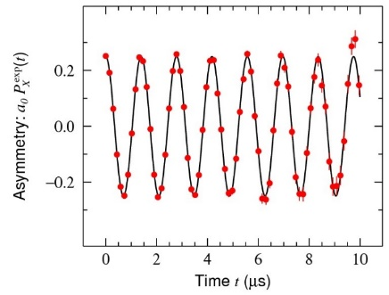
1 Design of muSR spectrometers
Precision: Source
Segments
Deadtime
Intensity
Frequency
Spectrometer
Beam
Rate
$$FoM= Rate∙a_{0}^{2}$$
$$σ^{2}=σ_{stat.}^{2}+σ_{syst.}^{2}$$
a₀
Spectrometer
Beam
Placements
Degrader
Time width
Polarization

Slide 7
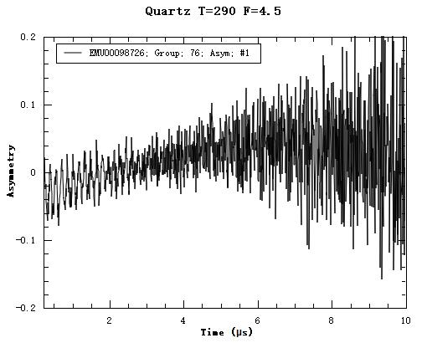
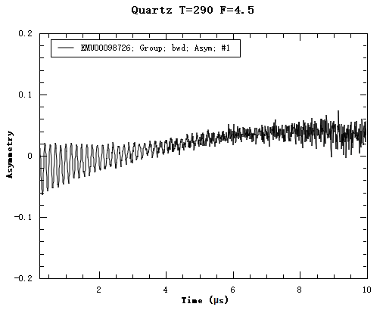
1 Design of muSR spectrometers
Precision: Counting rate
1 detector
Adding
counts
48 detectors
2.83 MEvents
97.97 MEvents
Requirements for spectrometers:
Covering a large solid angle
Highly segmented
Short dead time to tolerate high muon beam intensity

Slide 8
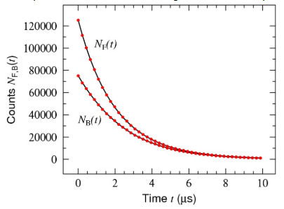
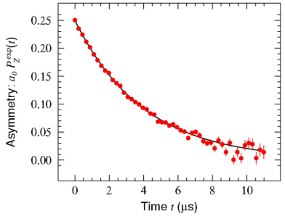
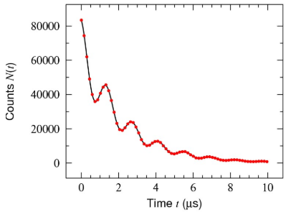
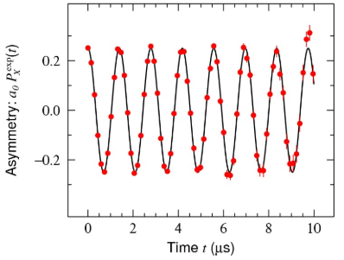
1 Design of muSR spectrometers
Precision: Asymmetry
ZF/LF
TF
$$N\left(t\right)=N_{0}\exp\left(−\frac{t}{τ_{μ}}\right)[1+a_{0}P^{exp}\left(t\right)]$$
a₀ is the intrinsic asymmetry of a μSR spectrometer!

Slide 9
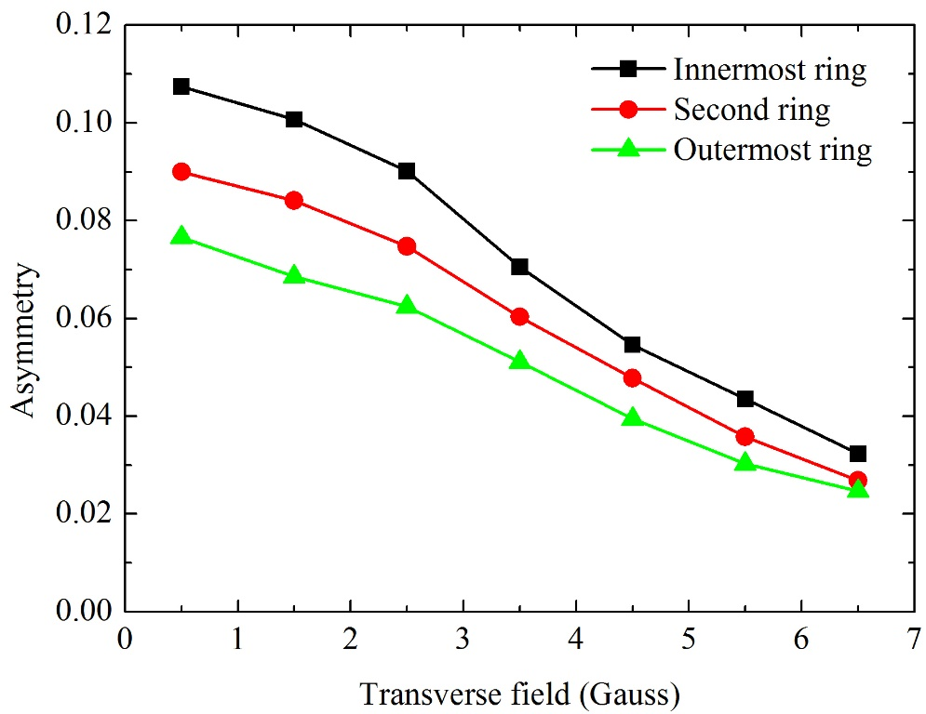
1 Design of muSR spectrometers
Precision: Asymmetry
Arrangement of EMU spectrometer
quartz
muons
sample
As the time width of muon pulses is large, the amplitude (asymmetry) of muon spin oscillation dephase (reduces).

Slide 10
1 Design of muSR spectrometers
Precision: Asymmetry
Arrangement of EMU spectrometer
quartz
muons
sample
Requirements for spectrometers:
Occupying high intrinsic asymmetries (a₀) in space
Optimizing detector arrangement
Optimizing degrader thickness

Slide 11
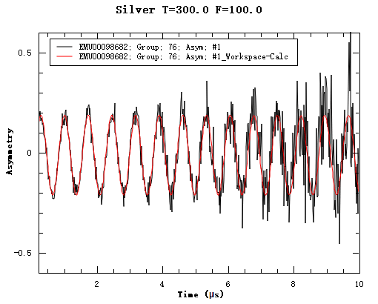
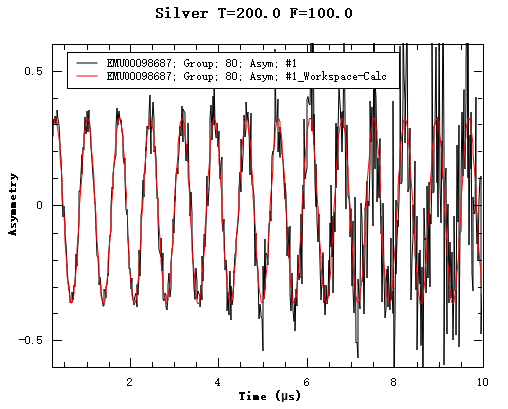
1 Design of muSR spectrometers
Precision: Asymmetry
Change placement
Adding degrader
Counts: 3.60×10⁵ muons
Asymmetry: 0.199
Counts: 1.79×10⁵ muons
Asymmetry: 0.376
After optimizing the intrinsic asymmetry, the oscillation becomes more significant.

Slide 12
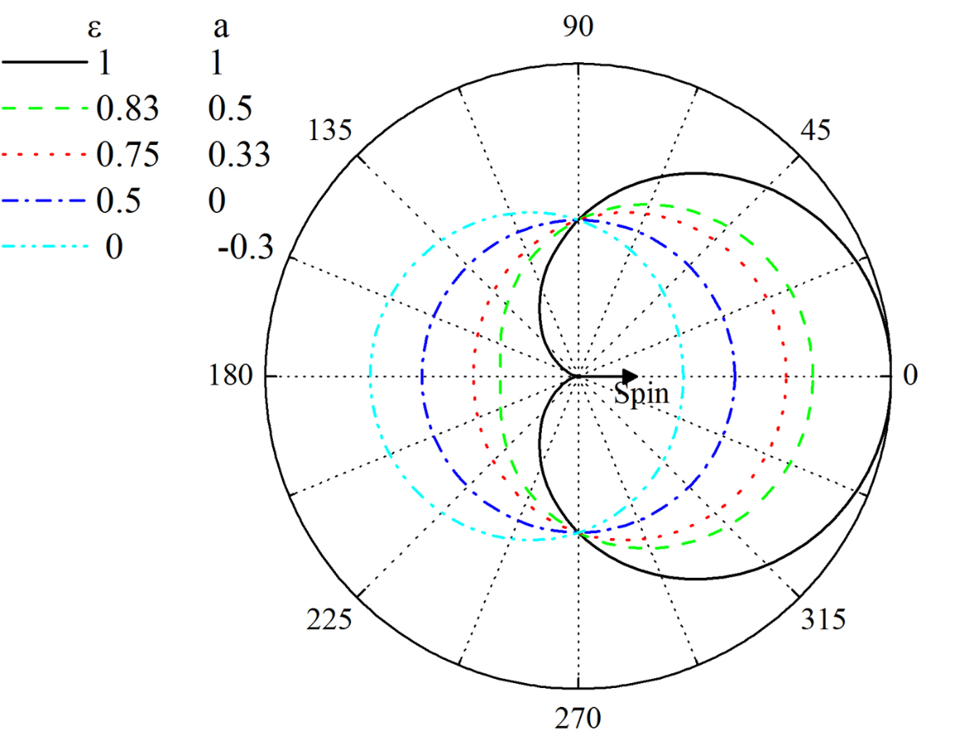
1 Design of muSR spectrometers
Asymmetrical decay
Intrinsic asymmetry：
$$A=\frac{\int{E\left(ε\right)a\left(ε\right)dε}}{2\int{E\left(ε\right)dε}}(cosθ_{1}+cosθ_{2})$$
$$=\frac{\frac{1}{3}−ε_{0}^{4}+\frac{2}{3}ε_{0}^{3}}{2\left(1−{2ε}_{0}^{3}+ε_{0}^{4}\right)}\left(cosθ_{1}+cosθ_{2}\right)$$
θ₂
θ₁
$$≤\frac{\frac{1}{3}−ε_{0}^{4}+\frac{2}{3}ε_{0}^{3}}{1−{2ε}_{0}^{3}+ε_{0}^{4}}cosθ_{1}$$
Maximum value：
$$A_{max}=\frac{\frac{1}{3}−ε_{0}^{4}+\frac{2}{3}ε_{0}^{3}}{1−{2ε}_{0}^{3}+ε_{0}^{4}}$$
ε is normalized kinetic energy of positrons
ε₀ is the lower limit of primary kinetic energy of detected positrons

Slide 13
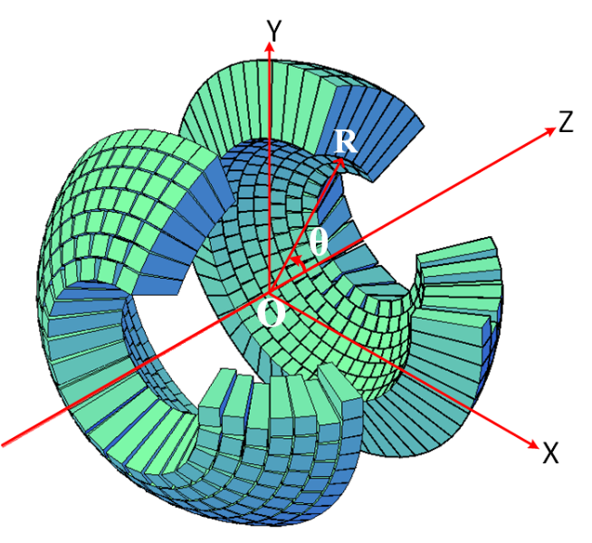
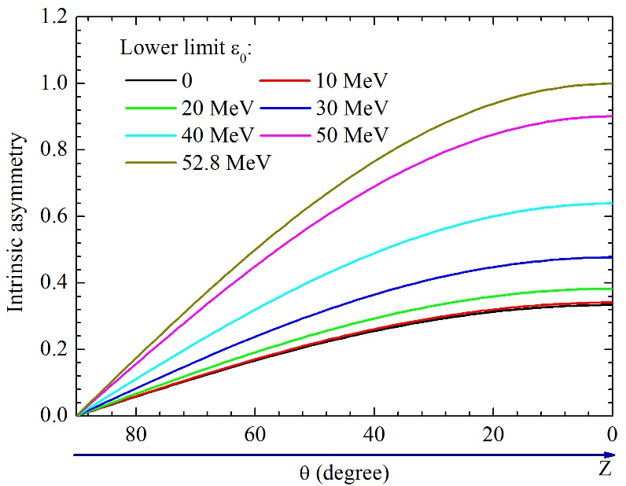
1 Design of muSR spectrometers
Detector arrangement: sphere
A_{max}
Detector rings far from the sample occupy high asymmetry
Asymmetry can be increased by selecting positrons with high energy
Degraders can be mounted on the path of positrons penetrating detectors to block low energy positrons with low asymmetries

Slide 14
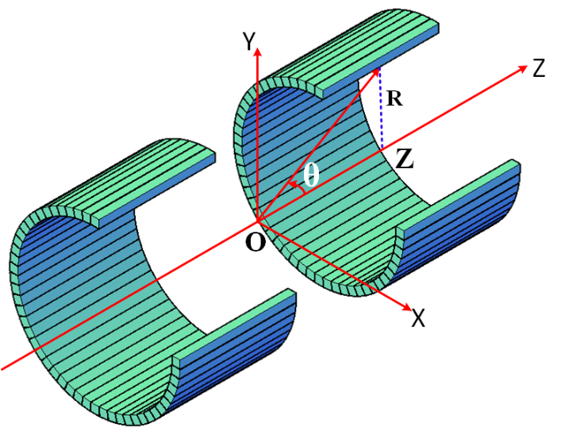
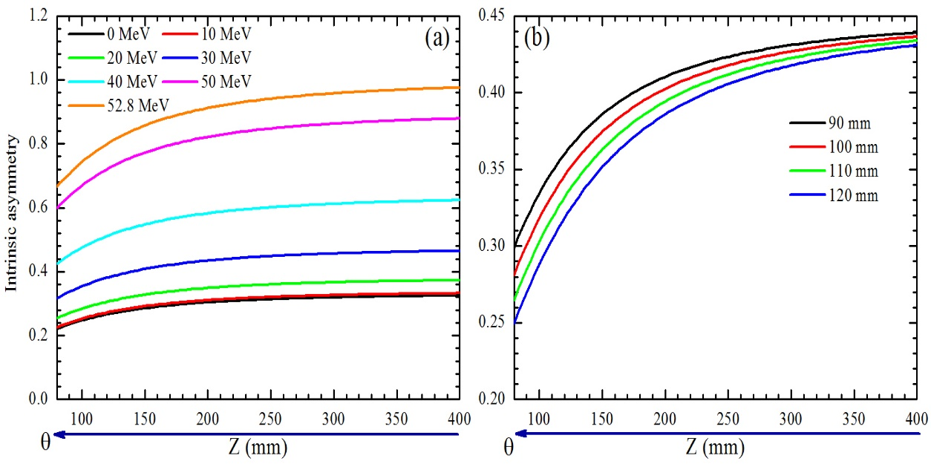
1 Design of muSR spectrometers
Detector arrangement: cylinder
Penetration positions far from the sample occupy high asymmetries
Detector rings with small radius have high asymmetries
Asymmetry can be increased by selecting positrons with high energy
Degraders can be mounted on the path of positrons penetrating detectors to block low energy positrons with low asymmetries

Slide 15
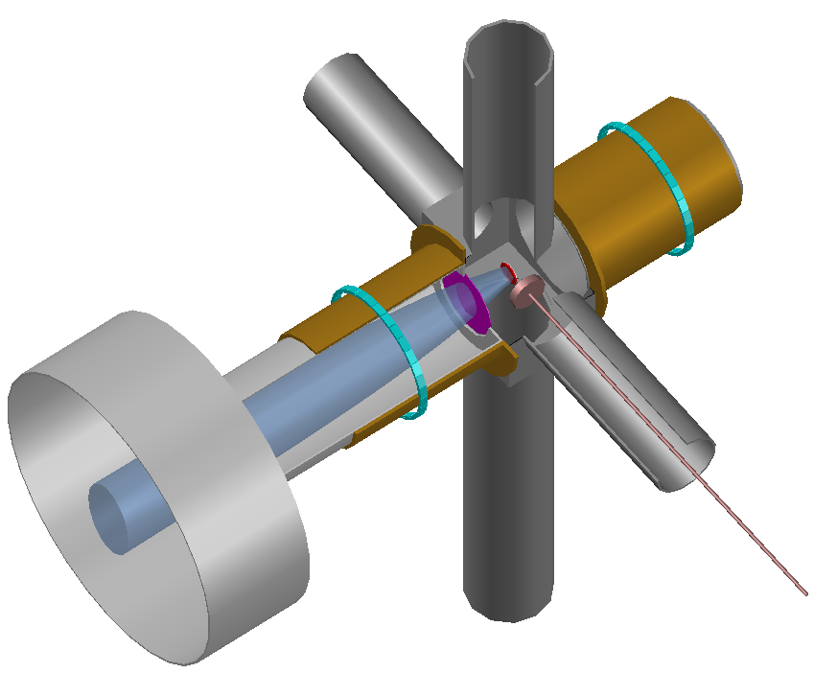
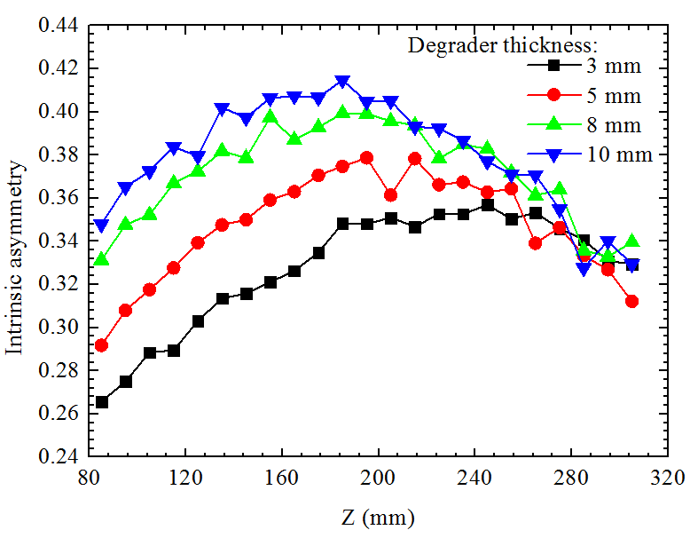
1 Design of muSR spectrometers
Demonstration of the theoretical calculation
degrader
For Z < 200 mm, the trend is similar to the theoretical calculation;
After that, asymmetry reduces as more and more positrons are not from the sample.

Slide 16
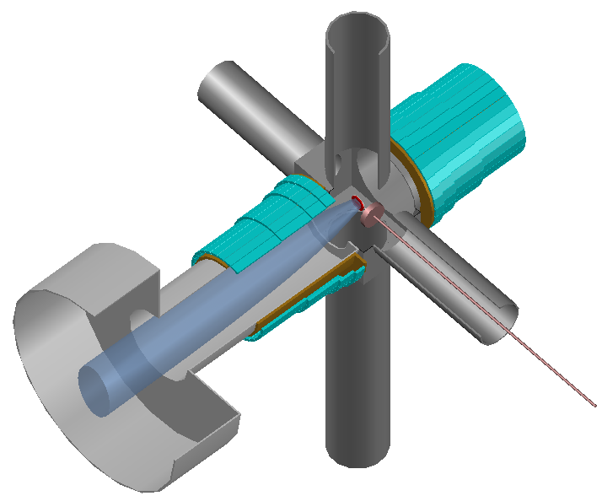
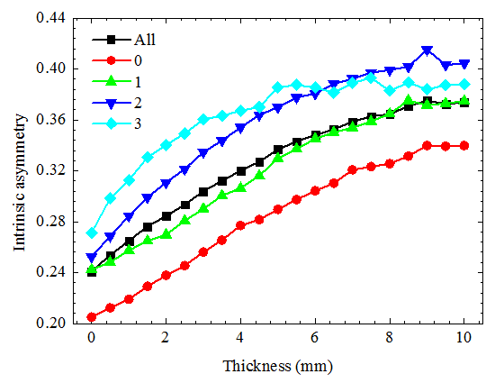
1 Design of muSR spectrometers
Design of Day-one spectrometer
256 Channels
Degrader (mm) | Highest asymmetry | Average asymmetry | Event rate (Mevents/hr)
9 | 0.415 | 0.375 | 22.39
0.28 @ ISIS
0.16 @ J-PARC

Slide 17
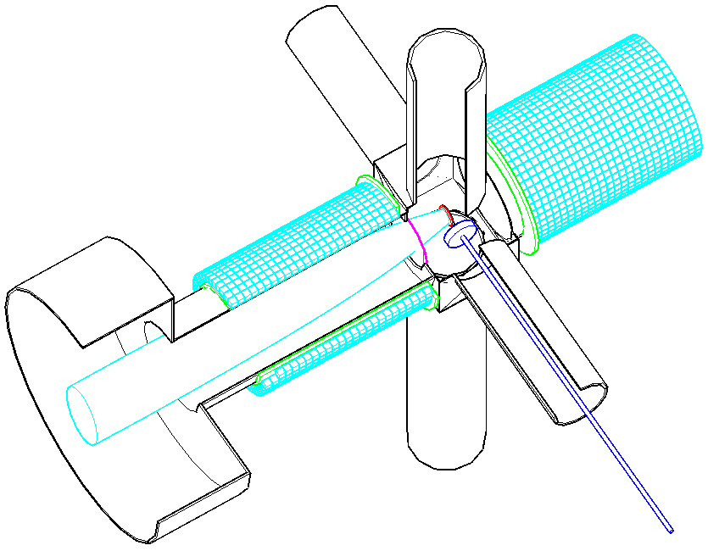
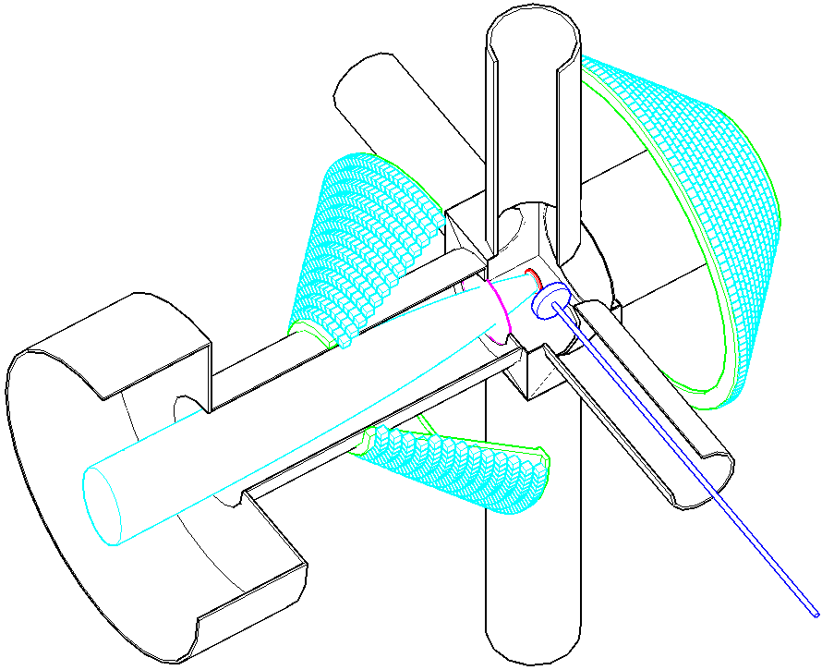
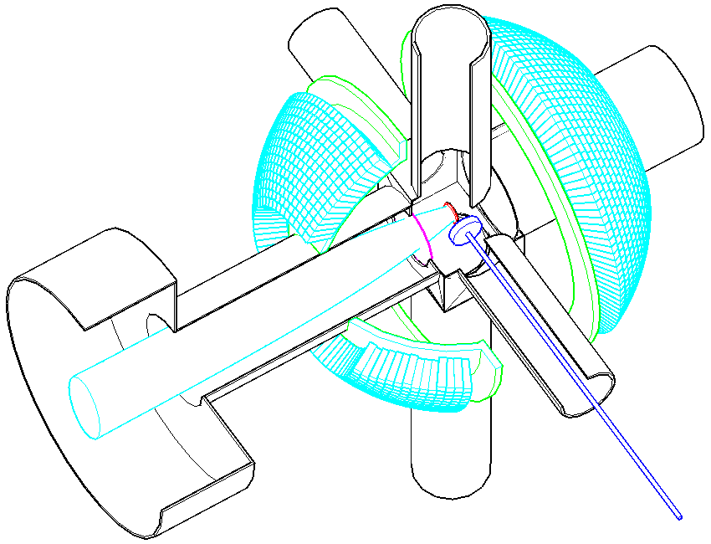
1 Design of muSR spectrometers
Design of Super-μSR spectrometer:
Cylinder
Cone
Sphere
Size：10×10×10 mm³
Number：2560
Rings：25×2
Solid angle：30.6%
Size ：10×10×10 mm³
Number ：2464
Rings：13×2
Solid angle ：64.1%
Size ：~ 4.9×4.9×50 mm³
Number ：2686
Rings：14×2
Solid angle ：42.5%

Slide 18
1 Design of muSR spectrometers
Design of Super-μSR spectrometer
Searching high asymmetry area
Z
-Z₀
Z₀

Slide 19
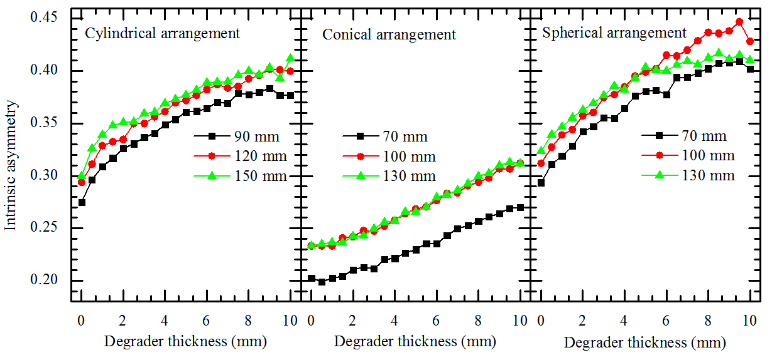
1 Design of muSR spectrometers
Design of Super-μSR spectrometer
Moving detector ring away from the sample can have high asymmetry
The increase of asymmetry tends to saturate when moving rings
Spherical shape has the highest asymmetry

Slide 20
1 Design of muSR spectrometers
Design of Super-μSR spectrometer
 | Thickness (mm) | Average asymmetry | Event rate (MEvents/hr)
Cylindrical | 9 | 0.384 | 60.35
Conical | 9.5 | 0.270 | 214.9
Spherical | 9.5 | 0.409 | 18.85

Slide 21
Outline
Design of μSR spectrometers (Day-one and Super-μSR)
Development of the first Chinese μSR spectrometer prototype

Slide 22
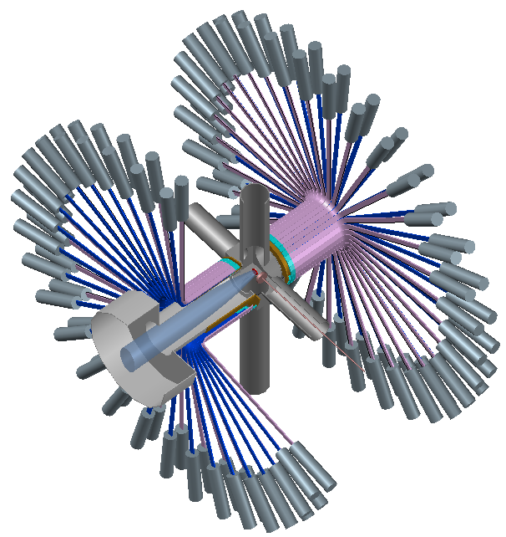
2 Development of the first Chinese μSR spectrometer prototype
Goal：constructing a 128-channel μSR spectrometer prototype
Positron detectors:
128 channels (scintillator + light guide + PMT)
Electronics：
LED / CFD + TDC
data acquisition software
Magnetic field：
zero field
longitudinal field: 0~300 Gauss
transverse field: 0~100 Gauss
Sample environment：
room temperature
sample holder

Slide 23
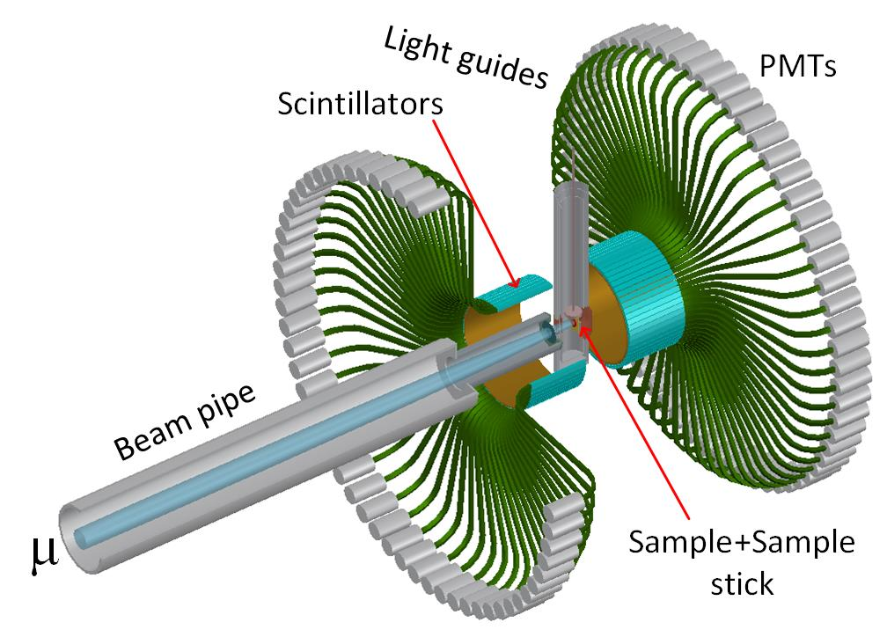
2 Development of the first Chinese μSR spectrometer prototype
What have been done:
Conceptual design and update 
update

Slide 24
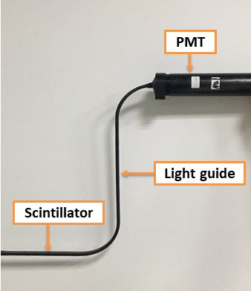
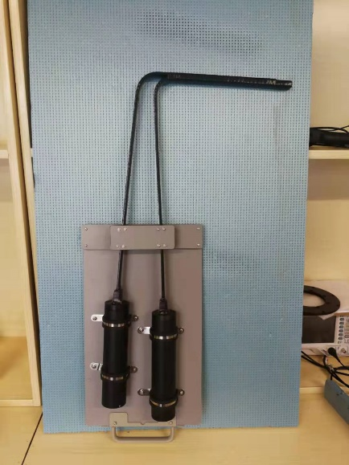
2 Development of the first Chinese μSR spectrometer prototype
What have been done:
Detector prototype
upgrade

Slide 25
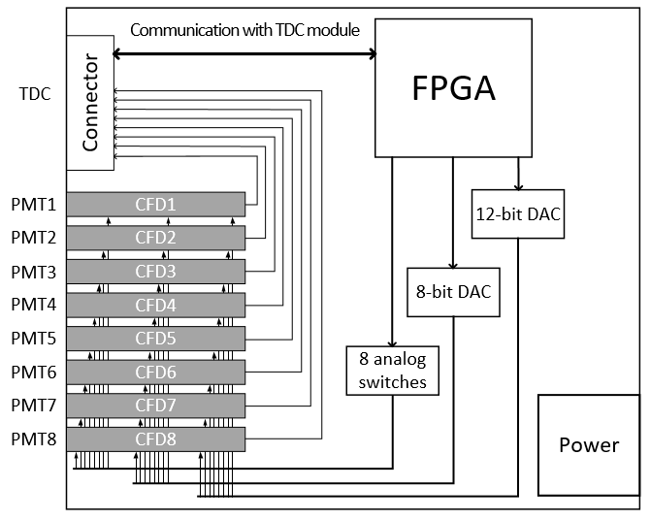
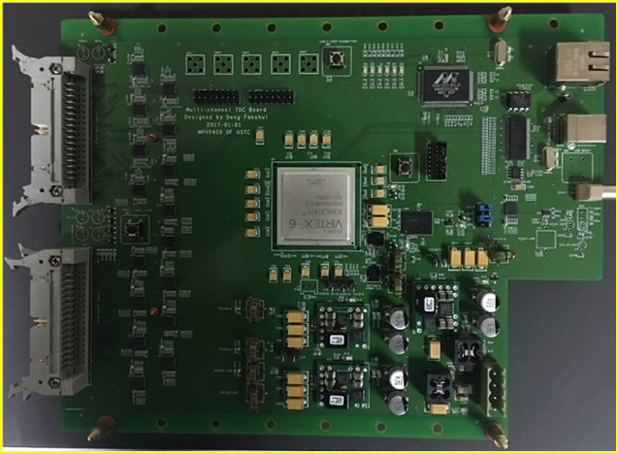
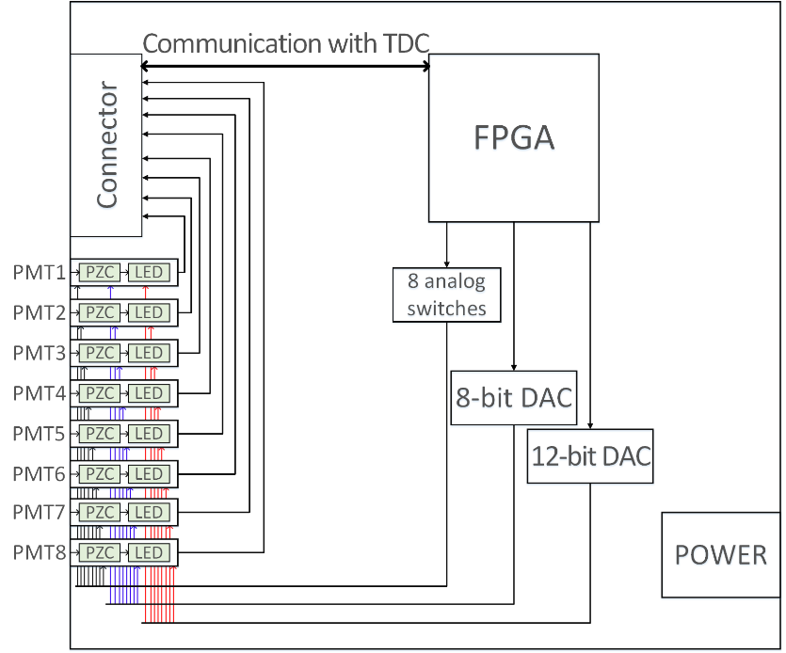
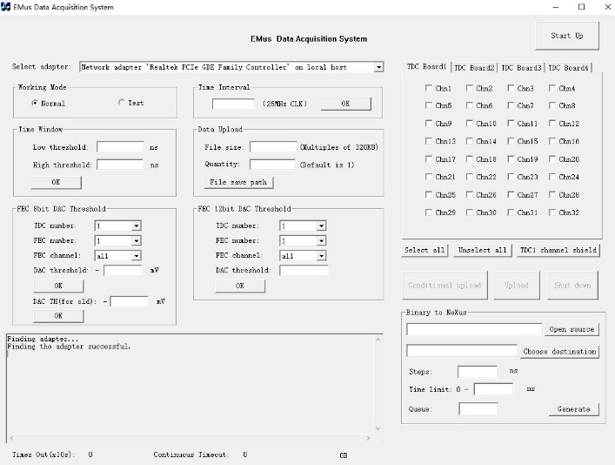
2 Development of the first Chinese μSR spectrometer prototype
What have been done:
Electronics and software
CFD
TDC
upgrade
LED
Software

Slide 26
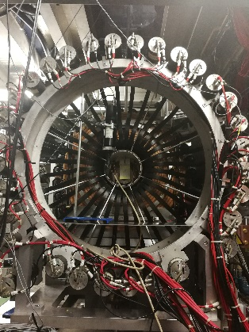
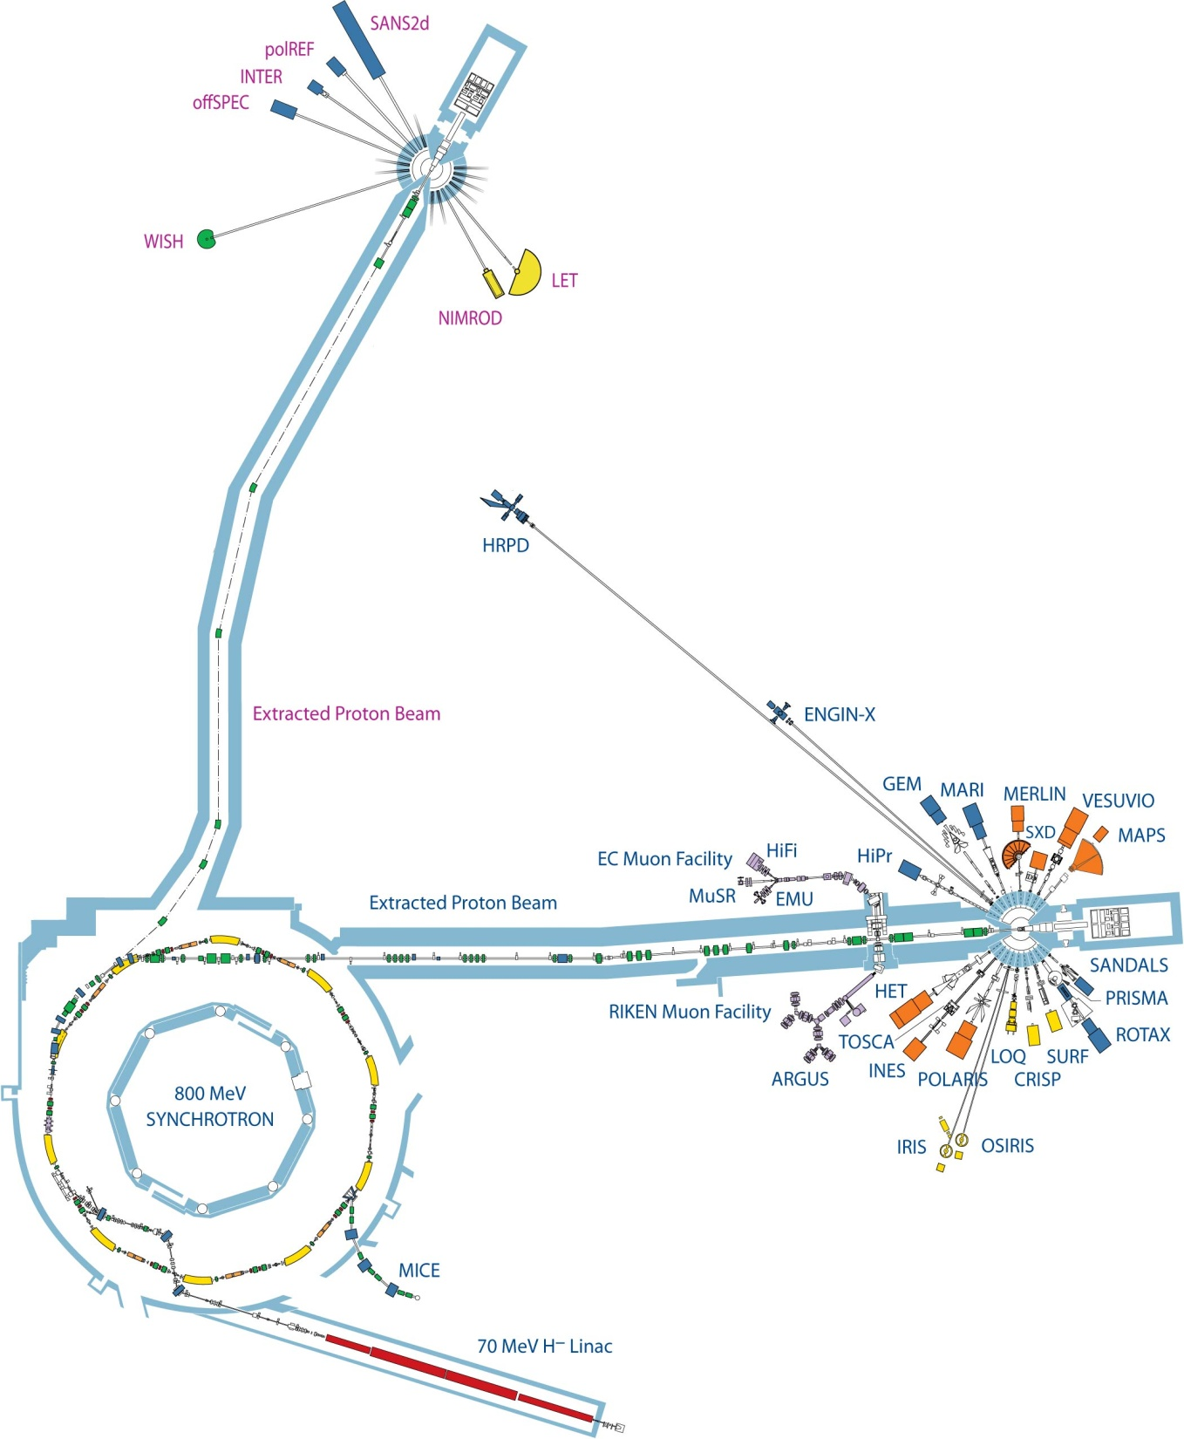
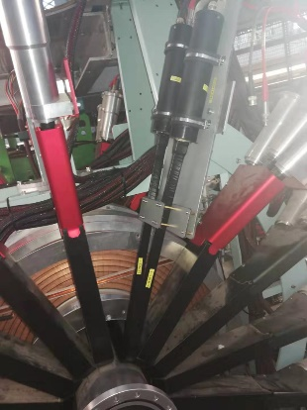
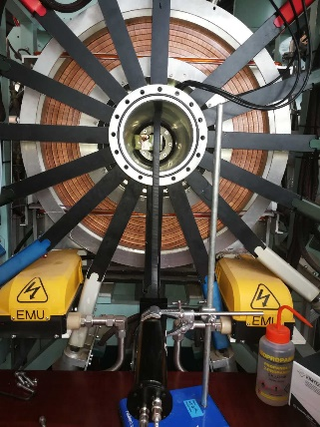
2 Development of the first Chinese μSR spectrometer prototype
First beam test
14th Mar. 2018
Third beam test
Second beam test
13th Nov. 2019
25th Sept. 2018

Slide 27
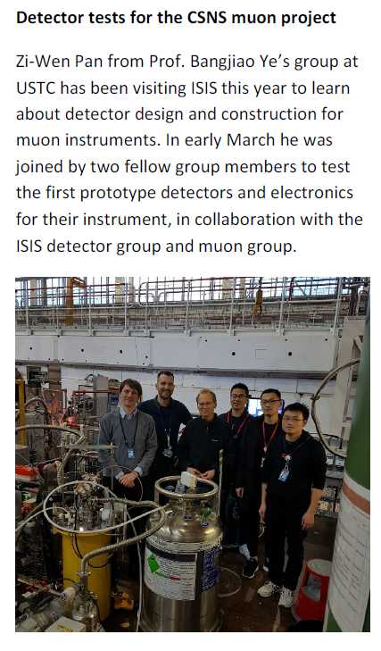
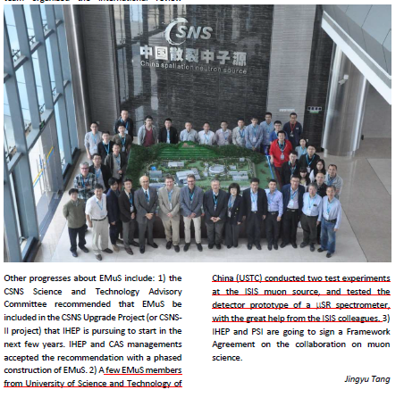
2 Development of the first Chinese μSR spectrometer prototype

Slide 28
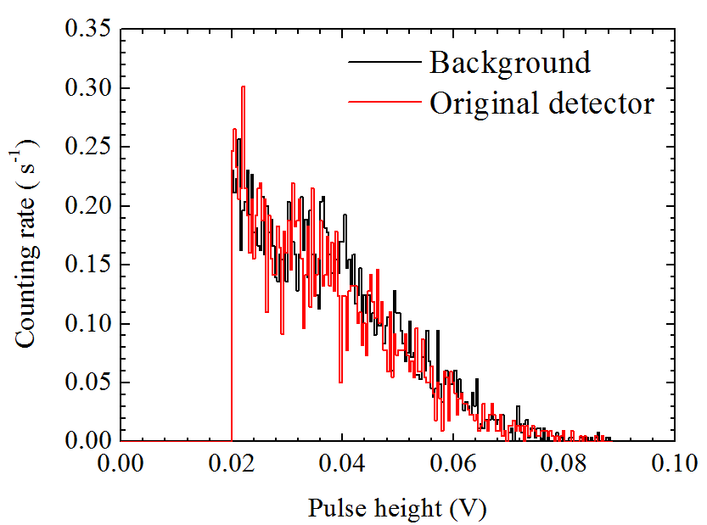
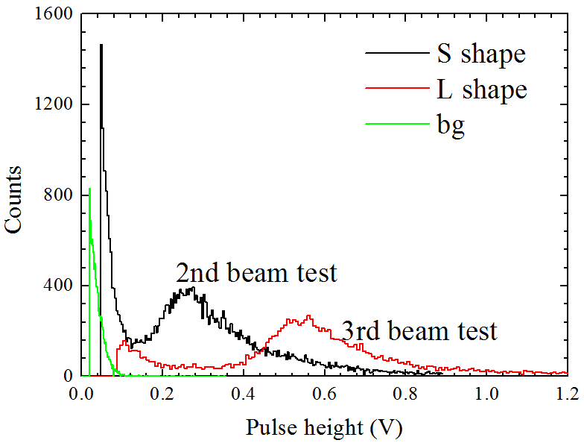
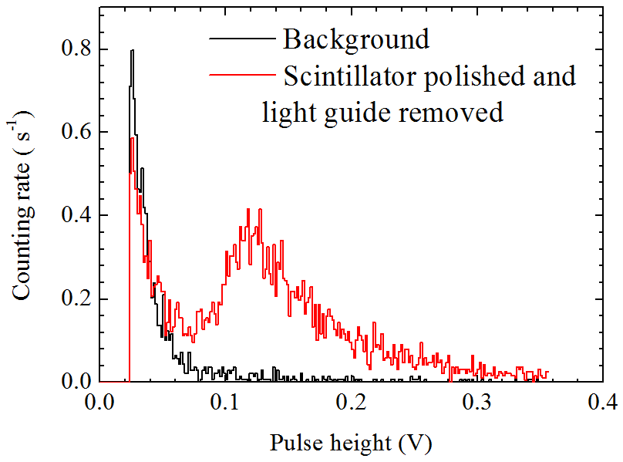
2 Development of the first Chinese μSR spectrometer prototype
Main results: pulse height spectra
1st beam test
2nd / 3rd beam test

Slide 29
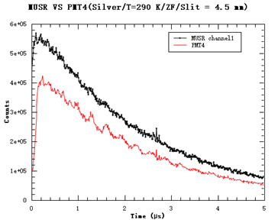
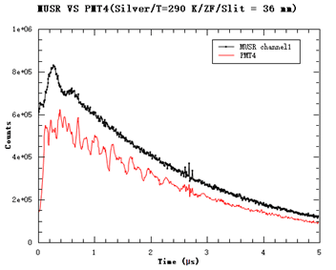
2 Development of the first Chinese μSR spectrometer prototype
Main results: μSR spectra
1st beam test
Low counting rate
High counting rate
Distortion
Crosstalk
Crosstalk
Unexpected oscillation

Slide 30
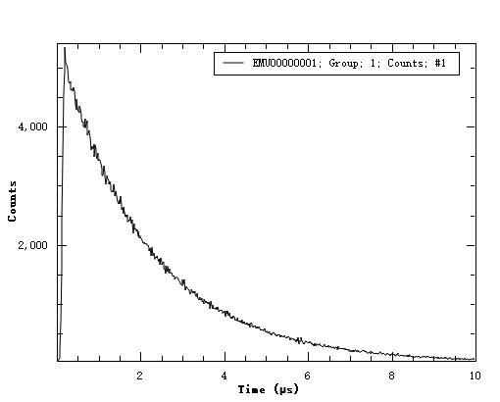
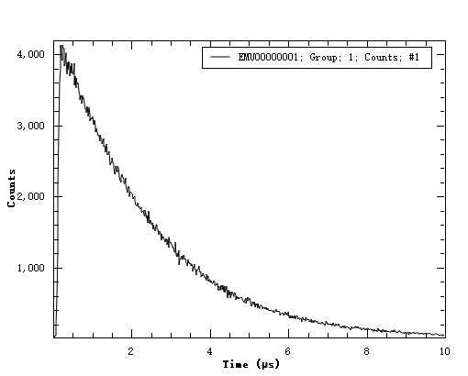
2 Development of the first Chinese μSR spectrometer prototype
Main results: μSR spectra
2nd beam test
Low counting rate
High counting rate

Slide 31
2 Development of the first Chinese μSR spectrometer prototype
Main results: μSR spectra
3rd beam test
Low counting rate
High counting rate

Slide 32
2 Development of the first Chinese μSR spectrometer prototype
Main results: dead time performance in comparison
2nd / 3rd beam test
After upgrading the front-end electronics (CFD → LED), distortion of μSR spectra in early times improves a lot.

Slide 33
2 Development of the first Chinese μSR spectrometer prototype
Main results: dead time performance in comparison
3rd beam test
The performance of Chinese μSR spectrometer prototype reaches an advanced level similar to ISIS instruments.

Slide 34
Conclusion
Day-one spectrometer
256 PMTs， 8 rings
Asymmetry：average-0.38, highest-0.42
Event rate：2.5×10⁷/hour
Super-μSR spectrometer
~2560 SiPMs
Asymmetry：average-0.35
Event rate：2 ×10⁸/hour

Slide 35
µSR: A quantum magnetism probe
Thanks!

