Slide 1
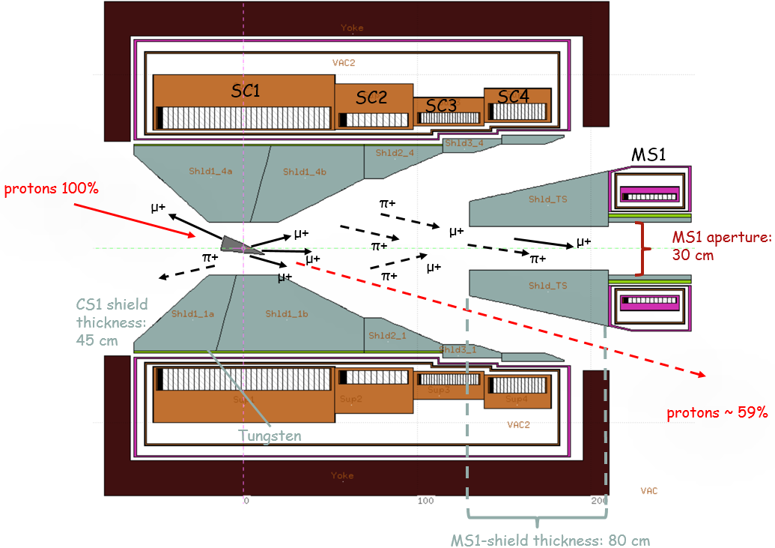
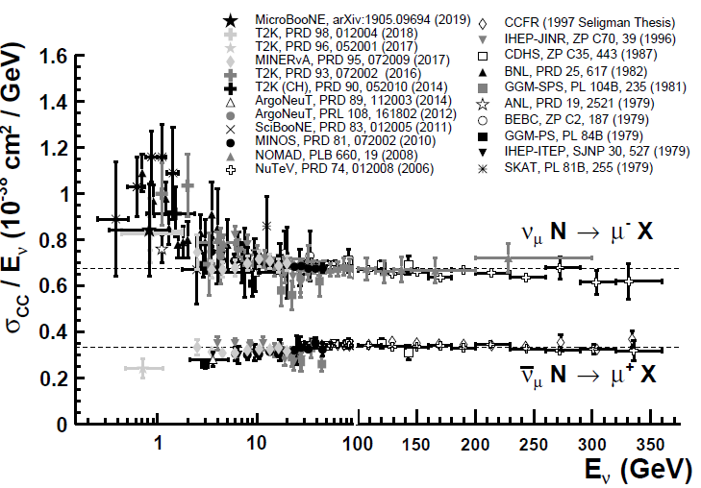
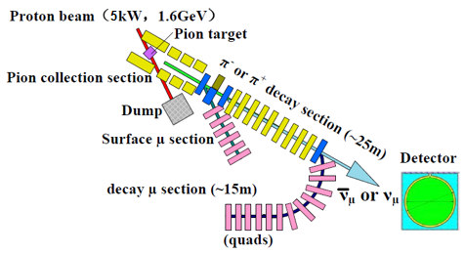
EMuS: Neutrinos for cross section measurements @ 25 kW
Nikos IHEP/CAS
EMuS

Slide 2
layout
Target systems for EMUS Baseline scheme/conical
Description of the target system
π+ rates, momentum distribution and adiabatic fields
Neutrinos
Aim of this study
Initial study of the neutrino situation at near distance from the π decay section

Slide 3
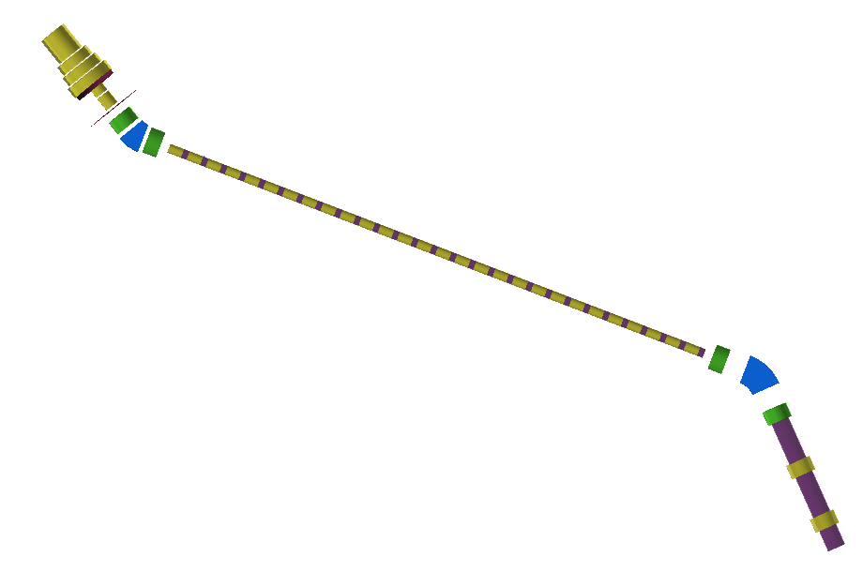
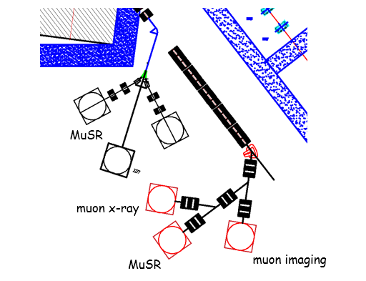
“Baseline” scheme: Surface and decay muons
Superconducting Capture Solenoid
Charge/momentum selection for surface muons/pions
25 m superconducting transport solenoids
pion decay section -> muons
“surface” muon section
2nd selection,
decay muons
Decay muon section
Detector, 3 m away
from selection
Working modes (independent):
Surface μ mode
Δp/p: <±5%
Ref. Pμ=29 MeV/c
Decay μSR mode
Δp/p: <± 10%
Ref. Pμ =40-150 MeV/c <-> Ref. Pπ = 100-260 MeV/c
High-momentum μ mode
μ imaging, neutrinos
Ref. Pπ=200-450 MeV/c
Neutrino beam (optional)
Ref. Pπ > 300 MeV/c
detectors

Slide 4
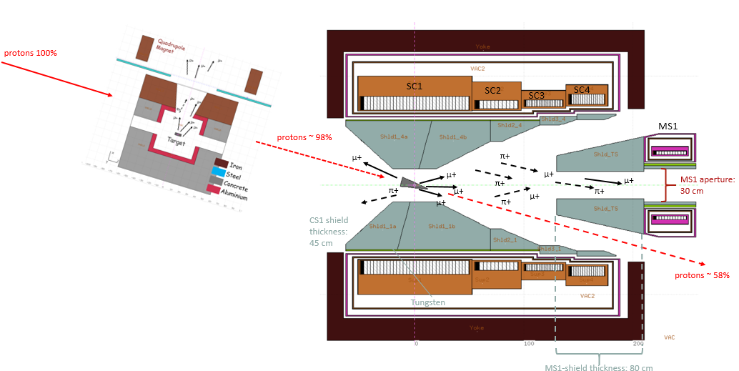
Capture using superconducting capture adiabatic solenoid
Forward spent-proton extraction, proton beam & target tilted in respect to magnetic axis, θp = 15º
NbTi-Al, adiabatic taper
Upstream “thin” target for highly polarized μSR beam
Conical target at Capture Solenoid
Forward collection ->
best π+ rates in the world
15⁰ tilt of protons/target with respect to magnetic field lines:
facilitate the extraction of spent-protons with a moderate length of CS through matching solenoid and capture coils
lower tilts as 10⁰ make the length of CS excessive and costly

Slide 5
proton and target parameters
proton beam parameters
E_{kin} (GeV) | σ (cm) | Power (kW)
1.6 | ~ 0.5 at target, double Gaussian | 5
target parameters - conical target
material | radius r1 large / r2 small (cm2) | length (cm) | Z | λ_{I} (cm)
C (1.82 gr/cm³) | 4.5 / 0.25 | 25 ~ 0.53 λ_{I} | 6 | 47
use only one target for surface muon and π+ collection
for surface muons
better surface muon collection than cylindrical shape
lower power deposition on the SC
for π+ collection at MS1
similar collection to cylindrical shape
r1 = 4.5 cm
r2 = 0.25 cm
Graphite

Slide 6
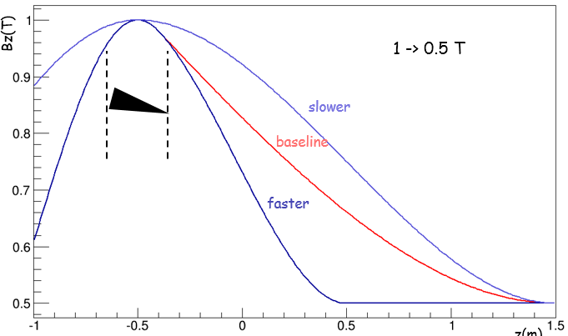
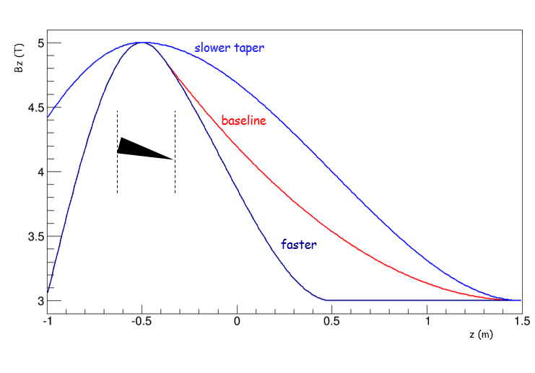
Test several adiabatic tapers for surface muons and pions (decay muons) capture
1 T -> 0.5 T “baseline” for surface muon mode
5 T -> 3 T “slower”, “4.5 T -> 2.5 T” faster for decay muon mode and higher rates
Gaussian and Polynomial representation of tapers
surface muons collection and high polarization
π+ (decay muon) collection
Bz(r=0) T
1 T -> 0.5 T
Bz(r=0) T
5 T -> 3 T
Similar for
4.5 T -> 2.5 T
z(m)
z(m)

Slide 7
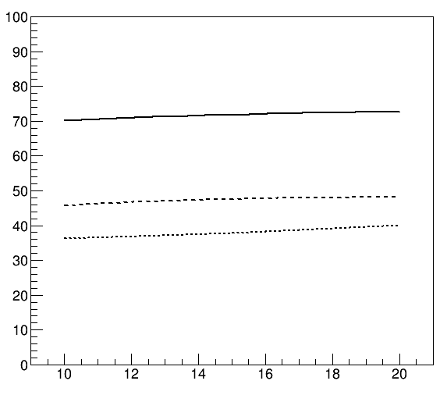
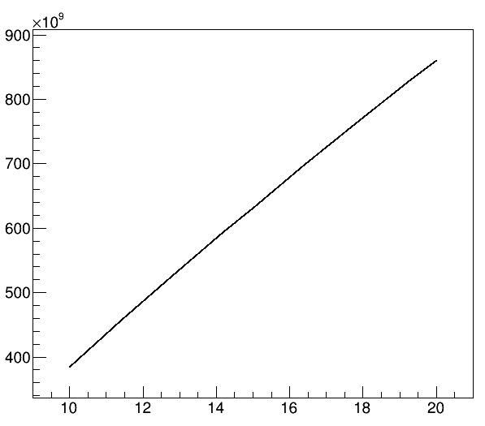
Polarization and rates as function of fields and proton/target tilts 1st coil exit
p
surface muons: best polarization at 1 T
tilt benefits surface muons & π+ rates
surface muons polarization
π+ rates
π+ / s
5 T -> 3 T
polarization (%)
1 T -> 0.5 T
2.5 T -> 0.5 T
5 T -> 3 T
baseline tilt 15⁰
baseline tilt 15⁰
proton/target tilt angle
proton/target tilt angle
1st coil study – no shielding, 5 kW studies
no emittance selection

Slide 8
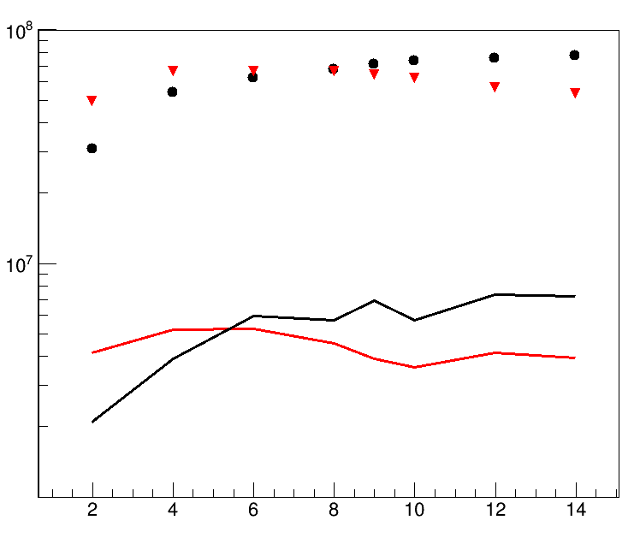
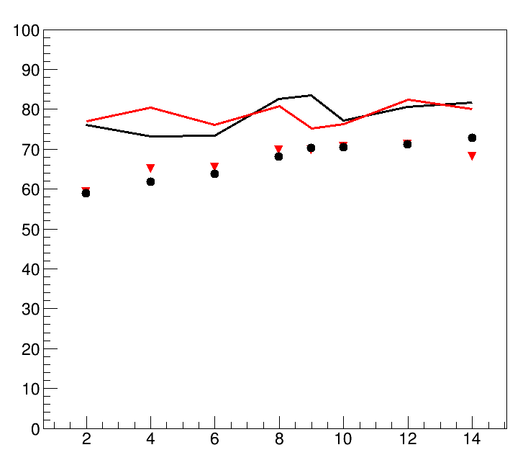
Choice of conical target
Conical target compared to cylindrical one has
higher surface muon rates
Similar polarization
μ+ with 25 ≤ P (MeV/c) ≤ 29.8
r1 = 4.5 cm
r2 = 0.25 cm
r1
rates and polarization as function of radius r1 (in σ_{b} = 0.5 cm) at MS1
10000 π mm mrad selection
μ+ / s
no emittance selection
stat. error ~ 1%
Polarization (%)
cone
cylinder
10000 π mm mrad
stat. error ~ 5%
no selection
baseline
r1 (σ_{b} )
r1 (σ_{b} )
5 kW shielding studies
rates @ 25 kW x ~4 due to shielding increase

Slide 9
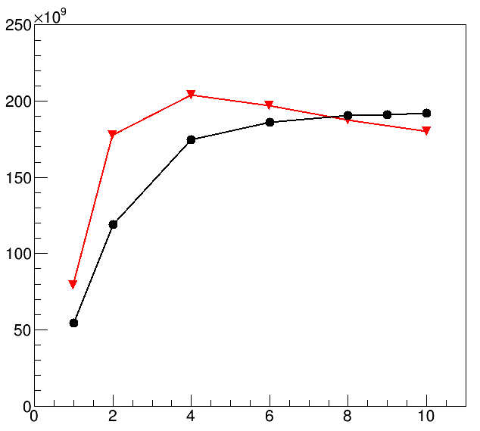
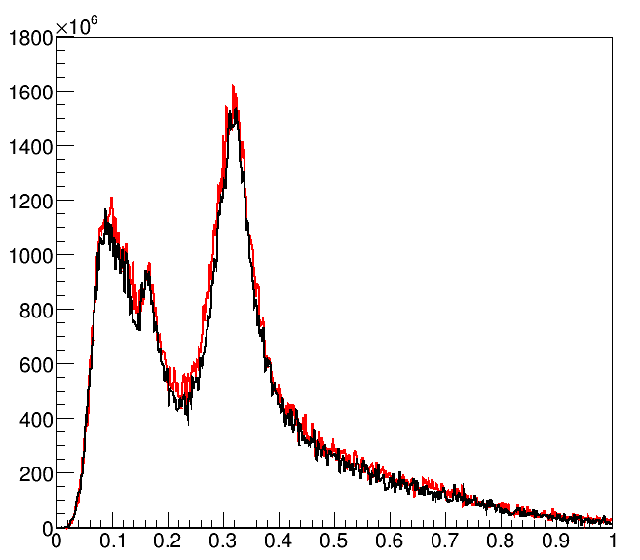
π+ collection with conical target at MS1
similar collection to cylindrical best
r1
r1 = 4.5 cm
r2 = 0.25 cm
rates as function of radius r1 (in σ_{b} = 0.5 cm) and momentum distributions
π+ / s
π⁺ / 2 MeV / s
conical best
cylinder best
best for cylinder
best for cone
no emittance selection
stat. error ~ 0.2%
r1 (σ_{b} )
P GeV/c
5 kW shielding studies

Slide 10
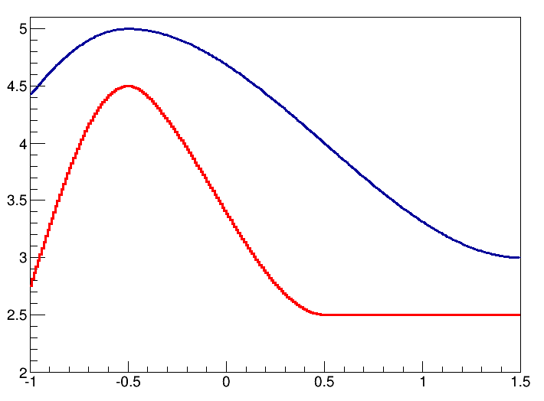
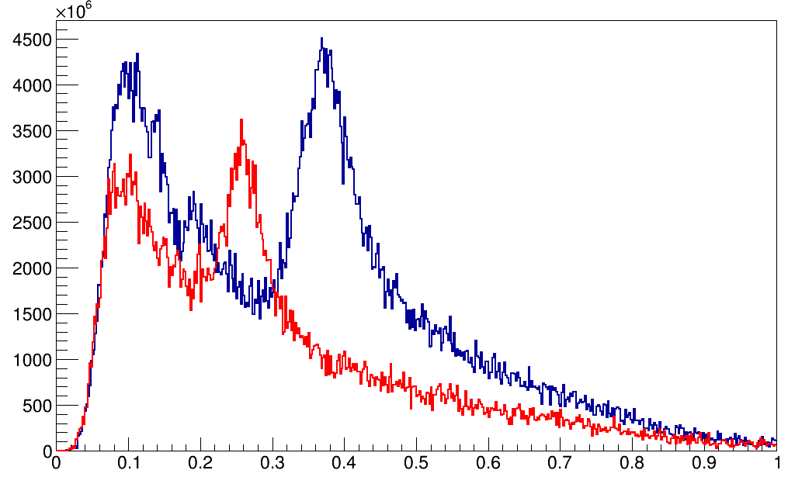
Field tuning for π+ collection at MS1 for decay muons & neutrinos
Reference 5 T and 4.5 T fields for π+ collection:
5 T “slower”, 4.5 T “faster” taper variations
π+ entering MS1 as function for different tapers
260 MeV/c
-> μ+ 150 MeV/c
Bz(r=0) T
π⁺ / 2 MeV / s
450 MeV/c
-> μ+ 450 MeV/c
100000 π mm mrad
100 MeV/c
-> μ+ 45 MeV/c
Z in m
P GeV/c
emittance (π mm mrad) | 100000
P (MeV/c) ± 10% | 100 | 260 | 450
intensity π+ (x10¹⁰) μ/sec | 4 | 8.5 | 10
stat. error ~ 3%

Slide 11
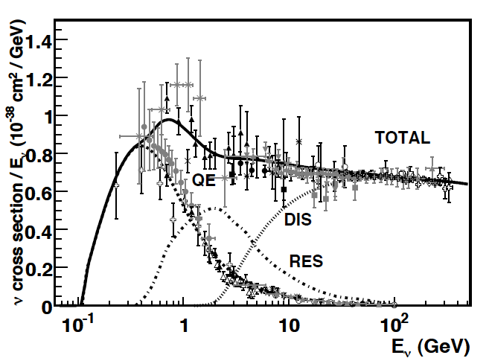
There is a lack of low energy neutrino cross section measurement
PDG/Particle Data Group - 2019
PDG/Particle Data Group - past
No measurement
QE
There is a lack of cross sections measurements below 0.300 GeV
“CCQE” only region

Slide 12
EMuS neutrino beam might be able to solve the lack of those low energy cross sections
Simulated EMuS layout parameters with FLUKA
Superconducting Capture Solenoid
5T -> 3 T
Charge/momentum selection for surface muons/pions (100%)
25 m superconducting transport solenoids (3 T)
pion decay section -> muons
“Surface” muon section
2nd selection,
decay muons
Detector, 3 m away
from selection
Decay muon section
Aim is to investigate the neutrinos 3 m away from pion decay section
Check if there are sufficient CCQE for a cross section measurement

Slide 13
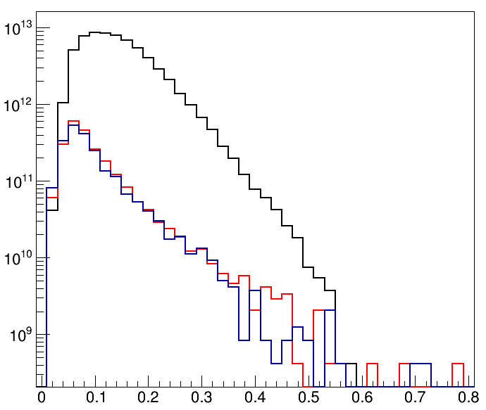
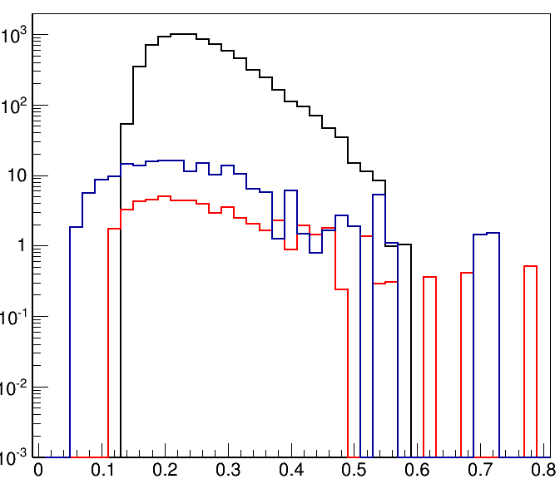
neutrino beam from π+ / no momentum selection
flux
CCQE
flux ν_{μ} , <E_{ν}> ~ 150 MeV
CC ν_{μ} , <E_{ν}> ~ 260 MeV
ν / cm² / 0.02 GeV bin
events = mass* flux(E)*xs(E)*ε_{d}(E)
ν_{e}
-
CC ν / ton / 0.02 GeV bin / 200 days
ν_{μ}
-
ν_{μ}
ν_{e}
E_{ν} GeV
25 kW
E_{ν} GeV
~1% stat. error | Ν _{ν} (x10¹³) / cm² / 200 days |  | CC / ton / 200 days
 | flux | % | events | %
ν_{μ} | 6.5 | 93.7% | 7725 | 97
ν_{μ} | 0.23 | 3.3% | 55 | 0.5
ν_{e} | 0.21 | 3% | 198 | 2.5
ν_{e} | - | - | - | -
SBN detectors parameters
-
there is a potential
of measuring cross sections
-

Slide 14
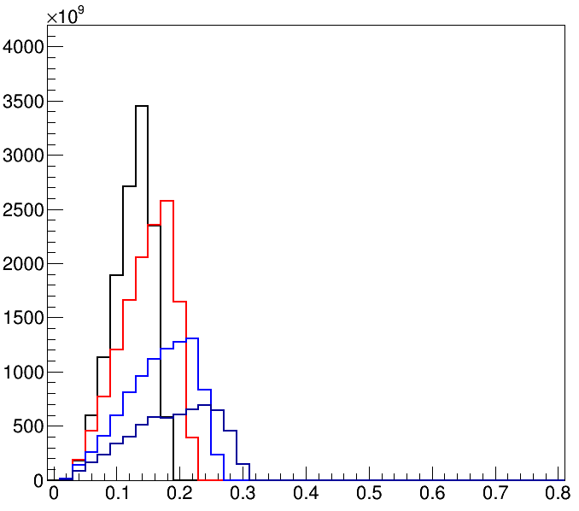
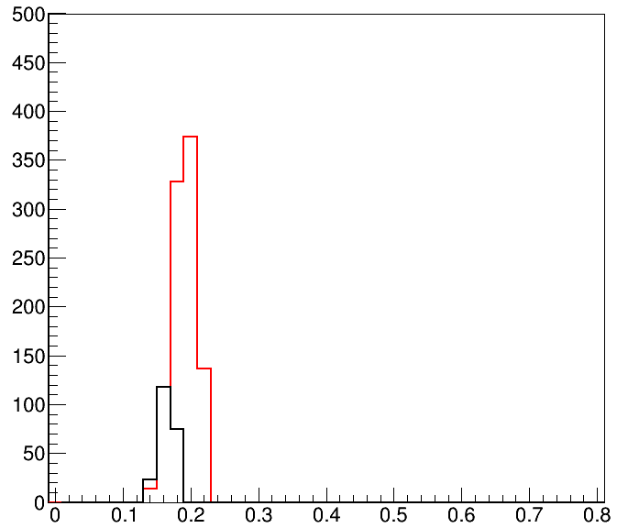
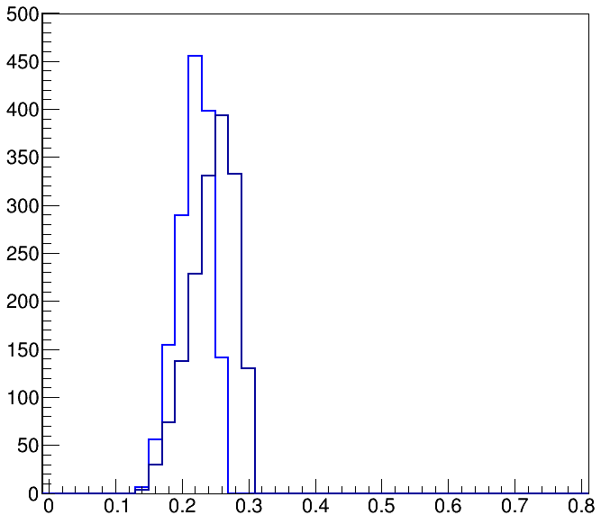
with π+ momentum selection at the first bend narrow band beams (preliminary)
flux
CCQE
ν_{μ} / cm² / 0.02 GeV bin
events = mass* flux(E)*xs(E)*ε_{d}(E)
<E_{ν}> GeV = 0.165
0.190
0.220
<E_{ν}> GeV = 0.125, selection 360 MeV
CC ν_{μ} / ton / 0.02 GeV bin / 200 days
CC ν_{μ} / ton / 0.02 GeV / 200 days
0.250
0.150, selection 450 MeV
0.170, selection 550 MeV
0.190, selection 650 MeV
E_{ν} GeV
E_{ν} GeV
25 kW
Selection π+, P(MeV/c) ± 10 % | 360 | 450 | 550 | 650
Ν _{ν} (x10¹³) / cm² / 200 days | 1.29 | 1.33 | 0.92 | 0.61
CC ν_{μ} / ton / 200 days | 215 | 970 | 1500 | 1658
Indication that can measure the ν_{μ} CCQE from 0.160 - 0.250 GeV
detector selection & simulation
to fully determine the potential
-

Slide 15
Conclusions so far
Particles at target station
Graphite conical target has been chosen as best solution for surface muons and pions capture
Superconducting solenoid has been chosen for capture a la Muon Collider/Neutrino Factory, Comet, etc…
Powerful surface muons @ ~10⁸ / sec and π+ ~ 10¹⁰ / sec @ exit of target station
Neutrino beam
Studies have shown many CCQE with/without momentum selections for pions downstream of target station
Narrow band neutrino beams and CCQE events distributions
Neutrino cross section measurements between 200-300 MeV/c look evitable depending on momentum selection for muon-imaging

Slide 16
extra

Slide 17
Z=0
Z=4359
Z=26848
Z=35848
Distance from the last quadruple to detector is 0.6m
X-ray
imaging
muSR
Z=33548

Slide 18
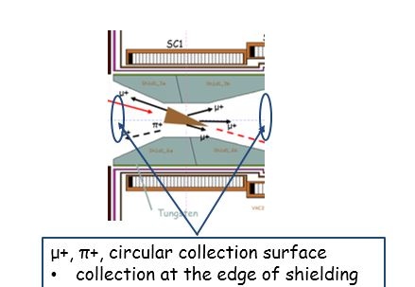
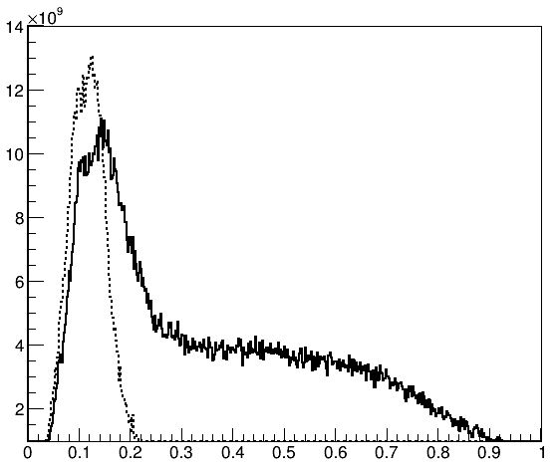
no-backward collection for π+ due to lower energy beam
graphite
100000 π mm mrad
1 λ_{I}
backward collection of π+

Slide 19
μSR: surface muon collection at MS1 from 1 to 5 T
emittance (π mm mrad) | 10000
momentum (MeV/c) | μSR - μ⁺ 25 < P < 29.8
Field (baseline type) | 1 -> 0.5 T | 2.5 -> 0.5 T | 3 -> 1.5 T | 4 -> 2.5 T | 5 - > 3 T
intensity (x10⁶) μ/sec | 7 | 18 | 21 | 26 | 32
polarization | -0.83 | -0.62 | -0.44 | -0.38 | -0.38
surface muon purity (%) | 86 | 68 | 55 | 50 | 50
stat. errors for both intensity and polarization ~ 5%
Highly polarized μSR beam at 1 T considering
the superconducting taper solenoid capture and transportation
5 kW shielding studies

Slide 20
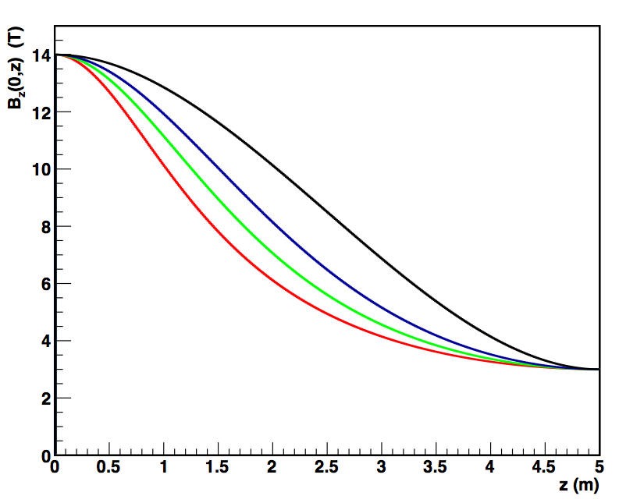
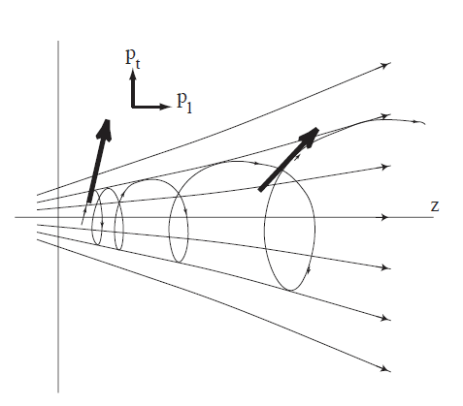
Adiabatic fields in solenoids: slower to fast tapers
For an adiabatic reduced field
coil shielding aperture limits maximum transverse momentum at target region
transverse momentum reduction along taper
beam size expansion <-> shield configuration at MCS
slower taper <-> thicker shielding
pion capture
P_{Tmax} = 3 * B₁ (T) * r_{cs} (cm) / 2
can be used for thicker shielding
B₂<B₁
Adiabatic, slow field change,
conservation of magnetic flux
B₁
helical trajectories
B x r² = C -> r₂/r₁ = √B₁/B₂
P²_{T} / B = C -> P_{T2}/P_{T1} = √B₂/B₁
MOMENT baseline

Slide 21
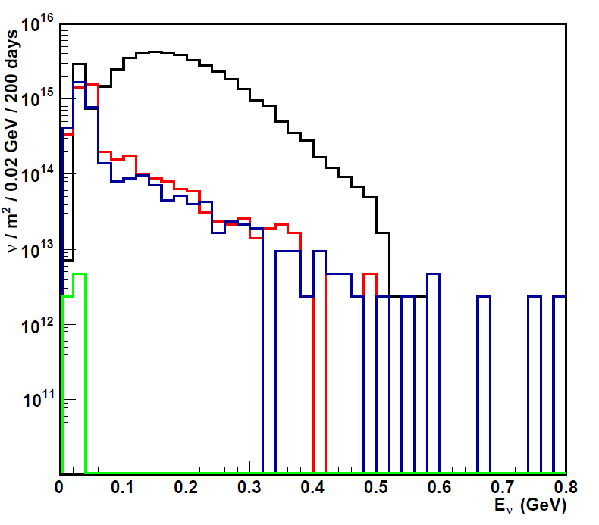
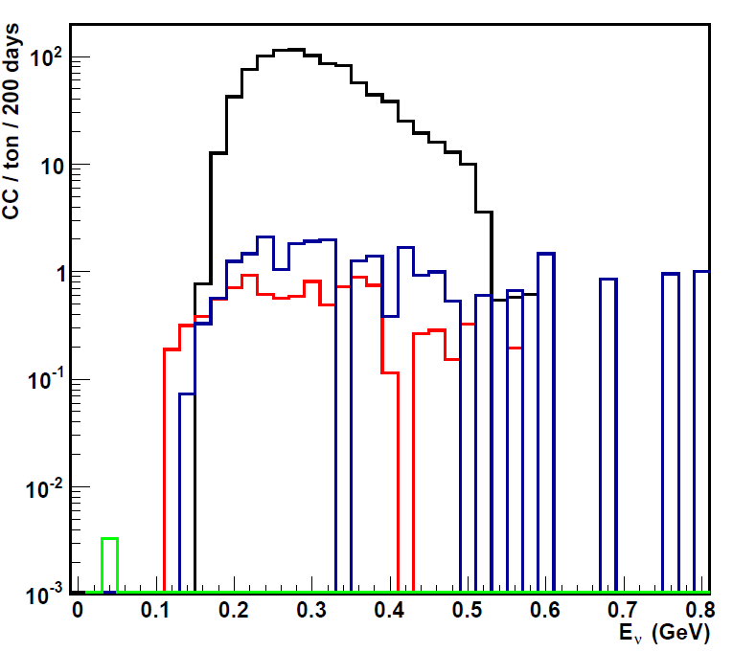
other applications for EMuS
The neutrino beam is an option under investigation. Motivation of the neutrino beam is the lack of recent cross sections measurements at lower energies
Flux ν_{μ} , <E_{ν}> ~ 200 MeV
CC ν_{μ} , <E_{ν}> ~ 300 MeV
-
ν_{e}
ν_{μ}
ν_{e}
-
ν_{μ}
1-8% stat. error, FLUKA | Ν _{ν} (x10¹⁶) / m² / 200 days |  | CC / ton / 200 days
 | > 53 MeV | % | - | %
ν_{μ} | 3.78 | 94.5 | 959 | 96.5
ν_{μ} | 0.13 | 3.2 | 10 | 1
ν_{e} | 0.09 | 2.3 | 25 | 2.5
ν_{e} | - | - | 0.004 | -
4 kW
-
CC ν_{μ} at <E_{ν}> = 300 MeV at EMuS
~ 1000 CC events / ton / year at 4 kW
~ 6250 CC events / ton / year at 25 kW
-

Slide 22
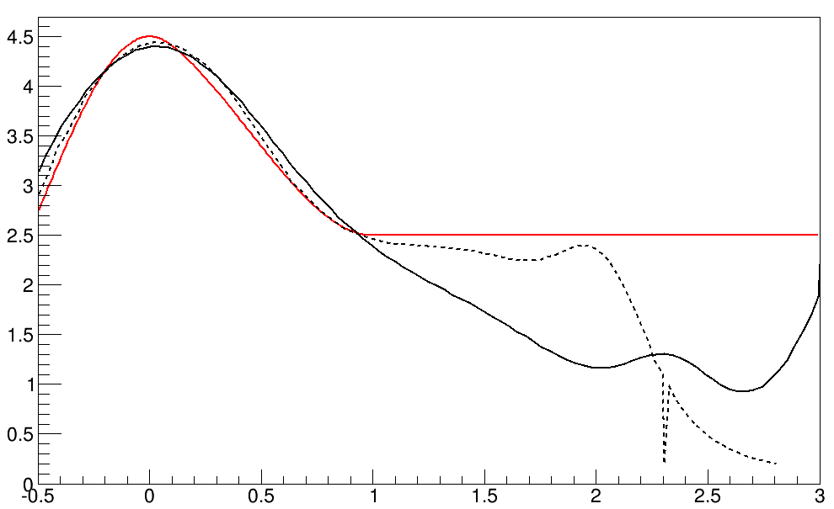
Bz(r=0) T
4.5 T reference
4.4 T coil 25 kW
4.4 T coil 5 kW
target center
MS1 shielding, 25 kW
exit MS1, 25 kW
z(m)
entrance MS1

Slide 23
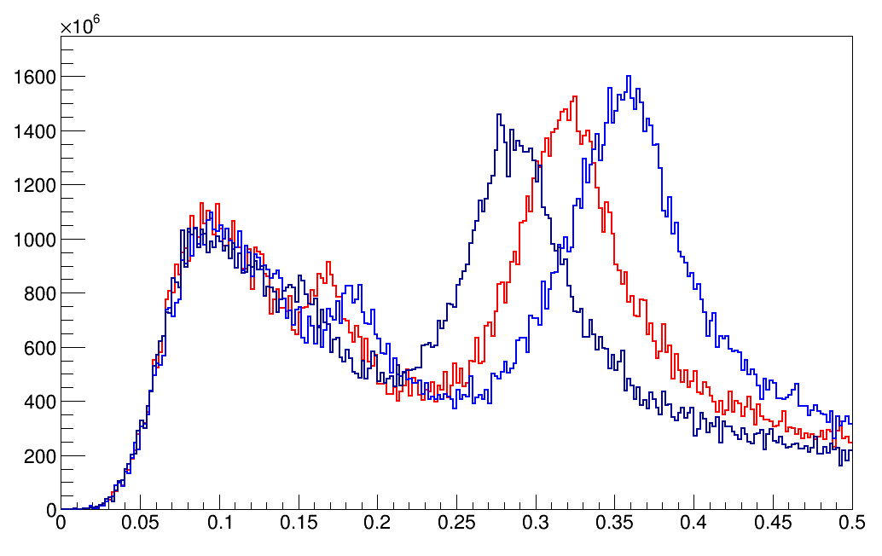
different adiabatic tapers <-> different momentum selection
5T case
polynomial representation of tapers
π+ entering MS1 as function
of different taper shapes at 5T
5T taper variations
100
260
450 MeV/c
~100 MeV/c
Bz(r=0) T
π⁺ / 2 MeV / s
Slower taper
Baseline
Faster
5 ->3 T
z(m)
P GeV/c
EMuS Review
NV - Target Studies

Slide 24
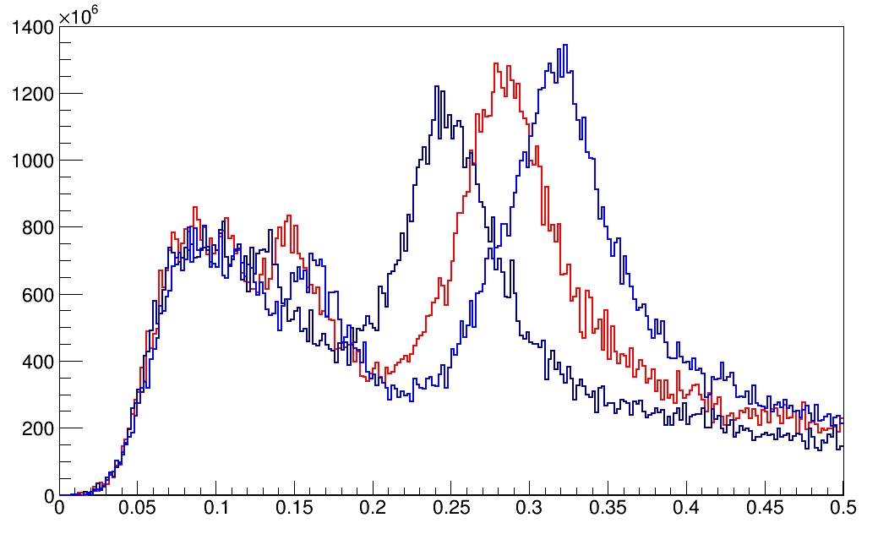
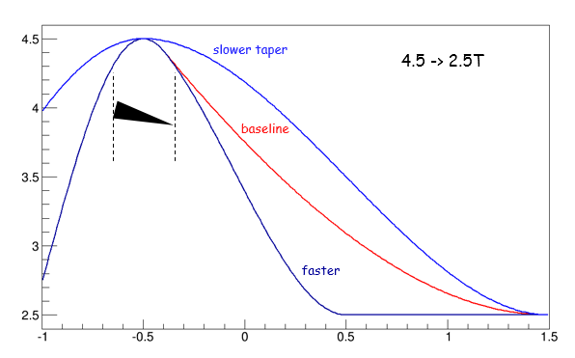
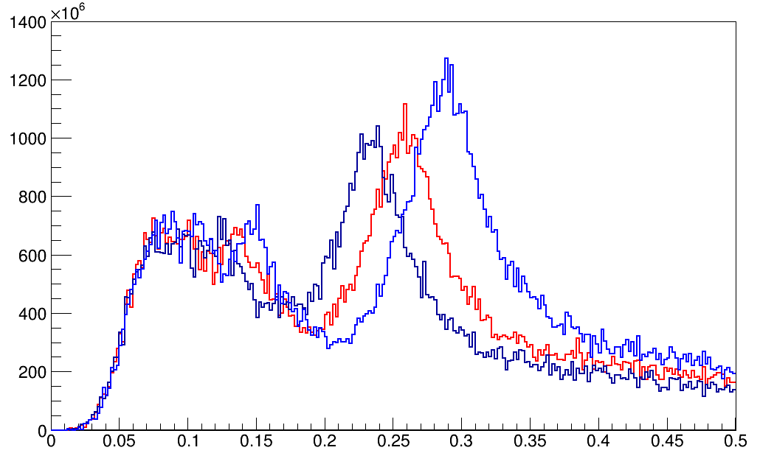
different momentum selection
4.5, 4 T cases
polynomial representation of tapers
260 MeV/c
4.5 -> 2.5 T
π⁺ / 2 MeV / s
4.5T taper variations
Bz(r=0) T
P GeV/c
260 MeV/c
4 -> 2.5 T
π⁺ / 2 MeV / s
z(m)
EMuS Review
NV - Target Studies
P GeV/c

Slide 25
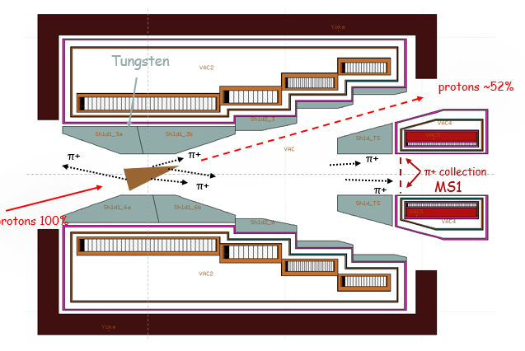
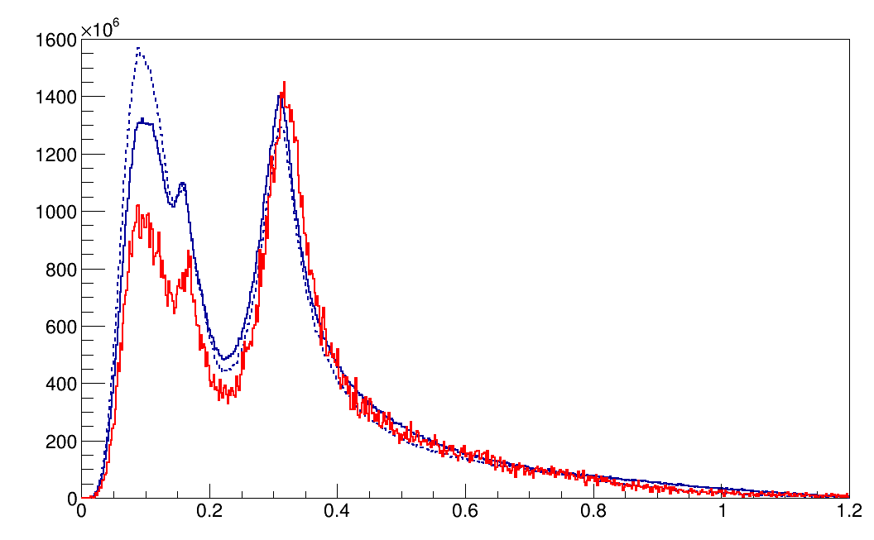
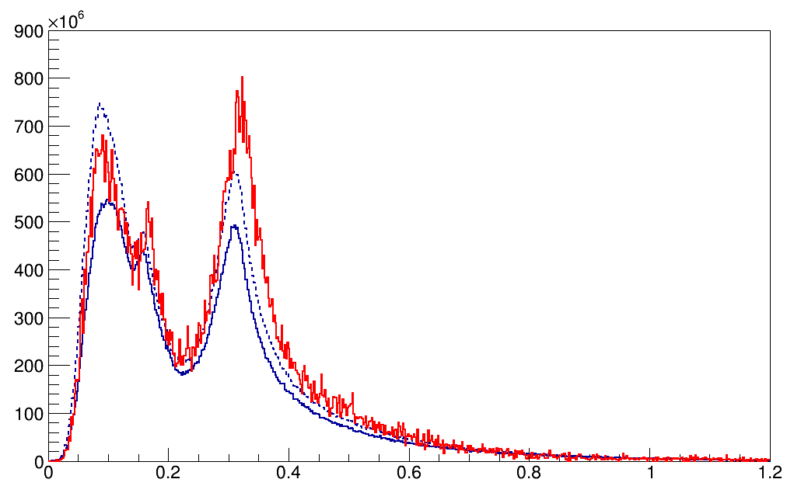
Systematics from monte-carlos: π+ and π- with FLUKA and G4 (BERTINI, INCL) at MS1, 5 Τ
π+, 5 T
π⁺ / 2 MeV / s
G4 bert
FLUKA = 1.7x10¹¹
G4 (bert) = 2x10¹¹
G4 (incl) = 2x10¹¹
G4incl
Ratio π+/π-:
FL = 1.9
G4 (bert) = 2.9
G4 (incl) = 2.2
Same baseline 5T taper used on both
P GeV/c
π-, 5 T
π⁻ / 2 MeV / s
FLUKA = 0.9x10¹¹
G4 (bert) = 0.7x10¹¹
G4 (incl) = 0.9x10¹¹
Total pions are similar with FLUKA and G4 (BERTINI)
G4(INCL) produces more pions
The distribution at the high momentum peak is similar
FLUKA predicts a ratio π+/π- = 2
G4: Song Yingpeng
P GeV/c

Slide 26
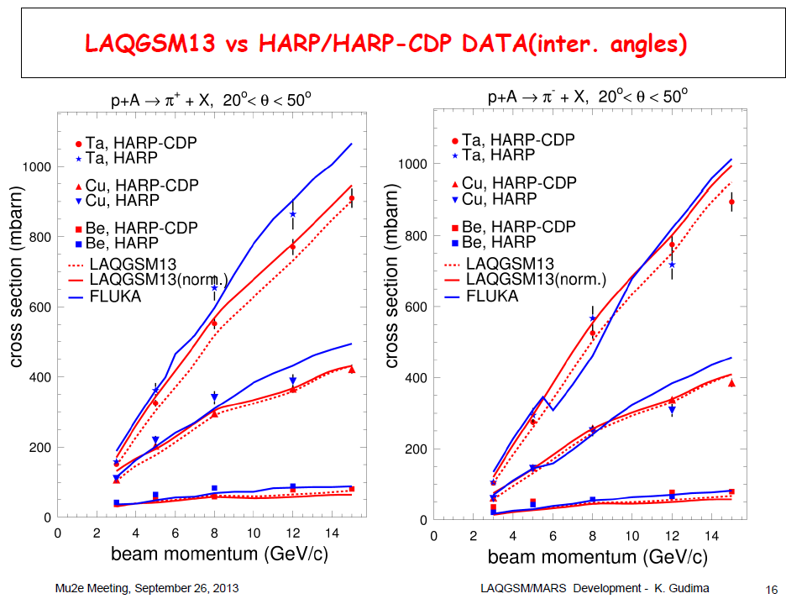
FLUKA vs MARS vs HARP
FLUKA is in agreement with MARS and HARP data @ E_{k} = 2.2 GeV

