Slide 1
Interaction mechanism of muon/positron and medium
Li Chong (李崇)
IHEP, CAS
2nd workshop on EMus application
USTC, HeFei
2019.12.14

Slide 2


Tables of contents
Program Introduction
Beam muon imaging
Scattering tomography
Transmission imaging;
Secondary positron imaging
Muon Detector
Muon radiation
Summary

Slide 3
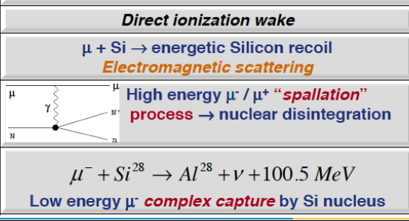
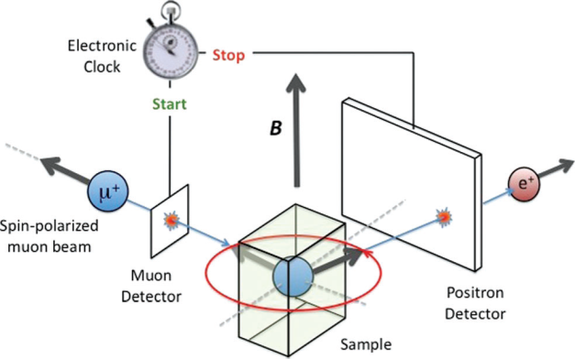
Program Introduction
Mechanism of particle interaction between Muon/secondary positron and medium
Brief information：
Fund by National Natural Science Foundation of China
Implementation cycle: 01 January 2020 — 31 December 2022
Joint Research Program based on the planning muon beam at CSNS
Motivation & Main contents：
Radiation
Imaging
μSR
Important application in life science, material science, energy science, and nuclear security

Slide 4
Program Introduction
Motivation & Main contents：
Imaging
Radiation
Transmission imaging: Beam parameters, sample density and structure , depth distribution.
Scattering tomography: Beam parameters, sample atomic number Z and structure, scatter distribution.
Secondary positron imaging: Positron depth distribution
Methodology study on highly accurate measurement of positron distribution
Muon Radiation: Electromagnetic process, energy deposit, beam energy.
Mechanism of particle interaction
Provide theoretical base for multidisciplinary application of future muon beam

Slide 5
Program Introduction
Mechanism of particle interaction between Muon/secondary positron and medium
Members and responsibility：
Cao Xngzhong, Professor: Overall support on Geant4 simulation of particle interaction mechanism through matter.
Zhang Zhiming, Professor: Overall support on detector technology including detector, electronics, and structure etc. design.
Li Chong, Postdoctoral fellow: Responsible for Geant4 simulation of muon depth/scatter distribution and secondary positron distribution.
Liu Fuyan, PhD Candidate: Responsible for part of simulation of particle interaction mechanism and electronics design
Zhai Jiajia, PhD Candidate: Responsible for Geant4 simulation of detector parameters and detector design.
Collaboration with the muon group at CSNS

Slide 6
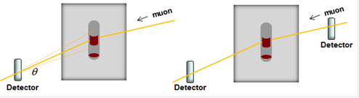
Muon imaging
Scattering tomography
Kume, N., et al. "Muon trackers for imaging a nuclear reactor." Journal of Instrumentation 11.9(2016)
Scattering tomography (locate high atomic number Z material):
Prevention of non-proliferation, Nuclear reactor, Nuclear waste.

Slide 7
Muon imaging
The muon scattering/displacement imaging was observed to provide detailed information about the damage to the reactor core
Schematic of scattering/displacement method
Nuclear reactor
Assembled muon trackers
The reactor model of Unit 2, Fukushima Daiichi
(a)Empty in the RPV. (b) Original fuel and deposition fuel debris. (c)Comparison fuel rod and steel rod.
Kume, N., et al. "Muon trackers for imaging a nuclear reactor." Journal of Instrumentation 11.9(2016)

Slide 8
Muon imaging
Transmission imaging
Scattering tomography
Kume, N., et al. "Muon trackers for imaging a nuclear reactor." Journal of Instrumentation 11.9(2016)
Transmission imaging (radiography of geophysical scale structure):
Pyramid structure, Volcanic eruptions, Geologic structure;
Scattering tomography (locate high atomic number Z material):
Prevention of non-proliferation, Nuclear reactor, Nuclear waste.

Slide 9

Muon imaging
Morishima, Kunihiro, et al. "Discovery of a big void in Khufu’s Pyramid by observation of cosmic-ray muons." Nature (2017).
Morishima, Kunihiro, et al. "Discovery of a big void in Khufu’s Pyramid by observation of cosmic-ray muons." Nature (2017).

Slide 10
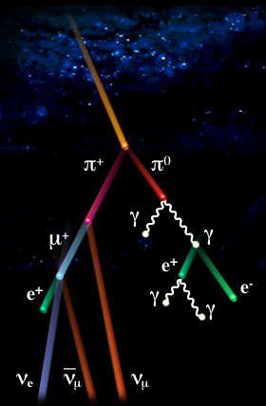
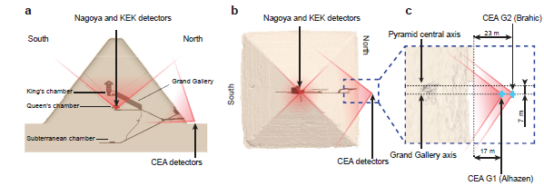
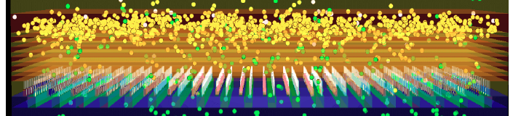
Muon imaging
Cosmic Muon(at sea‐level):
High energy (3.44 GeV) — large-scale substance
Low intensity—1μ/cm²·min
Morishima, Kunihiro, et al. Nature (21 Nov 2017).
质子
π 介子
π衰减
Muons
杂质
质子加速器
靶
聚焦
筛选
Accelerator Muon:
Low energy (28-450 MeV/c)
High intensity
Monochromaticity
能量选择
磁导向/扩散
入射粒子探测器
出射粒子探测器

Slide 11
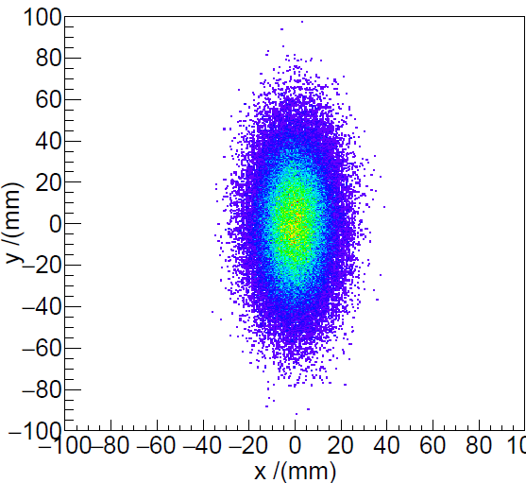
Muon imaging
#gaussian with a x/y FWHM 2/5cm
/gps/pos/shape Ellipse
/gps/pos/centre 0. 0. -10 cm
/gps/pos/sigma_x 0.86 cm
/gps/pos/sigma_y 2.14 cm
/gps/pos/rot1 1 0 0
/gps/pos/rot2 0 1 0
# 1D accelerator beam
/gps/particle mu+
/gps/pos/type Beam
the beam energy is in gaussian profile/gps/ene/type Gauss
/gps/ene/mono 450 MeV/c
/gps/ene/sigma 50. MeV

Slide 12
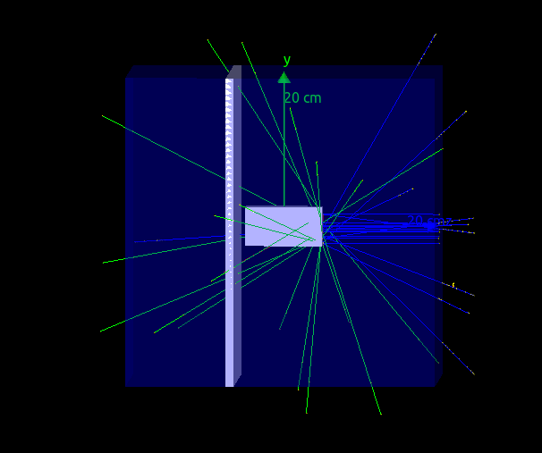
Scattering tomography
Schematic:
Magnetic lens
Detector
Detector
Beam parameter:
Geant4 model:
/gps/particle mu+
/gps/energy/ 50, 200 460 MeV
/gps/pos/type Beam
/gps/pos/Shape Square
/gps/pos/halfx 3 cm
/gps/pos/halfy 3 cm
gps/pos/direction 0. 0. -1
/run/beamOn 100000
Gamma
Positron
μ⁺ beam
Sample: X (5cm)*Y(5cm)*Z(10cm)
Al, Fe, Pb, U
Notes:
透视结构，射线，探测器？

Slide 13
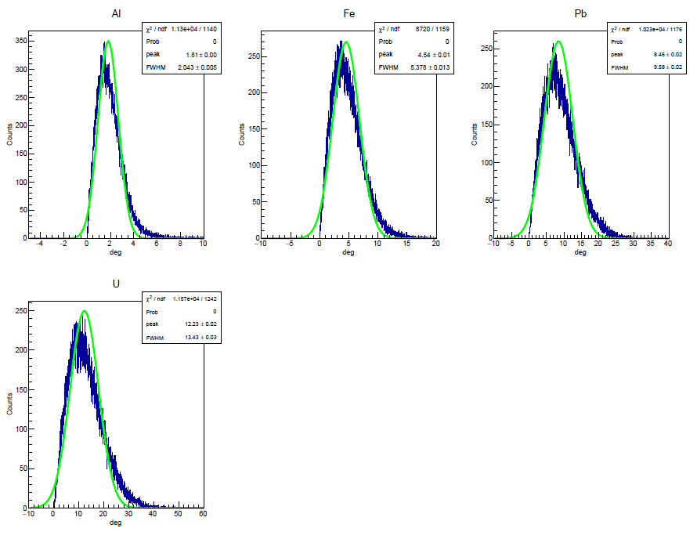
Scattering tomography
The distinguishable distribution of scatter angles in Al Fe, Pb, U provided the possibility of scattering tomography.
Proper energy choice may result in better imaging quality?
Notes:
样品尺寸变大散射角是否会发生变化
能量变化散射角是否会发生变化——是否有最优成像能量的结果？
其他物理问题？
原件

Slide 14
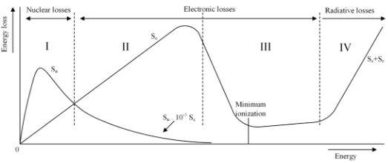
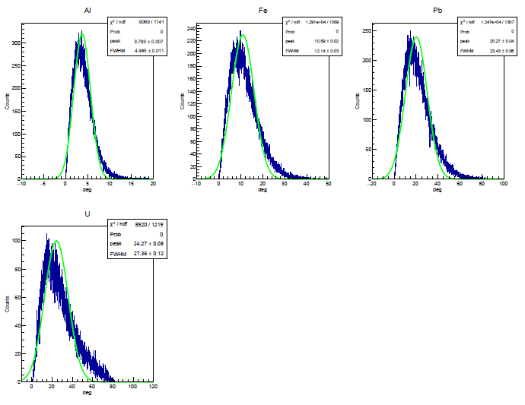
Scattering tomography
For high energy Muon, much should pass through matter with small deflection; for low energy, the distinction of scatter angle distribution was more prominent;
Nuclear collisions; discrete and great energy losses; significant change in direction;
Electronic collisions; continuous and small energy losses; small deflection
460 MeV
200 MeV
The frequency of nucleus-muon interactions increases with decreasing muon energy

Slide 15
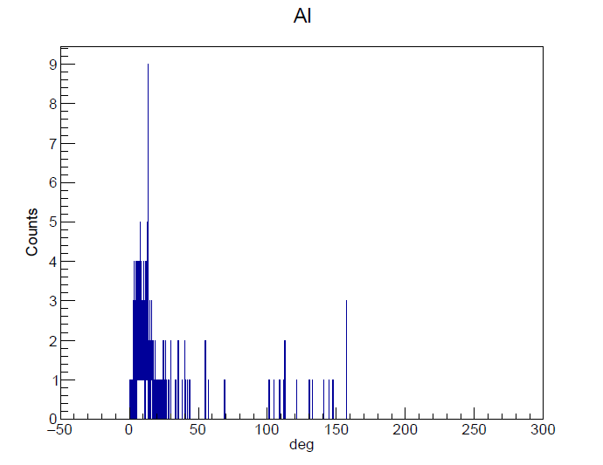
Scattering tomography
For high energy Muon, much should pass through matter with small deflection; for low energy, the distinction of scatter angle distribution was more prominent;
Low energy decay muon is preferable for sample tomography in cm or sub-cm scale (depend on the sample).
4 MeV
460 MeV
200 MeV
Low energy muon

Slide 16
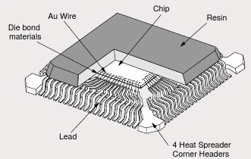
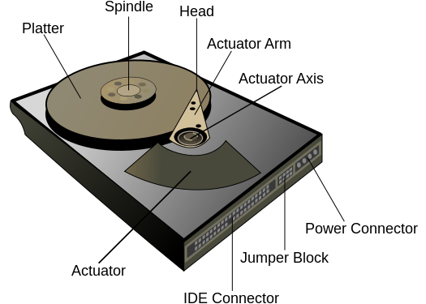
Transmission Imaging
Electronic devices
Hard disk
Image internal structure :
Packaged devices
Dust-free environment
Vacuum environment
Detector
μ⁺
Unopened; Non-destructive; Good penetrability
Imaging
Expose the devices with Muon beam in different directions to image the internal structure.

Slide 17
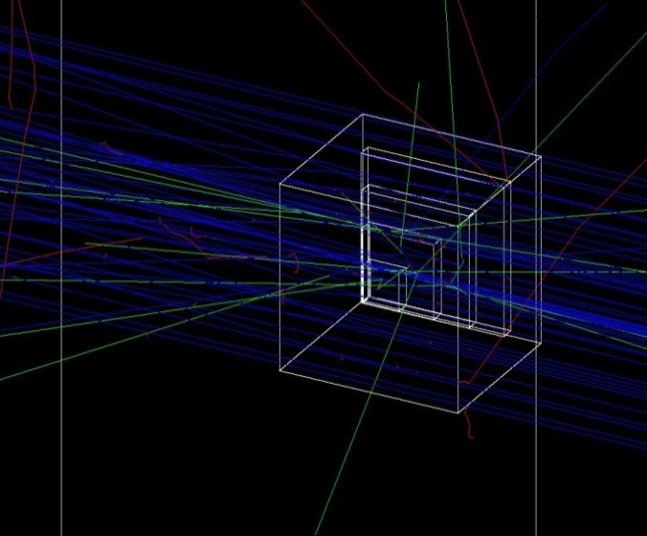
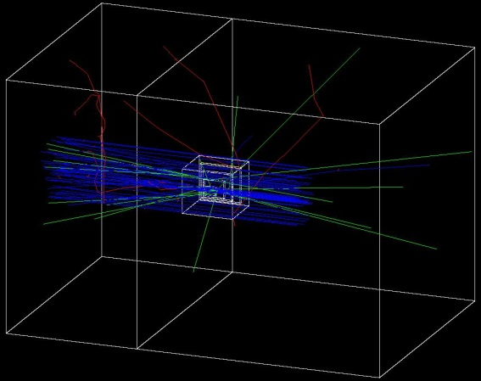
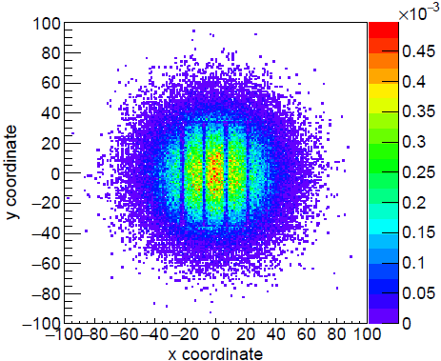
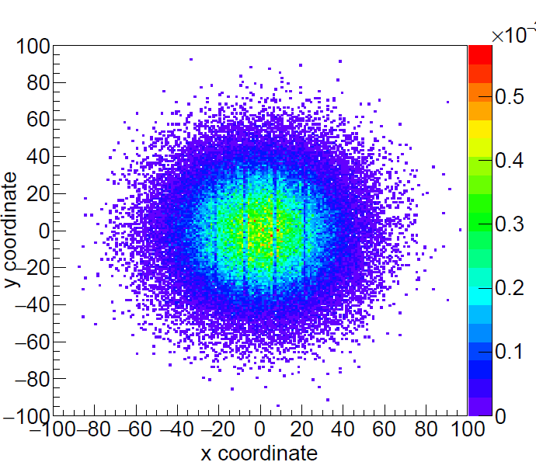
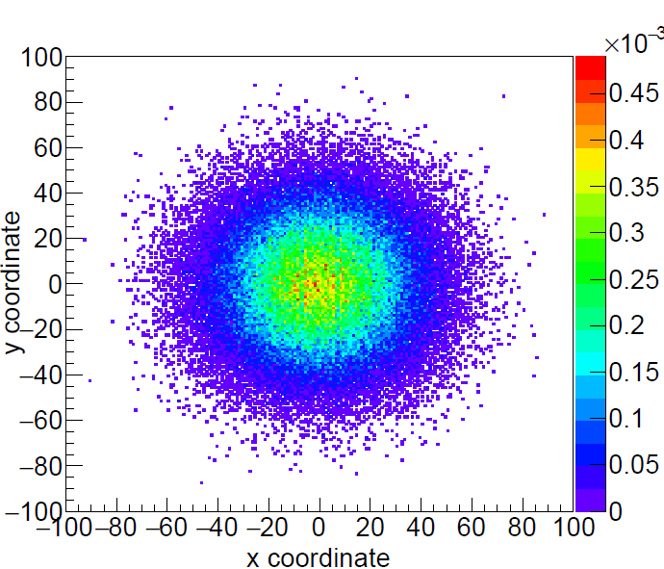
Transmission Imaging
Perpendicular to xy plane
PE
2mm
Detector
Y-35 mm
Geant4
X-35 mm
50MeV
200MeV
450MeV
Muon distribution can greatly influence the imaging quality, proper incident energy can result in better transmission imaging resolution

Slide 18
Transmission Imaging
(cm) | Muscle | SiO2 | Al | Ti | Fe | Cu | W
FWHM | 56.97 | 31.70 | 26.99 | 17.74 | 10.34 | 9.31 | 5.36
Depth | 198.97 | 110.54 | 95.32 | 61.49 | 35.93 | 32.64 | 18.03
FWHM (Mono) | 11.83 | 6.87 | 6.03 | 4.15 | 2.49 | 2.32 | 1.68
Good penetrability: 2m in human tissue; 1m in semiconductor; 0.35m in Fe and 0.2m in W;
Good Z-direction resolution compared with the implantation depth;
Better energy resolution can result in better depth resolution.

Slide 19
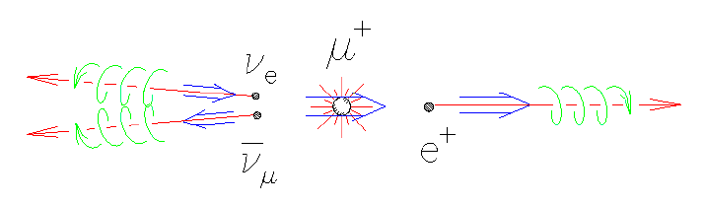
Transmission Imaging
Good depth resolutions were achieved with all incident energy muon
For increasing incident energy, muon beam just transmitted deeper with less expanding implantation profiles
Muon
Decay e⁺
^{γ,} ^{511KeV}
 |  | 50 | 200 | 460
Fe(cm) | FWHM | 0.16 | 0.95 | 2.49
 | Depth | 1.93 | 13.66 | 36.08
Decay mode

Slide 20


Secondary positron
By controlling the pre-sample size to make the positrons annihilate at certain location, then selective imaging and characterization may be done base on this.
^{γ,} ^{511KeV}
γ Detector
Magnetic lens
Pre -sample
The amount of e+ definitely exceed the Muon and increase with increasing density.
 | W | Cu | Fe | Ti | Al | SiO₂ | Plastic
Muon | 10⁵
Decay e⁺ | 10⁵
Secondary e⁺ (10⁵) | 17.1 | 8.1 | 7.2 | 6 | 3.5 | 2.8 | 0.9

Slide 21
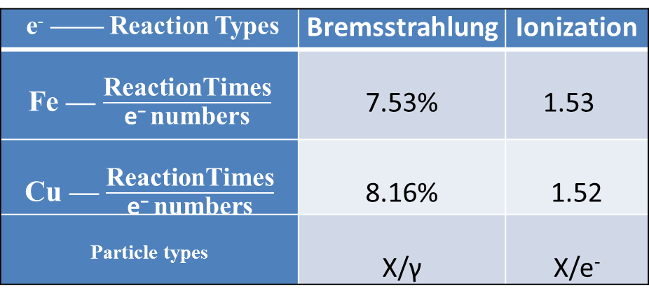
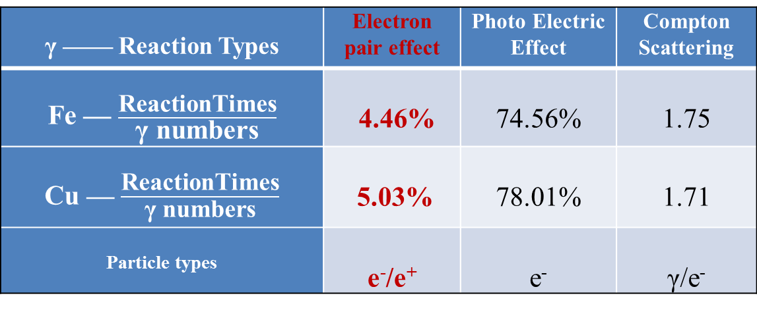
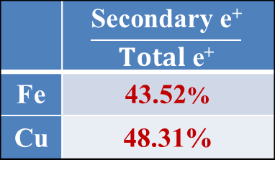
Secondary positron
52 MeV e⁺ in Fe and Cu
γ —— Reaction Types | Electron pair effect | Photo Electric Effect | Compton Scattering
Fe — $\frac{\text{R}\text{eactionTimes}}{\text{γ} \text{numbers}}$ | 4.46% | 74.56% | 1.75
Cu — $\frac{\text{R}\text{eactionTimes}}{\text{γ} \text{numbers}}$ | 5.03% | 78.01% | 1.71
Particle types | e⁻/e⁺ | e⁻ | γ/e⁻
Three major particles in the processes:
γ
e⁻
e⁺
e⁻ —— Reaction Types | Bremsstrahlung | Ionization
Fe — $\frac{\text{R}\text{eactionTimes}}{\text{e}\text{−} \text{numbers}}$ | 7.53% | 1.53
Cu — $\frac{\text{R}\text{eactionTimes}}{\text{e}\text{−} \text{numbers}}$ | 8.16% | 1.52
Particle types | X/γ | X/e⁻
 | $$\frac{\text{Secondary} \text{e}\text{+}}{Total \text{e}\text{+}}$$
Fe | 43.52%
Cu | 48.31%
More Electron-pair effect occurred in higher density material leading to more secondary e⁺

Slide 22
Transmission Imaging
For common materials, the depth of 400 MeV muon is large enough to provide the possibility of transmission imaging.
Low energy (tens MeV) muon beam or surface muon is proper for mm or sub-mm scale imaging as electronic device

Slide 23
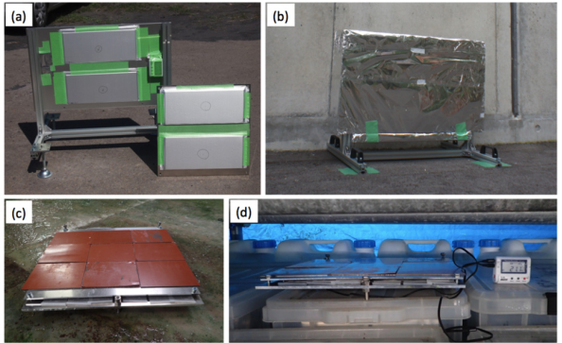
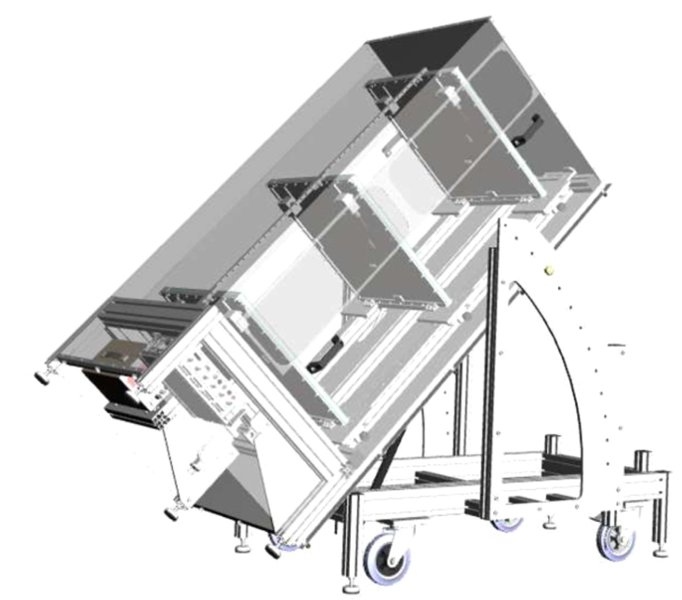
Detector
Transmission Imaging
Nuclear Emulsion Cloud Chamber, Univ.Negoya,
Solid dielectric: great stopping capacity
Low price: easy for large areas design
Spatial resolution: sub-μm
Sensitive to environment: precision and lifetime easily influence temperature, humidity, and exposure time.
a)
MPGD-Micromegas, Saclay, CEA Inc.
High signal gain: ~10
Spatial resolution: hundreds μm
Good stability under radiation and good uniformity in large areas measurement
Economical and easy to process in large areas
Enormous amount of readout electronics
b)

Slide 24
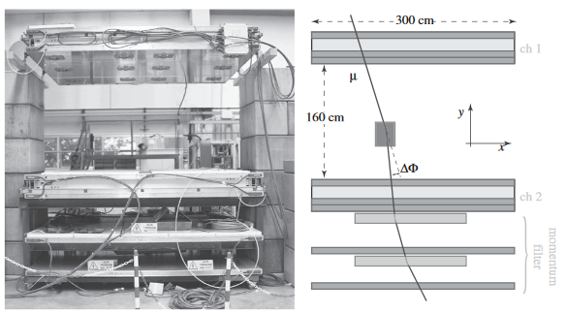
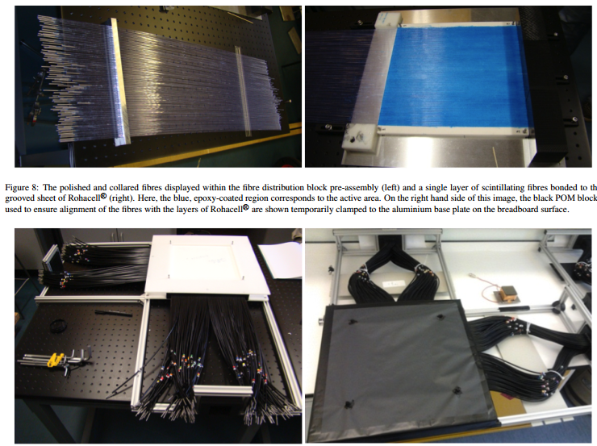
Detector
Scattering tomography
Drift Tube, LANL
Detect Efficiency：99.5%/layer
Angle solution：2~mrad
Spatial Solution：200μm
a)
Scintillator detector
Effective area：1.0×1.0m²
Detect Efficiency：85%
Angle solution：2-14mrad
Spatial Solution：3mm
b)

Slide 25
Detector
Scattering tomography and Transmission imaging detector in world
Type of Detector | Institute | Detect efficiency/layer | Active Area/cm2 | Spatial resolution | Angle resolution/mrad | Algorithm
Drift Tube | LANL | 99.5% |  | ~400 μm | 2 | -
Gas Electron Multiplier | FIT |  | 400×400 | ~130 μm | - | PoCA
Scintillating-Fibre | AWE, Glasgow, Bristol | ~85% | 30×30 | 800-1300 μm | - | MLEM
Resistive Plate Chamber |  | 80% | - | 1 mm | 7-10 | -
Nuclear Emulsion | Nagoya | 97% | 30×25 | sub-micron | 2-14 | Track Selector
MPGD-MicroMeGas | CEA | 95% | 50×50 | 300 | 0.8-4
Cosmic ray: low price, easy to process, great stopping capacity, good stability in long period of radiation
Excellent spatial resolution to extract the most possible information from each recorded track.
Influence and detection of positron and gamma ray on imaging plate

Slide 26
Irradiation
Electromagnetic Physics of muon
MuIonisation: the dominant mechanism of energy loss and can be described by Bethe formula excluding the density–effect correction.
N_{a}, r_{e}, m_{e}, are Avogadro’s number, Bohr radius, electron mass, I is mean ionization potential
MuBremsstrahlung: dominates other muon interaction process in the region of catastrophic collisions, that is at “moderate” muon energies above the kinematic limit for knock-on electron production.
MuPairProduction: direct electron pair production is one of the most important muon interaction processes.
CoulombScattering: coulomb Scattering with nuclei may cause large angle deflections and can be used to obtain the stored contents of a container
Decay: decay forms an electron or positron and corresponding neutrinos

Slide 27
Irradiation
Proton
alpha
muon
For Proton/Alpha, good energy deposition as μ+ while smaller penetrability
gamma
Good energy deposition
Good penetrability
For e-/e+/gamma, good penetrability as μ+ while about one-tenth energy deposition for e-/e+

Slide 28
Summary
Particle interaction Mechanism is important for multidisciplinary application of future muon beam
Proper energy choice and good resolution are significant both for scattering tomography and transmission imaging
From the energy and quantities, the secondary positron also provides the possibility of transmission imaging on imaging plates
Following Work:
Continued Geant4 simulation of the muon/secondary positron mechanism
Muon detector parameters simulation with Geant4
Detector design and test by cosmic ray

Slide 29
Thank you for your attention!

