Slide 1
Theoretical analysis of field rotation rate and Gauss-delta in ZF-μSR experiment
Li Deng, Bangjiao Ye
14/12/2019, 2nd workshop on CSNS Muon Source Multidisciplinary Applications
State Key Laboratory of Particle Detection and Electronics, USTC

Slide 2
OUTLINE
ZF-μSR spectrum and its parameters
What can ZF-μSR do via nuclear interaction
ν spectrum analysis: atoms’ diffusion behavior
Δ spectrum analysis: a probe of motional narrowing effect and materials defects
Summarize and work planning

Slide 3
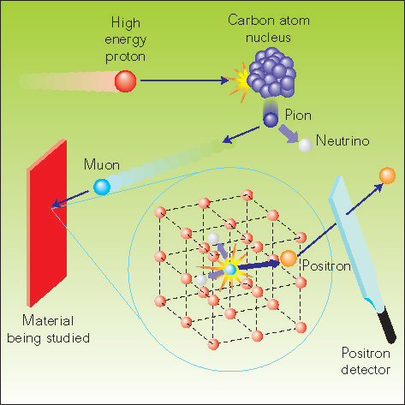
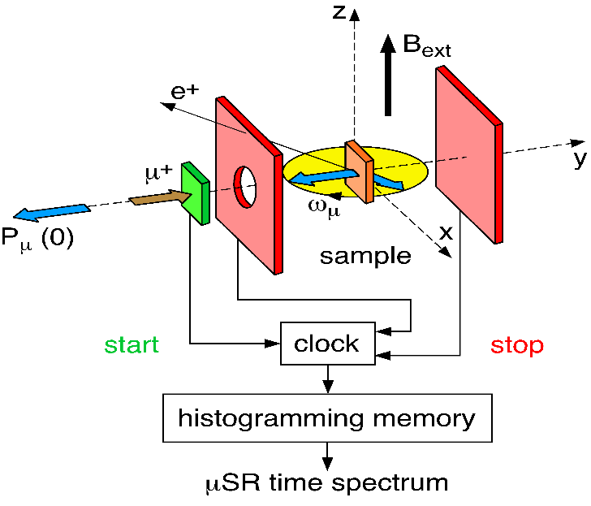
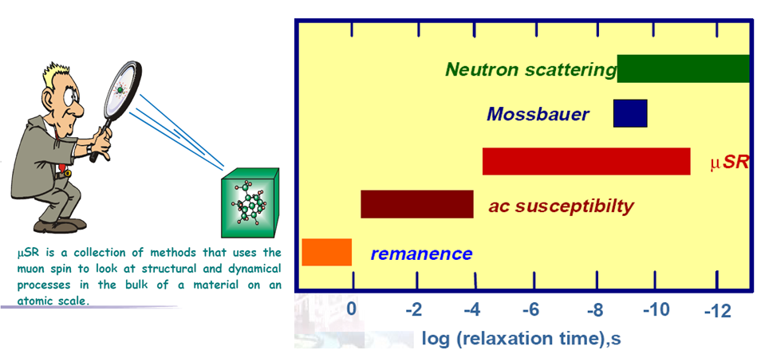
1. ZF-μSR spectrum and its parameters
[1]
Notes:
MuSR,mens*,is a technique used polarized muon to detect**.we use polarized muon pruduced by decay pionsas a beam implant to sample, If there is **. When muon decay into positrons, we can get imformation of * by positron shooting direction.||in **,two dectors,three types||compared to other**,unique detection range

Slide 4
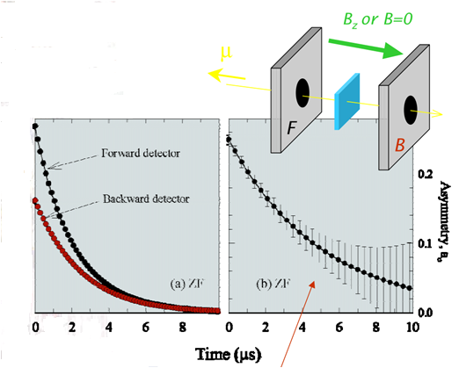
1. ZF-μSR spectrum and its parameters
[2]
Atomic case:
Nuclear case:
(Atoms' diffusion and vancies analysis)
Notes:
in our**,polarized * implanted to sample, and precess with local*.So the count number of a direction*.So we define the astymmetry**,in order to polarization changing, sensitive to B. Static Kubo, Dynamics Kubo. Different Magnetic moment.

Slide 5
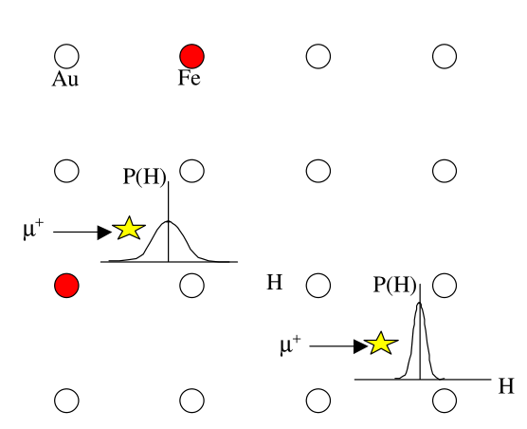
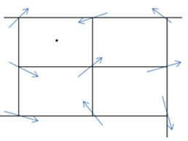
2.What can ZF-μSR do via nuclear interaction
μ⁺
[2]
Δ spectrum: Sensitive to muon magnetic environment.
ν spectrum: Sensitive to muon or atoms’ diffusion.
What can influence Δ:
Lattice structure and muon sites (If magnetic materials?);
Motional narrowing effect;
If muon is caught by defects.
What can produce ν:
Muon hopping;
Atoms ( which have higher magnetic moments and nearby to muon) diffusion ,usually in the case of vacancies.
Study motional narrowing effect, ensure muon sites, and get concentration information of defects which can capture muon.
Study muon hopping, or some atoms which have high magnetic moment diffusion ( and the vacancies they diffuse to).
Notes:
DIstance. 1.Relative component at each site.||2. Diffusion in vacancies is easier than complete lattice.

Slide 6
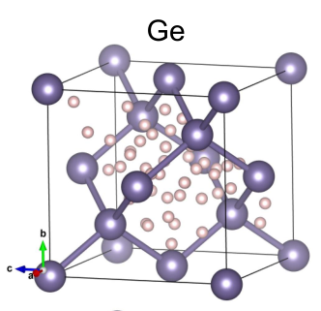
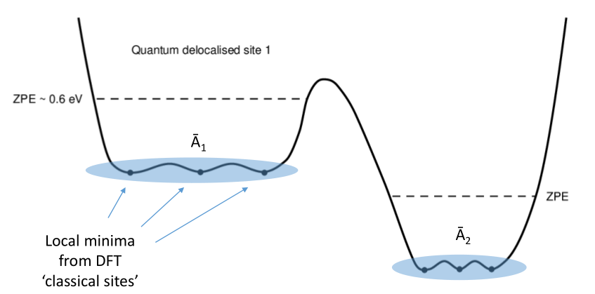
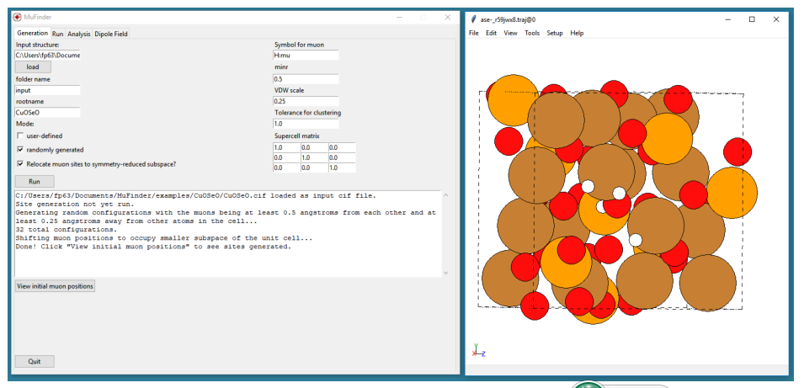
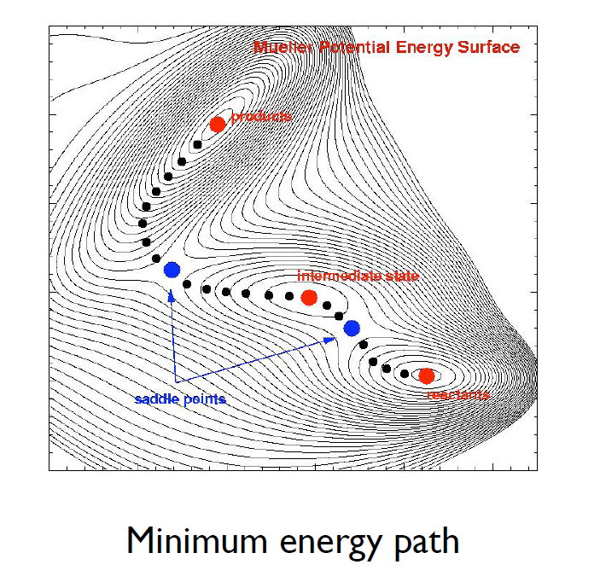
3. ν spectrum: atoms’ diffusion analysis
Finding muon site(s) :
[3]
[4]
[3]
Notes:
Important. Usually minimun energy site, but also local site.|| Basic method, put muon at different initial site, and**.||Mufinder || The problem we consider here*

Slide 7
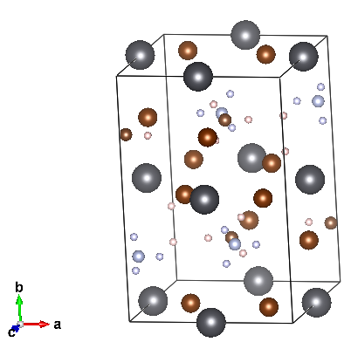
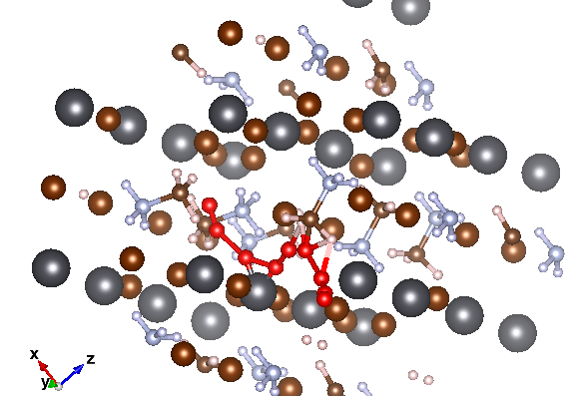
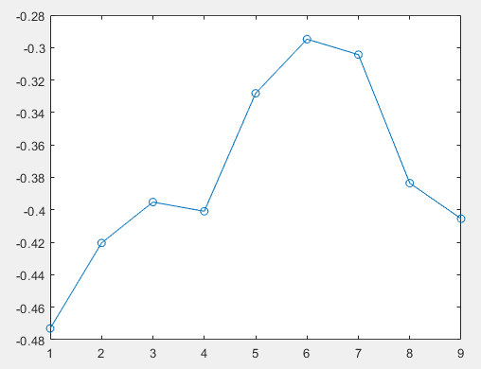
3. ν spectrum: atoms’ diffusion analysis
Example for CH₃NH₃PbBr₃
μ⁺
1. Lattice relax calculation
(Low temperature phase)
μ⁺
2. Minimum energy path (MEP) calculation

Slide 8
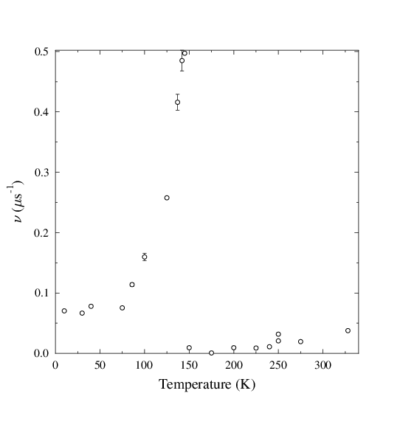
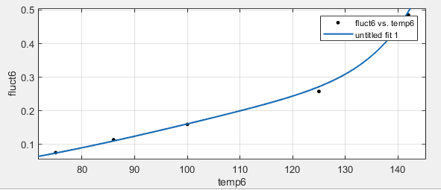
3.ν spectrum: atoms’ diffusion analysis
3. ν spectrum solution and analysis
Shallow combination of muon and impurities (maybe), and muon diffusion in lattice.
Br ion diffuse to Br vacancy is coming soon (ν already has a rising trend), but we can’t get high temperature data because of deliquescence.
For thermal defects:
The activation energy of shallow combination are too low to detect. And atoms diffuse to vacancy or muon diffusion has not appeared in this temperature.
Diffusion behavior | Activation Energy (eV)
μ+ (Tetragonal phase) | 0.178
μ+ (Orthorhombic phase) | 0.494
μ+ (Cubic phase) | Stable (not found)
Br atom to Br atom vacancy (C phase) | 0.470
H atom and muon exchange (T phase) | 2.120
H from CH3 and NH3 exchange (T phase) | 2.471
Double components fitting (ν ~ T relation). ν₁=1.6±0.6 μs⁻¹, ν₂= 10⁷ μs⁻¹ (fixed), ε₁=0.020±0.004 eV. ε₂=0.211±0.004 eV.
Table: Diffusion behavior and activation energy.
Notes:
Experiment. If atoms diffusion, Boltzamann, natural frequency (10 power 13 Hz), activation energy. K concentration, lamda relative possibility muon site. EnthrPy.|| Seven rising points.|| || aier dien(I).||conclusion , compute some diffusion behaviors, corresponding one. But Not always, so many behaviors, complex, sum.clearly.

Slide 9
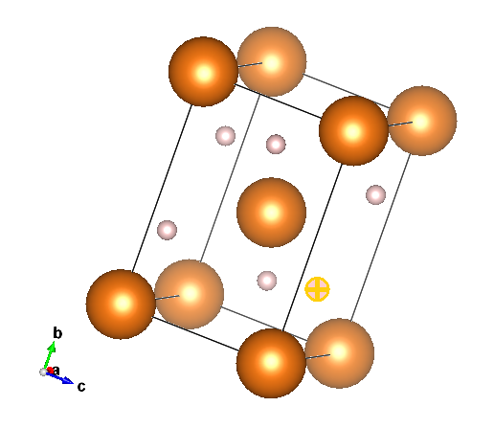
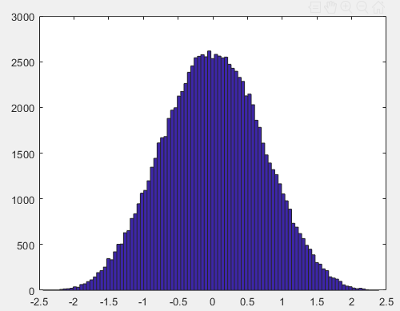
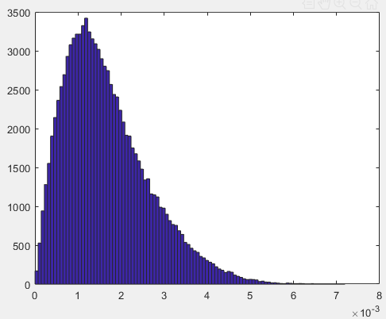
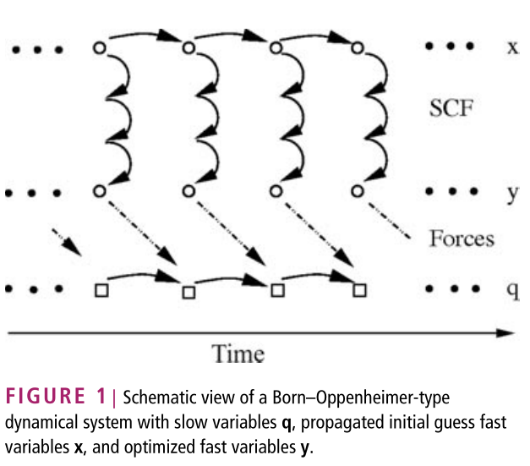
4. Δ spectrum: a probe of motional narrowing effect and materials defects
Dipolar-dipolar interaction :
Random orientation of nucleus:
Motional narrowing effect: Temperature dependence ab initio molecular dynamics :
CAR–PARRINELLO MOLECULAR
DYNAMICS (CPMD):
[5]
[5]
Notes:
how about delta. First, what if muon or an atoms site at stable points. Random direction of muon and nucleus.

Slide 10
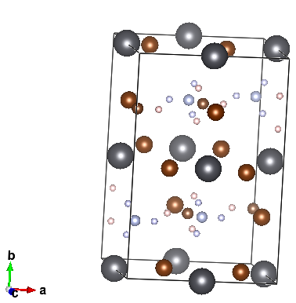
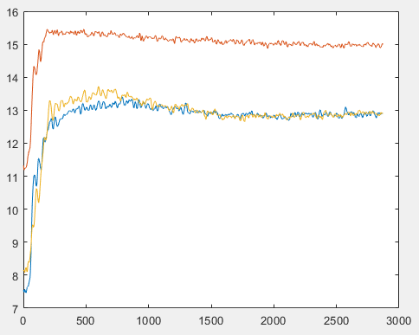
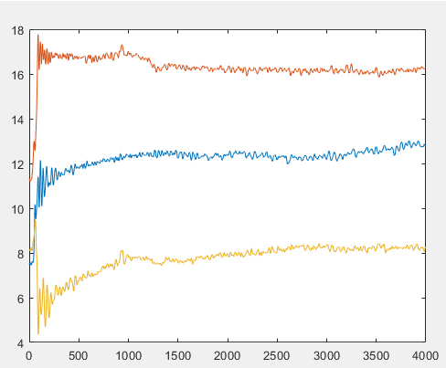
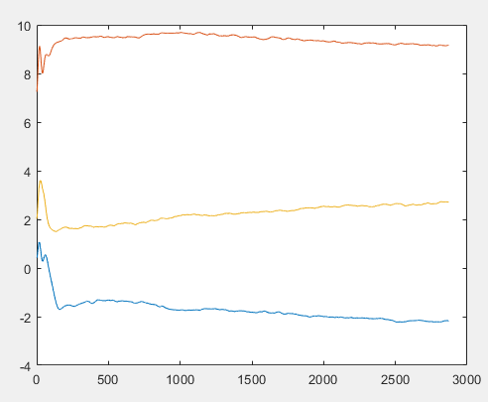
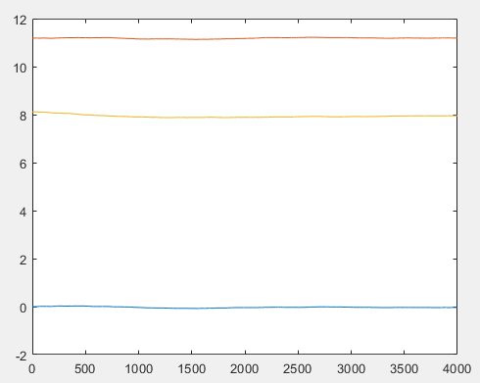
4. Δ spectrum: a probe of motional narrowing effect and materials defects
Example for CH₃NH₃PbBr₃ :
1.Dipolar field for motionless muon (0 K)
Site | Δ (μs⁻¹)
Candidate site | 0.653
Local site | 0.519
Pb site (no relax) | 0.082
Only H and Br have higher magnetic moment.
2.Muon and other atoms’ path by CPMD
Muon path (10K)
Muon path (140K)
H path (10K)
Pb path (140K)

Slide 11
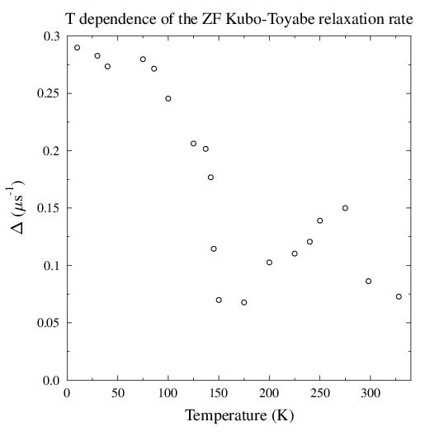
4. Δ spectrum: a probe of motional narrowing effect and materials defects
3.Experiment data analysis
Δ with motional narrowing at candidate muon site.
Orthorhombic phase and cubic phase: The component of muon sites at local sites changes by temperature, so average Δ may increase or decrease. Further calculation needed to confirm it.
Site | Δ (μs⁻¹)
Candidate site | 0.653
Local site | 0.519
Pb site (no relax) | 0.082
Δ: Combination of motional narrowing effect and vacancies concentration increasing.
Notes:
calculation delta with motional narrowing. Rapidly drease. Motional narrowing, not so much.|| CP calculation also shows, muon can site at different sites at higher temperature.

Slide 12
5. Summarize and work planning
We can do:
Diffusion behavior analysis from NEB calculation and ν spectrum;
Dipolar field calculation to ensure muon sites and whether muon is caught by vacancies;
Use CPMD to study motional narrowing effect at specified lattice and temperature.
We are doing:
Finish a complete calculation for Δ, including motional narrowing in the case of local sites and some vacancies;
Defects concentration analysis via ν (for atoms can diffuse), or via Δ (for vacancies can capture muon), needs further study of capture rate λ.
Further planning:
Develope an easy doing method to analyze atom's diffusion and defects' concentration, later for atomic case.

Slide 13
Thank you for listening!
References:
[1] Research progress of a prototype μSR spectrometer and future plan of EMuS, Bangjiao Ye, Hao Liang and Jingyu Tang.
[2] Muon Spin Relaxation Functions, Bob Cywinski, 2005.
[3] Using DFT to determine Muon Probe States, Francis Pratt.
[4] Computer Simulations for Interpreting μSR Experiments, Leandro Librorio.
[5] Car–Parrinello molecular dynamics, Hutter, Volume 00, January/February 2011, Advanced Review.

