Slide 1
EMuS science goals and general design
Tang Jingyu
2nd Workshop of the EMuS Muon Source Multidisciplinary Applications
Dec. 13-14, 2019, USTC, Hefei

Slide 2
Outline
Introduction to CSNS multi-beam applications
Opportunity to develop muon sources and μSR applications in China
Science goals and design schemes of EMuS
Planning and prospects
Domestic and international collaboration
Summary

Slide 3
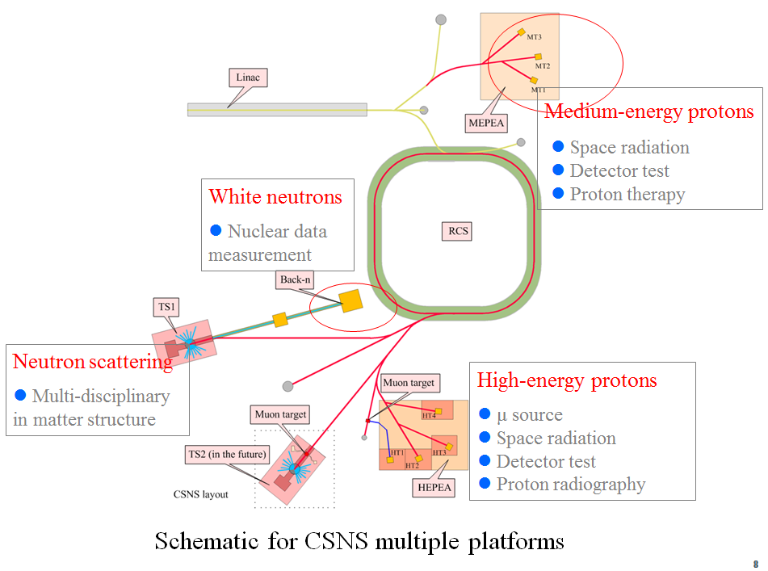
CSNS as multiple platforms
CSNS is the only large-scale proton accelerator in China today
Strong needs from other fields than neutron scattering
Excellent capability to support multiple platforms
Phased development
Muon beams
White neutron beams
Proton beams

Slide 4
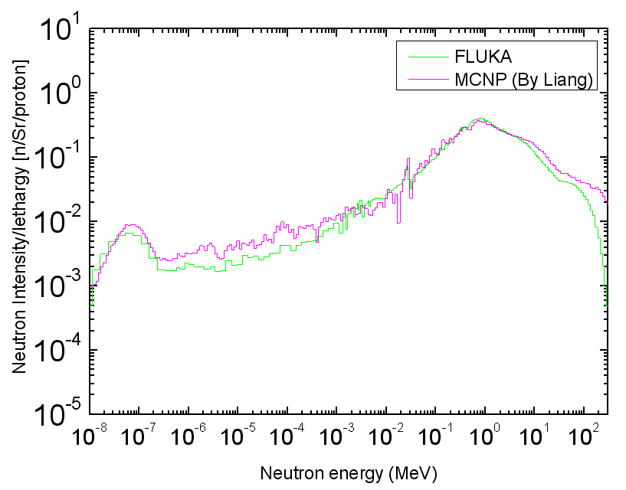
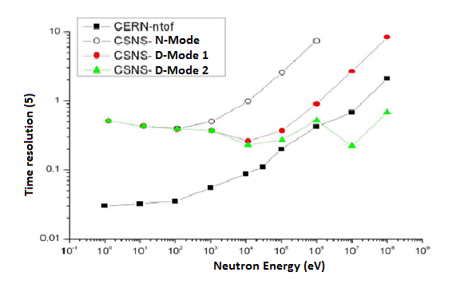
Back-streaming neutrons from the CSNS target
Back-streaming neutrons from the CSNS target into the RTBT channel
Very intense, harmful to the devices in RTBT, should be carefully treated Good energy spectrum and time structure, exploited as white neutron source (first its kind in the world)
(10⁷ n/cm²/s at 50 m)
World 3rd WNS based on spallation after LANL/LANSCE, CERN/n_TOF
Highest in neutron flux

Slide 5
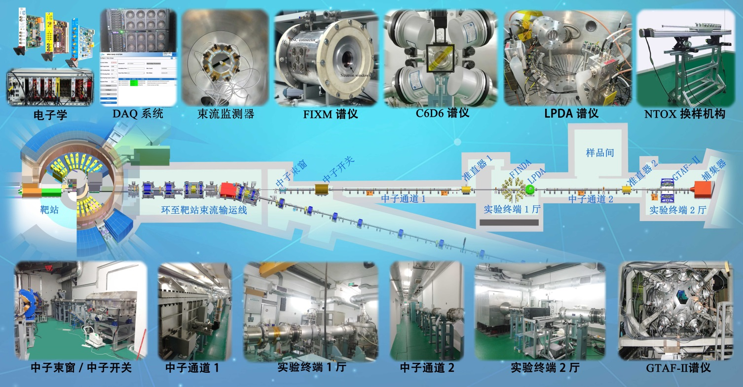
Research at the Back-n facility
Nuclear physics and technology: nuclear data measurements (neutron induced cross-sections: total cross-section, fission, capture, light-particle emission, inelastic, etc.)
Neutron irradiation effects: chips single-event effects, material property modification, radiation damage
Detector calibration and neutron dosimetry
White neutron resonant imagine: unique, distinguishing all nuclides

Slide 6
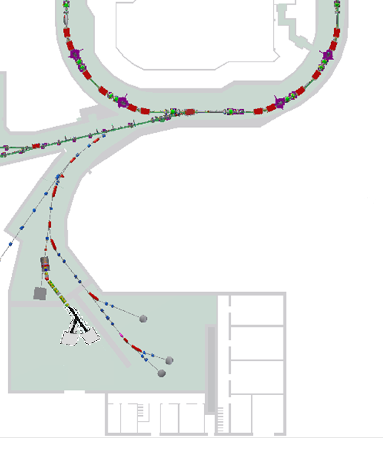
High-energy proton application area – Muon source and high-energy proton beams
CSNS-II Project
Proton preparation and transport
- Extracting extremely weak protons from RCS in the parasitic mode
- Splitting pulsed and/or weak proton beams from RTBT
Experimental Muon Source (EMuS) - 25 kW, 2.5 Hz
Parasitic extracting extr. weak protons
RTBT splitting
High-energy proton application area
Proton experimental endstations
- Extremely weak protons: 10⁴ -10⁷ pps, 0.5-1.6 GeV (detector calibration and space radiation effects)
- Low-rep and high-intensity protons: single pulse 10¹³, <0.01 Hz (proton radiography and irradiation)
Proton endstations
Muon source
6

Slide 7
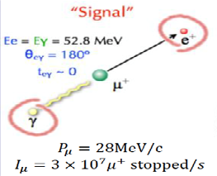
Opportunity to develop muon sources and μSR applications in China
High intensity μ sources are very important in particle/nuclear physics and multidisciplinary research
Particle physics: μ as a fundamental particle, μ sources are very important facilities in different research fields
Muon physics: rare decays and leptonic flavor violation experiments (Mu2e, COMET, MEG), μ g-2/EDM experiments
Neutrino factory: neutrino oscillation experiments
Muon collider: future energy -front facility
Fermilab: Mu2e experiment
Notes:
μ-to-e实验包括3个：e+gamma， e+3gamma，e

Slide 8
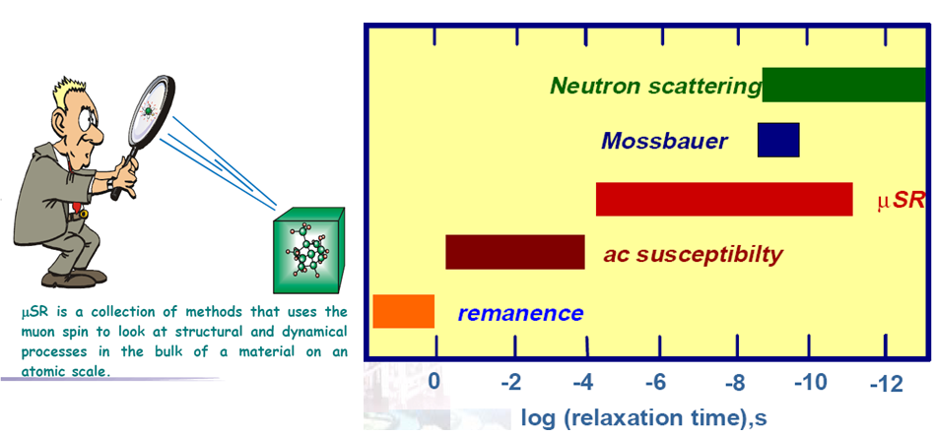
Multidisciplinary applications: μ’s special properties (surface μ 100% polarized, 2.2 μs lifetime）can be exploited via μ spin rotation, relaxation and resonance (or μSR) to study the structure of different materials (gas, liquid and solid) and also dynamics, covering condensed matter physics, materials, chemistry and biology.
Notes:
依次为：muSR谱仪示意图；muSR与其他方法比较。

Slide 9
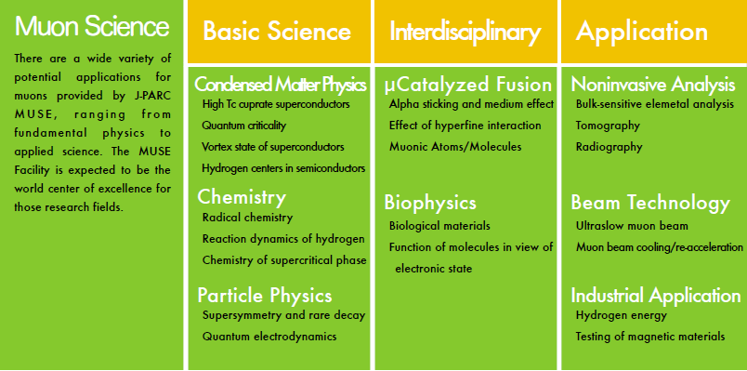
Science and technology based on muon sources
（Courtesy: J-PARC/MUSE）

Slide 10
Interests in muon sources in China
No muon source in China now
Chinese researchers on condensed matter have to go to international labs
Applying beam times (Lei Shu from Fudan U., Fanlong Ning from Zhejiang U., a few groups from IOP, Chengnan Wang from Peking U., etc.)
Sending samples: more practices (IOP, USTC, …)
A few groups (including IHEP) participating in COMET and Mu2e
Many researchers expressed to have Chinese muon sources
People are also discussing a future muon facility at CiADS (newly approved project, 500MeV-2.5MW)

Slide 11
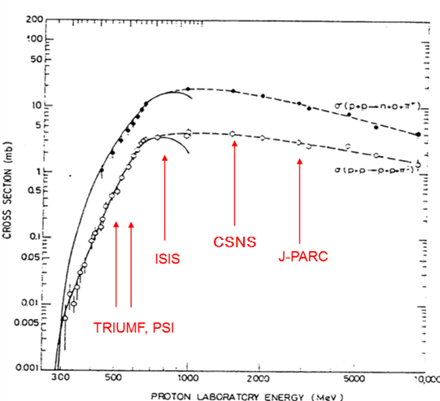
China has a good community in particle physics – neutrino physics and muon physics
Neutrino physics (Daya Bay, JUNO, MOMENT)
The particle physics community is interested in a Chinese muon facility besides participation in COMET and Mu2e
μSR and technical applications
Researchers are using international μSR facilities
We have a numbers of users using positron annihilation method, willing to go to muon techniques
High-power proton accelerator for μ source
Precious resources in the world
CSNS just completed, very much suitable to start the construction of a muon source
Single π production cross-section vs proton energy

Slide 12
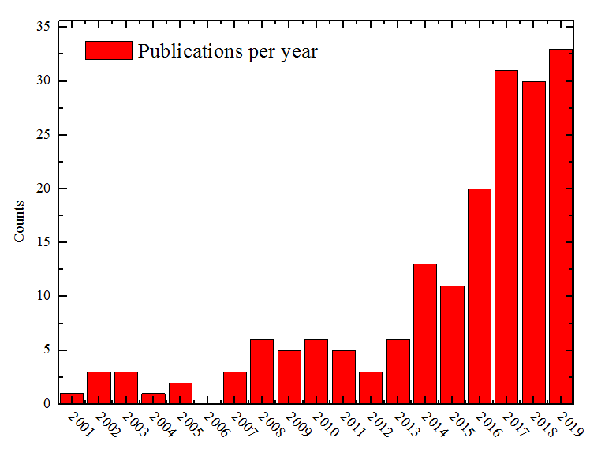
Rapid increase in Chinese μSR publications
Although no muon source in China, publications of Chinese users by using international μSR facilities increasing rapidly
更小样品
18 institutions published more than 2 papers
(ZJU, Fudan, IOP, USTC>10)
2001-2019：world μSR papers in disciplines
2001-2019：μSR papers by Chinese users
12

Slide 13
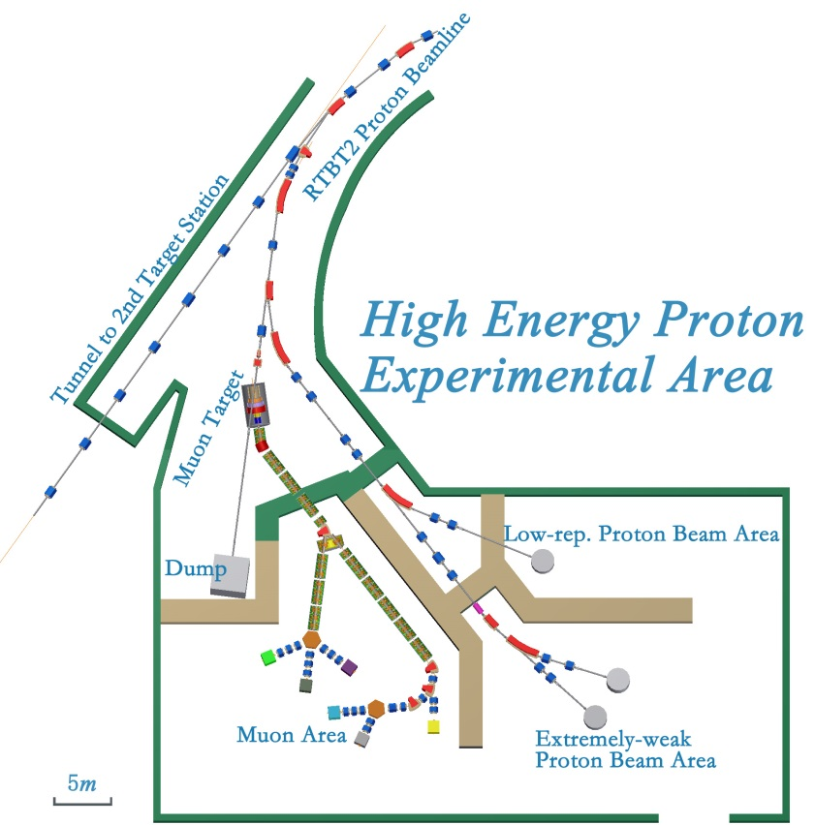
Experimental Muon Source (EMuS) at CSNS
CSNS EMuS located in the high-energy proton application hall, together with other direct proton beam applications
Proton beam: 1.6 GeV, 5 kW (5% of total), single bunch per pulse (2.5Hz)
Target: carbon, 300 mm in length, conical shape, forward extraction
Capture solenoid: 1-5 T (Al-based NbTi wires)
Science goals: μSR applications, muon beam techniques, MOMENT R&D, Neutrino cross-section meas.

Slide 14
Science goals of EMuS
μSR applications
Multidisciplinary research, complementary to neutron scattering
Surface muon beams, decay muon beams and future slow muon beams
Muon techniques
Muon imaging (high momentum up to 450 MeV/c)
Muon irradiation
Muonic X-ray analysis
Nuclear and particle physics
Looking for good proposals, currently investigating neutrino cross-section measurements and muonium to anti-muonium conversion

Slide 15
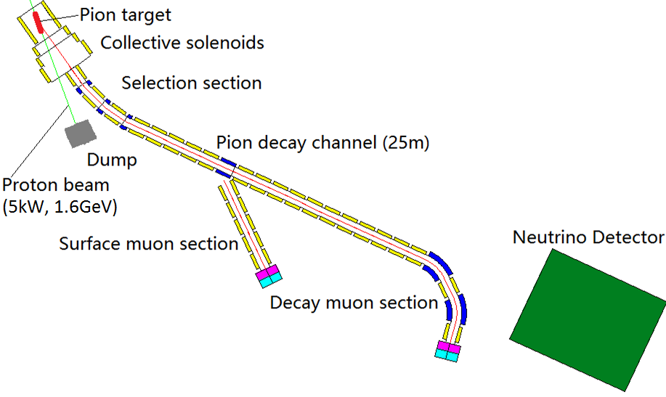
EMuS Layout and Working Modes
Working modes (indep.):
Surface μ mode
Δp/p: <±5%
Ref. Pμ=29 MeV/c
Decay μSR mode
Δp/p: <± 10%
Ref. Pμ =40-150 MeV/c
High-momentum μ mode
μ imaging, neutrinos
Ref. Pπ=200-450 MeV/c
Planning for future: slow muons

Slide 16
Major design features
EMuS will share the same experimental area with other high-energy proton applications:
Proton beam: 1.6 GeV, 25 kW, 2.5 Hz
Target station
Carbon target: 300 mm in length, conical shape
Capture SC solenoid: 1-5 T (NbTi) (15° w.r.t. target)
Forward collection: proton beam separated (higher momentum muons)
Muon/pion beam transfer line
Trunk beamline: SC solenoids based, μSR beam line SC or RT magnets
Large momentum range: surface muons (& slow muons), decay muons and high-momentum muons (also neutrino beam)
μSR spectrometers
High asymmetry or more detecting channel (2560) design coping with low-repetition and high flux muon pulses
A thin insertion target upstream for only surface muons also under study

Slide 17
Wide applications:
Surface muons, slow muons: μSR applications
Negative muons: muonic X-ray, muon catalyzed fusion
Decay muons: μSR, μ imaging and irradiation, muon physics
Pions: neutrino cross-section
Main target
Surface muon area: 3 μSR spectrometers planned
Decay muon area: 1 μSR spectrometer, 1 for negative muons, 1 for versatile (muon imaging/irradiation, nuclear physics, particle physics, etc.)
Thin target (vertical beamline)
1 μSR spectrometer

Slide 18
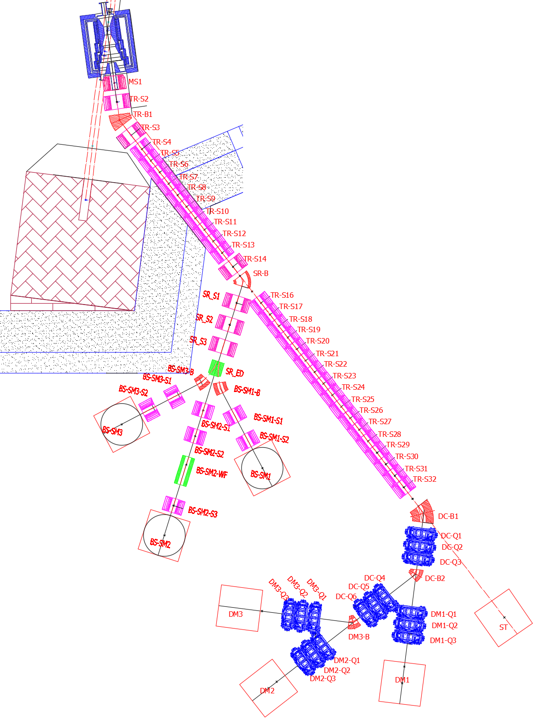
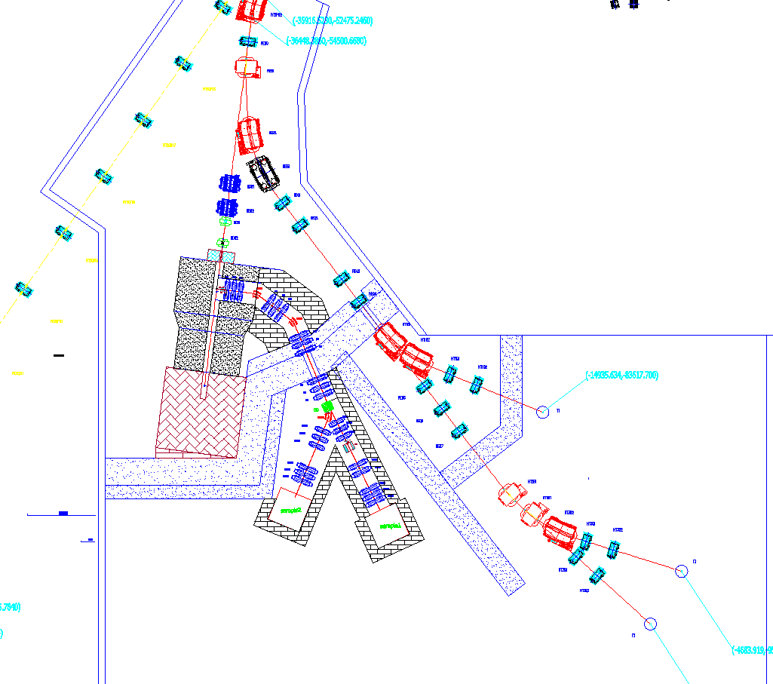
Baseline Scheme and Baby Scheme
Baseline Scheme: aiming at world-class facility, high-intensity, multiple spectrometers, wide applications, build-up by steps
Baby Scheme (First Step): with limited budget, two surface muon μSR spectrometers, compatible with the Baseline scheme in layout
Baby Scheme is included in the CSNS-II Project Proposal

Slide 19
Different beams:
Surface muons, slow muons: μSR applications
Negative muons: Muonic X-ray, muon catalyzed fusion
Decay muons: μSR, μ imaging and irradiation, muon physics
Pions: neutrino cross-section
Main target
Surface muon area: 3 μSR spectrometers planned
Decay muon area: 1 μSR spectrometer, 1 muon imaging/irradiation, 1 port tbd
Thin target (vertical beamline)
1 μSR spectrometer
Baby scheme
In case of low construction budget in the beginning, we will build a simplified muon source (called Baby Scheme), in order to start muon applications as early as possible.
Thick - free target, side collection, short muon beamline (RT magnets), two μSR spectrometers

Slide 20
Parameters | Baseline Scheme
 | Decay muon beam |  |  |  |  | Surface muon beam
 | μSR |  | Muonic X-ray |  | Muon imaging | Vertical | BS-SM1&3 | BS- SM2
Mom. (MeV/c) | 45 | 150 | 45 | 150 | 450 | 28 | 28 | 28
Int. (1E6/s) | 0.6 | 8.8 | 0.44 | 16 | 13000 | 0.82 | 0.4 | 0.31
PolZ | 0.82 | 0.81 | − | − | − | -0.95 | -0.78 | -0.76
Spot_{FWHM} (mm) | 27×30 | 19×29 | 30×30 | 26×36 | 20×51 | 27×20 | 26×32 | 26×22
dp/p_{FWHM} | 6.7% | 5.3% | 4.4% | 5.8% | ~5% | <8% | <8% | <8%
Parameters | Baby scheme
 | BB-SM1 | BB-SM2
Mom. (MeV/c) | 28 | 28
Intensity (1E6/s) | 1 | 0.76
PolZ | -0.92 | -0.89
Spot_{FWHM} (mm) | 30×28 | 30×22
dp/p_{FWHM} | <8% | <8%
 | Slow muon beam
Mom. (keV/c) | 0.5-0.30
Intensity (1E6/s) | 0.01
PolZ | -0.75
Spot_{FWHM} (mm) | 30×30
dp/p_{FWHM} | 8%

Slide 21
Status of design and R&D
Since 2007, we have been studying to add a muon source to CSNS, but until 2015 we obtained a major NSFC fund ‘Development of National Major Scientific Instruments’ to support the design and R&D
Study team: researchers and students from different IHEP divisions, USTC and Sun Yat-Sen University
As we do not have any experience in building muon sources and EMuS has a special design to serve multiple purposes, it is very challenging in the design and construction.
Learning from international experts and labs
R&D efforts are indispensable
Communication with potential users and influential top scientists have been in progress.

Slide 22
Major R&D efforts
Challenging issues
Compromised layout to support different programs
Low repetition rate of the proton beam
Target assembly prototype
Mechanical structure design
Inner shielding with Tungsten
Target support and cooling
Collimators for both pions/muons and protons
Compatibility with SC solenoids
Technique on large-aperture, high-field and radiation-hard superconducting solenoid
Preferably Al-based NbTi conductors
A prototype of the capture solenoid
A μSR spectrometer prototype of four rings
Sampling condition is also under consideration

Slide 23
Reviews and workshops for applications
2017.12: first workshop on the EMuS multidisciplinary applications
2018.11: International review on the EMuS conceptual design
2019.11: Internal review on the EMuS design schemes
2019.12: second workshop on the EMuS multidisciplinary applications

Slide 24
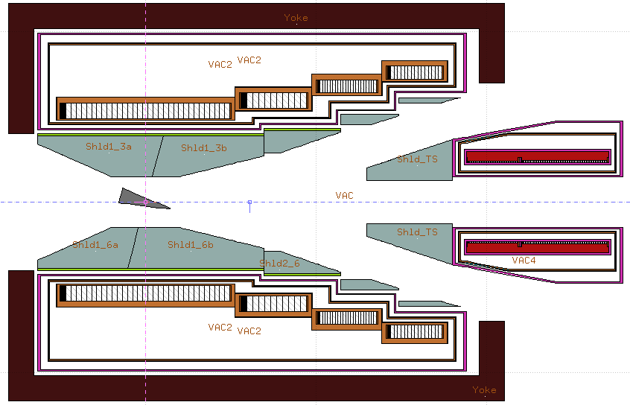
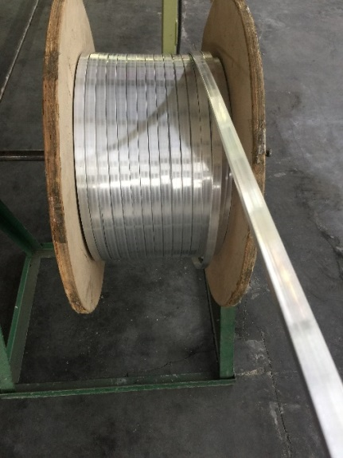
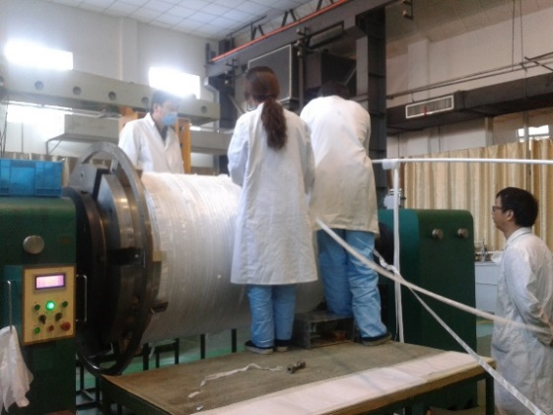
Prototyping of main capture solenoid
Large-aperture, high-field, radiation-resistant, very challenging
Selected for prototyping
End Nov.: 1-km cable completed
Last week: bidding for coils
fabrication and tests

Slide 25
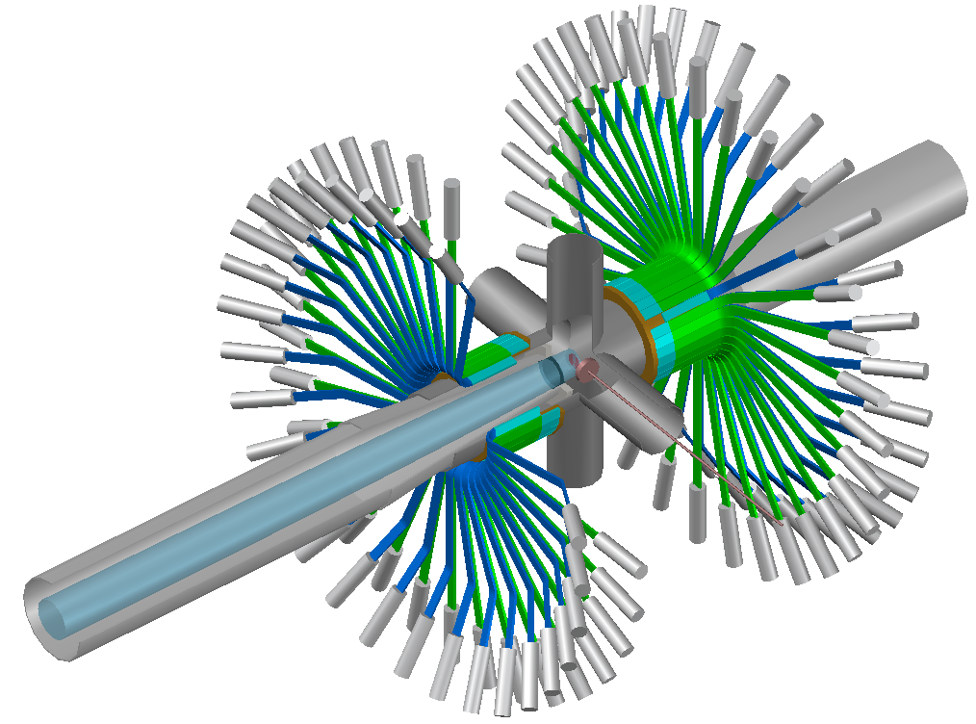
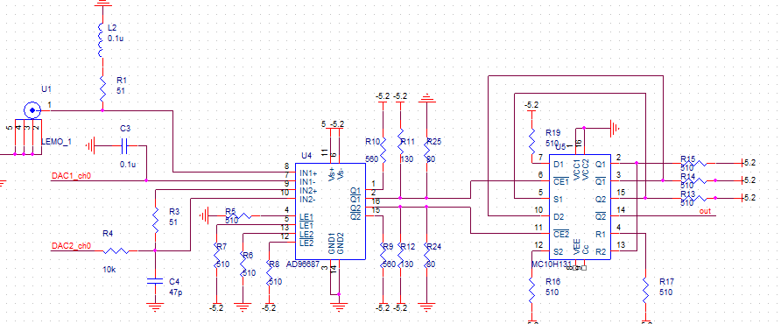
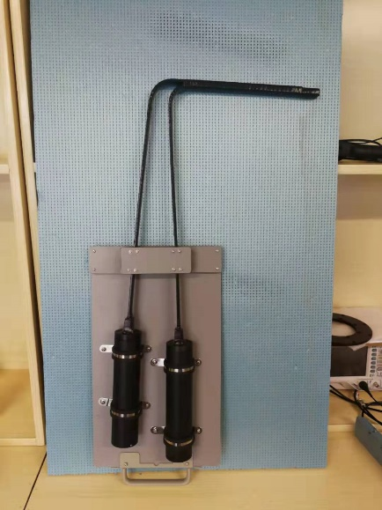
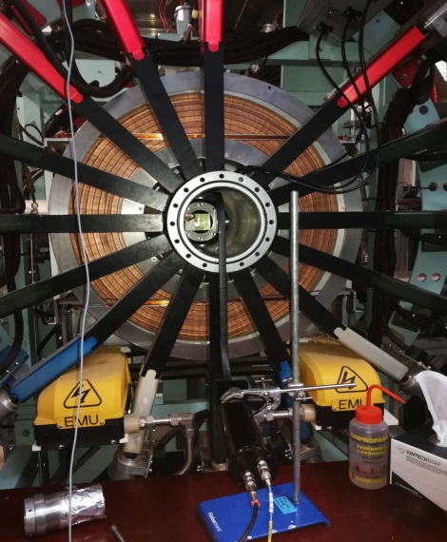
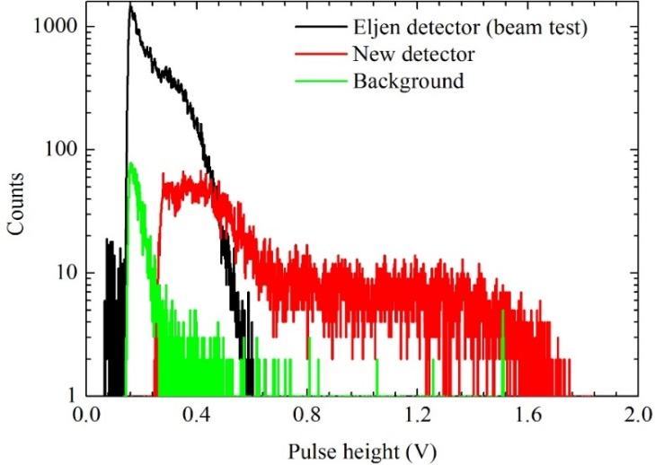
Prototyping of a μSR spectrometer
Prototyping:
4-ring based on scin.+PMT, 128 channel
3 times beam tests at RAL/ISIS
SiPM technique also under development
Electronics

Slide 26
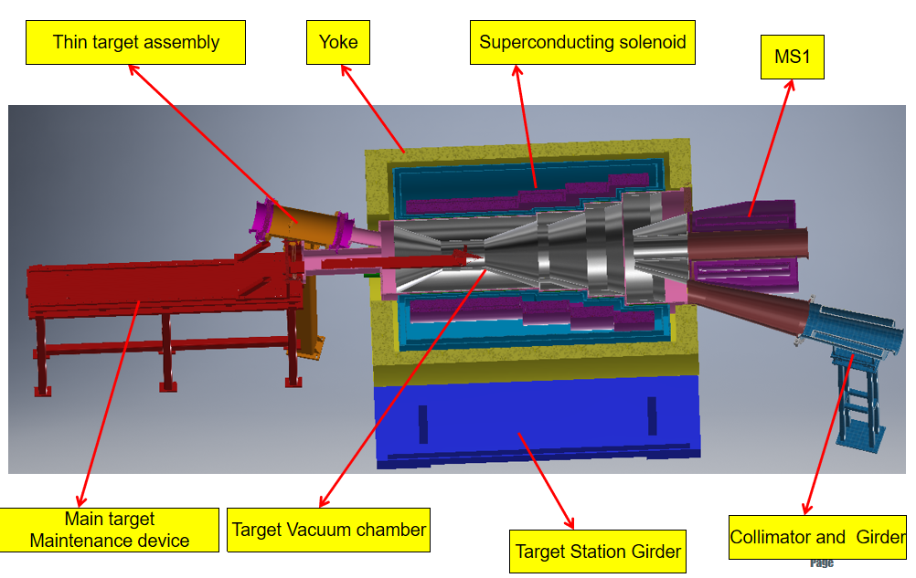
Schematic for target assembly prototype
Bidding very soon

Slide 27
Planning and prospects
Continuing design and R&D (-2020)
Muon moderation technique development in long-term (2017-)
Method study of muon beam applications (2019-2021)
Muonic X-ray analysis
Muon imagine
Participating in CSNS-II project application processes
Proposal, feasibility study, technical design report
User community development
International collaboration
Reviews, personnel training, Chinese μSR users, collaboration in particle physics, etc.
Phased construction (2022-)

Slide 28
Domestic collaboration
Attracting high-level users is essential for a common facility
muSR users in China: IOP, Fudan U., Zhejiang U., USTC, Peking U., SYSU, Sichuan U., Beijing Normal U., RUC, …
EMuS study team is composed of researchers and students from different institutions and IHEP divisions:
A group from USTC collaborating with us since 2007, on the design and R&D (6 PhD graduated, 4 PhD students)
Different IHEP divisions (Dongguan Branch, Exp. Particle Physics Div., Multidisc. Appl. Div., Acc. Div. ) are involved
Sun Yat-Sen Uni. (SYSU) collaborating on both particle physics and μSR applications
In the future:
μSR spectrometers and muon beam applications: user facility, but also possible user-funded spectrometers
For nuclear/particle physics at EMuS, domestic collaboration is even more important.

Slide 29
International collaboration
We have been contacting with international muon labs
RAL/ISIS: CSNS has formal collaboration agreement with it, wide collaboration including accelerators, neutron scattering and muon source
PSI/SμS: IHEP and PSI have formal collaboration agreement since 2009, but a dedicated collaboration on muon science signed in 2019, including both μSR applications and particle physics.
J-PARC/COMET, MUSE: IHEP and KEK have formal collaboration agreement; IHEP strong participation in COMET experiment; long-time contact with MUSE
RIKEN/RIKEN-RAL: we have been discussing with RIKEN about establishing a close collaboration
Other collaborations

Slide 30
Summary
EMuS as the first muon source in China and a competitive muon facility in the world is in good hope (phased construction), to serve both μSR applications and particle/nuclear physics
Design and R&D efforts of EMuS are well in progress
We will build up a user community that grows up together with the project.

