Slide 1
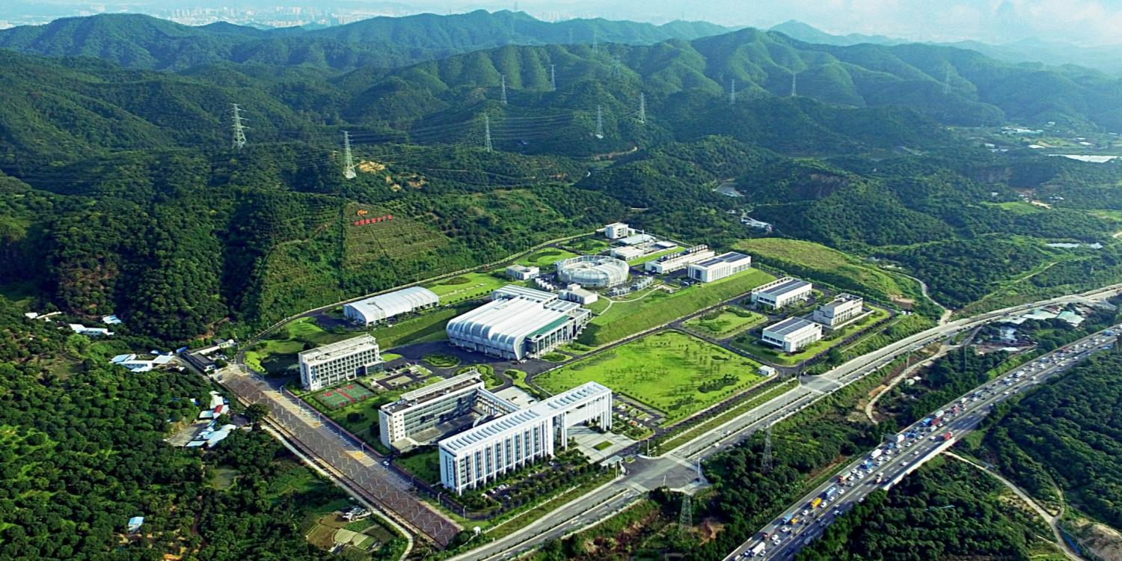

China Spallation Neutron Source
Fangwei Wang
On behalf of CSNS team
Institute of High Energy Physics, Chinese Academy of Science

Slide 2
Outline
Why Neutrons?
CSNS project overview
Commissioning & operation
User service and application
New instruments and future plan
Summary

Slide 3
Why Neutrons？
Neutron Scattering: a unique tool to characterize microscopic structure and dynamics

Slide 4
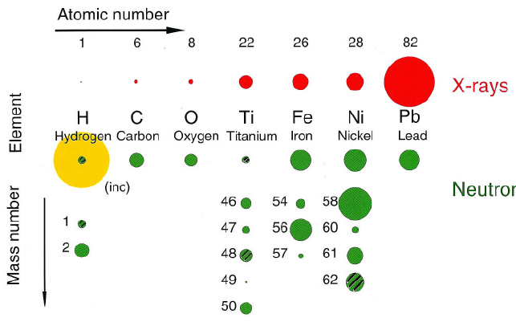
Specifics of Neutron
Interact with nuclear (no charge)
  Sensitive to light atoms (H, Li, C, O….)
  Distinguish isotopes (H/D)
Spin S=1/2
  Magnetic structure
High penetration depth
  Non-destructive measurement for engineering device
  In-situ study under complex sample environment
Energy in the order of meV
  Phonons and magnons
  Atomic diffusion
  Molecular vibration & macromolecular folding

Slide 5
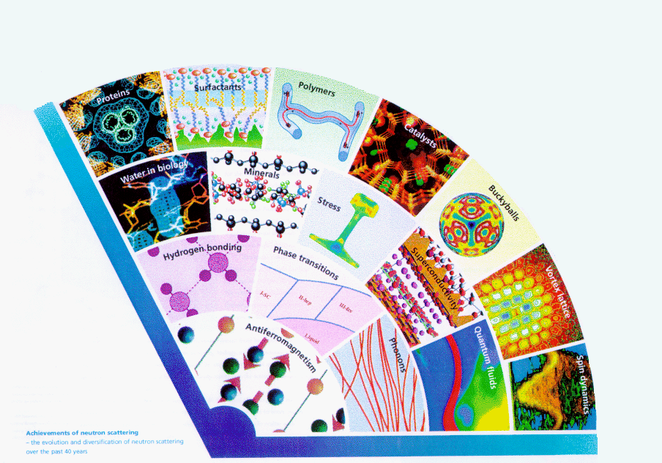
Multidisciplinary Applications
Soft
ISIS Fan
1990
1980
1970
1960
Hard

Slide 6
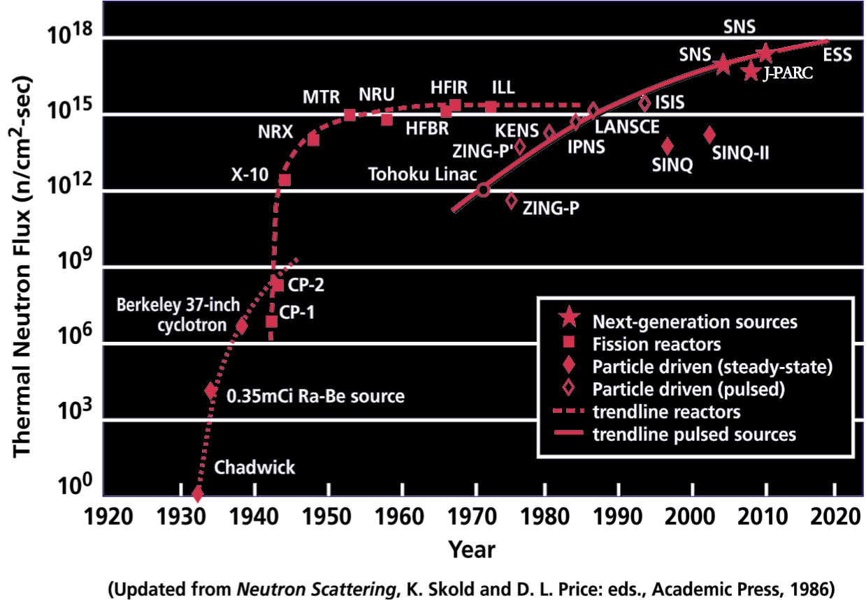
Development of Neutron Sources
CARR
CSNS
NP
6

Slide 7
Outline
Why Neutrons?
CSNS project overview
Commissioning & operation
User service and application
New instruments and future plan
Summary

Slide 8
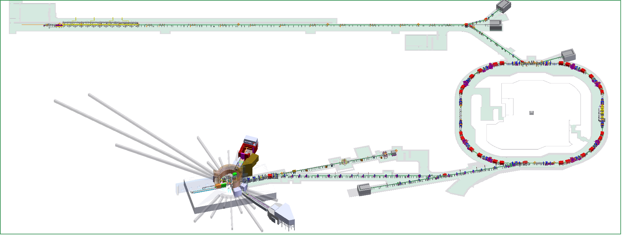
CSNS Layout
The phase-I CSNS facility consists of a Linac, a 1.6-GeV 100kW, 25Hz RCS, beam transport lines, a target station, and 3 day-one instruments.
Upgradable to 500kW and 20 instruments
Conducted jointly by IHEP & IOP, CAS
80MeV H⁻ linac
1.6GeV, 25Hz
100kW RCS
MR
SANS
Target station
GPPD

Slide 9
Key Milestones
Proposal for the CSNS Project
Proposal approved
Civil construction started
Feb. 2001
Jan. 2006
Sep. 2008
Sep. 2011
May 2012
Oct. 2014
Prototyping R&D started
Construction started
Construction complete
(6.5 years from start)
DTL-1 Beam commissioning
RCS commissioning start
Jan. 2016
Apr. 2017
May. 2017
Aug. 2017
Mar. 2018
Sep. 2019
Linac beam commissioning
First neutron
80kW

Slide 10

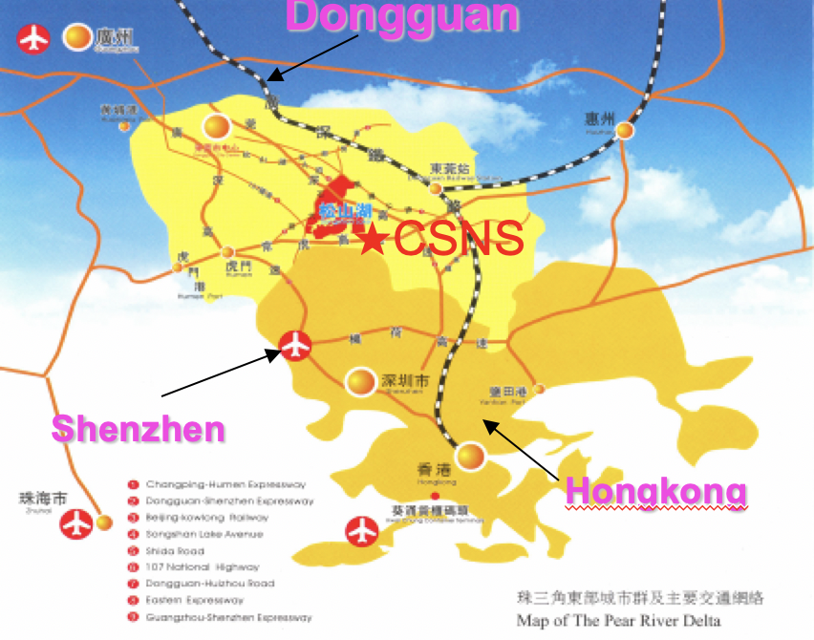
CSNS Site
★
CSNS
The Dongguan local government provided a land of about 0.67km² for campus. 0.27-km2 is used for the CSNS construction.
Dongguan branch of IHEP, CAS established on Feb. 19th 2013, to construct and manage the CSNS

Slide 11

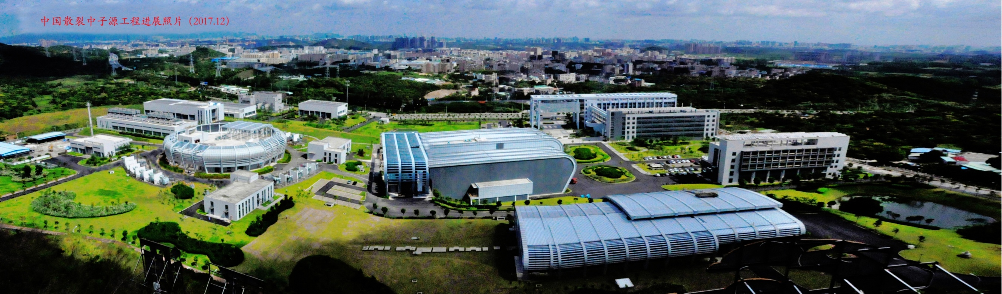
Before ground breaking, May，2009
CSNS Campus, Dec. 2017

Slide 12
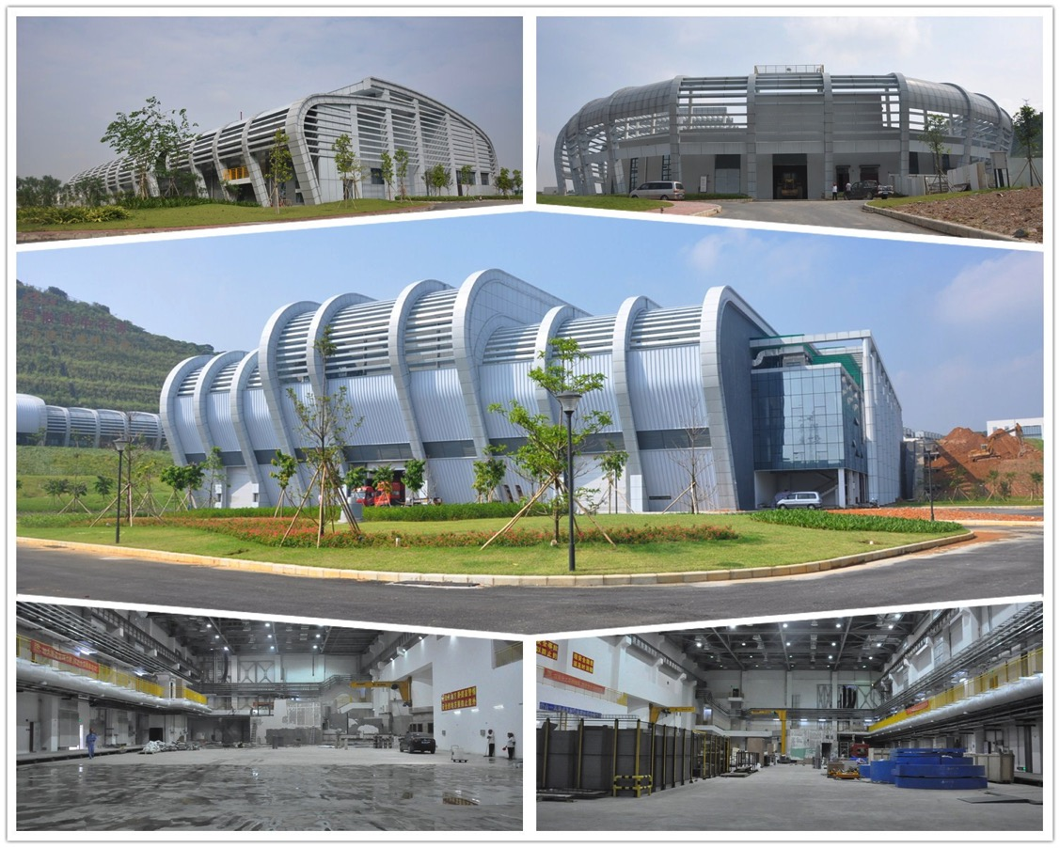
CSNS Civil Engineering
    Linac service building
    RCS service building
    Target station and instruments hall
    South instruments hall
    North instruments hall

Slide 13
Design Philosophy
Build facility within approved budget and time schedule
  phase-I budget 1.67B CNY (~US$250M)
  6.5 year construction duration
Build advanced facility with upgrade potential
  100kW beam power, expandable to 500kW (with minimum initial cost, lower energy linac + high energy RCS)
Adopt proven technology in order to reduce risk
  first high-power proton beam facility in China
  high operational reliability for an accelerator-based user facility
Develop domestic technology to control cost
  keep final fabrication in China as much as possible
  closely collaborate with world leaders

Slide 14
Major Design Consideration
High neutron production
  1.6GeV proton beam; cladding W target; Be reflector; heavy water cooling (light water at beginning due to budget limit)
Diverse neutron performance
  3 wings moderators: H₂O (300K, decoupled; LH2 replaced in upgrade), H₂ (20K, decoupled+poisoned), H₂ (20K, coupled)
High neutron utilization
  compact configuration between TMR and bulk shielding; moderation by para-hydrogen; supermirror neutron guide; efficient position sensitive neutron detector with large coverage
Optimization for 100 kW, but keeping the upgrade capacity to 500 kW
  Optimize the TMR for the beam power of 100 kW
  Design shields with dose control < 2.5 μSv/h up to 500 kW
  Embedded coolant pipes and tanks meet to requirement of 500 kW

Slide 15
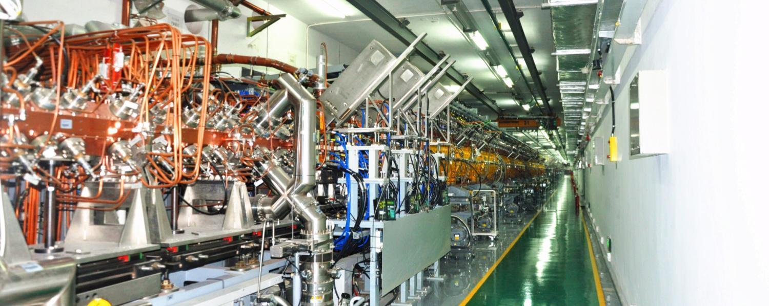
Linac Design
Linac tunnel

Slide 16
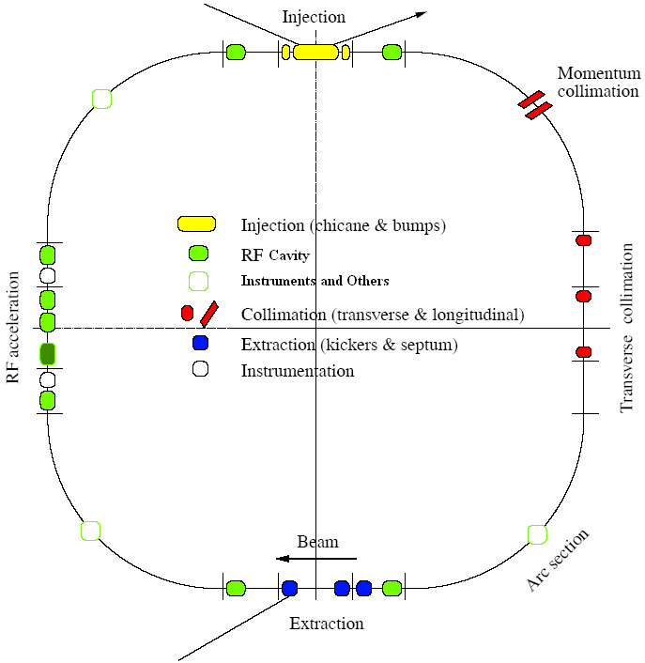
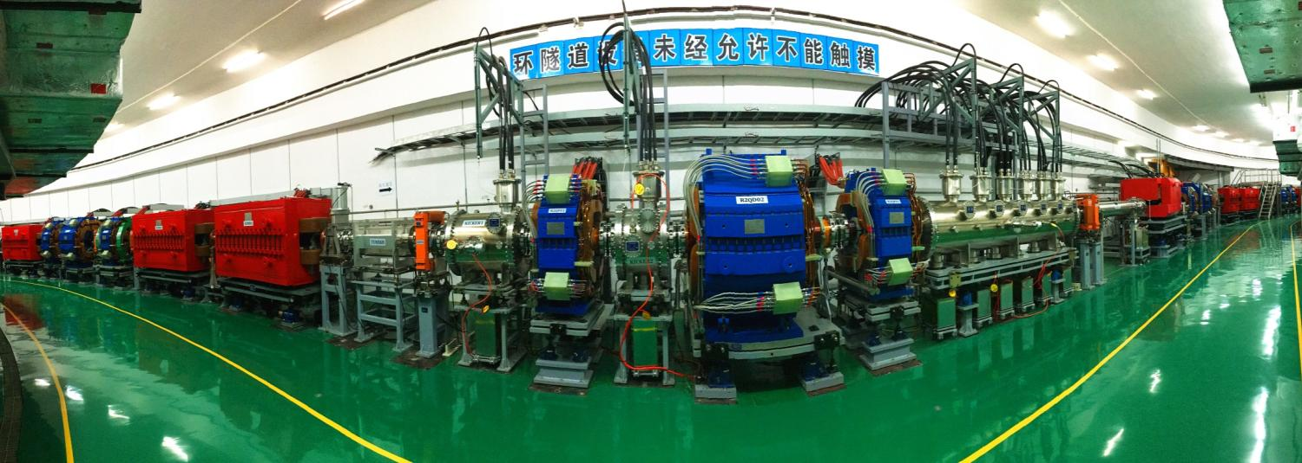
RCS Design
Lattice of 4-fold symmetry, triplet.
227.92m circumference.
Four long straight sections for injection, acceleration, collimation and extraction.
24 main dipoles with one power supply.
48 main quadrupoles with 5 power supplies.
8 RF ferrite loaded cavities.
RCS tunnel

Slide 17
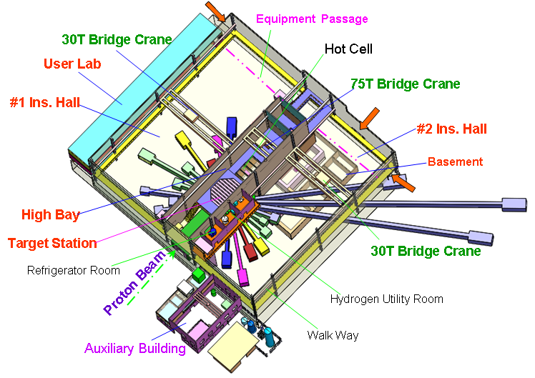
Neutron Scattering Hall

Slide 18
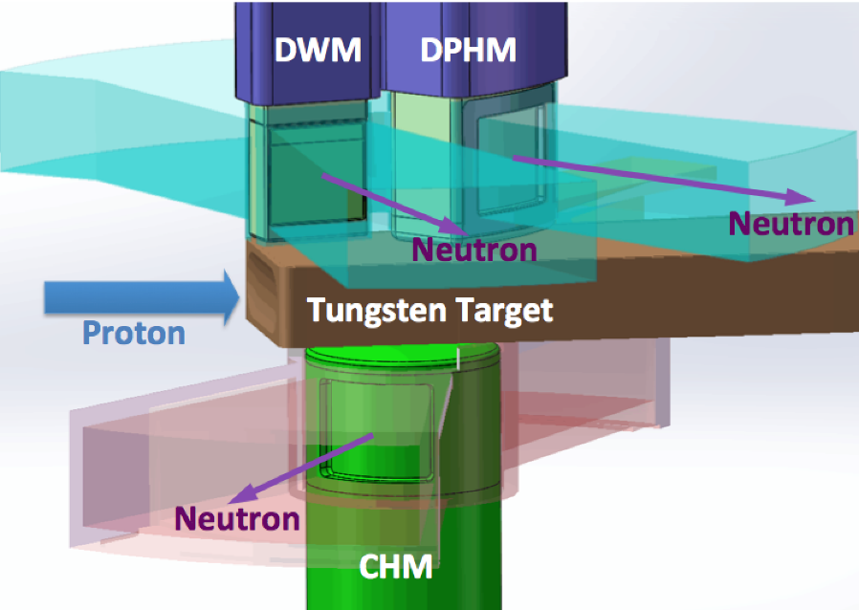
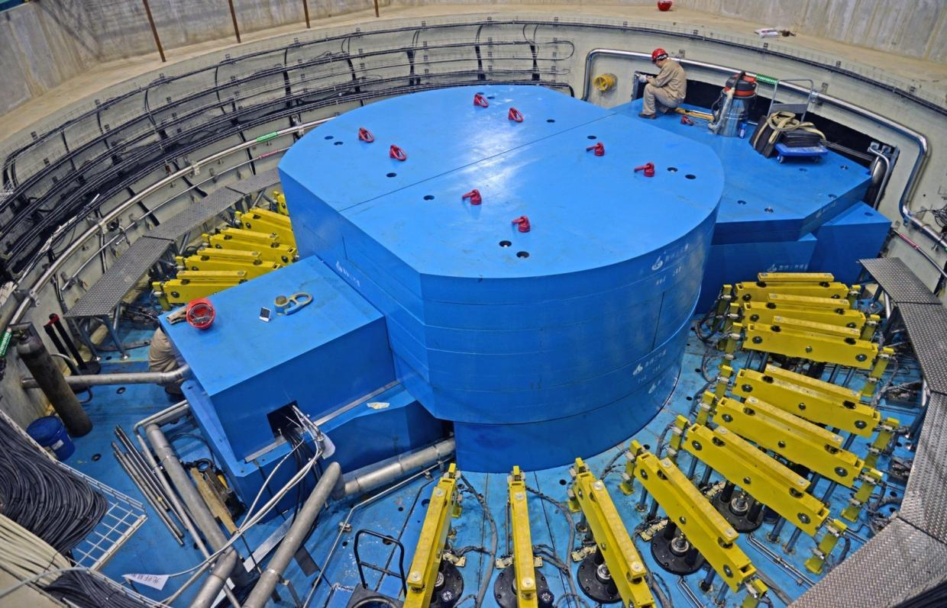
Target station

Slide 19
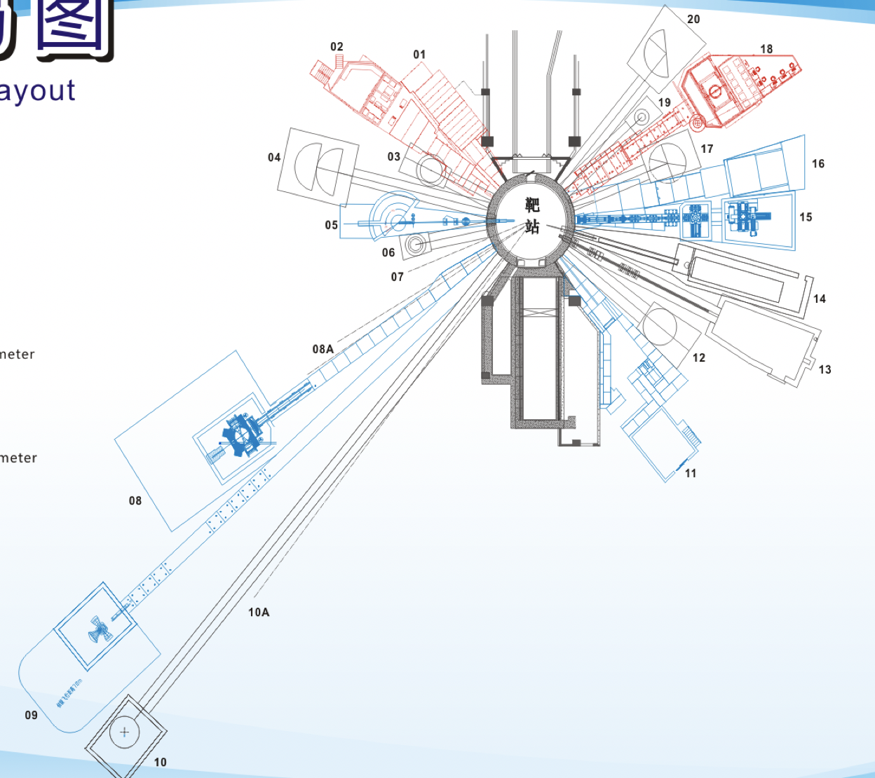
Instruments layout
Day one instruments
BL01: Small Angle Neutron Scattering (SANS)
BL02: Multi-purpose Reflectometer (MR)
BL18: General Purpose Powder Diffractometer (GPPD)

Slide 20
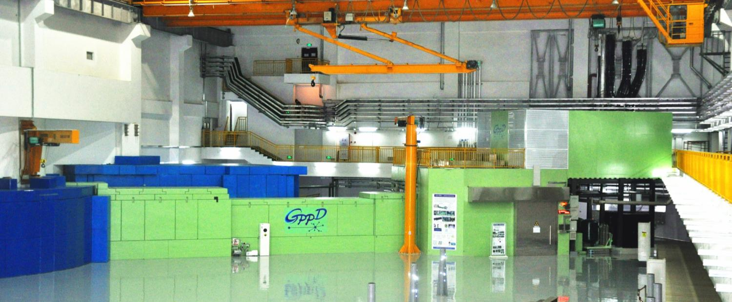
Neutron instrument: GPPD design
Moderator |  | DPHM（20 K）
Bandwidth(Δλ) |  | 4.5 Å
Max. Beam Size |  | 40(h)×20(w) mm
Flux at sample position |  | ~10⁷ n/cm²/s
Best Resolution(Δd/d) |  | 0.2 % at 2θ =150°
Guide |  | Taper focus, m=3
Source to sample distance L1 |  | 30 m
Sample-detector distance L₂ | 2θ =150° | 1.5 m
 | 2θ =90° | 2.0 m
 | 2θ =15° | 3.8 m
Performance:
  For most users to determine crystallographic and magnetic structures in general purposes
  Best resolution Δd/d ~ 0.2 %.
  ~ mimutes for a diffraction histogram used by Rietveld refinement on ~ 1-g-weight sample
  Easily loading the ancillary equipment such as cryostat, furnace and pressure cell

Slide 21
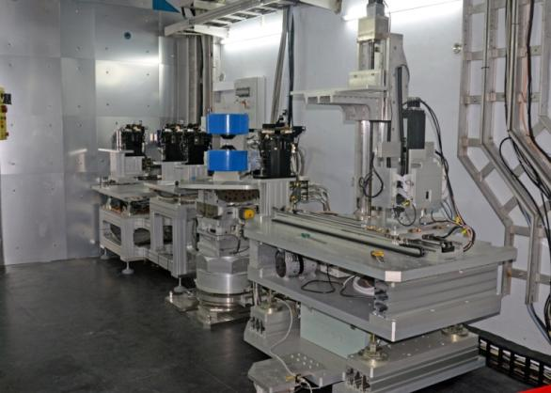
Neutron instruments: MR design
Performance:
Moderator | CHM (20 K)
Bandwidth（Δλ） | 6 Å
Guide | Bender+Sraight+Taper 40 × 60 → 20 × 30 mm²
SS distance L1 | 19.5 m
SD distance L2 | 2 m
Sample table | 6-axis movements
Polarizer/analyzer | Supermirror type
Detector | 2D position-sensitive detector Position resolution: 2 mm
  Vertical sample geometry: solid film
  Reflectivity/diffraction
  Best resolution ΔQ/Q < 1%
  Polarizing analysis for spinoelectronics.
  In-suit study on growing films
  In-suit MOKE magnetic analysis
  Off-specular scattering

Slide 22
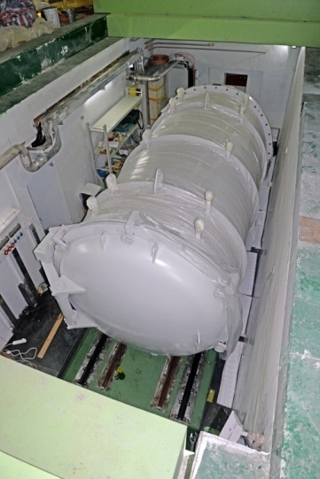
Neutron instruments: SANS design
Performance:
  Reliable SANS data between 0.01~0.5 Å-1, to characterize 1-100 nm particles.
  Instrument resolution better than ~30% around Qmin
  Good dynamic range, sample space
  Variable sample size
Moderator | CHM（20K）
MS distance | 14 m
SD distance | 1~5 m
Detector
Effective area | 50×50 cm²
Resolution | 1 cm (FWHM)
Δλ | 0.4-8 Å
q range | 0.004-3.4 Å⁻¹

Slide 23
Outline
Why Neutrons?
CSNS project overview
Commissioning & operation
User service and application
New instruments and future plan
Summary

Slide 24
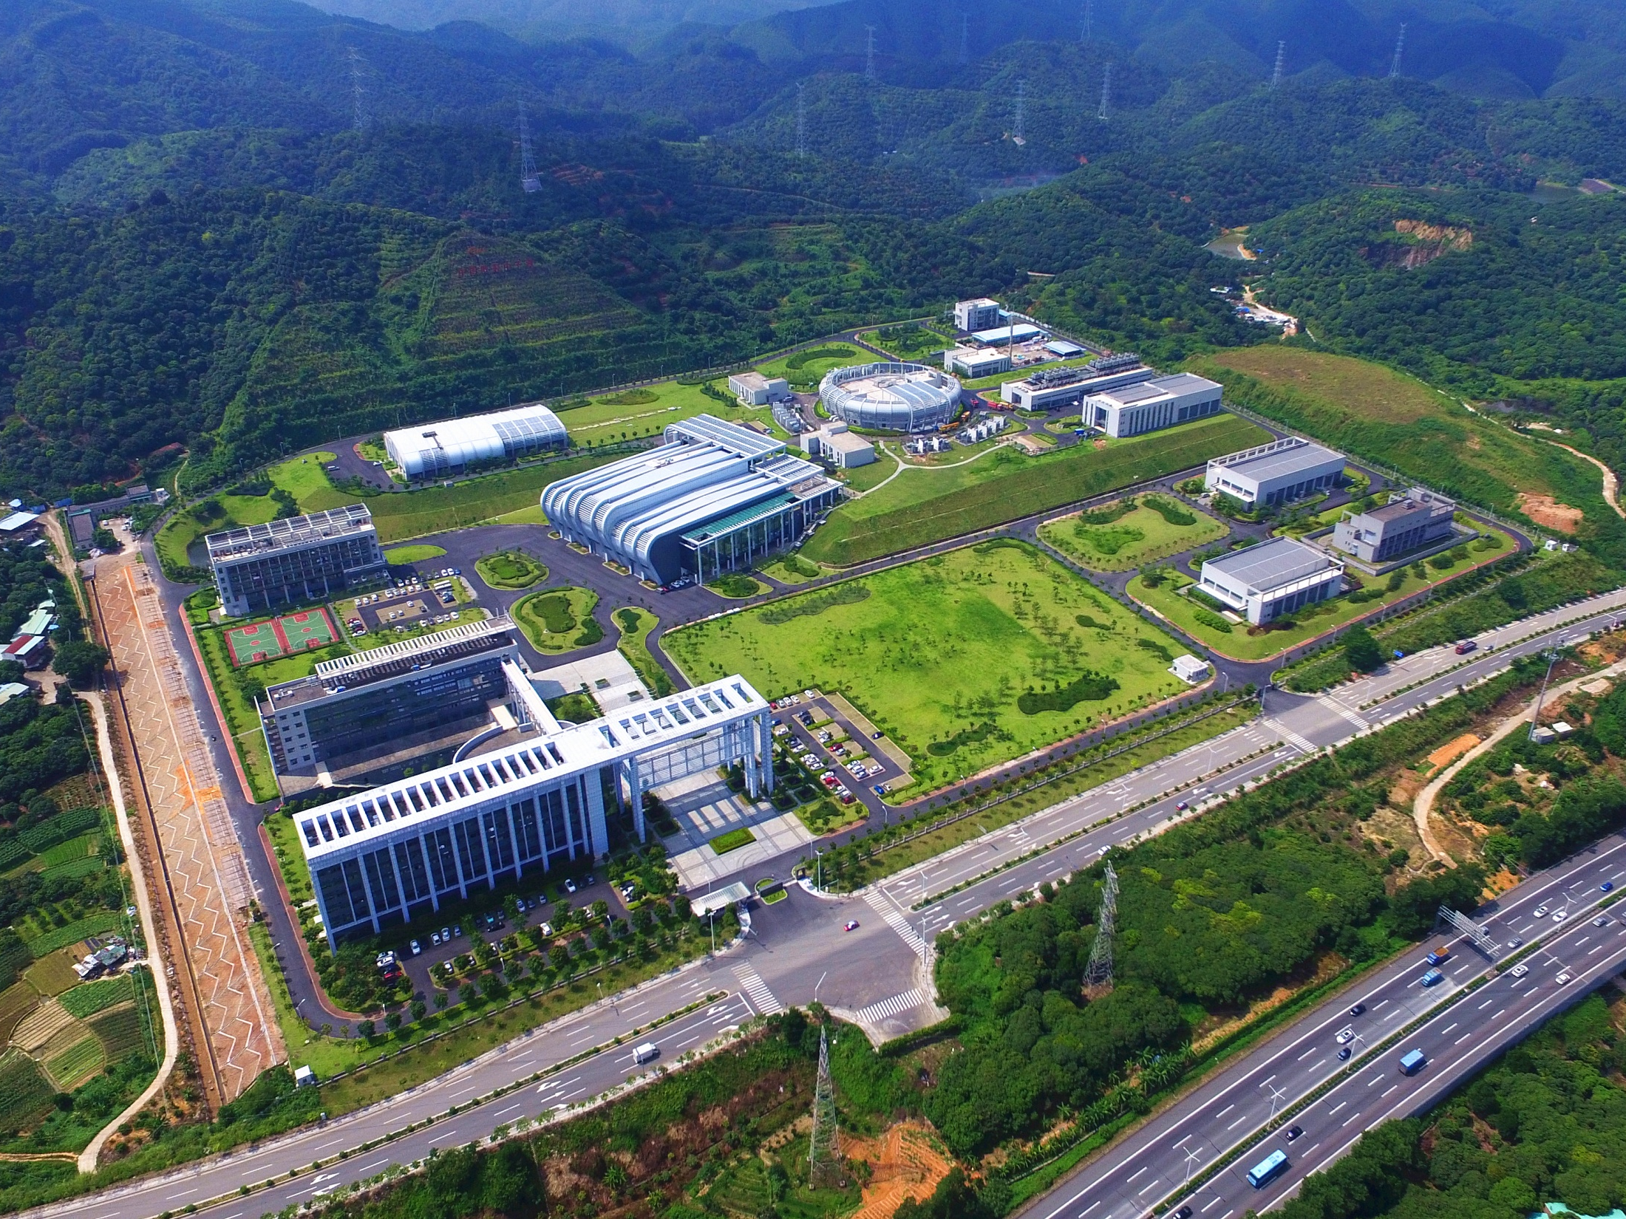
CSNS Site
Birds View of CSNS
August, 2017
    RCS service building
    Linac service building
    Target station and instruments hall

Slide 25
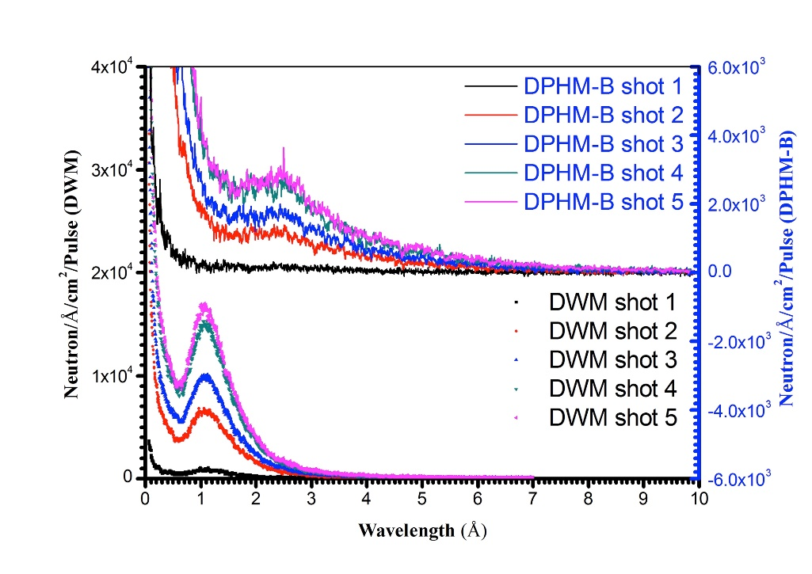
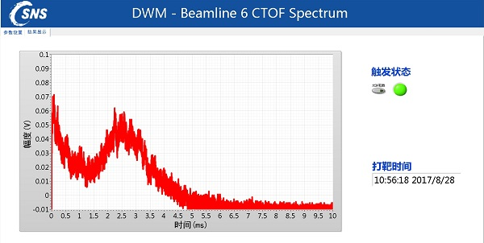
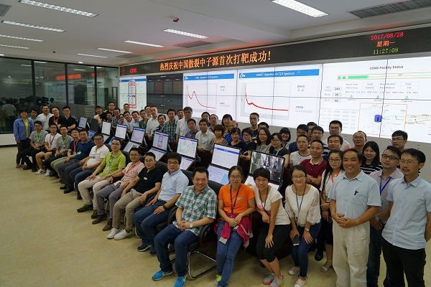
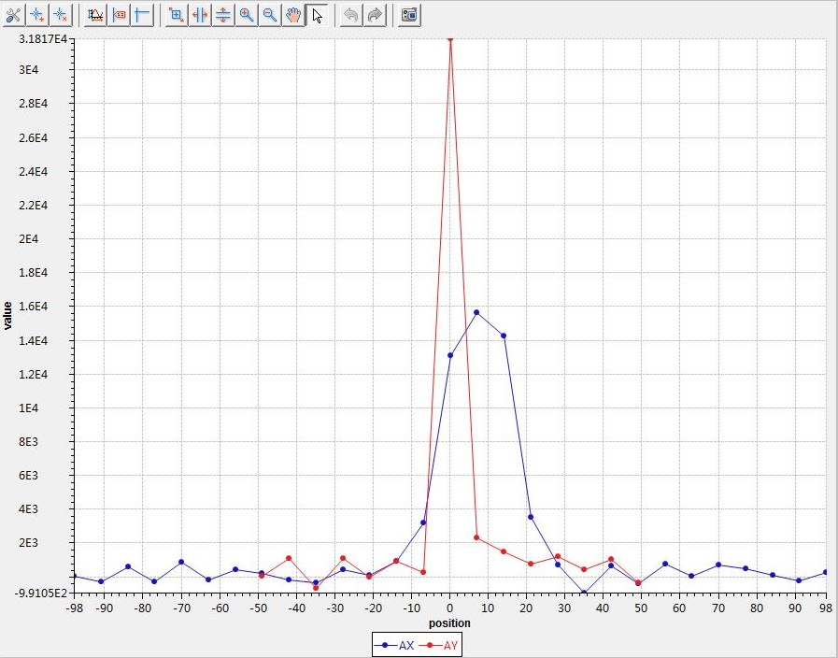
First Neutron @ Aug. 28, 2017

Slide 26
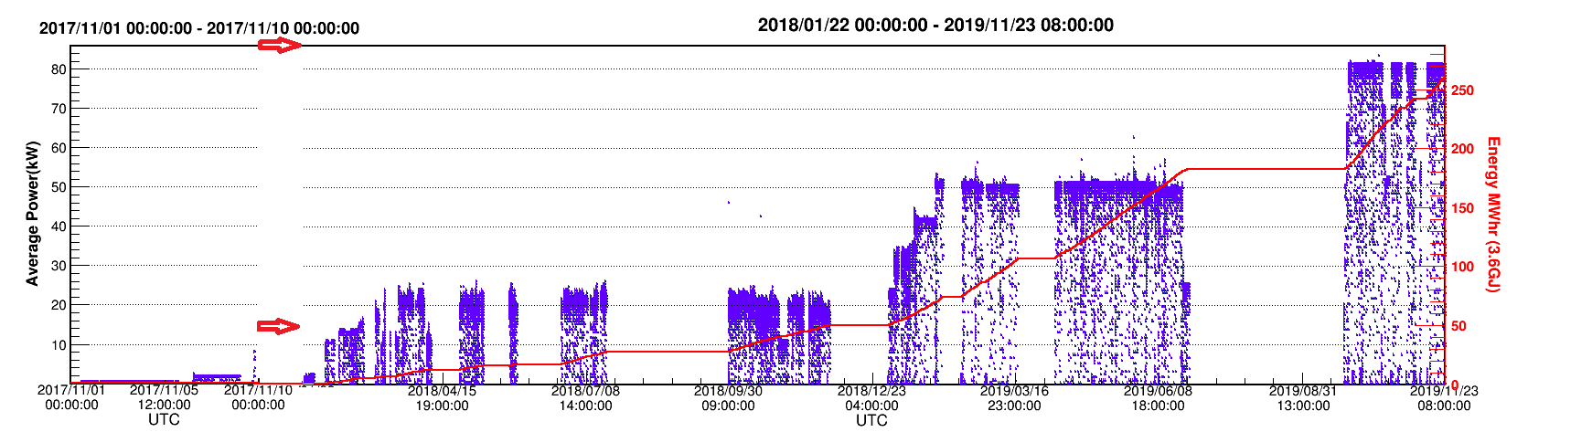
Beam power up to 80kW
First diffraction pattern First scientific paper Open to user
Beam availability > 90% 3858 hour this year Beam power 80kW
26

Slide 27
Running Scheme in 2019
System /Instrument | Planed Hour | Included Hour |  |  |  | Running Data of Similar International Advanced Facilities
 |  | Preparation | Beam Time(for User Experiments) | Instrument Development | Downtime
Accelerator | 6000 | 1000 | 3600 | 1000 | 400 | 5900
Target | 5600 | 1000 | 3600 | 800 | 200 | 3980
Instruments
GPPD | 3600 | 50 | 2800 | 600 | 150
MR | 3600 | 50 | 2600 | 800 | 150
SANS | 3600 | 50 | 2600 | 800 | 150
*Running data of similar international advanced facilities, refered to
running data of J-PARC in 2017.

Slide 28
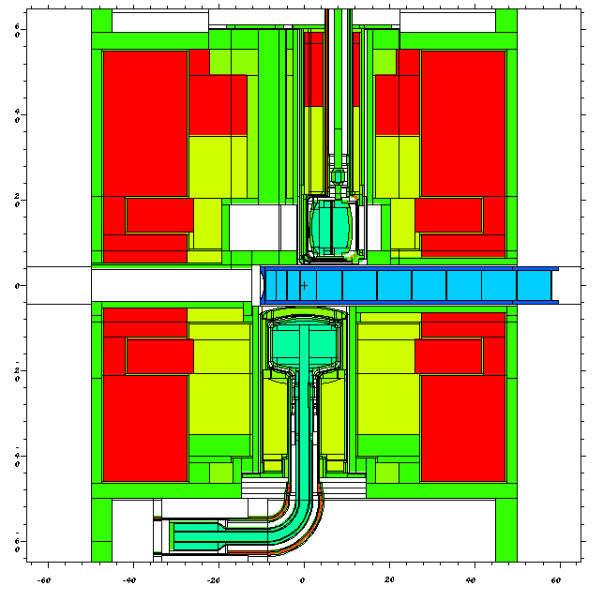
Neutronics Performance of Target Station
  Measured spectra & pulse shape agreed well with simulation.

Slide 29
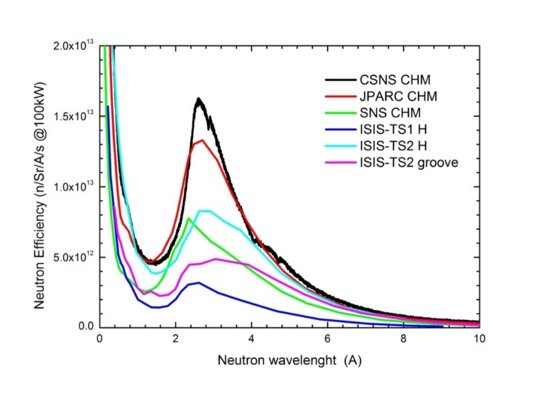
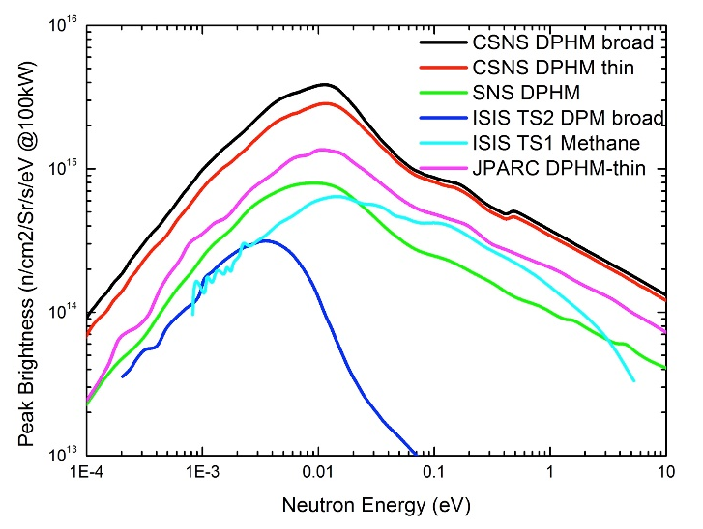
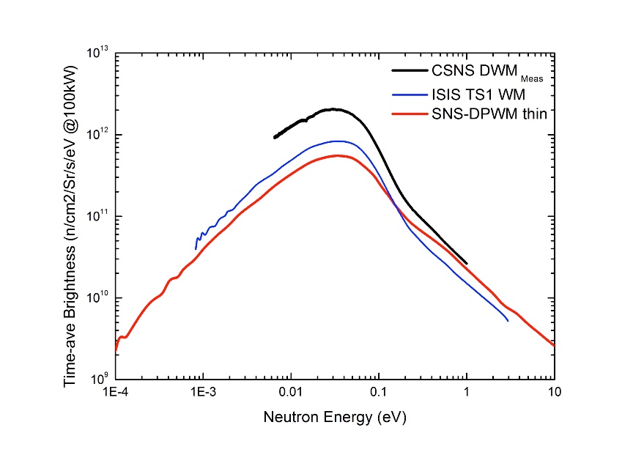
Neutronics Performance of Target Station
Wavelength spectra (CHM) Peak brightness (DPHM)
The neutronic performance of the source (and moderators) is excellent, and provides evidence of strong coupling between the target and the moderators.
NTAC10 report, Dec，2018
TAV brightness (DWM)

Slide 30
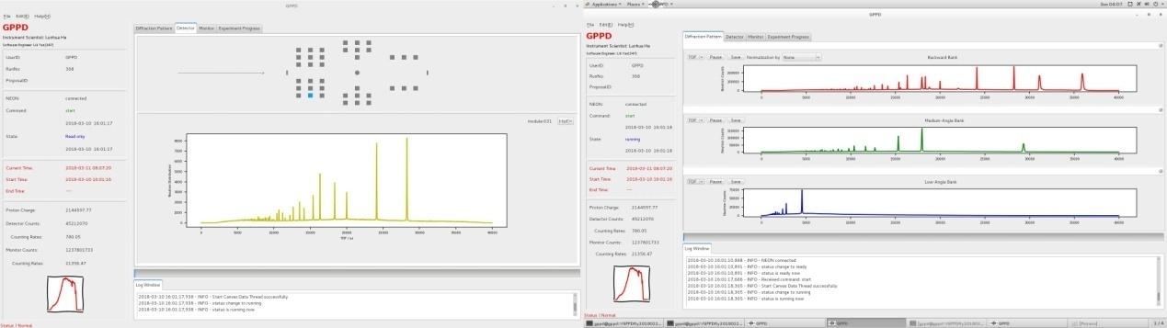
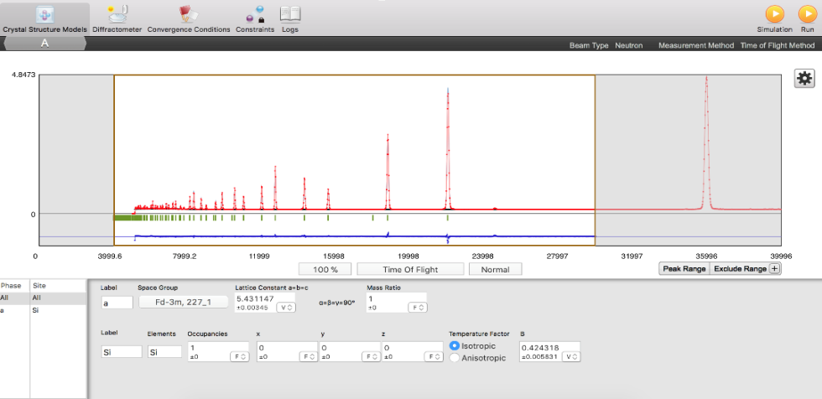
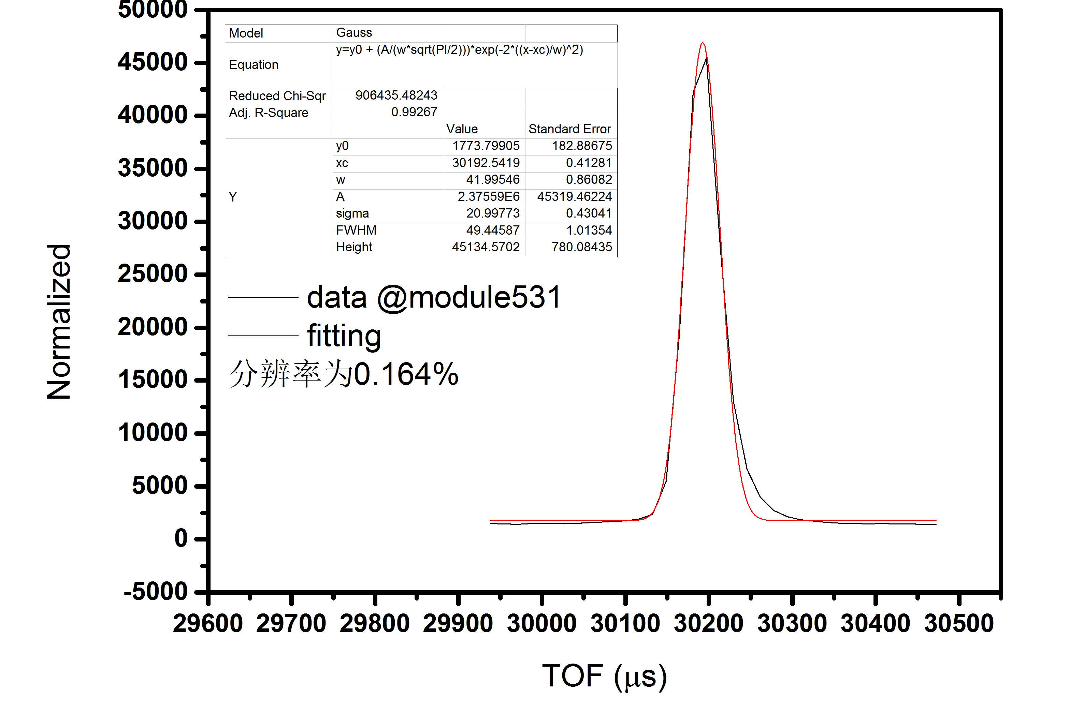
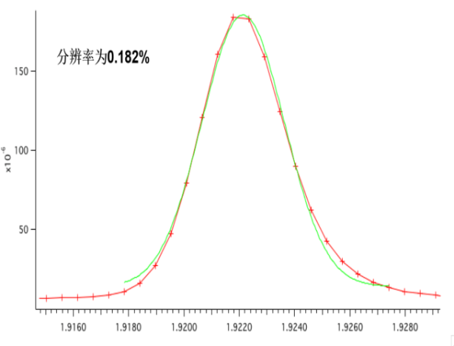
Commissioning of GPPD
NIST-640e standard sample Si, refinement Rp = 1.88%、Rwp= 2.89%
GPPD can obtain accurate and reliable information on the determination of crystal structure and magnetic ordered structure, the discrimination of light elements and adjacent transition elements and so on.
GPPD review committee, April, 2018
0.164% for one module
@ back scattering
0.182% for back scattering bank
Better than the design goal

Slide 31
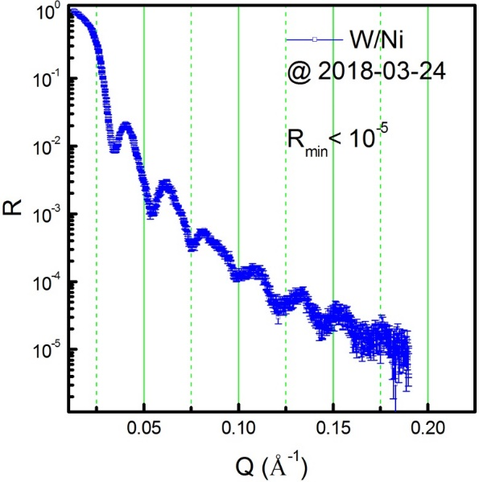
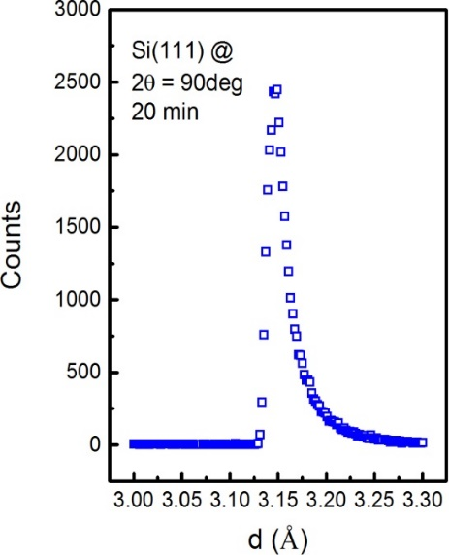
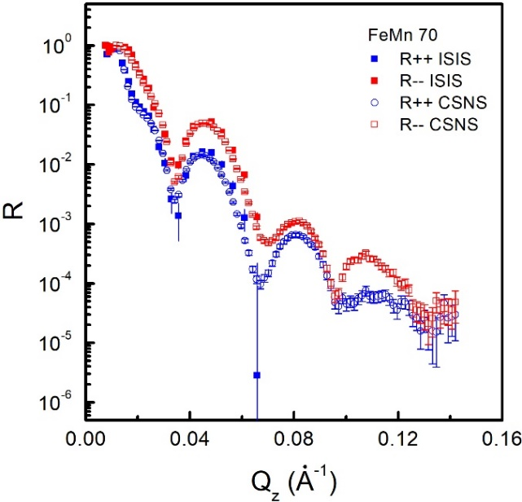
Commissioning of MR
∼20 hrs
Function NR：R_{min}<10⁻⁵ Diffraction: Δd/d = 0.6% PNR: well done

Slide 32
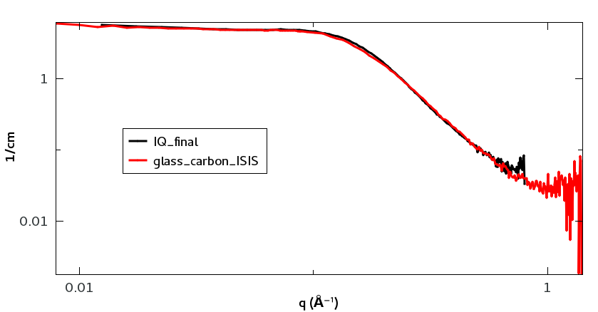
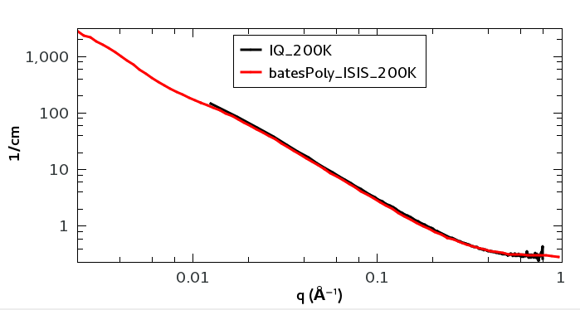
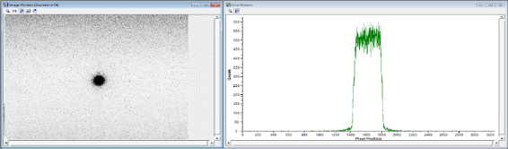
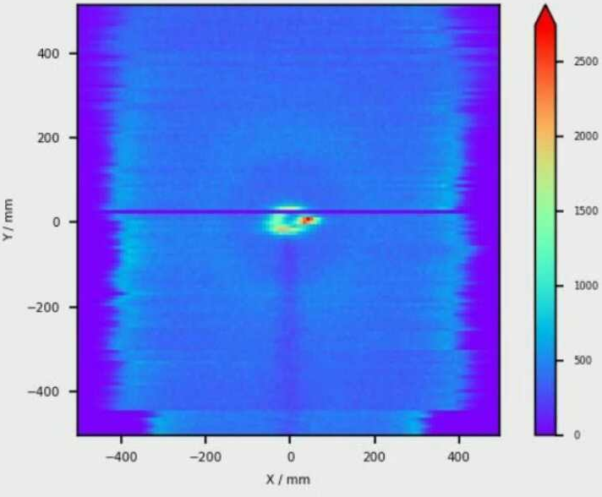
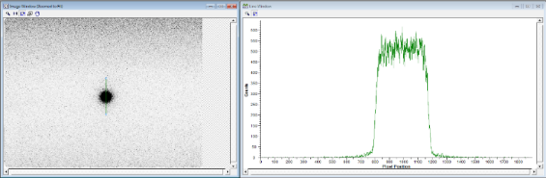
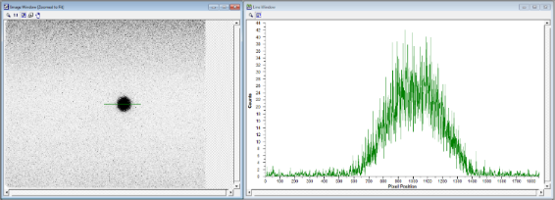
Glass carbon & Bates-poly，molecular weight: 200 k
Commissioning of SANS
Scattering from steel flange
Beam size diagnostic Background analysis

Slide 33
Outline
Why Neutrons?
CSNS project overview
Commissioning & operation
User service and application
New instruments and future plan
Summary

Slide 34
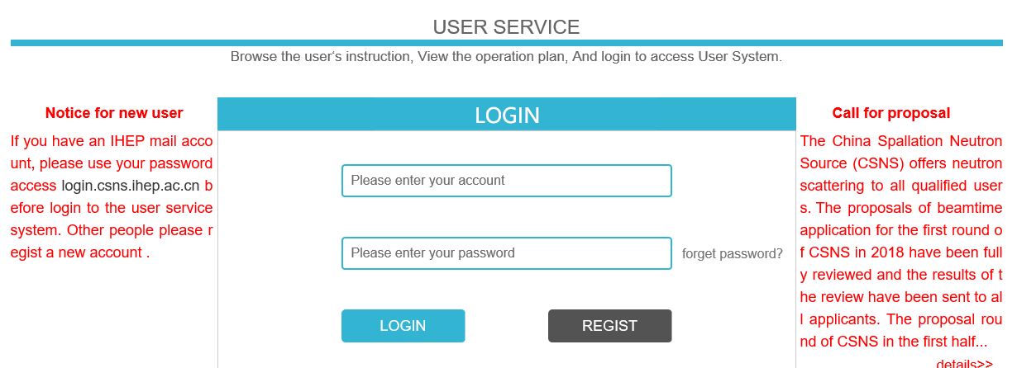
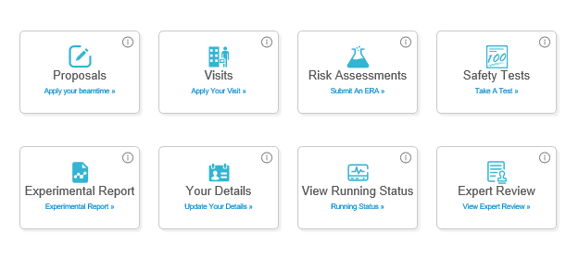
User service
https://user.csns.ihep.ac.cn (in both Chinese and English）
Register an account
Fourth call for proposal:
2019.11
For next round operation
2020.02-2020. 06
Submit a proposal
Proposal type：
1.Direct access
2.Rapid access

Slide 35
User Proposal
Proposal of 1st and 2 round operation（2018/9/29-2019/6/27）:
    approved and performed 101 (included 11 from oversea and Hongkong)
    Research fields: energy material, structural material， magnetic, film, alloy, polymer, nano, biology material, hydrogen storage, drug et. al.
Proposal of 3rd round operation（2019/9/26-2020/1/19）:
  regular application 164
  approved 57 (included 7 from oversea, Hongkong and Macao)
35

Slide 36
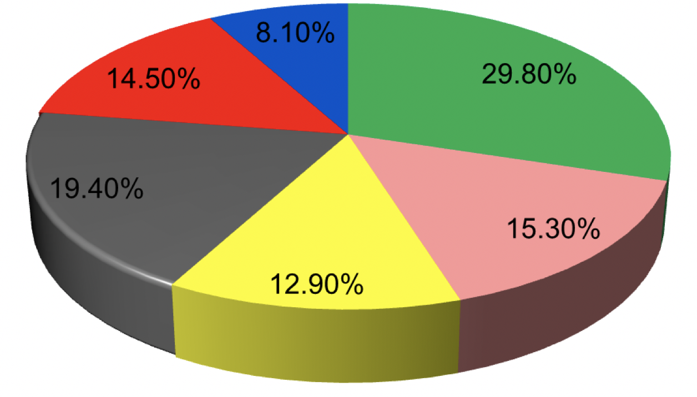
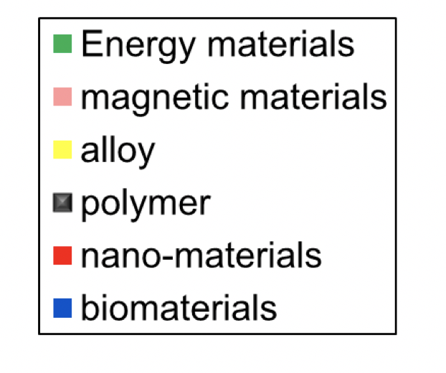
User Proposal
Registration user: 900+
Published or accepted user science paper: 15, more under prepare or review

Slide 37
User meeting & training
Application of neutron scattering & synchrotron on aeronautical material, July, 2018
Application of neutron technology on Gas Hydrate research, Dec. 2018
Neutron application workshop on battery, Jan. 2019
Neutron application workshop on Catalyst, energy and material, Jan. 2019
User meeting of neutron imaging, Apr. 2019
User meeting of SANS&VSANS， Apr. 2019
Neutron workshop on biology and soft matter science, May 2019
CSNS annual meeting, Sep. 2019
CSNS neutron school, Oct. 2019
National neutron scattering meeting, Nov. 2019

Slide 38
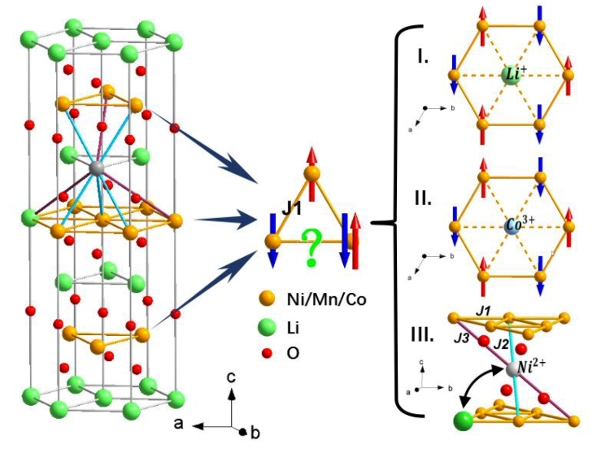
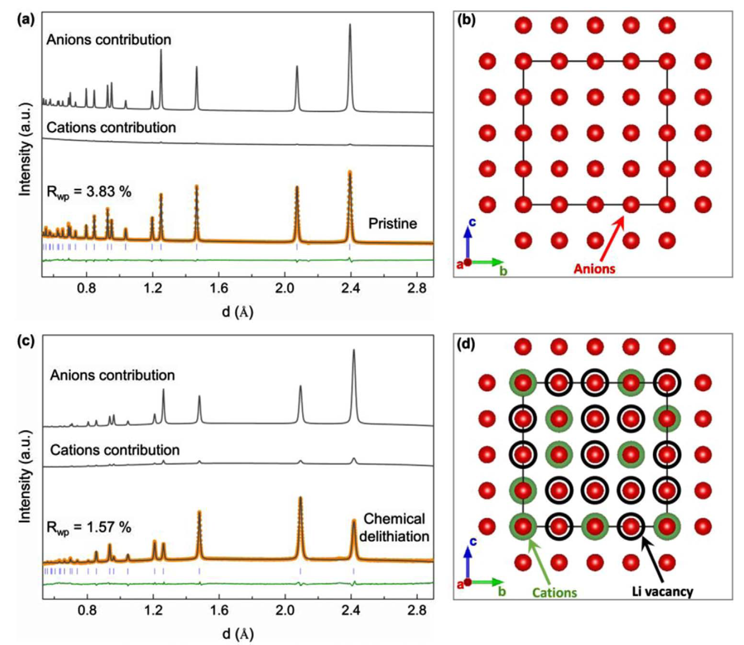
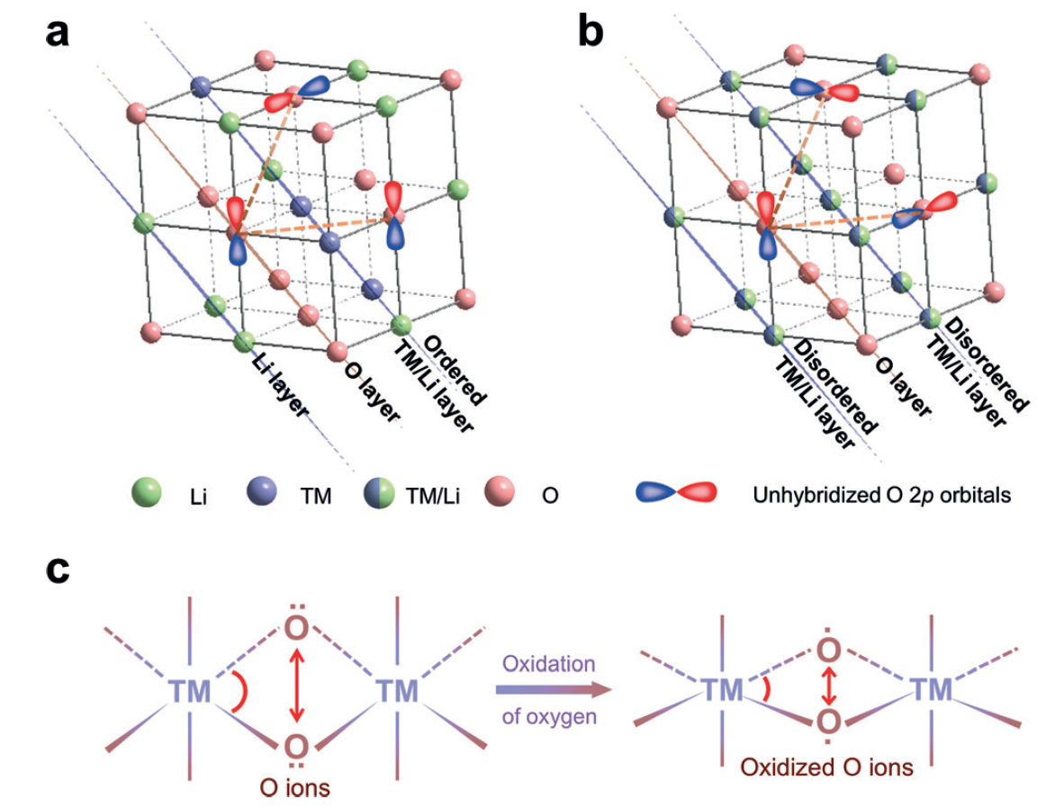
GPPD: LIBs materials
Li/Ni exchange ratios in series of LiNi_{x}Mn_{y}Co_{z}O₂ materials are precisely determined for the first time
The superior structure stability and robust anions framework of LTNNbOF (280 mAh/g) upon (de)lithiation process were experimentally demonstrated.
The structural-dimensionality effect on the l-OR and associated oxygen lattice stability in Li-rich cathodes have been characterized and clarified.
Illustration of a pair of Li/Ni exchange and arrangement of magnetic moments in the TM layer of triangular lattice
Rietveld refinement of the NPD patterns and calculated cations/anions diffraction patterns for the pristine and the corresponding schematic crystal structure.
a) 2D-ordered cation layer; b) 3D-disordered cation framework; c) Schematic representation of the shrinking distance between a pair of O–O ions and the corresponding structure distortion.
Y.G. Xiao et al. Nano Energy 2018, 49, 77–85
E.Y. Zhao et al. Energy Storage Materials 2019, 16, 354–363
E.Y. Zhao et al. Angew. Chem. Int. Ed. 2019, 58, 4323-4327

Slide 39
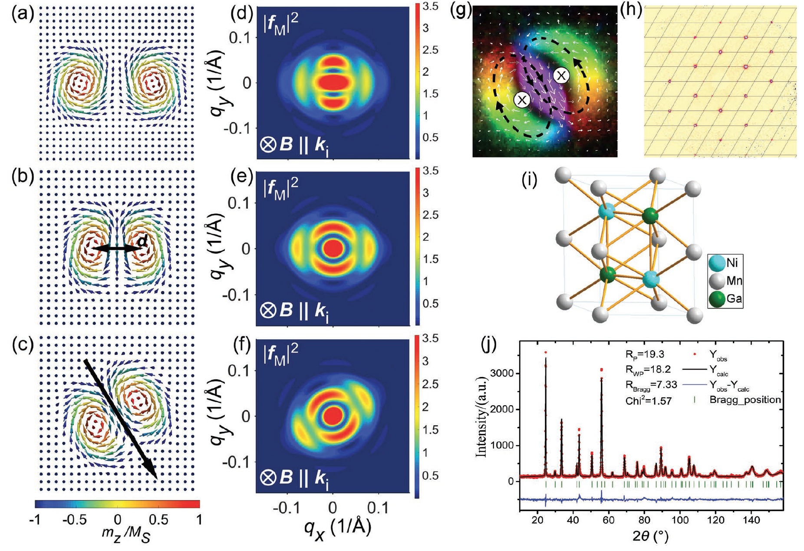
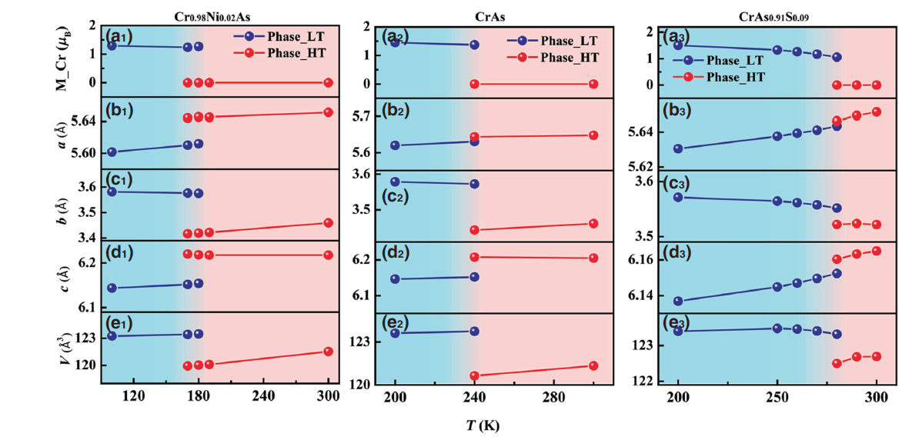
GPPD: Magnetism
The structural parameters of the biskyrmion state in MnNiGa bulk crystals was determined
Giant Negative Thermal Expansion in Antiferromagnetic CrAs-Based Compounds
(a₁₋₃) Temperature dependence of Cr magnetic moment. (b₁₋₃), (c₁₋₃), (d₁₋₃), (e₁₋₃) Temperature dependence of lattice parameters a, b, c and the unit-cell volume V for Cr_{0.98}Ni_{0.02}As, CrAs, and CrAs_{0.91}S_{0.09}. (Refined from neutron powder diffraction data.)
a–c) Structural parameters describing a C2v biskyrmion; d–f) The simulated magnetic form factors corresponding to (a–c), respectively; g) An in-plane magnetization of the biskyrmion configuration. h) The MnNiGa single-crystalline sample is checked using a single-crystal X-ray diffractometer; i,j) The refinement result of high-resolution neutron powder diffraction data.
Y. Hu, et al. Phys. Rev. A 12, 034027 (2019)
X.Y. Li, et al. Adv. Mater. 2019, 1900264
Notes:
1. Biskyrmions do not assemble into a long-range-ordered lattice. Instead, their correlation length always remains comparable to the periodicity of the stripe domains, and increases with increasing magnetic field.
2. Although biskyrmions do not order into periodic lattices on a large length scale, they are in-plane rotationally ordered, with the rotation direction being locked to certain crystallographic directions.
These polar molecular properties of the biskyrmion system suggest an intricate energy balance in MnNiGa, which is fundamentally different from chiral skyrmion systems. Such anisotropic nature, representing an extra degree of freedom for this type of skyrmions, may be exploited as information carrier. In this case, the two binary states are encoded within the same topological state, which reduces the energy consumption that is required for the state switching, demonstrating advanced device scheme for skyrmion-based memories.

Slide 40


MR: Thin film research
Probing the Transfer of the Exchange Bias Effect by Polarized Neutron Reflectometry
The behavior of helium atoms in He+ ion implanted W/Ni bilayer nanocomposite
Sensitivity to reveal the complicated
magnetic structure in the film.
X.Z. Zhan et al. 2019 Sci. Rep. 9, 6708
H.C. Chen et al. Appl. Phys. Surf. 486, 274 (2019)

Slide 41


MR: Interface Induced Enhancement of ISHE
Interface Induced Enhancement of Inverse Spin Hall Voltage in NiFe/Pt Bilayers Capped by MgO layer
First PNR data @ CSNS
The SLD profile shows an interface between pure Pt and MgO layers with their nominal SLDs, which supporting an interfacial induced ISHE enhancement.
T. Zhu et. al. J. Phys.: Condens. Matt 31, 285801 (2019)

Slide 42

MR: YIG thin films by PNR
142 emu/cm³
The magnetization profiles has been systematically studied by PNR, which consists with other techniques.
H. Bai, et. al. Appl. Phys. Lett. 115, 182401 (2019)

Slide 43


SANS: Metal glass
The pathway of amorphous-to-crystalline phase transformation in Zr-, Fe- and Pd-based bulk metallic glasses
the first observation of Reentrant glass transition leading to ultrastable metallic glass
W.X. Dong, et al. Journal of Alloys and Compounds, https://doi.org/10.1016/j.jallcom.2019.153049
Q. Du, et al. Materials today,
https://doi.org/10.1016/j.mattod.2019.09.002
Notes:
采用中子小角散射技术研究了Zr-基BMG由非晶到结晶的动力学问题，提出了一种基于短程原子输运的相分离机理。

Slide 44


SANS: Metal–Organic Polyhedron
The Microscopic Structure–Property Relationship of Metal–Organic Polyhedron Nanocomposites
Star Polymer
MOP
PS-MOP
SAXS：structure of core（Cu²⁺）
SANS: structure of polymer chains（C,H）
M.X. Zhang, et al. Angew. Chem. Int. Ed., 2019, 131,2–8
Notes:
采用中子小角散射技术研究了Zr-基BMG由非晶到结晶的动力学问题，提出了一种基于短程原子输运的相分离机理。

Slide 45
Outline
Why Neutrons?
CSNS project overview
Commissioning & operation
User service and application
New instruments and future plan
Summary

Slide 46
Cooperation Instruments
Multiple Physics Instrument cooperated with Dongguan Institute of Technology & CityU, Hongkong construction started
Engineering Diffractometer cooperated with Center for Excellent Advanced Materials (Dongguan) construction started
Atmosphere Neutron Irradiation cooperated with China Electronic Product Reliability and Environmental Testing Research Inst. construction started
High energy chopper spectrometer cooperated with SUN YAT-SEN Univ. contract signed
High Pressure Diffractometer cooperated with South China Univ. of Sciences and Technology (Shenzhen)
High resolution Diffractometer cooperated with Peking Univ. Shenzhen Graduate school (Shenzhen)
Guangdong Province Government Donation:
Very small angle neutron scattering
Energy resolved neutron imaging

Slide 47
Cooperation Instruments
BL14: Very small angle neutron scattering
BL13: Energy resolved neutron imaging
BL16: Multiple Physics Instrument
BL08: Engineering Diffractometer
BL11: Atmosphere Neutron Irradiation
BL05: High energy chopper spectrometer
BL15: High Pressure Diffractometer
BL09: High resolution Diffractometer

Slide 48
CSNS Phase II
Facility | Beam power | Upgrade plan | Number of spectrometers | Number of targets
SNS | 1 MW | 2.8 MW | 18+5 | 1+1 (CD2)
J-PARC | 1 MW | 1.5 MW | 18 | 1+1 (plan)
ISIS | 200 kW |  | 20+18 | 1+1
CSNS | 100 kW | 500 kW+ | 3+17 | 1
Construction of new instruments (Neutron + Muon)
More sample environment and user lab.
Beam power upgrade
  Linac (300 MeV+) + RCS upgrade → 500 kW+
Target station upgrade

Slide 49
Phase II Instruments
BL03: Liquid reflectometer
BL04: Cold inelastic Spectrometer
BL06: molecular vibration
BL08A: neutron technology test station
BL10: Backscattering spectrometer
BL12: Neutron Physics
BL17: Quasi-elastic spectrometer
BL19: Single crystal diffractometer
BL20: Polarized chopper spectrometer
BL07: Reserve
BL10A: Reserve
    Long term
    Second target stations
    Muon beams
  ……

Slide 50
Summary
CSNS passed the national acceptance on August 23, 2018, and was officially opened to users.
The operation of CSNS goes well with high efficiency. The user demand is very strong.
CSNS is transferring from the construction to the operation: stable running with high efficiency, improving performance.
The design and construction of cooperation instruments are underway.
The phase-II instrument construction and the power upgrade will be started rather soon.
Any comment and advice is appreciated!

Slide 51

Thank you ！

