Slide 1
Quark model，baryon-baryon interactions and dibaryons
Jialun Ping
Nanjing Normal university

Slide 2
Contents
  Introduction
  Symmetry and quark models
  Baryon-baryon interactions & dibaryons
  Summary

Slide 3
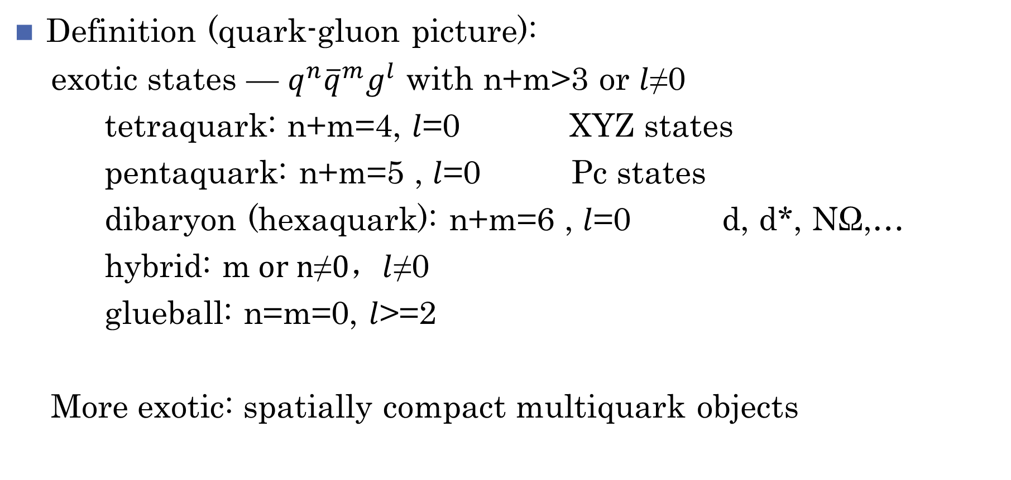
Introduction to exotic states
Definition (quark-gluon picture):
exotic states — $q^{n}{\overline{q}}^{m}g^{l}$ with n+m>3 or $l$≠0
tetraquark: n+m=4, $l$=0 XYZ states
pentaquark: n+m=5 , $l$=0 Pc states
dibaryon (hexaquark): n+m=6 , $l$=0 d, d*, NΩ,…
hybrid: m$or n\text{≠}0，l$≠0
glueball: n=m=0, $l$>=2
More exotic: spatially compact multiquark objects

Slide 4
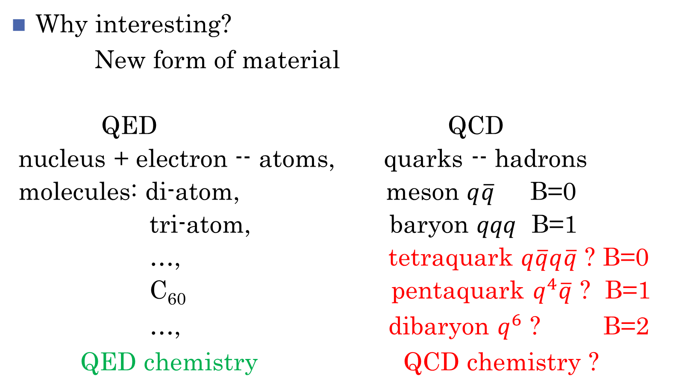
Why interesting?
New form of material
QED QCD
nucleus + electron -- atoms, quarks -- hadrons
molecules: di-atom, meson $q\overline{q}$ B=0
tri-atom, baryon $qqq$ B=1
…, tetraquark $q\overline{q}q\overline{q}$ ? B=0
C₆₀ pentaquark $q^{4}\overline{q}$ ? B=1
…, dibaryon $q^{6}$ ? B=2
QED chemistry QCD chemistry ?

Slide 5
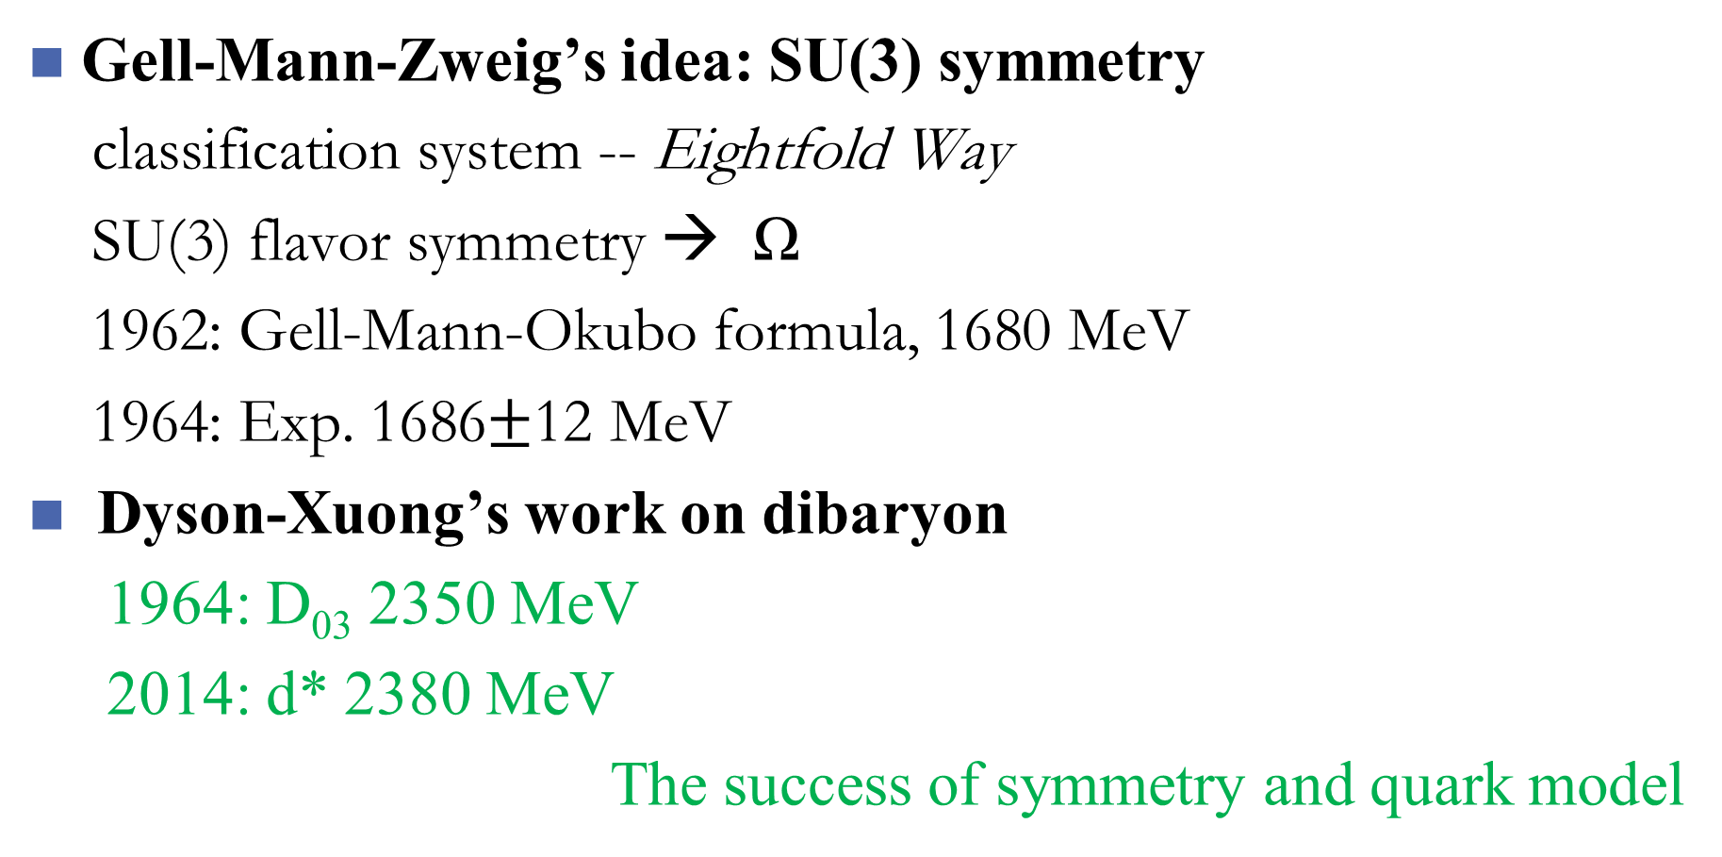
Symmetry and quark models
Gell-Mann-Zweig’s idea: SU(3) symmetry
classification system -- Eightfold Way
SU(3) flavor symmetry → Ω
1962: Gell-Mann-Okubo formula, 1680 MeV
1964: Exp. 1686$±$12 MeV
Dyson-Xuong’s work on dibaryon
1964: D₀₃ 2350 MeV
2014: d* 2380 MeV
The success of symmetry and quark model

Slide 6
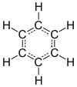
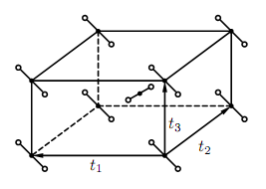
Geometry symmetry
molecules: point group,
C₆H₆ (D_{6h}), C₆₀ (I_{h})
crystal: space group
TiO₂(D_{4h}¹⁴)
[G,H]=0
……

Slide 7
Dynamical symmetry
Dynamical symmetry:
H: Hamiltonian of a system
C,C₁,C₂,……: Casimir operators or class operators of
group chain
properties:
Eigen energy of the system:
eigenvalues of operators C,C₁,C₂,……

Slide 8
Group chain of quark system
Light hadron ground states:
orbital: U^{x}(1) (baryon) or (dibaryon)
color: SU^{c}(3)
flavor: SU^{f}(3)
spin: SU^{σ}(2)
Group chain:

Slide 9
Dynamical symmetry applied to light quark systems
Color: singlet, [c] fixed
Gursey-Radicati mass formula (PRL13(1964)173)

Slide 10
Parameters the masses of baryons
A=9.2962 B=48.238 C=-196.34 D=35.080
(unit: MeV)
Baryon: M₀=1021.9 MeV
Dibaryon: M₀=2093 MeV

Slide 11
Baryons:
 | N | Λ | Σ | Ξ | Δ | Σ* | Ξ* | Ω
Y | 1 | 0 | 0 | -1 | 1 | 0 | -1 | -2
I | ½ | 0 | 1 | ½ | 3/2 | 1 | ½ | 0
J | ½ | ½ | ½ | ½ | 3/2 | 3/2 | 3/2 | 3/2
[f] | [21] | [21] | [21] | [21] | [3] | [3] | [3] | [3]
theo | 935 | 1114 | 1184 | 1328 | 1241 | 1384 | 1528 | 1672
err | 2.6 | 1.9 | 2.6 | 1.6 | 4.8 | 3.8 | 2.7 | 1.7
exp | 939 | 1116 | 1193 | 1318 | 1232 | 1383 | 1533 | 1672

Slide 12
Dibaryons:
 | D₀₁ | D₁₀ | D₀₃ | D₃₀ | D₁₂ | NΩ | ΩΩ | H
Y | 2 | 2 | 2 | 2 | 2 | -1 | -4 | 0
I | 0 | 1 | 0 | 3 | 1 | ½ | 0 | 0
J | 1 | 0 | 3 | 0 | 2 | 2 | 0 | 0
[f] | [33] | [42] | [33] | [6] | [42] | [321] | [6] | [222]
theo | 1873 | 1884 | 2355 | 2420 | 2173 | 2652 | 3072 | 2093
err | 5.6 | 6.6 | 6.6 | 13 | 7.2 | 4.0 | 4.7 | 2.9
exp | 1876 | 1878? | 2380 | ? | 2148? | ? | ? | ?

Slide 13
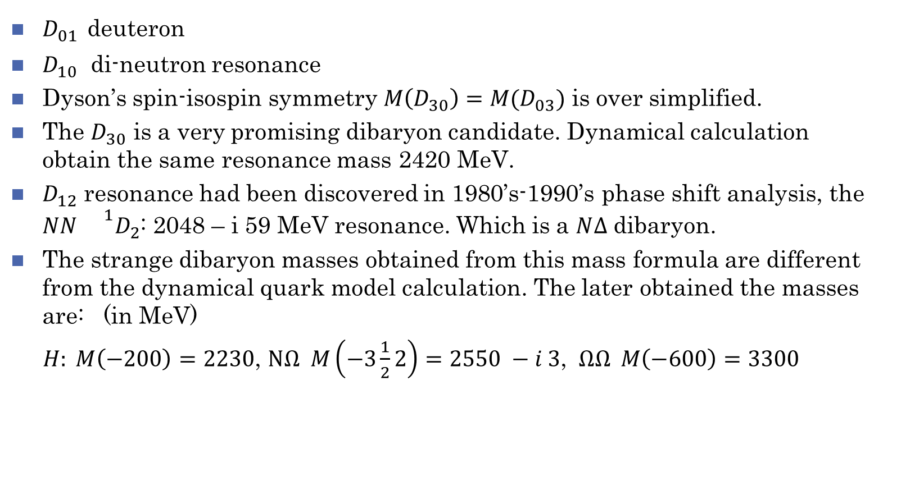
Note to the table
$D_{01}$ deuteron
$D_{10}$ di-neutron resonance
Dyson’s spin-isospin symmetry $M\left(D_{30}\right)=M(D_{03})$ is over simplified.
The $D_{30}$ is a very promising dibaryon candidate. Dynamical calculation obtain the same resonance mass 2420 MeV.
$D_{12}$ resonance had been discovered in 1980’s-1990’s phase shift analysis, the $NN {}^{1}D_{2}$: 2048 – i 59 MeV resonance. Which is a $N∆$ dibaryon.
The strange dibaryon masses obtained from this mass formula are different from the dynamical quark model calculation. The later obtained the masses are: (in MeV)
$H: M\left(−200\right)=2230$, $NΩ M\left(−3\frac{1}{2}2\right)=2550 −i 3$, $ΩΩ M\left(−600\right)=3300$

Slide 14
Quark Model
Naïve quark model (Glashow-Isgur)
A. De Rujula, H. Georgi, S. L. Glashow, Hadron masses in a gauge theory,
PRD 12 (1975) 147
N. Isgur, G. Karl, PRD 18 (1978) 4187; 19(1979) 2653; 20 (1979) 1191; …
S. Godfrey, N. Isgur, PRD 32 (1985) 189.
Quark model (color confinement + OGE):
a good description of hadron properties.
Baryon-baryon interactions: fail
Nucleon-nucleon interaction: repulsive core: yes,
intermediate attraction: no

Slide 15
Two approaches:
Hybrid quark model --- Chiral quark model
meson exchange between quarks introduced
Background: chiral symmetry spontaneous breaking
Tokyo group, IHEP group, Salamanca group
Quark delocalization color screening model
quark delocalization: enlarge the model space
color screening: modify the color confinement
Nanjing group
Both approaches give a good description of hadron-hadron interactions

Slide 16
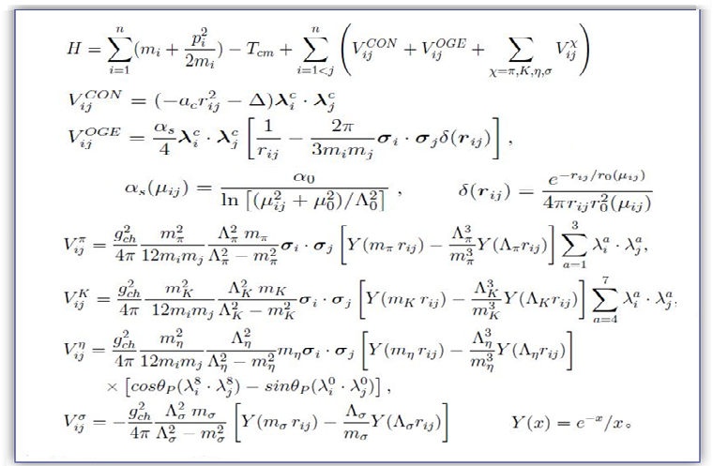
The chiral quark model (ChQM)
In ChQM:
Color confinement +
One gluon exchange
+
One boson exchange
J. Vijande, et al., JPG31 (2005) 481

Slide 17
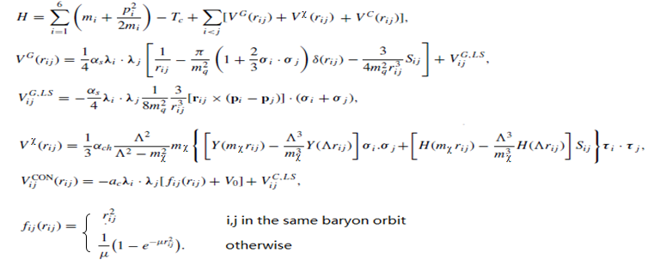
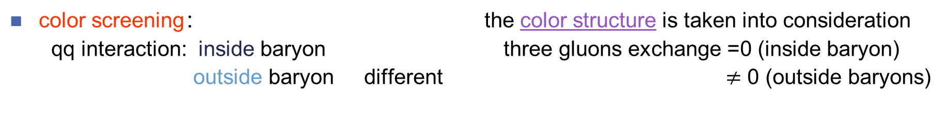
QDCSM (F.Wang et al. (Nanjing University) PRL69(1992)2901.)
color screening： the color structure is taken into consideration
qq interaction: inside baryon three gluons exchange =0 (inside baryon)
outside baryon different $≠$ 0 (outside baryons)

Slide 18
Quark delocalization:
the parameter ε is determined by system dynamics。
The main advantage of QDCSM :
Quark and gluon distribution: self-consistent
the delocalization parameter is determined through its own dynamics, so multiquarksystem choose its most favorable configuration by variation.

Slide 20
RGM+GCM
Resonating group method
Generating coordinate method

Slide 21
The criterions for a good model
1. Describing the vast strong interaction experimental data:
bound state: deuteron, NN, YN scattering data
2. Explaining something which other model cannot explain.
the similarity of nuclear force and molecular force
3. Predicting something new and if it confirmed by measurements.
dibaryon candidates

Slide 22
Explain the existing experimental data
deuteron

Slide 23
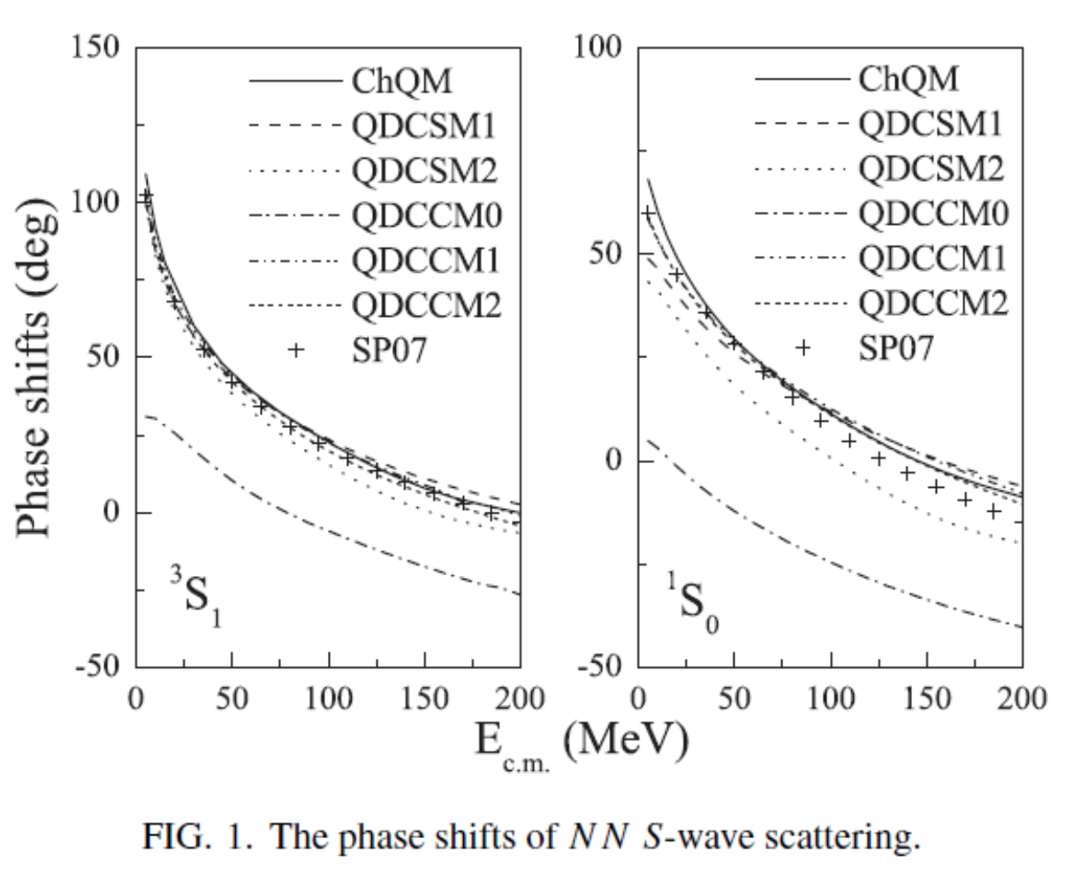

Slide 24
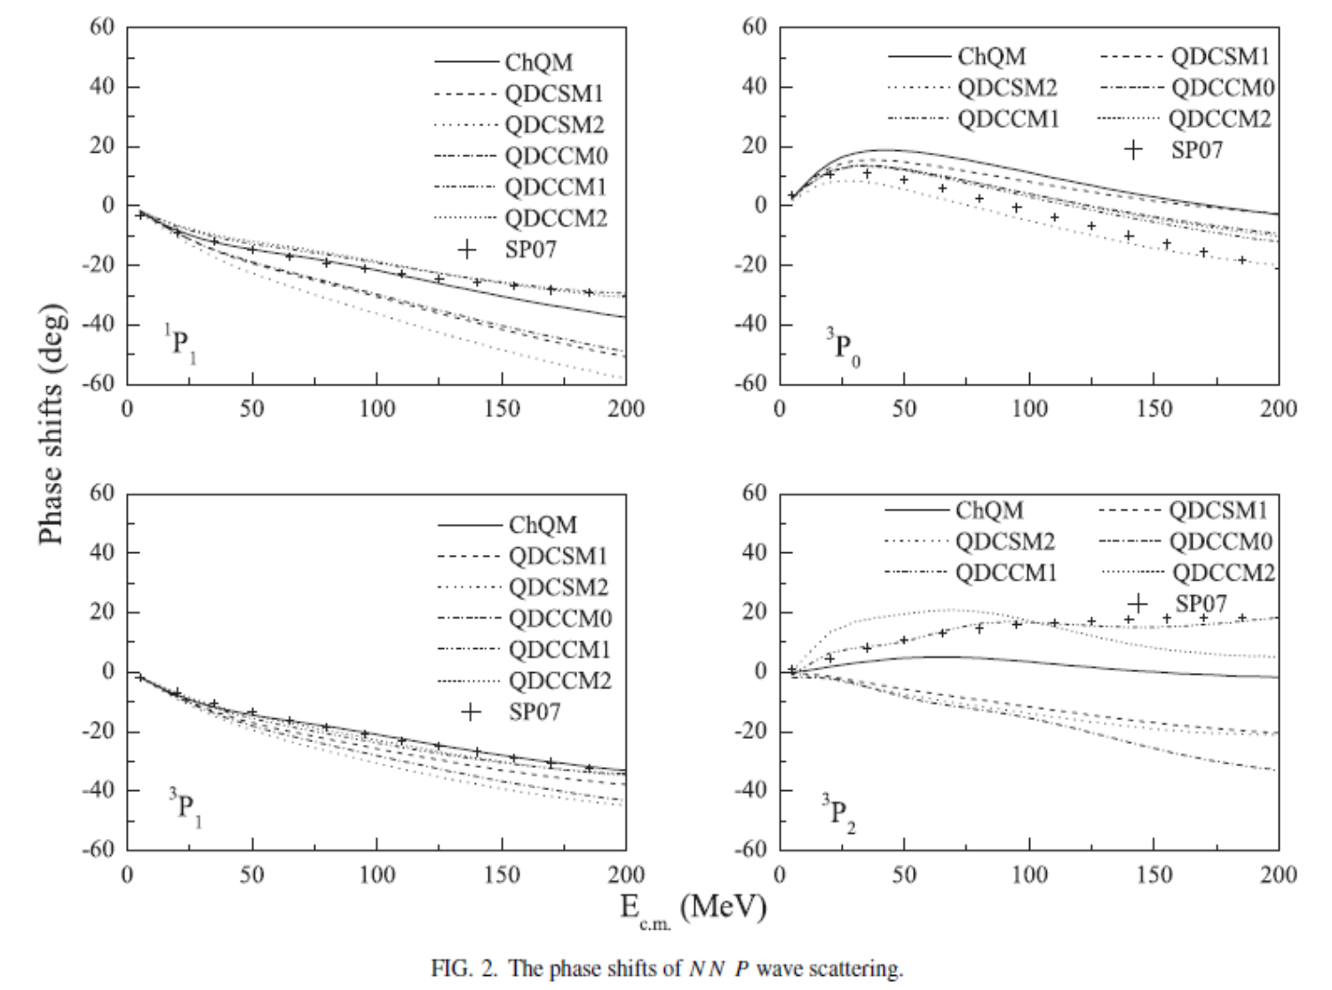

Slide 25
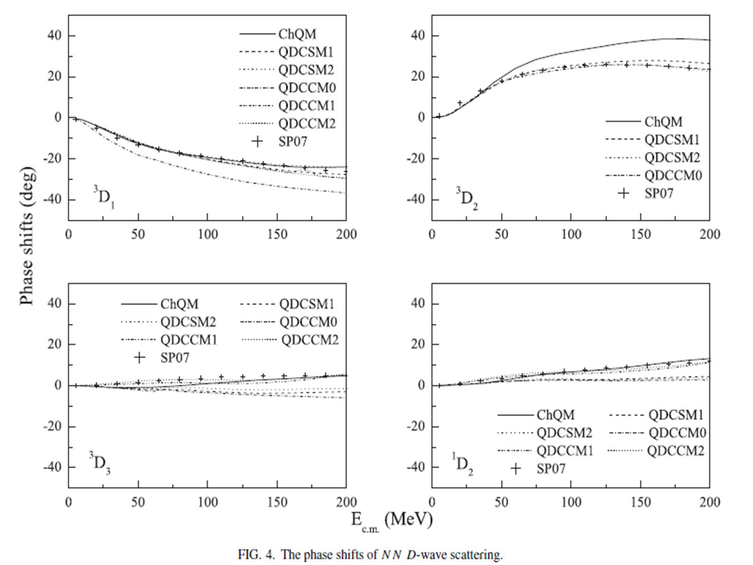

Slide 26
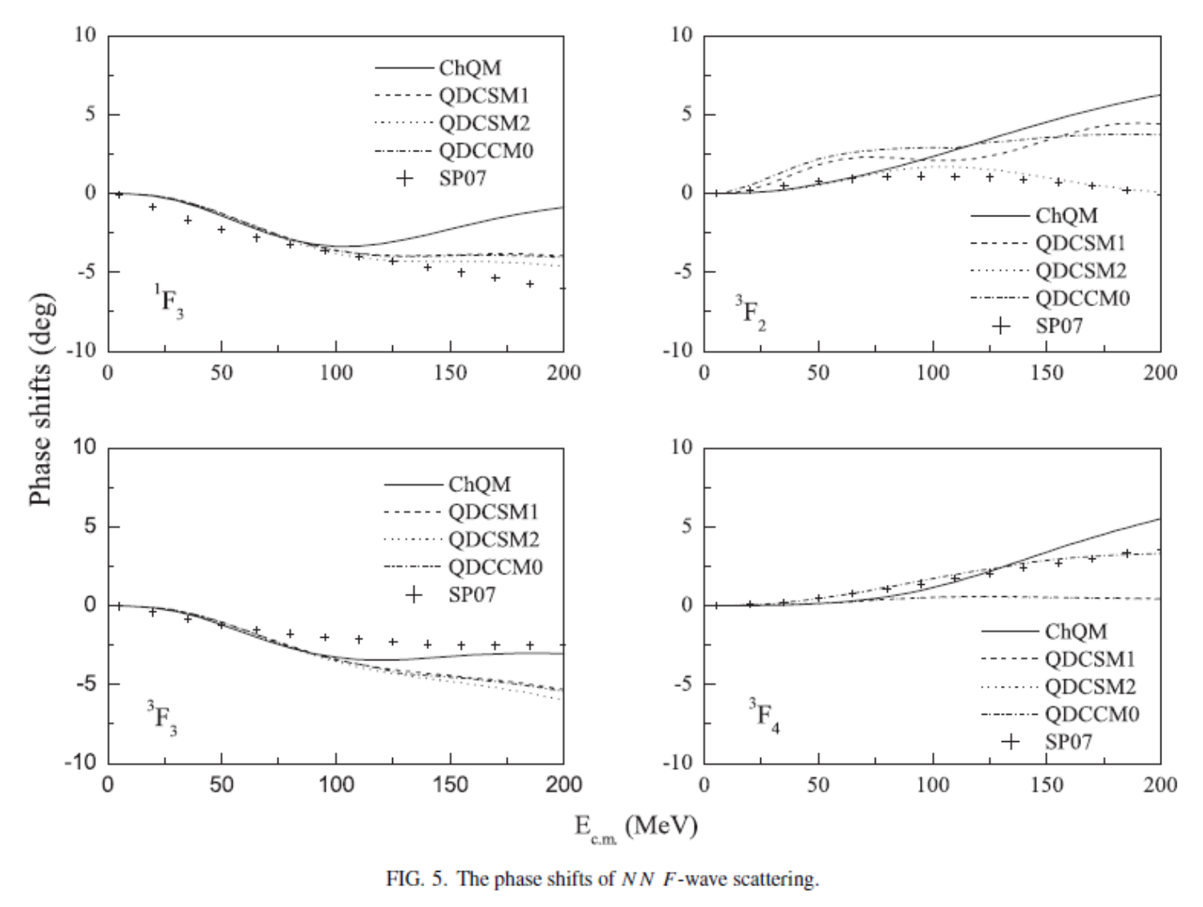

Slide 27
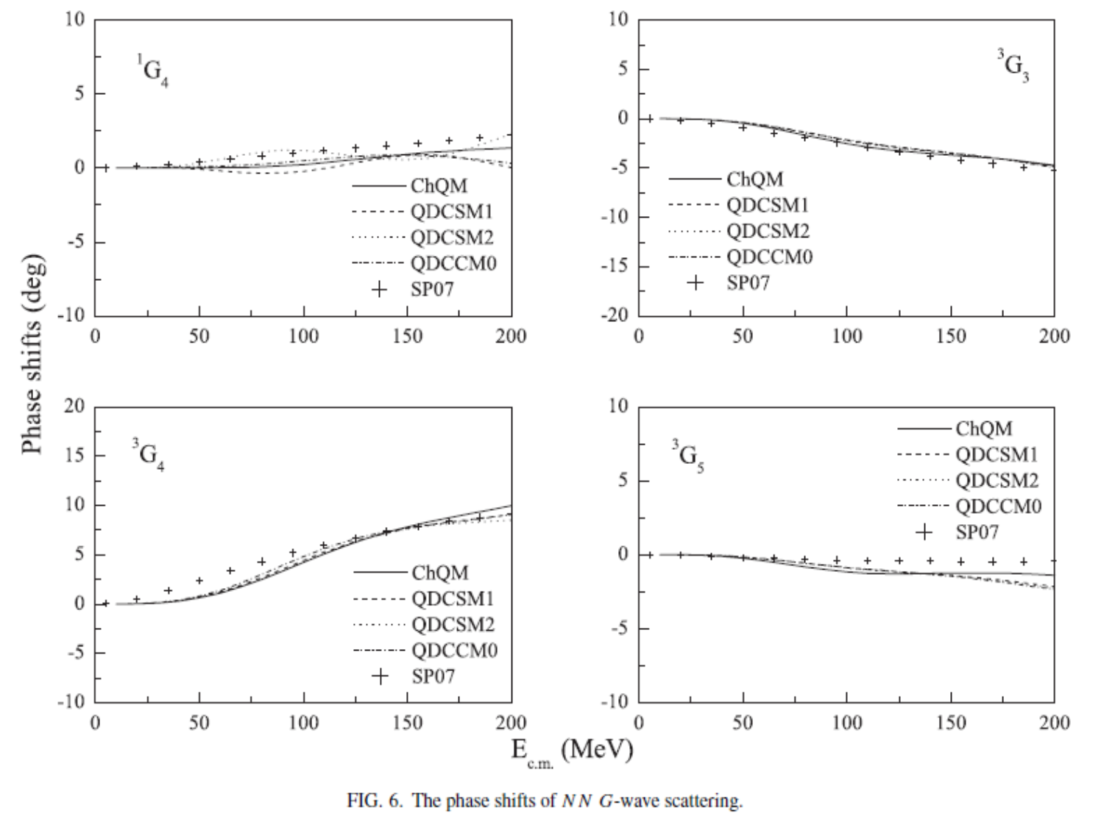

Slide 28
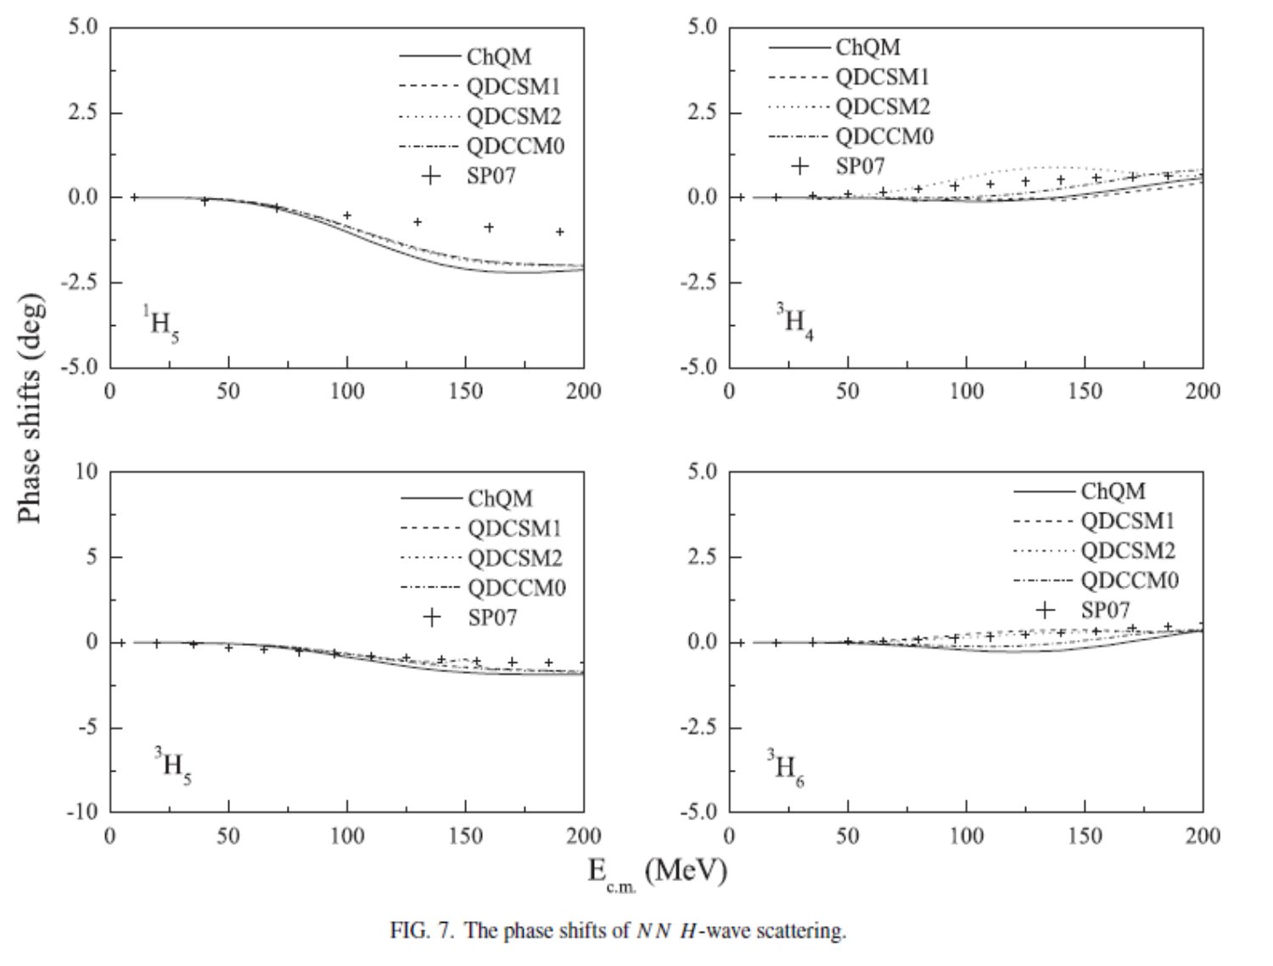

Slide 29
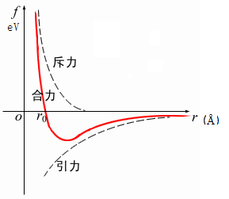
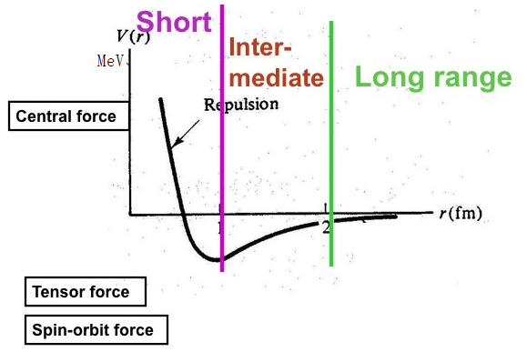
Molecular force vs nuclear force
Similarity: similar mechanism
electron percolation quark delocalization

Slide 30

S=0 interaction (arXiv: 1702.00734)
HAL QCD Collaboration
2 flavor
$m_{π}=146 \text{MeV}$

Slide 31
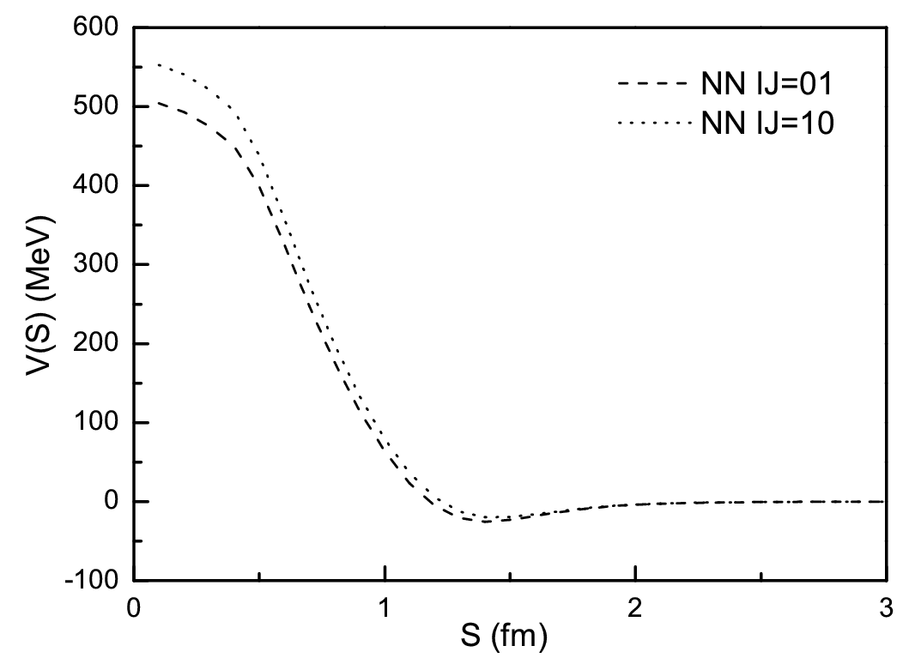
QDCSM

Slide 32
d*
Dyson & Xuong, PRL 13 (1964) 815
“inevitable”dibaryon
T.Goldman, K. Maltman, and F. Wang et al.,
Glueballs, hybrids and exotic hadrons, Brookhaven (1988) 413;
PRC39 (1989)1889.
1. Kinetic energies:
2. Color-Magnetic Interaction:
the existence of IJ^{P}=03⁺ dibaryon is inevitable
IJ^{P}=03⁺ dibaryon: a spin excitation of d, named d*

Slide 33
d*
PRC79 (2009) 024001

Slide 34
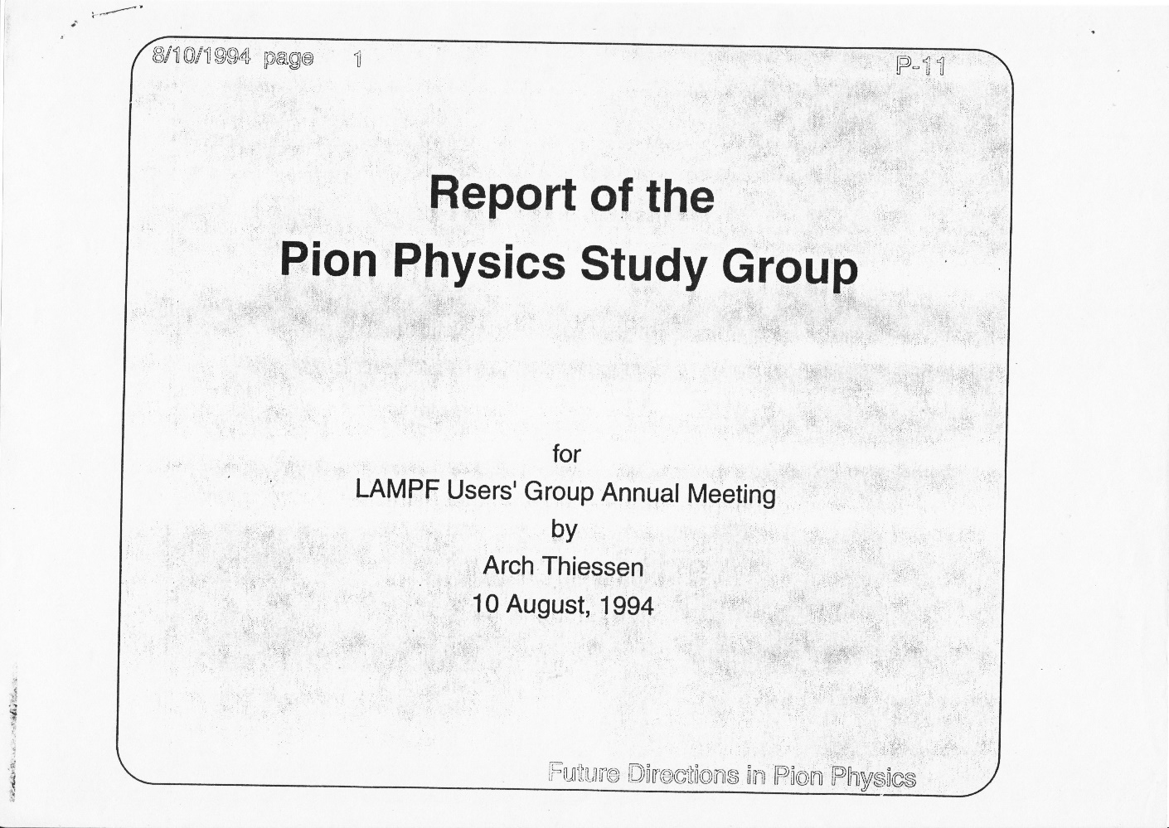
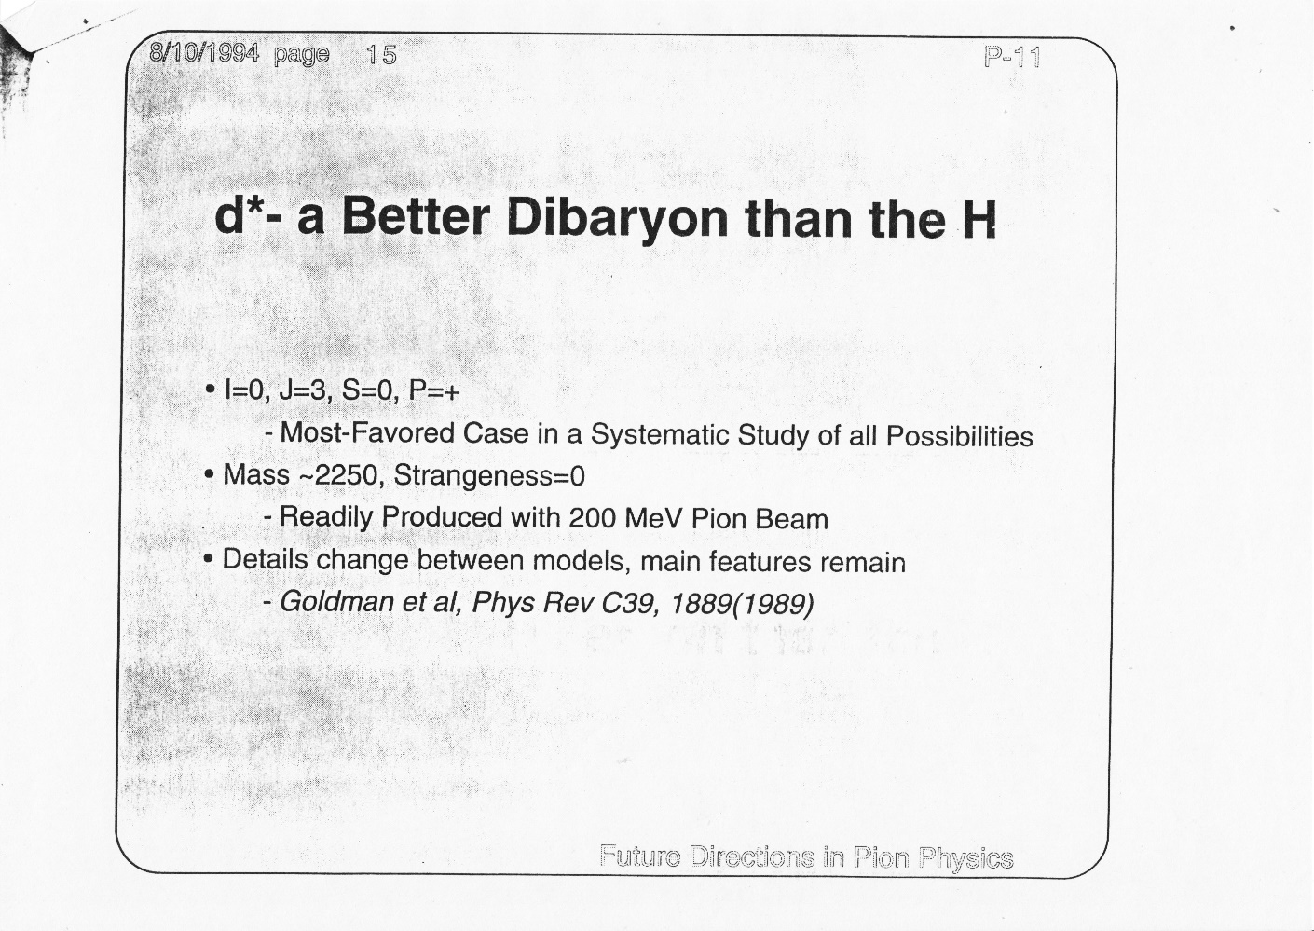
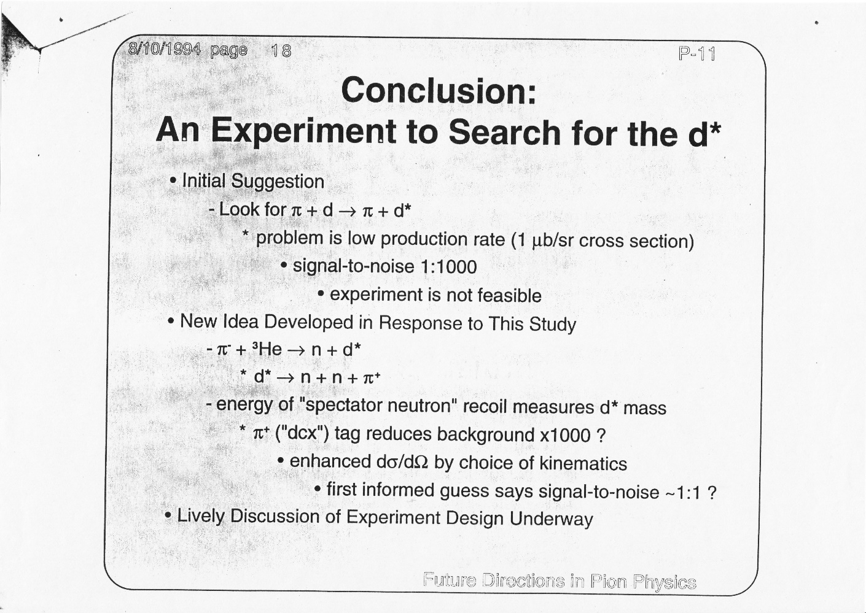
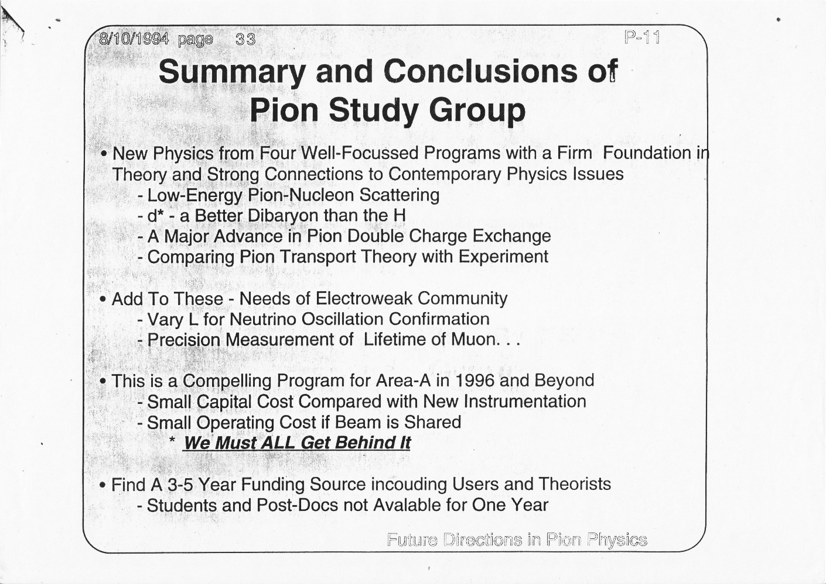
Proposals for d* searching

Slide 35
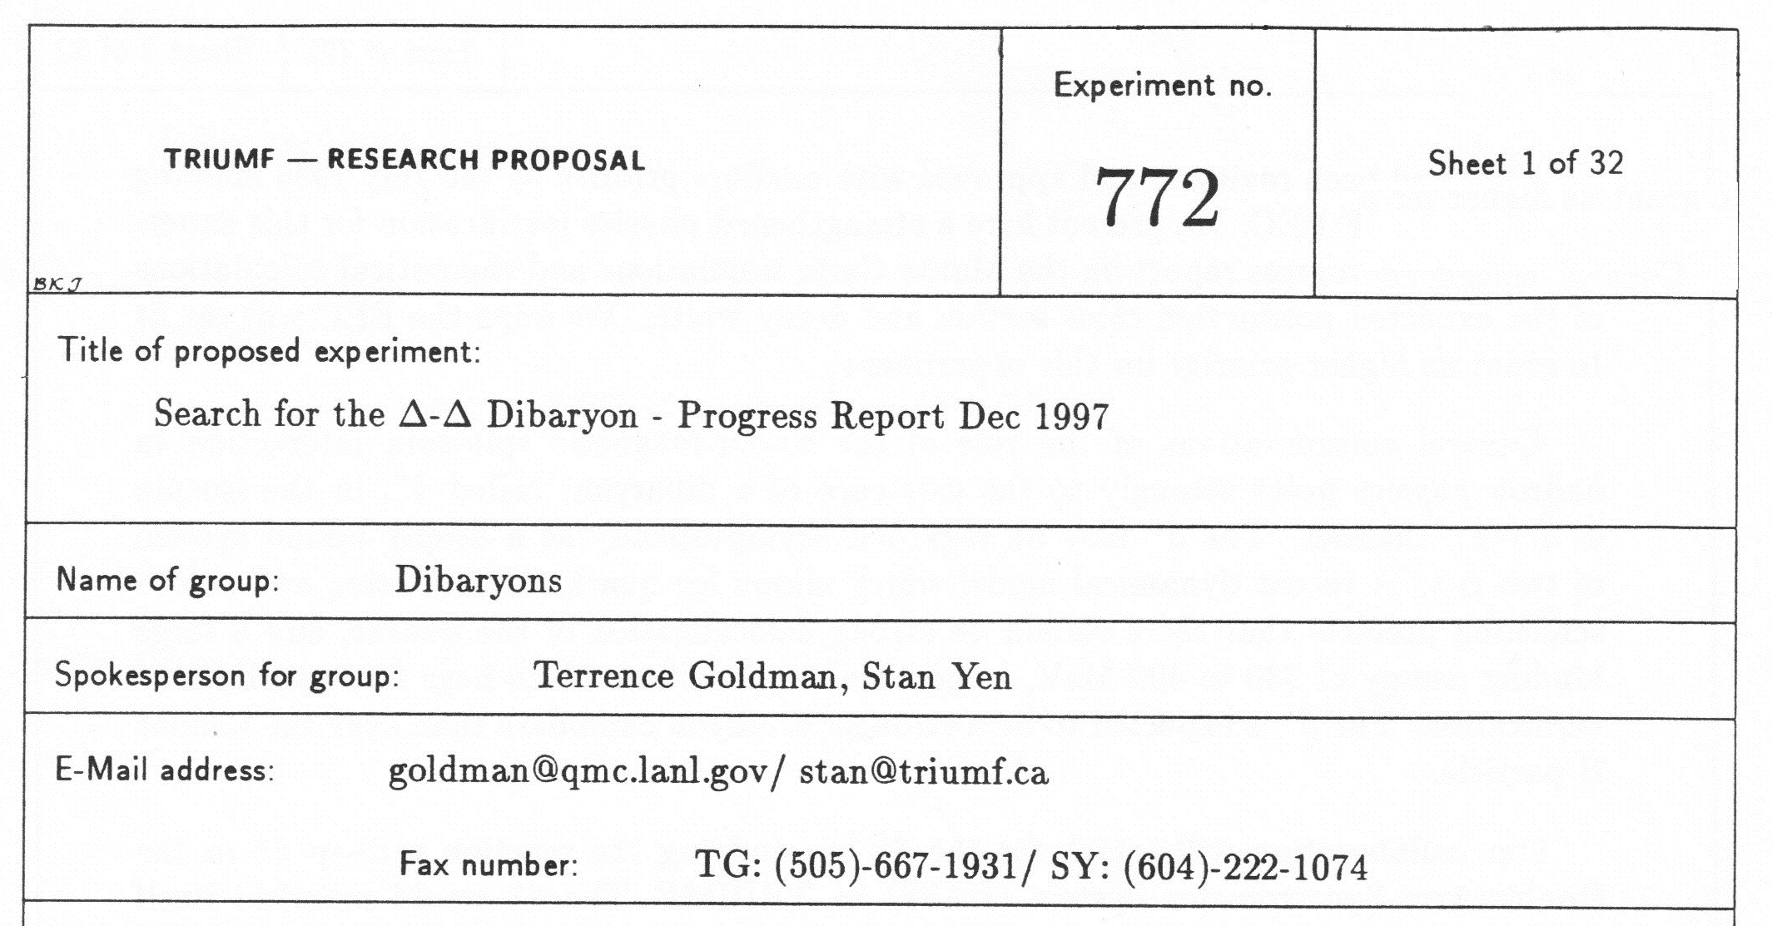
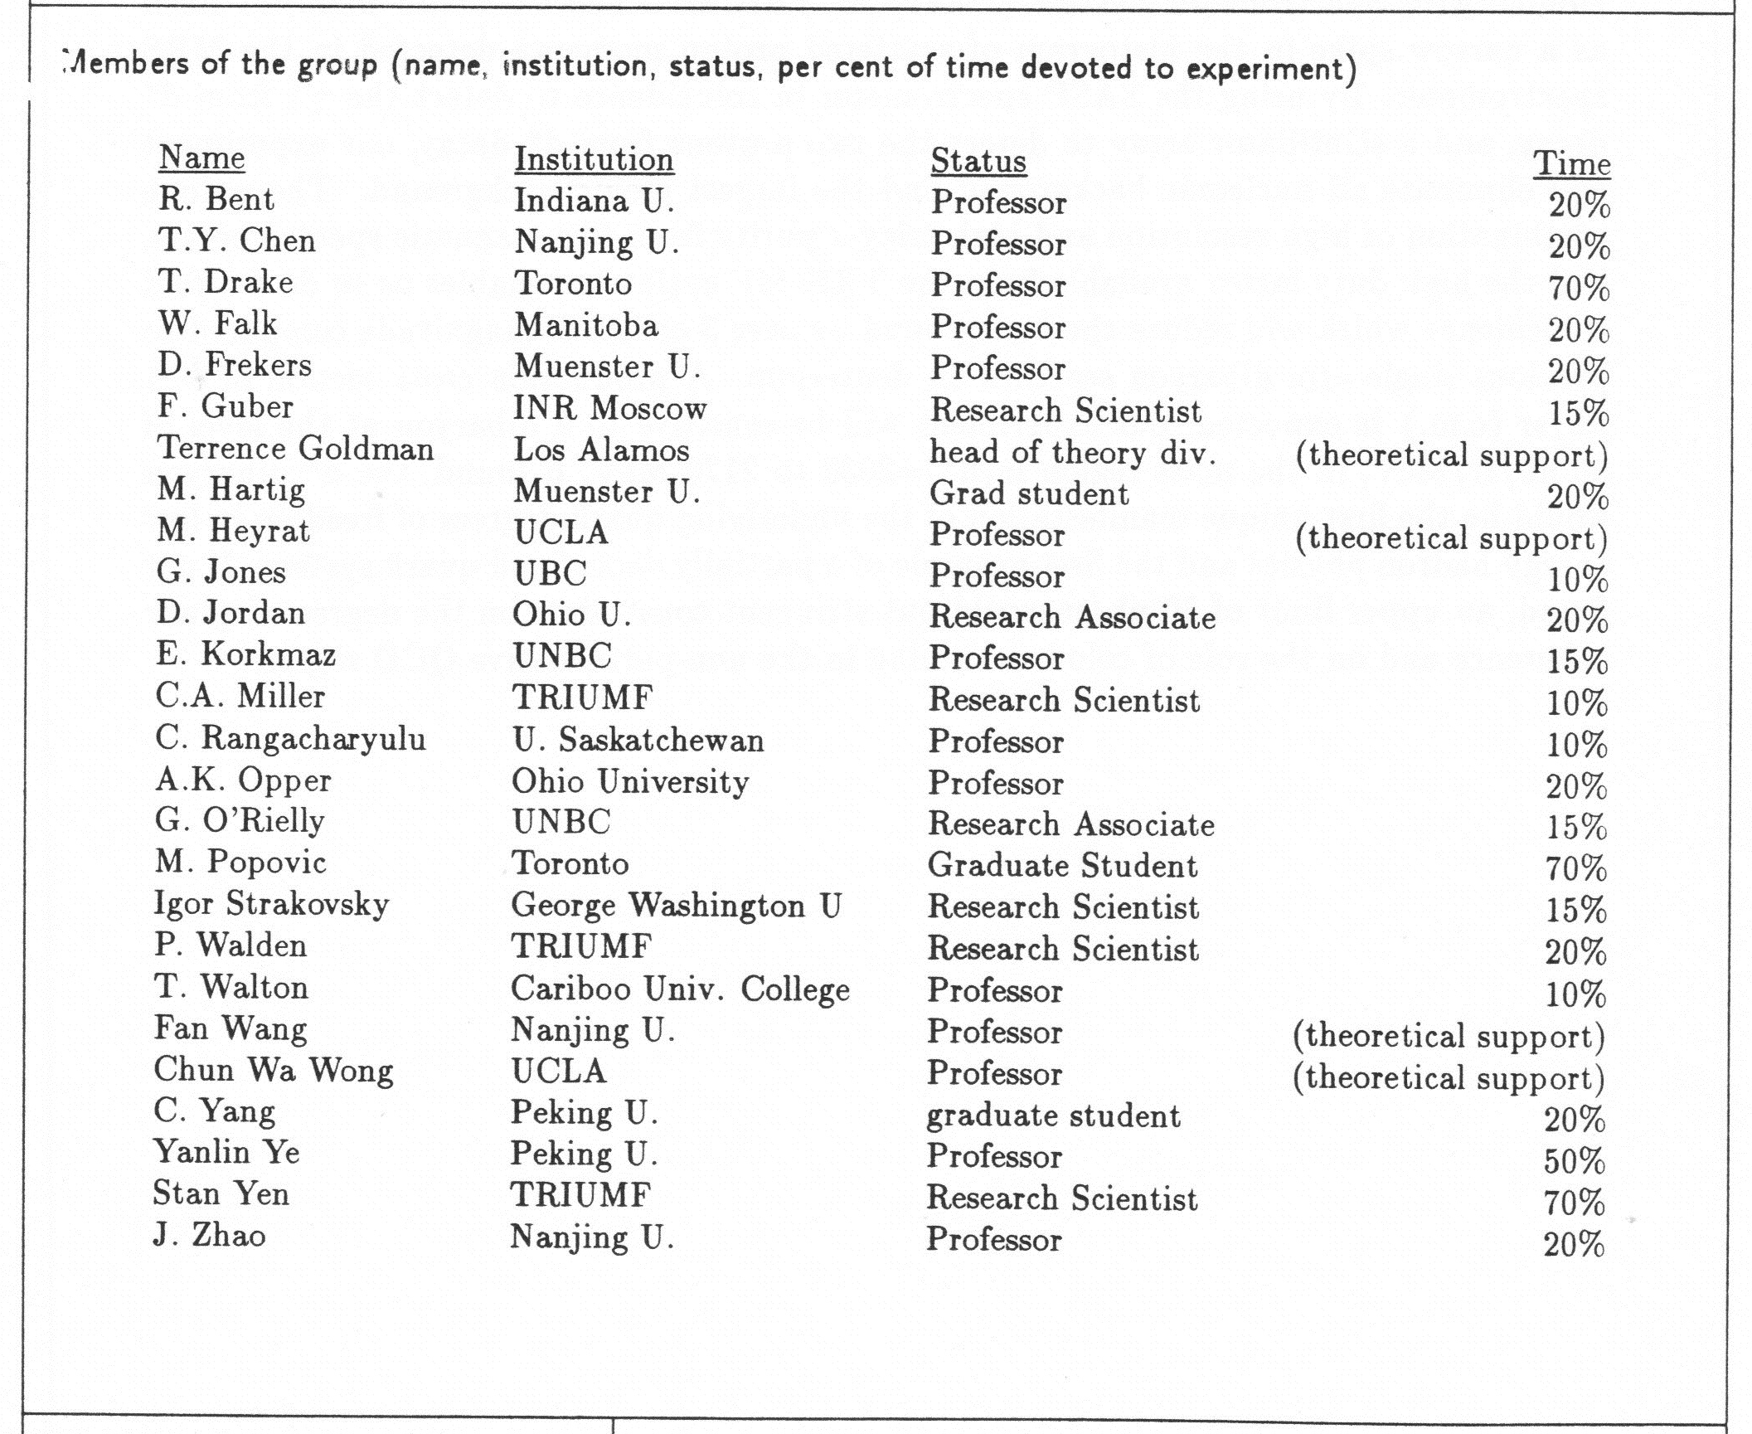
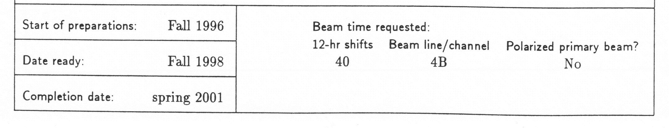

Slide 36
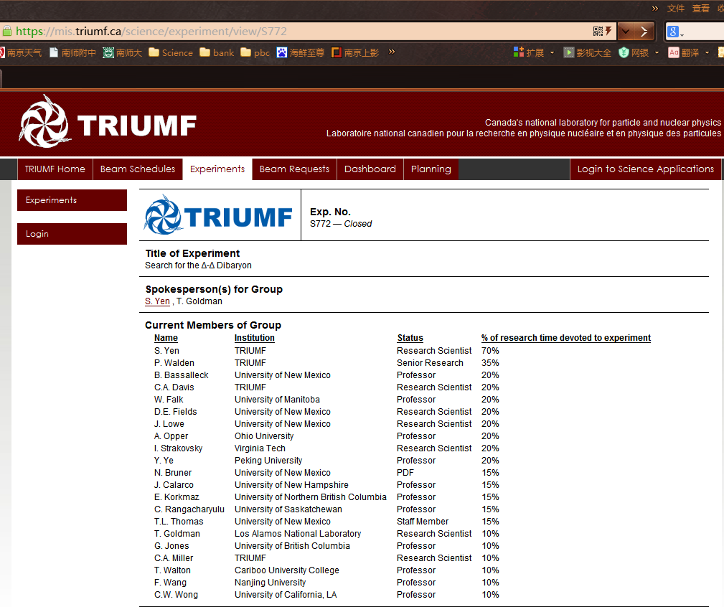

Slide 37
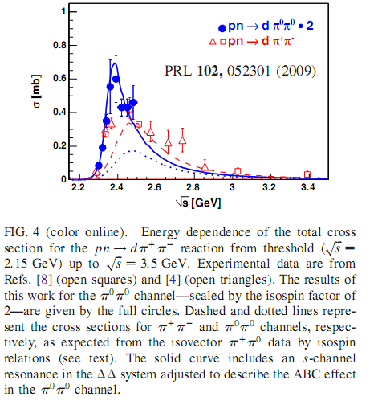
WASA-at-COSY measurements
Fudan University, 2019.9

Slide 38
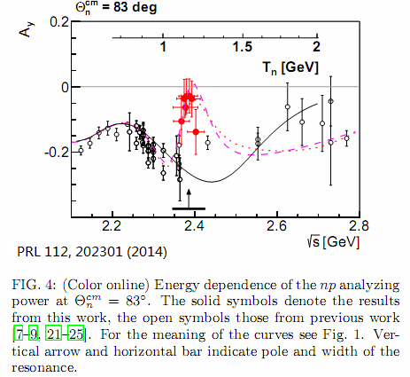
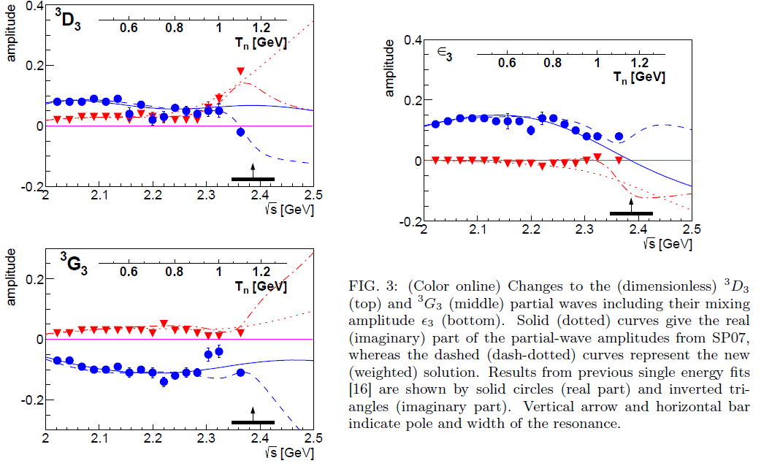
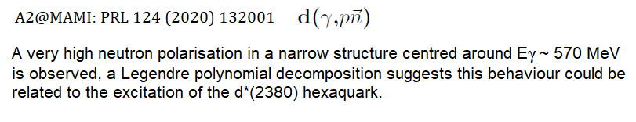

Slide 39
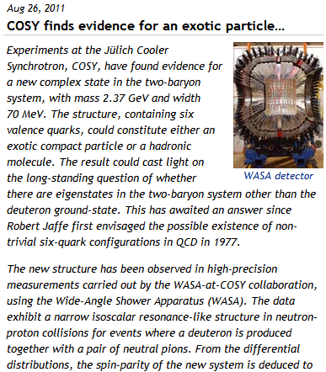
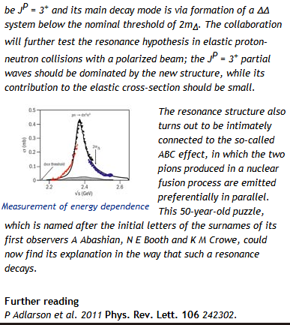
CERN Courier 2011
http://cerncourier.com/cws/article/cern/46855

Slide 40
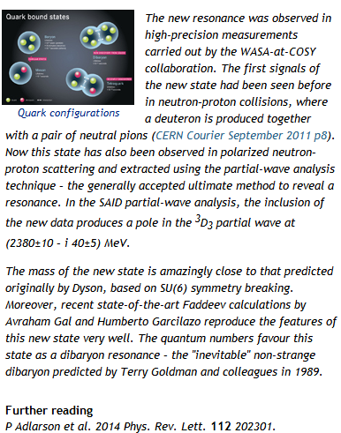
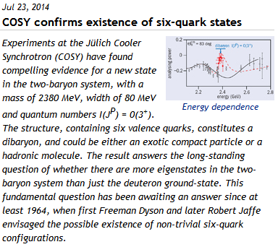
CERN Courier 2014
http://cerncourier.com/cws/article/cern/57836
Fudan University, 2019.9

Slide 41
D₁₂ and D₂₁
Dynamical symmetry approach

Slide 42
D₁₂ and D₂₁
Dynamical calculation: ¹D₂: E_{B}< 1 MeV
PRC 98(2018)034001
PRC 79(2009)024001

Slide 43
D₁₂ and D₂₁
Phys.Rev.165(1968)1834
PRL121(2019)052001

Slide 44

D₃₀
Dyson & Xuong: M(D₃₀)=M(D₀₃)
$pp→pp{π^{+}π^{−}π}^{+}π^{−}$ no clear-cut evidence
WASA-at-COSY Collaboration, Phys. Lett. B762 (2016) 455
PRC 89(2014)034001

Slide 45
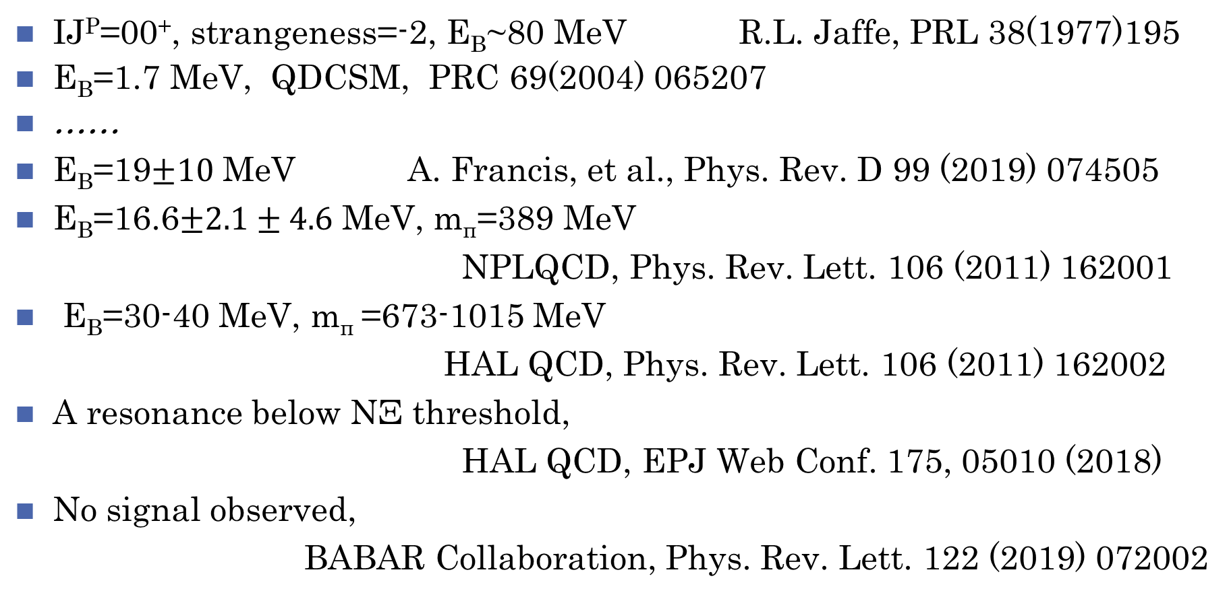
H
IJ^{P}=00⁺, strangeness=-2, E_{B}~80 MeV R.L. Jaffe, PRL 38(1977)195
E_{B}=1.7 MeV, QDCSM, PRC 69(2004) 065207
……
E_{B}=19$±10$ MeV A. Francis, et al., Phys. Rev. D 99 (2019) 074505
E_{B}=16.6$±2.1±4.6$ MeV, m_{π}=389 MeV
NPLQCD, Phys. Rev. Lett. 106 (2011) 162001
E_{B}=30-40 MeV, m_{π} =673-1015 MeV
HAL QCD, Phys. Rev. Lett. 106 (2011) 162002
A resonance below NΞ threshold,
HAL QCD, EPJ Web Conf. 175, 05010 (2018)
No signal observed,
BABAR Collaboration, Phys. Rev. Lett. 122 (2019) 072002

Slide 46

S=-2 interaction （arXiv:1504.01717, 1702.06241）
HAL QCD Collaboration
2+1 flavor
$m_{π}=660 \text{MeV}$ (2015), 146 MeV (2017)

Slide 47
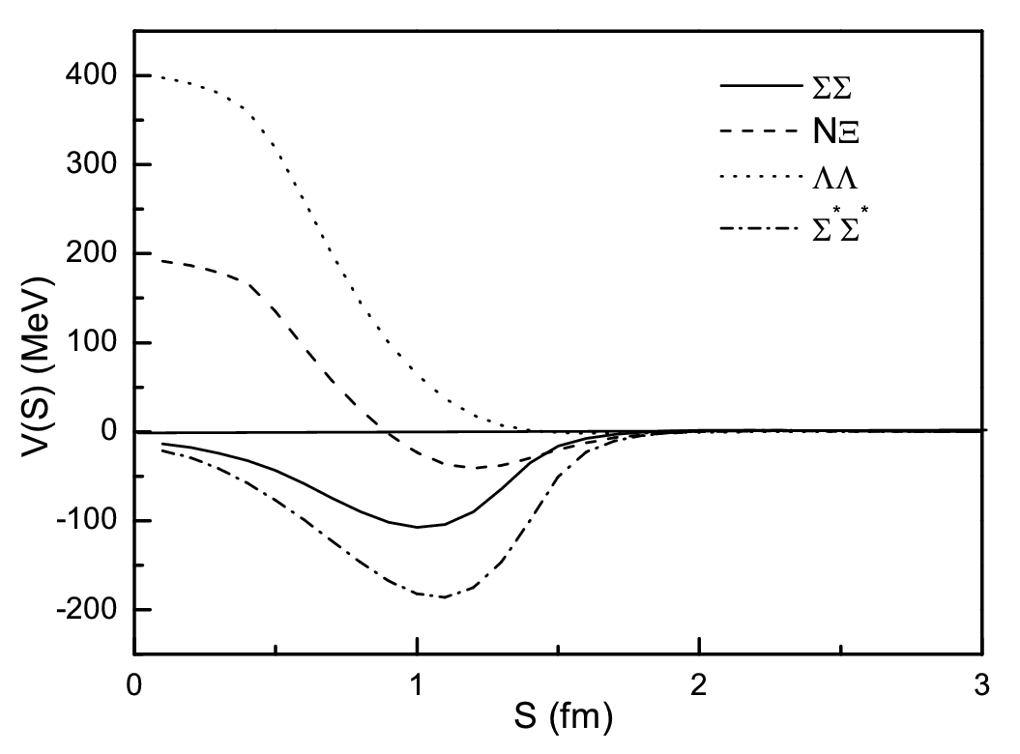
QDCSM

Slide 48
NΩ
J=1,2, two bound states, T. Goldman, et al., PRL 59(1987)627
J=2, narrow resonance state, m=2557 MeV, PRC 69(2004)065207
Q.B.Li and P.N. Shen, EPJA 8(2000) 417
E_{B}=18.9 MeV, HAL QCD, NPA 928(2014)89
2.46 MeV, 1810.03416
PRC 92 (2015) 065202
Favor pΩ state E_{B}~27 MeV slightly,
STAR Collaboration, Phys. Lett. B790 (2019) 490

Slide 49

S=-3 interaction （arXiv: 1702.03495）
HAL QCD Collaboration
2+1 flavor
$m_{π}=146 \text{MeV}$

Slide 50
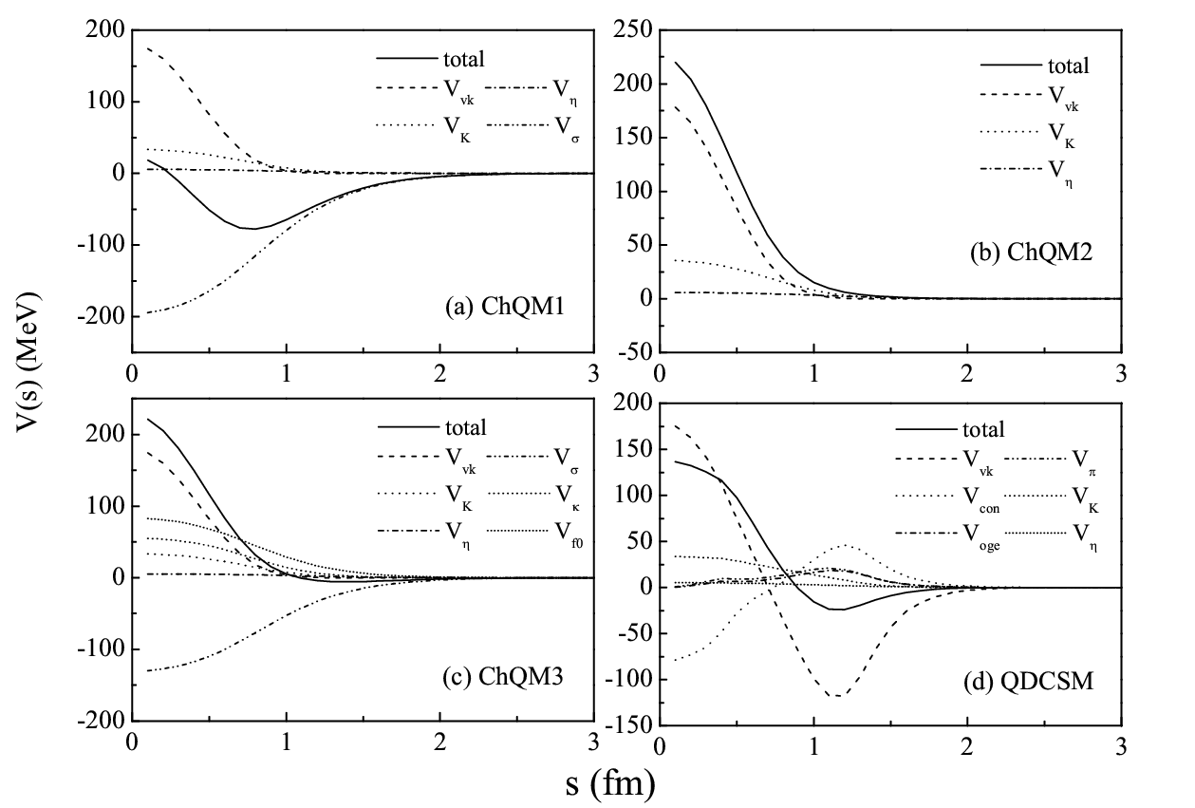
Quark model

Slide 51
ALICE results: Nature 588 (2020) 232

Slide 52
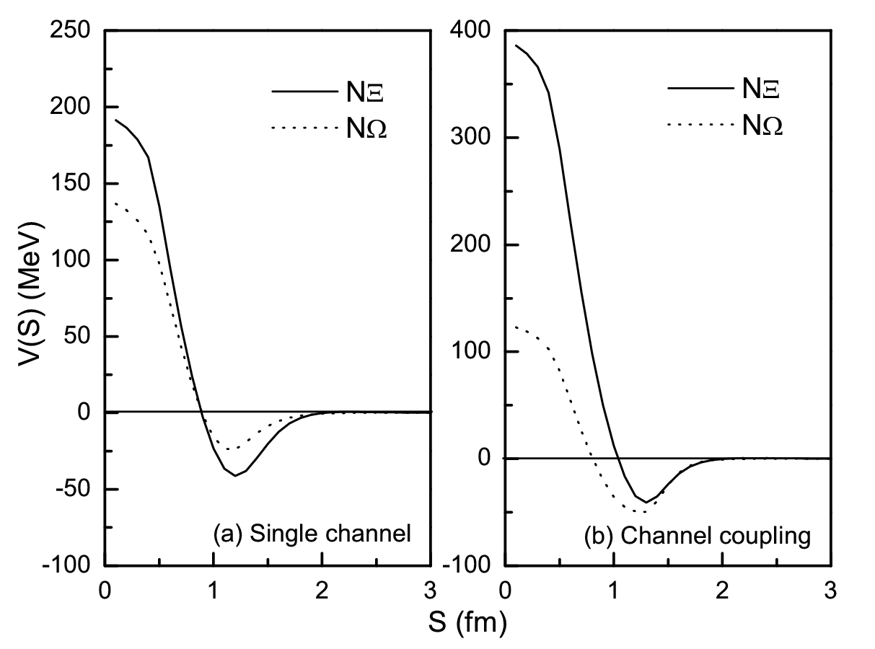
Quark model

Slide 53
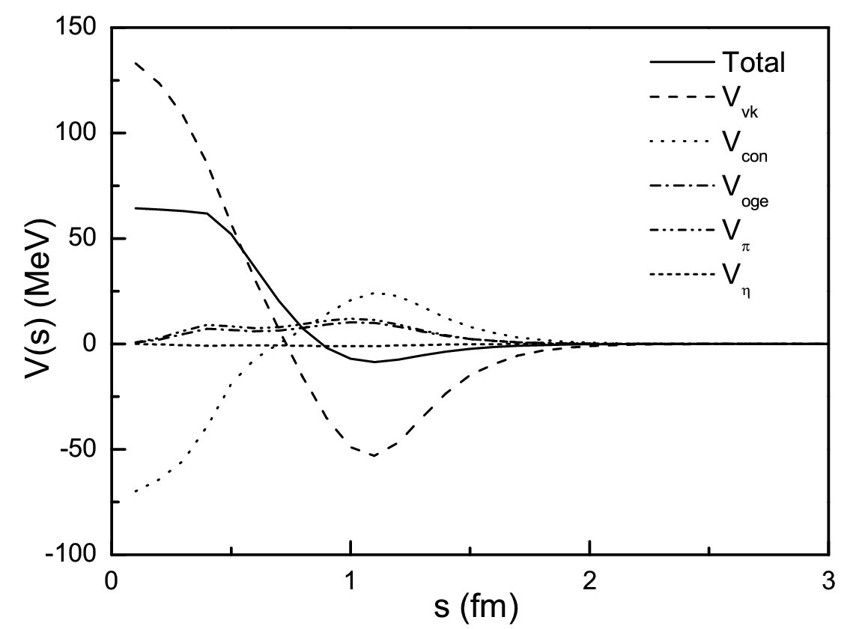
Quark model: NΩ_{ccc}
PRC101 (2020) 015204

Slide 54
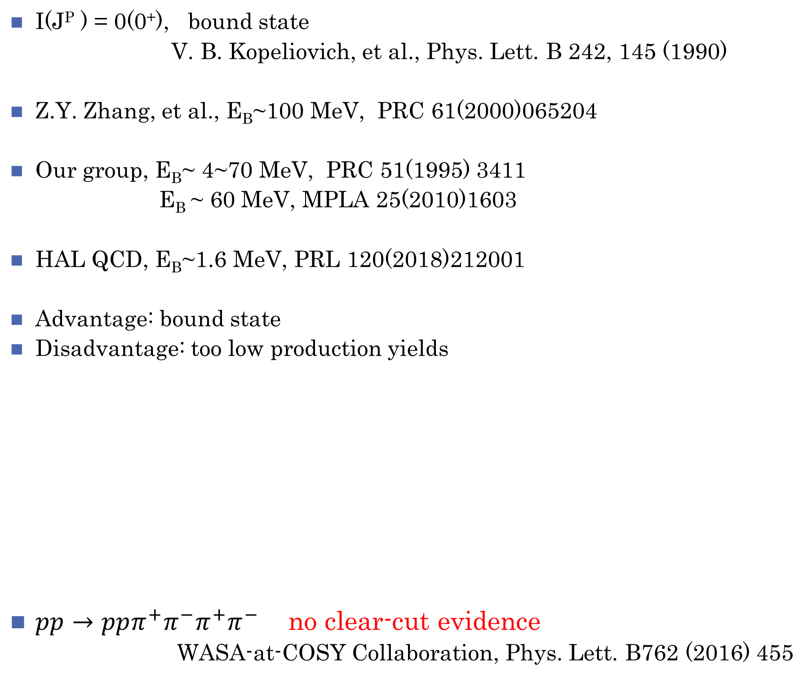
ΩΩ
I(J^{P} ) = 0(0⁺), bound state
V. B. Kopeliovich, et al., Phys. Lett. B 242, 145 (1990)
Z.Y. Zhang, et al., E_{B}~100 MeV, PRC 61(2000)065204
Our group, E_{B}~ 4~70 MeV, PRC 51(1995) 3411
E_{B} ~ 60 MeV, MPLA 25(2010)1603
HAL QCD, E_{B}~1.6 MeV, PRL 120(2018)212001
Advantage: bound state
Disadvantage: too low production yields
$pp→pp{π^{+}π^{−}π}^{+}π^{−}$ no clear-cut evidence
WASA-at-COSY Collaboration, Phys. Lett. B762 (2016) 455

Slide 55

ΩΩ interaction
HAL QCD Collaboration
2+1 flavor
$m_{π}=700 \text{MeV}$
Moderate attraction
at low energies,
bound state
PTEP 2015, 071B01 (arXiv: 1503.03189)
PRL120(2018)212001 (arxiv: 1709.00654): $m_{π}=146 \text{MeV}$, B=1.6 MeV

Slide 56
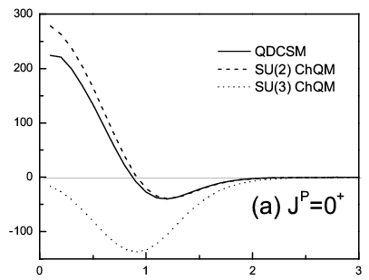
Quark model: ΩΩ
PRC101 (2020) 034004

Slide 57
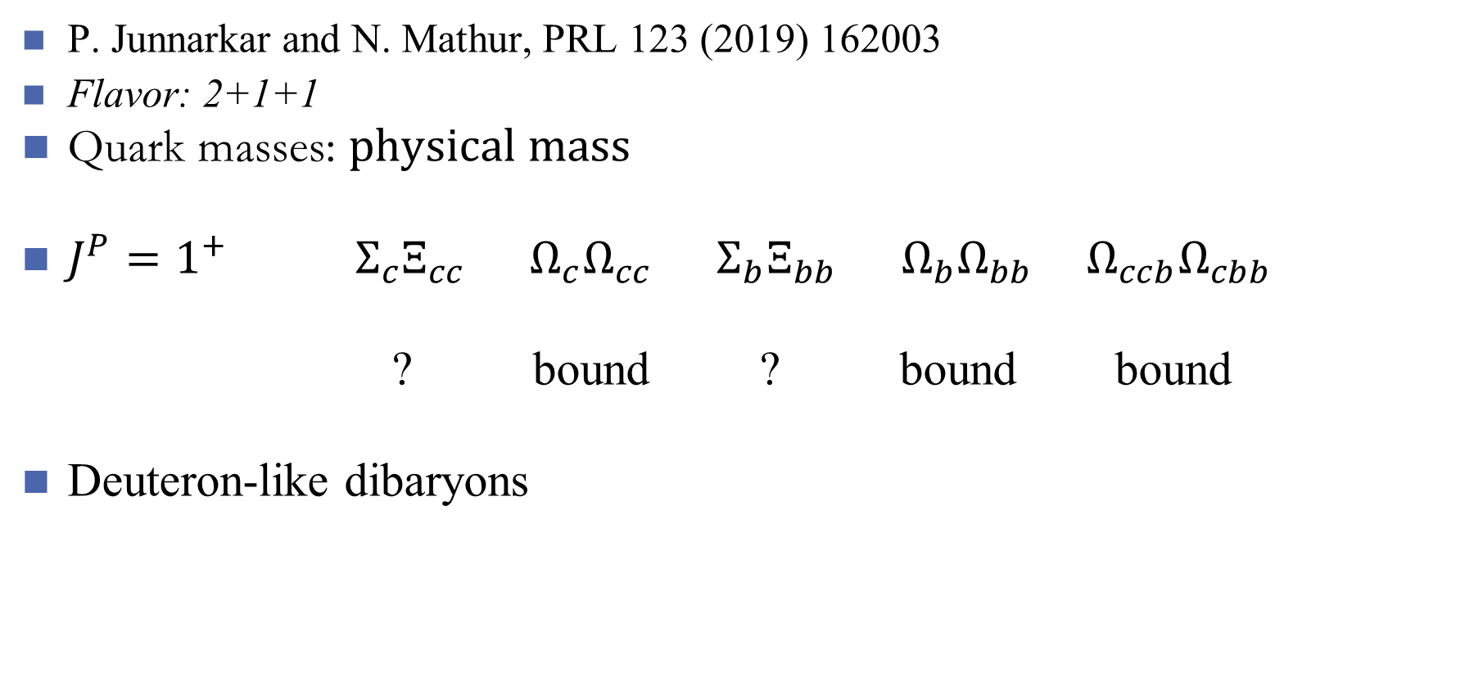
Heavy flavored dibaryons
P. Junnarkar and N. Mathur, PRL 123 (2019) 162003
Flavor: 2+1+1
Quark masses: $physical mass$
$J^{P}=1^{+} Σ_{c}Ξ_{cc}$ $Ω_{c}Ω_{cc}$ $Σ_{b}Ξ_{bb}$ $Ω_{b}Ω_{bb}$ $Ω_{ccb}Ω_{cbb}$
? bound ? bound bound
Deuteron-like dibaryons

Slide 58
Very heavy flavored dibaryons
J-M Richard, A. Valcarce and J. Vijande, PRL 124 (2020) 212001
Constituent quark model
There is no evidence for any stable super-heavy hexaquark
of the type bbbccc

Slide 59
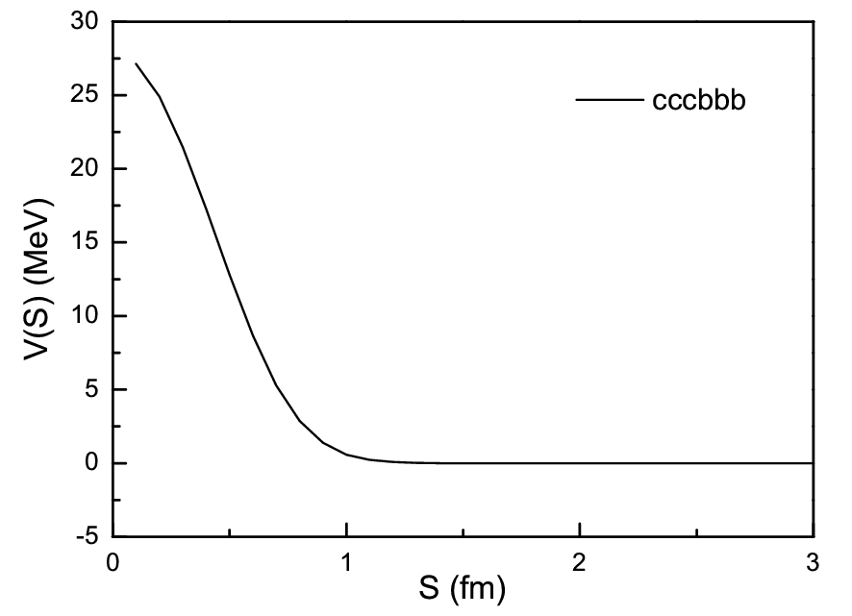
Our calculation (arXiv: 2011.00513)
Constituent quark model
There is no attraction
between two heavy
baryons

Slide 60
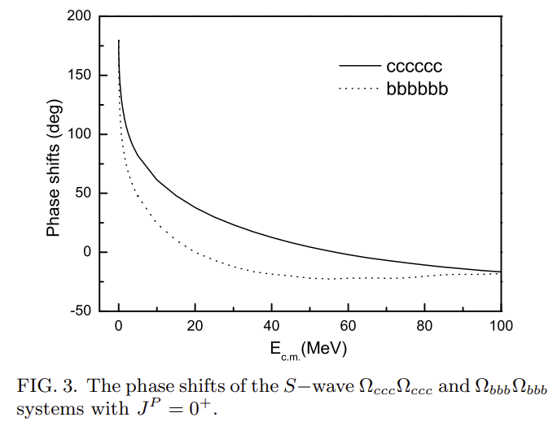
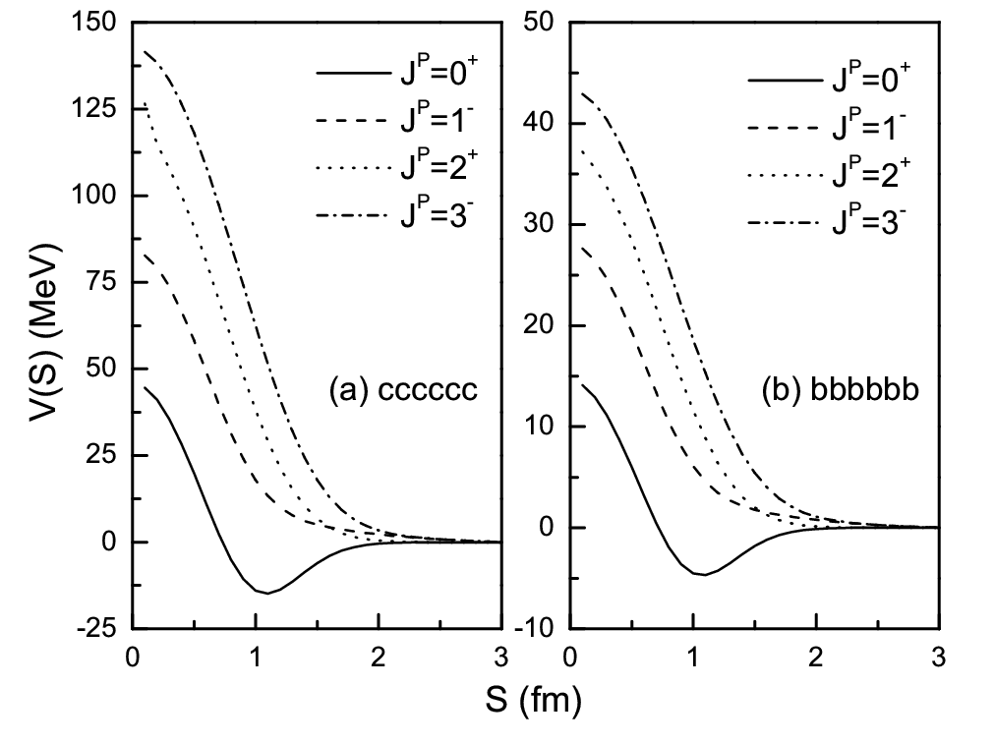
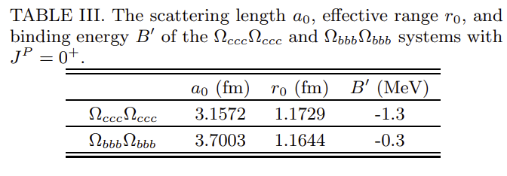

Our calculation (arXiv: 2011.00513)
Extended to $Ω_{ccc}Ω_{ccc}$ and $Ω_{bbb}Ω_{bbb}$

Slide 61
Summary
1、Since 2003, important progresses on tetra-, penta- and hexa-quark
systems have been made experimentally.
2. Experimental data baryon-baryon interaction will be accumulated rapidly
with LHC running.
3. Dibaryon is a unique system with B=2, which cannot mix with mesons
and baryons.
4. The multiquark spectroscopy needs more data. The theoretical method
will be more efficient based upon the large set of data.
5、QCD chemistry begins?

Slide 62
Thank you!

Slide 63



Slide 64
Dibaryons
[f]=[6] dim=28

Slide 65
[f]=[51] dim=35

Slide 66
[f]=[42] dim=27

Slide 67
[f]=[411] dim=10 [f]=[33] dim=10

Slide 68
[f]=[321] dim=8
[f]=[222] dim=1

Slide 69




Slide 70


Slide 71



Slide 72
S=-4 interaction （arXiv: 1702.01600）
HAL QCD Collaboration
2+1 flavor
$m_{π}=146 \text{MeV}$

Slide 73

S=-1 interaction
HAL QCD Collaboration
2+1 flavor
$m_{π}=660 \text{MeV}$
arXiv: 1702.00734)

